Slide 1
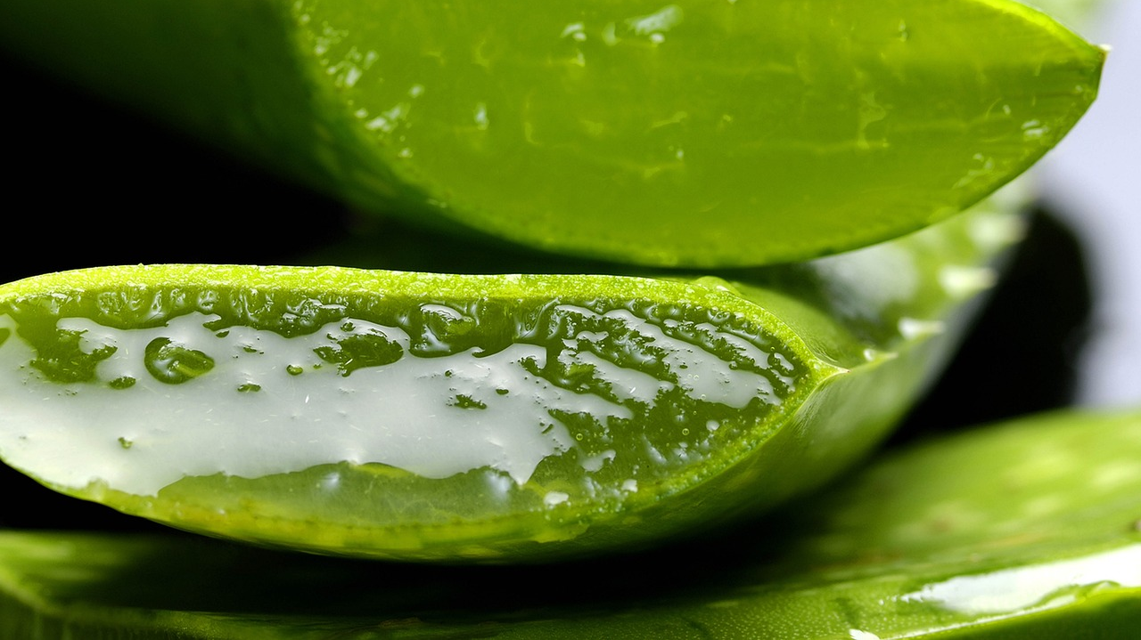
Does the method of isolation of aloin affect its content in the sample?
By: Agnieszka Darmos

Slide 2
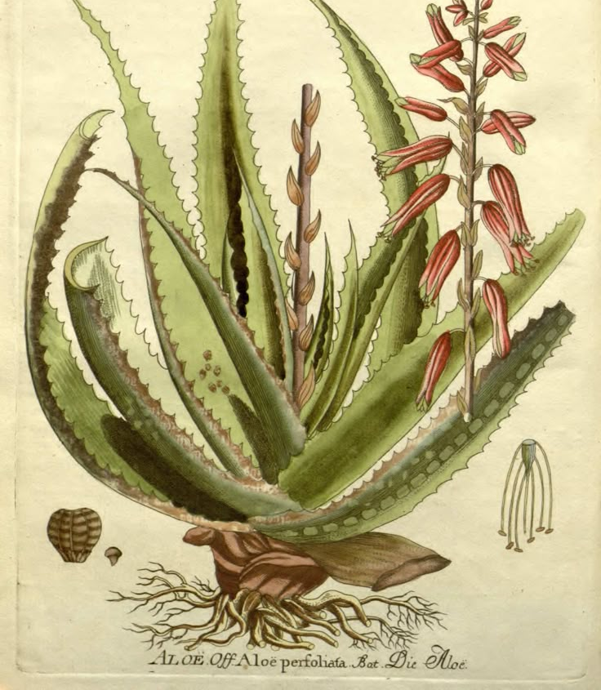
Why Aloe Vera?
The Aloe Vera plant has an Interasting and long history.
It is a very low maintaince succulent plant from the Asphodelaceae family.
It’s popularity.
(National Libary of Medicine)

Slide 3
What is my project about?
My project explores the presence of aloin in aloe juice using chromatography, a technique that separates chemical components in a mixture. By analyzing samples at different time intervals.

Slide 4
Aloin
Aloin is proven to be: anti-tumour, anti-inflammatory, anti-osteoporotic, organ-protective, antiviral, anti microbial, anti-parasitic, laxative activities, blood lipids and glucose regulation, neuropathic pain improvement, etc.
(National institutes of health)

Slide 5
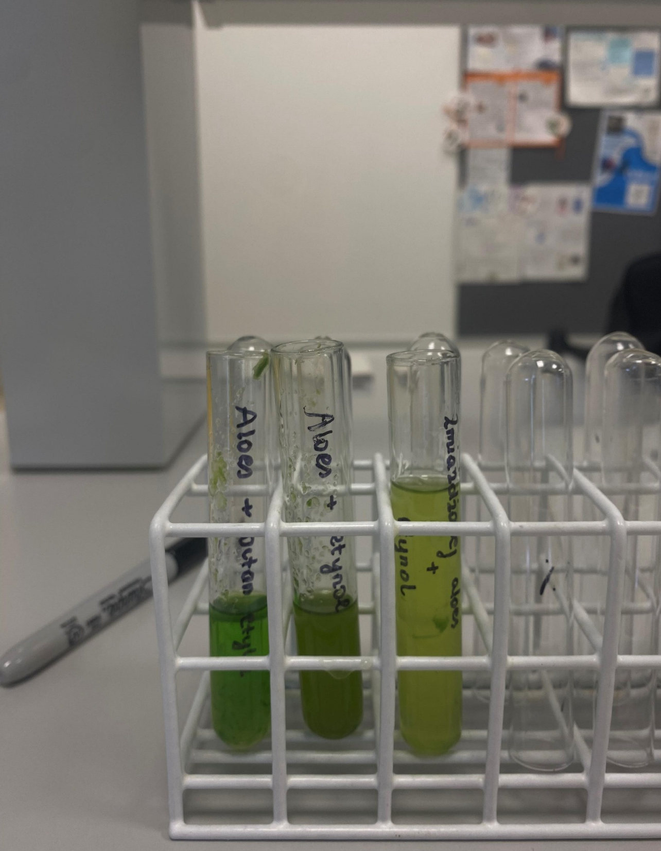
Methodology
Extraction of Aloin: Mix 5 mL of aloe vera juice with 5 mL of ethanol in a test tube. Shake well and let it settle. Use a dropper to collect the clear liquid.
Preparation of TLC Plate: Draw a light pencil line 1 cm from the bottom of the silica gel TLC plate. Spot the aloe juice extract and aloin standard solution on the line using a capillary tube.
Development of TLC Plate: Place the TLC plate in a beaker containing the mobile phase (ethyl acetate: methanol: water, 8:1.5:0.5). Allow the solvent to move up the plate until it reaches 3/4 of the way, then remove and let it dry.
Visualization: Place the plate under UV light (365 nm). Aloin will appear as a fluorescent yellow-green spot. Compare the Rf value (distance traveled by aloin ÷ distance traveled by solvent) with the standard.

Slide 6
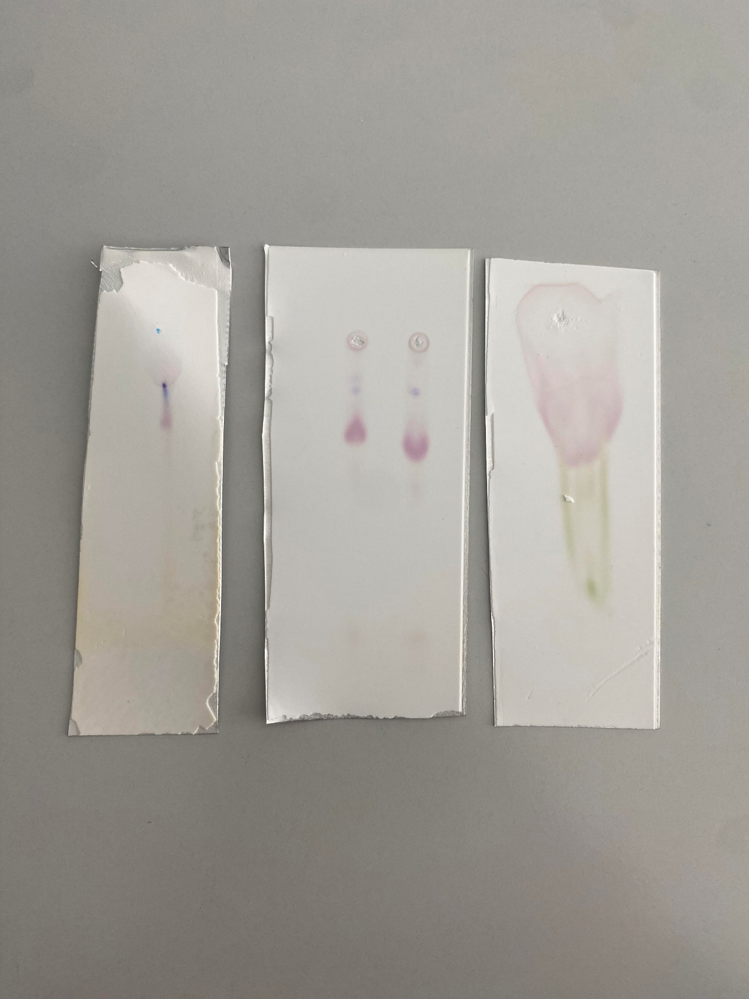
Chromotography results:
In the experiment, the aloin spot traveled 4.5 cm, while the solvent front reached 8.2 cm. To calculate the Rf value, we use the formula: Rf=Distance traveled by the solvent front/Distance traveled by the compound.
Rf=8.2cm/4.5cm ≈0.549
the Rf value for the aloin spot is approximately 0.549.

Slide 7
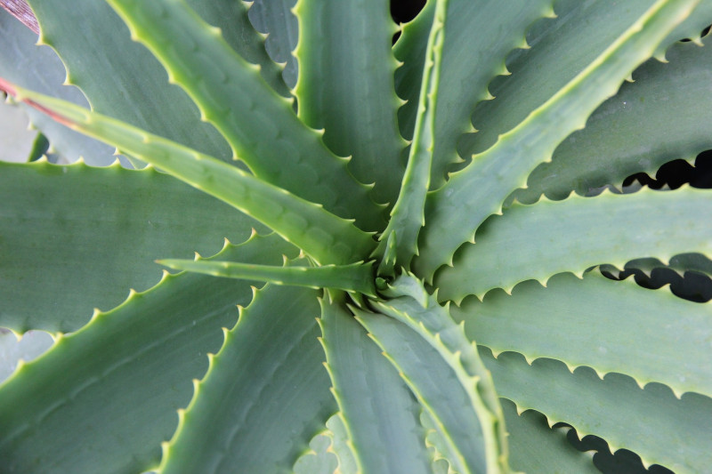
Why did I pick this project?
As humans we have a long history with herbology. Because of my project i will be able to learn more about it. Secondly I wanted to pick a project I could share with my family/friends. Lastly I consider aloe Vera very intriguing. It is very popular but people not know much about it.

Slide 8
Thank you for your attention!

Slide 9
Sources:
https://www.nccih.nih.gov/health/aloe-vera
https://pubmed.ncbi.nlm.nih.gov/28525602/
https://www.plantsavvy.com/blog/how-to-care-aloe-vera-plant
https://pmc.ncbi.nlm.nih.gov/articles/PMC2763764/
https://www.sciencedirect.com/topics/agricultural-and-biological-sciences/aloin

