Slide 1

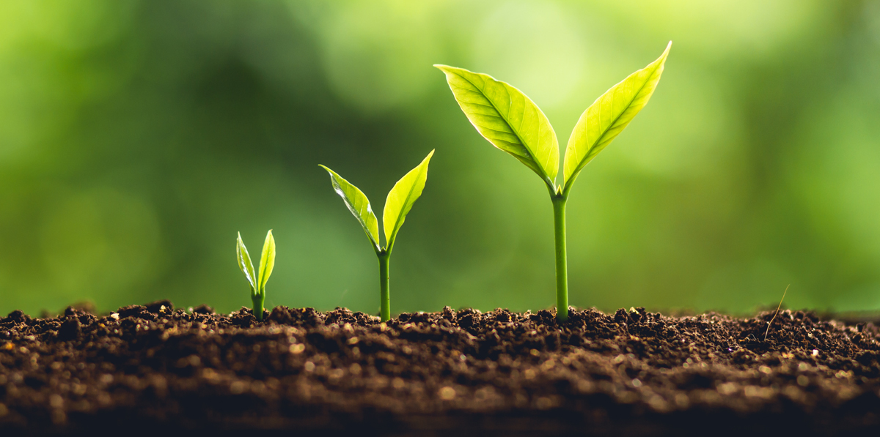
Impact of Polyethylene Microplastics on Plant Growth and the Nitrogen Cycle
Presented by:
Maia Pașca
Izabela Ninu
Cristian Hogaș

Slide 2
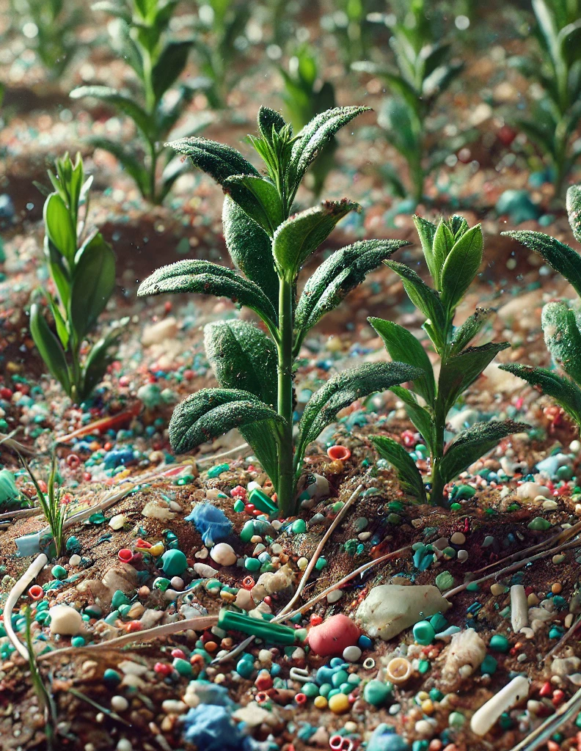
Why this project?
Microplastics are a growing environmental issue.
They affect soil ecosystems and nutrient cycles.
Our study focuses on polyethylene (PE) microplastics.
(30% of the global plastic production)

Slide 3
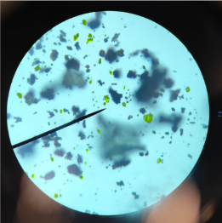
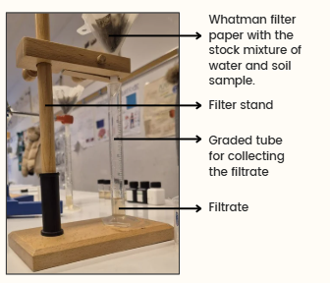
Hypothesis & Objectives
Microscope image of the microplastic particles infiltrated in our soil
Hypothesis: Higher PE concentrations negatively impact the nitrogen cycle and plant growth.
Objectives: Measure nitrate, nitrite, and ammonium levels in different PE concentrations.
Our setup for the colorimetric tests

Slide 4
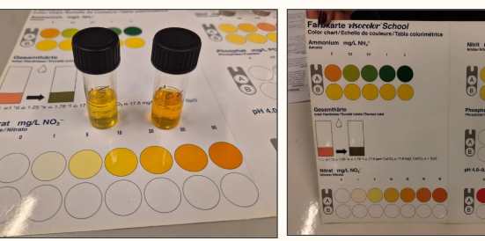
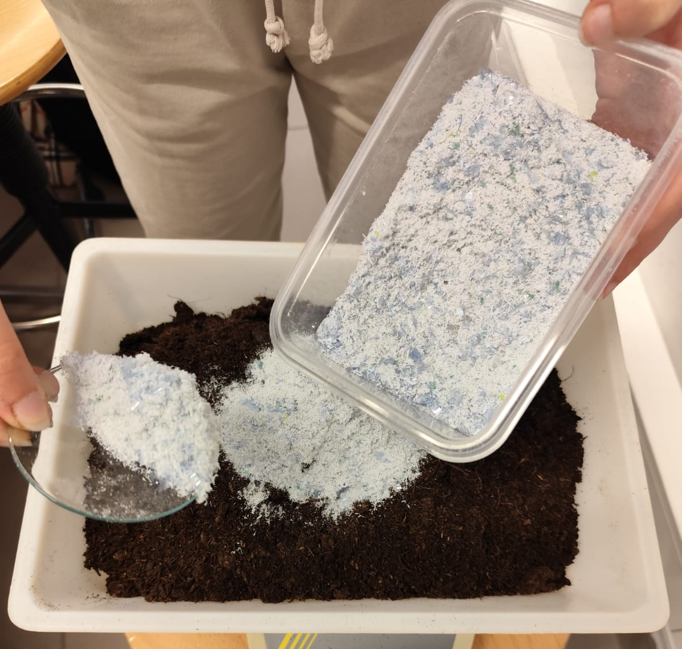
Materials & Methods
Obtained microplastics infiltrating in soil
VISOCOLOR kit
60 watercress plants grown in soil with 0%, 0.5%, 2%, and 5% PE.
PE microplastics sourced from plastic waste.
Nitrogen compounds measured using VISOCOLOR kits.

Slide 5
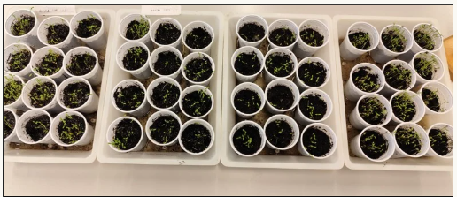
Experimental Setup
The planted pots
Standardized conditions:
- Light: 12 hours/day
- Temperature: ~22°C
- Watering: Equal for all samples.

Slide 6
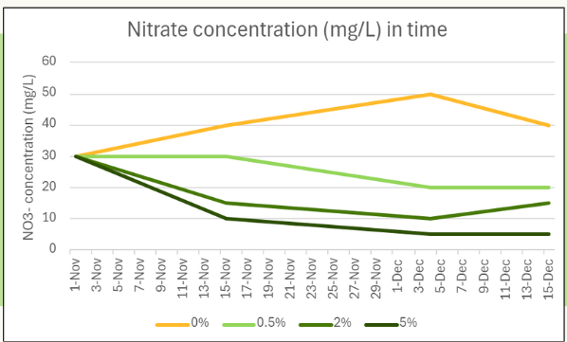
Results – Nitrate Concentration
Higher PE concentrations led to lower nitrate levels.
Graph shows clear decline in nitrate availability.

Slide 7
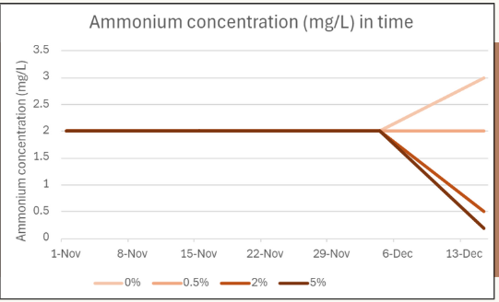
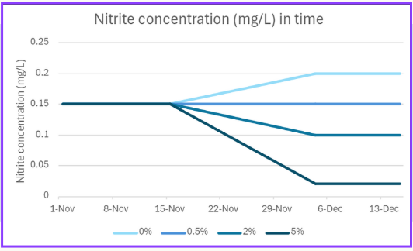
Results – Nitrite & Ammonium
Higher PE levels resulted in lower nitrite and ammonium.
Indicates microbial disruption in nitrogen cycle.

Slide 8
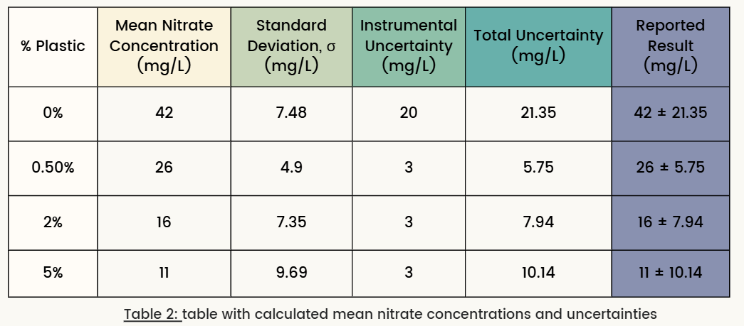
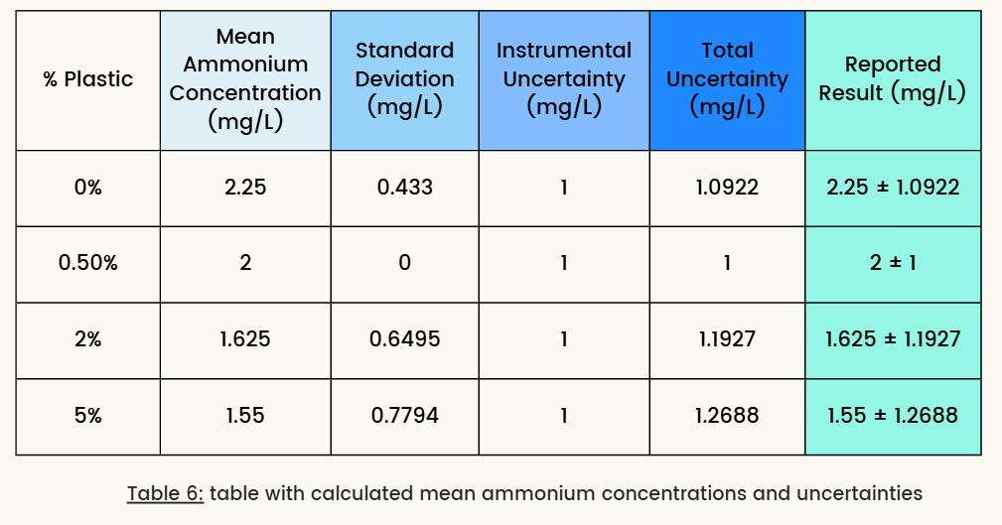
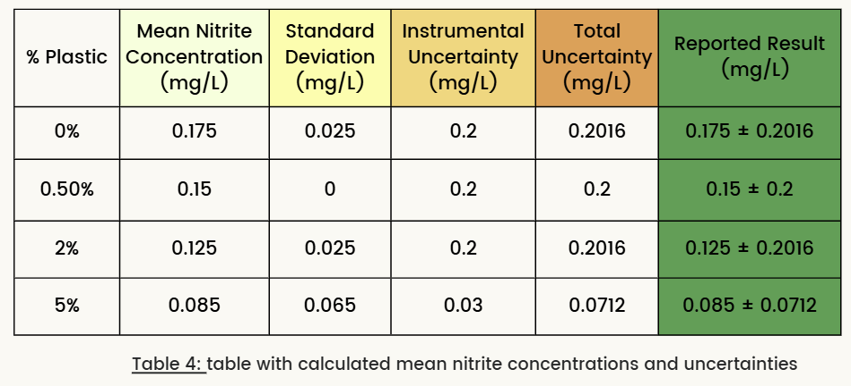
Values of incertitude
Knowing that any research has its flaws, we studied the uncertainty rate for our results.
They were quite high
We considered possible modifications to the method to limit the values
The project is still relevant

Slide 9
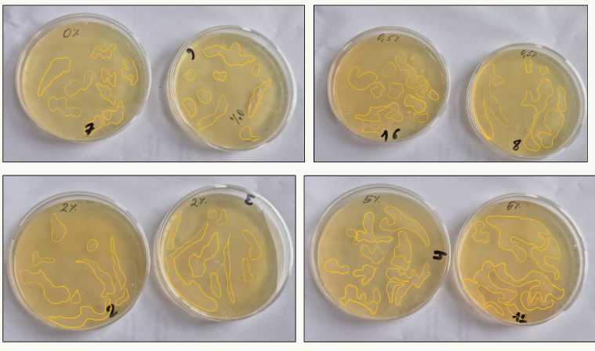
Bacterial Culture Findings
0.5% PE: 160.5 mm2
0% PE: 165.4 mm2
Microbial balance disrupted at higher PE concentrations.
Potential negative impact on soil fertility.
However, the test is not accurate.
2% PE: 153.3 mm2
5% PE: 372.2 mm2

Slide 10
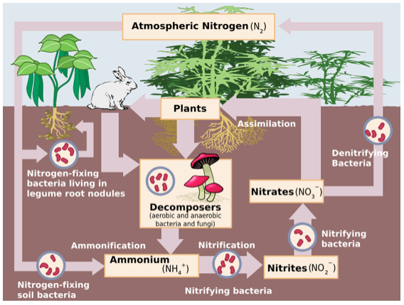
Discussion – Impact on Nitrogen Cycle
PE microplastics interfere with nitrifying bacteria.
This disrupts nitrogen transformations vital for plant growth.

Slide 11
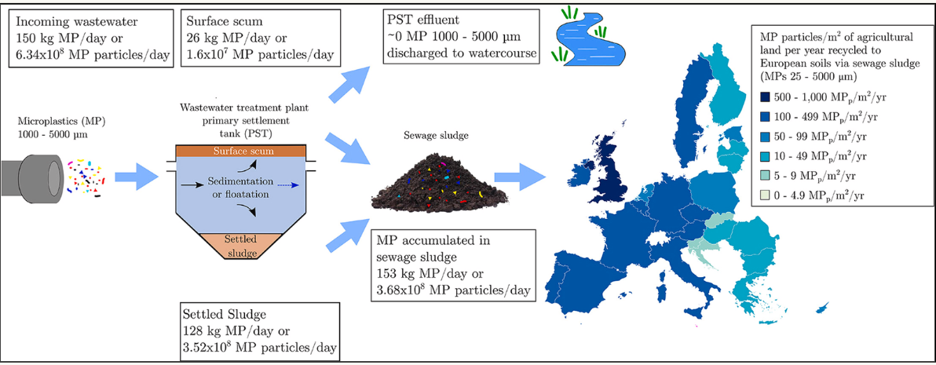
Significance – Why This Matters
Agricultural soils are increasingly polluted with microplastics.
This could affect food security and ecosystem stability.

Slide 12
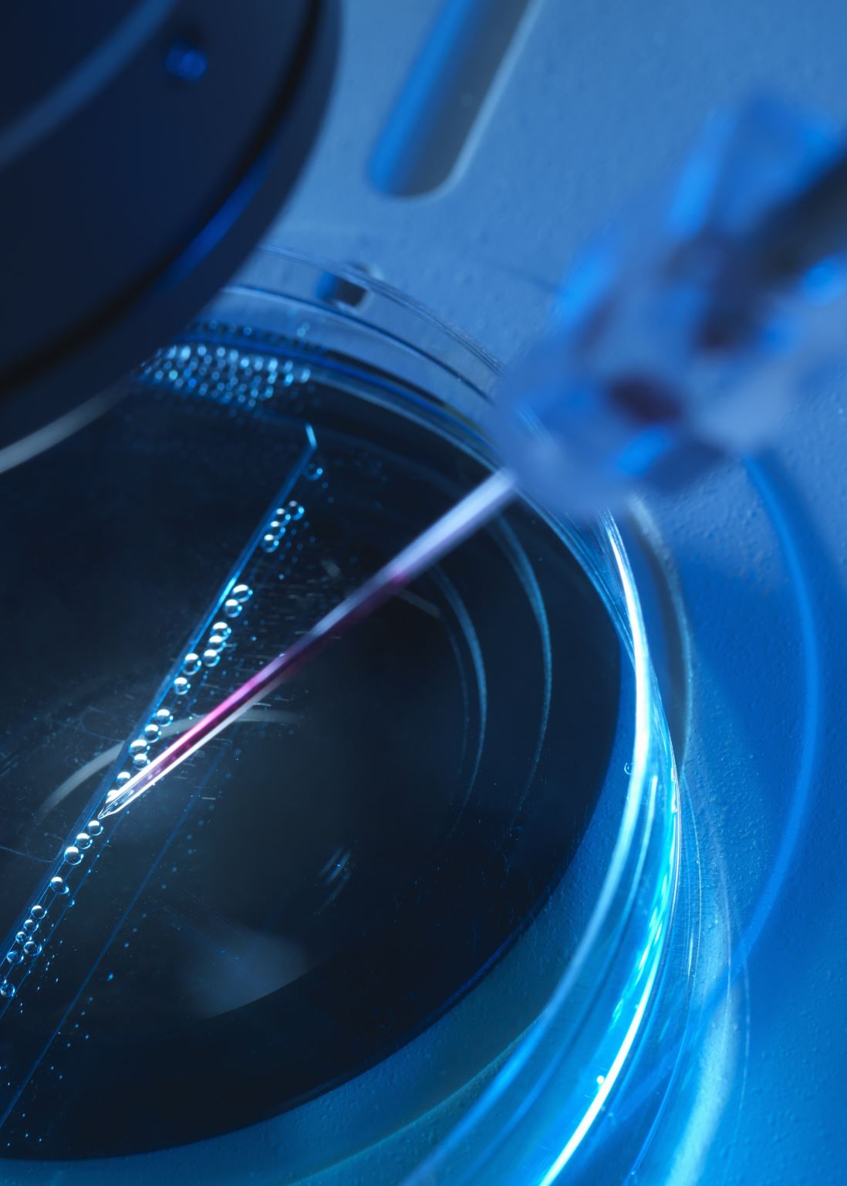
Conclusion & Future Research
PE microplastics significantly alter nitrogen availability.
Future research should focus on long-term effects and microbiome changes.

Slide 13
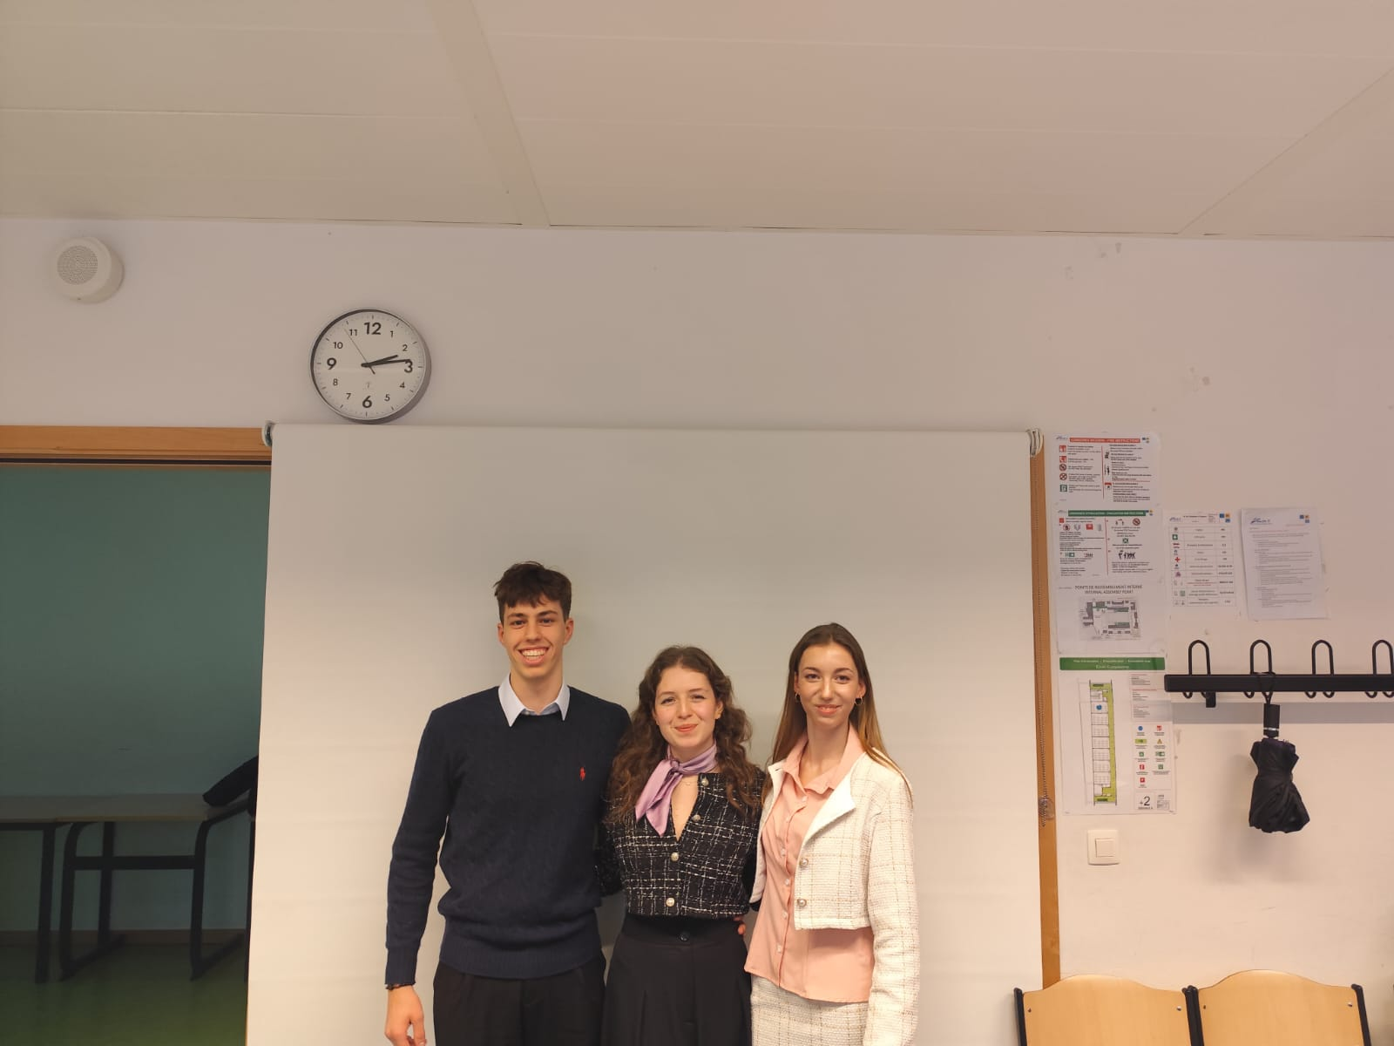
Thank you!

