Slide 1
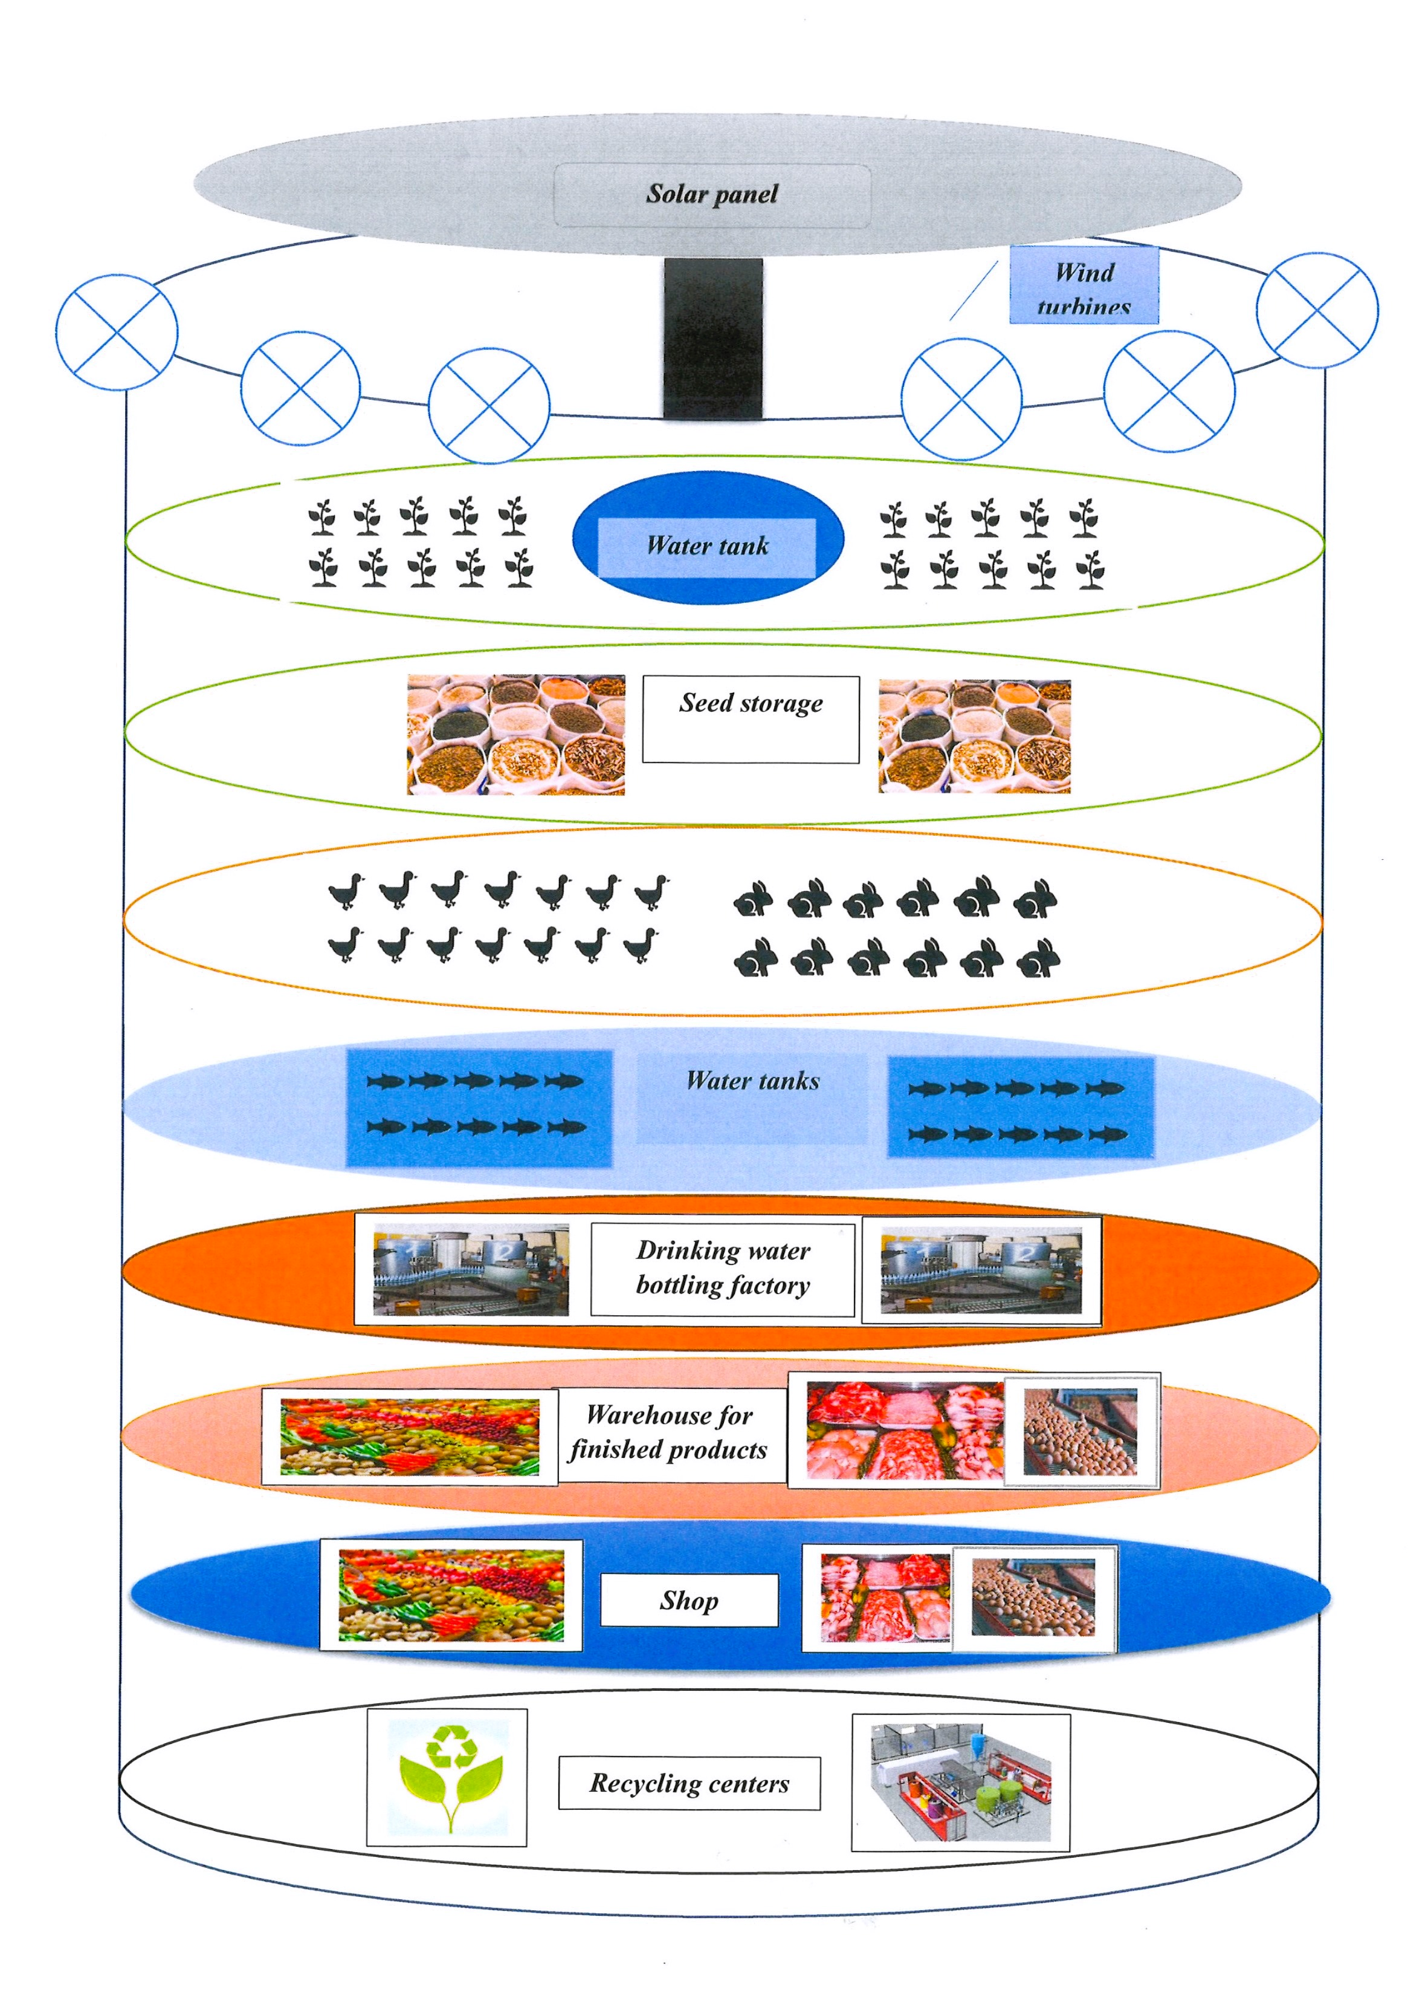
Vertical Farm
Vetisan Larisa Stefania S2RO ES Brussels IV

Slide 2
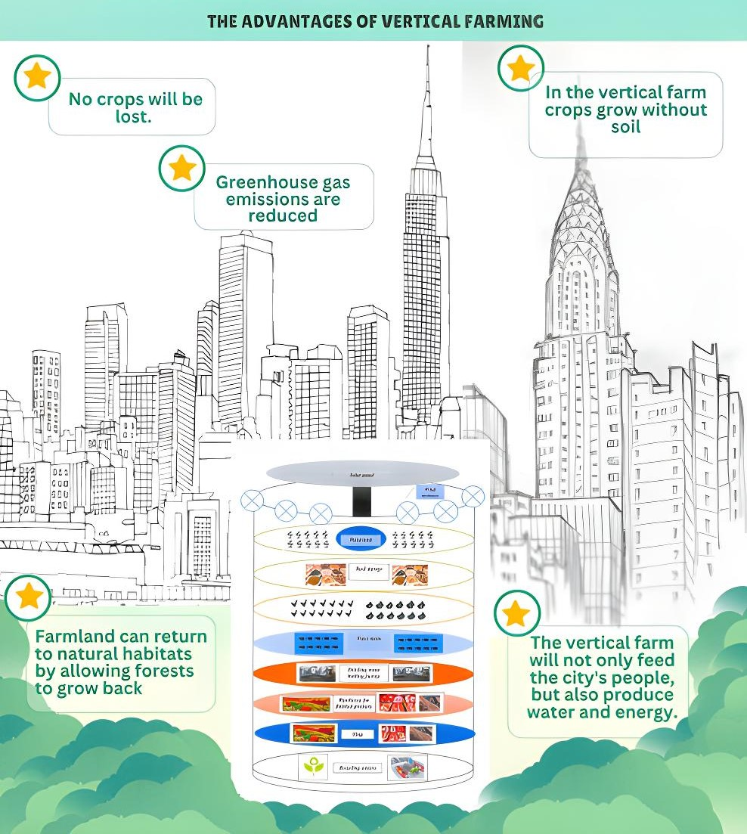
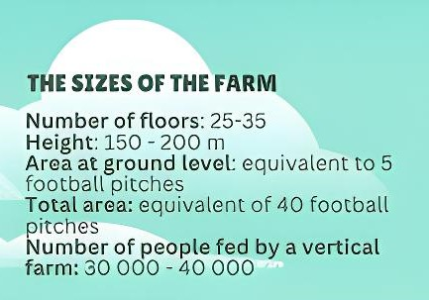
The challenges of vertical farms:
Urban integration
Choice of crops
Biodiversity
Jobs
Water consumption

Slide 3
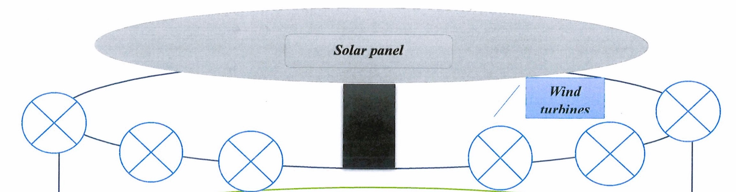
Organization and operation of vertical farms
Renewable energy
Solar panels and wind turbines
Glass walls

Slide 4
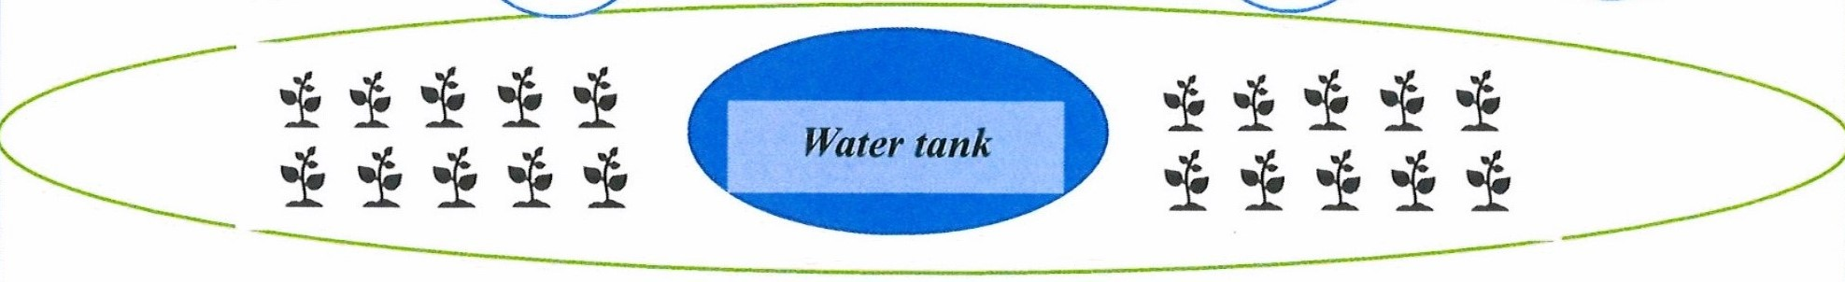
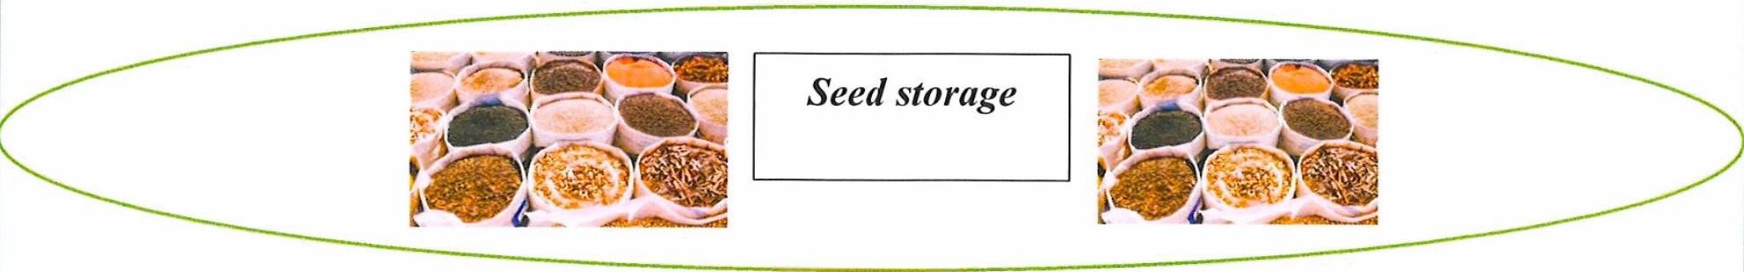
Plant cultivation floors
Seed storage
Diverse Species
Soilless cultivation
Natural light
Robotic monitoring
Water recycling
Careful harvesting
Selection and storage
Optimum conditions
Quality and uniqueness

Slide 5
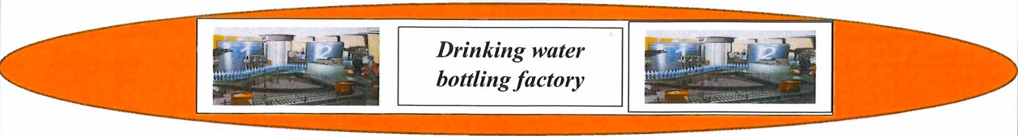
Plant transpiration
Water condensation
Collection and bottling
Production capacity

Slide 6
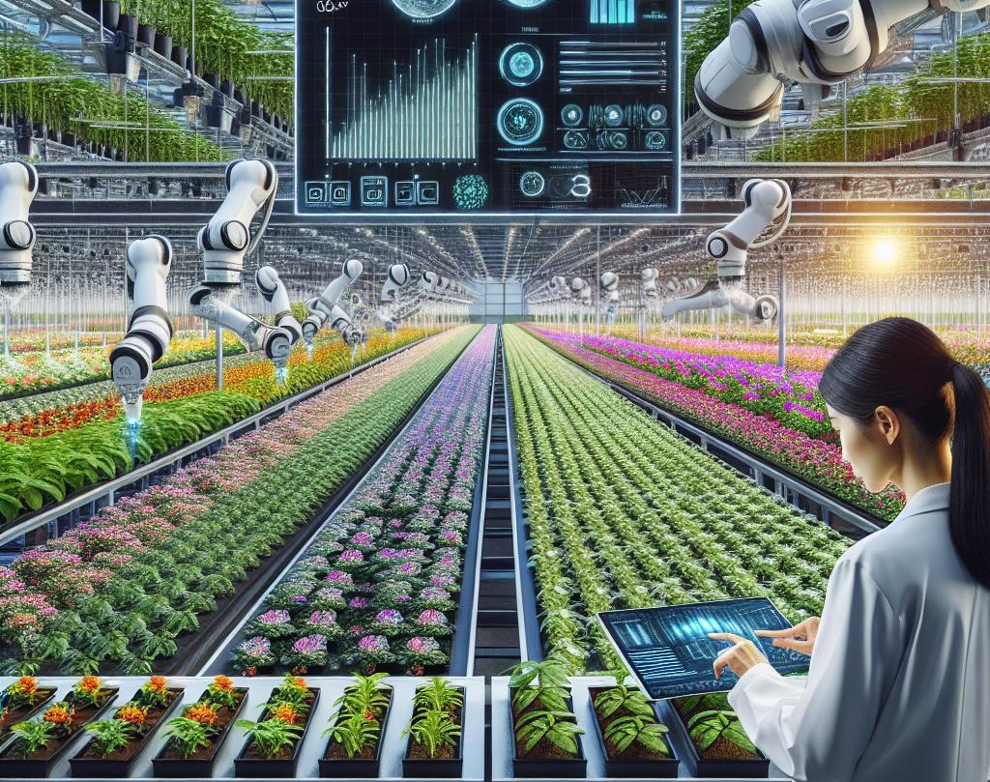
THE FARM'S CONTROL ROOM
Remote control of robots working on the farm

Slide 7
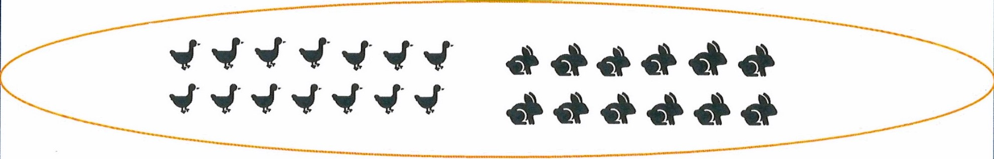
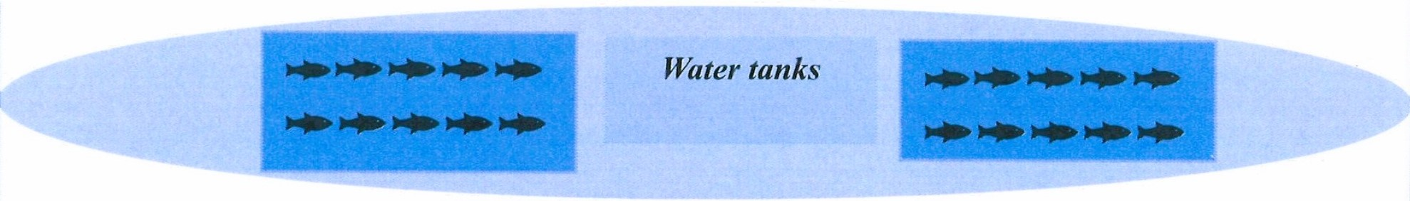
Floors for keeping birds, rabbits and fish
The farm will produce hundreds of thousands of rabbits and poultry, as well as millions of eggs annually for sale.
The farm will produce fish and shellfish species such as salmon, tuna, trout, sole, shrimp and lobster for sale each year.

Slide 8
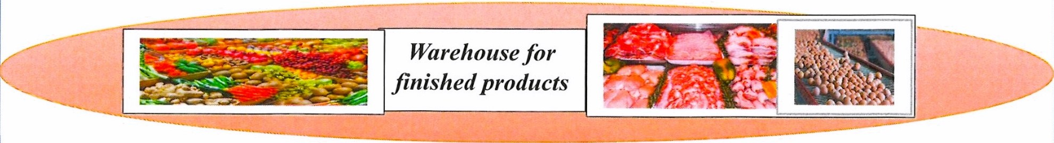
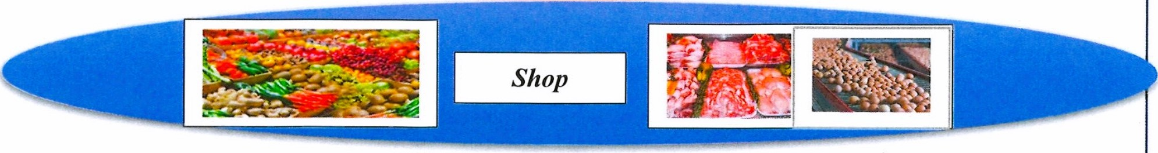
Storage and packaging of finished products and farm shop
Farm fresh food, vegetables, fruits, flour, pastries, meat, meat preparations, fish and eggs will be stored, packaged and sold.

Slide 9
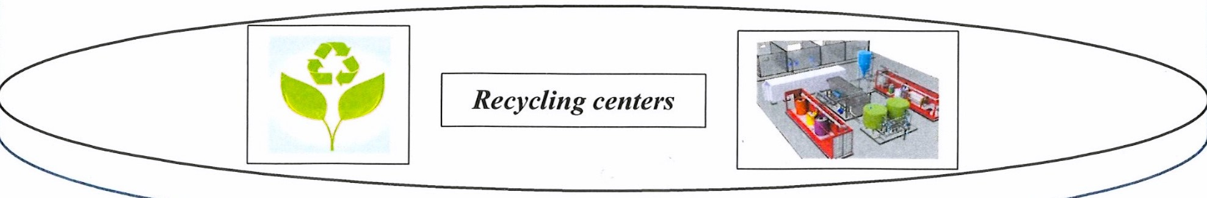
Organic waste from the farm and the city will be burned to produce energy for the farm.
Wastewater from the farm but also from the town will be cleaned in the farm's sewage treatment unit.
Wastewater solids will be palletized and incinerated to produce energy.
The treated wastewater will be used in agriculture.

Slide 10
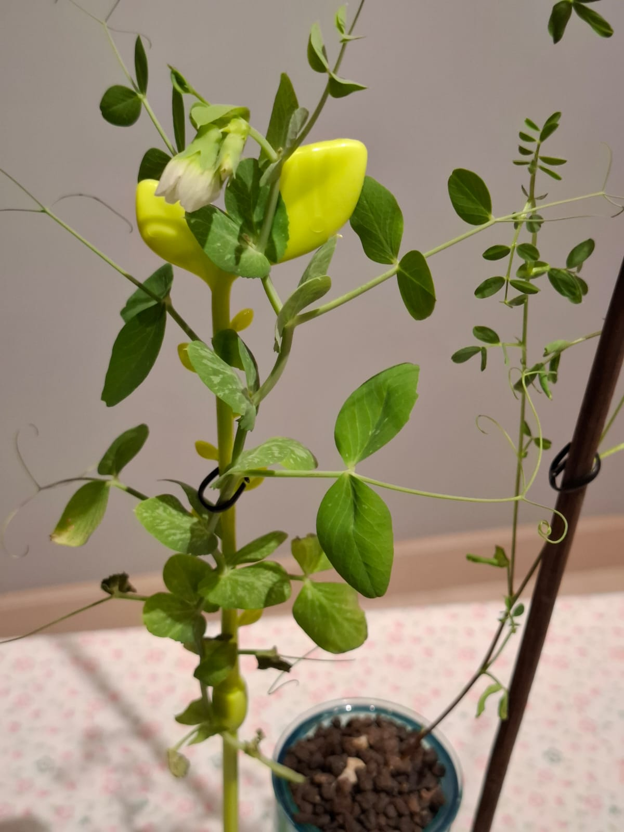
SOILLESS PLANT CULTIVATION
Aim of the experiment
I want to see if plants can be grown to survive on the proposed farm.
Working hypothesis
If I will grow plants whose roots are submerged directly in water I expect that they will grow little or not at all.

Slide 11


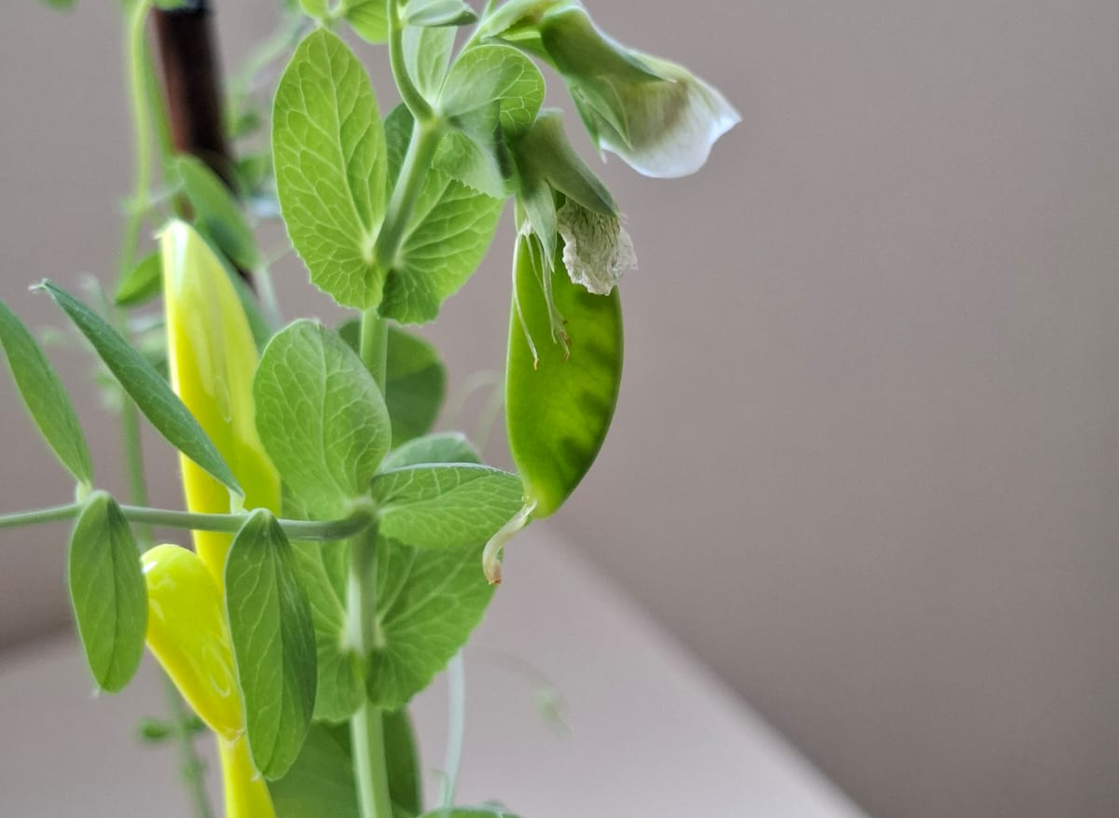

Conclusion
The results obtained from the experiment are promising. They confirm that in the vertical farm different varieties of plants will be able to be grown without the need for soil.

Slide 12
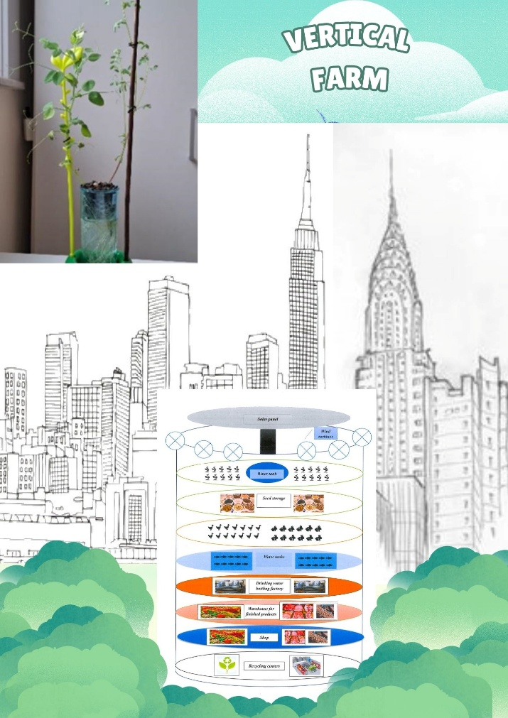
Given that the imagined vertical farm is a theoretical construct, it is difficult to predict all, advantages, challenges and potential benefits that may arise.

Slide 13
Bibliography
https://www.urbanbotaniks.ro/blog-article/8/ce-sunt-sistemele-hidroponice-si-cumlucreaza.html;
https://airgarden.com.au/blogs/news/aeroponics-vs-hydroponics;
https://ro.rx-generators.com/info/vertical-axis-wind-turbines-vs-horizontal-axis-61077384.html;
https://www.biogreen-energy.com/what-is-pyrolysis;
https://www.livinggreensfarm.com/blog/aeroponics-vs-hydroponics;
http://www.verticalfarm.com;
https://www.scientia.ro/stiri-stiinta/82-tehnologie/4956-autocuratarea-si-dioxidul-de-titan.html;
https://www.keweimining.com/news/benefits-of-titanium-dioxide-coating-on-glass/;
https://www.water.ie/conservation/water-education-in-school;
Decision Making, A Mock Town Meeting on a Proposed Tank Farm | US EPA;
Teaching resources | WaterAid UK;
Science Resources for Teachers on Water Footprints;

