Slide 1
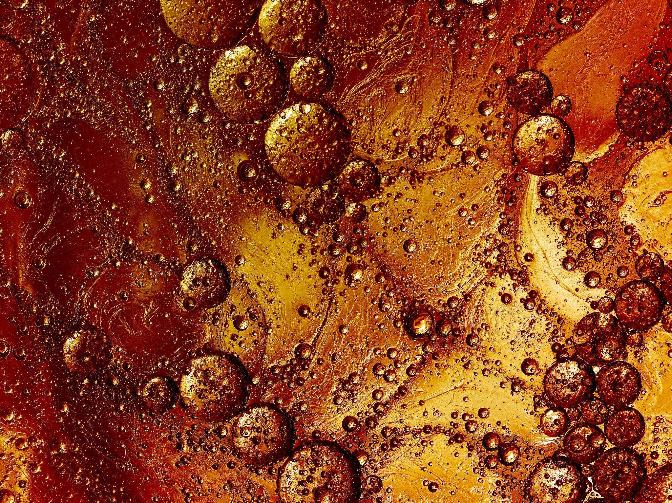
Containment of oil spillage on surface water
By Jack Laban and Tristan Weller – S1 ENA
European School Karlsruhe

Slide 2
Abstract
Oil spillage is a hazard to marine life and the environment, while also being costly to clean up. In our project, cheap. Readily available materials were investigated to find out which ones were most effective at containing oil spillage on surface waters.

Slide 3
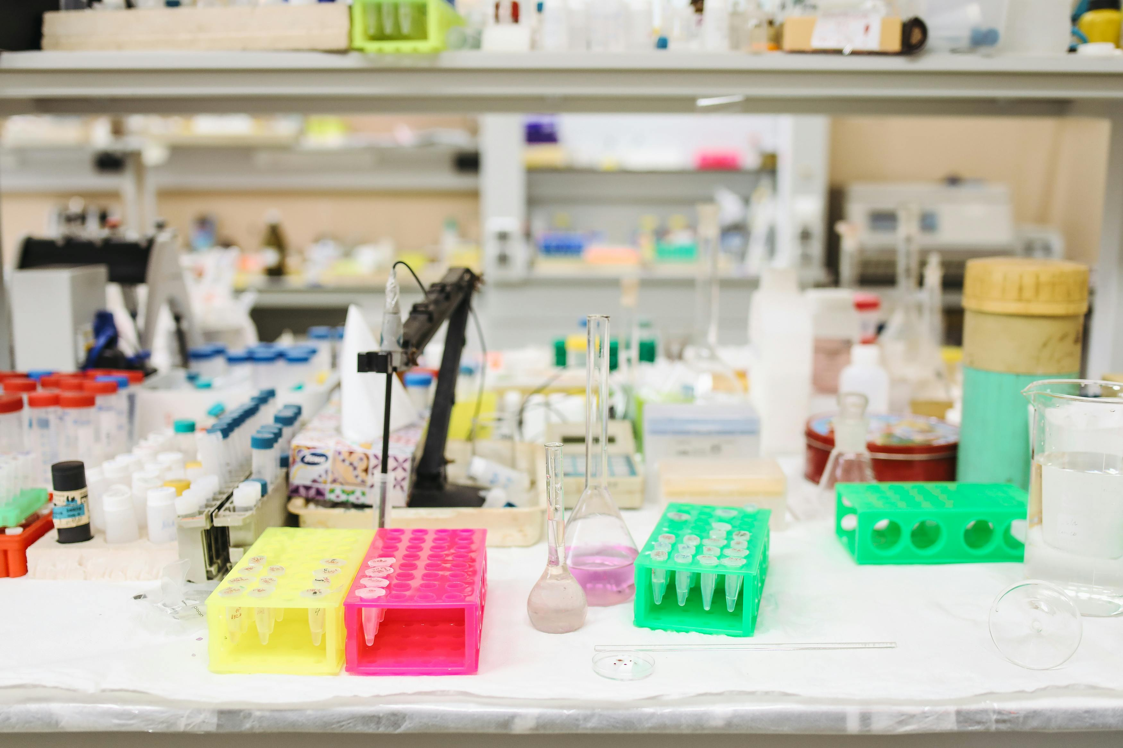
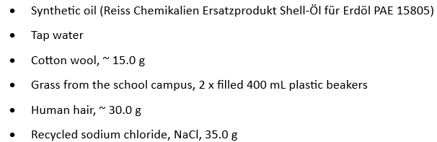
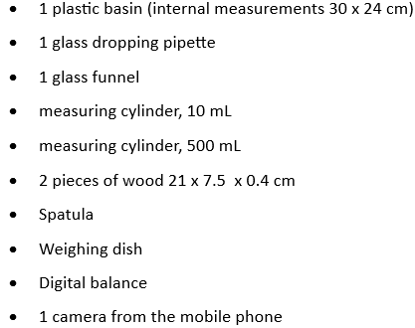
Materials used per experiment

Slide 4

Experiments
Six separate experiments were carried out, each beginning with the basin filled with fresh tap water.
In Experiments 5 and 6, 35 grams of sodium chloride were added to 1 L of water and stirred thoroughly. The salt was introduced to mimic the salinity of ocean water.

Slide 5
Materials investigated
Cotton
Hair
Dry grass (dried for 6 days)
Fresh + dry grass ( dried for 6 days)

Slide 6
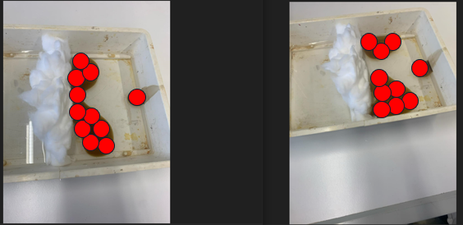
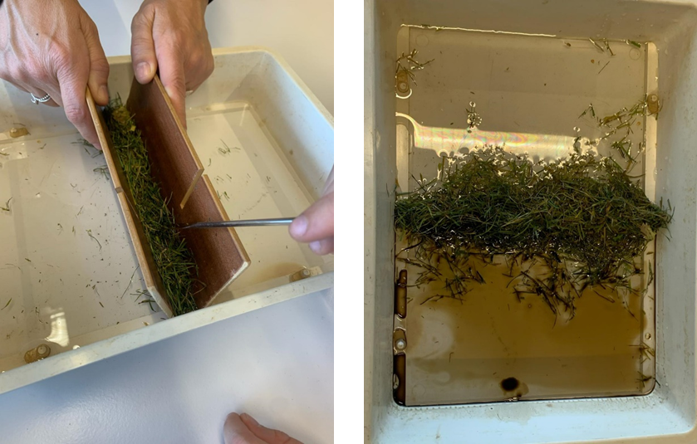
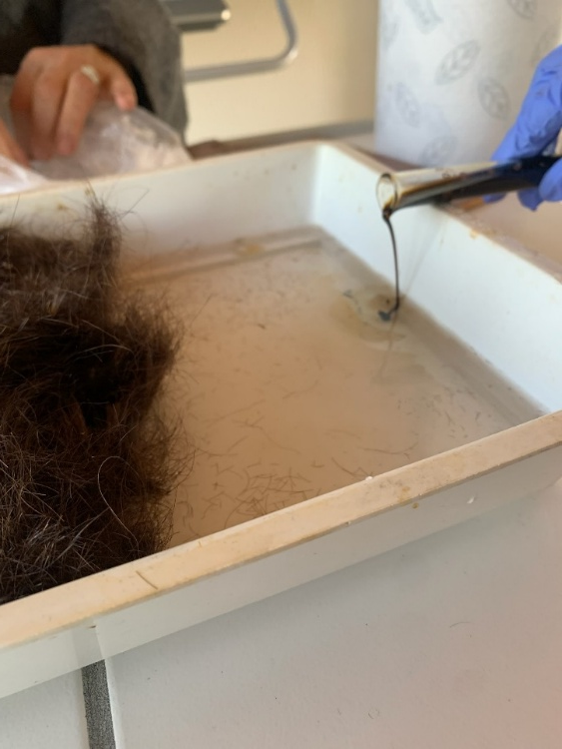
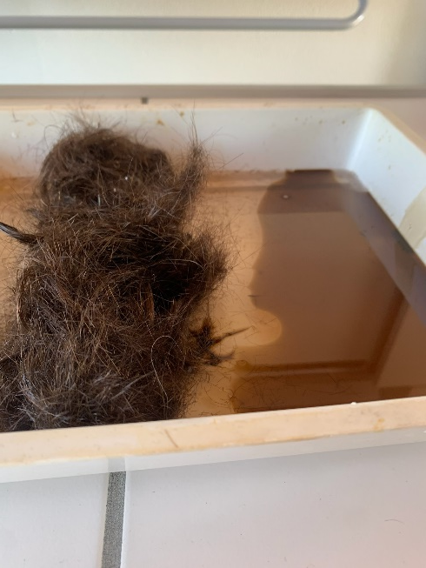
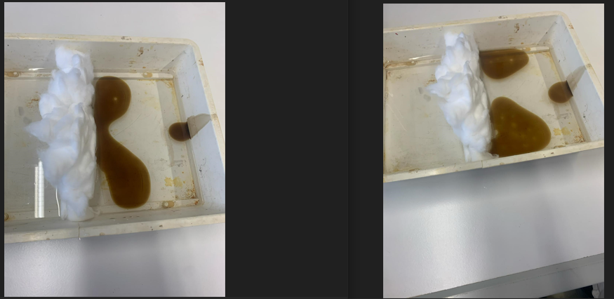

Slide 7
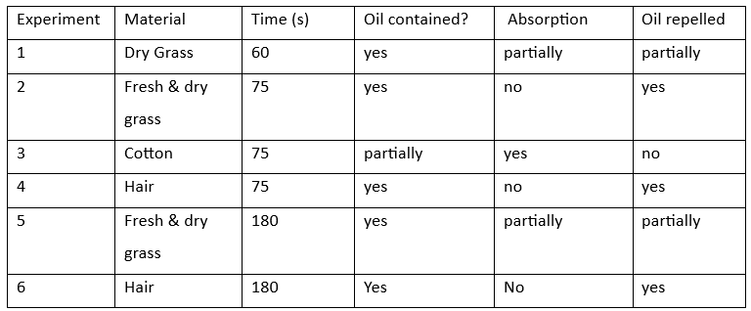
Data analysis

Slide 8
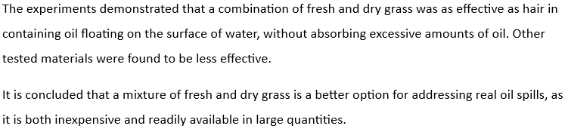
Conclusion

Slide 9
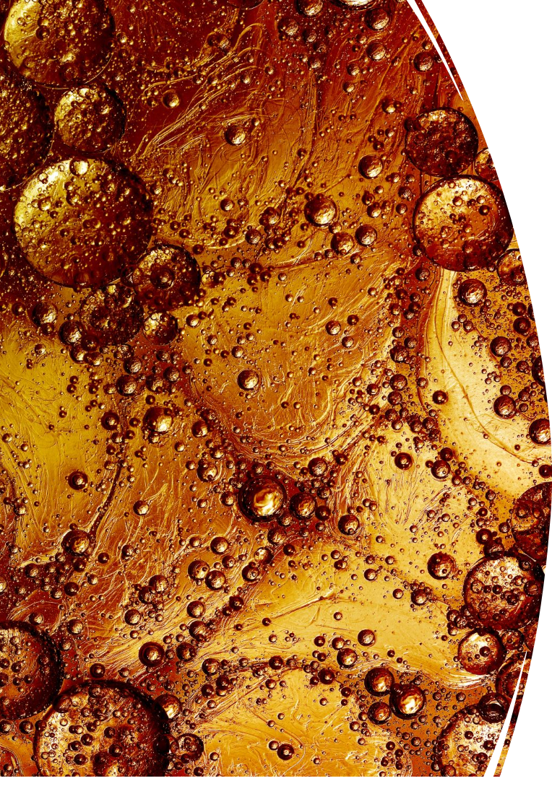
Reference
1. Sea Water | National Oceanic and Atmospheric Administration, “Sea Water”,
https://www.noaa.gov/jetstream/ocean/sea-water
(accessed 19/02/2025)
2. Wikipedia, “Oil Spill”,
https://simple.wikipedia.org/wiki/Oil_spill
( accessed 10/03/2025)
3. Wikipedia, “Oil Spill”, https://en.wikipedia.org/wiki/Deepwater_Horizon_oil_spill
( accessed 10/03/2025)

Slide 10
The end
Thank you for listening

