Slide 1

The Plant-Caring Robot:
Feeding our planet and Mars!
ESSS 2025
By Newton Raphaël and Sniter Raphaël

Slide 2
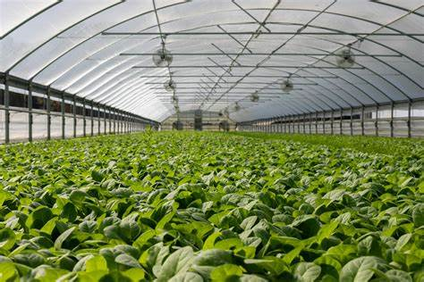
Introduction
In our presentation, we will explore the challenges facing our planet and how innovative technologies, such as precision farming and automated robots, can provide sustainable solutions.
What is our project about?
Only one planet to feed us all
Precision farming: a solution?

Slide 3
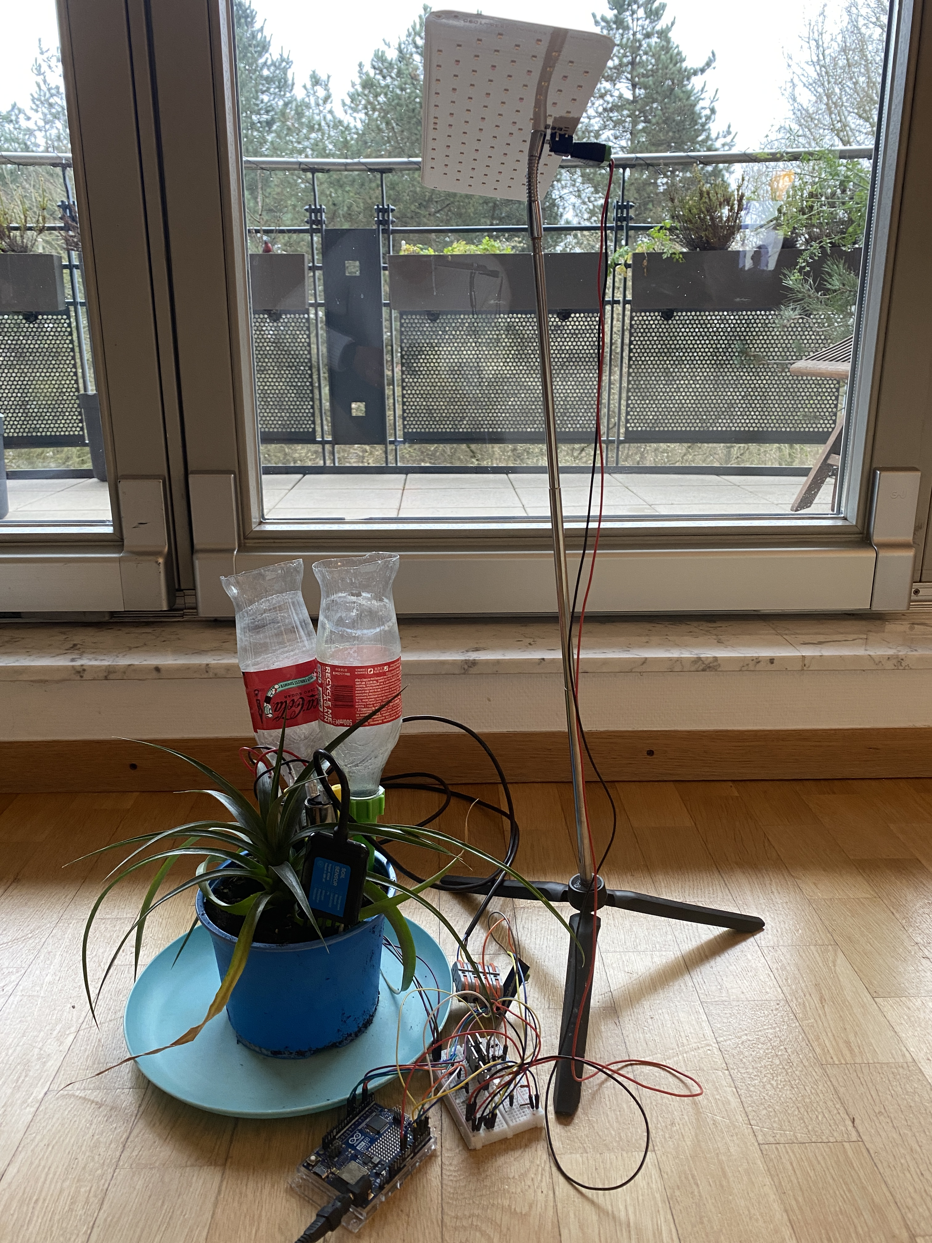
What is our project about?
Our project consists of a robot based on arduino technology that meaures the plant's needs and gives it the light, water and nutrient it needs.
Imagine being on holiday and not having to worry about all your plants or worrying about having to pay someone to look after your plant(s).

Slide 4
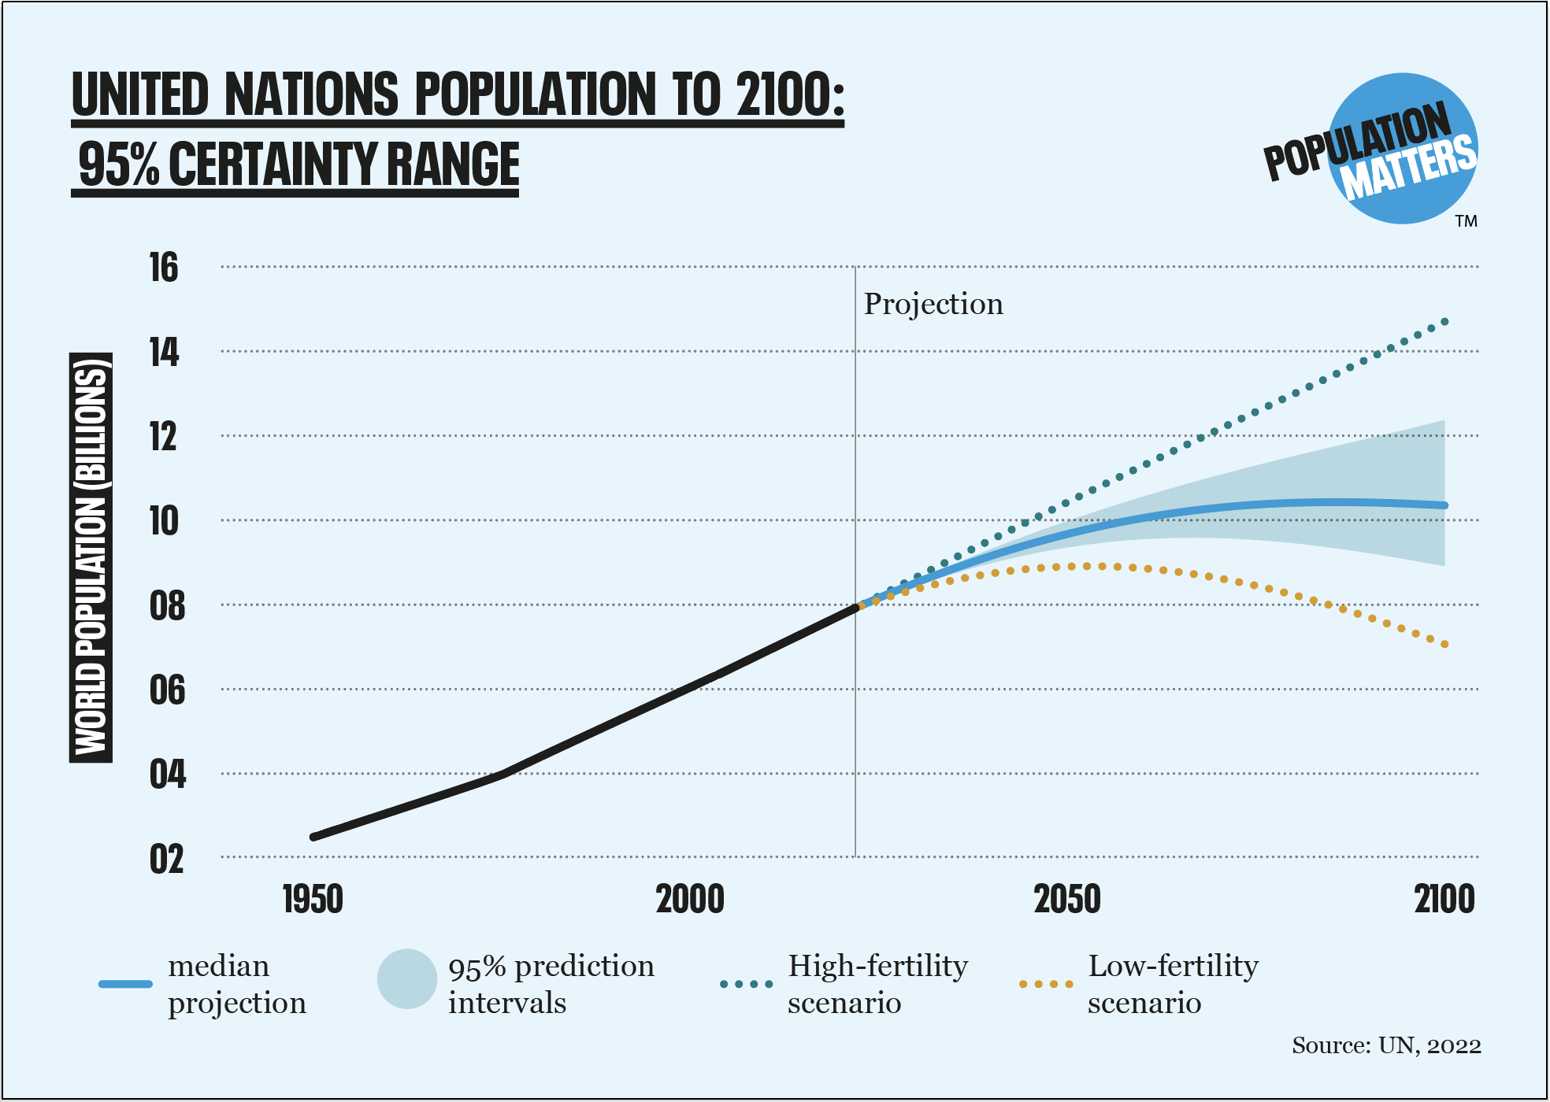
Only one planet to feed us all
We know that the population will increase, and we will have less space on earth for agriculture. There will soon be more than 10 billion humans to feed.
Using our project in digital farms will allow to produce more and at a lower cost.
With our plant-caring robot, everyone can easily become a great gardener.

Slide 5
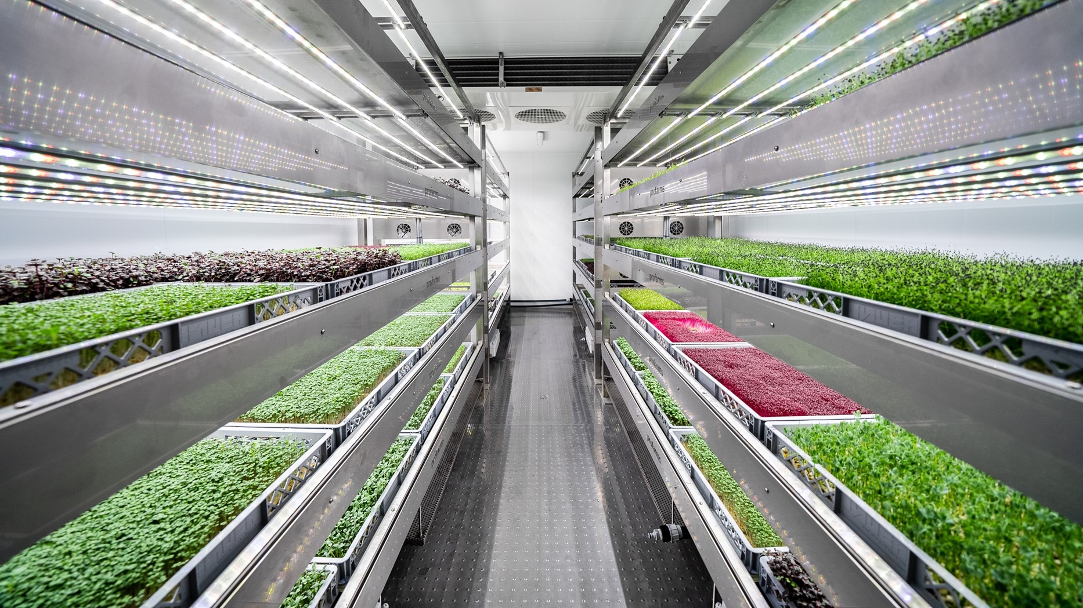
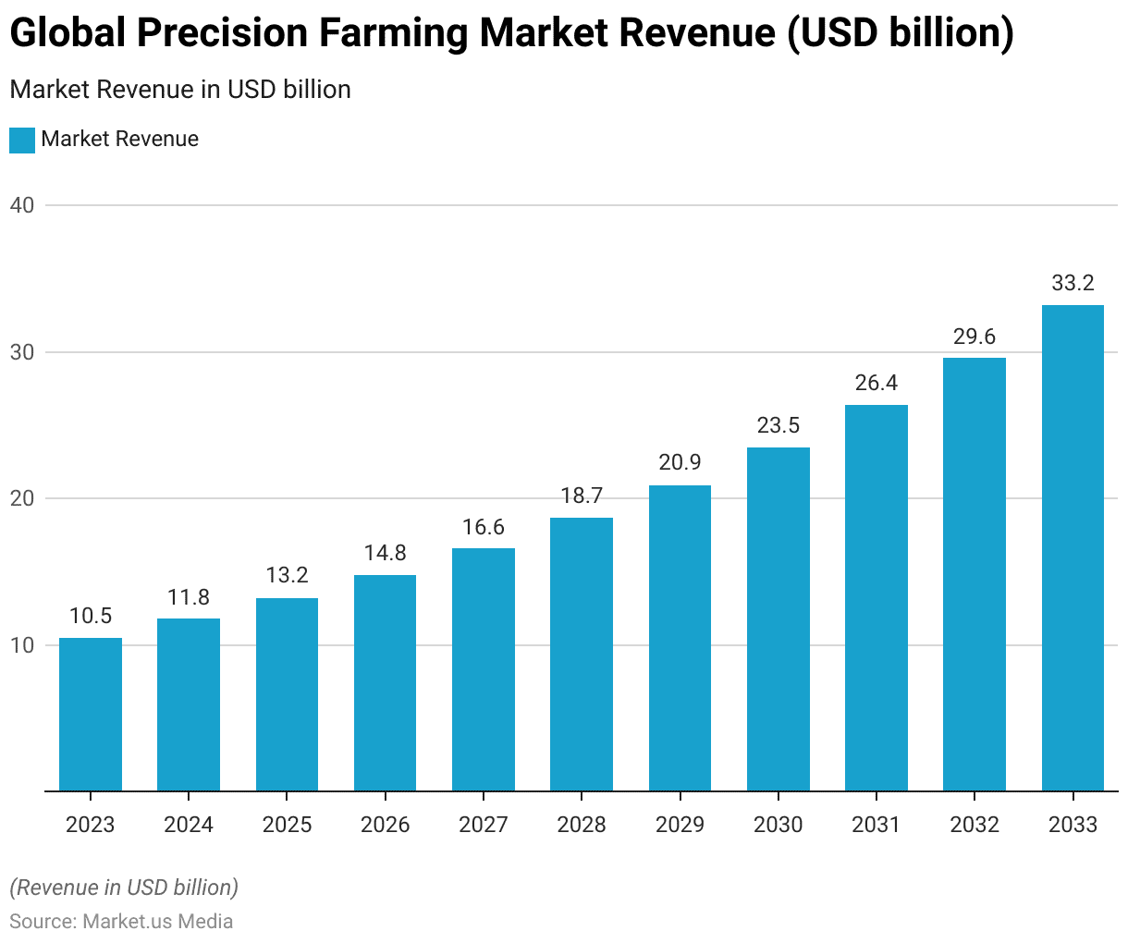
Precision farming : a solution ?
Precision farming uses technology to optimize the use of land, water, nutrients, and pesticides. By automating certain farming processes with plant-caring robots, we can achieve higher yields while minimizing environmental impact.
Precision farming will be important in the future. It is projected that by 2033, the market revenue of global farming precision will triple.

Slide 6
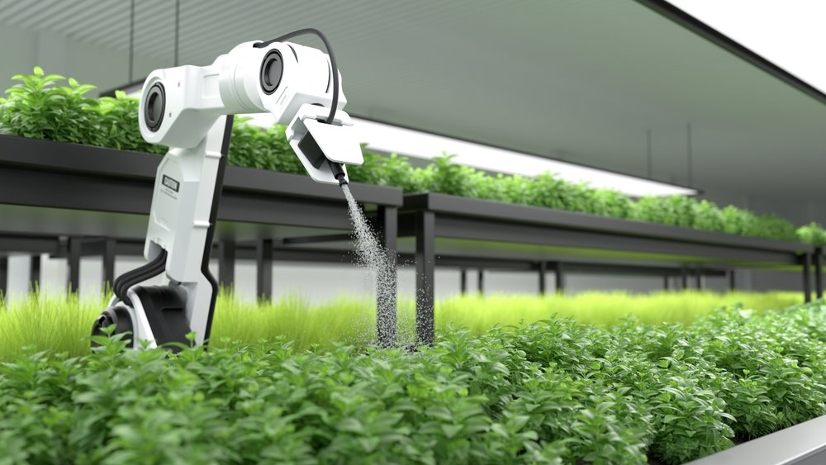
THE PLANT-CARING ROBOT
The design and components
The coding

Slide 7
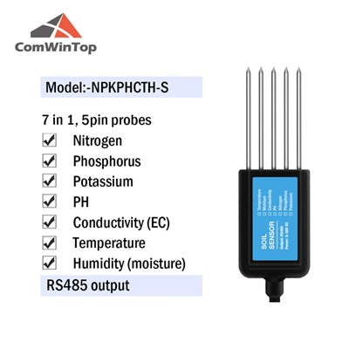
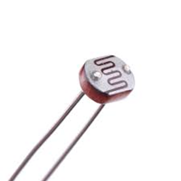
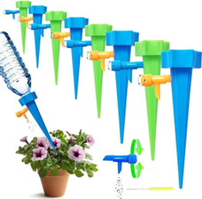
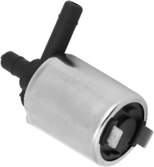
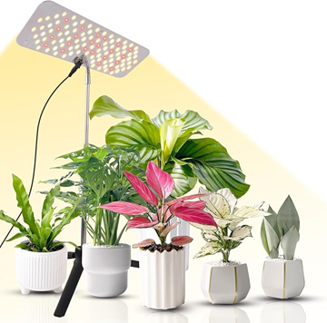
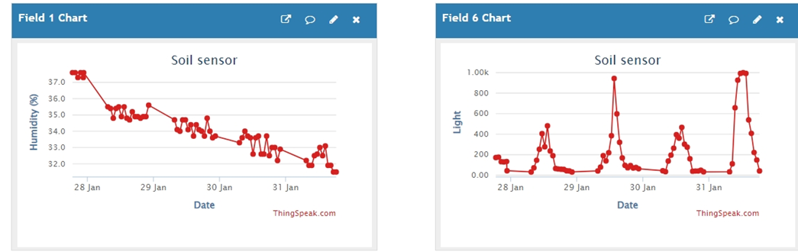
The design and components
 | Water/nutrients | Light
Measuring
Caring
Recording

Slide 8
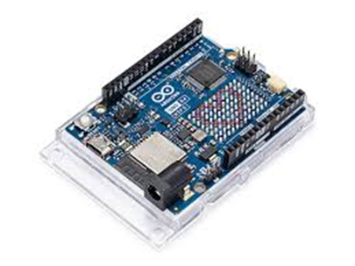
The coding
The different steps of the code are:
  Connecting to the wifi network
  Getting the data from the ComWinTop sensor and photoresitor
  Sending this data to Thingspeak
  Comparing the data to the pre-defined thresholds
  If needed, turning on the light, the water, the fertiliser
  Loops every hour

Slide 9
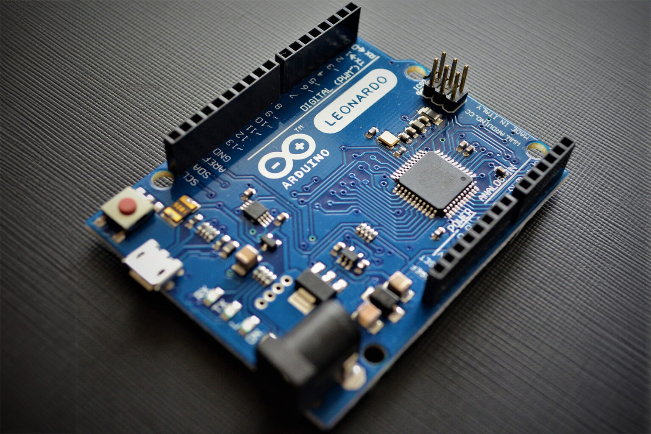
The experiment
Objective & set-up
Results
Overall conclusion

Slide 10
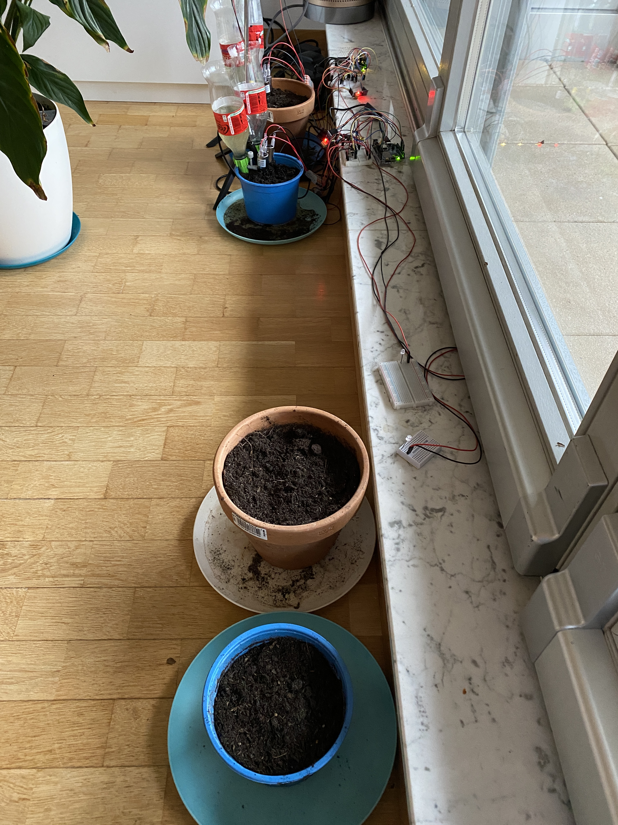
Objective & set-up
Radish
Salad
Check whether our robot helps plants grow faster
Compared to home gardener (watering once a week)
Seeds: radish, salad
Plants measured everyday
Duration: 3 weeks
Radish
Salad

Slide 11
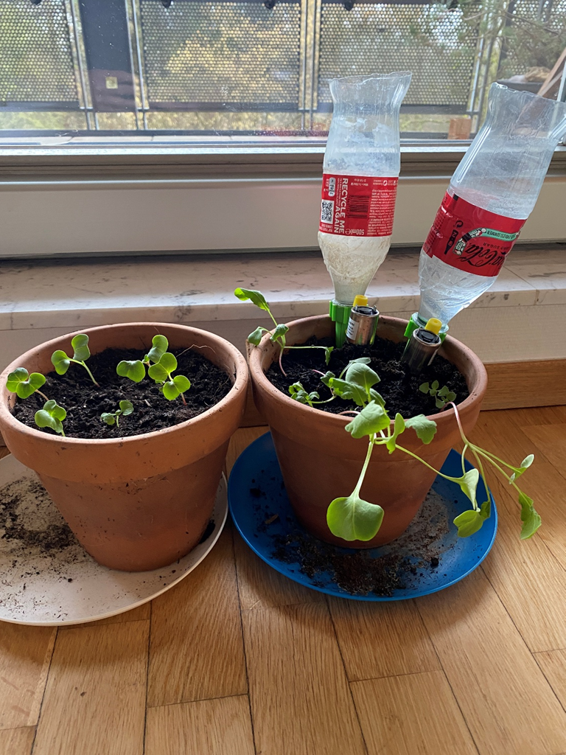
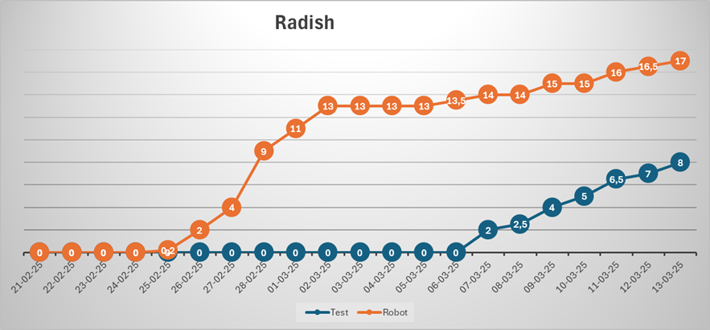
Results
Germinated earlier
Grew faster
Similar results for salads
After 3 weeks

Slide 12
Overall conclusion
A fully operational Plant-Caring Robot, that handles water, nutrient and light needs
Producing healthier and bigger plants than an average home gardener
Further experiments with:
  different threshold values for humidity/nutrients/light
  other seeds
  longer periods

Slide 13
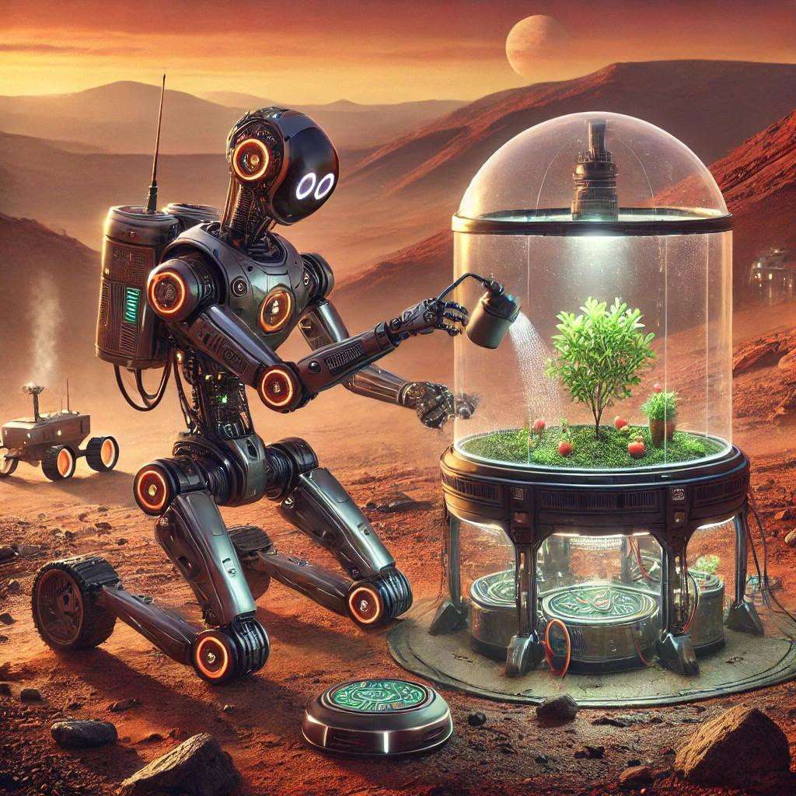
We think our robot can be used in many ways:
precision farming
scientific experiments,
helping lazy home gardeners,
and maybe even in space for future missions to Mars!
Thank you for your attention!

