Slide 1

E-School: A Digital Gateway to School Life
Luka Takki, S4-FIA
European School of Luxembourg 1

Slide 2
Introduction
Centralised platform for school information (menus, events, activities, absences, news)
Developed by students using modern web tools, AI, and coding
Supported by research—83% of students supported a centralized portal
Enhances communication, engagement, and digitalisation in schools
Notes:
Designed to be modern, accessible, and user-friendly
Works as a club for students to get real-life experience on managing a website
Created with modern web tools

Slide 3
The Website
Website initially prototyped using HTML, CSS, and JavaScript
Later designed in Figma for optimal user experience
Final version built on Wix for ease of use and security
Information gathered from Sodexo, the Pupils Committee, and other organisations

Slide 4
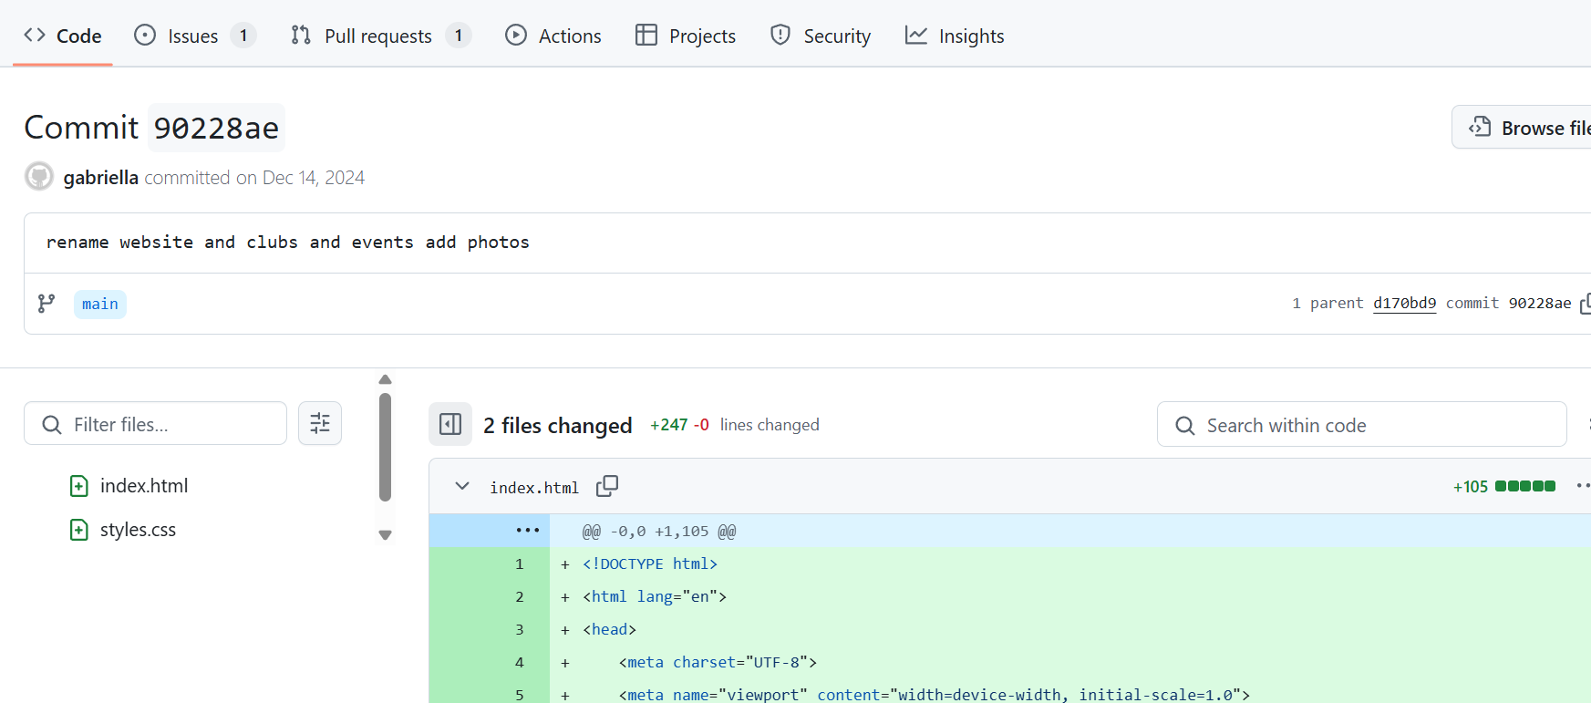
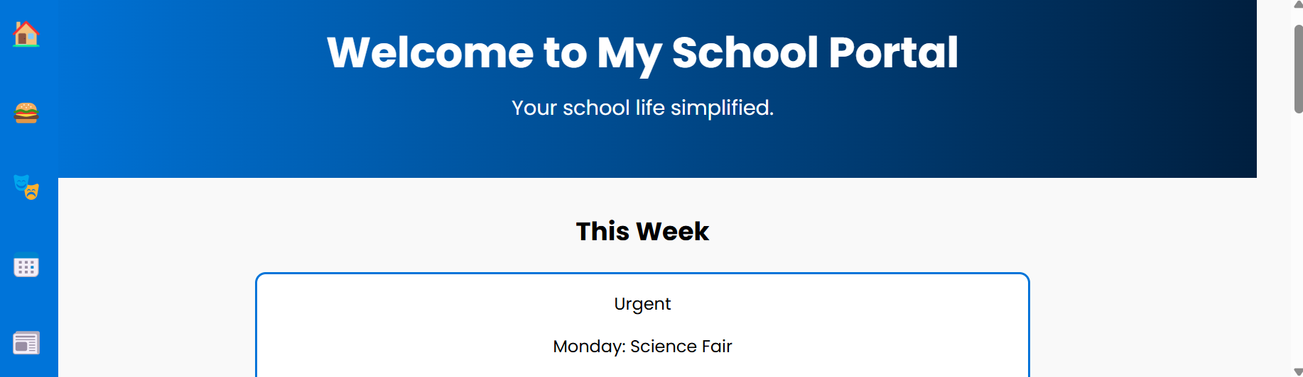
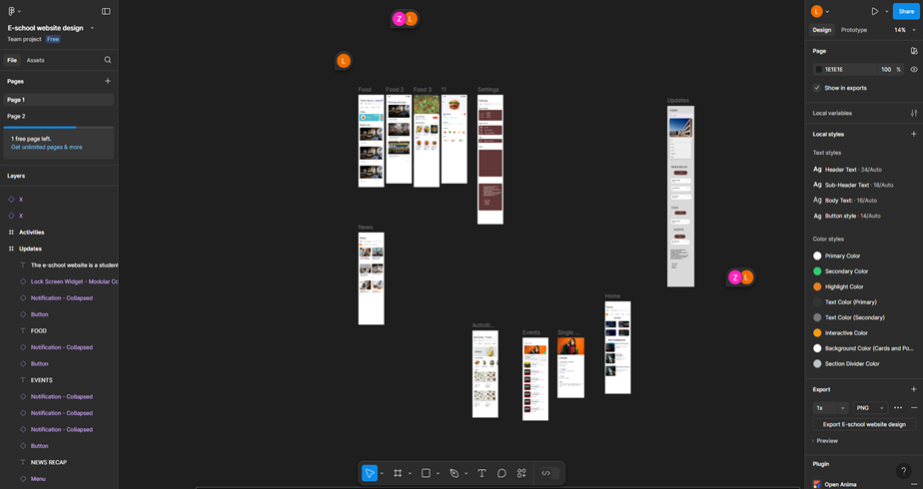
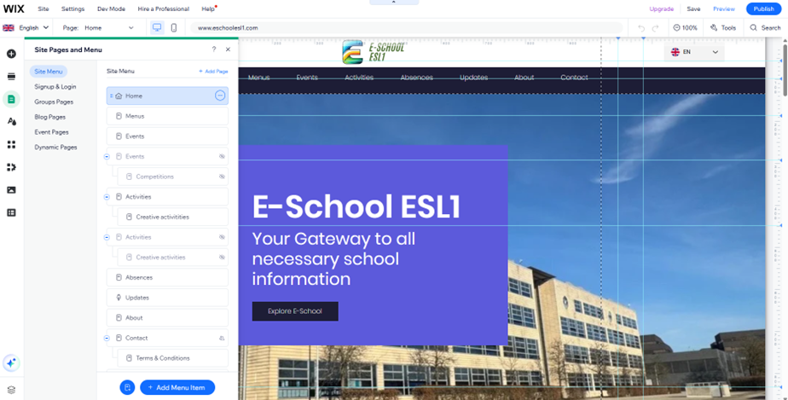

Slide 5
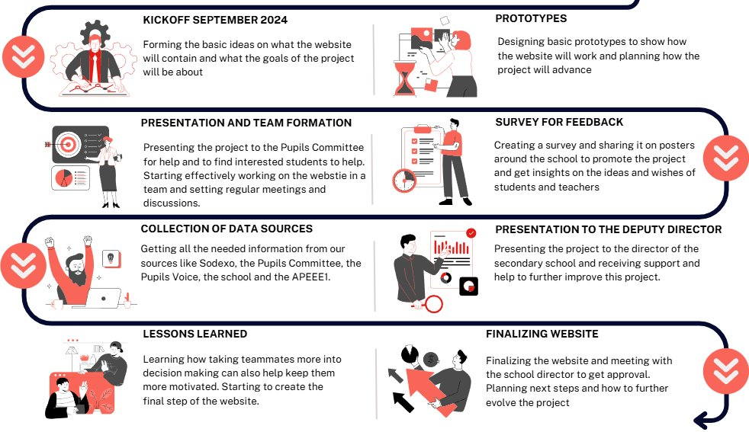
The Process
Ideation phase and creating prototypes
Finnishing prototypes, presenting to PC, forming teams
Starting website developement, advertising, gathering information and meeting management
Finalizing with valuable ideas from school management, meeting information providers, IT team, DPO, etc…
Notes:
Reviewed by teachers, the Pupils Committee, and the Secondary Director
Website prototypes tested for functionality and accessibility

Slide 6
Research & Data
Conducted a survey with 90 students:
  83% reported difficulties in accessing information
  50%+ wanted to participate in E-School
Survey on motivation for students and teachers part of the team:
  100% found E-School as a project motivating
  Learned new life-long skills with real-life experience
Further questionnaires and inteviews to be conducted for school-wide results

Slide 7

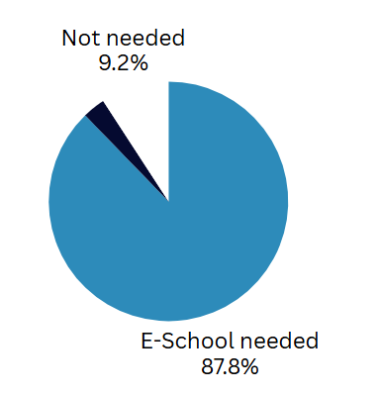
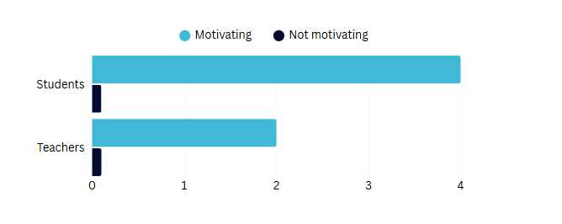
Results

Slide 8
Challenges & Solutions
Identifying essential tools for creation
Building a Collaborative team & Delegating tasks
Managing Website Ownership & Accountability
Securing Approval & Support
Notes:
Students maintain and update the website
Teachers & Admin Board oversee major updates and ensure quality
Information Providers (Sodexo, Pupils Committee, etc.) are responsible for content accuracy
Major Updates (new tools, major design changes) are reviewed by the school
Regular Updates (small improvements, bug fixes) are handled by students and teachers

Slide 9
Impact & Benefits
Improved student engagement and motivation
Easier access and available resources
Encourages digitalisation in schools
Skills developed in:
  ICT
  Leadership
  Teamwork
  Problem-solving
  Business

Slide 10
Conclusion
E-School solves a real problem by centralising essential information
Student-led projects like E-School enhance motivation and skills
The hybrid responsibility model ensures quality control and oversight
A modern, well-maintained digital platform benefits the entire school community

Slide 11
References
European Research Council. Digital Transformation in Education. https://www.erc.europa.eu/. Accessed 28/02/2025.
W3C. Web Accessibility Guidelines. https://www.w3.org/WAI/. Accessed 15/02/2025.
Hattie, J. (2009) - "Visible Learning: A Synthesis of Over 800 Meta-Analyses Relating to Achievement" Accessed 15/12/2024.
Fredricks, J. A., Blumenfeld, P. C., & Paris, A. H. (2004) - "School Engagement: Potential of the Concept, State of the Evidence" Accessed 04/02/2024.
Thomas, J. W. (2000) - "A Review of Research on Project-Based Learning" Accessed 10/03/2025.

Slide 12
Acknowledgements
Dr. Lipponen Mraz – for guidance and support throughout the project
Pupils’ Committee and their members:
  Ambre Lesauvage, President
  Florian Maat, Vice President
  Malwina Dorda, Secretary General
  For their support from the beginning.
Carole Lemarie, School Deputy Director – for bringing the project to the school
My team – for their trust and commitment throughout the journey
Participants of the numerous questionnaires – for their valuable contributions
My wonderful mom – for her constant support and belief in me

Slide 13
Thank you for your attention

