Slide 1

Preventing eye strain by monitoring a user's distance from the screen using python
By Alp Demir S4ENA, European School of Bergen

Slide 2
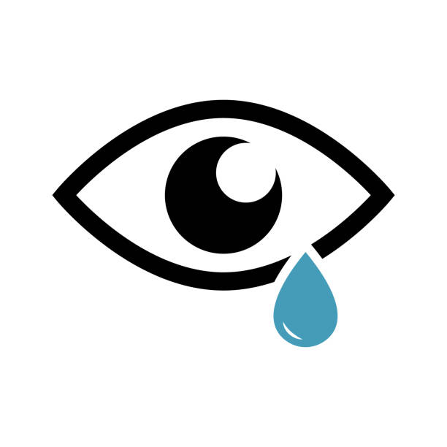
Index
Introduction
Materials
Python script
Method
Results
Discussion
Conclusion
Why this project?
References

Slide 3

Introduction
Python script that monitors the distance of a user from the screen
Warns them if they are too close
Hypothesis: by warning a user if they are too close, it is possible to prevent eye strain and help long-term eye health

Slide 4

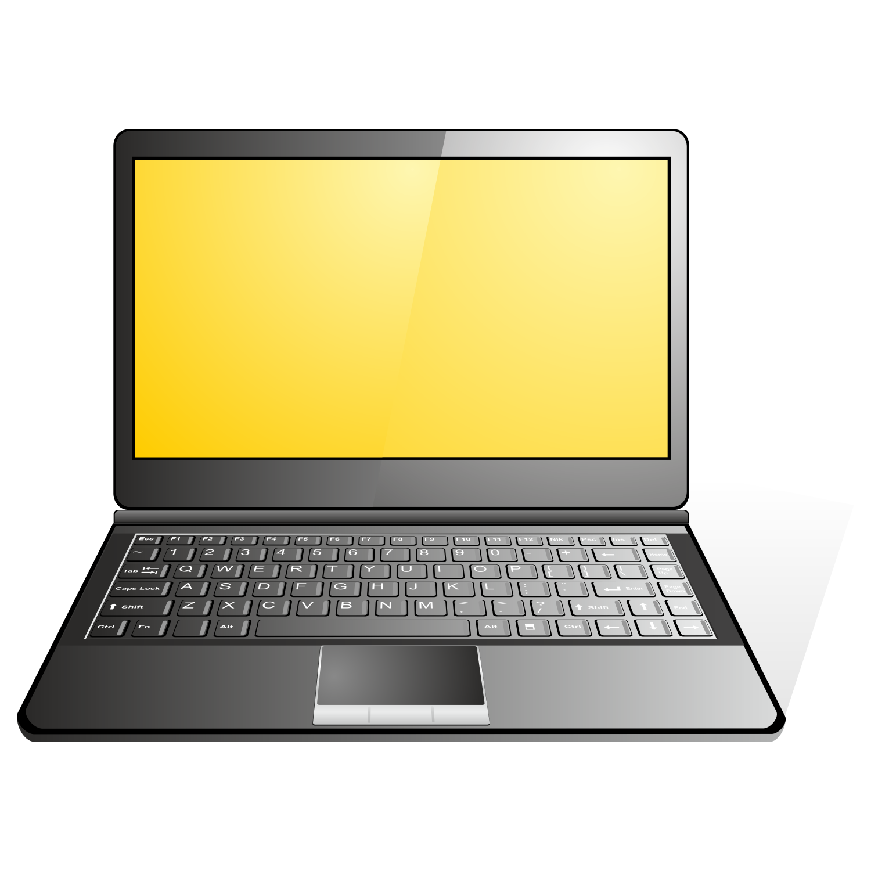
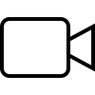
Materials
Participants
Video: A short documentary on unhealthy foods by business insider
Computer with python script and webcam

Slide 5
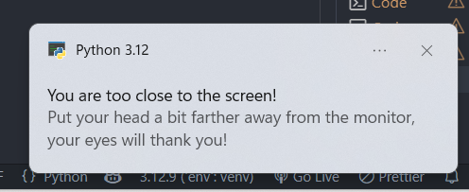

Python Script
OpenCV: access to the webcam, pre-trained face detection model
Performance: Converts image to grayscale
Distance estimation: given information: Average face width at 15 cm Webcam focal length: 600px Formula: Distance = (Known width x Focal length) / Width in pixels
Warning: warns via a buzzer and a notification if distance <50 cm
Logging and display: Records face width, distance and position and displays face on webcam

Slide 6
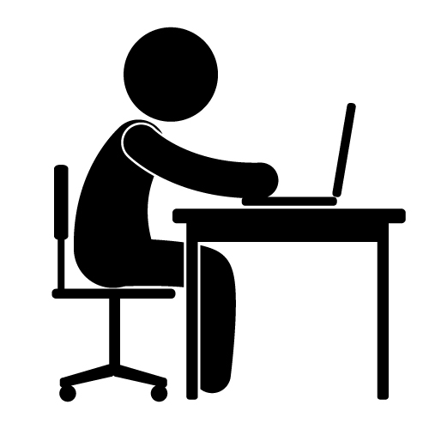
Method
Setup: Set up the experiment
Adjustment: Ensure the participant is visible in the webcam
Video playing: Play the video after setup
Recording results: Track the number of times the participant got too close (<50) in the both halves (5 min each)
Analysis: If the participant got closer less in the second half, the experiment was successful
Additional analysis: Repeat and compare results

Slide 7
Results
Participant: | Too close in first half: | Too close in second half: | Difference:
1 | 7 | 3 | -4
2 | 5 | 2 | -3
3 | 3 | 2 | -1
4 | 0 | 1 | 1
5 | 3 | 0 | -3
6 | 3 | 1 | -2
7 | 5 | 3 | -2
8 | 1 | 1 | 0
9 | 2 | 1 | -1
10 | 5 | 3 | -2

Slide 8
Discussion
Supports hypothesis: 8/10
Exceptions:
  Participant 4: 1 more in the second half
  Participant 8: Same amount in both halves
Patterns:
  Participants who have prescription glasses (1,7,10) had more total instances
  Participant 4 had the least number of instances as she maintained a seating position
Future improvements:
  More participants to increase accuracy
  Let participants choose their own video, negative- not all videos require same amount of attention

Slide 9
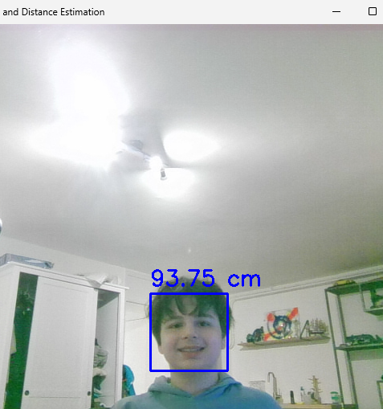
Conclusion
Hypothesis was proven by my results
In a majority of the participants there were less instances

Slide 10
Why this project?
To help reduce eye strain in people who sit too close to screens
Main motivator: my sister's eye discomfort caused by watching the television too closely
Secondary motivator: to prevent my own discomfort as I code and watch movies on my laptop.

Slide 11
References
Mayo Clinic: https://www.mayoclinic.org/healthy-lifestyle/adult-health/in-depth/office-ergonomics/art-20046169
OpenCV-Python documentation:https://docs.opencv.org/4.x/d6/d00/tutorial_py_root.html
OpenCV-Python open-source face identification model: https://github.com/opencv/opencv/blob/master/data/haarcascades/haarcascade_frontalface_default.xml
Pyimagesearch: a website with information about computer vision and deep learning: https://pyimagesearch.com/2015/01/19/find-distance-camera-objectmarker-using-python-opencv/
PyGame-audio: https://www.pygame.org/docs/ref/mixer.html

Slide 12
The end
Thanks for listening, are there any questions?

