Slide 1

Classroom Environment Monitoring: Information for a Better Learning Space
Scuola Per l'Europa Parma
Alabiso Matteo, Álvarez Lucas, S4EN

Slide 2
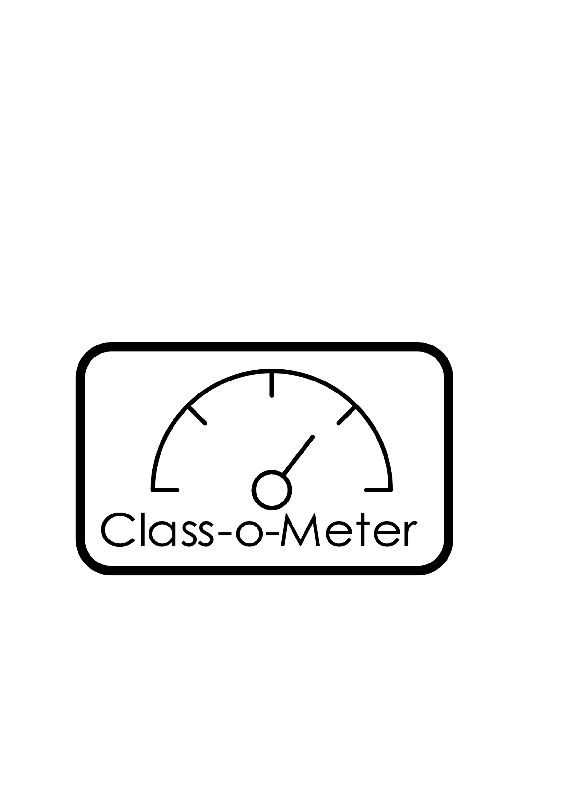
Introduction
This project focuses on measuring two factors in the school environment that affect student learning: noise and CO₂ levels. We developed an Arduino-based device that measures CO₂ levels in the air and the duration of noise above a preset threshold. We chose to undertake this project because our class has always been noisy. By identifying trends based on time of day, day of the week, and other variables, we aim to develop solutions improve our classroom environment.
The project's logo

Slide 3
Materials
Hardware:
Noise sensor: KY-037
CO₂ sensor: SGP30
Board: ESP32-WROOM-DA Module
Arduino jumper wires
Standard Arduino breadboard
Computer
Micro-USB cable
Power bank
Software:
Looker Studio
Google Sheets
Google Apps Script
Arduino IDE
Github
WiFi connection
Fig

Slide 4
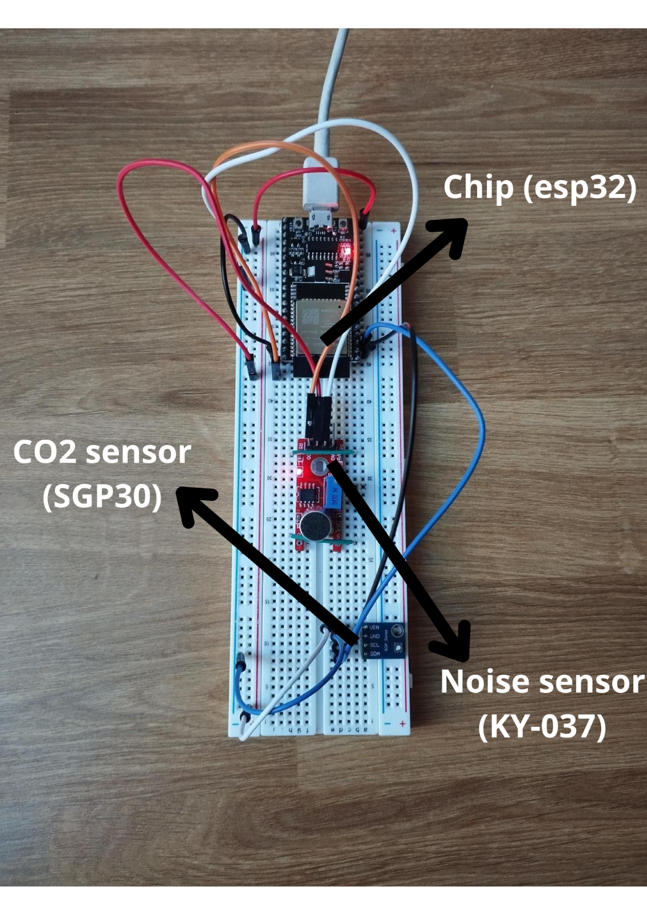
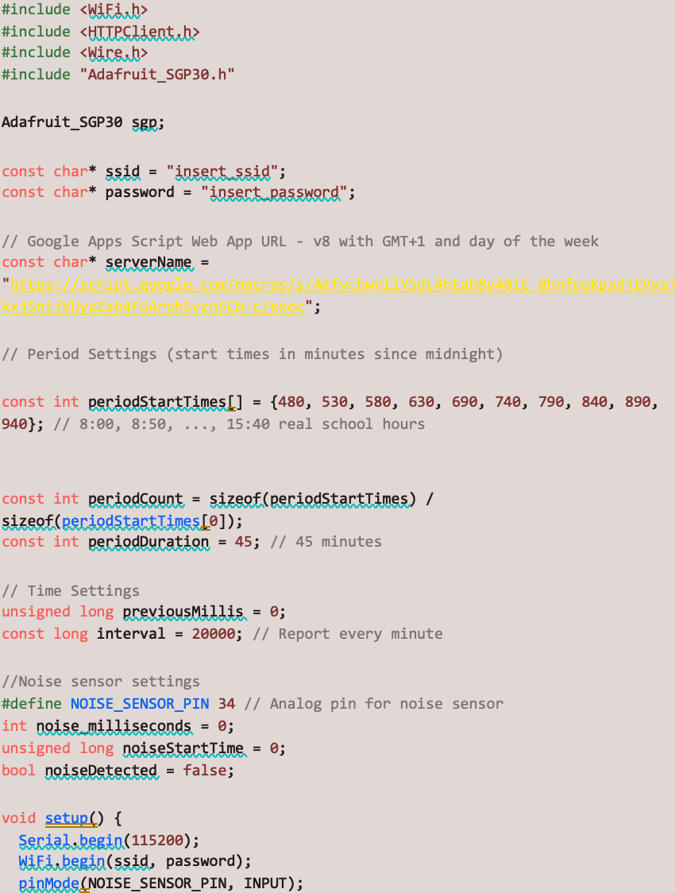
RESULTS
Our prototype without a case
A part of the code.

Slide 5
Our system successfully monitored classroom noise and CO₂ levels, updating Google Sheets every 20 seconds and calculating averages per period. The data, collected over the course of four school weeks, are preliminary and provide an initial insight into variations across different days of the week and periods of the school day. While the system functioned well overall, the trends shown in the provided graphs should be interpreted as indicative rather than definitive at this stage, as further validation and analysis are required.

Slide 6
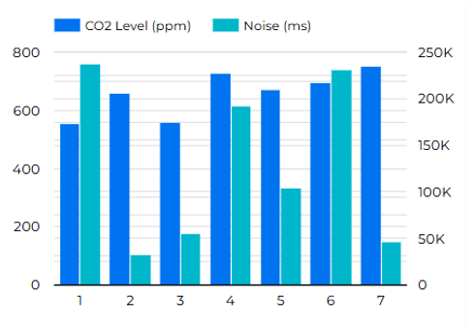
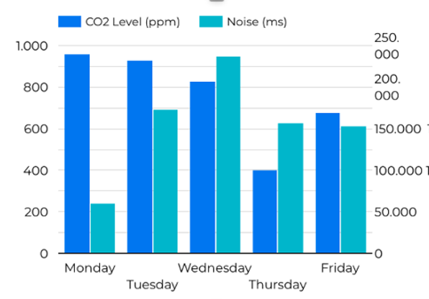
CO₂ and Noise Levels Across Different Days of the Week in School
CO₂ and Noise Levels Throughout the School Day by Period
period

Slide 7
SURVEY
In addition to our main research, we conducted a survey among S1–S7 students at our school to assess the impact of noise on their ability to concentrate while studying, identify the most distracting types of noise, and explore the strategies they use to manage noise.
A total of 353 students participated, including 57 from S1, 57 from S2, 50 from S3, 52 from S4, 53 from S5, 38 from S6 and 46 from S7.

Slide 8
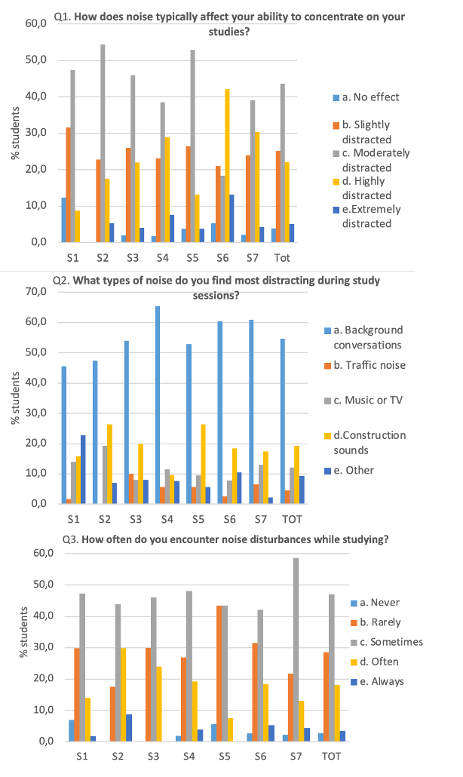
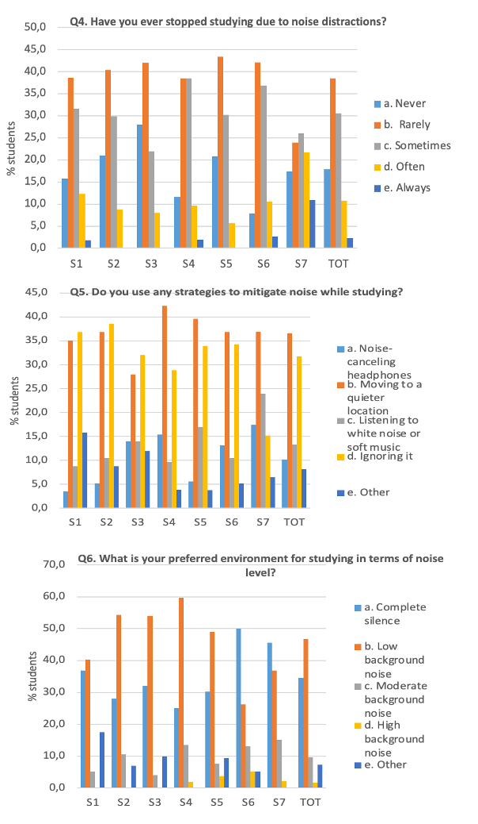
SURVEY QUESTIONS
Q1: How does noise typically affect your ability to concentrate on your studies?
Q2: What types of noise do you find most distracting during study sessions?
Q3: How often do you encounter noise disturbances while studying?
Q4: Have you ever stopped studying due to noise distractions?
Q5: Do you use any strategies to mitigate noise while studying?
Q6: What is your preferred environment for studying in terms of noise levels?

Slide 9
CONCLUSION AND FUTURE STEPS
Our device successfully detects CO₂ and noise variations in the classroom. Our supplementary survey found that noise disturbances are prevalent across all grades (S1-S7 students) and that background conversations is overwhelmingly the most distracting noise type across all groups.
At this stage, the data collected with our device are preliminary. To implement it as an effective tool for improving the classroom environment, we need to:
Collect more data and use better hardware, like a sensor which can measure noise in dB
Analyse peak levels and minimum levels and fluctuations
Test in different conditions – Conduct trials across various classrooms and activities to validate effectiveness.
Define optimal thresholds – Establish appropriate CO₂ and noise limits based on activity type.
Engage students in setting noise management goals, reviewing collected data, and developing strategies to maintain an optimal learning environment.

Slide 10
references
References:
Gheller, F., Spicciarelli, G., Scimemi, P., & Arfé, B. (2023). The Effects of Noise on Children’s Cognitive Performance: A Systematic Review. Environment and Behavior, 55(8-10), 698-734. https://doi.org/10.1177/00139165241245823
Ammar Y. Alqahtani, Anas A. Makki, Hassan M. Alidrisi, Revealing factors influencing classroom noise in the universities teaching and learning environment: A design of experiments approach, Journal of Engineering Research, Volume 11, Issue 1, 2023
Yuejie Fan, Xiaodong Cao, Jie Zhang, Dayi Lai, Liping Pang, Short-term exposure to indoor carbon dioxide and cognitive task performance: A systematic review and meta-analysisBuilding and Environment, Volume 237, 2023
https://oshwiki.osha.europa.eu/en/themes/indoor-air-quality-iaq
Arduino official forum https://forum.arduino.cc/

Slide 11
Thank you for your attention

