Slide 1
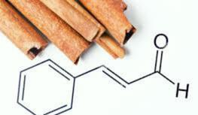
Conversion of Polystyrene Plastic into
Cinnamaldehyde
Matej Hradec S2ENA
Scuola Europea Varese

Slide 2
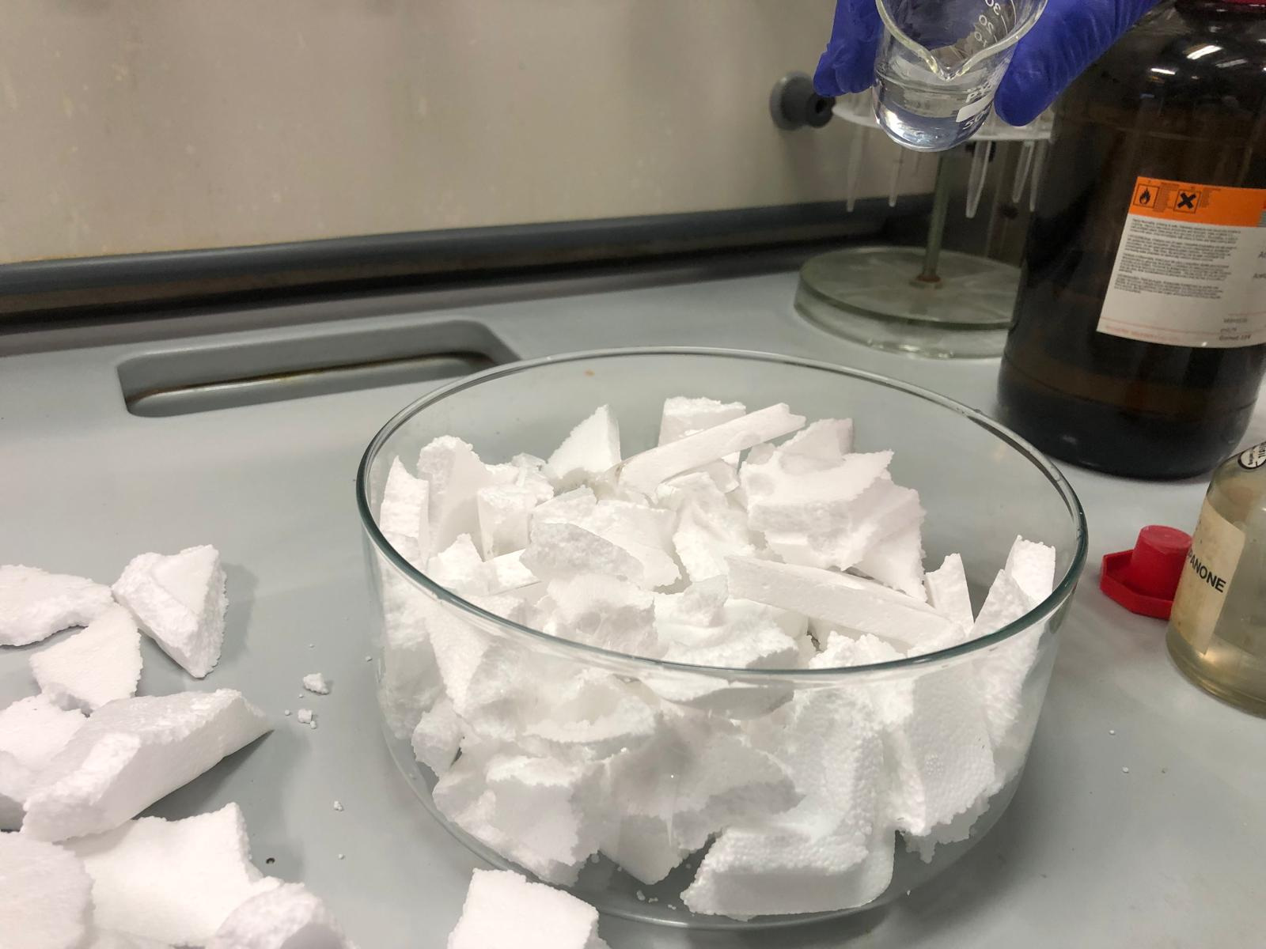
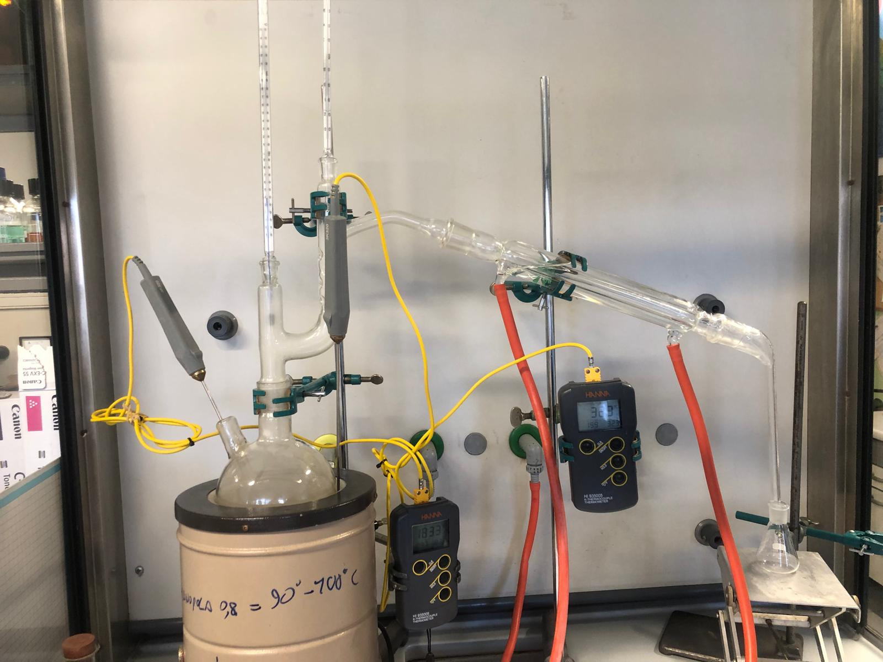
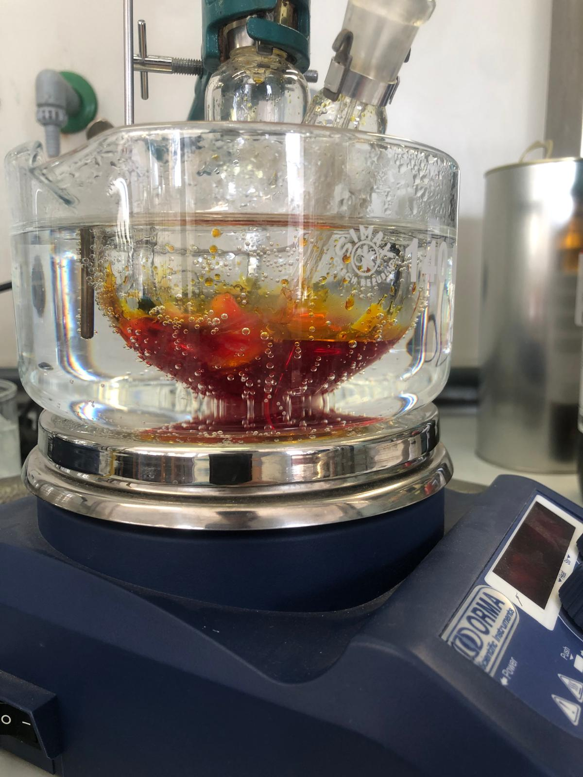
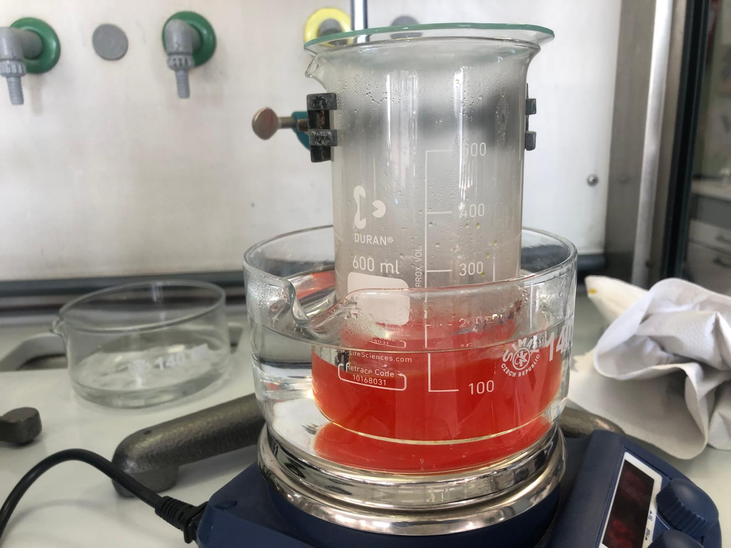
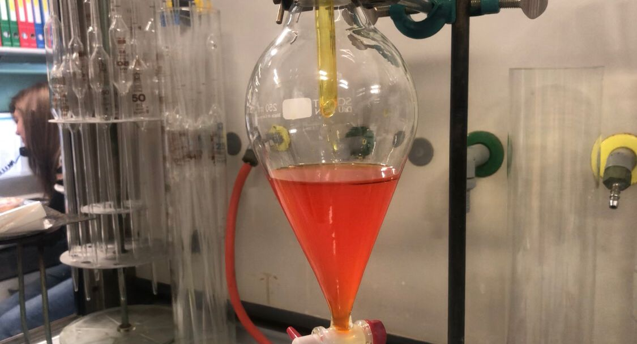
Introduction
This research was conducted in order to recycle plastics, that would pollute the environment, into a flavourant in the taste of cinnamon.
The main scientific question for this project was :
How can you turn polystyrene into the aromatic flavourant known as cinnamaldehyde?
The Five Main Parts of the Project
Collection & Preparation of Polystyrene Pyrolysis Process Synthesis of Cinnamaldehyde via the Vilsmeier-Haack Reaction Purification & Analysis

Slide 3

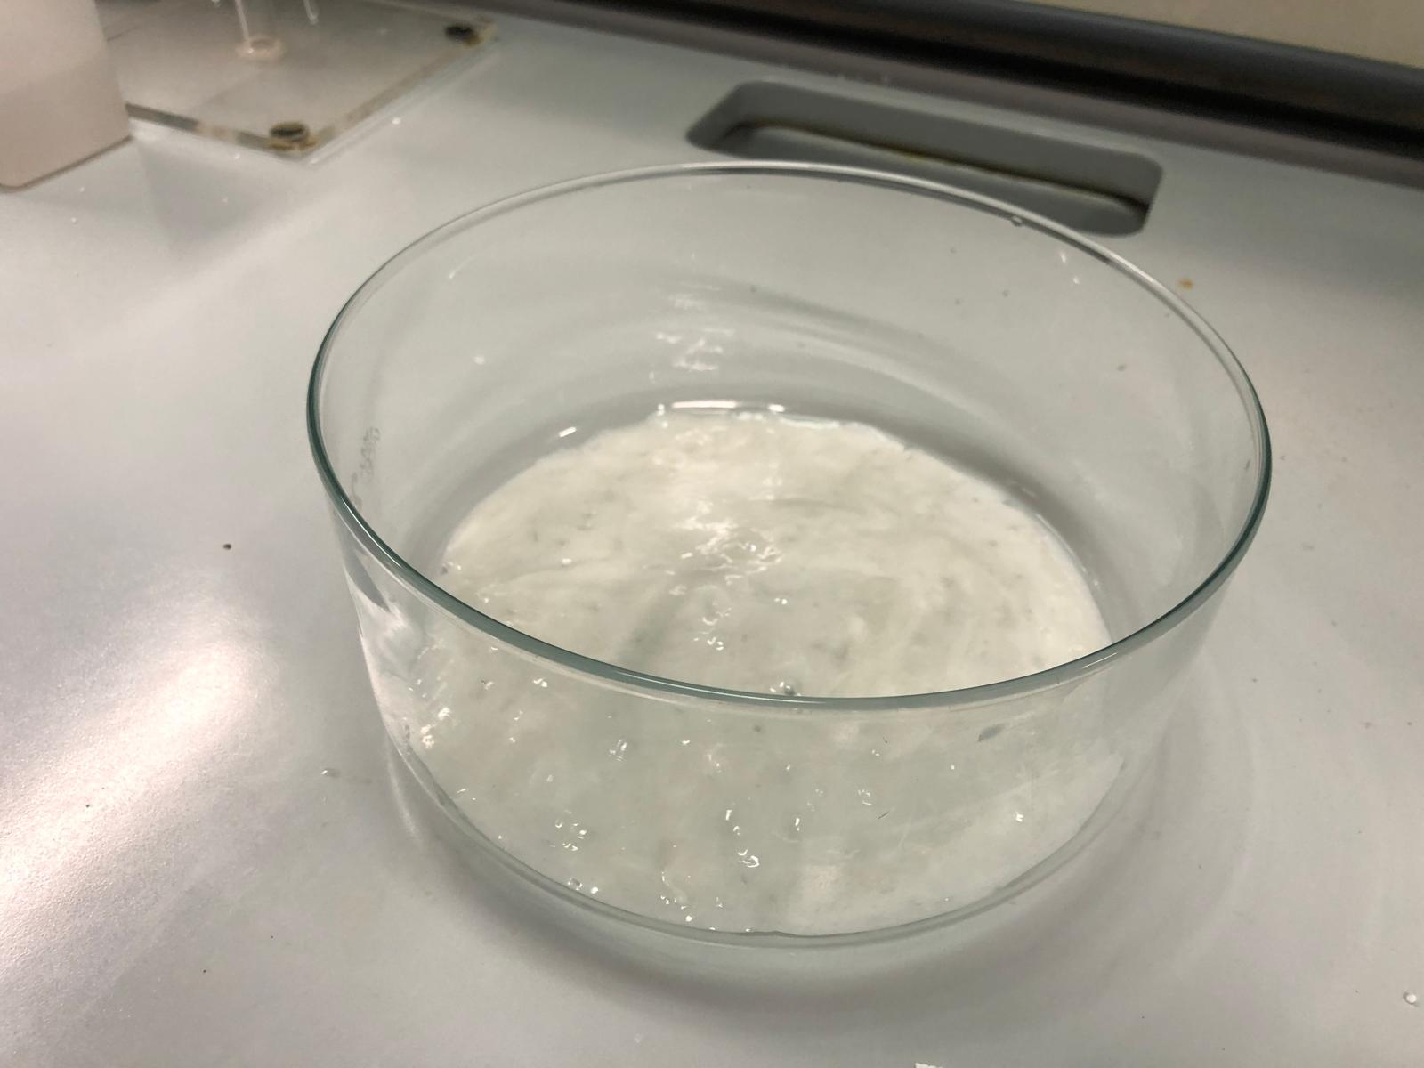

Collection & Preparation of Polystyrene
The collected polystyrene was decontaminated
Melted down with acetone.
Left out to dry.
Mixed in a mixer into powdered form.
Arrangement of materials
PS in acetone solvent
Grinding Process
Drying Process

Slide 4





Setup of Pyrolysis Process
Electrical thermometer
Thermometers
Condenser
Materials
Electrical heater
500ml Flask
Distillation column
2x Thermometers
2x Electrical thermometers
Condenser
Collection flask
2x Electrical thermometers
2x conical collection flask
Collection Flask
Electrical thermometers
500ml Flask
Electrical heater

Slide 5
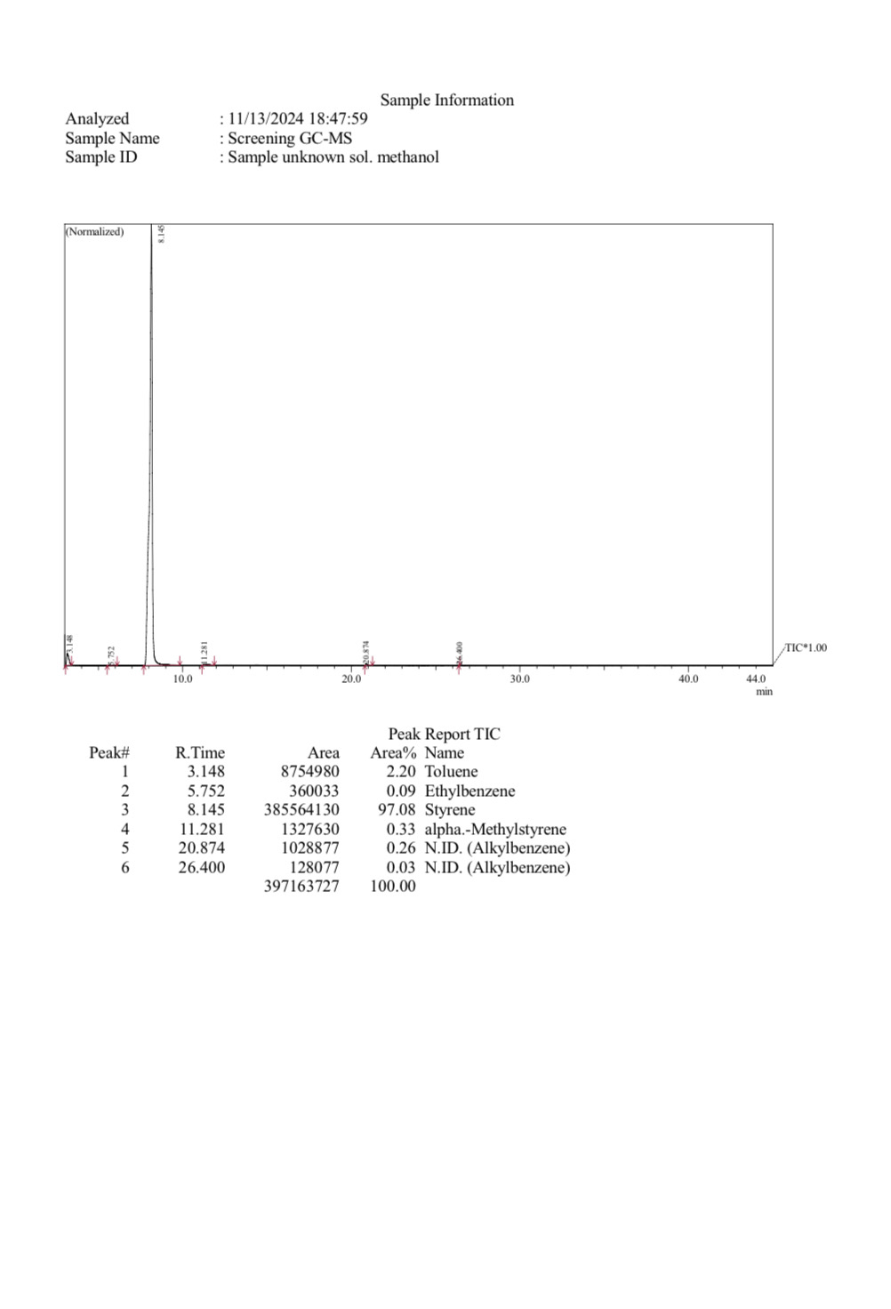
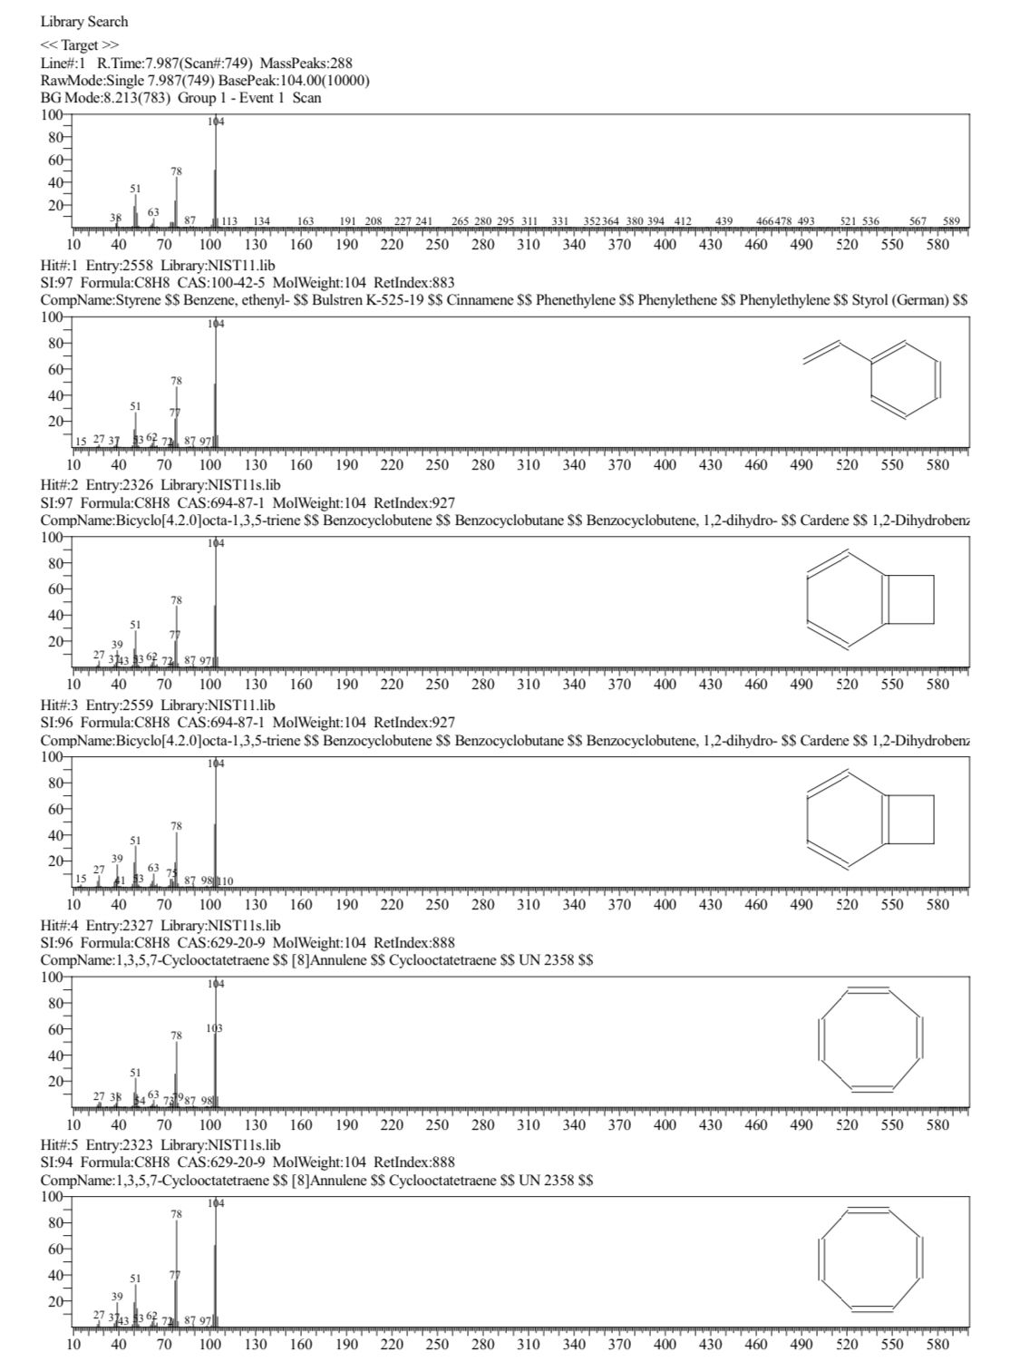
Styrene
The aim was to obtain styrene through distillation at 144C- 46C, side products were identified to be toluene, benzene, xylenes, dimeric styrene, trimeric styrene. A purity of 97.08% styrene was ultimately achieved through redistillating the product twice.
Styrene Obtained:
Quantity Obtained : 21ml
Stored in a sealed flask in 2C-6C temperature
The product was obtained by switching collection flasks while in range of boiling point of styrene.

Slide 6
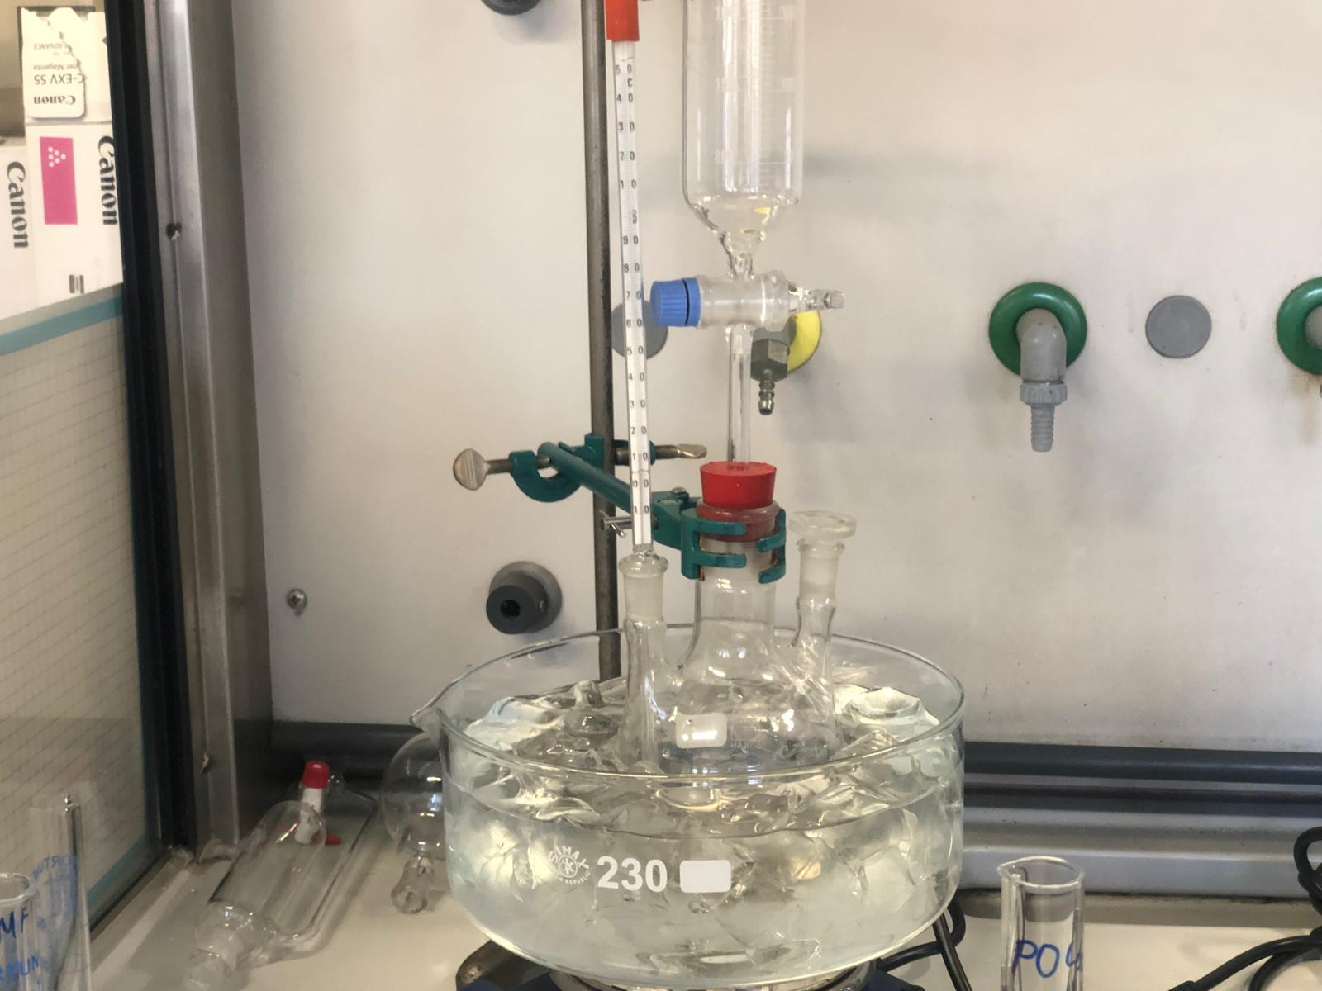
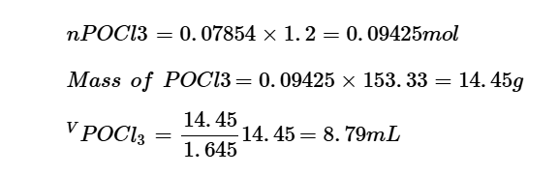
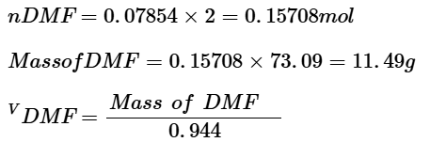






Setup of Formylation Process (Step 1)
Materials :
Three neck 500ml Flask
Magnetic Stirrer
Heating Plate
Thermometer
Ice bath setup
Addition funnel
Measuring cylinders x3
Addition Funnel
Stopper
Thermometer
500ml Flask
(with stirrer)
9ml C₆H₆
8.8ml POCl₃
12.2ml DMF
Ice Bath
Heating Plate

Slide 7
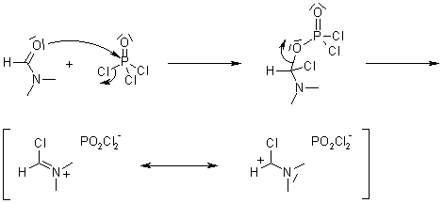
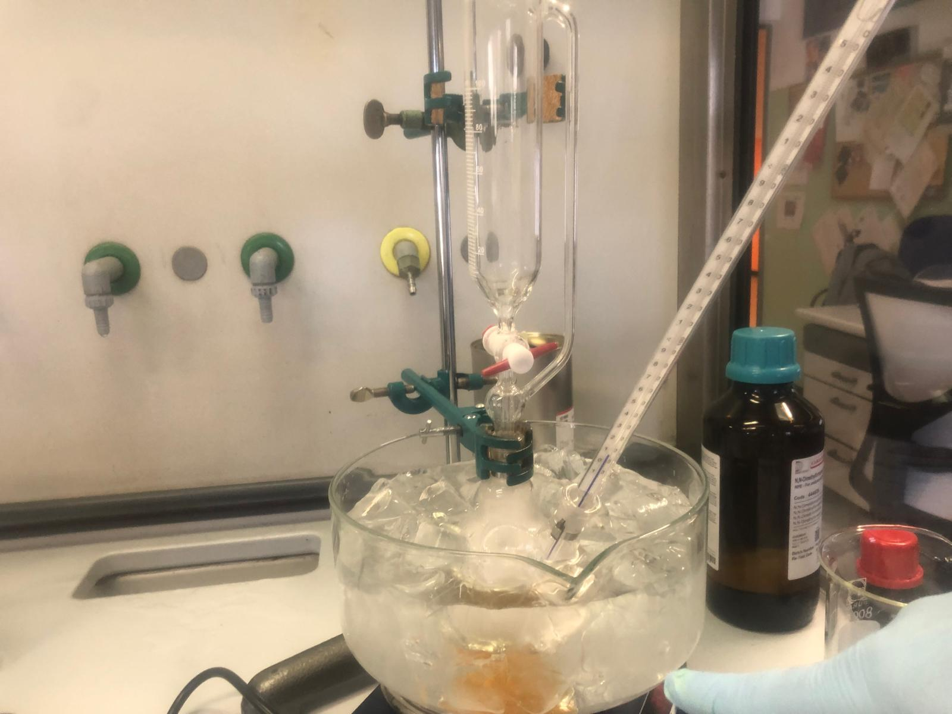
Step 1
POCl₃ reacts with DMF, forming a chloroiminium ion (Vilsmeier reagent), a strong electrophile.
DMF's oxygen attacks POCl₃, causing Cl⁻ release and iminium formation.
POCl₃ is added slowly to control heat, prevent side reactions, and avoid DMF decomposition.
After this reaction is done, styrene is added.
Ice removed
Started Heating to 75C
Causing the styrene and Vilsmeier Reagent to react.
Image of Vilsmeier reagent forming

Slide 8
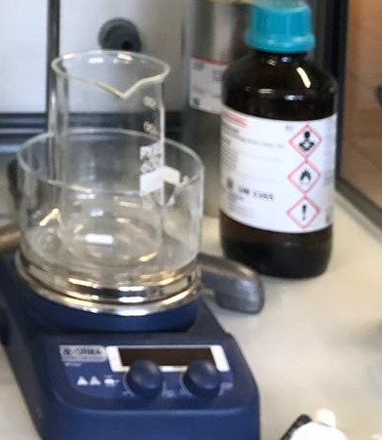


Set up of Formylation Process (Step 2)
600ml Beaker
Materials:
600ml beaker
Small ice bath
Heating plate
Magnetic Stirrer
Watch glass
Small Ice Bath
Heating Plate

Slide 9
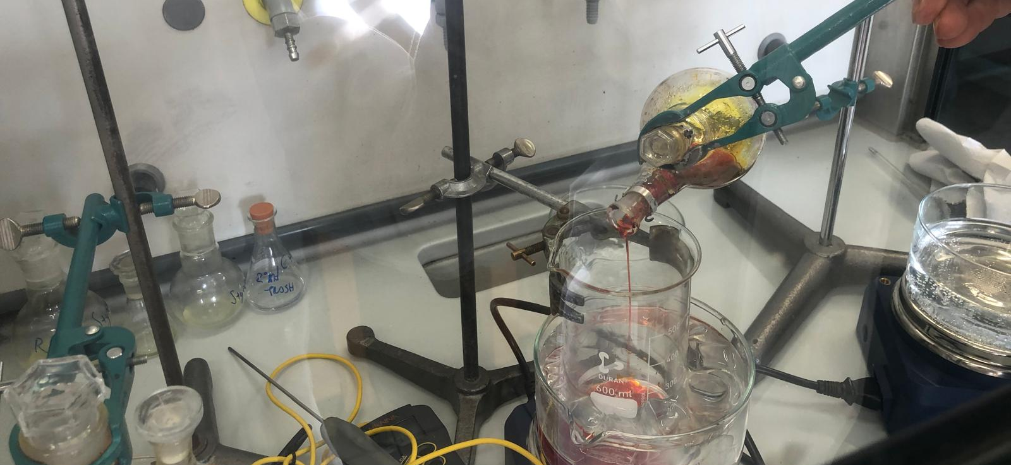
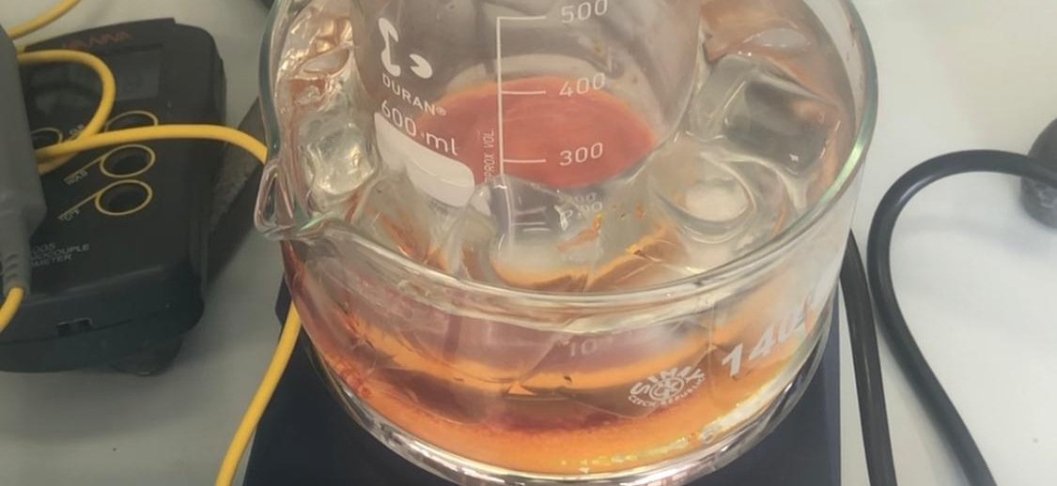
Step 2
The next step was cooling down the reaction, for that I set up another ice bath and started preheating water to 75C for the next step.
Once the mixture was poured into the beaker, it started rapidly cooling down and solidifying on the sides.
At that point I slowly poured in a mixture of Sodium acetate and water.
28.8g Sodium Acetate (C₂H₃NaO₂)
65ml Water
Cooling stabilizes Vilsmeier reagent, which prevents decomposition and side reactions. Exposure to moisture results in partial hydrolysis, resulting in solidified layer on the sides.

Slide 10
Formylation Process (Step 3)
The last step was moving the beaker into a preheated water bath, that triggers the electrophilic aromatic substitution (EAS) the Vilsmeier reagent reacts with styrene, forming a chloroalkene intermediate.
Hydrolysis converts it into Cinnamaldehyde, while sodium acetate buffers the reaction for high yield and purity.
Materials:
600ml beaker
Preheated water bath (75C)
Heating plate
Magnetic Stirrer
Watch glass

Slide 11
Purification Process
Liquid Separation Process
• Left overnight in fridge (2C-6C) to separate layers.
• Transferred to separatory funnel.
• Washed with (C₂H₅)₂O to remove DMF and waste.
• Mixed with water to remove diethyl ether and POCl3.
The next step would be performing a distillation under nitrogen gas of the black layer to achieve the final cinnamaldehyde.
Final amount of undistilled cinnamaldehyde : 9ml

Slide 12
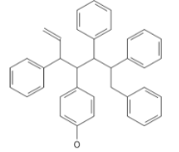
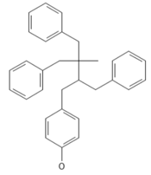
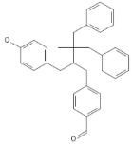
Surprising Byproduct
The estimated molecular composition of the adhesive varied with temperature:
An unexpected byproduct from the pyrolysis process, a semi-liquid, tacky styrene-polystyrene mixture, exhibited moderate adhesive properties for temporary bonding applications.
However, over time, it exhibited potential degradation due to oxidation and polymer instability.
Current Structure (Room Temperature, ~160°C):
Oligomers + Free Styrene + 5% Oxidation
(C₈ H₈ )n +C₈ H₈
Estimated Structure at 250°C:
(C₈ H₈ )n +C₆ H₆ +C₁₀ H₈
Estimated Structure at 350°C:
Shorter Oligomers + Increased Styrene Content
Predominantly Styrene Monomers + Some Dimers
C+C₆ H₆ +C₈ H₁₀ +C₁₀ H₈

Slide 13
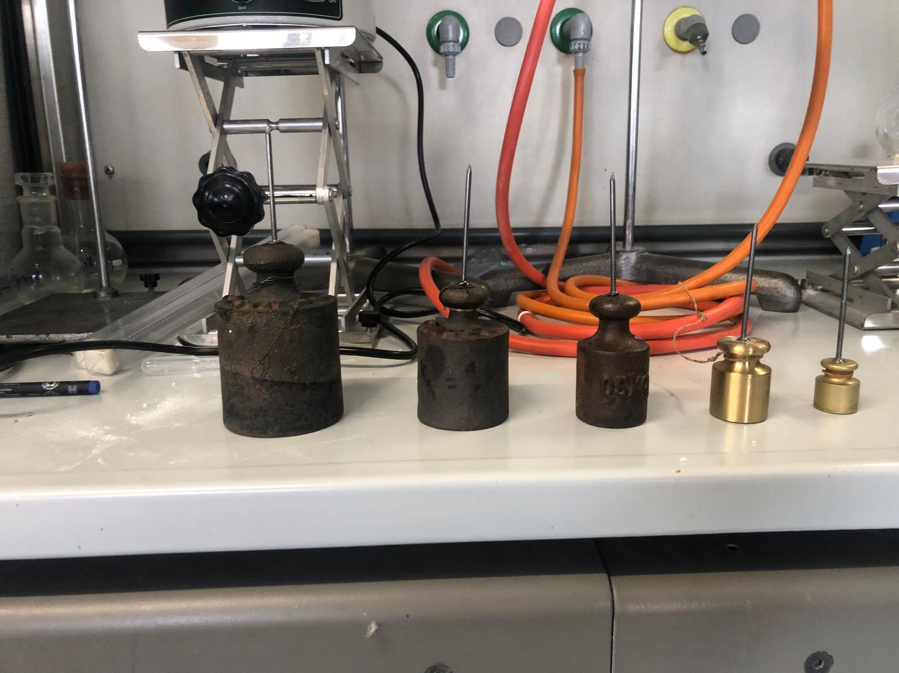
Adhesive Capabilities
The glue was tested on 5 different weights, including :
2kg
1kg
0.5kg
300g
100g
They all passed the weights at 0.5ml/weight

Slide 14
Summary of the Adhesive
• Successfully supported weights up to 2kg in a controlled test, but failed at 5kg, indicating moderate bonding strength.
• Limitations include susceptibility to oxidation and polymer instability over time.
• Potential improvements include cross-linking agents, adding divinylbenzene or benzoyl peroxide, and mixing with butadiene-styrene rubber or polybutadiene.
• This shows potential of chemical recycling as an alternative to traditional mechanical recycling.
• Scalability and process optimization can be improved.

Slide 15
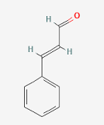
Discussion
The Vilsmeier-Haack reaction successfully converted styrene into cinnamaldehyde, but the process was halted before full completion due to time constrains.
Resulting in the output being a mixture of products besides the pure cinnamaldehyde, that needed to be further separated by distillation under nitrogen gas.
Optimizing reagent concentrations, catalyst selection, and refining the purification process could improve efficiency and prevent oxidation.
Cinnamaldehyde (C₉H₈O)

Slide 16
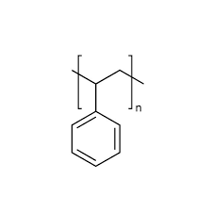
Conclusion
While this experiment successfully demonstrated the conversion of waste polystyrene into cinnamaldehyde, further refinements in reaction conditions, purification, and process optimization are necessary for practical application.
Additionally, the discovery of repolymerized styrene glue opens a new avenue for exploring novel adhesives, provided its structural limitations can be addressed. Future research should focus on improving reaction efficiency, investigating alternative catalysts, and testing potential applications for both cinnamaldehyde and the adhesive.
Polystyrene (C₈H₈)n

Slide 17
Questions?

Slide 18
Pérez-Bravo, A., Paredes, P., Díaz-García, M., & Rodríguez, R. (2022). Catalytic Pyrolysis Process to Produce Styrene from Waste Expanded Polystyrene Using a Semi-Batch Rotary Reactor. Sustainability, 14(22), 14914. https://doi.org/10.3390/su142214914 Accessed 11/09/24
U.S. Environmental Protection Agency. (2024). EPA sustainable materials management for plastics. U.S. EPA. Retrieved July 12, 2024, from https://www.epa.gov/plastics
Liu, Y., Qian, J., & Wang, J. (1999). Pyrolysis of polystyrene waste in a fluidized-bed reactor to obtain styrene monomer and gasoline fraction. Fuel Processing Technology, 62(1), 45-55.
Schmidle, C. J., & Barnett, P. G. (1956). The Preparation of Cinnamaldehydes by the Formylation of Styrenes. Journal of the American Chemical Society, 78(13)
Princeton University, Department of Chemistry. (2023, November 28). Chemical recycling to monomer of commercial polymers using photothermal conversion. Frick Chemistry Laboratory. Retrieved from https://stache.princeton.edu/research/chemical-recycling-to-monomer-of-commercial-polymers-using-photothermal-conversion

Slide 19
Sigma-Aldrich. (2024). Safety data sheet of N,N-dimethylformamide. Retrieved November 9, 2024 from https://www.sigmaaldrich.com/IT/en/sds/sial/227056
Sigma-Aldrich. (2024). Safety data sheet of phosphorus oxychloride (POCl₃). Retrieved November 9, 2024, from https://www.sigmaaldrich.com/IT/en/sds/aldrich/201170

