Slide 1

Index:
Our Hiccup Lollies
Hiccups
Our Motivation
The making process
Our tries
Ingredients that help stop hiccups
Our protocol for inducing hiccups
Our data collection method
The testing data
Conclusion
How to make the lollies
Photos of the testing
Our Sources
By Nika Iankova Ignatieva and
Natalia Chylinska
S3EN European School of Alicante
By Nika Iankova and Natalia Chylinska

Slide 2
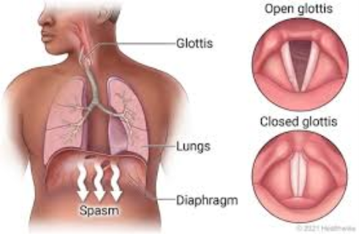
Hiccups
What are hiccups?
Sounds made by spasms of the diaphragm
When do they happen?
When something irritates the nerves that cause your diaphragm to contract
How can our lollipops help?​
The sour compound in them will rest the vaugus nerve and stop the spasm

Slide 3
Our Motivation
Has anything similar been done before?
A company in America. Though we wanted to find out the ingredients that stop hiccups and then make our own recipe
How can our project help society?
An enjoyable way to get rid of hiccups
What would we like to achieve this project?
Find out how to stop hiccups in a simple way.
Why are we doing this project?
To show everyone how to make anti hiccup lollipops at home. (We plan on making a video and posting the step-by-step recipe on how to make them)

Slide 4
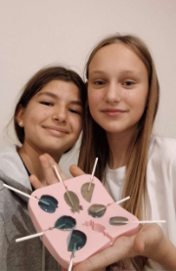
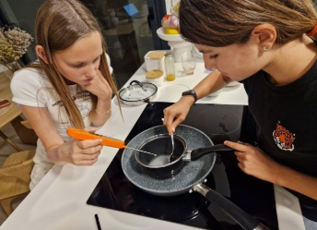
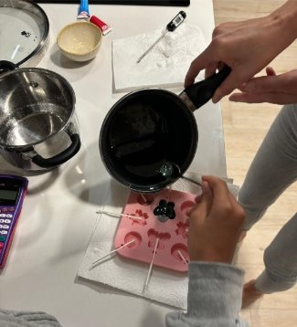
The making process
It took us 6 tries to get it right
We used different ingredients for try 1-4 and 5-6​

Slide 5
Our Tries
Try 1: Tasted horrible, watery consistency.
Try 2: Too sweet, watery consistency, wrong amount of ingredients.
Try 3:The lollipop worked so we decided to test them on people. But the lollipop melted so we had to keep it in the freezer. We decided to do another try.
Try 4: The lollipops would not stay solid so for the next try we decided to with different ingredients...
Try 5: It was not sour enough, so it did not stop the hiccups.
Try 6: It worked perfectly! So we tested them on people.
On try 3 and 6 we decided to conduct an experiment.

Slide 6
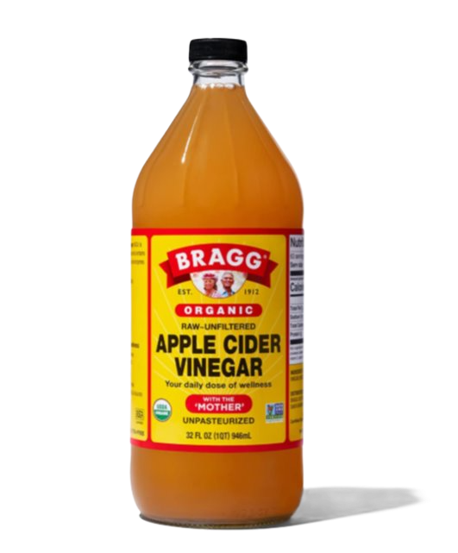
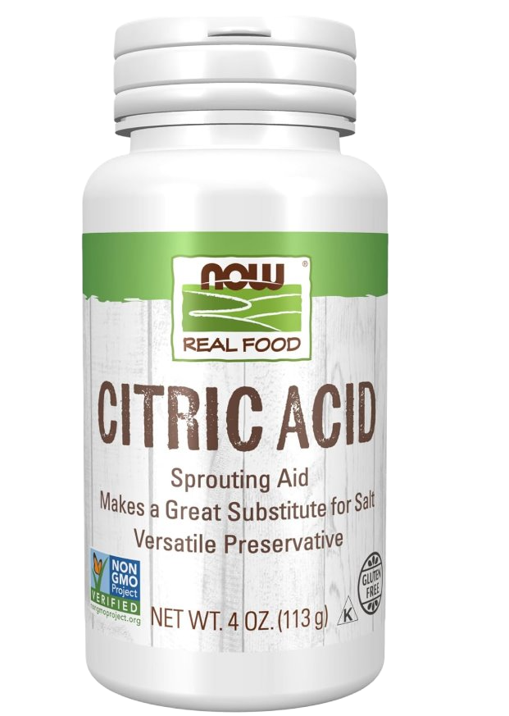
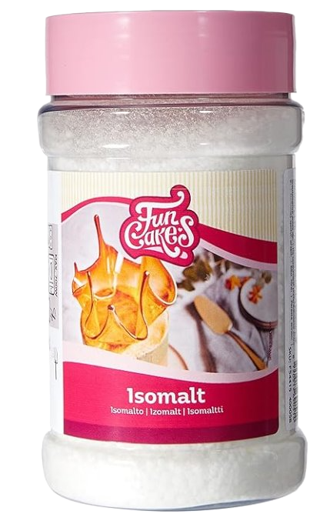
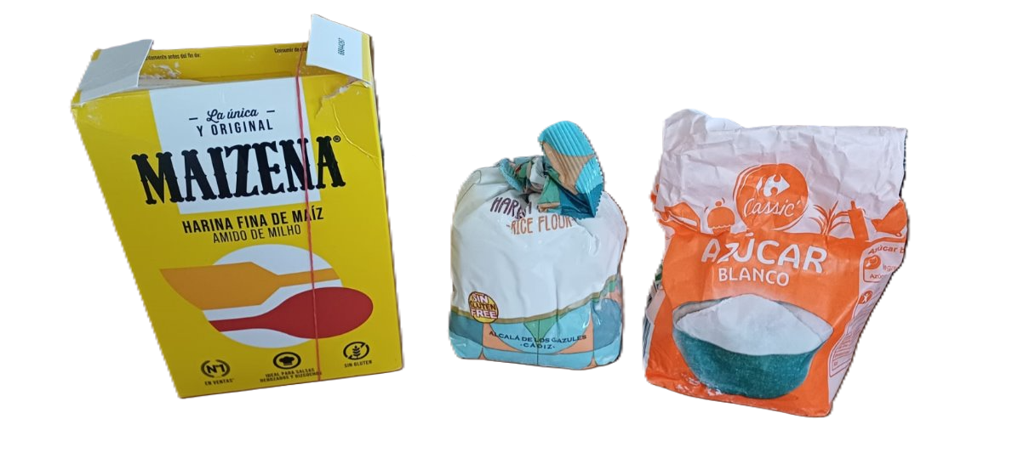
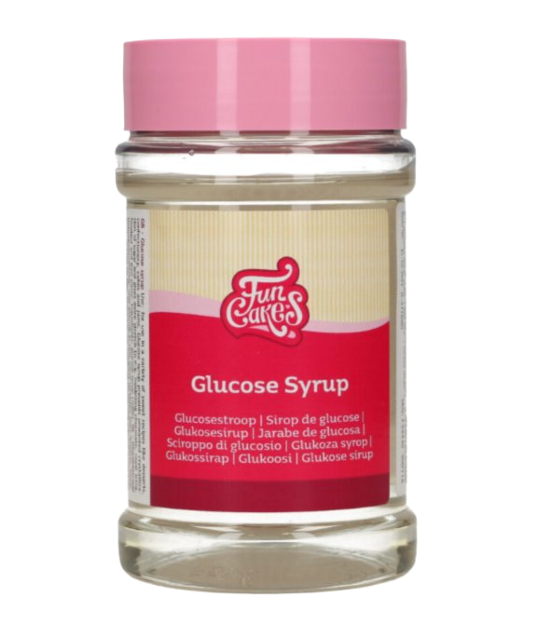
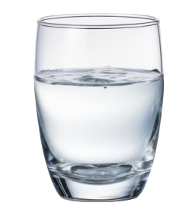
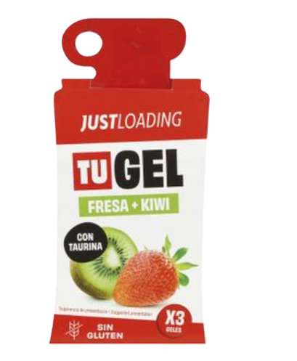
Ingredients that help to stop hiccups
TRY 1-4 :
APPLE CIDER VINEGAR
CITRIC ACID
ISOMALT
RICE FLOUR
MAIZE STARCH
WATER
SUGAR
MALTODEXTRIN
TRY 5 AND 6 :
APPLE CIDER VINEGAR
CITRIC ACID
GLUCOSE DE 42
WATER
FLAVOURING

Slide 7
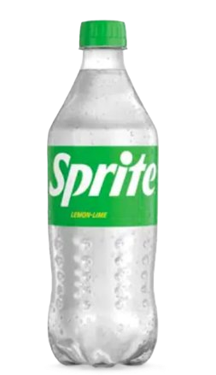
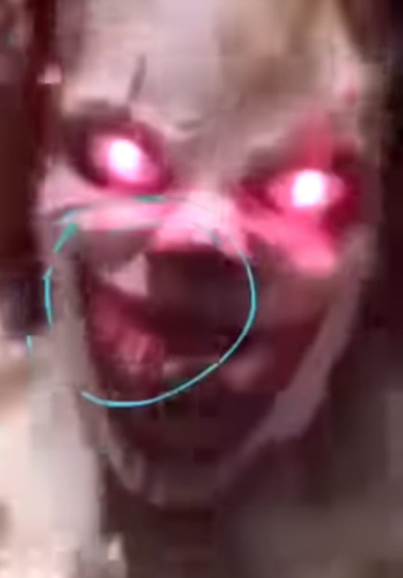
Our protocol for inducing hiccups
We have 2 ways of inducing hiccups
1.Sprite
2.Scaring

Slide 8
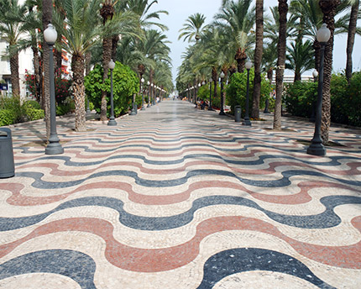
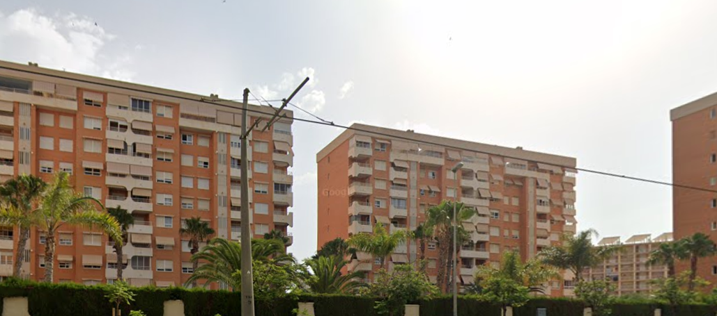
Our data collection method
The center of Alicante
2. Our friends’ urbanization

Slide 9
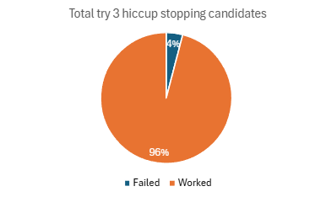
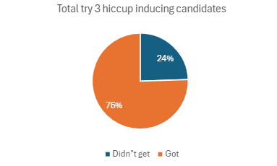
The testing data
TRY 3 HICCUP INDUCING DATA:
 | Boys (47) | Girls (51) | Total (98)
Total | 64% (30/47) | 86% (44/51) | 76% (74/98)
0-16 | 88% (14/16) | 100% (17/17) | 94% (31/33)
17+ | 51% (16/31) | 79% (27/34) | 66% (43/65)
TRY 3 HICCUP STOPPING DATA:
 | Boys (30) | Girls (44) | Total (74)
Total | 97% (29/30) | 95% (42/44) | 96% (71/74)
0-16 | 93% (13/14) | 100% (17/17) | 97% (30/31)
17+ | 100% (16/16) | 93% (24/27) | 95% (40/43)

Slide 10
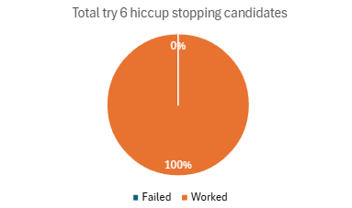
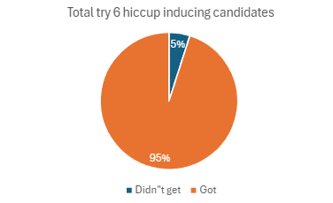
The testing data
TRY 6 HICCUP INDUCING DATA:
 | Boys (27) | Girls (34) | Total (61)
Total | 96% (26/27) | 92% (32/34) | 95% (58/61)
0-16 | 90% (8/9) | 90% (17/19) | 90% (25/28)
17+ | 100% (18/18) | 94% (15/16) | 97% (33/34)
TRY 6 HICCUP STOPPING DATA:
 | Boys (26) | Girls (32) | Total (58)
Total | 100% (26) | 100% (32) | 100% (58)
0-16 | 100% (8) | 100% (17) | 100% (25)
17+ | 100% (18) | 100% (15) | 100% (33)

Slide 11
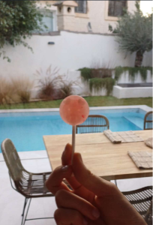
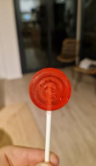
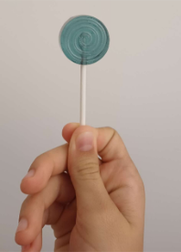
Conclusion
When inducing hiccups girls get them easier while boys have a harder time getting them
Age does not really matter when inducing hiccups.
We achieved our goals!
We found a way that is easier to make and cheaper!

Slide 12
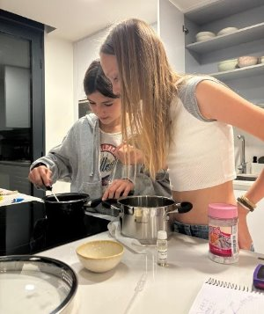
How to make the lollies
Warm up glucose to 70°C
Mix the water and sugar​ and warm them up to 110°C
Add the warm glucose to the sugar and water to 148°C​
Let everything cool down to 120°C
For 1 batch (12 lollipops) it takes us 30 minutes to produce them
One of our lollipops costs approximately 55 cents
Add the flavouring, Citric acid, Apple cider vinegar and colouring while cooling​

Slide 13
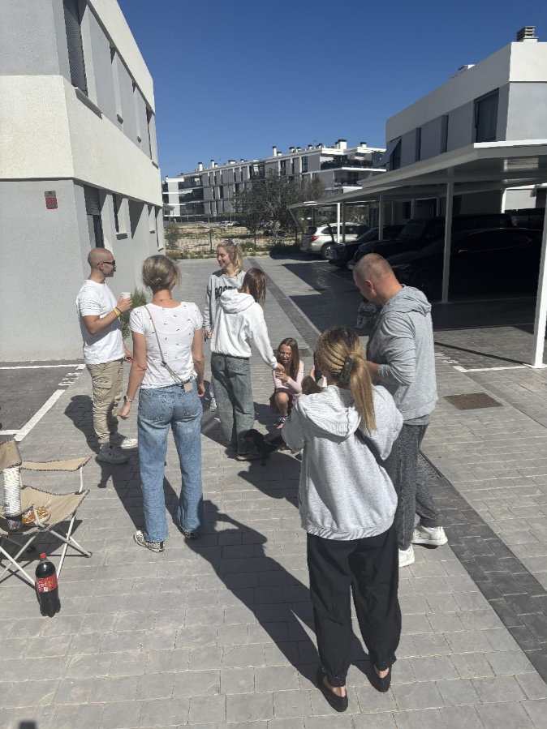
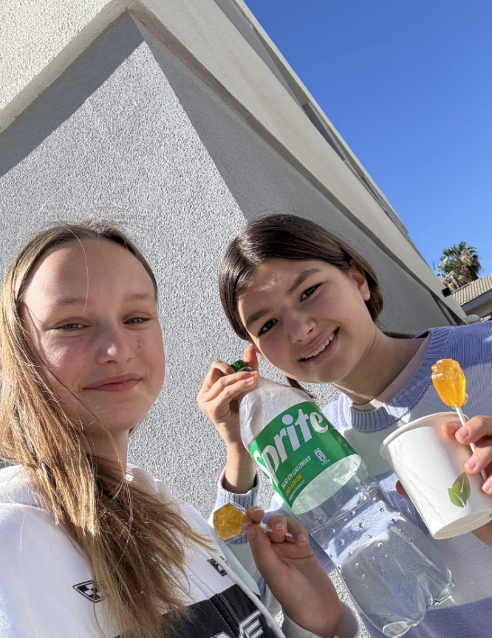
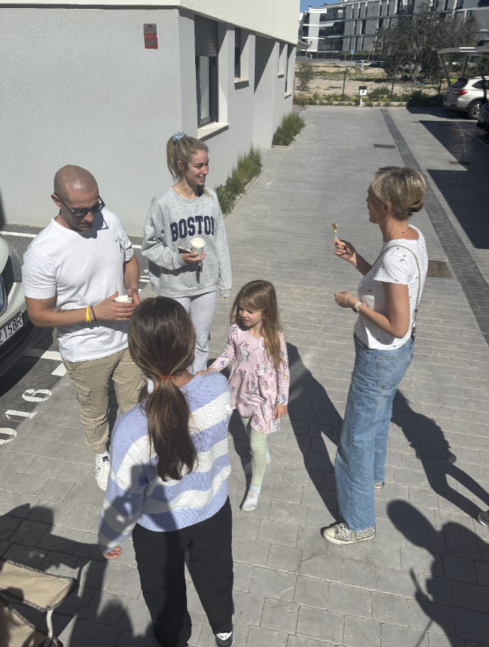
Photos of the testing

Slide 14
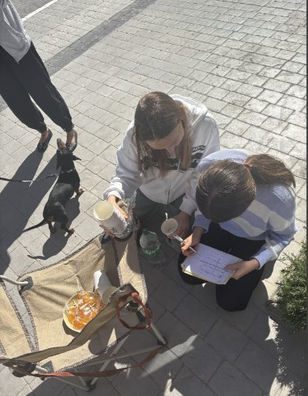
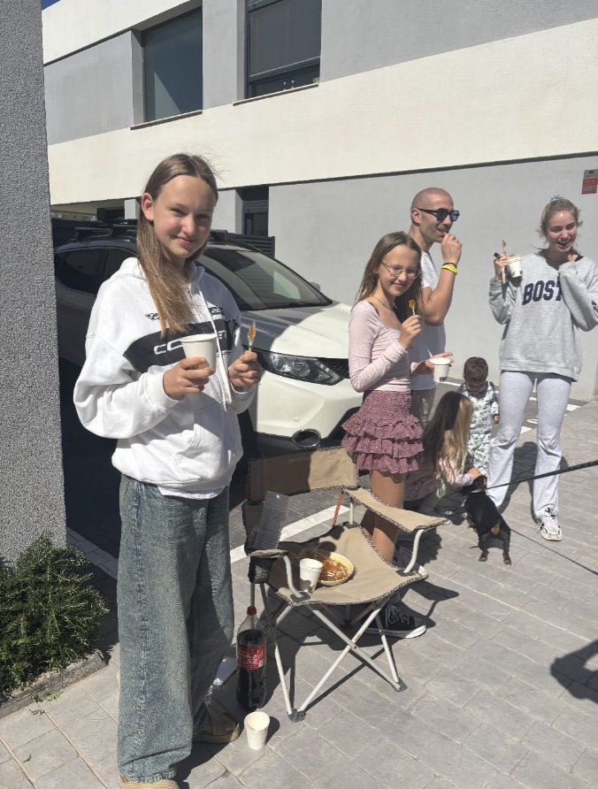
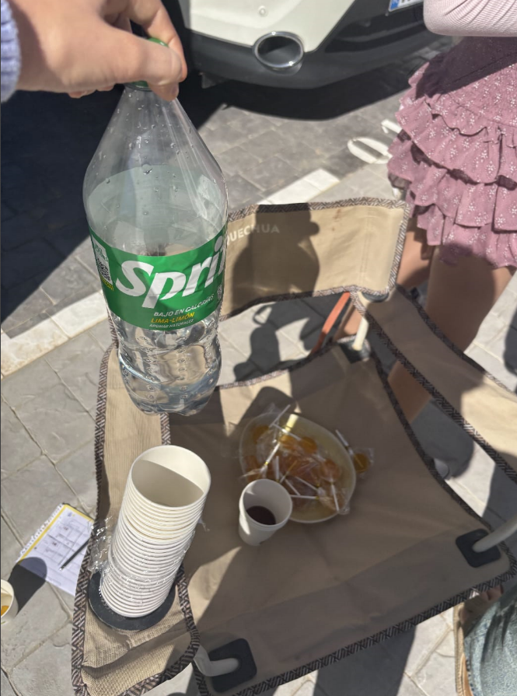
Photos of the testing

Slide 15
Our sources
Wikipedia
Hiccupops
Rela Institute
Mayo Clinic
Meridian Health
NHS
Cleveland Clinic

Slide 16

Thank you!
Any questions?

