Slide 1
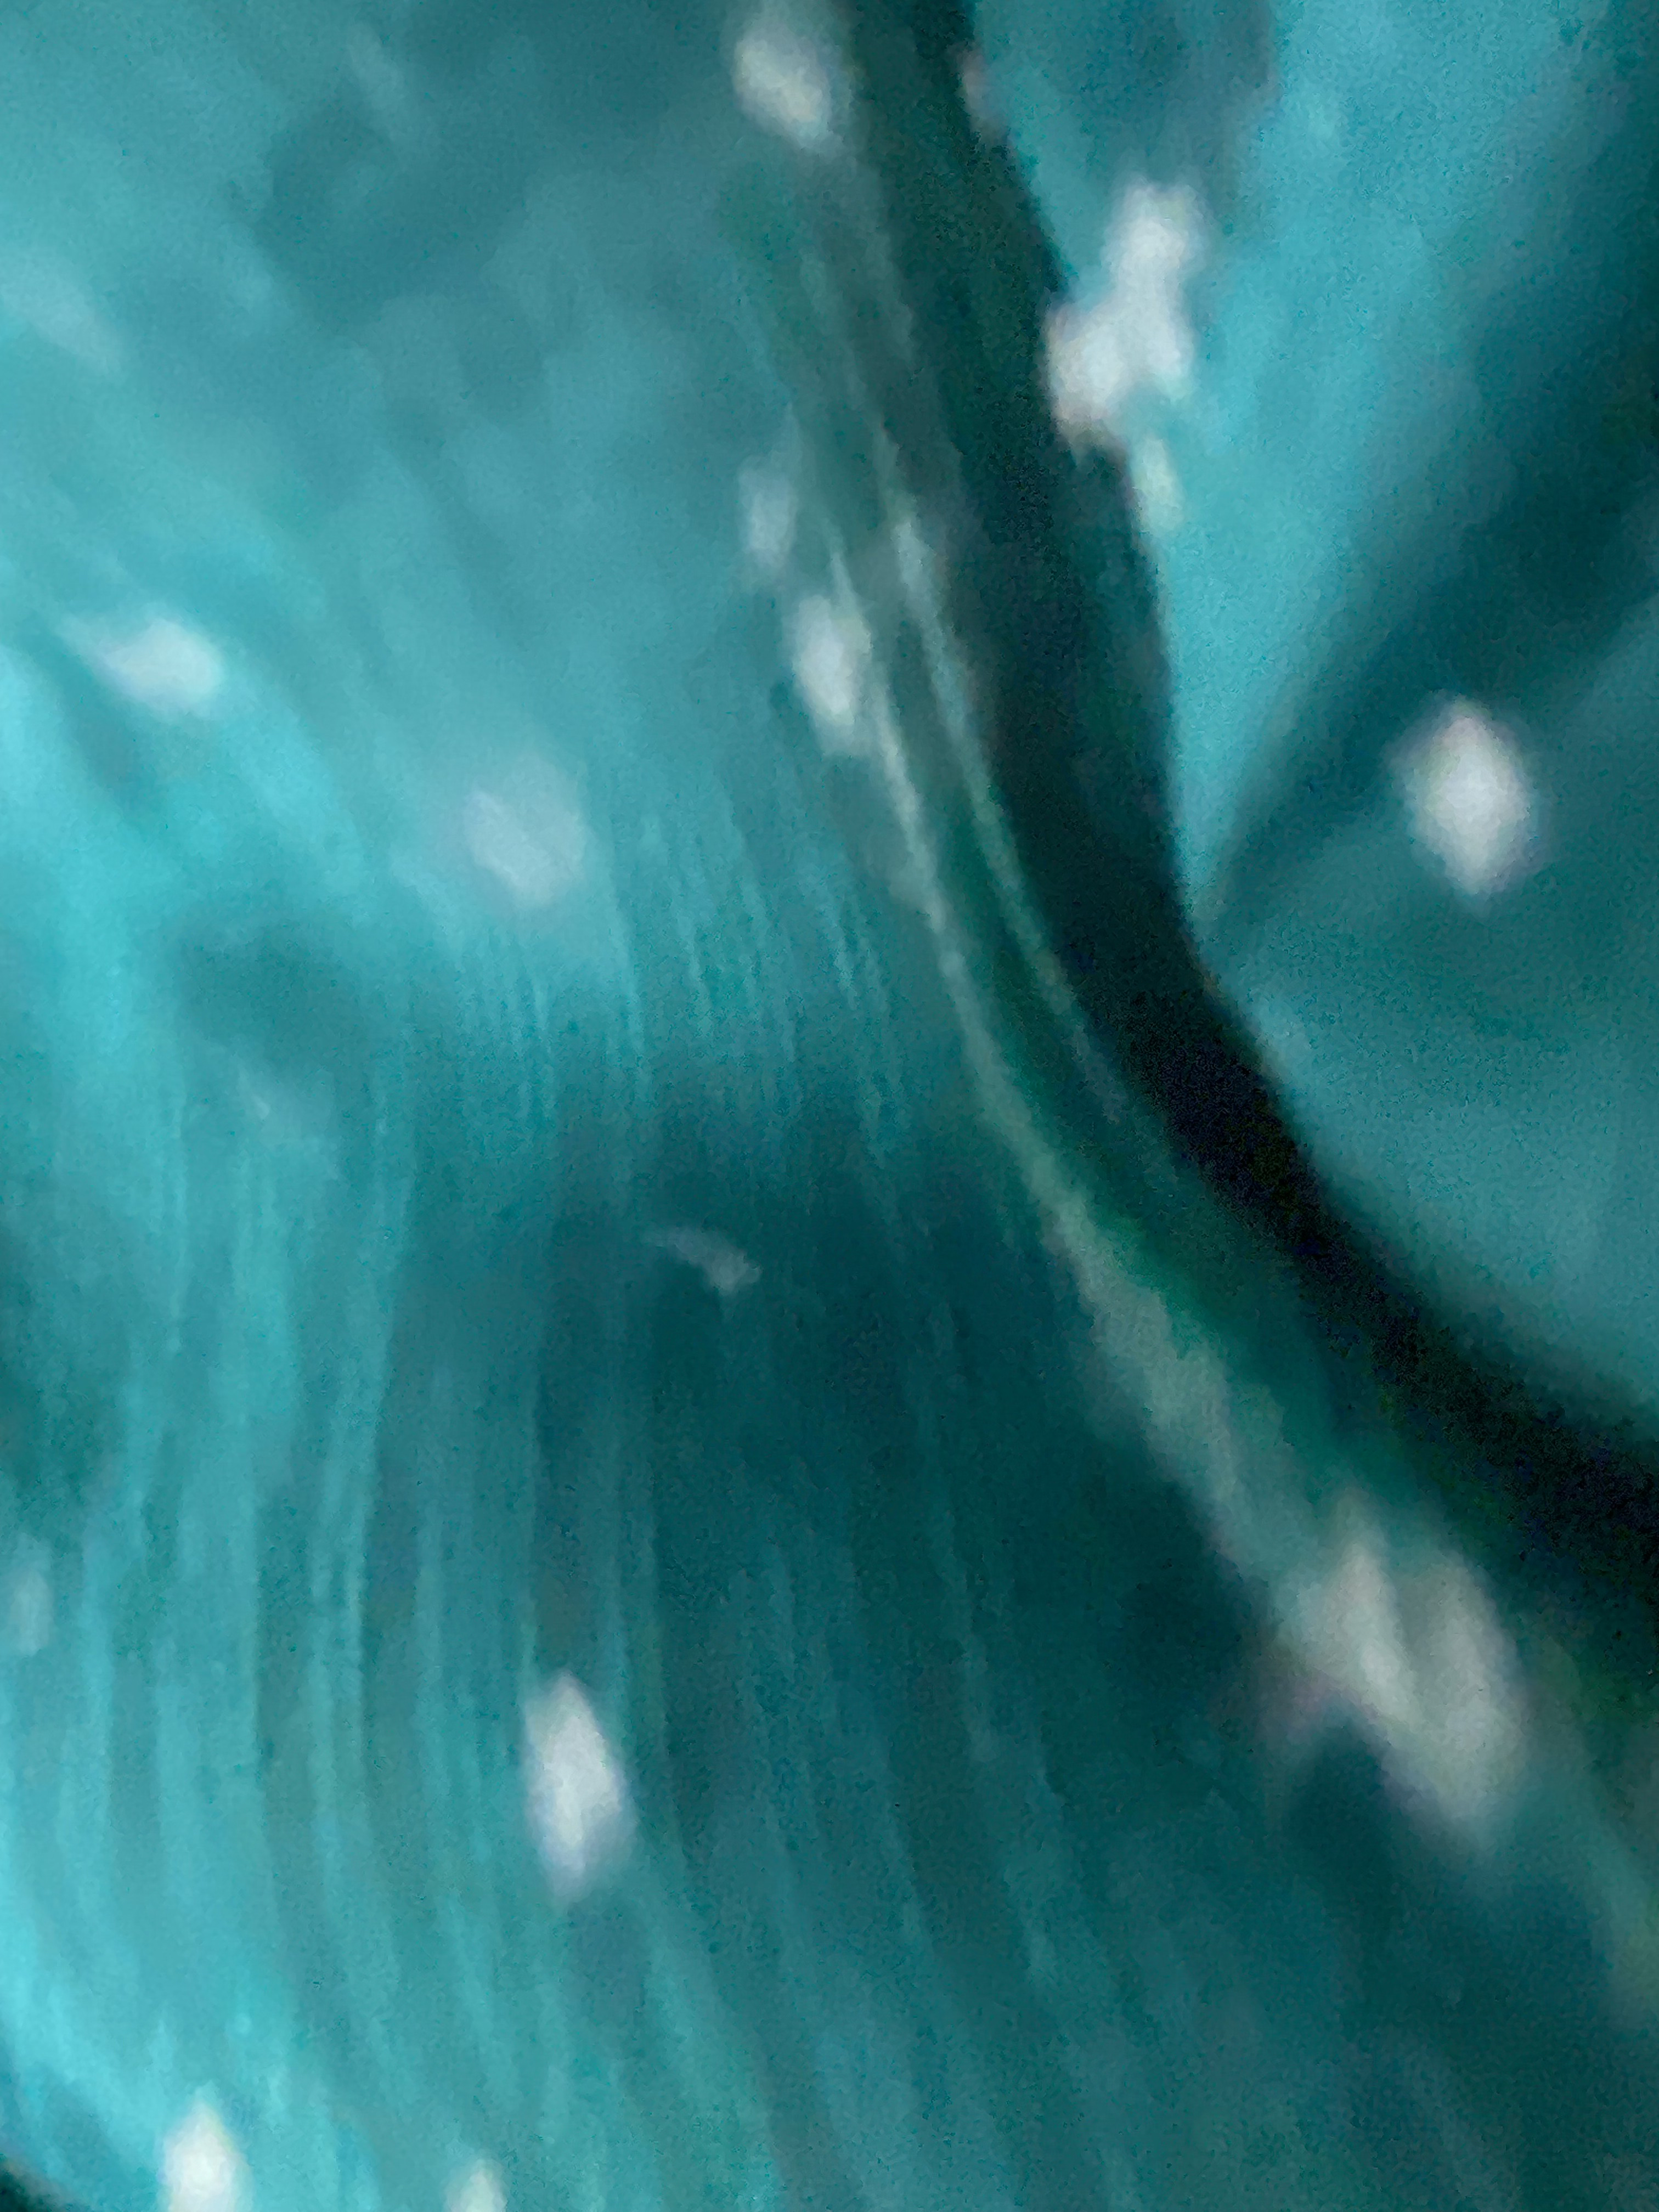

Slide 2

Small Plastics,
Big Problem
Eliza Slavova, Maja Limantaite and Oleksandra Yevtushenko (B1 S3ENa/b)
Notes:
TBD
(Eliza) – Hi, have you guys seen my lipgloss? I think I lost it somewhere around here.
(Sasha)- Lipgloss? Nope, sorry.
(Maja) –Eliza, I think you use a bit too much lipgloss to be honest, and it really isn’t necessary for our presentation.
(Eliza) – How about lipstick?
(Sasha)- Well you know you shouldn’t use too much lipstick either because that also has quite a lot of micro plastic particles in it. Did you know that every third lipstick contains micro plastic??!
(Maja) – Yep, Sasha’s right, and micro plastic is also found in eyeshadow, blush, mascara, and bronzer!
These affect the health of millions of people. And now, I’m sure that we can all agree that these small plastics, are a BIG problem. (point to slide)

Slide 3
Table of contents
Introduction and Aim of our Project
Survey
01
02
Our own bioplastic
03
Plastic Globally
04
Questions
Results
What are microplastics?
Problems caused by microplastics
How can we reduce them
What it is, process of creation + results
Worldwide Statistics
Future of microplastics
05
The future of microplastics
Companies taking action

Slide 4
Aim of our Project
Explain the problem microplastics cause
Find if people know how present microplastics are in our daily lives and raise awareness
Create our own bioplastics which is sustainable
The measures we can take to reduce them

Slide 5











01
Introduction
Did you know that Indonesia has the highest micro plastic consumption and Paraguay-the lowest?
it

Slide 6
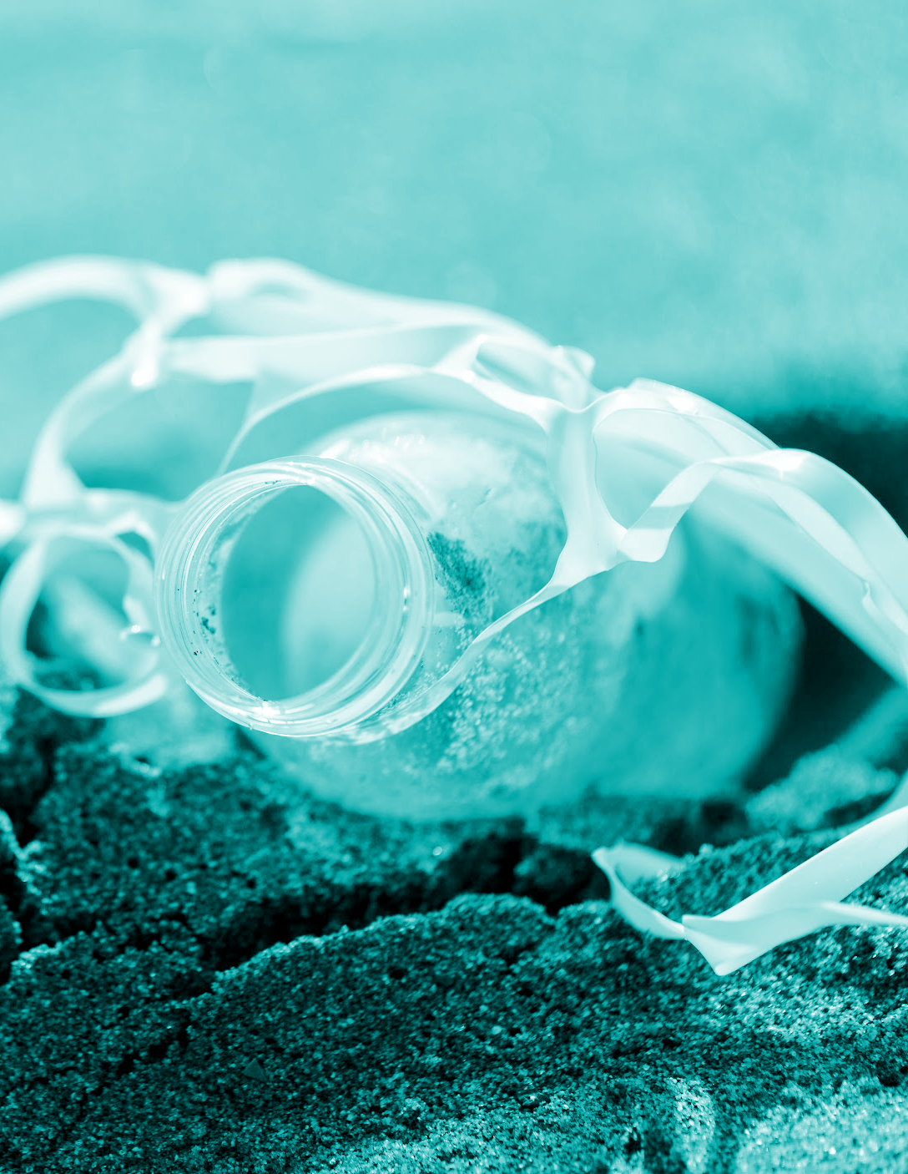
What are microplastics?
Small pieces of plastic
Less than 5mm
Carbon and hydrogen
7 main types- Microbeads, scrubbers, nurdles, plastic powders, fibers, foam, secondary microplastics
Primary microplastics and secondary microplastics

Slide 7
Problems caused by microplastics
In the human body
Pain, suspected link to cancer development, weaker immune system, microplastics in arteries
In nature
Pollution, contaminated water, kills plants and animals, damages and poisons
In animals
Problems with reproduction, death, diseases difficult to fight, multiple species affected
In food
Found in highly processed protein
products and drinks
In products
Found in hygiene products, tyres, makeup,
clothing, painted products, carpets
and sofas
Notes:
As we already know, micro plastics cause many serious problems to life on Earth.
In the human body, micro plastics can cause abdominal pain, changes in bowel habits, risks for cancer development. Also, scientists found these plastics in our brain, blood, and even some organs like the liver.
In animals, micro plastics cause problems with reproduction, make it hard to fight off diseases, etc. A study shows that at least 267 species of animals are affected, most of them marine animals.
In nature, micro plastics cause immense pollution and unclean water sources making it hard for plants to survive.
In food, the most likely source of micro plastic is in highly processed protein products like fish sticks, chicken nuggets, and out of drinks-bottled water and beer. A group of researchers from all over Europe decided to conduct an experiment. They found plastic in 5 out of 6 tea brands that they bought in Ireland. 4 of them even seemed to be made of paper, but still plastic was found.
MORE
In a study of more than 7000 products from brands including these…, 87% of the products contained micro plastic. This causes health problems to many.

Slide 8
New plastic dissolves in the water overnight leaving no microplastics
RIKEN have developed a new plastic type
made with supramolecular polymers
reversible bonds
When mixed in water they form a viscous material
dissolves completely in saltwater in about 8 hours. no good for certain liquids because they can dissolve it
Notes:
Scientists at RIKEN in Japan have developed a new plastic type which dissolves in saltwater leaving behind save compounds. This new plastic type is made with supramolecular polymers which have reversible bonds that function like sticky notes that can be attached, removed and reattached. The team identified a particular combination that seems to work. This combination is sodium hexametaphosphate and monomers based on guanidinium ions. When this two compounds are mixed in water they form a viscous material that can be dried to form plastics. When the saltwater soaks this plastic the bonds unlock and the material dissolves. The plastic dissolves completely in saltwater in about 8 hours. The team also found that this type of plastic is as good as the normal one, but when this plastic cup is no good for certain liquids because they can dissolve it.

Slide 9
How can we reduce them ?
?
Buy organic clothes
Avoid single use plastics
Reduce shellfish consumption
Use public transport
Buy plastic-free cosmetics
Boiling water and filtering tap water
Potential ways to detox microplastics from body – lots of sauna use, phospholipid supplements, liver support, etc.

Slide 10
02
Survey
In 2024, Italian researchers found that people with microplastics in the plaques in their arteries were more likely to get a stroke, heart attack, or die.

Slide 11

12 Questions
(knowledge, awareness, action)
KNOWLEDGE/ AWARENESS
Do you know what microplastics are?
Are you aware of how present microplastics are in your daily life?
Do you think microplastics have a serious negative impact on the human health/ environment?
Which of these items contain microplastics? Tyres, clothing, painted products, hygiene and cosmetic products, carpets and sofas
Which of the following are a concern when it comes to microplastics? Animal health, ocean pollution, soil pollution, absorption or accumulation in plants
ACTION
Are you willing to learn more about it?
Do you think there should be clear labelling of the amount of microplastics in each product?
Do you think the government should take action in restricting the use of plastics and microplastics?
Julia Martin

Slide 12
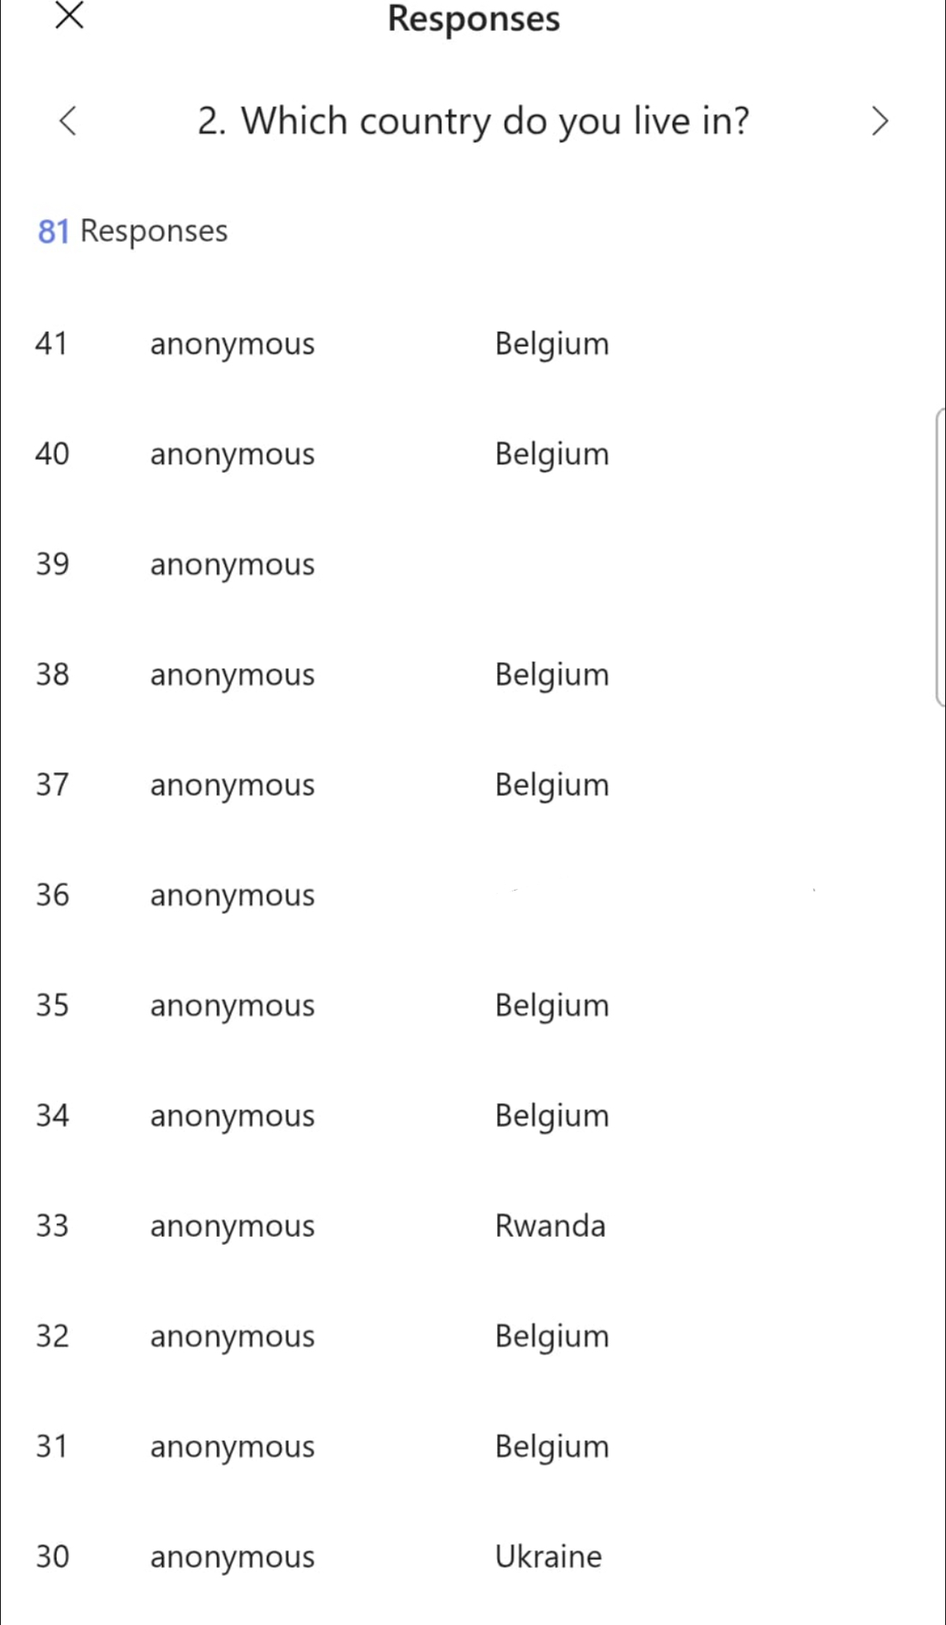
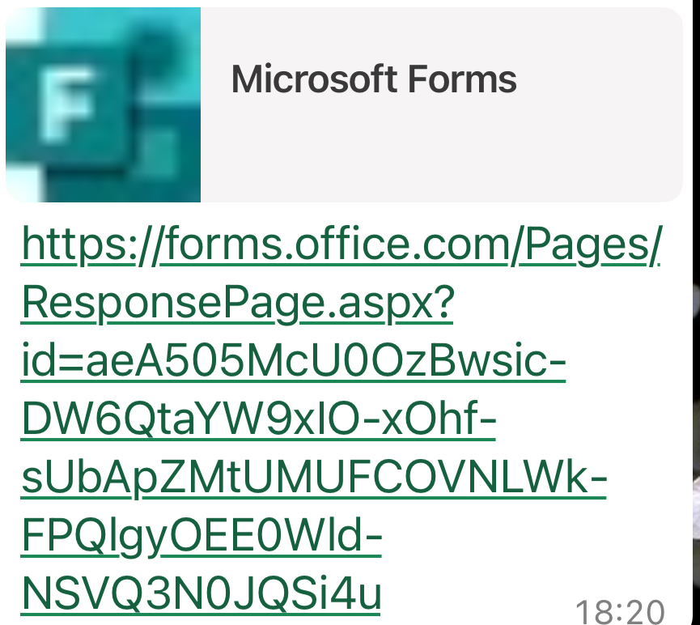
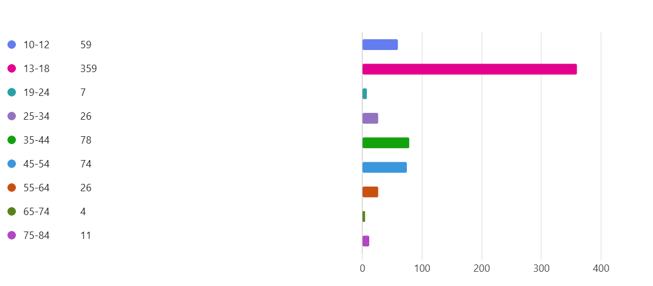
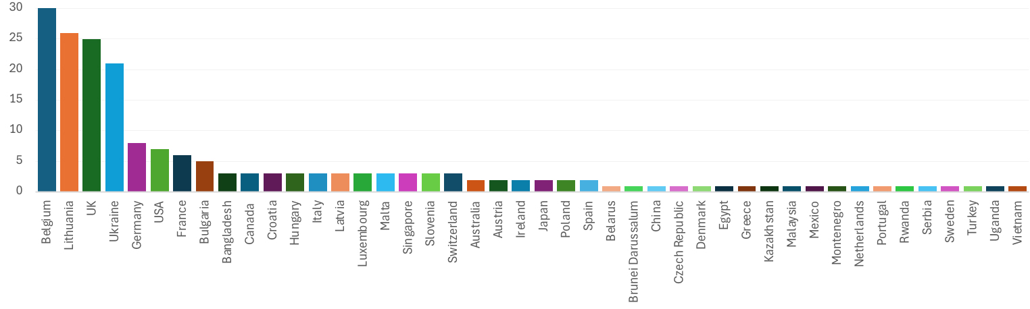
Results
672 actual responses but the data only displays and is based on 640
44 countries from all continents except South America
Ages from 10-75+
Geographical Distribution of Responses
Age distribution

Slide 13
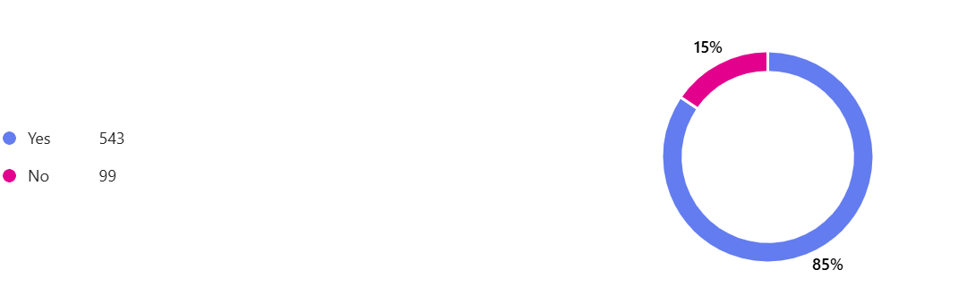
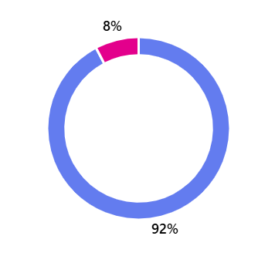
Results
Do you know what microplastics are?
85% know
15% do not know
With the least knowledge in 10 -18 year-olds
Are you aware of the presence of microplastics in your daily life?
85% aware
15% unaware
Do you think the government should take action in restricting the use of plastics and microplastics?

Slide 14
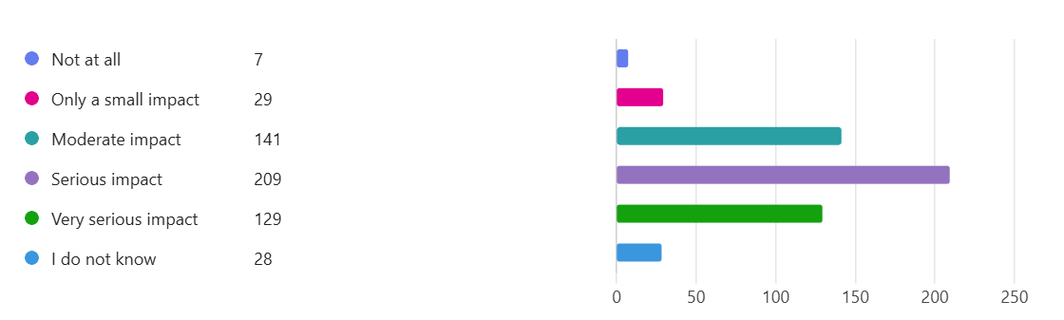
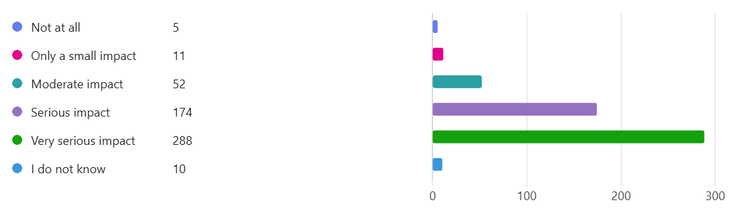
Further Results
Do you think microplastics have a serious negative impact on human health?
Do you think microplastics have a serious negative impact on the environment?
The survey shows that the respondents believe that microplastics have a more serious negative effect on the environment than on human health.

Slide 15
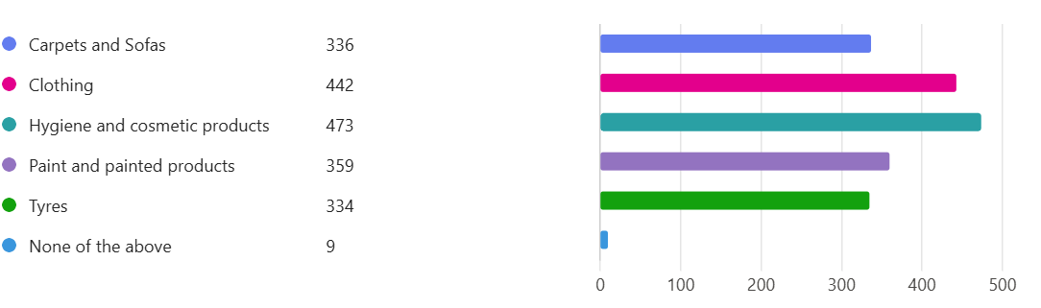
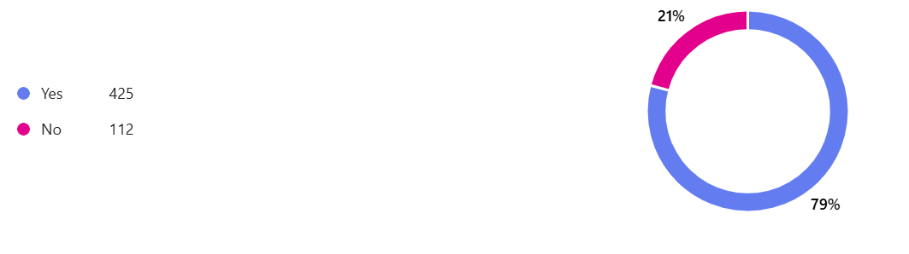
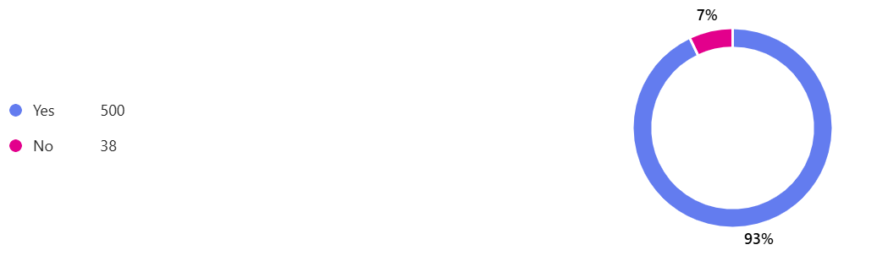
Further Results
Which of these items do you think contain microplastics? (More than one answer possible)
Are you willing to buy products with less microplastics even if they cost more?
Do you think there should be a clear labelling of the amount of microplastics in each product?
There is an overall agreement for clear labelling of microplastics in products

Slide 16
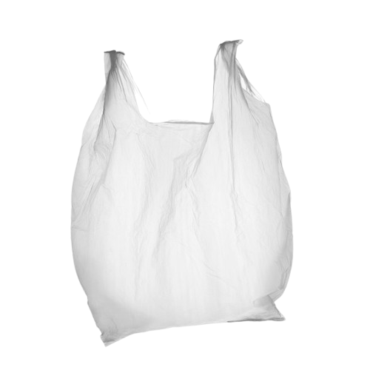
03
Plastic Globally
Individual tea bags can release billions of microplastics

Slide 17
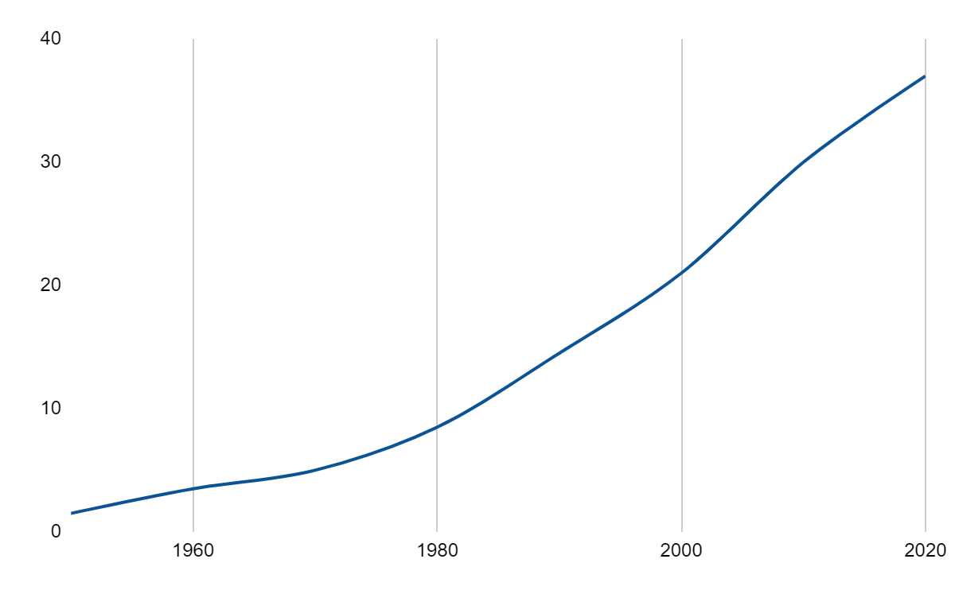
World plastic production
0
2022
400 million tones
0
0
0
1950
2 million tones
Key:
100 = 100 million metric tones

Slide 18
Top Ocean Plastic Contributors
India
126,513 MT
Malaysia
73,098 MT
Philippines
356,371 MT

Slide 19
04
Our own bioplastic
It is biodegradable!

Slide 20
What are bioplastics?
Made from renewable biological sources
HISTORY:
In the 1800s,
In the 20th century,
Bioplastics like PLA gained popularity in the
1980s-2000s
TYPES:
Biodegradable
Non-biodegradable but renewable
Compostable
Benefits
Challenges
Certain enzymes can help break plastic down faster
Molecular scissors
Some bacteria produce enzymes like PETase
Chemical bonds in the polymer
Speed up
Notes:
Bioplastics are plastics made from renewable biological sources like plants, instead of petroleum. They are more eco-friendly, often biodegradable or recyclable. In the 1800s, Parkesine, made from cellulose, was an early attempt at bioplastics. In the 20th century, petroleum-based plastics became dominant. Bioplastics like PLA gained popularity in the 1980s-2000s as eco-friendly alternatives. Biodegradable (e.g., PLA, PHA). Non-biodegradable but renewable (e.g., bio-based PET). Compostable (e.g., PLA). Benefits- Lower carbon footprint, reduces plastic waste. Challenges- High costs, land use competition, and specific degradation needs.
Certain enzymes can help break plastic down faster by breaking the long chains of plastic molecules (polymers) into smaller pieces. These enzymes act like molecular scissors, cutting the plastic into smaller fragments that microbes can more easily digest. For example, some bacteria produce enzymes like PETase, which break down PET (a type of plastic used in bottles) by attacking the chemical bonds in the polymer. With these enzymes, it speeds up the natural process of plastic degradation, making it possible for plastic to be broken down in a much shorter time compared to traditional methods.

Slide 21
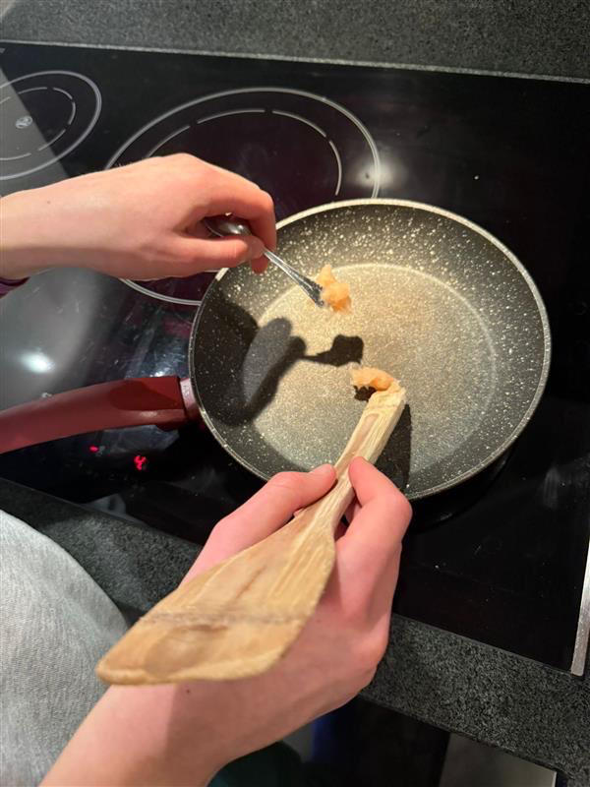

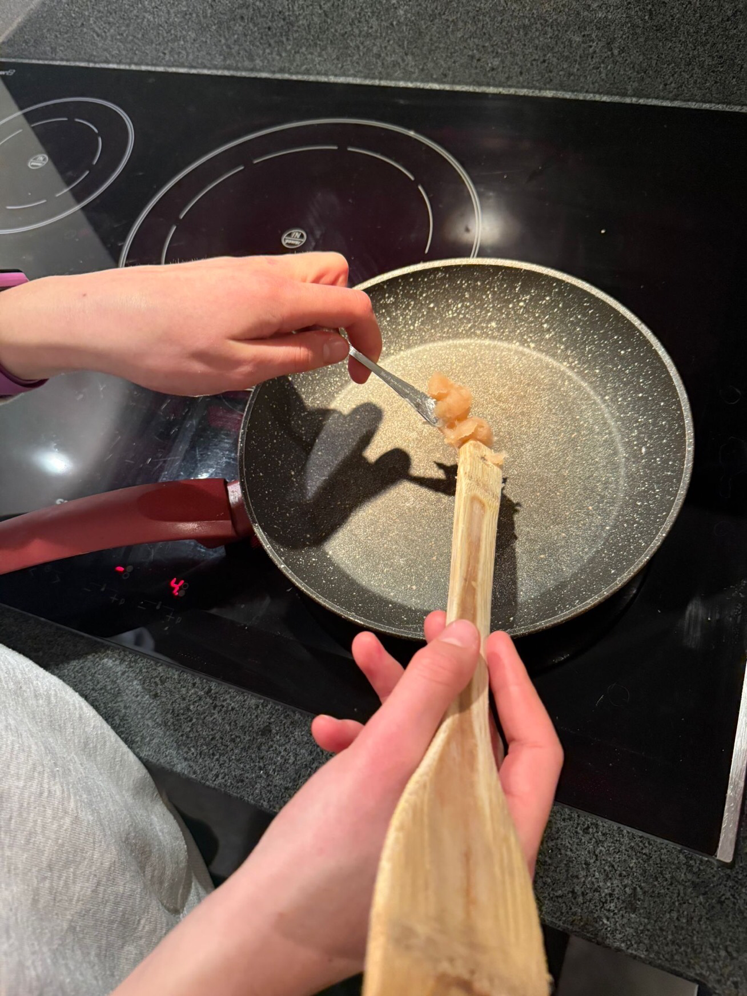
The process of making it
The ingredients were gathered and measured out. 20ml of water, 2ml of vinegar, 3g of cornstarch, and 3g of glycerol.
All the ingredients were combined and stirred together in a saucepan.
The pan was heated on medium heat on a stove and the mixture was stirred continuously.
After around 12 min, or when the mixture got thick and and clumped together, the heat was turned off.
The mixture was poured onto baking paper and shaped.
The plastic was set to dry for 2 days.
The bioplastic was hard and ready to be shown to the audience at the EEB1’s Science Festival and ESSS.
Notes:
Bioplastic is usually biodegradable. The one we made is. To make the bioplastic, water, cornstarch, vinegar, and glycerol were used.
Glycerol, also called glycerine, is a non-toxic, edible, and biodegradable substance. Cornstarch is also biodegradable, but cornstarch food packaging takes around 5 months to do so. White vinegar, which is 100% biodegradable and is made of non-toxic ingredients, was also used. Water is obviously good for the environment.
The recipe was found on the website “wikihow” and adapted by us.

Slide 22
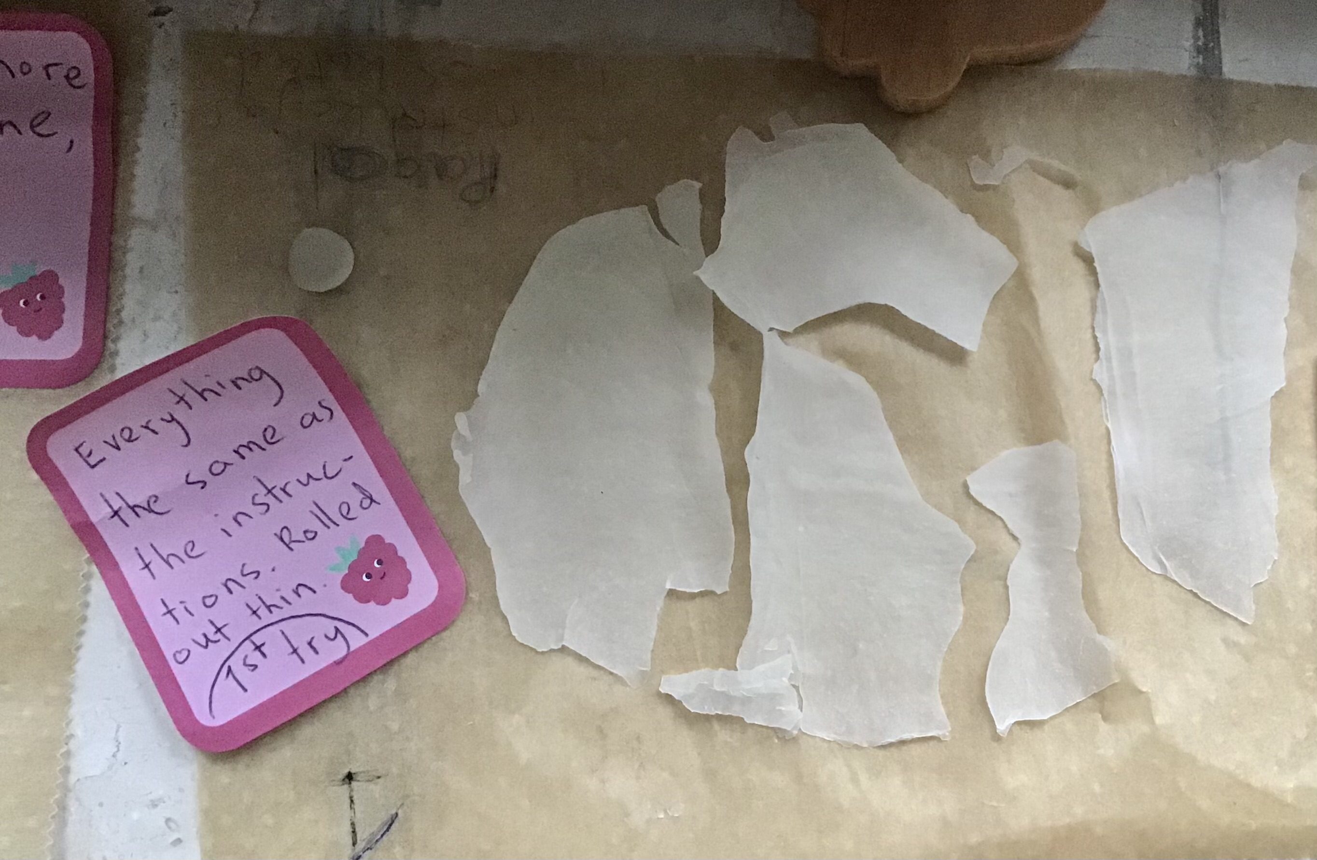
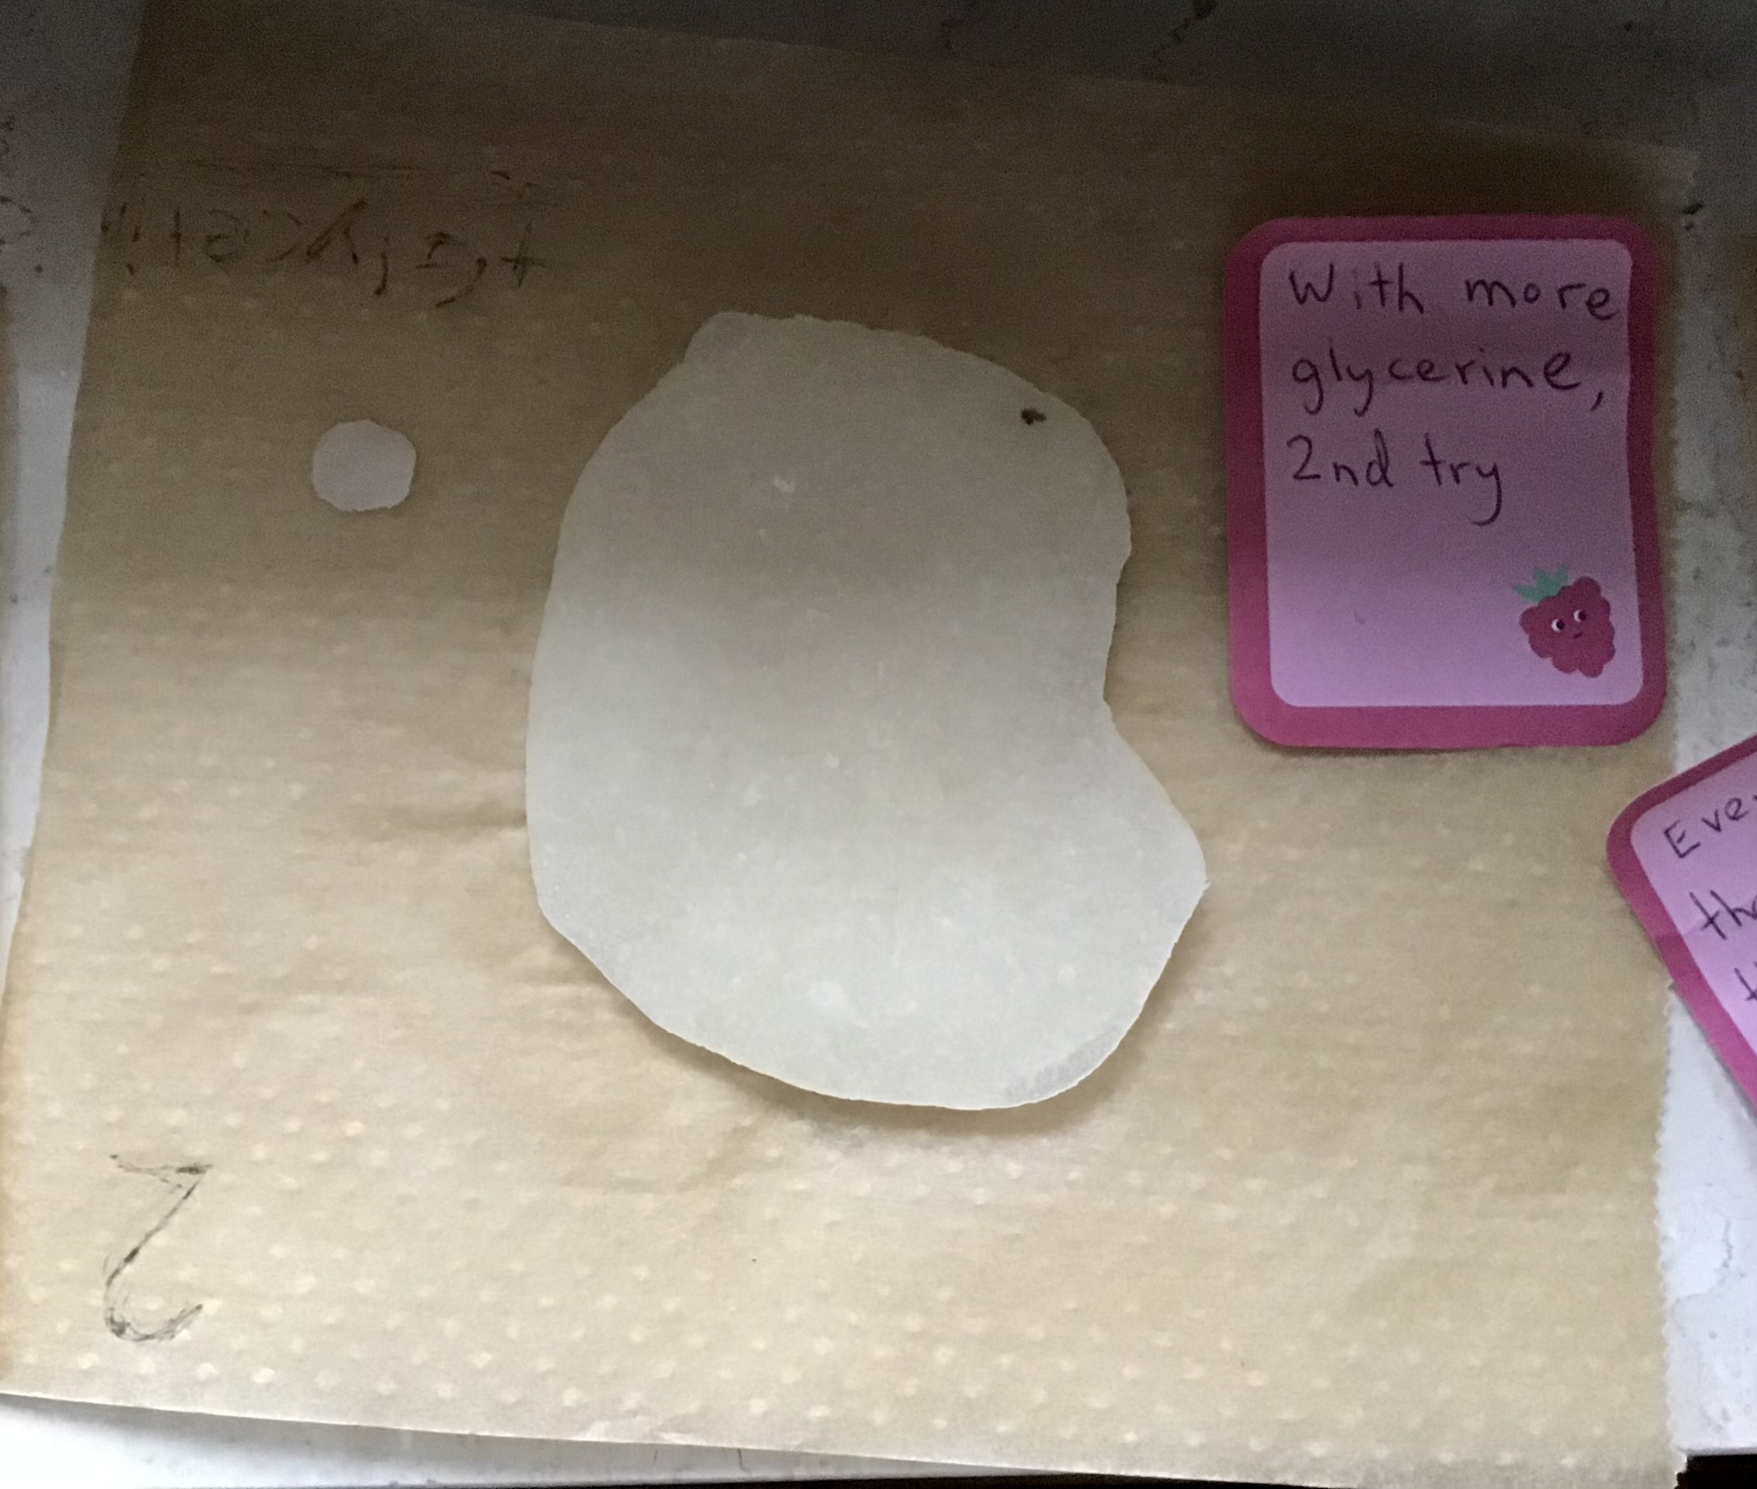
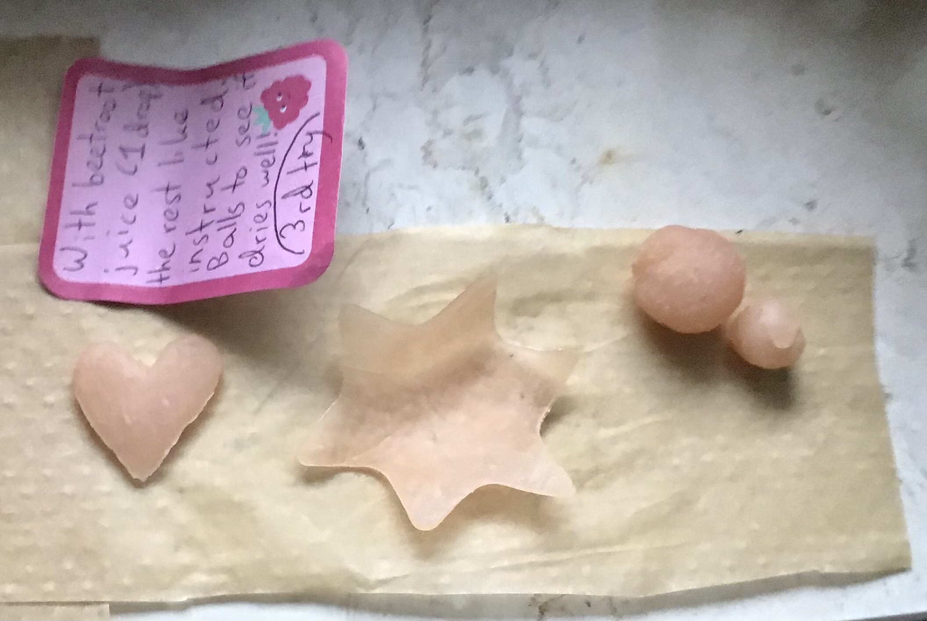
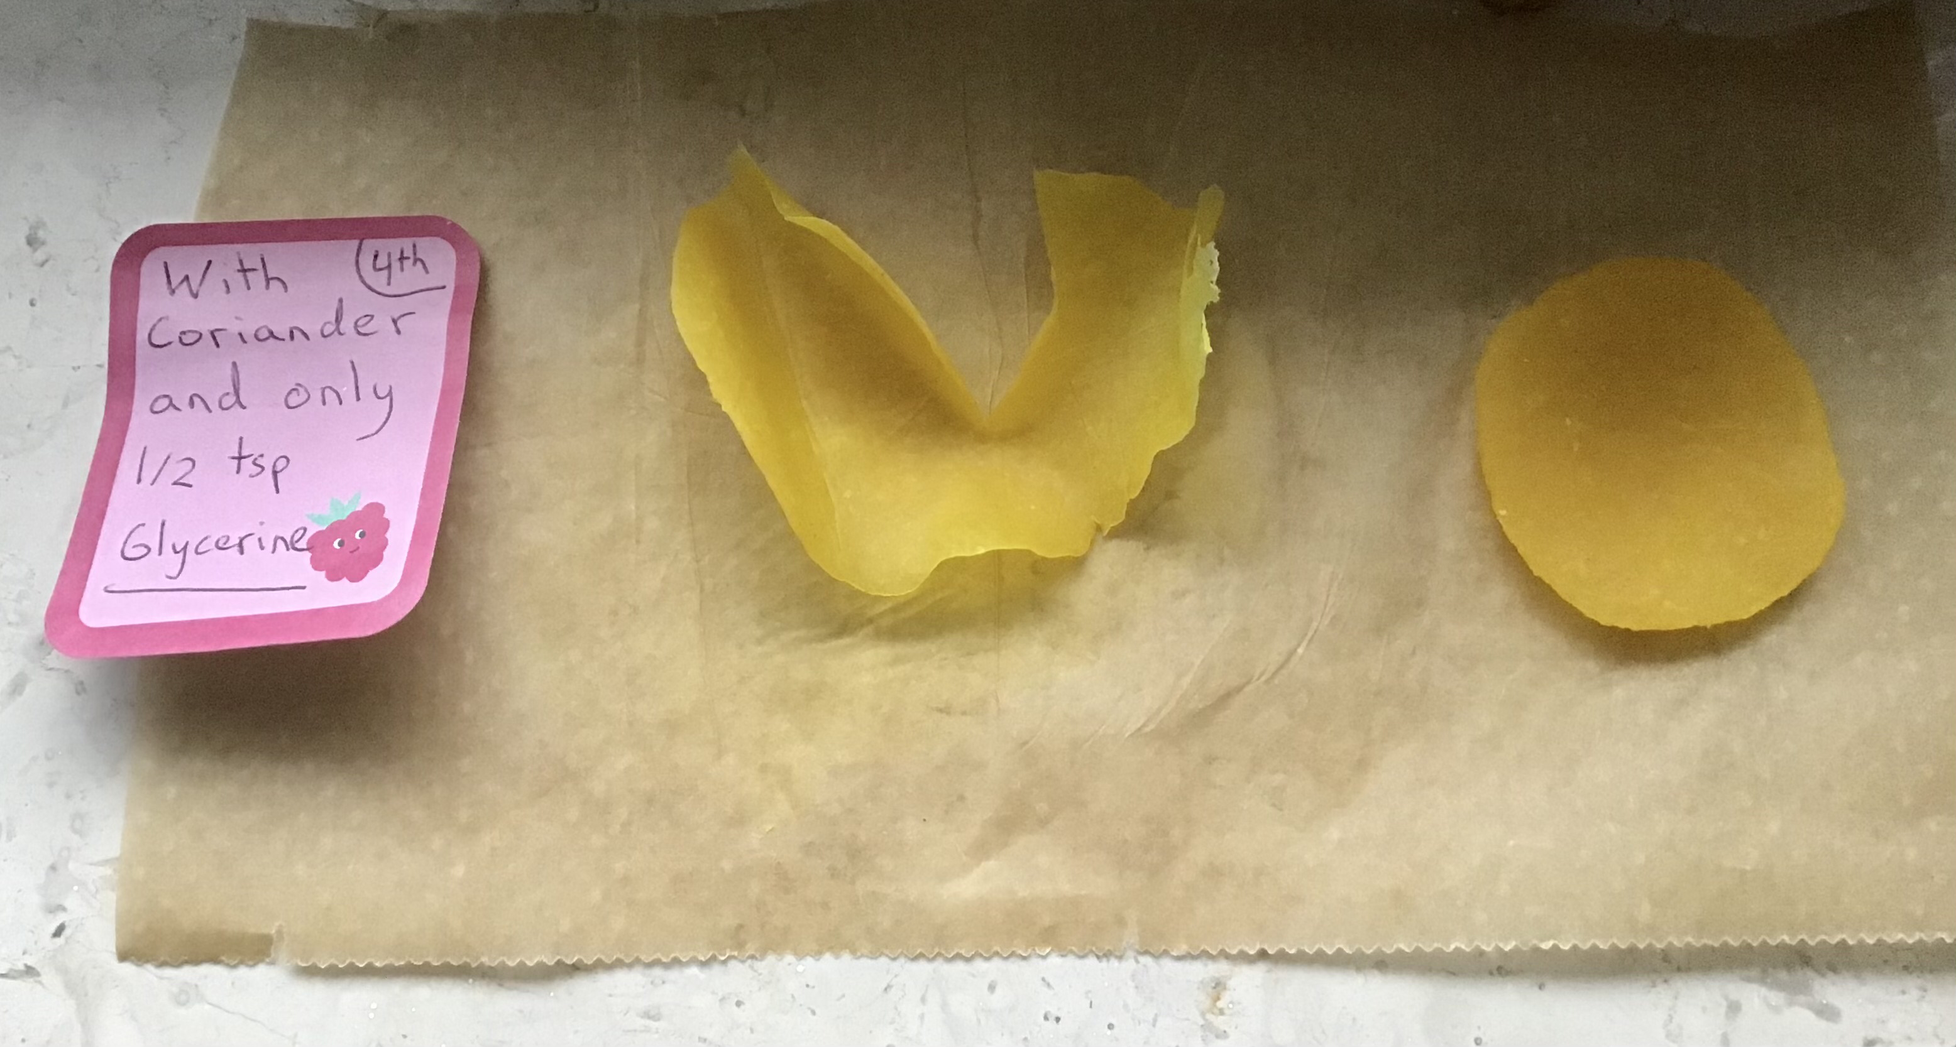
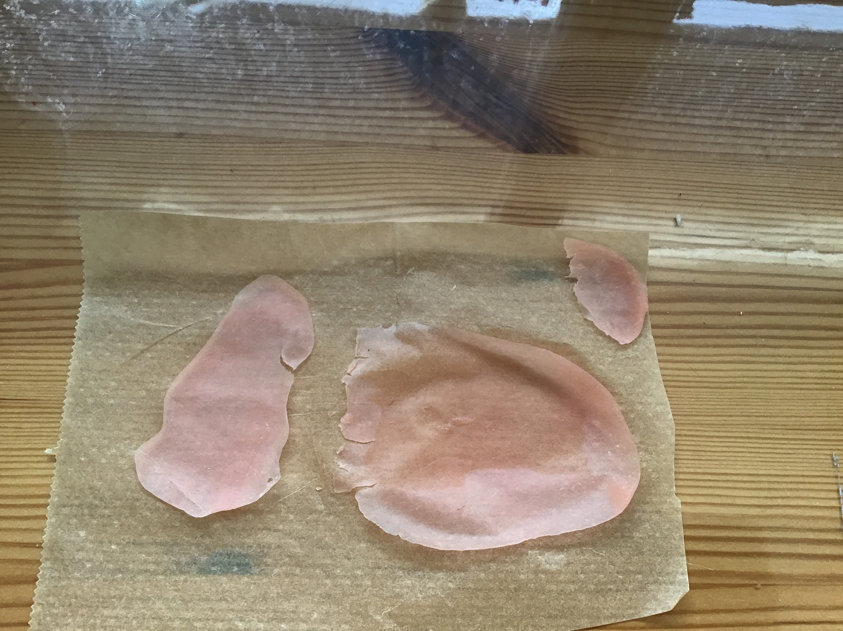
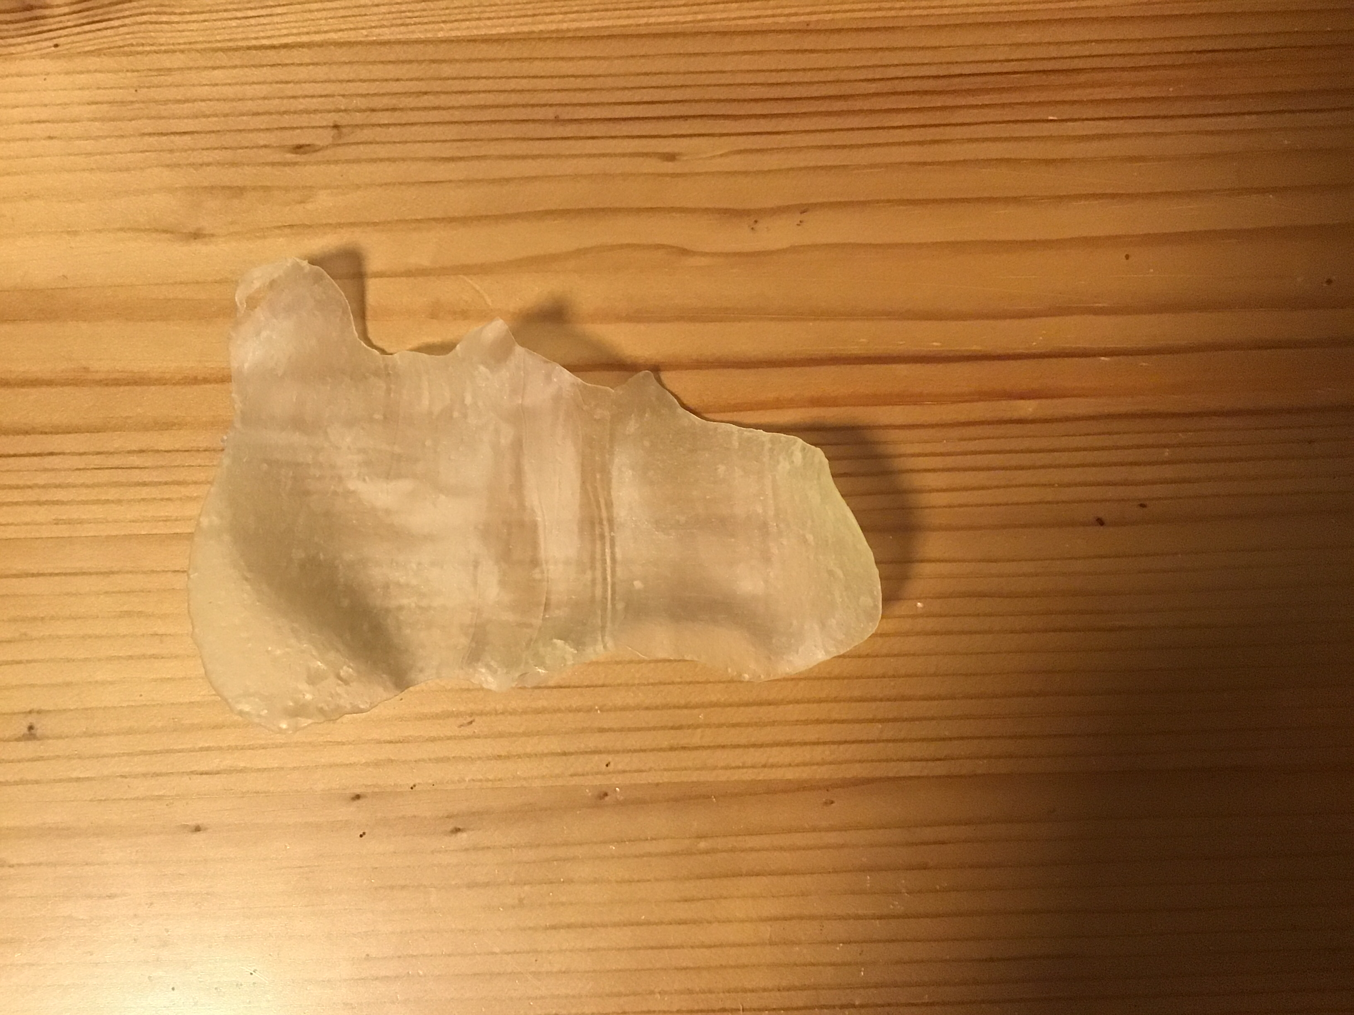
The 6 different plastics we made
After one day of drying
1st attempt- Everything according to the recipe and method.
2nd attempt- 2g more glycerine was added.
3rd attempt- Added some colour with a drop of beetroot juice.
4th attempt- 3g of coriander was added for a yellow colour to it, and only half of the amount of glycerine used.
5th attempt- Coloured with 2 drops of raspberry juice and ¼ less glycerine was used.
Last attempt- everything according to the recipe but heated a bit longer and less glycerine was used
1
2
3
4
6
5

Slide 23
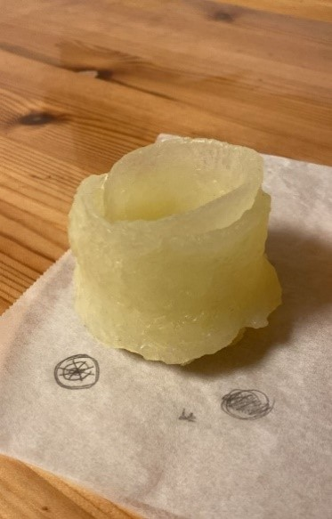
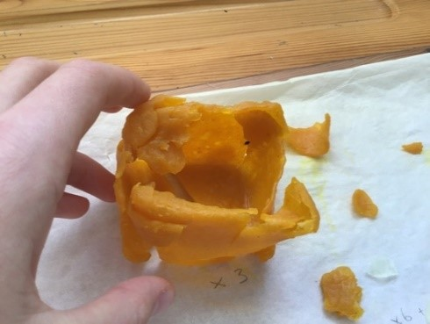
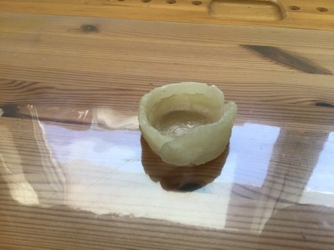
Bioplastics: Cups and Bowls
After our successful attempts to make bioplastics we decided to try to make it into more complicated shapes.
7
8
9

Slide 24
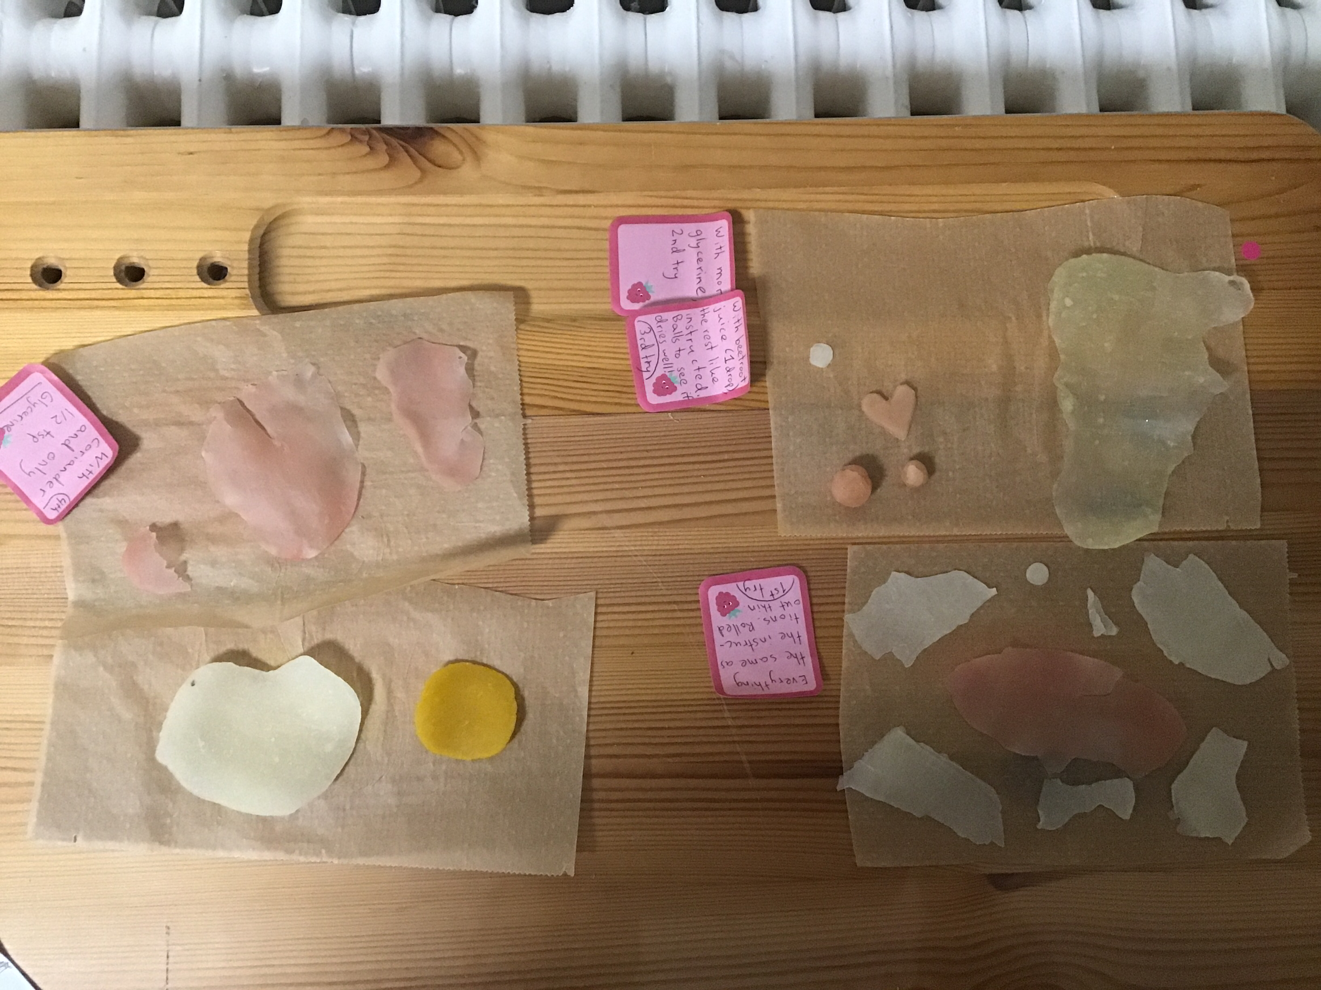
Results
After 50 hours of drying, the plastics were ready.
Most similar to plastic- 6, 3, 5, 7, 9
Least similar to plastic- 2, 1, 8
Most rubbery- 2
Most sturdy- 4, 6, 8
Overall winners- 6, 5, 3, 7, 9
PICS
2
3
1
5
4
6
Notes:
1st try- Everything according to the recipe and method.
2nd try- More glycerine.
3rd try- beetroot juice.
4th try- Coriander and only half of the amount of glycerine used.
5th try- raspberry juice and ¼ less glycerine
Last try- heated a bit longer and less glycerine
What went well- dried quite quickly, only 1 broke apart, all the different variations of the recipe worked out well, they turned out similar to plastic.
What could have been better- when drying could have stayed flat and not bend, none breaking, we could have made more different types.
If we would repeat this experiment- we would add less glycerine than instructed to the plastics, created bigger shapes, tried more various thicknesses, keep on the heat for a minute or so longer.

Slide 25

05
The future of microplastics
You can see most microplastics with a UV light.
it

Slide 26
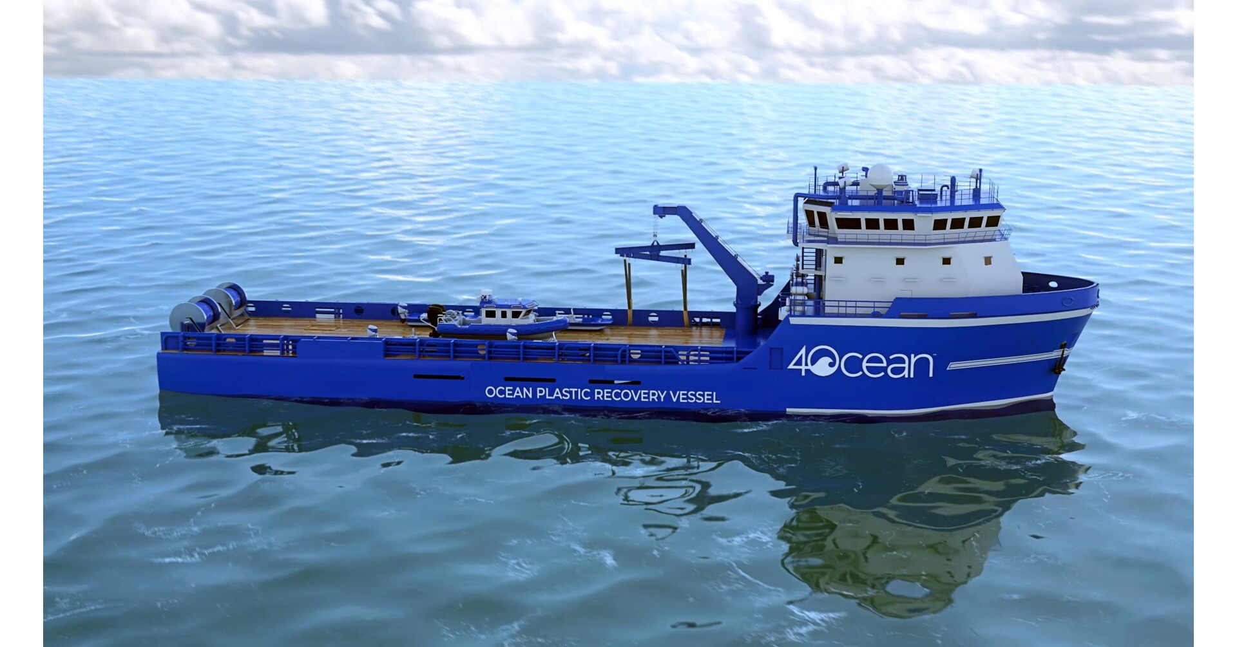
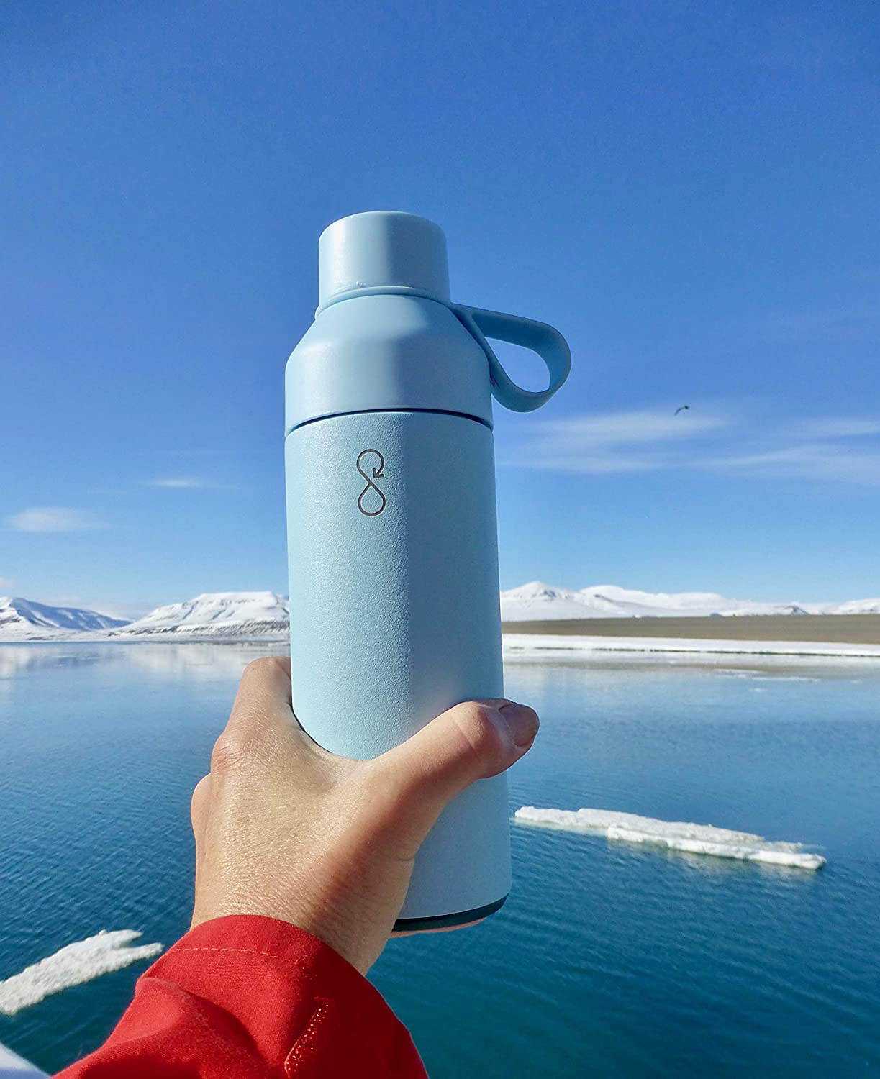
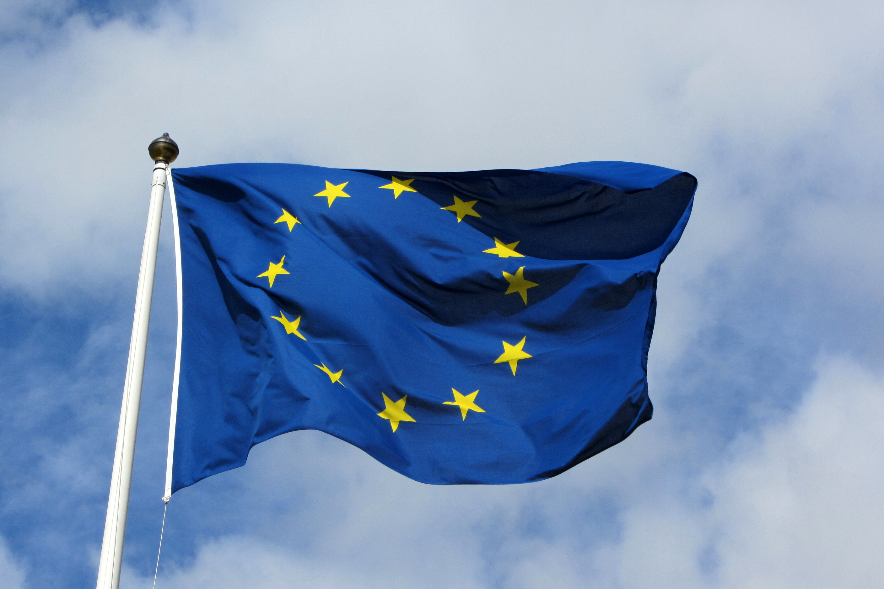
Companies and institutions taking action:
What the issue of microplastics would look like in 50 years (according to us)
Ocean Bottle
4Ocean
Parley for the Oceans (working with Adidas)
EU chemical legislation REACH
Plastic Bank
IF WE DON'T TAKE ACTION
Even bigger problem
Will harm wildlife, disrupt ecosystems
Cause long-term health problems for humans
The cost of cleaning up microplastics could grow significantly
IF WE TAKE ACTION
Raised awareness
Companies and governments reduce the use of plastics
Reduced levels of plastics and microplastics overall
Notes:
In 50 years, microplastics could become an even bigger problem. They are already in our oceans, soil, and food, but their levels could increase dramatically. This will harm wildlife, disrupt ecosystems, and cause long-term health problems for humans, such as inflammation or hormonal issues. Crops could also be affected, as microplastics in soil might lower its quality and reduce food production. The cost of cleaning up microplastics could grow significantly. To prevent this, we need to reduce plastic use, improve recycling, and develop biodegradable alternatives. Without action, microplastics could cause serious environmental and health crises.
Companies might take action on microplastics if laws get stricter, consumers demand eco-friendly products, or new sustainable materials are developed. Some businesses are already making changes, but without strong rules and global cooperation, progress could be slow.

Slide 27
Conclusion
The awareness of the presence of microplastics in our daily life is still a work in progress.
We can conclude that people have more knowledge on certain topics such as the negative impact of microplastics on the environment than on human health.
The level of knowledge when it comes to presence of microplastics in various products in our daily lives also varies.
There is collective agreement among the respondents that governments should take action to reduce microplastics.
Bioplastics are a sustainable alternative to plastics and are easy to make.
Microplastics cause many problems for us and life on Earth, so we must work together to fight them. Many governments and companies need to take action, but so do citizens. Together, we can create a safe, clean world for people, nature and animals alike.

Slide 28
Sources
The world of plastic waste: A review - ScienceDirect
7 Places Microplastics Are Secretly Hiding in Your Kitchen and Easy Swaps - CNET
Tea Bags Release Billions of Microplastic Particles When Steeped, According to a New Study
Plastic | Composition, History, Uses, Types, & Facts | Britannica
Polyethylene - Wikipedia
New methodology to measure microplastics in EU’s drinking water - European Commission
Toxicity evaluation of polypropylene microplastic on marine microcrustacean Artemia salina: An analysis of implications and vulnerability - ScienceDirect
Polypropylene - Wikipedia
Wikihow.com
Microplastics Everywhere | Harvard Medicine Magazine

Slide 29
Acknowledgements
We would like to thank the following people:
Ms. Dorottya Csonka- for helping us, guiding us and supporting us throughout our project
Mr. Arthur Baranowski and Mr. Diarmuid Crowley- for guiding us and giving us ideas to improve our project
Ms Maya Beckman Lapre- for helping us send our survey around the school and supporting us
Siana Glouharova- for helping us proofread our report and supporting us
Georgi Slavov- for helping us organise our data and supporting us
Agne Limante- for supporting us throughout our project, helping with the bioplastics and report
Manfredas Limantas- for supporting us throughout our project
Vitalija Limantiene- for helping us create the bioplastics
Oleksiy Yevtushenko- for supporting us throughout our project
Tatiana Sacharuk- for supporting throughout our project
Etain O'Mahony- for supporting us and giving us ideas throughout our project

