Slide 1

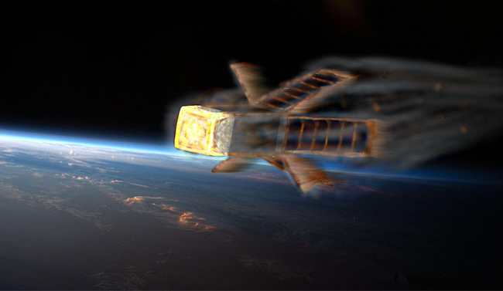
What does an
AEROSPACE ENGINEER do?
Special guest:
QARMAN CubeSat!
And other Space jobs!
Amandine Denis - denis@vki.ac.be

Slide 2
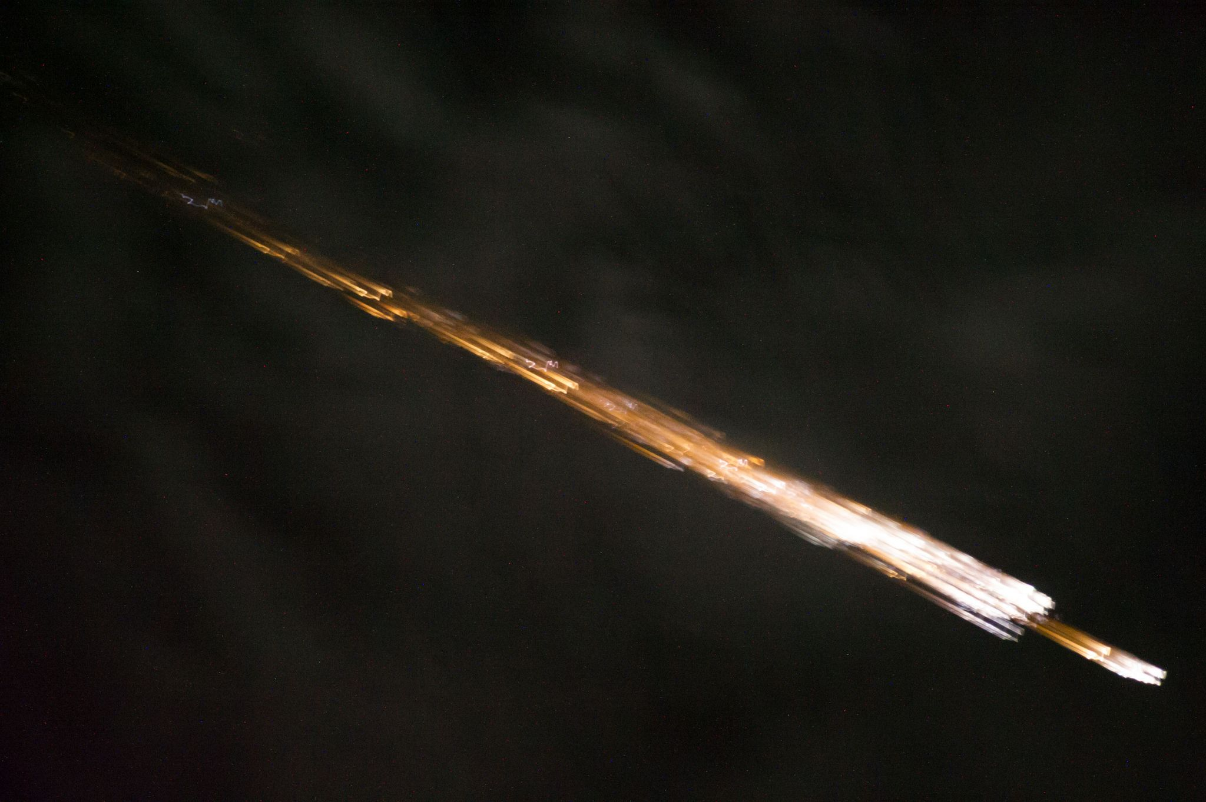
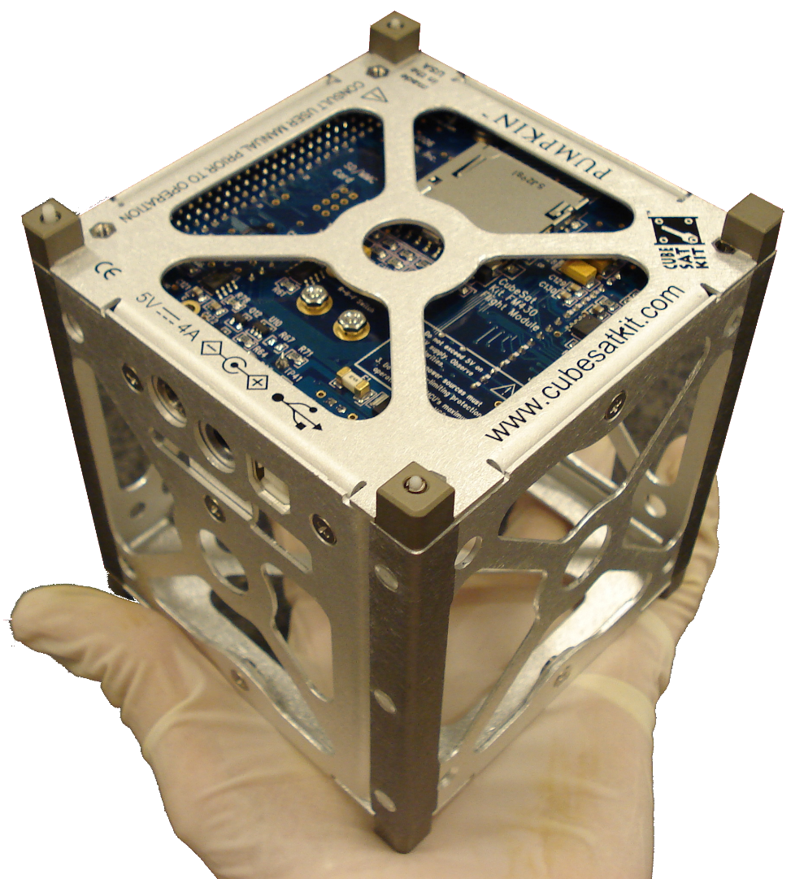
☞ Take up challenges!
What happens when a satellite re-enters the atmosphere?
Can we study it with a CubeSat?
➔ QARMAN: VKI reentry CubeSat
Credit: OUFTI-1, ULiège

Slide 3
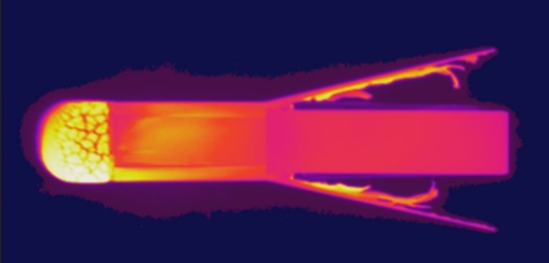
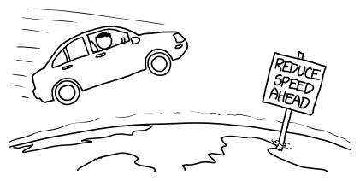
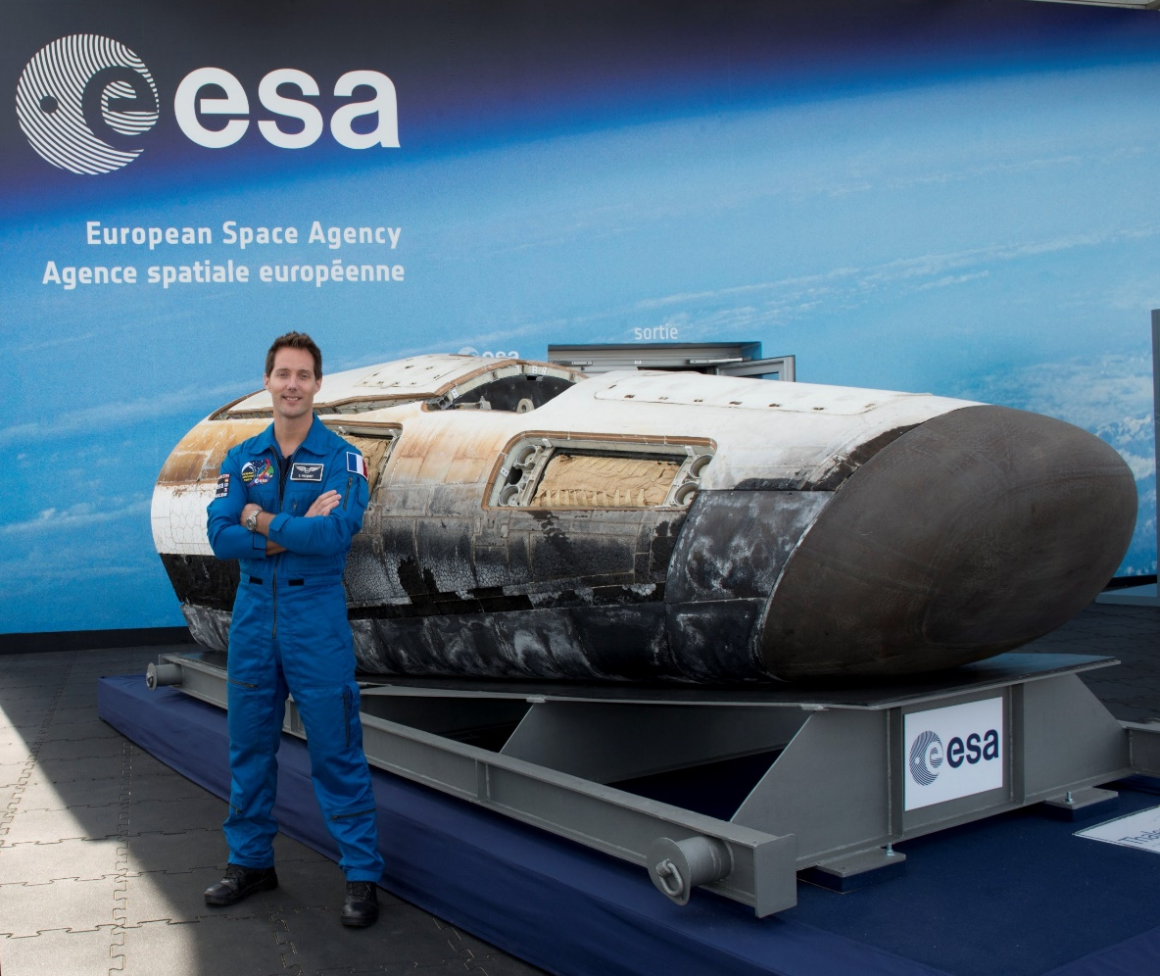
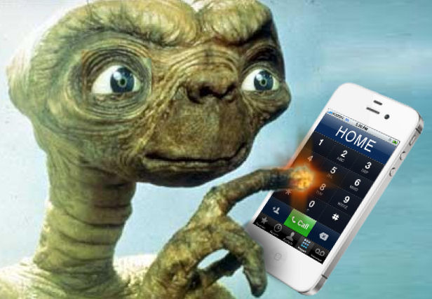
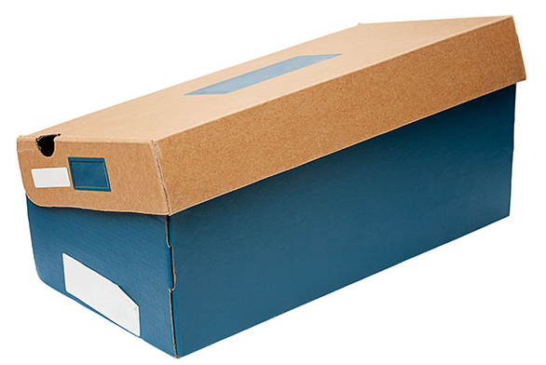
☞ Solve problems & imagine solutions!
Credit: xkcd.com
25920
0
Credit: ESA

Slide 4
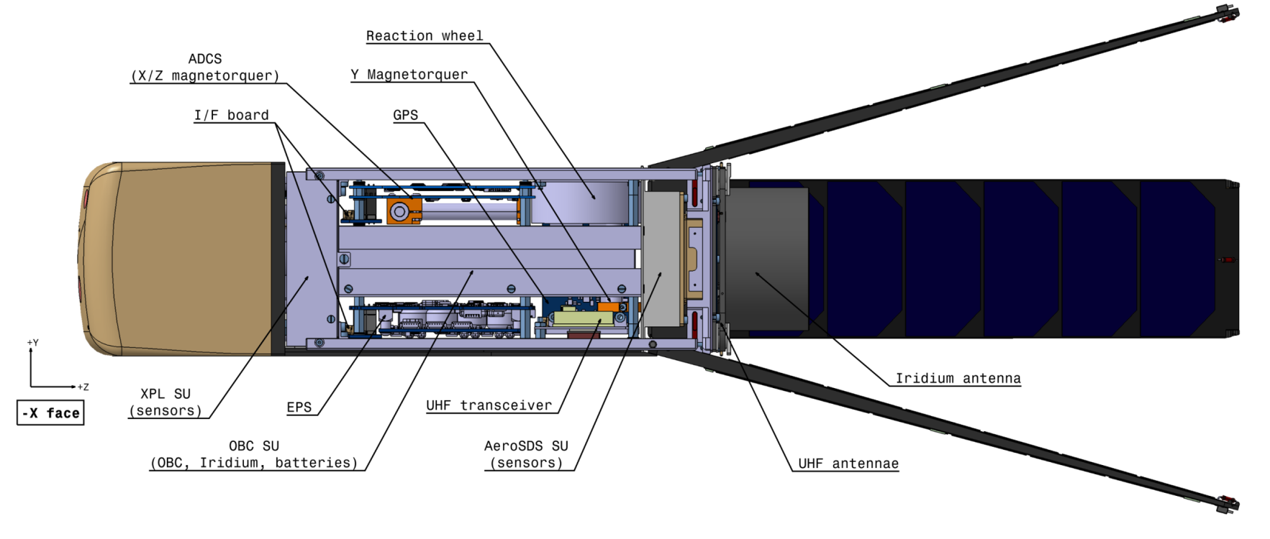
☞ Solve problems & imagine solutions!
Engineers, mission analysts, thermicists, computer scientists, researchers, draftswomen, …

Slide 5
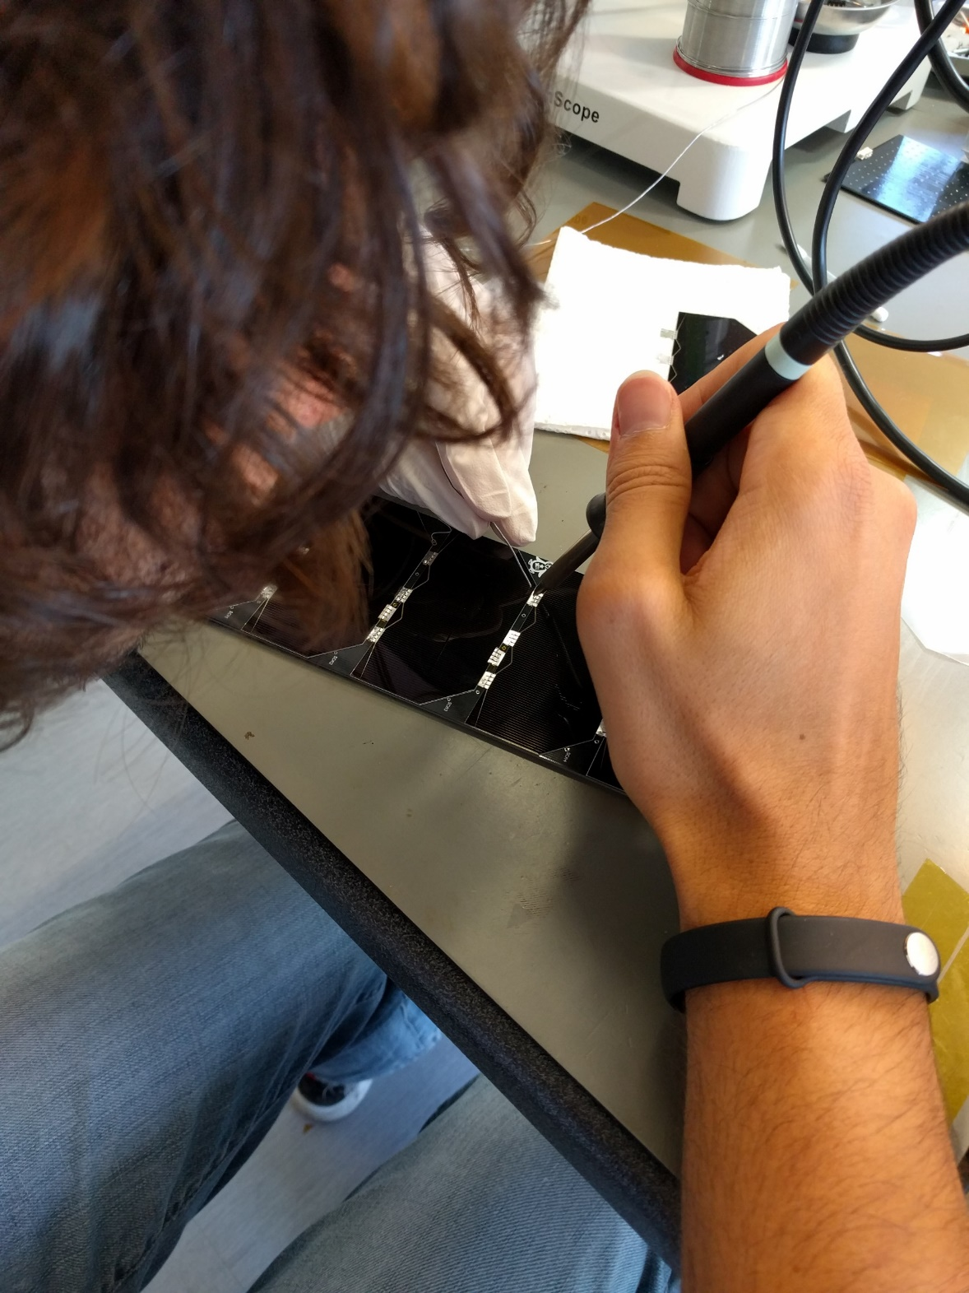
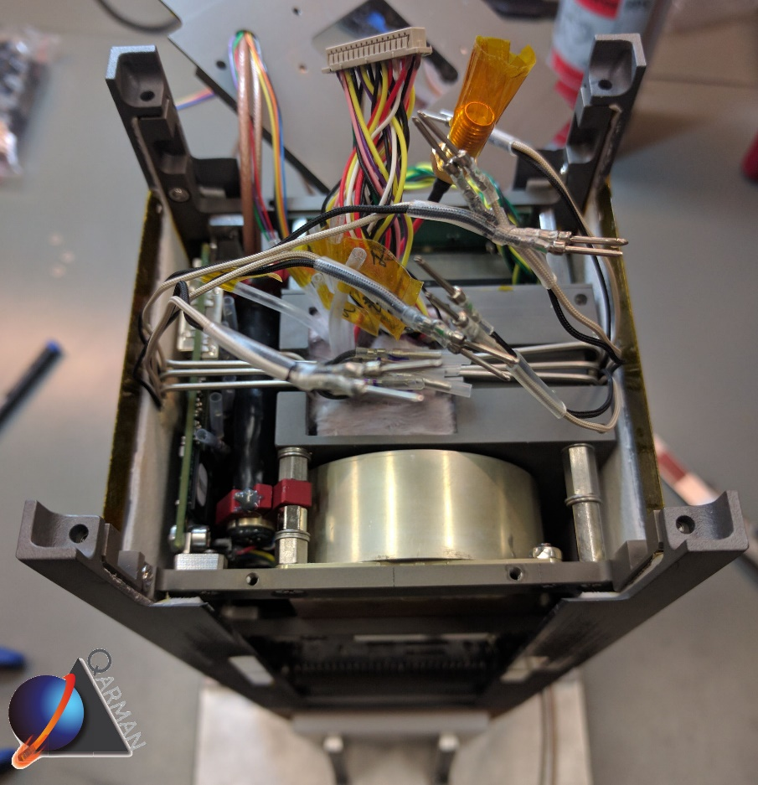
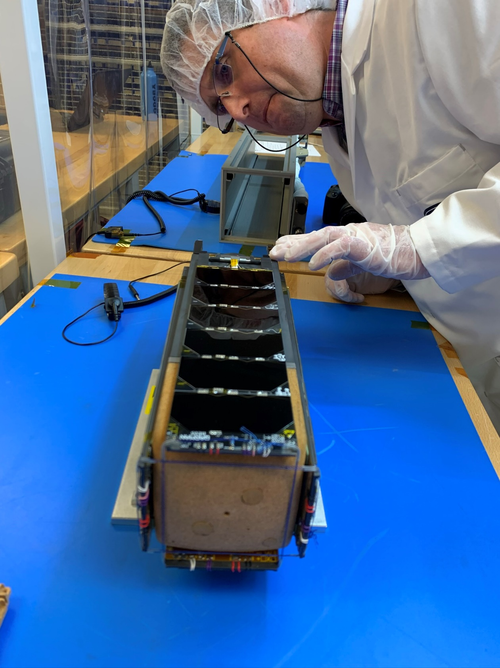
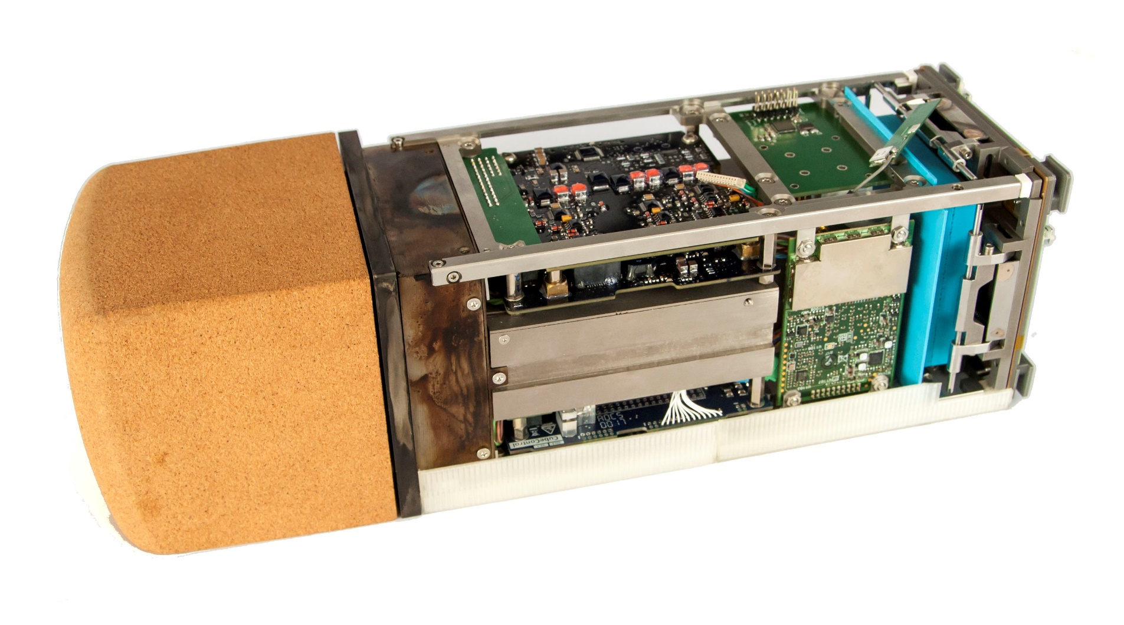
☞ Build, integrate,… have it work!
Technicians,… watchmaker (!), dressmaker (!!),…

Slide 6
☞ Test !
Facility technicians & engineers, test engineers, …

Slide 7
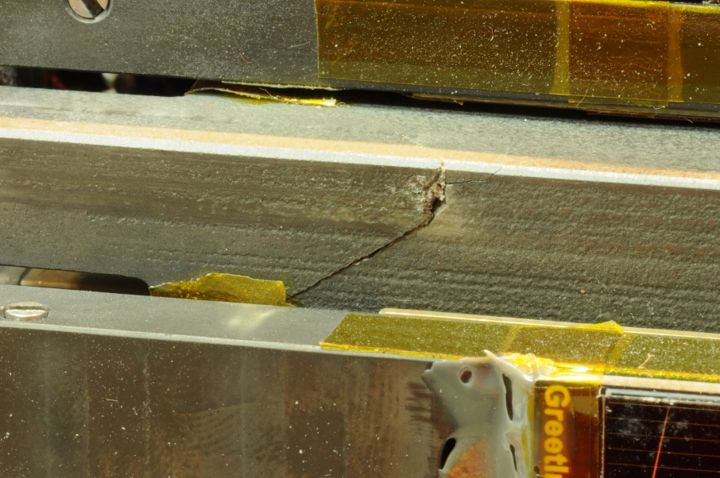
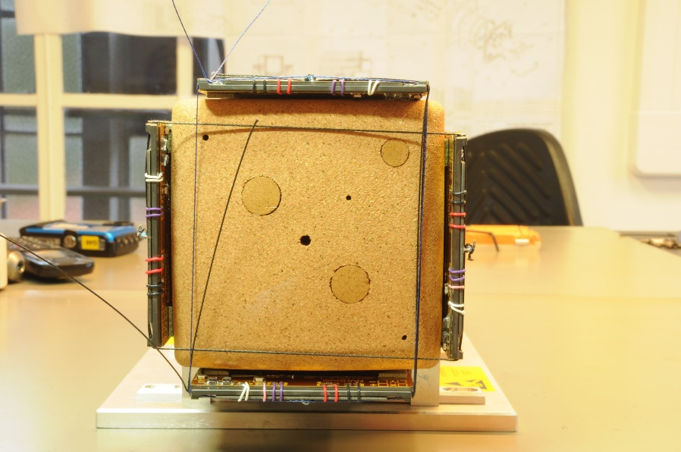
☞ Analyse data… and solve problems again!
Responsibles for product & quality assurance,…

Slide 8
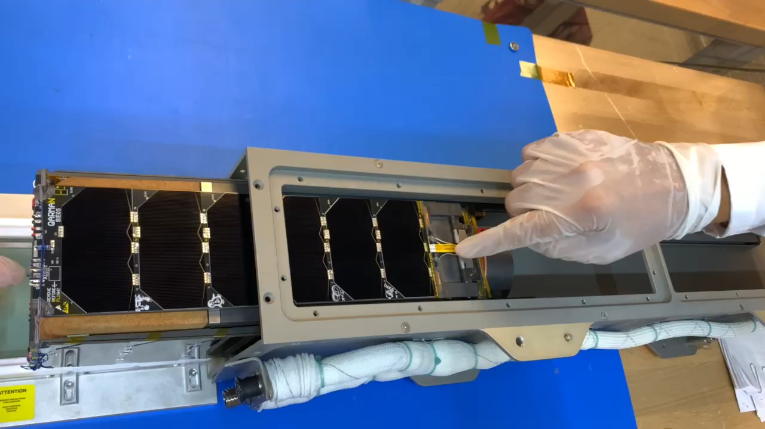
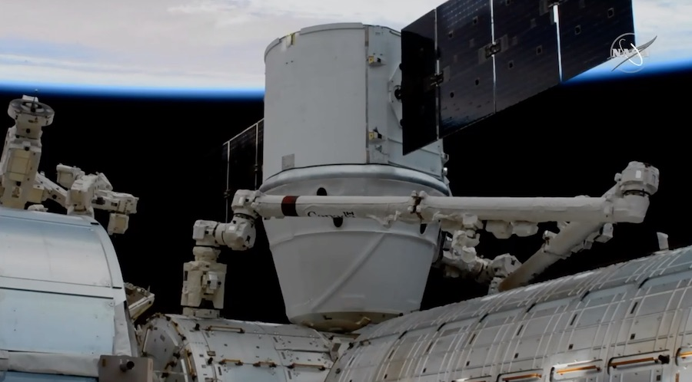
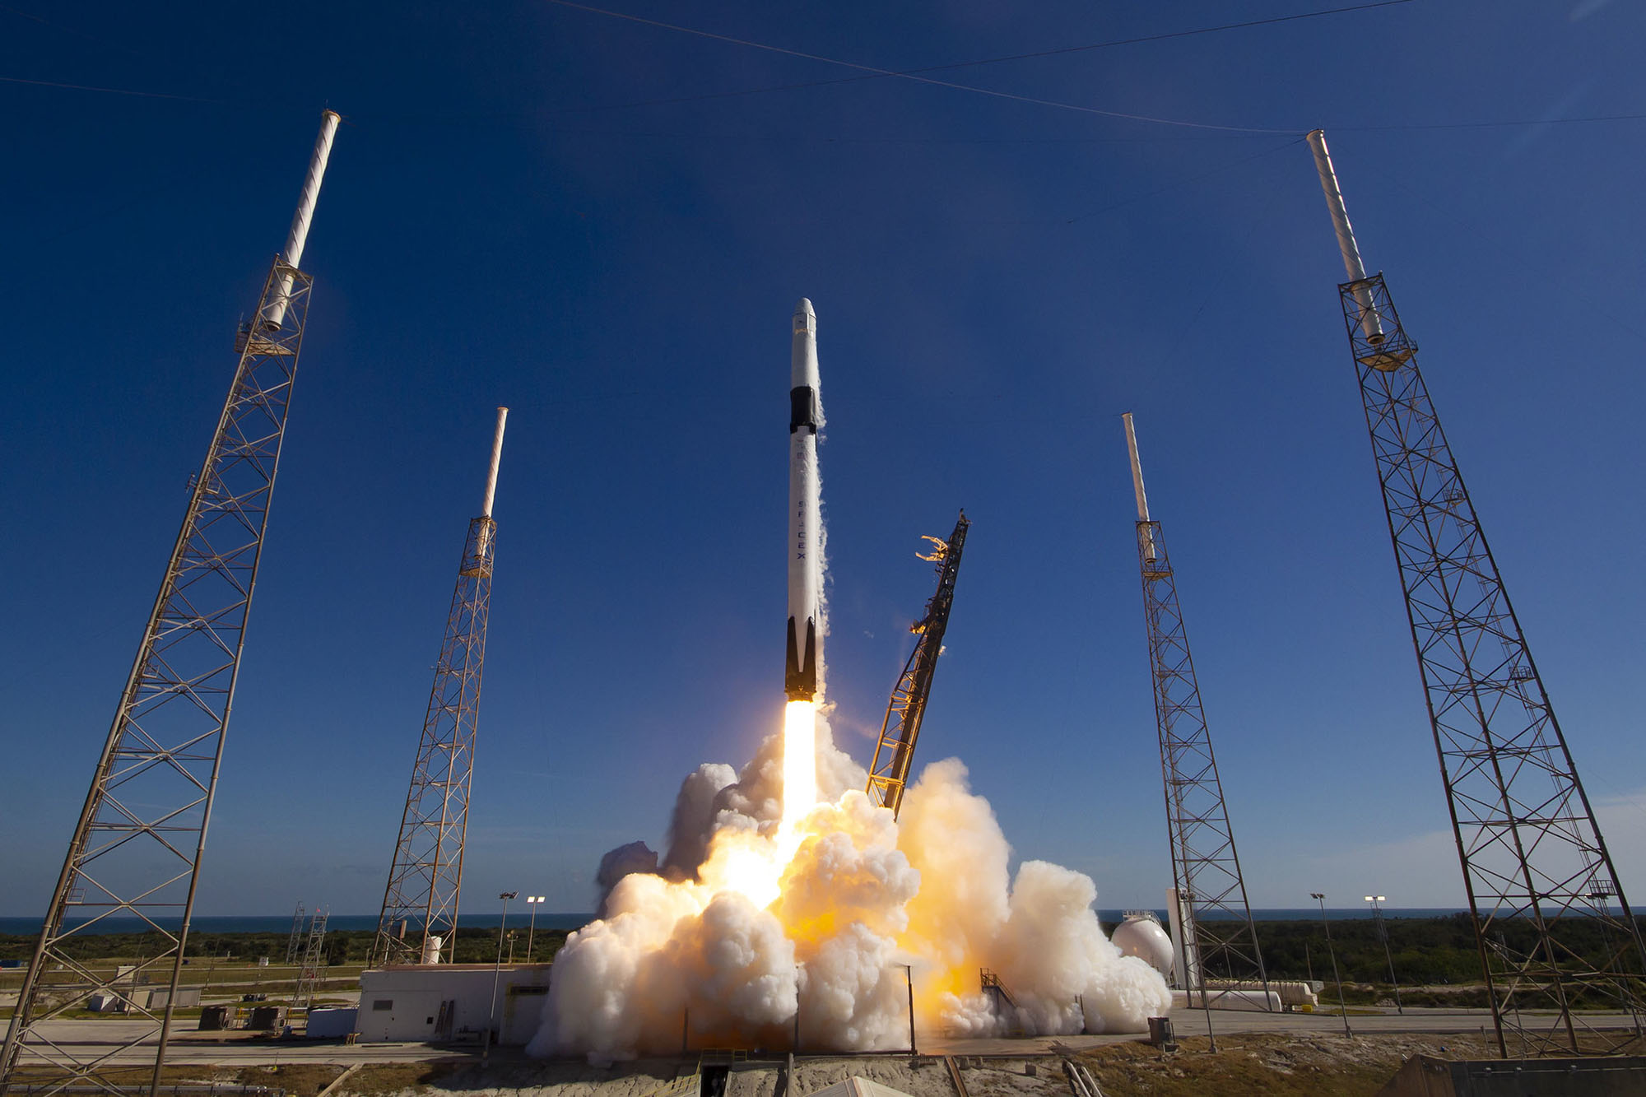
☞ Have it launched!
… and don’t be illegal!
Space lawyers, officials,…
5/12/2019

Slide 9
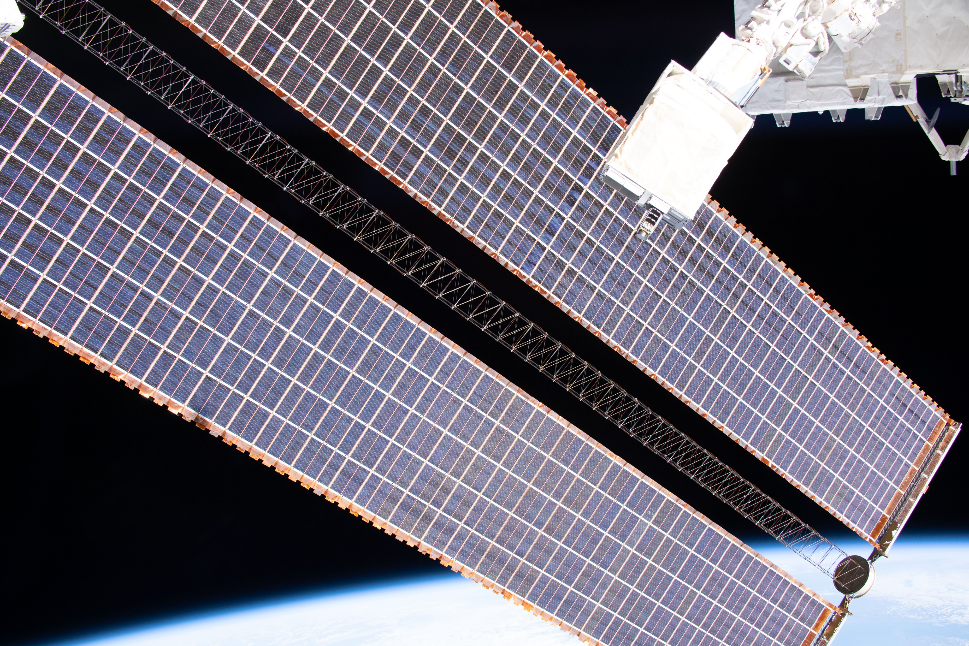
☞ Enjoy the view ☺
Astronauts!, operation support, journalists, …
19/2/2020

Slide 10
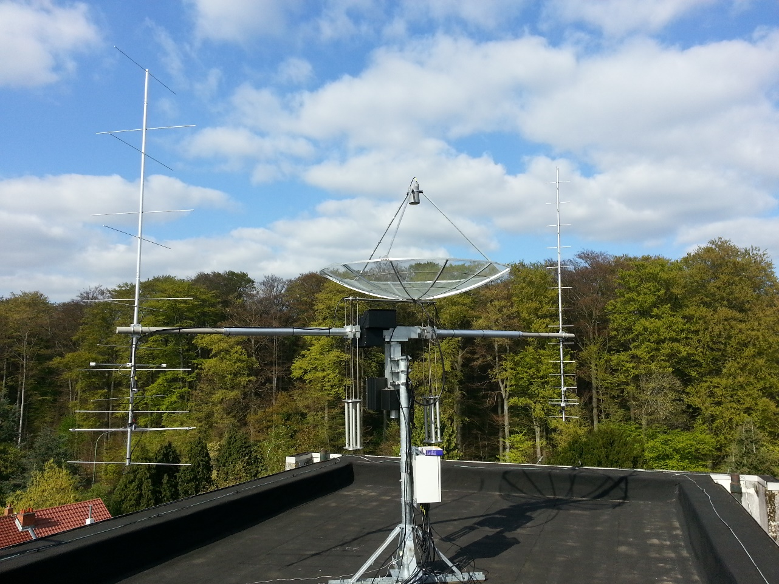
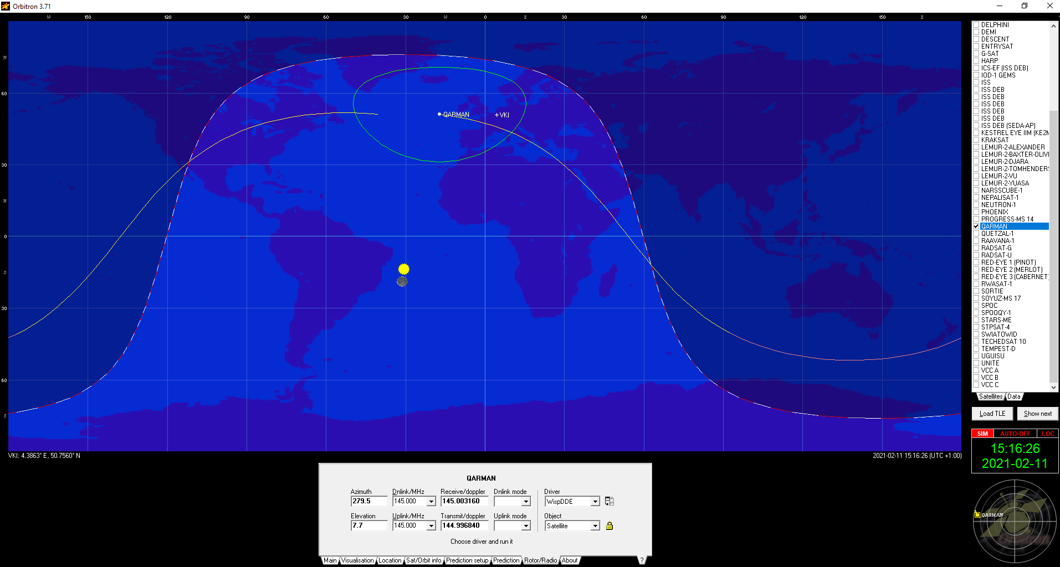
☞ Operate
Radio operators, mission controllers, scientists,…

Slide 11
☞ … and solve problems again again…
?

Slide 12
☞ … and solve problems again again…
22850 s
351589 s

Slide 13
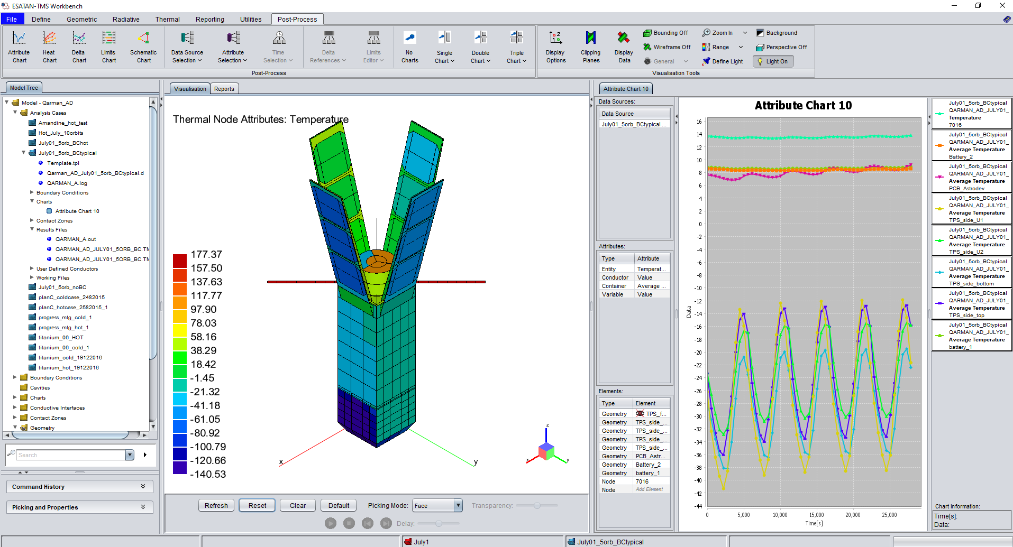
☞ Learn and try again!

Slide 14
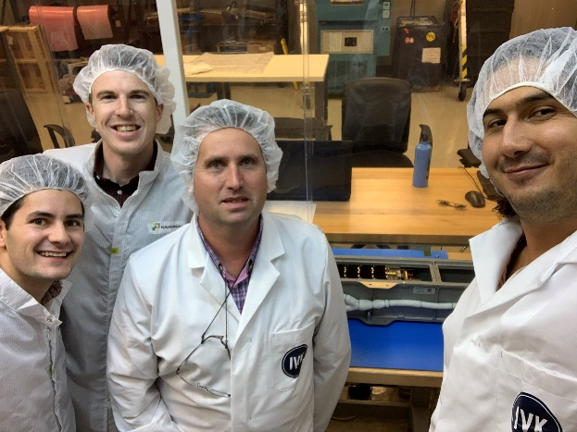
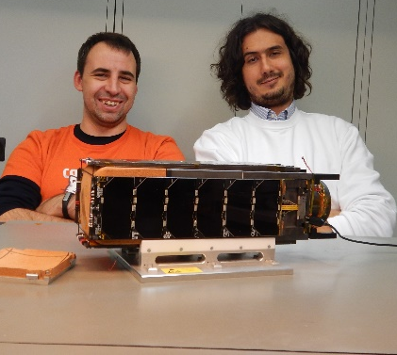
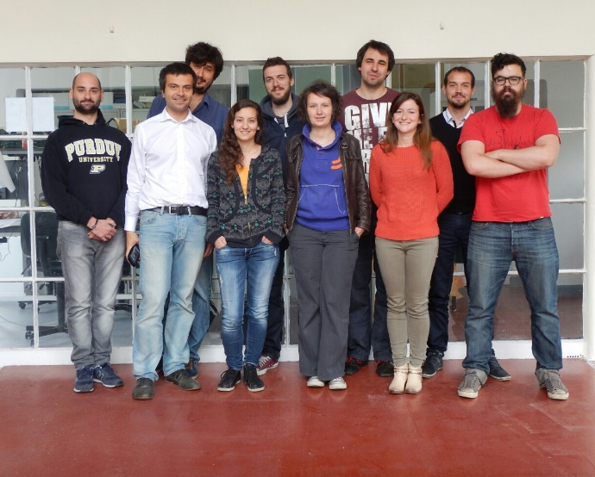
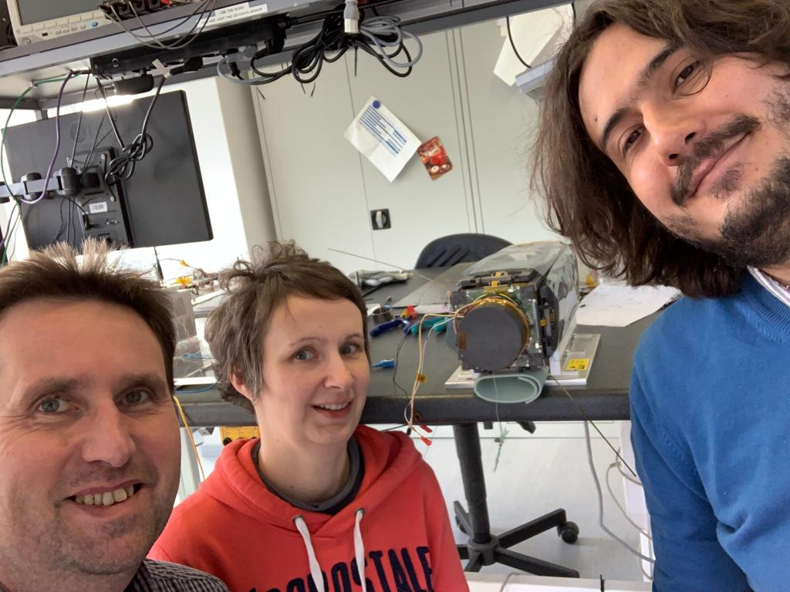
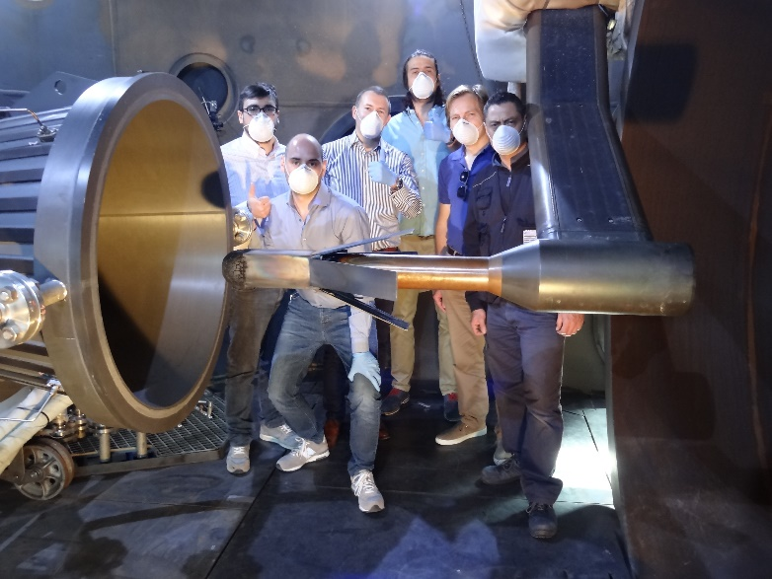
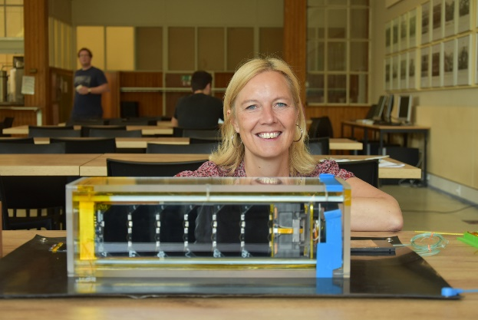
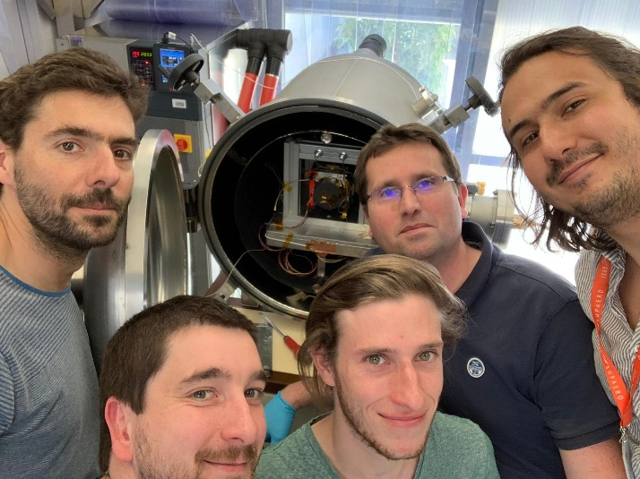
☞ Teamwork!
☞ A wide range of space careers for all profiles!

Slide 15
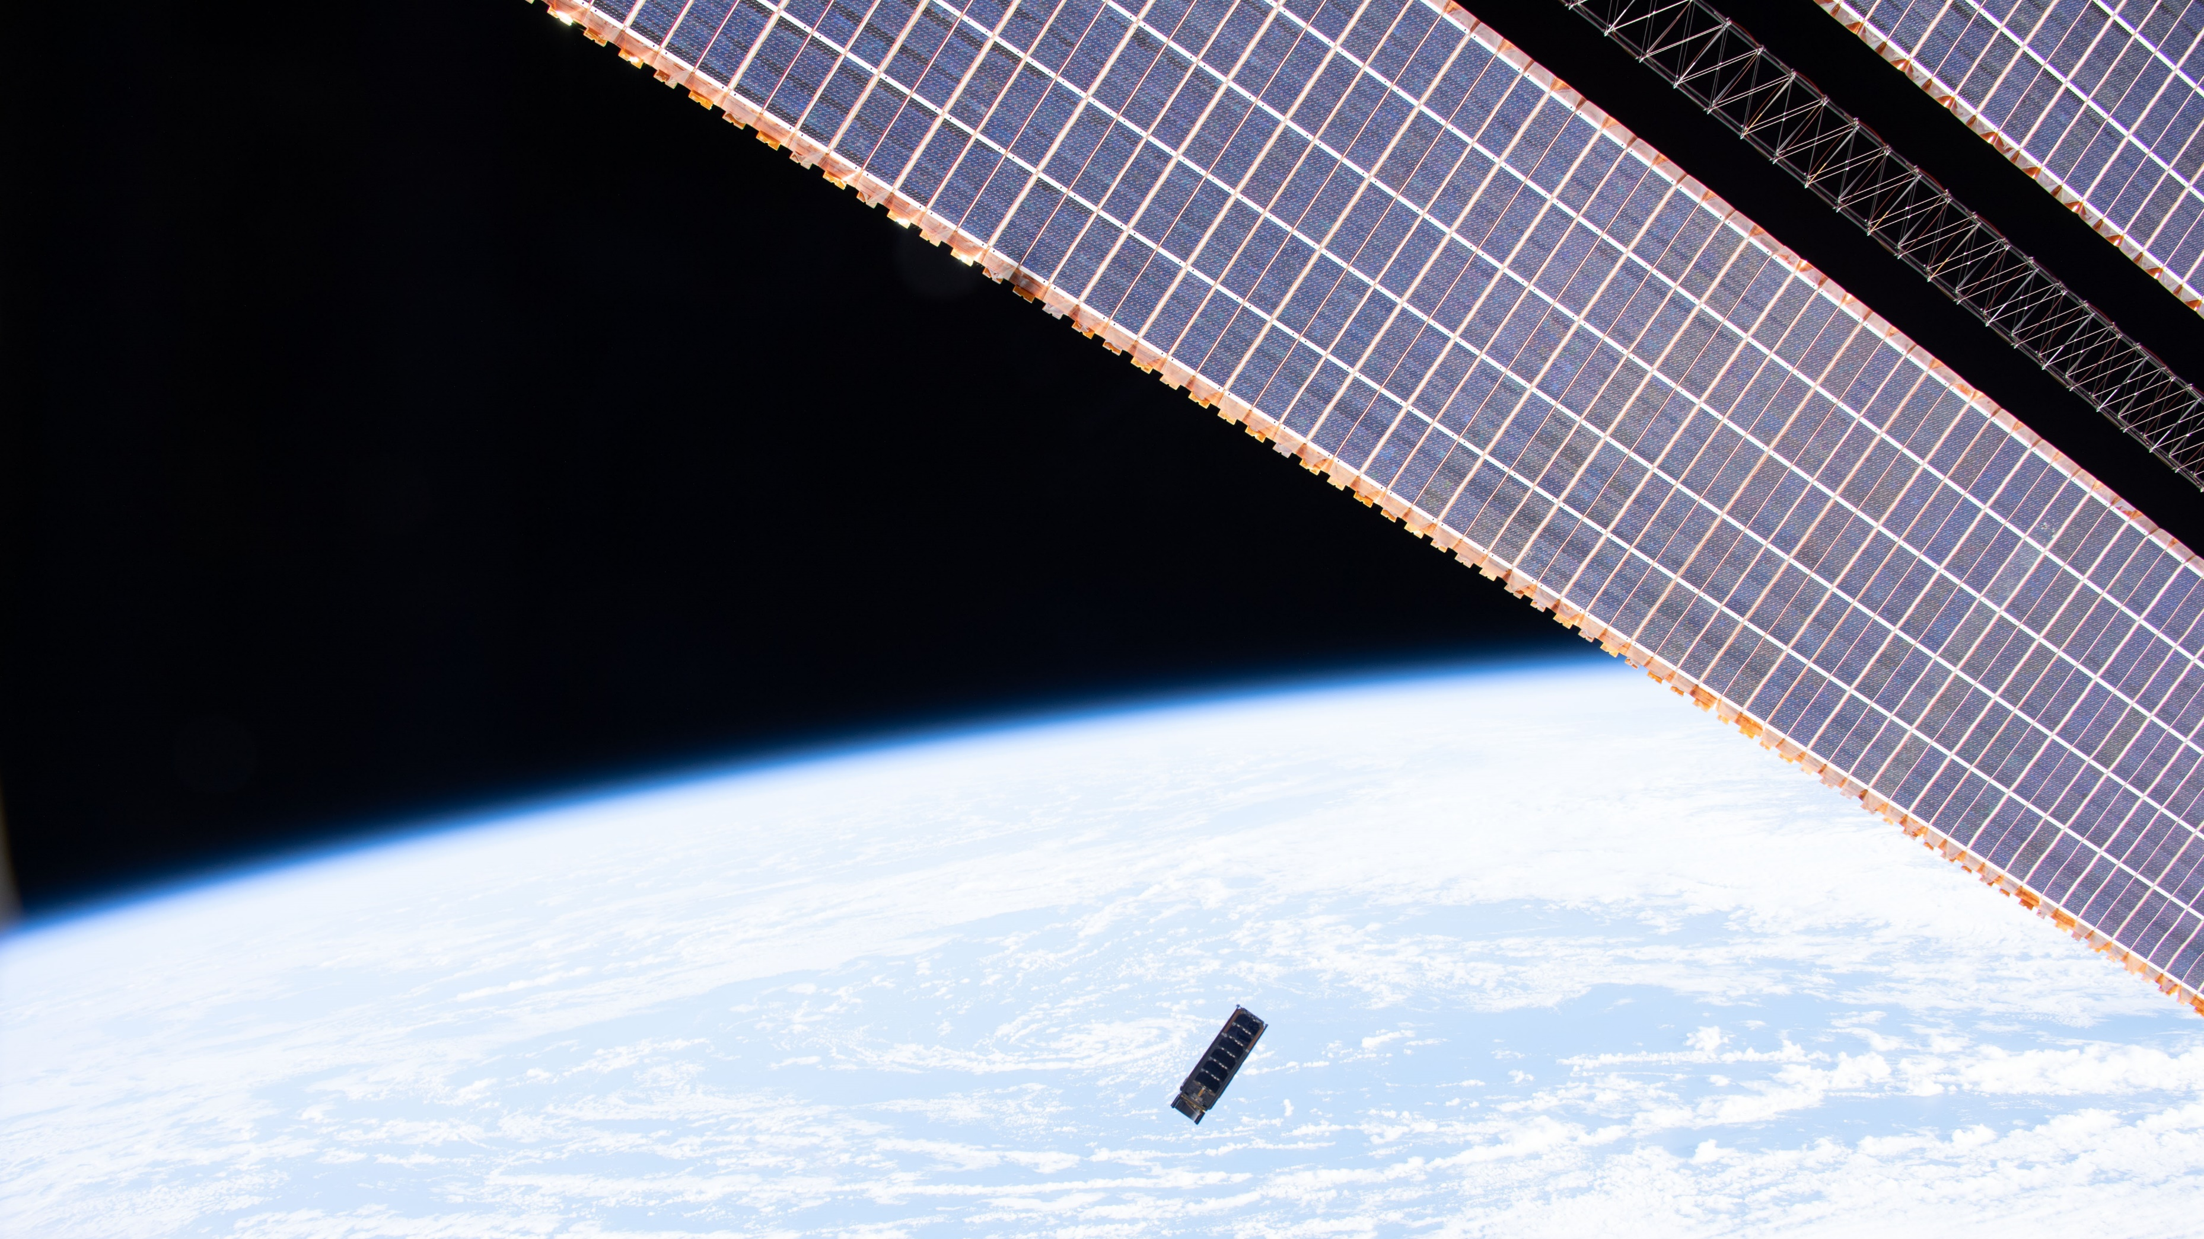

Slide 16

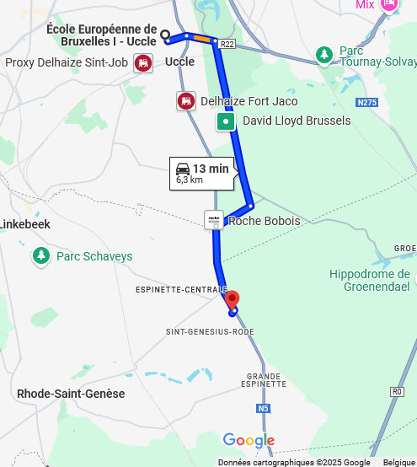
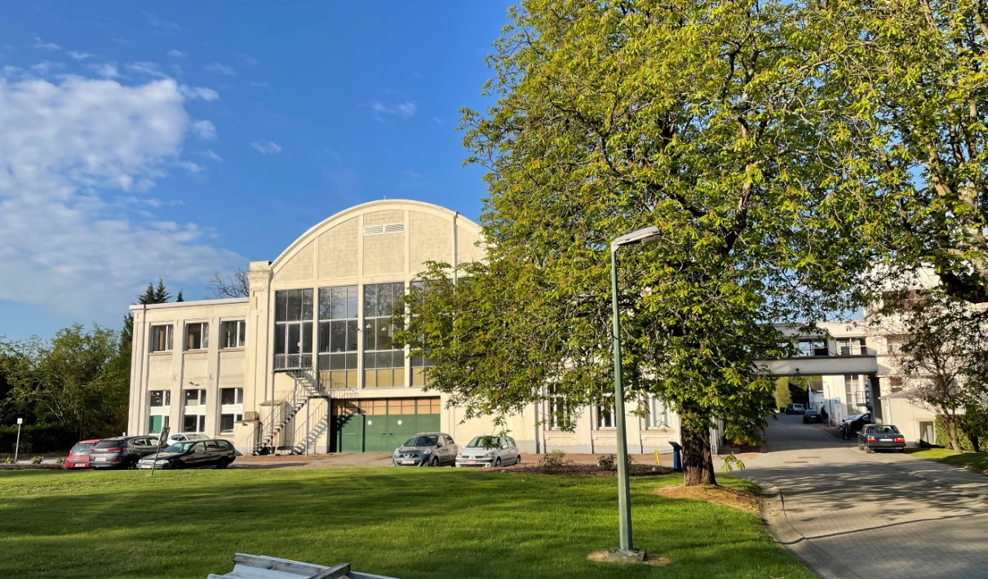
You are here!
International Center
for Advanced Education
and Research in Fluid Dynamics
Post-graduate education
World unique test facilities (windtunnels, Plasmatron,…)
Consulting and research
3 departments:
  Environmental & applied fluid dynamics
  Turbomachinery and propulsion
  Aeronautics and aerospace
QB50 project, QARMAN re-entry CubeSat, EARS, DRACO, ….
→ www.vki.ac.be

