Slide 1
An ion spectrometer for the identification of molecular bound states with positronium
Florian Sterkl
SMI Seminar
27.03.2025

Slide 2
Overview and outlook
Motivation: Positronium containing molecules
Beam line overview
Spectrometer
Spectrometer magnets
Conclusion
Outlook
Positron Beamline
Notes:
Magnets
Potential divider
Pulser
Parts of my spectrometer mit unterpunkten oda so lol
Mochs so afoch wie möglich ☺
Simulations
Construction
Measurements and Results

Slide 3
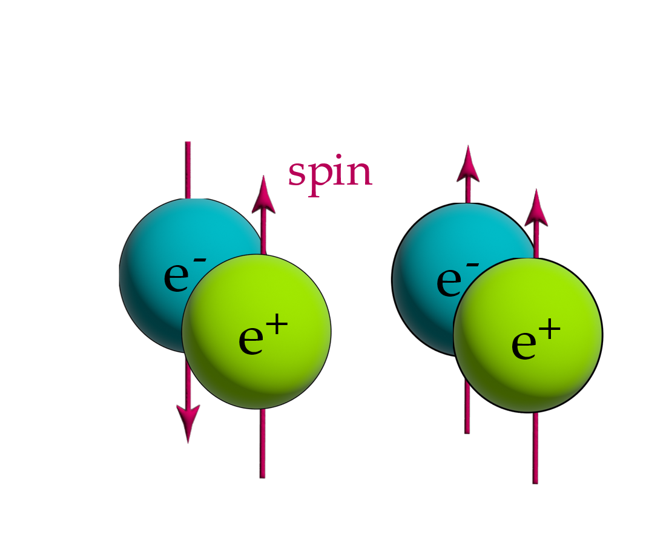


What is positronium (Ps)?
Positronium is the bound state of e⁺ and e⁻.
Similar energy level structure to hydrogen,
but with energy levels halved.
Short lifetime due to self annihilation.
para-Ps $→2γ$
$$τ=125 ps$$
ortho-Ps $→3γ$
$$τ=142 ns$$
Can this exotic atom bind to other atoms?
Positron Beamline
Notes:
Short lifetime
Matter antimatter bound system exotic atom
Spin anti parallel or parallel

Slide 4
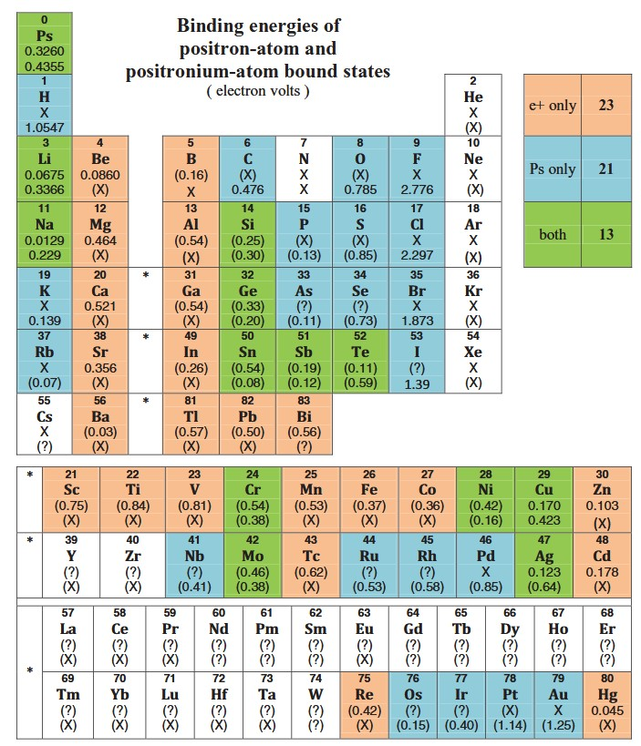
Motivation to measure Ps bound states
Molecular bound states of positronium
(PsA) predicted in numerous quantum
calculations [e.g. Cheng 2012, Ludlow
Gribakin 2010].
No precision binding energy
measurement has been performed.
Ps interactions important for related fields
like material physics (e⁺ annihilation
spectroscopy) or biomedicine (PET scans).
Positron Beamline
X. Cheng, D. Babikov, and M. Schrader. Binding-energy predictions of positronium. Phys. Rev. A 85, 012503 (2012).
Notes:
Cheng semi empirical model Ps binding energy to basic atomic properties. Used known Ps binding energies from theoretical calculations to a limited set of neutral atoms.
Solid and Surfaces relevant positronium interactions because in porous materials positrons can bind and form positronium

Slide 5
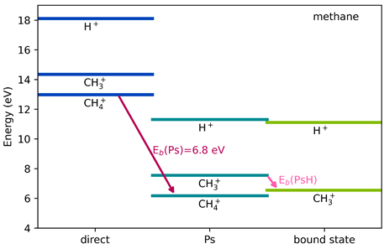
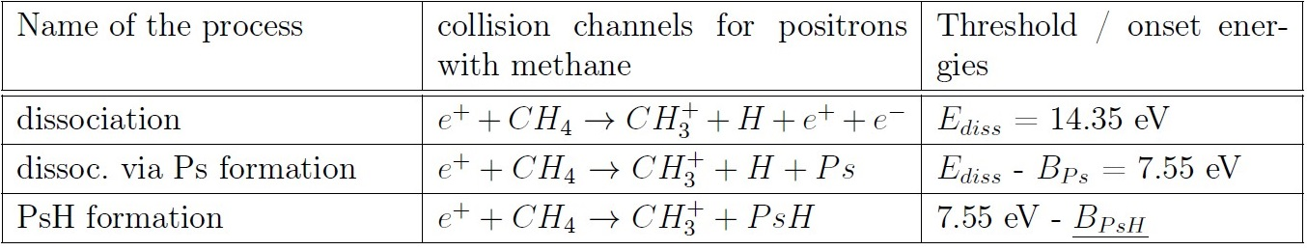
Measurement technique and goal
One experiment observed PsH by colliding methane gas with positrons (Schrader 1992).
Measured EB = (1.1 ± 0.2) eV from ion yield thresholds.
Limited by energy spread of the beam ∆E ~ 1 eV.
The onset energy of CH3⁺gets reduced by the binding energy of PsH.
-> The goal is to measure B_PsH by detecting CH3⁺ below 7.55 eV.
Appearance energies
for methane ions.
Positron Beamline
Notes:
Schrader Energy spread same order than the energy measurement. ->
Need precision to distinguish between different mass ions found in the same energy range.

Slide 6
Overview and outlook
Motivation: Positronium containing molecules
Beam line overview
Spectrometer
Spectrometer magnets
Conclusion
Outlook
Positron Beamline
Notes:
Magnets
Potential divider
Pulser
Parts of my spectrometer mit unterpunkten oda so lol
Mochs so afoch wie möglich ☺
Simulations
Construction
Measurements and Results

Slide 7
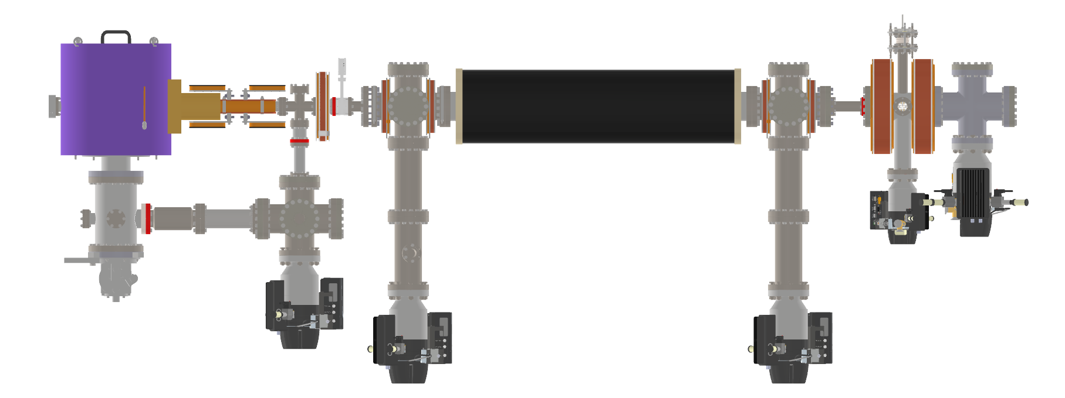
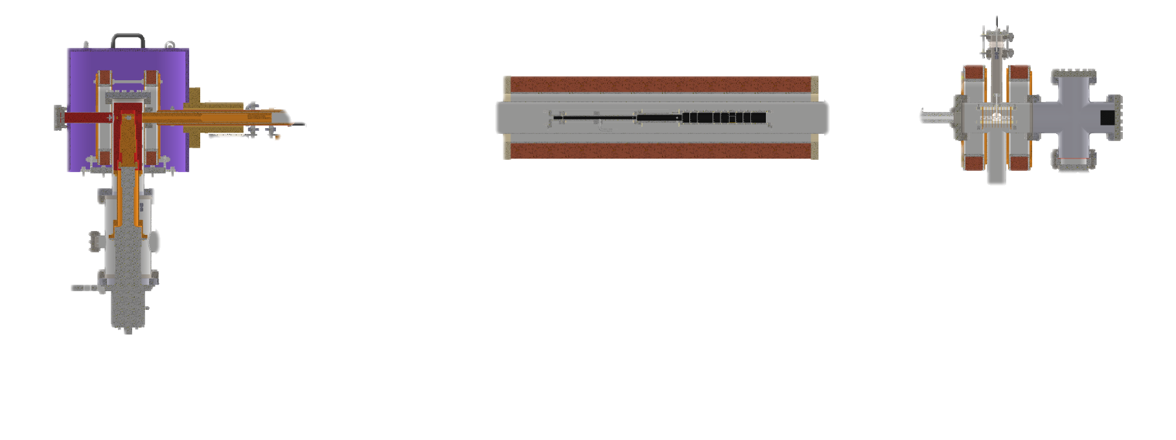
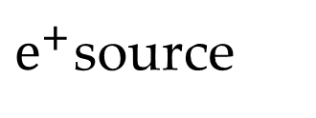
Positron beamline
spectrometer
$e^{+}$source
deflection coils
positron trap
Positron Beamline

Slide 8
Source and deflection coils
spectrometer
$e^{+}$source
deflection coils
positron trap
Positron Beamline

Slide 9
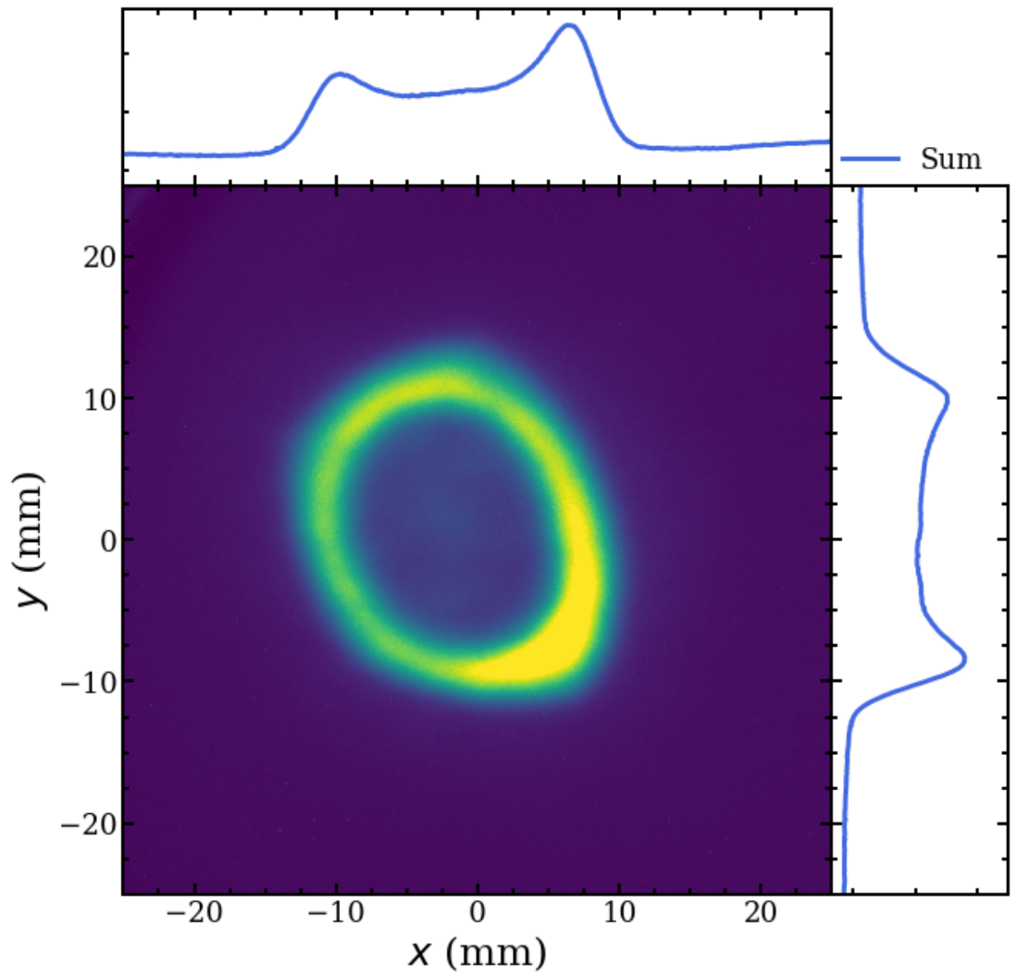



Slow positron beam
$$neon ice$$
$$moderator$$
Fast positron production by ²²Na-source.
Collisions with solid neon ice reduce $e^{+}$energy
from 300 keV down to ~ 1 eV.
Maximum efficiency ~ 1%.
Deflector coils remove line of sight between
the source and the trap.
²²Na Source
$$e^{+}$$
Positron Beamline
Slow beam without trapping
on the MCP.
Notes:
Sodium Chloride source.
Fast particles don’t follow the magnetic guiding field and hit the wall. Slow beam follows trajectory.
Reduces systematic effects by fast particles.
Positrons frozen on the cone shaped neon form a circle.

Slide 10
Positron trap
spectrometer
$e^{+}$source
deflection coils
positron trap
Positron Beamline

Slide 11
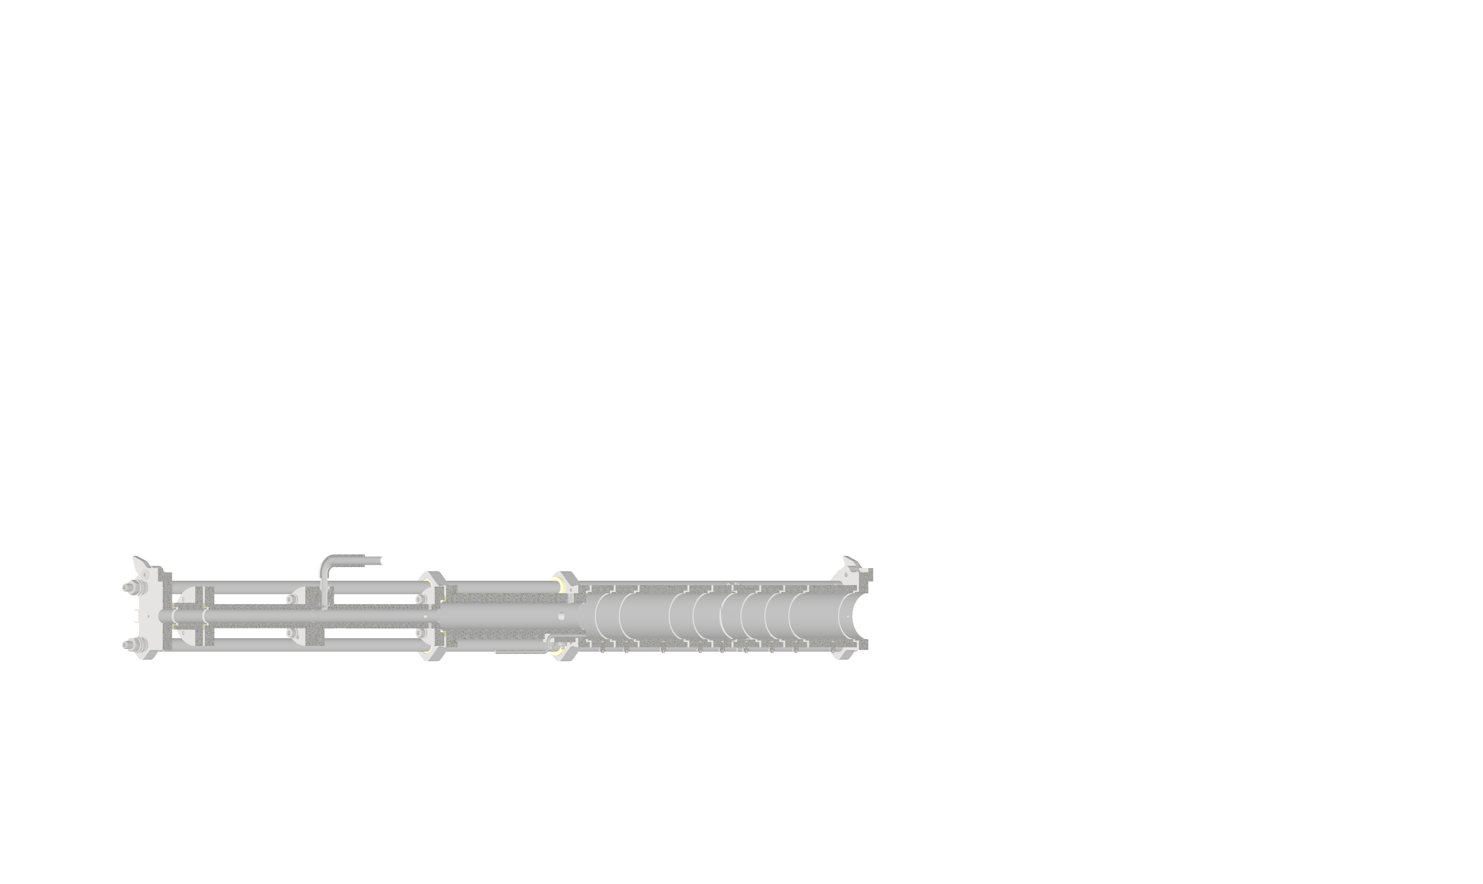
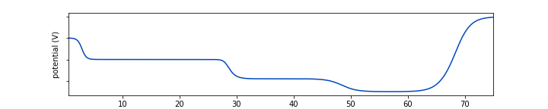





Buffer gas positron trap
The trapping process of the slow $e^{+}$ beam has several stages:
Radial confinement by the solenoid B-Field.
Axial confinement by three regions of decreasing electrical potential.
Energy loss due to collisions
with buffer gas N2 and
vibrational energy loss to SF6.
N2
$$e^{+}$$
SF6
${10}^{−3}$ mbar
${10}^{−4}$ mbar
${10}^{−6}$ mbar
potential (V)
1
2
Positron Beamline
3
z (mm)
Notes:
Differential pumping is used: the trap has smaller radius at the start and thus higher pressure.
It gets wider and the pressure decreases. Last stage also gets SF6 for rotational energy loss as a cooling gas.

Slide 12
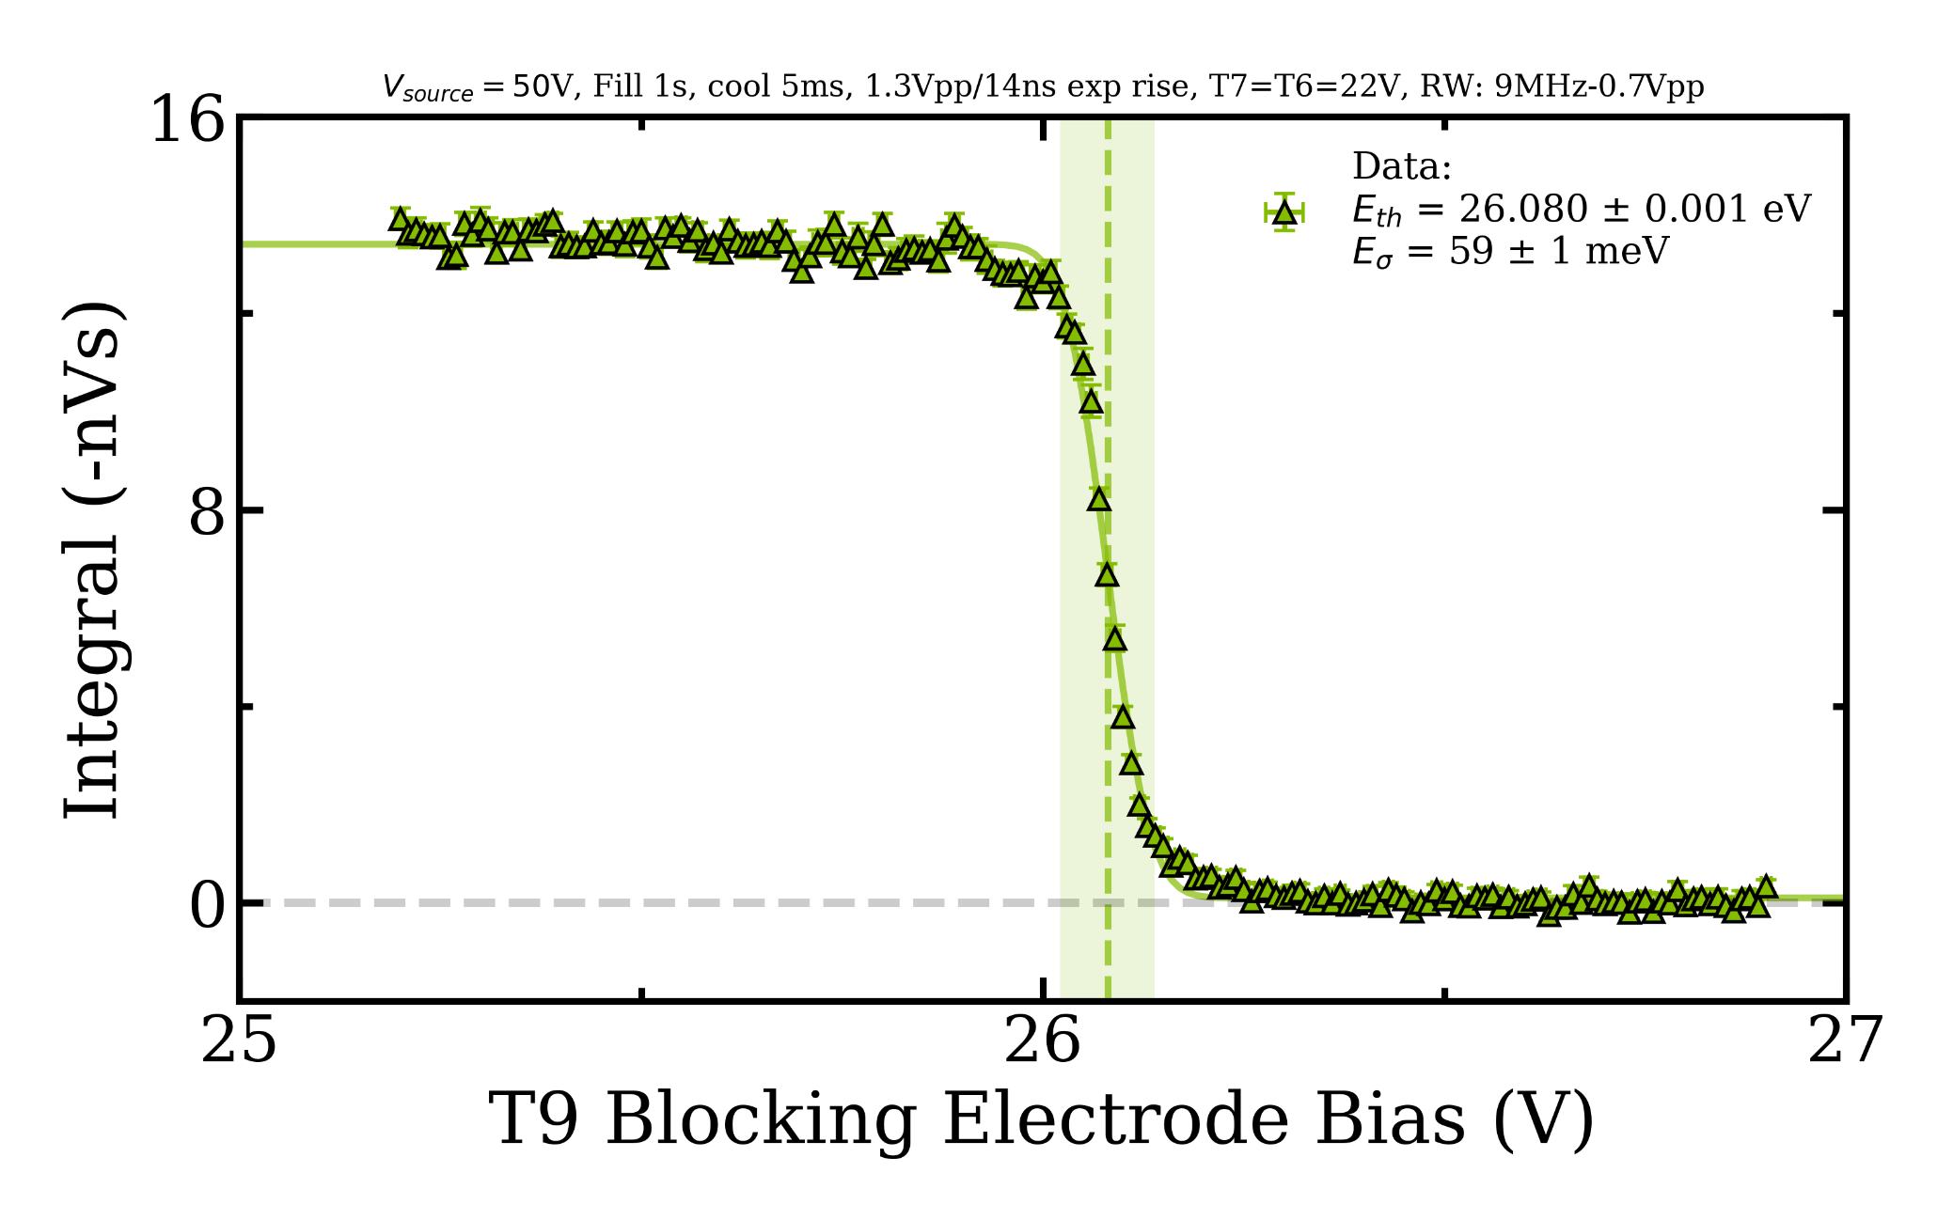

Rotating wall method and energy spread
90° phase shifted AC signal
applied to a 4-segment
electrode.
Rotating electric field
compresses the ion cloud.
Beam energy spread in trap
∆E = 5$9±$ 1 meV
(Schrader: ∆E ~ 1 eV).
Positron Beamline
Notes:
Beam intensity sinks as the blocking electrode voltage gets too high for the beam to pass
This drop is used for the beam energy measurement and the green area for the energy spread.

Slide 13
Overview and outlook
Motivation: Positronium Containing Molecules
Beam Line Overview
Spectrometer
Spectrometer Magnets
Conclusion
Outlook
Positron Beamline
Notes:
Magnets
Potential divider
Pulser
Parts of my spectrometer mit unterpunkten oda so lol
Mochs so afoch wie möglich ☺
Simulations
Construction
Measurements and Results

Slide 14
Spectrometer
spectrometer
$e^{+}$source
deflection coils
positron trap
Positron Beamline

Slide 15
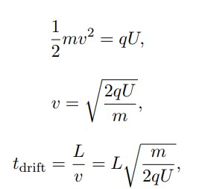
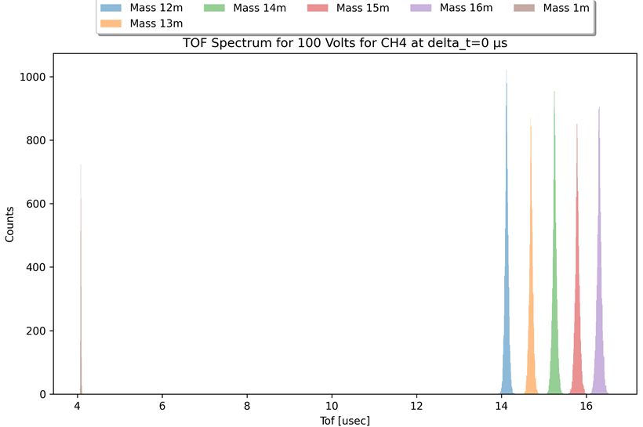

Time of flight (ToF) working principle
Charged ions gaining kinetic energy in an electric
field and fly towards a detector with a fixed velocity v.
The flight time tdrift is
proportional to$\sqrt{\frac{m}{q}}$.
Different mass ions
have different flight
times, resulting in a ToF spectrum.
Positron Beamline
Notes:
different mass-to-charge ratios yield different flight times, and the width of the peak (FWHM, Δ𝑡) when compared to the flight time 𝑡 directly provides the mass resolution.

Slide 16
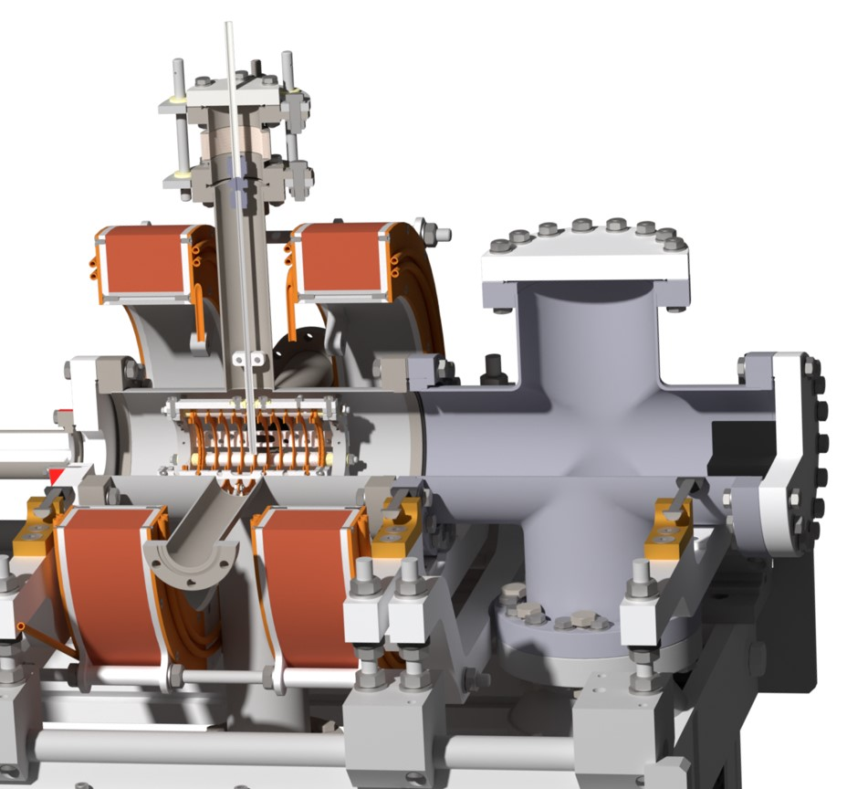
ToF spectrometer setup
Gas inlet CH4
Methane gas gets induced in the
spectrometer through a capillary array
(1mm thick glas plate, 50µm pores).
The slow positron beam hits the gas
jet and forms gas ions.
Time variable high voltage pulse applied
to the electrodes.
Accelerate the ions towards the MCP.
The magnets confine the beam
radially and guide it.
Field free drift region
MCP
Positron Beamline
Notes:
The experimental clear superiority of a capillary array source over a single tube source, of similar overall dimensions, in producing a well collimated molecular beam.
[Buckman et al. 1993].
plate ∅: 1mm
pore size: 50µm, 50% open area
thickness: 1mm
das sind die daten fürs capillary array
MCP: mikro channel plate which acts as an electron multiplier. Charged particles hit the wall and knock out secondary electrons. They get hv accelerated across the plate and produce an avalanche easy to detect as large fast pulse at the output.
used for good sensitivity and wide range of particles
Positron beam and ion beam are confined in the 500 Gauss Field. This mimics the trap field which is also at 500 Gauss.

Slide 17
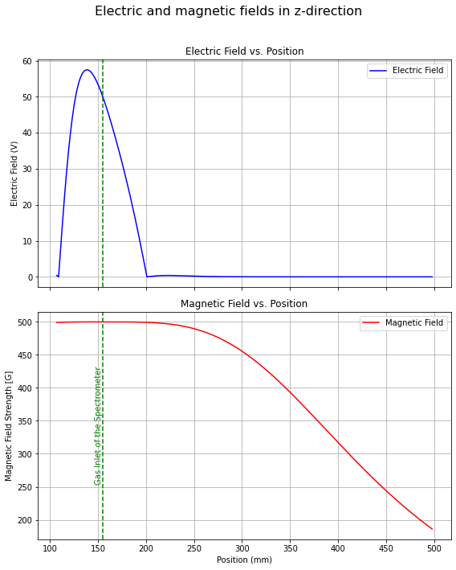
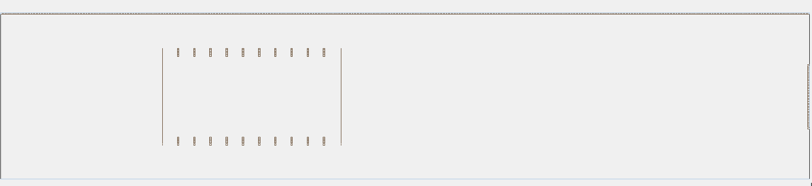
Electric and magnetic field simulations
Simion was used to calculate the electric
and magnetic field and ion trajectory.
E-field: Discretizes 10-ring electrodes
with finite-difference grid.
Iteratively solves the Laplace / Poisson
equation to obtain the field E = −∇ϕ.
Positron Beamline
Notes:
(like a fourth-order Runge–Kutta method) to compute the trajectories of the ions (as set up in your fly2 file), with custom ion-creation and processing routines defined in Lua.

Slide 18
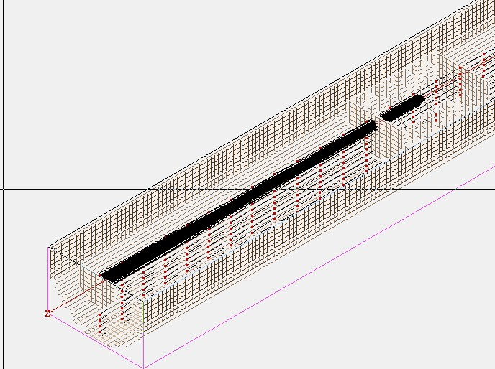
Ion trajectory simulations
Numerical integration of ion trajectory.
Ions get customized initial conditions
at birth.
Expansion in a constant potential for time
t_wait.
Extraction by time varying high voltage pulse.
Ion trajectory simulation
Notes:
Constant potential to block the positrons out

Slide 19
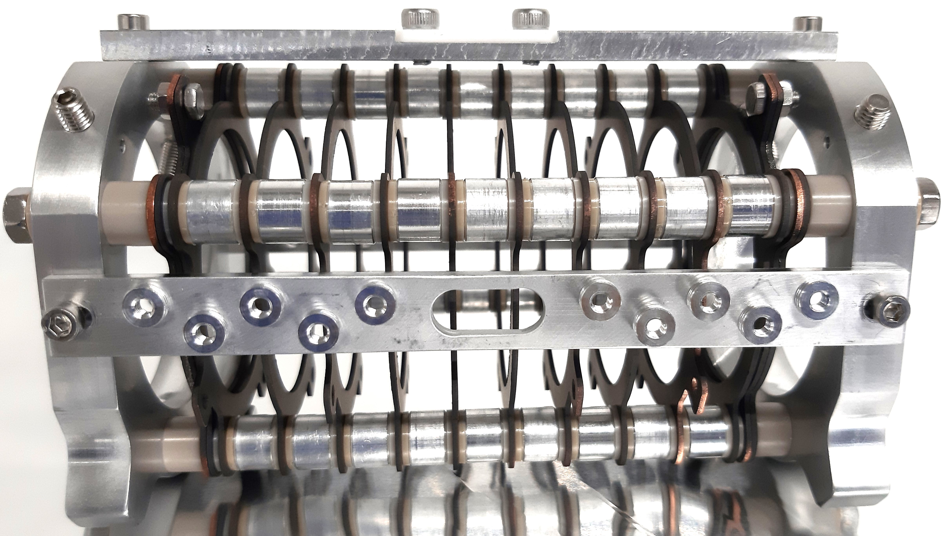
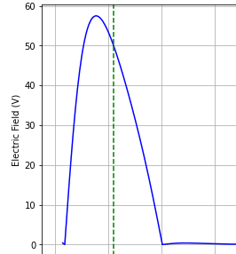
Time bunching ToF mechanism
Gas inlet CH4
Spectrometer electrodes coated with
colloidal graphite.
Meshes at the exit / entrance define
electrostatic boundary for field uniformity.
Gas ions have random motion at birth.
Particles further away from MCP
receive stronger acceleration fields.
Uniform extraction better mass resolution.
Positron Beamline
Notes:
Colloidal graphite reduce patch potentials, chemical stability in vacuum does not gas out.
Field leakage = fringing fields reduced by mesh.
Ramp potential to extract the ions more evenly than just apply 100 Volt at each electrode

Slide 20
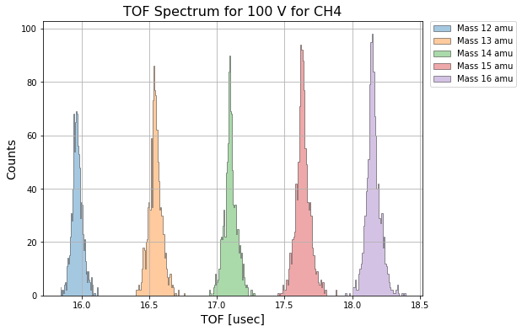
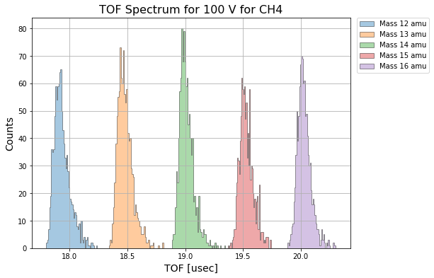
Time of flight spectra and wait time limits
Simulations suggest an upper limit of <1.5µs for high mass resolution.
1.5µs wait time, sharp peaks, lower FWHM
5µs wait time, broader peaks
Positron Beamline
Notes:
How long can we wait before we extract the ions?
Overlap harder to separate them.
Ratio t/delta t for resolution
Below 1.5 us all wait times have approximately the same resolution.

Slide 21
Overview and Outlook
Motivation: Positronium Containing Molecules
Beam Line Overview
Spectrometer
Spectrometer Magnets
Conclusion
Outlook
Positron Beamline
Notes:
Magnets
Potential divider
Pulser
Parts of my spectrometer mit unterpunkten oda so lol
Mochs so afoch wie möglich ☺
Simulations
Construction
Measurements and Results

Slide 22
Spectrometer magnets
Coil 1
Coil 2
Positron Beamline

Slide 23
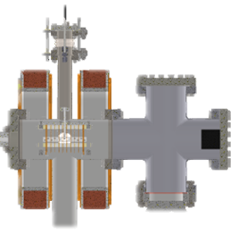
Spectrometer magnet setup
Helmholtz setup: 2 identical coils
separated by distance ~ coil radius
and same current direction.
Nearly uniform magnetic field in
center between them.
About 1.43 times stronger B field
than single coil.
Coil 1
Coil 2
Positron Beamline
Notes:
Perfect because there are our ions produced.
Extra slide for this calculation

Slide 24
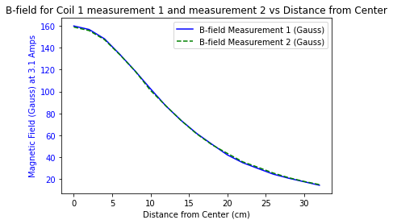
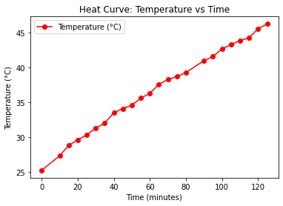
Spectrometer magnetic field and heat curve
Two water cooling coil electromagnets, permanently running.
First z direction magnetic field measurements and heat curve without water cooling at low current.
Positron Beamline
Notes:
Helmholtz setup bigger magnetic field than a single coil with 1.431 times as strong as just one

Slide 25
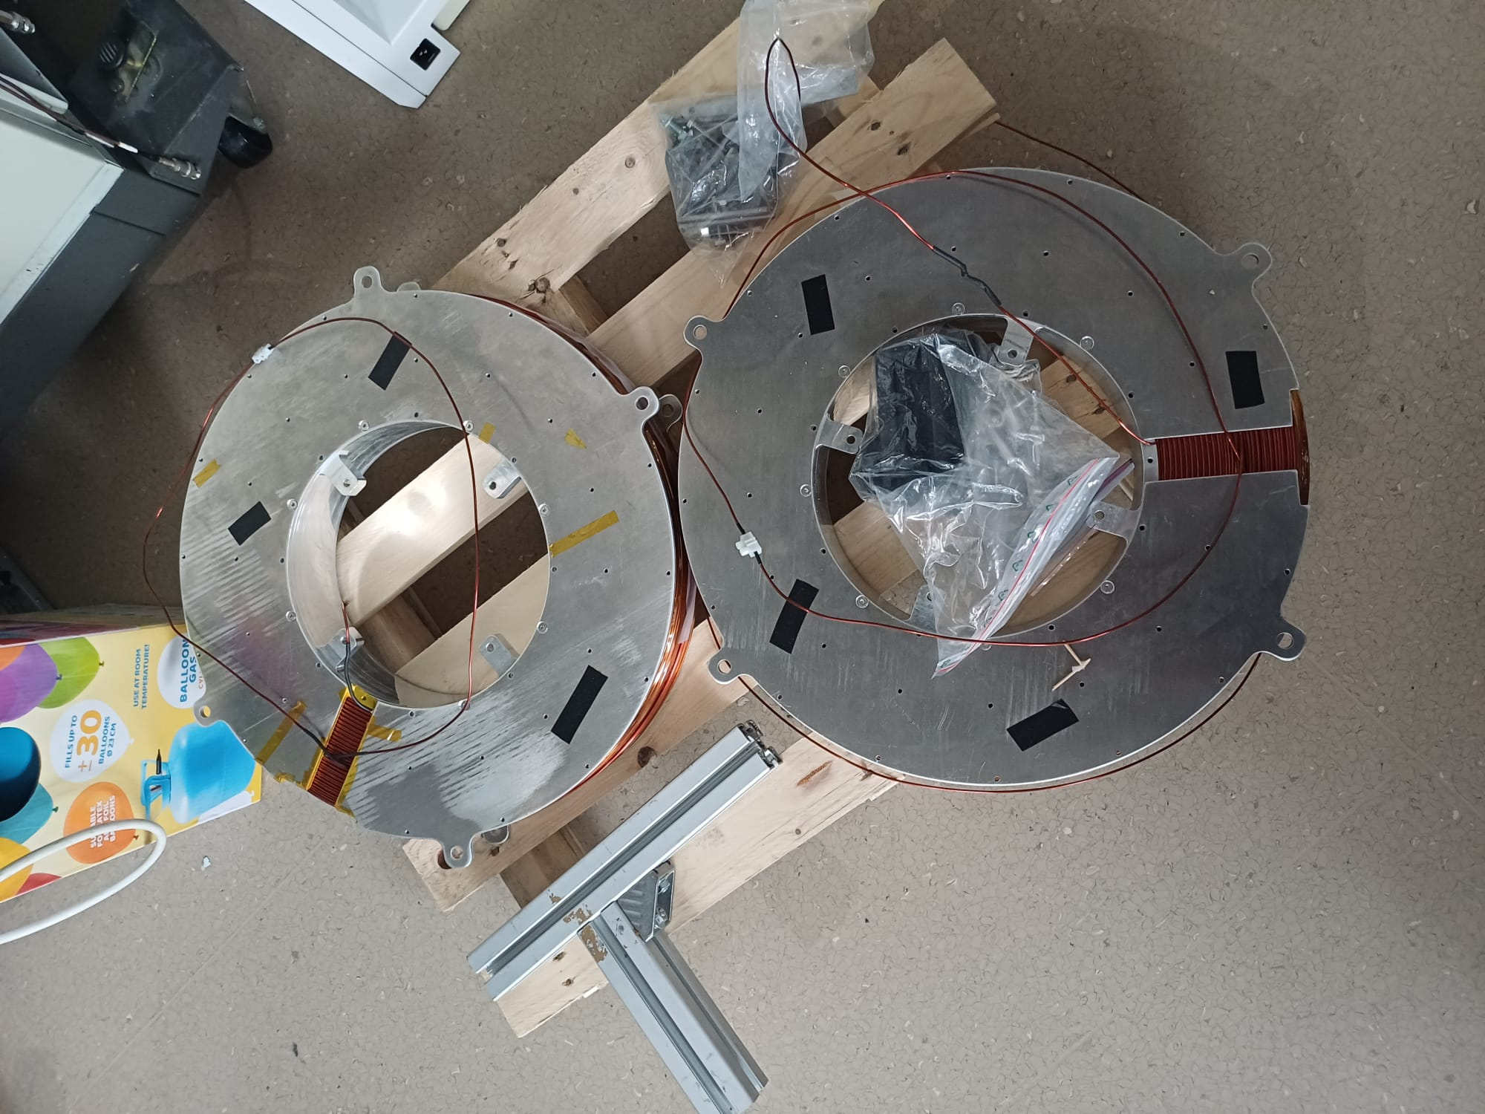
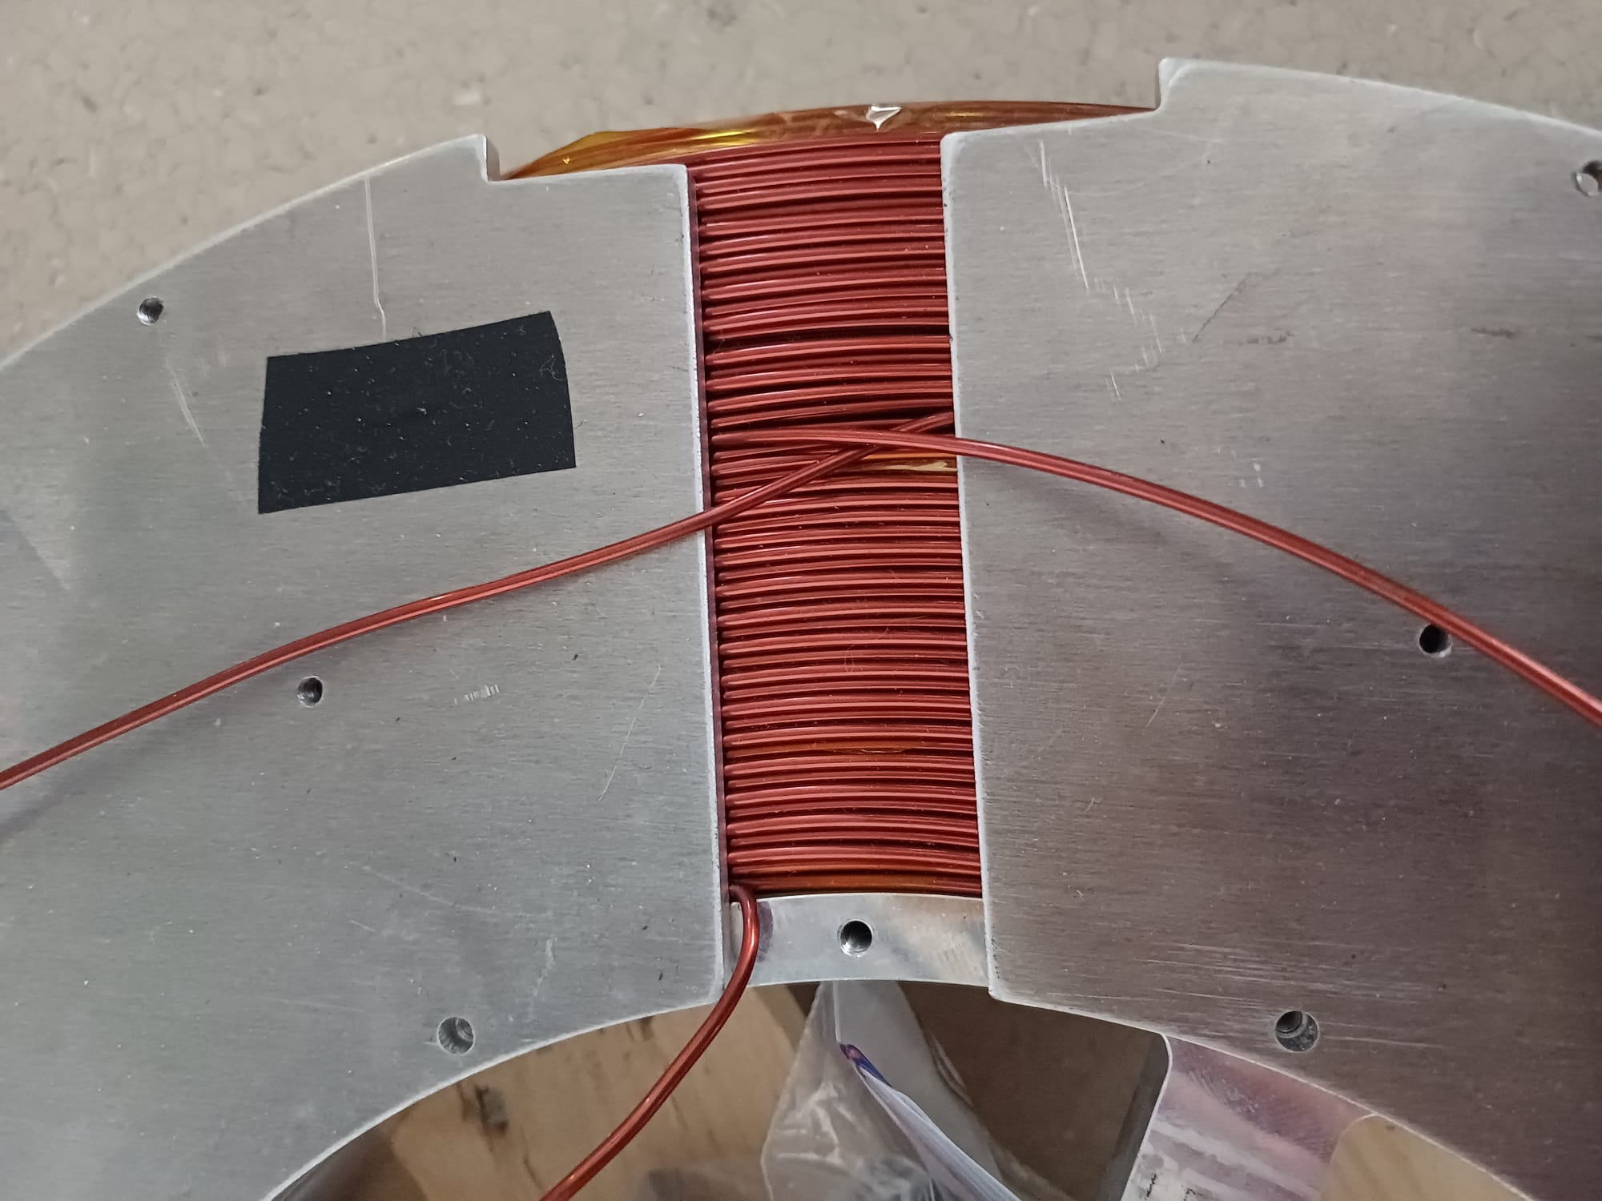
Spectrometer Coil Magnets
T
2 coil magnets, 44 kg / 1400 windings of wire each.
Outside connection and cutout to not
intersect with chamber.
Positron Beamline
Notes:
Dissipate heat generated from the running magnets.
I connected 2 * 22 kg of wire on one magnet, winded with 29 and 28 windings per layer resulting in about 1400 turns of wire.

Slide 26
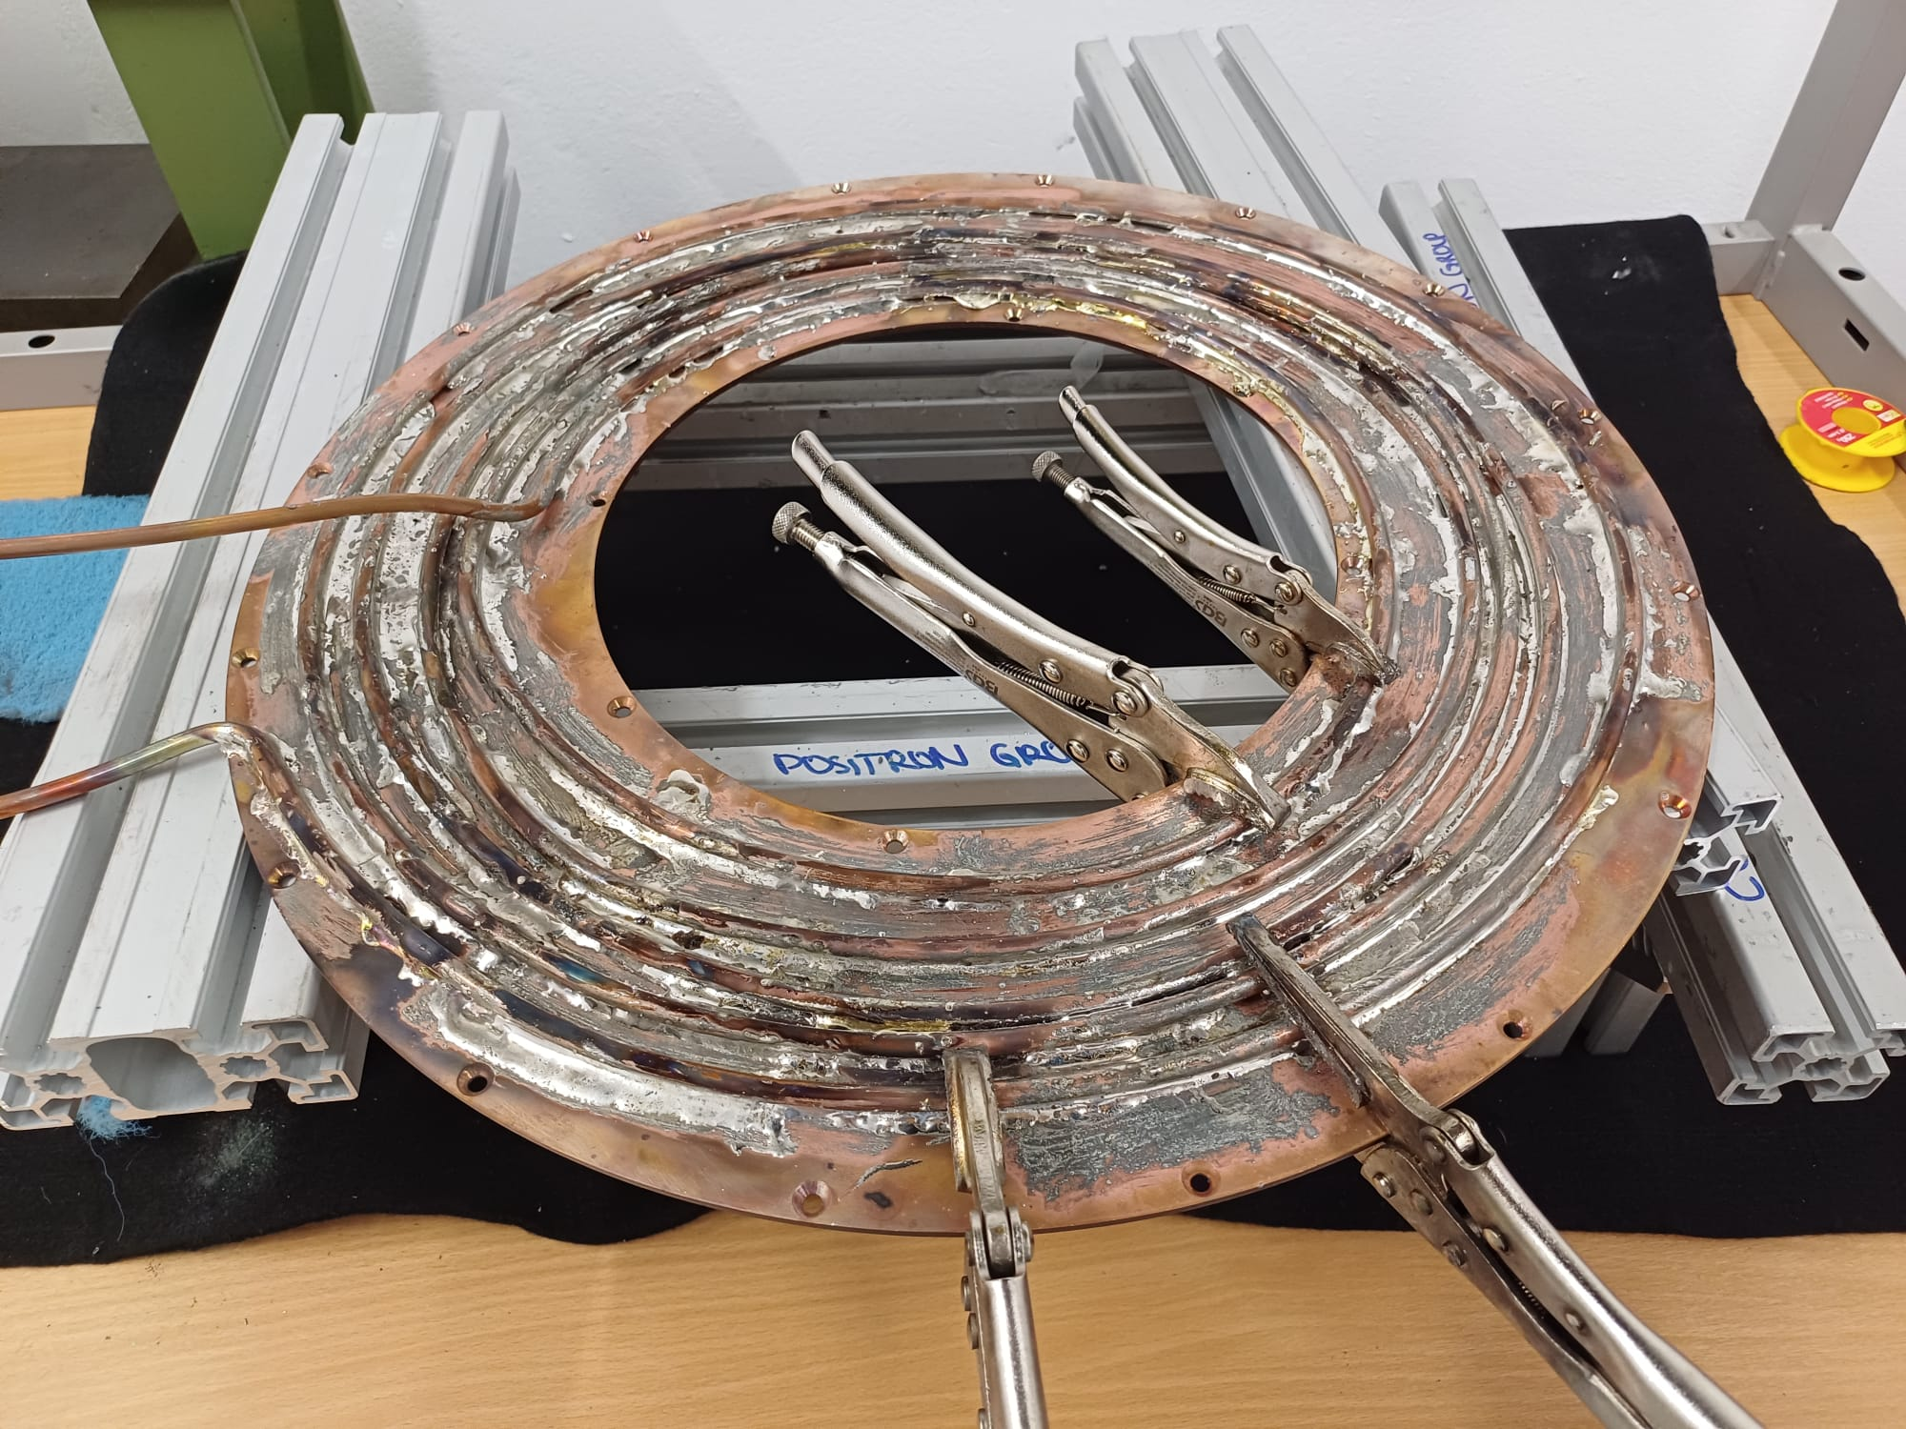
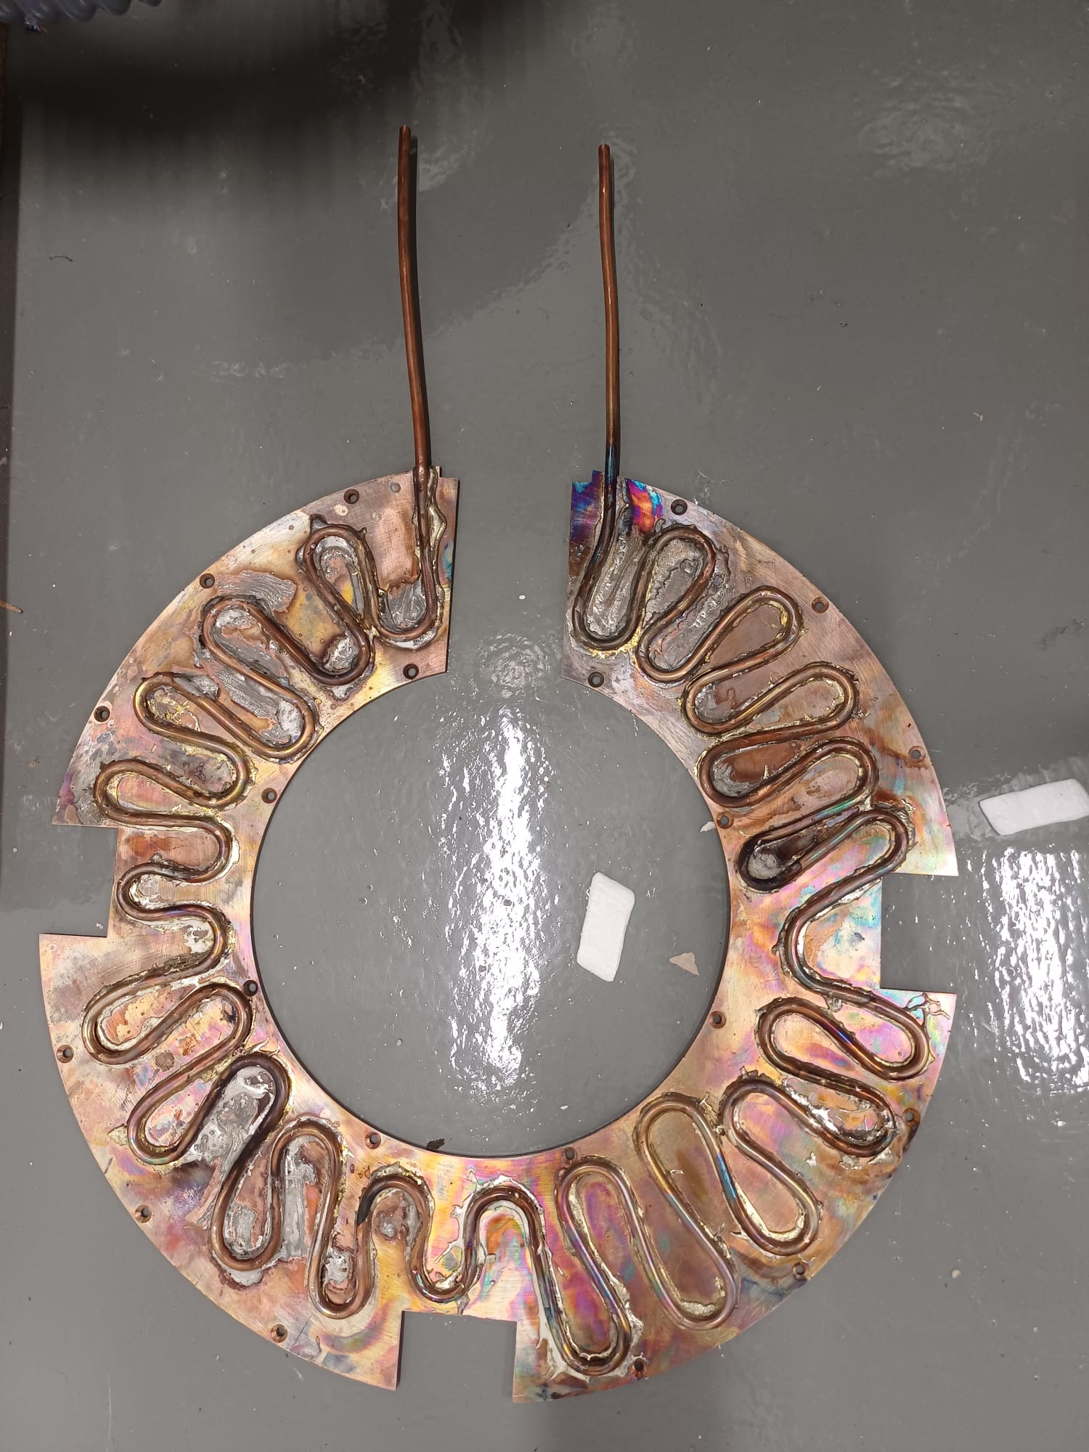
Watercooling pipes and copper plates
Copper plates for better heat dissipation and water cooling pipes soldered on top.
Positron Beamline
Notes:
Dissipate heat generated from the running magnets.

Slide 27
Conclusion
Time bunching Time of Flight spectrometer has been build to precisely measure the binding energies of molecules containing Ps.
The positron beam line is built up again.
Ion Trajectory Simulations with Simion have been made to simulate the extraction pulse and how long we can wait to apply it.
Magnets have been wound, water cooling copper plates have been soldered and heat curve measurements look promising.
Positron Beamline
Notes:
Magnets
Potential divider
Pulser
Parts of my spectrometer mit unterpunkten oda so lol
Mochs so afoch wie möglich ☺
Simulations
Construction
Measurements and Results

Slide 28
Outlook
HV pulser prototype tests to apply extraction potential.
Build a potential divider prototype for AC and DC components.
Assemble the gas line and cut the metal pipe.
Integrate the whole spectrometer setup into the beamline.
When everything comes together:
-> Measurement of molecular bound states with positronium.
Positron Beamline
Notes:
Magnets
Potential divider
Pulser
Parts of my spectrometer mit unterpunkten oda so lol
Mochs so afoch wie möglich ☺
Simulations
Construction
Measurements and Results

Slide 29


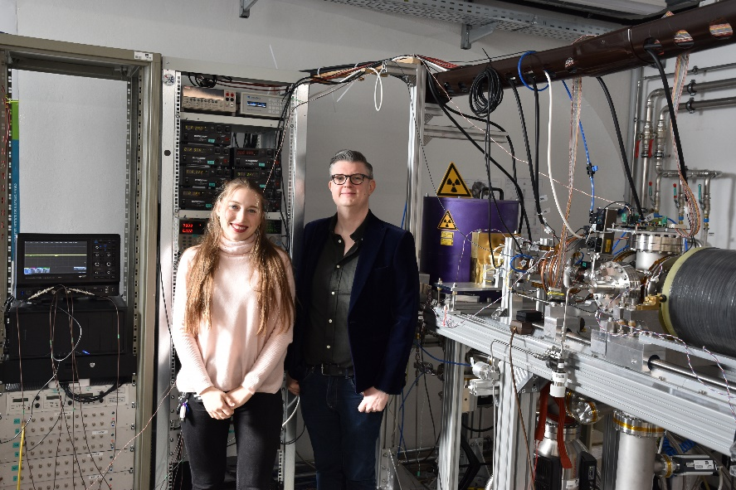
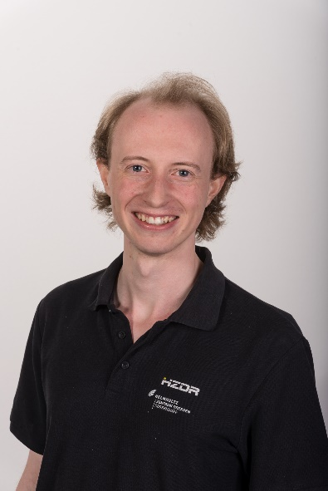



THANK YOU FOR
YOUR ATTENTION!
Follow us online:
Instagram
Website
Many thanks to everybody who supported this project:
SMI Positron Group
Matti Cerwenka
Eric Hunter
Andreas Lanz
Martin Simon
Eberhard Widmann
Johann Zmeskal
Fabian Duringer
Manuel Friedrich
Gerhard Kaiser
Lukasz Paszkowski
Leopold Stowasser
Alina Weiser
Daniel Murtagh
Ross Sheldon
Florian Sterkl

Slide 30
Back UP SLIDES ☺
Positron Beamline
Notes:
Magnets
Potential divider
Pulser
Parts of my spectrometer mit unterpunkten oda so lol
Mochs so afoch wie möglich ☺
Simulations
Construction
Measurements and Results

Slide 31
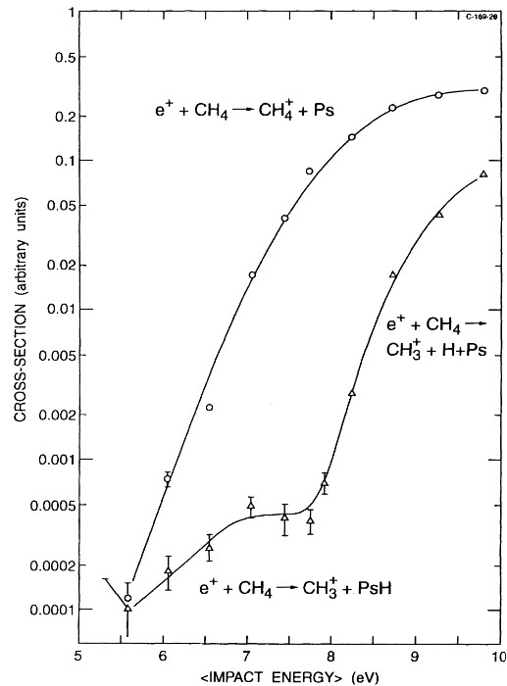
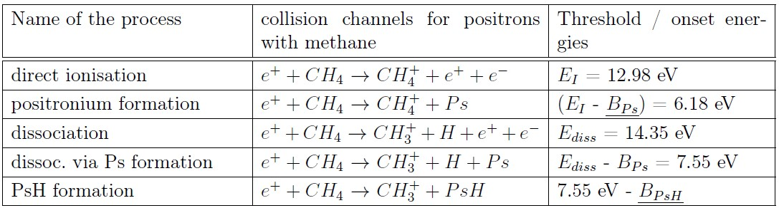
Schrader
Positron Beamline
Notes:
The threshold energy at which the PsH formation cross section becomes non-zero corresponds to the sum of the ionization energy of the ion product and the binding energy of PsH.

Slide 32
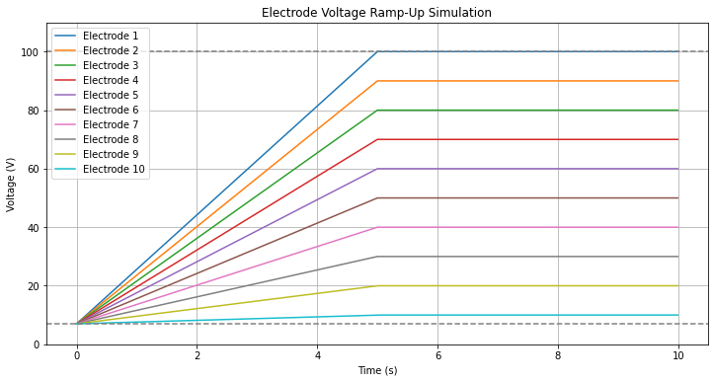
Electrode Voltage ramp up
Constant potential at the start for time period t_wait.
Linear ramp up to the extraction potential
Positron Beamline
t_wait
Notes:
(like a fourth-order Runge–Kutta method) to compute the trajectories of the ions (as set up in your fly2 file), with custom ion-creation and processing routines defined in Lua.
The linearly falling extraction potential at each electrode effectively creates a time bunching tof spectrometer

Slide 33
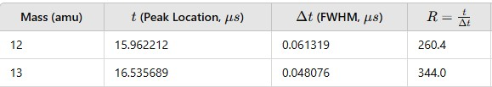

Time of flight spectra and wait time limits
Positron Beamline
Notes:
d/delta t large separation relative to their widths easier to distinguish. Measure of how sharp the peak is

Slide 34

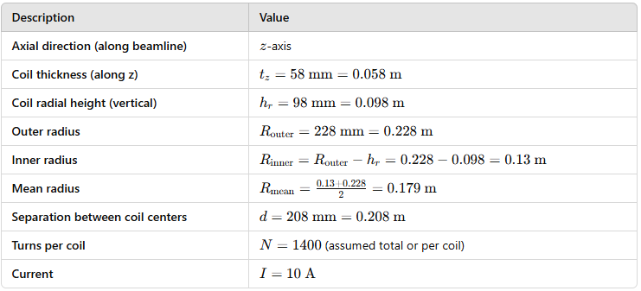
Helmholtz B field calculation
B field in center between the coils.
N Number of turns on each coil.
R radius of the coil.
I current.
µ magnetic vacuum permeability.
Positron Beamline
Notes:
43% B field increase than single coil.

Slide 35
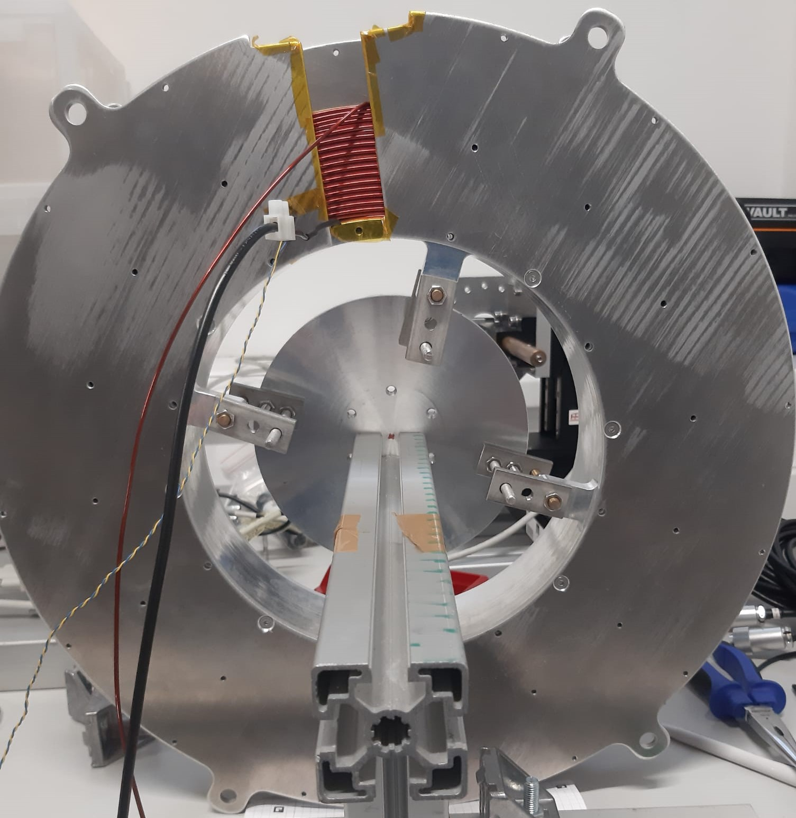
B Field z direction measurement
Probeguide and probe.
Heat probe on magnet.

Slide 36
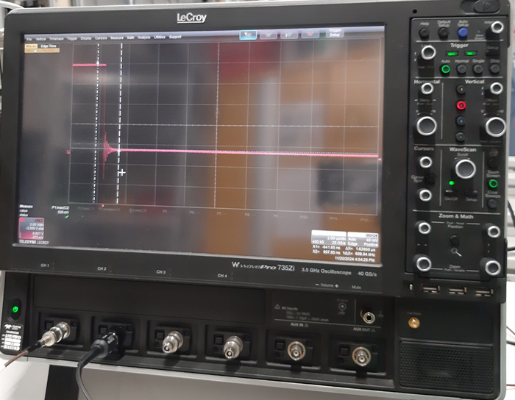
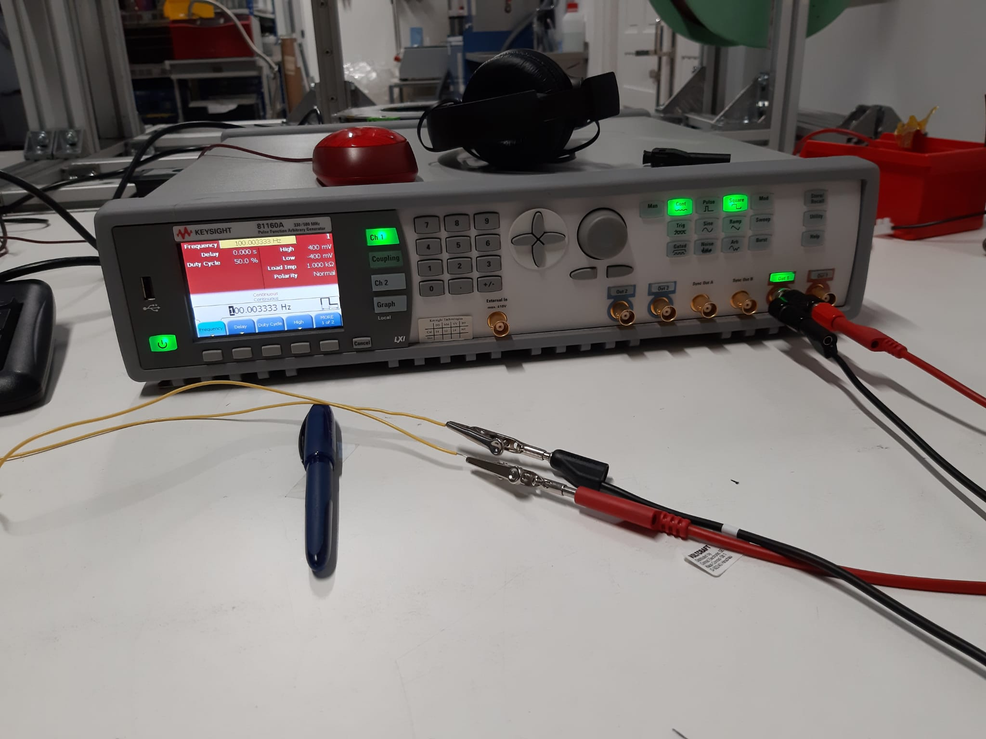
Potential Divider SECTION

Slide 37

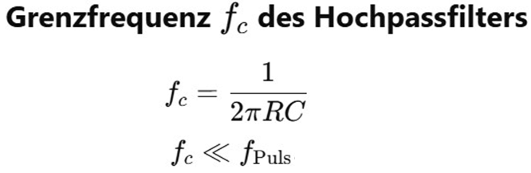
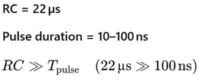

Ltspice potential divider simulations
Necessary in our setup to divide a high voltage pulse to the electrodes for the extraction while not dividing the constant potential at the electrodes.
I used 10 times the same resistor for a 10 Volt drop at each intersection.
Works as a high pass filter -> high frequency components pass, low frequency ones get blocked.
Positron Beamline
Notes:
Magnets
Potential divider
Pulser
Parts of my spectrometer mit unterpunkten oda so lol
Mochs so afoch wie möglich ☺
Simulations
Construction
Measurements and Results

Slide 38
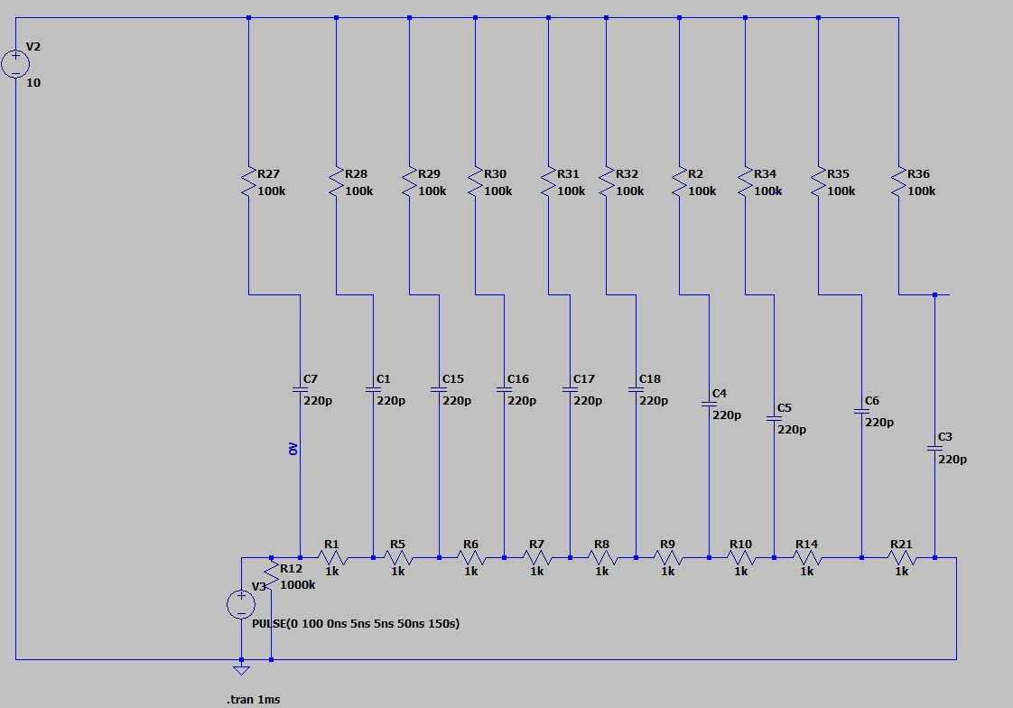
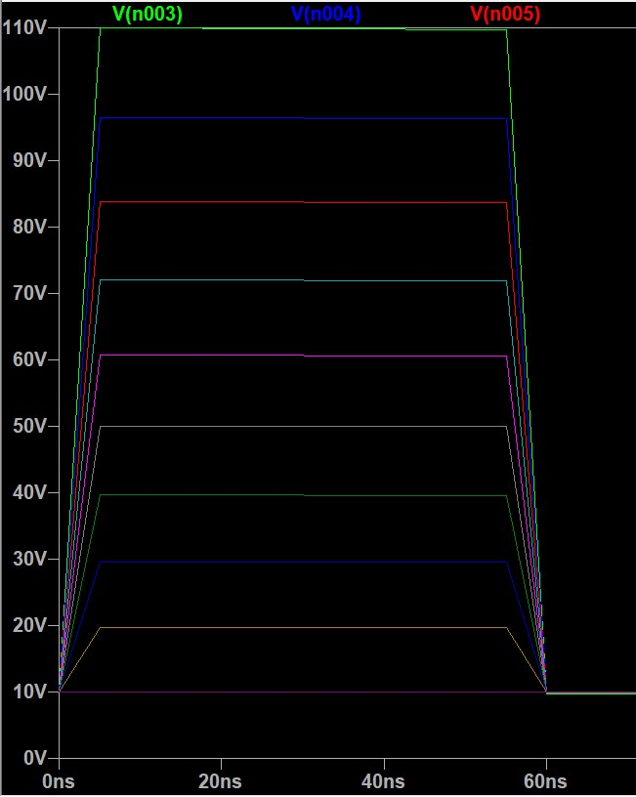
Ltspice potential divider simulations
Positron Beamline
Potential divider with output signal at each electrode.
Notes:
Magnets
Potential divider
Pulser
Parts of my spectrometer mit unterpunkten oda so lol
Mochs so afoch wie möglich ☺
Simulations
Construction
Measurements and Results

Slide 39
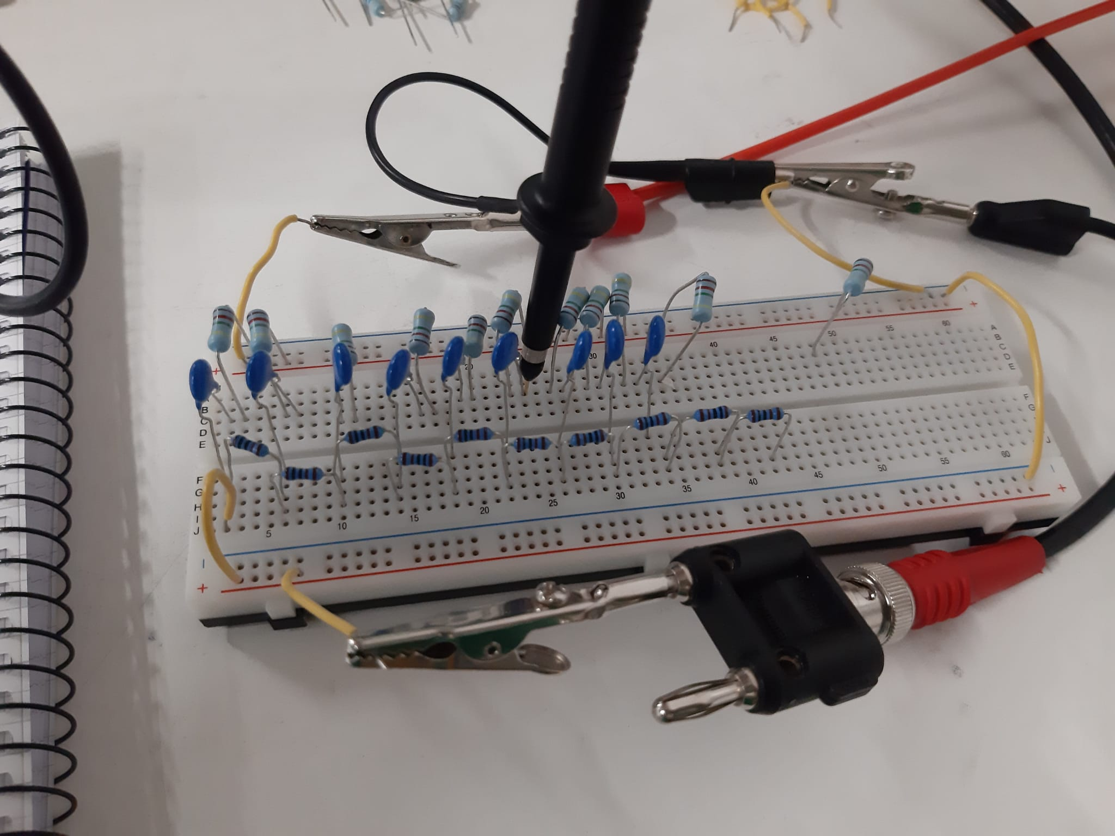
Potential divider test measurements
10 * 1kOhm resistors in series, 10 * 220 pf capacitors to couple in AC and 1MOhm resistors to couple to DC.
Measured with an oscilloscope probe.
10 Volt pulses from pulse
generator gets divided.
Divider output knots | Voltages V | Pulse rise time [ns]
0 | 9.5 V | 26
1 | 8.5 V | 64
2 | 7.5 V | 87
3 | 6.5 V | 87
4 | 5.6 V | 91
5 | 4.6 V | 91
6 | 3.8 V | 100
7 | 2.9 V | 101
8 | 1.7 V | 80
9 | 0.9 V | 90
Positron Beamline
Notes:
Magnets
Potential divider
Pulser
Parts of my spectrometer mit unterpunkten oda so lol
Mochs so afoch wie möglich ☺
Simulations
Construction
Measurements and Results

Slide 40
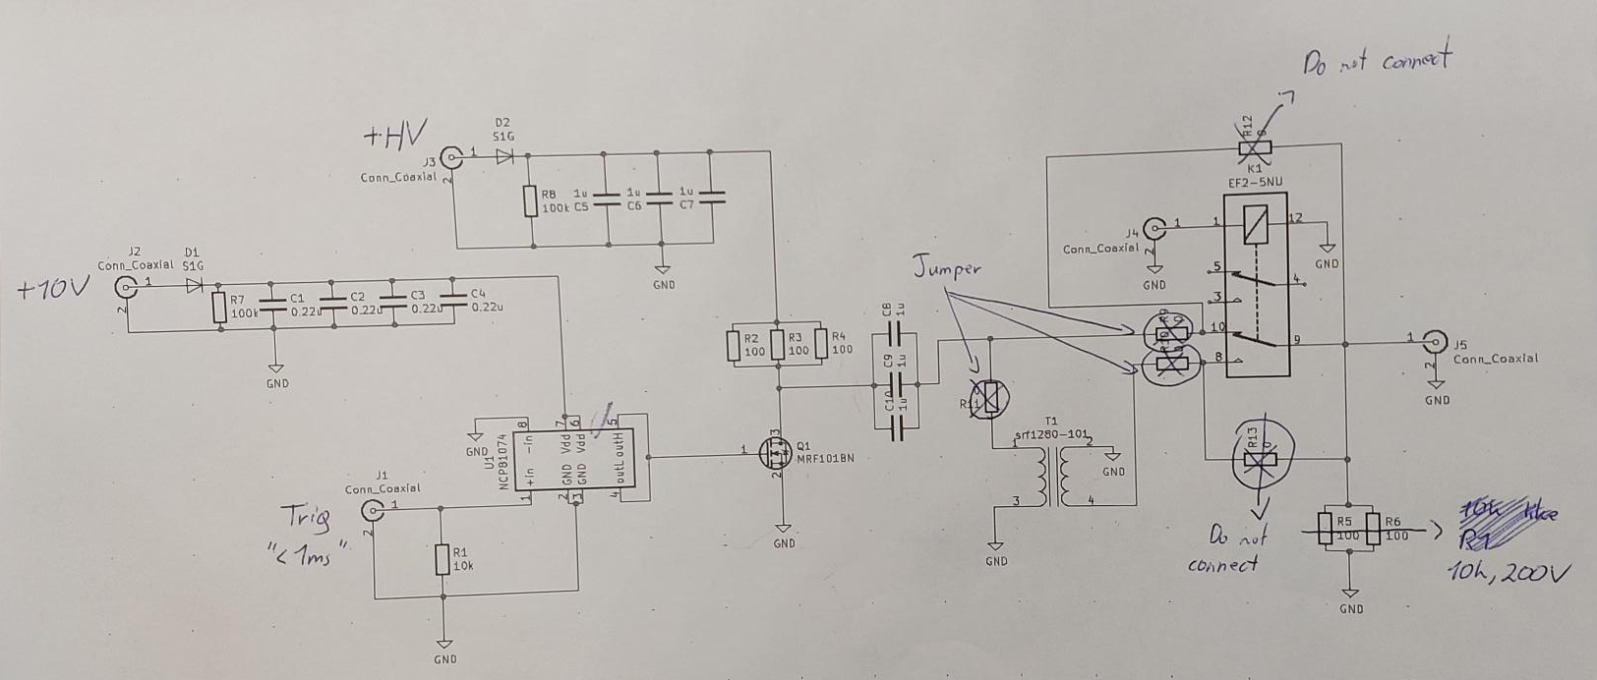
High Voltage Pulser
We want a sharp, nanosecond risetime pulse to extract the ions.
Simple mosfet-based high voltage pulser circuit. (Chaney 2004)

Slide 41

Measurements Divider

Slide 42


Spectrometer chamber
Positron Beamline
Notes:
Magnets
Potential divider
Pulser
Parts of my spectrometer mit unterpunkten oda so lol
Mochs so afoch wie möglich ☺
Simulations
Construction
Measurements and Results

Slide 43

Meshes and electrodes
10 Ring electrodes with mesh at the entrance.
Colloidal graphite reduces patch potentials which can distort electric fields.

Slide 44


PsH formation:

Slide 45


Soldering station

Slide 46





