Slide 1
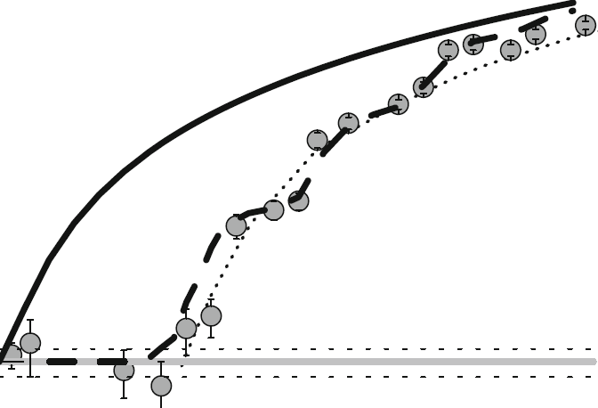

Master Thesis at SMI
GRASIAN:
Setup Improvements And Analysis
Daniel Kloppenburg

Slide 2
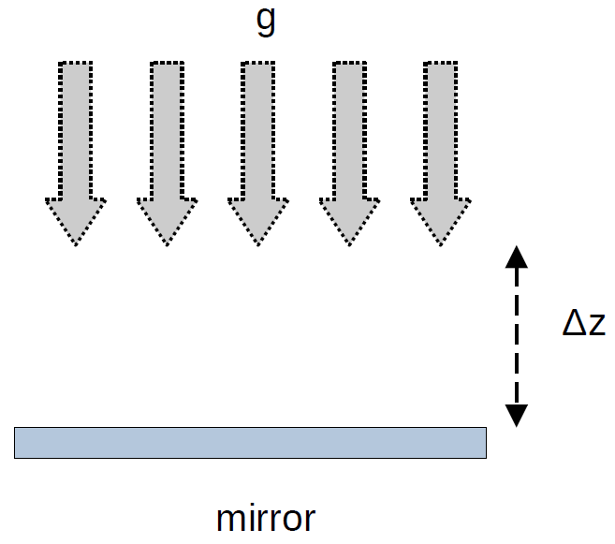
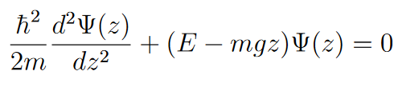
Gravitational Quantum States (GQS):
GRASIAN
Setup analysis
Quantum Reflection:
low energies
light neutral particles
rapidly changing potential
GQS:
quantum bound states
confined by mirror potential & gravitational potential
Ariy-function solution of Schrödinger eq.
Ref.: C. Killian et al., GRASIAN: towards the first demonstration of gravitational quantum states of atoms with a cryogenic hydrogen beam, Eur. Phys. J. D (2023) 77:50
Ref.: C. Killian, GRASIAN: towards the first demonstration of gravitational quantum states of atoms with a cryogenic hydrogen beam, Eur. Phys. J. D (2023) 77:50

Slide 3
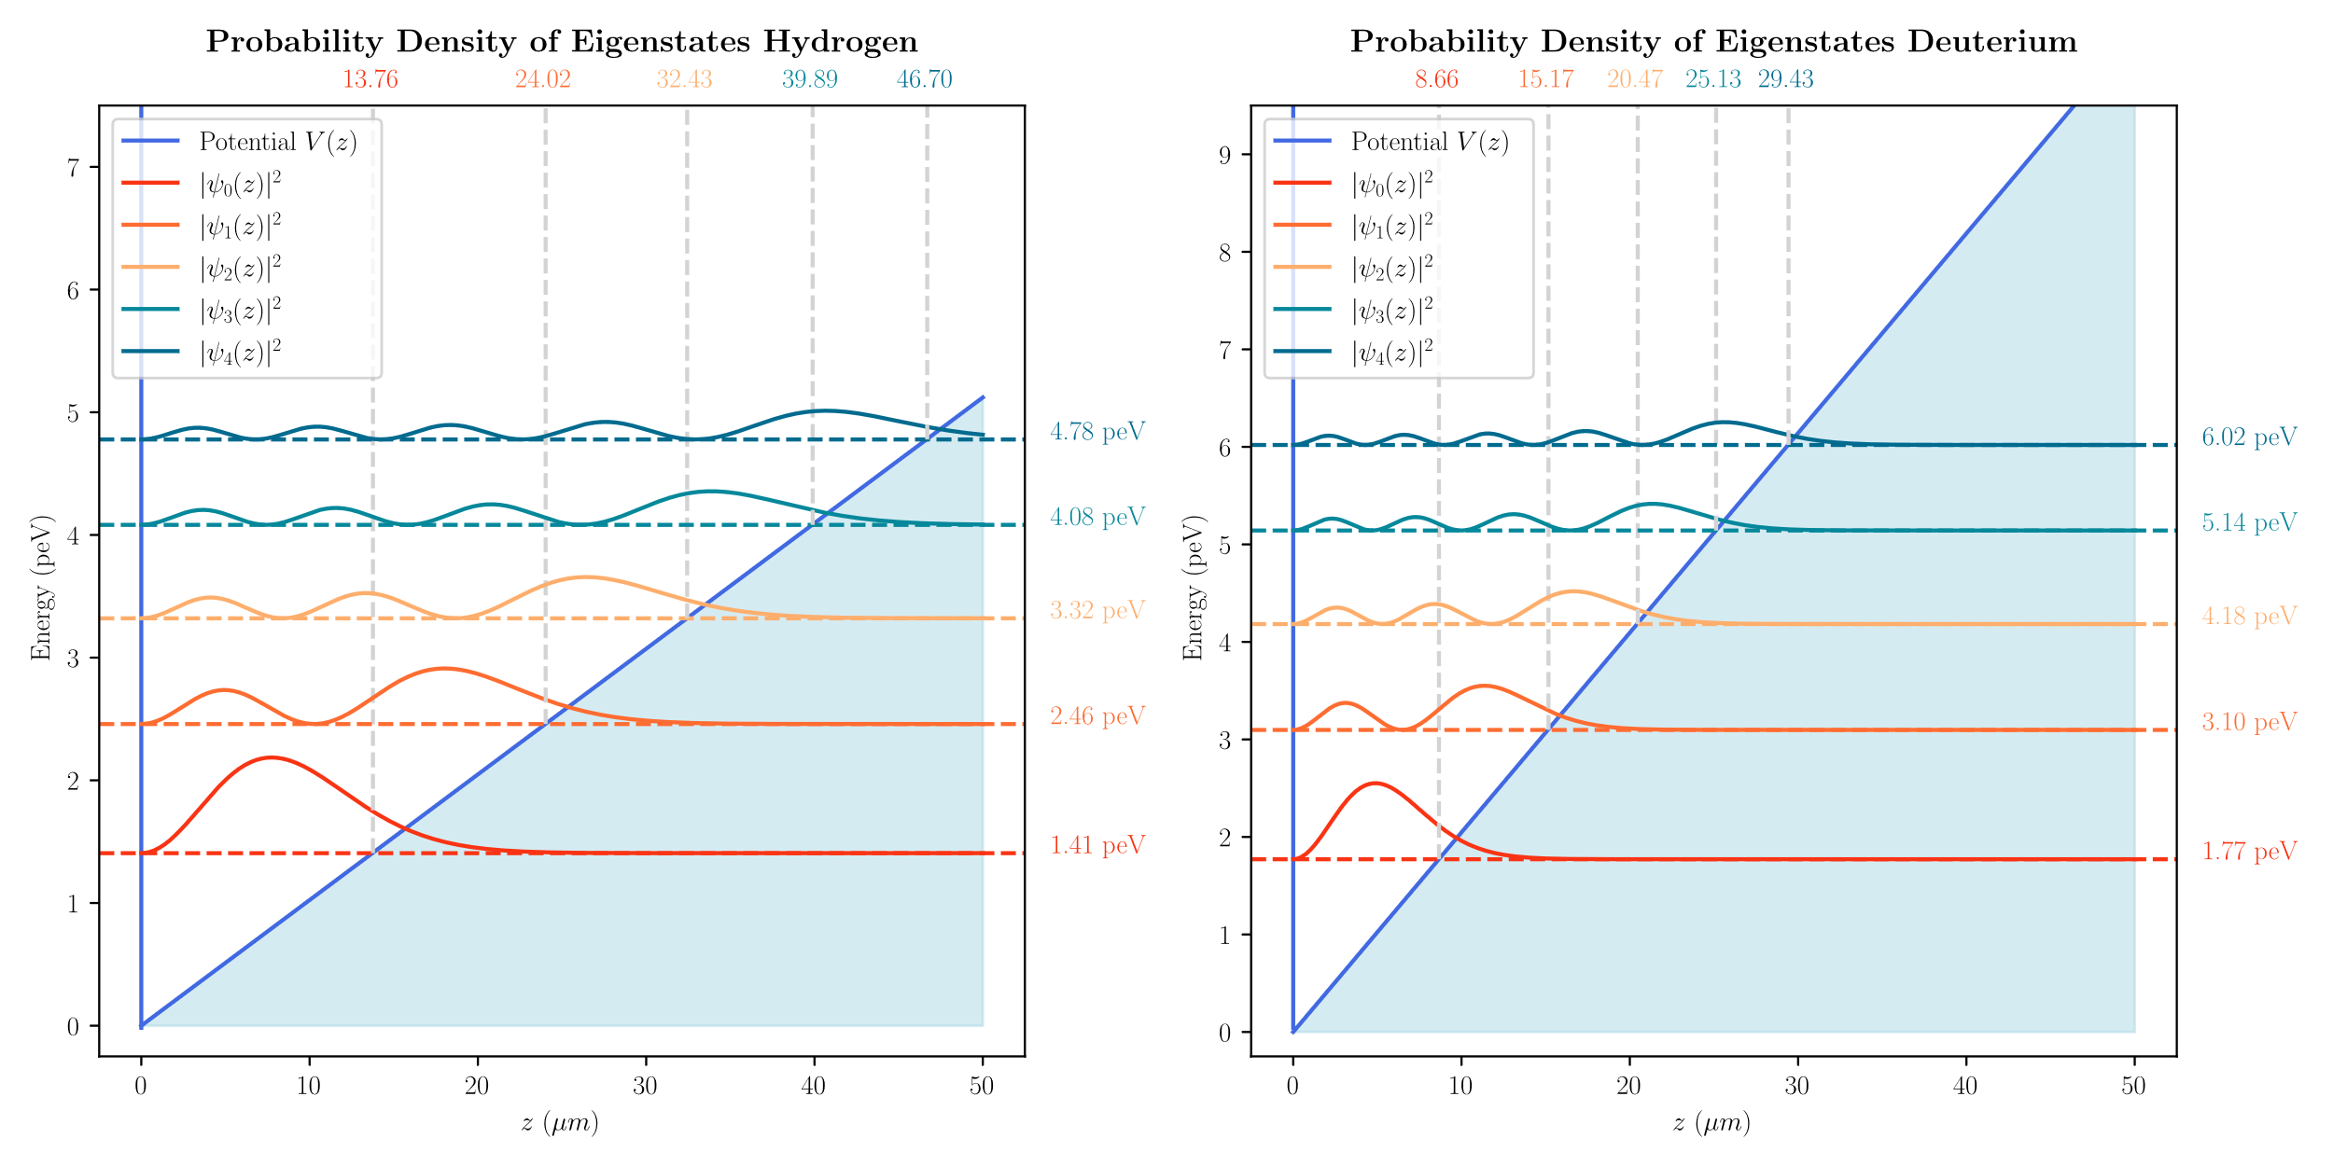
Gravitational Quantum States (GQS):
GRASIAN
Setup analysis
Ref.: C. Killian et al., GRASIAN: shaping and characterization of the cold hydrogen and deuterium beams for the forthcoming first demonstration of gravitational quantum states of atoms, Eur. Phys. J. D (2024) 78:132
Ref.: C. Killian, GRASIAN: shaping and characterization of the cold hydrogen and deuterium beams for the forthcoming first demonstration of gravitational quantum states of atoms, Eur. Phys. J. D (2024) 78:132

Slide 4
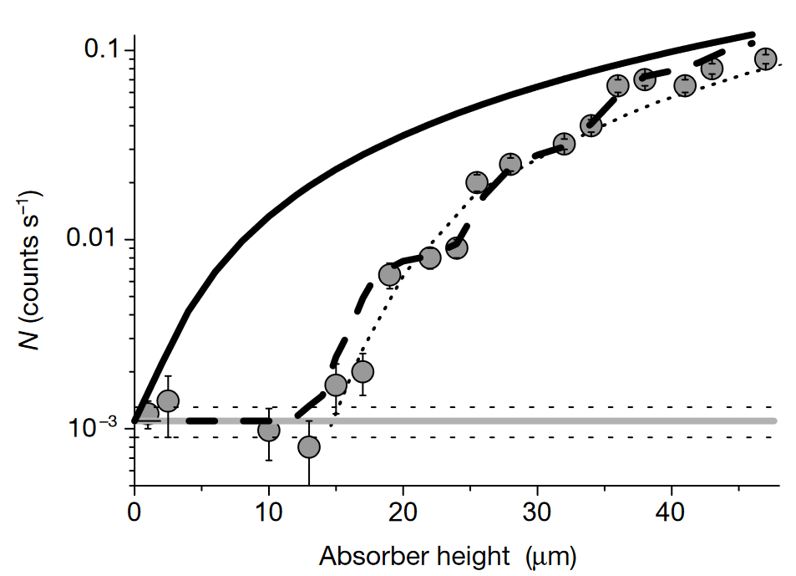
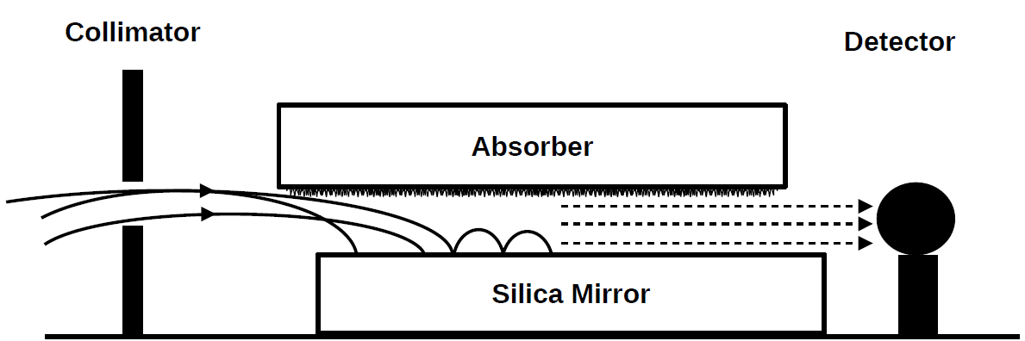
GQS of ultra cold Neutrons (2002):
GRASIAN
Setup analysis
Ref.: V. Nesvizhevsky et al., Quantum states of neutrons in the Earth’s gravitational field. Nature 415, 297 (2002).
Ref.: V. Nesvizhevsky, Quantum states of
neutrons in the Earth’s gravitational field. Nature 415, 297 (2002).

Slide 5

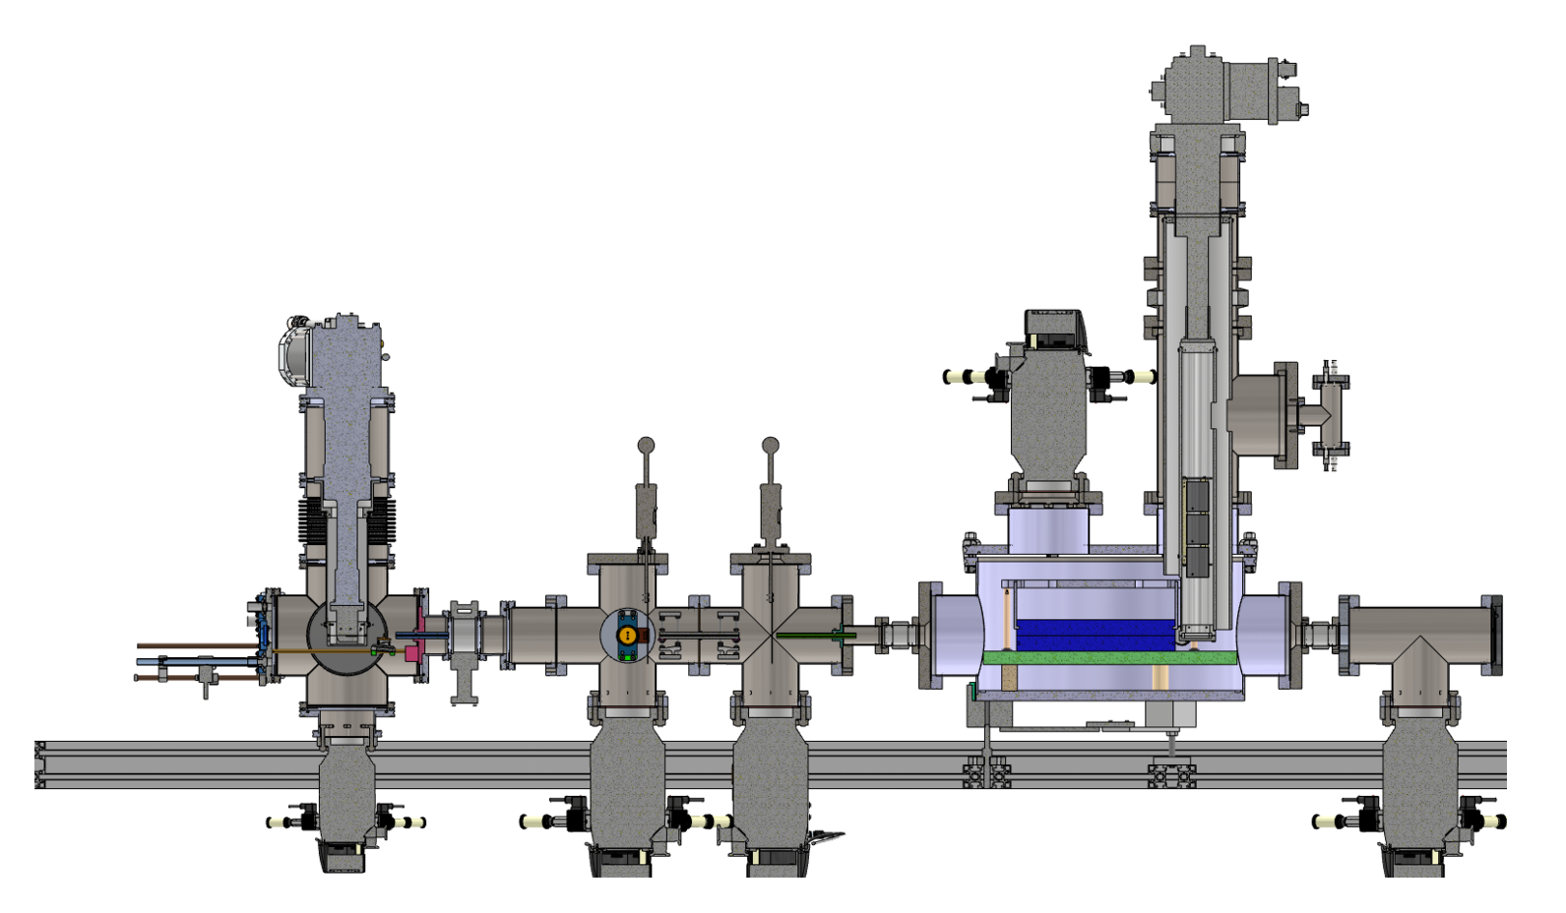
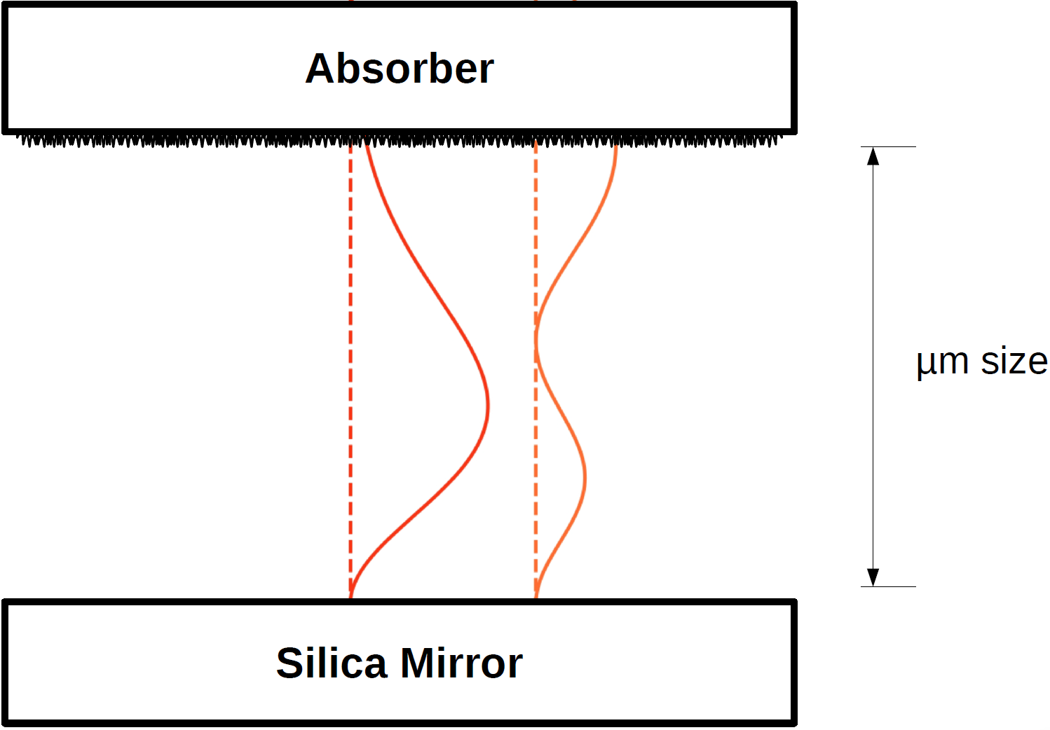

GQS of H & Setup:
GRASIAN
Setup analysis
DUST
Ultra cold H-Atoms are needed:
formation time τ ~ 0,5 ms
v_{H} < 100 $m/s$
ideal aim: v_{H} ~ 30 $m/s$
Ref.: F. Duringer, M. Simon, C. Killian

Slide 6
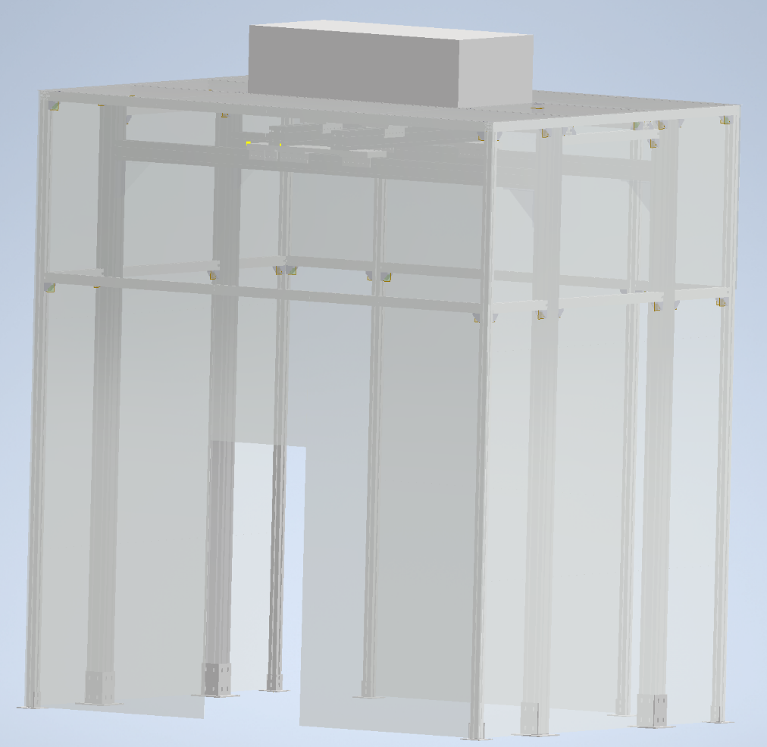
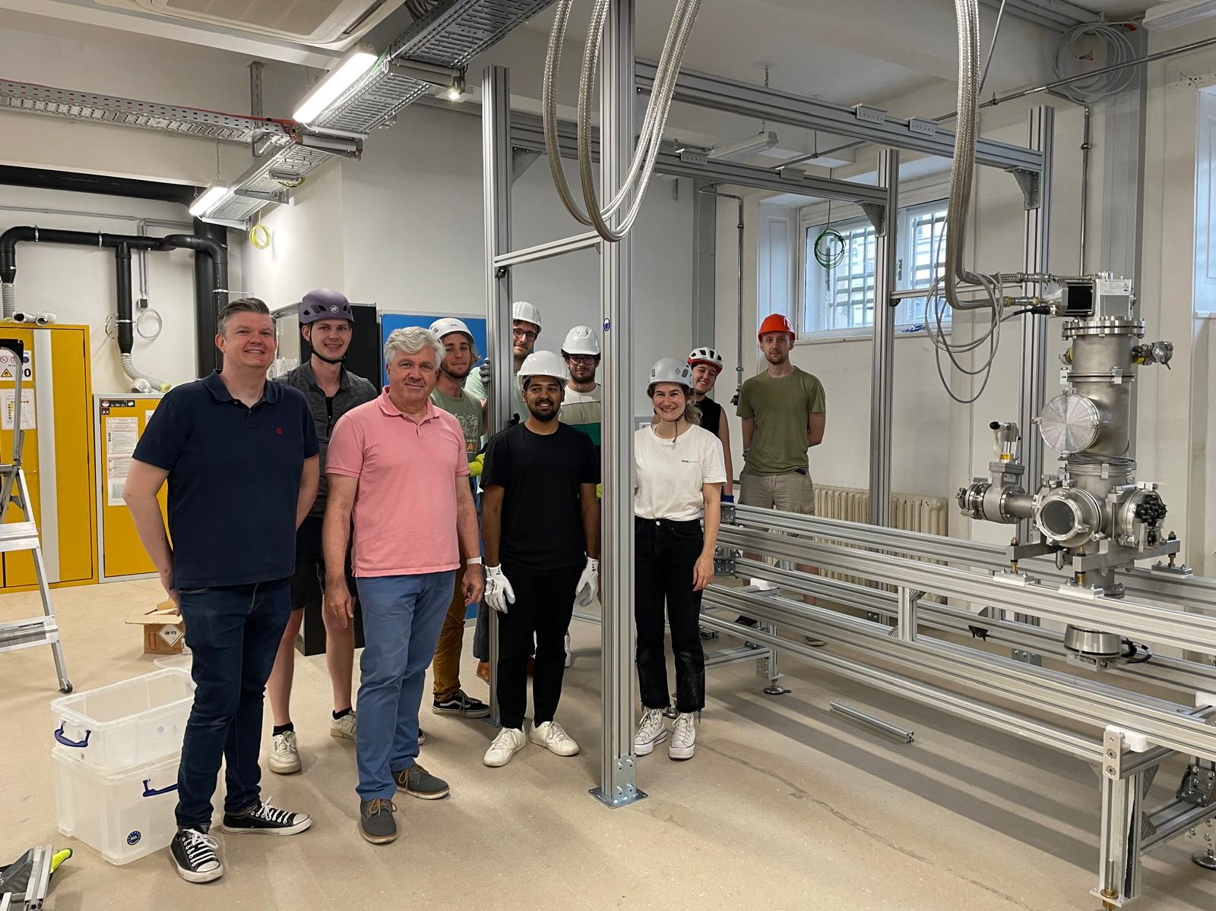
Cleanroom
GRASIAN
Setup analysis

Slide 7
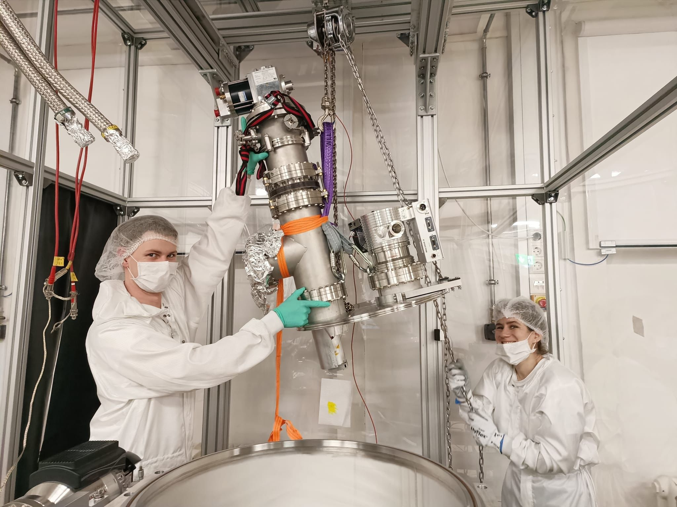
Cleanroom
GRASIAN
Setup analysis

Slide 8
GQS of H & Setup:
GRASIAN
Setup analysis
DUST
Ref.: F. Duringer, M. Simon, C. Killian

Slide 9
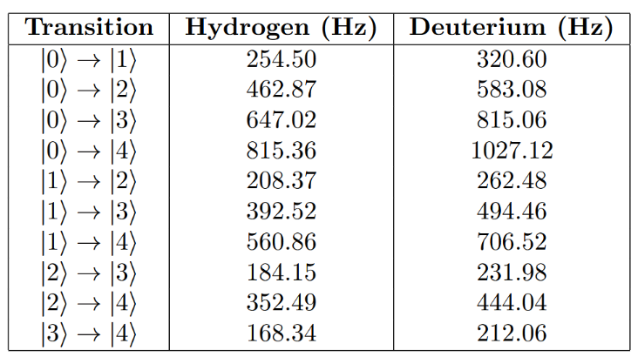
GQS of H & Setup:
GRASIAN
Setup analysis
DUST
VIBRATIONS
Ref.: F. Duringer, M. Simon, C. Killian

Slide 10
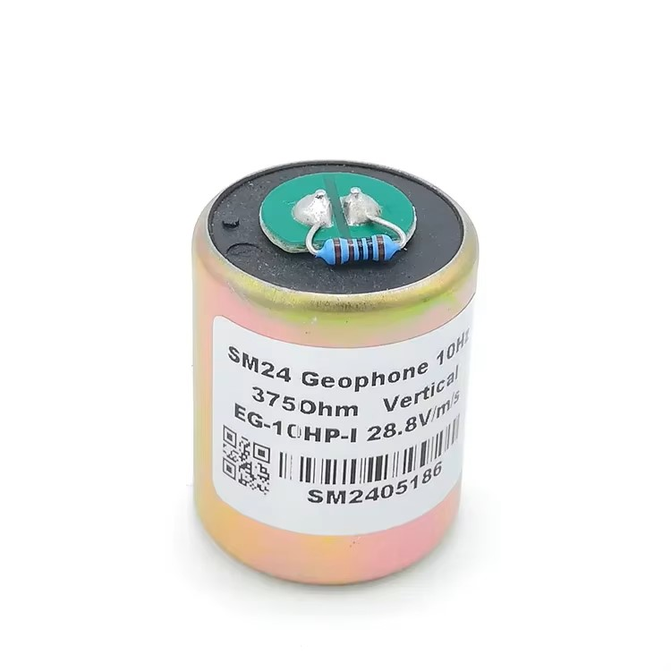
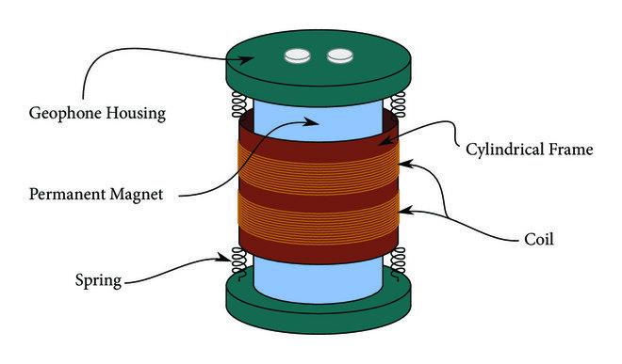
Geophone
GRASIAN
Setup analysis
Ref.: Klapez et al., Processing and Communication Delays in EWS: On the Performance of the Earthcloud Prototype. Wireless Communications and Mobile Computing. 2019. 1-13
Notes:
https://www.digikey.jp/ja/maker/projects/diy-extremely-sensitive-geophone-sensor-for-earthquake-detection/100df39edf7b4230b26846aacc94fe23
https://www.researchgate.net/figure/Inside-an-Earthcloud-Geophone_fig3_332001276
Klapez et al., Processing and Communication Delays in EWS: On the Performance of the Earthcloud Prototype. Wireless Communications and Mobile Computing. 2019. 1-13

Slide 11
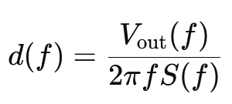
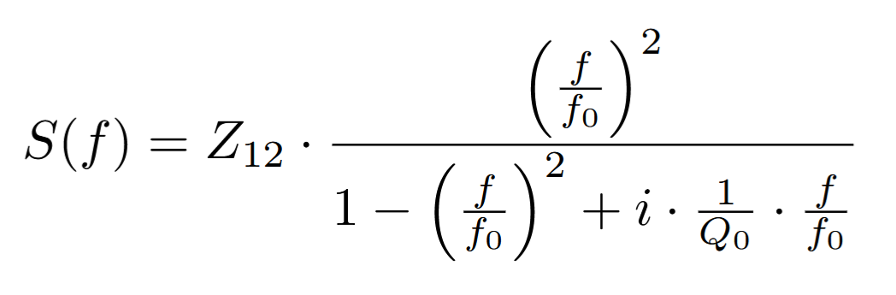
Geophone
GRASIAN
Setup analysis
Measure V(t) of Geophone
Fourier Transform V(t) → V(f)
Calculate displacement d(f)
f is frequency
f₀ resonance frequency
Q₀ is the quality factor
Z₁₂ is scaling factor related to impedance
Inverse Fourier Transform d(f) → d(t)
Ref.: G. Koolstra, Trapping a Single Electron on Superfluid Helium Using a Superconducting Resonator, 2019
Notes:
https://www.digikey.jp/ja/maker/projects/diy-extremely-sensitive-geophone-sensor-for-earthquake-detection/100df39edf7b4230b26846aacc94fe23
https://www.researchgate.net/figure/Inside-an-Earthcloud-Geophone_fig3_332001276

Slide 12
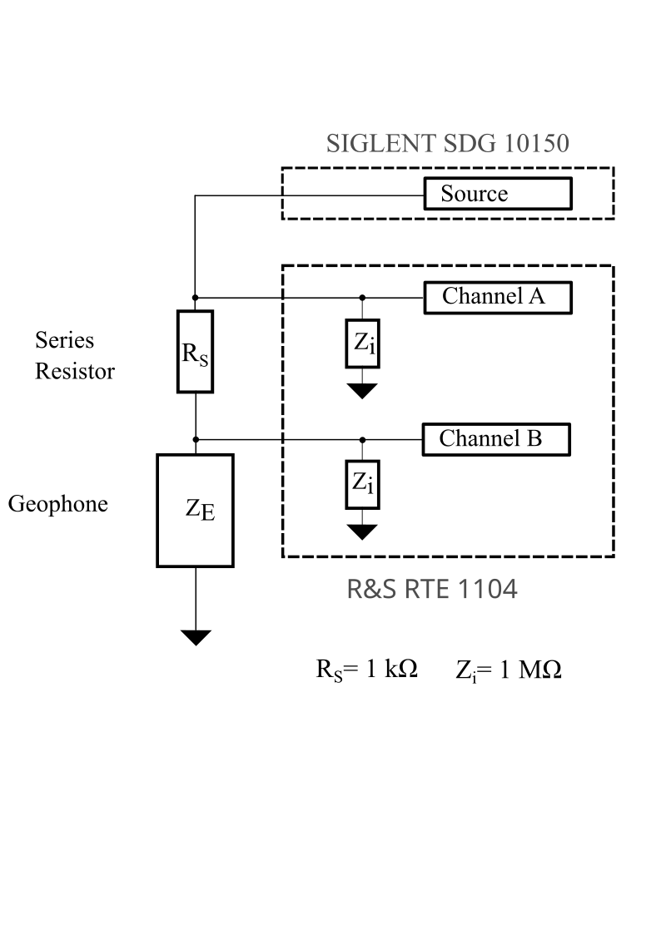
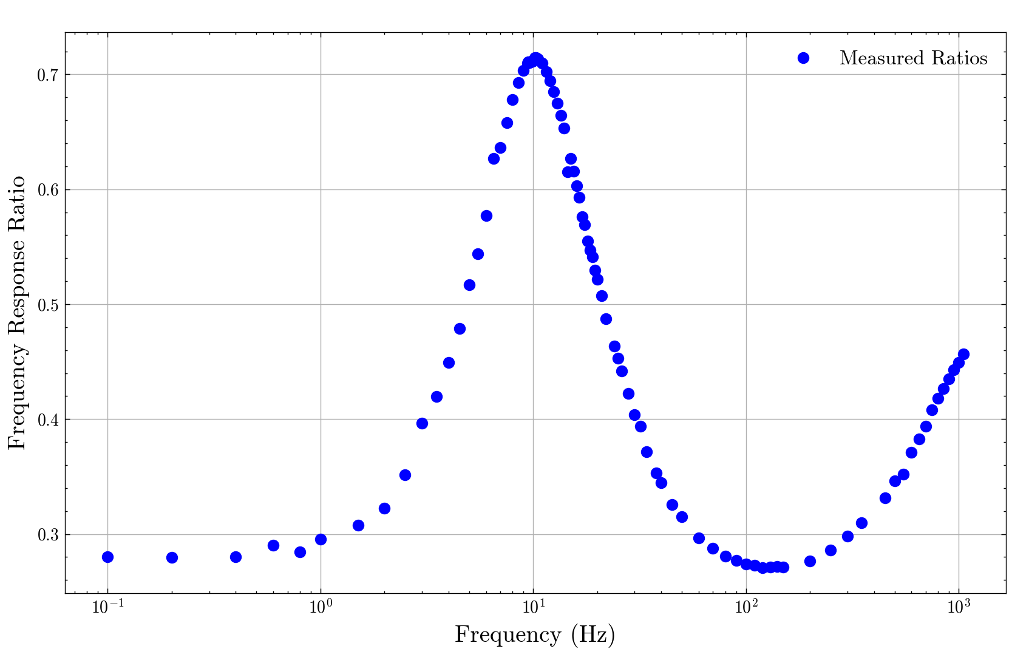
Geophone Calibration
GRASIAN
Setup analysis
Ref.: G. Koolstra, Trapping a Single Electron on Superfluid Helium Using a Superconducting Resonator, 2019
Notes:
https://www.digikey.jp/ja/maker/projects/diy-extremely-sensitive-geophone-sensor-for-earthquake-detection/100df39edf7b4230b26846aacc94fe23
https://www.researchgate.net/figure/Inside-an-Earthcloud-Geophone_fig3_332001276

Slide 13
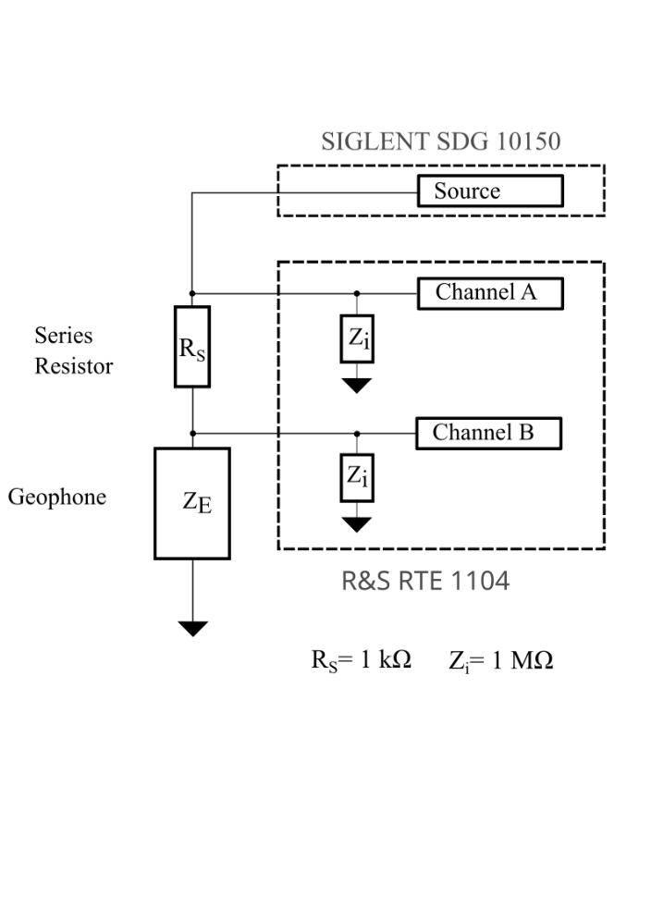
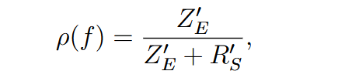
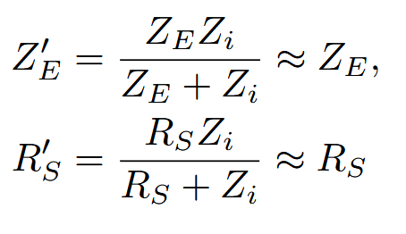
Geophone Calibration
GRASIAN
Setup analysis
Frequency response ratio ρ(f):
Ref.: G. Koolstra, Trapping a Single Electron on Superfluid Helium Using a Superconducting Resonator, 2019
Notes:
https://www.digikey.jp/ja/maker/projects/diy-extremely-sensitive-geophone-sensor-for-earthquake-detection/100df39edf7b4230b26846aacc94fe23
https://www.researchgate.net/figure/Inside-an-Earthcloud-Geophone_fig3_332001276

Slide 14
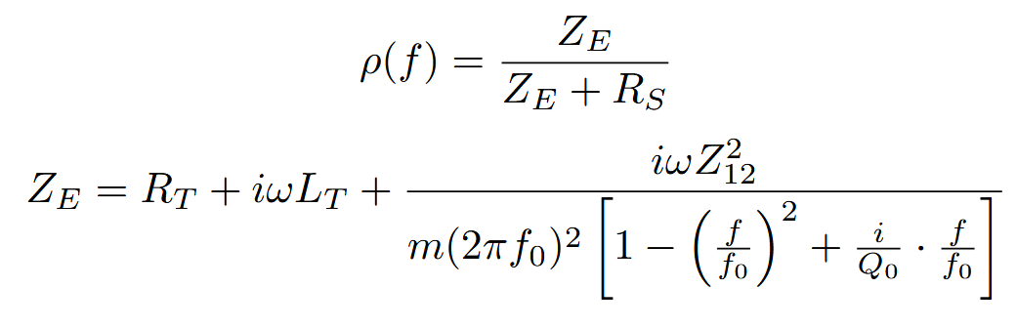
Geophone Calibration
GRASIAN
Setup analysis
Frequency response ratio ρ(f):
Ref.: Frank van Kann, John Winterflood; Simple method for absolute calibration of geophones, seismometers, and other inertial vibration sensors. Rev. Sci. Instrum. 1 March 2005; 76
Notes:
https://www.digikey.jp/ja/maker/projects/diy-extremely-sensitive-geophone-sensor-for-earthquake-detection/100df39edf7b4230b26846aacc94fe23
https://www.researchgate.net/figure/Inside-an-Earthcloud-Geophone_fig3_332001276
Frank van Kann, John Winterflood; Simple method for absolute calibration of geophones, seismometers, and other inertial vibration sensors. Rev. Sci. Instrum. 1 March 2005; 76

Slide 15
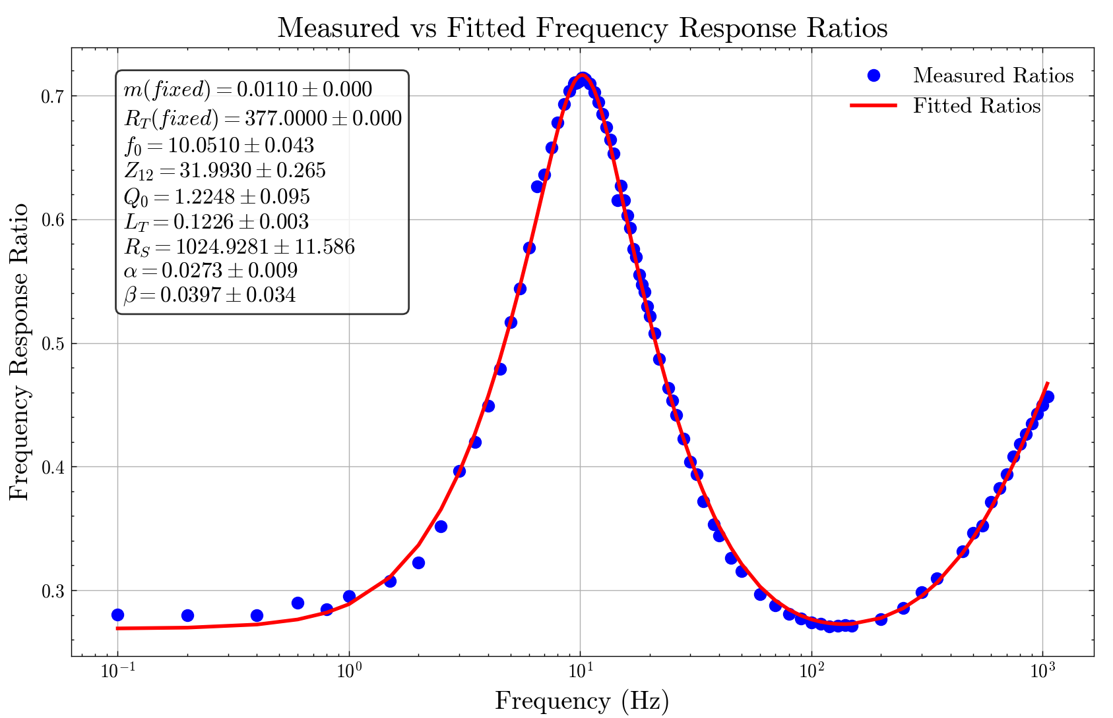
Geophone
GRASIAN
Setup analysis
Notes:
https://www.digikey.jp/ja/maker/projects/diy-extremely-sensitive-geophone-sensor-for-earthquake-detection/100df39edf7b4230b26846aacc94fe23
https://www.researchgate.net/figure/Inside-an-Earthcloud-Geophone_fig3_332001276

Slide 16
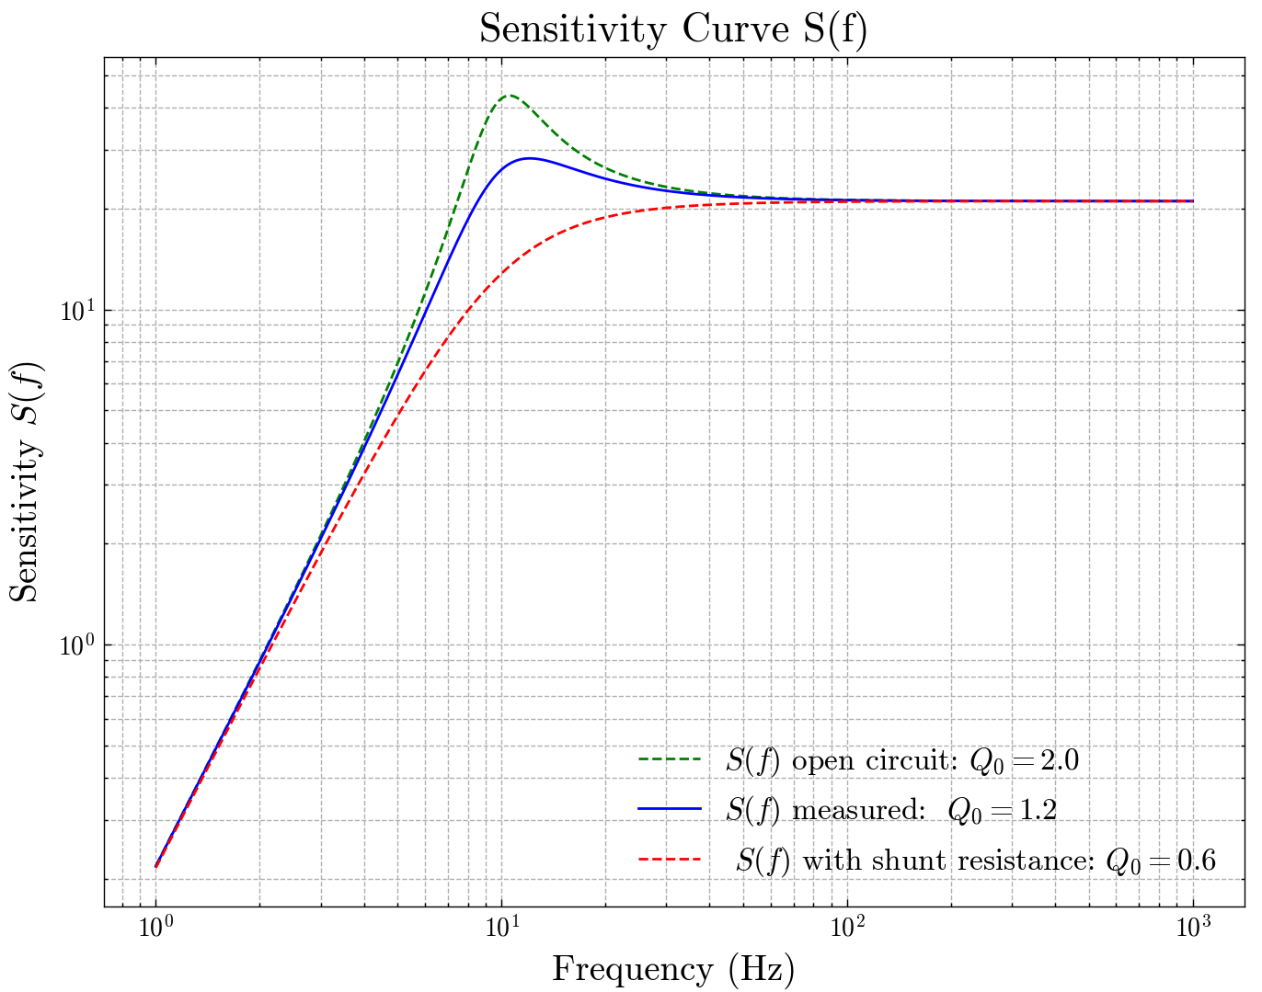
Geophone
GRASIAN
Setup analysis
Notes:
https://www.digikey.jp/ja/maker/projects/diy-extremely-sensitive-geophone-sensor-for-earthquake-detection/100df39edf7b4230b26846aacc94fe23
https://www.researchgate.net/figure/Inside-an-Earthcloud-Geophone_fig3_332001276

Slide 17
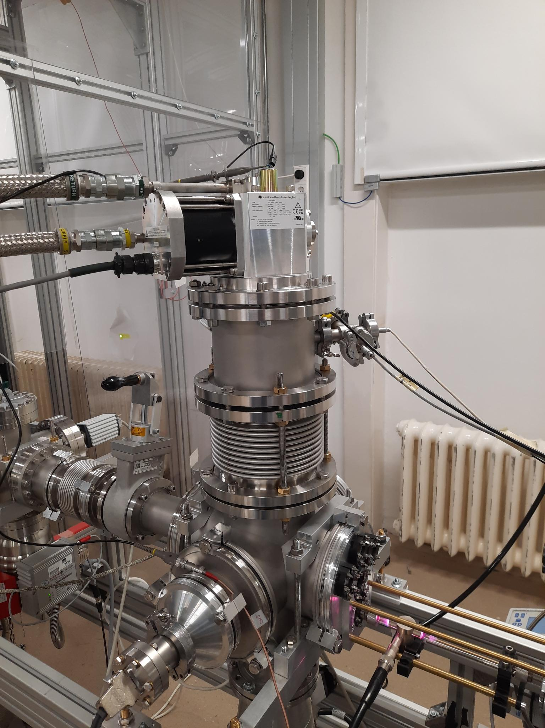
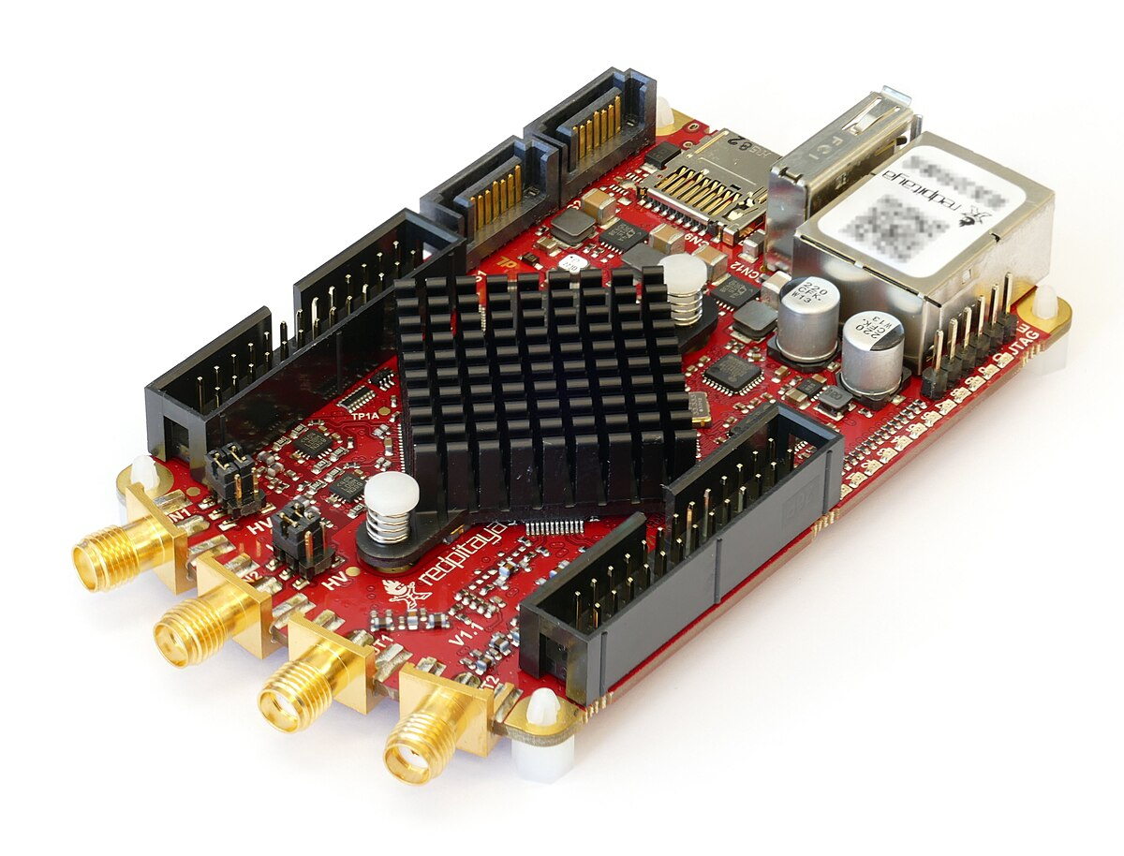
Geophone DAQ
GRASIAN
Setup analysis
Notes:
https://www.digikey.jp/ja/maker/projects/diy-extremely-sensitive-geophone-sensor-for-earthquake-detection/100df39edf7b4230b26846aacc94fe23
https://www.researchgate.net/figure/Inside-an-Earthcloud-Geophone_fig3_332001276

Slide 18
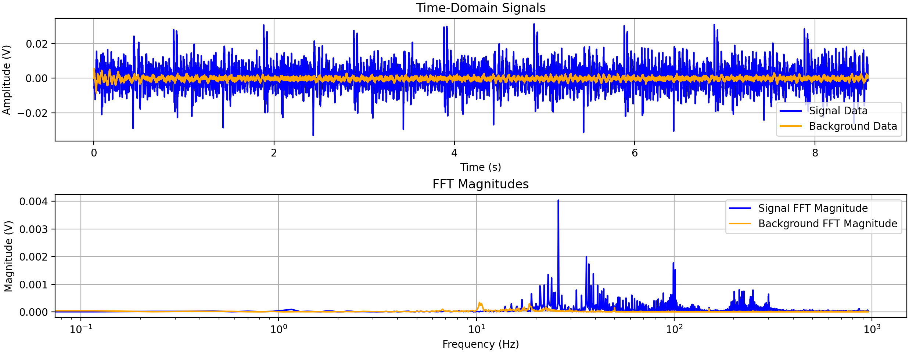
Geophone DAQ
GRASIAN
Setup analysis
Notes:
https://www.digikey.jp/ja/maker/projects/diy-extremely-sensitive-geophone-sensor-for-earthquake-detection/100df39edf7b4230b26846aacc94fe23
https://www.researchgate.net/figure/Inside-an-Earthcloud-Geophone_fig3_332001276

Slide 19
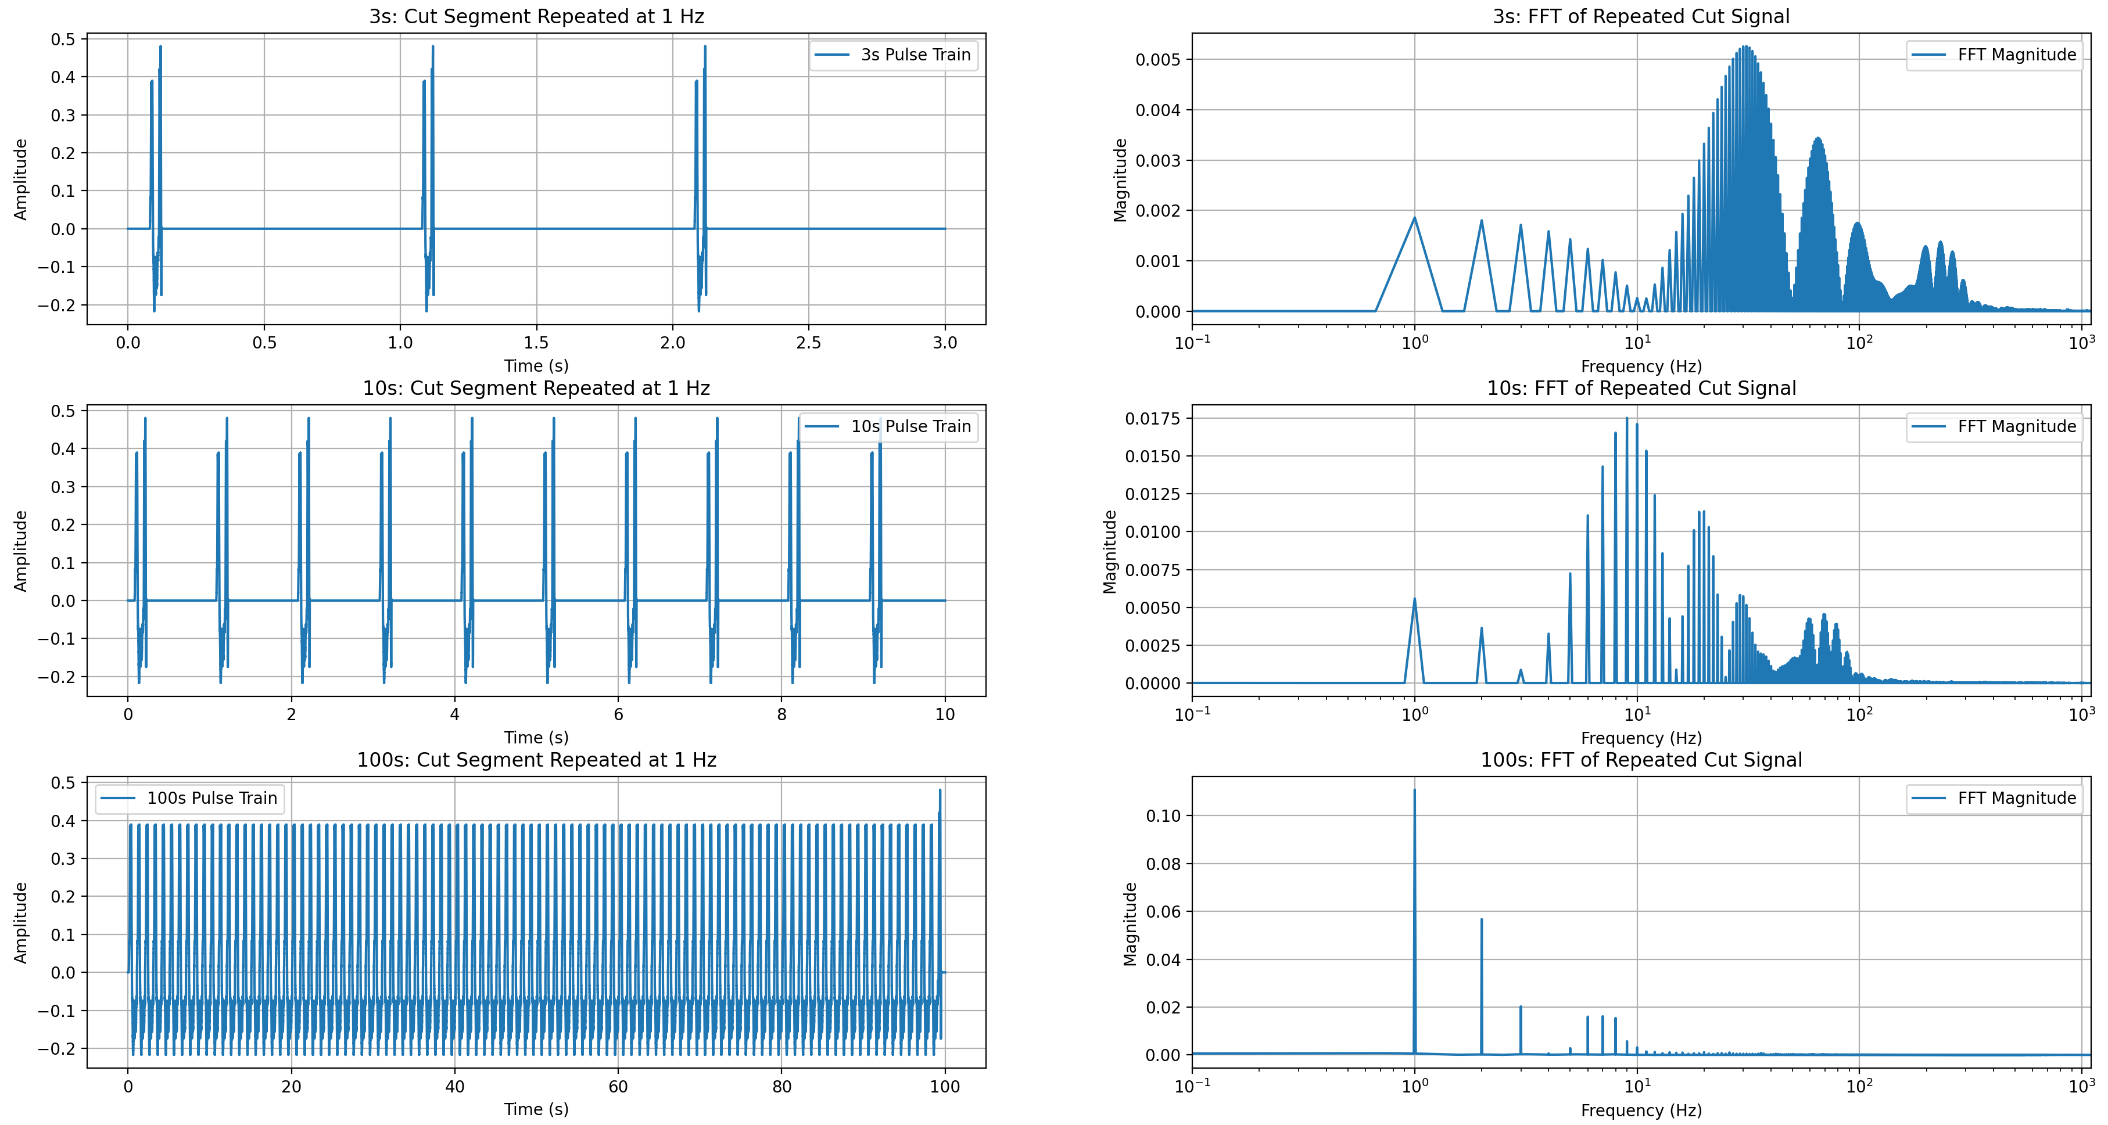
Geophone DAQ
GRASIAN
Setup analysis
Notes:
https://www.digikey.jp/ja/maker/projects/diy-extremely-sensitive-geophone-sensor-for-earthquake-detection/100df39edf7b4230b26846aacc94fe23
https://www.researchgate.net/figure/Inside-an-Earthcloud-Geophone_fig3_332001276

Slide 20
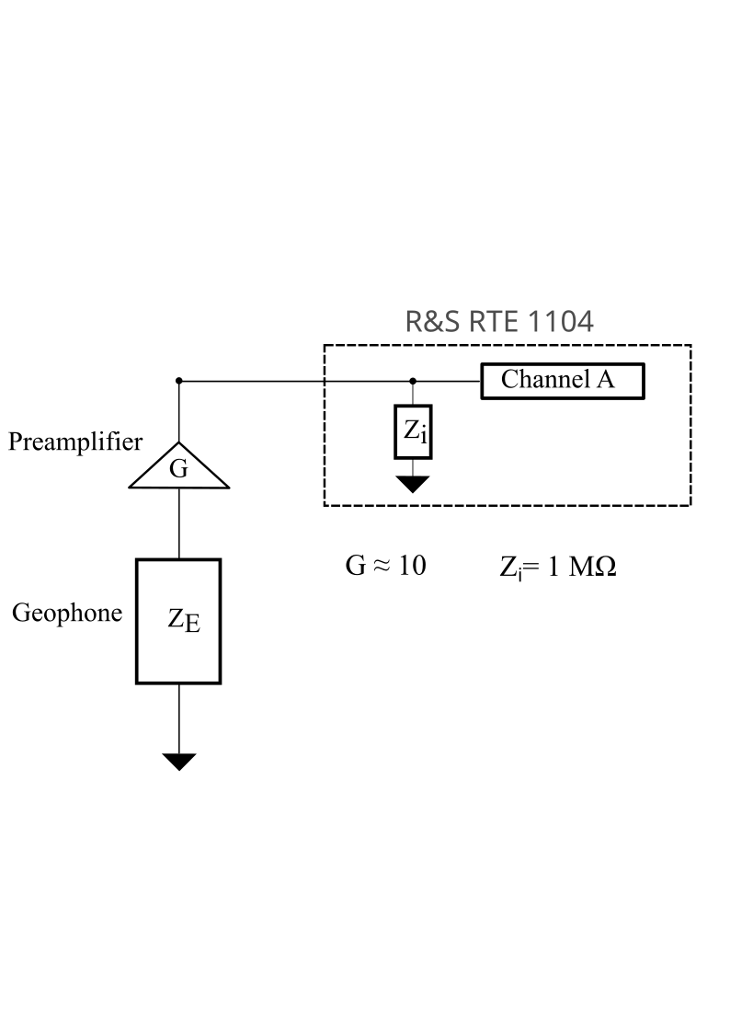
Geophone
GRASIAN
Setup analysis
Measure V(t) of Geophone
Fourier Transform V(t) → V(f)
Calculate displacement d(f)
Inverse Fourier Transform d(f) → d(t)
Ref.: G. Koolstra, Trapping a Single Electron on Superfluid Helium Using a Superconducting Resonator, 2019
Notes:
https://www.digikey.jp/ja/maker/projects/diy-extremely-sensitive-geophone-sensor-for-earthquake-detection/100df39edf7b4230b26846aacc94fe23
https://www.researchgate.net/figure/Inside-an-Earthcloud-Geophone_fig3_332001276

Slide 21
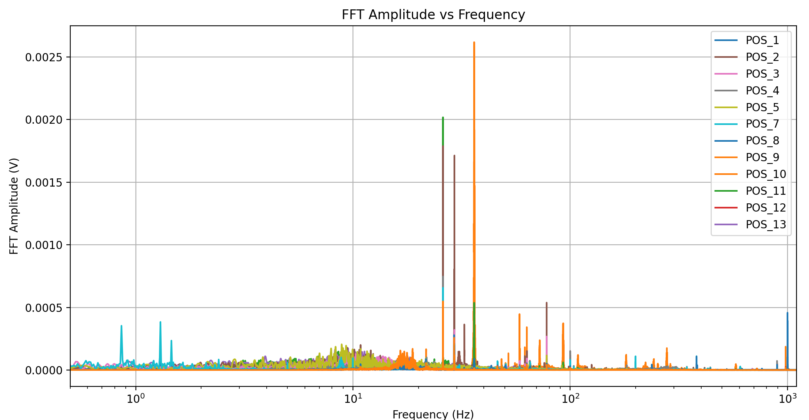
Geophone
GRASIAN
Setup analysis
Measure V(t) of Geophone
Fourier Transform V(t) → V(f)
Calculate displacement d(f)
Inverse Fourier Transform d(f) → d(t)
Notes:
https://www.digikey.jp/ja/maker/projects/diy-extremely-sensitive-geophone-sensor-for-earthquake-detection/100df39edf7b4230b26846aacc94fe23
https://www.researchgate.net/figure/Inside-an-Earthcloud-Geophone_fig3_332001276

Slide 22
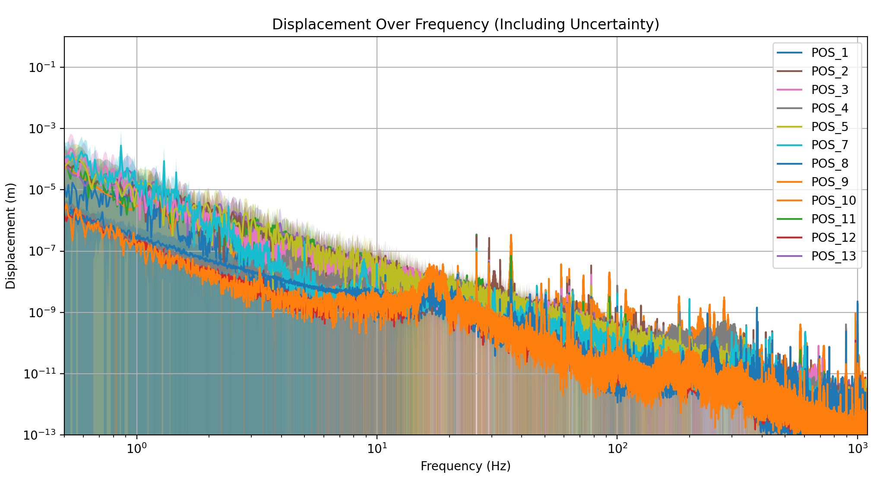
Geophone
GRASIAN
Setup analysis
Measure V(t) of Geophone
Fourier Transform V(t) → V(f)
Calculate displacement d(f)
Inverse Fourier Transform d(f) → d(t)
Notes:
https://www.digikey.jp/ja/maker/projects/diy-extremely-sensitive-geophone-sensor-for-earthquake-detection/100df39edf7b4230b26846aacc94fe23
https://www.researchgate.net/figure/Inside-an-Earthcloud-Geophone_fig3_332001276

Slide 23
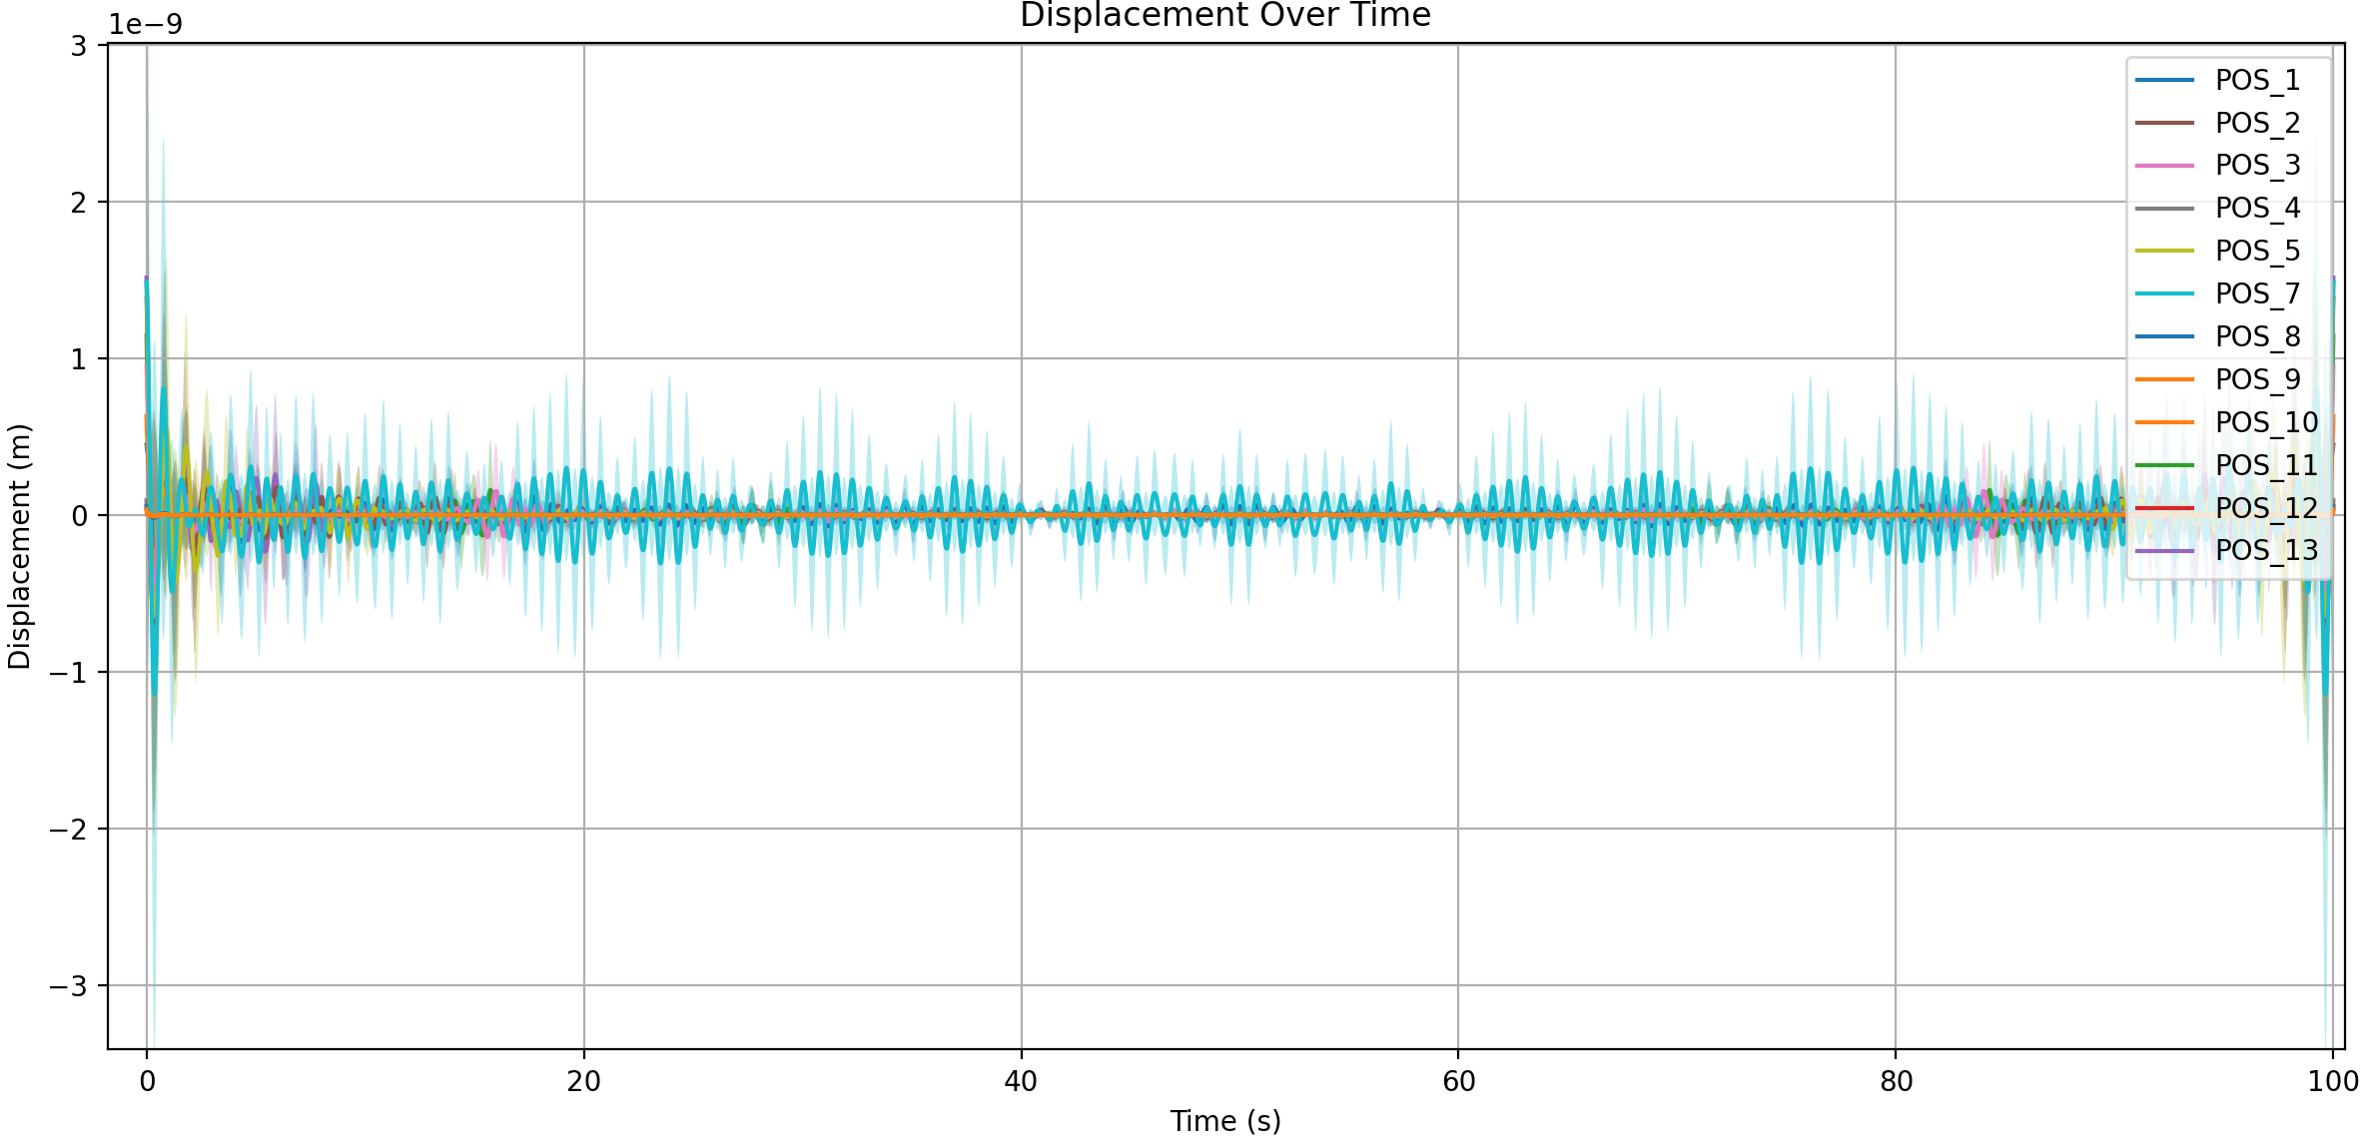
Geophone
GRASIAN
Setup analysis
Measure V(t) of Geophone
Fourier Transform V(t) → V(f)
Calculate displacement d(f)
Inverse Fourier Transform d(f) → d(t)
Notes:
https://www.digikey.jp/ja/maker/projects/diy-extremely-sensitive-geophone-sensor-for-earthquake-detection/100df39edf7b4230b26846aacc94fe23
https://www.researchgate.net/figure/Inside-an-Earthcloud-Geophone_fig3_332001276

Slide 24
Geophone
GRASIAN
Setup analysis
Measure V(t) of Geophone
Question:
Are the V(t) peaks too sharp in time domain?
Is the numpy fft reliable?
Are the displacement values d(t) reliable?
Fourier Transform V(t) → V(f)
Calculate displacement d(f)
Solution:
Verification measurement is needed
Inverse Fourier Transform d(f) → d(t)
Ref.: G. Koolstra, Trapping a Single Electron on Superfluid Helium Using a Superconducting Resonator, 2019
Notes:
https://www.digikey.jp/ja/maker/projects/diy-extremely-sensitive-geophone-sensor-for-earthquake-detection/100df39edf7b4230b26846aacc94fe23
https://www.researchgate.net/figure/Inside-an-Earthcloud-Geophone_fig3_332001276

Slide 25
Geophone
GRASIAN
Setup analysis
Measure V(t) of Geophone
New Approach:
Benefits:
Absolut measurement of d(t)
Expect no rapid change in d(t) … FFT more reliable
Measure d(t)
Fourier Transform V(t) → V(f)
Fourier Transform d(t) → d(f)
Calculate displacement d(f)
Inverse Fourier Transform d(f) → d(t)
Ref.: G. Koolstra, Trapping a Single Electron on Superfluid Helium Using a Superconducting Resonator, 2019
Notes:
https://www.digikey.jp/ja/maker/projects/diy-extremely-sensitive-geophone-sensor-for-earthquake-detection/100df39edf7b4230b26846aacc94fe23
https://www.researchgate.net/figure/Inside-an-Earthcloud-Geophone_fig3_332001276

Slide 26
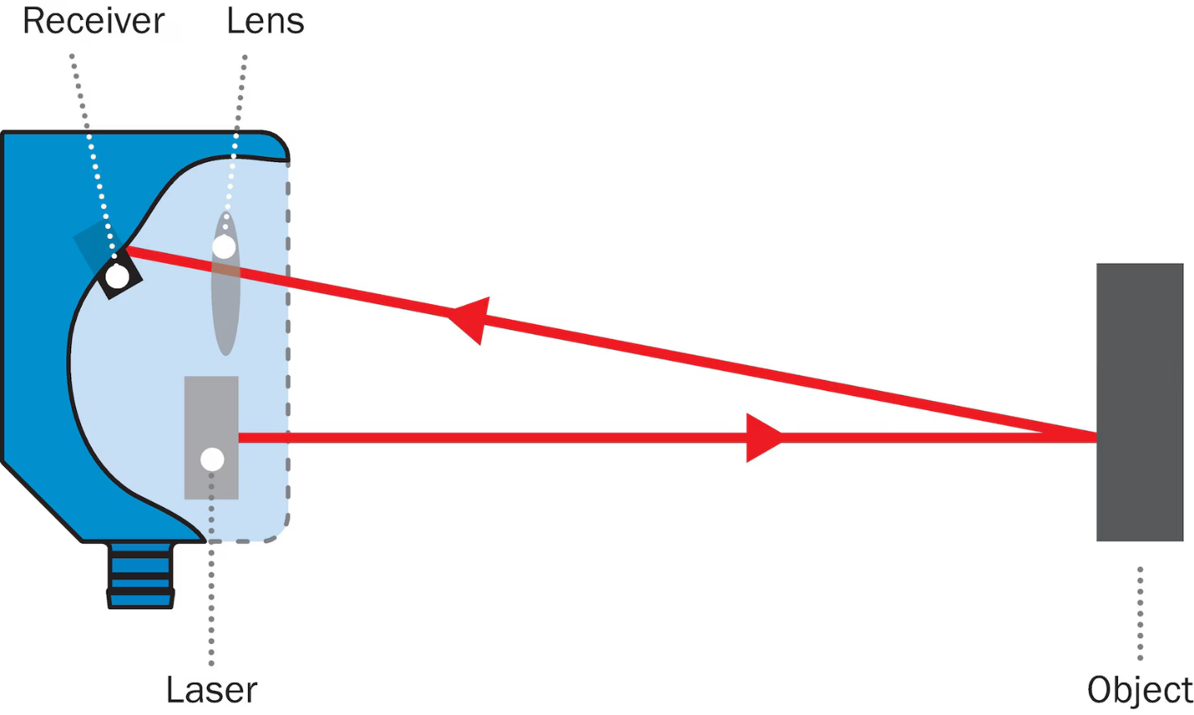
SICK OD5000
GRASIAN
Setup analysis
Laser Distance measurement:
measuring frequency of up to 80 kHz
Linearity: ± 1 µm
Measuring range: 14 mm - 16 mm
Ref.: www.sick.com

Slide 27
SICK OD5000
GRASIAN
Setup analysis
Question:
What’s the best way to mount this to avoid motion in the micrometer range?
Laser Distance measurement:
measuring frequency of up to 80 kHz
Linearity: ± 1 µm
Measuring range: 14 mm - 16 mm
Solution:
Concrete is not possible… the ceiling is not stable enough
Lead / Sand construction?
Ref.: www.sick.com
Notes:
What’s the best way to mount this to avoid motion in the micrometer range? 🫠

Slide 28
GQS of H & Setup:
GRASIAN
Setup analysis
DUST
VIBRATIONS
Ref.: F. Duringer, M. Simon, C. Killian

Slide 29
GQS of H & Setup:
GRASIAN
Setup analysis
DUST
VIBRATIONS
SLIT POSITIONS
Slit 1: 500 µm
Slit 2: 1 mm
Slit 3: 1 mm
Ref.: F. Duringer, M. Simon, C. Killian

Slide 30
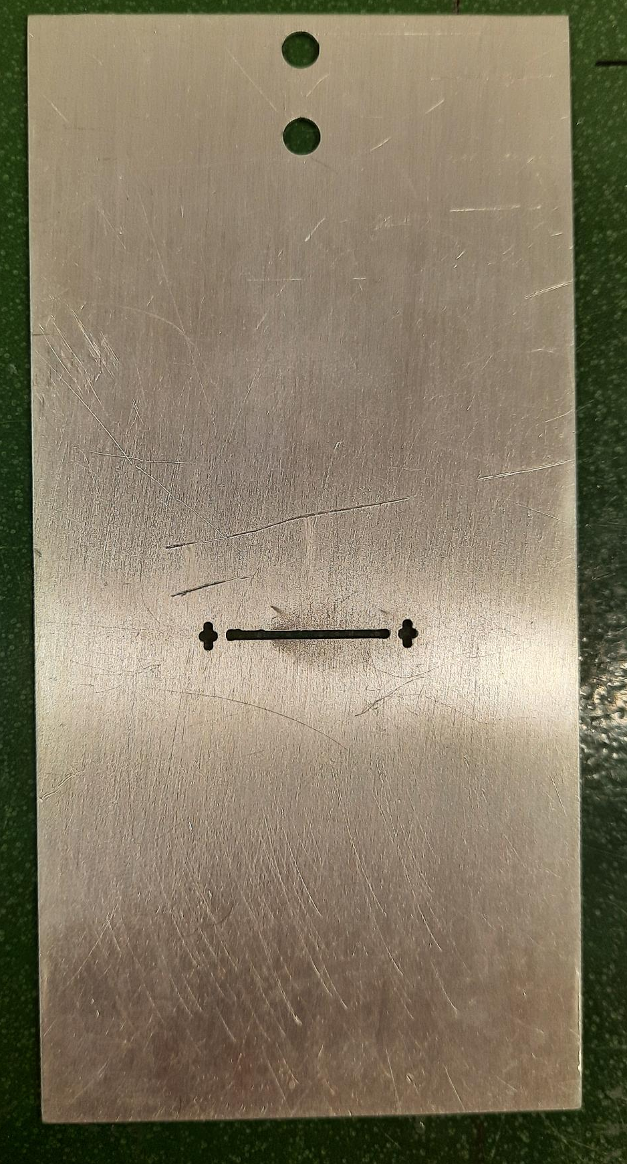
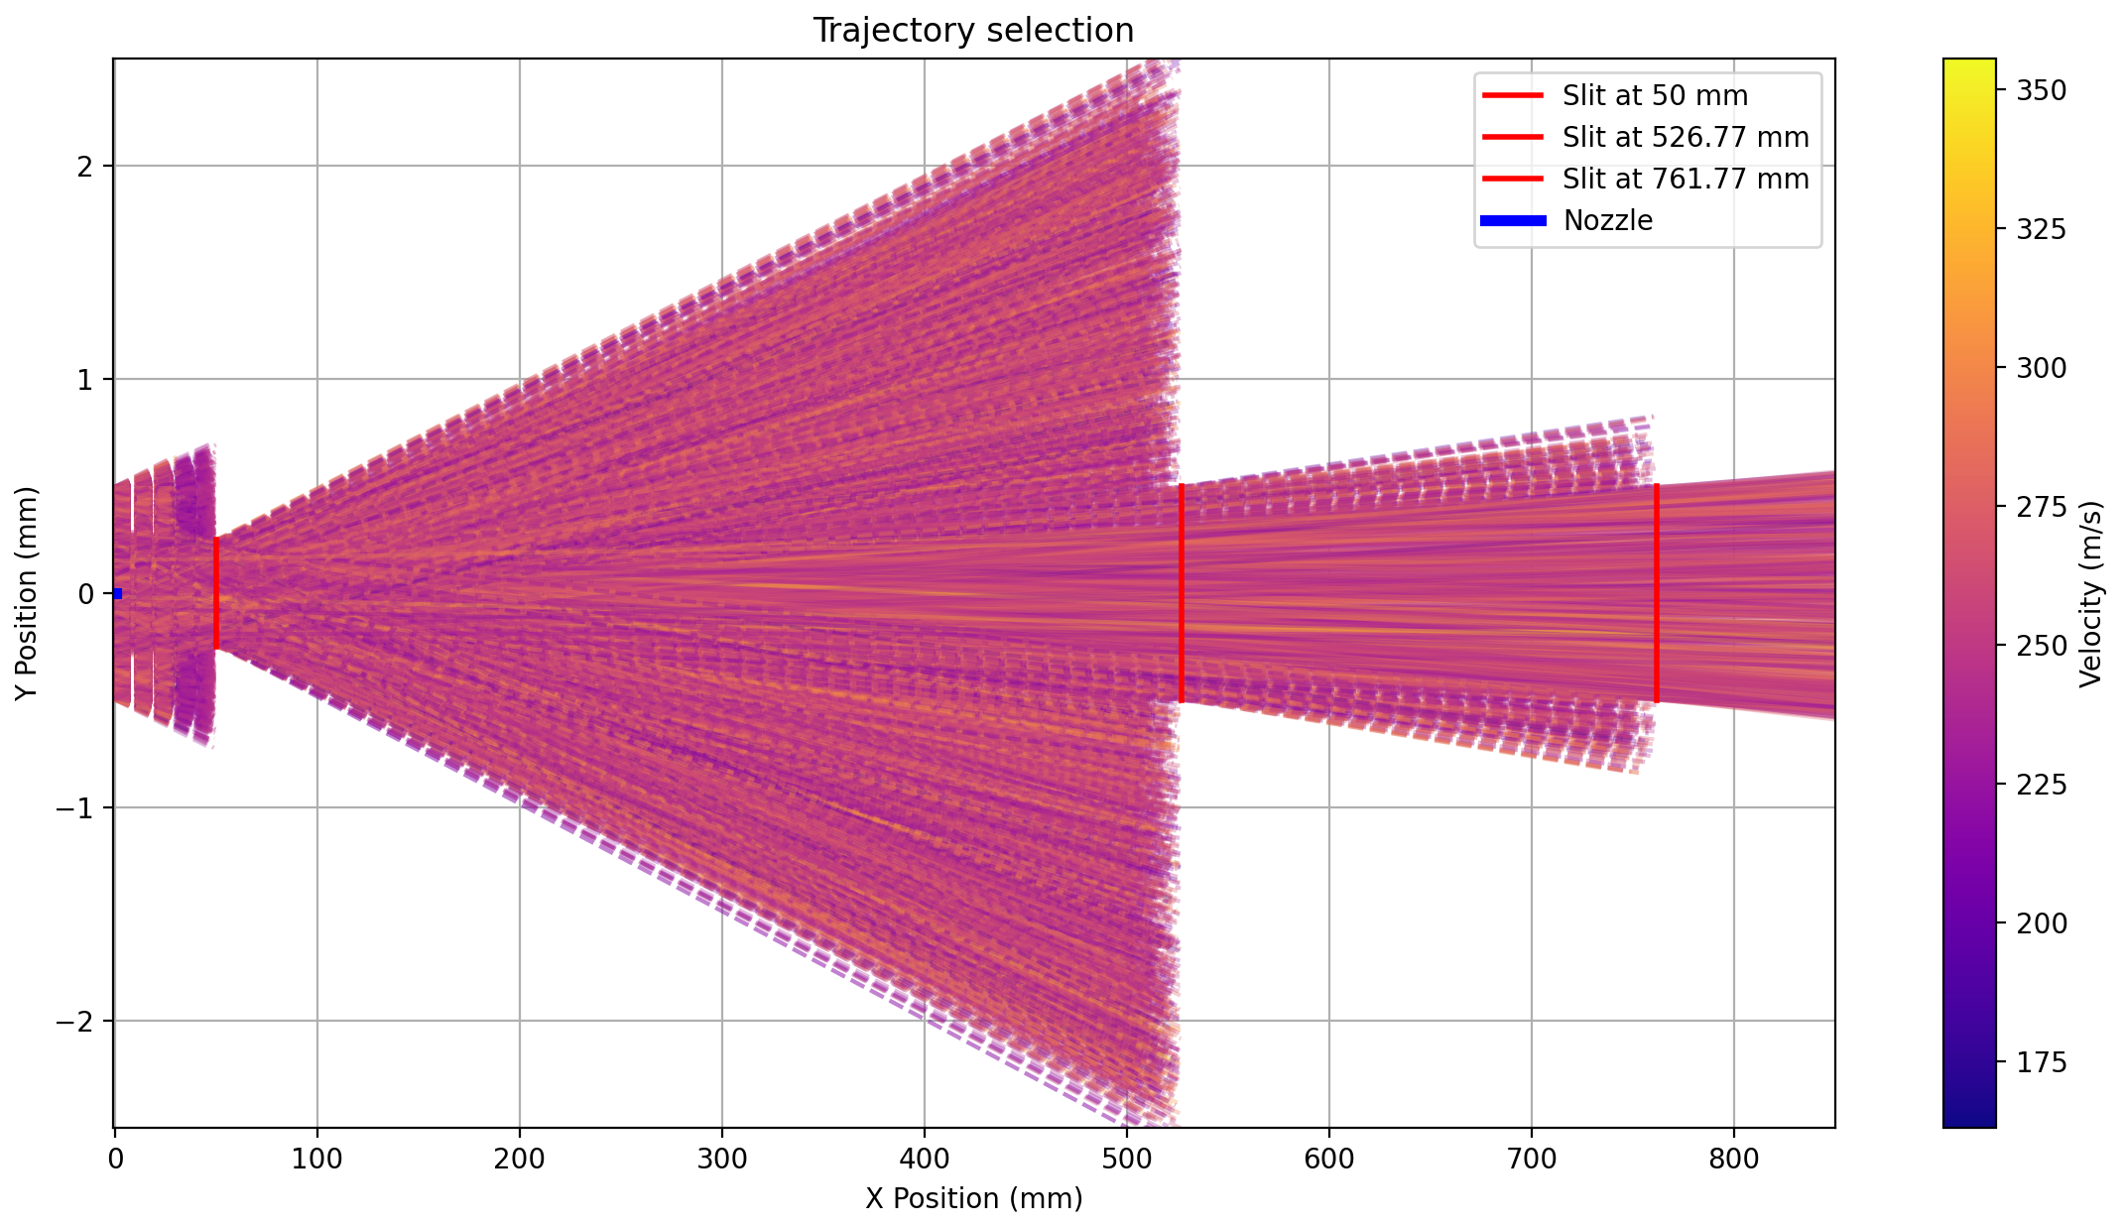
Slit Position
GRASIAN
Setup analysis
Notes:
https://www.digikey.jp/ja/maker/projects/diy-extremely-sensitive-geophone-sensor-for-earthquake-detection/100df39edf7b4230b26846aacc94fe23
https://www.researchgate.net/figure/Inside-an-Earthcloud-Geophone_fig3_332001276

Slide 31
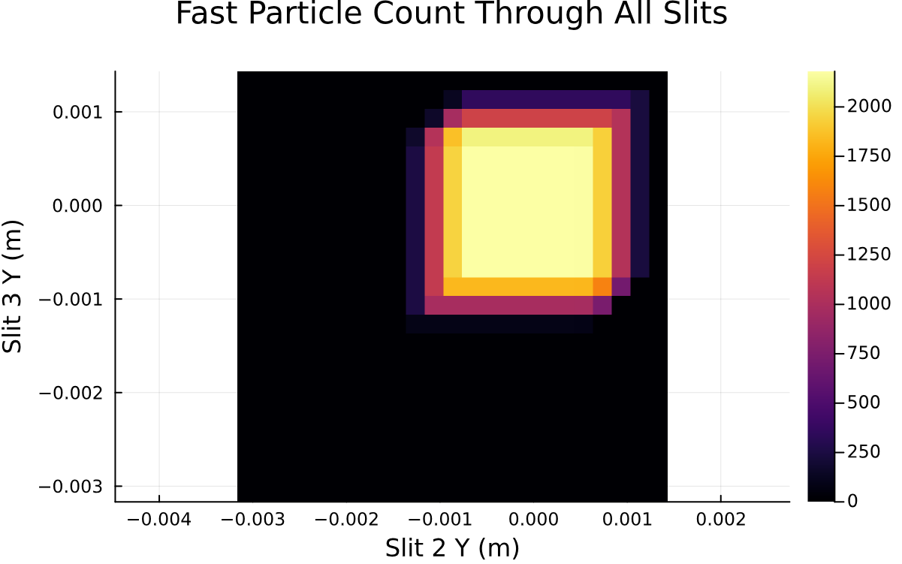
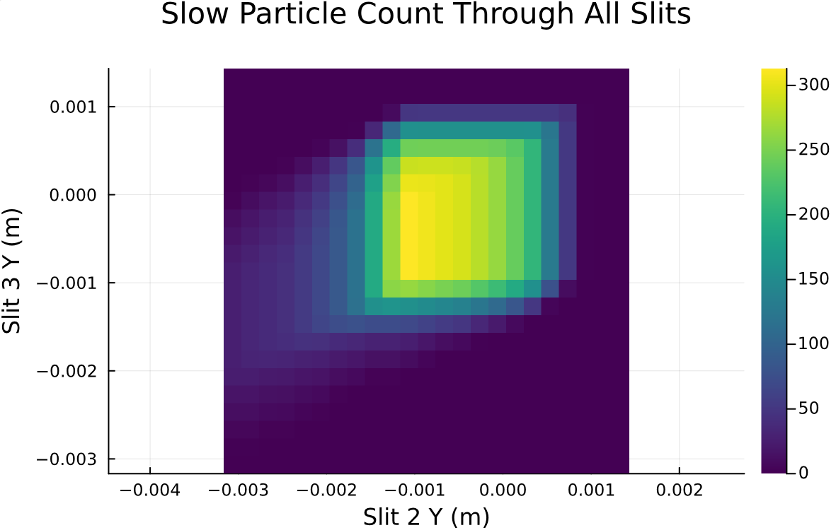
Slit Position
GRASIAN
Setup analysis
Notes:
https://www.digikey.jp/ja/maker/projects/diy-extremely-sensitive-geophone-sensor-for-earthquake-detection/100df39edf7b4230b26846aacc94fe23
https://www.researchgate.net/figure/Inside-an-Earthcloud-Geophone_fig3_332001276

Slide 32
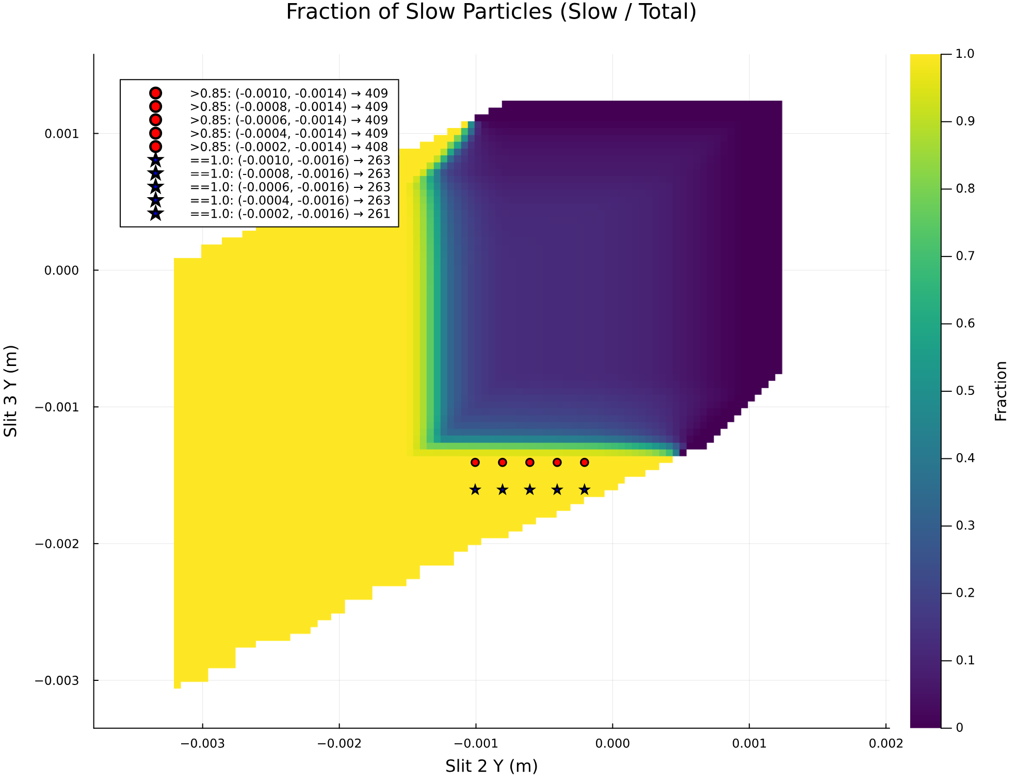
Slit Position
GRASIAN
Setup analysis
Notes:
https://www.digikey.jp/ja/maker/projects/diy-extremely-sensitive-geophone-sensor-for-earthquake-detection/100df39edf7b4230b26846aacc94fe23
https://www.researchgate.net/figure/Inside-an-Earthcloud-Geophone_fig3_332001276

Slide 33
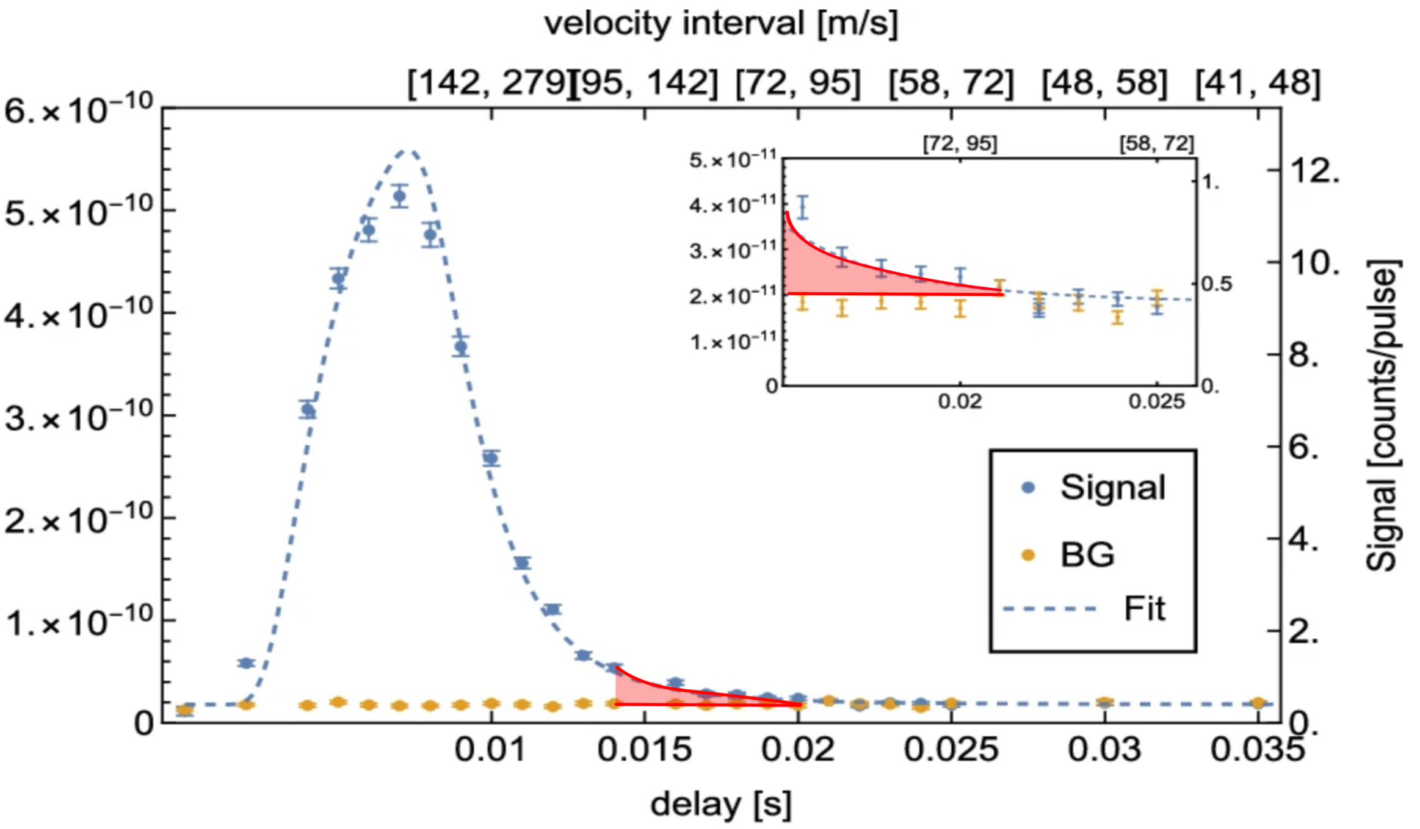
Slit Position
GRASIAN
Setup analysis
Ref.: C. Killian et al., GRASIAN: shaping and characterization of the cold hydrogen and deuterium beams for the forthcoming first demonstration of gravitational quantum states of atoms, Eur. Phys. J. D (2024) 78:132
Notes:
https://www.digikey.jp/ja/maker/projects/diy-extremely-sensitive-geophone-sensor-for-earthquake-detection/100df39edf7b4230b26846aacc94fe23
https://www.researchgate.net/figure/Inside-an-Earthcloud-Geophone_fig3_332001276

Slide 34

Conclusion:
GRASIAN
Präsentation
Setup analysis
Aim:
Finalize vibration measurement
Verification of vibration measurement
Find best suited slit position and verify
Challenges:
Find best mount with view vibrations
Ref.: F. Duringer, M. Simon, C. Killian
Notes:
Precise error estimation for velocity distribution. Not only chopper opening also Vibra-
tion at slits and Temperature dependence.

Slide 35
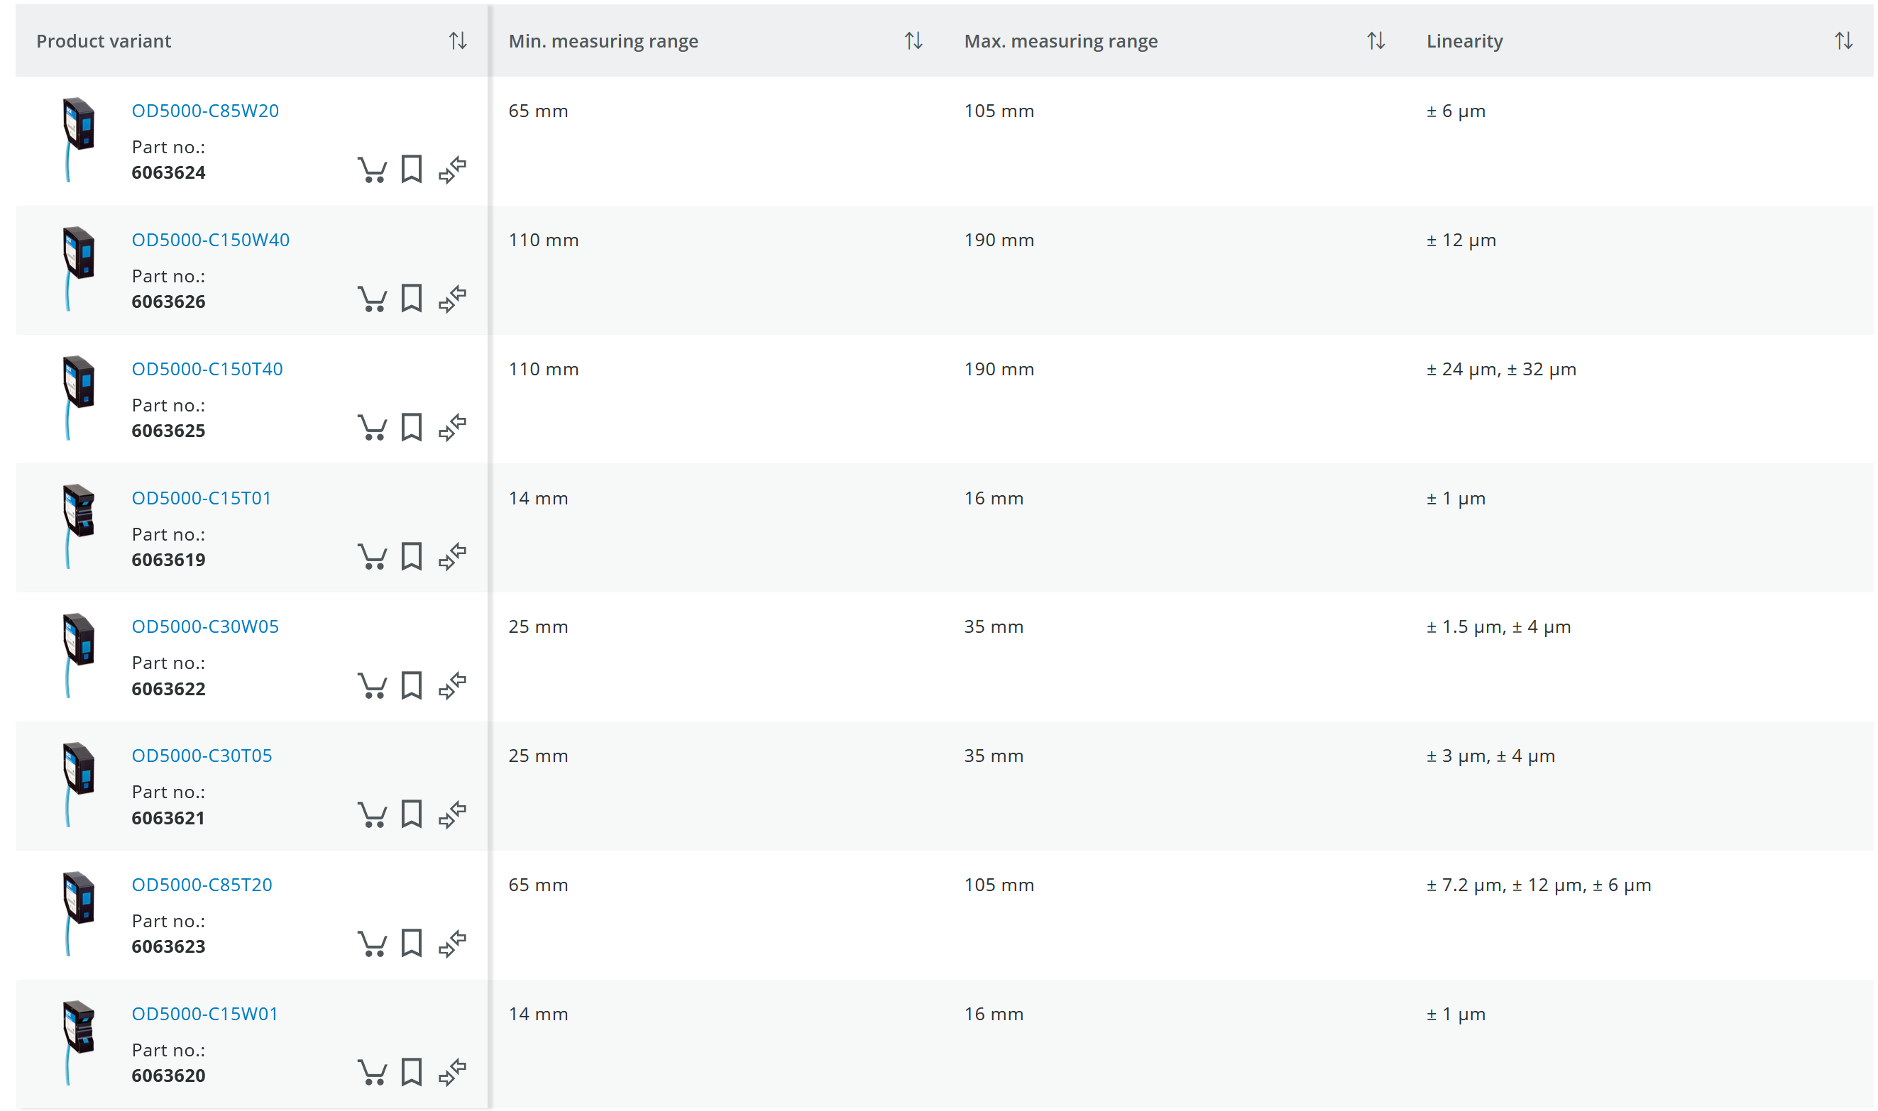
Geophone Verification OD5000
GRASIAN
SETUP Analysis

Slide 36
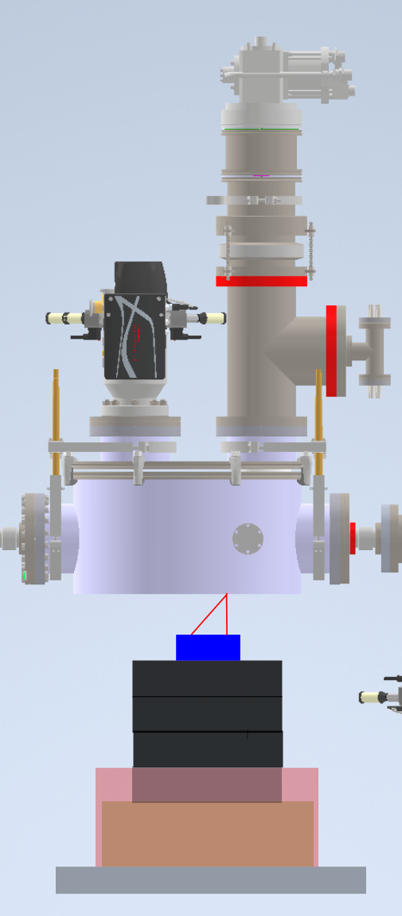
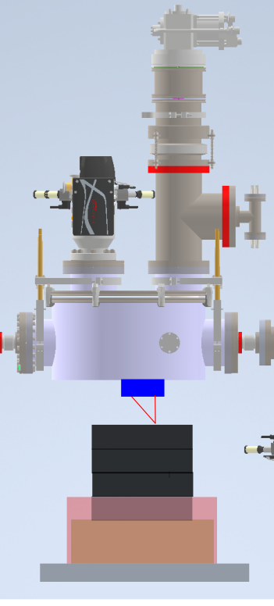
Geophone Verification OD5000
GRASIAN
SETUP Analysis
Lead blocks
Sand bucket
Rubber mat

