Slide 1
EIC Controls System and Virtual Accelerator Plans
EIC IACCT Working Group Meeting
James Jamilkowski
L3 CAM for Accelerator Controls
April 21, 2025

Slide 2
Outline
EIC Controls Overview
Software Backbone
Hardware Plans
Interface to Hadron Injector Controls
Controls Interfaces to Other Systems
Core Interface Requirements
Pulse to Pulse Modulation for EIS
Virtual Accelerator Interfacing
  Scope
  Scheme
Commissioning Tool Integration Process
VA Planning and EIC Schedule

Slide 3
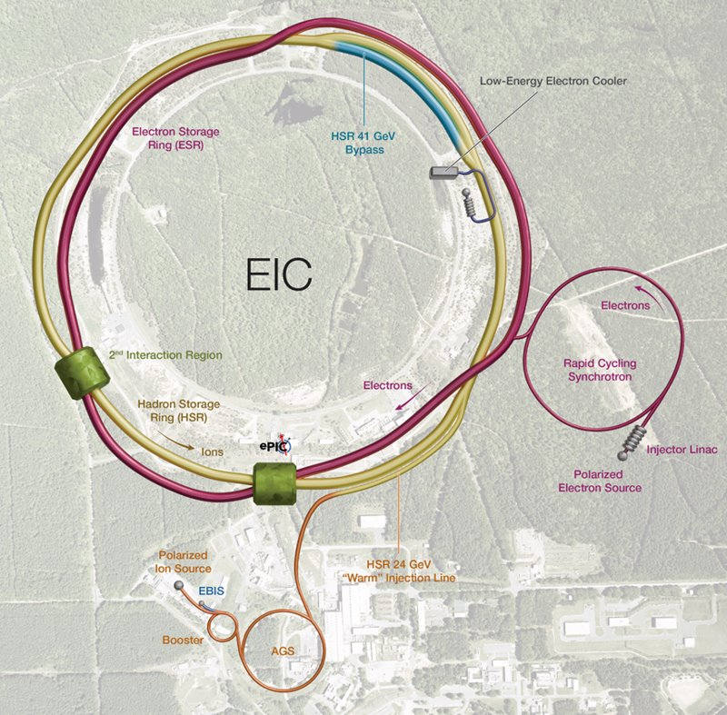
EIC Controls Overview
Provide core accelerator controls interfaces for Electron Ion Collider (EIC) users
  GUI applications
  Back-end services (data logging & retrieval, snapshots/recovery tools, alarm aggregation, etc.)
  Networking services for most EIC systems
  Safety Systems functionality for EIC areas (mitigation of hazards from beam, RF, cryogen)
  A hardware platform capable of supporting many accelerator applications
Interface to other systems
  Most Detector scope is handled by ePIC team
  See slide 7 for EIC details
  Hadron Injector Controls
    Not in scope for the EIC Project
    Existing proprietary HW and SW interfaces ("ADO"-based Controls System)
    See slide 6 for details
Facilities
  Reuse Relativistic Heavy Ion Collider (RHIC) Tunnel along with certain RHIC-era buildings and infrastructure to support the EIC Collider
  Add new buildings to support EIC Collider
    Hadron Storage Ring systems
    Electron Storage Ring systems
  Add new buildings, tunnel, and infrastructure
    Electron Injector Systems (EIS)

Slide 4
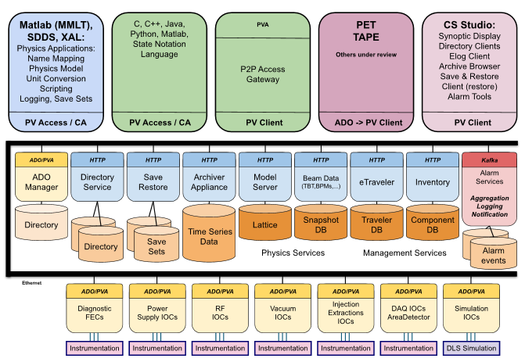
Software Backbone
Using EIC-managed GitHub repo
Read The Docs for internal documentation
EPICS 7 base
  Core protocol, PVXS
  Channel Access may be supported, but is not considered “core”
Developing a local EPICS image copied initially from NSLS-II’s
Core GUI application, CS Studio Phoebus
AI/ML services support is not currently in scope, though plans are being evaluated in a separate Working Group
K. Shroff

Slide 5
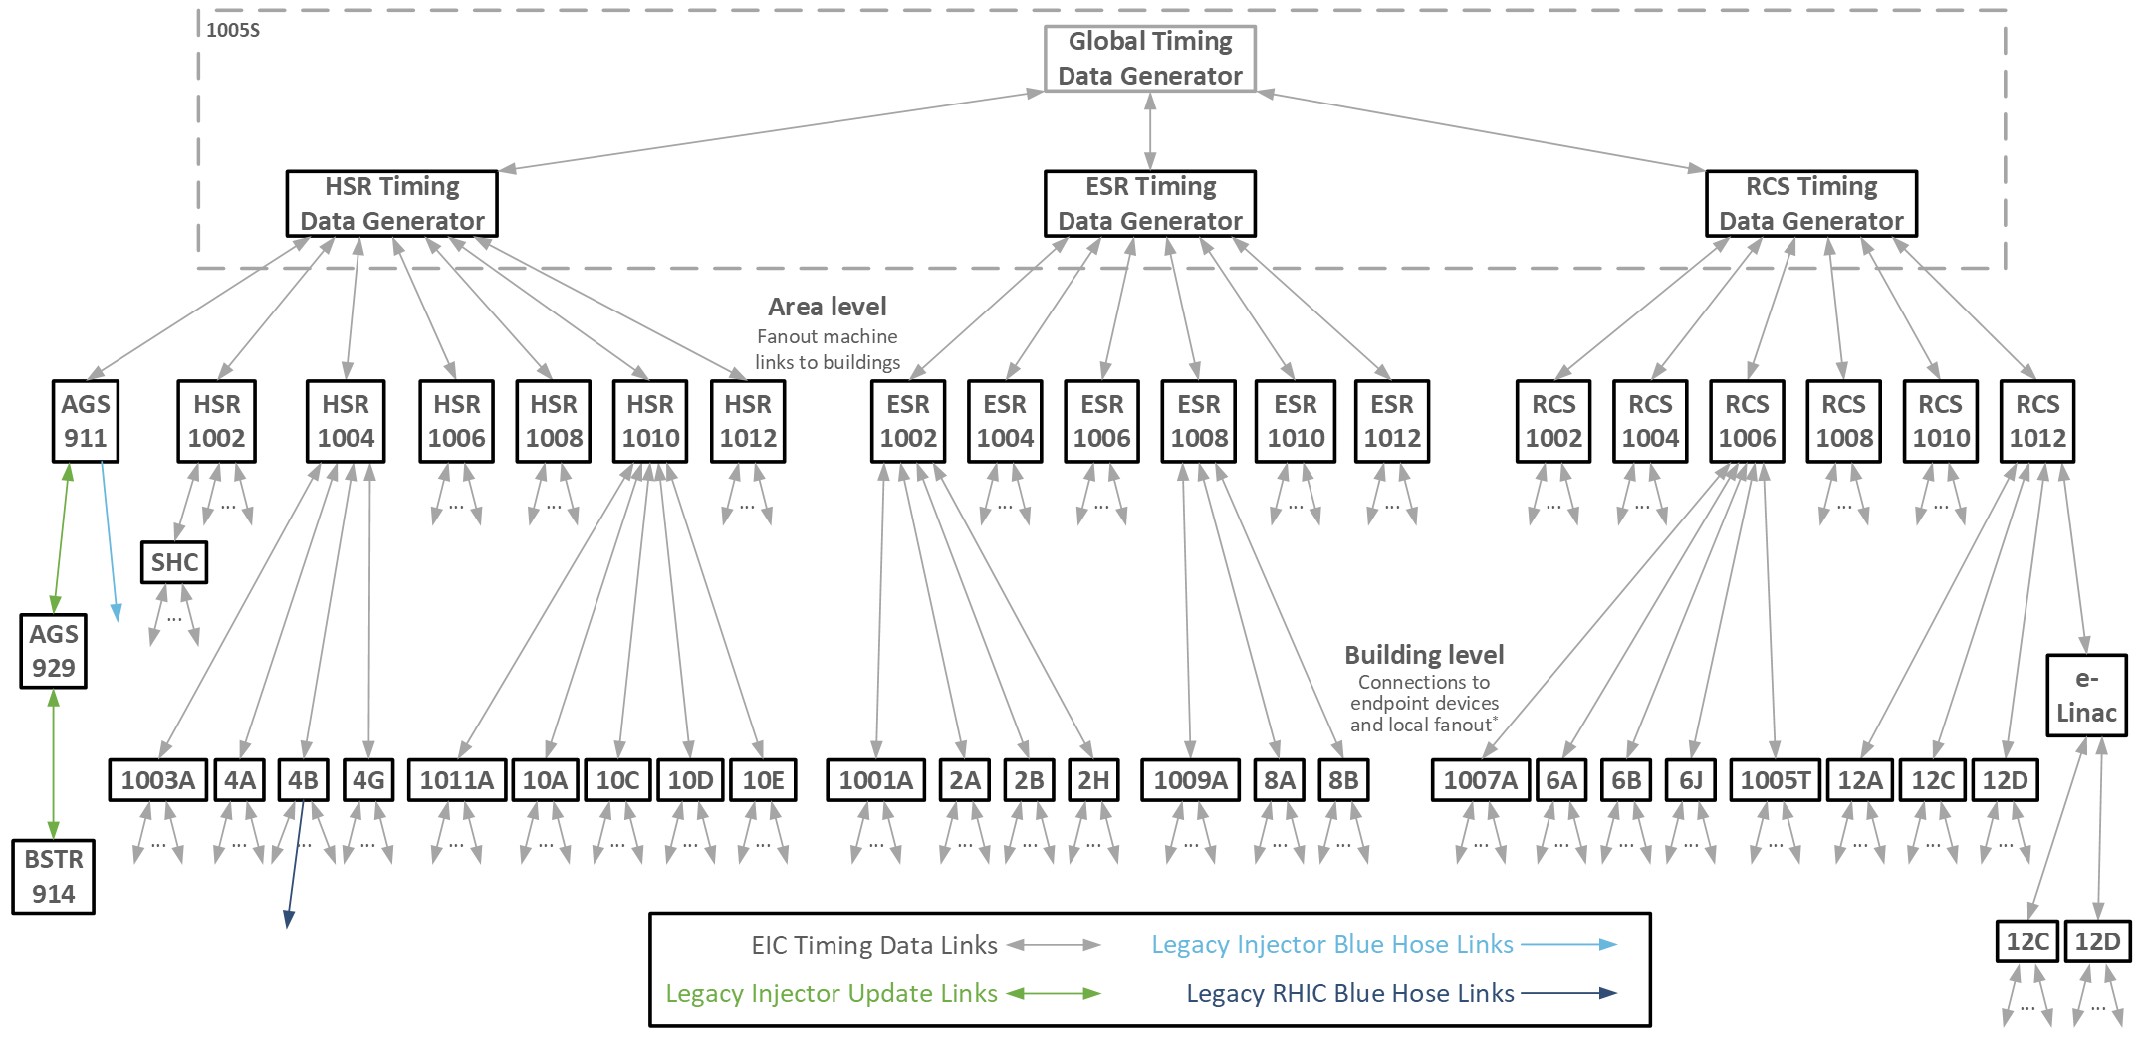
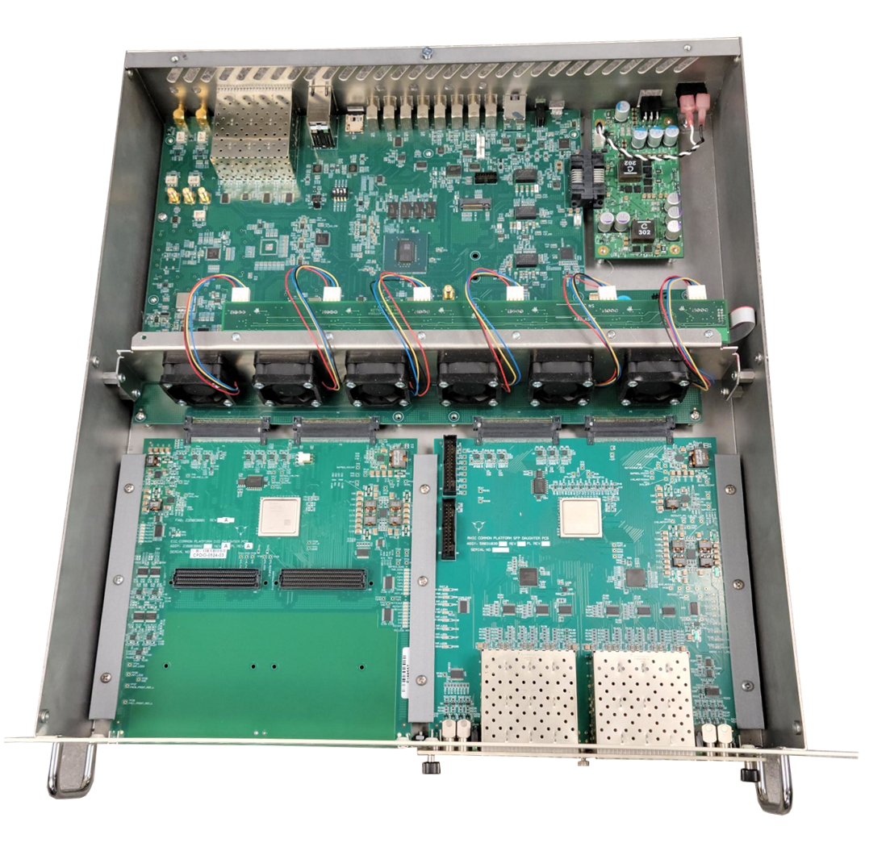
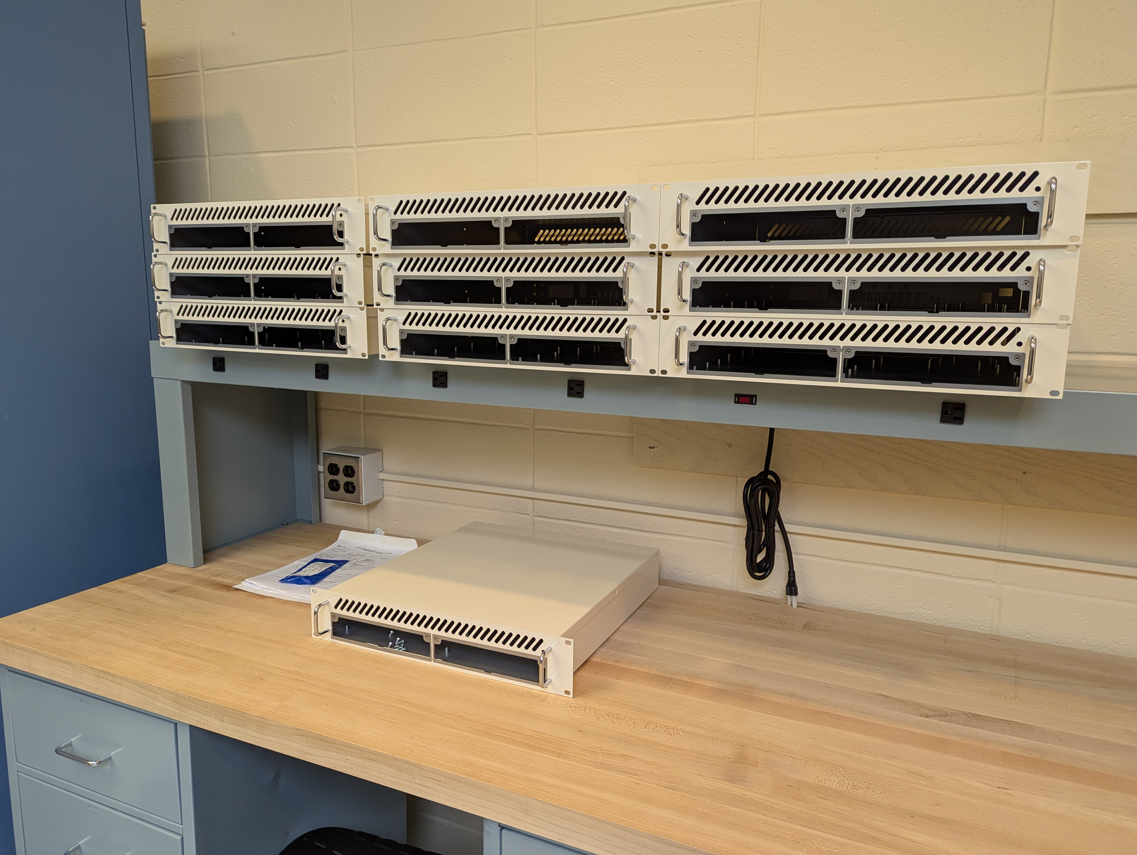
Hardware Plans
Develop and maintain network/fiber backbone to all geographic locations including tunnel locations within the EIC scope
  Includes fiber connections to support synchronized timing/data distribution (Timing Data Link) and machine/detector protection (MPS Link)
  Hierarchical distribution between Core, Machine, and End Nodes within field locations
Develop and deploy custom Front End Computers using the EIC Common Platform
  Pizza-box/2U form-factor
  Modular design
    Carrier board for upstream interfaces
    Two Daughter Card sites for application interfacing and processing
    Separate Power Distribution Unit
  Modern FPGA-based implementation for Carrier board
    Xilinx Zynq Ultrascale+ FPGA
    SFP connections for high-speed serial communication
    Currently integrating the remote interface to the Carrier and first two Daughter Cards
  Using EPICS pscDrv between remote IOC and Carrier
Internal/external support for AI/ML functionality has been evaluated, but is not currently in scope for the Project
K. Mernick / G. Narayan

Slide 6
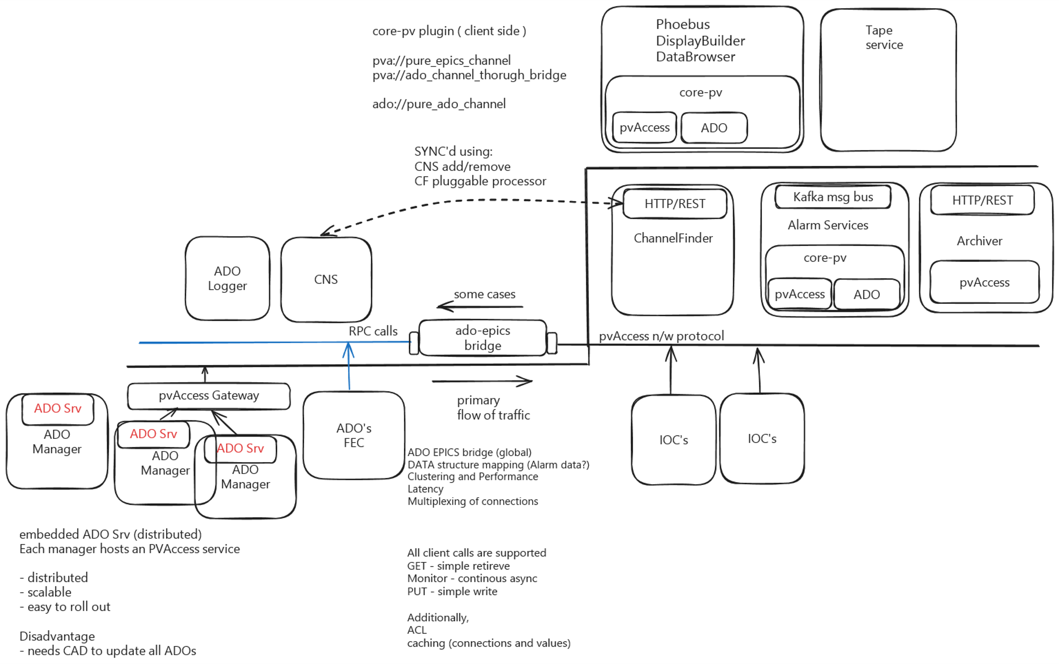
Interface to Hadron Injector Controls
There will be a set of mechanical and electrical interfaces between the Hadron Storage Ring and the Hadron Injector chain
EIC Project Scope does not include support for hardware or software upgrades to the HI systems
We’re currently evaluating requirements and implementation plans for bridging between legacy HI systems and EIC Controls
  Accelerator Device Objects (ADOs) hosted by Front End Computers (VxWorks) or via server processes (Red Hat Linux)
  Legacy/proprietary services
K. Shroff

Slide 7
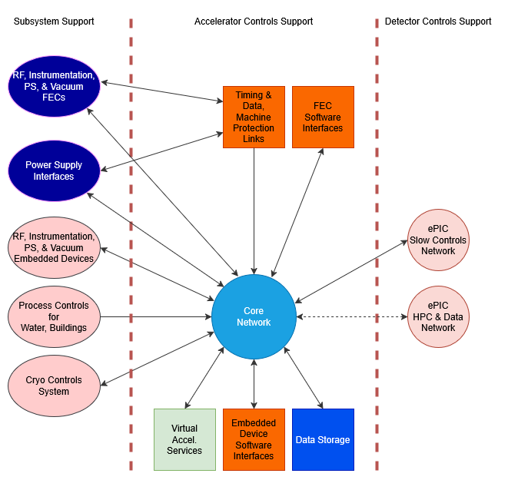
Controls Interfaces to Other Systems
FEC integration
  Controls, RF, Instrumentation, Vacuum (digitizing certain analog signals)
  Power Supplies include SFP digital interface
Embedded device integration
  Water Systems
  Building Management Systems
  RF, Instrumentation, Vacuum
Data exchange
  Cryogenic Systems Controls
  Detector / ePIC Slow Controls
  Considering potential Detector data AI/ML application requiring correlation with Accelerator data
Virtual Accelerator services
  Anticipate digital twin functionality for some subset of RF, Instrumentation, and Power Supply signals based on virtual operating mode

Slide 8
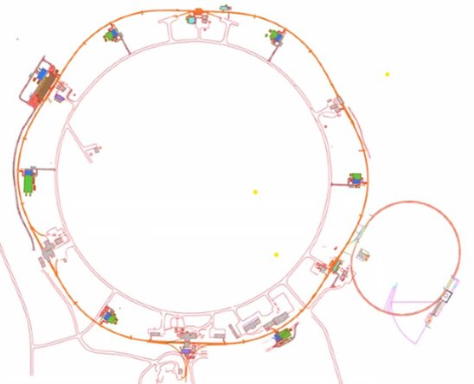
Core Requirements
Hadron Storage Ring
  Based on RHIC Yellow Ring, with significant modifications
  Ramped machine
  Ramps take many minutes
  Beam will be polarized for physics activities, though not from the start of commissioning
  Crab cavities and Interaction Region transverse orbit correction for collision optimization
  Slow general orbit corrections and fast local corrections
  Power Supplies mostly legacy ones from RHIC, with updated controls interfaces
  “Bypass” line added during Project to support wider energy range, using elements of RHIC Blue Ring
  Addition of Low Energy Cooler electron machine for hadron beam during Project, using unpolarized beam
Electron Storage Ring
  Uses existing RHIC tunnel
  Storage only, so no ramping
  Beam will be polarized for physics activities, though not from the start of commissioning
  Crab cavities and Interaction Region transverse orbit correction for collision optimization
  Slow general orbit corrections and fast local corrections
  PS Group planning on deploying ALS-U Power Supply Controller units to support new power supplies
Electron Injector Systems
  Brand new facility
  Comprised of eLinac, Bunch Accumulator Ring, and Rapid Cycling Synchrotron Ring
  Beam will be polarized
  RCS cycle ~1Hz, fed by one or more Linac cycles with BAR supporting bunch merging
  Considering Pulse to Pulse Modulation functionality (see slide 9)
  PS Group planning on using ALS-U Power Supply Controller units

Slide 9
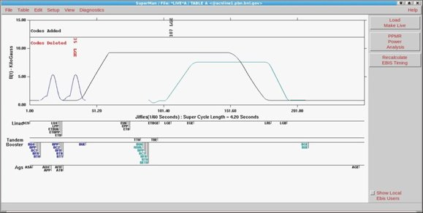
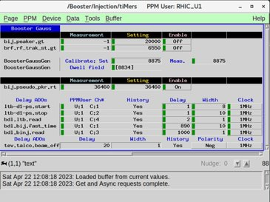
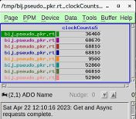
Pulse to Pulse Modulation
Allows the configuration of beam operations for a given machine to be toggled in a coherent fashion
  Scalar settings
  Waveform settings​
When employed at the RHIC Injector facilities, it tends to be embedded at the HW, comm tools, SW infrastructure, and GUI application levels​
Contexts are captured in “PPM Users”, which are numbered 1 through 8​ in the legacy Controls System
Each User is either active or inactive at any given time​
While some EPICS-based facilities have their own proprietary implementation, none are using a form that is generally supported by the community​
This functionality will benefit the Electron Injector Systems operations if we develop support in the related systems, especially for Power Supply and RF controls

Slide 10

Virtual Accelerator Interfacing Scope
Stakeholders
  Testing of Controls-supported systems including prior to commissioning
  Physics modelling, before and after commissioning starts
    Interest has been expressed in having a VA scheme online in less than a year from now
Modeling tools support planning
  BMAD
  MADX
  ELEGANT
  Others?
Subsystems support scope to consider
  Which portions of RF, Instrumentation, Power Supplies interfaces need a twin?
  For each interface, ramped/storage/pulsed categories many impact their data structures
    For example, RCS RF (pulsed) would be different than ESR RF (storage) or HSR (ramped) waveforms or settings
  Need for parallelization to support twinning separate operating states simultaneously?
    For example, HSR injection and HSR store (100 to 275 GeV, depending on species/physics program)
    Likely critical to track which state/twin is the target for each Machine, to support live/virtual comparisons
RCS RF
ESR Orbit
HSR WCM
Tune
Spin

Slide 11
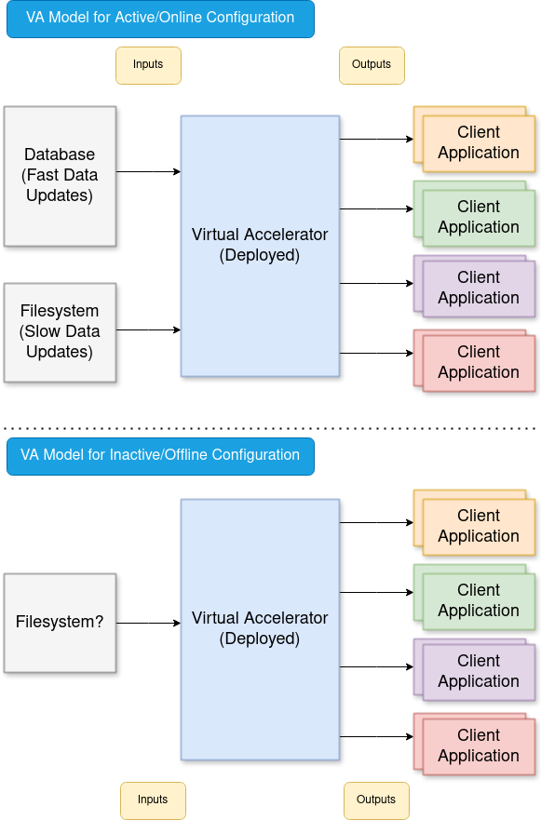
Virtual Accelerator Interfacing Scheme
Interface for users
  Integration with CS Studio Phoebus
    Side by side comparison as needed against live data
  Python tools
    Popular language
    Anticipating support for comm with EIC systems (via PVXS)
    Controls provides a standard packaging scheme
      We've done this before (Caddy) in the C-AD Controls System
  Web tools
    Support for integrating EIC Controls System access w/common tools used by physicists and engineers
      For example, MatLab support
        DeviceService experience from C-AD Controls System
  Development sandbox versus deployment area for production
  Requirements input will need to be developed that will support all stakeholders
    Functional
      Scope of dynamic parameters to subscribe to (ie. via database or alternative access)
      Scope of infrequently changing parameters to read (ie. via file access)
    Performance
      Up to 10Hz data stream for all (dynamic) parameters?
Virtual Accelerator Interfacing for Online/Offline Machine States

Slide 12
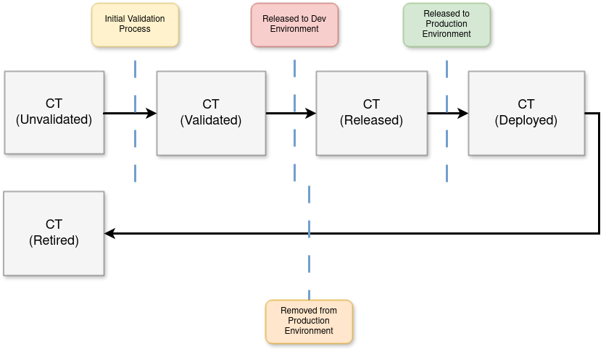
Commissioning Tool Integration Process
Cybersecurity requirements must be met on a continual basis
  DOE
  Brookhaven National Lab
  EIC (details under development)
Development and Release Policies
  Code is currently managed via GitHub in a private repo (eicorg)
  Policies and processes for contributing content to development environment and releasing to production environment are under development
SW Life Cycle
  Software needs to be commissioned before regular use from the production environment
  Outdated software need to be removed/retired from the production area periodically
Commissioning Tool Integration Process

Slide 13
Virtual Accelerator Planning & EIC Schedule
Virtual Accelerator development effort
  Current focus is on Controls interfaces and requirements development, and preparing for Preliminary Design technical reviews
  Not currently pursuing demonstration VA activities
  Plan to review available matrixed staff to see what could start soon
  Consider hiring to fill the VA and physics model support role
    This may need to wait due to funding realities
EIC Project dates in FY25
  EIS technical design and cost review, April 8 – 10 (completed)
  OPA Review of EIC Project, Aug 5 – 7
    Update on technical advancement
    Update on subproject breakdown, including early cost and scheduling details
      First subproject is expected to include a subset of the Collider components
      EIS scope is currently expected be incorporated in a later subproject

Slide 14
Thanks for your attention!
Any questions?

Slide 15
Backup

