Slide 1


PICO Bubble Chambers
EIEIOO 2025
Emily Adams 16ela1@queensu.ca

Slide 2
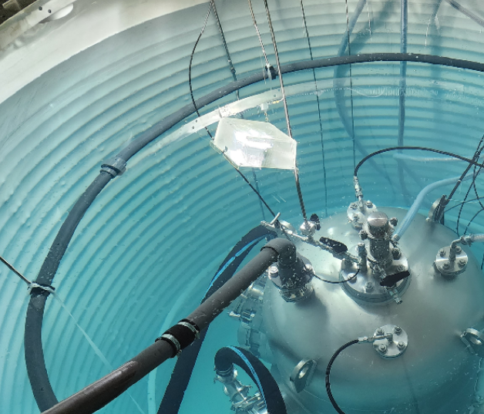

Agenda
Bubble chamber introduction
Working principle
Data acquisition
PICO-40L detector
  Particle identification
PICO-500 detector
  New features
  Construction update
PICO-40L uncovered water tank at SNOLAB

Slide 3
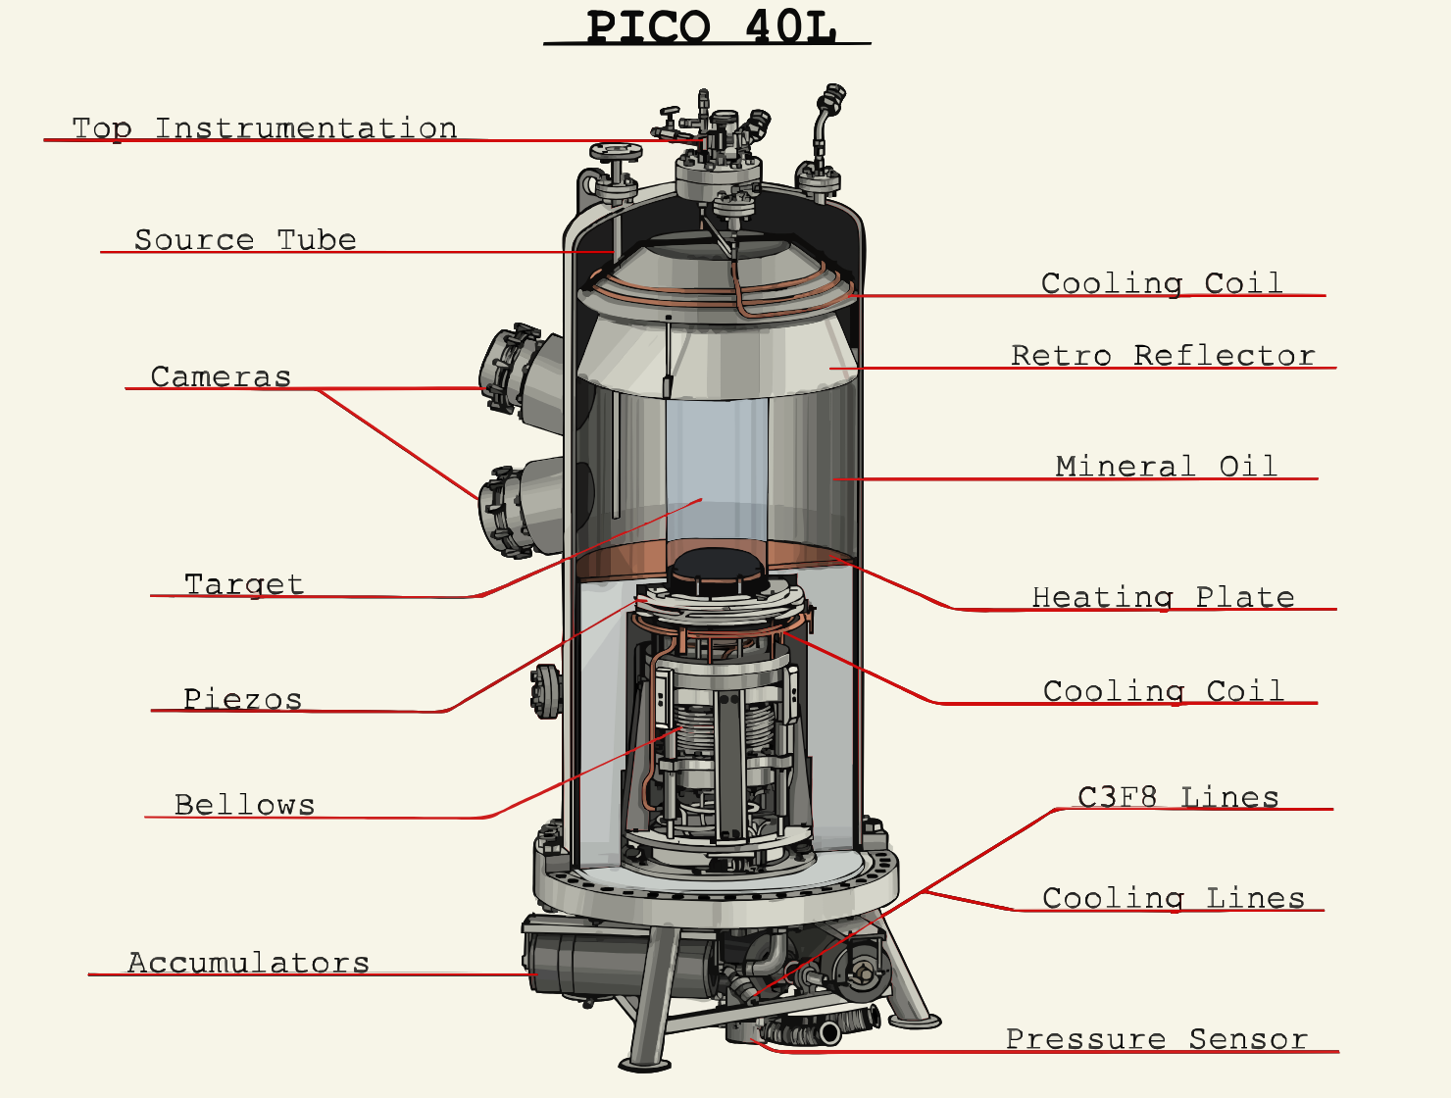
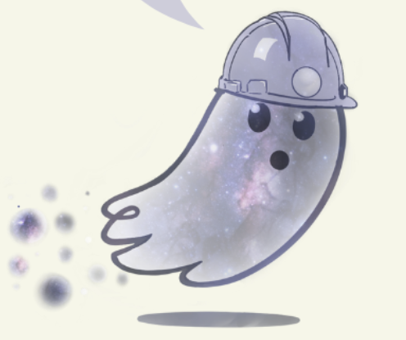

Check out picoexperiment.com/learn !
“Boiler”
“Bubbles”

Slide 4
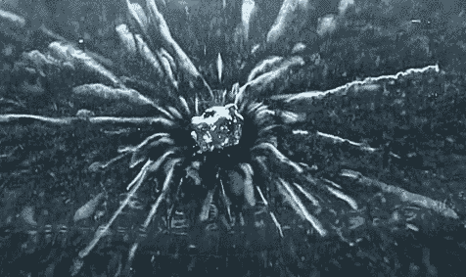
Before the Bubble Chamber…
The Cloud Chamber
Incoming particle ionizes supersaturated vapour (usually water or alcohol) inside the chamber
Vapour condenses around the resulting ions, creating misty tracks of liquid droplets
Trails of particles visible with the naked eye!
Uranium nugget decaying in a cloud chamber

Slide 5
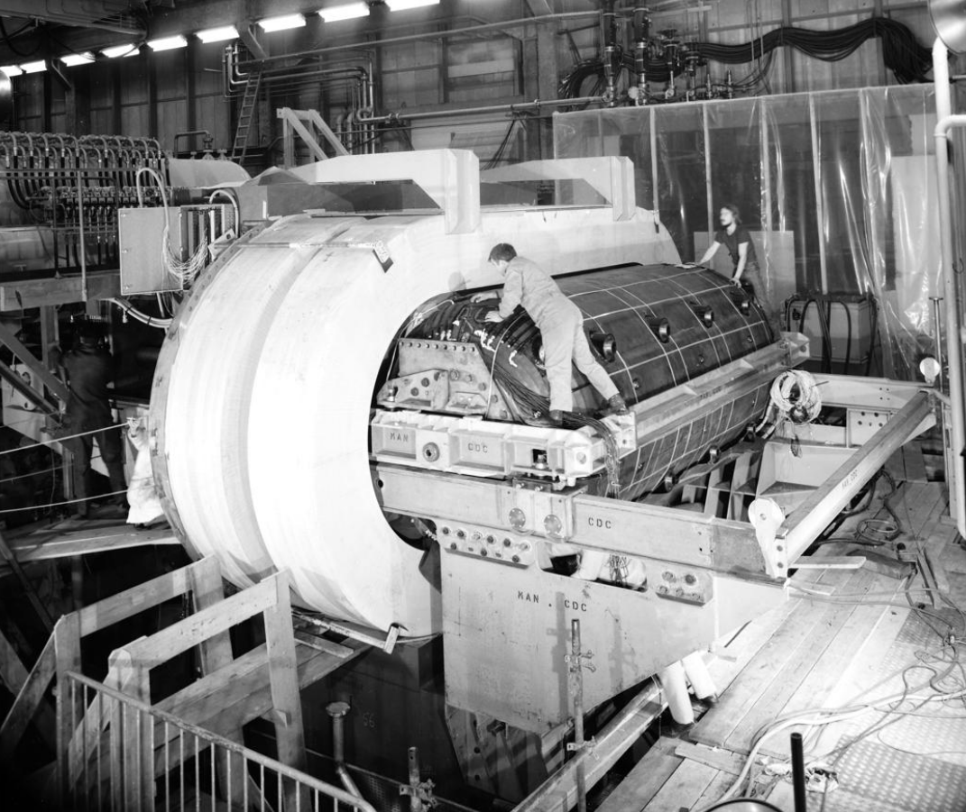
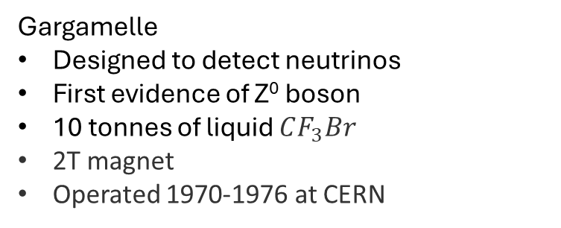
Early Bubble Chambers
Target
  Saturated vapour → superheated fluid
  Denser target → greater interaction probability
Operating conditions
  Pressure and temperature conditions more feasibly attainable than in cloud chamber
Gargamelle
Designed to detect neutrinos
First evidence of Z⁰ boson
10 tonnes of liquid $CF_{3}Br$
2T magnet
Operated 1970-1976 at CERN

Slide 6
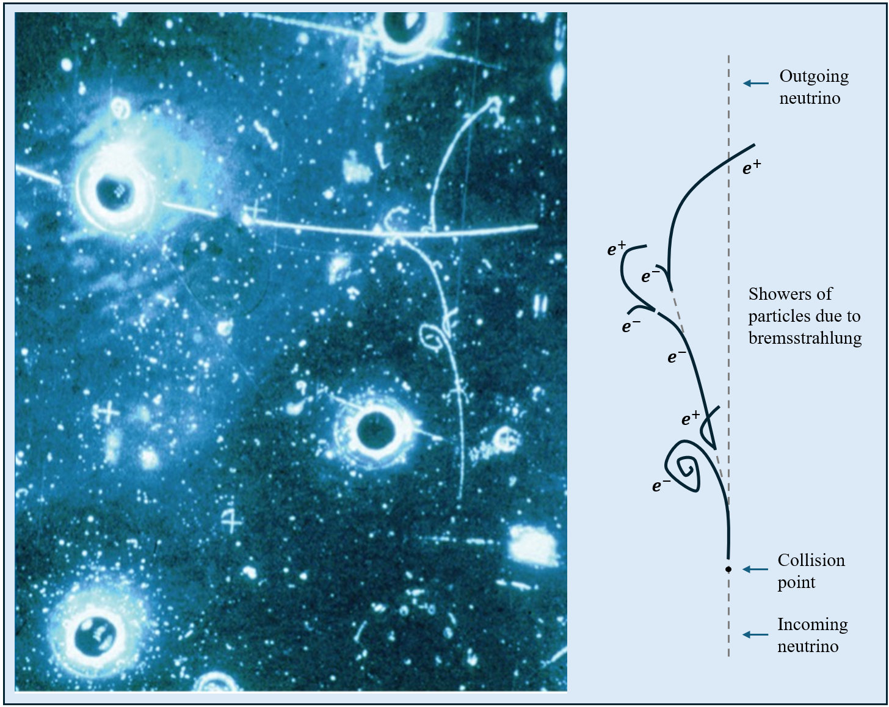
Early Bubble Chambers
Superheated target fluid
Trails of tiny bubbles created by energy depositions from charged particles
Visualize particle trails
  Validation of physical models
    Pair production, annihilation
    Weak neutral current
  Discovery of new physics
    Meson
 | First photograph of the weak neutral current by the Gargamelle Bubble Chamber in 1973 [CERN]
6
Notes:
Innovation on cloud chamber
Visualize particle interactions
Validated Weak neutral current
DM – strategically chosen threshold

Slide 7
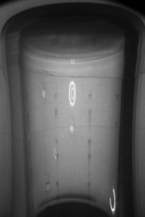
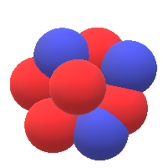






Bubble Formation & Growth
WIMP collision with nuclei in target medium causes a nuclear recoil
Recoil energy, $E_{R}$, is deposited into the surrounding target fluid
Causes localized boiling creating microscopic proto-bubbles
$$χ$$
A proto-bubble will continue to grow if $E_{R}>Q_{Seitz}$
Deposition length scale:
$$χ$$
target
$$Q_{Sietz}=4πr_{c}^{2}\left(σ−T\frac{∂σ}{∂T}\right)+\frac{4π}{3}r_{c}^{3}ρ_{b}\left(h_{b}−h_{l}\right)−\frac{4π}{3}r_{c}^{3}\left(P_{b}−P_{l}\right)$$
[2]
$$E_{R}$$
Surface Tension
Phase Transition
Expansion of Vapour
(3.1)
$$r_{l}=r_{c}{\left(\frac{ρ_{b}}{ρ_{l}}\right)}^{1/3}$$
7
Notes:
r_c is the critical bubble radius. Radius at which E_r = Q_Seitz

Slide 8
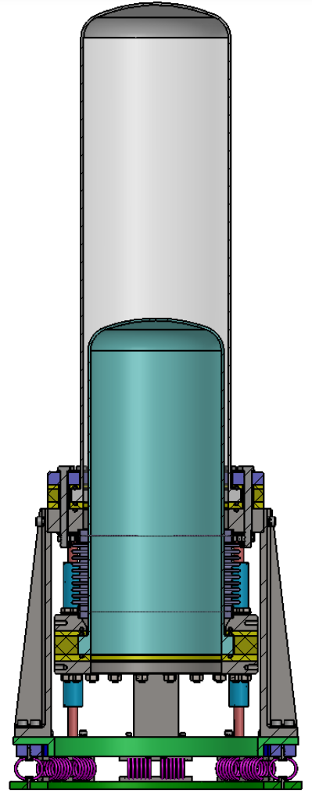
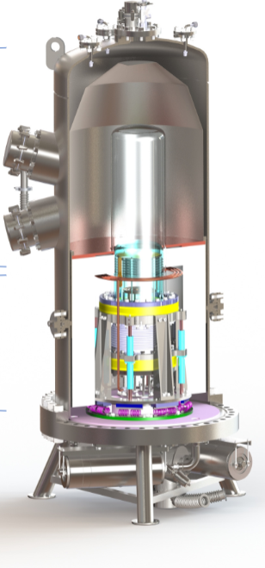
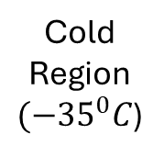
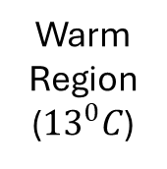
PICO-40L
Warm Region (${13}^{0}C$)
At SNOLAB 2km below surface
“Right-Side-Up” Design
  Bellows on bottom
  Removed buffer fluid (PICO 60)
Cold region prevents superheating the target fluid in contact with stainless steel bellows
Cold Region$({−35}^{0}C$)
8

Slide 9
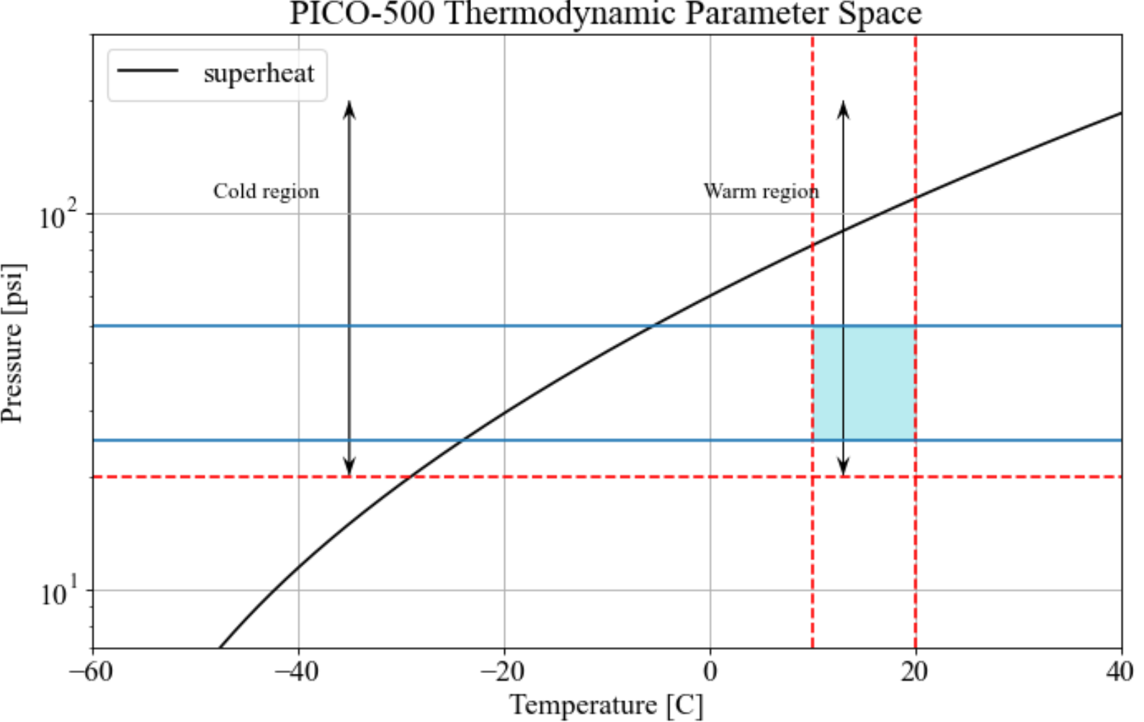
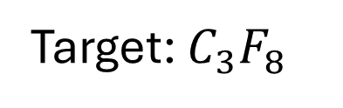
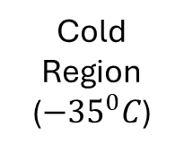
PICO-40L
Target: $C_{3}F_{8}$
Warm Region (${13}^{0}C$)
Cold Region (${−35}^{0}C$)
9

Slide 10
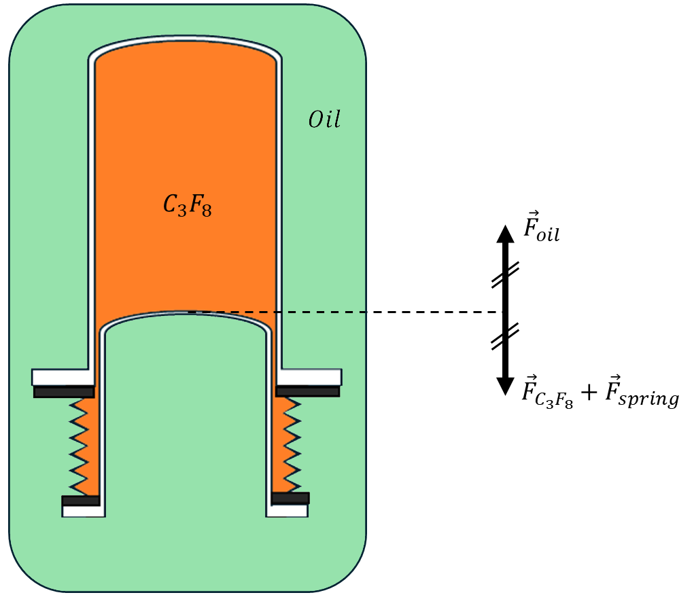


Pressure Control
$T_{warm}$ = constant = ${13}^{0}C$
Pressure Vessel
Target fluid inside nested silica jars
  Pressure is controlled by changing volume at fixed temperature
  Bellows move to compensate pressure differential across jars
$P_{oil}=P_{target}$
Outer Jar
Inner Jar
Bellows
10

Slide 11
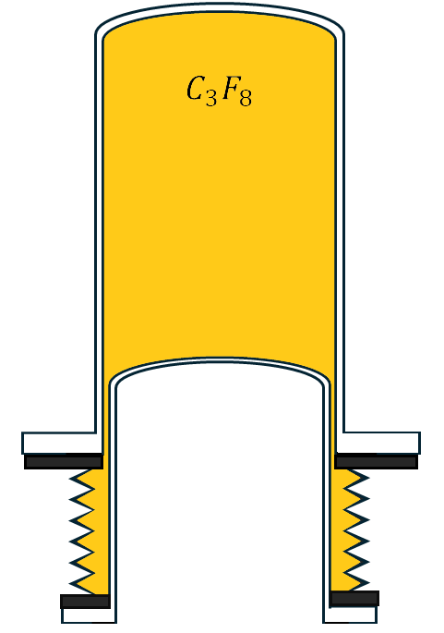
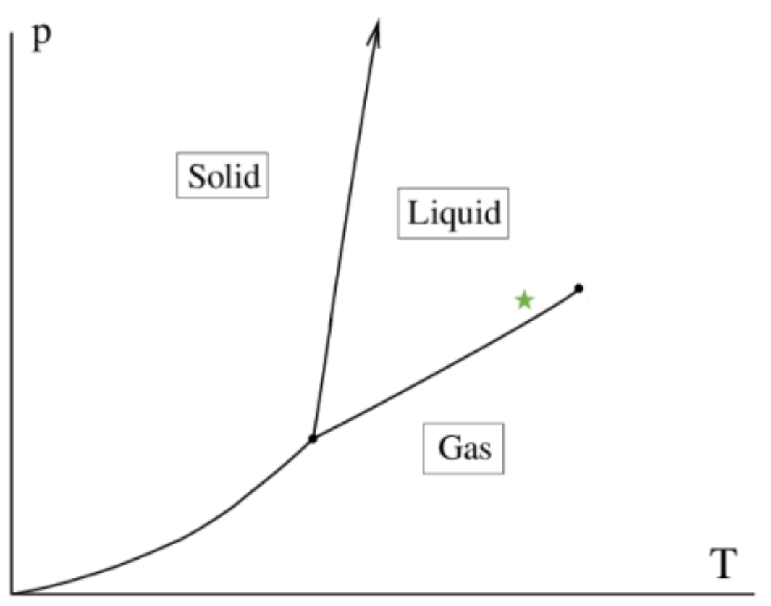
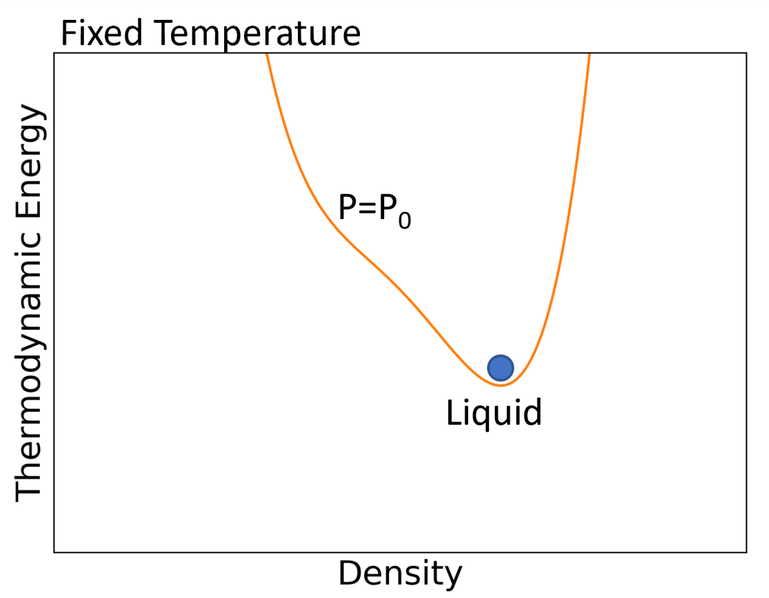
Compression Cycle
Detector state: compressed
Target state: liquid
neutral
11

Slide 12
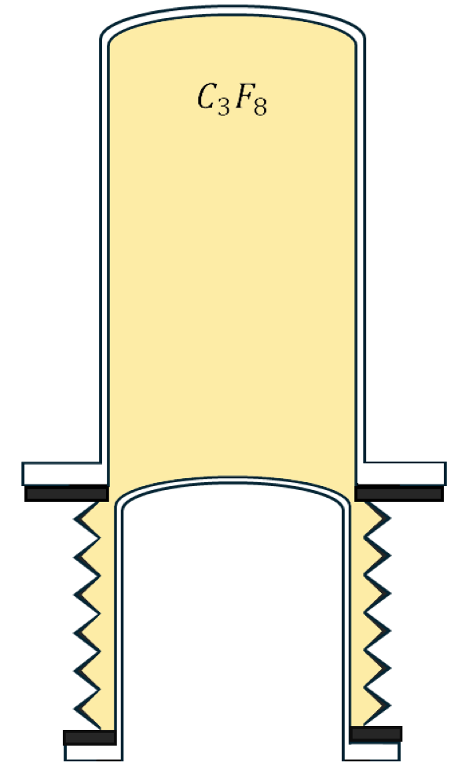
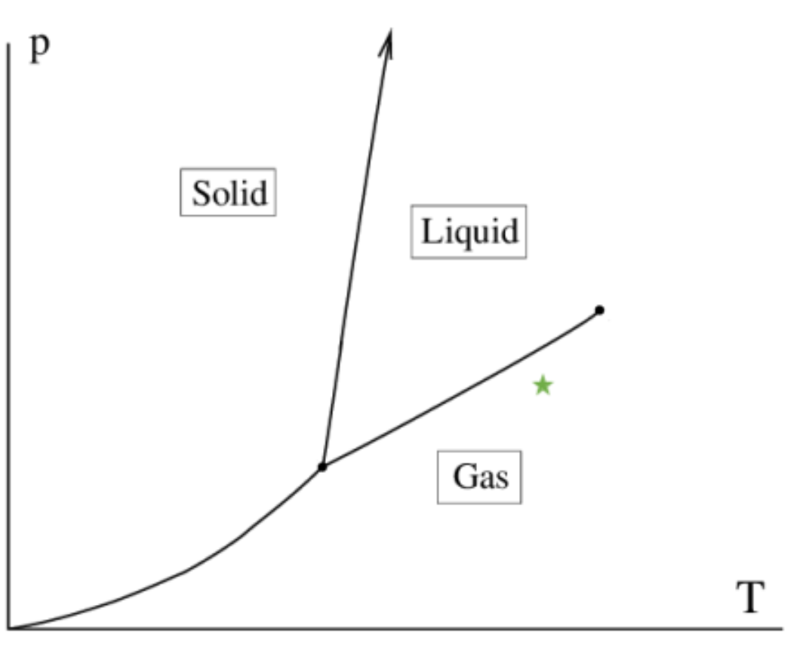
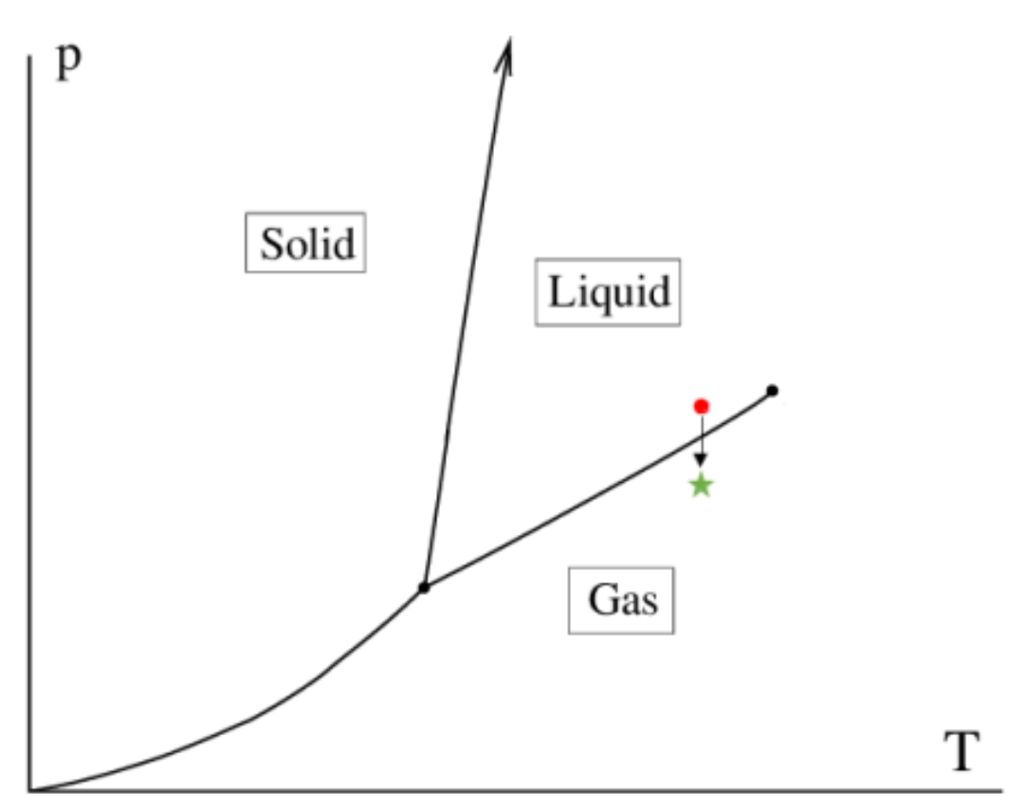
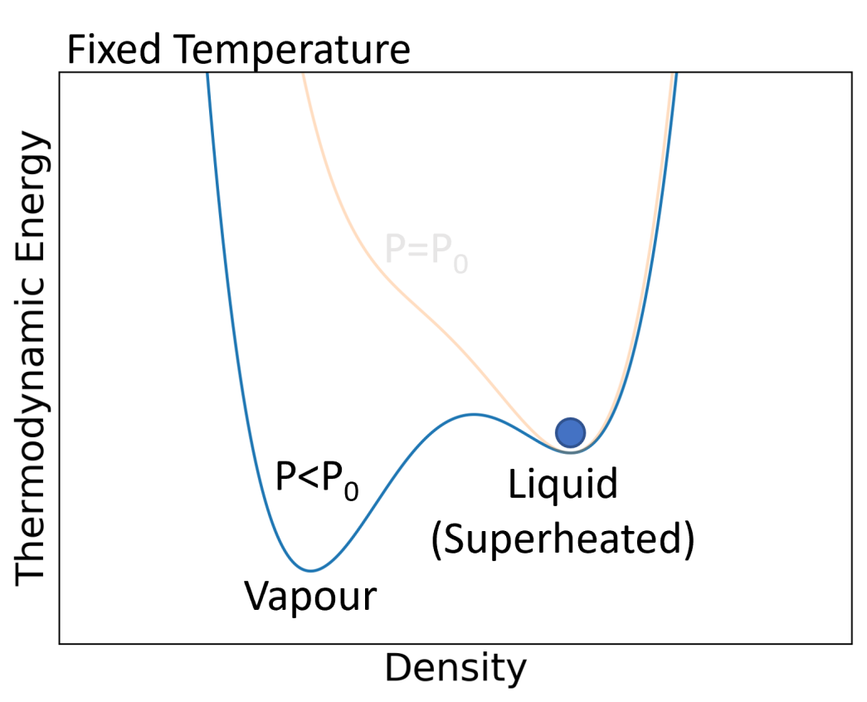
Compression Cycle
Detector state: expanded
Target state: superheated
neutral
12

Slide 13
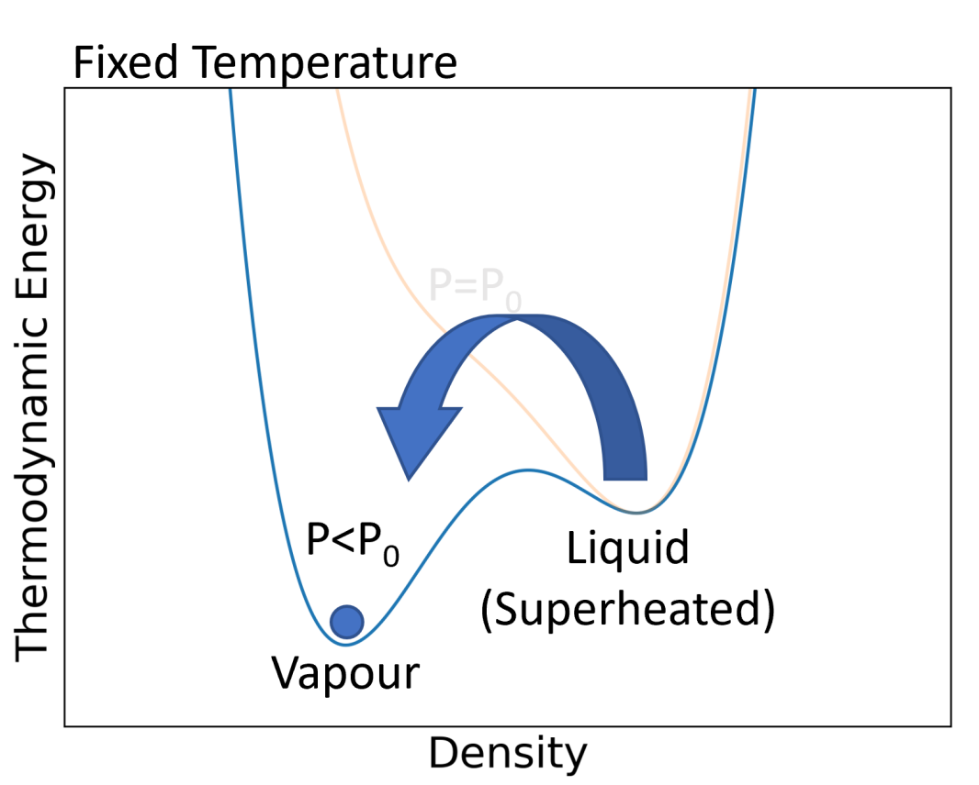

Compression Cycle
$$χ$$
Detector state: expanded
Target state: superheated – bubble!
neutral
13

Slide 14
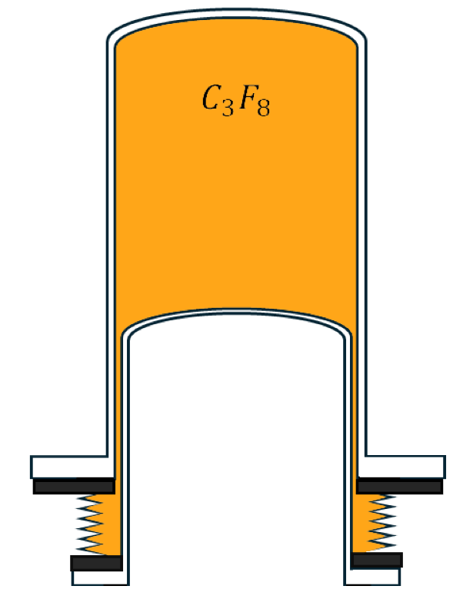
Compression Cycle
Detector state: compressed
Target state: liquid
neutral
14

Slide 15
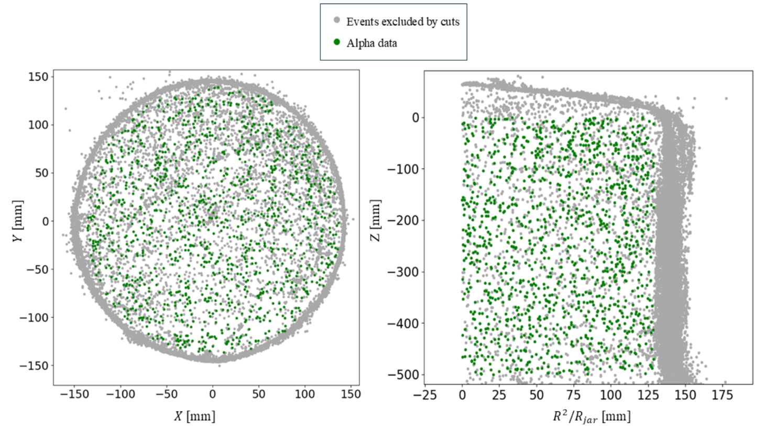
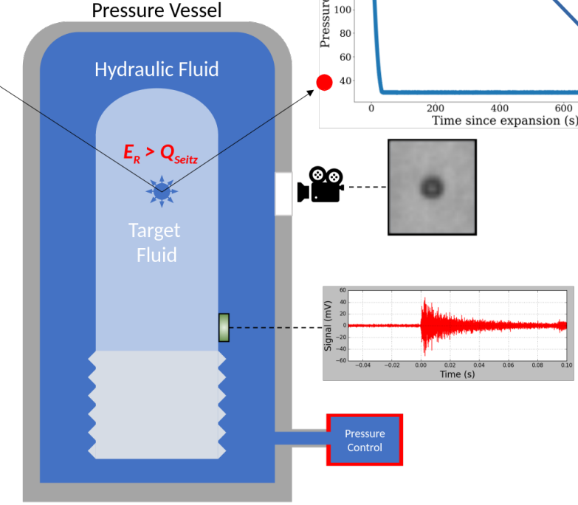
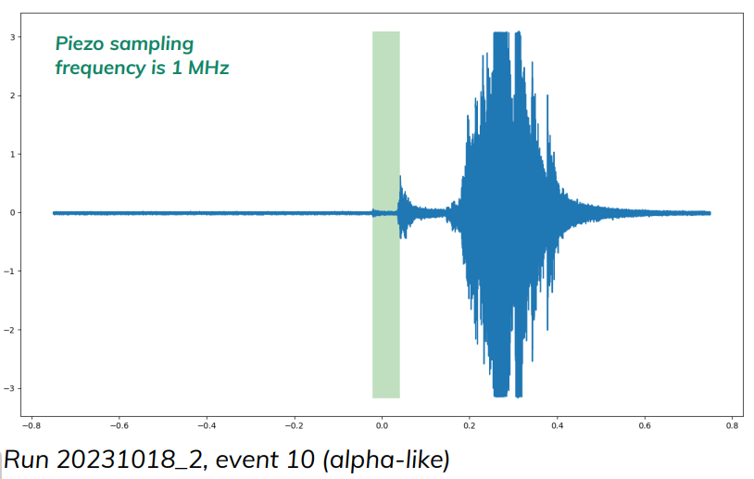
Data Acquisition
Optical position reconstruction
Acoustic signal (piezometric transducers)
15

Slide 16
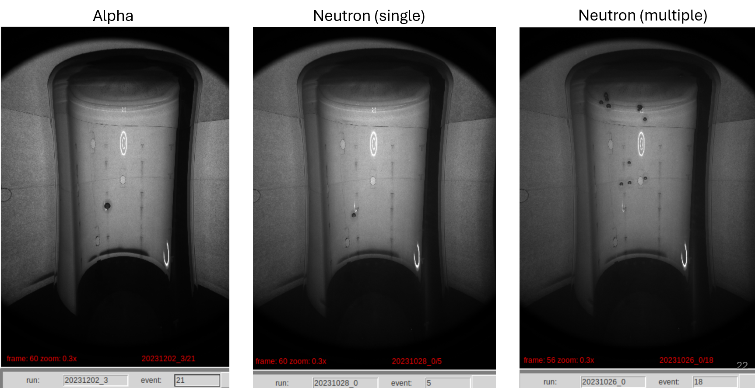
Bubble Types
16

Slide 17
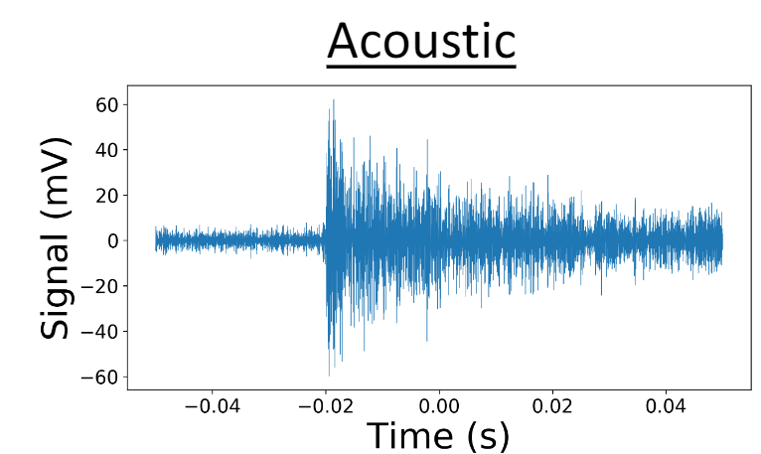
Acoustic Acquisition
Bubble
Recompression
Valves Open
17

Slide 18
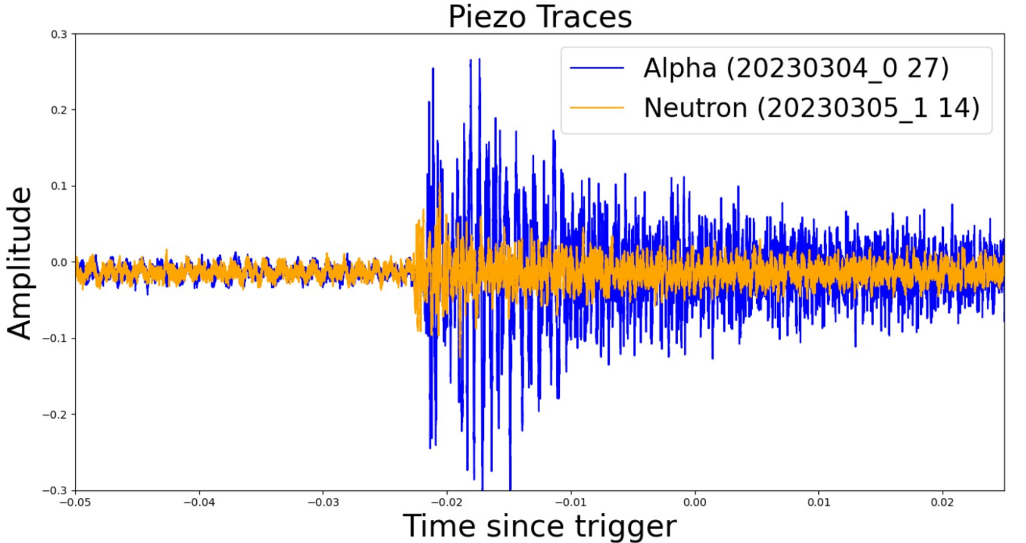

Acoustic Particle Discrimination
For each nucleation, a resonant energy, $𝓡$, is calculated from the frequency spectrum
$𝓡_{alpha }$> $𝓡_{neutron}$
Used to generate AP (Acoustic Parameter) histogram
18
18

Slide 19
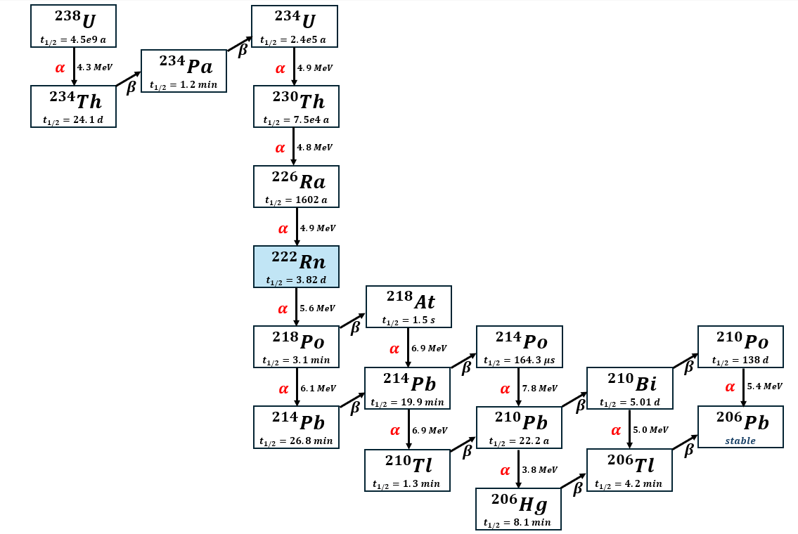
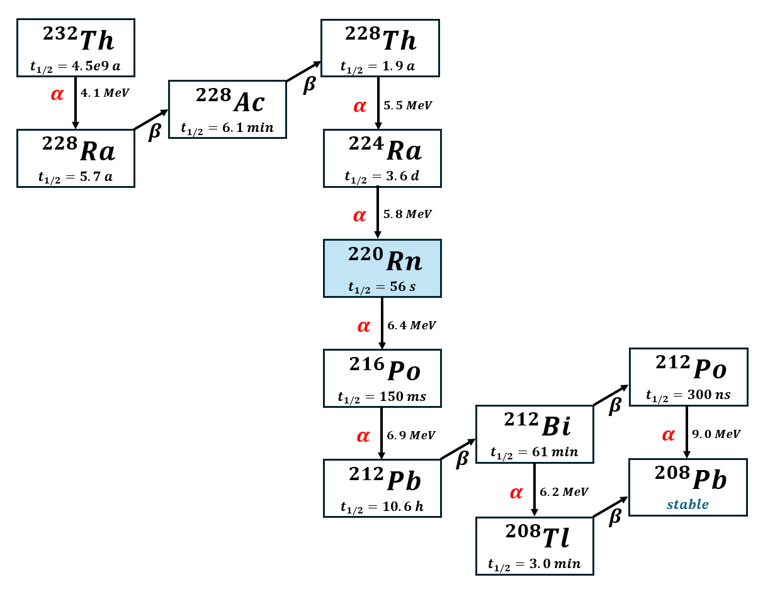


238-Uranium Series
232-Thorium Series
Gaseous Radon
$$t_{\frac{1}{2}}=3.82 d$$
$$t_{\frac{1}{2}}=56 s$$

Slide 20
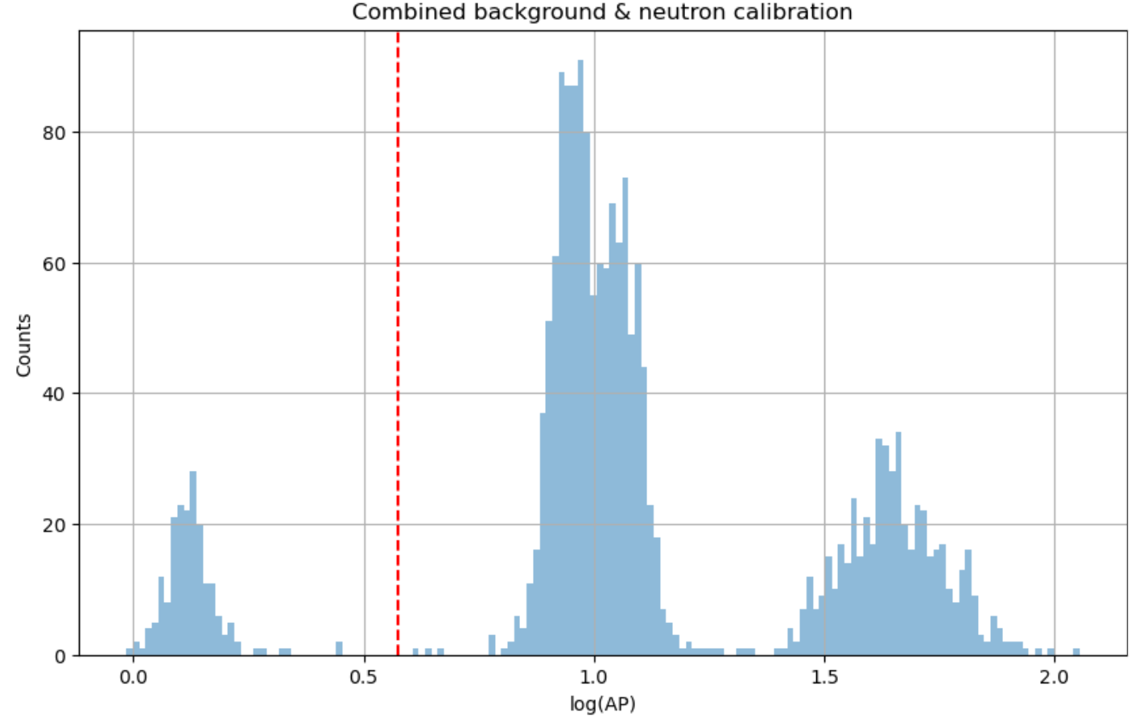
Acoustic Parameter (AP)
Region of interest: SS neutron calibration, WIMP
High AP: alpha decay region

Slide 21

PICO Detectors
Insensitive to electron recoil
Alpha rejection using acoustics
Ability to change active fluid
  Use different target nuclei
  Current target: $C_{3}F_{8}$ (SD WIMP-proton)
Tunable nucleation thresholds
  WIMP has a large range of possible masses and unknown interaction mechanism

Slide 22
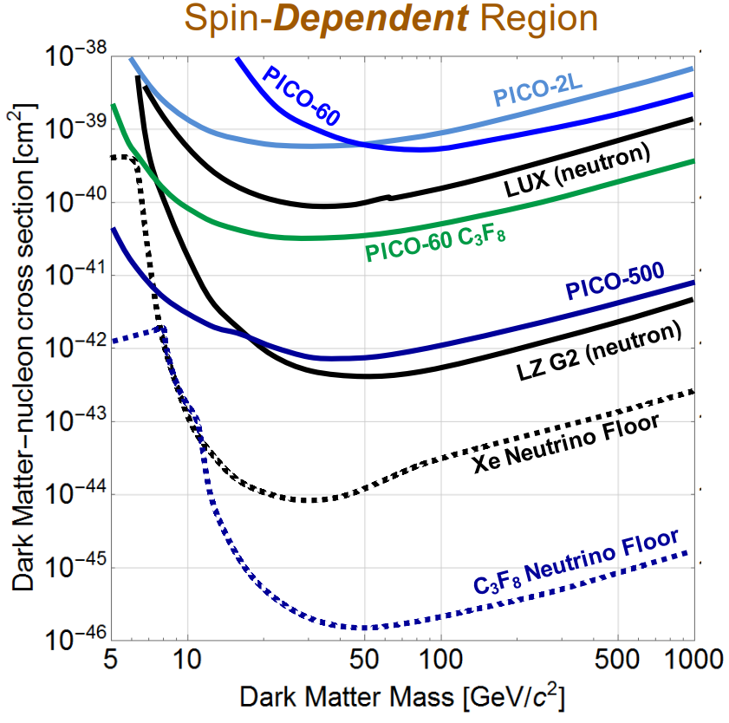
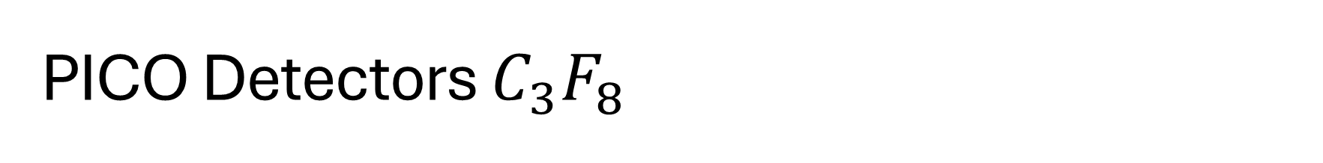
PICO Detectors $C_{3}F_{8}$
PICO program has significant SD reach.
Complementary to other DM experiments with SI interactions and higher mass reach.
Lower neutrino floor opens unique search region to PICO

Slide 23
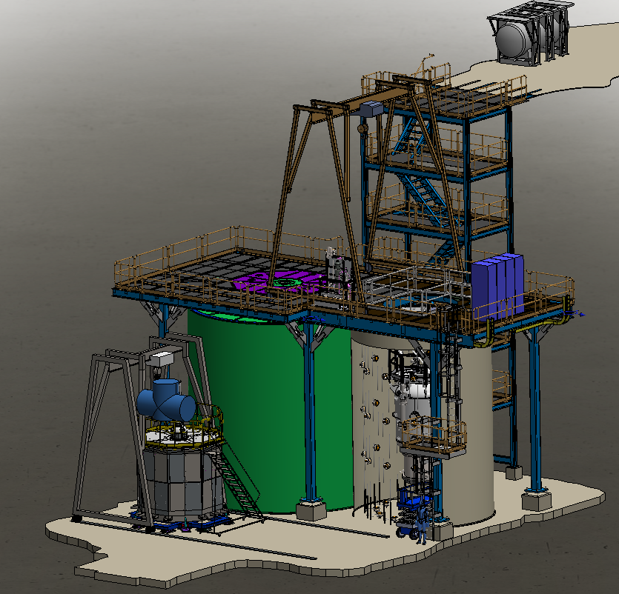
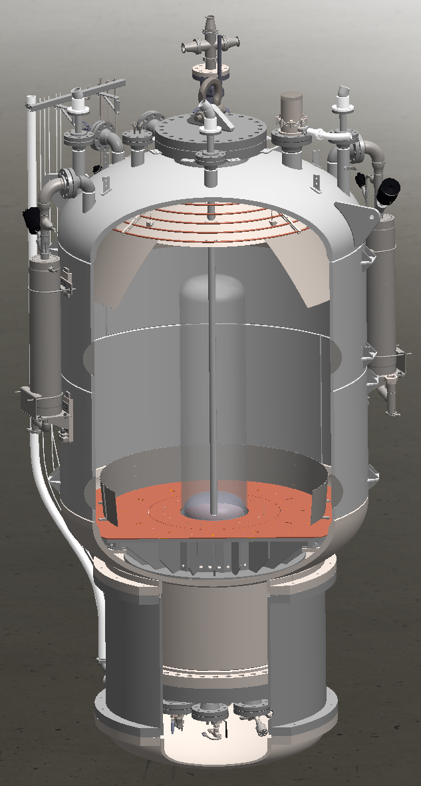
Agenda
PICO-500
Coming soon

Slide 24
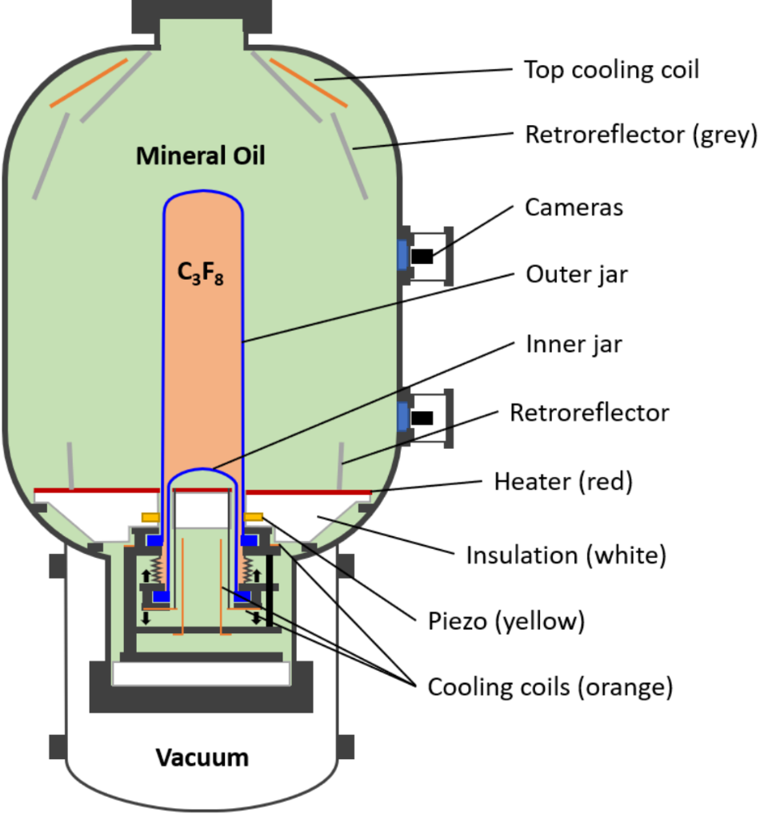
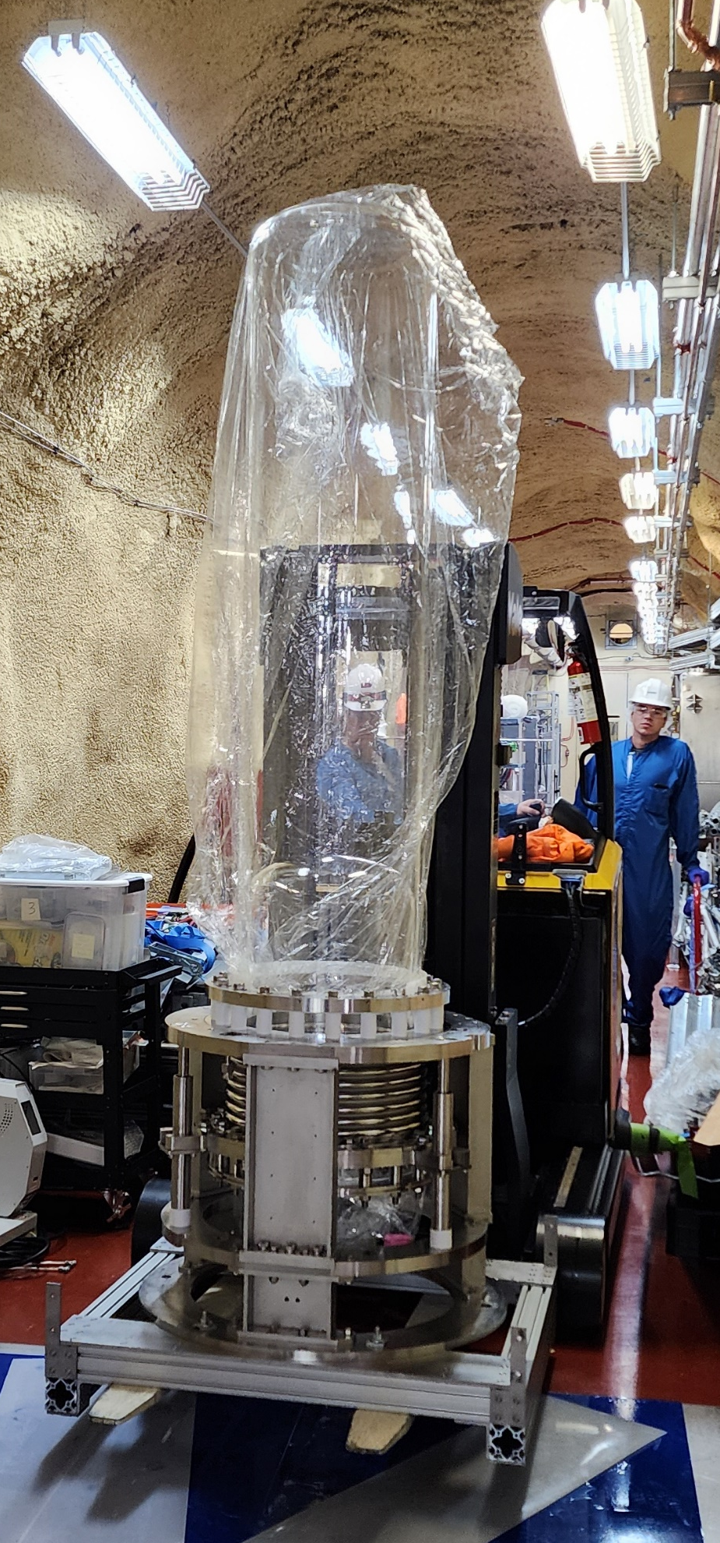
PICO-500
84” OD
Major New Features
260L target
Vacuum jacket
Muon Veto
Degassing Tank
Improved Heater design
Fully Connectorized
Engineering Design Reviews

Slide 25
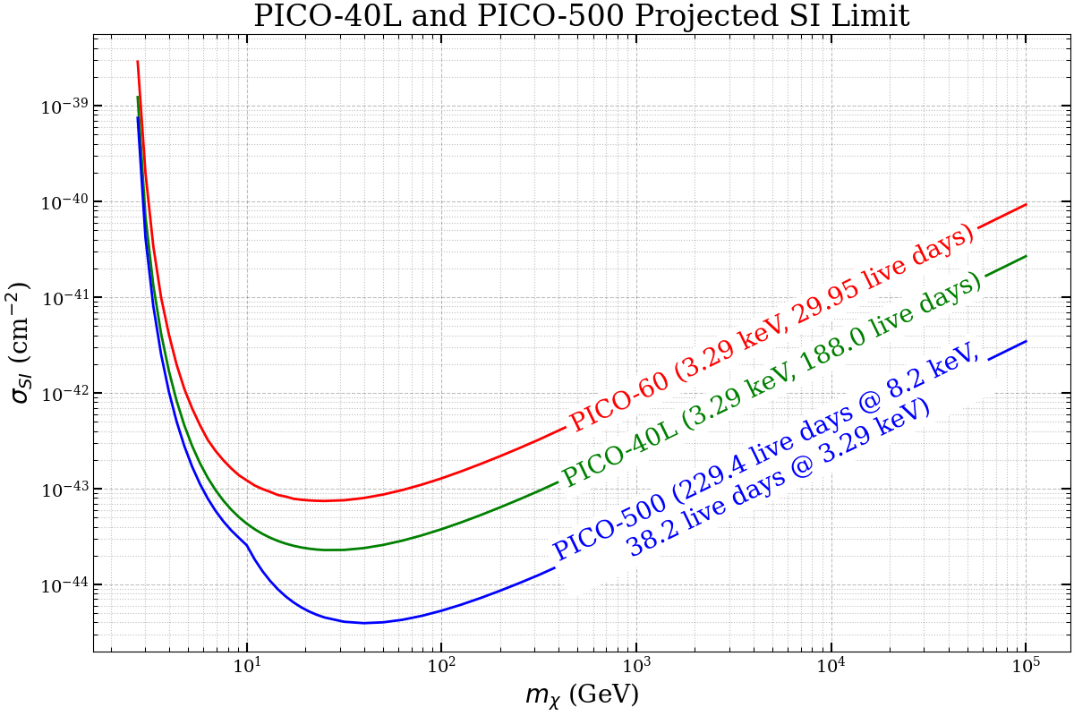
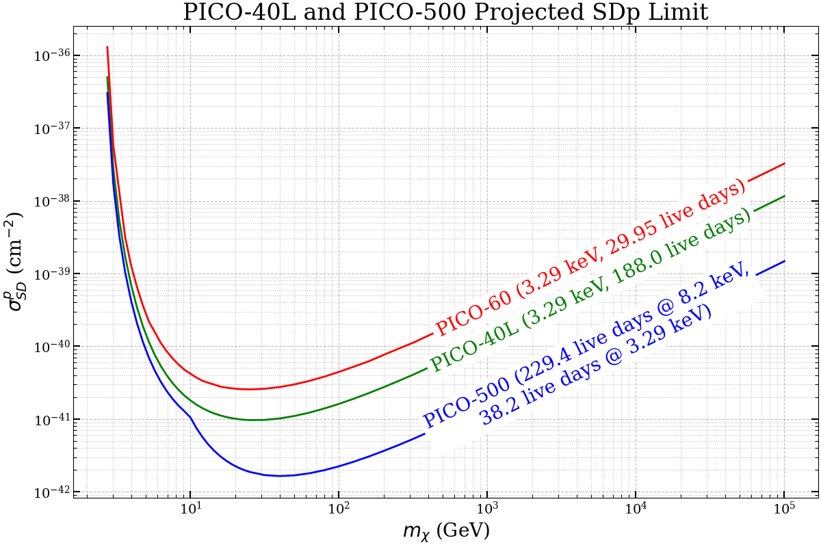
PICO Exposure Forecast
Spin-Independent Spin Dependent

Slide 26
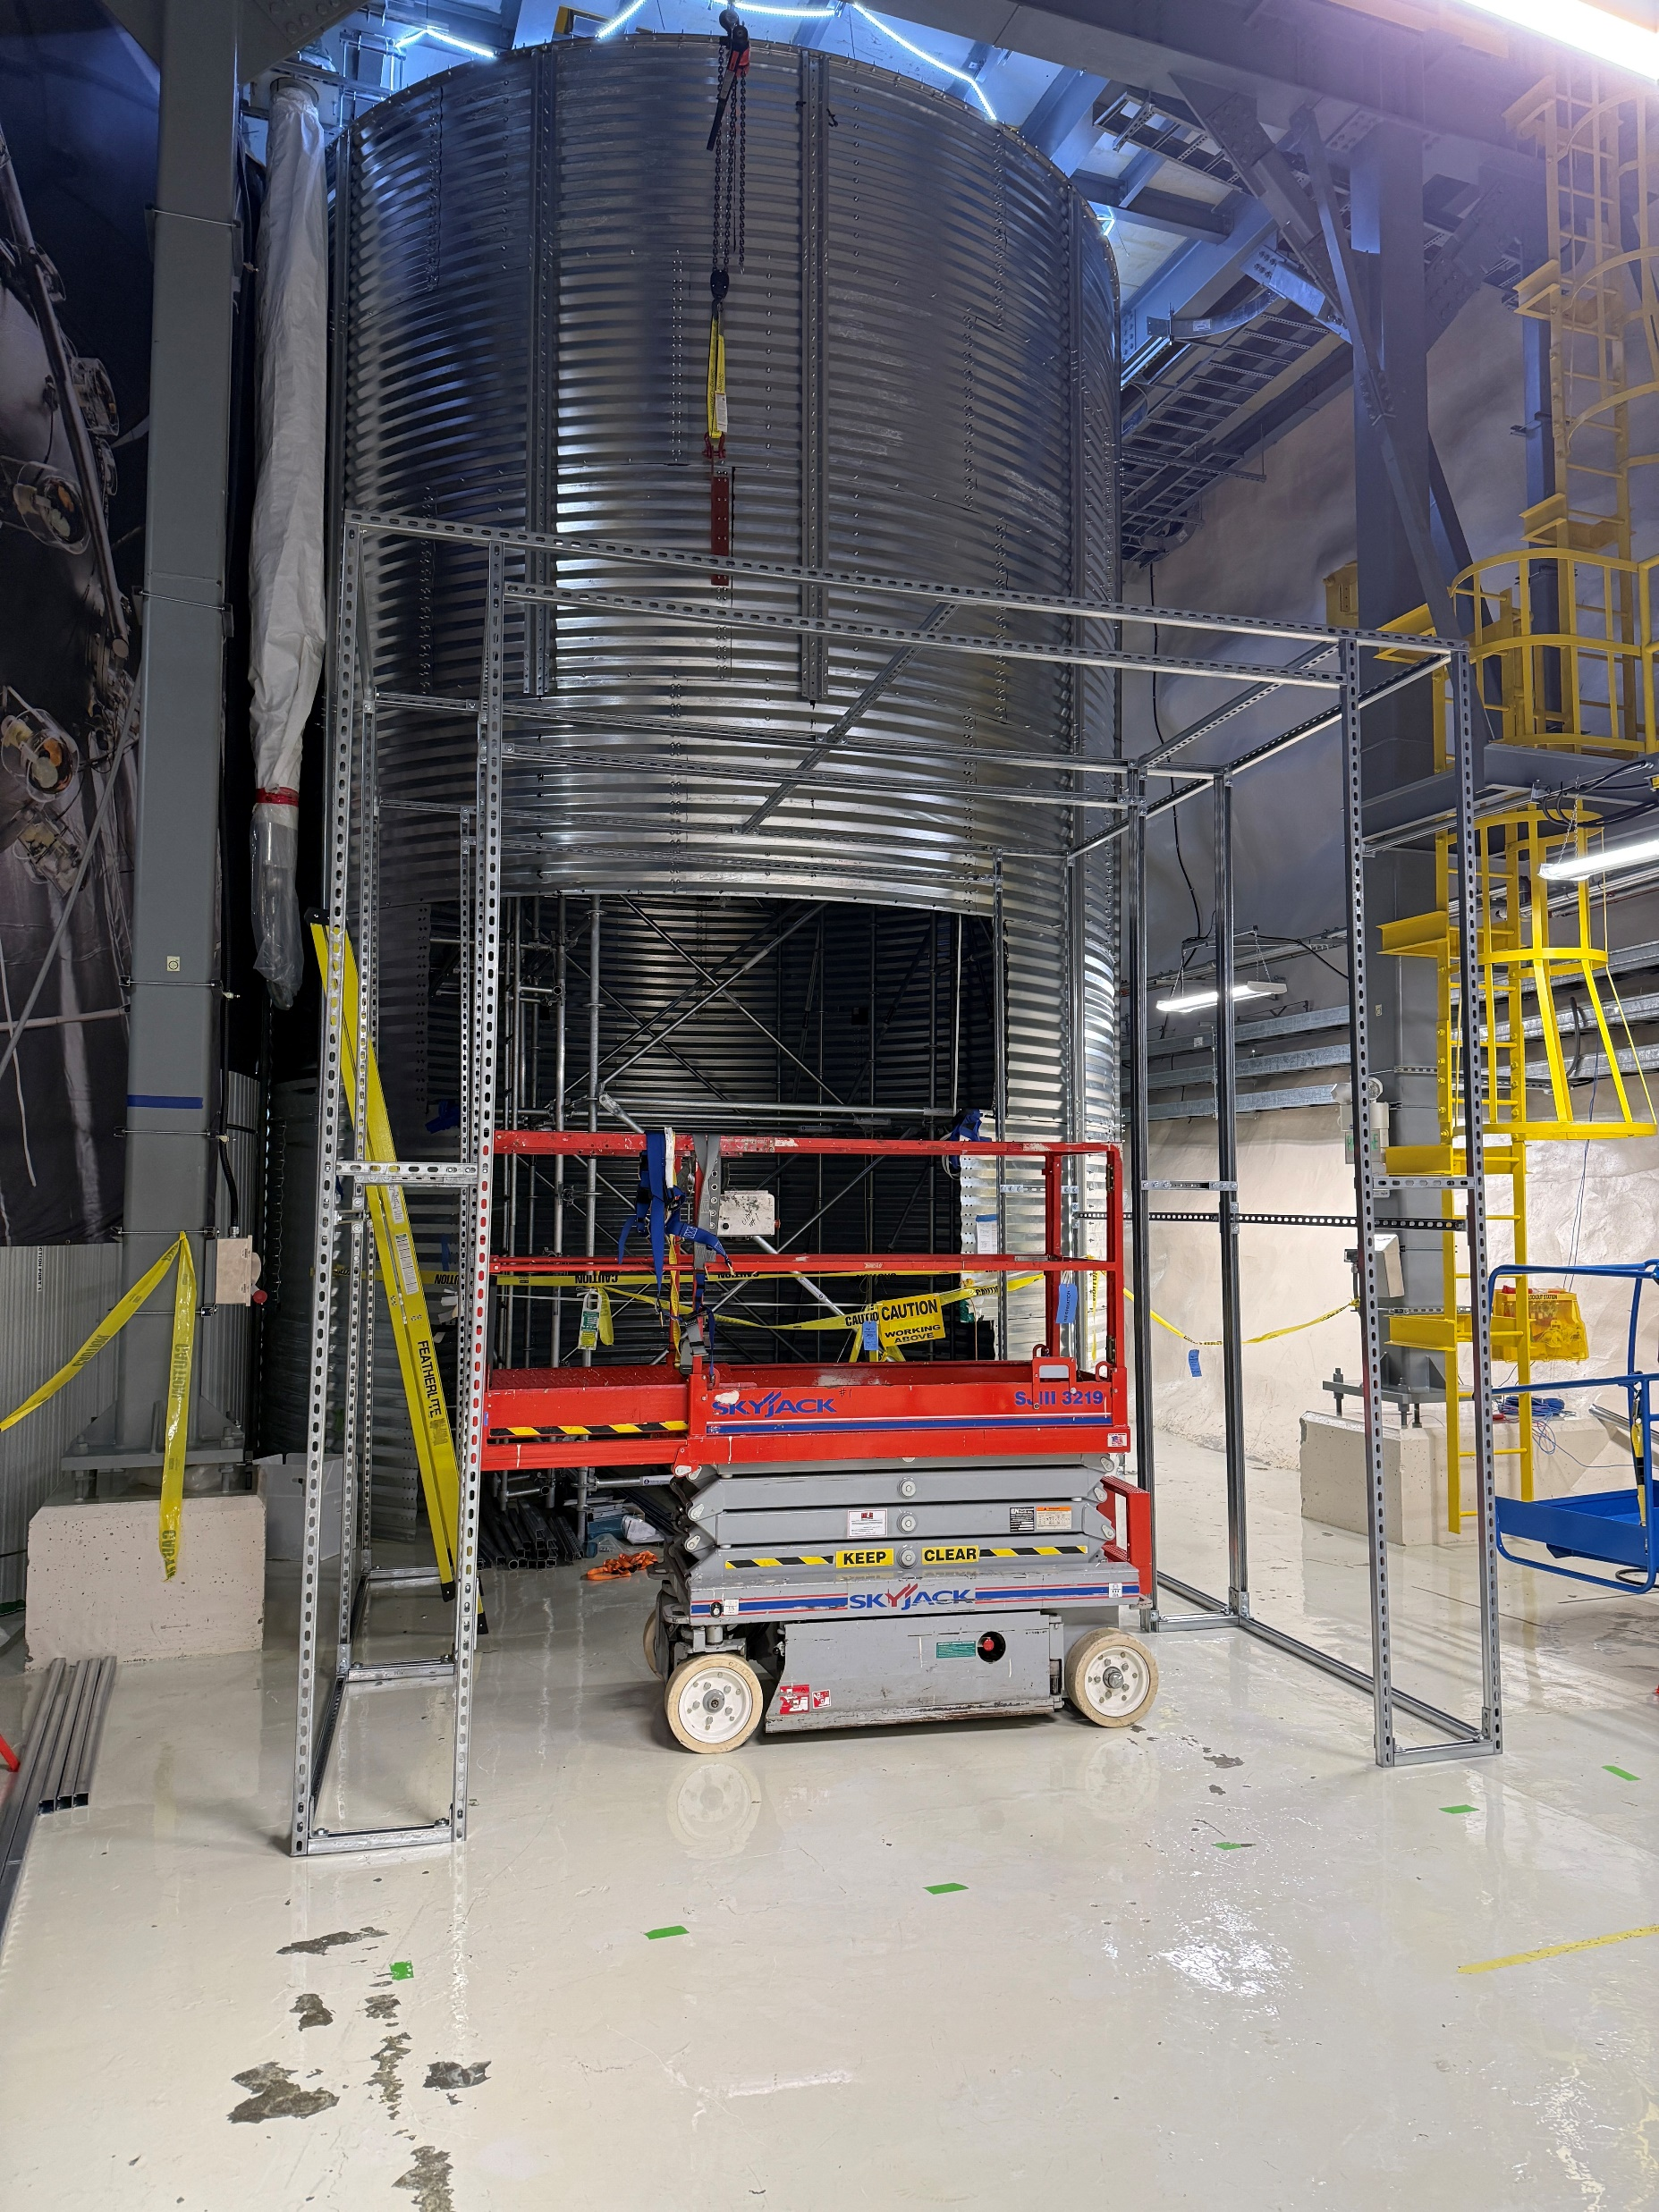

Water Tank
background shielding

Slide 27



Base Flange Assembly Table

Slide 28



Pressure Vessel

Slide 29

Pressure Vessel welding now!

Slide 30


Slide 31


Slide 32


Slide 33

Hello from inside the PV

Slide 34



















R. Filgas, D. Mamedov,
E. Rukhadze, I. Stekl
D. Priya, S. Priya, Y. Yan
C.E. Dahl
P.S. Cooper, M. Crisler, A. Sonnenschein
A. Acevedo-Rentería,
A. García-Viltres,
E. Vázquez-Jáuregui
O. Harris
R. Neilson
R. Castilloux, R. Fournier, P. Grylls, A. Mathewson,
I. Lawson, M. Ralph, S. Sekula
J. Basu, M. Das,
V. Kumar
J.I. Collar
M. Baker,S. Fallows,
C. Krauss, Q. Malin, S. Miller,
M. Rangen, C. Rethmeier,
P. Welingampola
E. Behnke, C. Cripe,
I. Levine,
E. Adams, M. Bai, K. Clark, J. Corbett,
D. Cranshaw, M. Dean, K. Dering,
G. Giroux, H. Herrera, A. Mir
C. Moore, N. Moss, A. Noble, M. Robert
I. Brooklyn Varela, L. Desmmarais,
P. Frédérick, M. Laurin, V. Monette,
H. Nozard, A. Robinson, J. Savoie,
N. Starinski, V Zacek, C. Wen Chao
J. Farine, A. Le Blanc,
C. Licciardi, U. Wichoski
I. Arnquist, C.M. Jackson,
B. Loer
Notes:
34

Slide 35
Thank You!
35

Slide 36
References
[1] | https://home.cern/news/news/physics/forty-years-neutral-currents
[2] | https://doi.org/10.1103/PhysRevD.100.082006
[3] | https://lss.fnal.gov/archive/2017/slides/fermilab-slides-17-012-ae-e.pdf

Slide 37



Alpha
What do bubbles sound like?
Neutron
Credit: Stephen Sekula

Slide 38

PICO TDR, Internal Documentation

Slide 39

Superheat Principle
*Plots from Eric Dahl
As pressure decreases, minimum free energy appears at vapor state μ_{v} .
Energy barrier keeps system at metastable liquid state μ_{l} – liquid is “superheated”.
Sufficient energy deposition within a small radius can overcome the energy barrier and form a bubble.

Slide 40

Stopping Power
Particles with higher stopping power are more likely to nucleate bubbles
Major advantage of bubble chambers: electron recoils are extremely inefficient at nucleating bubbles due to low stopping power
Detectors are designed to budget less than 1 gamma event in their dark matter search periods
P. Mitra (2018). PhD thesis
Notes:
Neutrons come from:
Radioactive impurities in detector materials
Induced by high energy gammas emitted after neutron or alpha captures in rock
Induced by cosmic muons – muon spallation, muons start EM showers and photons get absorbed by nuclei causing them to decay, hadronic cascades induced by muon
In order to achieve deposition of the threshold energy within a short enough track, the interacting particle needs to have a high enough stopping power – it must lose a certain amount of energy per unit length. This plot shows the stopping power for various particles of different energies. What we don’t want to see in our detector is gammas or electrons, and one of the main advantages about bubble chambers is that they are intrinsically nearly insensitive to electron recoils because of the low stopping power of electrons. We use a very very hot gamma source to probe those extremely rare electron recoil events to characterize the gamma rejection of the detector, and choose a threshold that is as sensitive as possible to wimps and as insensitive as possible to gammas.
Great, but you might notice we have a problem up here, especially with 222-Rn alphas, given that radon likes to settle to the floor, and we happen to be operating in the deepest underground physics lab on the planet.

