Slide 1

Conclusion of the 7th edition of the
International Workshop On Nuclear Data for Reactor applications

Slide 2
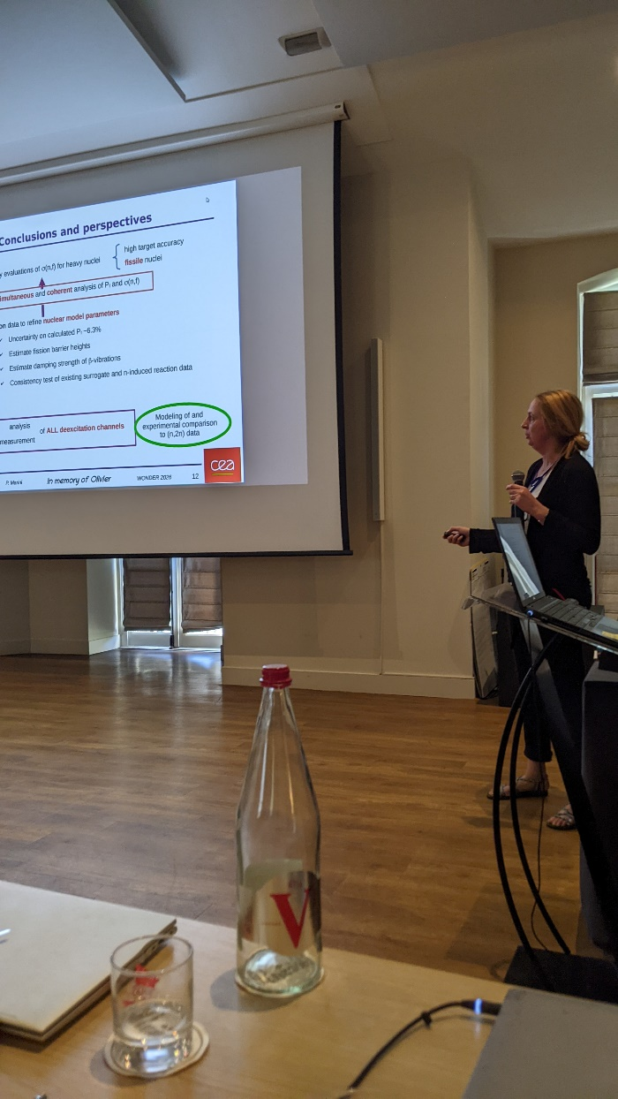

Slide 3
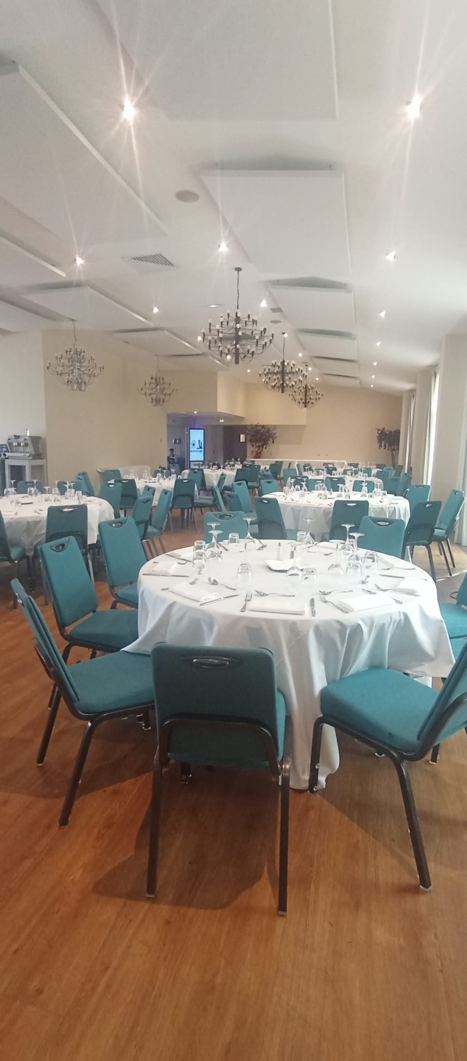
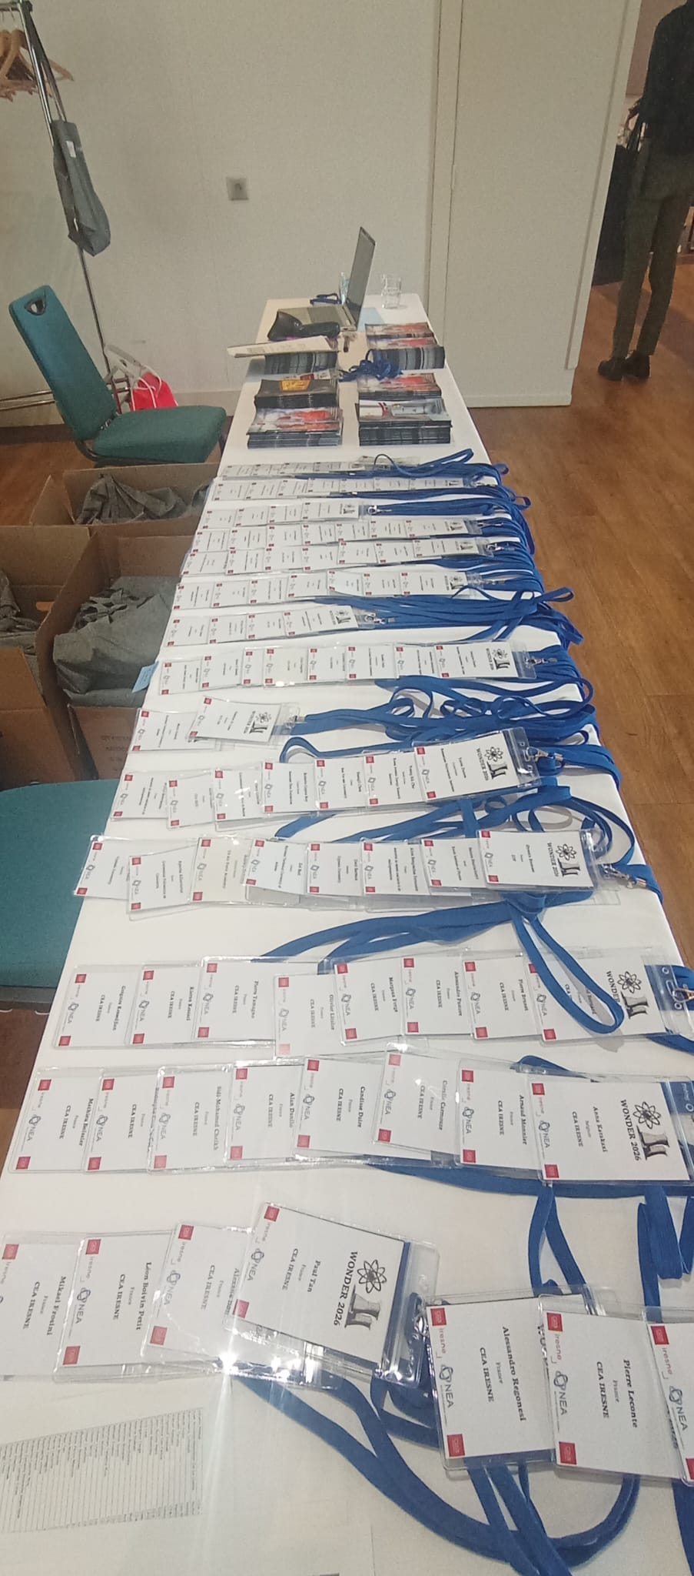
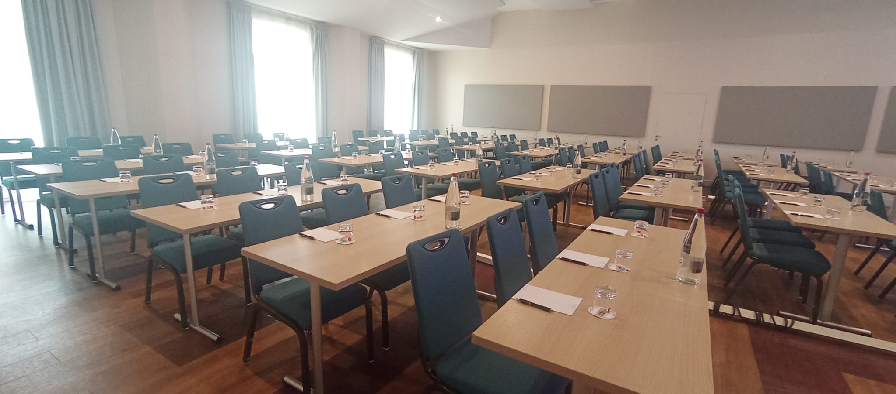

Slide 4
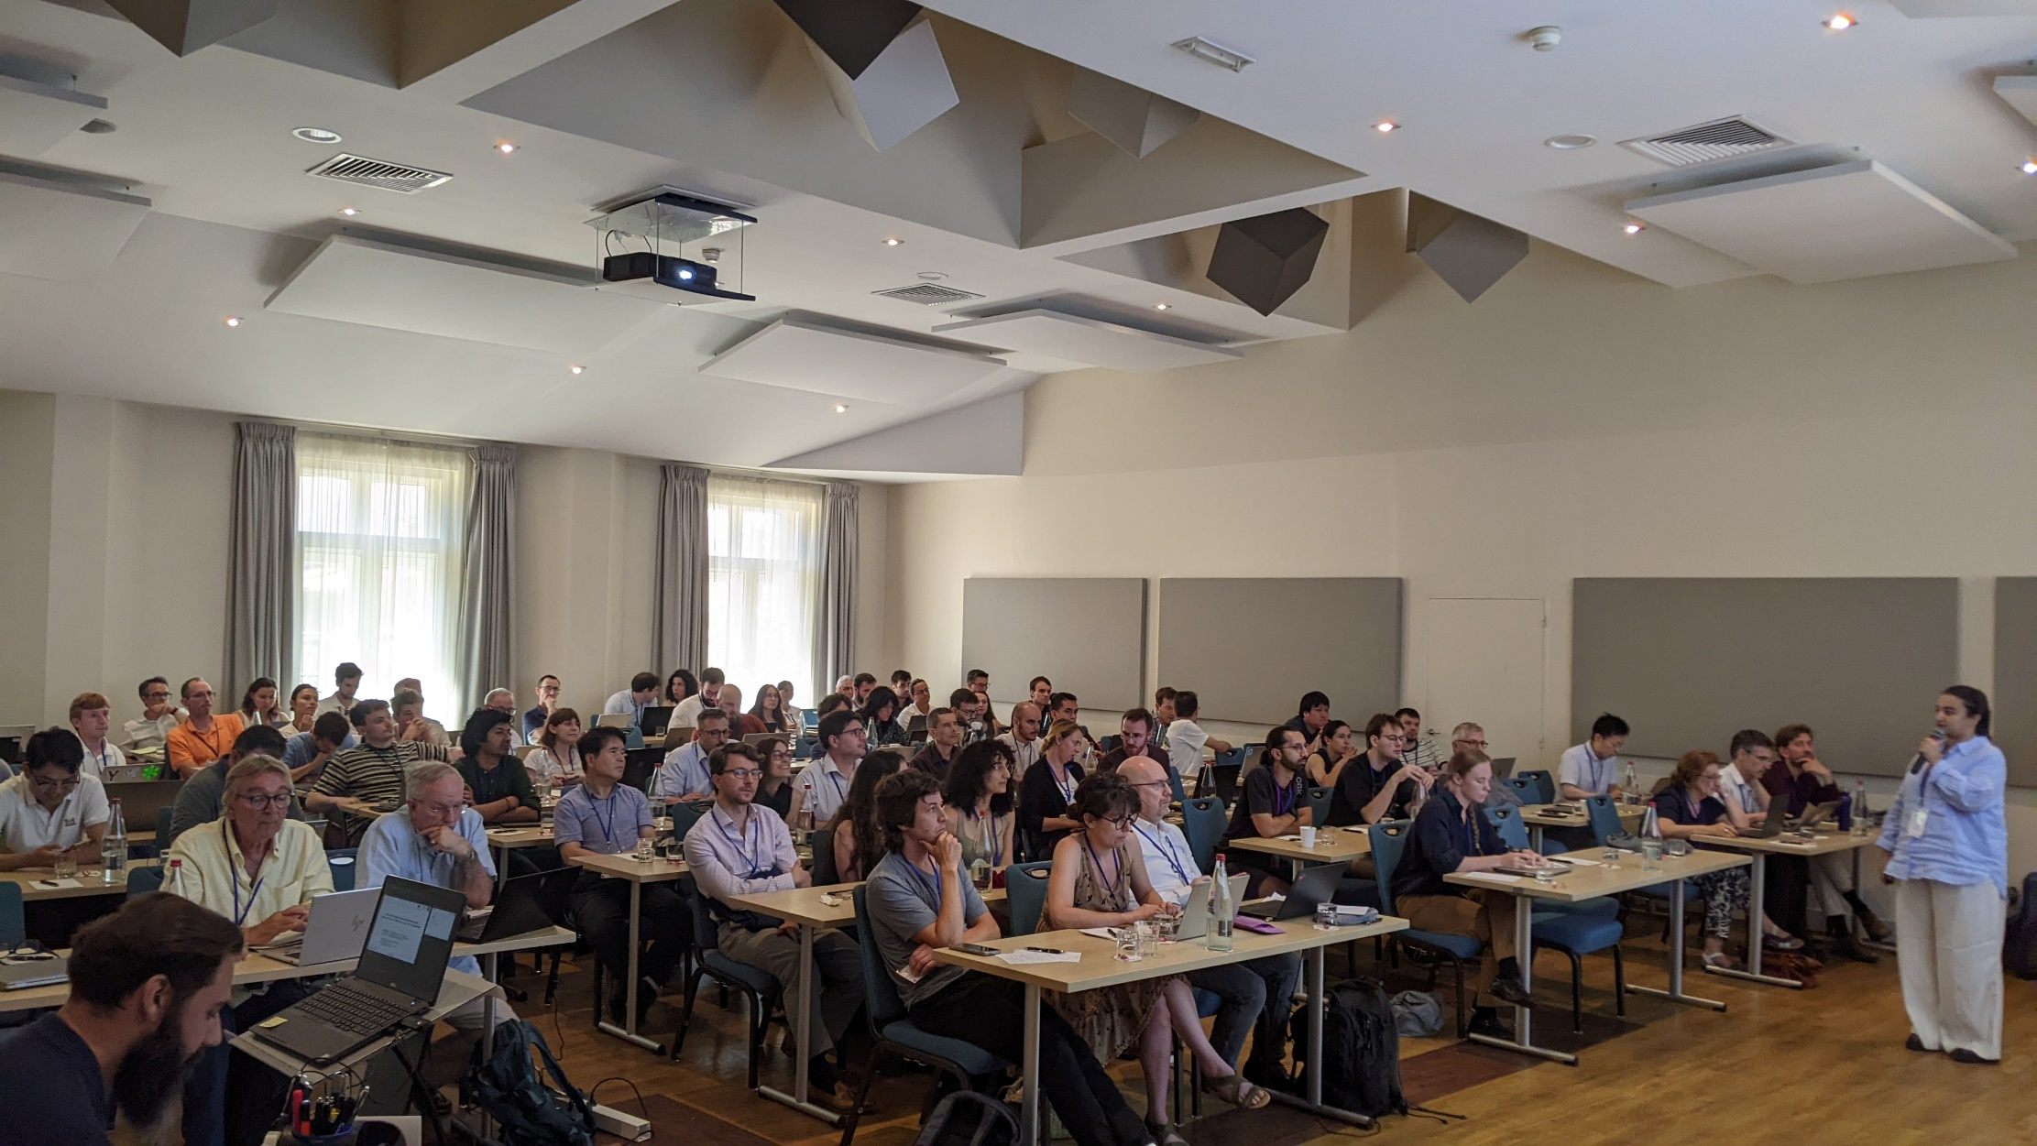

Slide 5
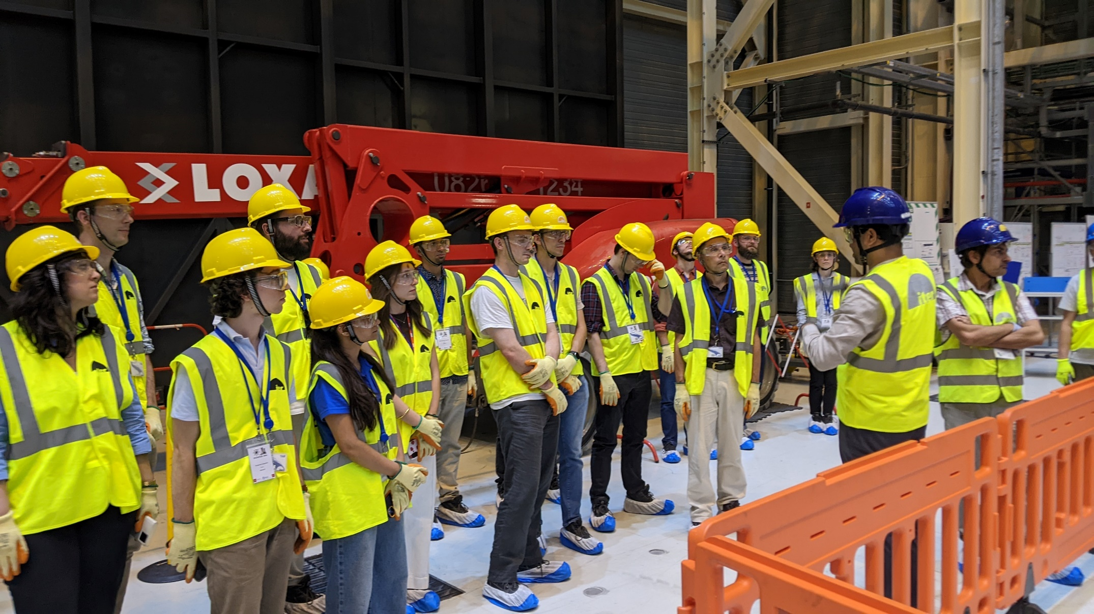
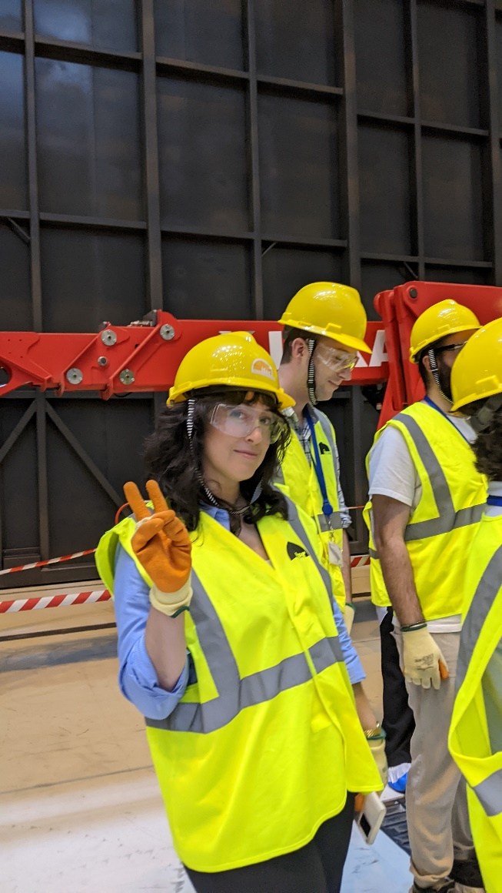

Slide 6
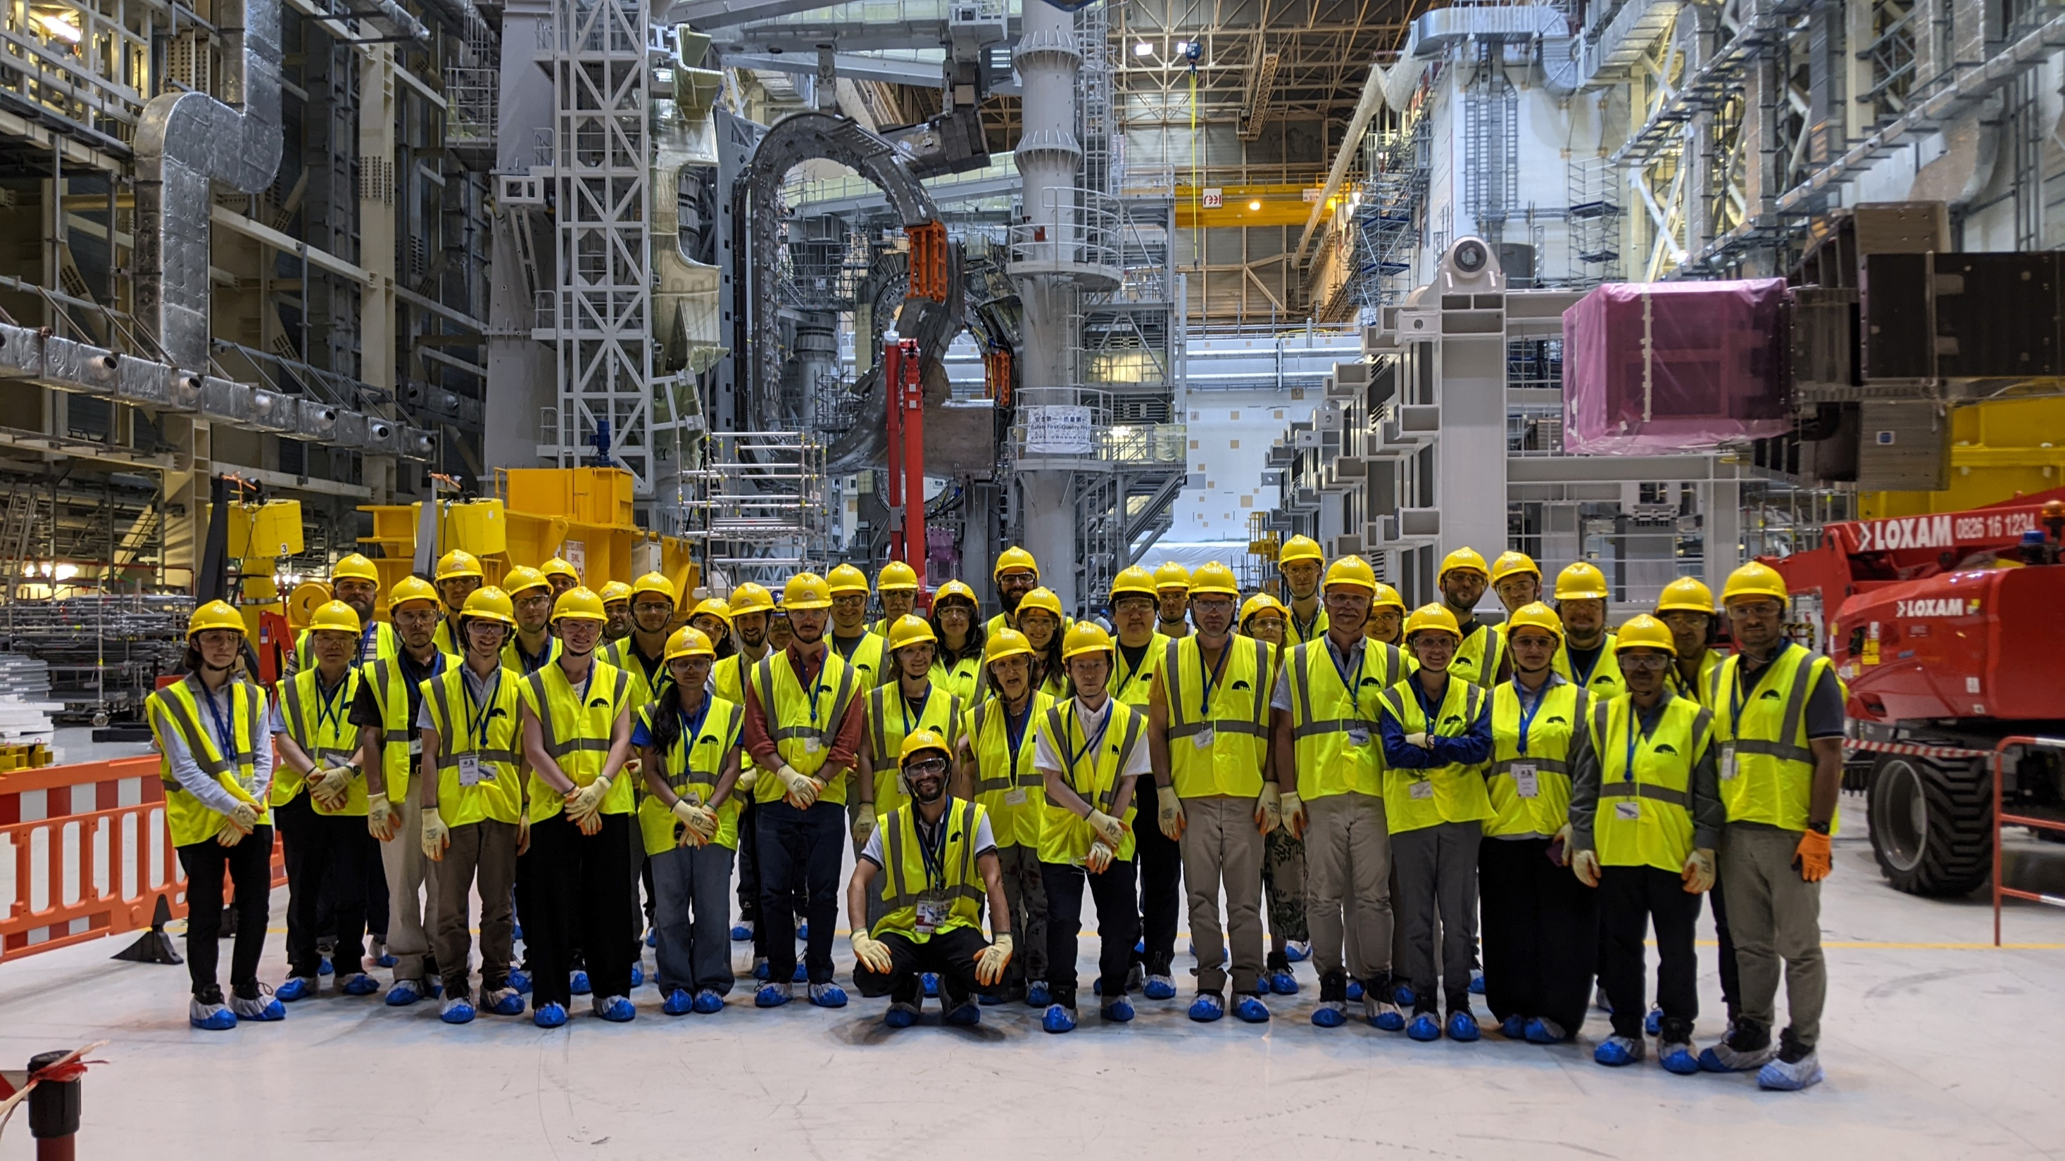

Slide 7
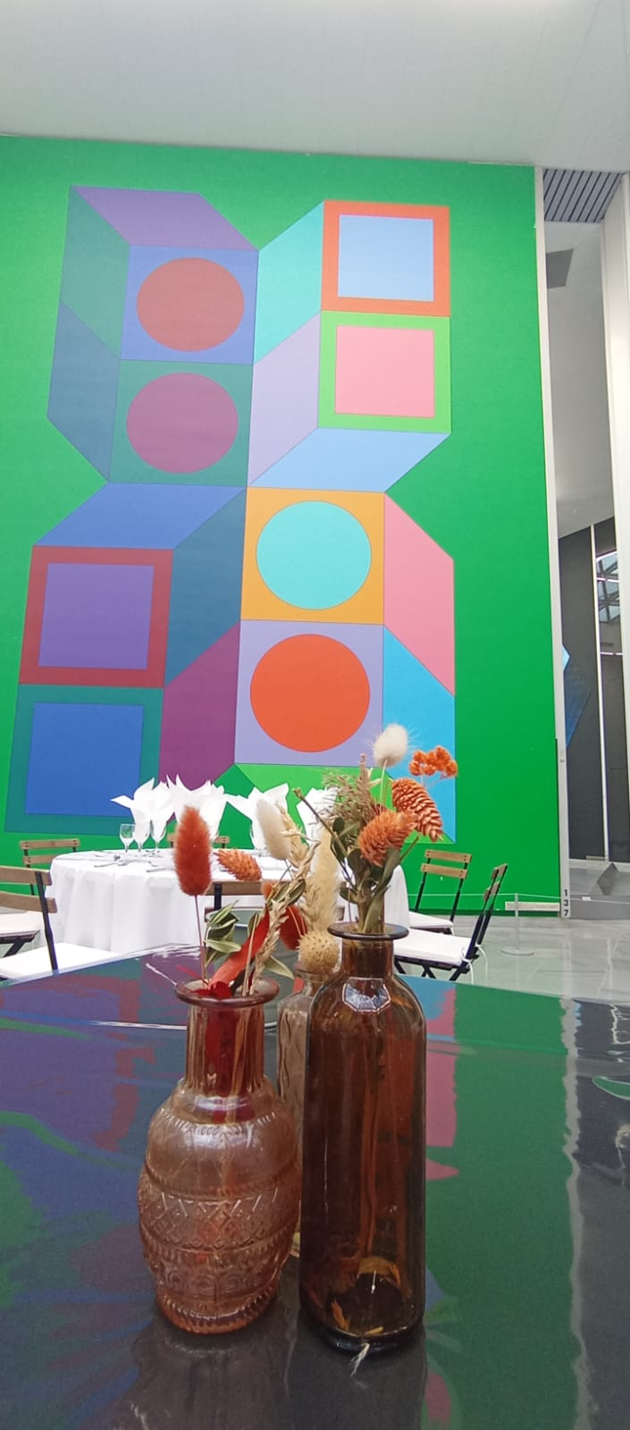
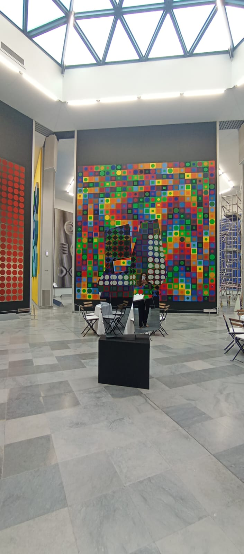
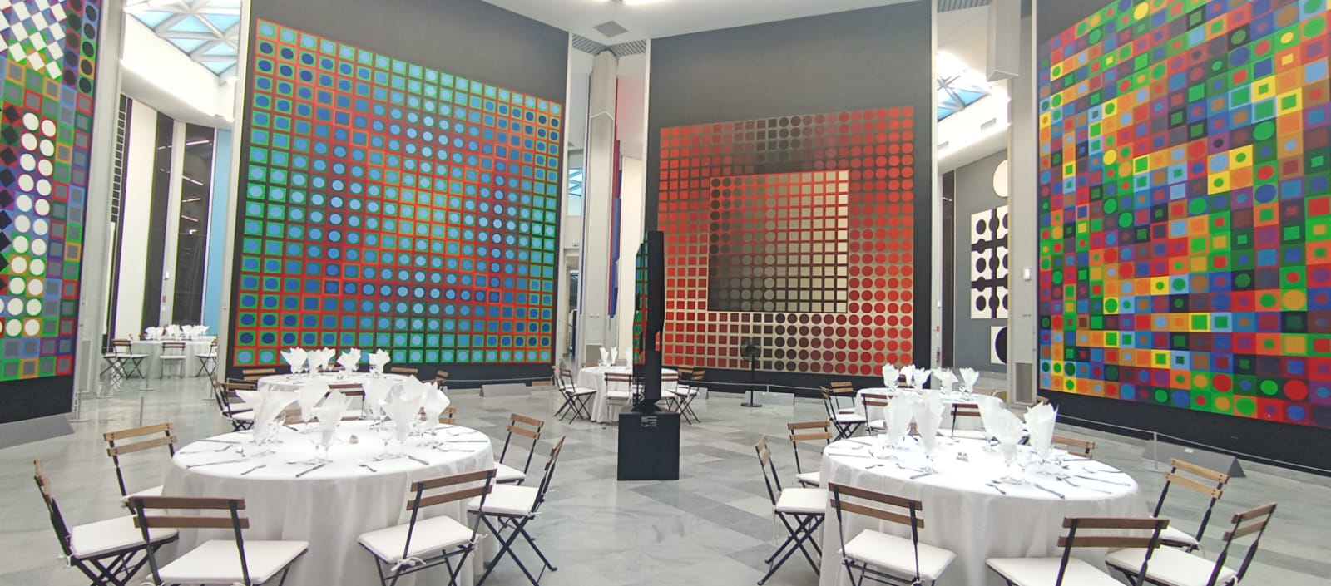

Slide 8
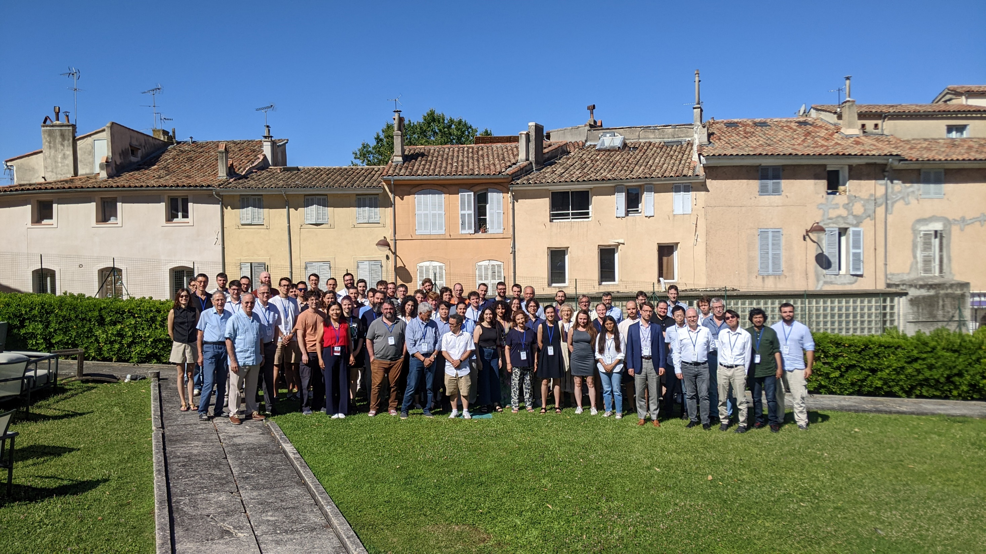
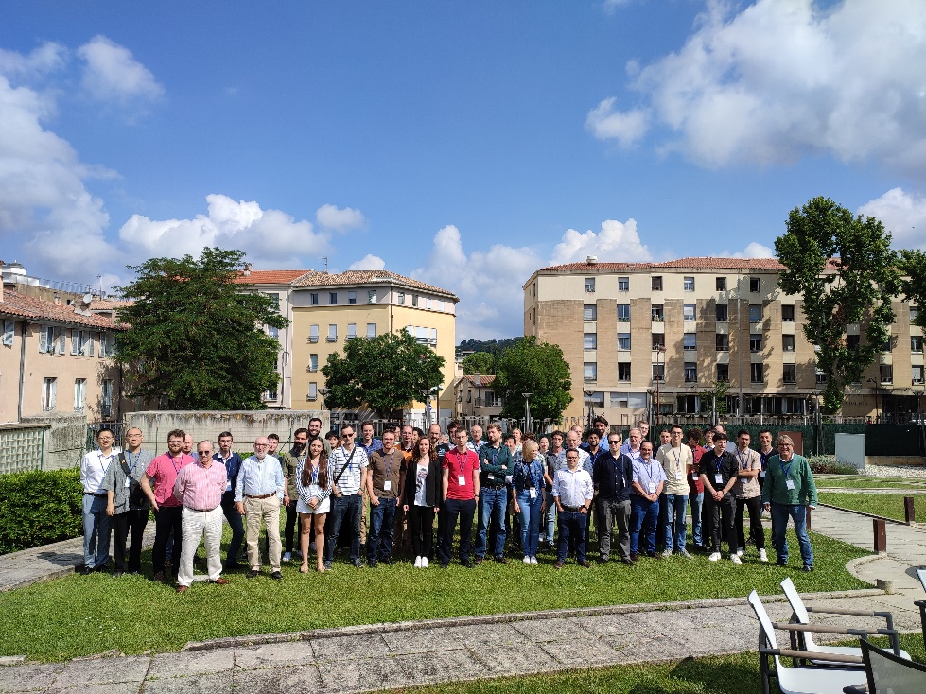
2026
2006
2009
2012
2015
2018
2023
2023

Slide 9
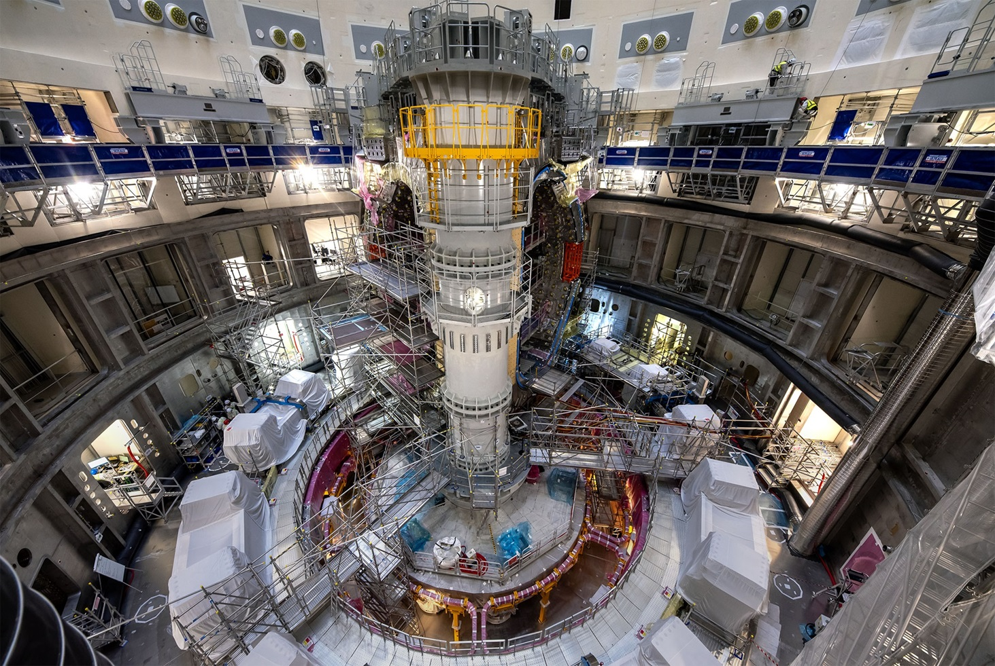
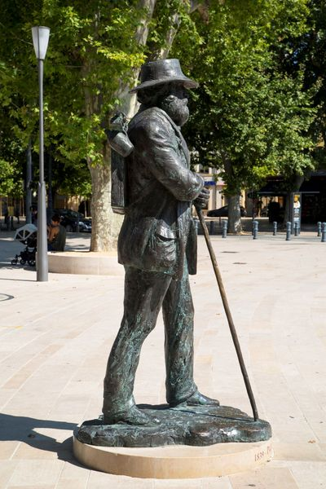
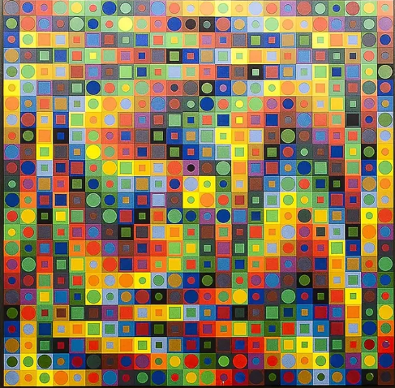
Thank you to the CEA, ITER, Vasarely foundation, Aquabella, Eventia, VertCom,
the speakers, the chairman, the audience, Anna, Aurianne, and Olivier! 🎤👥👏

Slide 10
Thank you to the CEA, ITER, Vasarely foundation, Aquabella, Eventia, VertCom,
the speakers, the chairman, the audience, Anna, Aurianne, and Olivier! 🎤👥👏
Last WONDER organized by Olivier👏
Some gifts for this milestone !
Thank you Olivier !

Slide 11
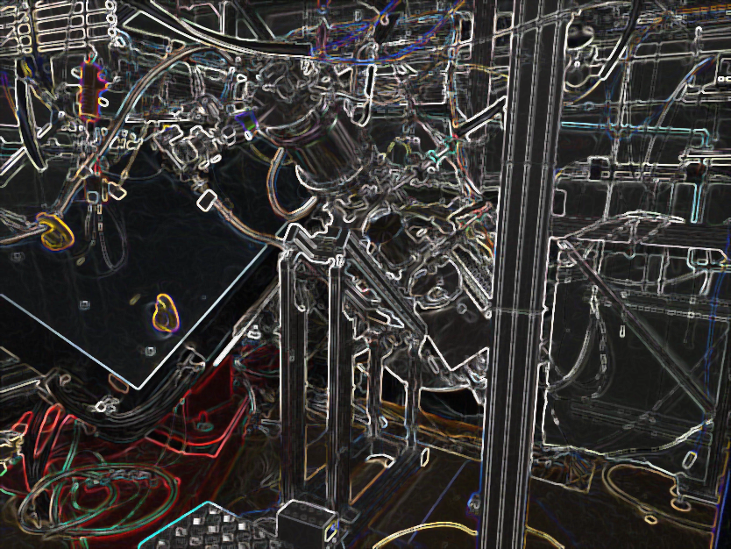

Thank you and see you in 3 years !
Abdel Chebboubi, Olivier Serot, Aurianne Roucairol, Olivier Provitina
on behalf of the organizing committee

