Slide 1

Bayesian Inference using microscopic and integral measurements to infer nuclear data parameters
International Workshop On Nuclear Data Evaluation for Reactor Applications (WONDER-2026)
Presenter: | Daan Houben
Co-authors: | M. Hursin, L. Fiorito, P. Schillebeeckx, G. Van den Eynde and P.E. Labeau
Date: | 30/06/2026

Slide 2
Introduction
Objective
Methodology
Case study: ⁵³Cr
Conclusions
3
7
8
10
18

Slide 3
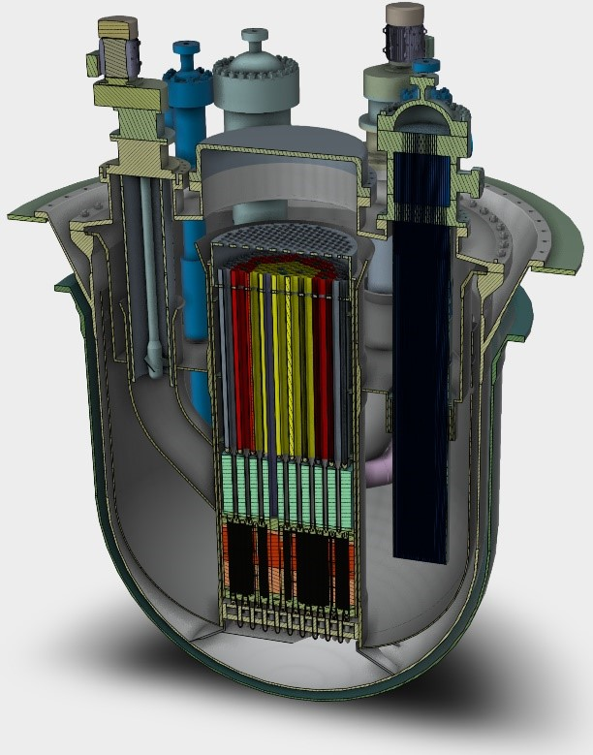
Introduction
SCK CEN is committed to building LFR SMR
  EAGLES-300
  Cooled with liquid lead
  MOX fuel to close fuel cycle
Enhanced safety
Efficient fuel use
HL waste reduction
Passive cooling
Corrosion
Weight
Freezing risk
Limited operating experience
…
FOAK
EAGLES-300 conceptual design

Slide 4
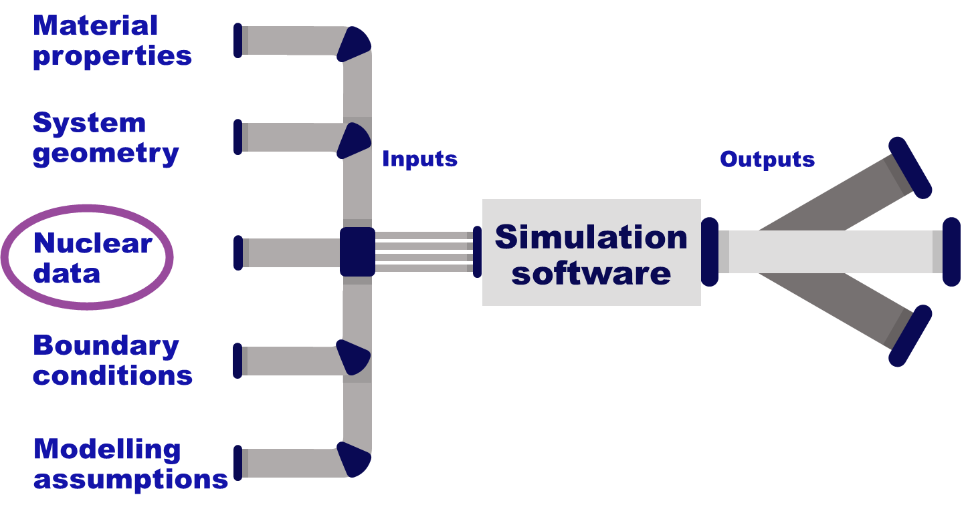
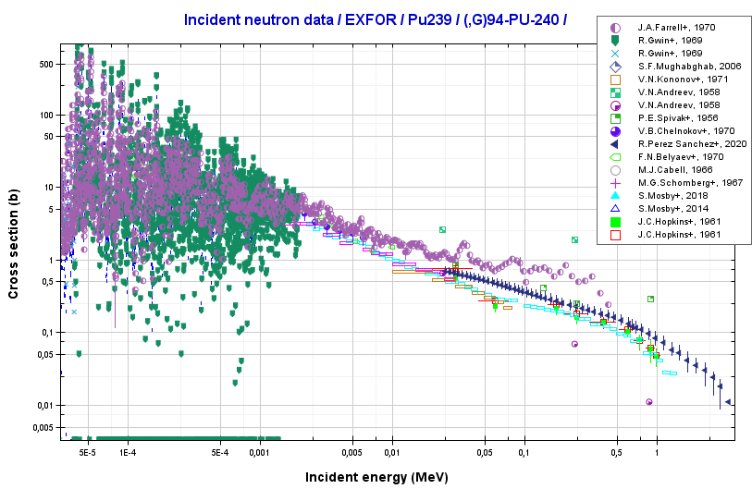
Introduction
Design and safety studies of a FOAK
Use of predictive simulations
Algorithms well known
Large uncertainty margins attributed to:
  Input model parameters
  Nuclear data
Increased costs for design and safety studies
Major source of common uncertainty → Nuclear Data

Slide 5
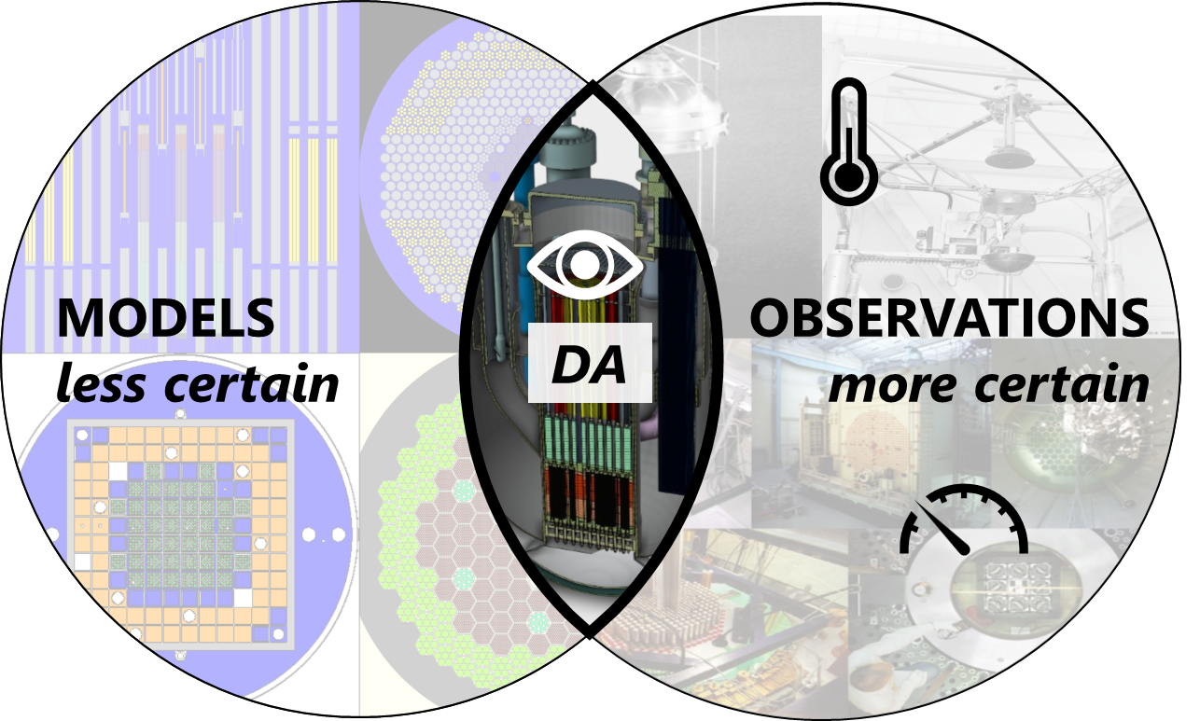
Introduction
Possible route to decrease prediction uncertainty:
  Data assimilation leveraging past experiments
For LFR highly similar experiments scarce
  Use experiments not designed for LFR
MORE ACCURATE PREDICTIONS

Slide 6
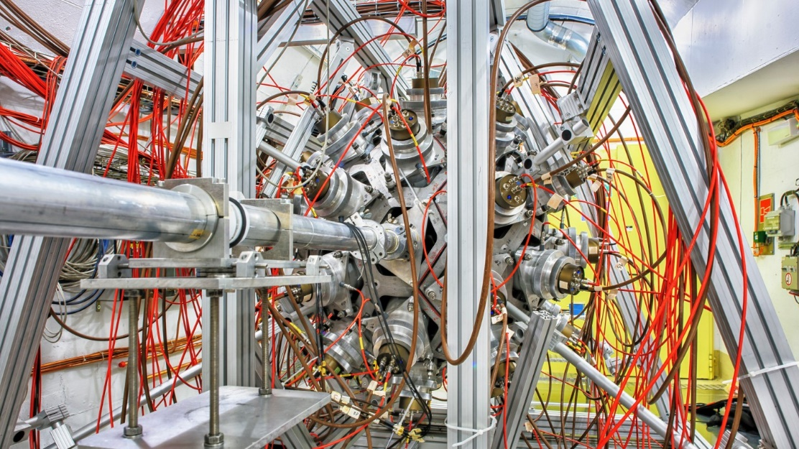
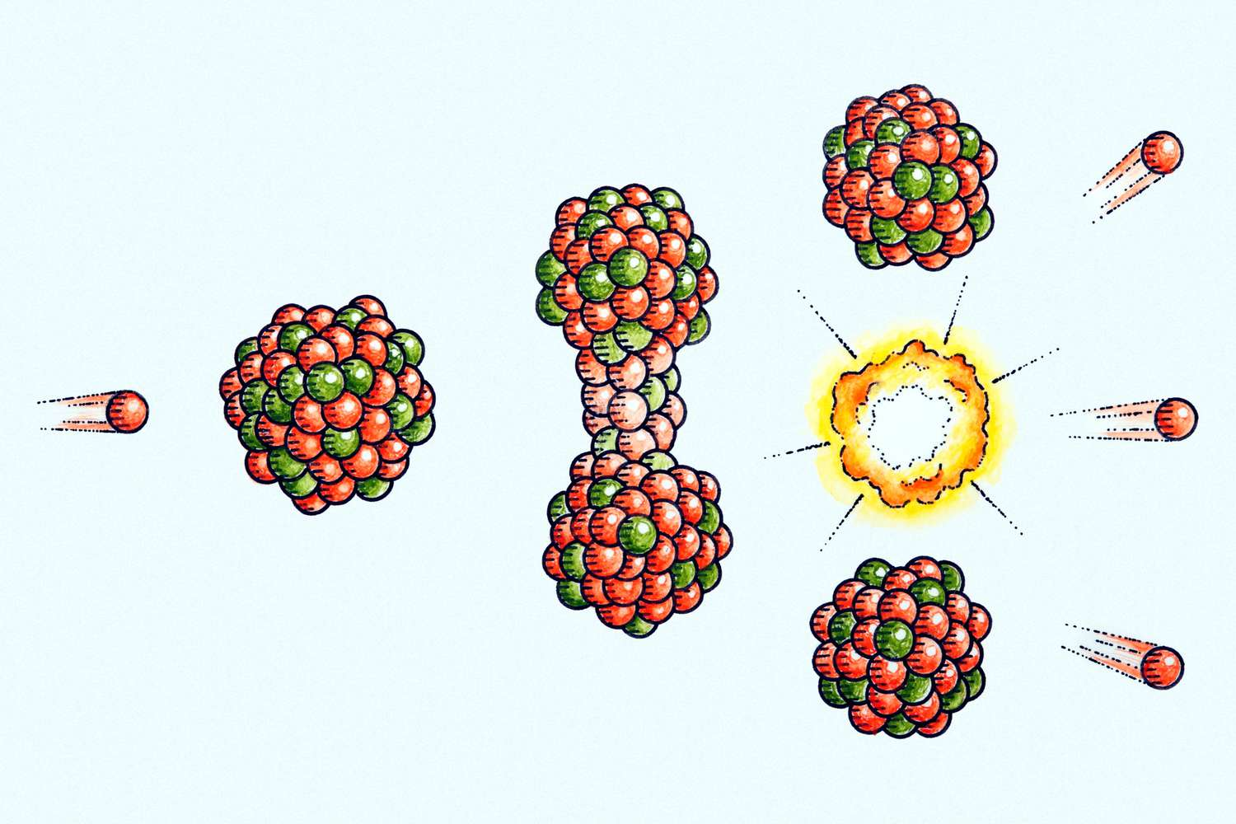
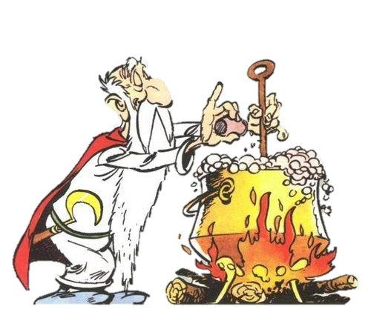
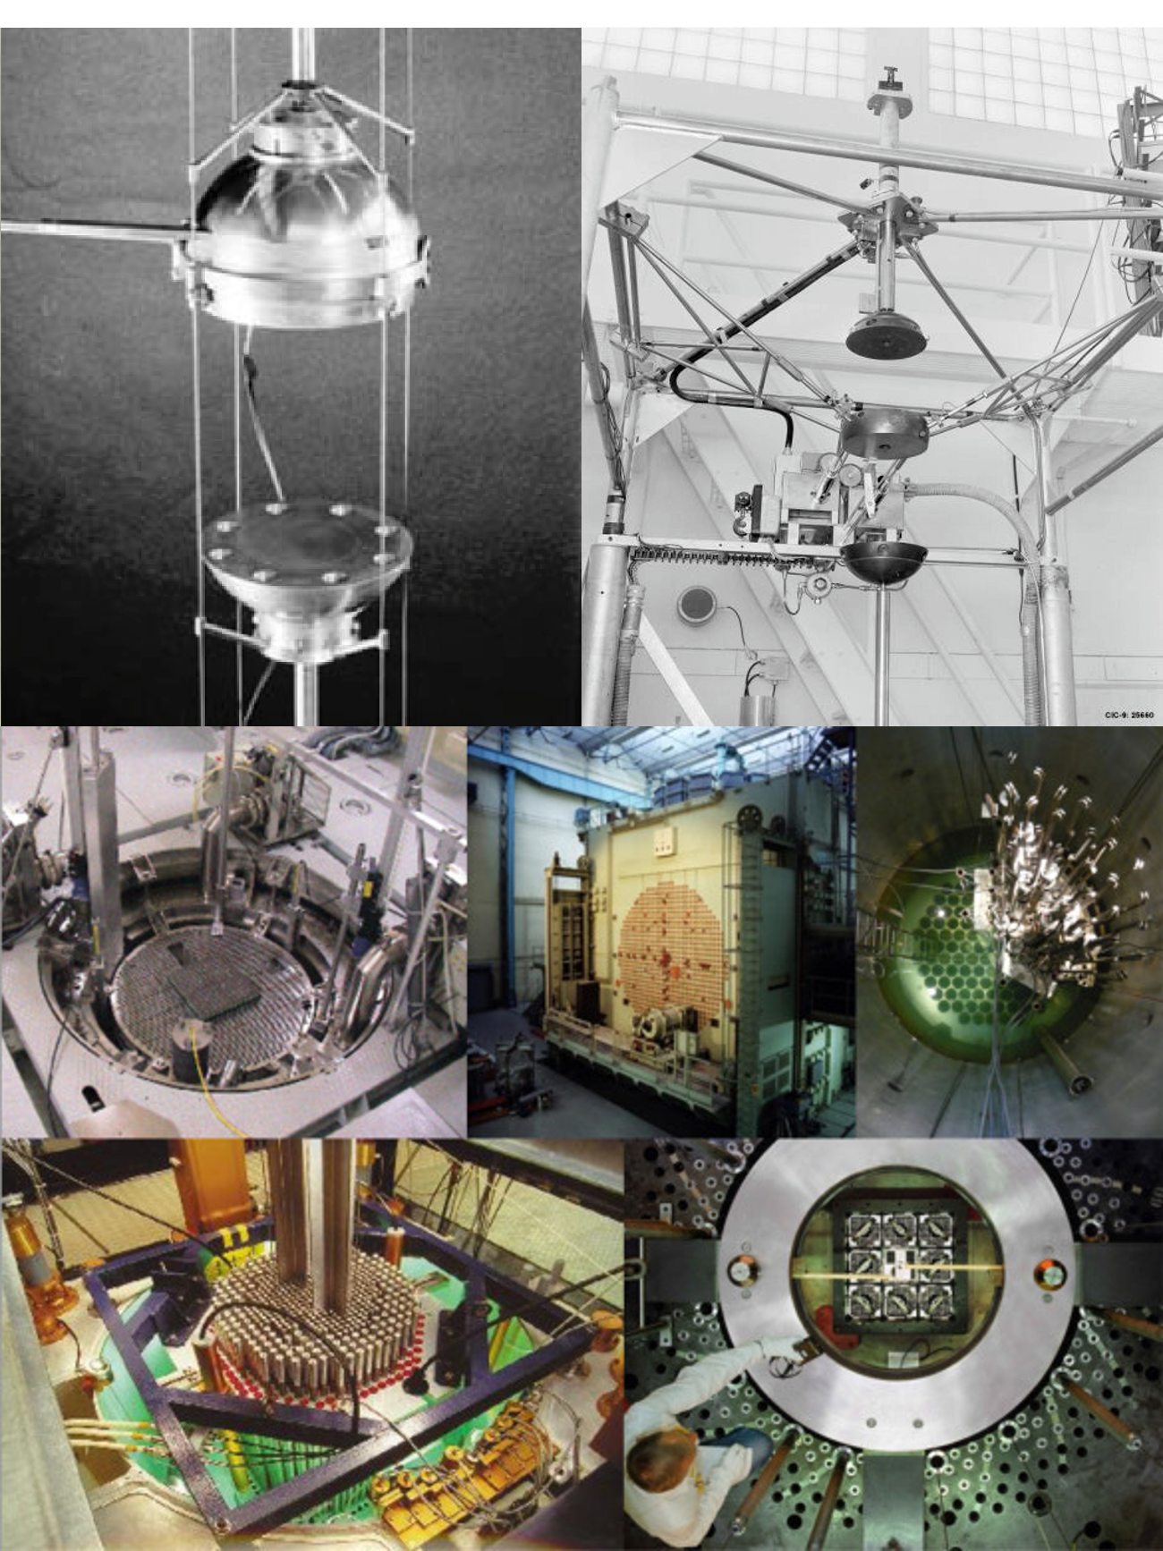
Introduction
Microscopic
experiments
Nuclear theory
Nuclear data evaluation process
  Multi-step process
  Evaluation ➔ Bayesian approach
  Integral experiments used for validation
Evaluate
Process
Validate
Library
Fine-tuning
Integral experiments

Slide 7
Objective
Microscopic
experiments
Nuclear theory
Data Assimilation using both microscopic and integral measurement
Identify limitations and challenges
Evaluate
Process
Validate
Library
Fine-tuning
Integral experiments

Slide 8
Methodology
Overview
SURROGATE MODELLING
PRIOR ND
BAYESIAN
OPTIMIZATION
POSTERIOR ND
SAMMY
SERPENT
Goodness of fit on micro exp
Goodness of fit on integral exp

Slide 9





Methodology
$$χ^{2}=\frac{{\left(C−E\right)}^{2}}{Σ}$$
Formulation unnormalized posterior
PRIOR
MICROSCOPIC
INTEGRAL
$$−\frac{1}{2}χ_{ND}^{2}$$
$$−\frac{1}{2}χ_{m}^{2}$$
$$−\frac{1}{2}χ_{i}^{2}$$
$$ln(p)=$$

Slide 10
Case study: ⁵³Cr

Slide 11
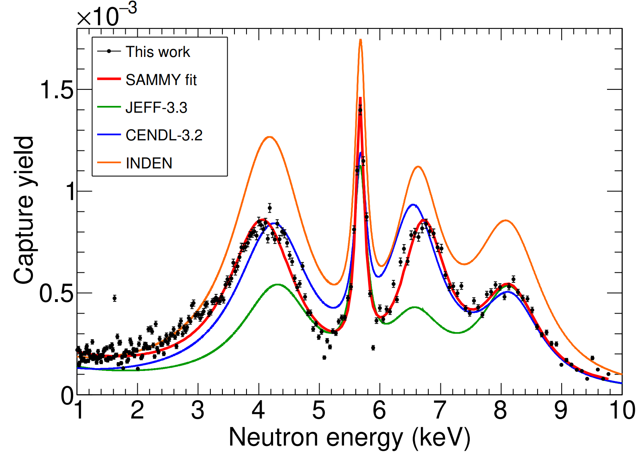
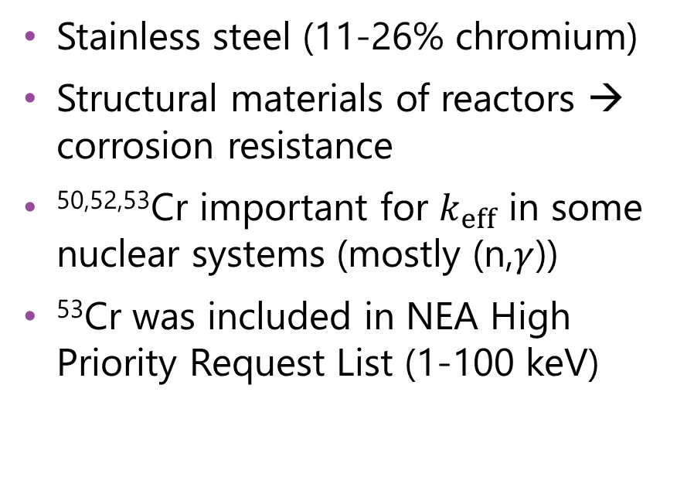
Case study: ⁵³Cr
Isotope | Abundance (%)
Cr-50 | 4.34
Cr-52 | 83.8
Cr-53 | 9.50
Cr-54 | 2.37
Why ⁵³Cr?
Stainless steel (11-26% chromium)
Structural materials of reactors → corrosion resistance
^{50,52,53}Cr important for $k_{eff}$ in some nuclear systems (mostly (n,$γ$))
⁵³Cr was included in NEA High Priority Request List (1-100 keV)
⁵³Cr
form P. Pérez-Maroto et al., “50Cr and 53Cr neutron capture cross sections measurement at the n_TOF facility at CERN,” 2025

Slide 12
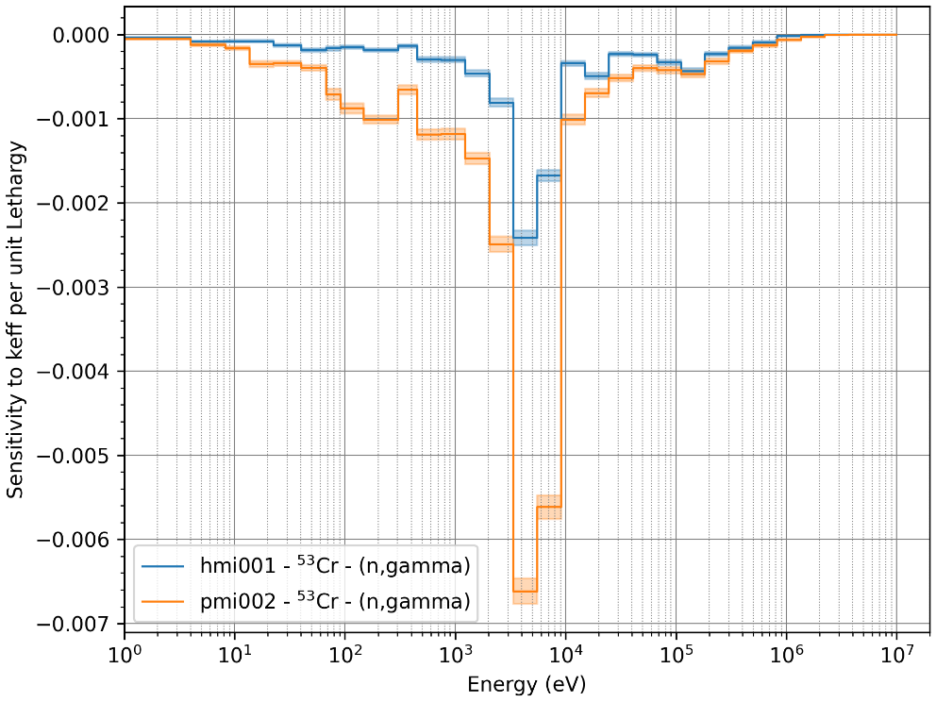
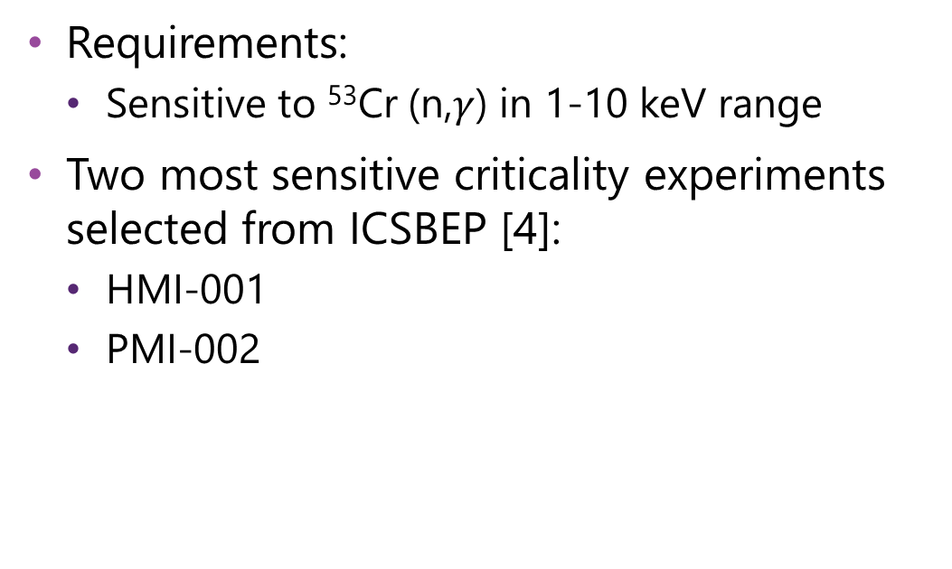
Case study: ⁵³Cr
Selection of integral experiments
Requirements:
  Sensitive to ⁵³Cr (n,$γ$) in 1-10 keV range
Two most sensitive criticality experiments selected from ICSBEP [4]:
  HMI-001
  PMI-002

Slide 13

Case study: ⁵³Cr
$$χ^{2}=\frac{{\left(C−E\right)}^{2}}{Σ}$$
Formulation unnormalized posterior
PRIOR
MICROSCOPIC
INTEGRAL
$$−\frac{1}{2}χ_{ND}^{2}$$
$$−\frac{1}{2}χ_{m}^{2}$$
$$−\frac{1}{2}χ_{i}^{2}$$
$$ln(p)=$$

Slide 14
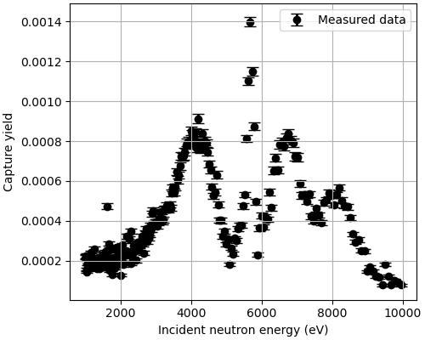



Case study: ⁵³Cr
$$χ^{2}=\frac{{\left(C−E\right)}^{2}}{Σ}$$
Formulation unnormalized posterior
PRIOR
MICROSCOPIC
INTEGRAL
$$−\frac{1}{2}χ_{ND}^{2}$$
$$−\frac{1}{2}χ_{m}^{2}$$
$$−\frac{1}{2}χ_{i}^{2}$$
$$ln(p)=$$
4 input parameters:
  $Γ_{γ}$ E=4.1 keV
  $Γ_{γ}$ E=5.7 keV
  $Γ_{γ}$ E=6.8 keV
  $Γ_{γ}$ E=8.2 keV
20% rel. unc. $Γ_{γ}$
No correlation
Multivariate normal
256 observations
Treat normalization uncertainty as fitting parameter
$Σ_{m}=Σ_{exp}+Σ_{norm}+Σ_{α}$
$$Σ_{i}=Σ_{exp}+Σ_{GP}+Σ_{α}$$

Slide 15
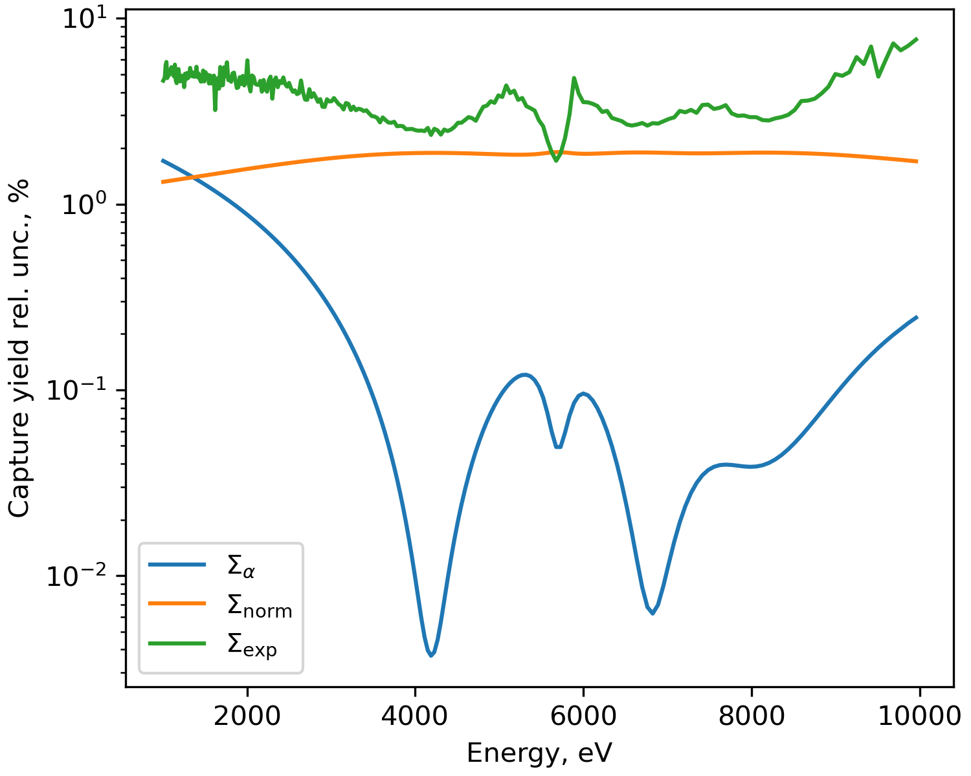


Case study: ⁵³Cr
$$χ^{2}=\frac{{\left(C−E\right)}^{2}}{Σ}$$
Formulation unnormalized posterior
MICROSCOPIC
$$−\frac{1}{2}χ_{m}^{2}$$
256 observations
Treat normalization uncertainty as fitting parameter
$Σ_{m}=Σ_{exp}+Σ_{norm}+Σ_{α}$
$Σ_{exp}$: Experimental setup
$Σ_{norm}$: Normalization factor
$Σ_{α}$: Other nuclear data

Slide 16
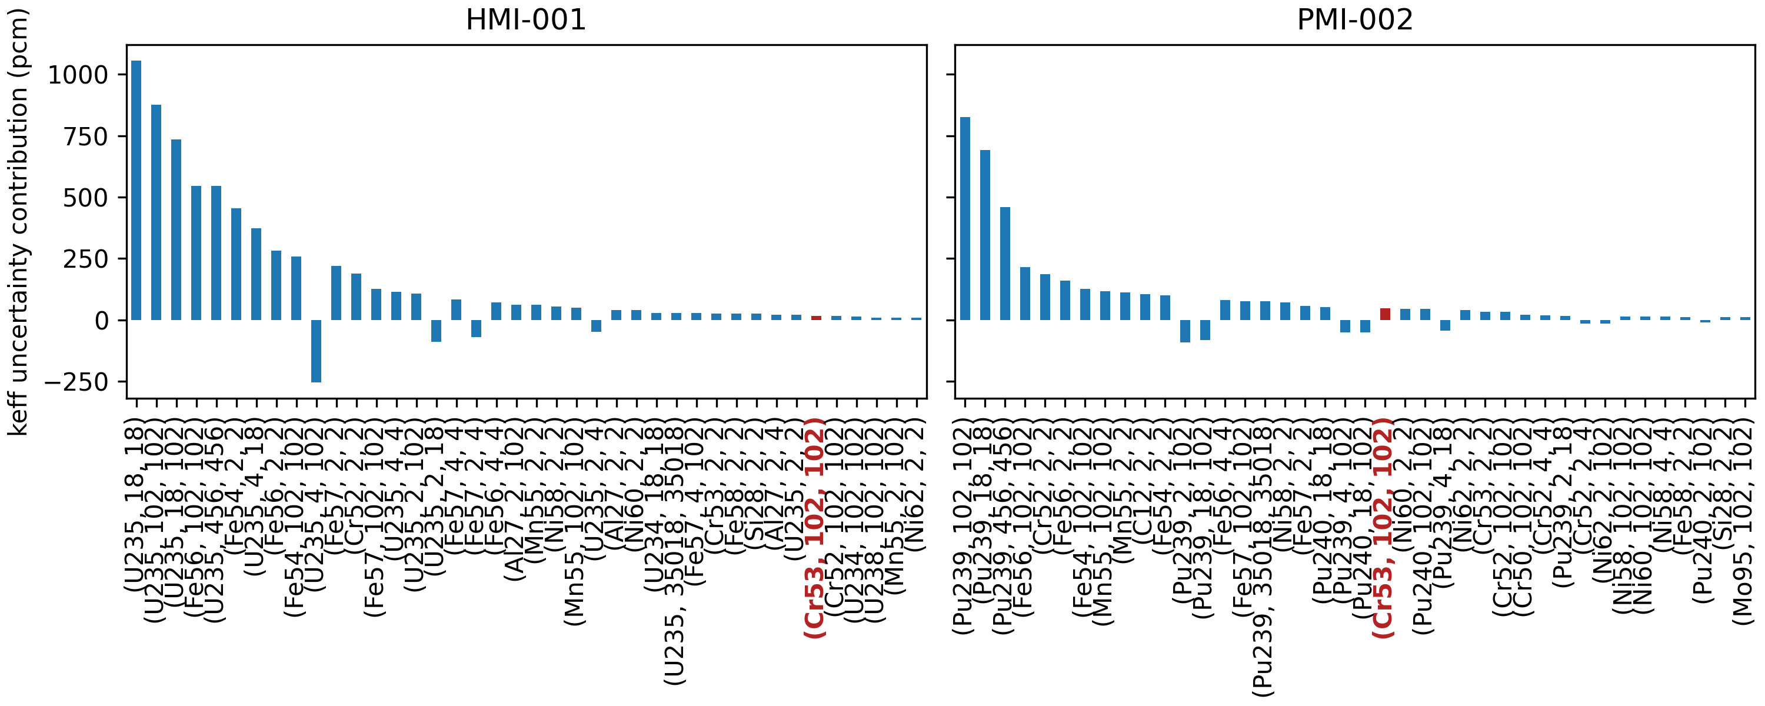


Case study: ⁵³Cr
$$χ^{2}=\frac{{\left(C−E\right)}^{2}}{Σ}$$
Formulation unnormalized posterior
INTEGRAL
$$−\frac{1}{2}χ_{i}^{2}$$
$$Σ_{i}=Σ_{exp.}+Σ_{GP}+Σ_{α}$$

Slide 17
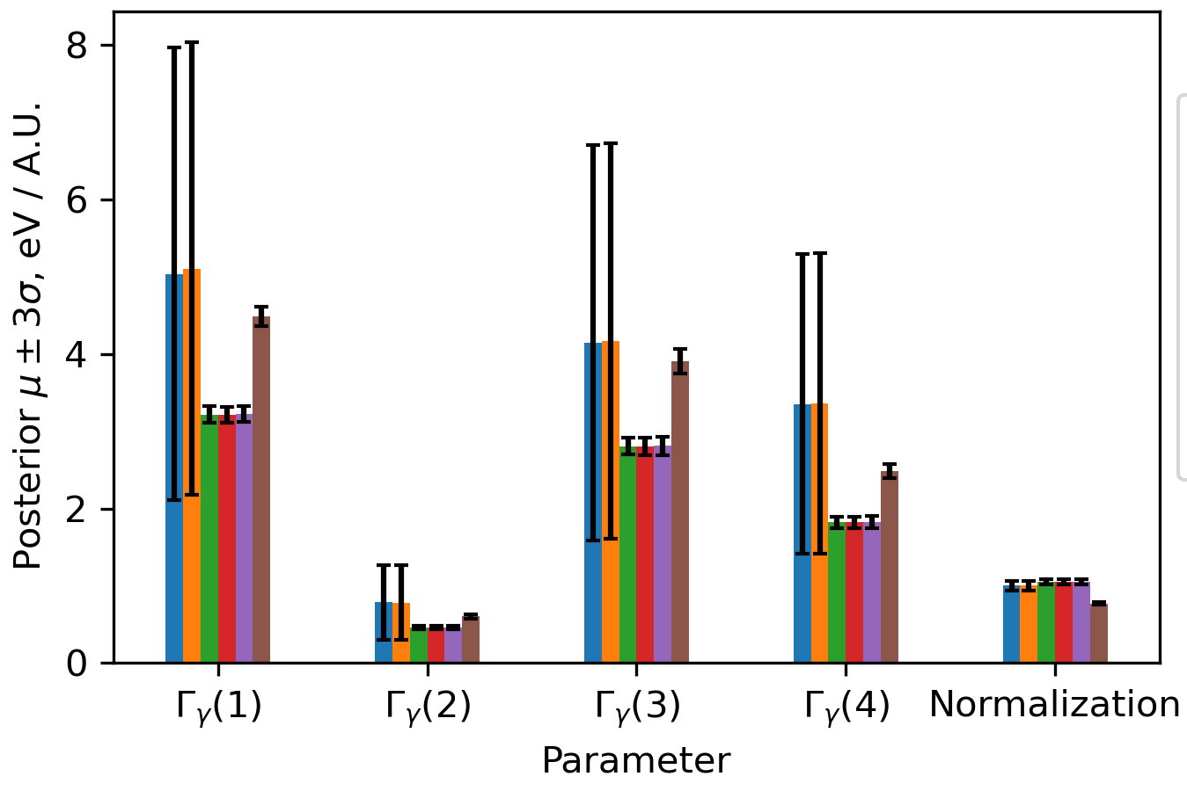
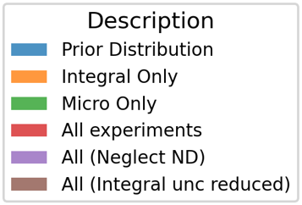
Results
Bayesian optimization

Slide 18
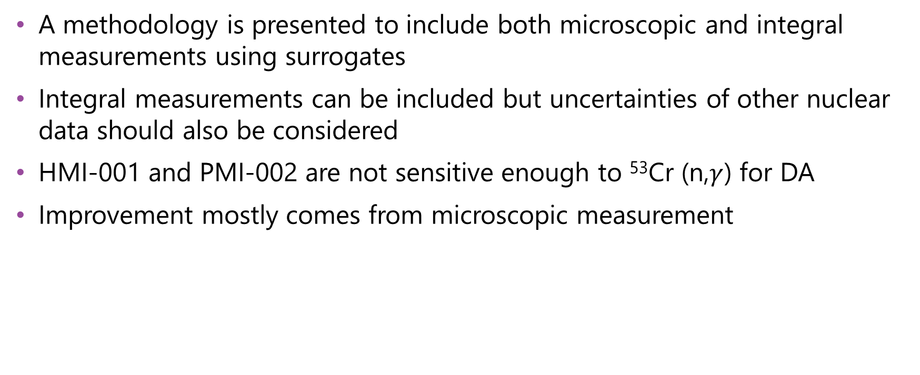
Conclusions
A methodology is presented to include both microscopic and integral measurements using surrogates
Integral measurements can be included but uncertainties of other nuclear data should also be considered
HMI-001 and PMI-002 are not sensitive enough to ⁵³Cr (n,$γ$) for DA
Improvement mostly comes from microscopic measurement

Slide 19
References
N. M. Larson, “Updated User’s Guide for Sammy: Multilevel R-Matrix Fits to Neutron Data Using Bayes’ Equations,” ORNL/TM-9179/R8, 941054, Oct. 2008. doi: 10.2172/941054.
J. Leppänen, V. Valtavirta, A. Rintala, and R. Tuominen, “Status of Serpent Monte Carlo code in 2024,” EPJ Nuclear Sci. Technol., vol. 11, p. 3, 2025, doi: 10.1051/epjn/2024031.
P. Pérez-Maroto et al., “50Cr and 53Cr neutron capture cross sections measurement at the n_TOF facility at CERN,” 2025
J. D. Bess, T. Ivanova, J. Martin, I. Hill, and L. Scott, “The 2020 edition of the ICSBEP handbook,” Nuclear Energy Agency, Organization for Economic Co-Operations and Development, 2020.
A. Trkov, O. Cabellos, and R. Capote, “Sensitivity of selected benchmarks to Cr-53 and Cr-50 capture”.
G. P. A. Nobre et al., “Newly Evaluated Neutron Reaction Data on Chromium Isotopes,” Nuclear Data Sheets, vol. 173, pp. 1–41, Mar. 2021, doi: 10.1016/j.nds.2021.04.002.

Slide 20
Additional slides

Slide 21
Introduction
Nuclear data evaluation process
EXPERIMENTS
EVALUATE
VALIDATE
LIBRARY
Experimental input
Prior knowledge
PROCESS
Integral experiments
General purpose ND library
Exp. correlations
Model defects
Prepare Nuclear Data
k_{eff}
RRR
JEFF-4.0
THEORY
Capture yield meas.
Parameter uncertainties
NJOY
…
ENDF/B-VIII.1
Transmission meas.
Model cross sections
FRENDY
…
…
Bayesian update
FEEDBACK

Slide 22
Objective
Combine integral and microscopic experiments in one step
EXPERIMENTS
EVALUATE
Integral exp.
LIBRARY
Experimental input
Prior knowledge
PROCESS
General purpose ND library
Exp. correlations
k_{eff}
Model defects
Prepare Nuclear Data
RRR
THEORY
Capture yield meas.
…
Parameter uncertainties
NJOY
JEFF-4.0
Transmission meas.
Model cross sections
FRENDY
ENDF/B-VIII.1
…
…
Bayesian update

Slide 23
Methodology
Surrogate modelling
y
high-fidelity model
samples
Gaussian Process
SAMMY and mostly SERPENT evaluations are expensive
Train easy to evaluate surrogate model
  Sample input parameters
  Evaluate sample in high-fidelity code
  Split in training and testing set (80/20)
  Train a Gaussian Process with training set
  Test GP on testing set
x

Slide 24
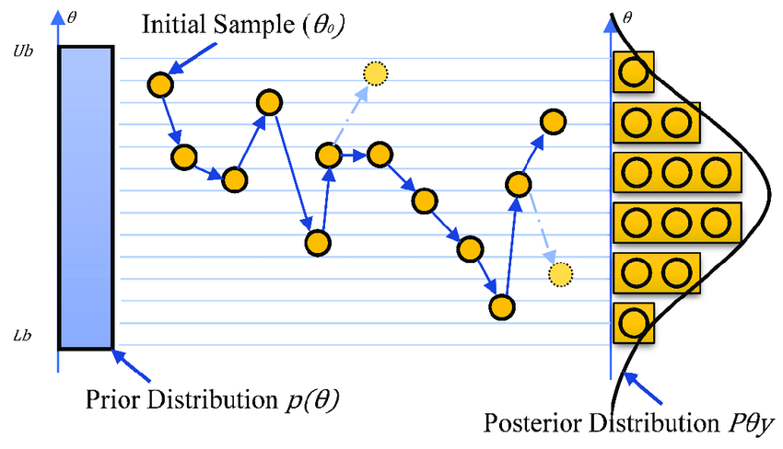
Methodology
Hastings, W. Keith. "Monte Carlo sampling methods using Markov chains and their applications." (1970): 97-109.
Markov Chain Monte Carlo
Instead of randomly sampling the input space
Carefully select next sample based on likelihood
Propose new position:
  If position is more likely → Accept
  If not → sample to Accept / Reject
If Accepted → go there
Rejected → propose new position
Eventually we sample from stationary distribution = target distribution

Slide 25
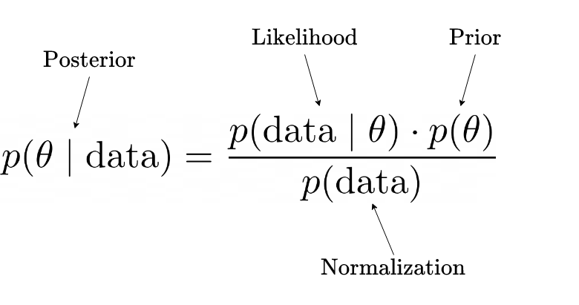
Methodology
Markov Chain Monte Carlo
Accept proposed state based on ratio of unnormalized posterior:
  Probability of observing proposed state in prior distribution
  Probability of observing experiments given proposed state
Probabilities can be small!
  Take log for numerical stability
Proposed^{(n+1)}
Current^{(n)}

Slide 26
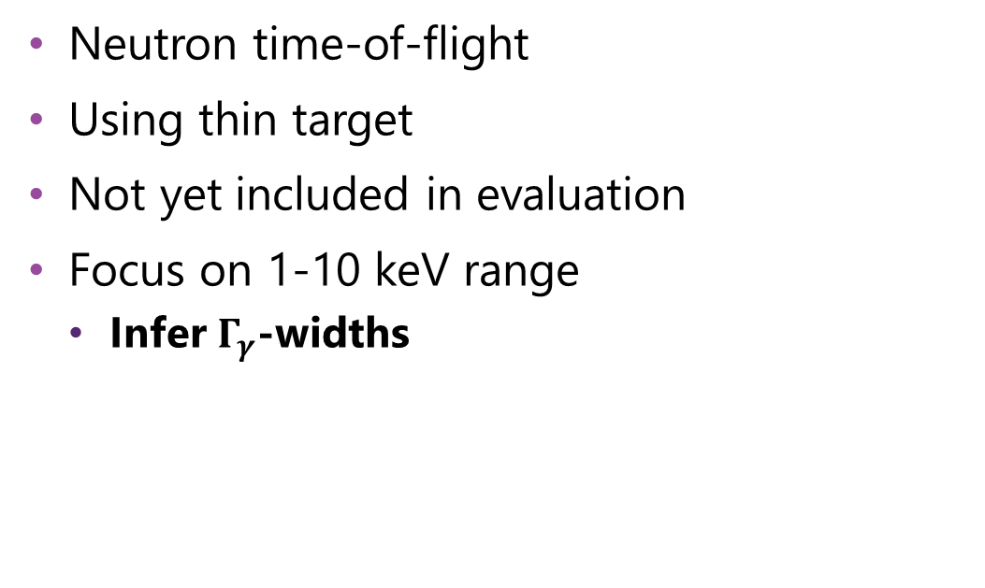
Case study: ⁵³Cr
New capture yield measurement
Cr-53
Neutron time-of-flight
Using thin target
Not yet included in evaluation
Focus on 1-10 keV range
  Infer $Γ_{γ}$-widths
form P. Pérez-Maroto et al., “50Cr and 53Cr neutron capture cross sections measurement at the n_TOF facility at CERN,” 2025

Slide 27
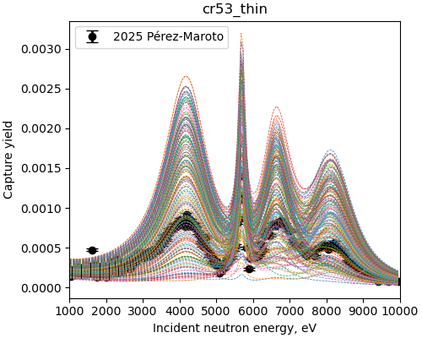
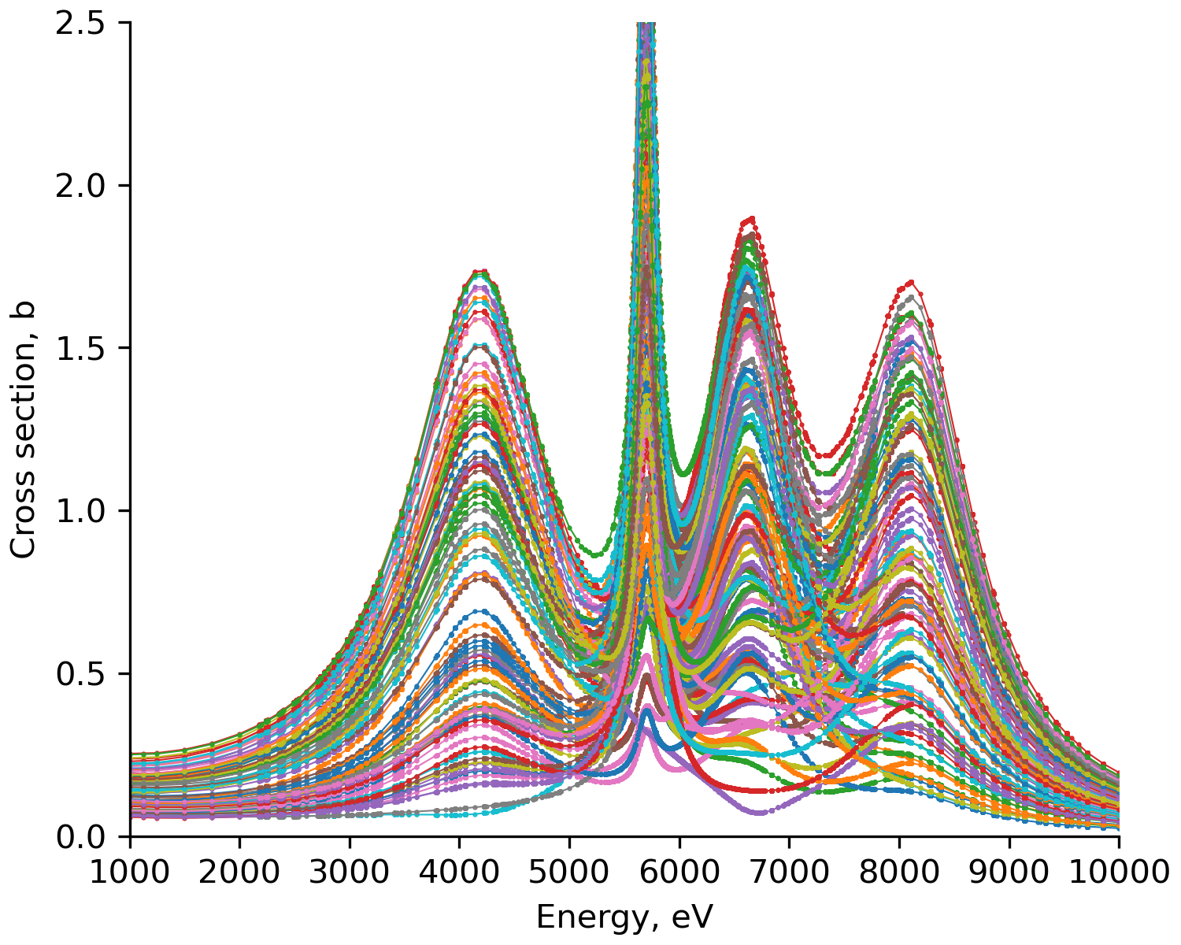

Results
Input data
Draw 100 uniform samples of:
  $Γ_{γ}$’s
  Normalization for capture yield

Slide 28
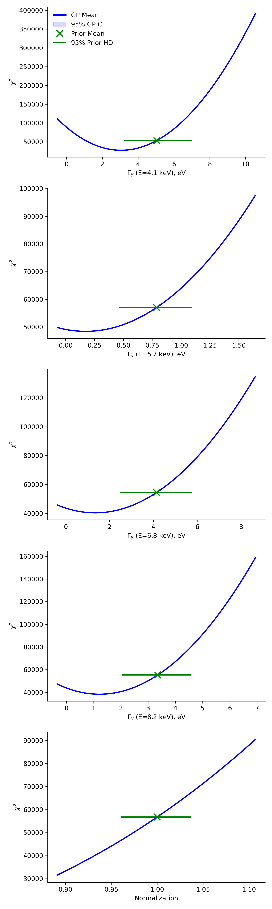
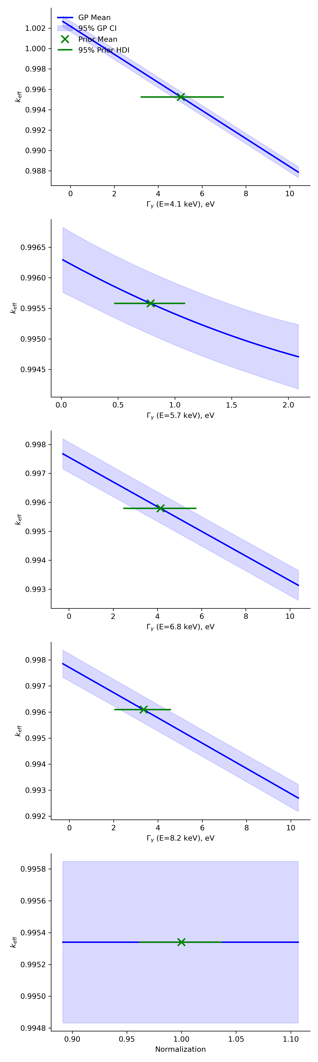
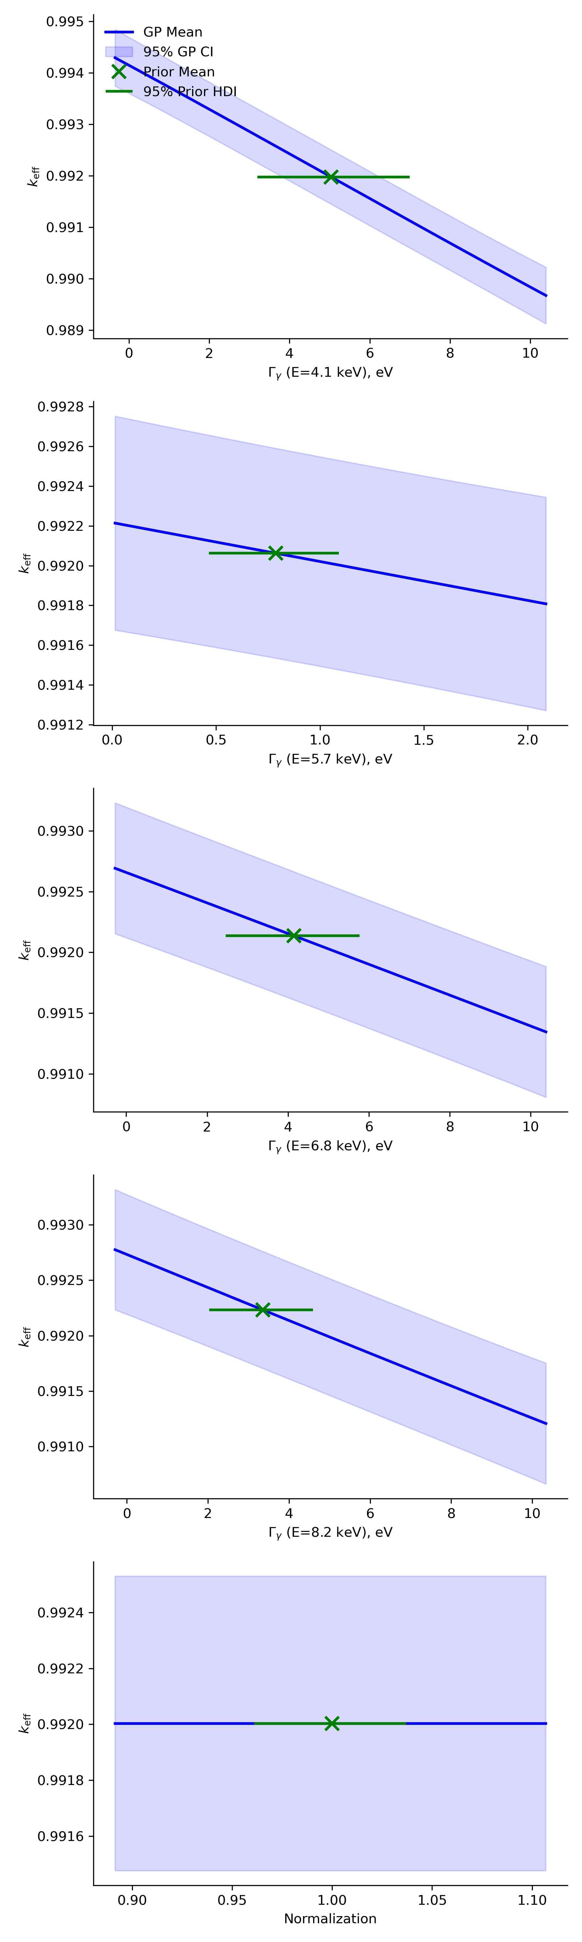
Results
Surrogate behavior
Learn behavior of experiment
GP performance on testing set
SAMMY
SERPENT

Slide 29
Results
Bayesian optimization

Slide 30
Results
Bayesian optimization

Slide 31
Results
Bayesian optimization

Slide 32
Results
Bayesian optimization

Slide 33
Results
Bayesian optimization

Slide 34
Results
Bayesian optimization

Slide 35
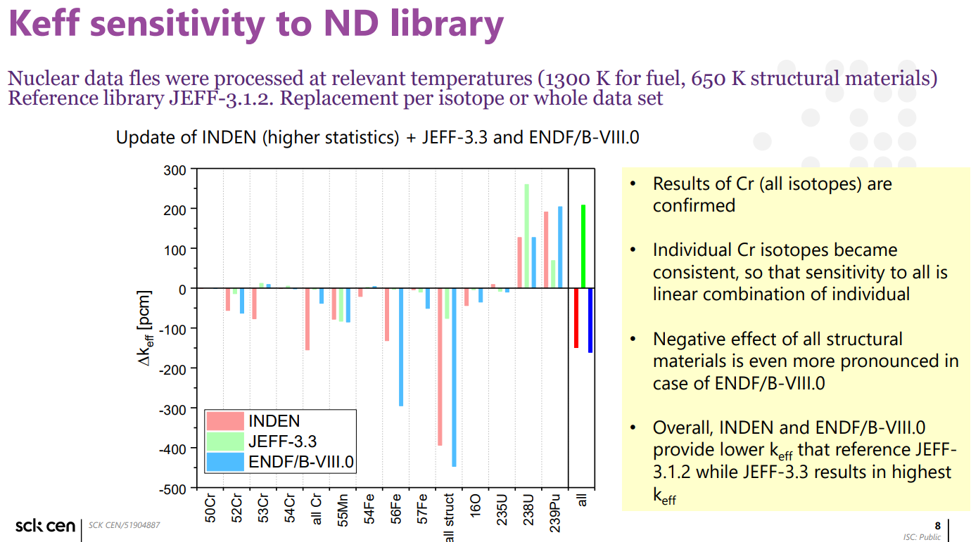

Slide 36
Methodology
Metropolis-Hastings algorithm
1. Start from a random starting position $θ$
2. Propose new position $θ′$ by sampling from lognormal distribution centered in $θ$
3. Accept or reject new position: $α\left(θ^{′} | θ\right)=\min\left(1,\frac{π\left(θ^{′}\right)}{π\left(θ\right)}⋅\frac{Q\left(θ | θ^{′}\right)}{Q\left(θ^{′} | θ\right)}\right)$
  $\frac{π\left(θ^{′}\right)}{π\left(θ\right)}$ is ratio of unnormalized posterior distributions
    Likelihood x prior (normalizing constant cancels in ratio)
  If reject → propose another position
4. Sample many times until stationary distribution is reached
Stationary distribution = target distribution
$$θ$$
$$θ′$$

Slide 37
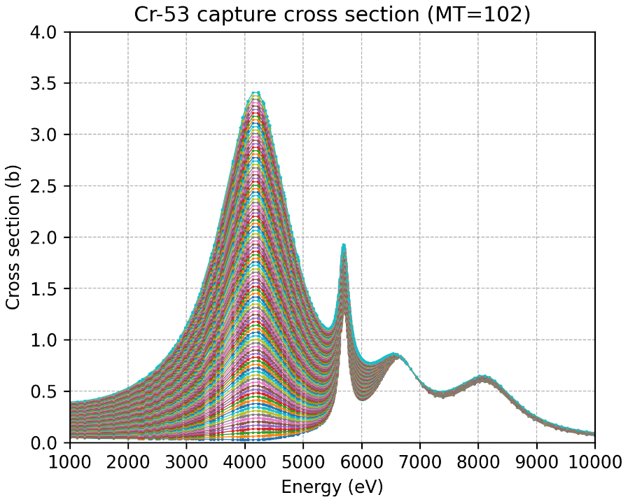
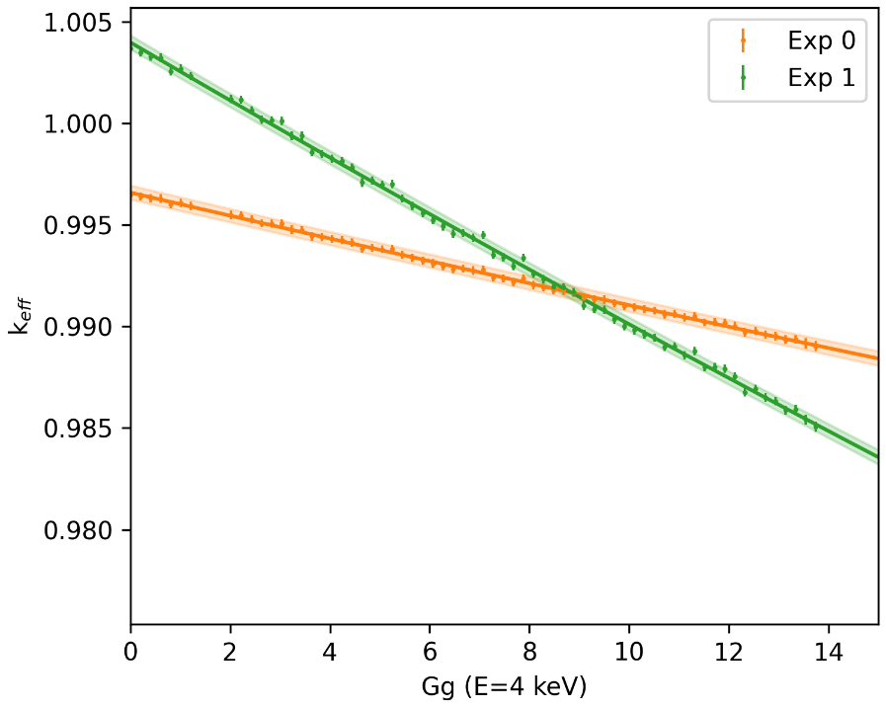
Results
PRELIMINARY
Surrogate integral measurement
Vary the first $Γ_{γ}$ width (4 keV)
For 2 criticality experiments:
  Sensitive to Cr-53

Slide 38
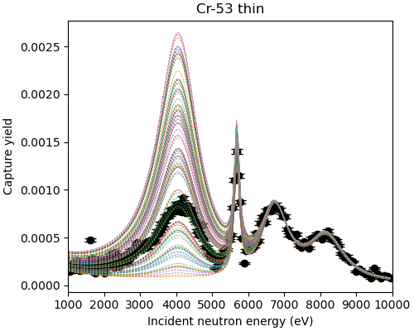
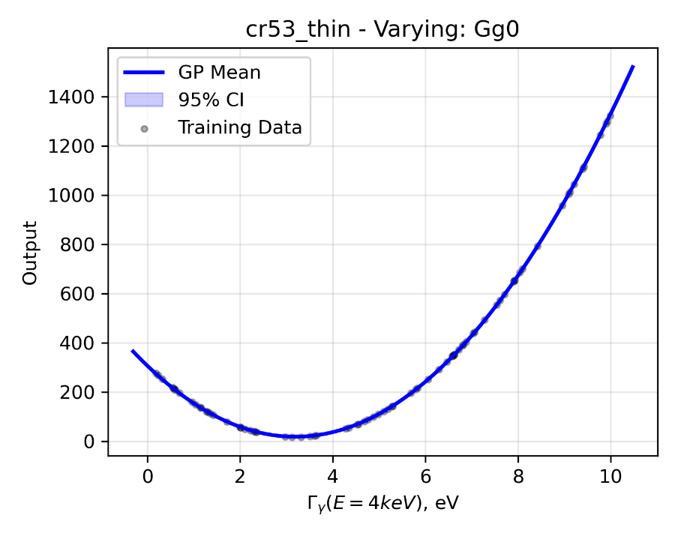
Results
PRELIMINARY
Microscopic measurement: nTOF
Vary the first $Γ_{γ}$ width (E=4 keV)
Calculate chi-squared on measurement

Slide 39
Sensitivity to Gg (PMI002)

Slide 40
Introduction
Evaluated ND
(mean values and covariance)
ND Evaluation
Experimental input
Prior knowledge
Experiment correlations
Model defects
Parameter uncertainties
Capture yield measurements
Bayesian update
Model cross sections
Transmission measurements
from D. Neudecker et al..

Slide 41
Intoduction
EXPERIMENTS
EVALUATE
PROCESS
VALIDATE
LIBRARY
Experimental input
Prior knowledge
Prepare Nuclear Data
Integral experiments
General purpose ND library
Exp. correlations
Model defects
NJOY
k_{eff}
RRR
JEFF-4.0
THEORY
Capture yield meas.
Parameter uncertainties
FUDGE
ENDF/B-VIII.1
…
…
Transmission meas.
Model cross sections
…
Bayesian update
FEEDBACK

Slide 42
Introduction
Validation on integral experiments
Well-known benchmarks
Calculate C/E:
  Critical assemblies
  Pulsed spheres
  Shielding benchmarks
Inverse modelling to provide feedback

Slide 43
Introduction
Microscopic
experiments
Nuclear theory
Nuclear data evaluation process
  Multi-step process
  Evaluation ➔ Bayesian approach
  Integral experiments used for validation
Evaluate
Process
Validate
Library
Fine-tuning
Integral experiments

Slide 44
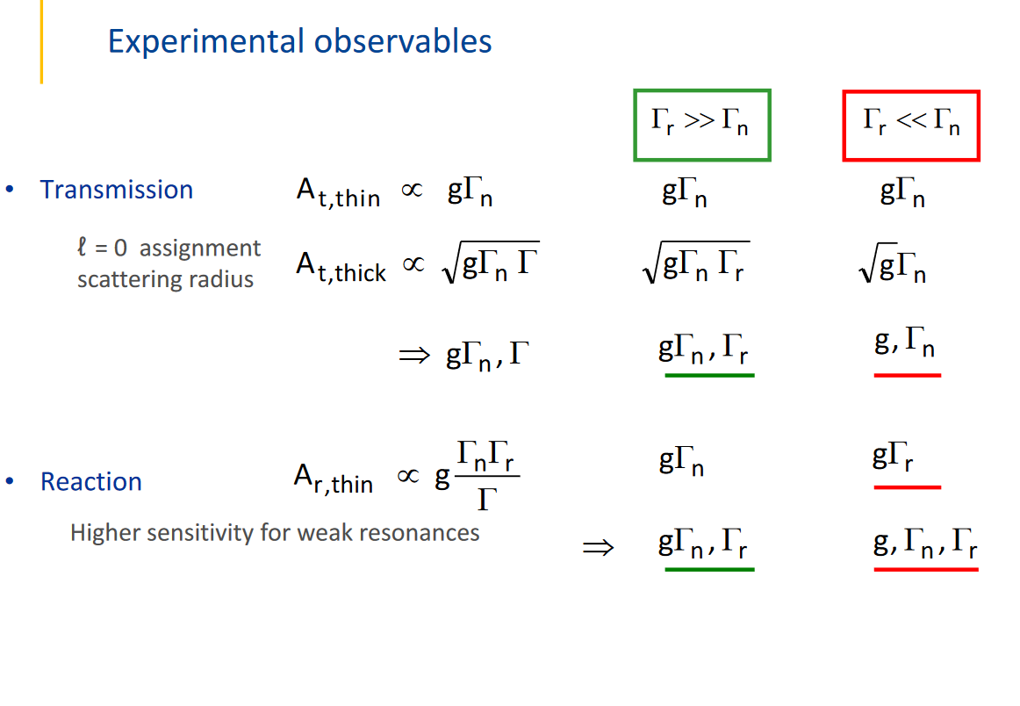

Slide 45
Copyright © SCK CEN
PLEASE NOTE!
This presentation contains data, information and formats for dedicated use only and may not be communicated, copied, reproduced, distributed or cited without the explicit written permission of SCK CEN.
If this explicit written permission has been obtained, please reference the author, followed by ‘by courtesy of SCK CEN’.
Any infringement to this rule is illegal and entitles to claim damages from the infringer, without prejudice to any other right in case of granting a patent or registration in the field of intellectual property.
SCK CEN
Belgian Nuclear Research Centre
Foundation of Public Utility
Registered Office: Avenue Herrmann-Debrouxlaan 40 – BE-1160 BRUSSELS
Operational Office: Industriezone Boeretang Zuid - Boeretang 190 – BE-2400 MOL

