Slide 1
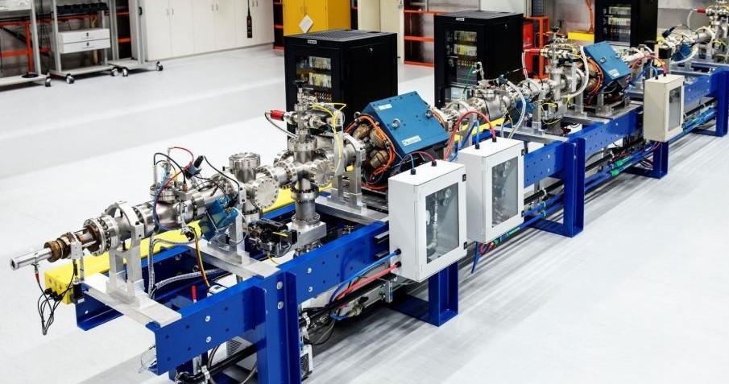
GEANT4 simulation of a monoenergetic neutron source
M. Boissier, P. Leconte, K. Kessaci
Workshop WONDER-2026, 29th June – 3rd July 2023, Aix-en-Provence
CEA/DES/IRESNE/DER/SPRC/LEPh

Slide 2
Outline
Introduction
Accelerator Based Neutron Sources (ABNS)
GEANT4 simulation of ABNS
Results
Conclusions and outlooks

Slide 3
Introduction
1

Slide 4
The ALDEN collaboration
2018 : Launch of the ALDEN framework (Average Lifetime of DElayed Neutrons)
Objective :
Accurate measurement of delayed neutron macroscopic data.
ILL (Grenoble, France) → thermal fission
PTB (Germany) → fast fission ²³⁸U (1 MeV – 20 MeV)
Aim of the PhD→ fast fission ²³⁹Pu (1 MeV – 20 MeV) at JRC Geel
Energy dependance of delayed neutrons data
+
GEN-IV needs
2018
2019
2020
2021
2022
2023
2024
2025
2026
2027
ILL
²³⁵U
ILL
²³⁵U
ILL
²³³U + ²³⁹Pu
PTB
²³⁸U
PTB
²³⁸U
ILL
²⁴¹Pu
ILL
²⁴¹Pu
JRC
²³⁸U
?? JRC
²³⁹Pu
thermal
fast
thermal
fast

Slide 5
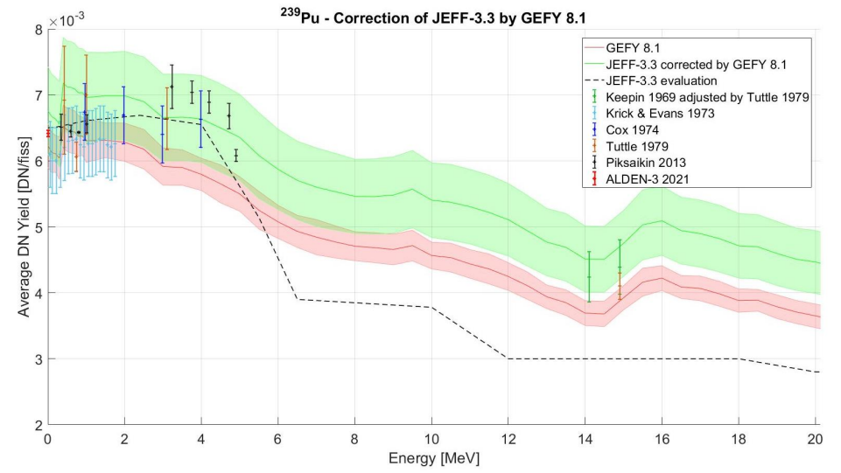
The ²³⁹Pu case – Delayed neutrons yield
Rare recent experimental data
No data between 5 MeV and 14 MeV
No data between over 15 MeV
Inconsistencies between evaluations

Slide 6
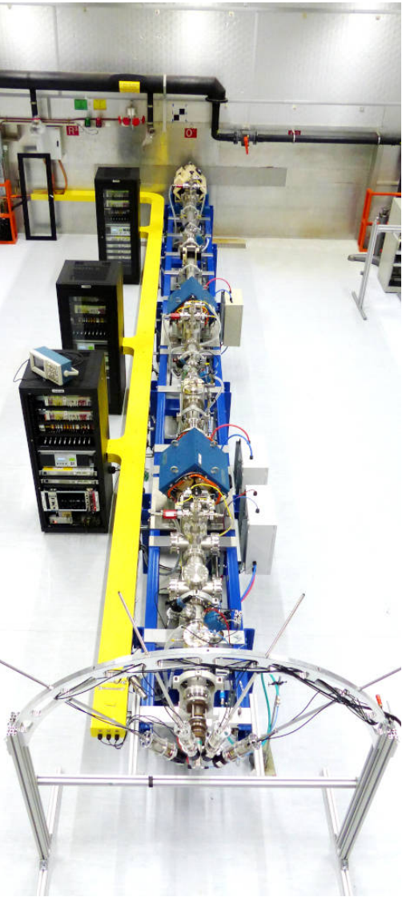
Experiments for delayed neutrons energy dependance
Incident neutrons energy
Monoenergetic spectrum (MONNET facility)
Secondary reactions
Difficulties in PTB campaigns analysis:
Inconsistencies between different flux estimation techniques (crucial parameter)
T(p,n)³He → 1 MeV – 6 MeV
D(d,n)³He → 4 MeV – 7,5 MeV
T(d,n)⁴He → 14 MeV – 20 MeV
Need for a better understanding
Accurate simulation

Slide 7
Accelerator Based Neutron Source
2

Slide 8
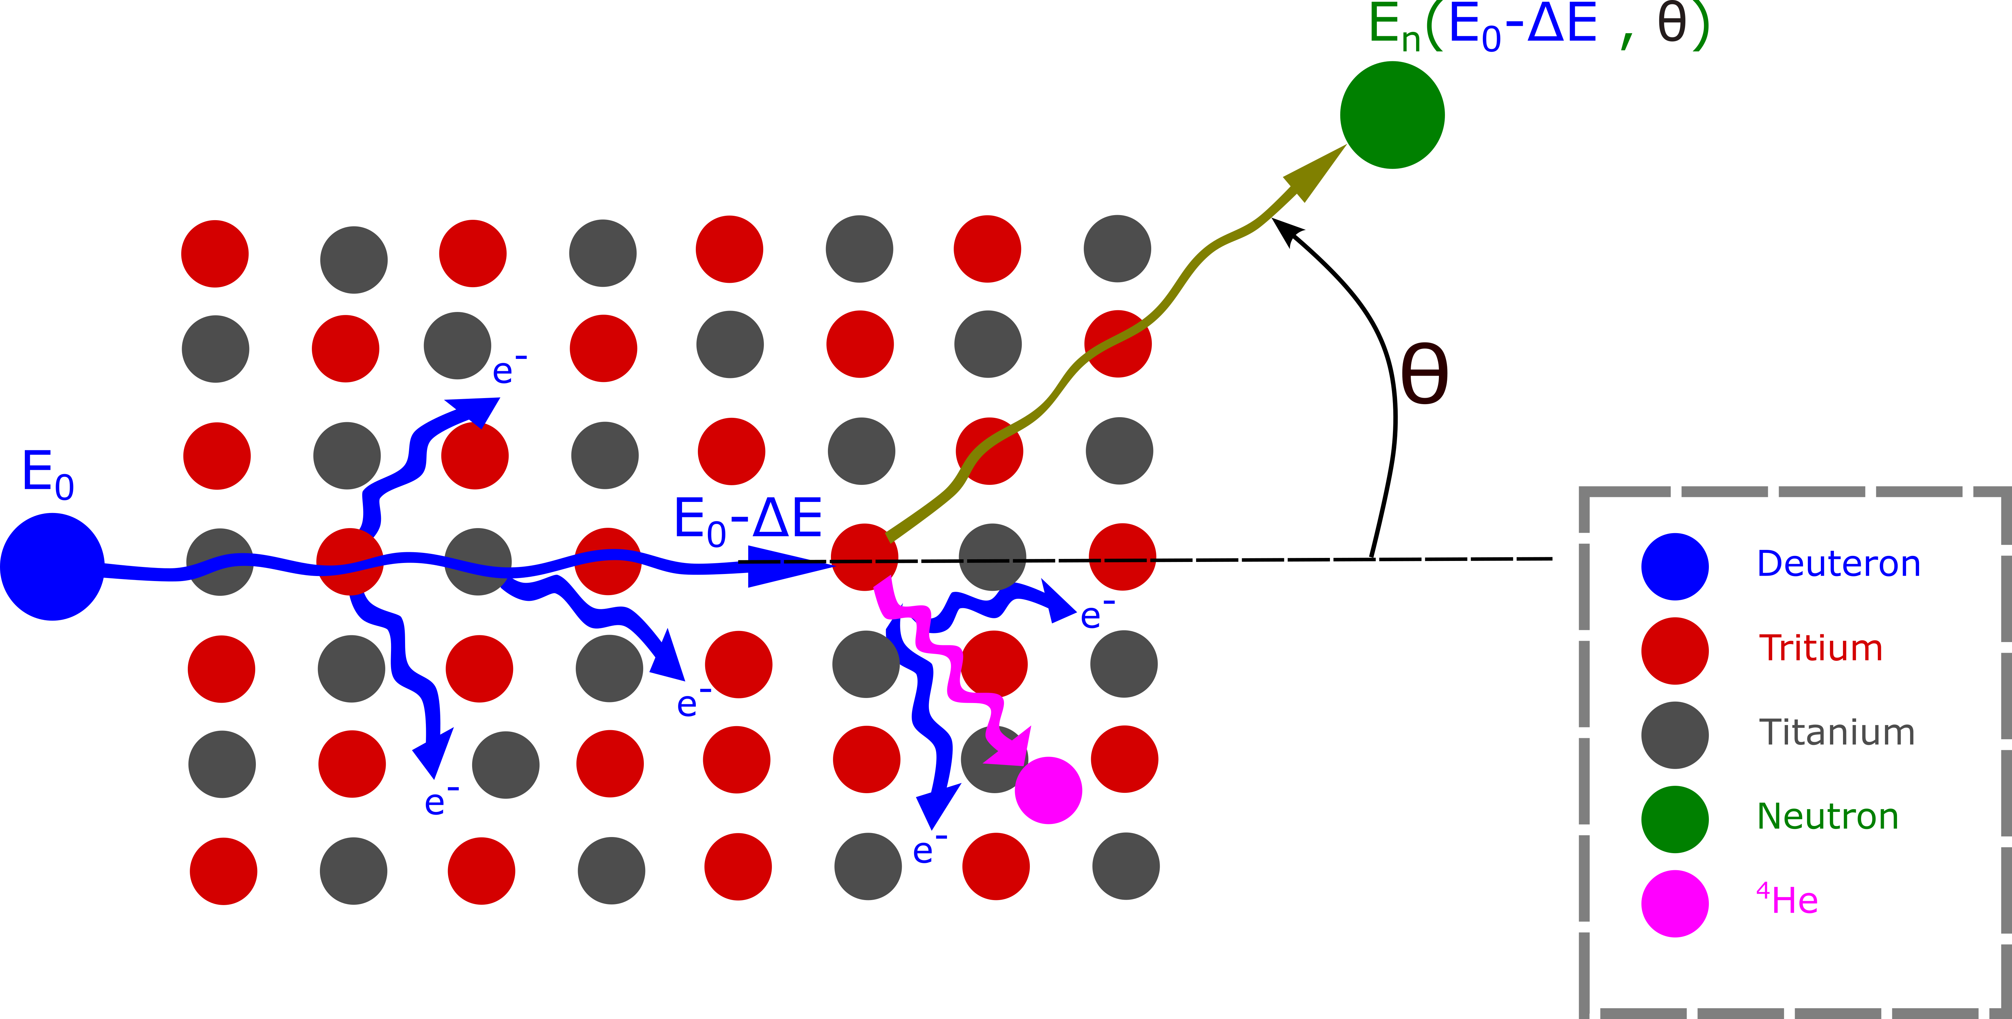
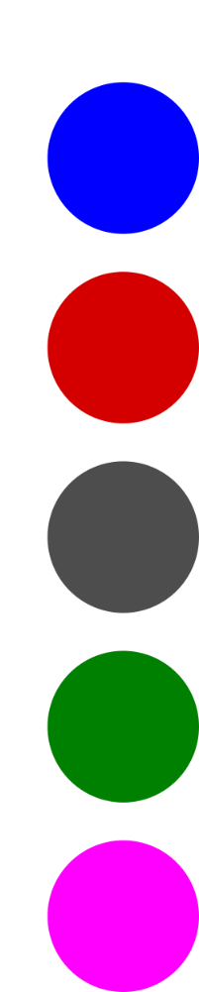
Accelerator Based Neutron Source (ABNS)
Example: TiT target, deuteron beam
Process:
Deuteron beam
Energy loss
Reaction with tritium T(d,n)⁴He
Associated issues:
Tritium decay (T_{1/2} = 12,32 years) → ³He accumulation
Deuterons implantation → secondary source D(d,n)³He
Deuteron/Titanium reactions → secondary source
Deuteron
Tritium
Titanium
Neutron
⁴He

Slide 9
ABNS simulation tools
Deterministic approach
Stopping power table → energy profile
Cross section data → neutron yield
+ : Fast
- : Difficult to update, not flexible, possibility to omit physical processes
NeuSDesc
Developped in JRC Geel (2009)
Stopping power tables from 1977
Used in ALDEN-4&5
NEBOAS
Developped in JRC Geel (2024)
Stopping power tables more recent (SRIM-2013+NIST)

Slide 10
ABNS simulation tools
Monte Carlo approach
Use of a Monte Carlo code to simulate the transport of ions and neutrons in the target
+ : Takes into account any physics process considered by the code, easy to maintain and update
- : Higher computing time
Requirements:
Transport of charged particles
Accurate simulation of energy loss
Accurate simulation of light ion induced nuclear reaction
Choice: GEANT4
Modular
Open source
Neutron physics

Slide 11
GEANT4 simulation of ABNS
3

Slide 12
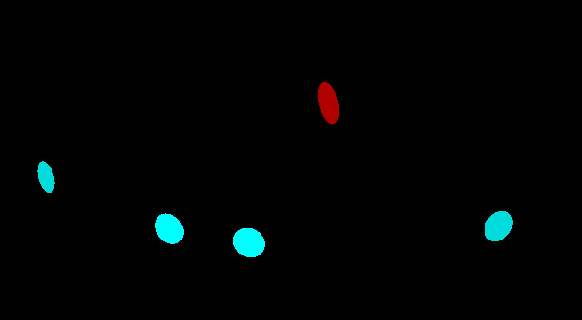




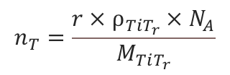
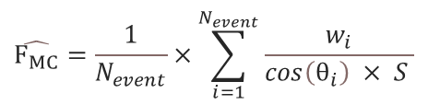


GEANT4 model for ABNS
Geometry / Composition
Nuclear Data
Variance reduction
Scoring
Target + 4 detectors
Deuterons Interactions
Cross section biasing
Reaction rate
QGSP_BIC_AllHP
$$σ_{eff}=b×σ$$
$$\hat{R_{MC}}=\sum_{i = 1}^{N_{steps}}{Σ_{i,k}\frac{l_{i}×w_{k,i}}{V}}$$
TENDL-2019
Increase of the statistical weight of non-reacting deuterons
Target’s composition
$$r=\frac{N_{T}}{N_{Ti}}$$
Deuteron energy loss
$$w_{d, i+1}=w_{d, i}×e^{\left(b−1\right)×Δλ}$$
Fluence rate
$$\hat{F_{MC}}=\frac{1}{N_{event}}×\sum_{i=1}^{N_{event}}{\frac{w_{i}}{cos\left(θ_{i}\right) × S }}$$
EM_option4
$$ρ_{TiT_{r}}=\frac{M_{Ti}+M_{T}r}{M_{Ti}}×ρ_{Ti}×0.85$$
Decrease of neutrons weight
$$n_{T}=\frac{r×ρ_{TiT_{r}}×N_{A}}{M_{TiT_{r}}}$$
$$w_{n}=\frac{w_{deuton}}{b}$$
Bethe-Bloch + Bragg

Slide 13
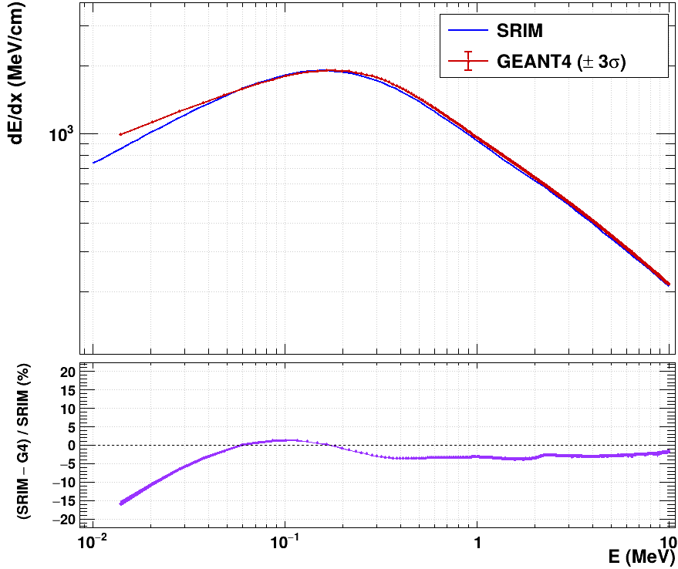
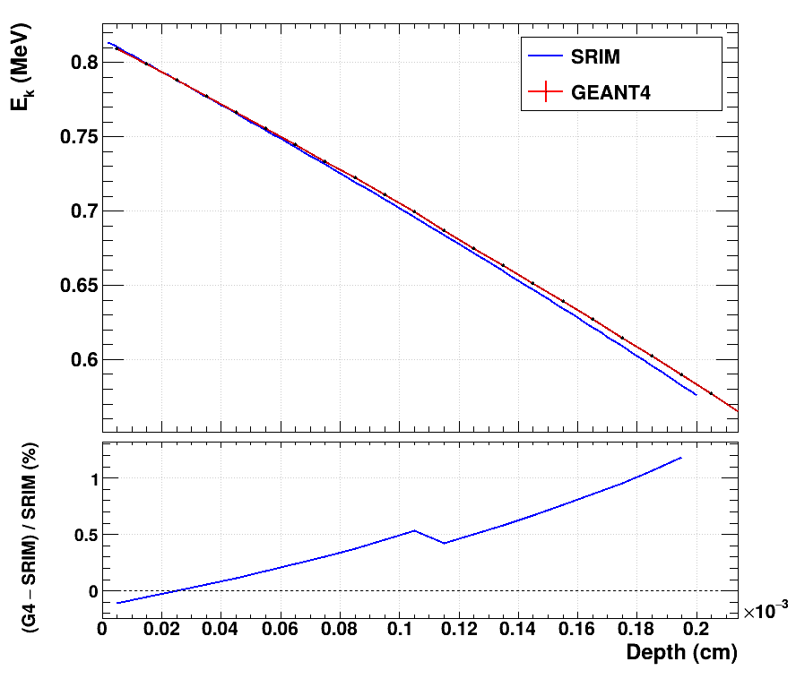
Accuracy check
Stopping power
Stopping power vs Energy
Energy vs Depth in the target
Agreement with SRIM over 100 keV
Minimal impact for thin targets

Slide 14
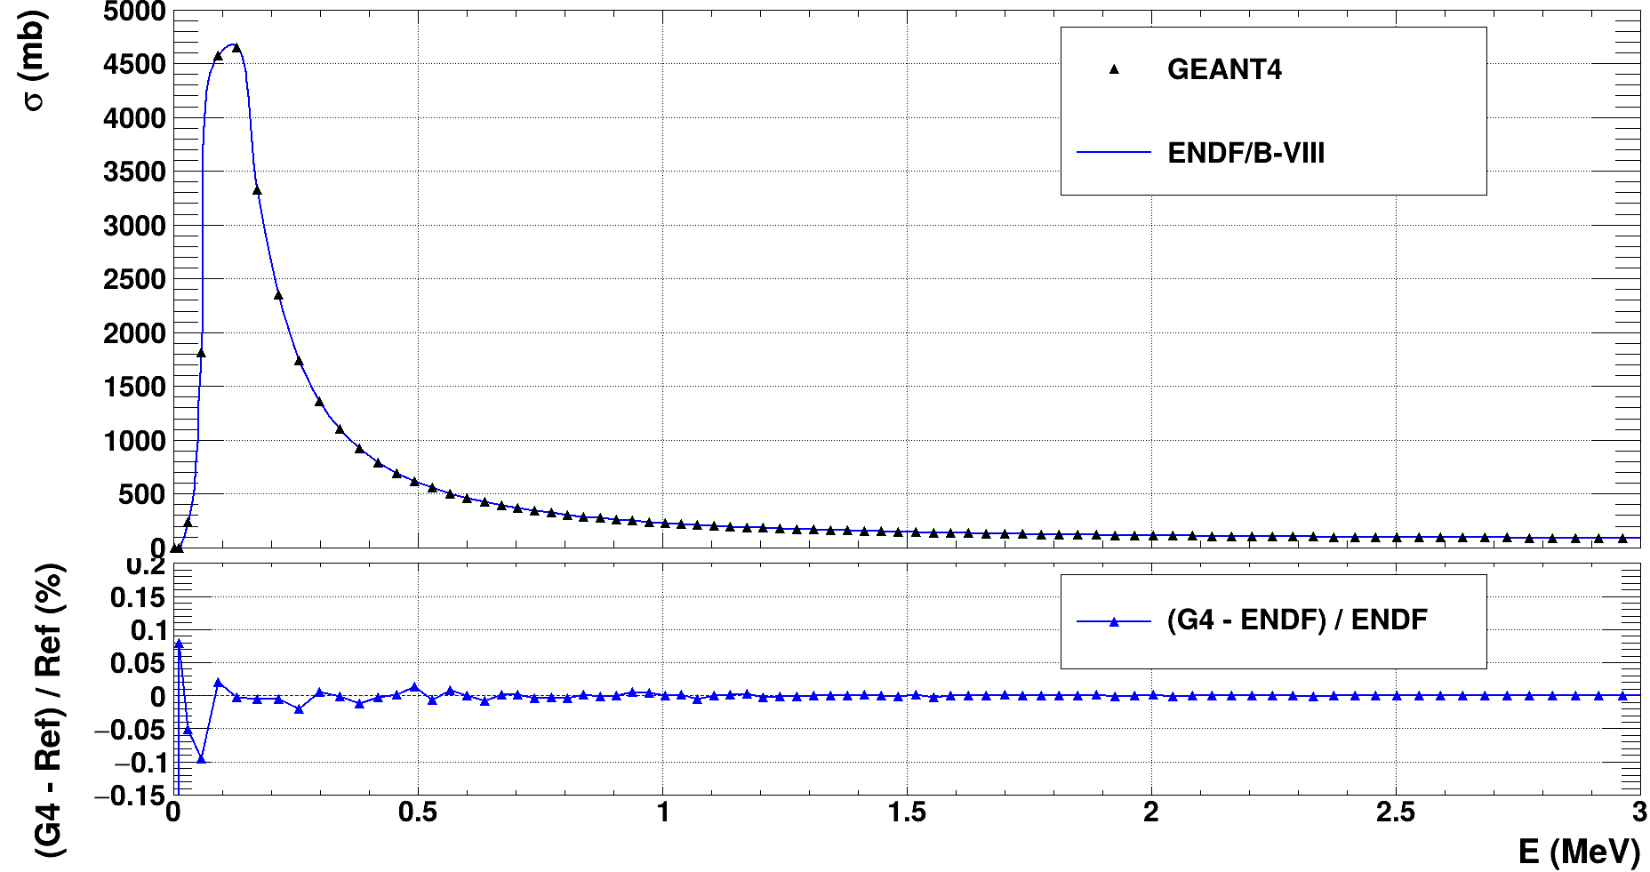
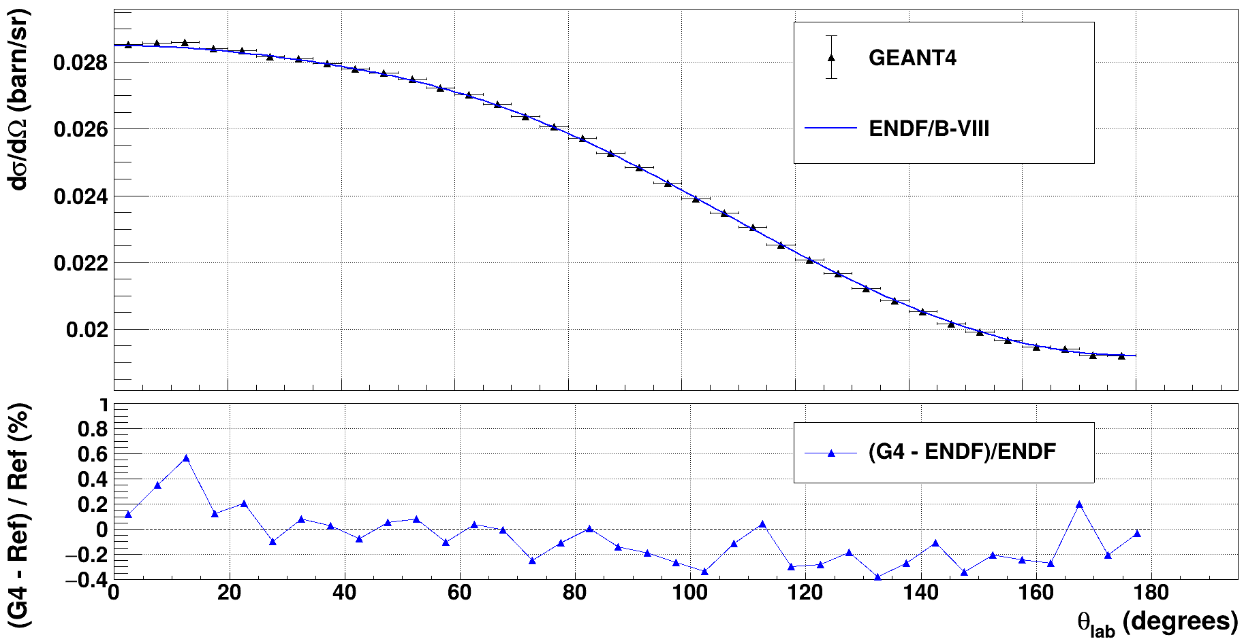
Accuracy check
T(d,n)⁴He reaction
T(d,n)⁴He reaction
Cross section
Angular distribution
Excellent agreement with ENDF for the whole energy range of interest

Slide 15
Results
4

Slide 16
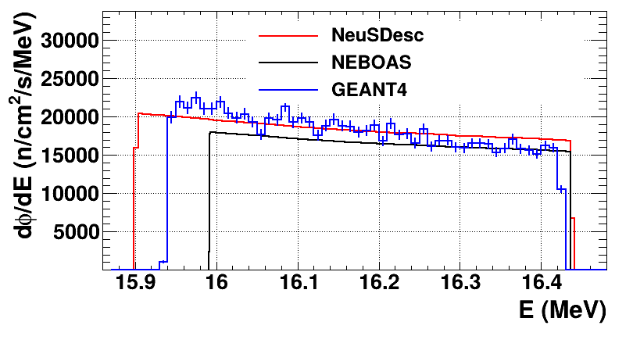

Results – Comparison to NeuSDesc and NEBOAS
Fluence rate 0°, $E_{d}=816 keV$
Differences :
Energy range → different stopping power data
Intensity differences → potential composition differences
Impacts :
Energy range: not significant (regarding fission cross-section)
Intensity: rescaled with flux monitors

Slide 17
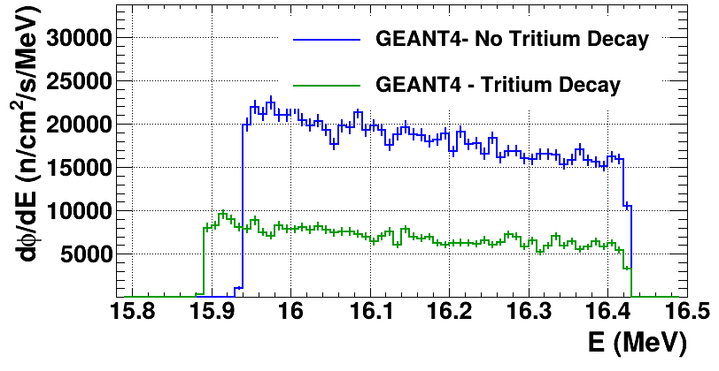
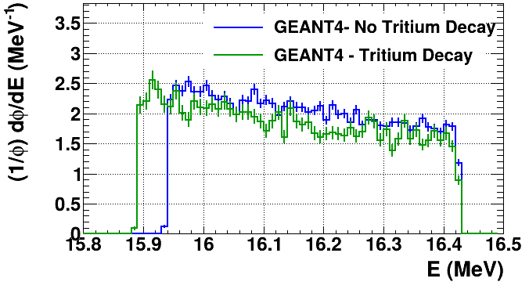
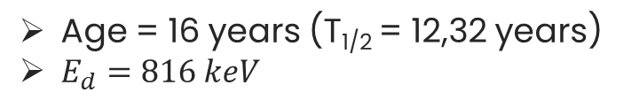
Results – Tritium decay
Study case : ALDEN-8 target
Age = 16 years (T_{1/2} = 12,32 years)
$E_{d}=816 keV$
T:Ti ratio = 1,5
Thickness = 932 µg/cm²
Absolute fluence rate 0°
Normalized fluence rate 0°
Tritium decay → Intensity decrease
Helium accumulation → Stopping power increase → Small influence on final spectrum

Slide 18
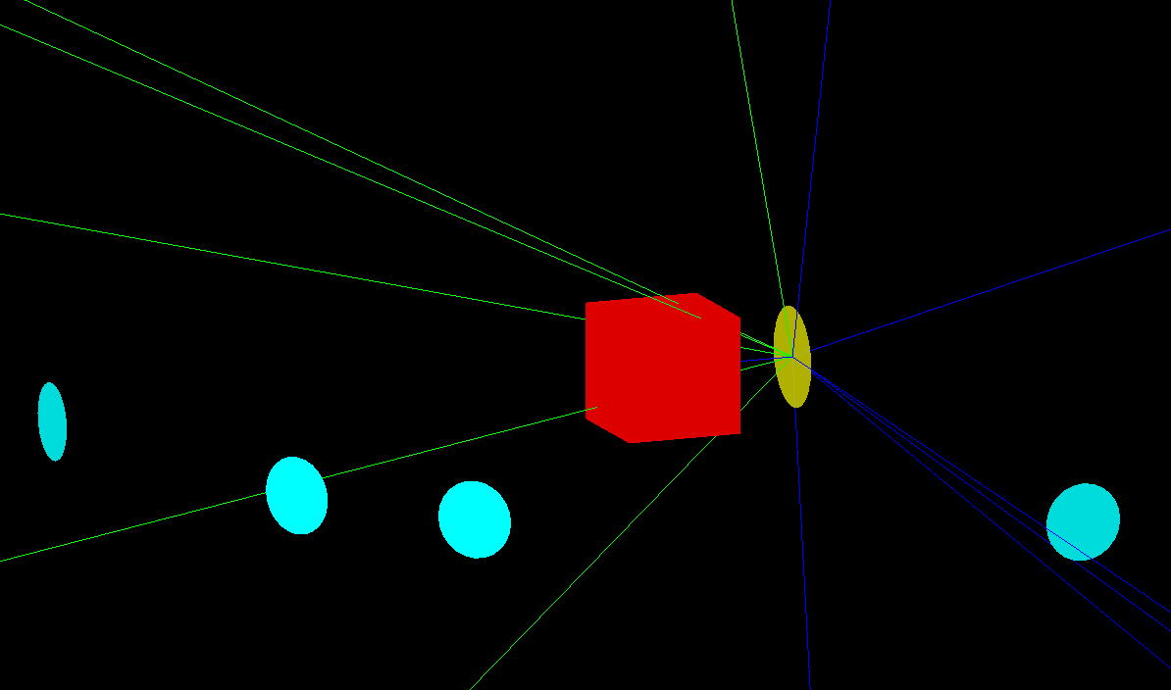
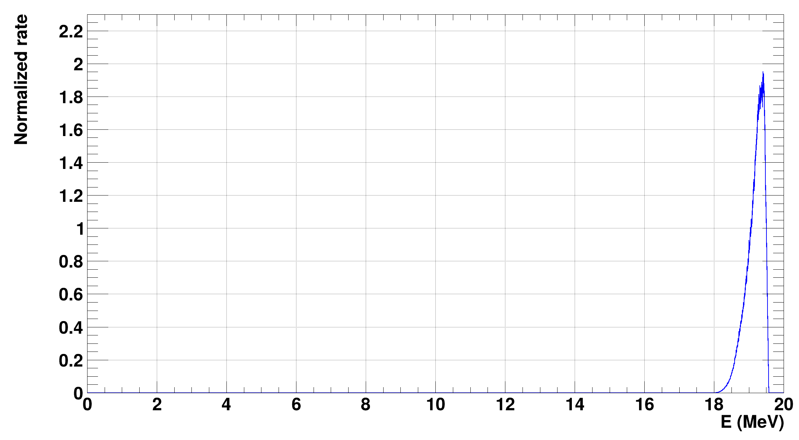
Results – Secondary sources
“Problematic” case : 3 MeV deuteron beam on 10 years old target with deuterium implanted (2,55 C)
“Expected” fission rate spectrum
²³⁹Pu
Target

Slide 19
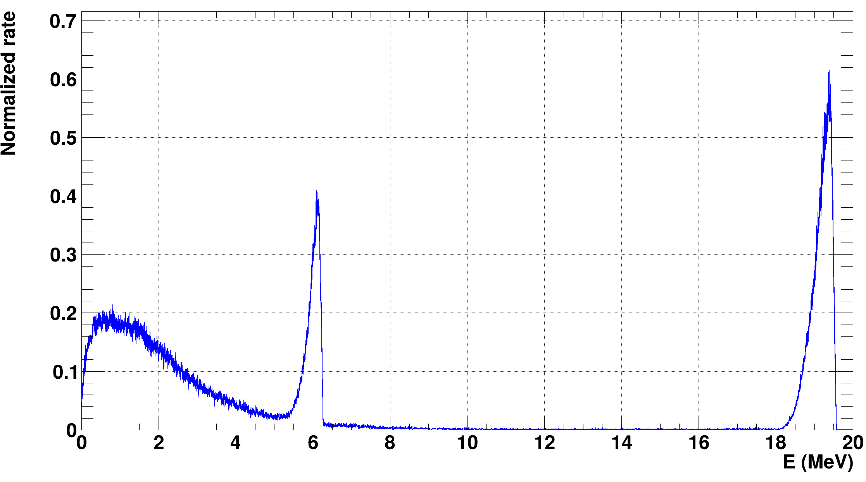
Results – Secondary sources
Fission rate spectrum with secondary sources consideration
^{A}Ti(d,n) 53%
D(d,n)³He
16%
T(d,n)⁴He
31%

Slide 20
Conclusion
5

Slide 21
Conclusion
We developed a simulation tool for ABNS, following an alternative approach compared to existing tools (full Monte-Carlo with GEANT4 toolkit)
The model already gives promising results and allows to tackle some of the problematics encountered with ABNS
Outlooks
Extension (oxygen and carbon secondary reactions) and experimental validation (thanks to TOF from MONNET (JRC) and AMANDE (ASNR) teams)
Chemical analysis of targets (SEM)
Development perspective : extension to deuterium targets with breakup reaction (9 MeV – 14 MeV)
Important topic for all past and future experiments using ABNS

Slide 22
Thank you for your attention !
Questions ?

Slide 23
References
[1] P. Leconte & al., Eur. Phys. J. A, 2024
[2] D. Belverge, Theses, Université Grenoble Alpes [2020-....], 2024.
[3] R. Böttger & al., Nucl. Instrum. Methods Phys. Res. Sect. Accel. Spectrometers Detect. Assoc. Equip., 1989.
[4] S. Agostinelli & al., Nucl. Instrum. Methods Phys. Res. Sect. Accel. Spectrometers Detect. Assoc. Equip., 2003.
[5] J. F. Ziegler & al., Nucl. Instrum. Methods Phys. Res. Sect. B Beam Interact. Mater. At., 2010.
[6] C. R. Kleinfeldt & al., Nucl. Instrum. Methods Phys. Res. Sect. B Beam Interact. Mater. At., 2025.
[7] E. Birgersson & G. Lövestam, « NeuSDesc – Neutron Source Description Software Manual », JRC Report, 2008
[8] M. Macías & al., Comput. Phys. Commun., 2024.
[9] E. Mendoza & al., Nucl. Instrum. Methods Phys. Res. Sect. Accel. Spectrometers Detect. Assoc. Equip., 2020

Slide 24
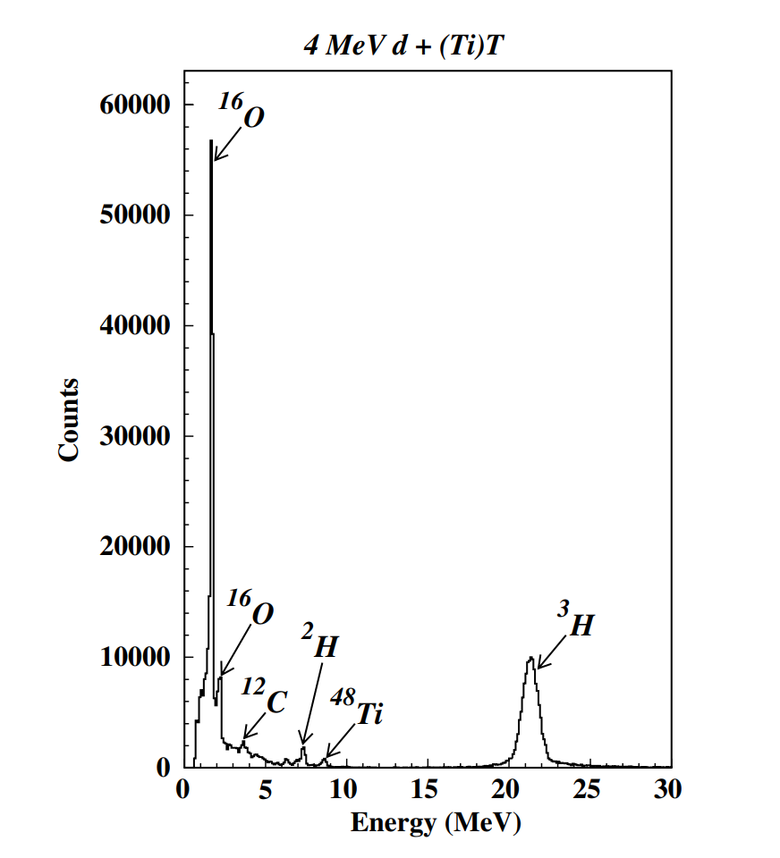
Secondary reactions
TOF from Varignon & al. NIM B. 2006
No detector efficiency correction

Slide 25
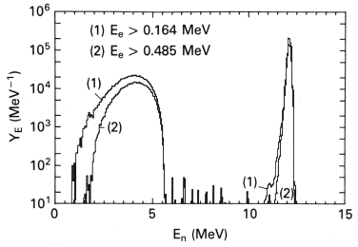
Deuteron BreakUp
D + d → n +p +d
Tree bodies → neutron energy continuum

Slide 26
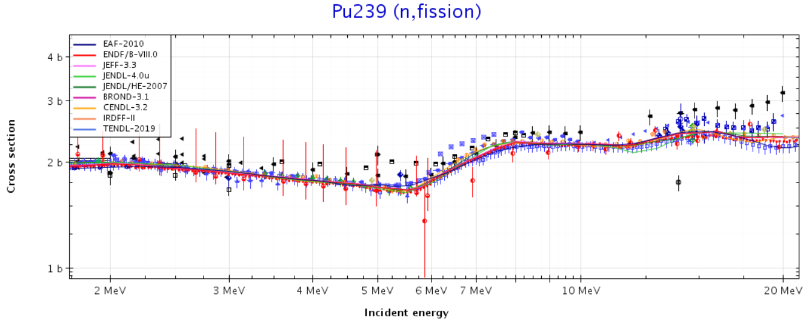
Fission Cross Section

Slide 27
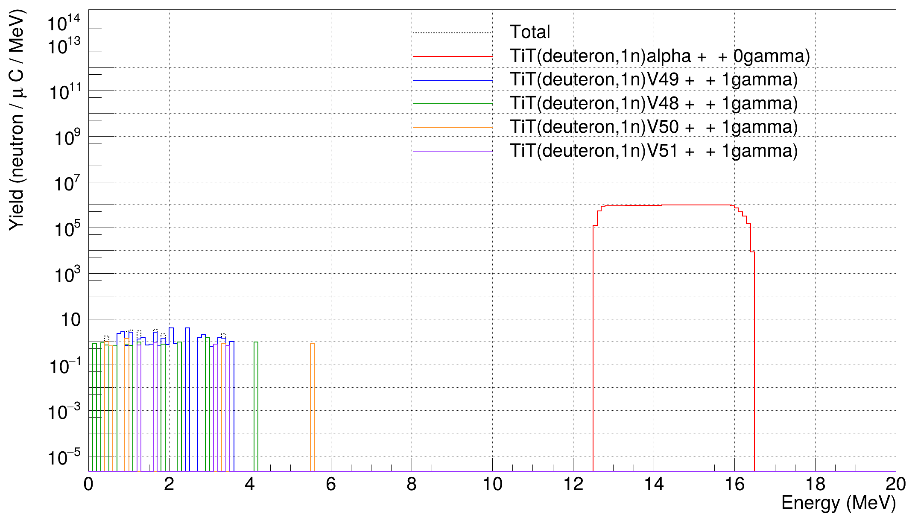
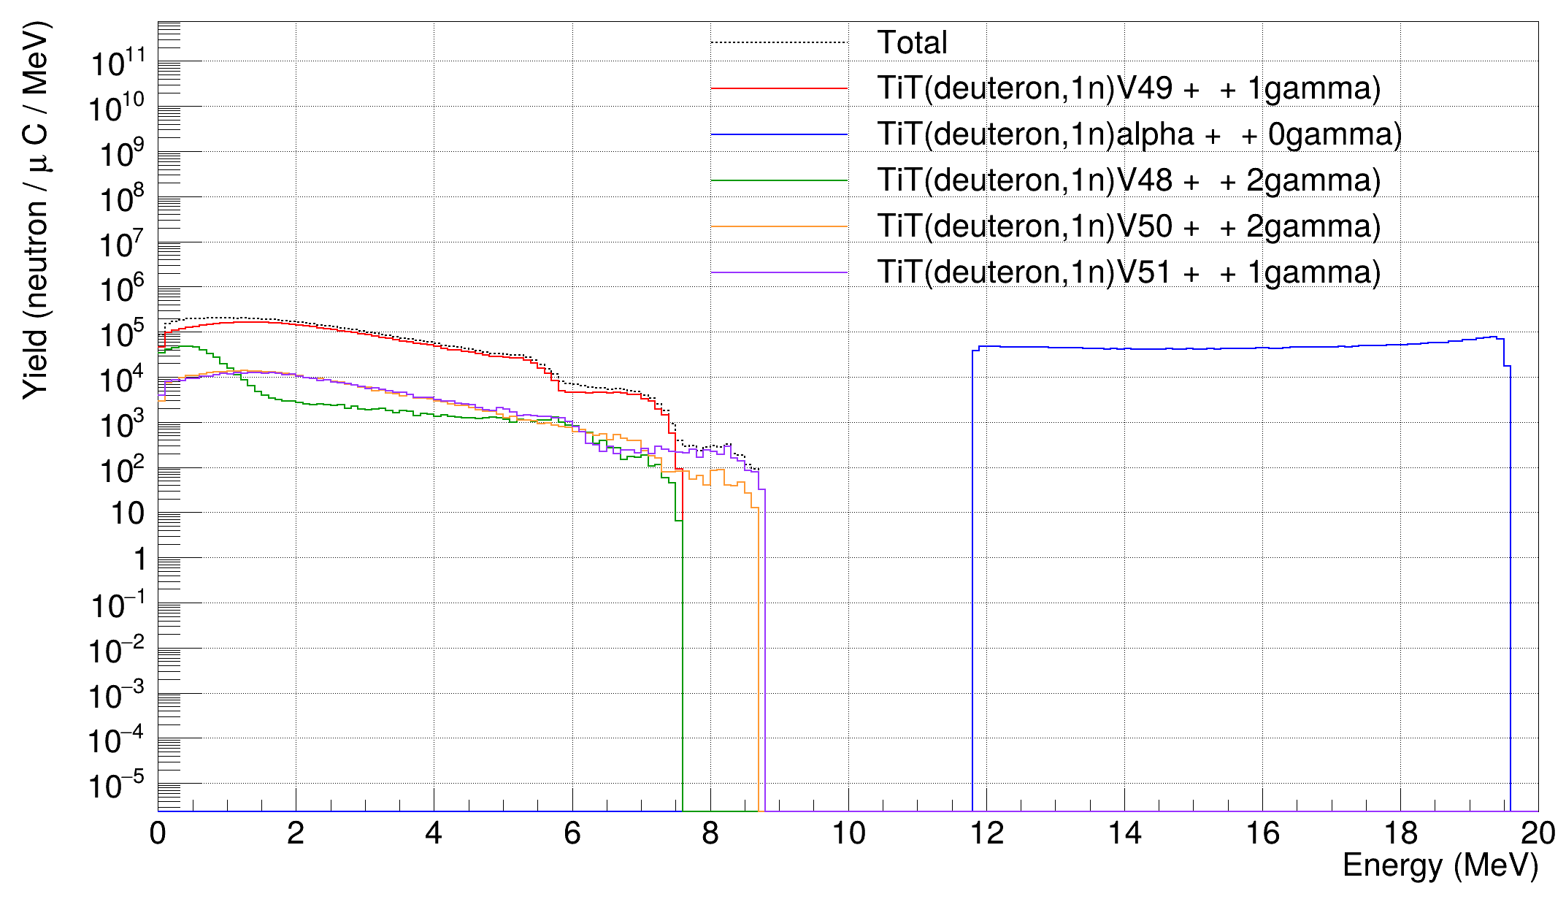


Reactions on Titanium
$4π$neutron yield $E_{d}=816 keV$
$4π$neutron yield $E_{d}=3 MeV$
Observations :
Negligible contribution at low incident energies
Dominant for few MeV incident energies → Problematic for 18,5 MeV to 20 MeV neutron fields

Slide 28
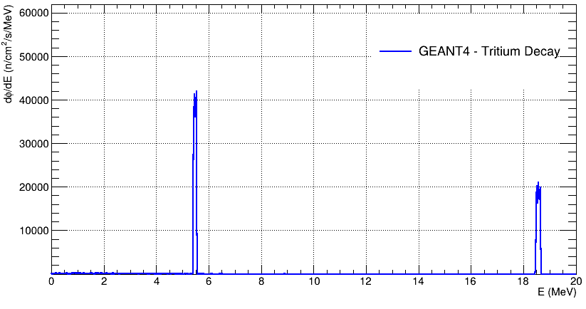
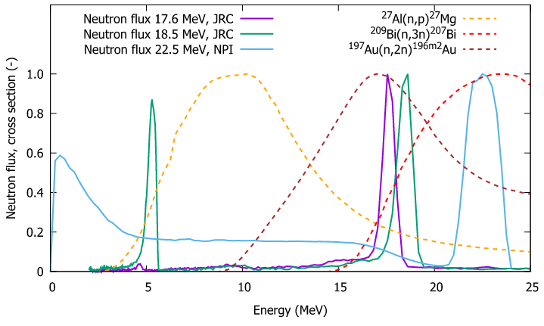

Deuterium implantation
Absolute fluence rate 0°, $E_{d}=2300 keV$
Time of flight measurements (Jarosik & al.)
Secondary peak position reproduction
Relative intensities still unknown

