Slide 1





Activation cross section measurements of short-lived reaction products on Mo, Ge and Au isotopes induced by 16 to 20 MeV neutrons
Z. Bari¹, M. Diakaki¹, M.Kokkoris¹, R.Vlastou¹, V. Michalopoulou¹, C. L. Fontana², E. Mafucci², C. Bonaldi², W. Geerts², S. Oberstedt², G. Gkatis²
¹National Technical University of Athens
²European Commission Joint Research Centre (JRC), Retieseweg 111, Geel, 2440, Belgium

Slide 2
Motivation
Accurate cross-section measurements for short-lived reaction products are vital for:
  Nuclear Astrophysics: understanding of processes such as slow and rapid neutron capture
  Fundamental Physics: constrains statistical models
  Applications: Critical for nuclear waste management, innovative fuel cycles, etc
The investigation of neutron-induced reaction cross sections on short-lived nuclei suffers from severe experimental limitations
The Experimental Challenge : The rapid decay of the reaction products and interference from neighboring isotopes
The Solution : 1. Fast Pneumatic "Rabbit" System
2. Highly Enriched Targets (of Mo, Ge and Au)
But why are these materials important?
Mo: Important for producing the most widely known medical isotopes, ^{99m}Tc, and as structural material for advanced nuclear reactors
Ge: Many applications in high-frequency electronics, fiber-optic communication and space-grade solar panels.
Au: Global dosimetry standards – reference reaction

Slide 3
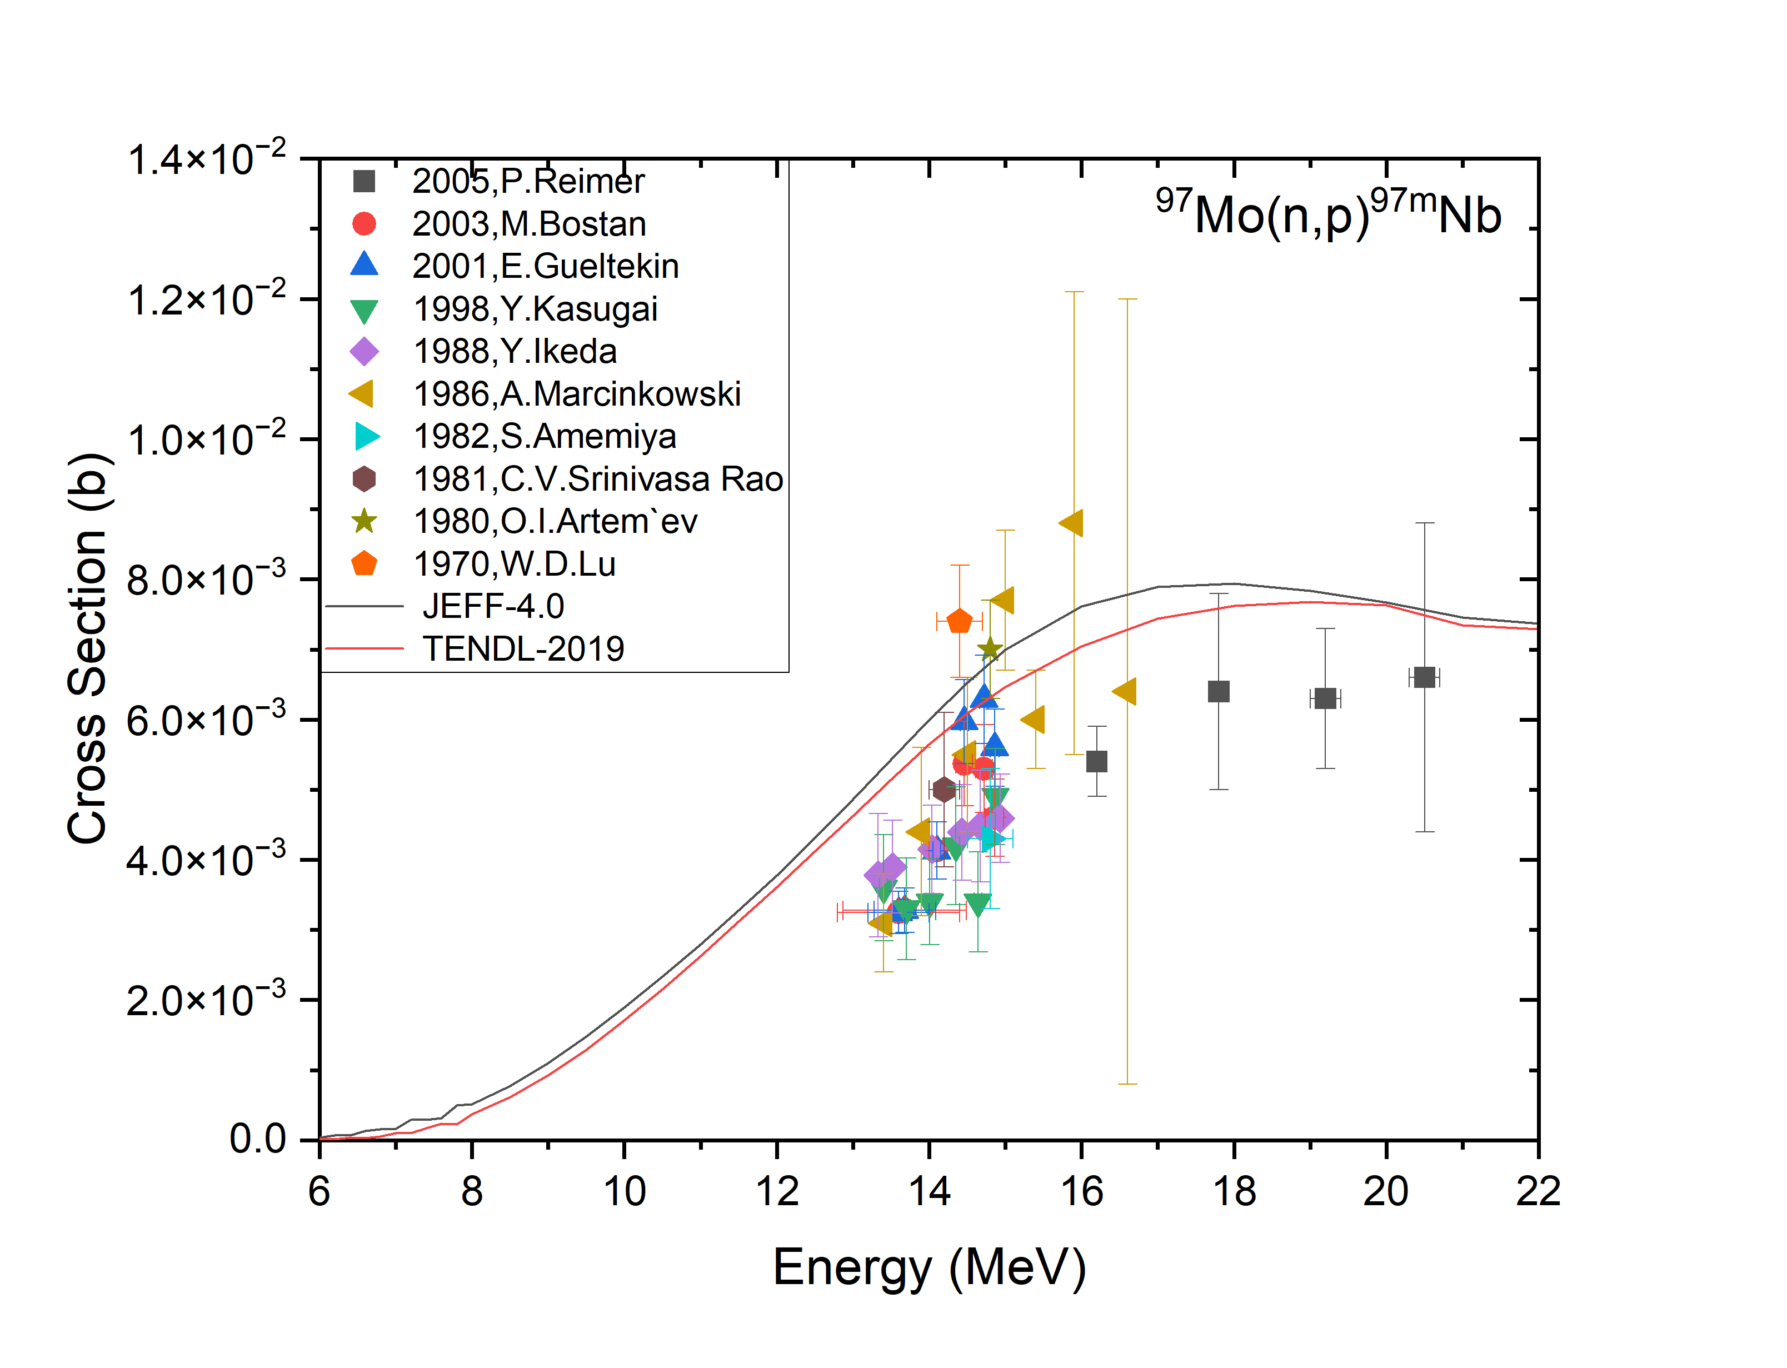
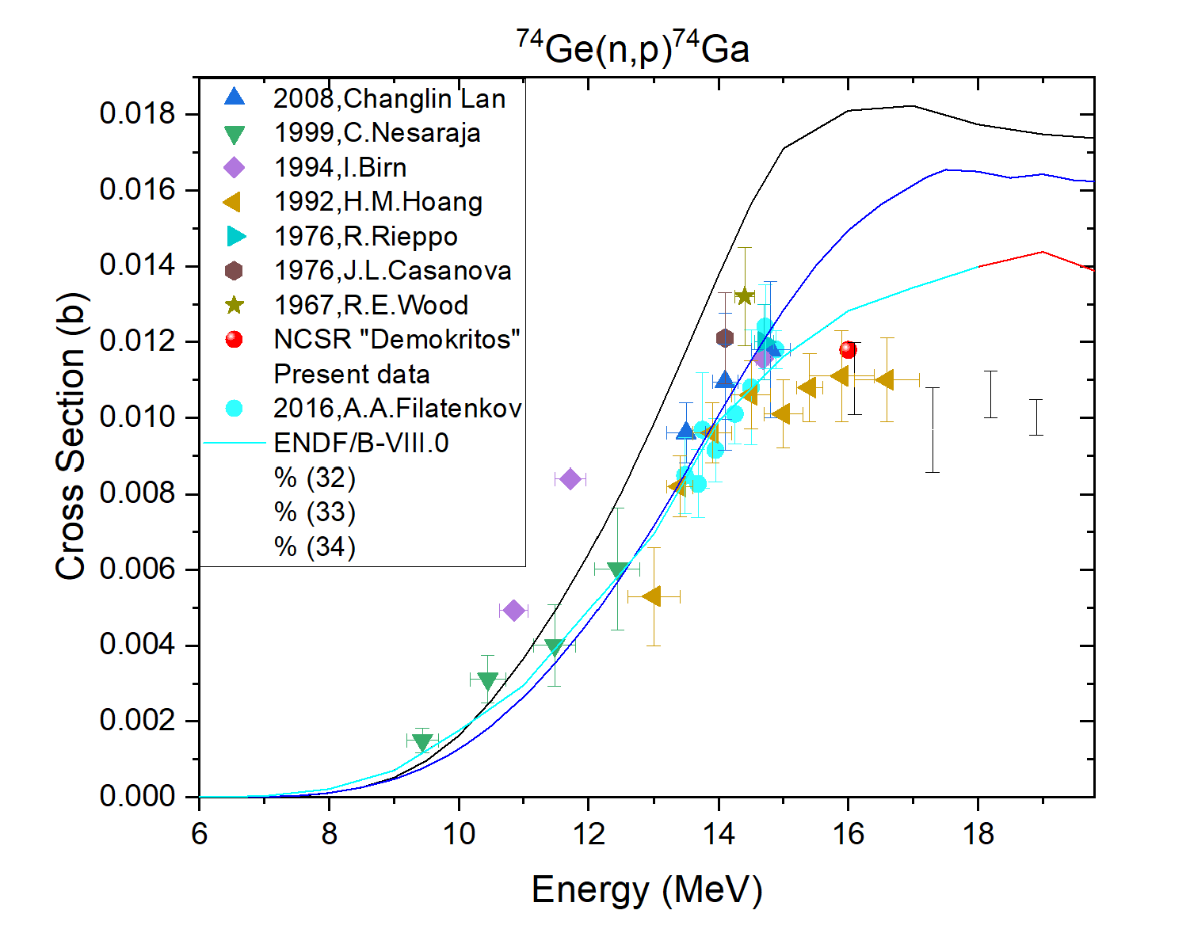


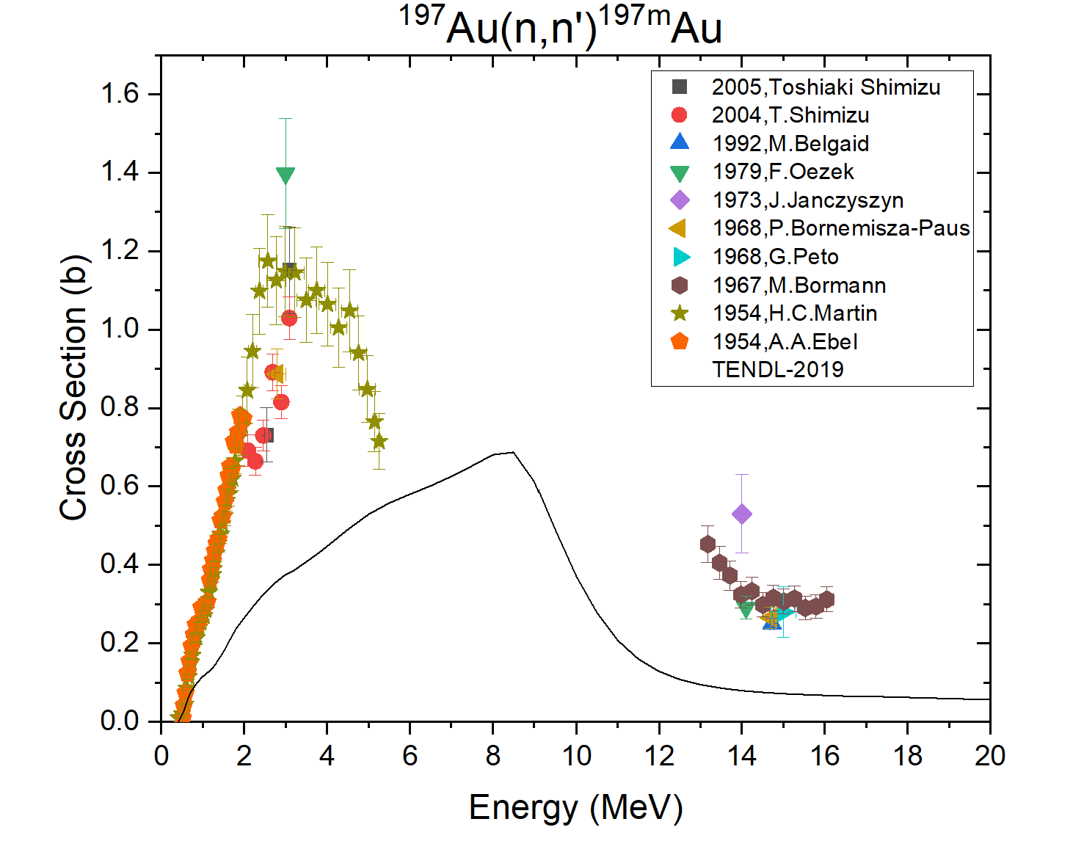
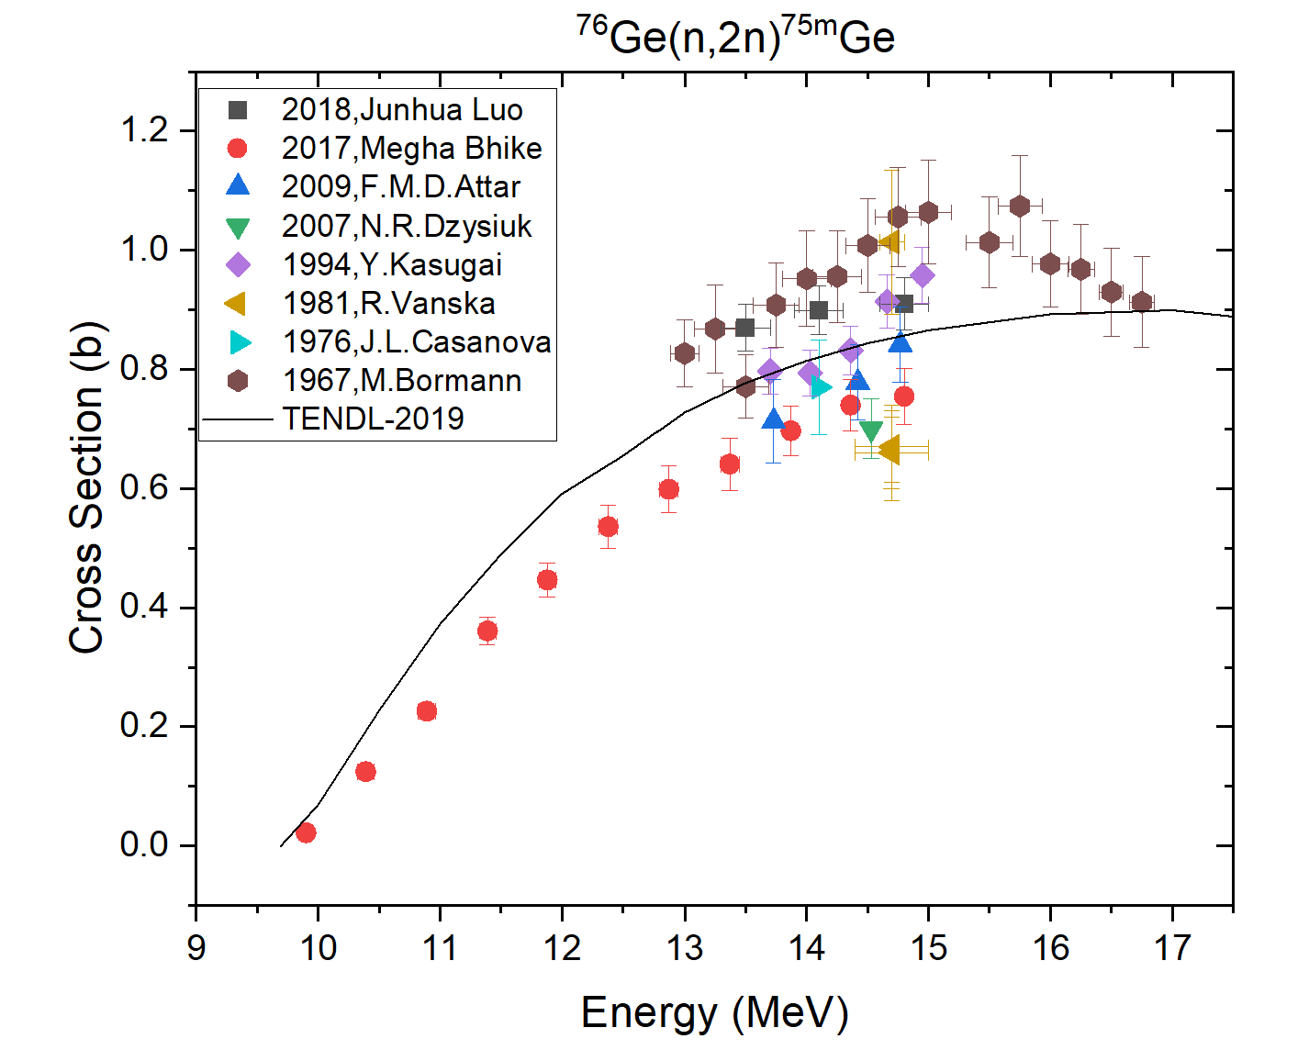
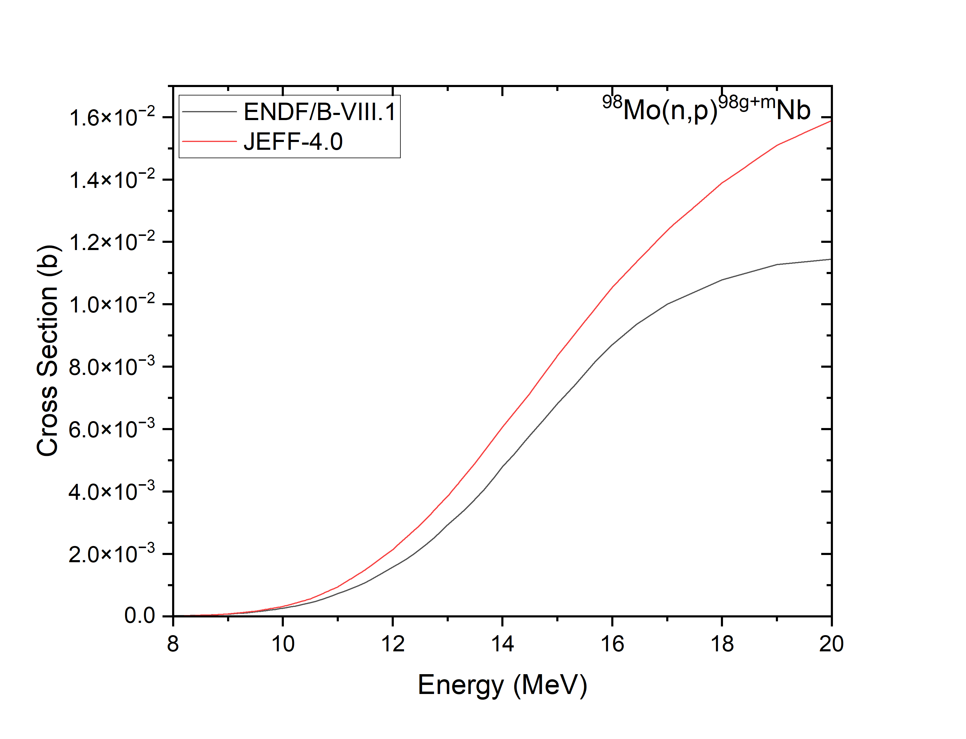
Existing experimental data

Slide 4
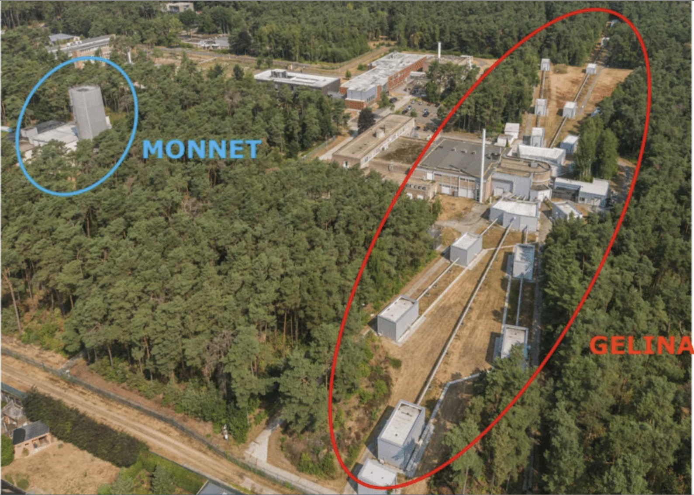
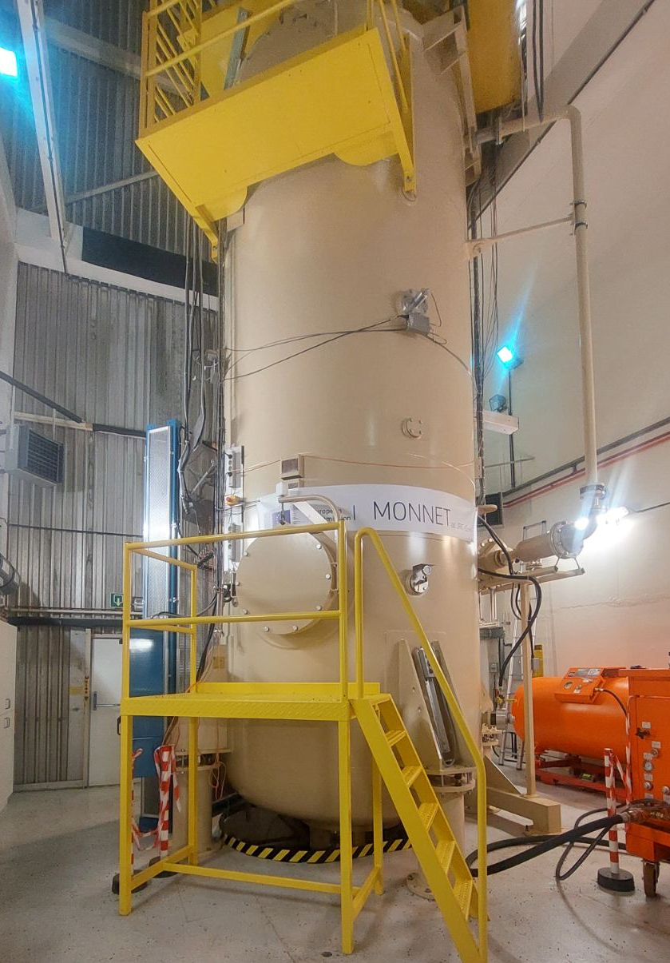
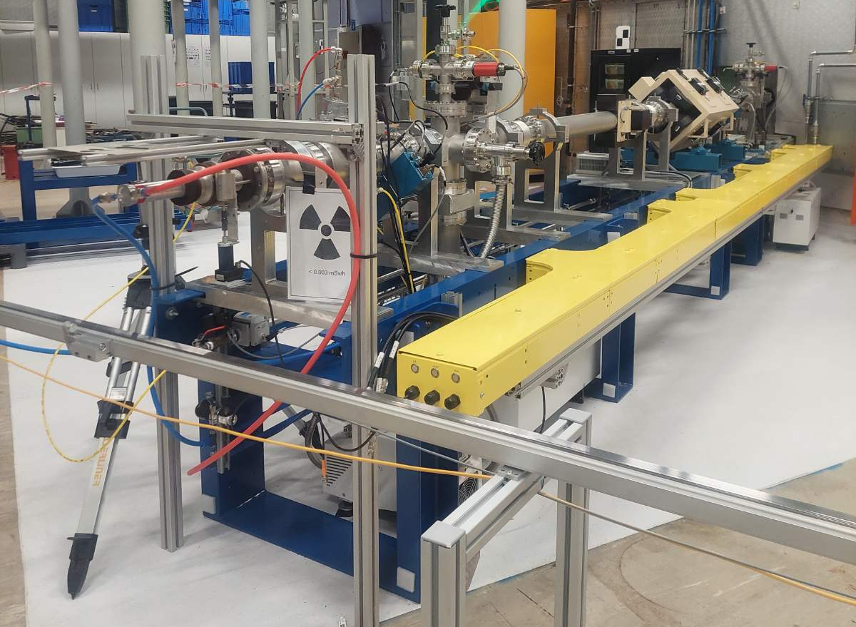
The MONNET Facility at JRC-Geel
The facility operates under the Joint Research Centre's nuclear research center in Geel, Belgium
Neutron Source: A high-intensity, quasi-monoenergetic fast neutron facility (up to 24 MeV)
Accelerator: Van De Graff 3.5 MV accelerator
Beam Flexibility: Continuous and pulsed proton, deuteron, and helium ion beams
Applications: Nuclear data research for activation, fission and scattering experiments, complementing the GELINA time-of-flight facility

Slide 5
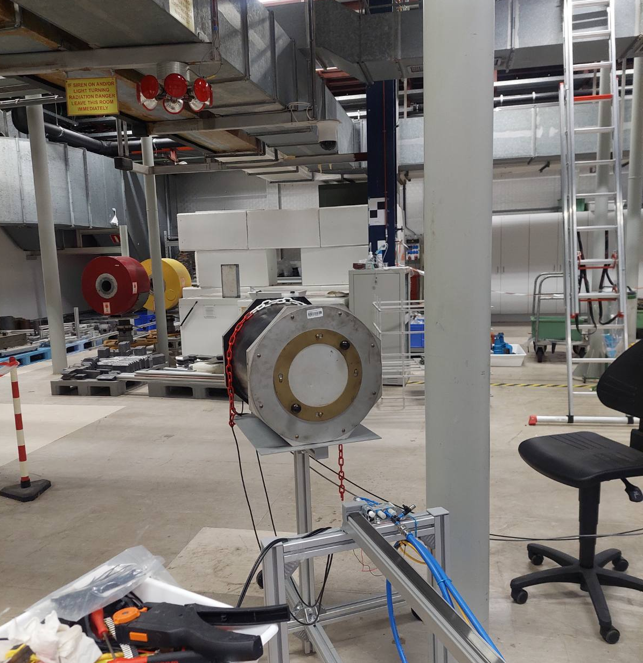
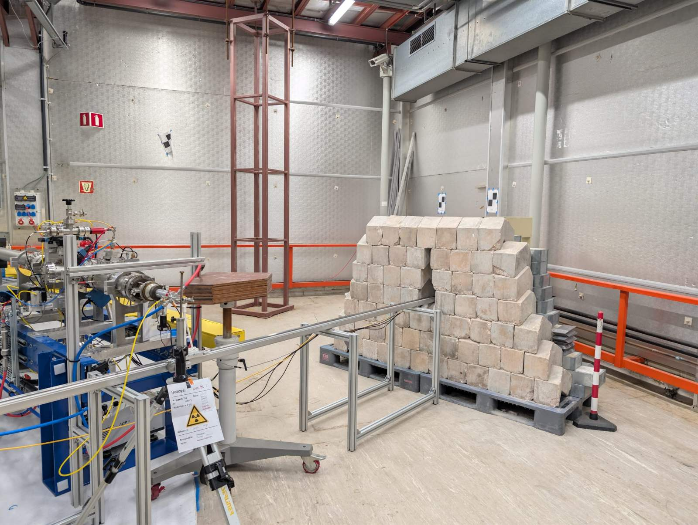
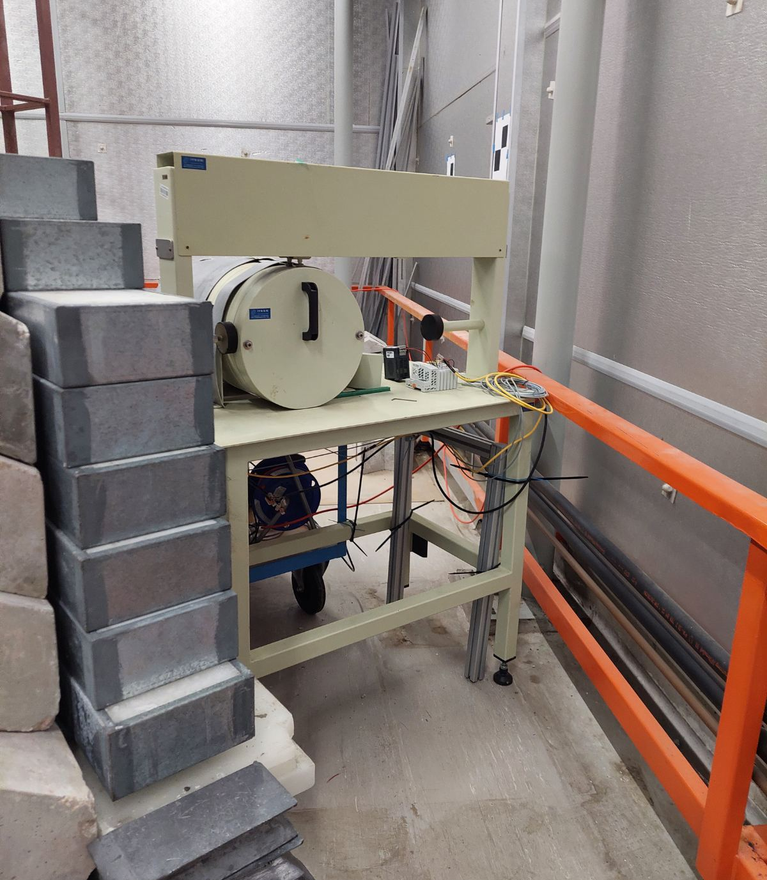
Experimental Set-up
The Pneumatic “Rabbit” System: High-speed transport system (FESTO)
Flux Monitor: A De Pangher Proportional Long Counter (PLC) equipped with a 10 Hz pulser to continuously monitor neutron flux and system dead-time
HPGe Detector: HPGe detector of 48.2% relative efficiency
Shielding: consisting of Pb, Cu and a custom-made wall of Pb and concrete

Slide 6

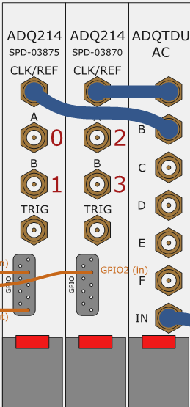
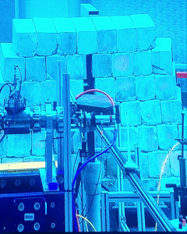
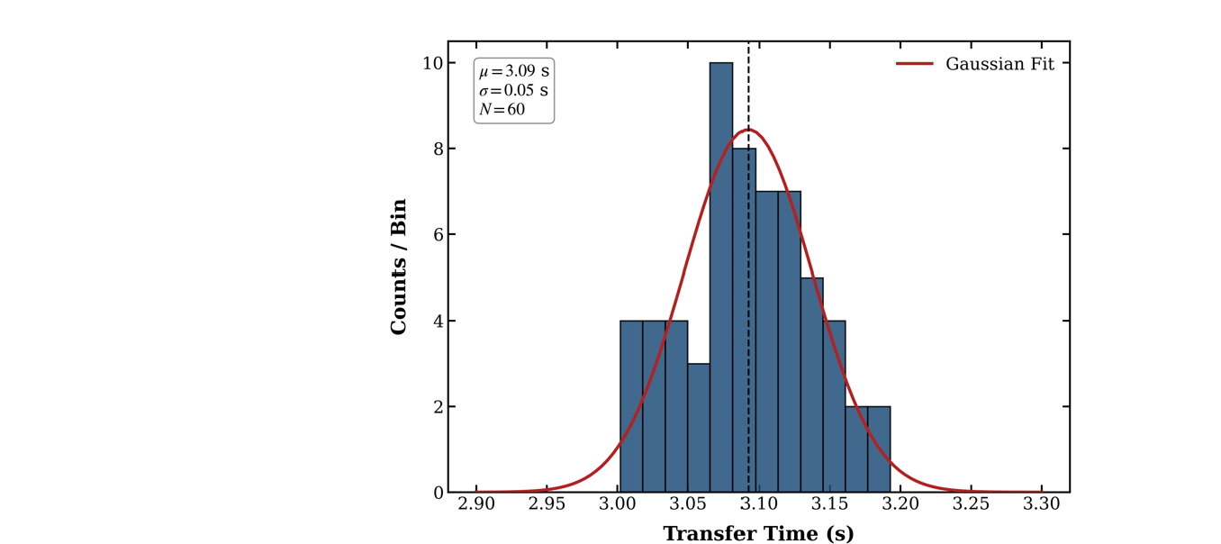
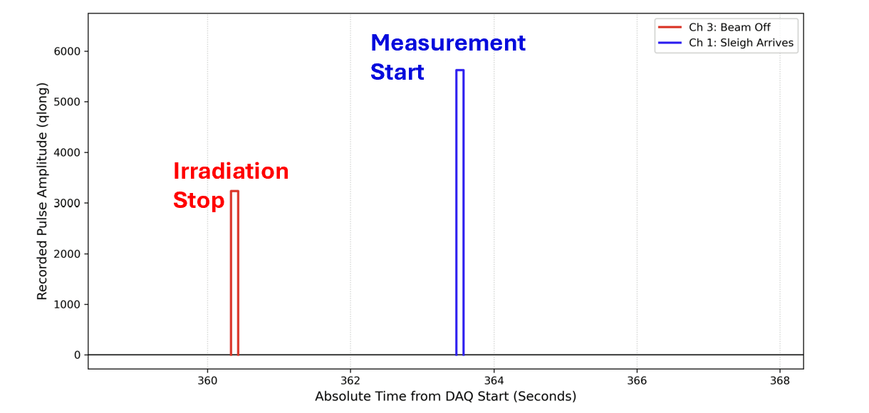
High-Precision transfer time
Timing Calculation Signals:
Signal 1 (Start): The accelerator pulse (DAQ Ch3) marking the end of the irradiation (NEPTUNE).
Signal 2 (Stop): The Rabbit optical sensor (DAQ Ch1) detecting the sample's arrival inside the lead castle.
t_{tranfer}

Slide 7
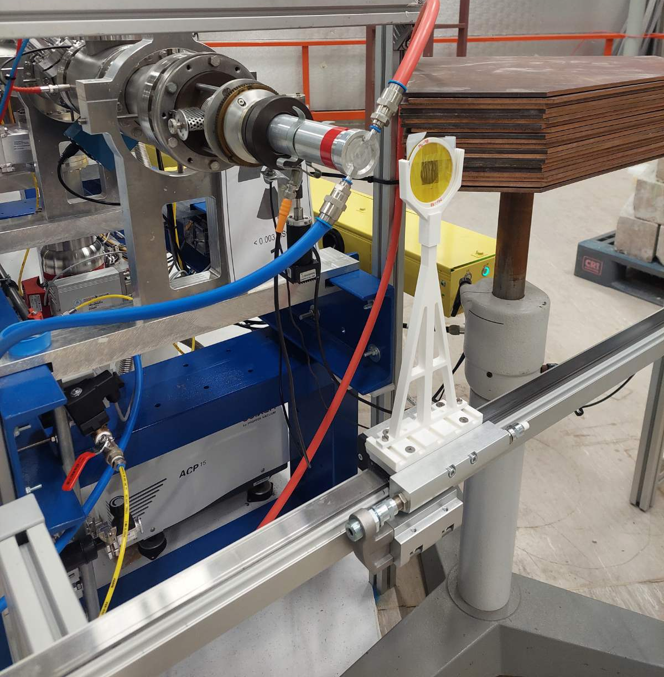

Methodology: Neutron Activation Analysis
Neutron Production: Quasi-monoenergetic fast neutrons produced via the ³H(d,n)⁴He reaction (E_{n} = 16 to 20 MeV)
Configuration: Sequential irradiation (Al foil & targets) at the exact same position (~9 cm away from T target)
Irradiation
Cyclic Activation: Multiple irradiation-measurement cycles applied to the targets to build sufficient counting statistics for short-lived products
Target | Enrichment (%) | Reaction | Half-life | Number of cycles
⁹⁷Mo* | 98.2 | ⁹⁷Mo(n,p)^{97m}Nb | 58.7 s | 2-12
⁹⁸Mo* | 98.67 | ⁹⁸Mo(n,p)^{98g+m}Nb | 2.86 s | 15
⁷⁴Ge* | 95.51 | ⁷⁴Ge(n,p)⁷⁴Ga | 8.12 min | 1-2
⁷⁶Ge* | 88.46 | ⁷⁶Ge(n,2n)^{75m}Ge | 47.7 s | 2-12
¹⁹⁷Au | 100 | ¹⁹⁷Au(n,3n)^{195m}Au | 30.5 s | 2-12
 |  | ¹⁹⁷Au(n,n')^{197m}Au | 7.86 s | 2-12
²⁷Al | 100 | ²⁷Al(n,p)²⁷Mg | 9.58 min | 1
Transfer
Irradiation
* Provided by the CERN n_TOF collaboration
Measurement
7

Slide 8
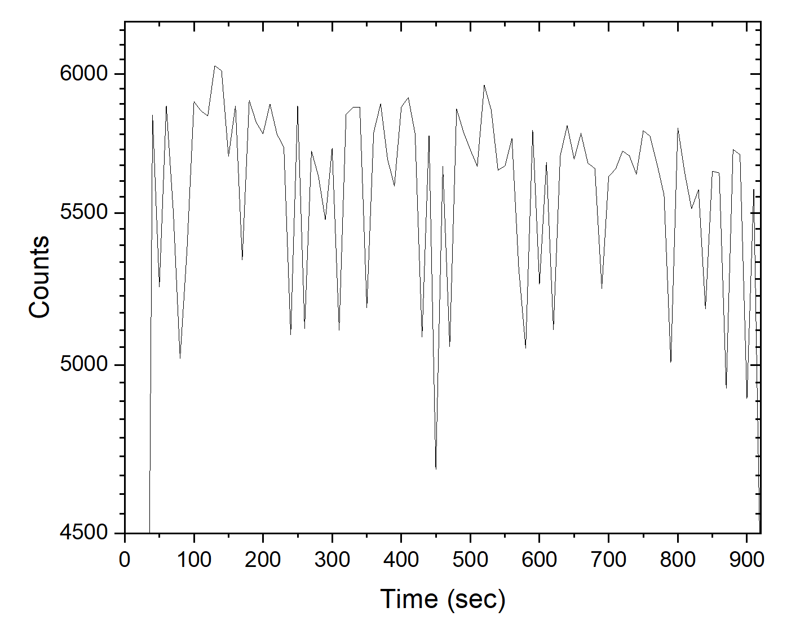
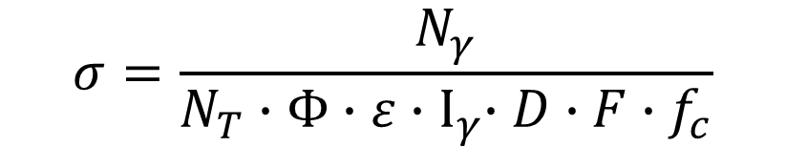
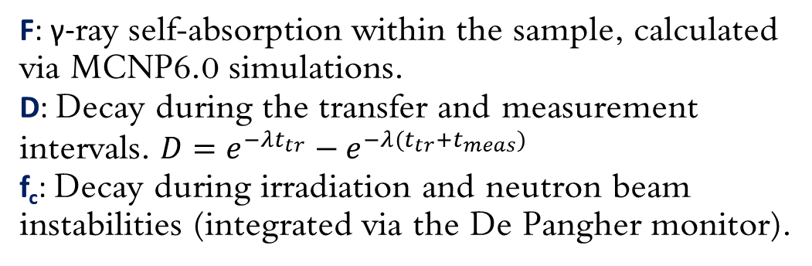
Cross Section
$$σ=\frac{N_{γ}}{N_{T}∙Φ∙ε{∙Ι}_{γ}∙D∙F∙f_{c}}$$
Cross Section formula:
Ν_{T}: Total number of target nuclei
Ν_{γ}: Integral of the γ-ray peak of interest
Ι_{γ}: Characteristic γ-ray intensity
ε: Absolute efficiency of the HPGe detector
Φ: Neutron flux is derived from the reference reaction ²⁷Al(n,p)²⁷Mg.
Normalization: The integrated flux is normalized to the target’s beam current and specific irradiation time to yield the neutron flux for the target samples.
Correction factors:
F: γ-ray self-absorption within the sample, calculated via MCNP6.0 simulations.
D: Decay during the transfer and measurement intervals. $D=e^{−λt_{tr}}−$ $e^{−λ(t_{tr}+t_{meas})}$
f_{c}: Decay during irradiation and neutron beam instabilities (integrated via the De Pangher monitor).
Al irradiation at 18.2 MeV,
t_{irr} = 900 sec

Slide 9
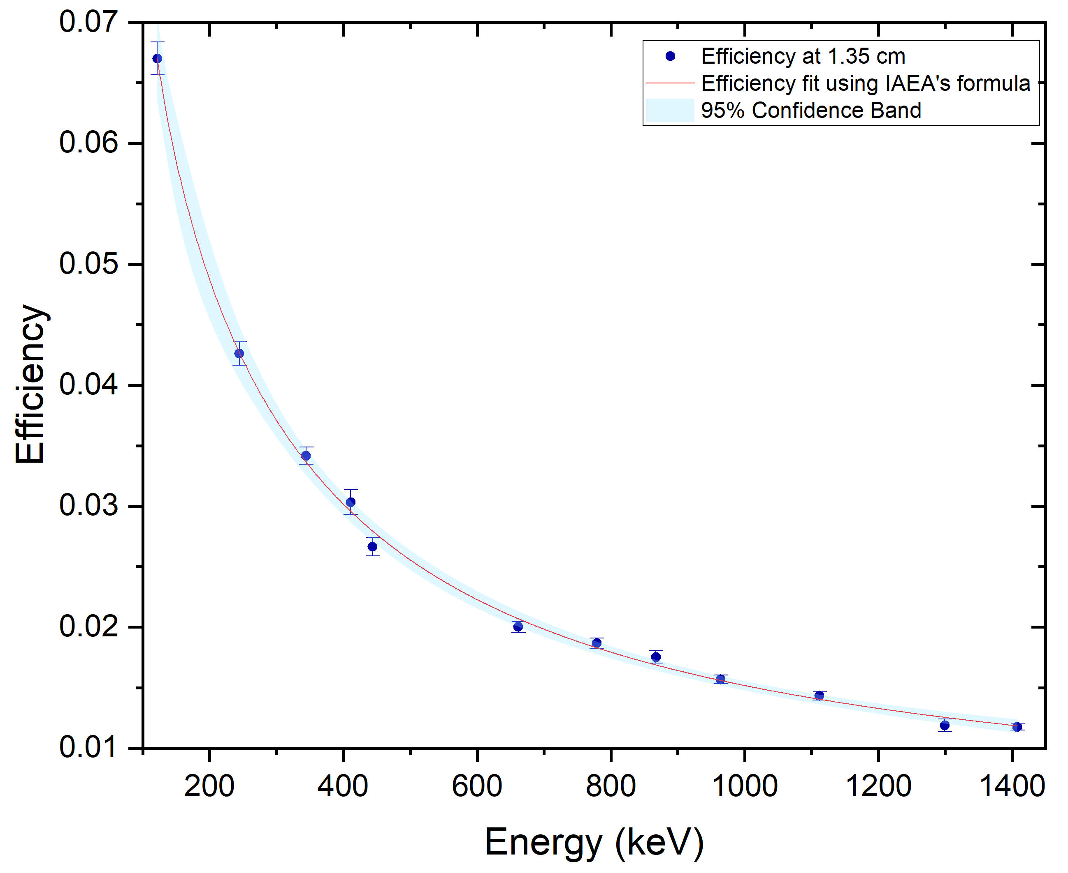
HPGe detector & Efficiency Measurement
Detector Specifications:
Model: Canberra HPGe GR4520 (48.2% relative efficiency).
Calibration Sources: ¹⁵²Eu and ¹³⁷Cs point sources
Efficiency & Geometry Corrections:
Distance Mapping: Measured at 13, 9, 5, 4, 3, 2, and 1.35 cm to study True Coincidence Summing (TCS) effects.
Current Methodology: Efficiency at 1.35 cm derived by applying a geometrical scaling factor to the 13 cm reference position.
TCS Corrections: Ongoing MCNP-CP simulations to correct for cascading γ-rays.

Slide 10
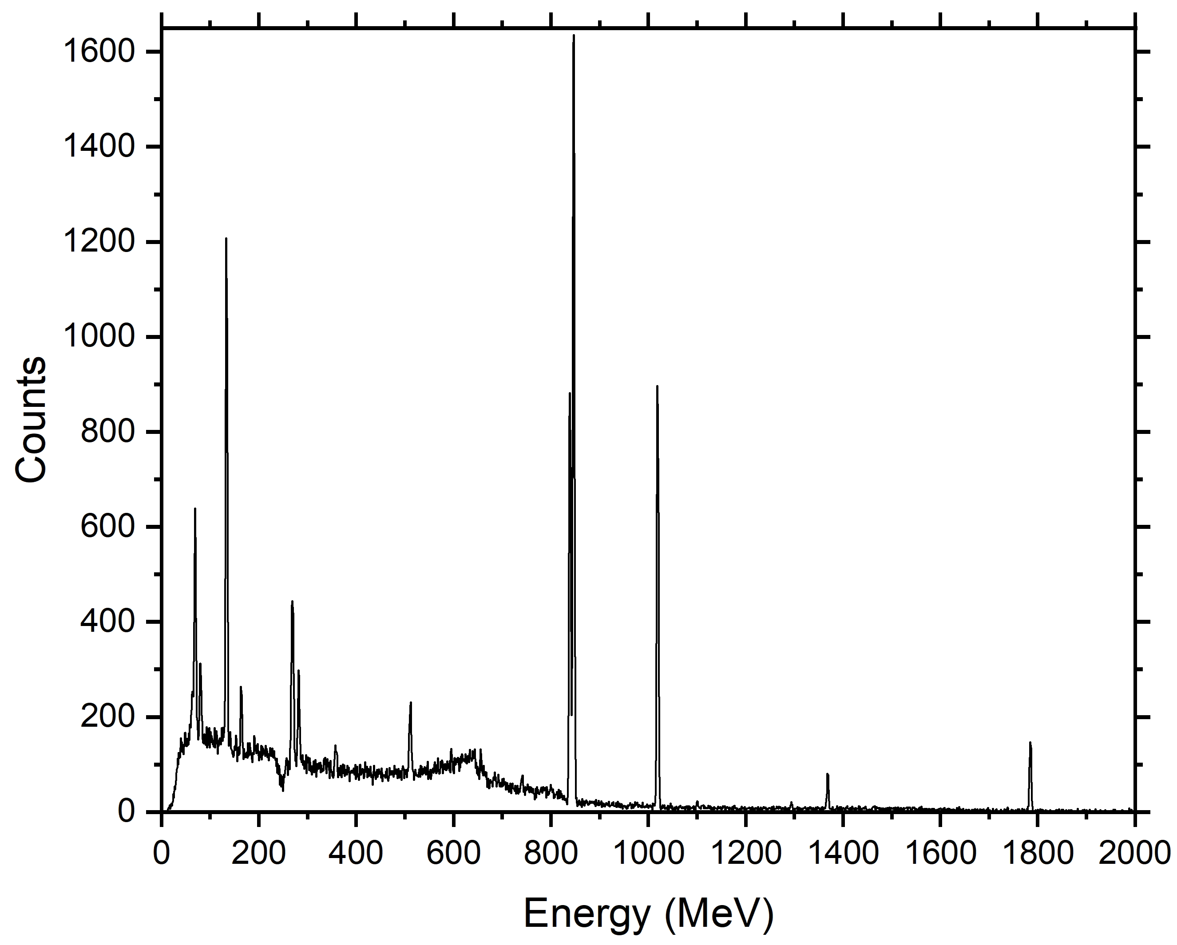
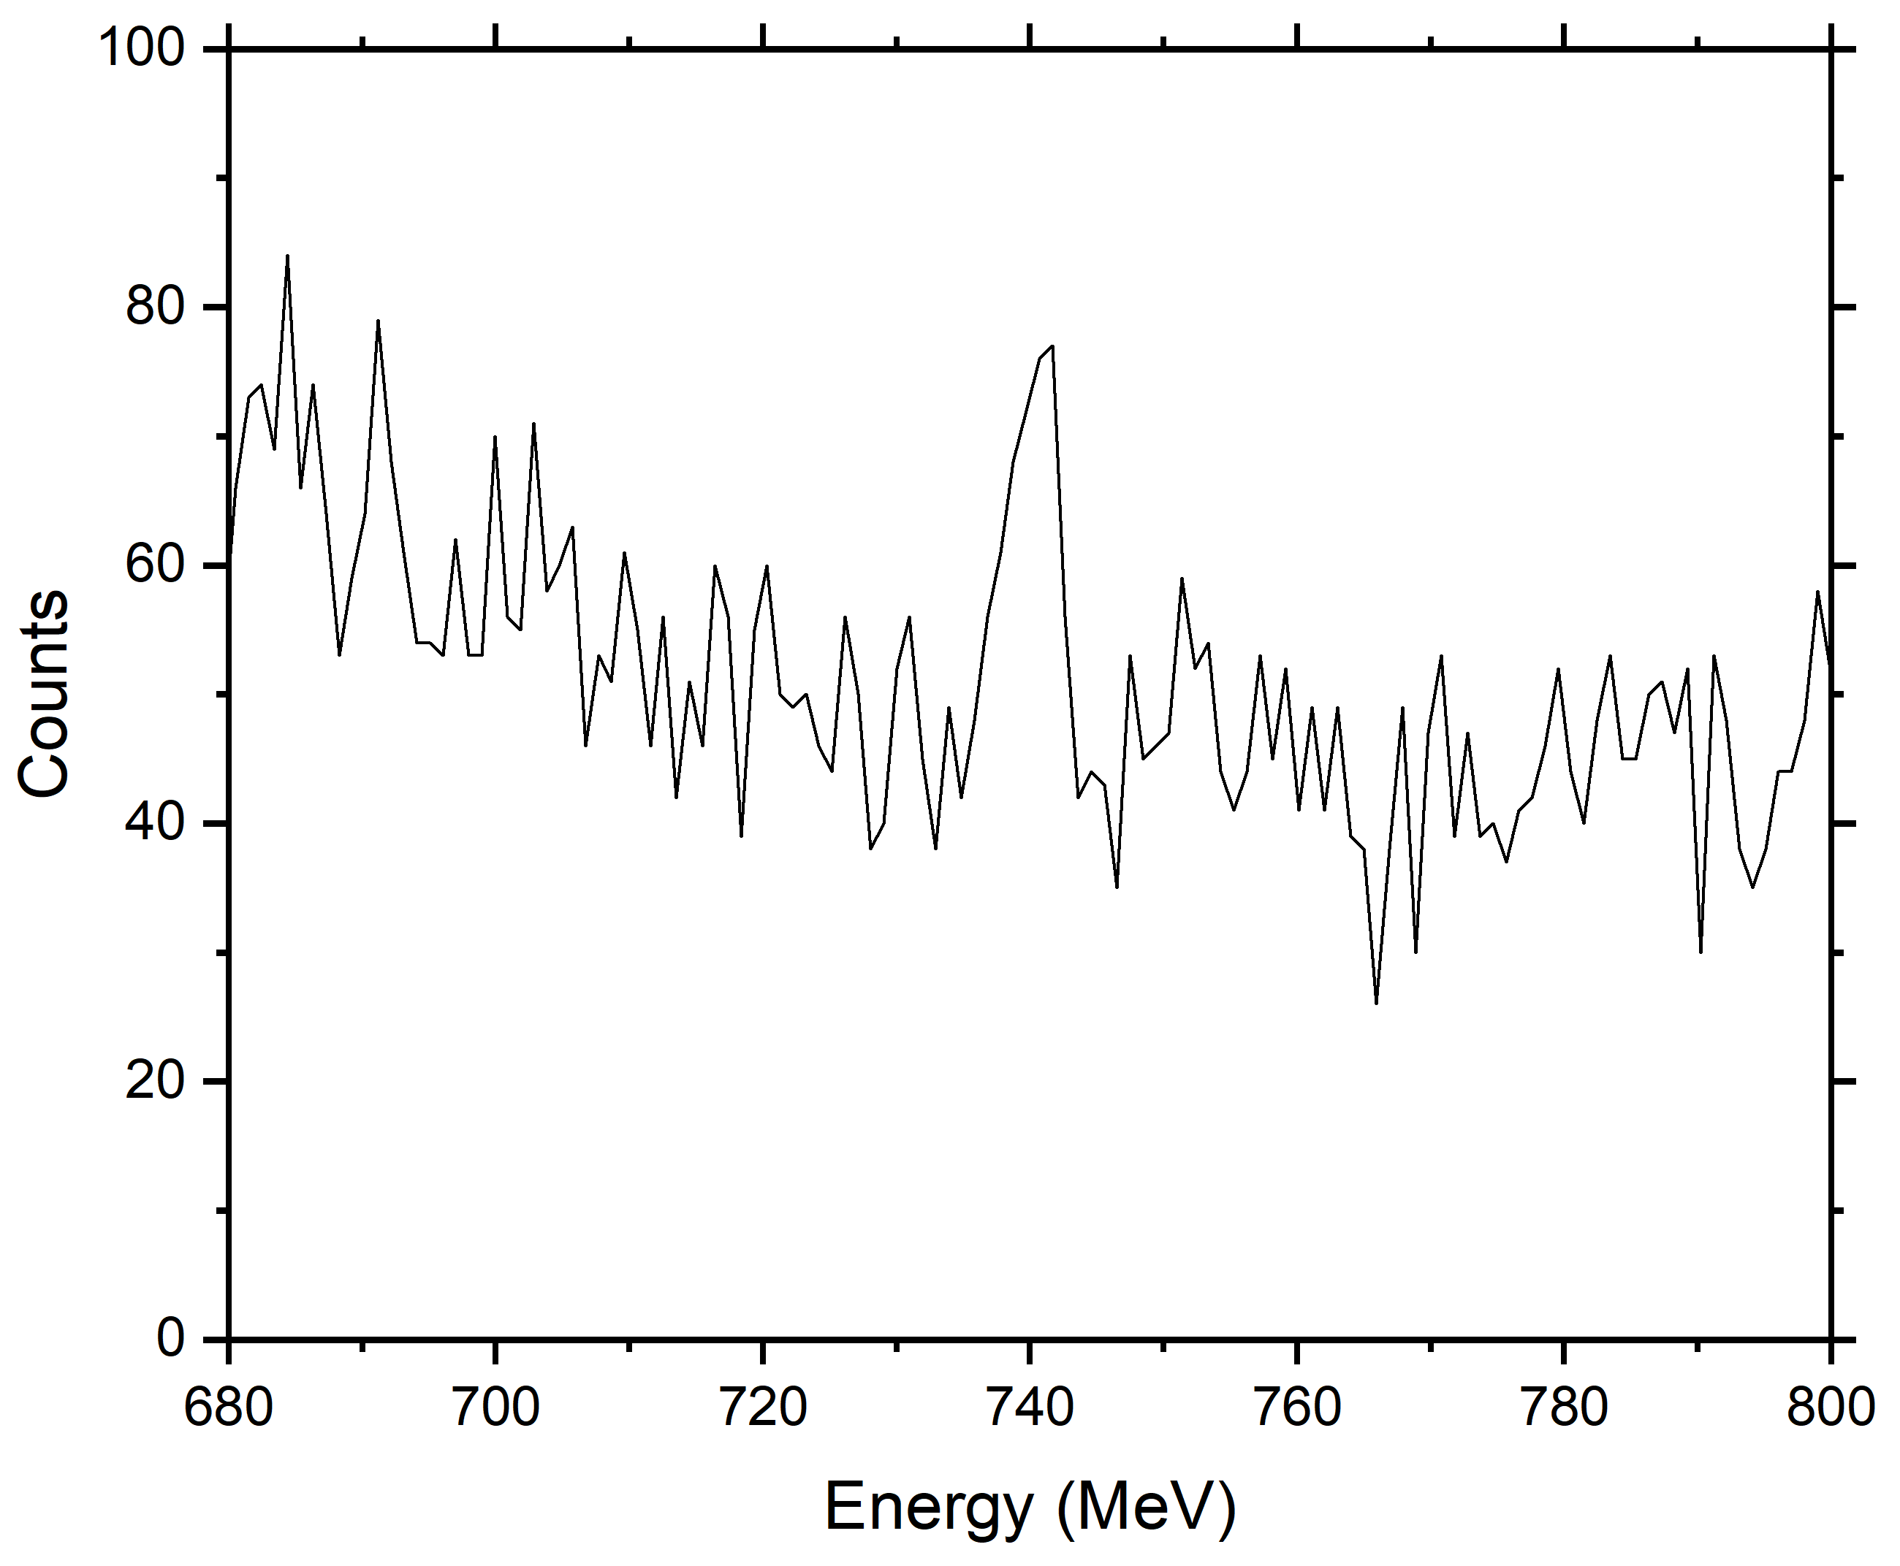
Typical spectrum
^{97m1}Nb
Eγ = 743.36 keV
HPGe spectrum from the irradiation of ⁹⁷Mo at E_{n} = 16.1 MeV

Slide 11
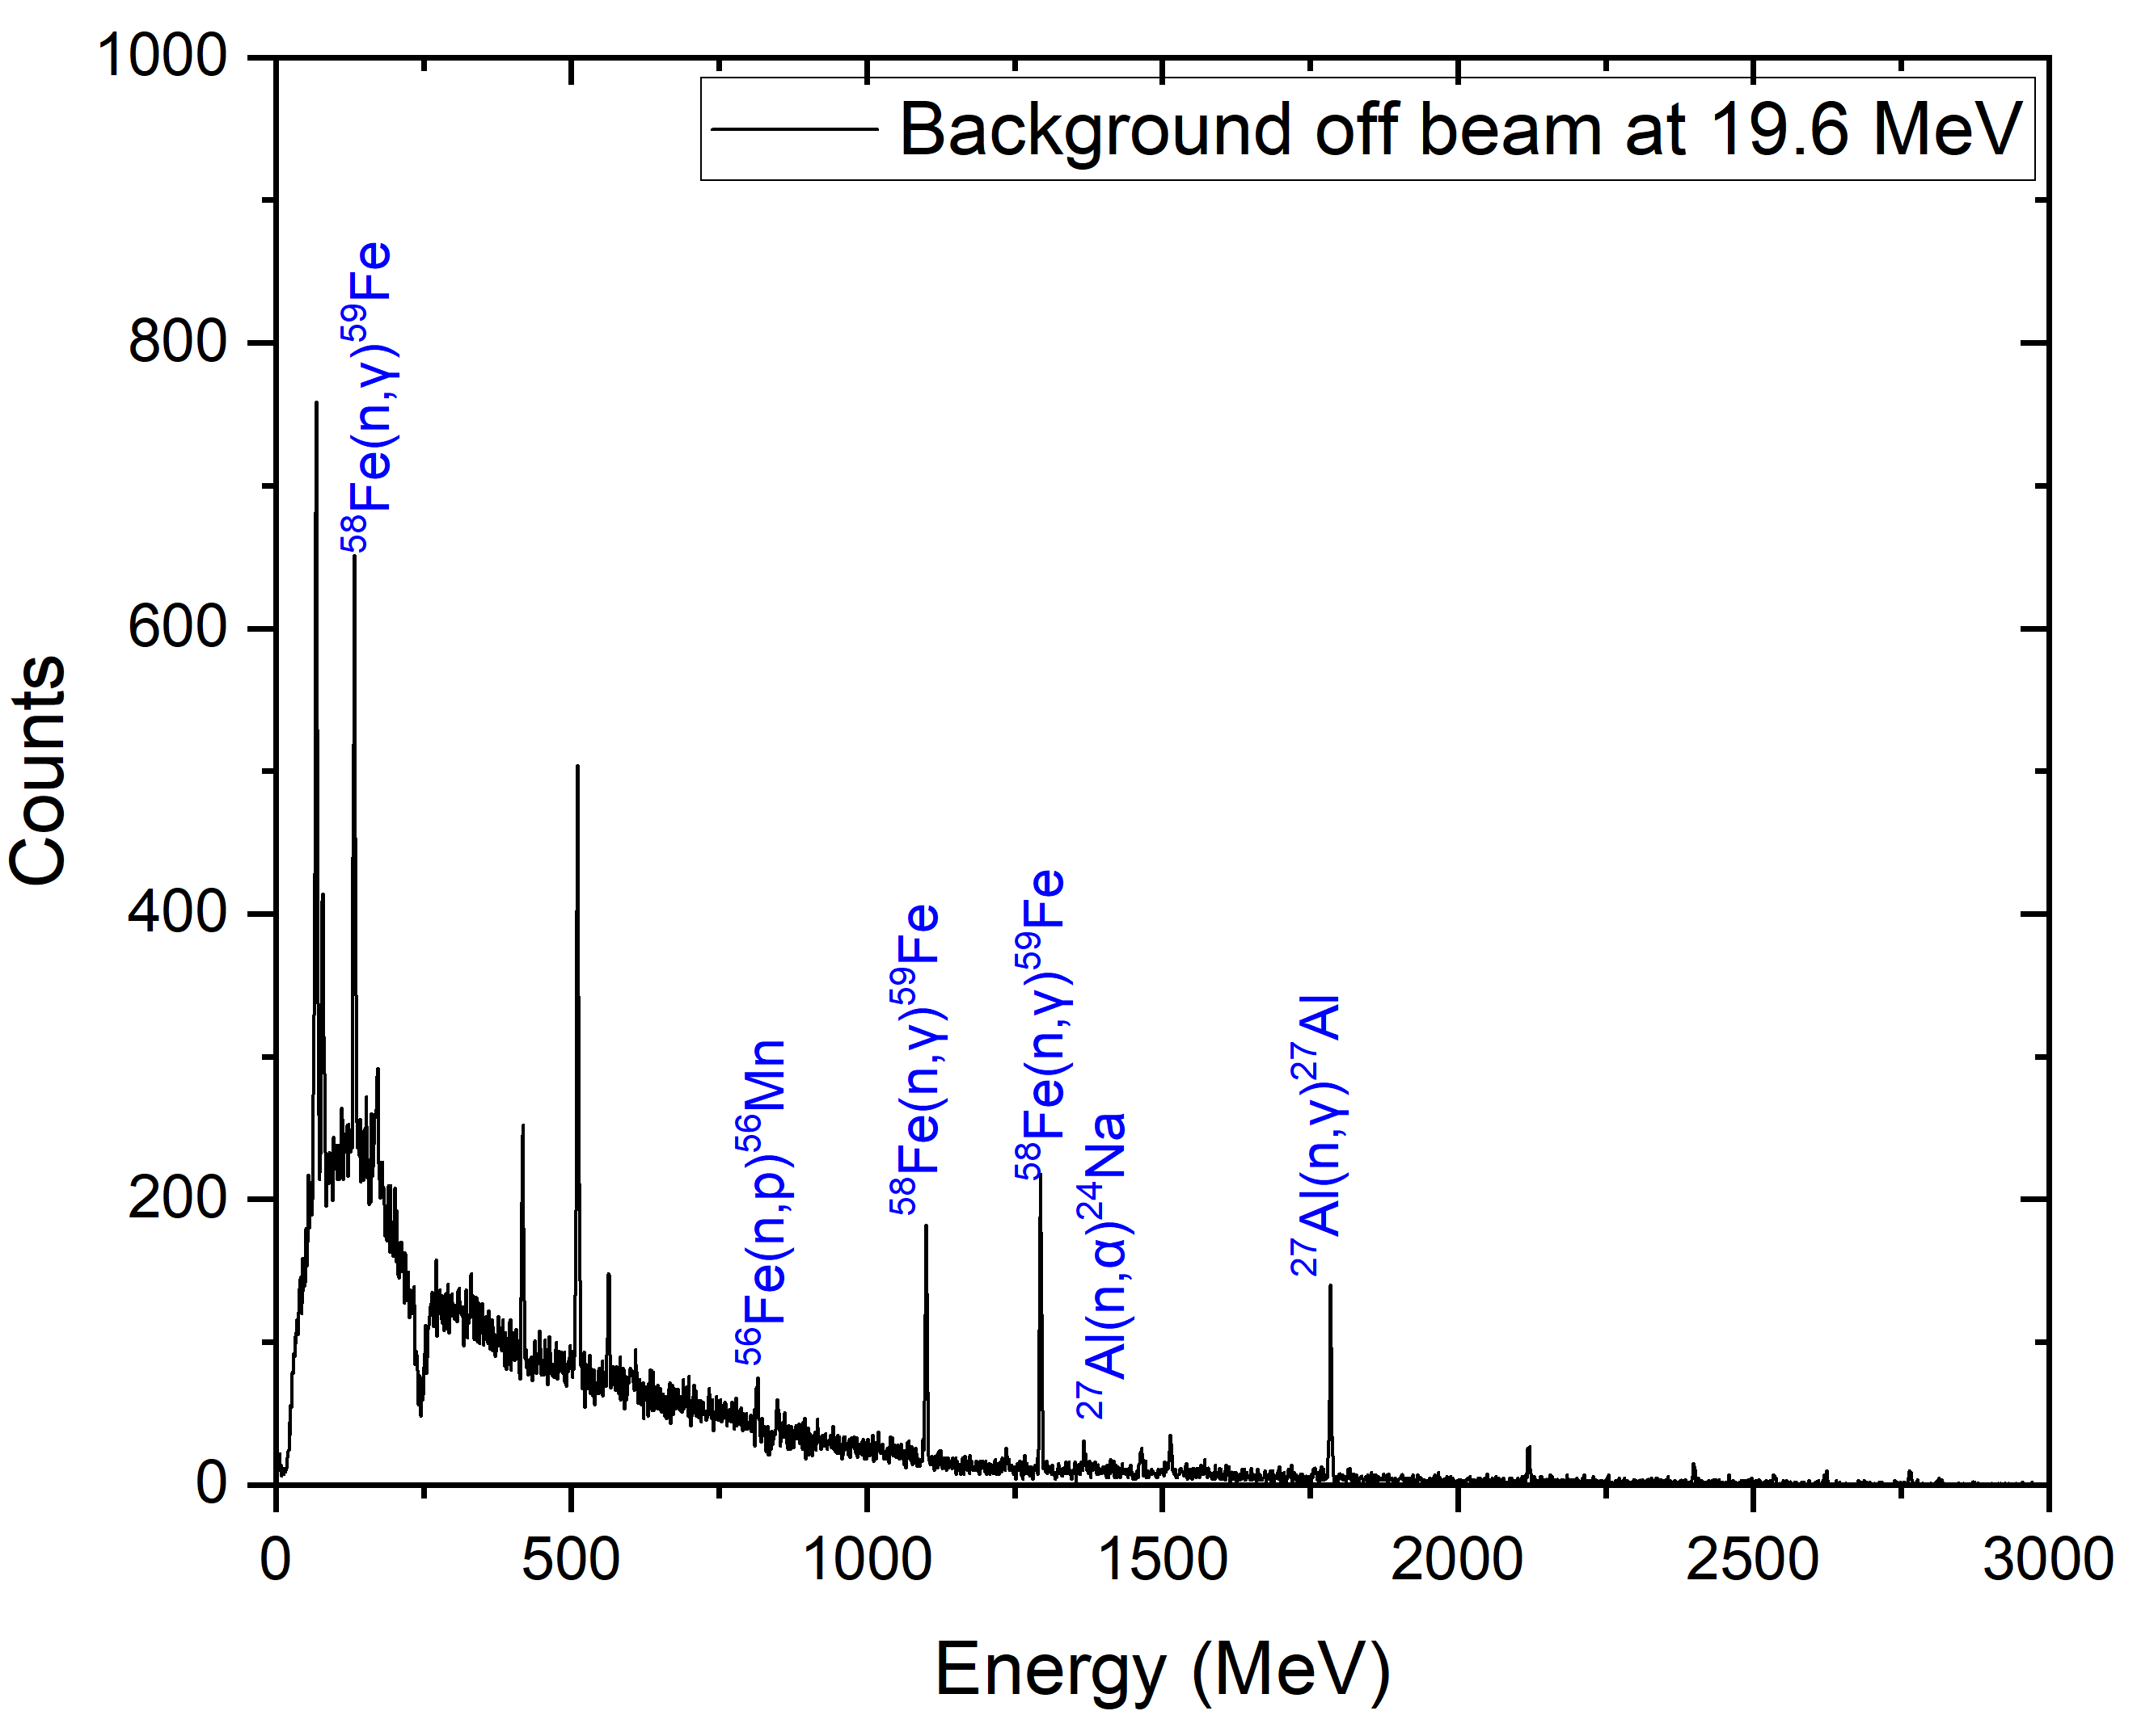
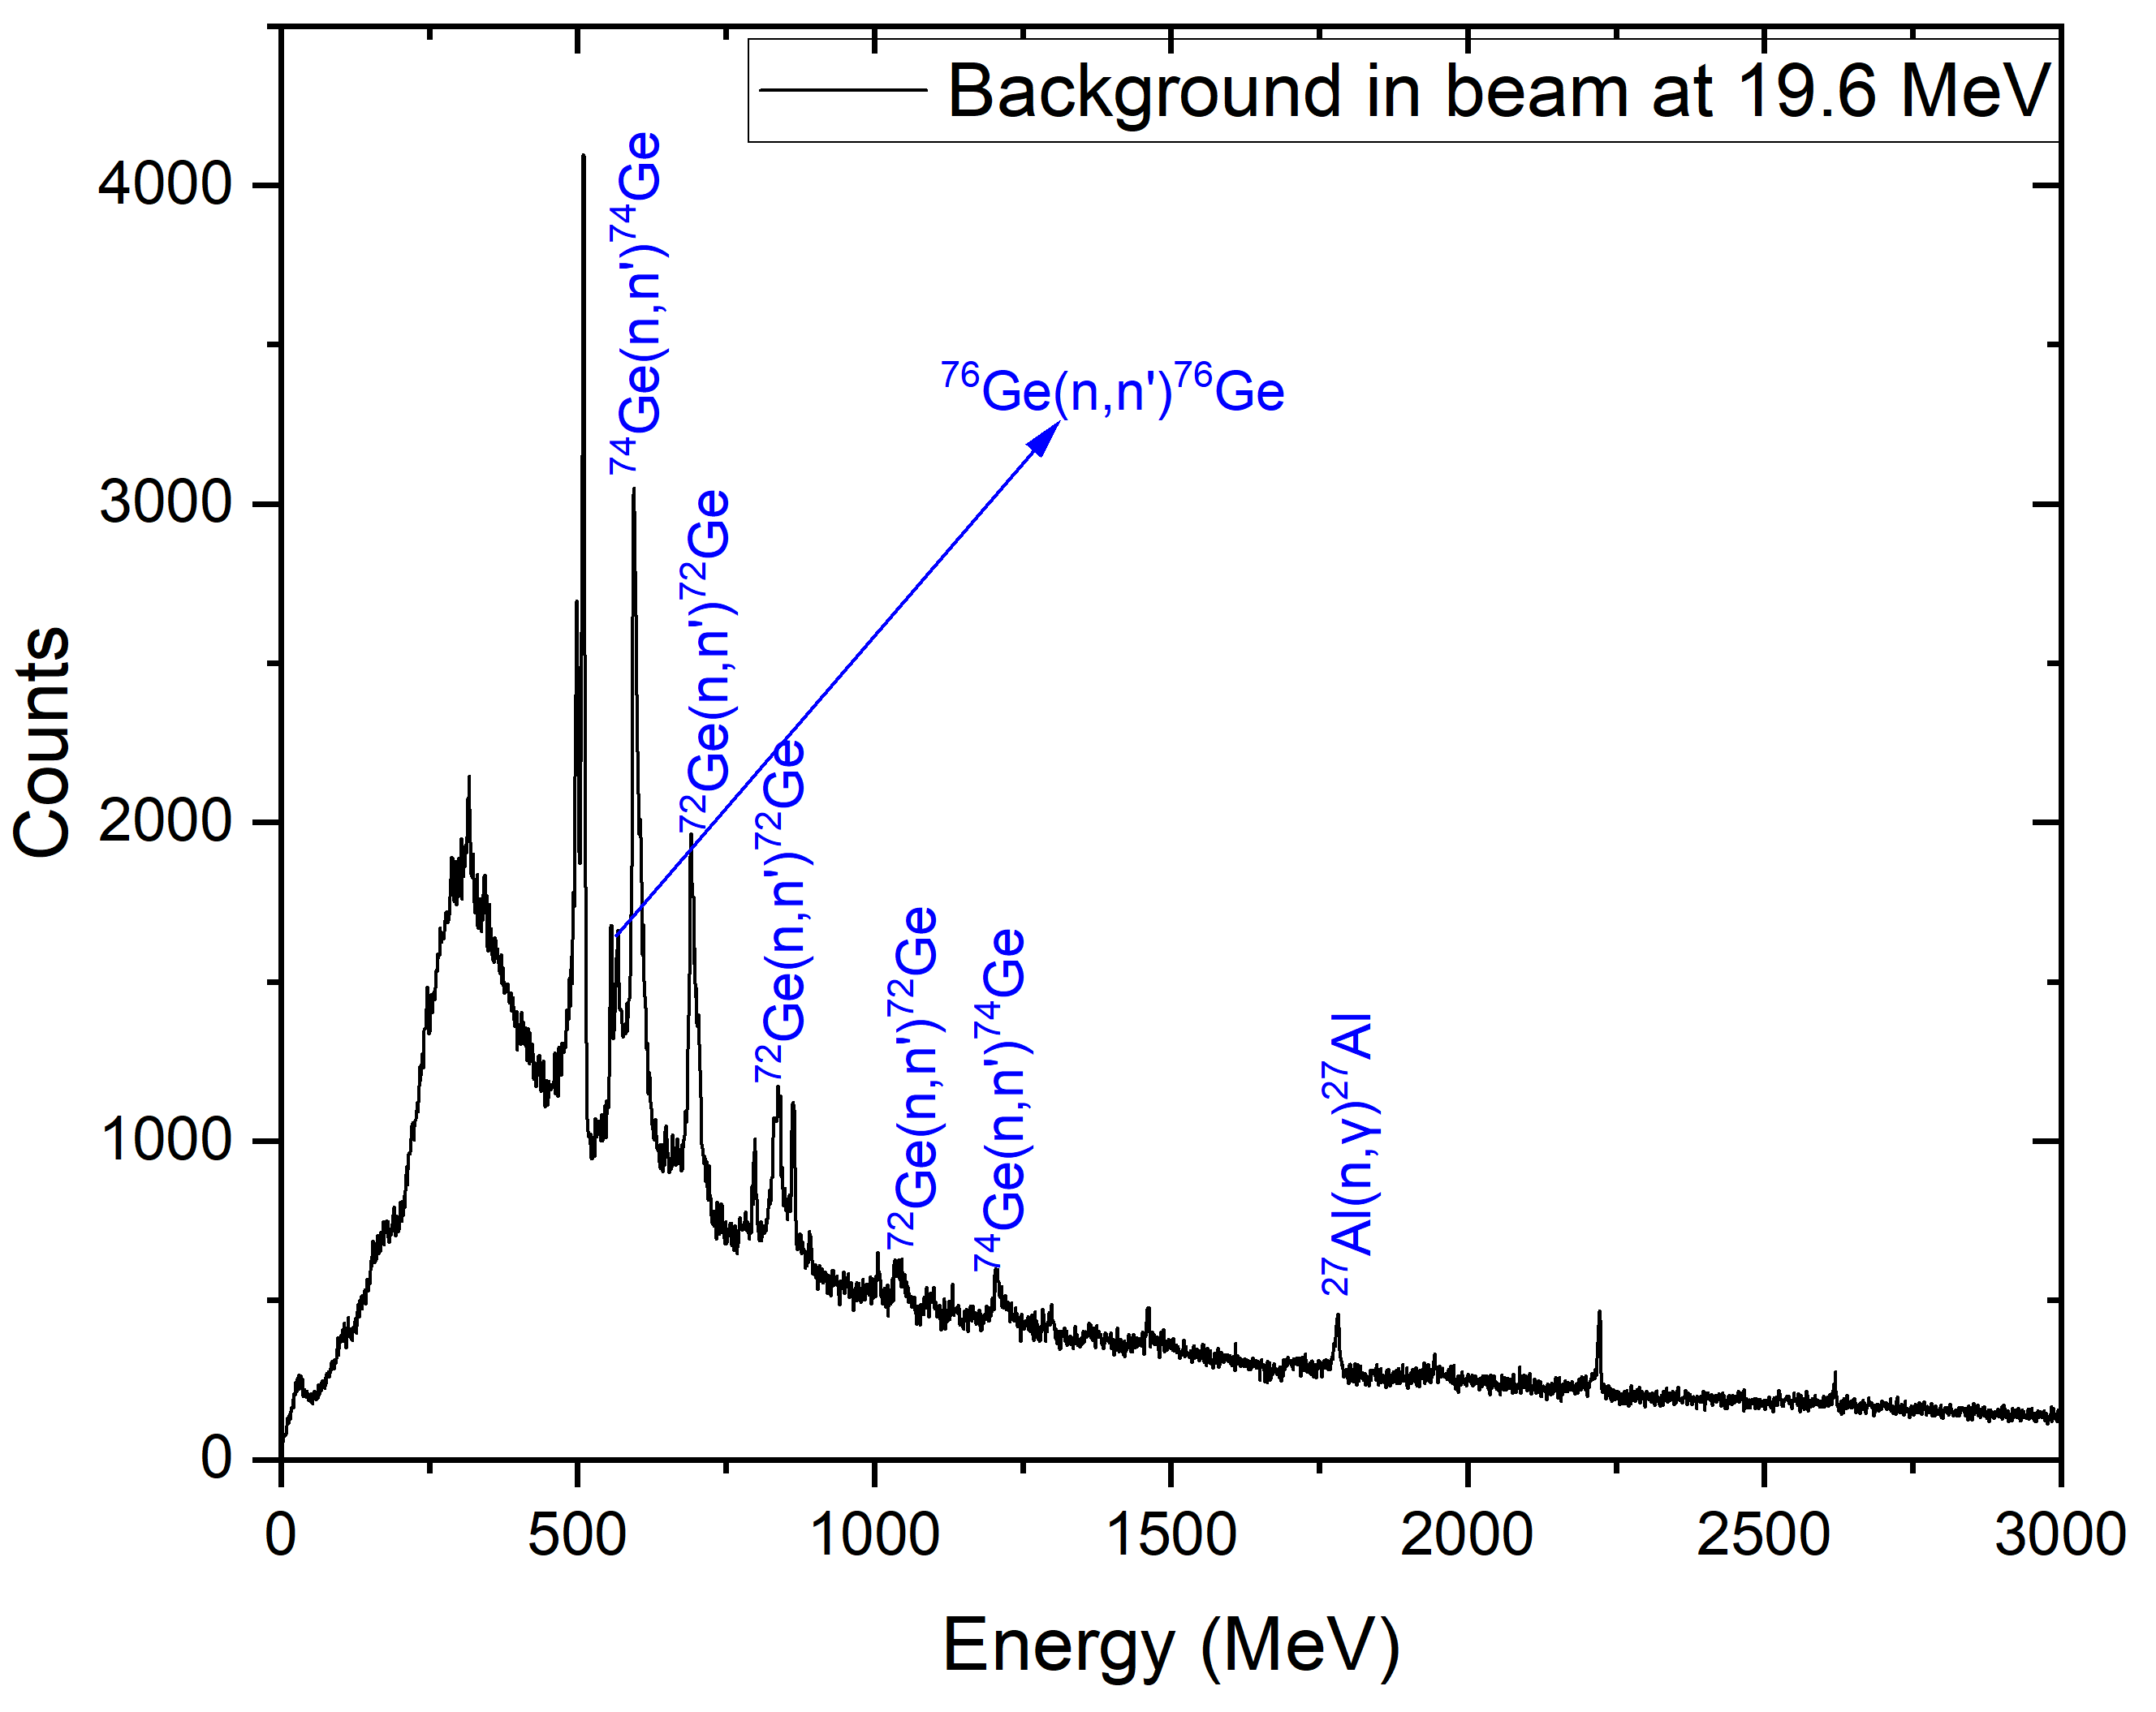
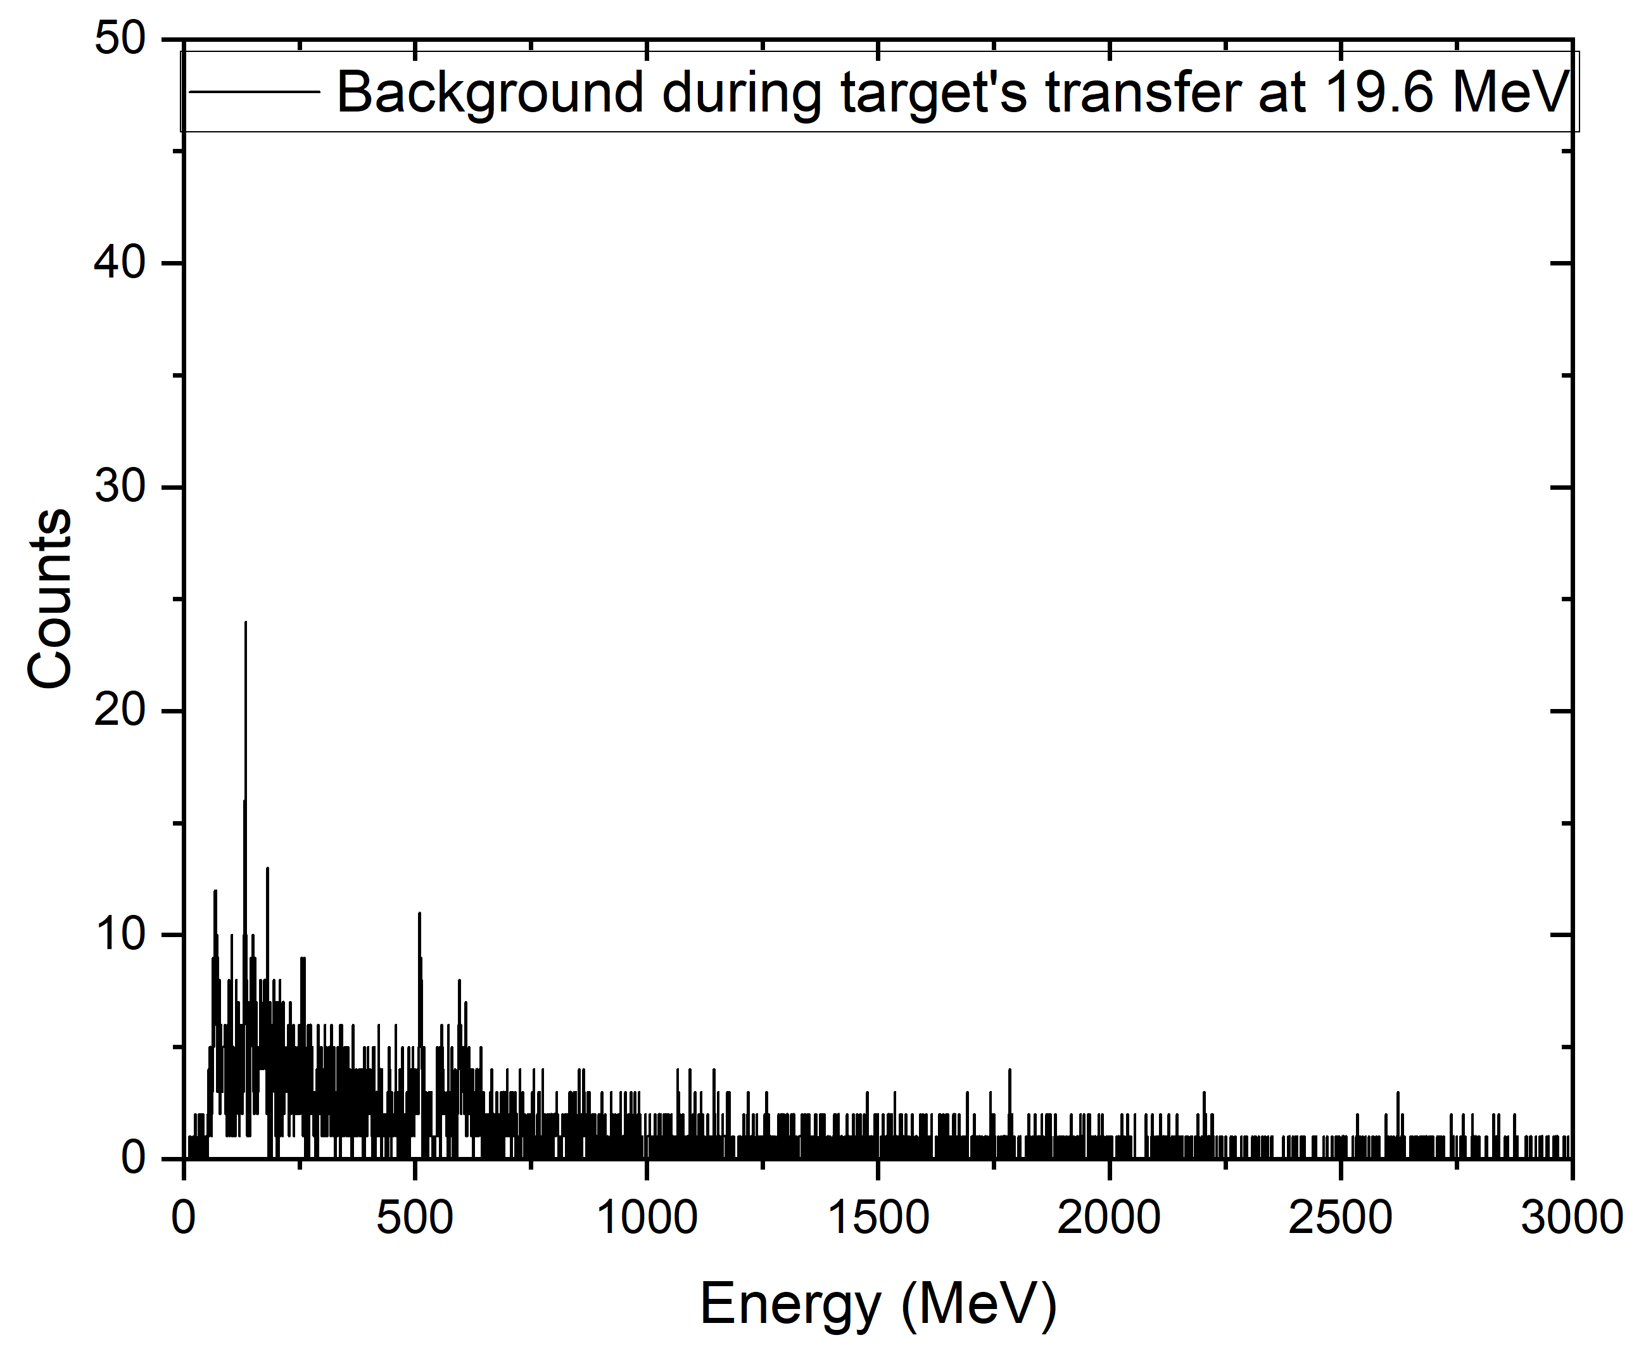
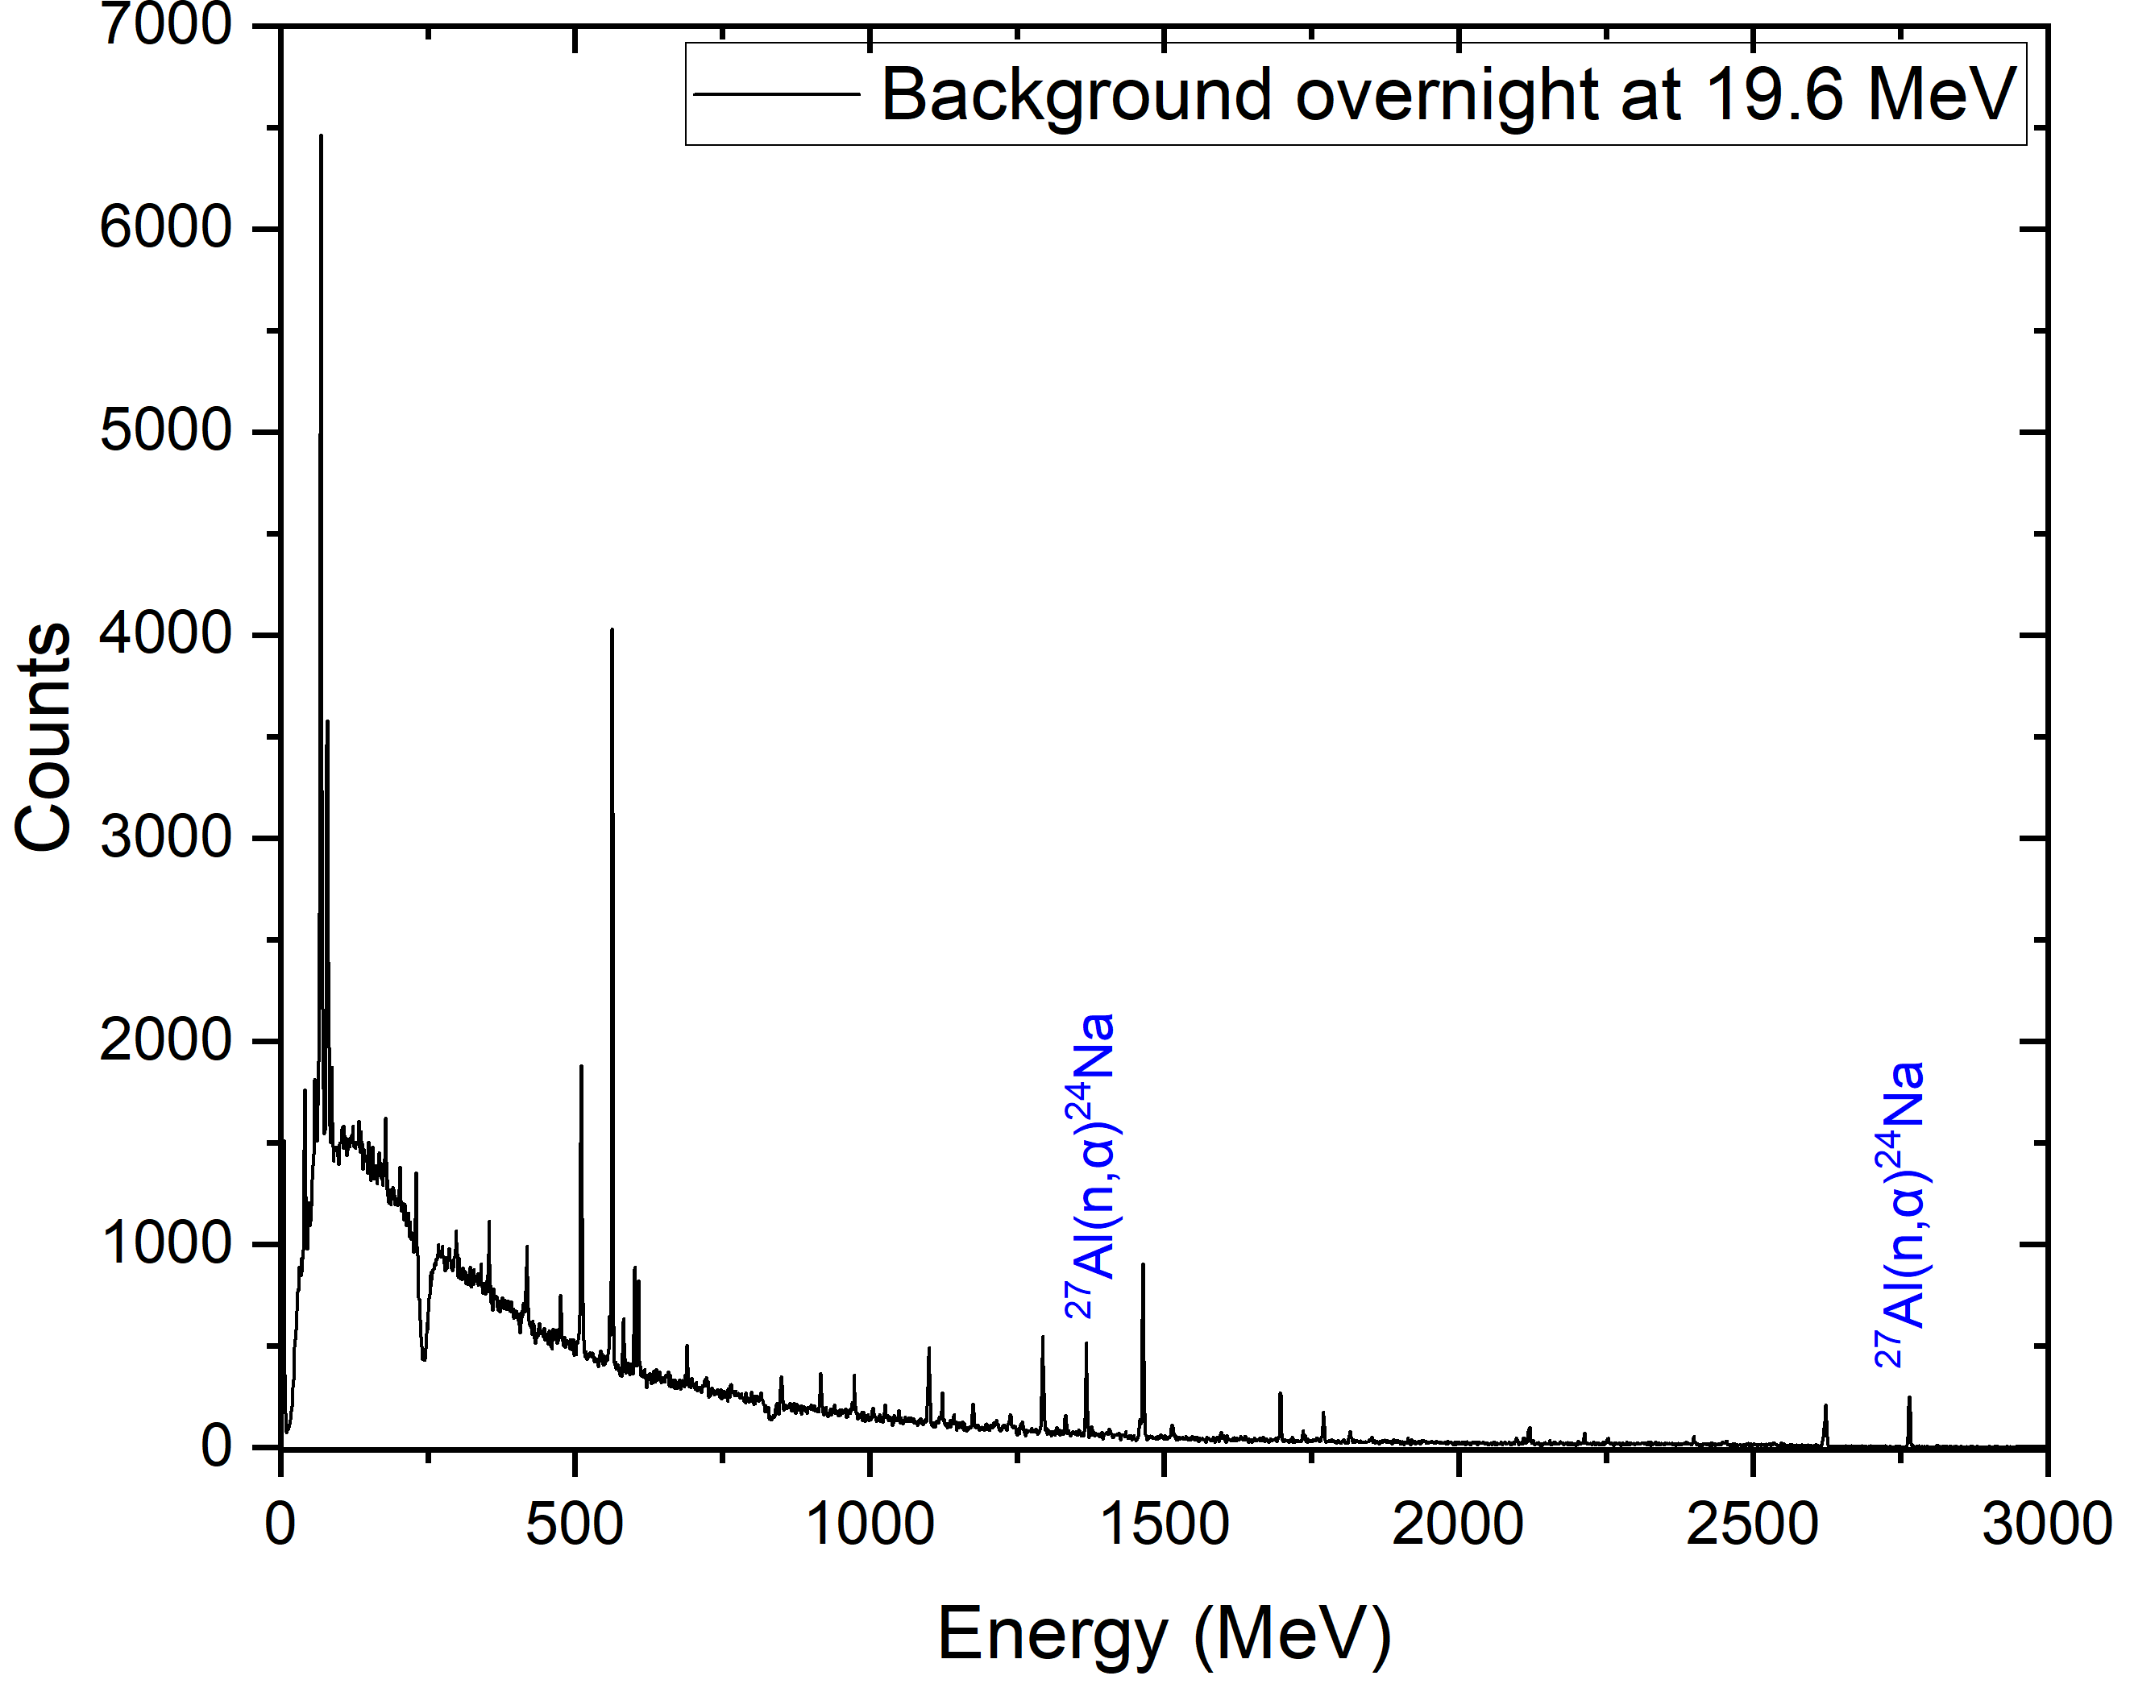
Background measurements
During Irradiation
Immediately After
Overnight
t_{meas} = 15 min
t_{meas} = 30 min
t_{meas} = 12.5 h

Slide 12
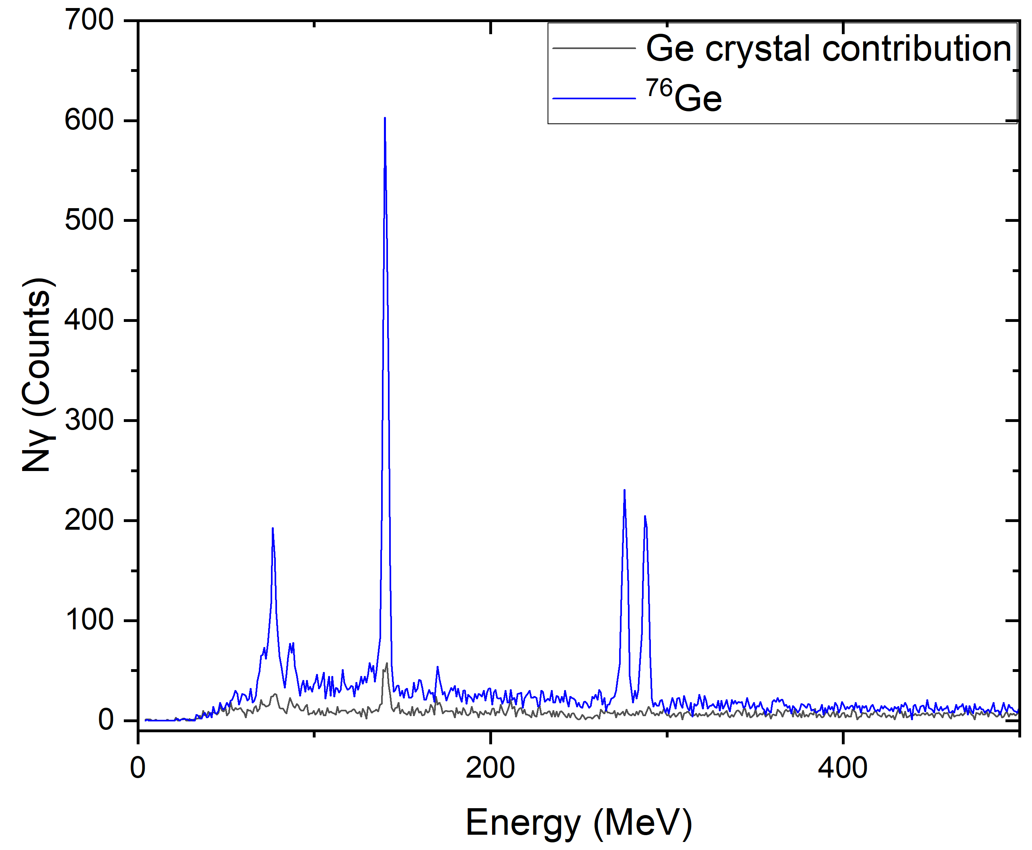
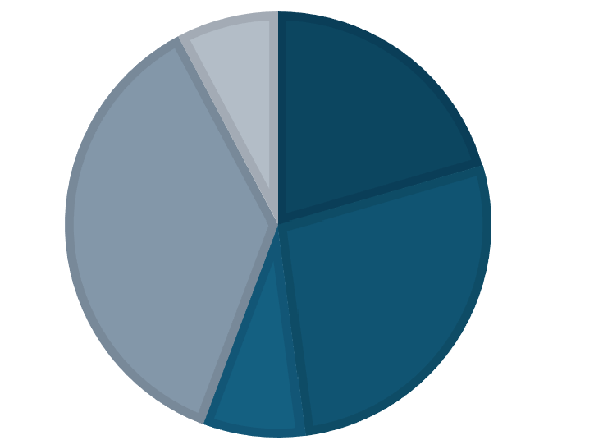
Germanium Target Corrections: Detector Crystal Interference
The Interference Problem
Target Reaction: ⁷⁶Ge(n,2n)^{75m}Ge
Detector Composition: The HPGe detector crystal itself is composed of Ge
Internal Activation: Scattered fast neutrons induce the exact same reaction internally within the detector crystal
Parasitic Channel: Additional internal interference occurs via the ⁷⁴Ge(n,γ)^{75m}Ge and ⁷⁶Ge(n,2n)^{75m}Ge reaction
Correction Impact: ~ 4 % subtraction from the total integrated peak at E_{n} = 16.1 MeV
⁷³Ge,
7.76 %
⁷⁰Ge,
20.5 %
⁷⁴Ge,
36.5 %
⁷²Ge,
27.4 %
⁷⁶Ge,
7.75 %
For the ⁷⁴Ge(n,p)⁷⁴Ga reaction the contamination was negligible
E_{n} = 16.1 MeV

Slide 13
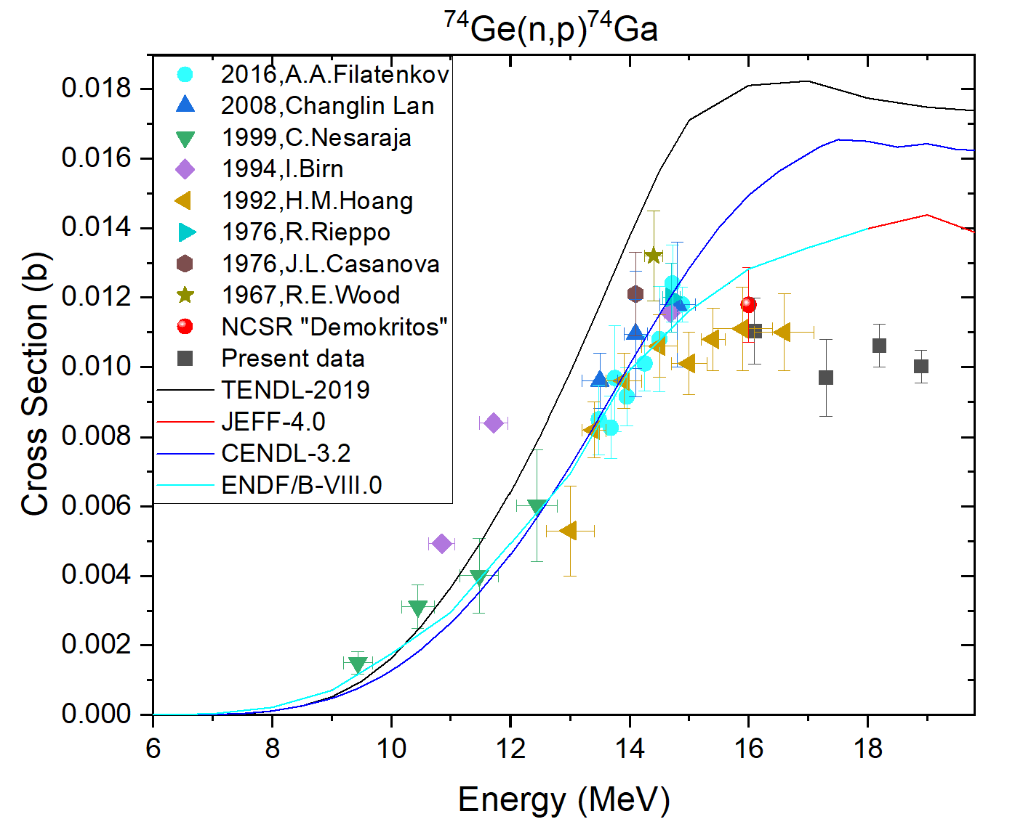
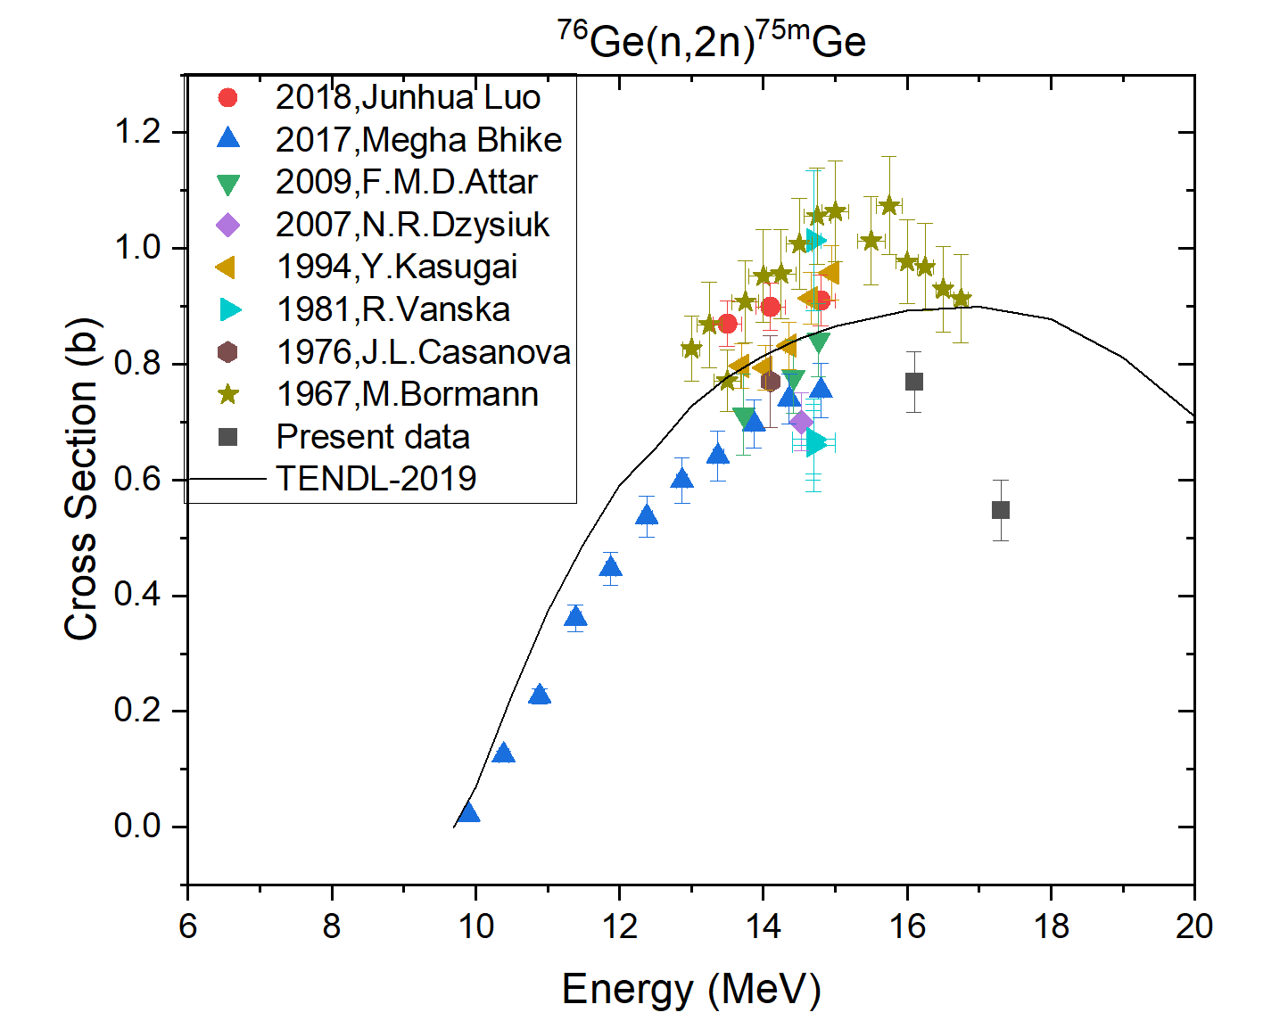
Preliminary Results: Ge reactions
t_{1/2} = 8.12 min
t_{1/2} = 47.7s

Slide 14
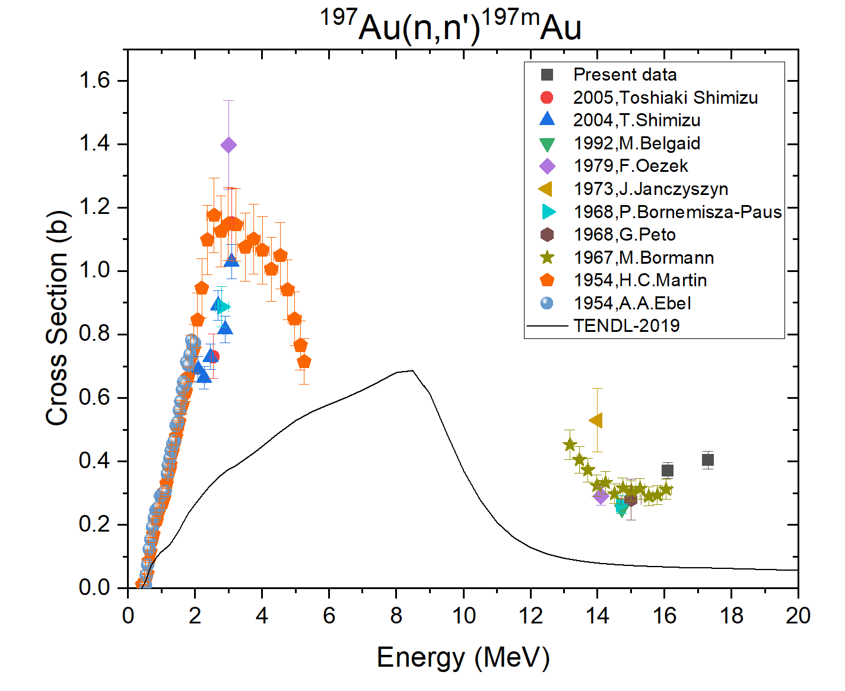
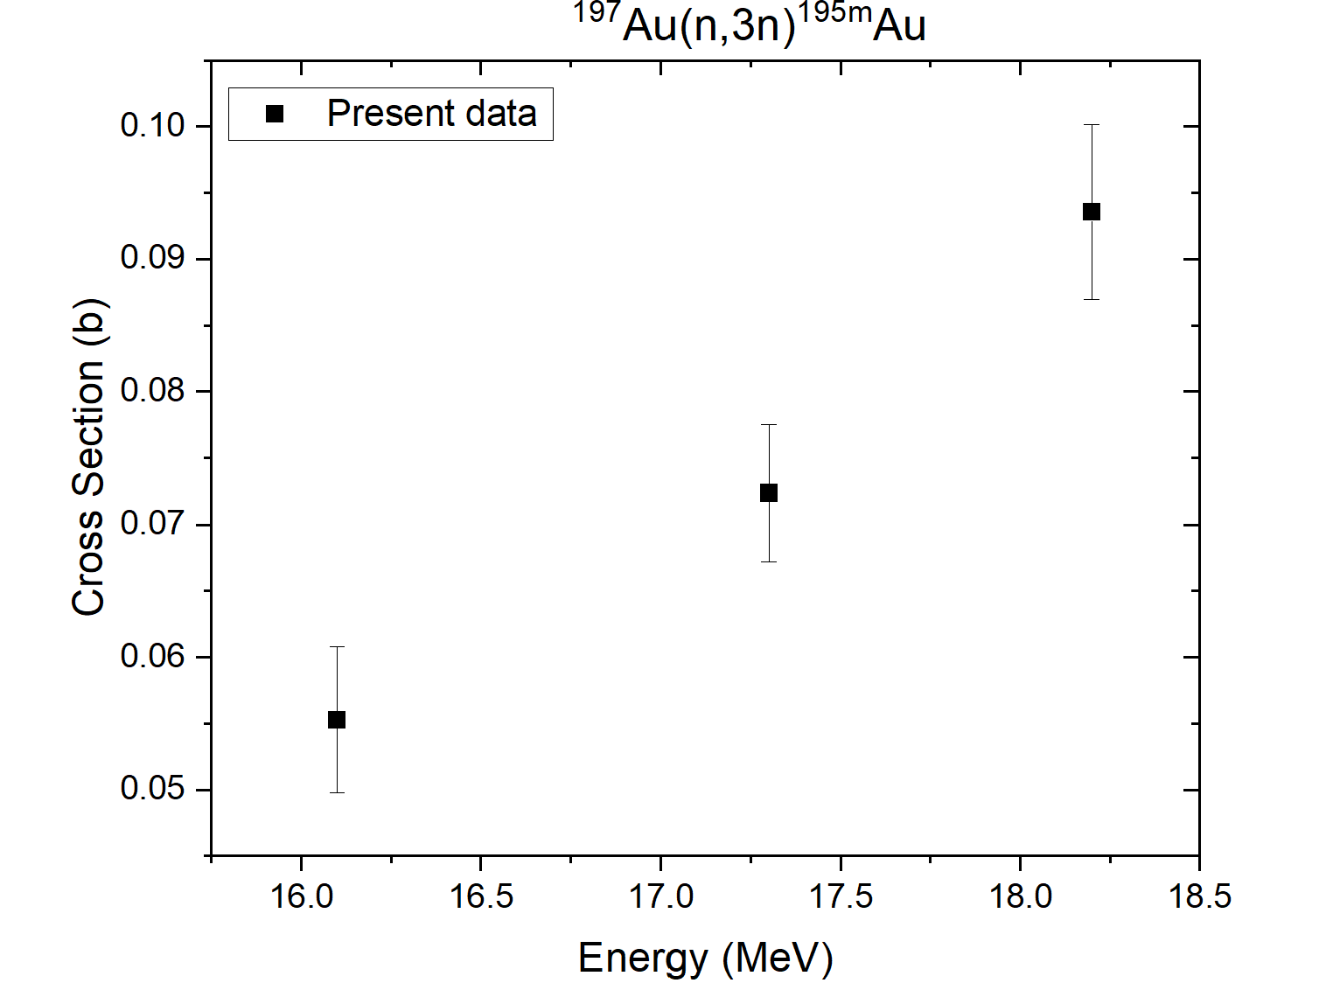
Results: Au reactions
t_{1/2} = 7.78 s
t_{1/2} = 30.5 s

Slide 15
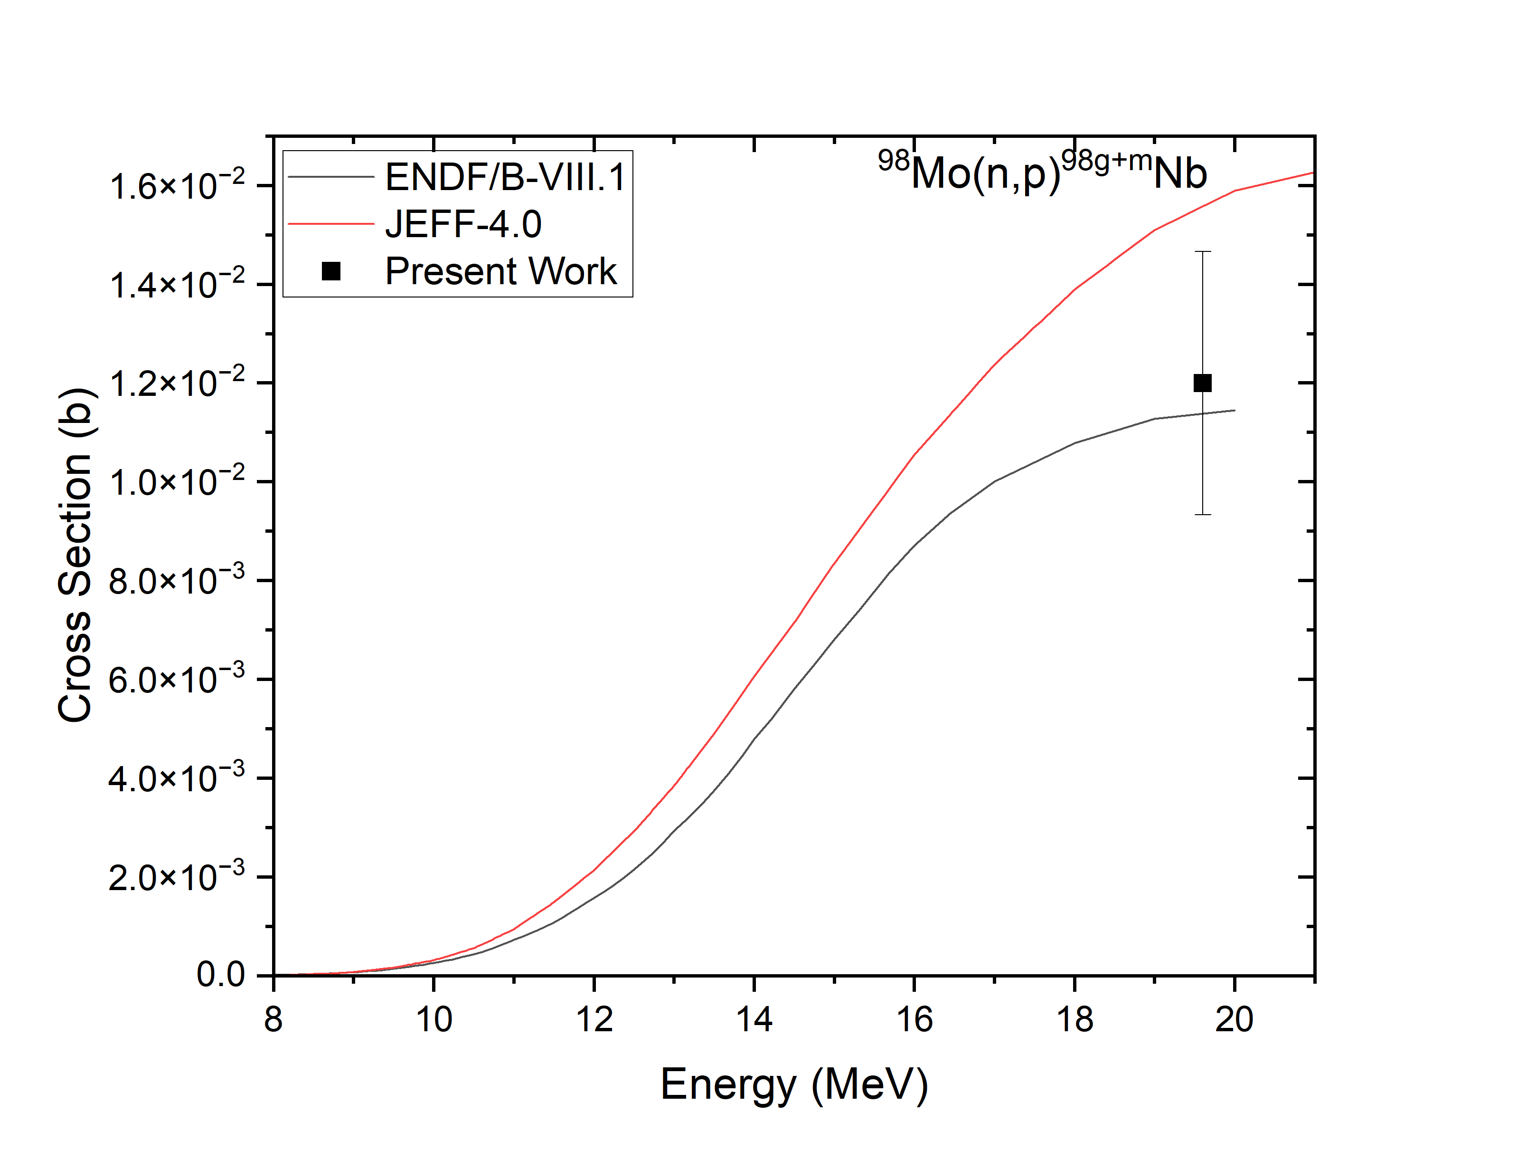
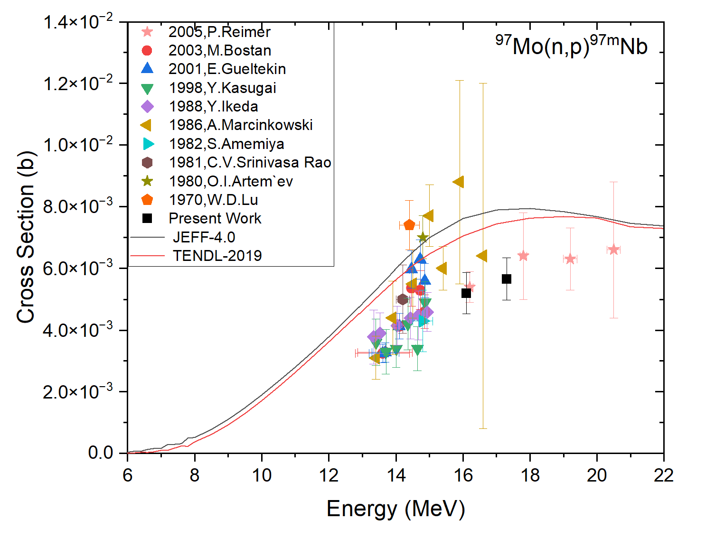
Preliminary Results: Mo reactions
t_{1/2} = 58.7 s
t_{1/2} = 2.86 s

Slide 16
Conclusions & Future Perspectives
Cross-section measurements of the short-lived reaction products for isotopes of Mo, Ge and Au.
A minimum measurable half-life threshold has been successfully established for this specific setup.
The reaction ⁹⁸Mo(n,p)^{98g+m}Nb and ¹⁹⁷Au(n,3n)^{195m}Au has been measured for the first time
Data analysis for additional energies measured during this experimental campaign is currently ongoing, alongside MCNP simulations for TCS corrections
Measure additional neutron energies across the 16–20 MeV range, with a specific focus on ⁹⁸Mo
Investigate the remaining highly enriched Mo isotopes (⁹²Mo, ¹⁰⁰Mo) and other materials

Slide 17
Thank you for your attention!!

Slide 18
DAQ System & Configuration
Hardware & Software Setup:
DAQ Software: ABCD¹
Signal Digitizers: Two SP Devices ADQ214 (50 MHz sampling rate)
Timing & Synchronization: External 10 MHz reference clock with synchronized timestamps across both digitizers
Source: JRC own elaboration
Acquisition Channels:
Ch0: HPGe detector
Ch1: Rabbit optical sensor (detects sample arrival at the detector)
Ch2 (Flux & Dead-Time): De Pangher PLC neutron flux monitor coupled with a 10 Hz pulser
Ch3 (Irradiation): NEPTUNE pulse (drives/monitors the accelerator irradiation)
¹https://github.com/ec-jrc/abcd

