Slide 1




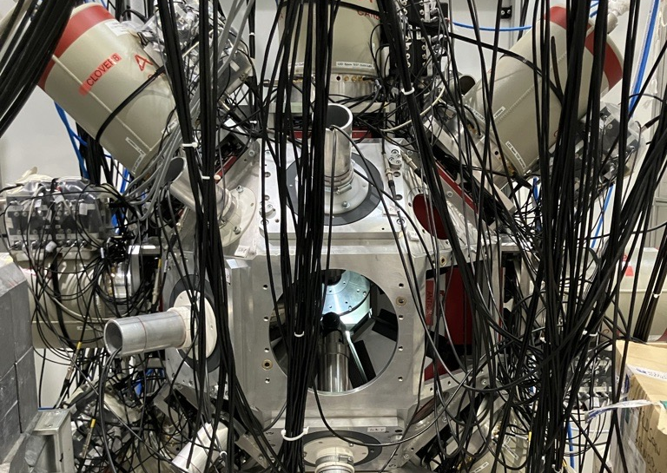
Investigating Thermal Neutron Capture in ⁸⁸Zr Using Prompt Gamma-Ray Spectroscopy at FIPPS
Ashley Baklarz
United States Air Force Academy

Slide 2
Overview
Background & Motivation
⁸⁸Zr Sample Preparation
Experimental Setup of FIPPS
Identifying Energy Levels & Transitions
Future Work

Slide 3
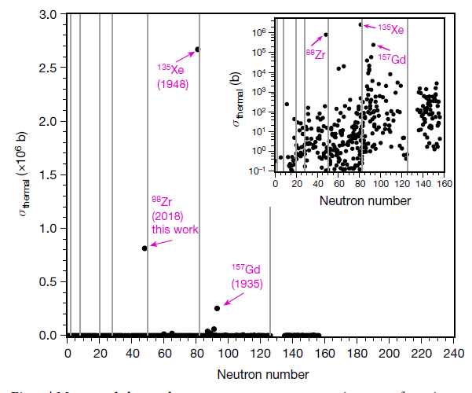
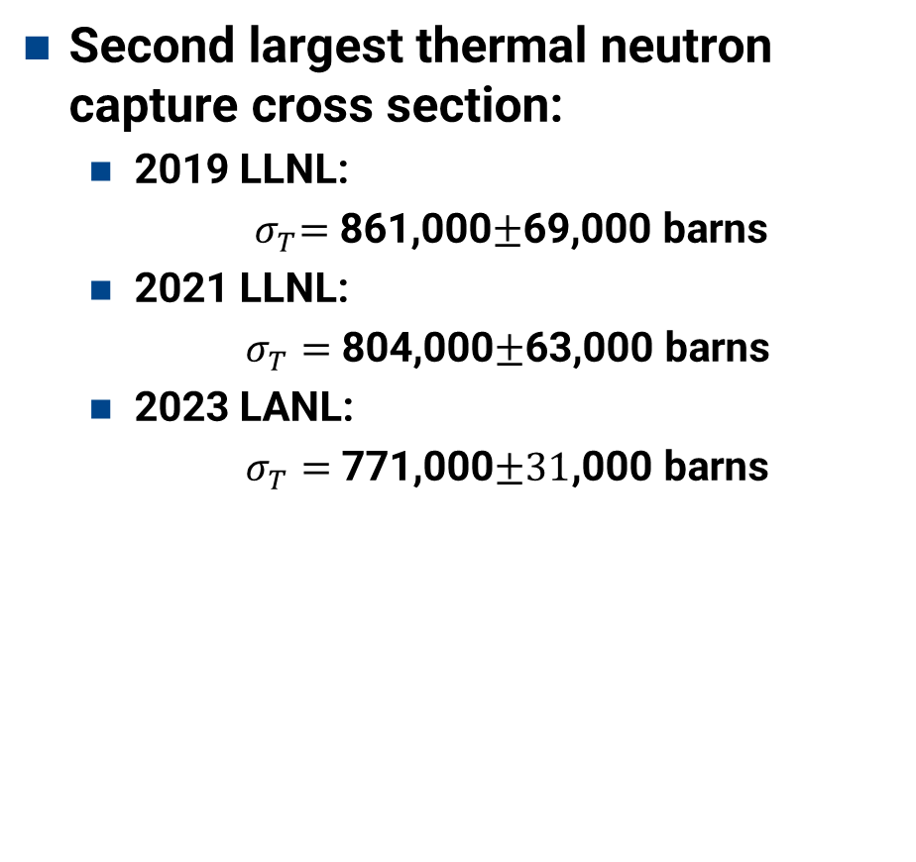
Background – ⁸⁸Zr
Second largest thermal neutron capture cross section:
  2019 LLNL:
      ${ σ}_{T}=$ 861,000$±$69,000 barns
  2021 LLNL:
      $σ_{T}=$ 804,000$±$63,000 barns
  2023 LANL:
      $σ_{T}=$ 771,000$±31$,000 barns
Shusterman, J. A. et al. The surprisingly large neutron capture cross-section of 88Zr. Nature 565, 328–330 (2019).

Slide 4
Why ⁸⁸Zr?
n_TOF and DICER found that a thermal resonance at 0.171 eV causes large cross-section
Due to a known high background, the lower bound for gammas at n_TOF was set as 3.5 MeV
  This study is able to look at those lower energies

Slide 5
Why ⁸⁸Zr?
Goals:
  Improve the ⁸⁹Zr level scheme and γ-ray branching ratios
  Provide complementary information to the n_TOF resonance measurement & help explain the large thermal neutron capture cross section
Impact:
  Improved neutron fluence diagnostics
  Better nuclear data for reaction modeling
  Potential medical uses (⁸⁹Zr immunoPET imaging)

Slide 6
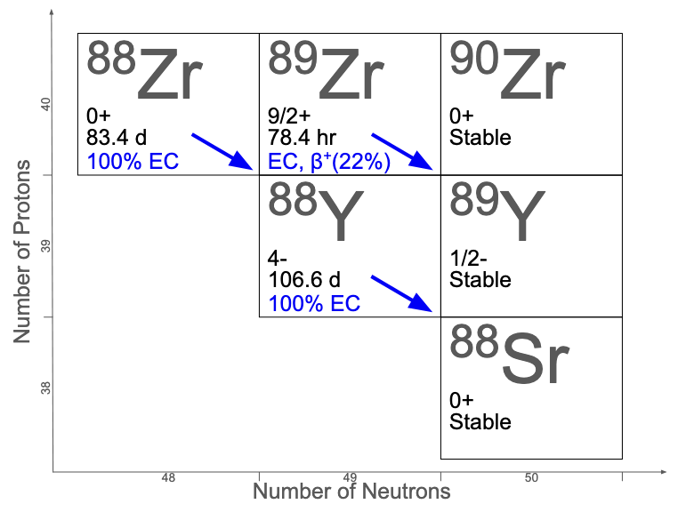
⁸⁸Zr Sample
⁸⁸Zr produced at LANL
⁸⁹Y(p,2n)⁸⁸Zr
⁸⁸Zr has 83.4 day half life
  Decays to ⁸⁸Y
  393 keV
⁸⁸Y buildup creates large background
  898 keV
  1836 keV

Slide 7
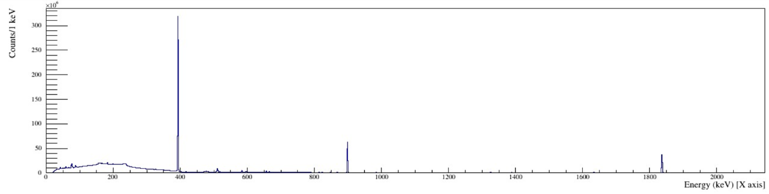
⁸⁸Zr Sample Challenges
88Zr EC: 393 keV
88Y EC:
898 keV
88Y EC: 1.836 MeV

Slide 8

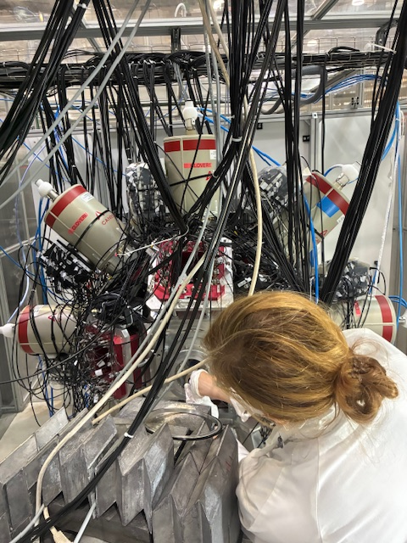
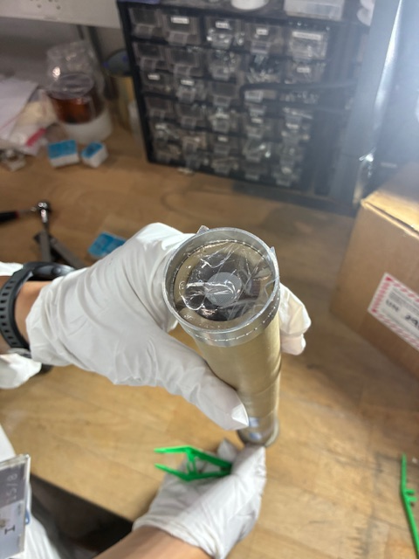
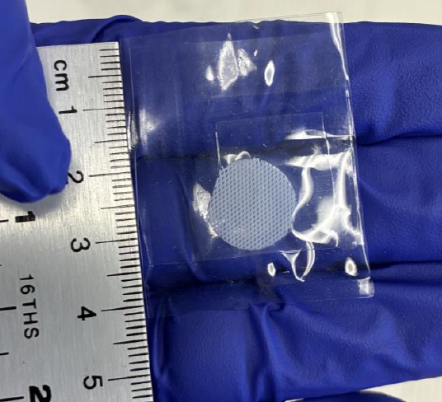
⁸⁸Zr Sample
Chemically separate ⁸⁸Zr and ⁸⁸Y in Texas
  Additionally, get rid of excess ³⁵Cl
Quickly ship sample to ILL
Held in place by teflon strings
⁸⁸Zr Sample on PTFE mesh
LiBr tube
PFA bags

Slide 9
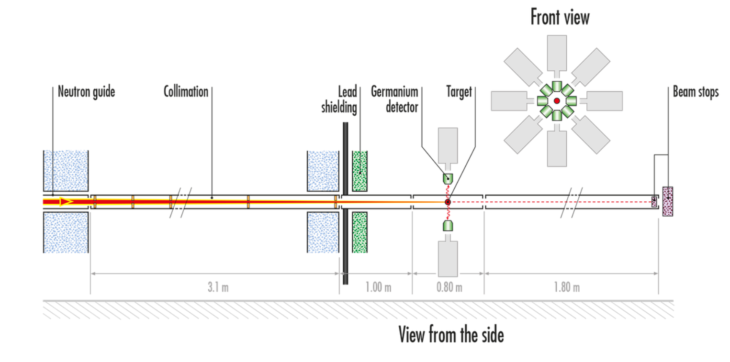
FIssion Product Prompt gamma–ray Spectrometer (FIPPS)

Slide 10
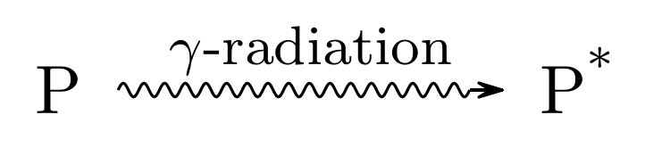
FIPPS
⁸⁸Zr + n → ⁸⁹Zr*
Prompt gamma rays emitted immediately
Germanium detectors label coincidences
Coincidences reveal cascades
Remove background peaks
Map level scheme
2 campaigns for a total of 26 days!
507.1 keV
770.3 keV

Slide 11
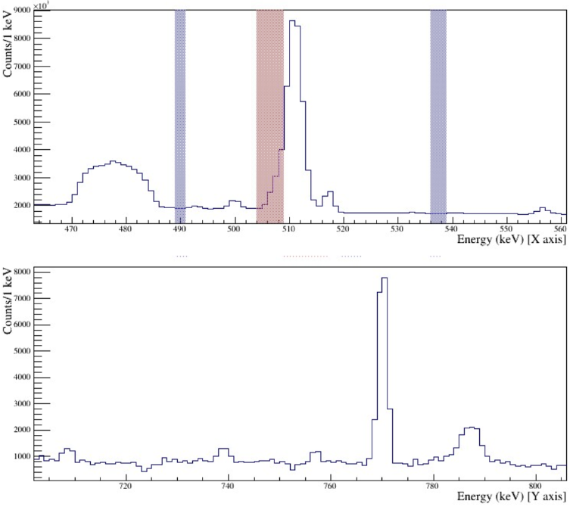
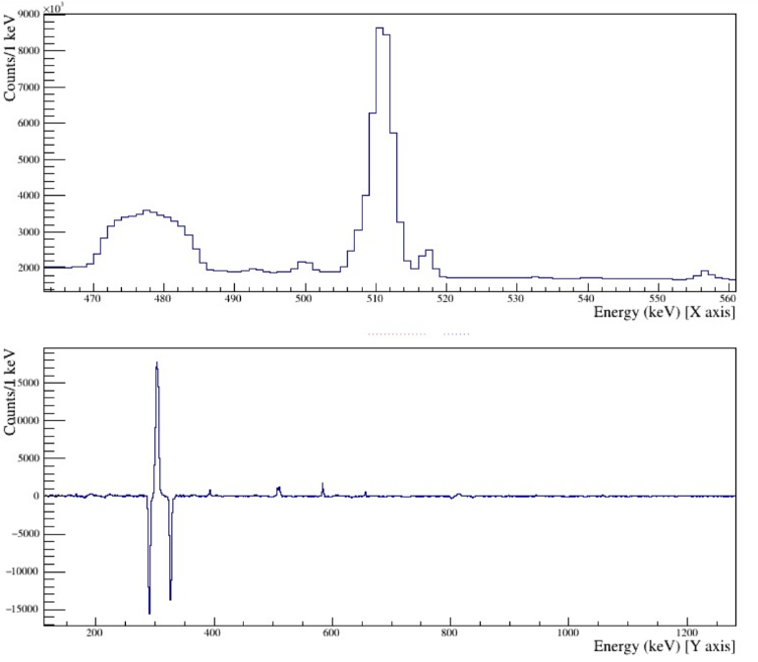
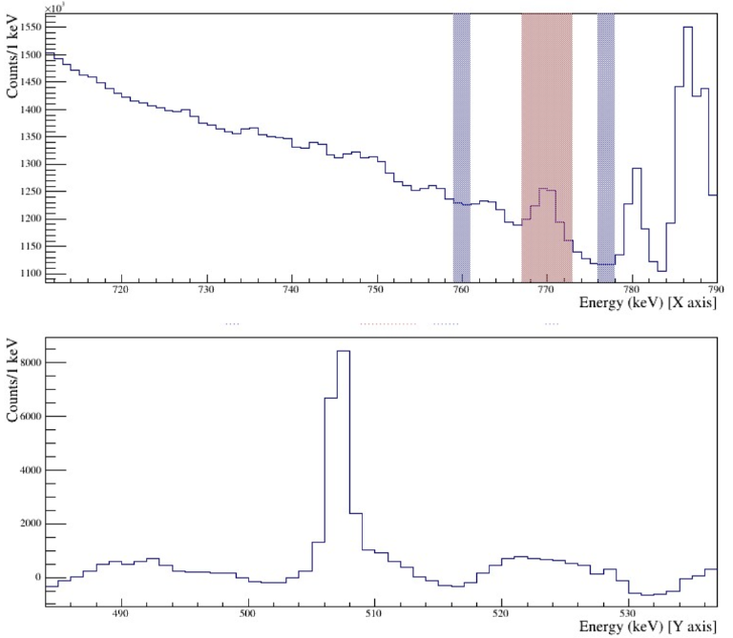
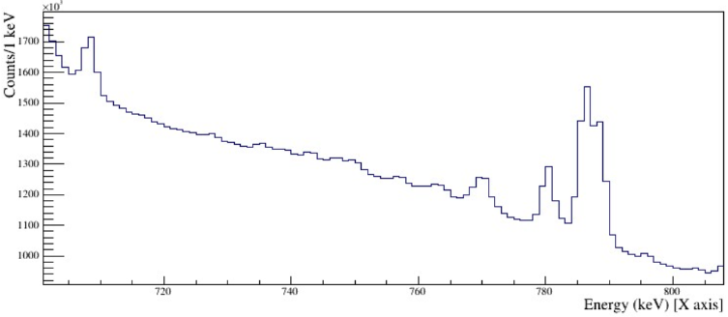
Known Transitions
511 keV
770.3 keV
507.1 keV
507.1 keV
770.3 keV

Slide 12
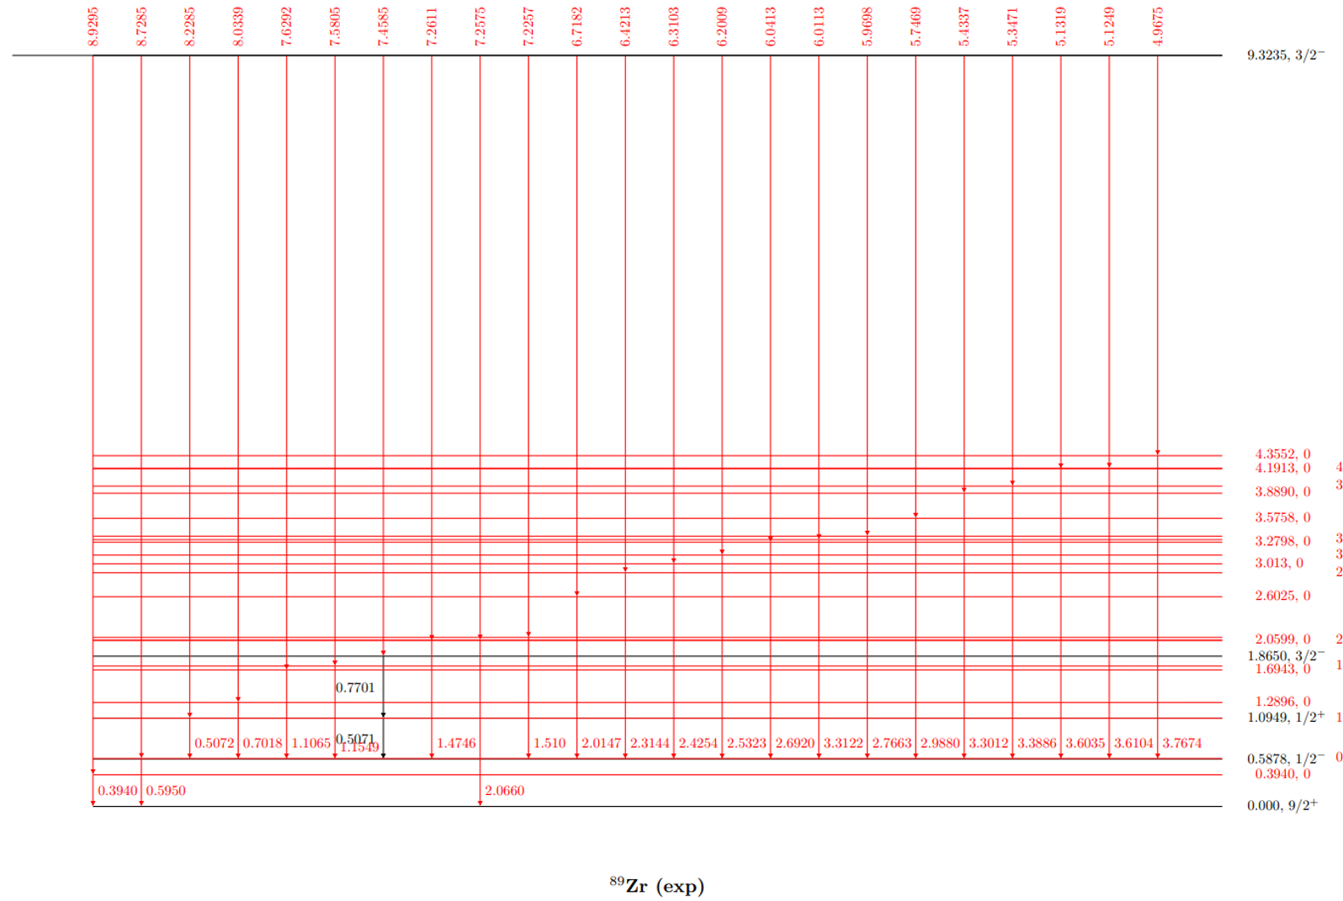
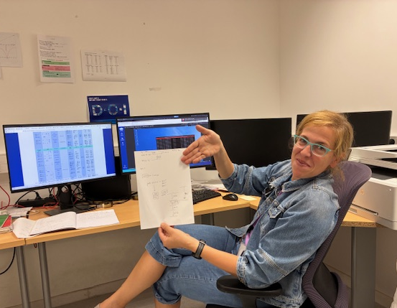
Preliminary Results

Slide 13
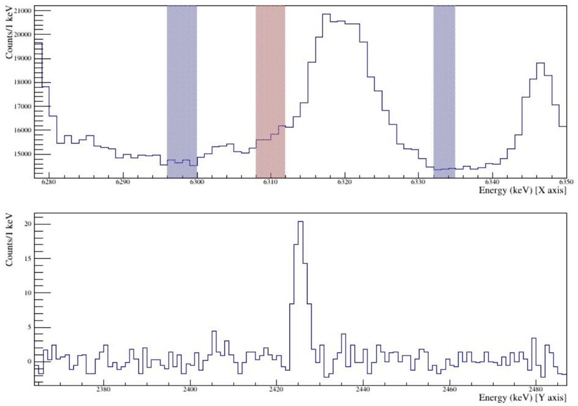
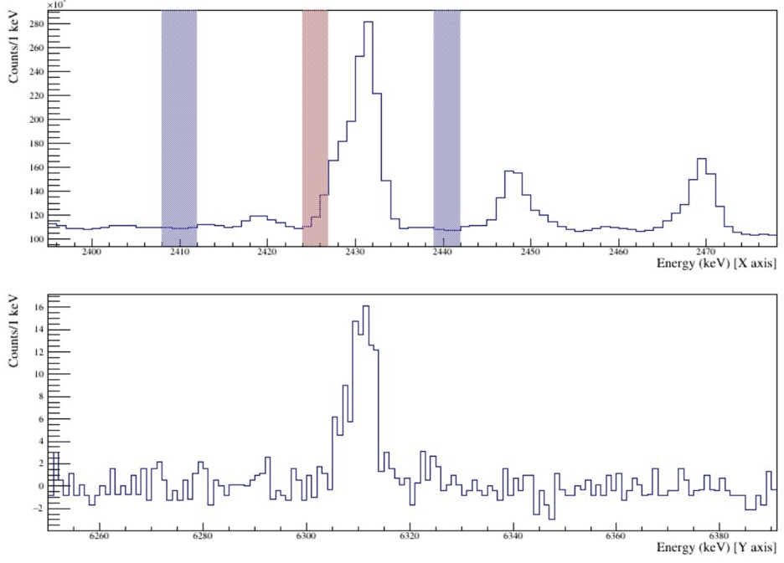
Finding Transitions
6.3103 MeV
2.4254 MeV
2.4254 MeV
6.3103 MeV

Slide 14
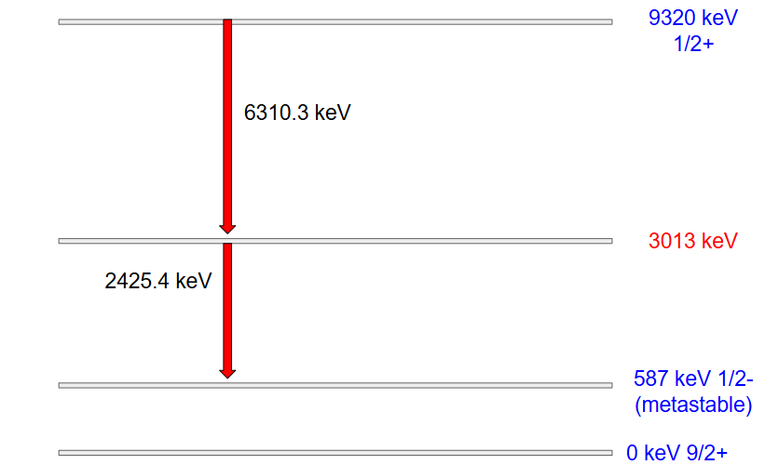
Finding Transitions
New!

Slide 15
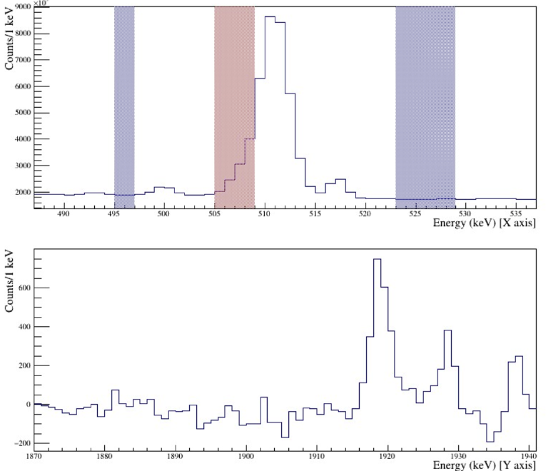
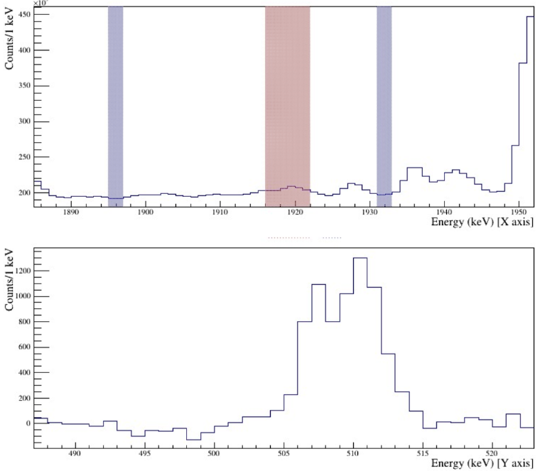
Finding Transitions
507.1 keV
1919.5 keV
1919.5 keV
507.1 keV

Slide 16
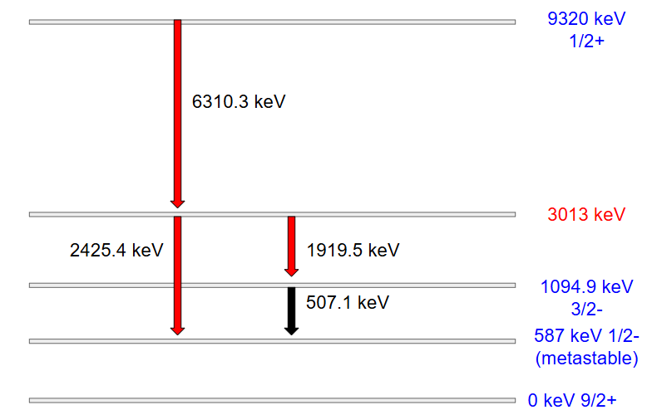
Finding Transitions
New!

Slide 17
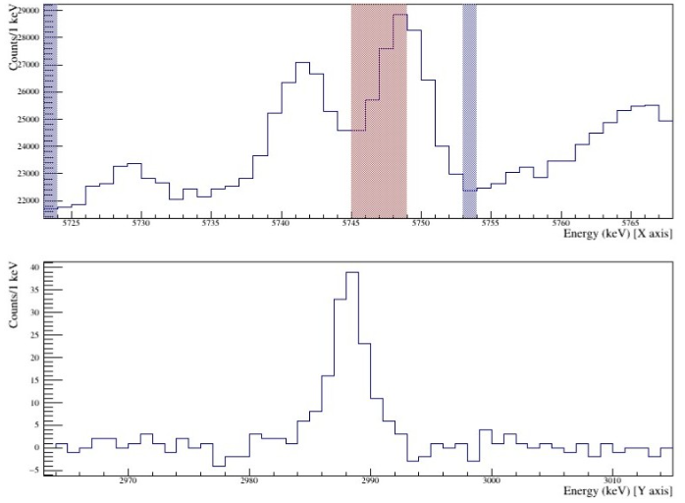
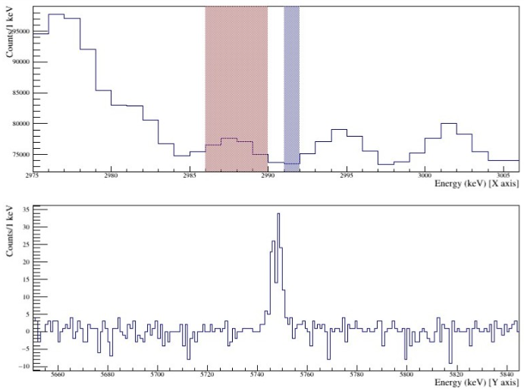
Finding Transitions
2988.0
587.8
5746.9 keV
2988 keV
2988 keV
5746.9 keV

Slide 18
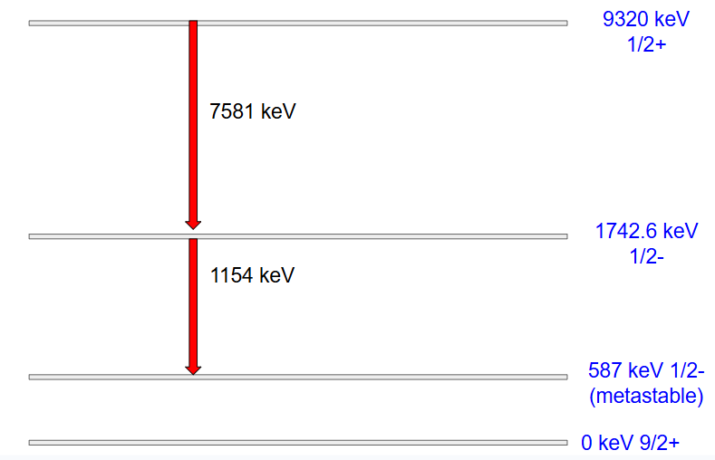
Challenges
High background
  Ge, Al, Fe, H, B, Cl, etc.
Comparison to beam-off data

Slide 19
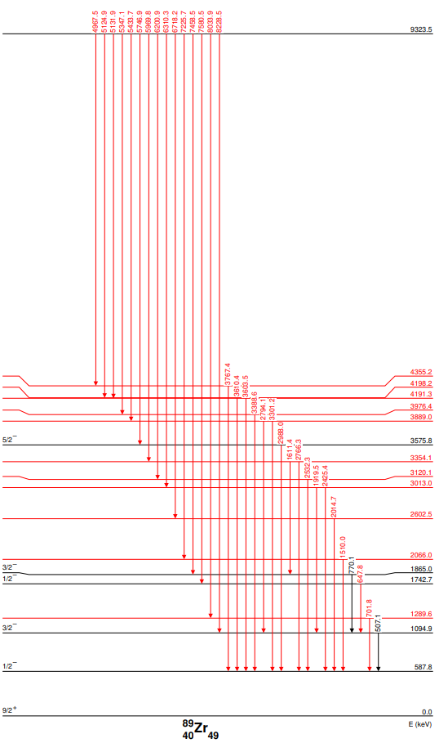
Progress
11 new energy levels!
31 new transitions!

Slide 20
Future Work
Complete cascade construction
Angular correlation & spin assignments
Publish results

Slide 21
Acknowledgements
High resolution gamma spectroscopy of zirconium-88 neutron absorption at FIPPS.
Flanagan^{1,2}, T. Gordon¹, Caterina Michelagnoli³, M. Stryjczyk³, J. Moldenhauer¹, Francisco Garcia-Infantes⁴, J. Balibrea⁵, J.Lerendegui-Marco⁵, M. Krtička⁶, and the n_TOF Collaboration⁷
1. Department of Physics, University of Dallas, Irving, Texas, USA
2. Nuclear Engineering and Teaching Laboratory, University of Texas, Austin, Texas, USA
3. Institut Laue-Langevin, Grenoble, France
4. School of Physics and Astronomy, University of Edinburgh, United Kingdom
5. Instituto de Fısica Corpuscular, CSIC- Universidad de Valencia, Spain
6. Charles University in Prague, Prague, Czech Republic
7. https://ntof-exp.web.cern.ch/, CERN, Switzerland
Thank you to the United States Air Force Academy Stamps Scholars Program for funding my travel

Slide 22

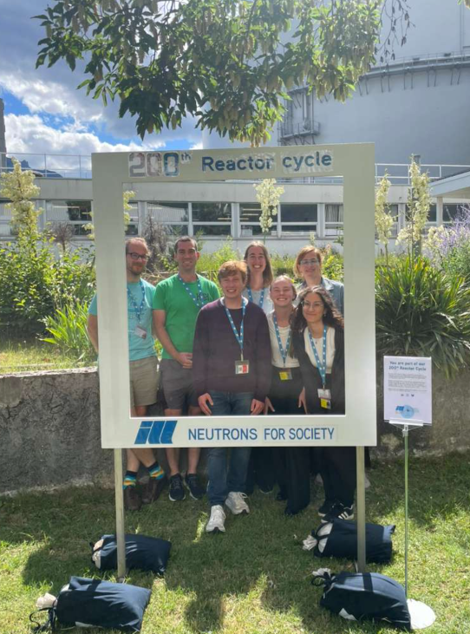
Thank you for listening!

