Slide 1
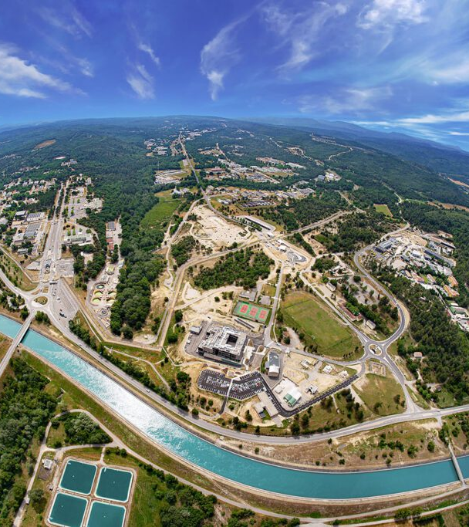
New ²³⁵U(n_{th},f) Evaluation of pre-neutron emission mass yields and neutron multiplicity
A. REGONESI , G. KESSEDJIAN, O. SEROT, S.M. CHEIKH
DES/IRESNE/DER/SPRC/LEPh
WONDER 2026 | 29th June – 3rd July 2026

Slide 2
Content of the presentation
FY evaluation program @ CEA Cadarache
New methodology for evaluation of Pre-neutron
mass yields : application to ²³⁵U(n_{th},f)
Prompt neutron multiplicity analysis
Conclusion and perspectives

Slide 3
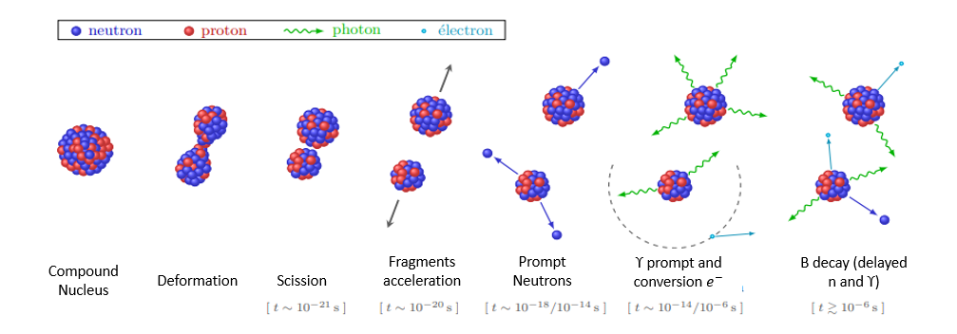
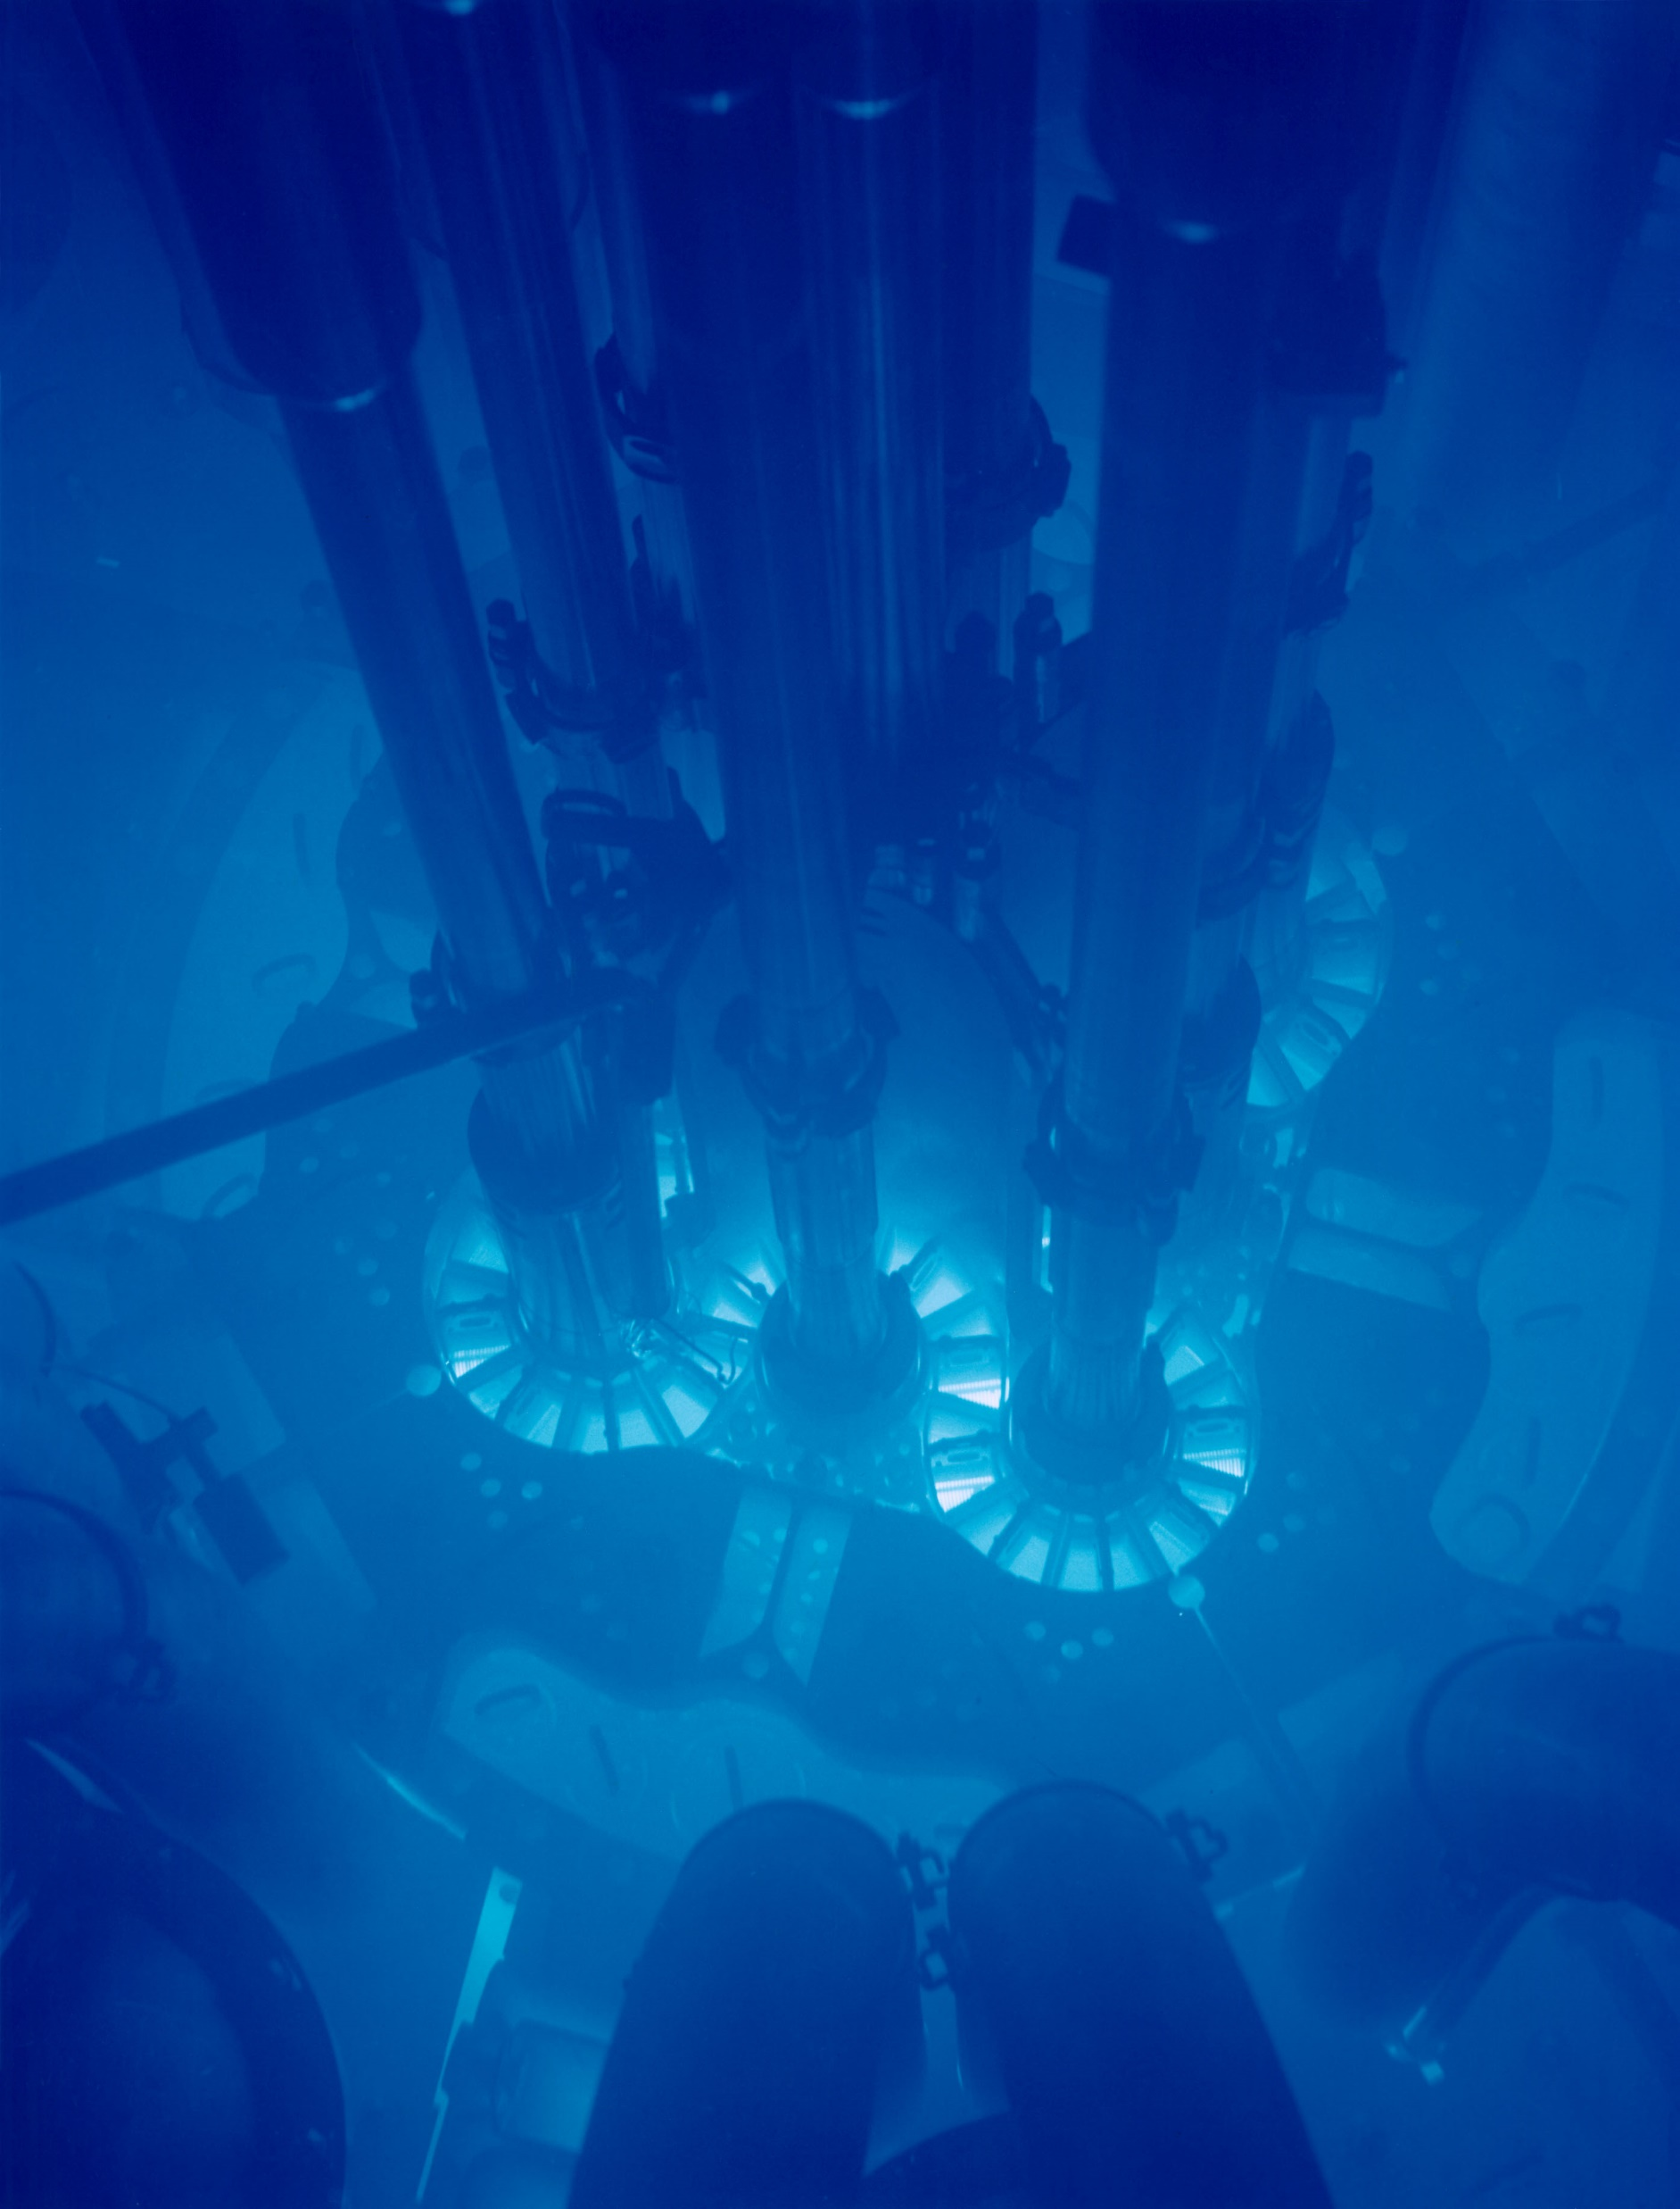
Mass Yields
Interpretation of integral experiments on :
decay heat
depletion/inventory
…
for Gen III, IV reactors
[t ~ 10⁻²¹ s] [t ~ 10⁻²⁰ s] [t ~ 10⁻¹⁸/ 10⁻¹⁴ s] [t ~ 10⁻¹⁴ / 10⁻⁶ s] [t ≥ 10⁻²¹ s]
PIAU, Valentin. Prédiction par calcul des observables de fission à partir d'expériences dédiées. 2022. Thèse de doctorat. Université Grenoble Alpes
Fission Yields (FY) = production rate of nuclei generated by a fission event, more precisely, by mass yields we mean the probability of formation of a nucleus with a certain mass from the fission of the initial compound nucleus.

Slide 4
FY evaluation program
@ CEA Cadarache
1

Slide 5
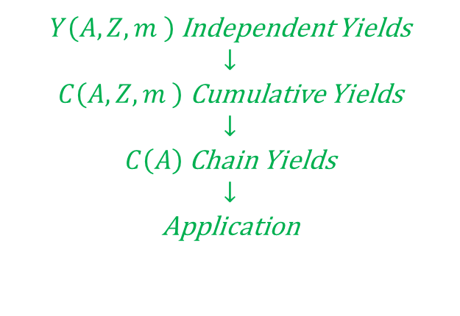
Context: Methodology of (n_{th},f) FY evaluation
→ S.-M. Cheikh ’s PhD thesis (2023)
$Y\left(A,Z,m \right)$ Independent Yields
↓
$C\left(A,Z,m \right)$ Cumulative Yields
↓
$C\left(A\right)$ Chain Yields
↓
Application
Fuel Cycle applications
Reactivity losses (BU)
PIE (BU) : Post-Irradiated Experiment
CFE
Decay Heat

Slide 6
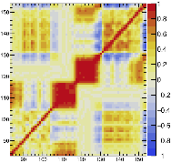
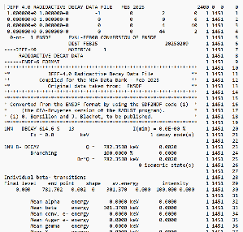
Context: Methodology of (n_{th},f) FY evaluation
→ S.-M. Cheikh ’s PhD thesis (2023)
$Y\left(A,Z,m \right)$ Independent Yields
↓
$C\left(A,Z,m \right)$ Cumulative Yields
↓
$C\left(A\right)$ Chain Yields
↓
Application
Fuel Cycle applications
Reactivity losses (BU)
PIE (BU) : Post-Irradiated Experiment
CFE
Decay Heat

Slide 7
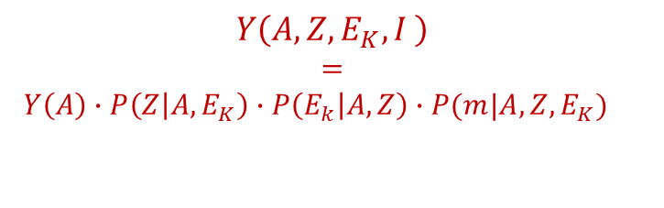
Context: Methodology of (n_{th},f) FY evaluation
→ S.-M. Cheikh ’s PhD thesis (2023)
$$Y\left(A,Z,E_{K},I \right)$$
$$=$$
$Y\left(A\right)∙P\left(Z | A, E_{K}\right)∙P\left(E_{k} | A,Z\right)∙P(m|{A,Z,E}_{K})$
$Y\left(A,Z,m \right)$ Independent Yields
↓
$C\left(A,Z,m \right)$ Cumulative Yields
↓
$C\left(A\right)$ Chain Yields
↓
Application
↔
Mass
Charge
Kinetic
Energy
Isomeric
Fuel Cycle applications
Reactivity losses (BU)
PIE (BU) : Post-Irradiated Experiment
CFE
Decay Heat

Slide 8
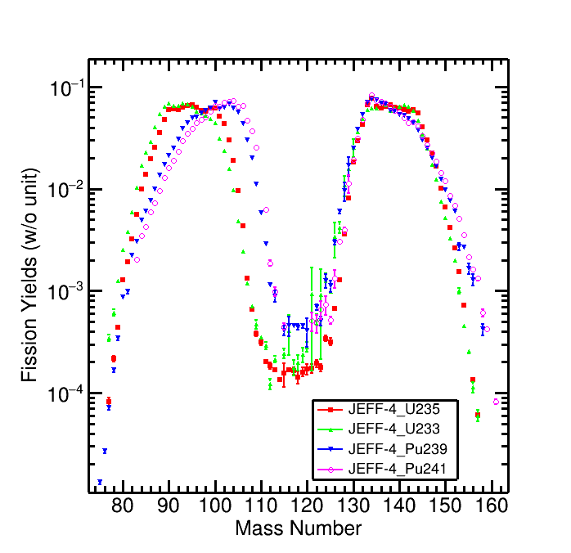
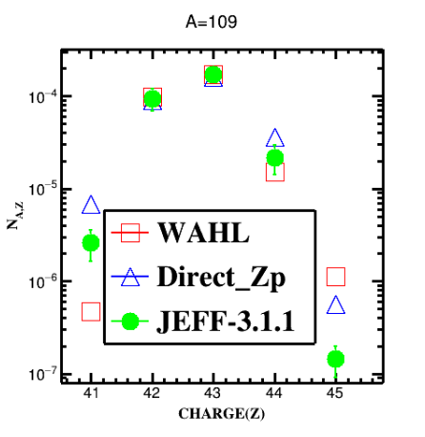
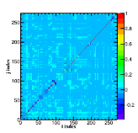
Context: Methodology of (n_{th},f) FY evaluation
→ S.-M. Cheikh ’s PhD thesis (2023)
$$Y\left(A,Z,E_{K},I \right)$$
$$=$$
$Y\left(A\right)∙P\left(Z | A, E_{K}\right)∙P\left(E_{k} | A,Z\right)∙P(m|{A,Z,E}_{K})$
$Y\left(A,Z,m \right)$ Independent Yields
↓
$C\left(A,Z,m \right)$ Cumulative Yields
↓
$C\left(A\right)$ Chain Yields
↓
Application
↔
Mass
Charge
Kinetic
Energy
Isomeric
Fuel Cycle applications
Reactivity losses (BU)
PIE (BU) : Post-Irradiated Experiment
CFE
Decay Heat

Slide 9
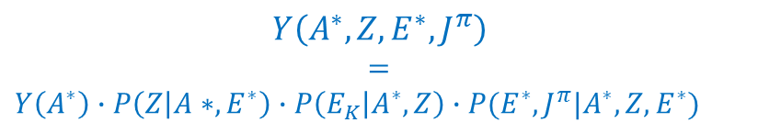
Context: Methodology of (n_{th},f) FY evaluation
→ S.-M. Cheikh ’s PhD thesis (2023)
$$Y\left(A^{∗},Z,E^{∗},J^{π}\right)$$
$$=$$
$Y\left(A^{∗}\right)∙P\left(Z | A∗, E^{∗}\right)∙P\left(E_{K} | A^{∗},Z\right)∙P(E^{∗},J^{π}|A^{∗},Z,E^{∗})$
$$Y\left(A,Z,E_{K},I \right)$$
$$=$$
$Y\left(A\right)∙P\left(Z | A, E_{K}\right)∙P\left(E_{k} | A,Z\right)∙P(m|{A,Z,E}_{K})$
$Y\left(A,Z,m \right)$ Independent Yields
↓
$C\left(A,Z,m \right)$ Cumulative Yields
↓
$C\left(A\right)$ Chain Yields
↓
Application
↔
↔
Mass
Charge
Kinetic
Energy
Isomeric
Pre-neutron Mass, charge, excitation energy
Fission models
Fuel Cycle applications
Reactivity losses (BU)
PIE (BU) : Post-Irradiated Experiment
CFE
Decay Heat

Slide 10
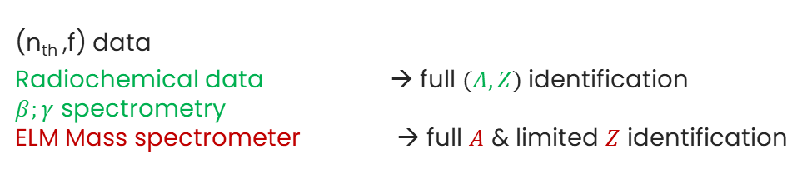
Context: Methodology of (n_{th},f) FY evaluation
→ S.-M. Cheikh ’s PhD thesis (2023)
$$Y\left(A^{∗},Z,E^{∗},J^{π}\right)$$
$$=$$
$Y\left(A^{∗}\right)∙P\left(Z | A∗, E^{∗}\right)∙P\left(E_{K} | A^{∗},Z\right)∙P(E^{∗},J^{π}|A^{∗},Z,E^{∗})$
$$Y\left(A,Z,E_{K},I \right)$$
$$=$$
$Y\left(A\right)∙P\left(Z | A, E_{K}\right)∙P\left(E_{k} | A,Z\right)∙P(m|{A,Z,E}_{K})$
$Y\left(A,Z,m \right)$ Independent Yields
↓
$C\left(A,Z,m \right)$ Cumulative Yields
↓
$C\left(A\right)$ Chain Yields
↓
Application
↔
↔
Mass
Charge
Kinetic
Energy
Isomeric
Pre-neutron Mass, charge, excitation energy
Fission models
(n_{th} ,f) data
Radiochemical data → full $(A,Z)$ identification
$β;γ$ spectrometry
ELM Mass spectrometer → full $A$ & limited $Z$ identification
Fuel Cycle applications
Reactivity losses (BU)
PIE (BU) : Post-Irradiated Experiment
CFE
Decay Heat
→ JEFF-4.0

Slide 11
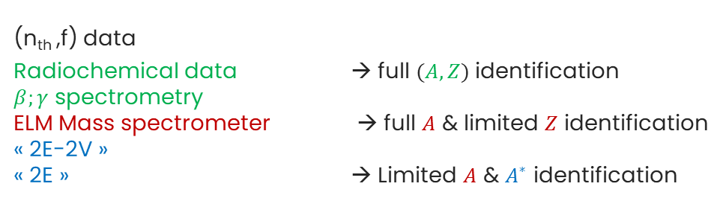
Context: Methodology of (n_{th},f) FY evaluation
→ S.-M. Cheikh ’s PhD thesis (2023)
$$Y\left(A^{∗},Z,E^{∗},J^{π}\right)$$
$$=$$
$Y\left(A^{∗}\right)∙P\left(Z | A∗, E^{∗}\right)∙P\left(E_{K} | A^{∗},Z\right)∙P(E^{∗},J^{π}|A^{∗},Z,E^{∗})$
$$Y\left(A,Z,E_{K},I \right)$$
$$=$$
$Y\left(A\right)∙P\left(Z | A, E_{K}\right)∙P\left(E_{k} | A,Z\right)∙P(m|{A,Z,E}_{K})$
$Y\left(A,Z,m \right)$ Independent Yields
↓
$C\left(A,Z,m \right)$ Cumulative Yields
↓
$C\left(A\right)$ Chain Yields
↓
Application
↔
↔
Mass
Charge
Kinetic
Energy
Isomeric
Pre-neutron Mass, charge, excitation energy
Fission models
(n_{th} ,f) data
Radiochemical data → full $(A,Z)$ identification
$β;γ$ spectrometry
ELM Mass spectrometer → full $A$ & limited $Z$ identification
« 2E-2V »
« 2E » → Limited $A$ & $A^{∗}$ identification
Fuel Cycle applications
Reactivity losses (BU)
PIE (BU) : Post-Irradiated Experiment
CFE
Decay Heat
→ JEFF-4.0
→ To be included in future evaluation : JEFF-4.1
- ²⁴¹Pu(n_{th},f)
- ^{235,238}U(n_{fast}, f); ²³⁹Pu(n_{fast},f)
- minor actinides

Slide 12
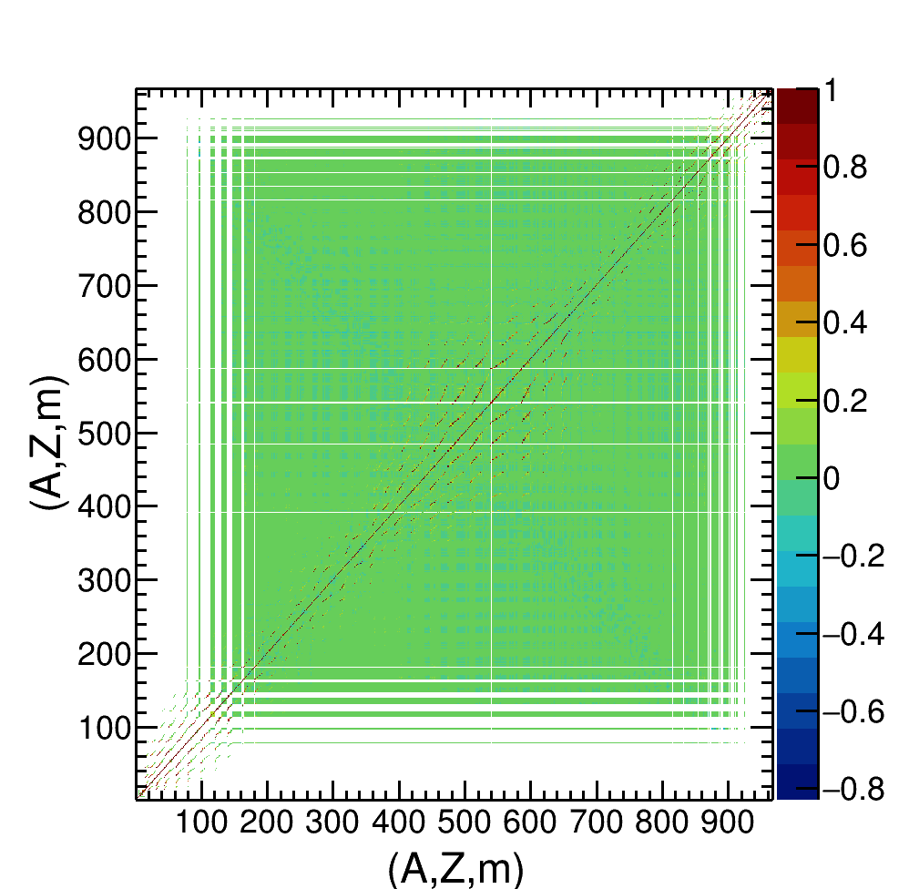




Context: Methodology of (n_{th},f) FY evaluation
→ S.-M. Cheikh ’s PhD thesis (2023)
JEFF-4.0
$$C\left(A,Z,m|nth \right)$$
$$(nth,f)⟹$$
$$Y\left(A |nth\right)$$
$$P\left(Z | A,nth\text{, }\text{JEFF}\text{−3.3}\right)$$

Slide 13


Context: Methodology of (n_{th},f) FY evaluation
→ S.-M. Cheikh ’s PhD thesis (2023)
→ A. Regonesi’s PhD (2024-2027)
JEFF-4.0
$$C\left(A,Z,m|nth \right)$$
$$(nth,f)⟹$$
$$Y\left(A^{∗}|nth\right)$$
$$P\left(ν | A^{∗}, nth\right)$$
$$Y\left(A |nth\right)$$
$$P\left(Z | A,nth\text{, }\text{JEFF}\text{−3.3}\right)$$

Slide 14



Context: Methodology of (n_{th},f) FY evaluation
→ S.-M. Cheikh ’s PhD thesis (2023)
→ A. Regonesi’s PhD (2024-2027)
→ N. Teixeira Rua PhD (2025-2028)
JEFF-4.0
$$C\left(A,Z,m|nth \right)$$
$$(nth,f)⟹$$
$$Y\left(A^{∗}|nth\right)$$
$$P\left(ν | A^{∗}, nth\right)$$
$$Y\left(A |nth\right)$$
$$P\left(Z | A^{∗}, nth\right)$$
$$P\left(Z | A,nth\text{, }\text{J}\text{EFF}\text{−3.3}\right)$$

Slide 15



Context: Methodology of (n_{th},f) FY evaluation
→ S.-M. Cheikh ’s PhD thesis (2023)
→ A. Regonesi’s PhD (2024-2027)
→ N. Teixeira Rua PhD (2025-2028)
JEFF-4.0
$$C\left(A,Z,m|nth \right)$$
$$(nth,f)⟹$$
$$Y\left(A^{∗}|nth\right)$$
$$P\left(ν | A^{∗}, nth\right)$$
$$Y\left(A |nth\right)$$
$$P\left(Z | A^{∗}, nth\right)$$
$$P\left(Z | A,nth\text{, }\text{J}\text{EFF}\text{−3.3}\right)$$
Major experimental data
$$(nfast,f)⟹$$
$$C\left(A|En\right)$$
(n_{fast} ,f) data
Radiochemical data → full $(A,Z)$ identification
$β;γ$ spectrometry
ELM Mass spectrometer → full $A$ & limited $Z$ identification
« 2E-2V »
« 2E » → Limited $A$ & $A^{∗}$ identification
?

Slide 16


Context: Methodology of (n_{th},f) FY evaluation
→ S.-M. Cheikh ’s PhD thesis (2023)
→ A. Regonesi’s PhD (2024-2027)
→ N. Teixeira Rua PhD (2025-2028)
JEFF-4.0
$$C\left(A,Z,m|nth \right)$$
$$(nth,f)⟹$$
$$Y\left(A^{∗}|nth\right)$$
$$P\left(ν | A^{∗}, nth\right)$$
$$Y\left(A |nth\right)$$
$$P\left(Z | A^{∗}, nth\right)$$
$$P\left(Z | A,nth\text{, }\text{J}\text{EFF}\text{−3.3}\right)$$
« 2E » & « 2E-2V »
Pheno. Models
(Brosa-like)
Pheno. Models
(Wahl-like)
Major experimental data
$$(nfast,f)⟹$$
$$Y\left(A^{∗}|nfast\right)$$
$$C\left(A|En\right)$$
$$P\left(Z | A^{∗}, nfast\right)$$
(n_{fast} ,f) data
Radiochemical data → full $(A,Z)$ identification
$β;γ$ spectrometry
ELM Mass spectrometer → full $A$ & limited $Z$ identification
« 2E-2V »
« 2E » → Limited $A$ & $A^{∗}$ identification
?

Slide 17



Context: Methodology of (n_{th},f) FY evaluation
→ S.-M. Cheikh ’s PhD thesis (2023)
→ A. Regonesi’s PhD (2024-2027)
→ N. Teixeira Rua PhD (2025-2028)
JEFF-4.0
$$C\left(A,Z,m|nth \right)$$
$$(nth,f)⟹$$
$$Y\left(A^{∗}|nth\right)$$
$$P\left(ν | A^{∗}, nth\right)$$
$$Y\left(A |nth\right)$$
$$P\left(Z | A^{∗}, nth\right)$$
$$P\left(Z | A,nth\text{, }\text{J}\text{EFF}\text{−3.3}\right)$$
« 2E » & « 2E-2V »
Pheno. Models
(Brosa-like)
Pheno. Models
(Wahl-like)
Major experimental data
Pheno. Models
(FIFRELIN, GEF, CGMF, FREYA)
$$(nfast,f)⟹$$
$$Y\left(A,Z|En\right)$$
$$C\left(A|En\right)$$
$$(nfast,f)⟹$$
$$Y\left(A^{∗}|nfast\right)$$
$$P\left(ν | A^{∗}, En\right)$$
$$P\left(Z | A^{∗}, nfast\right)$$
$$P\left(Z | A^{∗}, nfast\right)$$
(n_{fast} ,f) data
Radiochemical data → full $(A,Z)$ identification
$β;γ$ spectrometry
ELM Mass spectrometer → full $A$ & limited $Z$ identification
« 2E-2V »
« 2E » → Limited $A$ & $A^{∗}$ identification
?

Slide 18
Context: Methodology of (n_{th},f) FY evaluation
→ S.-M. Cheikh ’s PhD thesis (2023)
→ A. Regonesi’s PhD (2024-2027)
→ N. Teixeira Rua PhD (2025-2028)
Goal: JEFF-4.0 →JEFF-4.1
JEFF-4.0
$$C\left(A,Z,m|nth \right)$$
$$(nth,f)⟹$$
$$Y\left(A^{∗}|nth\right)$$
$$P\left(ν | A^{∗}, nth\right)$$
$$Y\left(A |nth\right)$$
$$P\left(Z | A^{∗}, nth\right)$$
$$P\left(Z | A,nth\text{, }\text{J}\text{EFF}\text{−3.3}\right)$$
« 2E » & « 2E-2V »
Pheno. Models
(Brosa-like)
Pheno. Models
(Wahl-like)
Major experimental data
Pheno. Models
(FIFRELIN, GEF, CGMF, FREYA)
$$(nfast,f)⟹$$
$$Y\left(A^{∗}|nfast\right)$$
$$P\left(ν | A^{∗}, En\right)$$
$$Y\left(A,Z|En\right)$$
$$C\left(A|En\right)$$
$$P\left(Z | A^{∗}, nfast\right)$$
$$P\left(Z | A^{∗}, nfast\right)$$
(n_{fast} ,f) data
Radiochemical data → full $(A,Z)$ identification
$β;γ$ spectrometry
ELM Mass spectrometer → full $A$ & limited $Z$ identification
« 2E-2V »
« 2E » → Limited $A$ & $A^{∗}$ identification
?

Slide 19
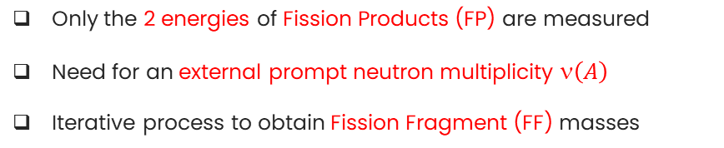
Methods 2E and 2E-2v
2E method
Sample
DETECTOR 1
DETECTOR 2
Only the 2 energies of Fission Products (FP) are measured
Need for an external prompt neutron multiplicity $\left(A\right)$
Iterative process to obtain Fission Fragment (FF) masses

Slide 20
Methods 2E and 2E-2v
2E method
2E-2v method
Sample
Sample
DETECTOR 1
DETECTOR 2
DETECTOR 1
DETECTOR 2
STOP 1
START 1
START 2
STOP 2
Only the 2 energies of Fission Products (FP) are measured
Need for an external prompt neutron multiplicity $\left(A\right)$
Iterative process to obtain Fission Fragment (FF) masses
TOF 1
TOF 2
Both the 2 energies and velocities of Fission Products (FP) are measured
Assumption of isotropic neutron emission in the CM system
Exploit the conservation laws to obtain FF masses

Slide 21
Methods 2E and 2E-2v
2E method
2E-2v method
Sample
Sample
DETECTOR 1
DETECTOR 2
DETECTOR 1
DETECTOR 2
STOP 1
START 1
START 2
STOP 2
Only the 2 energies of Fission Products (FP) are measured
Need for an external prompt neutron multiplicity $\left(A\right)$
Iterative process to obtain Fission Fragment (FF) masses
TOF 1
TOF 2
Both the 2 energies and velocities of Fission Products (FP) are measured
Assumption of isotropic neutron emission in the CM system
Exploit the conservation laws to obtain FF masses
As regards ²³⁵U, there are no actual measurements of 2E-2v so far, rather, the method used is (2E-1v)x2, where a complementary event is used to reconstruct the complete measurement

Slide 22
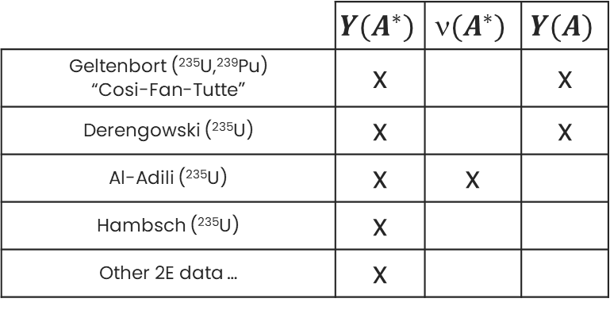
Methods 2E and 2E-2v
2E method
2E-2v method
Sample
Sample
DETECTOR 1
DETECTOR 2
DETECTOR 1
DETECTOR 2
STOP 1
START 1
START 2
STOP 2
Only the 2 energies of Fission Products (FP) are measured
Need for an external prompt neutron multiplicity $\left(A\right)$
Iterative process to obtain Fission Fragment (FF) masses
TOF 1
TOF 2
Both the 2 energies and velocities of Fission Products (FP) are measured
Assumption of isotropic neutron emission in the CM system
Exploit the conservation laws to obtain FF masses
As regards ²³⁵U, there are no actual measurements of 2E-2v so far, rather, the method used is (2E-1v)x2, where a complementary event is used to reconstruct the complete measurement
 | $$Y(A^{∗})$$ | $$(A^{∗})$$ | $$Y(A)$$
Geltenbort (²³⁵U,²³⁹Pu) “Cosi-Fan-Tutte” | x |  | x
Derengowski (²³⁵U) | x |  | x
Al-Adili (²³⁵U) | x | x
Hambsch (²³⁵U) | x
Other 2E data … | x

Slide 23
New methodology for evaluation of Pre-neutron mass yields
2

Slide 24
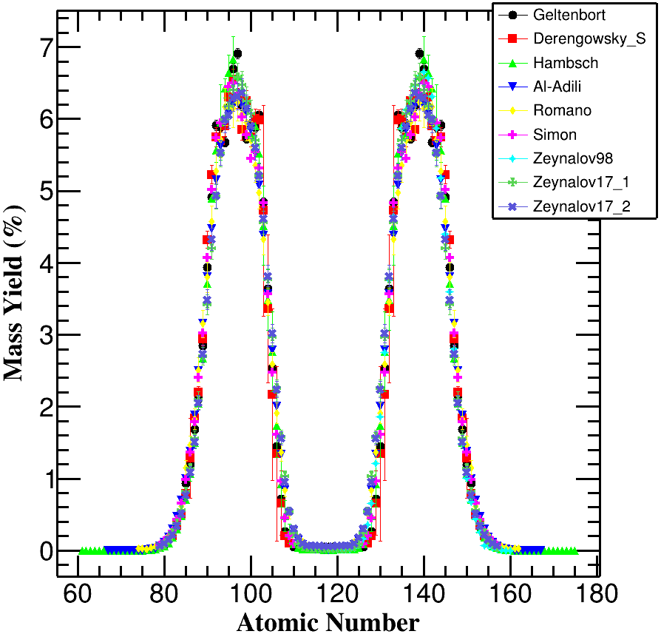
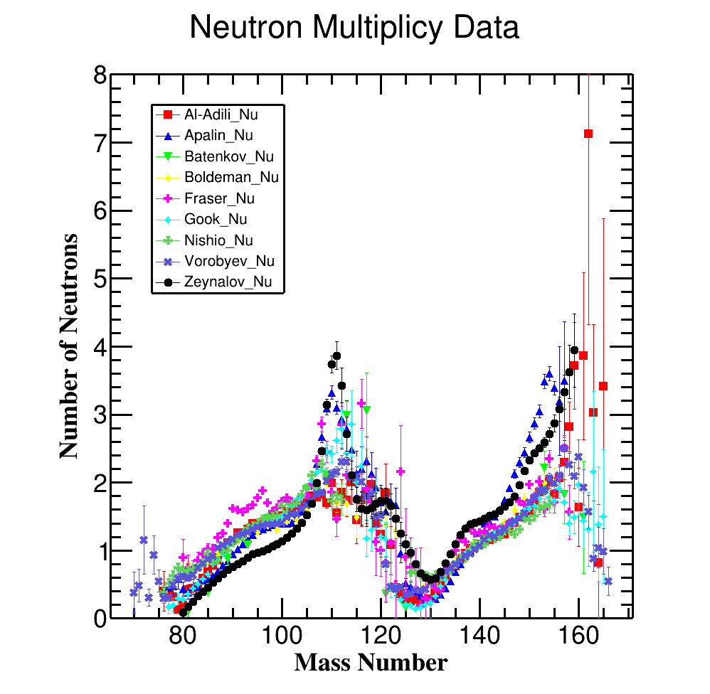
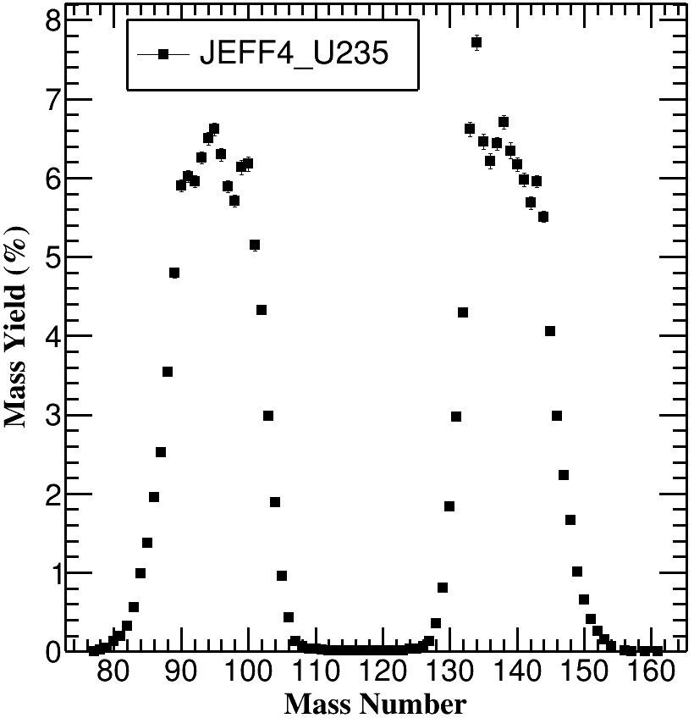


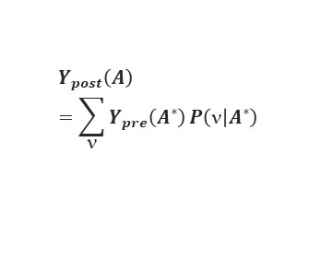
²³⁵U(n_{th},f) evaluation of Pre-neutron fission yields
Experimental Data for ²³⁵U
JEFF-4.0
$$Y_{post}\left(A\right)=\sum_{}{Y_{pre}\left(A^{∗}\right)}P\left( | A^{∗}\right)$$
$A^{∗}=A+$ν
Conservation laws and symmetry
Validation on JEFF-4.0 mass yields
Full A identification
Challenge: Experimental limit of Mass Resolutions

Slide 25
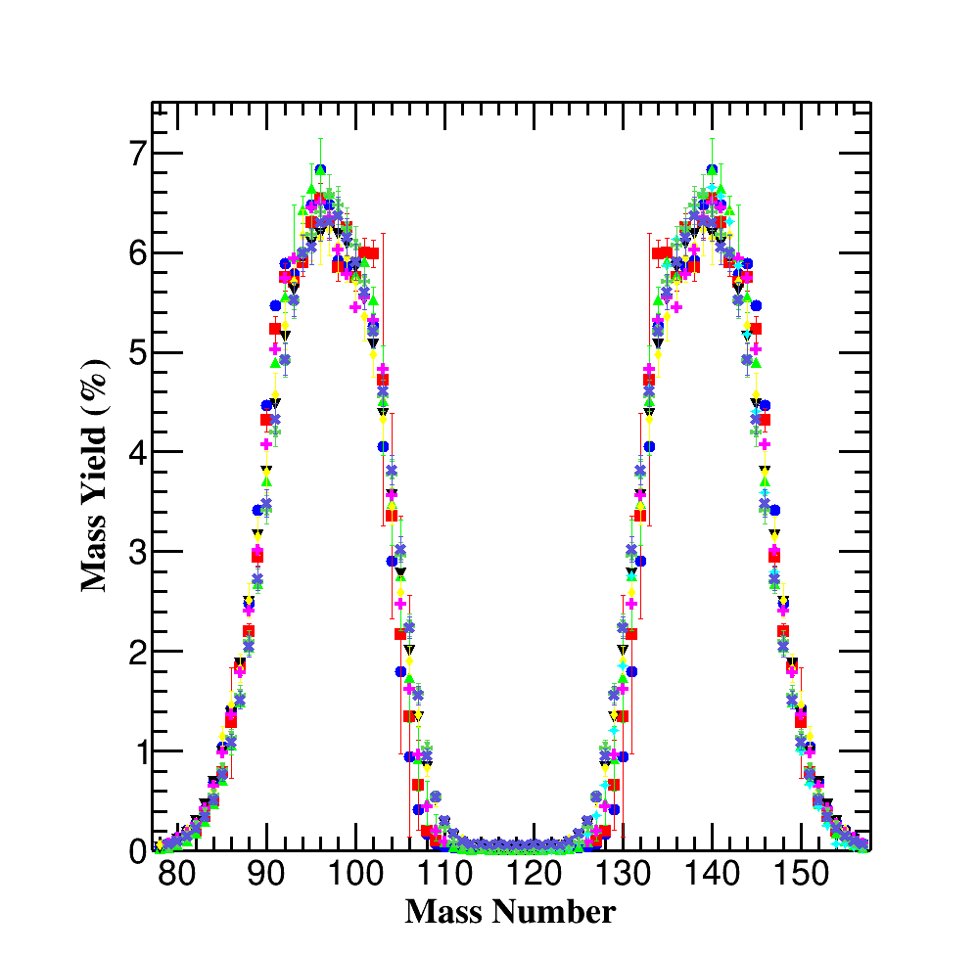
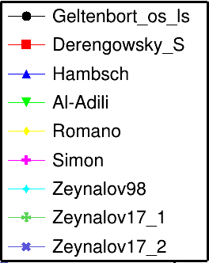
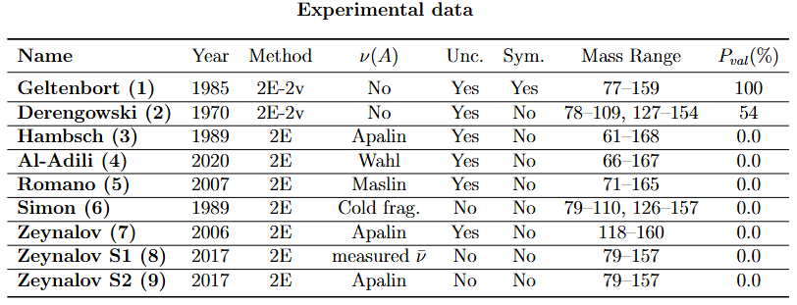
²³⁵U(n_{th},f) evaluation of Pre-neutron fission yields
Bibliography of Experimental Data (EXFOR database)
(2E-1v)x2
(2E-1v)x2
9 series of data symmetrised and quasi-complete mass range allowing absolute normalization
Generalised compatibility tests (with correlations) :
  Geltenbort et Derengowski : → Y(A*) and Y(A) available data
      → absolute mass resolutions determined in comparison to JEFF-4.0 Y(A)
  2E data mass resolutions : → mainly no Y(A) available data
                → Only compatibility tests with 2E-2v measurements are possible

Slide 26

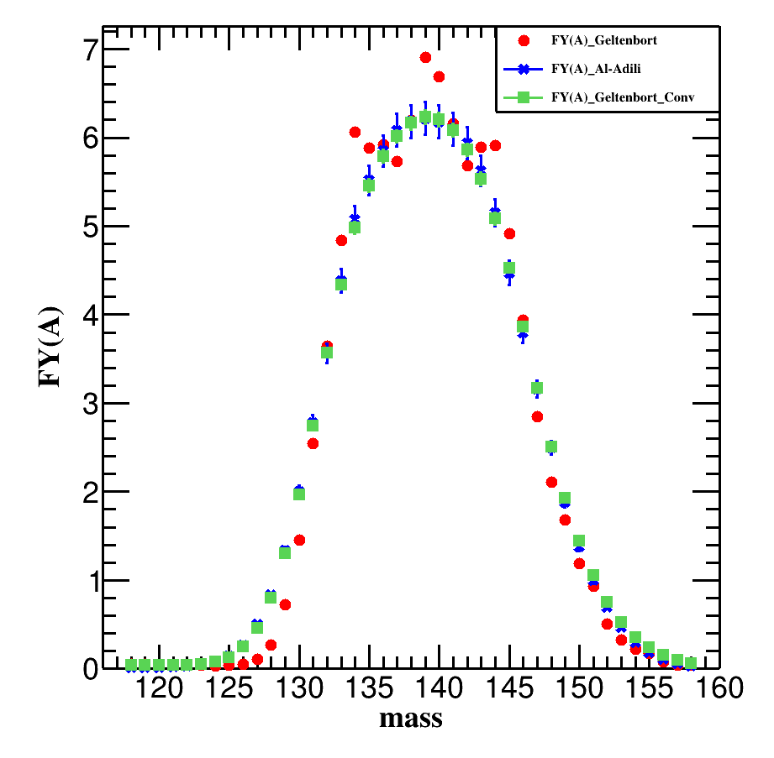
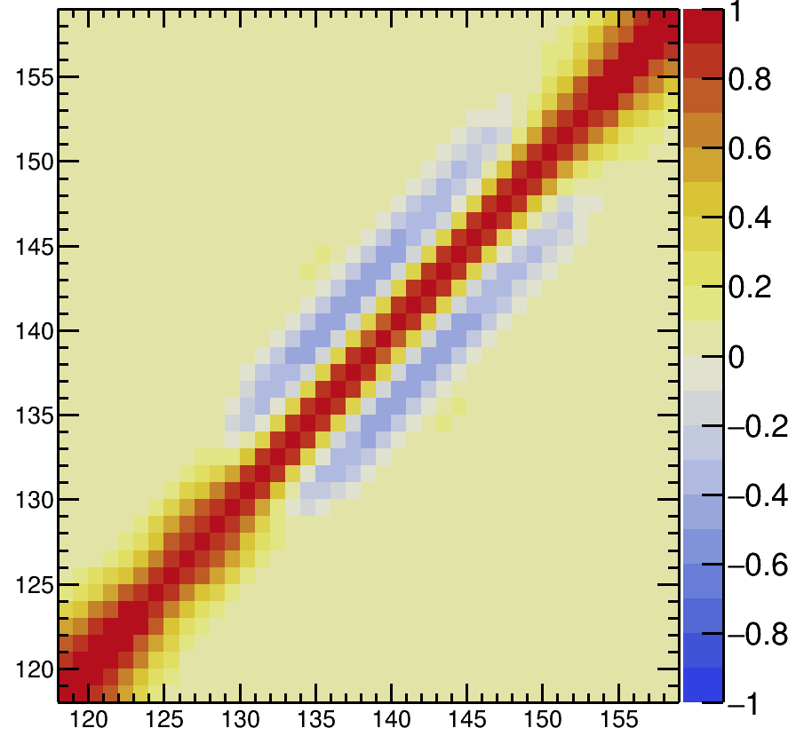

²³⁵U(n_{th},f) evaluation of Pre-neutron fission yields
Problem due to the different mass resolutions of experimental data → Solved via convolution function and comparison in the space of convolutions
(2E-1v)x2
(2E-1v)x2

Slide 27
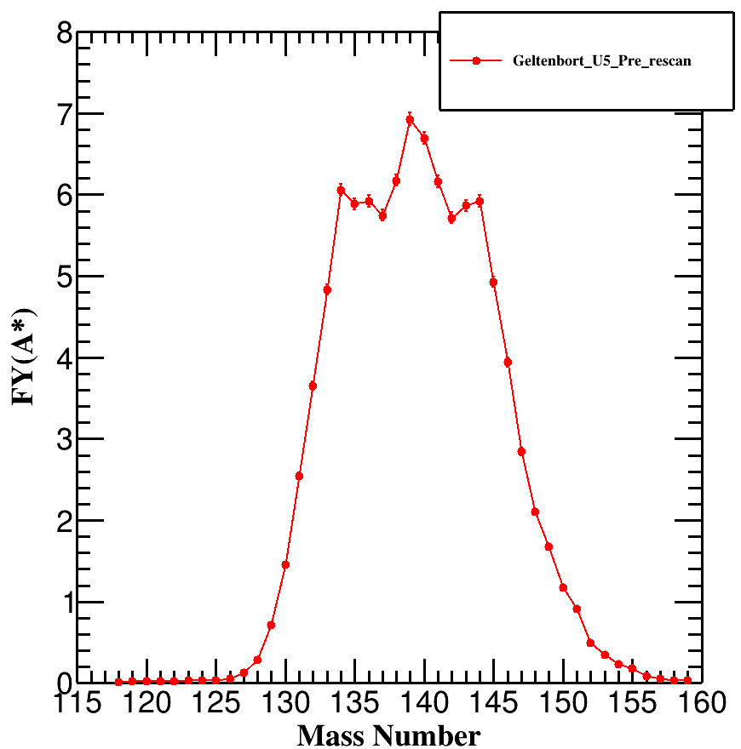
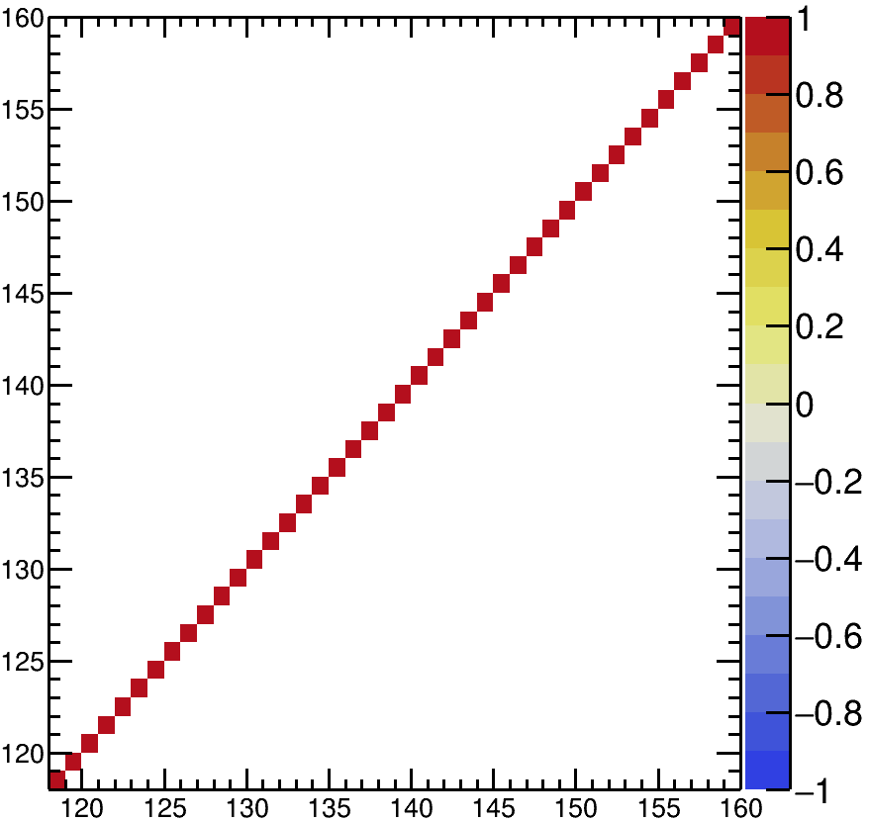
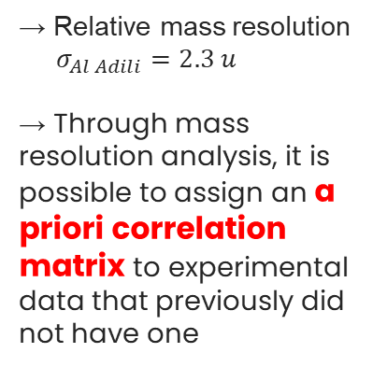
²³⁵U(n_{th},f) evaluation of Pre-neutron fission yields
Problem due to the different mass resolutions of experimental data → Solved via convolution function and comparison in the space of convolutions
(2E-1v)x2
(2E-1v)x2
→ Relative mass resolution
$σ_{Al Adili}=2.3 u$
→ Through mass resolution analysis, it is possible to assign an a priori correlation matrix to experimental data that previously did not have one
Geltenbort

Slide 28
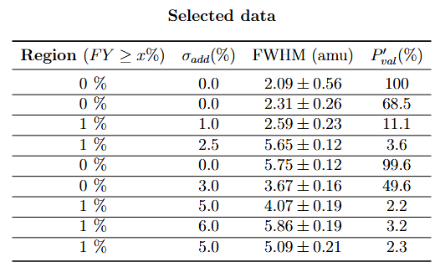
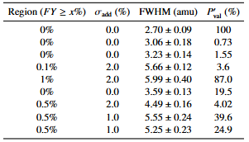
²³⁵U(n_{th},f) evaluation of Pre-neutron fission yields
Problem due to the different mass resolutions of experimental data → Solved via convolution function and comparison in the space of convolutions
(2E-1v)x2
(2E-1v)x2
→ Relative mass resolution
$σ_{Al Adili}=2.3 u$
→ Through mass resolution analysis, it is possible to assign an a priori correlation matrix to experimental data that previously did not have one
Geltenbort

Slide 29
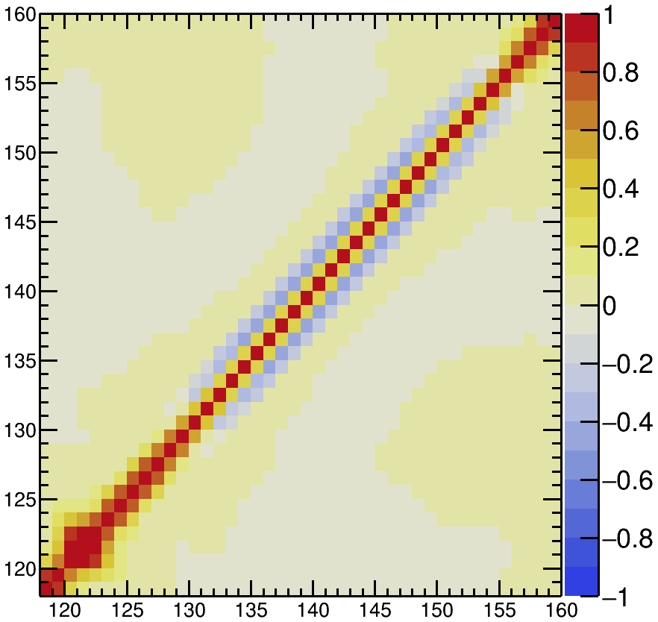
²³⁵U(n_{th},f) evaluation of Pre-neutron fission yields
Problem due to the different mass resolutions of experimental data → Solved via convolution function and comparison in the space of convolutions
(2E-1v)x2
(2E-1v)x2
→ Relative mass resolution
$σ_{Al Adili}=2.3 u$
→ Through mass resolution analysis, it is possible to assign an a priori correlation matrix to experimental data that previously did not have one
Geltenbort
A priori correlation matrix

Slide 30
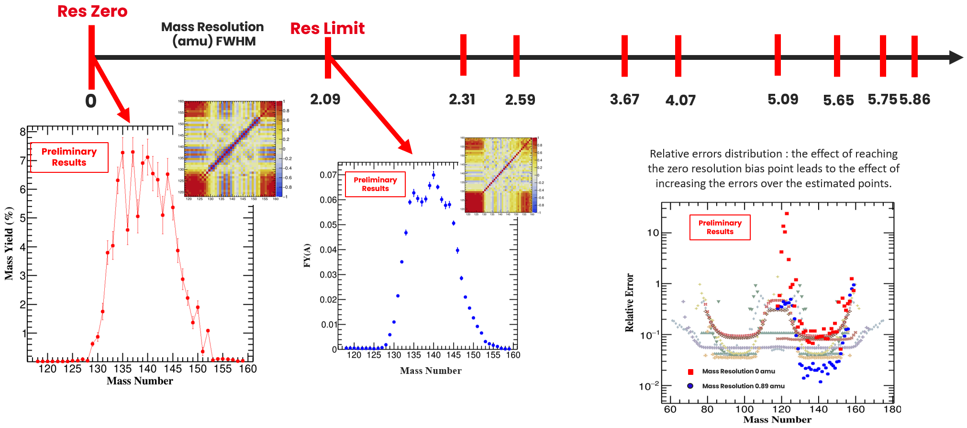
²³⁵U(n_{th},f) evaluation of Pre-neutron fission yields
Problem due to the different mass resolutions of experimental data → Solved via convolution function and comparison in the space of convolutions
Once identified all the mass resolutions → merging with of MCMC code DREAM to calculate fission yields at the best experimental resolution and at resolution zero
Res. Zero
Res. Limit
2.70
3.06
3.23
3.59
4.49
5.25
5.55
5.66
5.99

Slide 31
²³⁵U(n_{th},f) evaluation of Pre-neutron fission yields
Problem due to the different mass resolutions of experimental data → Solved via convolution function and comparison in the space of convolutions
Once identified all the mass resolutions → merging with of MCMC code DREAM to calculate fission yields at the best experimental resolution and at resolution zero
Res. Zero
Res. Limit
2.70
3.06
3.23
3.59
4.49
5.25
5.55
5.66
5.99
Extrapolation biases : high anticorrelations,
peaks position uncertain
01/07/2026

Slide 32
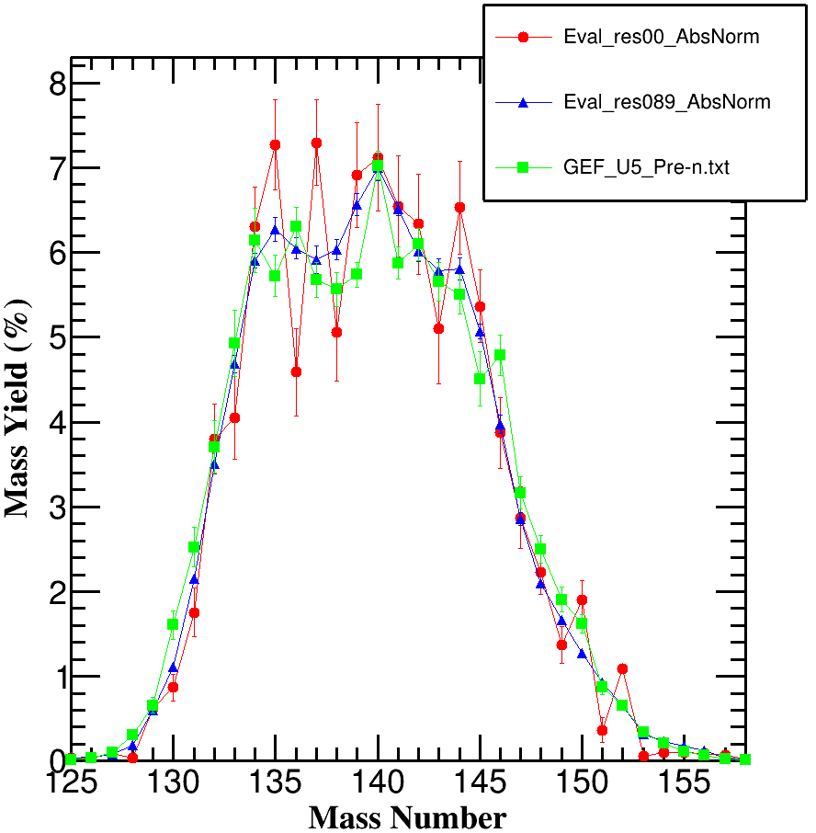
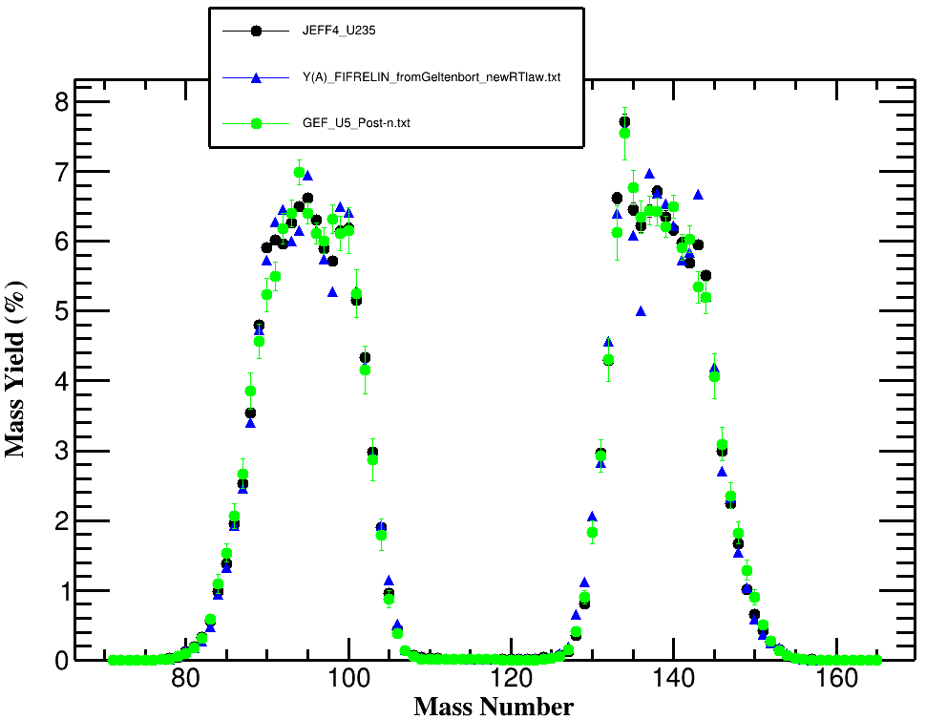
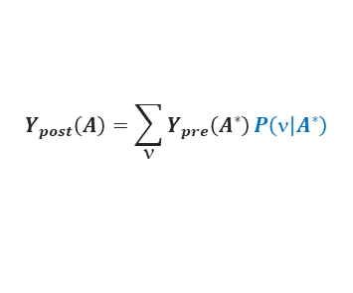
²³⁵U(n_{th},f) evaluation of Pre-neutron fission yields
Y(A*) Eval Res. Zero
JEFF-4.0
Y(A*) Eval Res. Limit
Y(A)_FIFRELIN Res Limit Y(A*)
GEF_²³⁵U_Post-n
GEF_²³⁵U_Pre-n
$$Y_{post}\left(A\right)=\sum_{}{Y_{pre}\left(A^{∗}\right)}P\left( | A^{∗}\right)$$
$A^{∗}=A+$ν
Post-n
Pre-n
01/07/2026

Slide 33
Prompt neutron multiplicity analysis
3

Slide 34
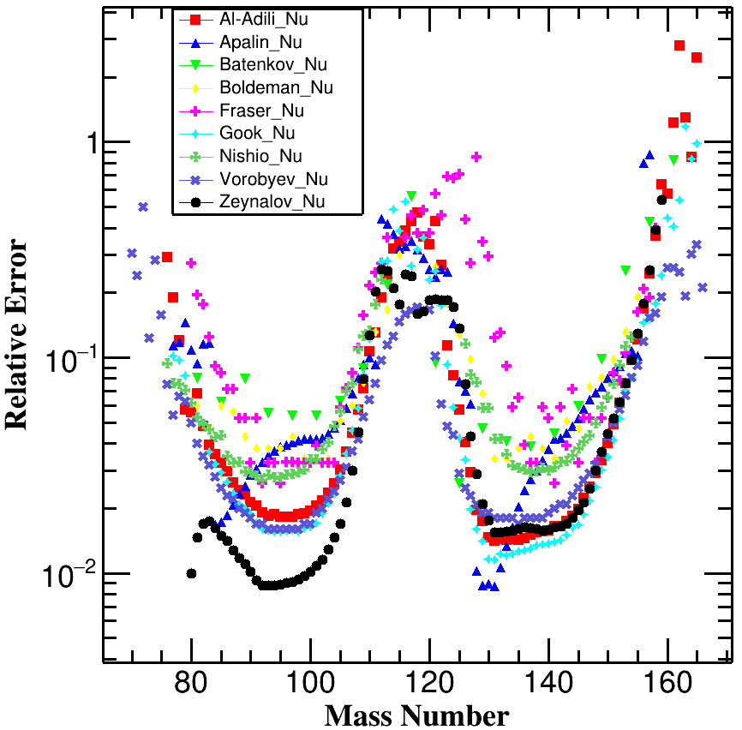
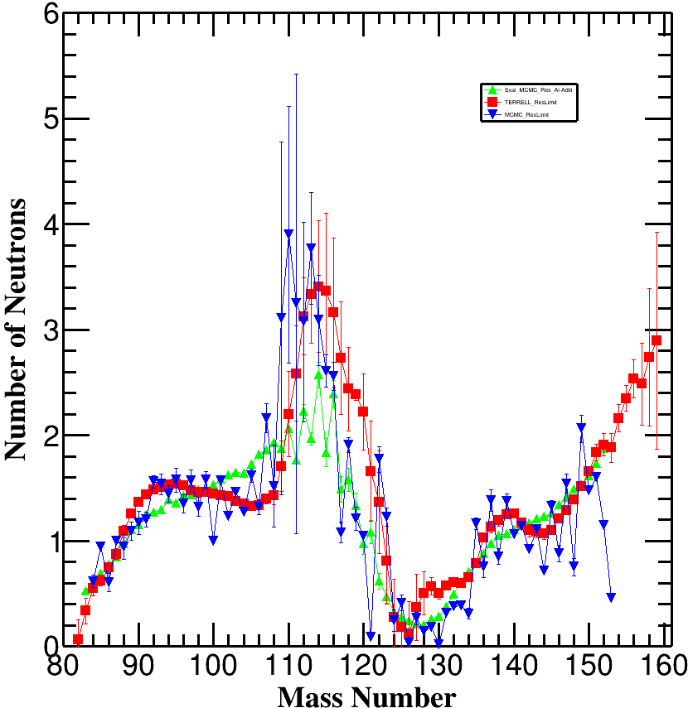
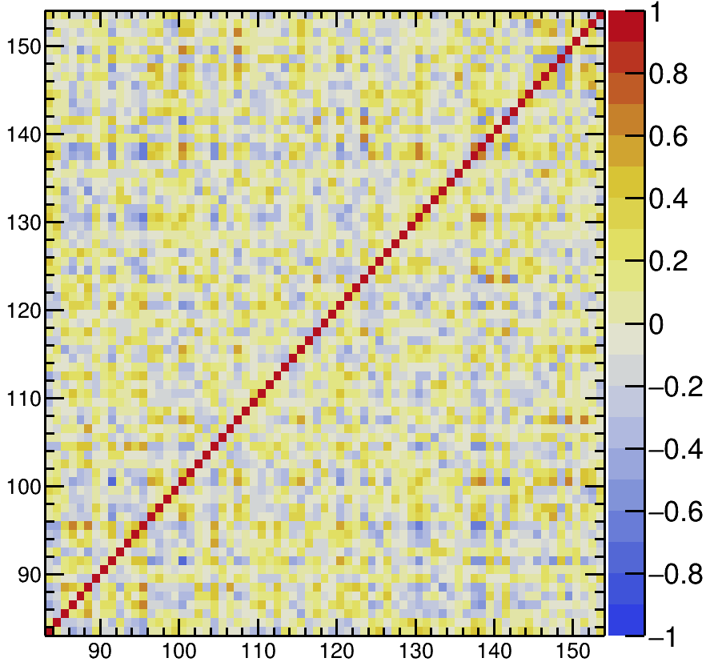
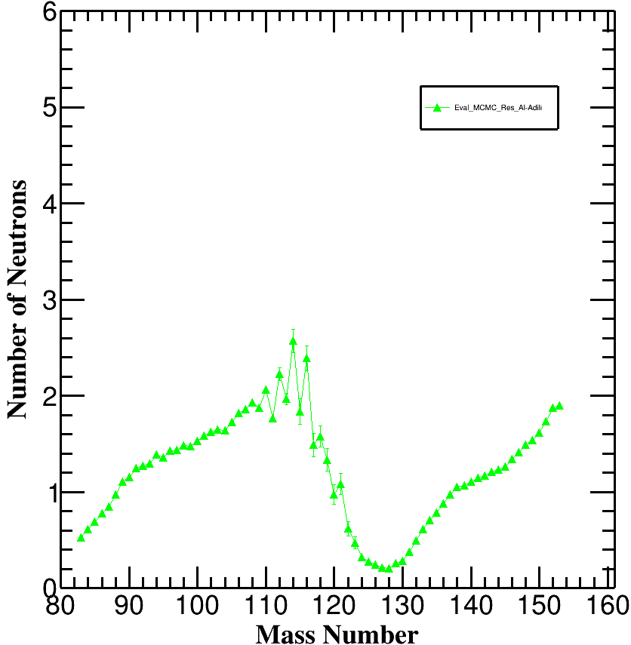
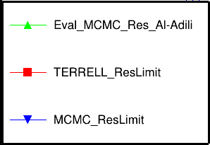
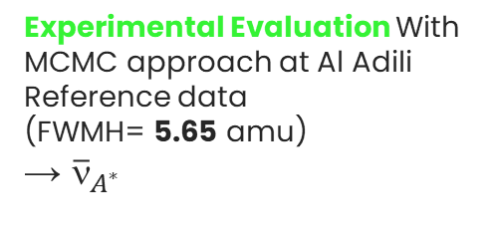
Prompt neutrons multiplicity analysis
9 data sets available
Al-Adili, Ali, et al. "Prompt fission neutron yields in thermal fission of U 235 and spontaneous fission of Cf 252." Physical Review C 102.6 (2020)
Experimental Evaluation With MCMC approach at Al Adili Reference data
(FWMH= 5.65 amu)
→ ${\overline{ν}}_{A^{∗}}$
ν(A*) Eval | Res Exp
Pre-n
Pre-n

Slide 35
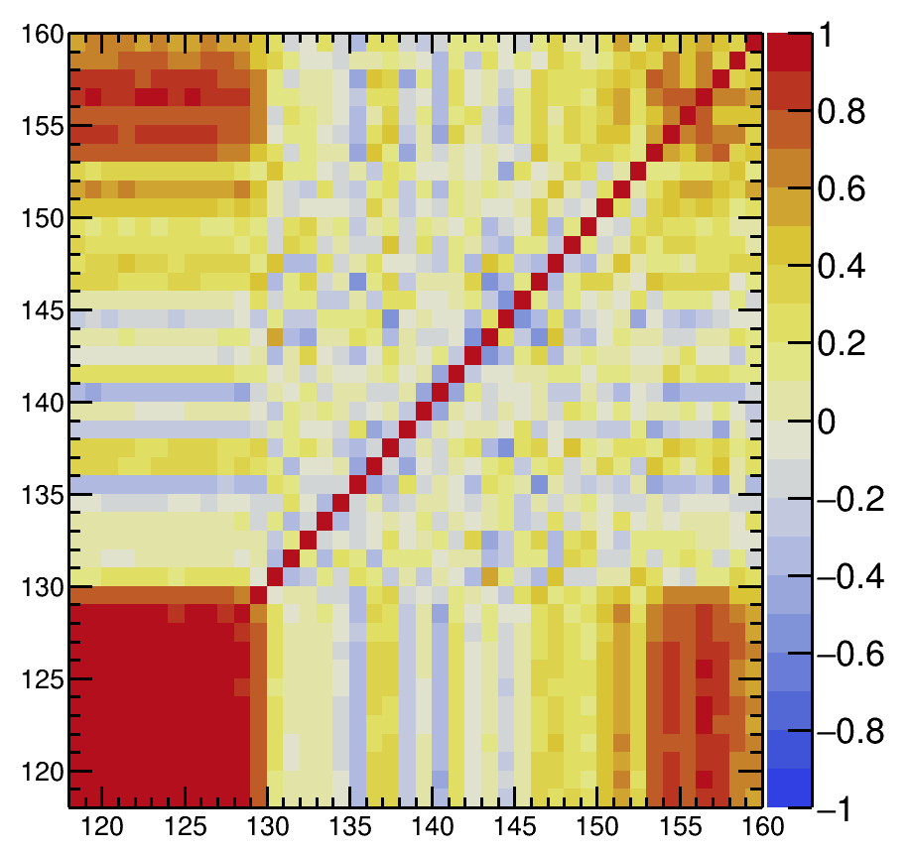
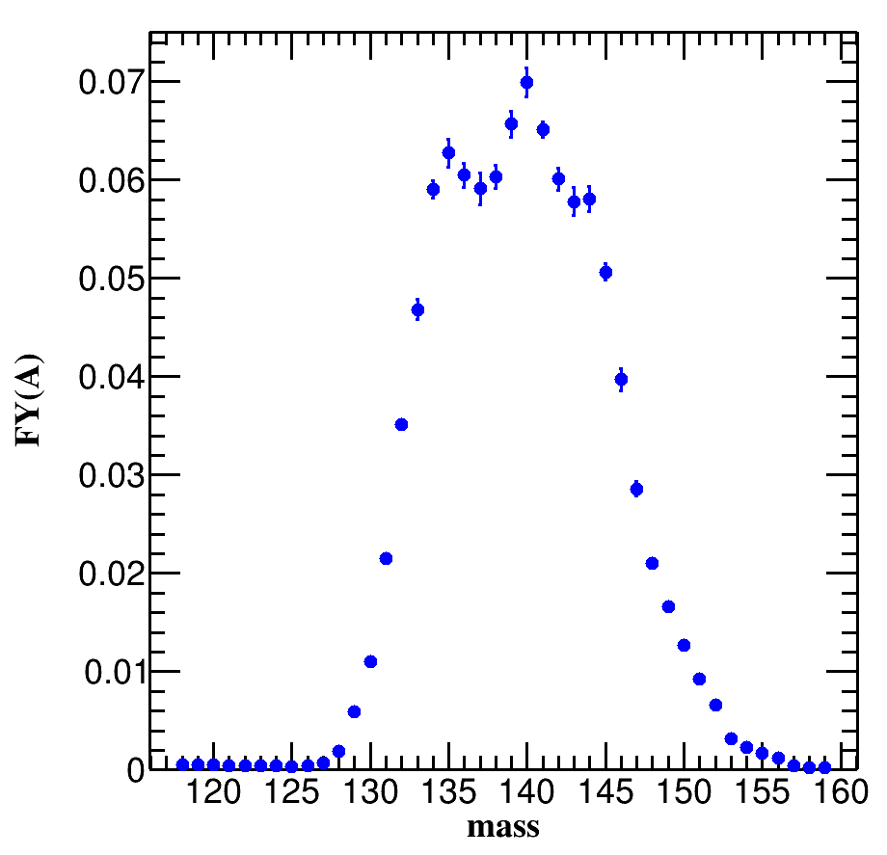

Prompt neutrons multiplicity analysis
9 data sets available
Al-Adili, Ali, et al. "Prompt fission neutron yields in thermal fission of U 235 and spontaneous fission of Cf 252." Physical Review C 102.6 (2020)
Experimental Evaluation With MCMC approach at Al Adili Reference data
(FWMH= 5.65 amu)
→ ${\overline{ν}}_{A^{∗}}$
ν(A*) Eval | Res Exp
Calculations :
$$P\left(_{A^{∗}} | Y_{A^{∗}};Y_{A}\right)$$
+
Pre-n

Slide 36
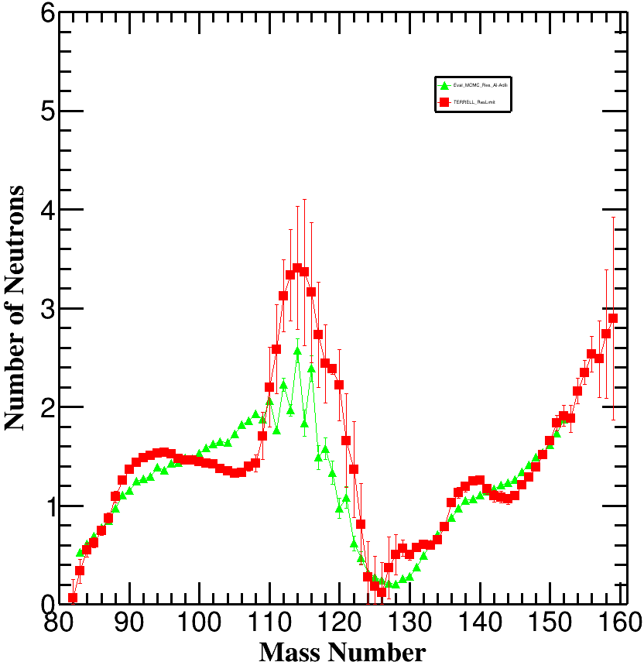
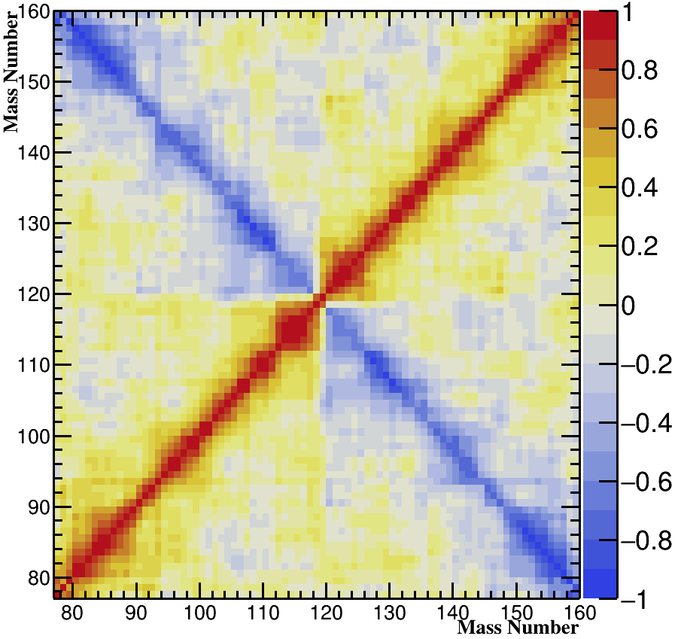
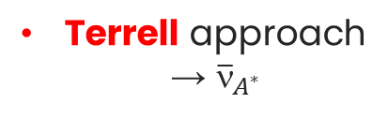
Prompt neutrons multiplicity analysis
9 data sets available
Al-Adili, Ali, et al. "Prompt fission neutron yields in thermal fission of U 235 and spontaneous fission of Cf 252." Physical Review C 102.6 (2020)
Experimental Evaluation With MCMC approach at Al Adili Reference data
(FWMH= 5.65 amu)
→ ${\overline{ν}}_{A^{∗}}$
ν(A*) Eval | Res Exp
ν(A*) Terrell | Y(A*)
ν(A*) Calc | Y(A*)
Calculations :
$$P\left(_{A^{∗}} | Y_{A^{∗}};Y_{A}\right)$$
Terrell approach
→ ${\overline{ν}}_{A^{∗}}$
+
Pre-n

Slide 37
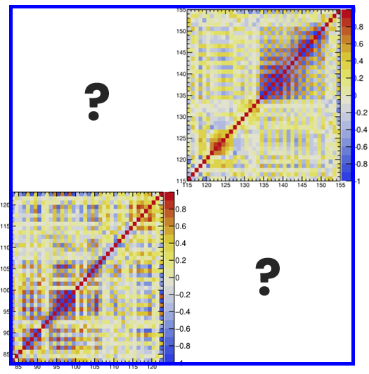
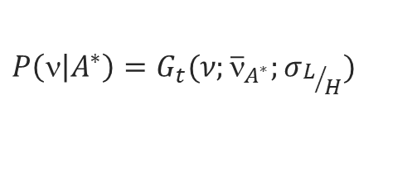
Prompt neutrons multiplicity analysis
9 data sets available
Al-Adili, Ali, et al. "Prompt fission neutron yields in thermal fission of U 235 and spontaneous fission of Cf 252." Physical Review C 102.6 (2020)
Experimental Evaluation With MCMC approach at Al Adili Reference data
(FWMH= 5.65 amu)
→ ${\overline{ν}}_{A^{∗}}$
ν(A*) Eval | Res Exp
ν(A*) Terrell | Y(A*)
ν(A*) Calc | Y(A*)
Calculations :
$$P\left(_{A^{∗}} | Y_{A^{∗}};Y_{A}\right)$$
Terrell approach
→ ${\overline{ν}}_{A^{∗}}$
+
MCMC approach
$$P\left( | A^{∗}\right)=G_{t}(ν;{\overline{}}_{A^{∗}};σ_{L/H})$$
Pre-n

Slide 38
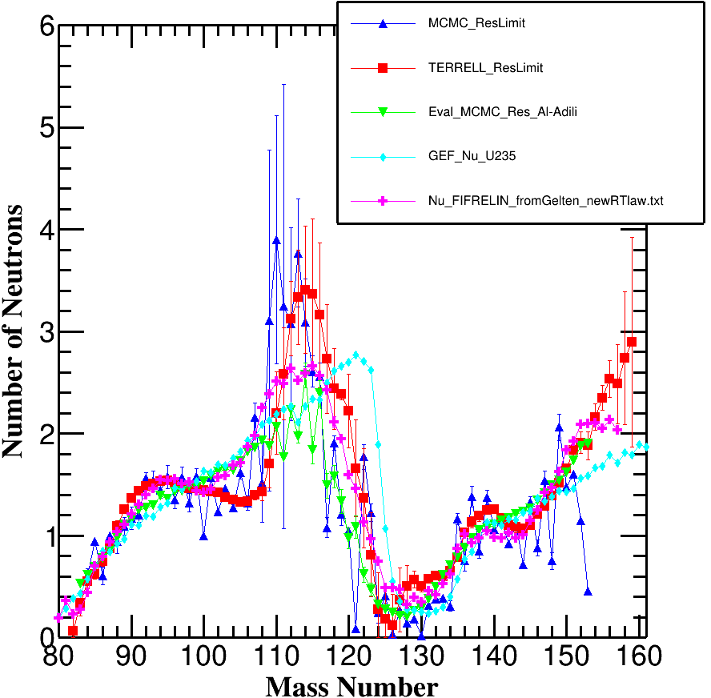
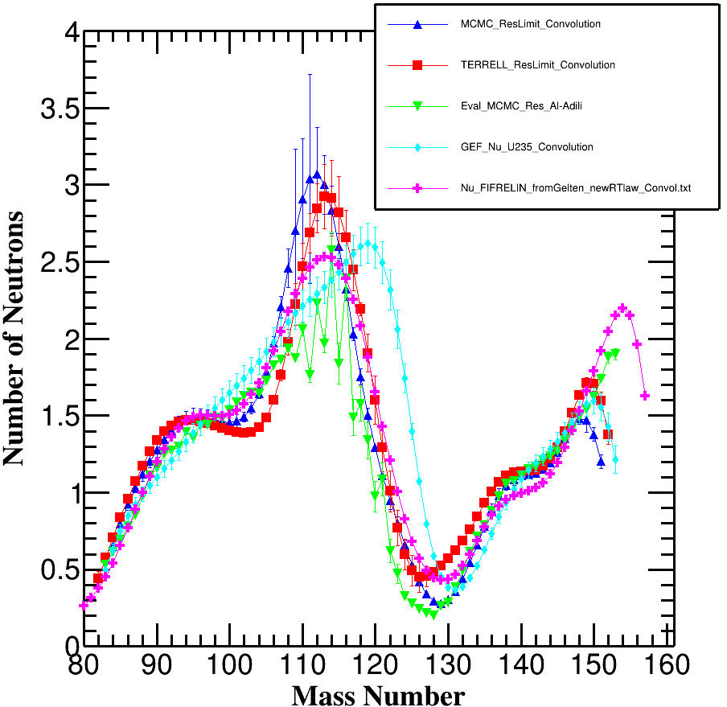
Prompt neutrons multiplicity analysis
ν(A*) Calc | Y(A*)
ν(A*) Calc | Y(A*) Conv. 5.66 u
ν(A*) Terrell | Y(A*)
ν(A*) Terrell | Y(A*) Conv. 5.66 u
ν(A*) Eval | Res Exp 5.66 u
ν(A*) Eval | Res Exp 5.66 u
ν(A*) GEF
ν(A*) GEF Conv. 5.66 u
ν(A*) FIFRELIN | Y(A*)
ν(A*) FIFRELIN Conv. 5.66 u
Pre-n
Pre-n
Notes:
The space of data comparison is not the theoretical space
But the convolved space according to the best experimental mass resolution

Slide 39












^{Validation with JEFF-4.0 :}
JEFF-4.0
ν(A*) Eval Res Limit Y(A*)
Y(A)_Terrell calc
Y(A)_Eval Res Limit Y(A*)
Mass Resolution Limit
ν(A*) Terrell calc
Y(A)_ Eval Res Exp
ν(A*) Eval Res Exp
FWMH= 5.66 u
FWHM=2.7 u
Analysis of ν(A*) from :
Experimental data at the best experimental mass resolution
→ Evaluation (resolution limit)
Calculations from Y(A*) and Y(A) using :
→ MCMC
→ Terrell method
Preliminary Results
Y(A*) Evaluation with error propagation and covariance matrix using Monte-Carlo-Markov-Chain (MCMC) :
→ at best experimental resolution
Validation on JEFF-4.0 Y(A) :
$$Y_{post}\left(A\right)=\sum_{}{Y_{pre}\left(A+\right)}P\left( | A+\right)$$
Gauss, Poisson…

Slide 40



P_{value} > 1 – CL→ Accepted $χ_{g}^{2}$ test
^{Validation with JEFF-4.0}
JEFF-4.0
JEFF-4.0
Y(A)_Terrell calc
Y(A)_Terrell calc
Y(A)_Eval Res Limit Y(A*)
Y(A)_Eval Res Limit Y(A*)
Y(A)_ Eval Res Exp
FWMH= 5.66 u
Y(A)_ Eval Res Exp
MCMC Calculation(blue points) reproduces the best JEFF-4.0 data
Light peak
→ P_{value} = 0.226 > 1 – 0.997 (3σ)
Heavy peak
→ P_{value} = 0.072 > 1 – 0.997 (3σ)

Slide 41

^{Validation with JEFF-4.0}
JEFF-4.0
Y(A)_Eval Res Limit Y(A*)
GEF_²³⁵U_Post-n
Y(A)_FIFRELIN Res Limit Y(A*)

Slide 42
Conclusion and perspective
4

Slide 43

Conclusion
Evaluation methodology of 2E & 2E2V data
→ reinterpretation Exp. mass resolutions
→ complete the JEFF-4.0 evaluation methodology
Evaluation of pre-n mass yields, with
→ full assessment of uncertainties and correlations for the first time
→ Two Evaluations: at Limit Resolution and Resolution Zero
→ physical reinterpretation of mass structures (work in progress…)
Calculation & evaluation of the prompt neutron multiplicity
coupling pre-n & post-n yields satisfying $χ_{g}^{2}$ test (correlation matrix)→ for the first time
Statistical test of data has to be defined at the same mass resolution

Slide 44

perspectives
The same process has to be carried out also for ${}_{}^{239}{Pu}\left(n_{th},f\right)$
Finalization of the evaluation process and comparison with GEF (physical interpretation)
Investigation of physical models (Brosa-like) to be compared to our evaluations
Adjustment of the parameters of the models on the basis of experimental data on independent yields (as a function of E_{n} ) at different energies

Slide 45

Thank you for your attention
Any questions?
iresne@cea.fr
Site internet CEA IRESNE
LinkedIn CEA IRESNE
CEA CADARACHE
IRESNE/DIR – Bât.707
13115 Saint Paul Lez Durance Cedex, France
Standard. + 33 4 42 25 70 00

Slide 46
Backup
5

Slide 47


Mass Yields
Post-n or independent Fission Yields
Asymmetrical
Important for determining quantities useful for reactor operation
[t ~ 10⁻²¹ s] [t ~ 10⁻²⁰ s] [t ~ 10⁻¹⁸/ 10⁻¹⁴ s] [t ~ 10⁻¹⁴ / 10⁻⁶ s] [t ≥ 10⁻²¹ s]
PIAU, Valentin. Prédiction par calcul des observables de fission à partir d'expériences dédiées. 2022. Thèse de doctorat. Université Grenoble Alpes
Pre-n Fission Yields
Symmetrical
They contain information on the physics of the fission process

Slide 48

Mass Yields
$$(A^{∗})$$
Legend
Post-n or independent Fission Yields
Asymmetrical
Important for determining quantities useful for reactor operation
[t ~ 10⁻²¹ s] [t ~ 10⁻²⁰ s] [t ~ 10⁻¹⁸/ 10⁻¹⁴ s] [t ~ 10⁻¹⁴ / 10⁻⁶ s] [t ≥ 10⁻²¹ s]
PIAU, Valentin. Prédiction par calcul des observables de fission à partir d'expériences dédiées. 2022. Thèse de doctorat. Université Grenoble Alpes
Pre-n Fission Yields
Symmetrical
They contain information on the physics of the fission process
Legend

Slide 49
Mass Yields
[t ~ 10⁻²¹ s] [t ~ 10⁻²⁰ s] [t ~ 10⁻¹⁸/ 10⁻¹⁴ s] [t ~ 10⁻¹⁴ / 10⁻⁶ s] [t ≥ 10⁻²¹ s]
PIAU, Valentin. Prédiction par calcul des observables de fission à partir d'expériences dédiées. 2022. Thèse de doctorat. Université Grenoble Alpes
No direct Measurements
of fragment yields after full acceleration but before prompt neutrons
2E
2E – 2v

Slide 50




Upgraded methodology
First step : if Post-n FY exist
Post-n Data with No a Priori correlation Matrix
$$Resolution$$
$$Recalibration$$
JEFF-4.0
$χ_{g}^{2}$ test
NO
YES
Pre-n Data +a Priori Matrix $(Res_{i};σ_{Res_{i}}\text{)}$
second step : Pre-n FY
i^{th} dataset $(Res_{i};σ_{Res_{i}}$)

Slide 51







Upgraded methodology
second step : Pre-n FY
$χ_{g}^{2}$ test
Pre-n Data +a Priori Matrix $(Res_{i};σ_{Res_{i}}\text{)}$
2 by 2 test
COMMON MASSES
${\frac{1}{\sqrt{2}}σ}_{St}\left(A_{NP}\right)$ additional uncertainty applied for problematic Masses ${(A}_{NP)}$on a priori covariance matrix
1er step : Minimization Chi2
$$χ_{g}^{2}=∆^{T}∙{Cov}^{−1}∙∆$$
$$Res_{i}|ref$$
$$σ_{Res_{i}|ref}$$
$$∆={Data}^{i}∙f\left(res\right)−{Data}^{j}$$
$$Cov={Cov}_{{Data}^{i}∙f(res)}+{Cov}_{{Data}^{j}}$$
ONLY STAT
${Res_{i}|ref , σ}_{Res_{i}|ref}$ & $σ_{St}\left(A_{NP}\right)$
2eme step : Test Compatibility
Masses that didn’t pass the test
NO
$$χ_{g}^{2}=∆^{T}∙{Cov}^{−1}∙∆$$
$$∆={Data}^{i}∙f\left(res\right)−{Data}^{j}$$
Reference Data
+ corrected a Prior
Correlation Matrix
$$Cov={Cov}_{{Data}^{i}∙f(res)}+{Cov}_{{Data}^{j}}$$
YES
STAT + RES
Third step : if Pre-n FY w/o Post-n FY exist

Slide 52












Upgraded methodology
Third step : if Pre-n FY w/o Post-n FY exist
Reference Data
+ corrected a Prior
Correlation Matrix
Pre-n Data
+ Diagonal Correlation Matrix
2 by 2 test
COMMON MASSES
$χ_{g}^{2}$ test
1er step : Minimization Chi2
a Priori Covariance Matrix corrected $(Res_{i}|ref;σ_{Res_{i}}|ref\text{)}$
$$χ_{g}^{2}=∆^{T}∙{Cov}^{−1}∙∆$$
$$Res_{i}|ref$$
$$σ_{Res_{i}}$$
$$∆={Data}^{i}∙f\left(res\right)−{Data}^{j}$$
$${Abs.Res_{i} , σ}_{Res_{i}}+ σ_{add}/Region$$
$$Cov={Cov}_{{Data}^{i}∙f(res)}+{Cov}_{{Data}^{j}}$$
ONLY STAT
a Priori Covariance Matrix $(Res_{i}|ref;σ_{Res_{i}}|ref\text{)}$
$$σ_{add}/Region$$
Pre-n Data corrected + a Priori Matrix
$${Absolute Res_{i} , σ}_{Res_{i}}+ σ_{add}/Region$$
2eme step : Test Compatibility
NO
$$χ_{g}^{2}=∆^{T}∙{Cov}^{−1}∙∆$$
$$∆={Data}^{i}∙f\left(res\right)−{Data}^{j}$$
$$Cov={Cov}_{{Data}^{i}∙f(res)}+{Cov}_{{Data}^{j}}$$
YES
MCMC Calculation
Limit Resolution
Resolution Zero
STAT + RES

Slide 53




Assignment of a priori correlation matrix
Geltenbort

Slide 54




Assignment of a priori correlation matrix
Hambsch_corrected
Al-Adili_corrected

Slide 55
Data compatibility tests (generalized χ²)
Effect of mass resolution
Example of the effect of mass resolution (data blurring)
Taking into account the effect of mass resolution by a convolution function
correlation matrix of the convoluted data set
Example
Mass Res. ≈ 2.3u but P_{value} not OK for all the mass range
→ Keep only FY≥1%

Slide 56



Components of the Matrix of Covariances
2 main components :
correlation matrix of the convoluted data set
One due to the spreading of the contribution of each mass yields on the nearby masses (red dots)
Another to the effect of the uncertainty on the mass resolution (blue crosses)
Merger les deux slides (sans eq.)

Slide 57
²³⁵U(n_{th},f) Pre-neutrons fission yields evaluation
Once identified all the mass resolutions → merging with of MCMC code DREAM to calculate fission yields at the best experimental resolution and at resolution zero
Graph des données selectionées

Slide 58


Prompt neutrons multiplicity analysis from : Experimental data
ν(A*) Eval 9 Datasets
9 data sets available
ν(A*) Eval 6 Datasets
No Correlation matrix
Weighted mean or STUDENT distribution
over the 6 most compatible sets or
over the 9 data sets available
Effective resolution unknown
ν(A*) Eval 9 Datasets
ν(A*) Eval Res Exp (5.65)
With correlation matrix
Evaluation MCMC at Al-Adili resolution (FWHM = 5.65)
No more Student !!!
Al-Adili, Ali, et al. "Prompt fission neutron yields in thermal fission of U 235 and spontaneous fission of Cf 252." Physical Review C 102.6 (2020)

Slide 59

Prompt neutrons multiplicity analysis from : Calculation using Y^{Eval}(A*) and Y^{JEFF4.0}(A)
Monte Carlo Markov Chains (MCMC) DREAM code
Preliminary Results
ν(A*) Calc | Y(A*)
Capable of accounting for covariance matrices at each step
2 peaks calculated separately to reduce computational costs
S. M. Cheikh, PhD thesis, Université Grenoble Alpes, 2023

Slide 60


Prompt neutrons multiplicity analysis from : Calculation using Y^{Eval}(A*) and Y^{JEFF4.0}(A)
Monte Carlo Markov Chains (MCMC) DREAM code
Preliminary Results
ν(A*) Calc | Y(A*)
ν(A*) Terrell | Y(A*)
Capable of accounting for covariance matrices at each step
2 peaks calculated separately to reduce computational costs
S. M. Cheikh, PhD thesis, Université Grenoble Alpes, 2023
Terrell Method
$$\sum_{0}^{M_{0}−ν_{f}\left(M_{0}\right)−\frac{1}{2}}{Y_{post}\left(M\right)=\sum_{0}^{M_{0}−\frac{1}{2}}{Y_{pre}\left(M\right)}+\frac{1}{2}\left(\frac{dY_{pre}}{dM}\right)\left\langle σ^{2}\left(ν_{f};M\right)\right\rangle +…}$$
Terrell, J. (1962). Neutron yields from individual fission fragments. Physical Review, 127(3), 880
Commencer per Terrell

Slide 61

Prompt neutrons multiplicity analysis from : Calculation using Y^{Eval}(A*) and Y^{JEFF4.0}(A)
Monte Carlo Markov Chains (MCMC) DREAM code
Preliminary Results
ν(A*) Calc | Y(A*)
ν(A*) Terrell | Y(A*)
Capable of accounting for covariance matrices at each step
2 peaks calculated separately to reduce computational costs
ν(A*) Eval | Res Exp
S. M. Cheikh, PhD thesis, Université Grenoble Alpes, 2023
Terrell Method
$$\sum_{0}^{M_{0}−ν_{f}\left(M_{0}\right)−\frac{1}{2}}{Y_{post}\left(M\right)=\sum_{0}^{M_{0}−\frac{1}{2}}{Y_{pre}\left(M\right)}+\frac{1}{2}\left(\frac{dY_{pre}}{dM}\right)\left\langle σ^{2}\left(ν_{f};M\right)\right\rangle +…}$$
Terrell, J. (1962). Neutron yields from individual fission fragments. Physical Review, 127(3), 880
Add FIFRELIN and GEF

Slide 62



Saw-Tooth ν(A*) - Comparaison
Entre Calcul MCMC resLim | Calcul TERRELL resLimit | FIFRELIN res Limit | GEF | Eval MCMC res Al-Adili

Slide 63



Saw-Tooth ν(A*) - Comparaison
Entre Calcul MCMC resLim | Calcul TERRELL resLimit | FIFRELIN res Limit | GEF | Eval MCMC res Al-Adili
Convolé à la résolution d’Al-Adili (2.69 u.m.a.)

Slide 64




Context: methodology of FY Evaluation for thermal neutron induced fission
$$\text{Theoretically}$$
$$Y\left(A^{∗},Z,E^{∗},J^{π}\right)$$
$$=$$
$Y\left(A^{∗}\right)∙P\left(Z | A∗, E^{∗}\right)∙P\left(E_{K} | A^{∗},Z\right)∙P(E^{∗},J^{π}|A^{∗},Z,E^{∗})$
Experimentally
$$Y\left(A,Z,E_{K},I \right)$$
$$=$$
$Y\left(A\right)∙P\left(Z | A, E_{K}\right)∙P\left(E_{k} | A,Z\right)∙P(m|{A,Z,E}_{K})$
Application
$Y\left(A,Z,m \right)$ Independent Yields
↓
$C\left(A,Z,m \right)$ Cumulative Yields
↓
$C\left(A\right)$ Chain Yields
↔
↔
Mass
Charge
Kinetic
Energy
Isomeric
Pre-neutron Mass, charge, excitation energy
Fission models
Fuel Cycle applications
Reactivity losses (BU)
PIE (BU) : Post-Irradiated Experiment
CFE
Decay Heat

Slide 65



Context: methodology of FY Evaluation for thermal neutron induced fission
$$\text{Theoretically}$$
$$Y\left(A^{∗},Z,E^{∗},J^{π}\right)$$
$$=$$
$Y\left(A^{∗}\right)∙P\left(Z | A∗, E^{∗}\right)∙P\left(E_{K} | A^{∗},Z\right)∙P(E^{∗},J^{π}|A^{∗},Z,E^{∗})$
Experimentally
$$Y\left(A,Z,E_{K},I \right)$$
$$=$$
$Y\left(A\right)∙P\left(Z | A, E_{K}\right)∙P\left(E_{k} | A,Z\right)∙P(m|{A,Z,E}_{K})$
Application
$Y\left(A,Z,m \right)$ Independent Yields
↓
$C\left(A,Z,m \right)$ Cumulative Yields
↓
$C\left(A\right)$ Chain Yields
↔
↔
Mass
Charge
Kinetic
Energy
Isomeric
Pre-neutron Mass, charge, excitation energy
Fission models
Fuel Cycle applications
Reactivity losses (BU)
PIE (BU) : Post-Irradiated Experiment
CFE
Decay Heat

Slide 66
Context: methodology of FY Evaluation for thermal neutron induced fission
$$\text{Theoretically}$$
$$Y\left(A^{∗},Z,E^{∗},J^{π}\right)$$
$$=$$
$Y\left(A^{∗}\right)∙P\left(Z | A∗, E^{∗}\right)∙P\left(E_{K} | A^{∗},Z\right)∙P(E^{∗},J^{π}|A^{∗},Z,E^{∗})$
Experimentally
$$Y\left(A,Z,E_{K},I \right)$$
$$=$$
$Y\left(A\right)∙P\left(Z | A, E_{K}\right)∙P\left(E_{k} | A,Z\right)∙P(m|{A,Z,E}_{K})$
Application
$Y\left(A,Z,m \right)$ Independent Yields
↓
$C\left(A,Z,m \right)$ Cumulative Yields
↓
$C\left(A\right)$ Chain Yields
↔
↔
Mass
Charge
Kinetic
Energy
Isomeric
Pre-neutron Mass, charge, excitation energy
Fission models
Fuel Cycle applications
Reactivity losses (BU)
PIE (BU) : Post-Irradiated Experiment
CFE
Decay Heat
MC-FY| Correlation
→ N. Teixeira Rua’s PhD (2025-2028)

Slide 67

Overview: why they are important ?
JEFF-4.0
Validation
Y^{Eval} (A*, E_{th} )
ν(A*) (Eval / Calc)
Y(A, E_{th})
Y_{Ind}(A, Z, E_{th}) & Y_{Cum}(A, Z, E_{th})
Thermal
P(Z|A, E_{th})
  Application of Brosa fission model coupled with microscopic models for fine structures
  Adjustment of the model parameters on the basis of available experimental data as a function of E_{n}
Only partial experimental data currently available
Y(A*, E_{n})
Fast
+
Y(A, E_{n}) + P(Z|A, E_{n}) Y_{Ind}(A, Z, E_{n}) C(A, Z, E_{n})
ν(A*)(code Fifrelin)
Need for new evaluation with covariance matrices to reinterpret experiences

Slide 68




Context: methodology of FY Evaluation for thermal neutron induced fission
$$Y\left(A^{∗},Z,E^{∗},J^{π}\right)$$
$$=$$
$Y\left(A^{∗}\right)∙P\left(Z | A∗, E^{∗}\right)∙P\left(E_{K} | A^{∗},Z\right)∙P(E^{∗},J^{π}|A^{∗},Z,E^{∗})$
$$Y\left(A,Z,E_{K},I \right)$$
$$=$$
$Y\left(A\right)∙P\left(Z | A, E_{K}\right)∙P\left(E_{k} | A,Z\right)∙P(m|{A,Z,E}_{K})$
$Y\left(A,Z,m \right)$ Independent Yields
↓
$C\left(A,Z,m \right)$ Cumulative Yields
↓
$C\left(A\right)$ Chain Yields
↓
Application
↔
↔
Mass
Charge
Kinetic
Energy
Isomeric
Pre-neutron Mass, charge, excitation energy
Fission models
Radiochemical data
$β;γ$ spectrometry
ELM Mass spectrometer → full $A$ & limited $Z$ identification
« 2E-2V »
« 2E »
Fuel Cycle applications
Reactivity losses (BU)
PIE (BU) : Post-Irradiated Experiment
CFE
Decay Heat
→ full $(A,Z)$ identification
→ Limited $A$ & $A^{∗}$ identification

