Slide 1








Preparation of the measurement of the ³⁹K(n, cp) reaction cross section at n_TOF
K. Stasiak¹, J. Perkowski¹, V. Alcayne², M. Bacak³, D. Cano-Ott², Ch. E. Düllmann^{5,6,7}, A. Gawlik-Ramięga¹, E. González-Romero², T. Martınez², E. Mendoza², A. Pérez de Rada Fiol², D. Renisch^{5,6}, A. Sánchez-Caballero², P. Žugec⁴ and the n_TOF Collaboration⁸
¹University of Lodz, Poland
²Centro de Investigaciones Energéticas Medioambientales y Tecnológicas (CIEMAT), Spain
³Technische Universität Wien (TU Wien), Austria
⁴University of Zagreb, Croatia
⁵Johannes Gutenberg University Mainz, Germany
⁶Helmholtz Institute Mainz, Germany
⁷GSI Helmholtzzentrum für Schwerionenforschung GmbH Darmstadt, Germany
⁸www.cern.ch/ntof
This measurement is a part of new EU project – APRENDE (Addressing PRiorities of Evaluated Nuclear Data in Europe), HORIZON-EURATOM-2023

Slide 2
Motivation
NEA high priority request – differential cross section measurements for ³⁹K(n,p) oraz ³⁹K(n,np) for energies 10-20 MeV with 10% accuracy ^{[1]}
the results are crucial for the development of fast-neutron and fusion reactors that will use a sodium-potassium alloy as coolant
the current experimental and evaluation data in the high energy region is scarce and inconsistent
[1] https://www.oecd-nea.org/jcms/pl_68831/19-k-39-n-p-n-np
Notes:
dodać literature na dole

Slide 3

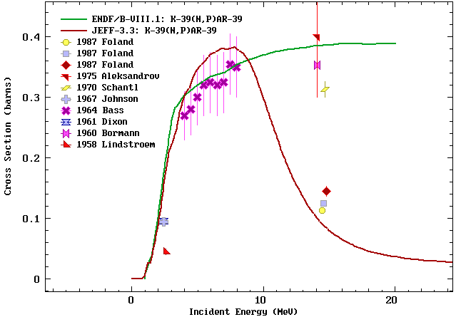
³⁹K (n,p)

Slide 4

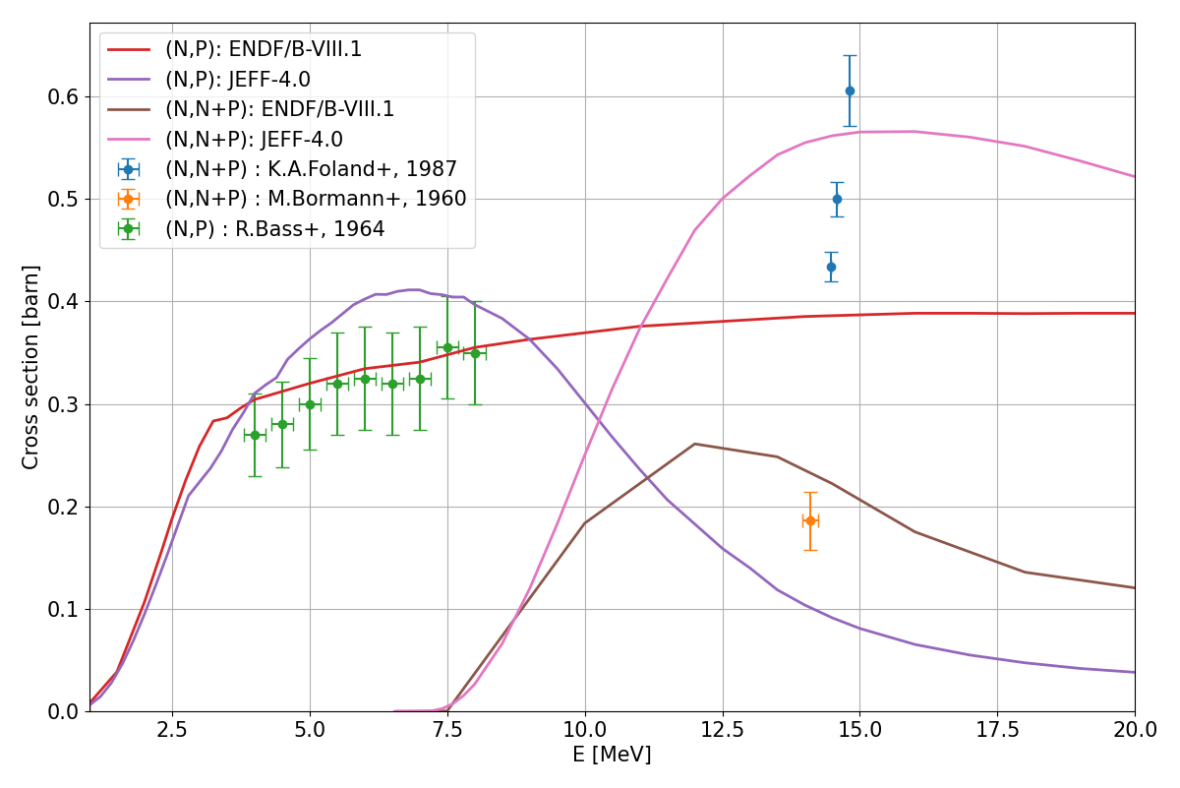
³⁹K (n,p) vs ³⁹K (n,np)

Slide 5

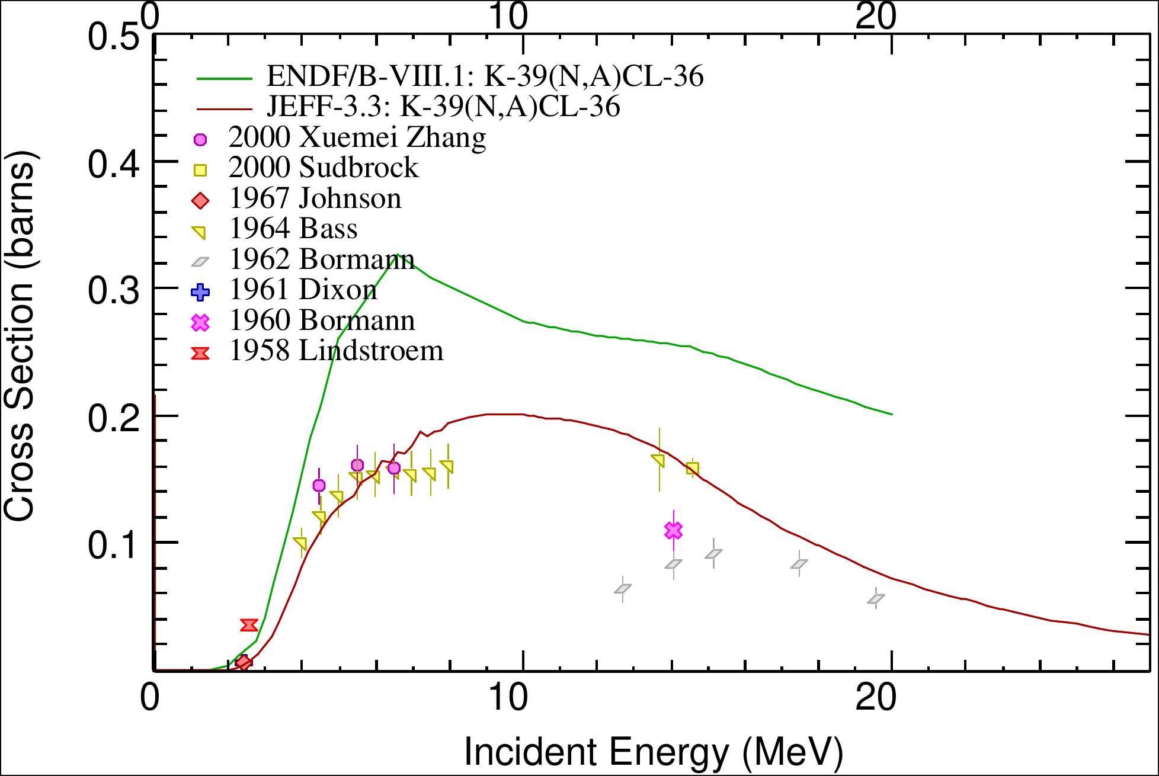
³⁹K (n,α)

Slide 6
Aim
³⁹K(n,p) reaction cross section measurement for 5-15 MeV neutron energies
potentially also ³⁹K(n,α)
potentially also ³⁹K(n,np) and up to 20 MeV
potentially also angular distribution
Preparation plan
construct setup prioritizing efficiency and particle differentiation
prepare the target for the experiment
conduct a test experiment

Slide 7
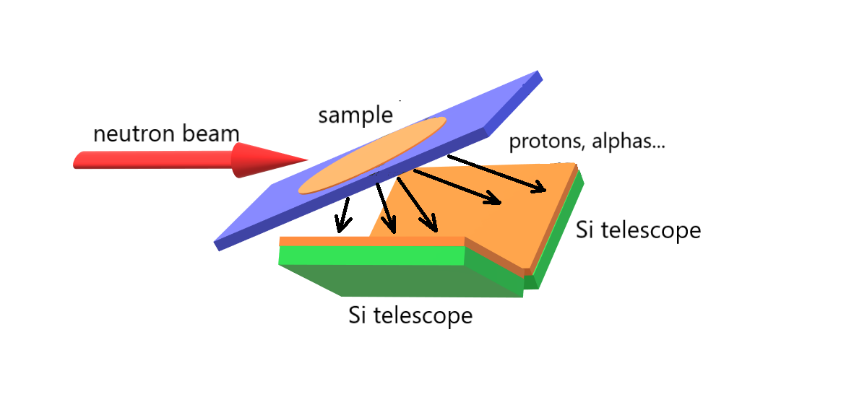
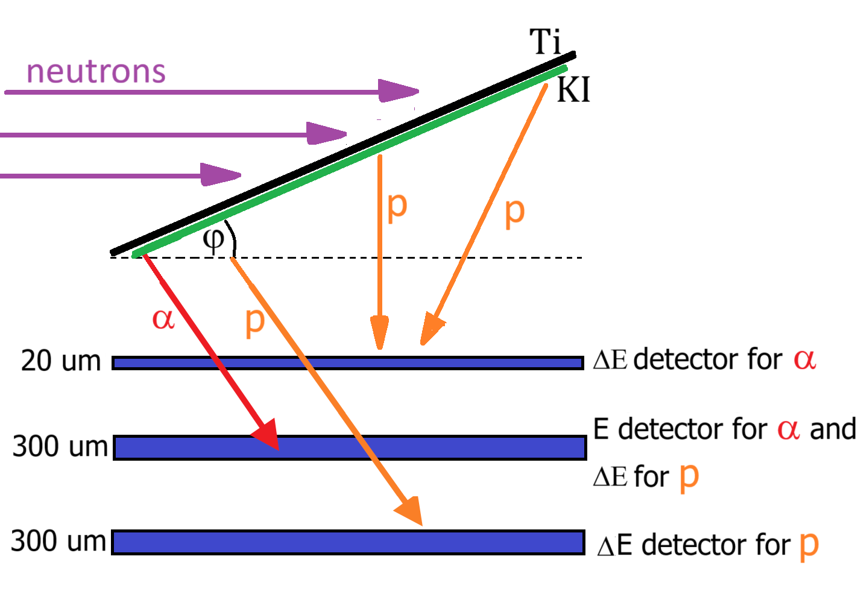
V setup
Pros:
Higher geometrical efficiency
Geometric efficiency:
7.5-10%
“Normal” setup
Pros:
Better particle differentiation
Geometric efficiency:
5.5-7%
Notes:
powiedzieć że pierwszy układ odrzucamy

Slide 8
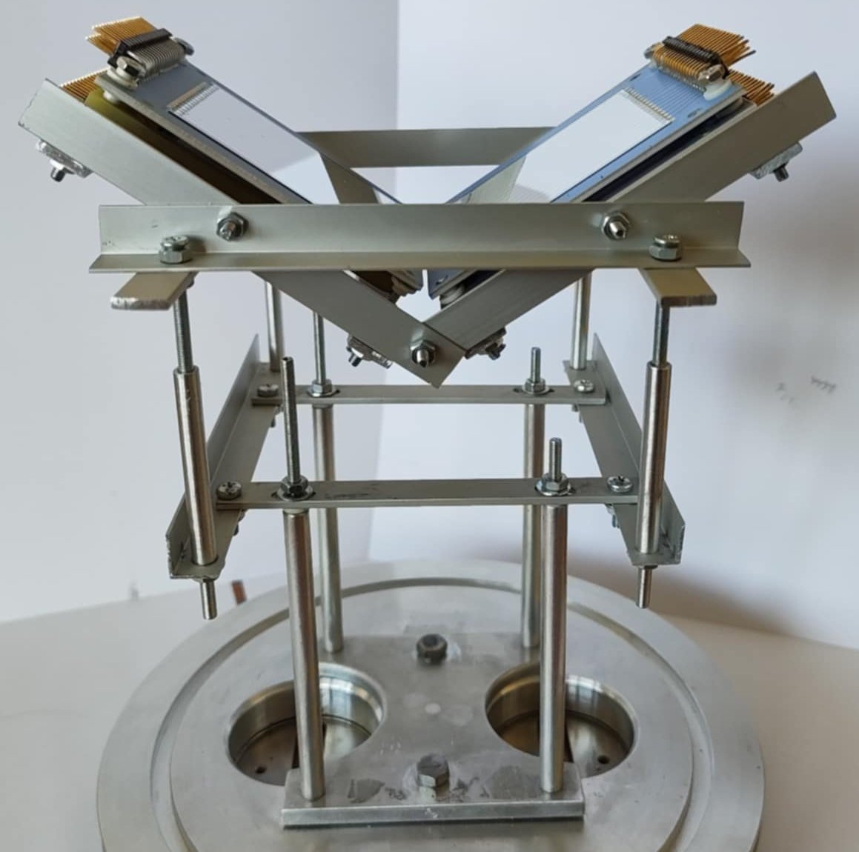
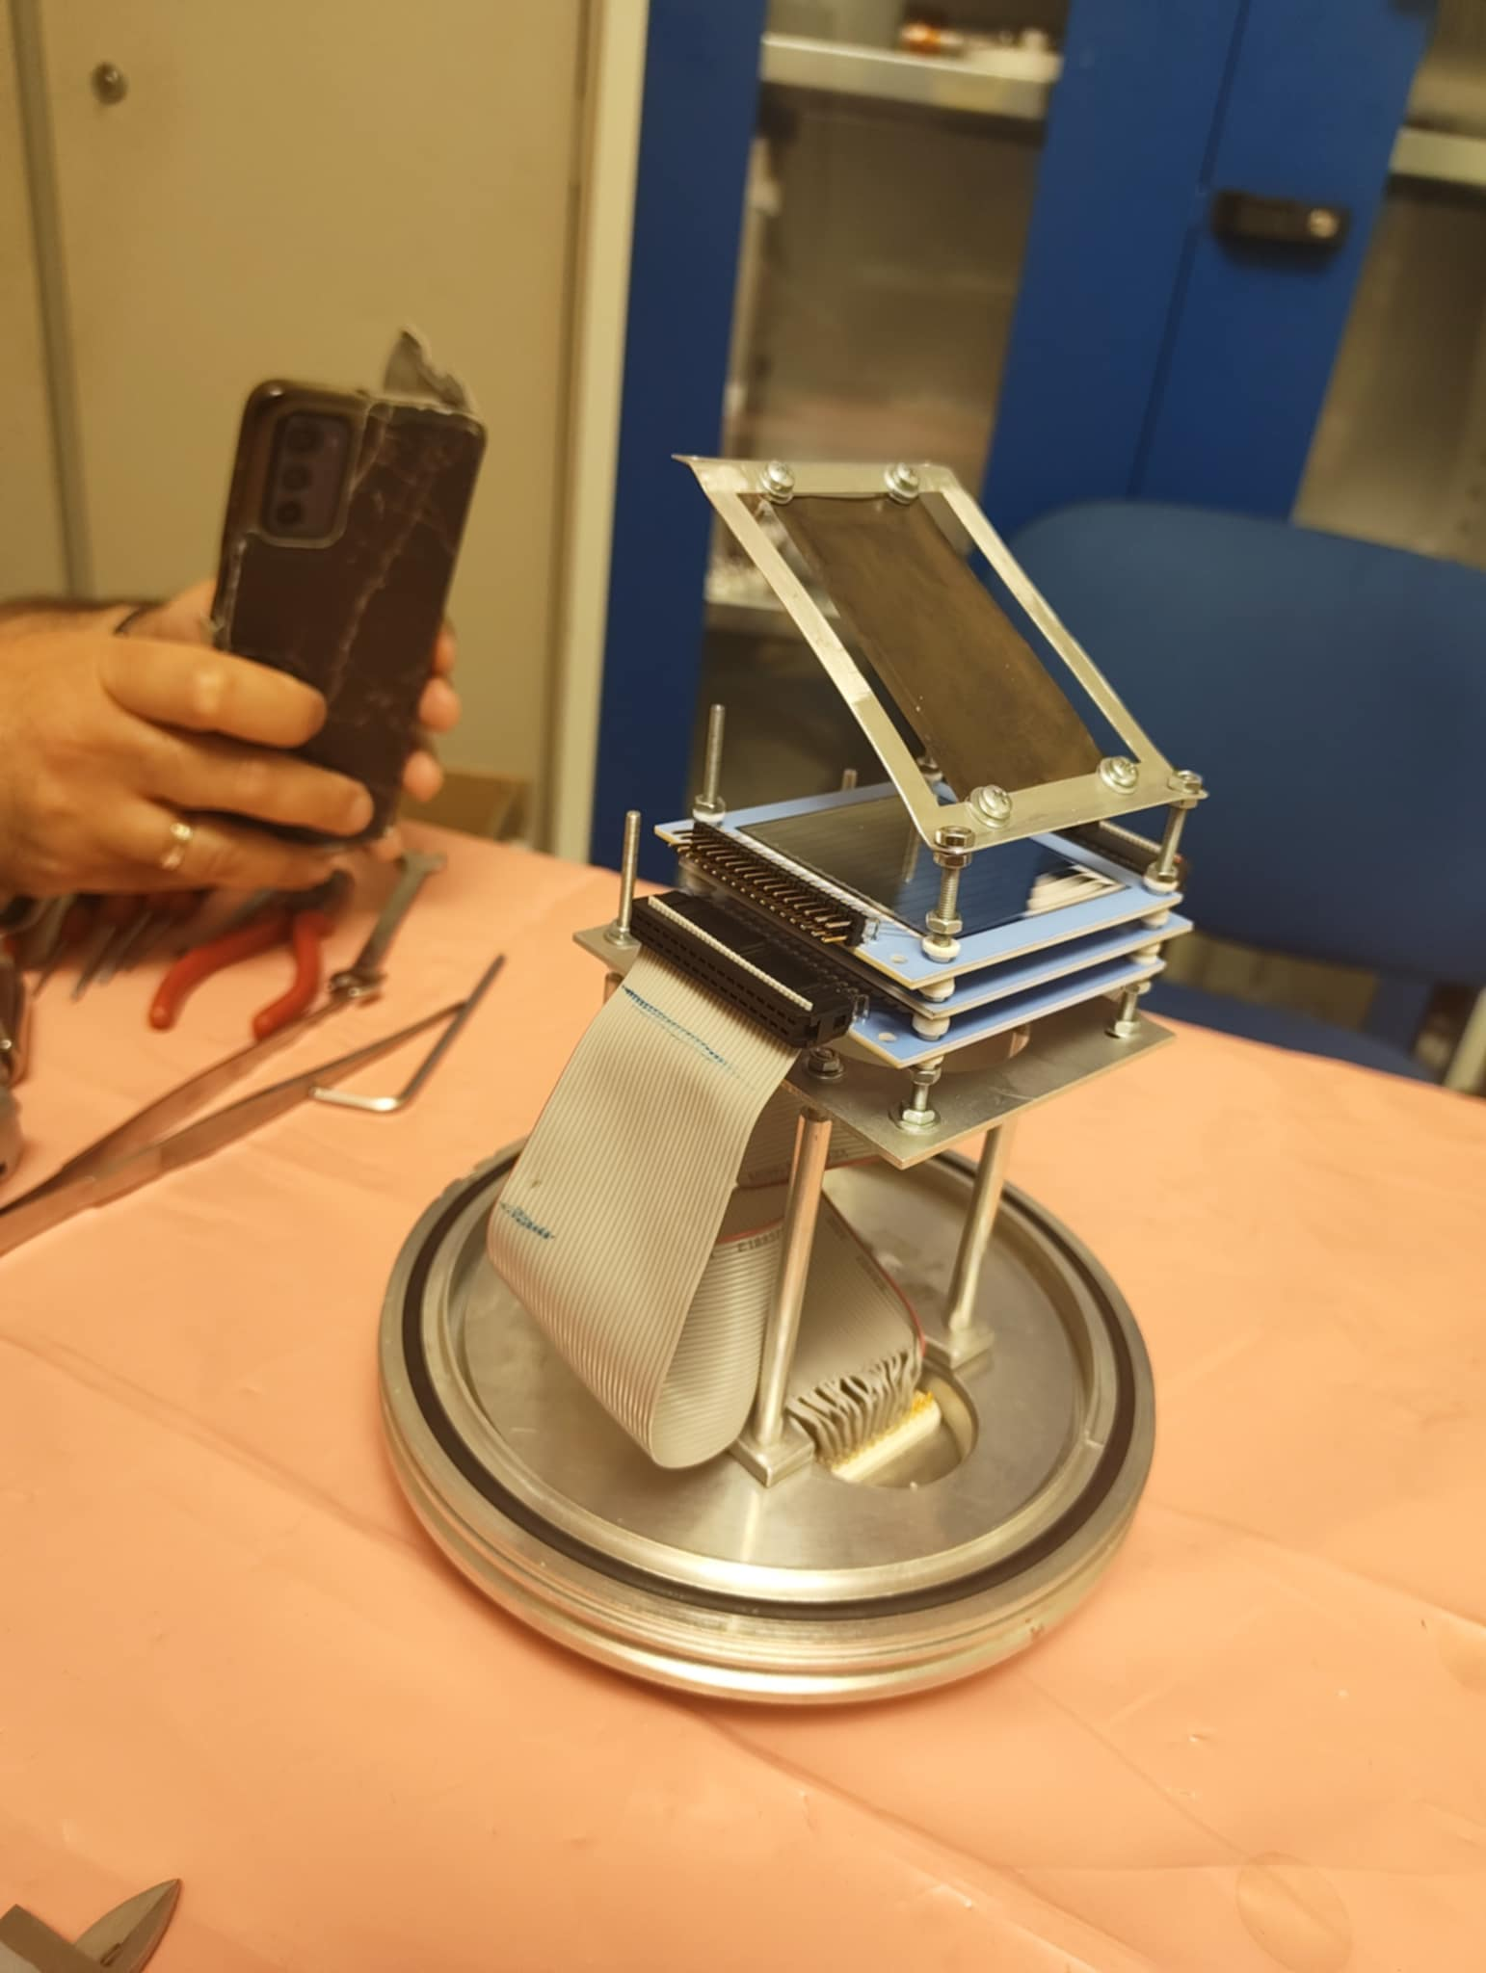

Slide 9



1
2
3

Slide 10
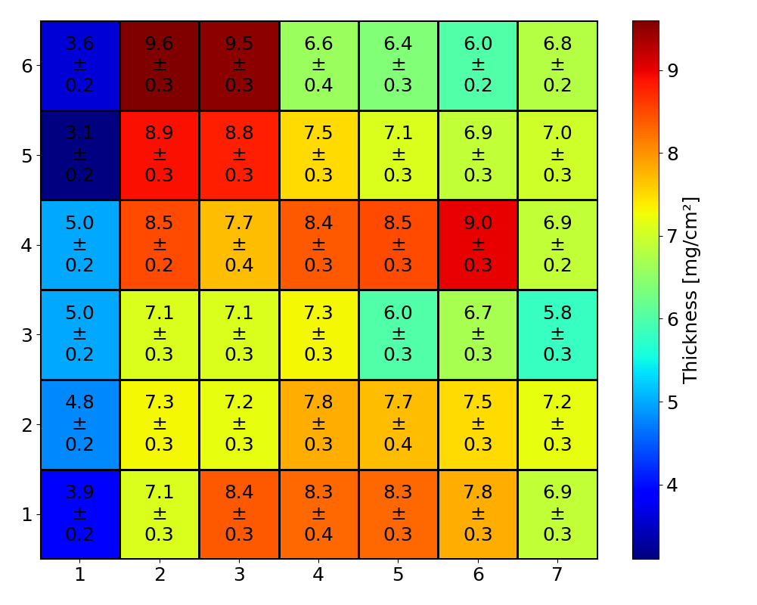
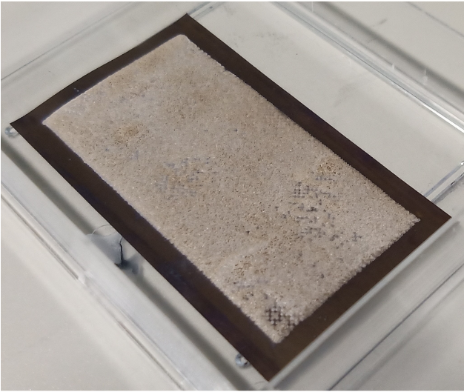
KI: (7.1 ± 0.3) mg/cm²
3x6 cm²
Ti: 22 μm
4x7 cm²
Johannes Gutenberg University Mainz, Germany

Slide 11
Test goals
Check if Ti backing is not giving too high noise
Determine which one of 2 setups to use
Check if we can use 1500 µm detector in this experiment
Calculate the beam requirements for the experiment
Notes:
opisać czemu każdy cel tu jest (1500 podkreślić o gamma flashu)

Slide 12
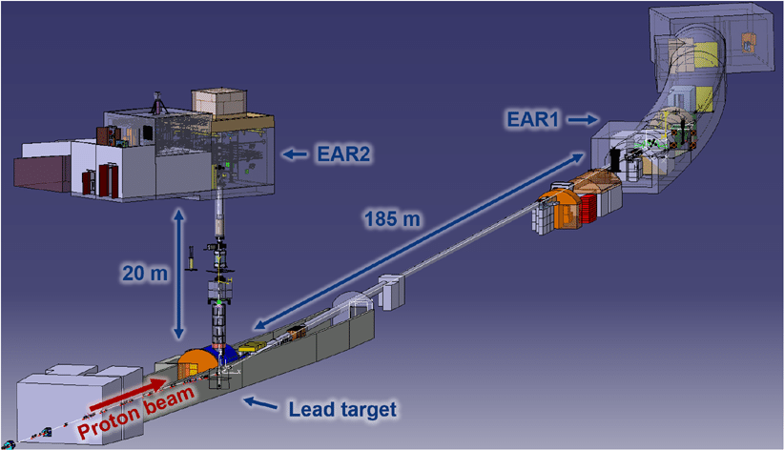
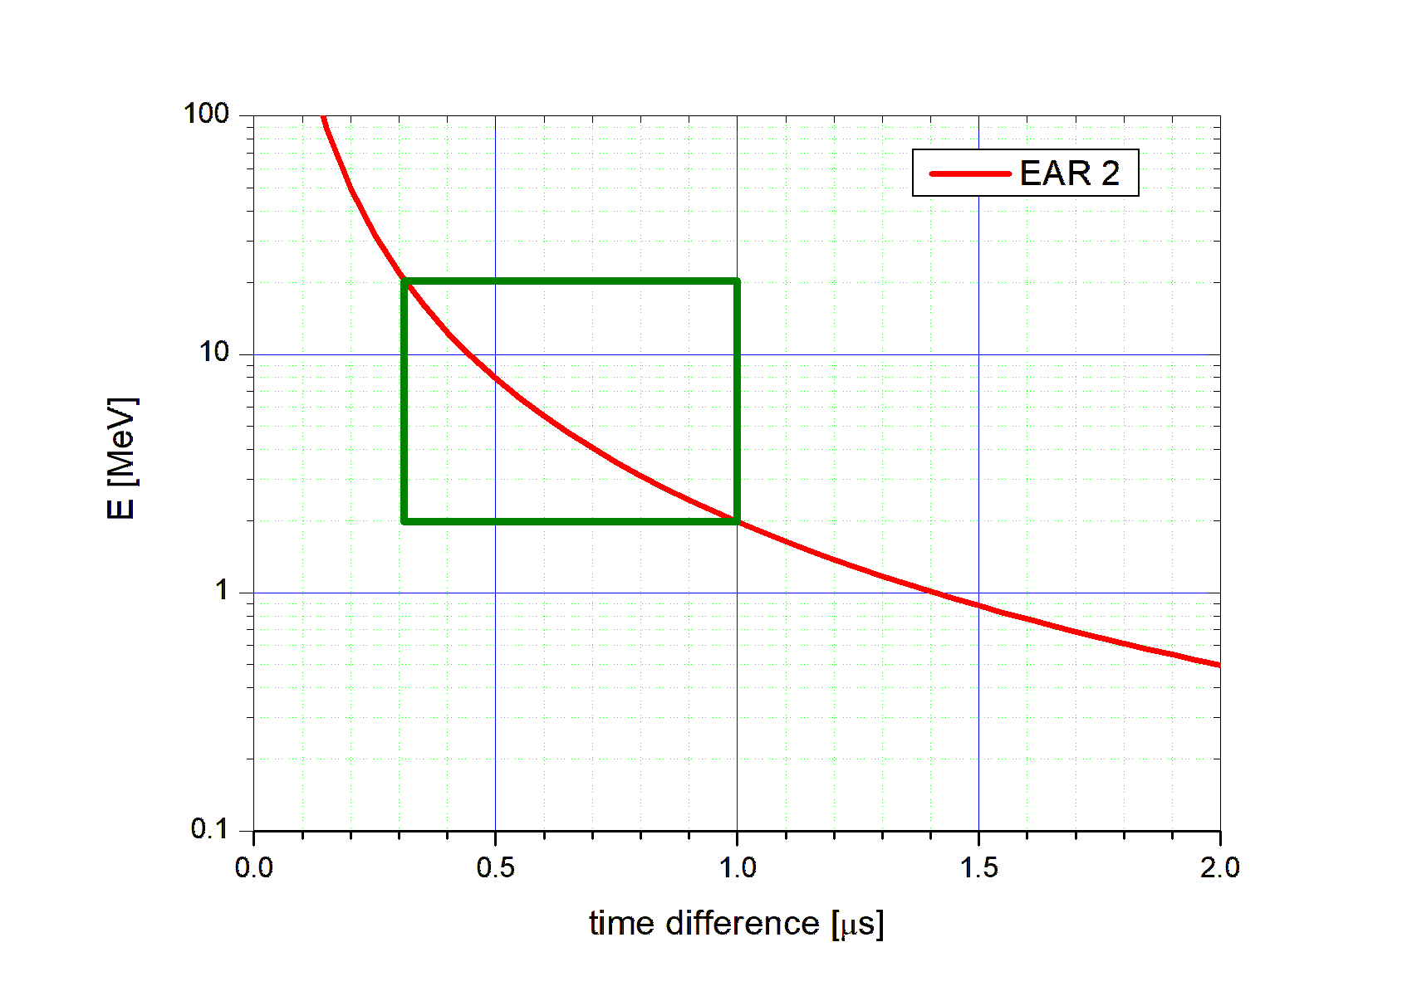
Proton Energy 20 GeV
R.M.S. 7 ns
Protons per pulse 8.5 · 10¹²

Slide 13
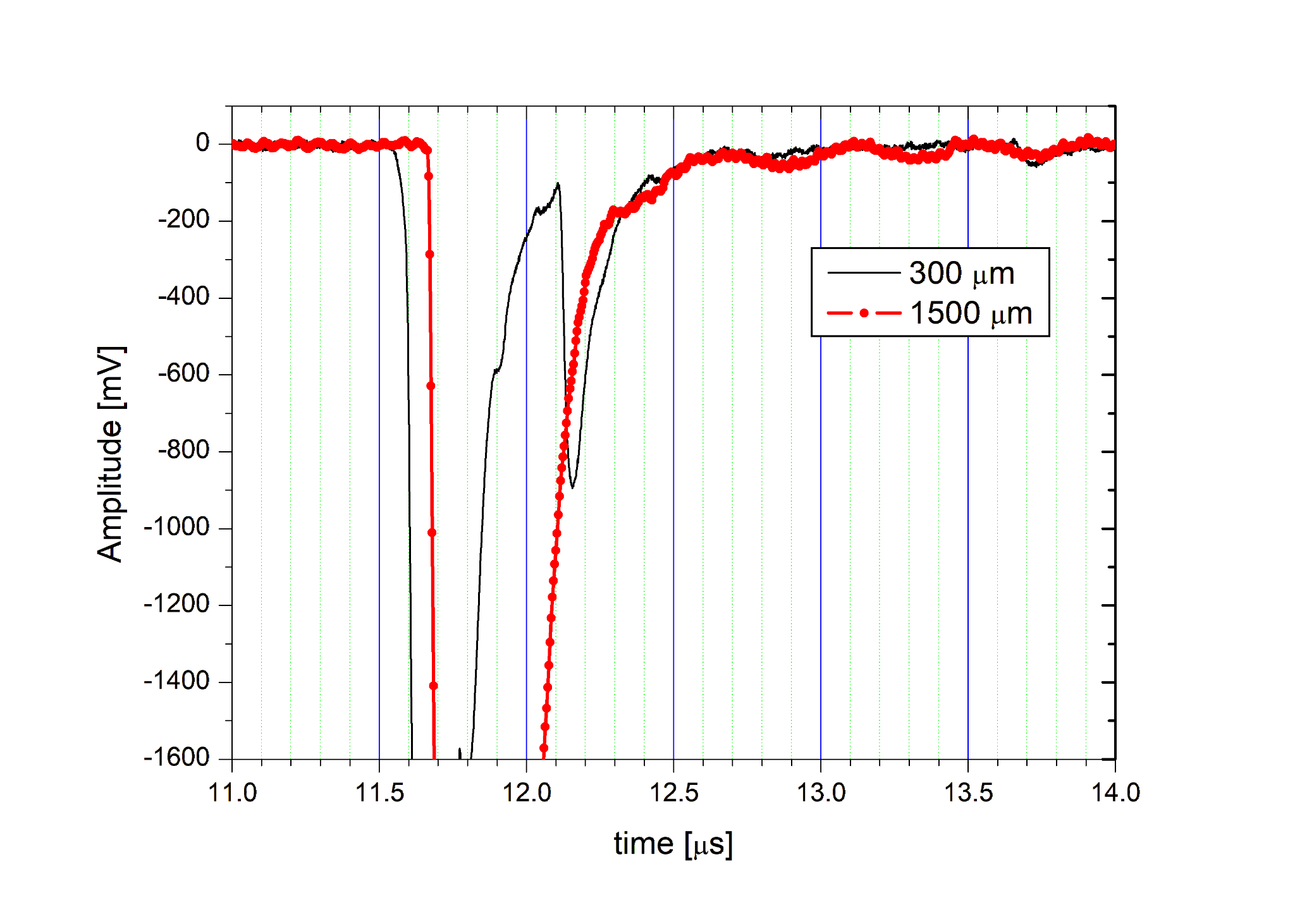

Slide 14
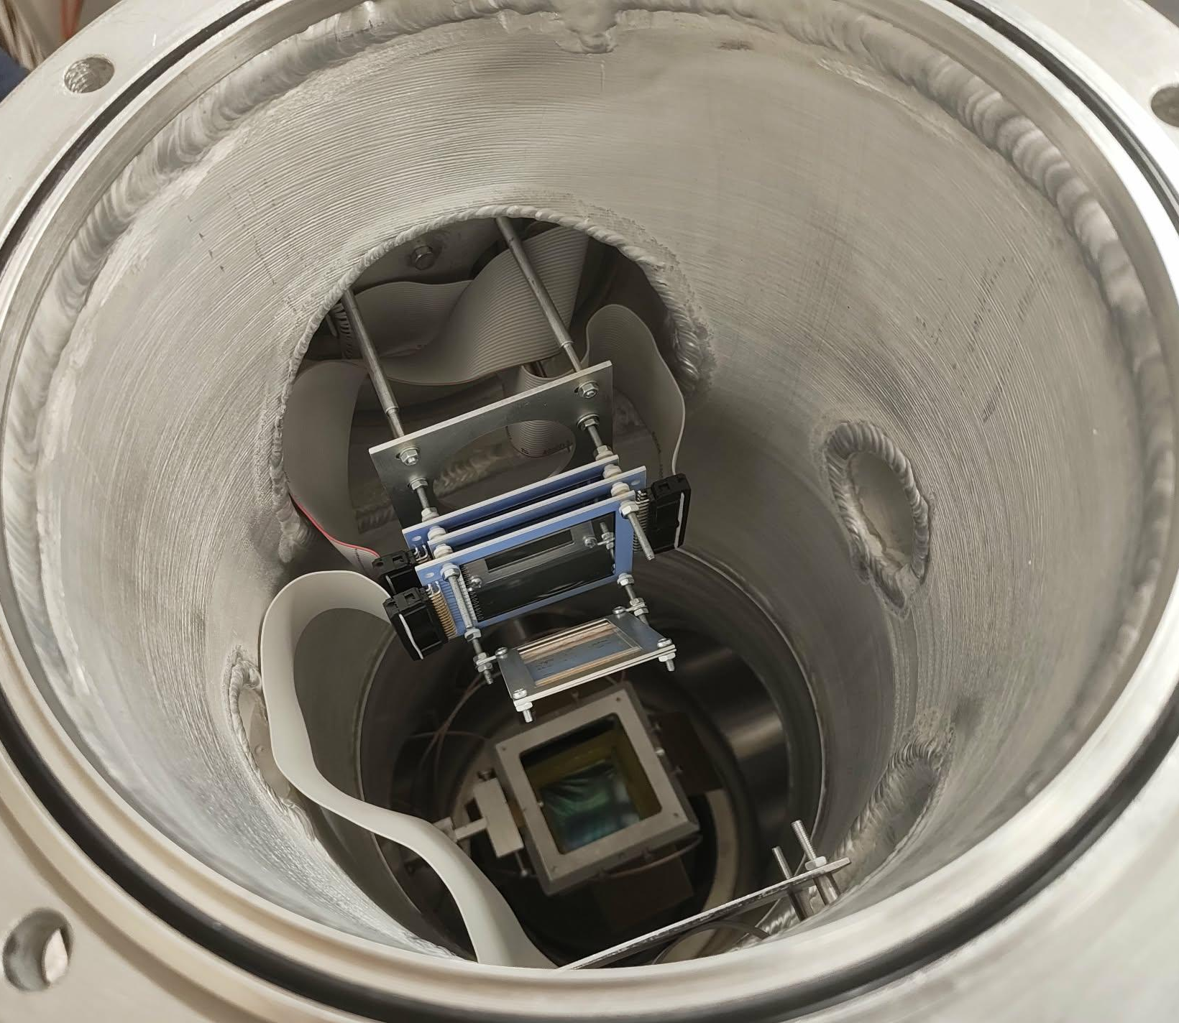
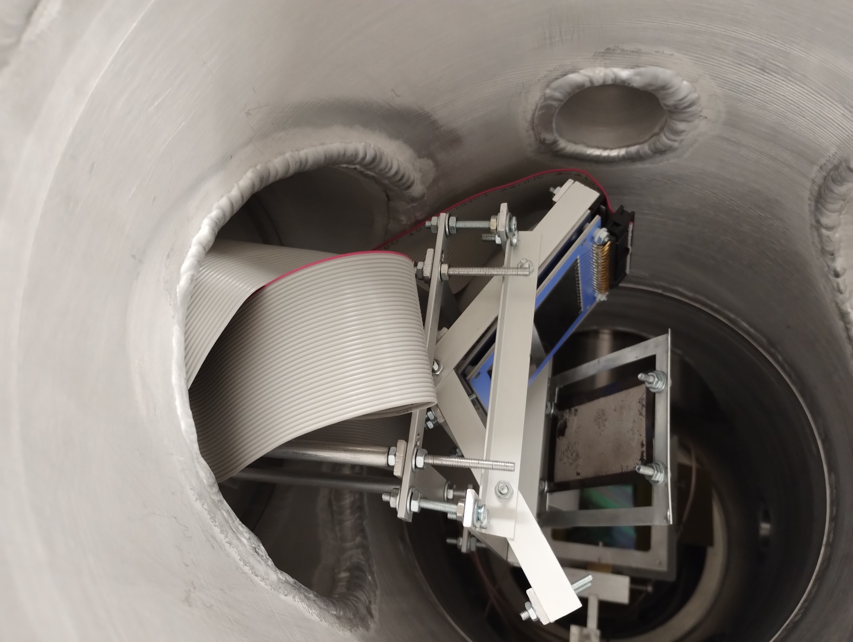
⁶Li + ¹n -> ⁴He + ³H

Slide 15
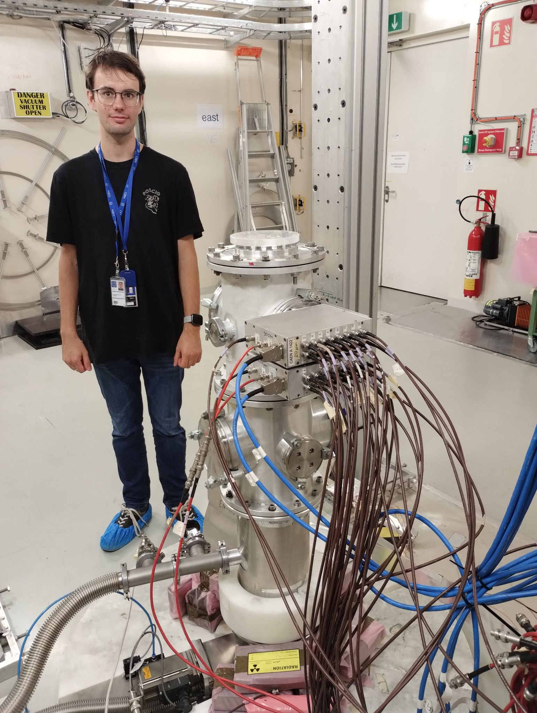
1st - 9th july 2025
measurement | protons
V-setup | 3.8 · 10¹⁷
N-setup | 4.5 · 10¹⁷
Ti backing | 2.5 · 10¹⁷
sum | 1.1 · 10¹⁸

Slide 16
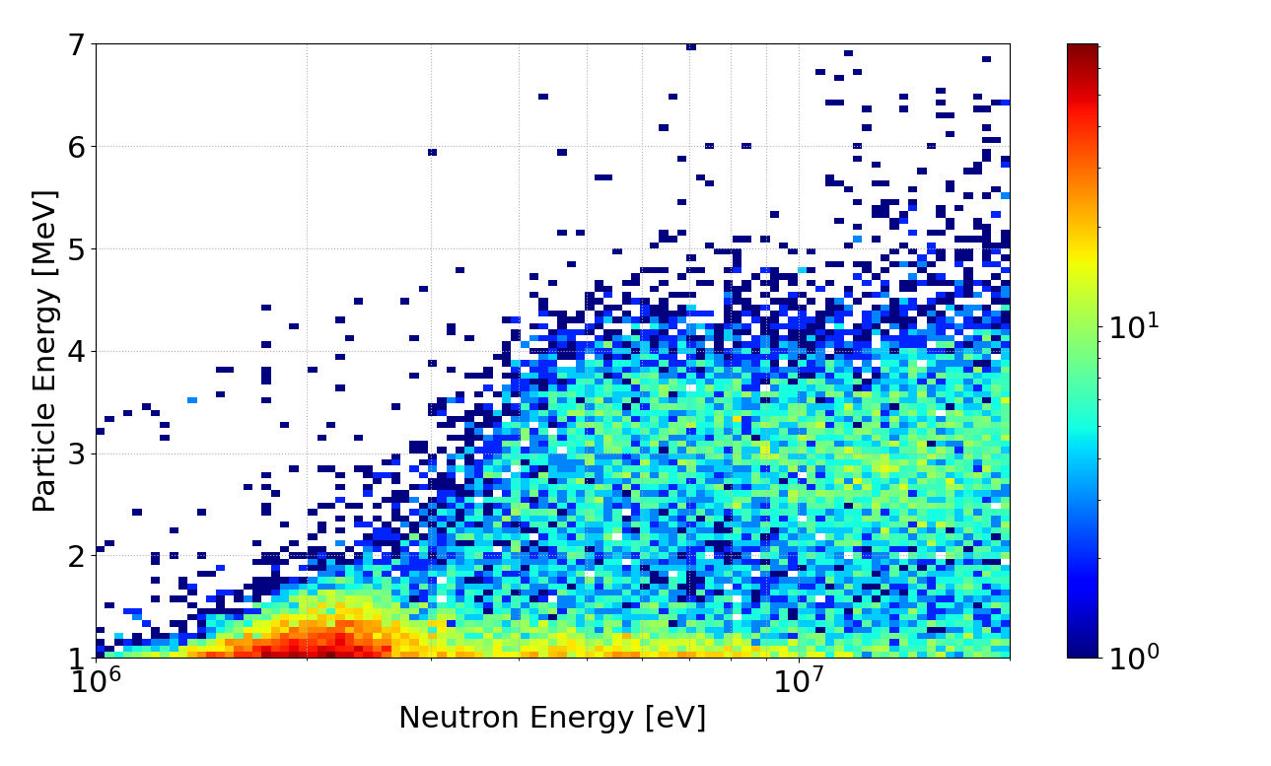
20 µm detector

Slide 17
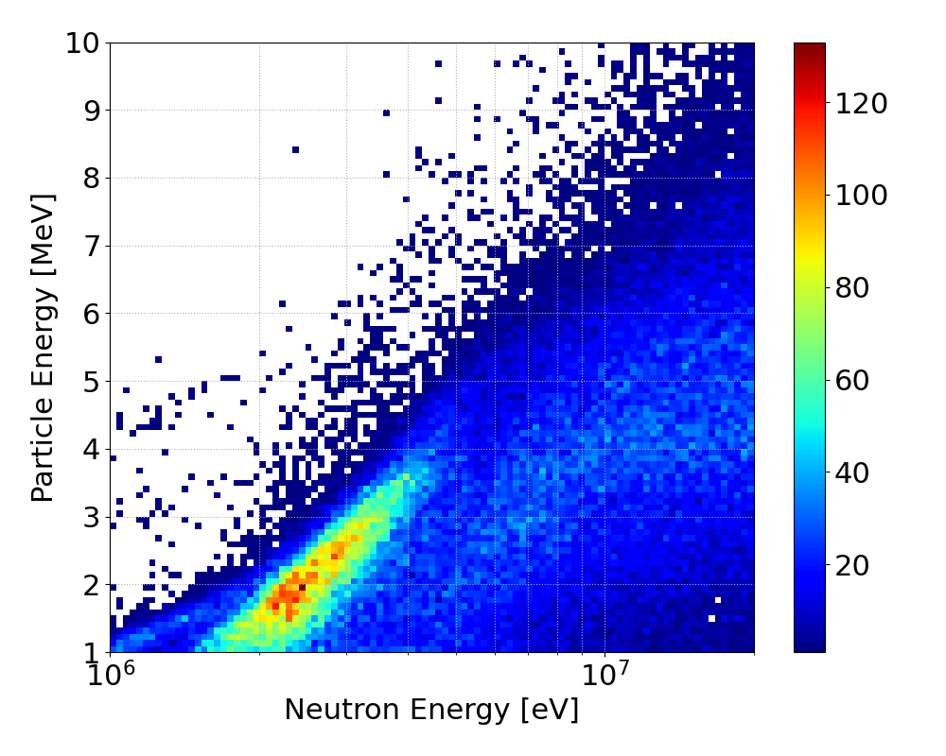
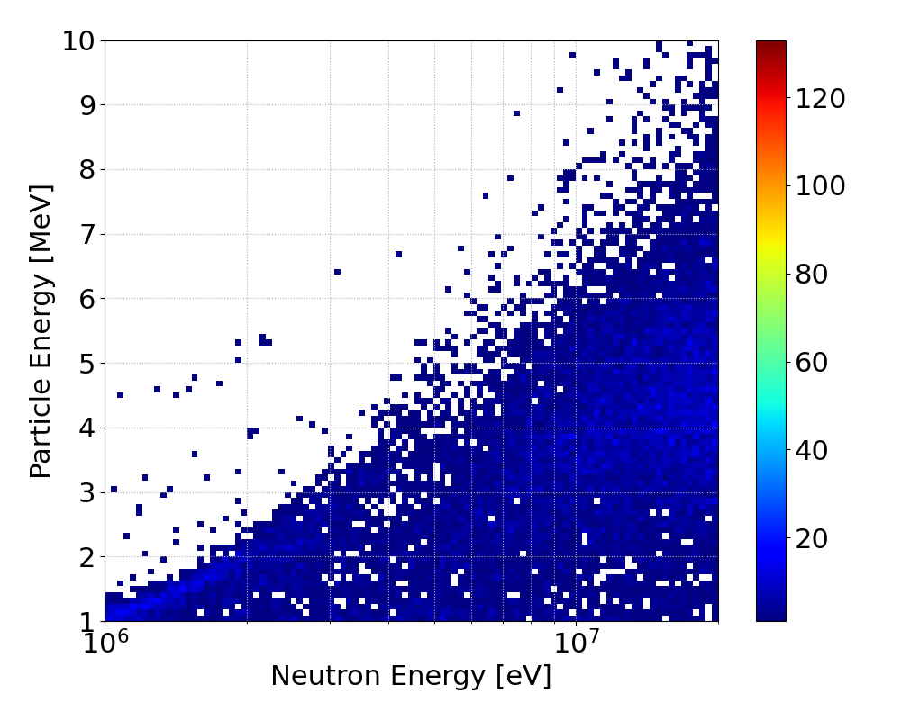
The first 300 µm detector
KI+Ti
Ti

Slide 18
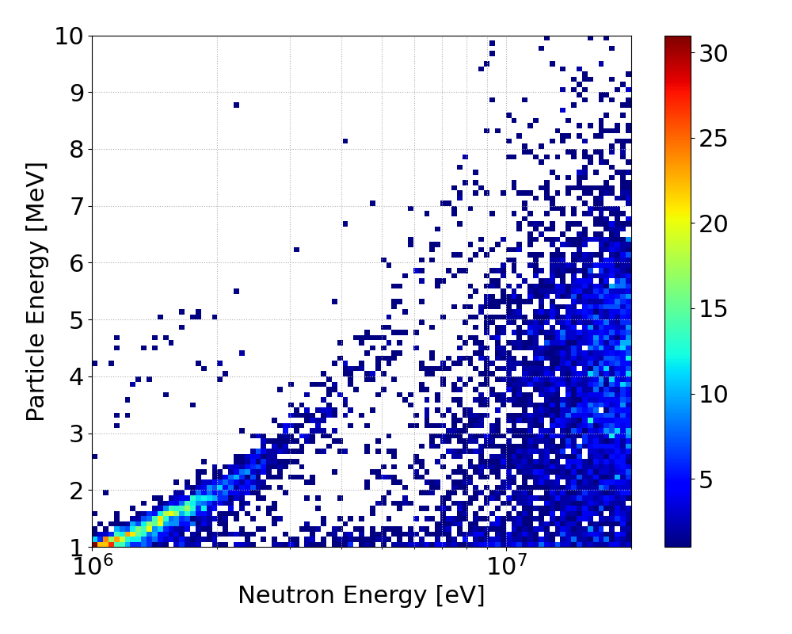
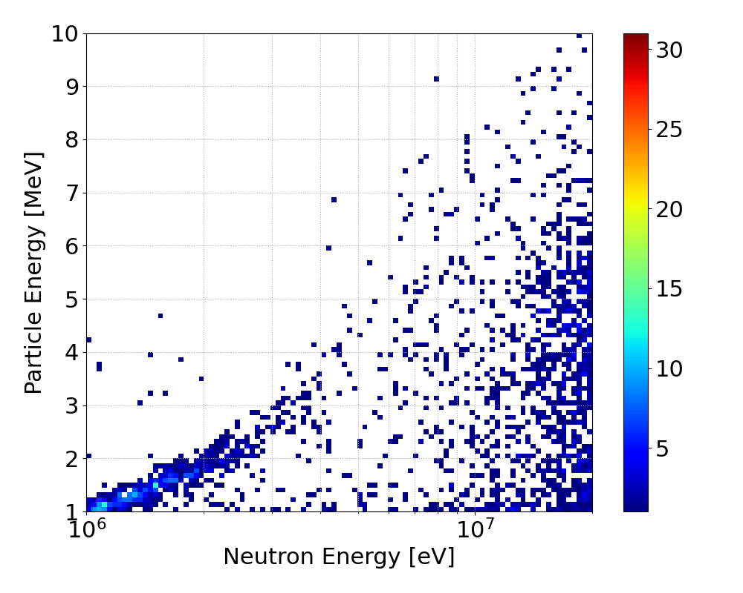
The 2nd 300 µm detector
KI+Ti
Ti
7 MeV

Slide 19
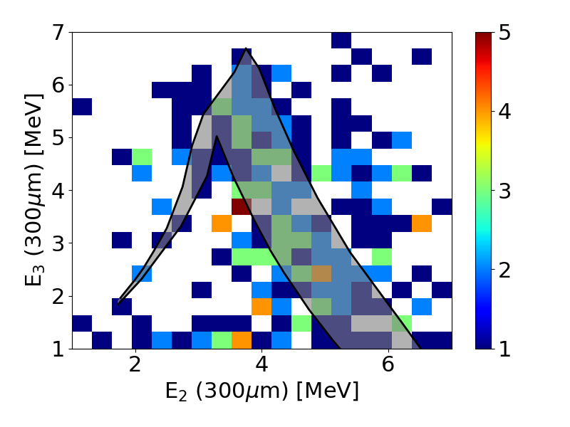
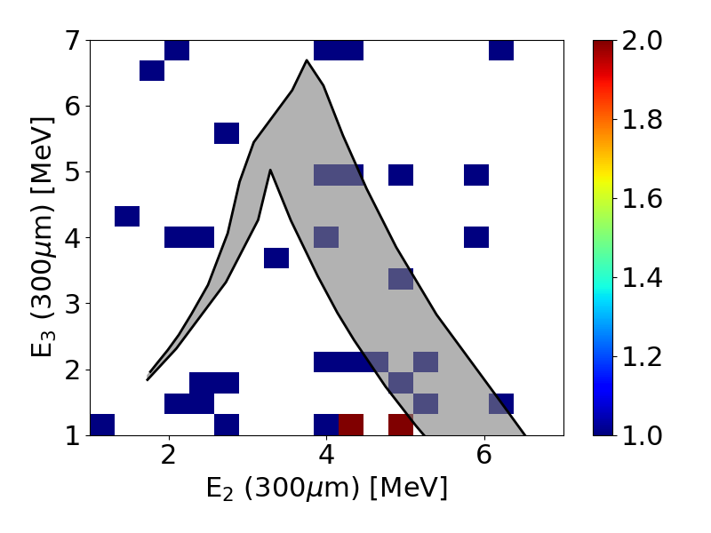
Proton coincidence
For neutron energies 5-15 MeV
KI+Ti
Ti
Notes:
pamiętać żeby powiedzieć że jest to najbardziej strict przypadek

Slide 20
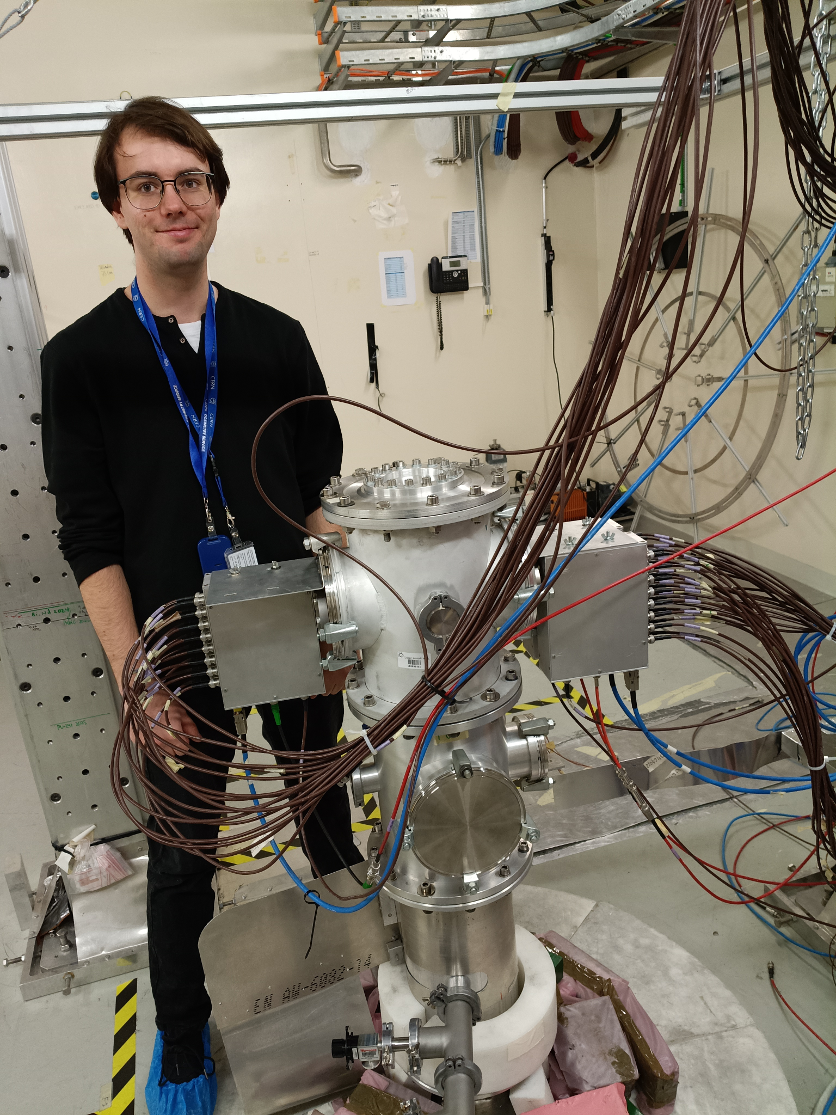
10th march - 5th may 2026
measurement | protons
Li | 0.25 · 10¹⁸
KI | 5 · 10¹⁸
Ti | 2.5 · 10¹⁸
sum | 7.75 · 10¹⁸

Slide 21
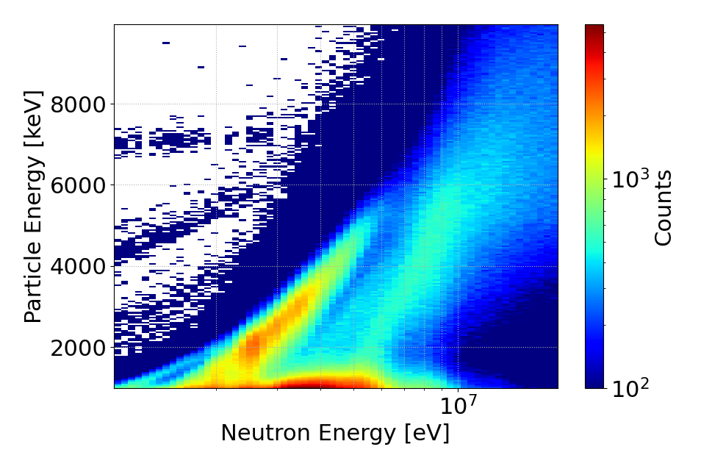
First 300 µm detector
VERY preliminary
alphas
4 MeV
protons

Slide 22
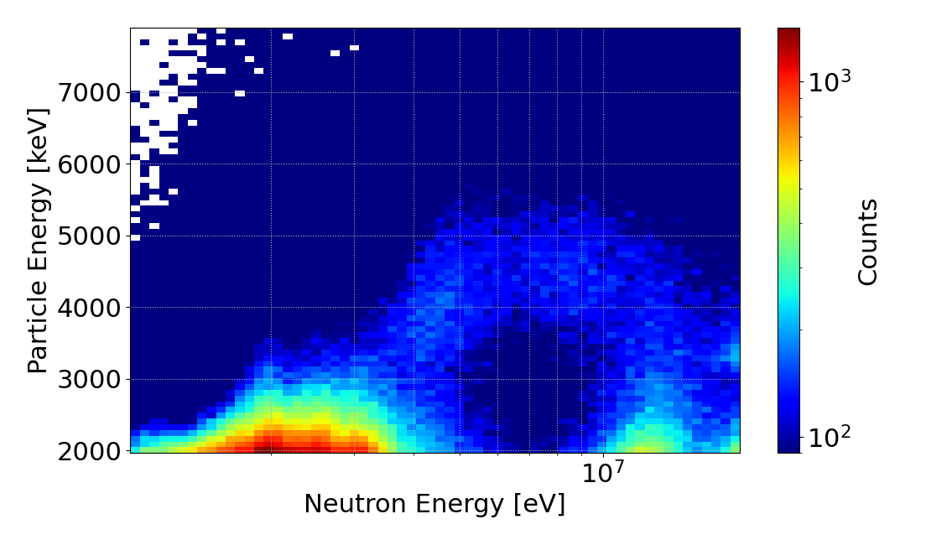
20 µm detector
VERY preliminary
4 MeV
alphas

Slide 23
Conclusions
The experiment was successfully conducted
We selected the “normal” setup due to additional measurement capabilities
1500 µm detector did not meet our neutron energy requirements
The E2-E3 coincidence selection is used for calculating required statistics
Used KI target with Ti backing fulfils requirements of the conducted experiment
The results from the test and the experiment are consistent
This measurement is a part of new EU project – APRENDE (Addressing PRiorities of Evaluated Nuclear Data in Europe), HORIZON-EURATOM-2023

Slide 24
Thank you for your attention

Slide 25
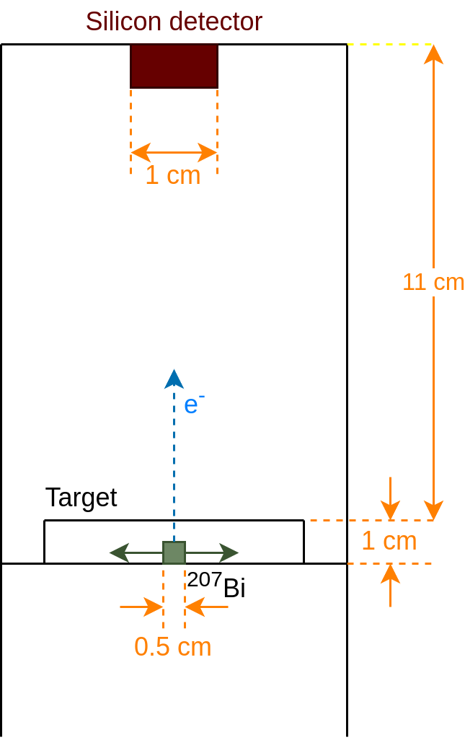
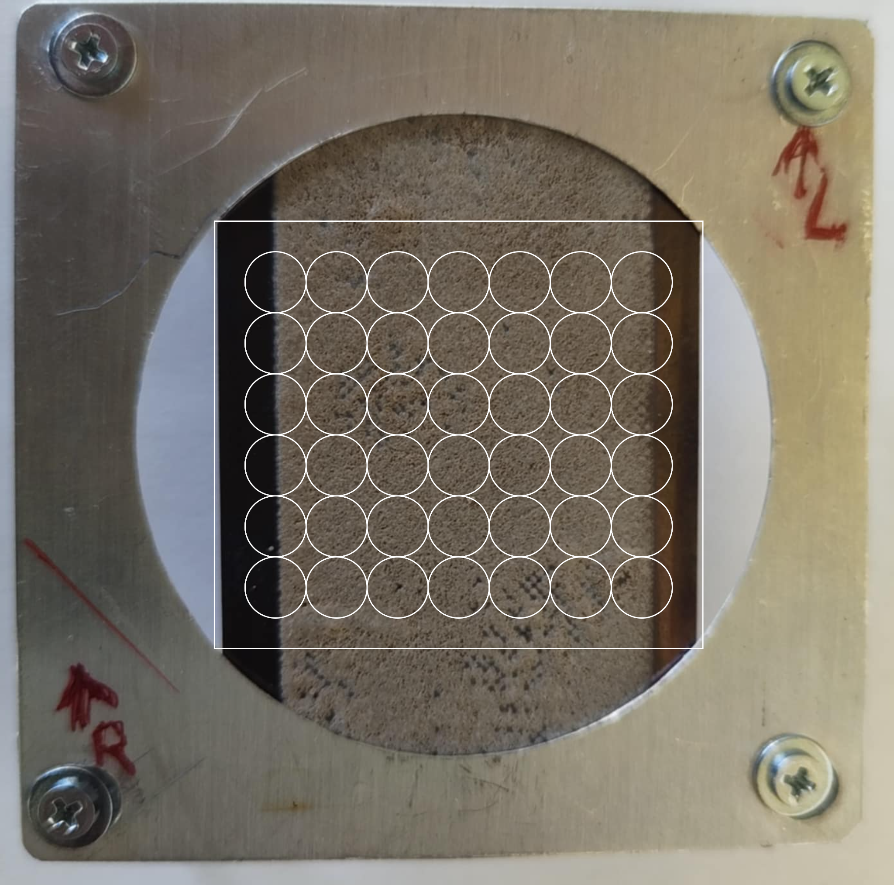

Slide 26
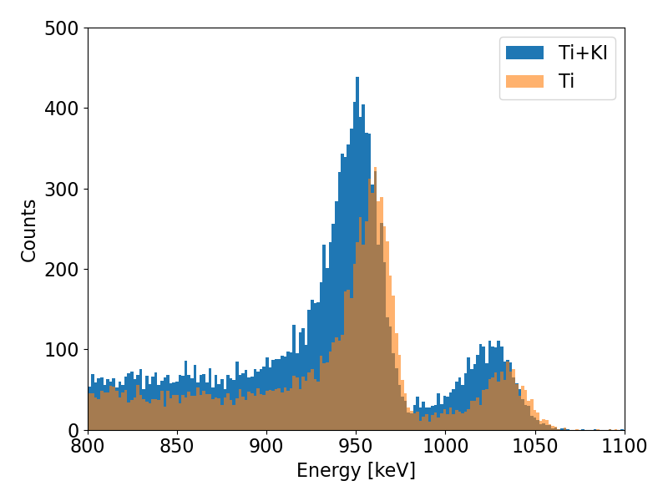

Slide 27
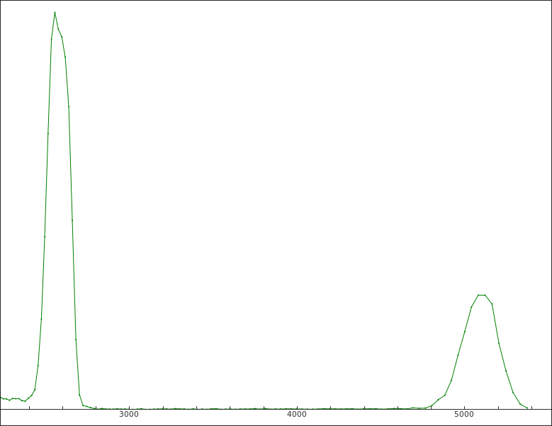
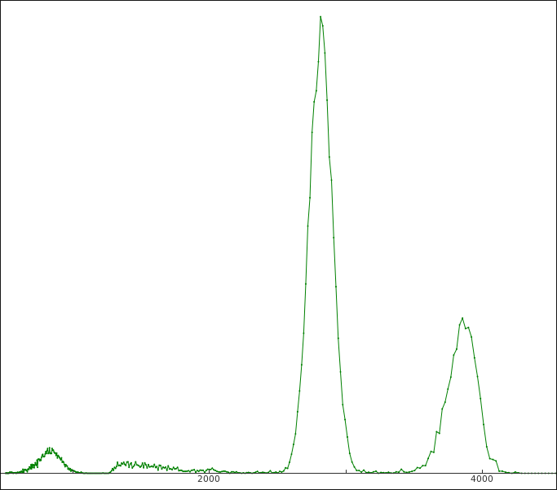
Calibration
⁶Li + ¹n -> ⁴He + ³H
The first 300 µm detector
20 µm detector
pulser
pulser
³H, ~2.7 MeV
³H, ~2 MeV

