Slide 1



From Sudden Approximation to
Dynamical Model:
Emission of Scission Neutrons from ²³⁵U(n_{th},f)
Wonder 2026
Florian Guezet, PhD Student, LP2i, Gradignan, France
Notes:
Hello everybody, I’m … And i am PhD student at LP2i at Gradignan. And today I will present you a side activity that I carry out during my thesis : is about the emission of scission neutron from the thermal neutron induced fission of 235 uranium by different models.
Let’s go to the content of my talk

Slide 2
Content
Motivation
Formalism
Scission neutrons multiplicity
Estimation of prompt neutron evaporation
Mean kinetic energy distribution of scission neutrons
Conclusion and perspectives
Notes:
Firstly, I will give you some elements that motivates this study. Then, I introduce the formalism of the model which will allow me to tell you about my results on … Finally I will present you some conclusions and perspectives of this work
Firstly ... Then I introduce the formalism which allowed me to calculate this different quantities and finally I give you some conclusions and perspectives of this work

Slide 3
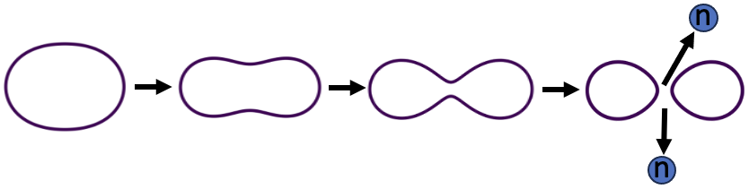
I. Motivation: a bit of history
End 1938: Discovery of fission by O. Hahn & F. Strassman (interpreted Feb. 1939 by L. Meitner & O.R. Frisch)
Feb. 1939: - fission fragments (FF) are radioactive
- observation of delayed emission of neutrons by fragments
(E. McMillan, Phys. Rev., 1939)
(R.B. Roberts, R.C. Meyer, P. Wang, Phys. Rev., 1939)
(L. Szilard, W.H. Zinn, Phys. Rev., 1939)
(H.L. Anderson, E. Fermi, H.B. Hanstein, Phys. Rev., 1939)
(H. von Halban, F. Joliot, L. Kowarski, Nature, 1939)
March - May 1939: evidence of fast n emission (< 10⁻¹⁴ s)
Sept. 1939: Theoretical description of fission based on liquid drop model
N. Bohr and J.A. Wheeler, Phys. Rev., 1939:
- Analogy for fission: “fluid mass of unstable form divides into two smaller masses of greater stability […] tiny droplets are generally formed”
- Delayed n from “high nuclear excitation following $β$-ray emission from fission fragment”
- Emission of prompt n ”arise either from the compound nucleus at the moment of fission or by evaporation from the fragment as a result of excitation imparted to them as they separate”
Liquid drop model suggests neutron production during scission $≠$ those emitted from excited fragments
Notes:
Few months after, observation of neutron delayed and fast
And just after, a first theoretical ....

Slide 4
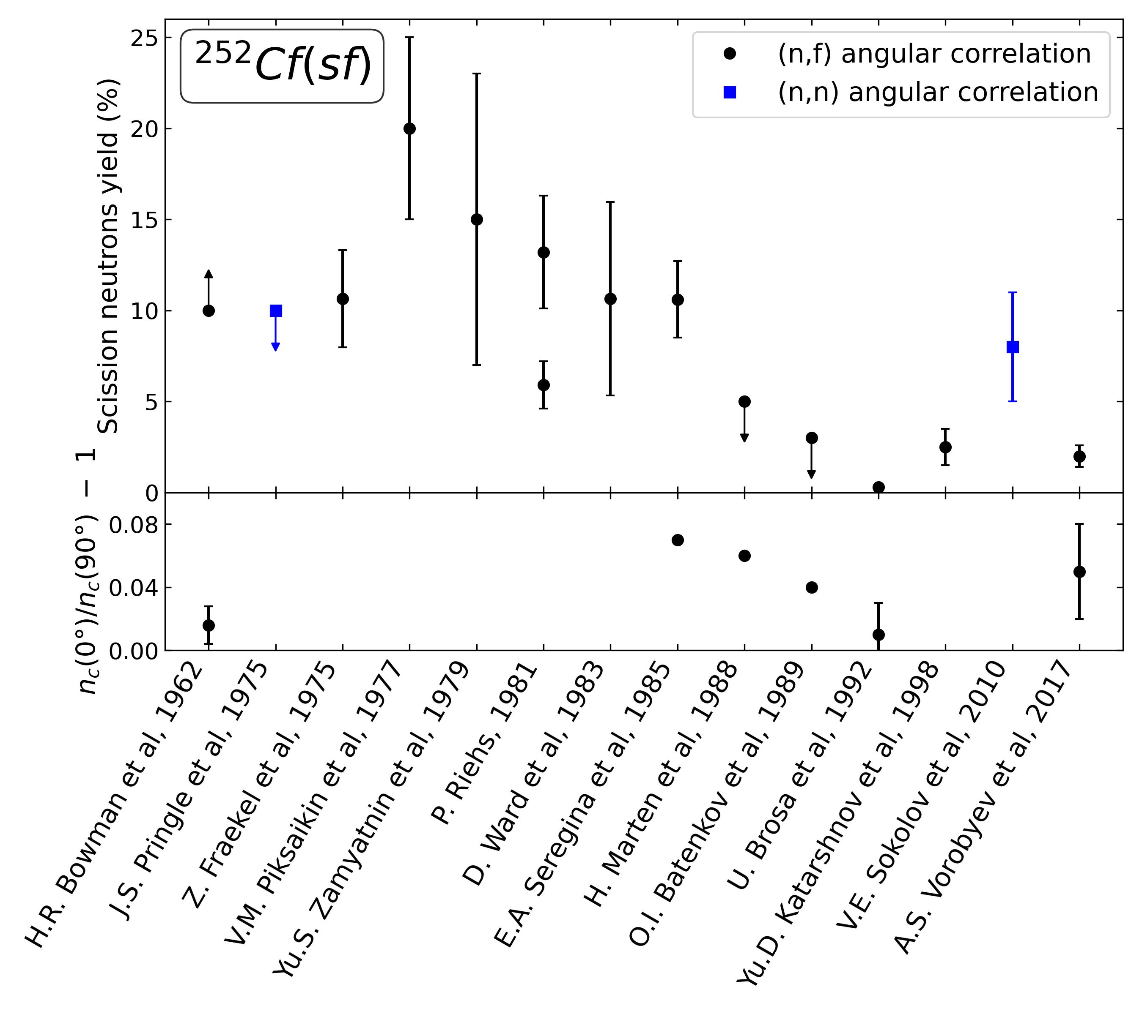
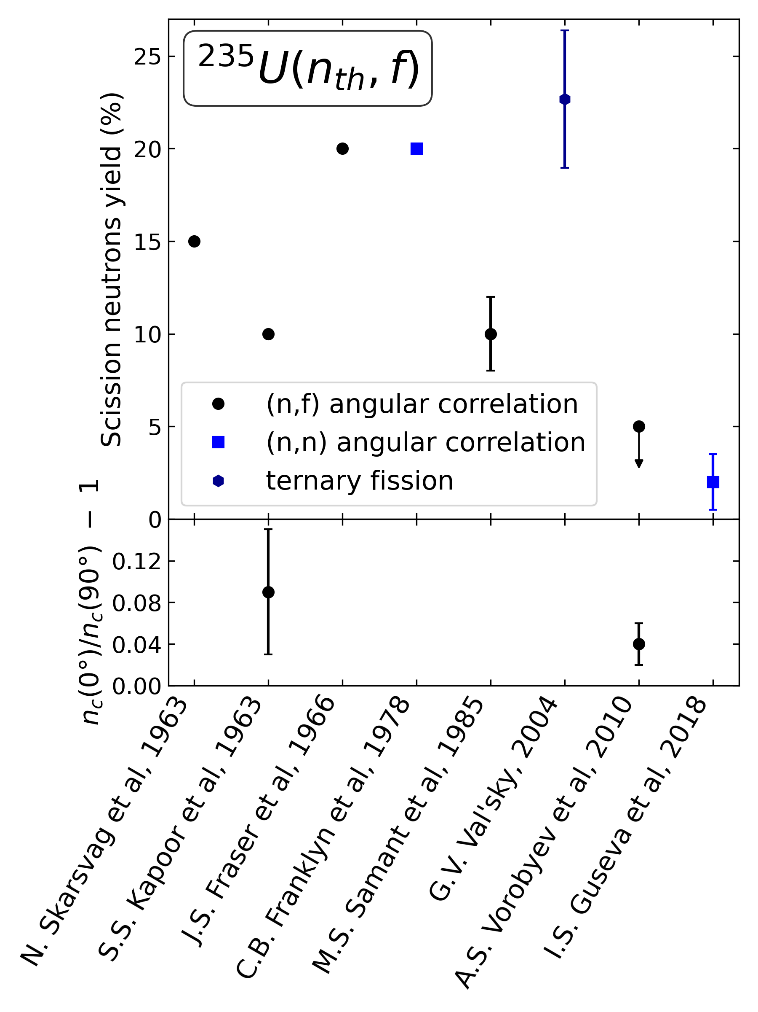
I. Motivation: experimental efforts : summary
1962 : ²⁵²Cf(SF) and 1965 (²³⁵U(n_{th},f) : deviations (10%) from the hypothesis of isotropic neutron emission by accelerated fragments
(H.R. Bowman et al., Phys. Rev., 1962)
(J.C.D. Milton, J.S. Fraser, vol. II, 39-55, IAEA, 1965)
Suggest existence of energetic and isotropic neutron source during scission => Scission Neutrons (SN)
Since 1962: experiments to measure this deviation and estimate the yield of Scission Neutrons
Disparate values because yield of SN depends to the parameters used for model calculation
Part of scission neutrons should be small
Adapted from : A. S. Vorobyev, O.A. Shcherbakov, Exp. Investigation of Properties of Scission Neutrons In Thermal-Neutron Induced Fission of ²³³U and ²³⁵U, INDC, IAEA, 2020
Notes:
1st hint of the existence of SN in ….
Here, it's important to note that the part of SN should be small
lower part = anisotropy of angular distribution of PFNs in the center-of-
mass system of fission fragments.

Slide 5
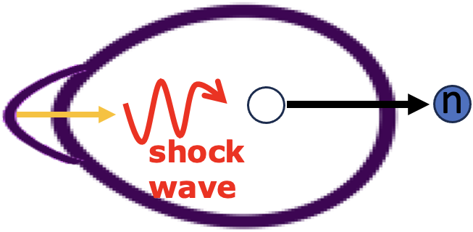
I. Motivation: theory efforts
For 70 years, different approaches for the emission mechanism of scission neutrons:
- Stavinskii: shock wave created by the absorption of the outgrowth of each fragment which can eject nucleons (less than 1 neutron due to damping)
(V.S. Stavinskii, JETP, 1958)
- Fuller: -> diabatic change of nuclear potential during scission: energy transfer to nucleons and SN emission
-> imagine rises of an inverse square well “volcano” in initial square well that splits it in two wells (FF)
(R.W. Fuller, Phys. Rev., 1962)
- Boneh & Fraenkel: single-part. excitation during transition saddle to scission => probability and number of SN
(Y. Boneh and Z. Fraenkel, Phys. Rev. C, 1974)
- Mädler: moving inner potential increase the energy of a moving nucleon on the fragment by reflection, if his energy is sufficient => “Catapult particles” (Model use by R. Capote, cf previous talk)
(P. Mädler, Z. Phys. A, 1985)
- Abdurrahman et al.: apply TDDFT to the scission process
(I. Abdurrahman et al., Phys. Rev. Lett, 2024)
Each model have its strengths and weaknesses
Global conclusion: both theory and experiment, give hints on existence of SN,
but cannot quantify it
Notes:
Fuller can used his model for the limiting cases : adiabatic limit and sudden rupture of the neck, TDDFT demands many computer ressources => Impractical to carry out detailed study
One approach it seen in the previous talk
And a global conclusion of this historical review is that both ....

Slide 6
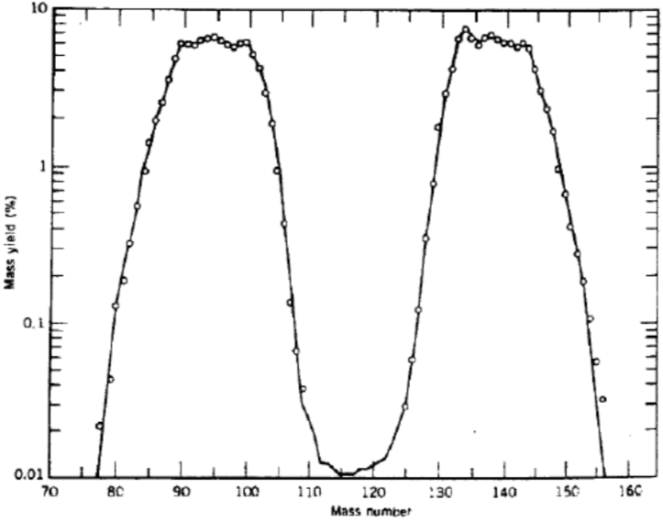




II. The used approach formalism: general aspects
Applied microscopic model SN emission (N. Carjan & collaborators) to the most probable mass division ²³⁵U(n_{th},f)
$${}_{ }^{96}X$$
$${}_{ }^{140}Y$$
Transition between 2 steps: just-before and immediately-after scission
Ref : K. S. Krane, D. Halliday, Introductory Nuclear Physics, vol. 465, Wiley New-York, 1988
Coupling strength between neutron degrees of freedom and rapidly changing nuclear potential depends on ∆T
(Scission time ∆T increases => Coupling less diabatic)
∆T = 0 for Sudden Approximation (limiting case)
(N. Carjan, P. Talou, O. Serot, NPA, 792, 102–121, 2007)
Time evolution between shapes
∆T $≠$ 0 for Dynamical process (realistic case)
(M. Rizea, N. Carjan, NPA, 909, 50–68, 2013)
This work: different scission times are considered : ∆T = 0, 1 or 2.10⁻²² s
Notes:
To the most probable mass split of the fission of Uranium. (pas besoin de dire la réaction)
...
So, contrary to the previous talk, my scission neutrons are emitted during the scission process, not after

Slide 7
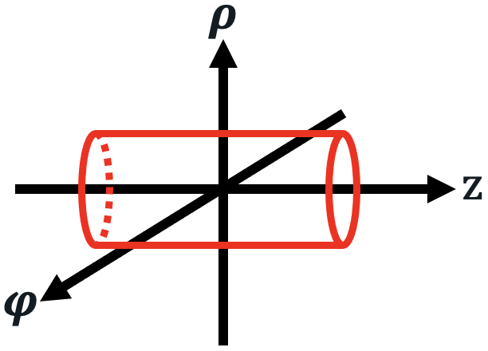
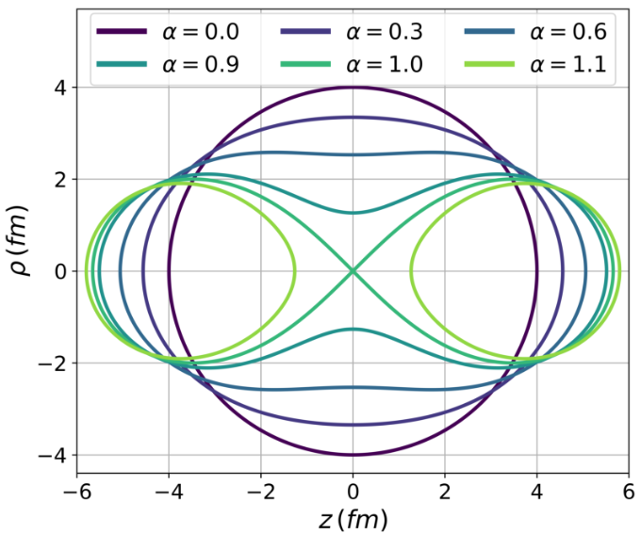
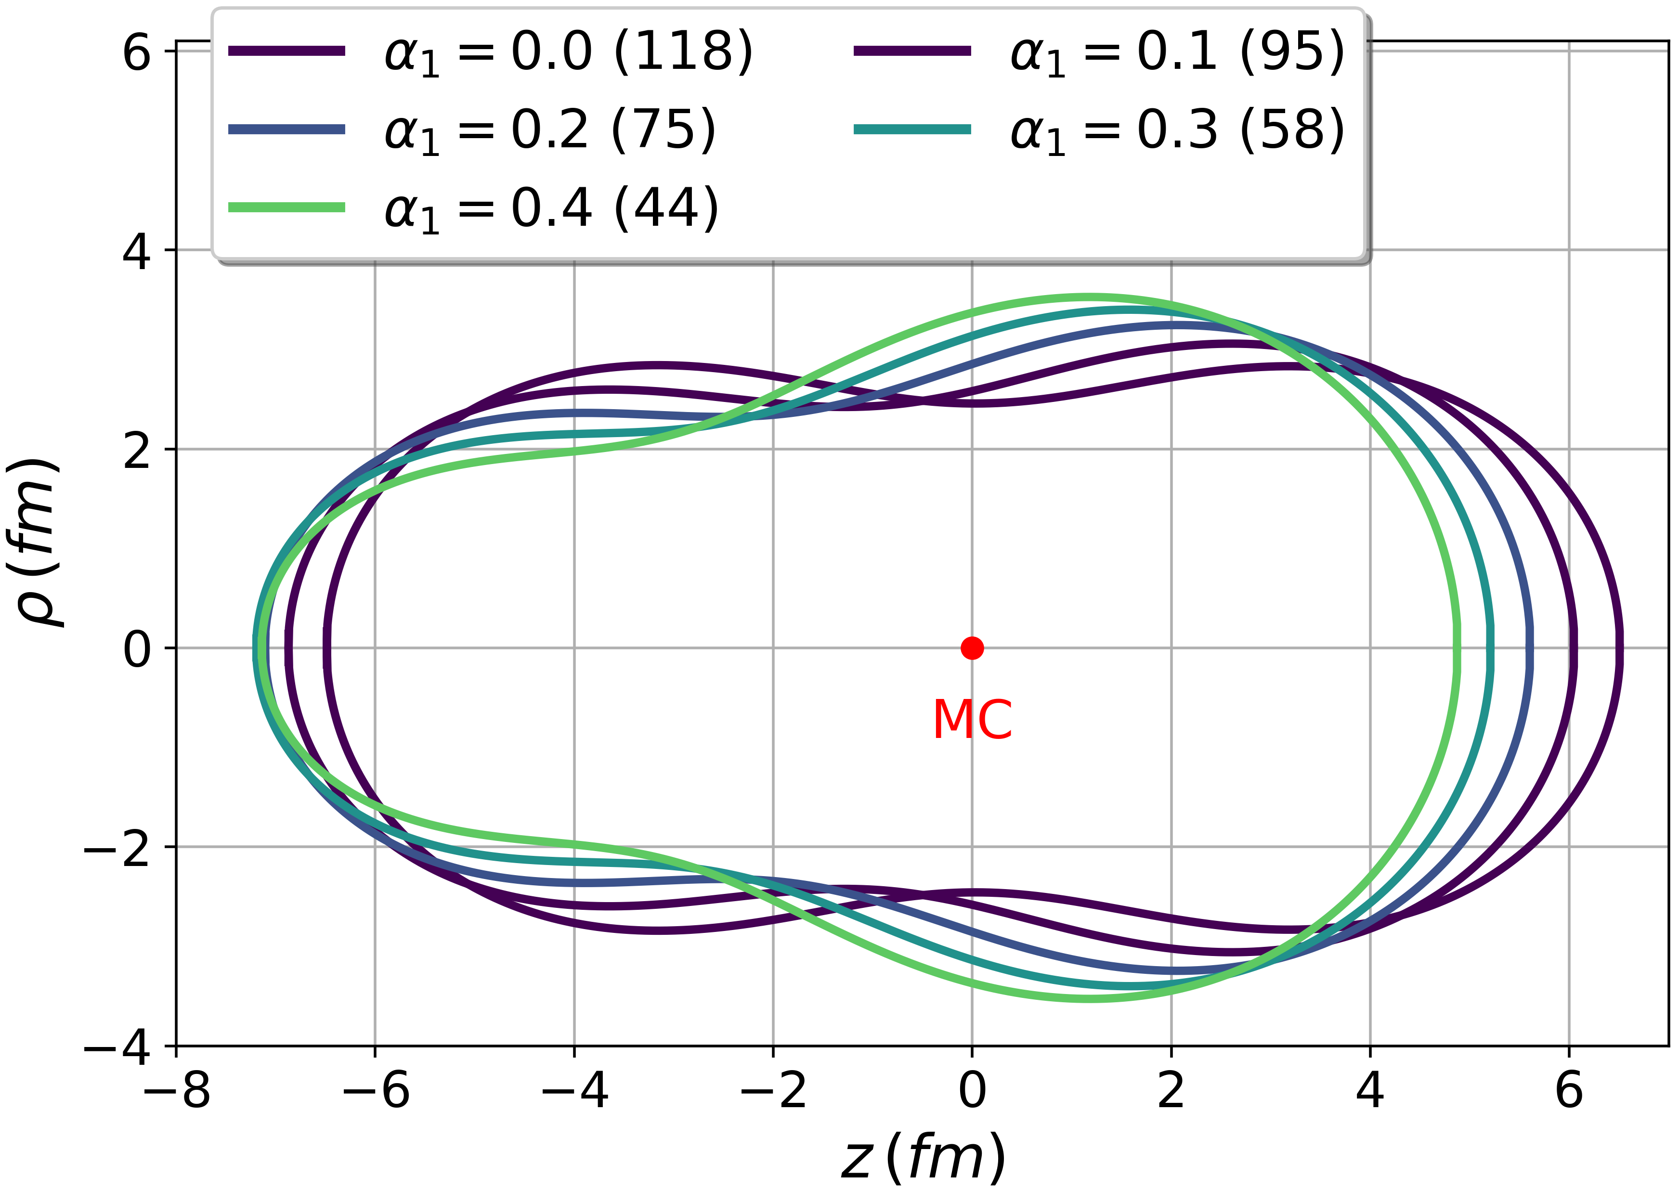
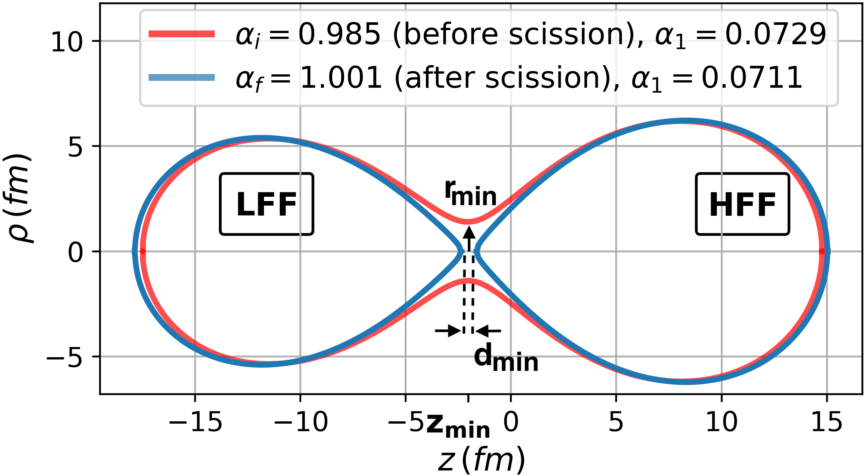

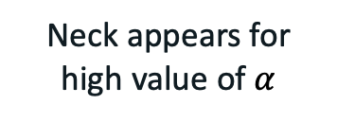

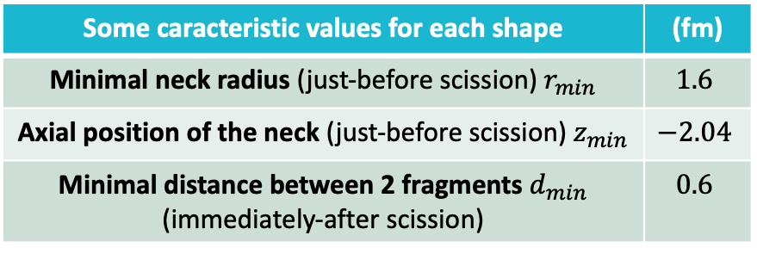
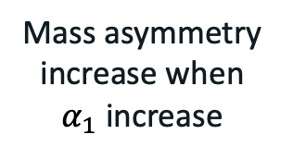


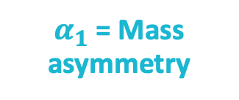
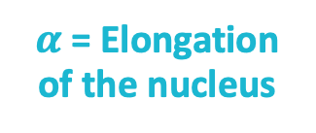

II. The used approach formalism: shape of the nuclei
Axially symmetric shapes in cylindrical coord. + 2 deformation parameters ($α,α_{1}$) for each shape
$$α_{1}=0$$
$$α=0.75$$
$α_{1}$ = Mass asymmetry
$α$ = Elongation of the nucleus
Mass asymmetry increase when $α_{1}$ increase
Neck appears for high value of $α$
Some caracteristic values for each shape | (fm)
Minimal neck radius (just-before scission) $r_{min}$ | $$1.6$$
Axial position of the neck (just-before scission) $z_{min}$ | $$−2.04$$
Minimal distance between 2 fragments $d_{min}$ (immediately-after scission) | $$0.6$$
$${}_{ }^{96}X$$
$${}_{ }^{140}Y$$
Notes:
parler Cassini
préciser que forme scission sont comme la figure de bas
The configuration alpha_i comes to the minimal neck radius. It is known that the neck collapses for a radius less than 2 fm (size of an alpha particle). For the final configuration alpha_f, we consider that the distance between the fragments its 0.6 fm, and this imposes the value of alpha_f but there is no indication for this distance. We take it like 0.6 fm.
To represent the shape of the nuclei, we consider at scission, only axially symmetric shapes in cylindrical coord. , they are represent here (fig bas) and to obtained it, we used 2 deformation parameters. Alpha for the elongation of the nucleus, and alpha1 which represent the mass asymetry between the fragments. In this table, I summarized some caracteric values for each shape. Note that at left of the neck, we have the light fragment and at the right, we have the heavy one.

Slide 8
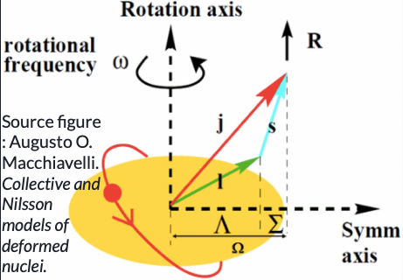

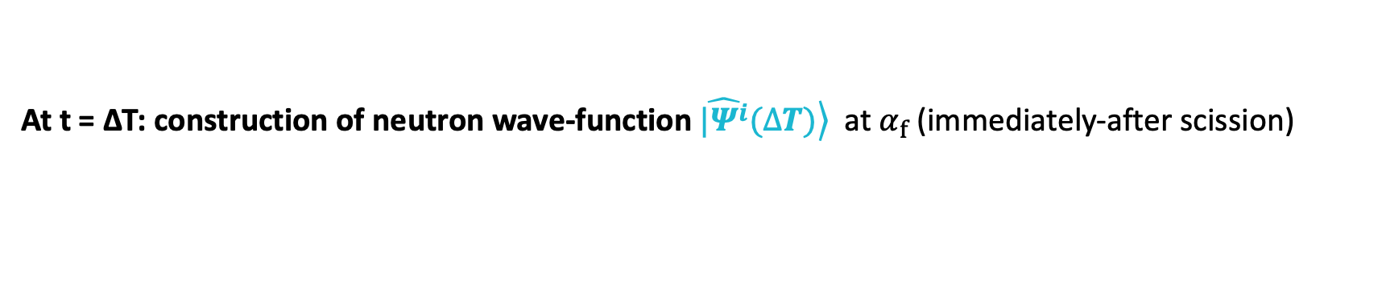
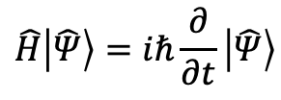
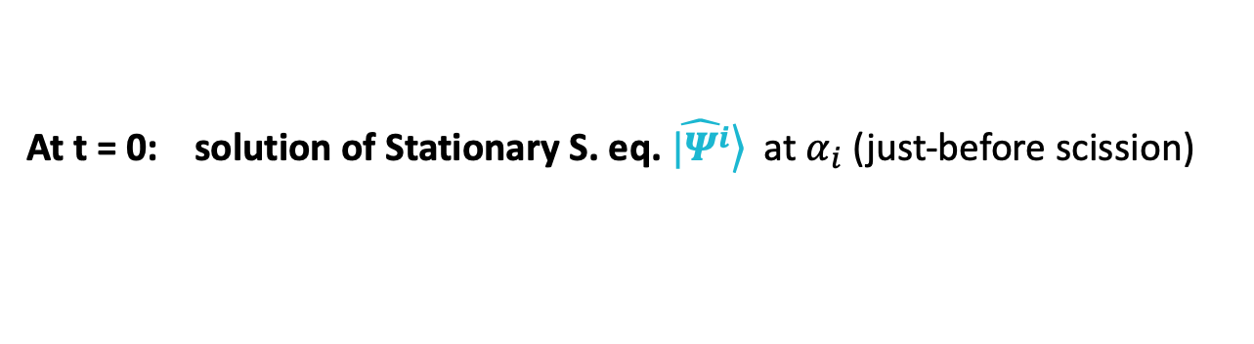
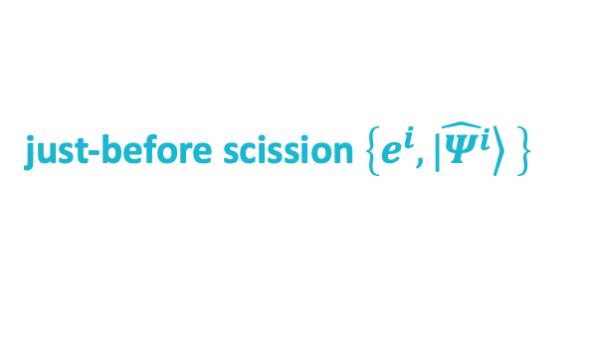

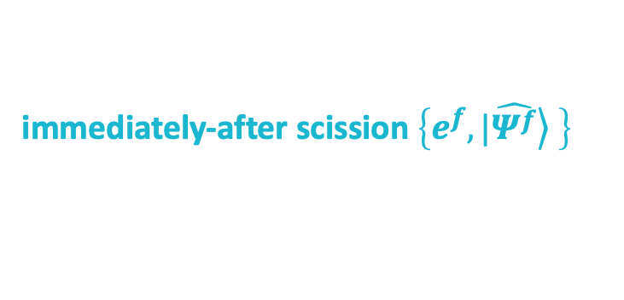
II. The used approach formalism: calculation method
Calculation method of each single-particle wave-function:
Time Dependent Schrödinger equation:
$$\hat{H}\left|\hat{Ψ}\right\rangle =iℏ\frac{∂}{∂t}\left|\hat{Ψ}\right\rangle$$
with
$$\hat{H}(shape,t)=\hat{T}+\hat{V}(shape,t)+\hat{V_{so}}(shape,t)$$
Axially symmetric nucleus + Spin-Orbit:
$$\hat{Ψ}\left(ρ,φ,z,t\right)=g_{1}\left(ρ,z,t\right)e^{iΛ_{1}φ}\left|↑\right\rangle +g_{2}\left(ρ,z,t\right)e^{iΛ_{2}φ}\left|↓\right\rangle$$
, $Λ=\frac{1}{2}±Ω$
Solving stationary Schrödinger eq. $\hat{H}\left|\hat{Ψ}\right\rangle =E\left|\hat{Ψ}\right\rangle$ with Fortran Package (ARPACK):
just-before scission $\left\{e^{i},\left.\hat{|Ψ^{i}}\right\rangle \right\}$
Bound states (E $≤$ 0)
immediately-after scission $\left\{e^{f},\left.|\hat{Ψ^{f}}\right\rangle \right\}$
If Dynamical scission (∆T $≠$ 0) => Solving TDSE with Time Dependent Potential by Cranck-Nicolson algorithm:
At t = 0: solution of Stationary S. eq. $\left.\hat{|Ψ^{i}}\right\rangle$ at $α_{i}$ (just-before scission)
At t = ∆T: construction of neutron wave-function $\left.\hat{|Ψ^{i}}(∆T)\right\rangle$ at $α_{f}$ (immediately-after scission)
Notes:
Omega = projection of the total angular momentum on the symmetry axis
Omega is the only quantum number used
S S eq = Nlike Nilsson model with a very deformed potential
With a time and shape dependant Hamiltonian
Thanks to this SO term and the assumption of the axially symmetric nucleus, ...

Slide 9
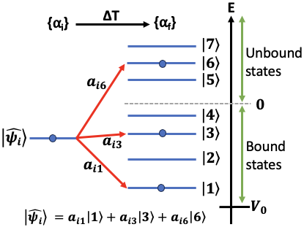
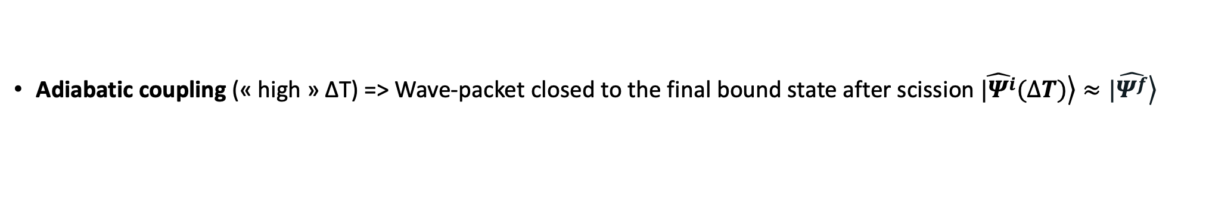
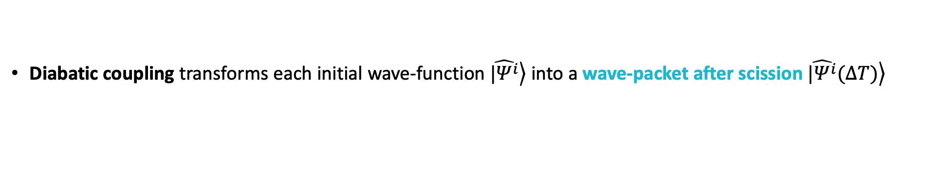

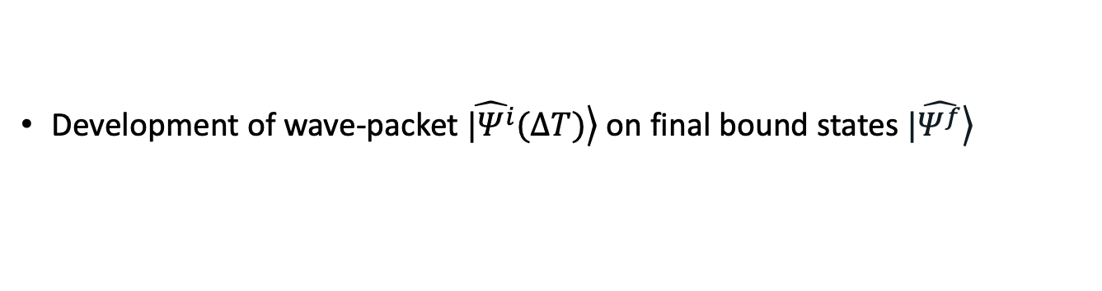

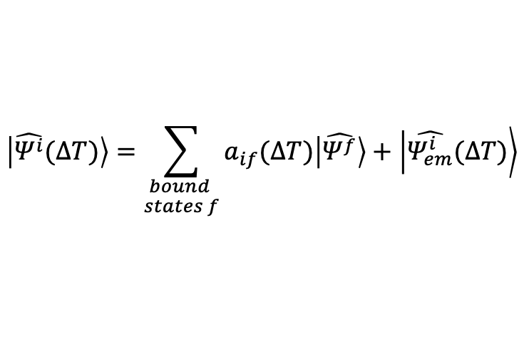
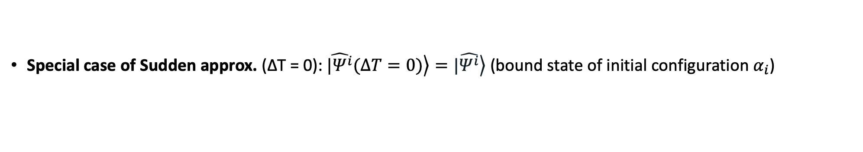
II. The used approach formalism: impact of coupling
Diabatic coupling transforms each initial wave-function $\left.\hat{|Ψ^{i}}\right\rangle$ into a wave-packet after scission $\left.\hat{|Ψ^{i}}(∆T)\right\rangle$
Development of wave-packet $\left.\hat{|Ψ^{i}}(∆T)\right\rangle$ on final bound states $\left.|\hat{Ψ^{f}}\right\rangle$
Extraction of emitted part of the wave-packet:
$$\left|\hat{Ψ^{i}}(∆T)\right\rangle =\sum_{\begin{aligned}bound \\ states f\end{aligned}}{a_{if}(∆T)\left|\hat{Ψ^{f}}\right\rangle }+\left|\hat{Ψ_{em}^{i}}(∆T)\right\rangle$$
where $a_{if}(∆T)=\left\langle \hat{Ψ^{i}}(∆T) | \hat{Ψ^{f}}\right\rangle$
Neutron remains in fragments
Continuum Part = Scission neutron (SN)
Remark: $a_{if}=0 \text{if} Ω_{i}≠Ω_{f}$
Special case of Sudden approx. (∆T = 0): $\left.\hat{|Ψ^{i}}(∆T=0)\right\rangle =\left.|\hat{Ψ^{i}}\right\rangle$ (bound state of initial configuration $α_{i}$)
Adiabatic coupling (« high » ∆T) => Wave-packet closed to the final bound state after scission $\left.\hat{|Ψ^{i}}(∆T)\right\rangle ≈\left.|\hat{Ψ^{f}}\right\rangle$
=> SN emission is negligeable !
Notes:
a_if = overlap between final wave-packet $\hat{Ψ^{i}}(∆T)$ and eigenstates $\hat{Ψ^{f}}$ at final configuration $α_{f}$
appuyer sur la population d'états positifs pendant la scission (cf figure)

Slide 10
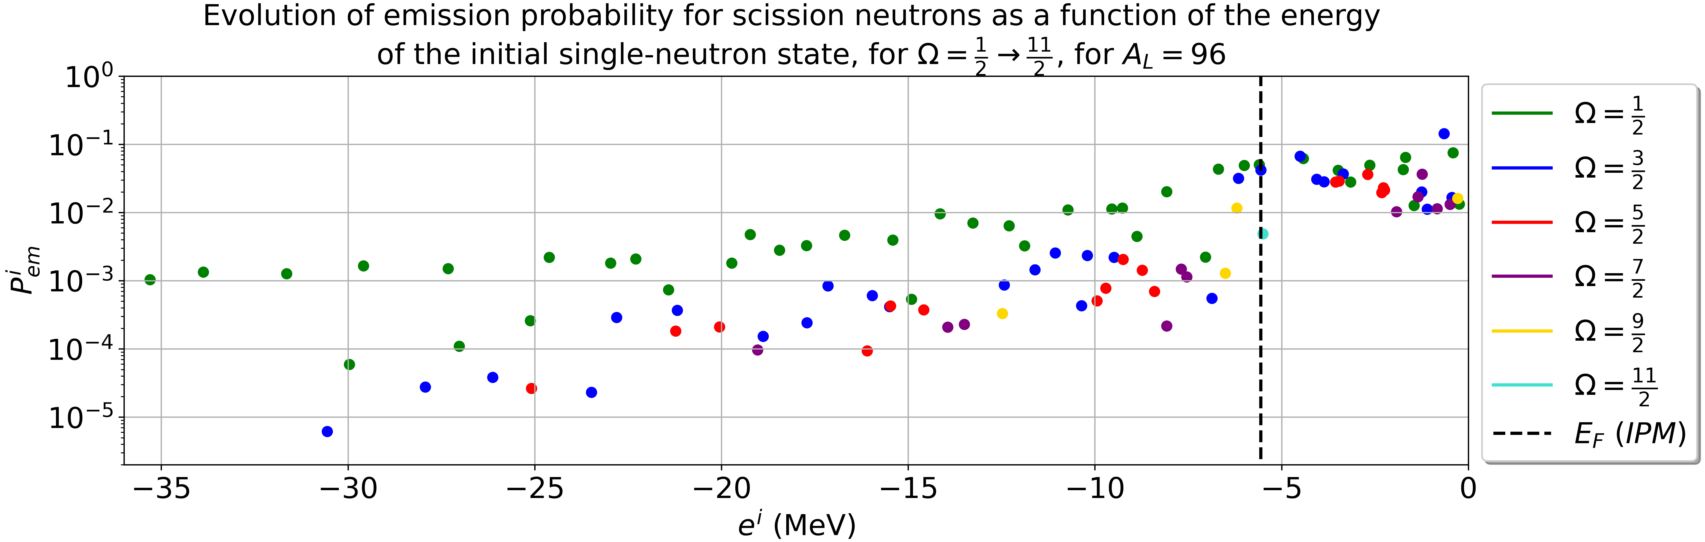

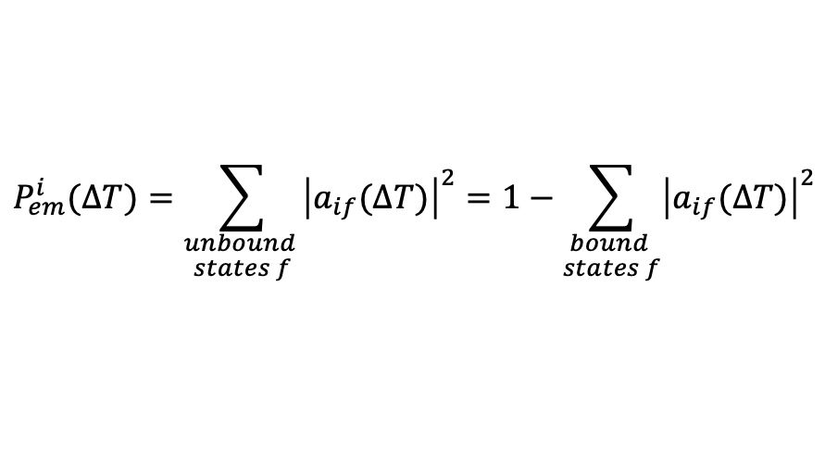
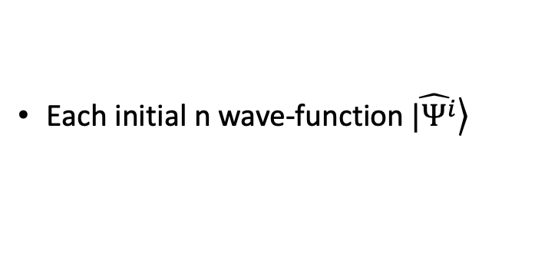
III. Scission neutrons multiplicity: SN emission probability
Each initial n wave-function $\left.\hat{|Ψ^{i}}\right\rangle$
SN emission probability:
$$P_{em}^{i}(∆T)=\sum_{\begin{aligned}unbound \\ states f\end{aligned}}{{\left|a_{if}(∆T)\right|}^{2}}=1−\sum_{\begin{aligned}bound \\ states f\end{aligned}}{{\left|a_{if}(∆T)\right|}^{2}}$$
Sudden approx. $(∆T=0)$
States with low $Ω\left(\frac{1}{2},\frac{3}{2}\right)$ have more chances to emit SN
$P_{em}^{i}$ significant just below and above the Fermi level (less bound) => Easy to emit
Notes:
Now, let's go to my results. ....
In this plot, for sudden approx. i Plot these probabilities in the initial potential well and we have the Fermi level here. We see in the plot, ....

Slide 11
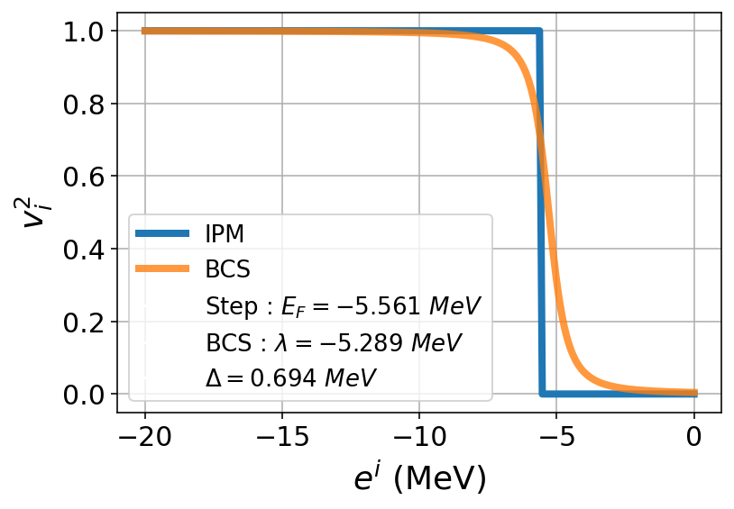
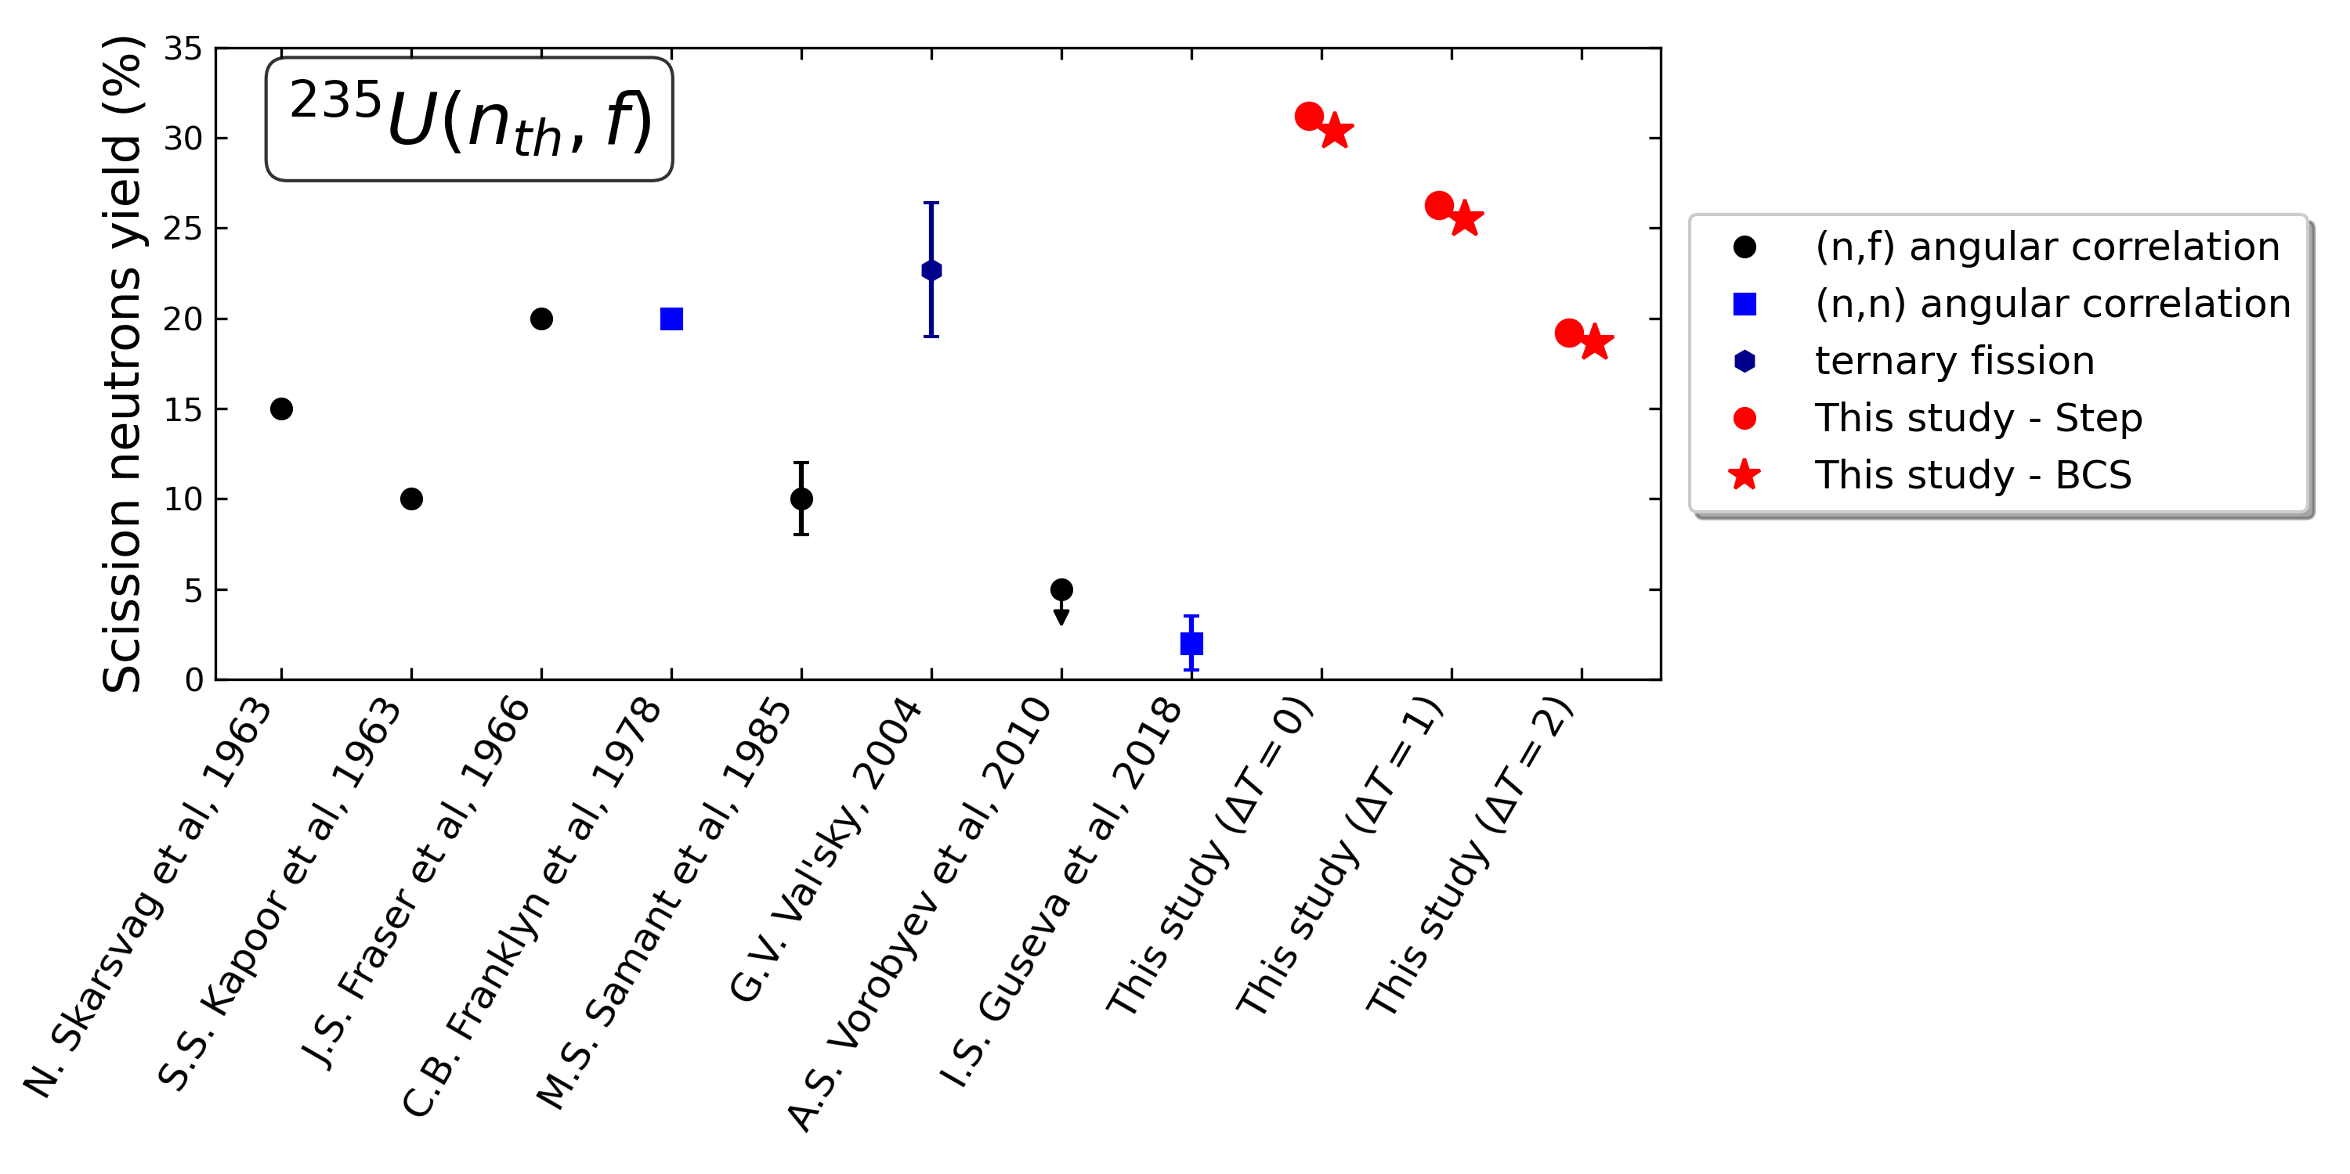




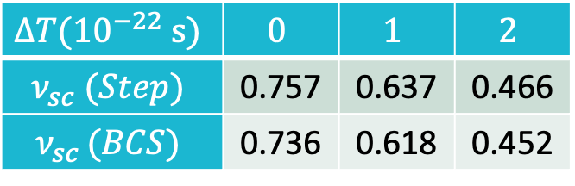
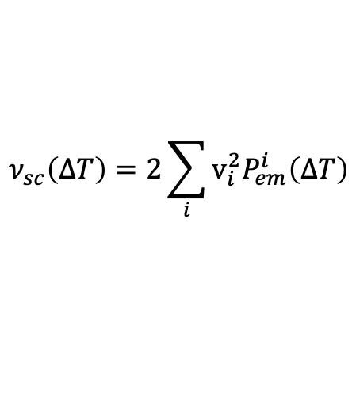
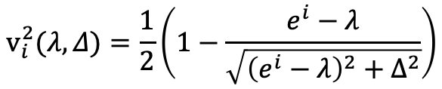
III. Scission neutrons multiplicity: SN yield
Each individual state has an occupation probability $v_{i}^{2}$
Independent $v_{i}^{2}=$Step function
$$Δ$$
Two-neutron correlations studied:
Paired (BCS) $v_{i}^{2}$ smooth
Spin factor
$$v_{i}^{2}(λ,Δ)=\frac{1}{2}\left(1−\frac{e^{i}−λ}{\sqrt{{\left(e^{i}−λ\right)}^{2}+Δ^{2}}}\right)$$
$$ν_{sc}\left(∆T\right)=2\sum_{i}{v_{i}^{2}P_{em}^{i}\left(∆T\right)}$$
Fermi Level
Yield of SN:
Gap
$$∆T(10^{−22} s)$$ | $$0$$ | $$1$$ | $$2$$
$$ν_{sc} (Step)$$ | 0.757 | 0.637 | 0.466
$$ν_{sc }(BCS)$$ | 0.736 | 0.618 | 0.452
For our mass division: $ν_{exp}=2.425 \text{n}\text{/}\text{fission}$
Scission neutron yield:
20-30% of the total n measured
Notes:
If I add my resultats to the previous plot for the SN yield, the yield for ∆T = 2 is in agreement with experimental results.

Slide 12
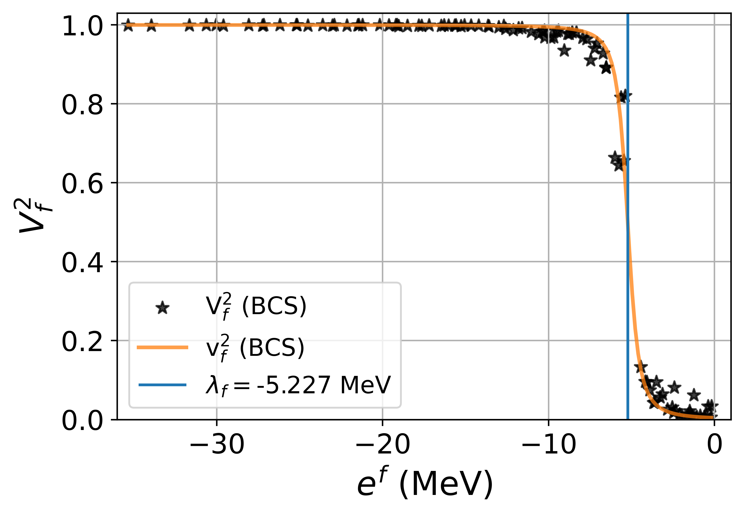
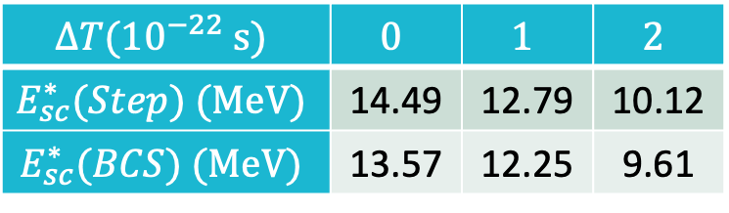
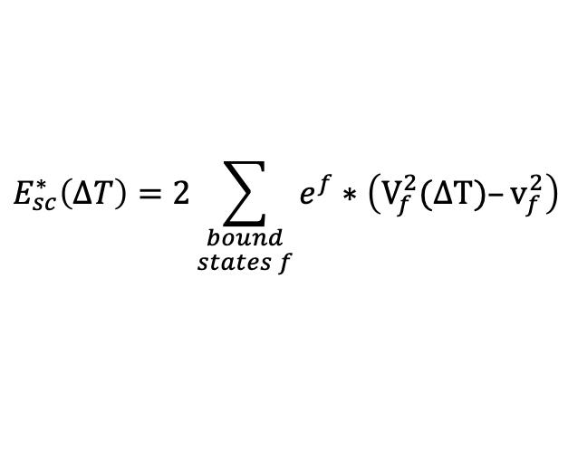

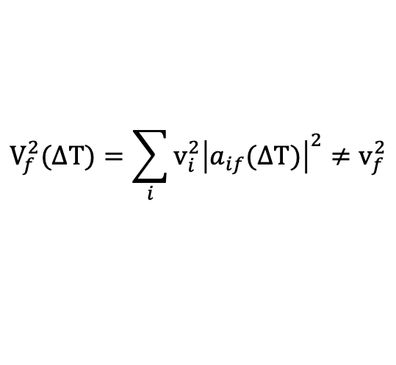
IV. Estimation of prompt neutrons evaporation: Intrinsic excitation energy of FFs
After scission: FFs in excited state
Evaporation of ($n,γ$) during acceleration phase
Occupation probabilities of each final bound state after scission:
$$V_{f}^{2}(∆T)=\sum_{i}{v_{i}^{2}{\left|a_{if}(∆T)\right|}^{2}}≠v_{f}^{2}$$
Final occupation in ground state (no excitation)
$$(∆T=2.10^{−22}s)$$
Diabatic coupling leads to the population of states above Fermi level, at the expanse of lower energy states
Excitation of the system immediately-after scission:
$$E_{sc}^{∗}\left(∆T\right)=2\sum_{\begin{aligned}bound \\ states f\end{aligned}}{e^{f}}∗\left(V_{f}^{2}(∆T)–v_{f}^{2}\right)$$
$$∆T(10^{−22} s)$$ | $$0$$ | $$1$$ | $$2$$
$$E_{sc}^{∗}(Step) (MeV)$$ | 14.49 | 12.79 | 10.12
$$E_{sc}^{∗}(BCS) (MeV)$$ | 13.57 | 12.25 | 9.61
E* energy of final conf.
G. S. energy of final conf.
Notes:
Avec les SN, regardons maitenant la partie émise

Slide 13
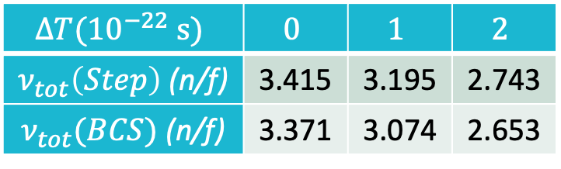
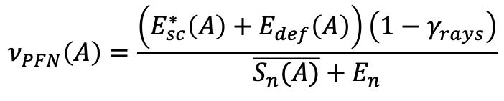
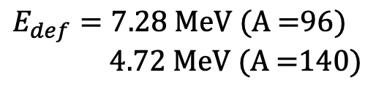
IV. Estimation of prompt neutrons evaporation
For each fragment, with intrinsic excited energy + energy stored in deformed fragment shape (from GEF)
Total excitation energy of fragments immediately-after scission
$$E_{def}=7.28 \text{MeV}\text{ (}\text{A}\text{ =96) }$$
$4.72 \text{MeV}\text{ (}\text{A}\text{ =140)}$
Correction for energy released by emission of $γ$ rays ($36.63 \% \text{ (}\text{A}\text{=96)}, 25.70 \% \text{ (}\text{A}\text{ = 140)}$)
(Pleasonton et al., Phys. Rev. C, 1972)
$$ν_{PFN}\left(A\right)=\frac{\left(E_{sc}^{∗}\left(A\right)+E_{def}\left(A\right)\right)\left(1−γ_{rays}\right)}{\overline{S_{n}(A)}+E_{n}}$$
Estimates prompt neutron multiplicity:
Mean n separation energy
Kinetic energy
(from nuclear charge distribution)
(mean value = 2 MeV)
(Lang et al., NPA, 1980)
SN + PFN yields => Total neutron yield:
$$∆T(10^{−22} s)$$ | $$0$$ | $$1$$ | $$2$$
$ν_{tot}\left(Step\right)$ (n/f) | 3.415 | 3.195 | 2.743
$ν_{tot}(BCS)$ (n/f) | 3.371 | 3.074 | 2.653
Good agreement with experimental yield
=> Estimated values higher than the experimental one (2.425 n/f)
Upper limit due to reabsorption of SN by fragments
Notes:
Partie intrinsèque et j'ajoute les valeurs liées à la forme from GEF

Slide 14
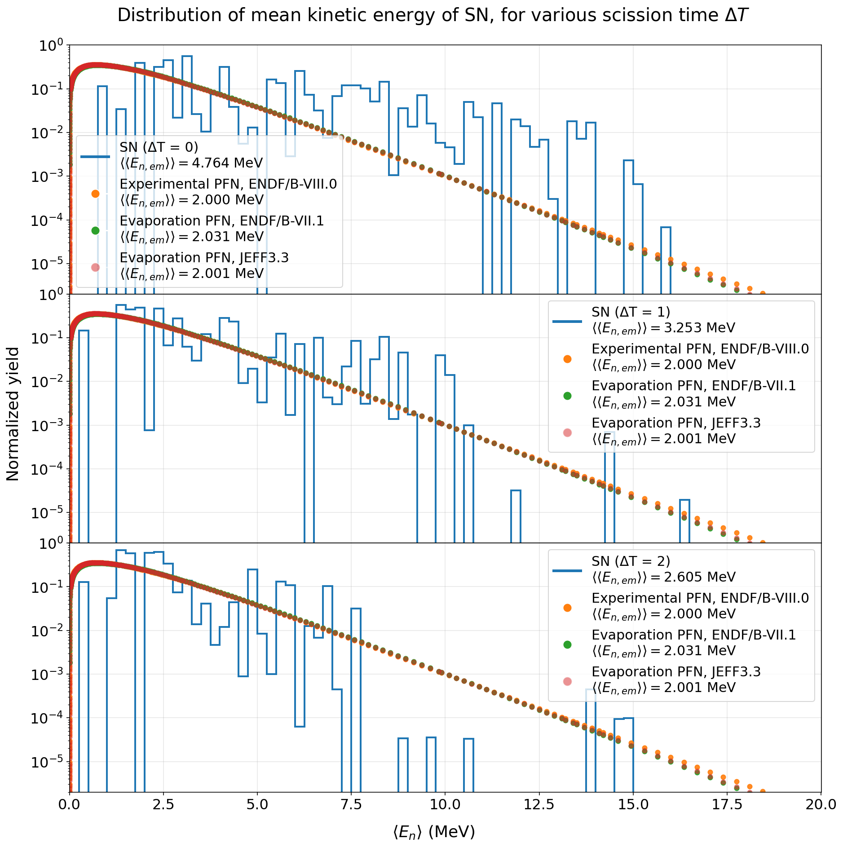




V. Mean kinetic energy distribution of scission neutrons
Each SN has its own spectrum and the associated mean value:
$$(∆T=0)$$
$$\left\langle E_{n, em}^{i}\right\rangle =\left\langle \hat{ψ_{em}^{i}} | \hat{H} (α_{f}) | \hat{ψ_{em}^{i}}\right\rangle$$
Hamiltonian of the final configuration
Emitted SN wave-function
$$(∆T=1.10^{−22}s)$$
ENDF/B.VII.1 and JEFF3.3 => Based on evaporation model (Los Alamos)
ENDF/B.VIII.0 => More realistic and takes into account high-energy n from dosimetry reactions
$$(∆T=2.10^{−22}s)$$
Scission neutrons contribute to the high energy tail of n spectrum that cannot be explained by evaporation
Notes:
Let’s have a look on the kinetic energy of SN
Observe a difference at high-energy
Préciser que j'ai calculé les distributions en bleu pour chaque ∆T.
With my results, I add also ....
We observe also a deviation between these libraries above 12 MeV that cannot be explained by an evaporation process.
...
We see that even the scission time changes, the high mean kinetic energy part rest

Slide 15
VI. Conclusion and perspectives
With a ”simple” microscopic model depending of the scission time, for the most probable mass division ²³⁵U(n_{th},f)
=> Estimates for the SN and PFN multiplicities (good agreement with experiment for ∆T = 2)
Mean kinetic energy distribution of SN => Presence of n with kinetic energy beyond the evaporation limit
But, after scission, a need to propagate the wave-packets far from the fragments, taking into account the optical potential model
=> Study of reabsorption impact of SN by fragments on:
- SN and total neutron yield (more realistic)
- Mean kinetic energy
Future: determine the unknown shape of SN spectrum and summing it to a typical PFN Spectrum
=> Comparison with the experimental spectrum (ENDF/B.VIII.0)

Slide 16
Thank you for your listening

