Slide 1
Impact of Nuclear Data Processing
Parameters on Cross Sections
An intra-code sensitivity study : same evaluation, same code, only the nuclear data processing parameters change
Part of the Nuclear Criticality Safety Program (NCSP)
international ND inter-code comparison exercise
Vaibhav JAISWAL
ASNR/PSN-RES/SNC/LN

Slide 2
Where This Fits | The NCSP Inter-Code Comparison
This study is one building block inside a larger international collaboration
Nuclear Criticality Safety Program (NCSP)
Scope of the comparison effort
NCSP Inter-Code Comparison exercise led by ASNR, with several institutions in the United States.
Goal: understand and quantify uncertainty introduced at every step of the nuclear data processing pipeline.
ND inter-code comparison : NJOY vs PREPRO vs AMPX vs GAIA vs FUDGE, etc.
This work: the intra-code piece — same evaluation, same code (NJOY2016), only internal tolerances vary
INTER-CODE
NJOY vs PREPRO vs AMPX vs FRENDY : different codes, same evaluation
INTRA-CODE ← WE ARE HERE
Same code (NJOY2016), same evaluation, only RECONR/BROADR parameters vary
CROSS SECTIONS
Direct, fast, no benchmark dependency, what this talk shows today
CRITICALITY BENCHMARKS (k_eff)
Propagate to ICSBEP — Phase 2, not covered today
A simple exercise, deliberately scoped ! A necessary and powerful first step before touching benchmarks !

Slide 3
Context & Motivation
Every step of nuclear data processing involves numerical choices that are
rarely questioned ! !
Processing chain considered in this study
ENDF-6 evaluation
The question
RECONR resonance reconstruction at 0 K
Nuclear data processing involves numerical choices: resonance reconstruction tolerance, integral criterion, thinning tolerance, thinning energy cutoff.
These are often set to default values and never questioned !
Do they visibly affect the processed cross sections?
BROADR Doppler broadening at 300 K
PENDF/ACE file input to MCNP / OpenMC / Serpent
THERMR & PURR: not varied in this study

Slide 4
RECONR | Resonance Reconstruction at 0 K
What RECONR does
Key Parameters (LA-UR-17-20093)
Converts ENDF resonance parameters (R-matrix, MLBW, Reich-Moore…) into a pointwise energy grid at 0 K
err
Fractional reconstruction tolerance
Default: 0.001 (0.1%)
Places energy points adaptively : denser near resonance peaks, coarser in smooth regions
Primary parameter : controls grid density
errmax
Tolerance when integral criterion is met (must be ≥ err)
The tolerance parameter err controls when accuracy is declared sufficient
Default: 10 × err
Secondary: smooth regions between resonances
Output: a linearised pointwise PENDF file ready for BROADR
errint
Max resonance-integral error per grid point
Most critical for nuclides with dense narrow resonances: U-238, Pu-239, Pu-241
Default: err / 20000
Controls integral thinning accuracy
Smaller err → more points → better resonance shapes
Larger err → fewer points → faster but less faithful
⚠ Constraint: errmax ≥ err always | errmax = err suppresses integral thinning

Slide 5
RECONR | Sensitivity Study Design
5 variants | 1 decade per step | V3 = NJOY default
Variant
err
errmax (=10×err)
errint (=err/20000)
Role
V1
1×10⁻¹
1.0
5×10⁻⁶
Coarsest (100× looser)
V2
1×10⁻²
0.1
5×10⁻⁷
Coarse (10× looser)
V3
1×10⁻³
0.01
5×10⁻⁸
← reference : NJOY default
V4
1×10⁻⁴
0.001
5×10⁻⁹
Fine (10× tighter)
V5
1×10⁻⁵
0.0001
5×10⁻¹⁰
Finest (100× tighter)
Comparison metric: Δσ(E)/σref(E) = [ σVi(E) − σref(E) ] / σref(E) × 100% evaluated for MT = 1, 2, 18, 102
All variants compared against V3 on a common energy grid. Interpolation on union grid before differencing.

Slide 6
BROADR | Doppler Broadening & Grid Thinning
What BROADR does
Key Parameters (LA-UR-17-20093)
Takes the 0 K PENDF from RECONR and broadens to target temperature using the SIGMA1 kernel
errthn
Fractional thinning tolerance
Default: 0.001 (0.1%)
Physical effect: resonance peaks lower and wider — thermal motion of the target nucleus
Primary — controls grid density after broadening
thnmax
Upper energy limit for broadening/thinning
Numerical effect: the energy grid is thinned — redundant points after broadening are removed
Default: 1.0 MeV
BROADR may also add points in wings where the broadened shape needs more resolution
Fixed at NJOY default throughout this study
errmax/errint
Same logic as RECONR (≥errthn, errthn/20000)
Key distinction: RECONR shapes the 0 K grid — BROADR shapes the final T-dependent grid
Default: 10×errthn / errthn÷20000
Secondary tolerances
Physical (broadening) and numerical (thinning)
effects are combined in one step
⚠ thnmax fixed at 1 MeV. Manual: errthn/errmax/errint should match RECONR values.

Slide 7
BROADR | Sensitivity Study Design
Same strategy as RECONR | thnmax fixed at 1 MeV | RECONR fixed at V3 default (err=0.001)
Variant
errthn
thnmax
errmax (=10×errthn)
errint (=errthn/20000)
V1
1×10⁻¹
1 MeV
1.0
5×10⁻⁶
V2
1×10⁻²
1 MeV
0.1
5×10⁻⁷
V3
1×10⁻³
1 MeV
0.01
5×10⁻⁸ ← reference
V4
1×10⁻⁴
1 MeV
0.001
5×10⁻⁹
V5
1×10⁻⁵
1 MeV
0.0001
5×10⁻¹⁰
Same comparison metric: Δσ(E)/σref(E) per MT channel, interpolated on common grid, MT = 1, 2, 18, 102
This isolates the pure BROADR effect — RECONR contribution is held constant across all 5 variants.

Slide 8
Isotope Selection | 33 Isotopes from ENDF/B-VIII.1
Evaluated Library & Reactions
Output & Comparison
Source: ENDF/B-VIII.1
MT=1 (total), MT=2 (elastic), MT=18 (fission), MT=102 (n,γ)
Temperature: 300 K | Free-gas thermal treatment
ACE files (for Monte Carlo)
PENDF files (for XS comparison)
Energy-dependent relative difference vs V3 on common grid
33 Isotopes for Criticality Safety
Actinides (12)
Fission Products (15)
Structural (6)
U-234, U-235, U-236, U-238
Pu-238, Pu-239, Pu-240, Pu-241, Pu-242
Np-237, Am-241, Am-243
Rh-103, Cs-133, Mo-95, Tc-99, Ru-101, Ag-109
Sm-147, Sm-149, Sm-150, Sm-151, Sm-152
Nd-143, Nd-145, Gd-155, Eu-153
Fe-54, Fe-56, Fe-57, Fe-58
Cu-63, Cu-65
Results shown today only for some representative isotopes — all 33 processed !

Slide 9
Comparison Method
1
Process with NJOY2016.78
2
Build common energy grid
For each variant (V1–V5), process ENDF/B-VIII.1 with the modified parameter. All other parameters fixed at NJOY defaults.
Output: 5 ACE + 5 PENDF files per isotope, per study.
Interpolate all variants on the same union energy grid.
This removes differences due to grid density and isolates genuine cross-section differences.
3
Compute relative difference
4
Analyse by energy region
For each energy point, each MT channel, each variant:
Δσ(E) = [ σ_Vi(E) − σ_ref(E) ] / σ_ref(E) ×100 %
Reference = V3 (NJOY default).
Focus on the resolved resonance region (≈10⁻² to 10⁴ eV).
Quantify: maximum |Δσ|, energy range affected, whether the effect is local (peak-by-peak) or systematic.
Plot format on next slides: top panel = processed cross section | bottom panel = relative difference Δσ/σref (%)
V. JAISWAL | IRSN/ASNR | WONDER 2026 | 9/24

Slide 10
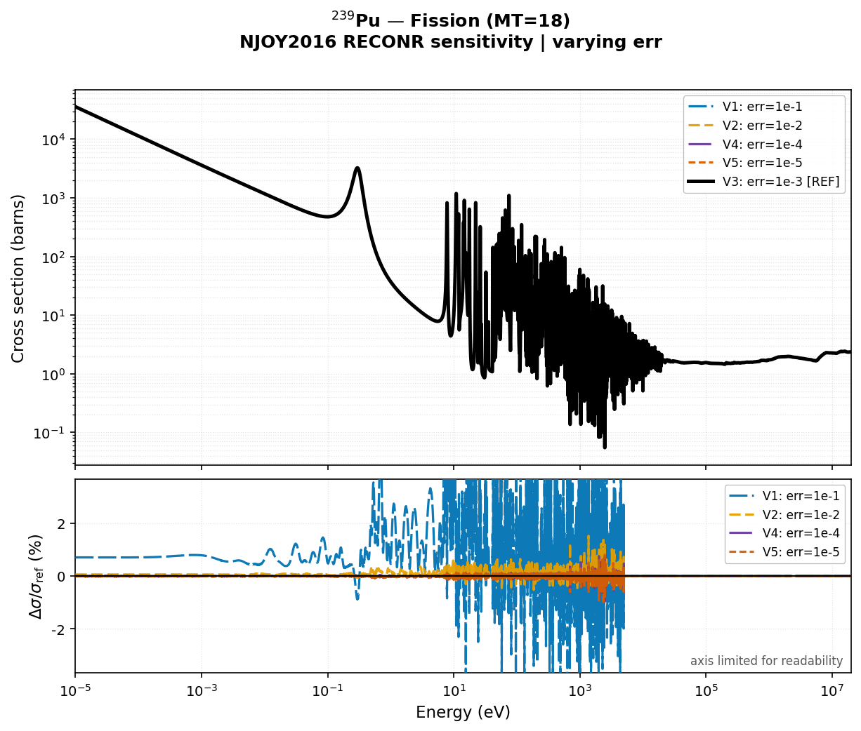
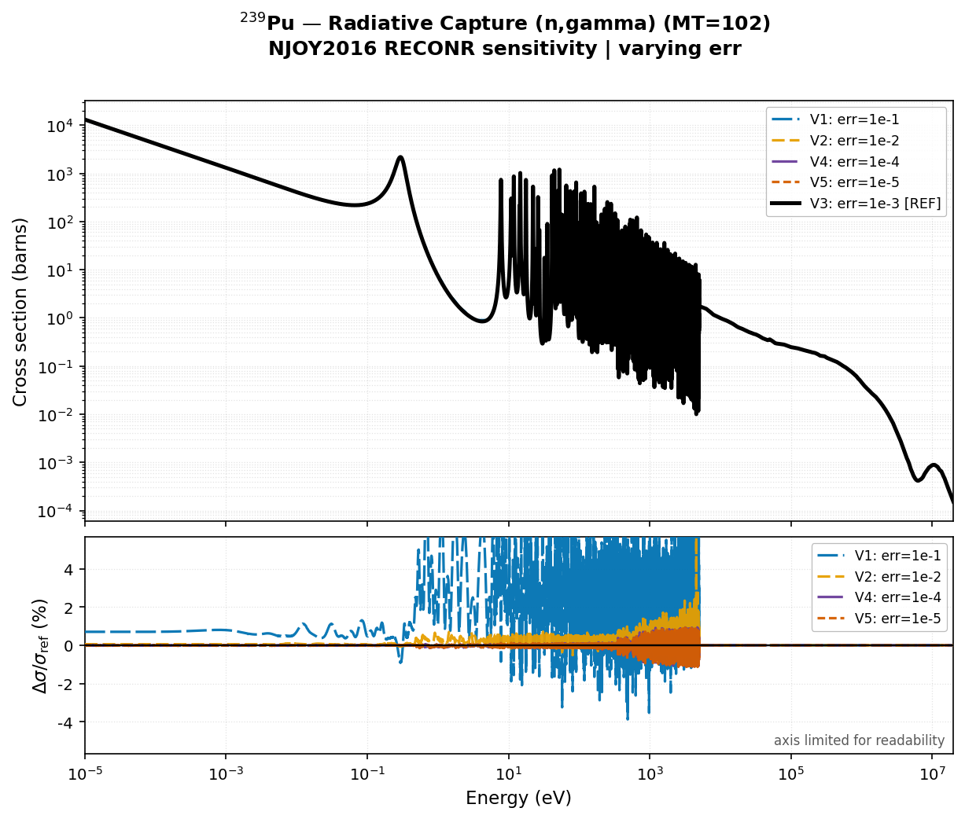
Pu-239 | RECONR Sensitivity
Pu239 ENDFB-VIII.1 : LRF = 7, R-Matrix Limited

Slide 11
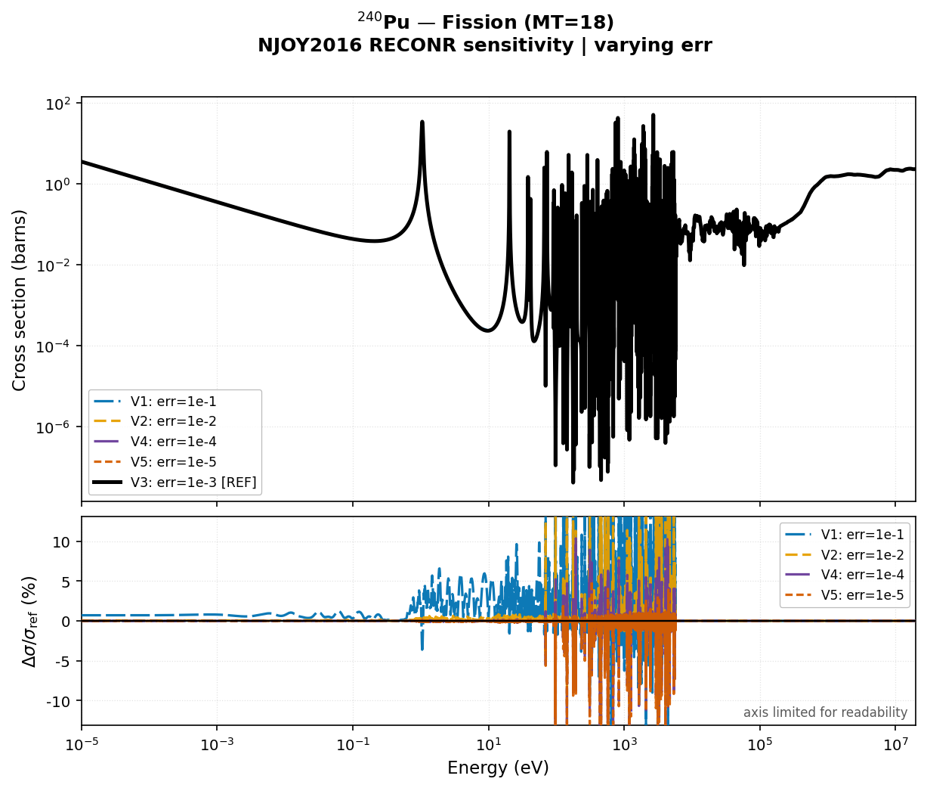
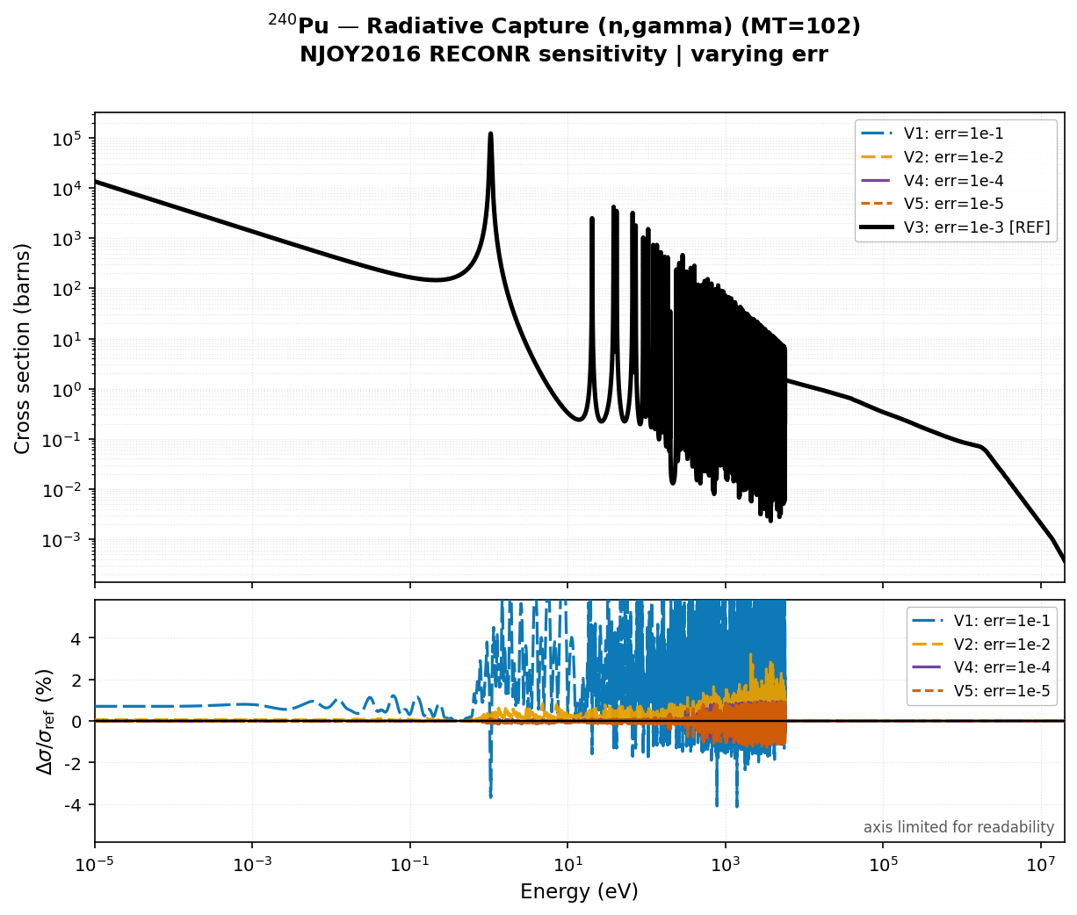
Pu-240 | RECONR Sensitivity
Pu-240 ENDFB-VIII.1 : LRF = 3, Reich-Moore formalism
Notes:
U-235 radiative capture. The bottom panel shows the relative difference. V1 shows local differences exceeding 1-2% at individual resonance peaks. V2 is mostly below 0.5%. V4 and V5 are indistinguishable from V3 — the NJOY default is converged. The effect is purely local, at each resonance peak, not systematic over the full energy range.

Slide 12
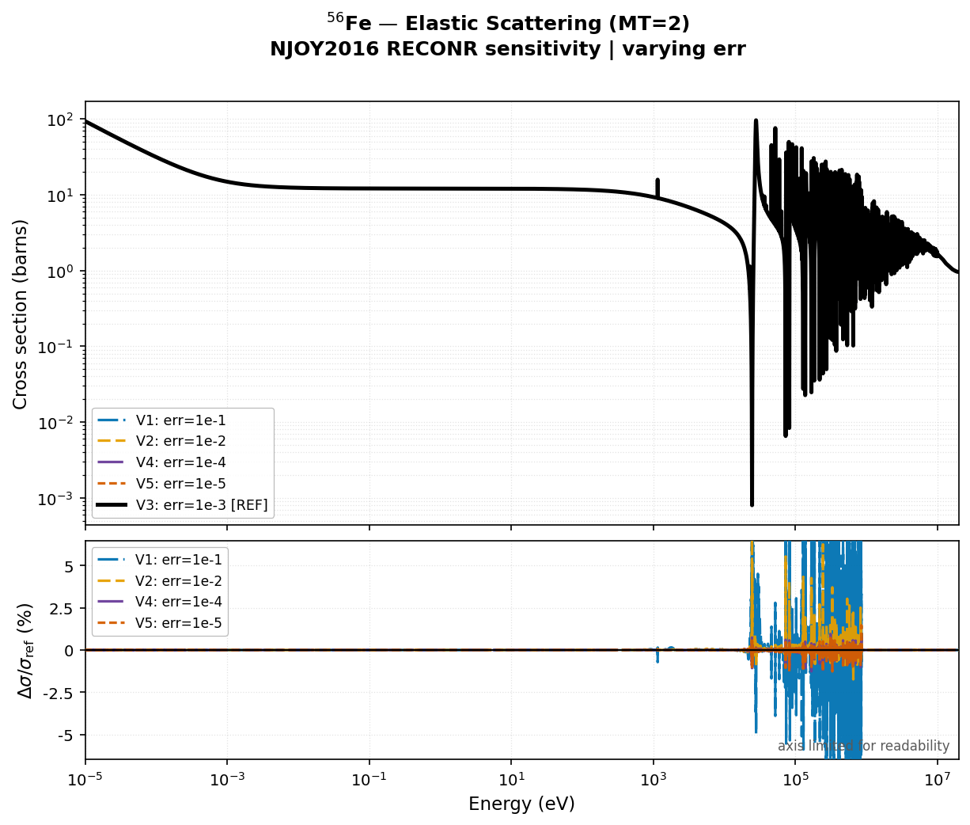
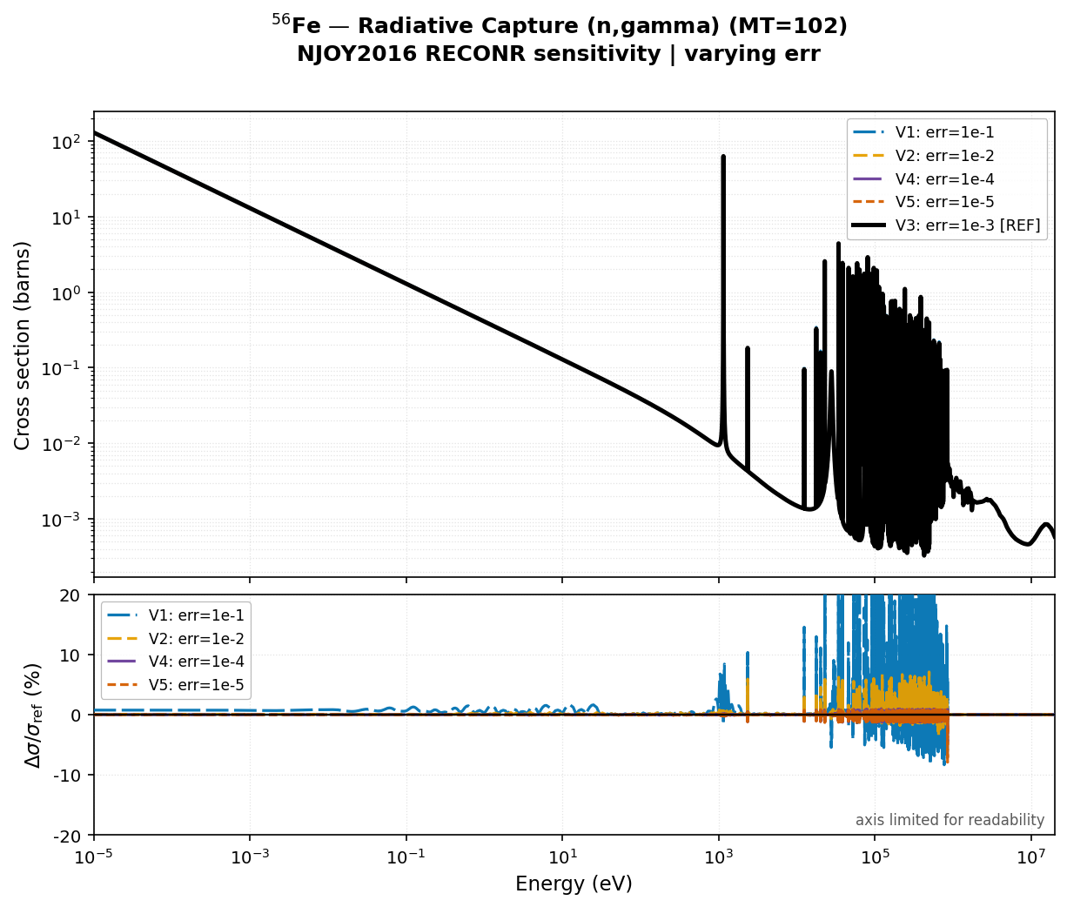
Fe-56 | RECONR Sensitivity
Fe-56 ENDFB-VIII.1 : LRF = 3, Reich-Moore formalism
Notes:
Pu-239 fission with BROADR variation. The key observation here is that BROADR affects the Doppler wings — the energy regions around resonance peaks — rather than the peak heights themselves. V1 shows >2% differences in the wings. V4 and V5 add nothing over V3.

Slide 13
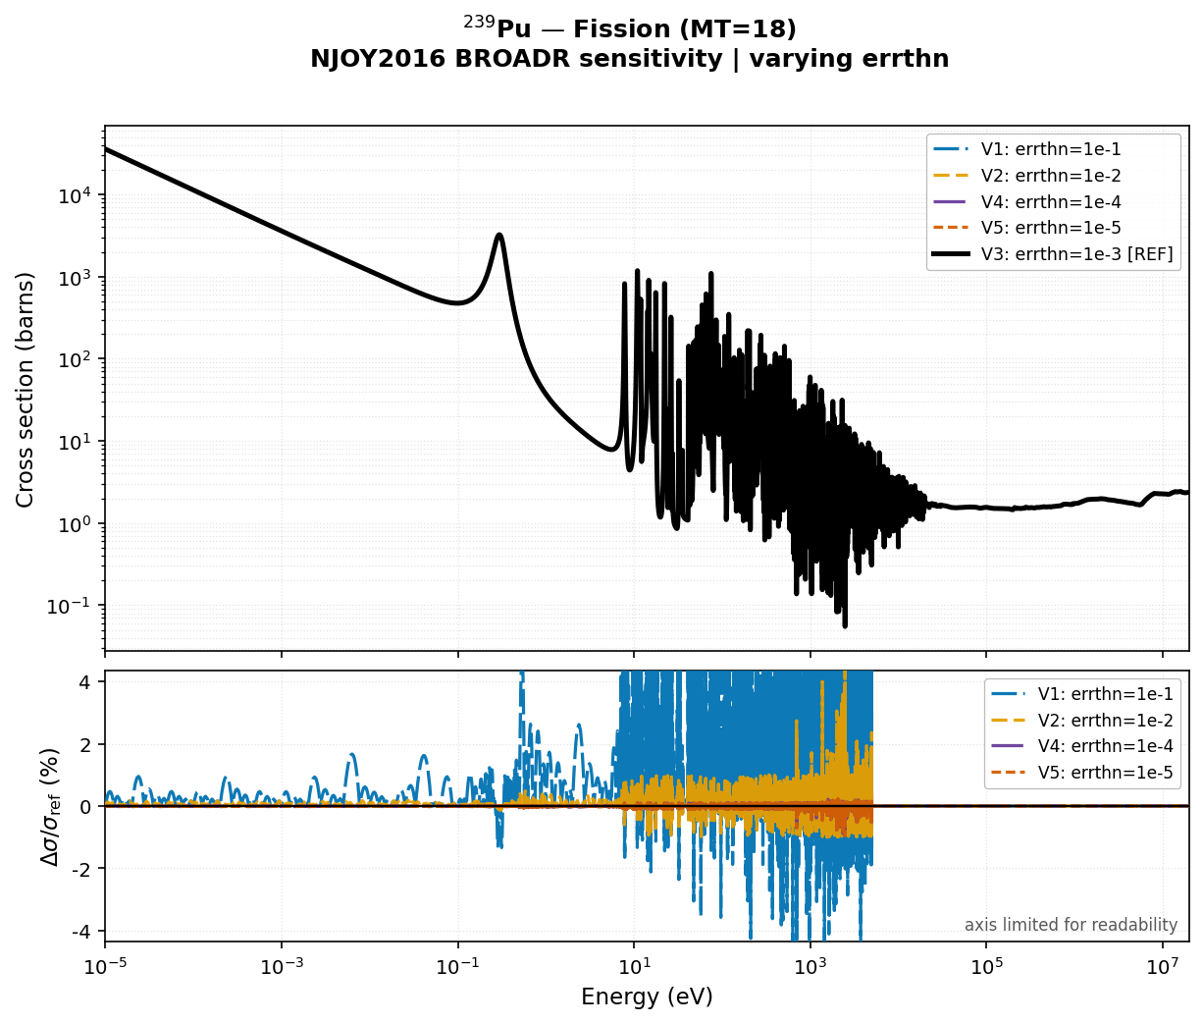
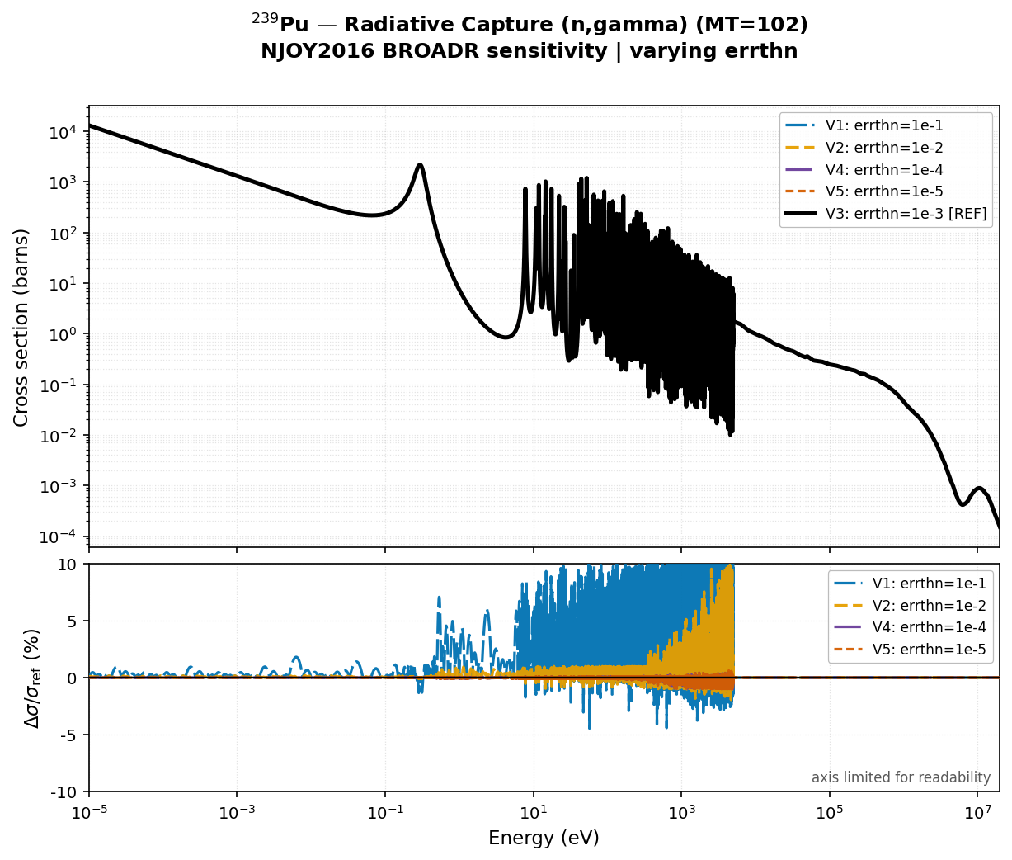
Pu-239 | BROADR Sensitivity

Slide 14
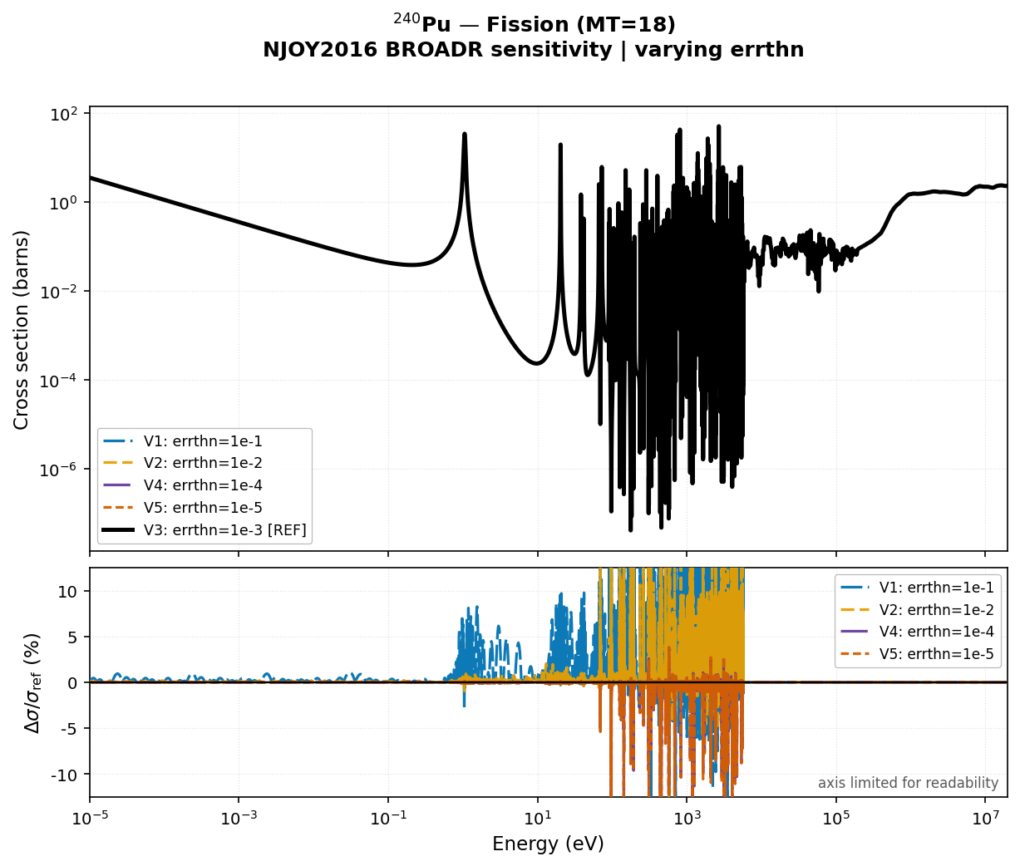
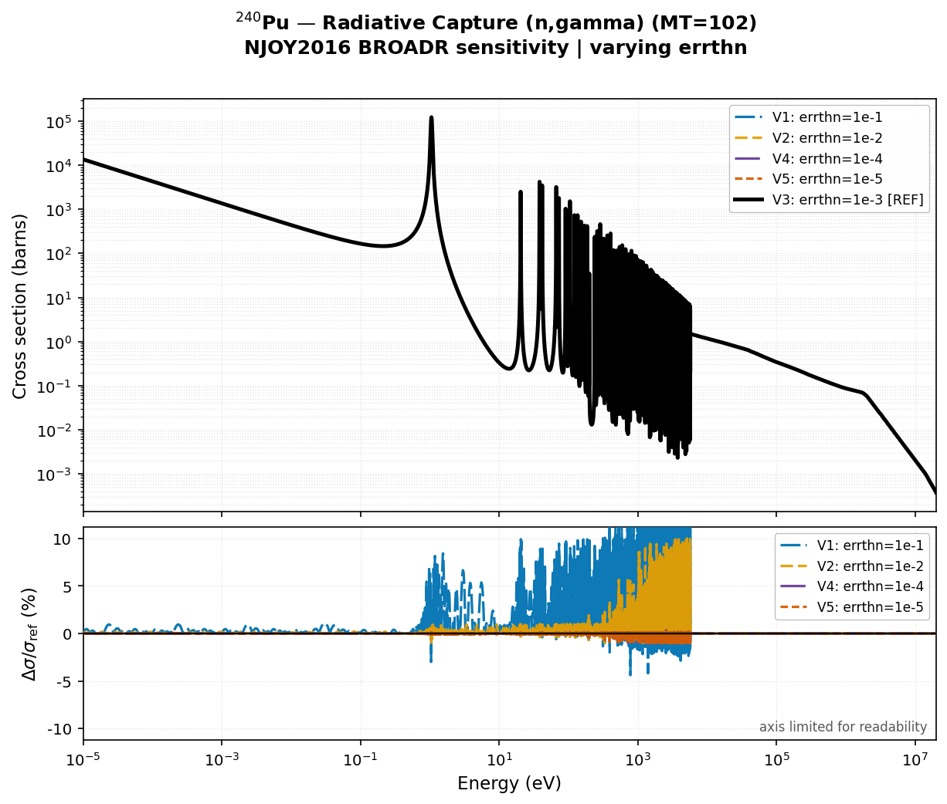
Pu-240 | BROADR Sensitivity

Slide 15
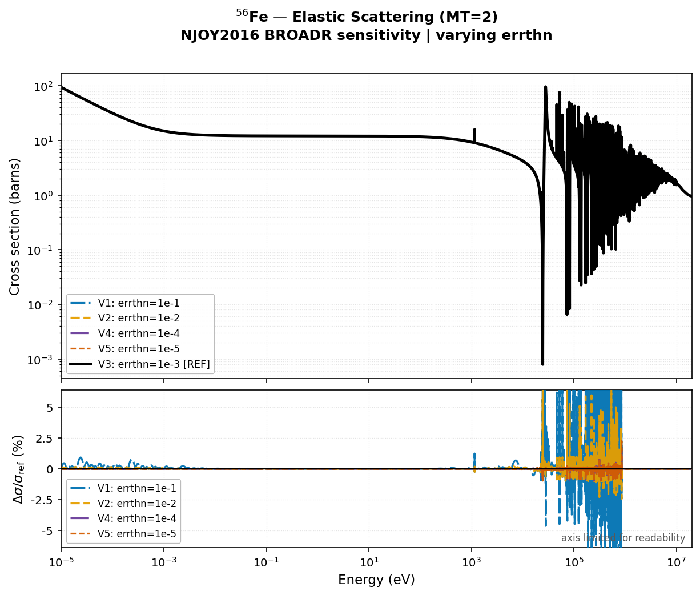
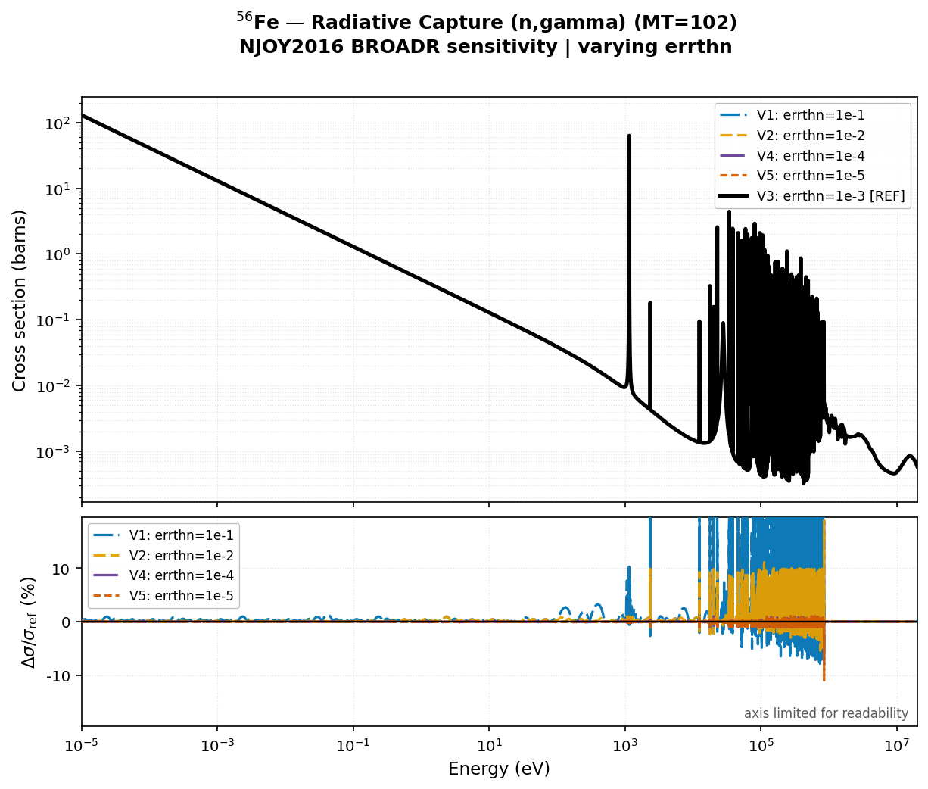
Fe-56 | BROADR Sensitivity

Slide 16
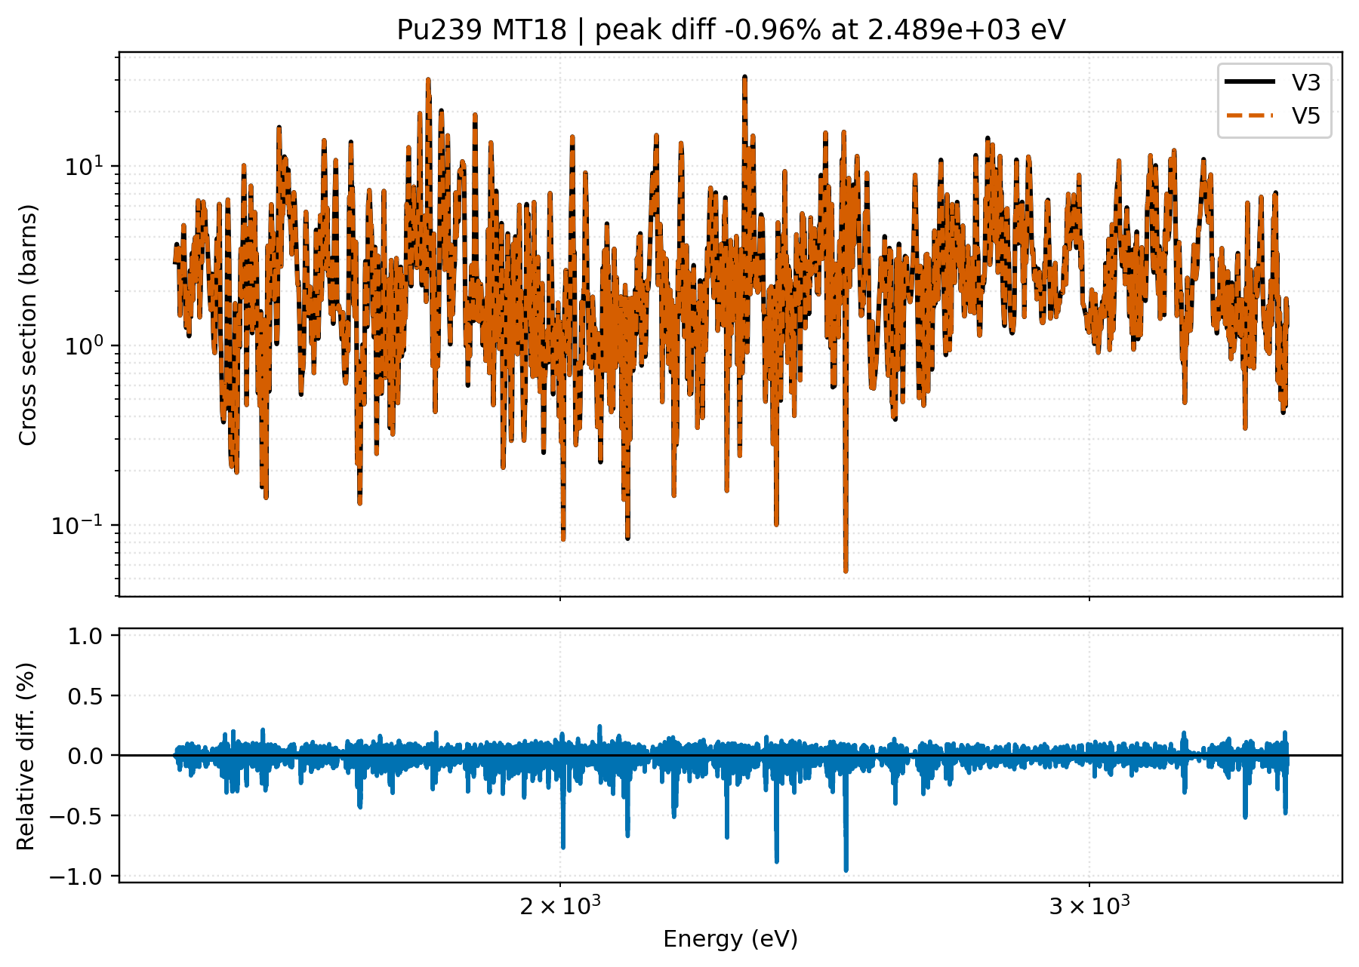
Is V5 (finest tolerance) actually better?

Slide 17
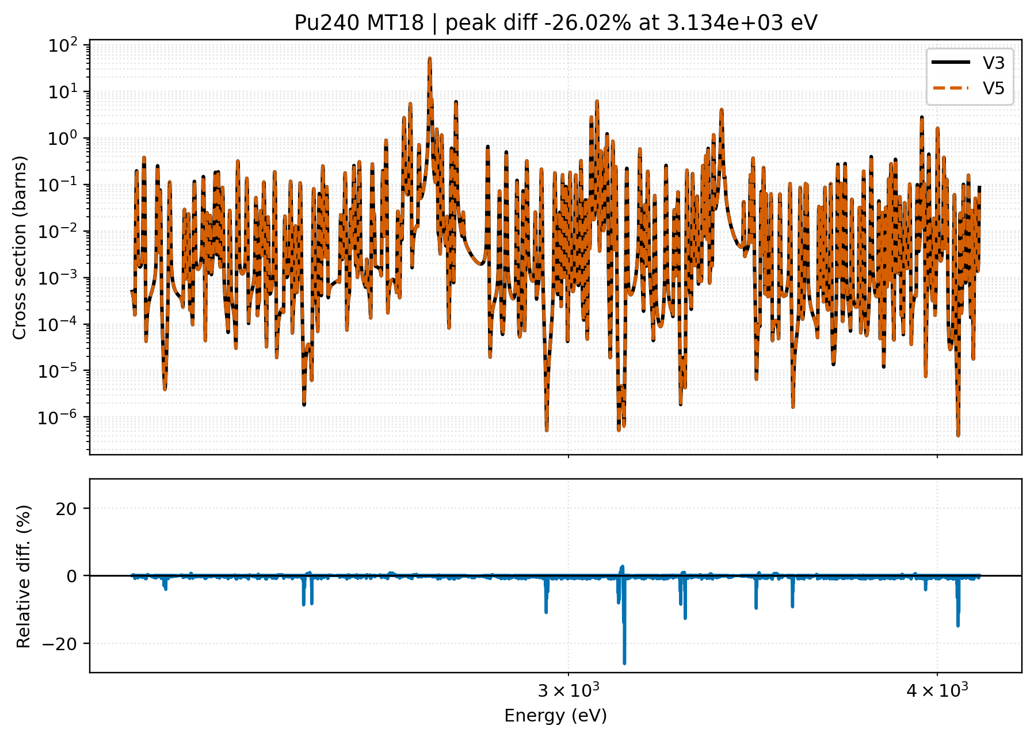
Is V5 (finest tolerance) actually better?

Slide 18
BROADR | PENDF File Size comparison
errthn varied | thnmax fixed at 1 MeV | % change in PENDF file size relative to V3 (errthn = 1×10⁻³)
Isotope
V1
(errthn=1e-1)
V2
(errthn=1e-2)
V3
REFERENCE
V4
(errthn=1e-4)
V5
(errthn=1e-5)
U235
-46.2%
52.22 MB
-39.8%
58.49 MB
0.00% (ref)
97.12 MB
+140.5%
233.56 MB
+510.2%
592.61 MB
Pu239
-41.7%
10.04 MB
-32.5%
11.62 MB
0.00% (ref)
17.20 MB
+92.0%
33.04 MB
+338.6%
75.45 MB
Fe57
-54.5%
1.72 MB
-45.4%
2.06 MB
0.00% (ref)
3.78 MB
+141.5%
9.12 MB
+564.6%
25.11 MB
Cu63
-39.1%
2.43 MB
-31.2%
2.74 MB
0.00% (ref)
3.98 MB
+96.5%
7.82 MB
+375.1%
18.92 MB
red = increase vs V3 green = decrease vs V3 bold = change exceeds 200%
Key pattern: coarser thinning (V1, V2) shrinks PENDF files 26–54%. Tighter thinning (V5) inflates files 223–565%, with Fe57 the most sensitive and Pu239 the least.

Slide 19
BROADR | NJOY Runtime comparison
errthn varied | thnmax fixed at 1 MeV | % change in NJOY runtime relative to V3 (errthn = 1×10⁻³)
Isotope
V1
(errthn=1e-1)
V2
(errthn=1e-2)
V3
REFERENCE
V4
(errthn=1e-4)
V5
(errthn=1e-5)
U235
-20.0%
0.82 min
-17.4%
0.85 min
0.00% (ref)
1.03 min
+60.4%
1.65 min
+225.5%
3.35 min
Pu239
-26.5%
0.23 min
-21.6%
0.24 min
0.00% (ref)
0.31 min
+66.5%
0.51 min
+237.8%
1.04 min
Fe57
-6.5%
0.14 min
-6.5%
0.14 min
0.00% (ref)
0.15 min
+19.6%
0.18 min
+76.1%
0.27 min
Cu63
-15.9%
0.06 min
-13.6%
0.06 min
0.00% (ref)
0.07 min
+43.2%
0.10 min
+163.6%
0.19 min
red = increase vs V3 green = decrease vs V3 bold = change exceeds 200%
Key pattern: runtime tracks file size for most isotopes but grows less steeply (U235: +226% runtime vs +510% file size). Pu239 is the exception — runtime (+238%) grows nearly as fast as file size (+339%).

Slide 20
RECONR | PENDF File Size comparison
err varied | errmax=10×err, errint=err/20000 | % change in PENDF file size relative to V3 (err = 1×10⁻³)
Isotope
V1
(err=1e-1)
V2
(err=1e-2)
V3
REFERENCE
V4
(err=1e-4)
V5
(err=1e-5)
U235
-19.7%
78.03 MB
-13.7%
83.84 MB
0.00% (ref)
97.12 MB
+42.3%
138.24 MB
+257.1%
346.83 MB
Pu239
-34.0%
11.36 MB
-23.8%
13.11 MB
0.00% (ref)
17.20 MB
+65.1%
28.41 MB
+362.9%
79.64 MB
Fe57
-7.3%
3.50 MB
-3.8%
3.63 MB
0.00% (ref)
3.78 MB
+7.8%
4.07 MB
+39.9%
5.28 MB
Cu63
-3.2%
3.85 MB
-1.2%
3.93 MB
0.00% (ref)
3.98 MB
+4.2%
4.15 MB
+26.6%
5.04 MB
red = increase vs V3 green = decrease vs V3 bold = change exceeds 200%
Key pattern: RECONR's file-size impact is consistently smaller than BROADR's for the same isotope (Cu63: ±27% vs ±375%), but remains large for fissile isotopes — Pu239 V5 still reaches +363%.

Slide 21
RECONR | NJOY Runtime comparison
err varied | errmax=10×err, errint=err/20000 | % change in NJOY runtime relative to V3 (err = 1×10⁻³)
Isotope
V1
(err=1e-1)
V2
(err=1e-2)
V3
REFERENCE
V4
(err=1e-4)
V5
(err=1e-5)
U235
-60.7%
0.46 min
-47.5%
0.61 min
0.00% (ref)
1.16 min
+95.5%
2.27 min
+485.2%
6.79 min
Pu239
-65.1%
0.11 min
-45.8%
0.17 min
0.00% (ref)
0.32 min
+124.5%
0.72 min
+691.1%
2.53 min
Fe57
-3.3%
0.15 min
-3.3%
0.15 min
0.00% (ref)
0.15 min
+7.7%
0.16 min
+40.7%
0.21 min
Cu63
-22.2%
0.06 min
-15.6%
0.06 min
0.00% (ref)
0.07 min
+46.7%
0.11 min
+213.3%
0.23 min
red = increase vs V3 green = decrease vs V3 bold = change exceeds 200%
Key pattern: Pu239 runtime explodes at V5 (+691%) — far exceeding its own file-size growth (+363%). For fissile isotopes, resonance reconstruction cost dominates over simple grid-point storage.

Slide 22
Conclusion | Discussion | Lessons Learned
1. Loosening the tolerance degrades the cross sections?
V1 (10×) and V2 broaden and distort resonance peaks: local differences of 1–10% appear, growing with energy.
2. Does tightening below NJOY defaults (V4, V5) improve things?
For certain isotopes and reactions, V4 (10× tighter) and even V5 (100× tighter) still show 1–2% spikes or even higher.
3. Are NJOY default automatically best?
The default is a reasonable, validated working point, but residual differences at V4/V5 shows, it needs further study.
4. The cost argument is severe and asymmetric
A single-temperature processed ENDF library at NJOY default is already ≈20 GB. Pushing to V4/V5 for a full production library at that precision could approach hundreds of GB or more.
5. Open question for Phase 2: does this 1–2% residual actually move k_eff?
Cross-section comparison alone cannot answer this. Propagating V1–V5 differences through ICSBEP-sensitive benchmarks — and checking whether they show up in k_eff or cancel out — is exactly why benchmark propagation is necessary, not optional.
Correct parameter choice is the real lesson — not that defaults are automatically right, and not that finer is automatically better.
Notes:
Four lessons: defaults are good, coarse tolerances are not free, the effect stays local to the resonance region, and there is a real computational cost to chasing unnecessary accuracy. The bigger lesson is methodological — this kind of focused exercise answers a real question cheaply.

Slide 23
Why stop at cross sections? | Next Steps
Why cross sections are the right first step
🚀 Next step — Phase 2 (benchmark propagation)
Cross sections are the fundamental, unambiguous quantity — no benchmark dependency, no cancellation effects
CALINS screening: Sensitivity-based benchmark selection from the DICE database (4,259 ICSBEP benchmarks). Already performed.
Every isotope can be checked, not just the ones with benchmark coverage
22 out of 33 isotopes have suitable ICSBEP benchmark coverage.
Fast: 5 variants × 33 isotopes processed in hours, not weeks
Spectral coverage: thermal, epithermal, and fast systems — 5 benchmarks per isotope where available.
Directly answers the real question: do NJOY tolerances change the physics output, yes or no?
k_eff sensitivity: propagate the cross-section differences from this study to criticality calculations. Do NJOY parameters affect k_eff?
Simple, reproducible, and a clean foundation before anyone commits resources to benchmark propagation
Future extension: THERMR and PURR parameters — thermal scattering and unresolved resonance probability tables.

Slide 24
Thank You!
Questions
Vaibhav JAISWAL | ASNR/PSN-RES/SNC/LN | vaibhav.jaiswal@asnr.fr

