Slide 1
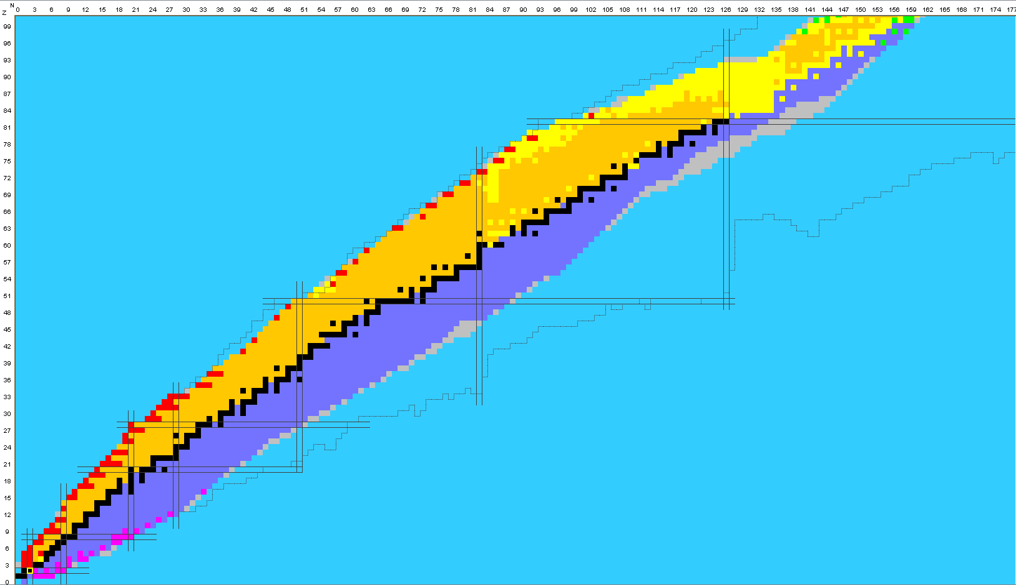
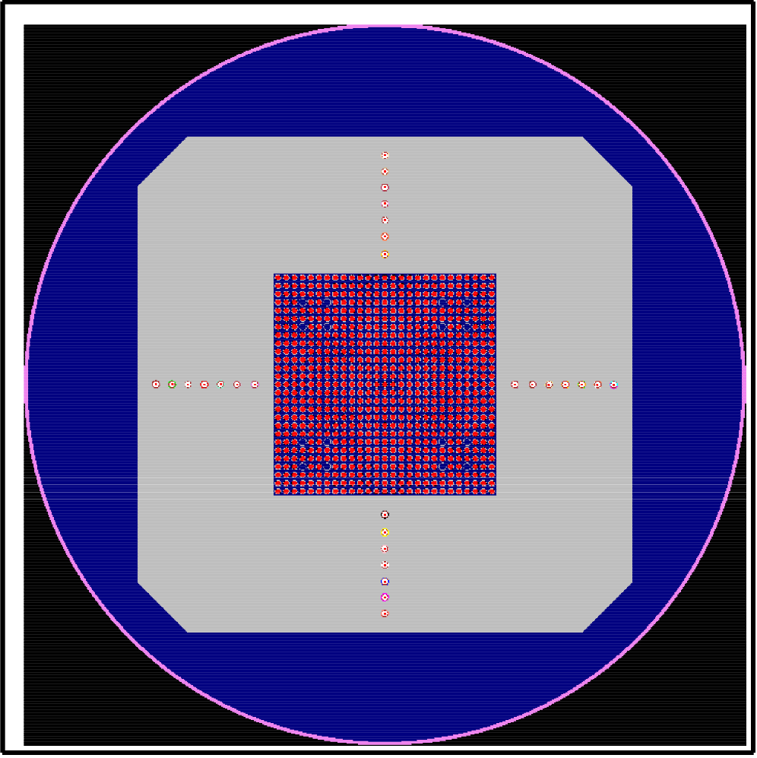
JEFF-4.0 γ-production evaluations and integral validation of γ-heating in ZPR/EOLE
D. Bernard, O. Litaize, A. Chebboubi, O. Serot
CEA, DES, IRESNE, DER, SPRC, Cadarache, Physics Studies Laboratory, 13108 Saint-Paul-lès-Durance, France
david.bernard@cea.fr

Slide 2
Outline
JEFF-4.0/GP capture-γ overall analysis
New JEFF-4.0 Prompt Fission & Capture Gamma Spectra & Multiplicities
Benchmarking and Validation of γ-heating in ZPR/LWR/EOLE core using JEFF-3.1.1 and JEFF-4.0
Conclusions & perspectives

Slide 3
Outline
JEFF-4.0/GP capture-γ overall analysis
New JEFF-4.0 Prompt Fission & Capture Gamma Spectra & Multiplicities
Benchmarking and Validation of γ-heating in ZPR/LWR/EOLE core using JEFF-3.1.1 and JEFF-4.0
Conclusions & perspectives

Slide 4
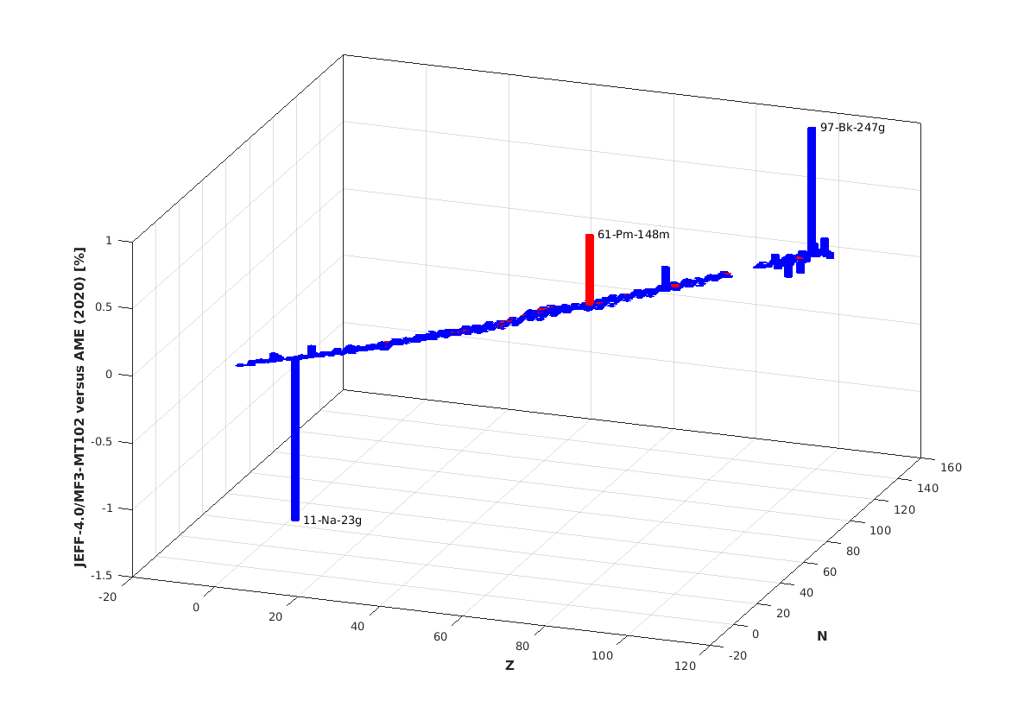
JEFF-4.0/GP capture-γ overall analysis
2010 (!): many MF3-MT102/Q-value were not correct in JEFF-3.1.1
JEFF-4.0 (593 files) corrected almost all of them (<1%):

Slide 5
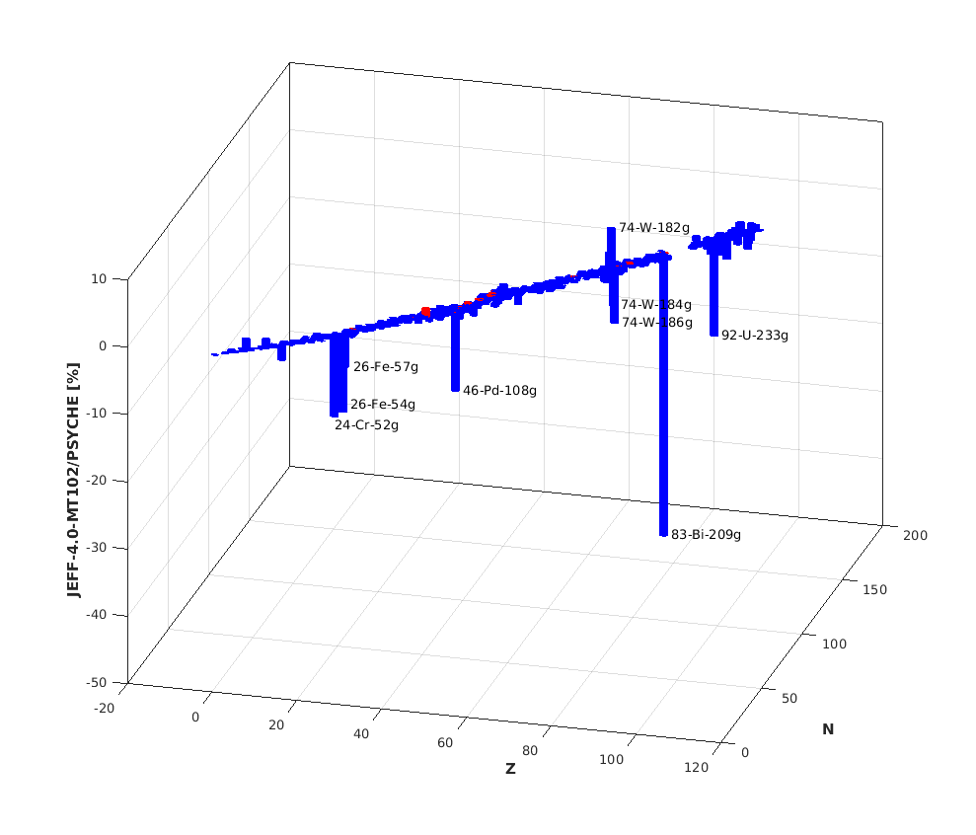
JEFF-4.0/GP capture-γ overall analysis
Since JEFF-4.0/MF3-MT102/Qvalues are correct,
the completeness of γ-spectra+multiplicities is tested by PSYCHE tool (thanks to NEA processing Docker files):
MF6 discrete (527 files): 29 041 γ-lines@thermal
MF6 continuum only (37 files)
or composite files MF5-12-13-15 (22 files)
No γ-production files (7 files: ^{113,115}In, ¹⁸O, ¹³C…)

Slide 6
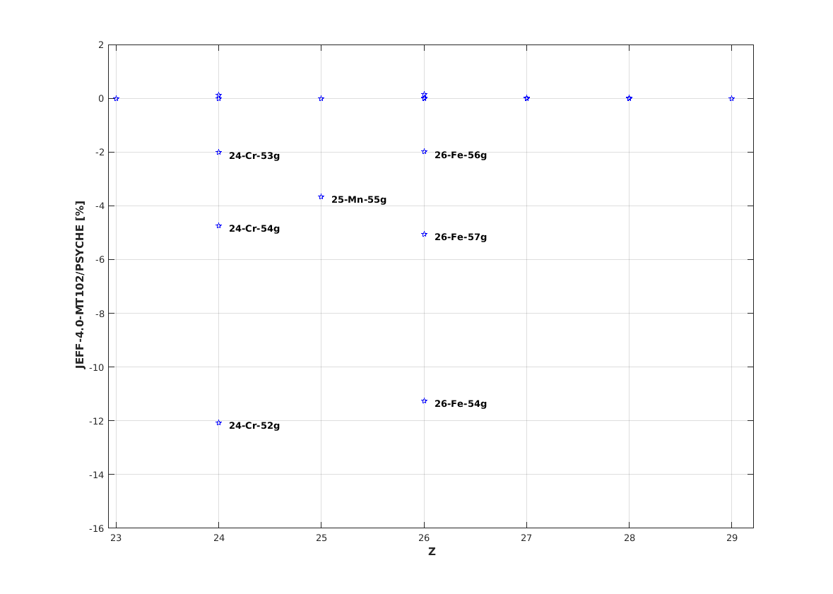
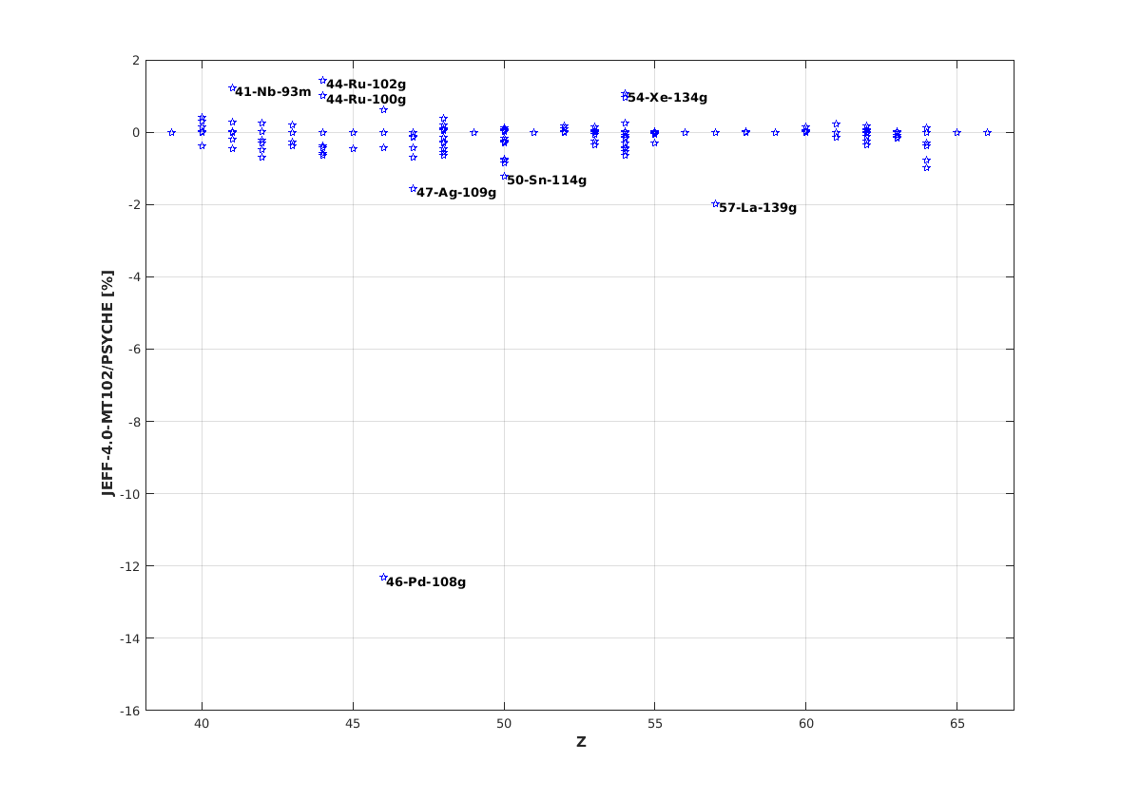
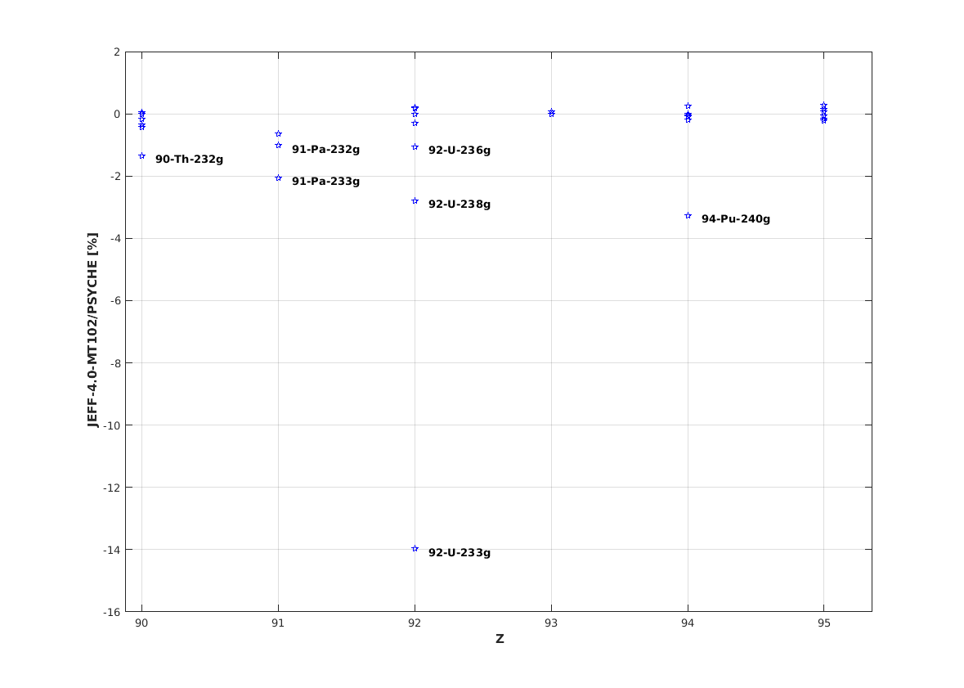
JEFF-4.0/GP capture-γ overall analysis
Incomplete MT102 γ-production files
^{52,53,54}Cr: -12.1%, -2.0%, -4.7% resp.
⁵⁵Mn: -3.7%
^{54,56,57}Fe: -11.2%, -2.0%, -5.1% resp.
¹⁰⁸Pd: -12.3% ^{93m}Nb: +1.2%
¹⁰⁹Ag: -1.6% ^{100,102}Ru: +1.0%, +1.4%
¹¹⁴Sn: -1.2% ¹³⁴Xe: +1.1%
¹³⁹La: -2.0%
²³²Th: -1.3%
^{233, 236,238}U: -14.0, -1.1%, -2.8% resp.
²⁴⁰Pu: -3.3%
JEFF-3.1.1/⁵⁶Fe(MF12-14-15): -1.3%
JEFF-3.2/⁵⁶Fe(MF6): -4.3% (ICC corrected)

Slide 7
Outline
JEFF-4.0/GP capture-γ overall analysis
New JEFF-4.0 Prompt Fission & Capture Gamma Spectra & Multiplicities
Benchmarking and Validation of γ-heating in ZPR/LWR/EOLE core using JEFF-3.1.1 and JEFF-4.0
Conclusions & perspectives

Slide 8
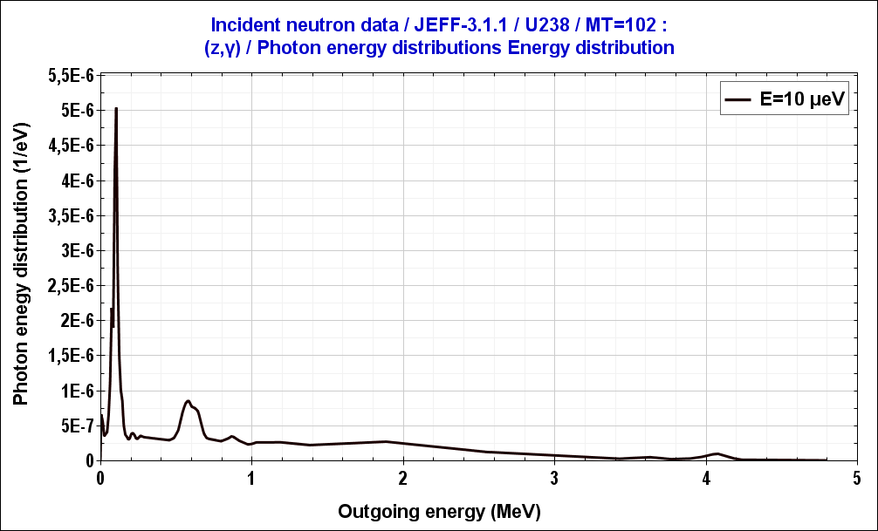
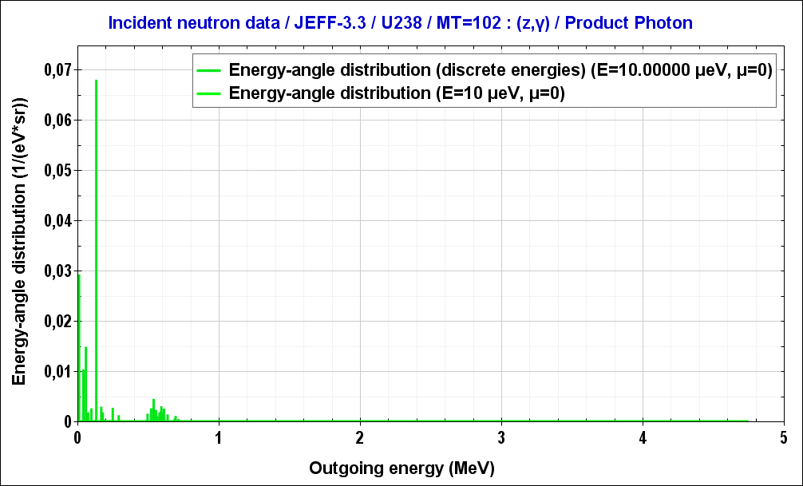
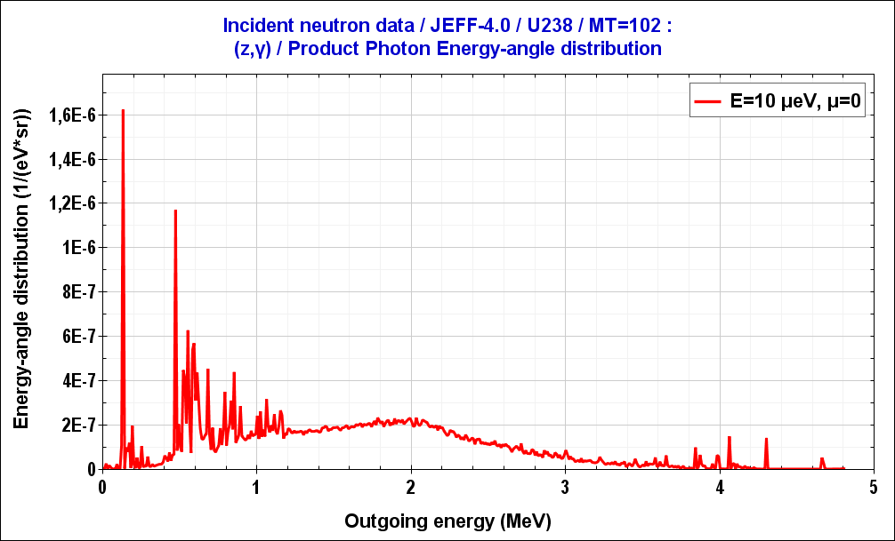
JEFF-4.0 Prompt Capture Gamma Spectra & Multiplicities
FIFRELIN calculations in decay mode at thermal point and 150 keV
U238 : LDM (CTM), PSF (MGLO 2xE1 + 3xM1 + 1xE2) adapted to better reproduce <Γ_{γ}>, <D₀> and
multi-step gamma-ray energy spectra measured at nTOF.
Pu240 : LDM, PSF from default models (CGCM/EGLO)
Conversion electrons accounted for but not stored in the γ-section of the evaluation (slight Q value difference, ~ 100 keV)
J. Moreno-Soto et al., Phys. Rev. C 105, 024618 (2022)
JEFF-3.1.1
(MF12-14-15)
JEFF-3.3
(MF6, discrete + cont’)
JEFF-4.0
(MF6, histog)

Slide 9
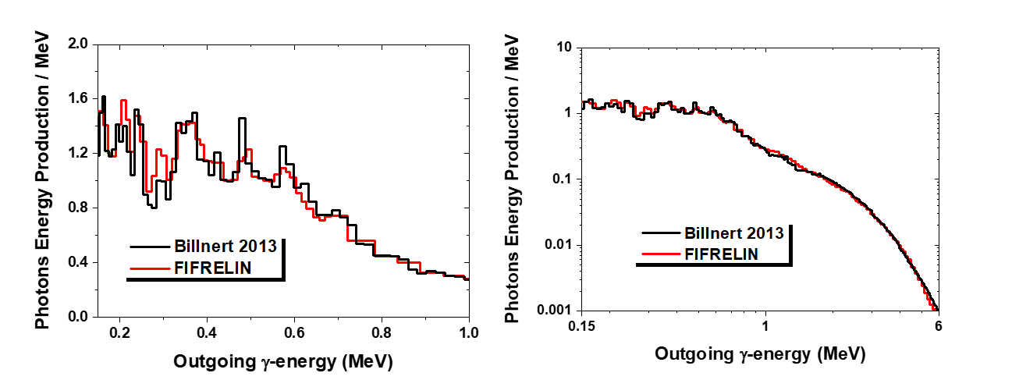
JEFF-4.0 Prompt Fission Gamma Spectra & Multiplicities
FIFRELIN calculation validated on PFGS and PFGM of ²⁵²Cf(sf) measured by Billnert
R. Billnert et al., Phys. Rev. C87, 024601 (2013)

Slide 10
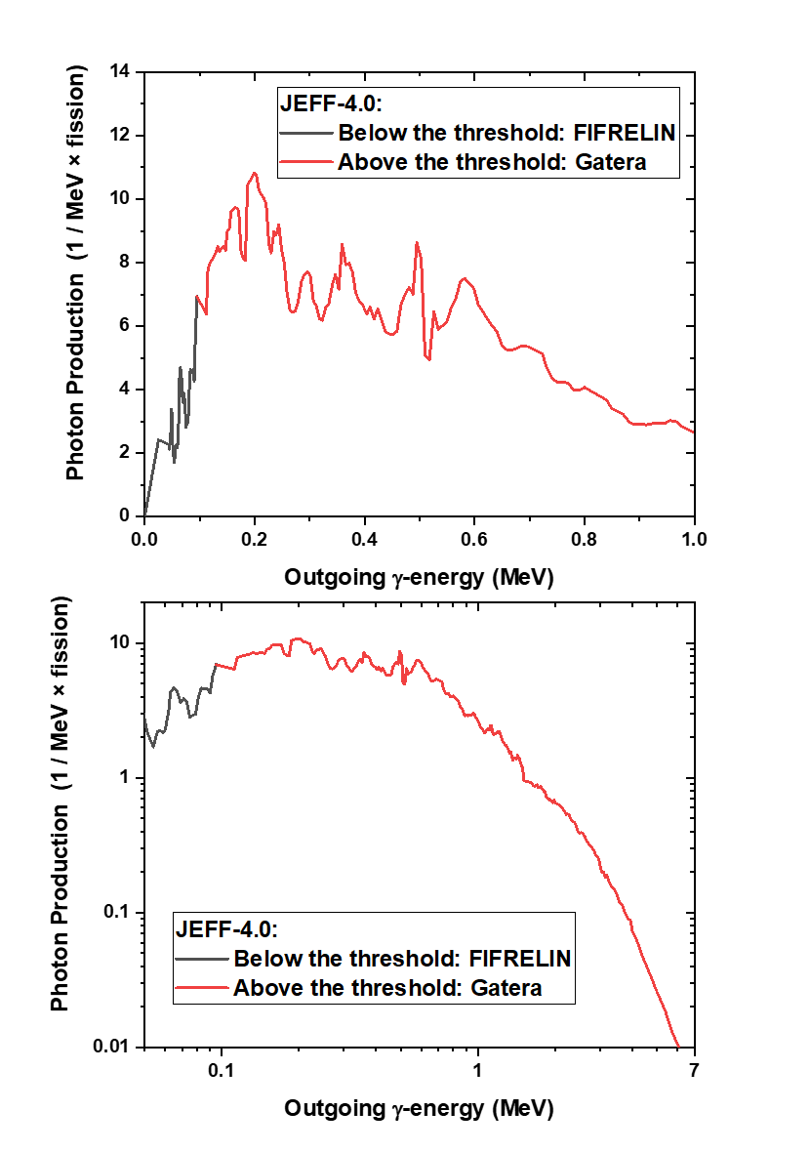
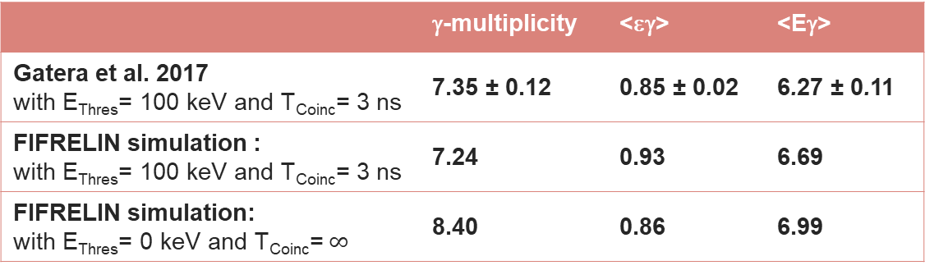
JEFF-4.0 Prompt Fission Gamma Spectra & Multiplicities
Example ²³⁹Pu(n_{th},f) reaction
 | γ-multiplicity | <εγ> | <Eγ>
Gatera et al. 2017 with E_{Thres}= 100 keV and T_{Coinc}= 3 ns | 7.35 ± 0.12 | 0.85 ± 0.02 | 6.27 ± 0.11
FIFRELIN simulation : with E_{Thres}= 100 keV and T_{Coinc}= 3 ns | 7.24 | 0.93 | 6.69
FIFRELIN simulation: with E_{Thres}= 0 keV and T_{Coinc}=$∞$ | 8.40 | 0.86 | 6.99
A. Gatera et al. PRC 95, 064609 (2017)

Slide 11
Outline
JEFF-4.0/GP capture-γ overall analysis
New JEFF-4.0 Prompt Fission & Capture Gamma Spectra & Multiplicities
Benchmarking and Validation of γ-heating in ZPR/LWR/EOLE core using JEFF-3.1.1 and JEFF-4.0
Conclusions & perspectives

Slide 12
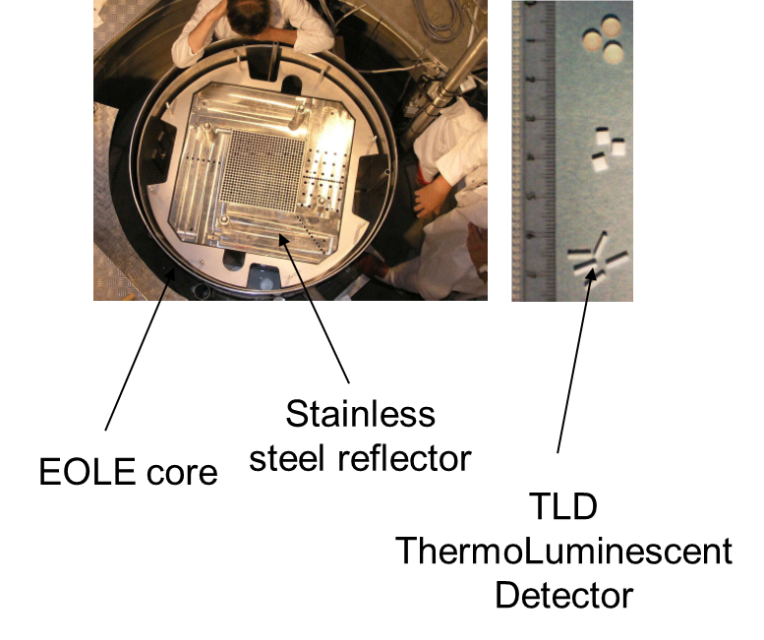
Experimental set-up
Sub-critical approach
10 W x 604s critical and
few minutes of cooling
Neutron dose correction (ASTM)

Slide 13
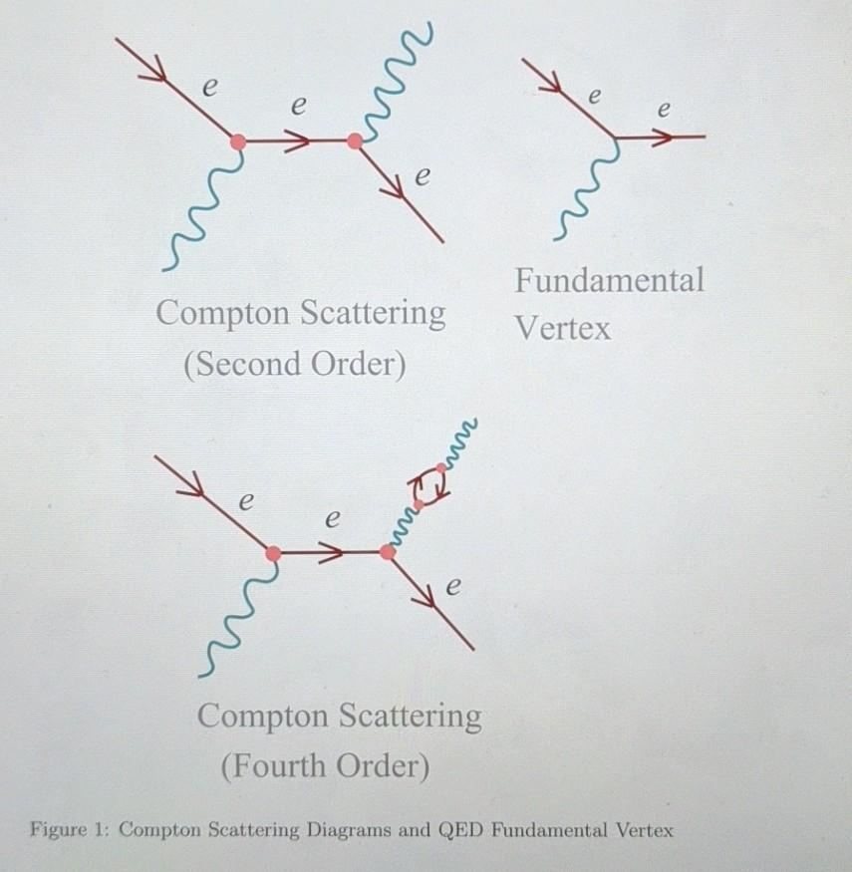
TRIPOLI-4® Calculation scheme
k_{eff}(JEFF-3.1.1)= 1.00 222
k_{eff}(JEFF-4.0) = 1.00 077
σ∼0.4pcm
Neutron+photon+electron+positon
EPDL-97 (photon transport)
∼100,000 h.cpu
EEDL&Mott (electron transport) + EADL (atomic relaxation)…

Slide 14
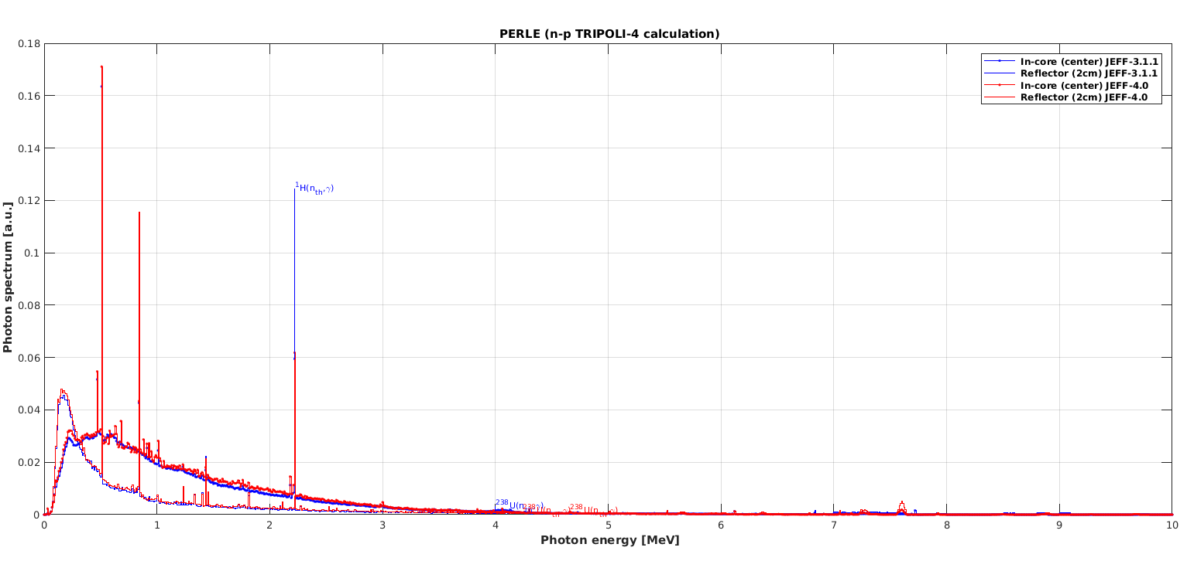
^{PERLE prompt-γ-spectra}

Slide 15
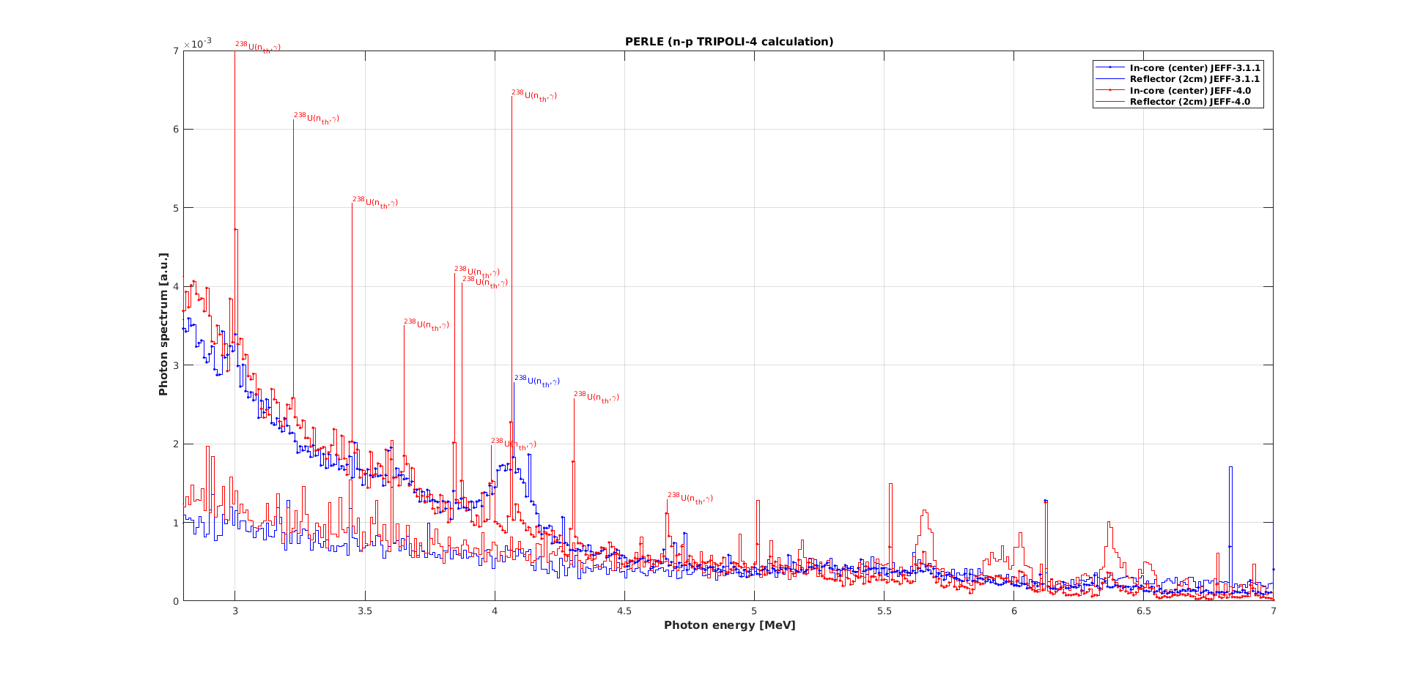
^{PERLE prompt-γ-spectra}

Slide 16
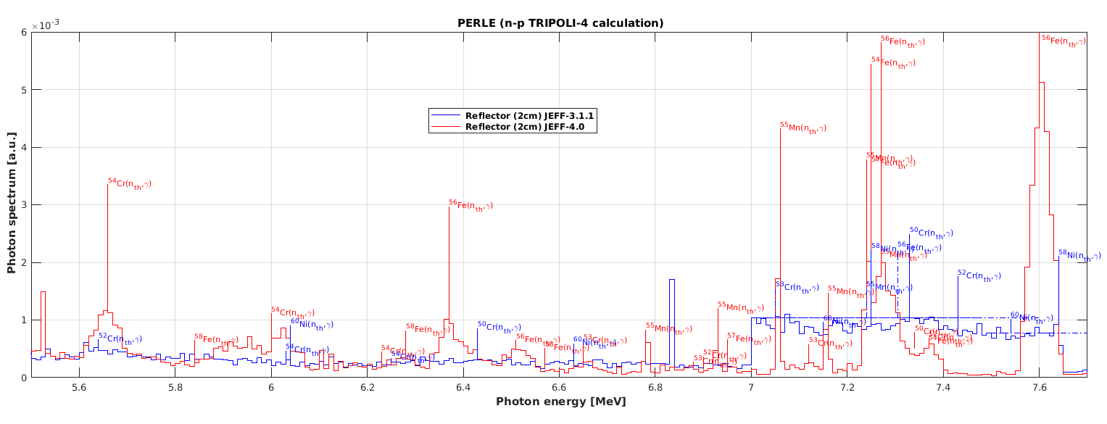
^{PERLE prompt-γ-spectra}

Slide 17
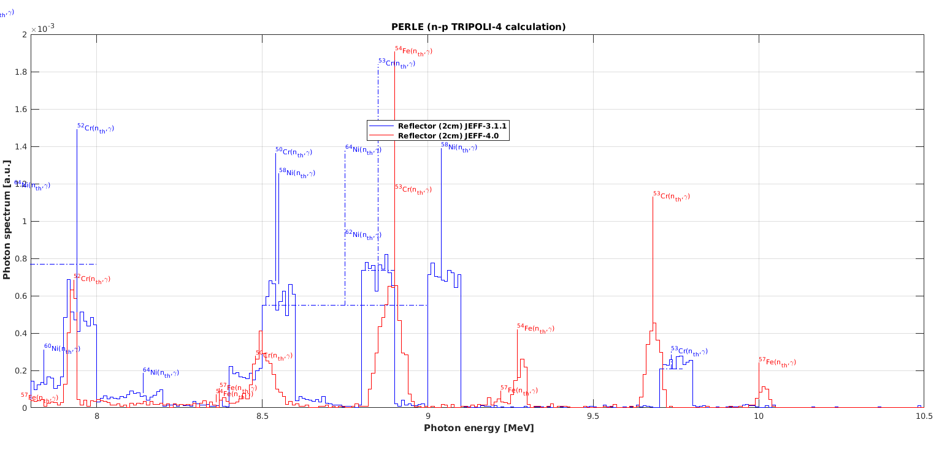
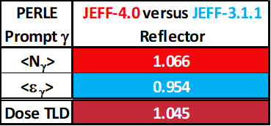
^{PERLE γ-spectra}

Slide 18
Complete scoring TRIPOLI-4.12.1® (JEFF-3.1.1)

Slide 19
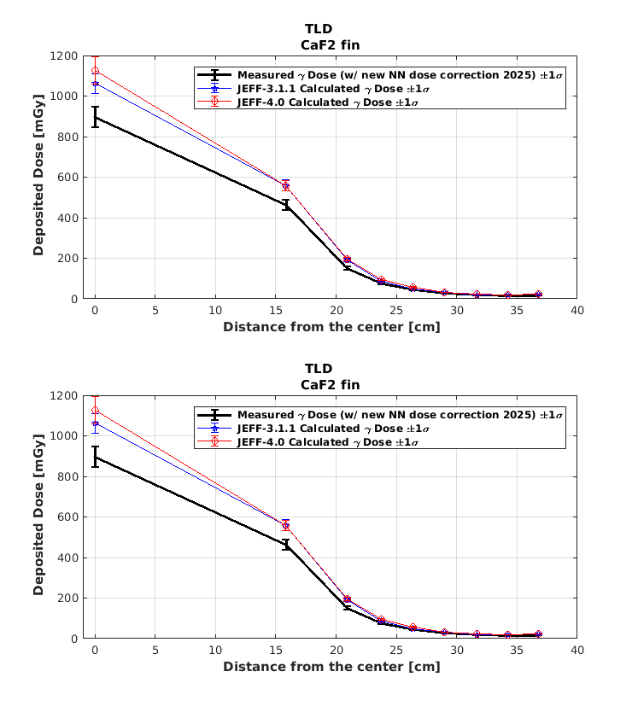
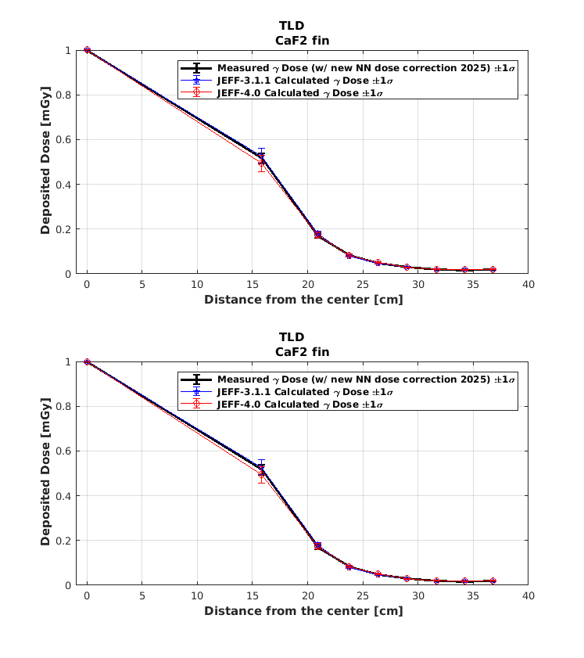
Detailed Results:
The Stainless-Steel prompt heating is increasing by (+4.5±0.9)% !
Probably due to:
The increase of the total capture rates by +1.5% : ⁵³Cr(n,γ) responsible for +1.1% (only 1/3rd on the ∼5 keV multiplet), ⁵⁵Mn for +0.6%, ⁵²Cr for +0.4%, ⁵⁶Fe for -0.4%, ⁵⁸⁺⁶⁰Ni for -0.5%...with respect of total capture in the reflector
The modification of γ-production files for probably 3%...
Absolute dose
Relative dose

Slide 20
Outline
JEFF-4.0/GP capture-γ overall analysis
New JEFF-4.0 Prompt Fission & Capture Gamma Spectra & Multiplicities
Benchmarking and Validation of γ-heating in ZPR/LWR/EOLE core using JEFF-3.1.1 and JEFF-4.0
Conclusions & perspectives

Slide 21
Conclusion
JEFF-4.0/prompt γ-production at thermal (29 041 discrete lines!) seems correct for most of nuclides (Atomic Mass Evaluation + PSYCHE), except:
    Qvalues: ²³Na, ^{148m}Pm, ²⁴⁷Bk
    Spectra & Multiplicities: Ag-^{113,115}In-Cd, Fe-Cr-Ni, Mn, Gd…, fission products, actinides…
JEFF-4.1:
  How to manage low nrj conversion emission ? And consecutive X-rays+Auger… (GNDS ?)
  Account for IAEA/EGAF and extend the incident energy range (cf. the IAEA initiative).
EOLE/PERLE interpretation shows a clear increase in γ-heating in ZPR. This partially addresses the OECD/NEA/HPRL requests #4&5 that were submitted exactly 20 years ago (May, 12, 2006) !
All these results will guarantee the reliability of JEFF-4.0 γ-heating calculations for the nuclear industry.

Slide 22
MERCI !
Questions ?

Slide 23
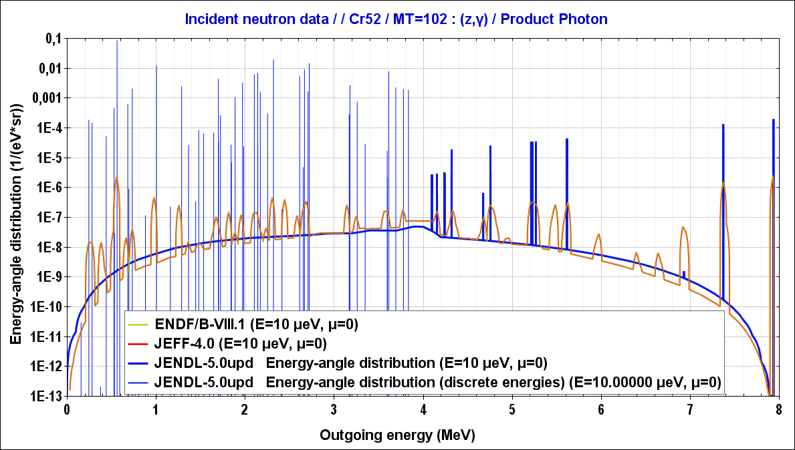
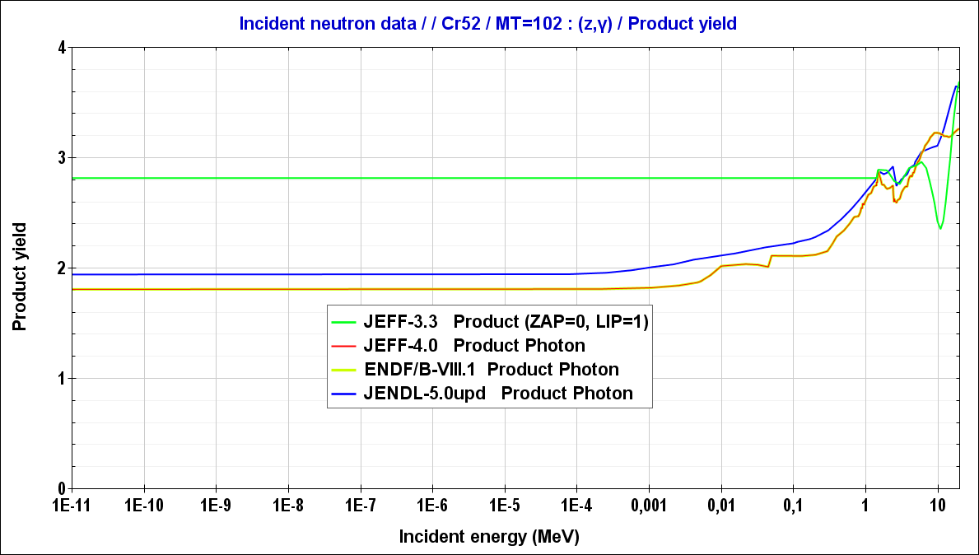
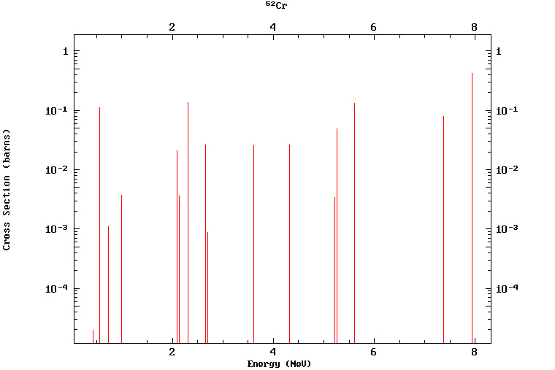
⁵²Cr(n_{th},γ)
JEFF-4.0: 0.854(28)b n-XS
IAEA/PGAA: 0.857(15)b reconstructed γ+$e_{ICC}^{−}$ production XS

Slide 24
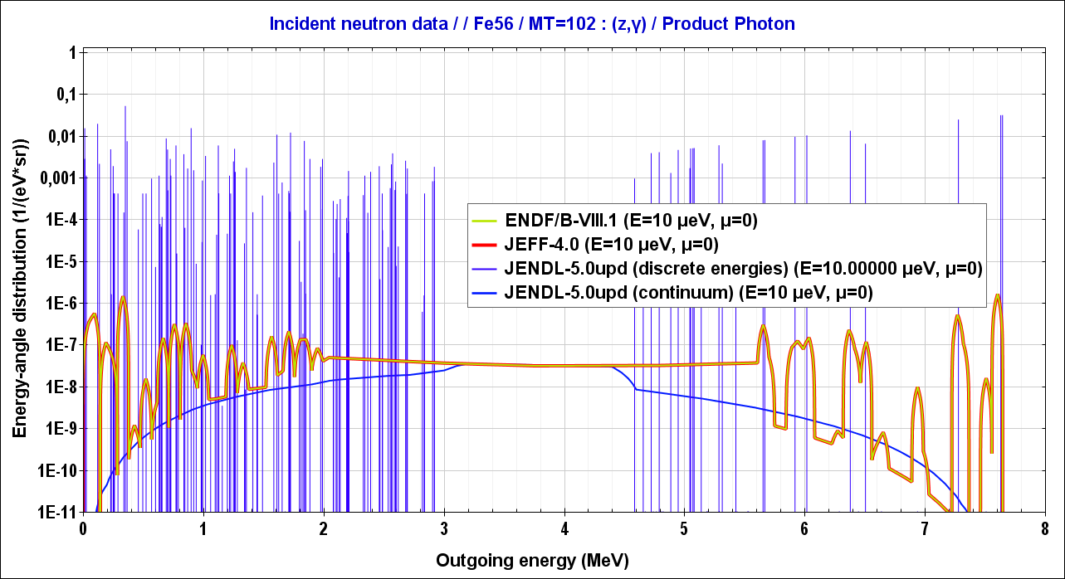
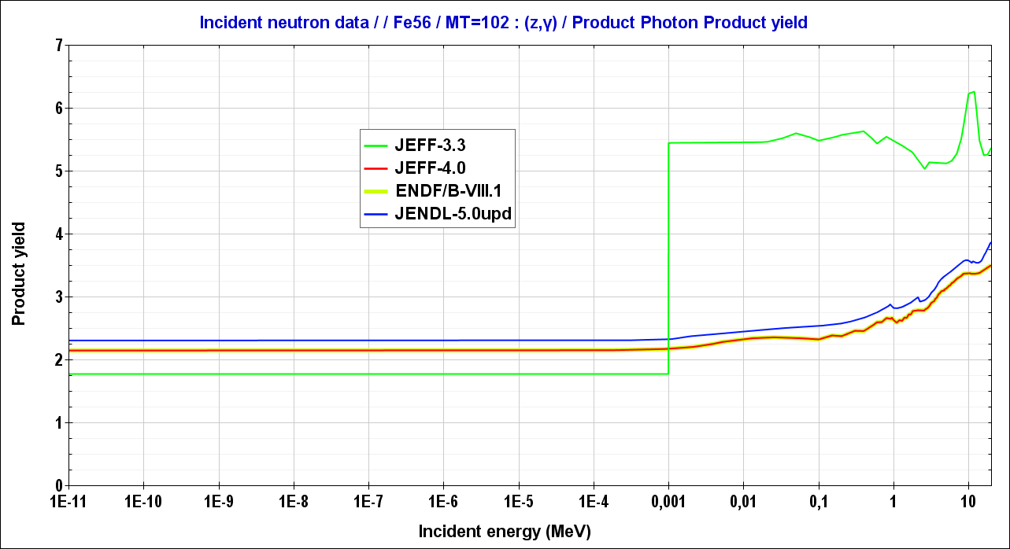
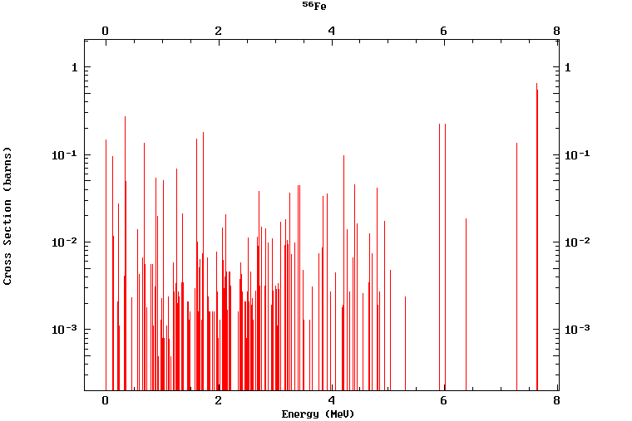
⁵⁶Fe(n_{th},γ)
JEFF-4.0: 2.59(13)b n-XS
IAEA/PGAA: 2.48(2)b reconstructed γ+$e_{ICC}^{−}$ production XS

Slide 25
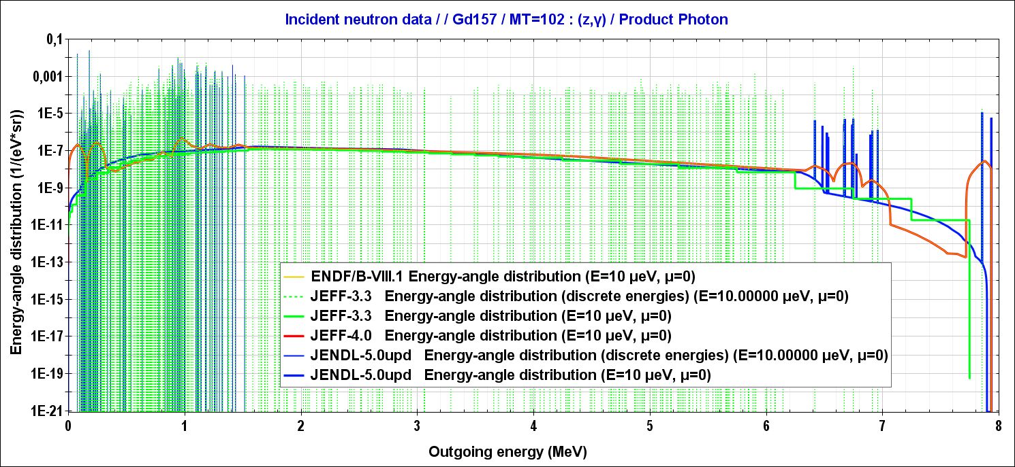
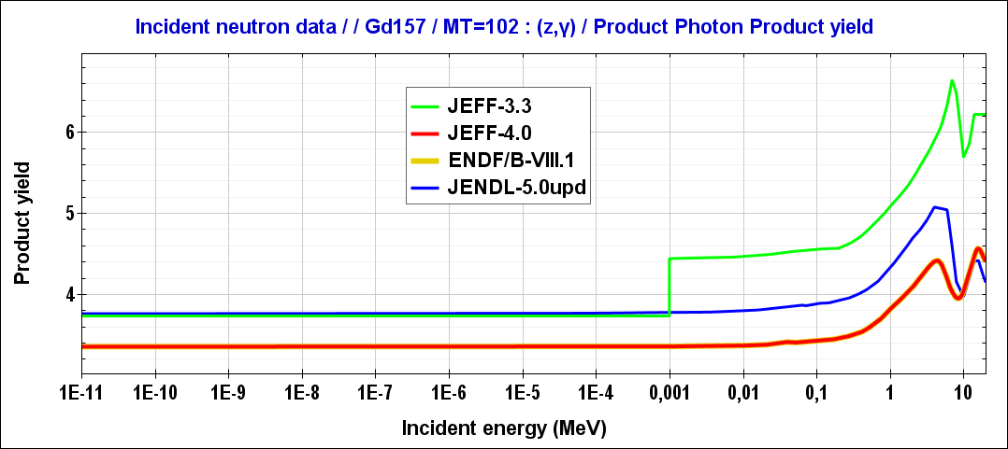
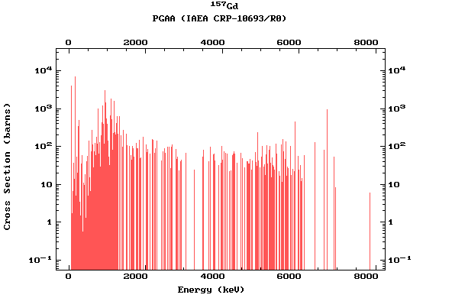
¹⁵⁷Gd(n_{th},γ)
JEFF-4.0: 254.6(0!)kb n-XS
IAEA/PGAA: 63.0(4)kb reconstructed γ production XS
IAEA/PGAA

Slide 26
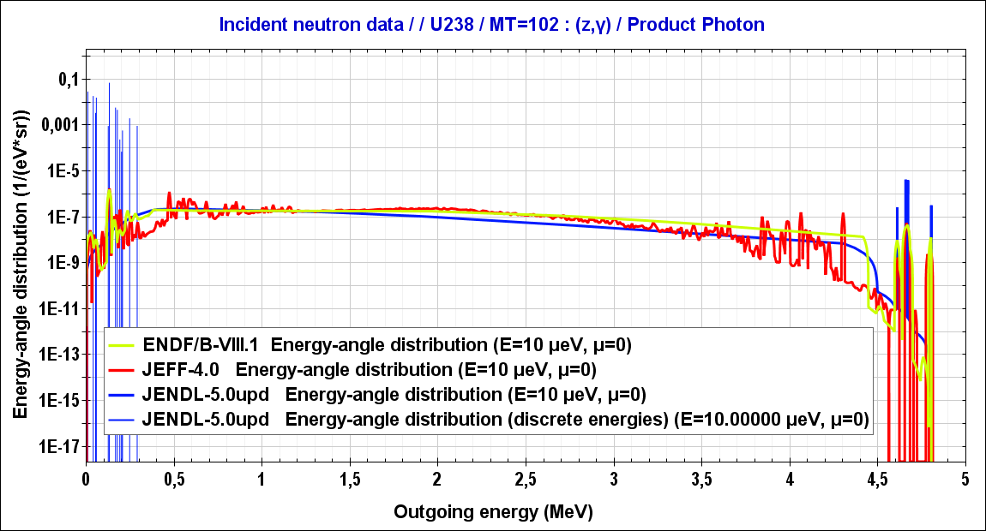
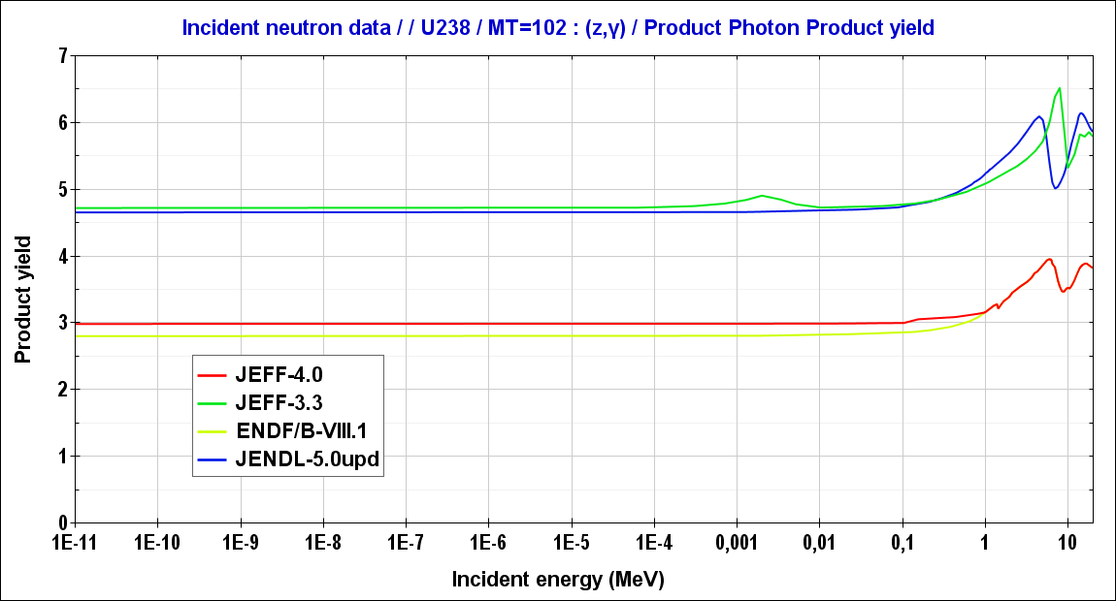
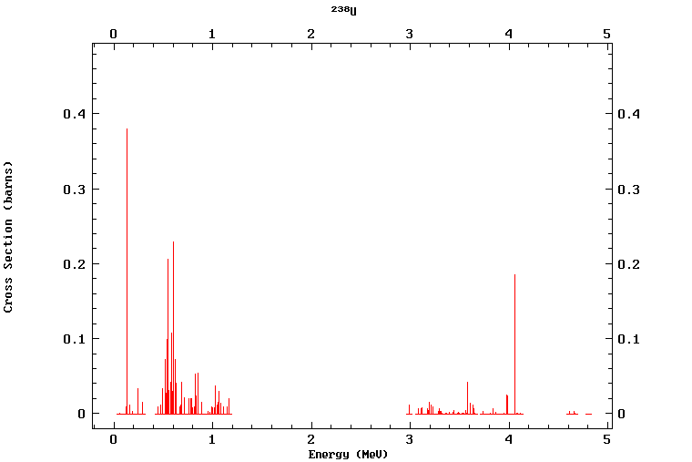
²³⁸U(n_{th},γ)
IAEA/PGAA

Slide 27
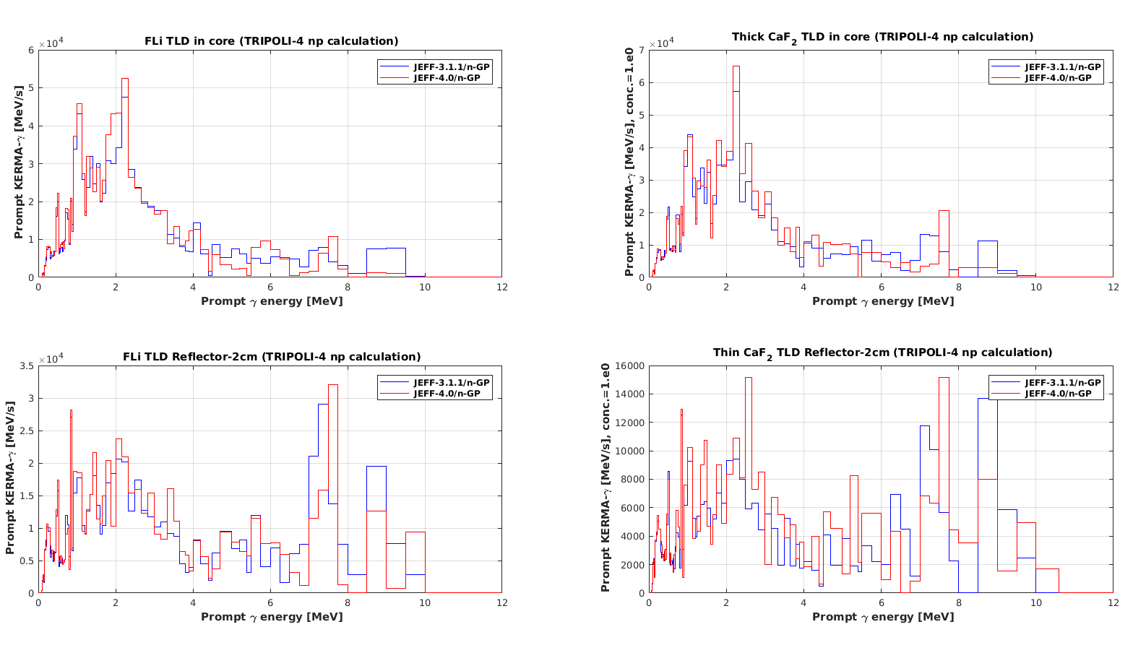
PERLE/KERMA-γ

Slide 28
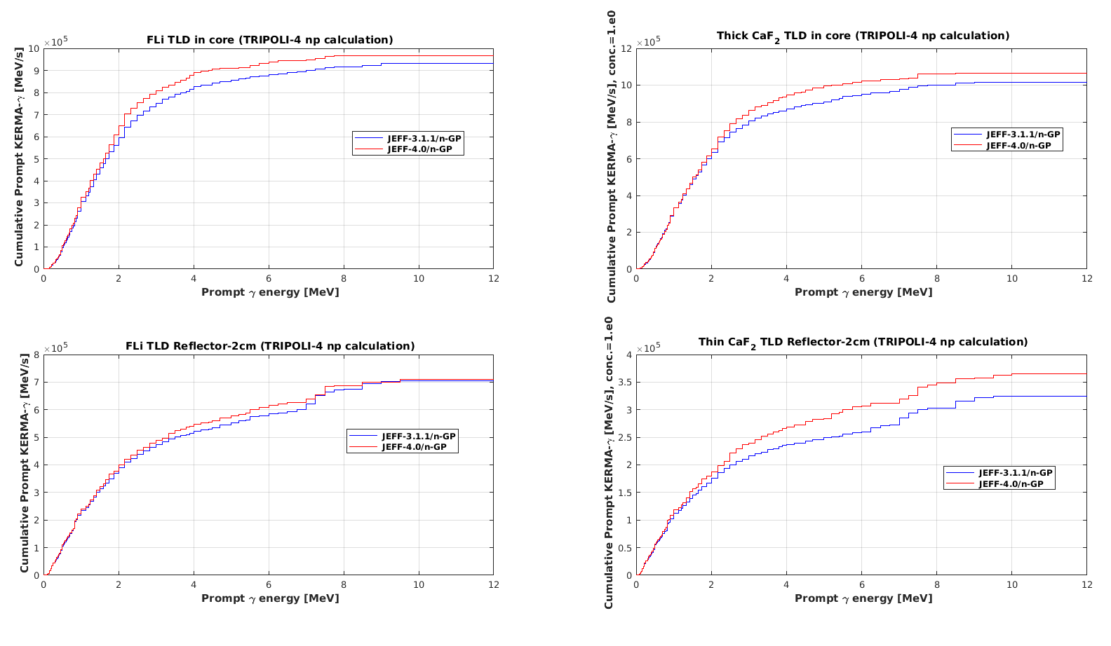
PERLE/cumulative(KERMA-γ)

