Slide 1


Neutron-induced fission and activation studies of NTUA
at the neutron facility of NCSR “Demokritos”
Rosa Vlastou
National Technical University of Athens (NTUA)
Department of Physics, Athens, Greece
Rosa Vlastou - WONDER 2026 – June 29 - July 3, 2026 - Aix-en-Provence, France 1/22

Slide 2
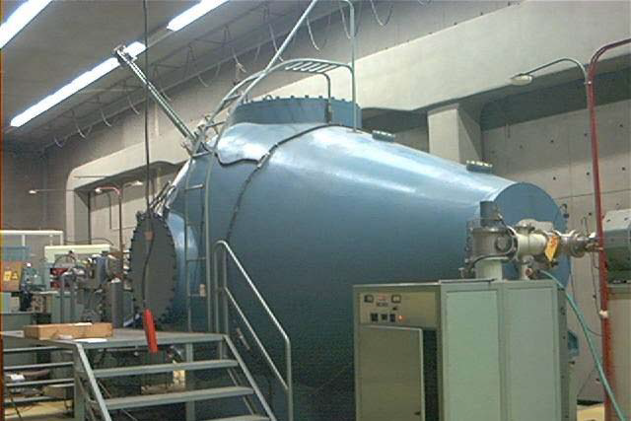
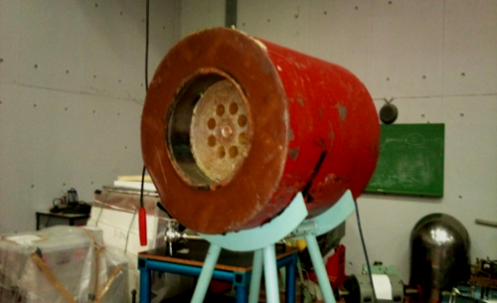
The Neutron Facility – Available Beams
The 5.5 MV tandem T11/25 Accelerator at NCSR “Demokritos”
in Athens is the only accelerator facility in Greece.
It has been recently renovated through the program CALIBRA/EYIE.
The neutron facility can deliver quasi-monoenergetic neutron beams at energies :
• ~ 120 – 900 keV via the ⁷Li(p,n)⁷Be reaction - Flux: ~ 10⁵n/cm²s
~ 2- 5.3 MeV via the ³H(p,n)³He reaction – Flux : ~ 10⁵n/cm²s
• ~ 4.0 – 11.4 MeV via the ²H(d,n)³He reaction - Flux: ~ 10⁶n/cm²s
• ~ 15 – 20 MeV via the ³H(d,n)⁴He reaction - Flux: ~ 10⁵n/cm²s
The flux variation of the neutron beam is monitored by using a BF3 detector with paraffin moderator, whose spectra are stored at regular time intervals. The absolute flux of the beam can be obtained with respect to reference reactions, such as ⁵⁶Fe(n,p), ²⁷Al(n,α), ¹⁹⁷Au(n,2n) and ⁹³Nb(n,2n) for cross section measurements implementing the activation technique as well as ²³⁸U(n,f) and ²³⁵U(n,f) for fission cross section measurements.
R.Vlastou. EPJ Techniques and Instrumentation (2023) 10:4.
Rosa Vlastou - WONDER 2026 – June 29 - July 3, 2026 - Aix-en-Provence, France 2/22

Slide 3
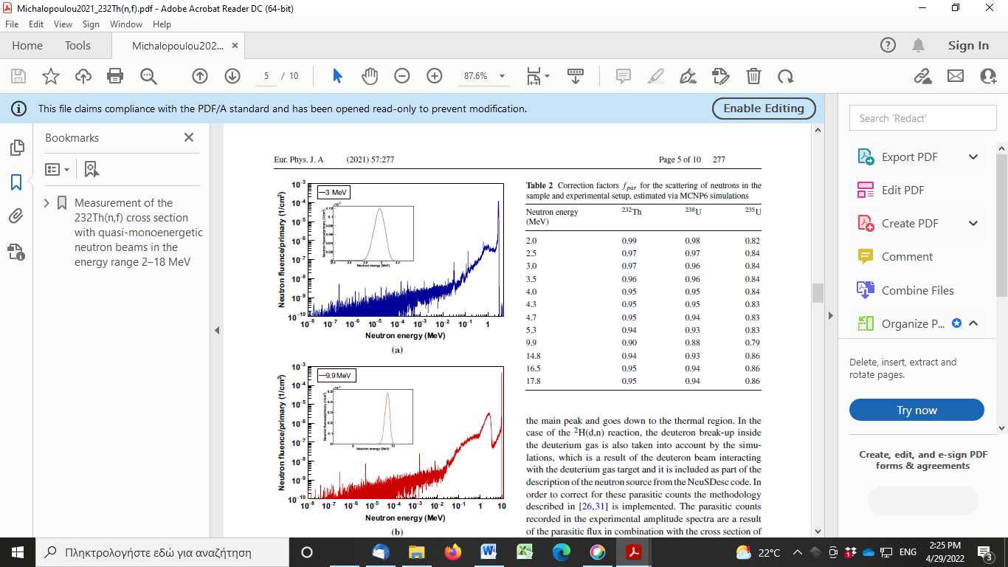
The Neutron Facility – the ⁷Li(p,n)⁷Be and ³H(p,n)³He reactions
⁷LiF target (~60 - 300 μg/cm²) on Au or Ta backing and proton beams in the energy range Ep = 1.9 – 2.4 MeV to produce purely mono-energetic neutrons at zero degrees between 120 keV and 650 keV, respectively. At proton energies above 2.4 MeV, neutron emission from the 1st excited state in ⁷Be at 429 keV is possible and produces a second group of monoenergetic neutrons.
Ti tritiated target of 373 GBq activity on a Cu backing (with 10μm Mo foil in front) and proton beams in the energy range 3.4 – 6.5 MeV to produce neutrons between 2- 5.3 MeV . Μono-energetic neutrons in the range ~ 2-3 MeV, then (p,n) reactions on Mo, Ti, Cu, C and ²H implanted in the TiT target from previous irradiations, become important and lead to a long neutron tail down to the thermal region.
In the absence of Time-of-Flight capabilities, methodologies that rely both on simulations and experimental techniques have been developed in order to study in detail the neutron production and propagation to account for the parasitic neutron spectrum – NeuSDesc/NEBOAS and MCNP simulations
A. Stamatopoulos et al., Eur. Phys. J. A (2018) 54: 7, V. Michalopoulou et al., Eur. Phys. J. A (2021) 57:277, M. Diakaki et al., Appl. Rad. Isotopes 226(2025)112113
Rosa Vlastou - WONDER 2026 – June 29 - July 3, 2026 - Aix-en-Provence, France 3/22

Slide 4
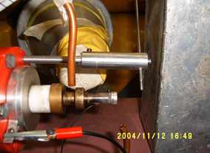
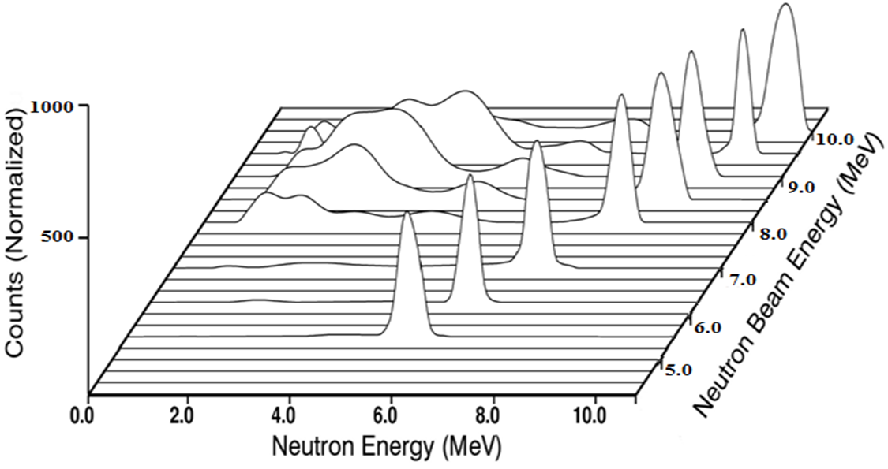
The Neutron Facility – the ²H(d,n)³He reaction
A 3.7 cm gas cell with a 5μm Mo entrance foil and deuteron beams in
the energy range 0.8 – 9.6 MeV to produce neutrons between
~ 4-11.4 MeV. Purely mono-energetic in ~ 4-7 MeV – above parasitic
neutrons mainly due to deuteron break up reactions :
²H(d,pn)²H above Ed = 4.5 MeV
²H(d,2n)²He above Ed = 8.9 MeV
reactions with the isotopes of Mo gas cell window, above the Coulomb barrier Ed = ~7 MeV and structural materials of the gas cell, collimators etc.
In absence of time-of-flight capabilities, the neutron beam has been characterized by means of a) MCNP5 Monte Carlo simulations, b) multiple foil activation technique in combination with unfolding codes and c) deconvolution of recoil energy spectra taken with the BC501A liquid scintillator detector at various neutron energies with the DIFBAS code d) Gas-in gas-out tests, irradiations with and without Cd foil in front of reference foils.
Threshold reactions can be safely measured, since the low energy parasitic neutrons involved in the beam, cannot affect the cross section measurements.
R.Vlastou et al. Nucl.Instr.Meth. B269 (2011)3266
M.Diakaki et al., EPJ Web of Conferences 239, 05001 (2020)
MCNP simulations
The energy distribution of the neutron flux from the ²H(d,n) reaction deduced via the DIFBAS code
Rosa Vlastou - WONDER 2026 – June 29 - July 3, 2026 - Aix-en-Provence, France 4/22

Slide 5
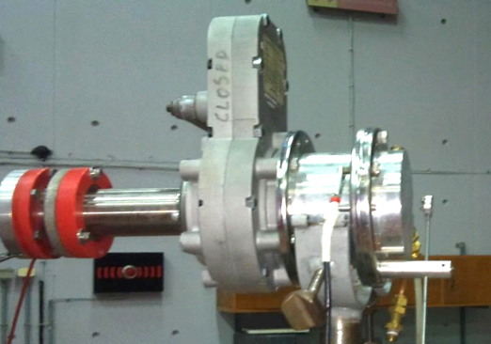
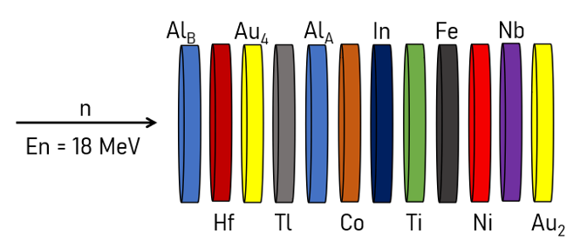
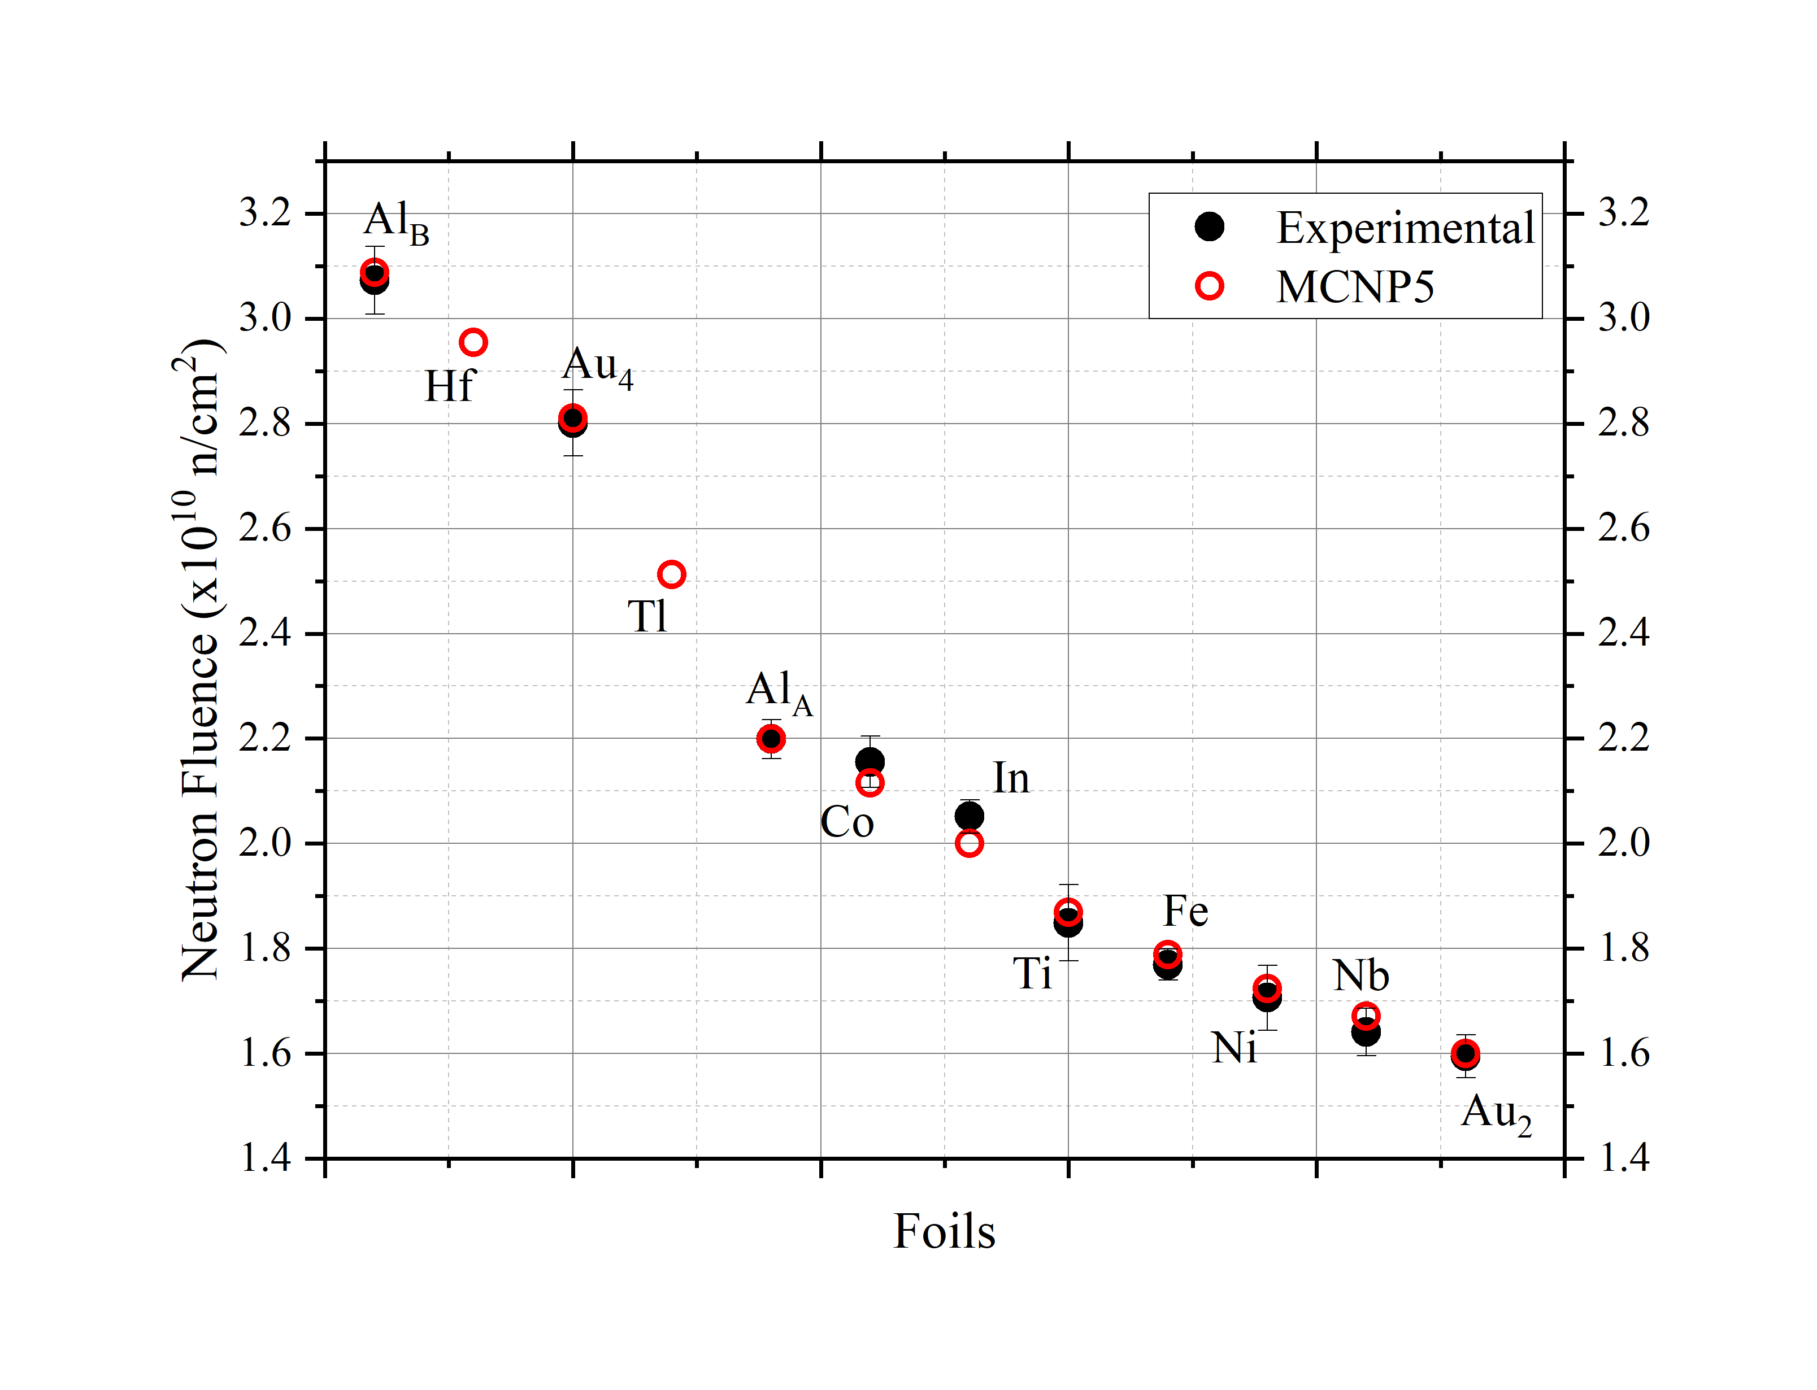
The Neutron Facility – the ³H(d,n)⁴He reaction
Ti tritiated target of 373 GBq activity on a Cu backing (with 10μm Mo foil in front) and deuteron beams in the energy range 0.8 – 3.7 MeV MeV to produce neutrons between ~ 15 - 20 MeV
Neutron beam not purely monoenergetic due to parasitic neutrons from deuteron break up reactions and reactions with materials of beam line and target : ³H(d,pn)³H, ²H(d,n)³He, Ti(d,n), O(d,n) and C(d,n)
Characterization via: NeuSDesc/NEBOAS and MCNP5 Monte Carlo Simulations, Multiple foil activation technique and other experimental techniques
R. Vlastou et al., Phys. Proc. 66, 425 (2015)
V. Michalopoulou, EPJ (2021) A57-277
The saturated activities were used as input in the SAND-II unfolding code to calculate the energy dependence of the neutron flux in the range 10⁻⁵ – 18 MeV - Preliminary results
Rosa Vlastou - WONDER 2026 – June 29 - July 3, 2026 - Aix-en-Provence, France 5/22

Slide 6
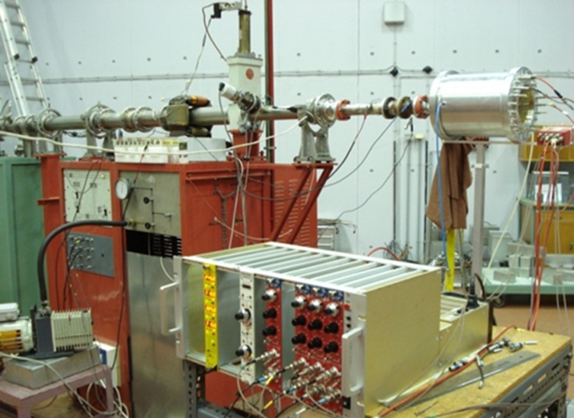
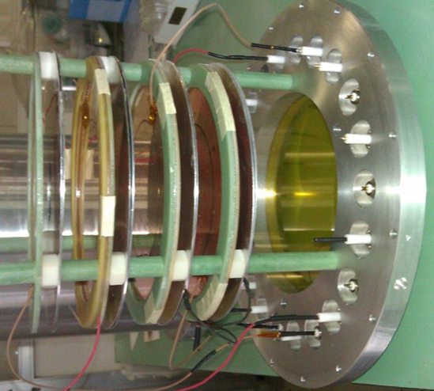
The Neutron Facility – Research Activities of NTUA group
a) Irradiations for applications:
detector physics (Diamond detectors, CERN ATLAS Muon Detector Tubes)
space electronics (ESA)
b) n-induced reactions relevant to nuclear energy applications:
Reactions on minor actinides with importance to fundamental research
and applications like development of fast reactor systems, nuclear waste etc
(n,2n) reactions by the activation method (²³²Th(n,2n), ²⁴¹Am(n,2n))
Fission cross sections with MicroMegas detectors (²³²Th, ^{233,234,236}U,²³⁷Np)
c) (n,2n), (n,p) and (n,α) cross section measurements by the activation
method relevant to practical applications for nuclear technology, high energy neutron dosimetry, detector physics etc. and also important for investigation of the model parameters of statistical model calculations
( Examples : Ge, Mo, Au, Ir, Tl isotopes) – Need for accurate data!
Rosa Vlastou - WONDER 2026 – June 29 - July 3, 2026 - Aix-en-Provence, France 6/22

Slide 7
The Neutron Facility – Research Activities of NTUA group
a) Irradiations for applications:
detector physics (Diamond detectors,CERN ATLAS Muon Detector Tubes)
space electronics (ESA)
b) n-induced reactions relevant to nuclear energy applications:
Reactions on minor actinides with importance to fundamental research
and applications like development of fast reactor systems, nuclear waste etc
(n,2n) reactions by the activation method (²³²Th(n,2n), ²⁴¹Am(n,2n))
Fission cross sections with MicroMegas detectors
(²³²Th, ^{233,234,236}U,²³⁷Np)
c) (n,2n), (n,p) and (n,α) cross section measurements by the activation
method relevant to practical applications for nuclear technology, high energy neutron dosimetry, detector physics etc. and also important for investigation of the model parameters of statistical model calculations
( Examples : Ge, Mo, Au, Ir, Tl isotopes) – Need for accurate data!
Rosa Vlastou - WONDER 2026 – June 29 - July 3, 2026 - Aix-en-Provence, France 6/22

Slide 8
Fission cross sections - Objectives
1) Nuclear industry research :
Improve safety and burn-up efficiency of current reactors (LWR), plant life extention. Manage Nuclear Waste.
Develop new generation of reactors (Gen-IV/SMR, fast reactors, ADS…)
Availability of accurate evaluated nuclear data on neutron induced reactions/fission => precise calculations for current/new generation reactor modeling
2) Fundamental nuclear physics research:
No ab-initio theory able to simultaneously predict all neutron induced fission observables.
Theoretical investigation of fission cross section still ongoing, mainly phenomenological. Tuning of model parameters based on microscopic experimental data (=> Evaluated nuclear data libraries).
Systematic studies important to better understand the process.
An extensive study of neutron-induced fission cross-sections at and above the fission threshold of various actinides has been carried out at the neutron beam facility of the National Centre for Scientific Research (NCSR) “Demokritos”.
Rosa Vlastou - WONDER 2026 – June 29 - July 3, 2026 - Aix-en-Provence, France 7/22

Slide 9
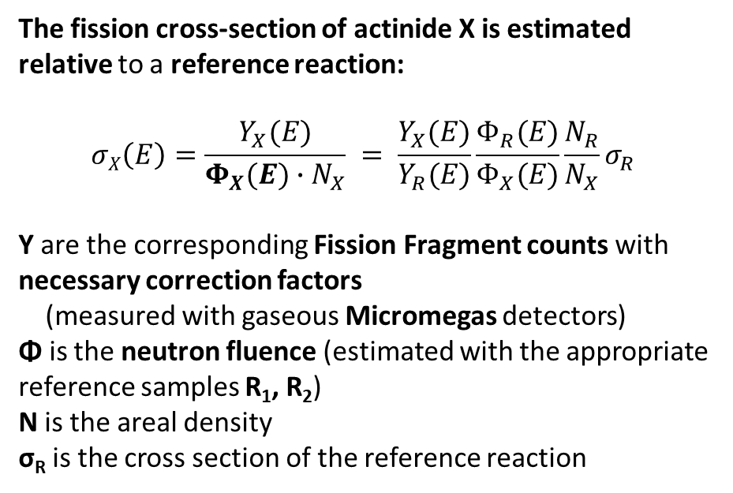
Fission cross sections - Outline
²³²Th(n,f), ^{233,234,236}U(n,f), ²³⁷Np(n,f) cross sections have been measured with quasi-monoenergetic neutron beams at different energies at NCSR “Demokritos” *
Determination of the NEUTRON FLUENCE Φ:
Reference reactions: ²³⁵U(n,f), ²³⁸U(n,f) (uncertainties <1%)
Reference samples configuration:
The fission cross-section of actinide X is estimated relative to a reference reaction:
$$σX\left(E\right)=\frac{Y_{X}(E)}{Φ_{X}(E)∙N_{X}} = \frac{Y_{X}(E)}{Y_{R}(E)}\frac{Φ_{R}(E)}{Φ_{X}(E)}\frac{N_{R}}{N_{X}}σ_{R}$$
Y are the corresponding Fission Fragment counts with necessary correction factors
(measured with gaseous Micromegas detectors)
Φ is the neutron fluence (estimated with the appropriate reference samples R₁, R₂)
N is the areal density
σ_{R} is the cross section of the reference reaction
“sandwich”:
Back-to-Back configuration
X
X
n
n
R₁
R₂
R₁
*
M. Diakaki et al., Eur. Phys. J. A (2013) 49: 62
M. Diakaki et al., Acta Phys. Pol. B 47(2016)789
A. Stamatopoulos et al., Eur. Phys. J. A (2018) 54: 7
M. Diakaki et al., EPJ Web Conf. (2020) 239: 05001
A. Kalamara et al., EPJ Web Conf. (2020) 239: 05005
V. Michalopoulou et al., Eur. Phys. J. A (2021) 57:277
M. Diakaki et al., Appl. Rad. Isotopes 226(2025)112113
and references therein
Rosa Vlastou - WONDER 2026 – June 29 - July 3, 2026 - Aix-en-Provence, France 8/22

Slide 10
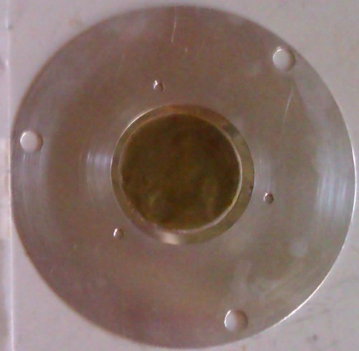
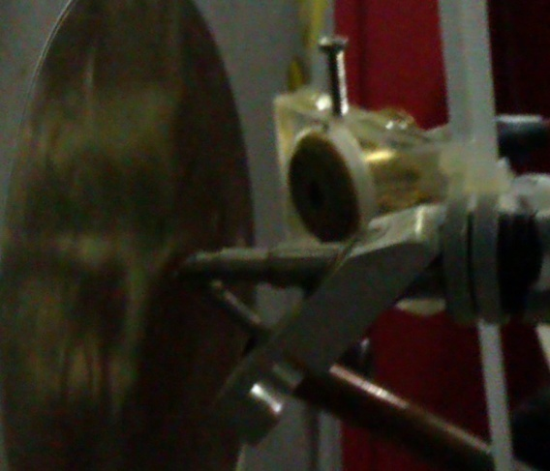
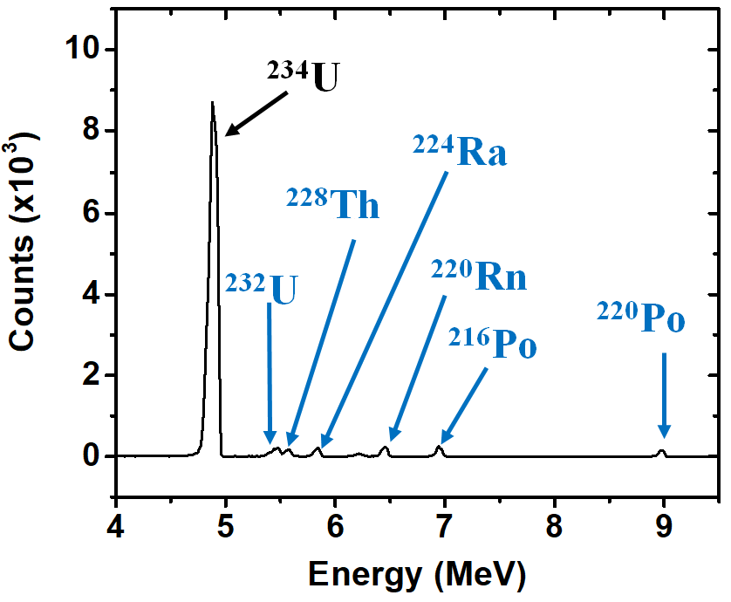
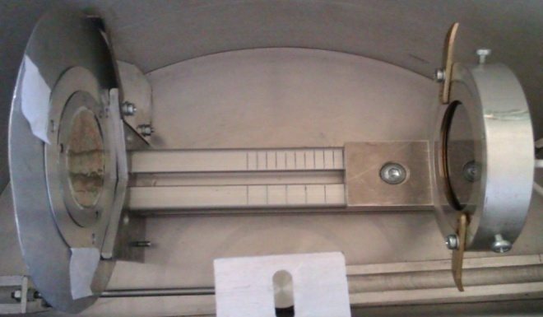
Fission cross sections – Actinide samples
High Purity samples of actinide oxide of ~0.3mg/cm² on 0.1mm Al backing were produced at IPPE (Obninsk) and JINR (Dubna) for the CERN n_TOF collaboration and were transported from CERN to NCSR “Demokritos”
5-8 cm diameter - Masks were used to reduce the α – activity
Homogeneity estimated via the Rutherford Backscattering Spectrometry technique at NSCR Demokritos - Homogeneous within 10-15%.
d=15.8cm
Mass estimated via α-spectroscopy
with SSB detectors–
Impurities: <10⁻⁶ mg/cm².
Rosa Vlastou - WONDER 2026 – June 29 - July 3, 2026 - Aix-en-Provence, France 9/22

Slide 11
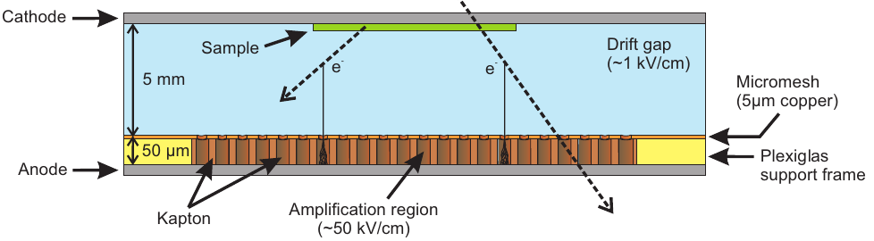
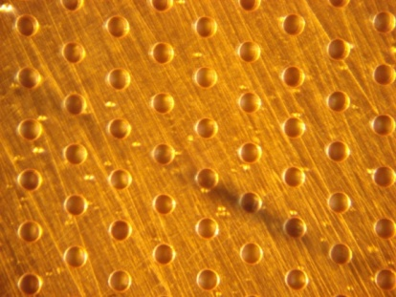
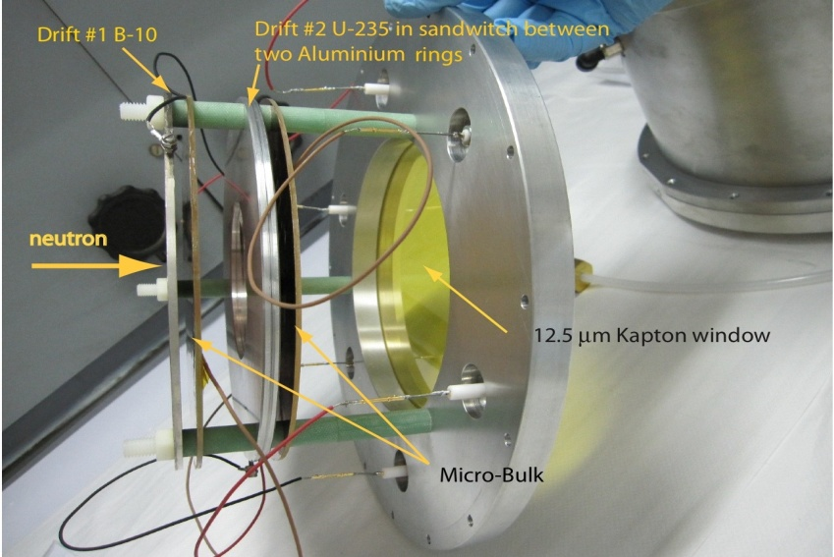
Fission cross sections - Micromegas detectors
Gaseous detector/two regions separated by ”Micromesh”: “drift region”with low electric field and “amplification region” with high electric field
Each micro-bulk consists of 5μm perforated copper foil ("micromesh") with holes of ∼35 μm in diameter at a distance of ∼50 μm, on 25 or 50μm thick kapton pillars deposited on 5μm of a bulk copper foil ("anode“).
Gas: circulating Ar:CO2 gas mixtures at atmospheric pressure
The drift electrode is the actinide target
Excellent time ( 20ns) and spacial ( 20m) resolution
Neutron resistant - Detector gain up to the order of 10 ⁴
Rosa Vlastou - WONDER 2026 – June 29 - July 3, 2026 - Aix-en-Provence, France 10/22

Slide 12
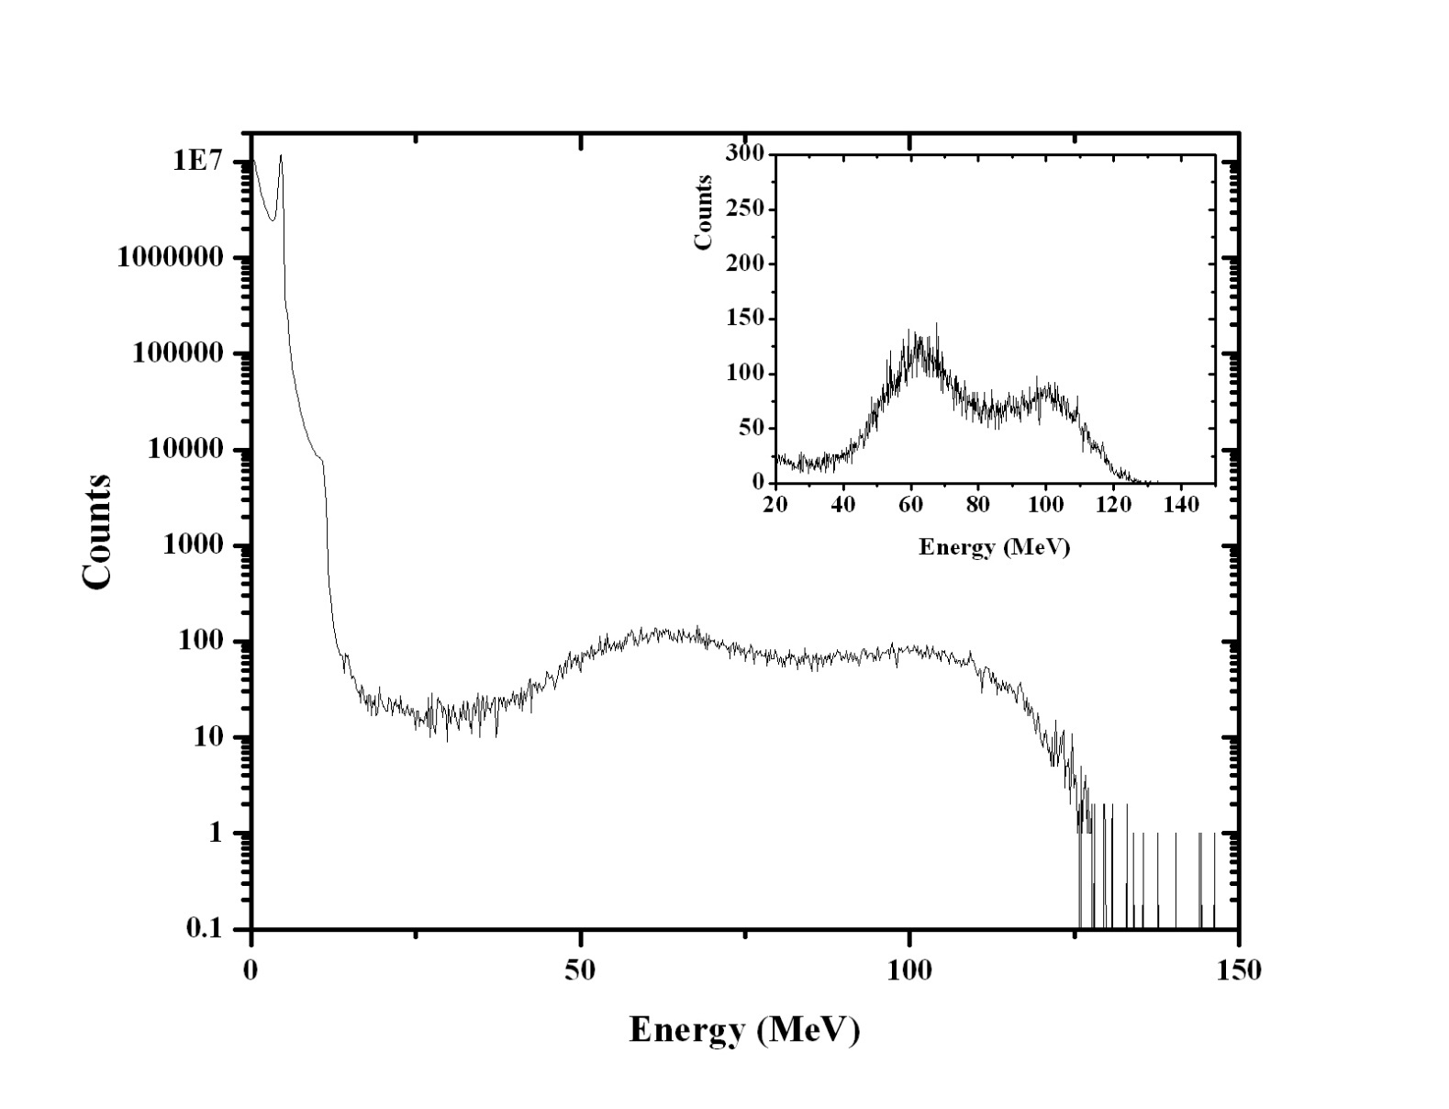
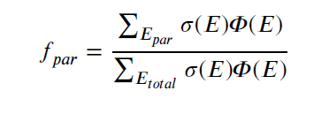
Fission cross sections – Detected events and corrections
α-activity
Huge α-pile-up peak in the recorded spectrum-Threshold from beam-off measurement
Fission Fragments
(FF)
Corrections of FF due to contribution of parasitic neutrons :
integrated reaction rate that corresponds to the energy range of parasitic neutron tail to the total energy integrated reaction rate
amplitude
threshold
²³⁷Np
Corrections of fission yield for:
Self-absorption and
Sub-threshold FF counts
Estimated with Monte Carlo simulations (FLUKA +GEF) ~5% correction for all targets and <1% for Y_{X}/Y_{R} and σ_{x}
Dead time – 0-2% for the highest activity targets – masks to reduce the α-activity
parasitic neutrons - Estimated with empty target measurements (without the main neutron producing target) – ~1-15% correction
Rosa Vlastou - WONDER 2026 – June 29 - July 3, 2026 - Aix-en-Provence, France 11/22

Slide 13
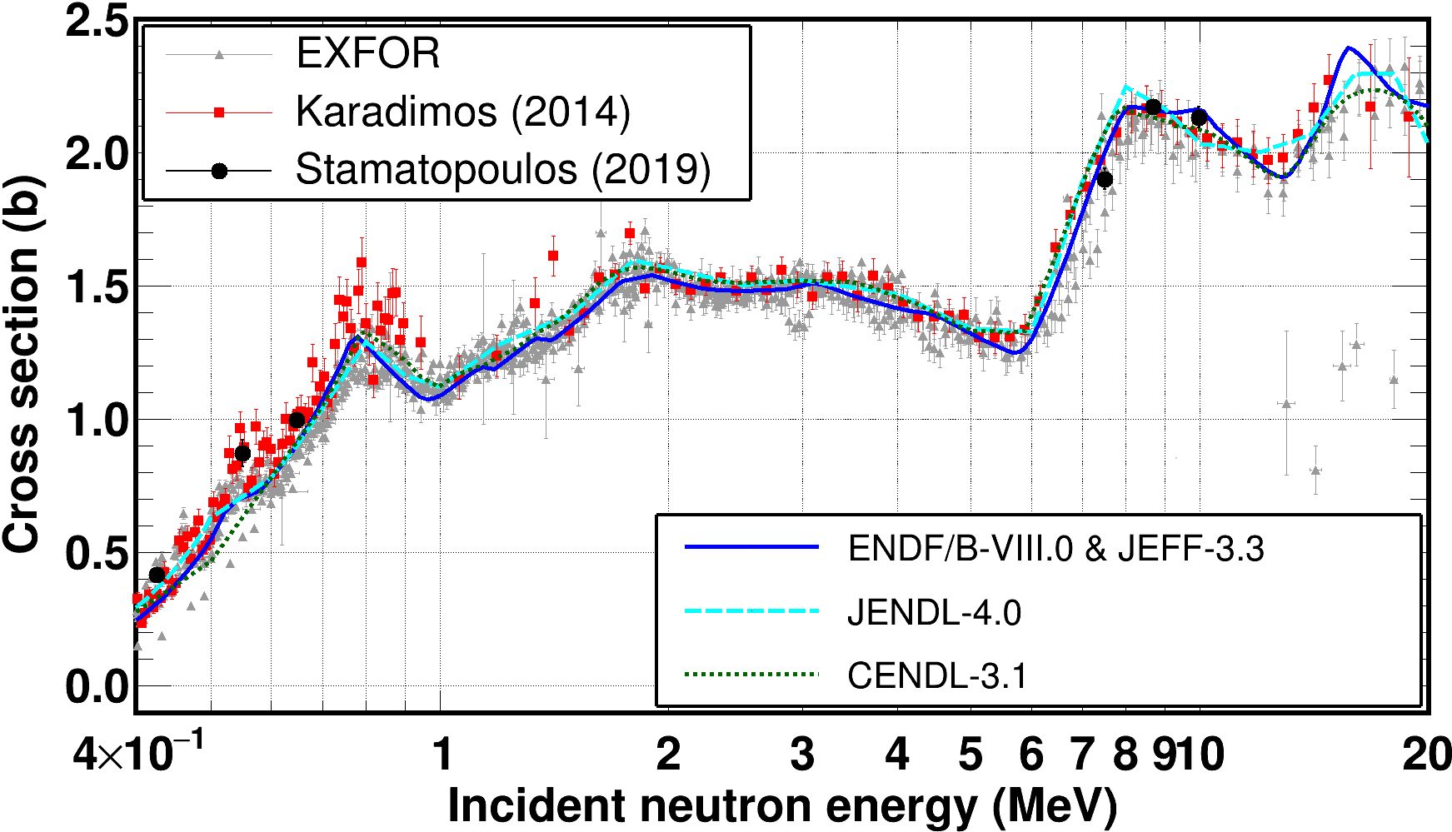
Fission cross sections – Some results [²³⁴U(n,f)]
Use of ²H(d,n)³He, ³H(d,n)⁴He and ⁷Li(p,n)⁷Be reactions
²³⁴U(n,f)
Rosa Vlastou - WONDER 2026 – June 29 - July 3, 2026 - Aix-en-Provence, France 12/22

Slide 14
Fission cross sections – Some results [²³⁷Np(n,f) & ²³⁶U(n,f)]
²³⁷Np
²³⁶U
More important contribution of parasitic neutrons
( d - breakup, d - induced reactions with materials in-beam)
Choice of reference reaction with similar shape
²³⁸U(n,f) reaction : used as reference (unc. 1-4%)
²³⁵U(n,f) reaction : evaluation of parasitic neutrons
Use of ²H(d,n)³He reaction
Rosa Vlastou - WONDER 2026 – June 29 - July 3, 2026 - Aix-en-Provence, France 13/22

Slide 15
Fission cross sections – Some results [²³²Th(n,f)]
²³²Th
²³²Th
Less important contribution of parasitic neutrons
²³⁸U(n,f) reaction : used as reference (unc. <1%)
²³⁵U(n,f) reaction : evaluation of parasitic neutrons
Not important contribution of parasitic neutrons (esp. E < 3 MeV)
< 3 MeV both reference reactions were used for ²³²Th
²³⁸U(n,f) reaction : used as reference for ²³²Th (unc. <1%)
²³⁵U(n,f) reaction : -> evaluation of parasitic neutrons
Use of ²H(d,n)³He, ³H(d,n)⁴He and ³H(p,n)³He reactions
Rosa Vlastou - WONDER 2026 – June 29 - July 3, 2026 - Aix-en-Provence, France 14/22

Slide 16
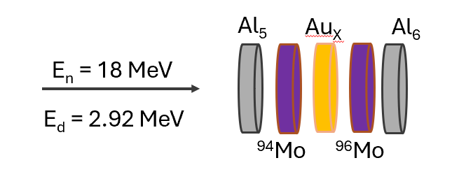
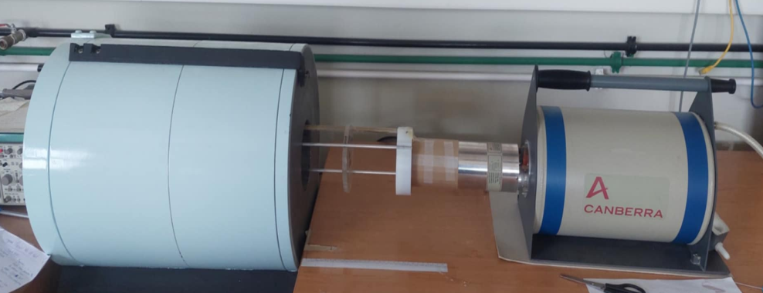
Neutron activation research activities – Outline
Samples: disks of ~1.2 cm diameter, high purity natural foils or isotopically highly enriched pellets
Extensive Monte Carlo simulations via MCNP are used for the neutron flux determination, taking into account the whole geometry of the irradiation setup as well as corrections for self-absorption of the emitted gamma-rays and for counting geometry
After the neutron irradiation : Off-line measurements of γ-ray transitions from the activated residual nuclei by using HPGe detectors, ε_{r} ≈ 80%, 56% and 16%, calibrated with a ¹⁵²Eu source
Rosa Vlastou - WONDER 2026 – June 29 - July 3, 2026 - Aix-en-Provence, France 15/22

Slide 17
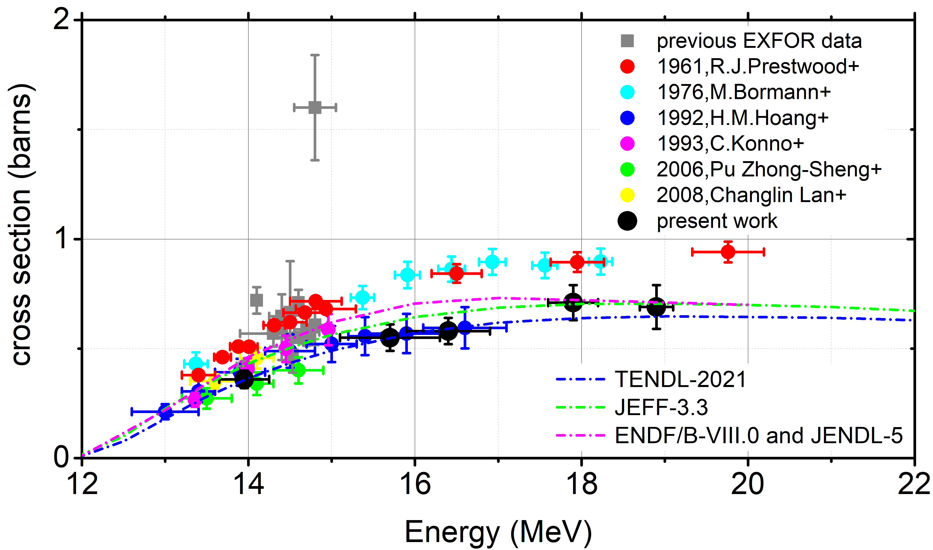
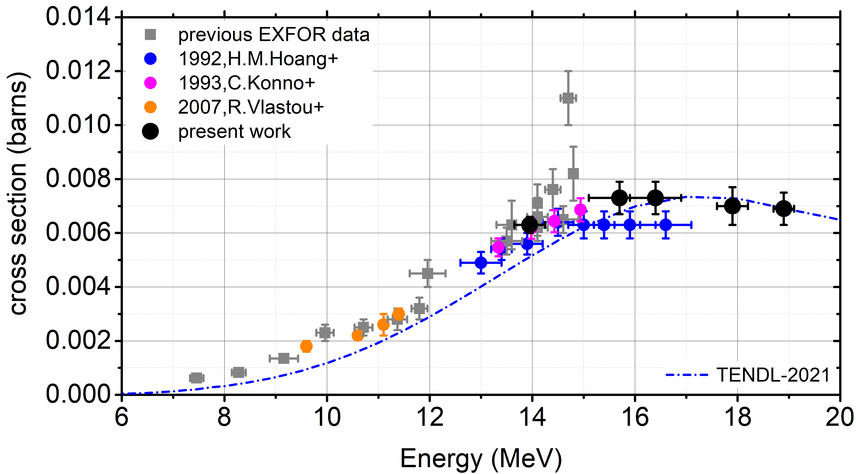
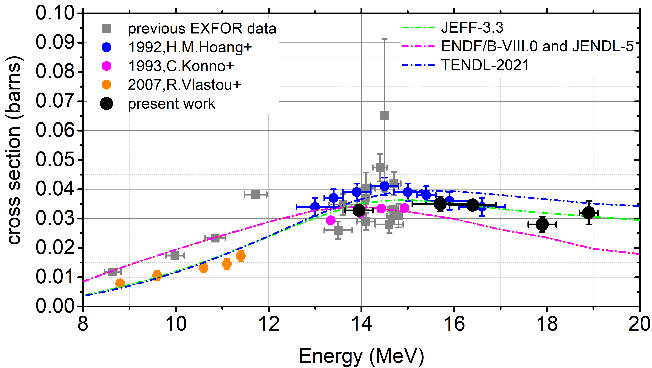
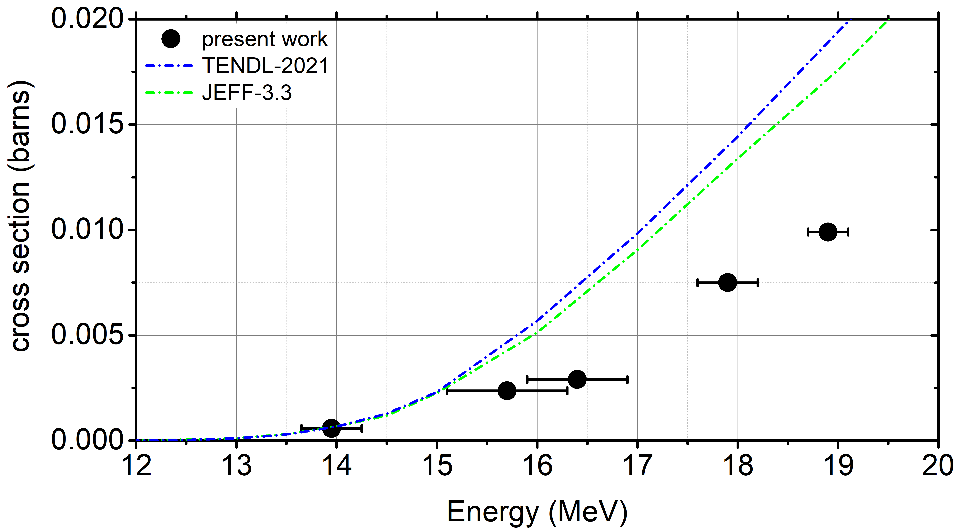
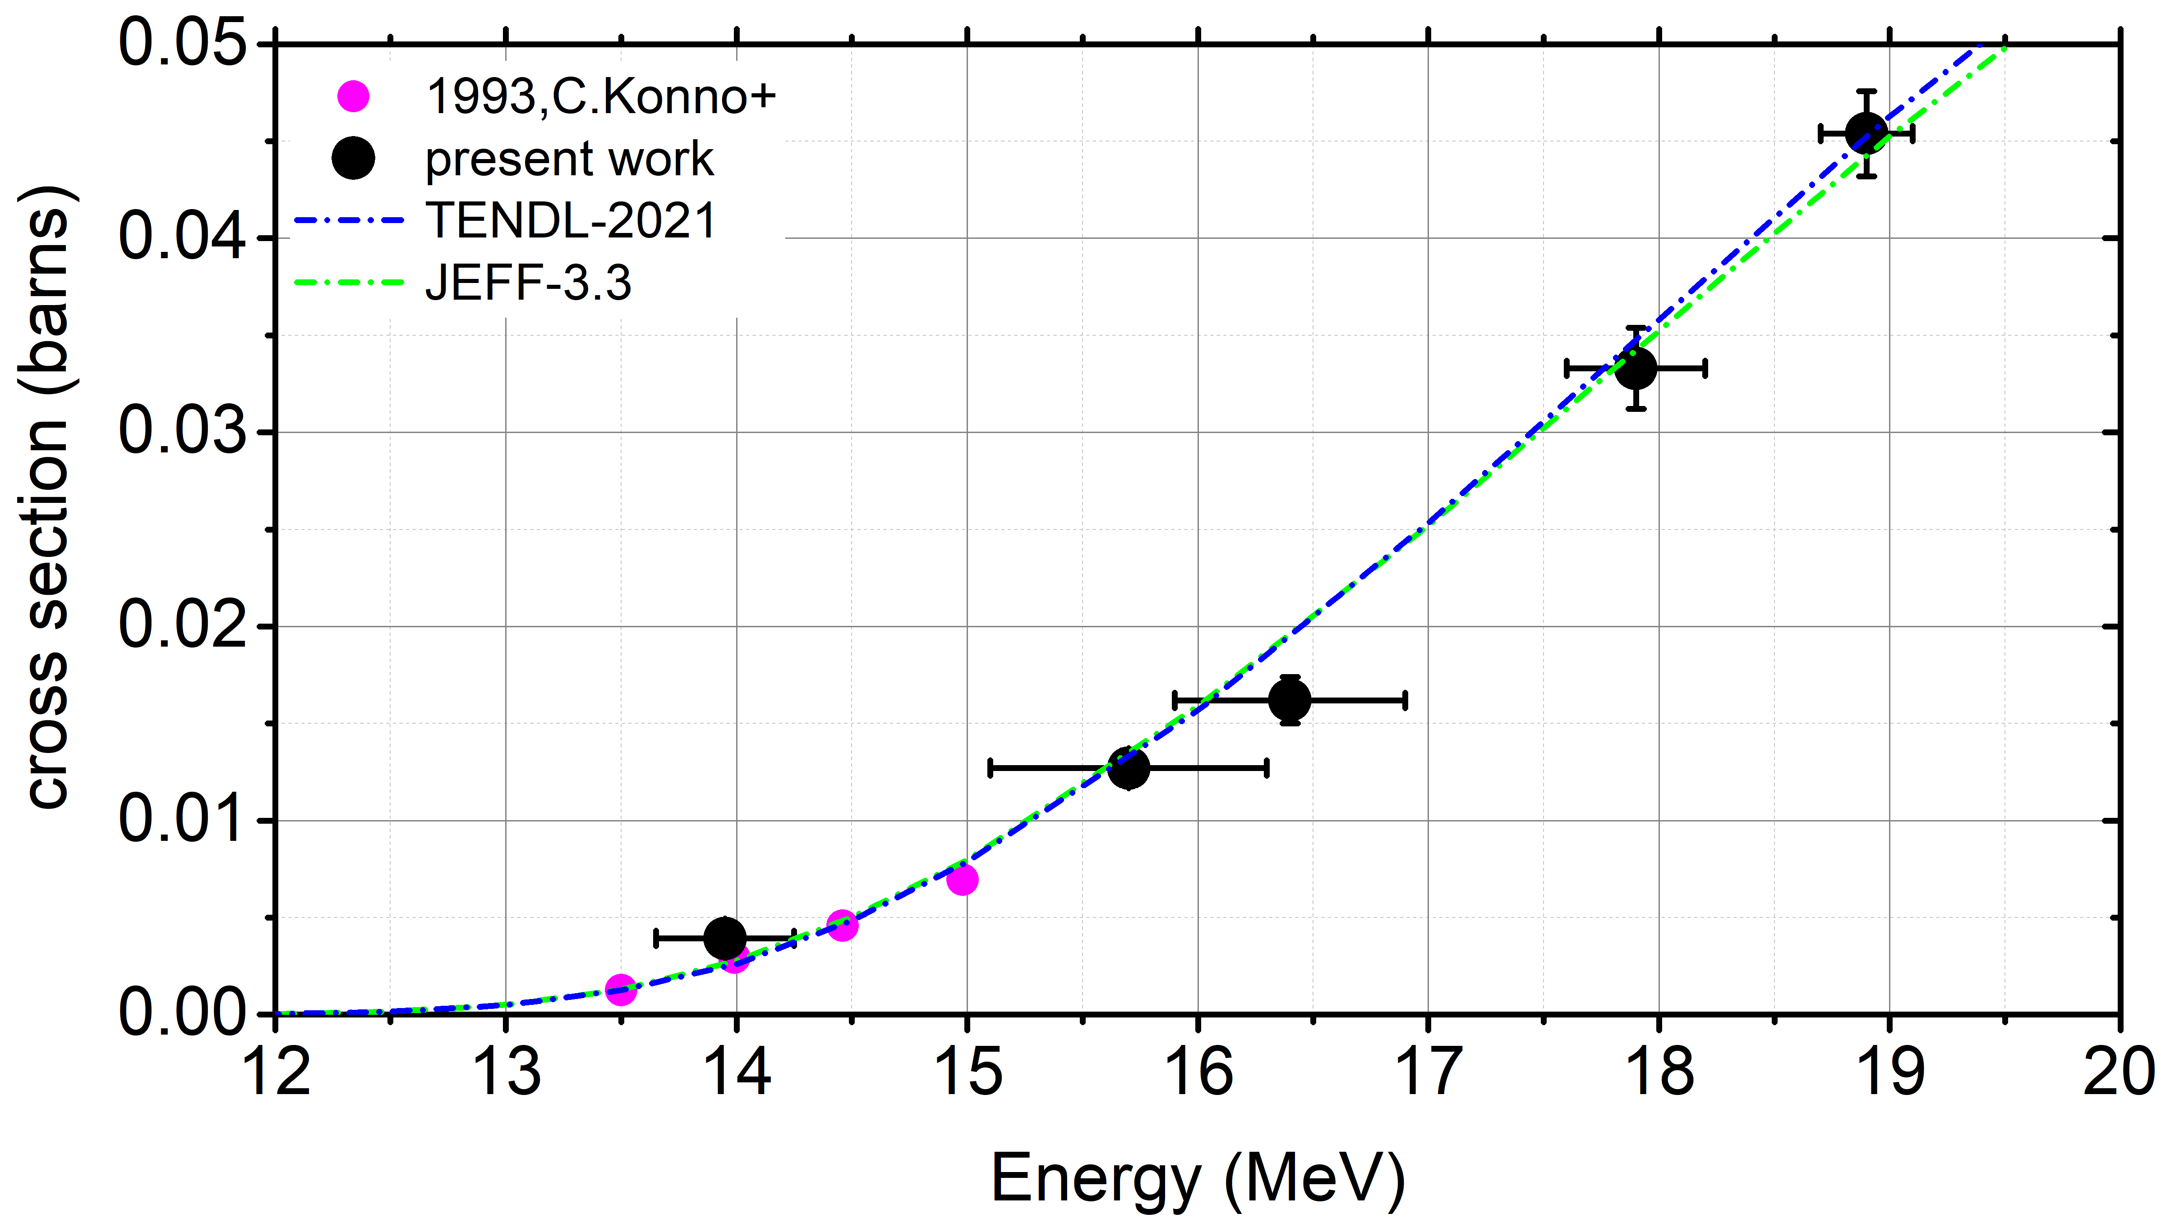
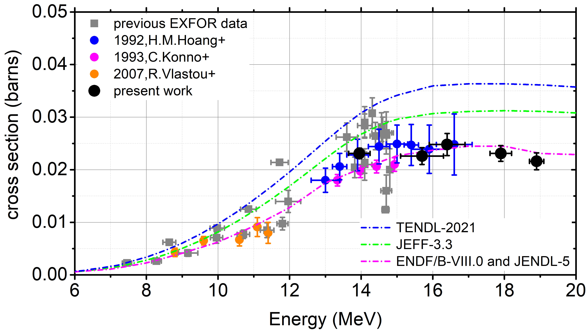
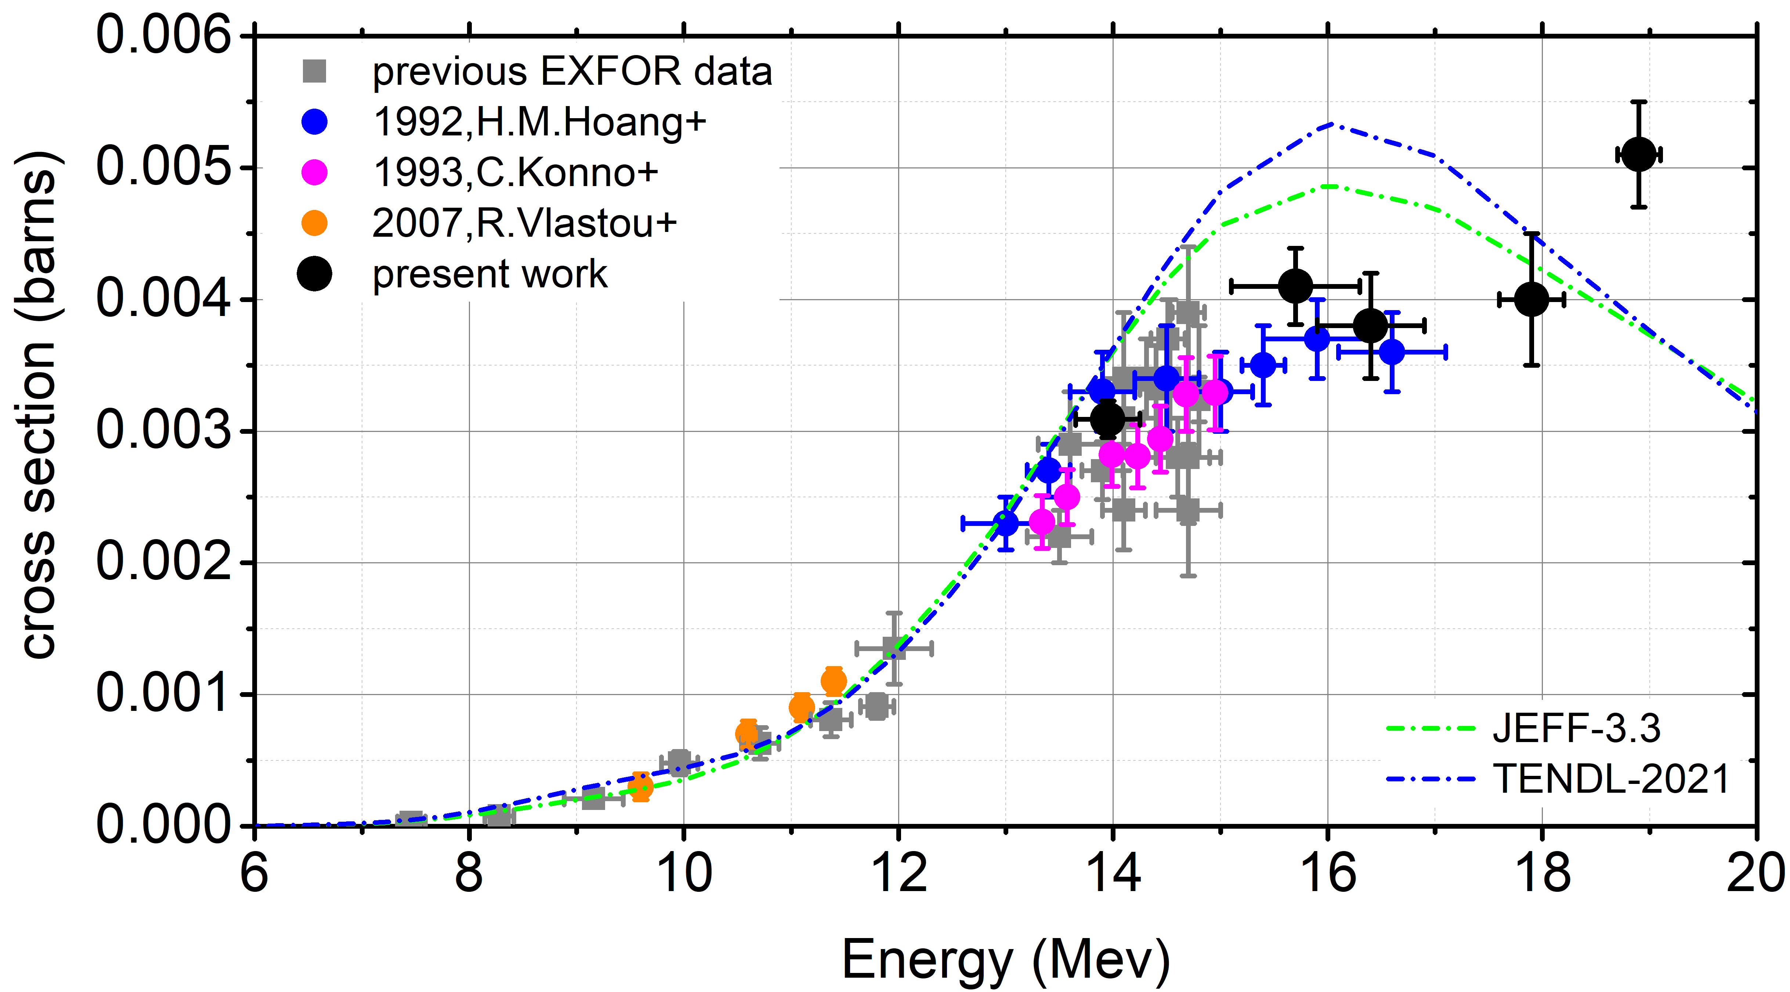
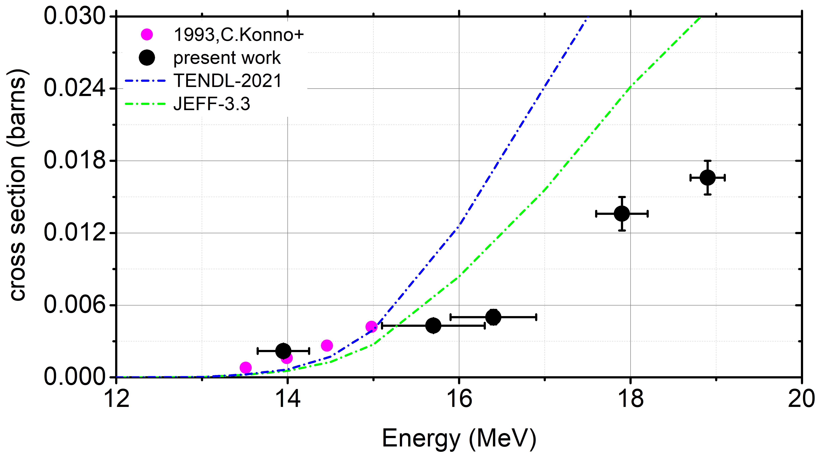
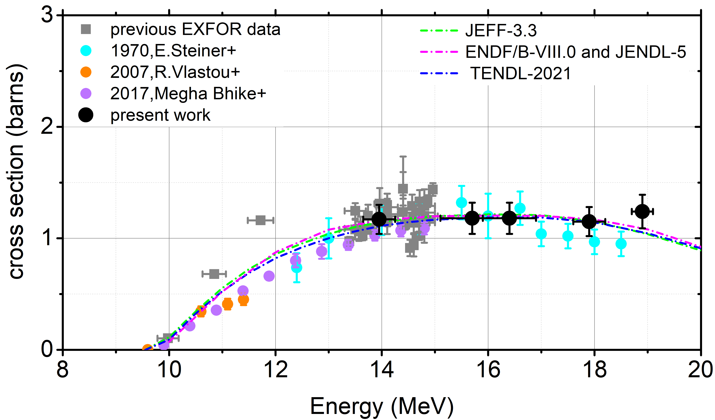
Neutron activation research activities – Ge isotopes
Ge is of critical importance both for practical applications (dosimetry, nuclear medicine, astrophysical projects, reactor and detector technology), but also for fundamental research in the Nuclear Physics field
Cross sections of 9 reactions : ⁷⁰Ge(n,2n)⁶⁹Ge,
⁷²Ge(n,α)^{69m}Zn,
⁷²Ge(n,p)⁷²Ga,
⁷³Ge(n,nα)^{69m}Zn, ⁷³Ge(n,np/d)⁷²Ga, ⁷³Ge(n,p)⁷³Ga,
⁷⁴Ge(n,α)^{71m}Zn, ⁷⁴Ge(n,np/d)⁷³Ga and ⁷⁶Ge(n,2n)⁷⁵Ge,
have been experimentally determined in the energy range between 14.0-18.9 MeV using isotopically enriched Ge targets provided by the n_TOF collaboration at CERN
S.Chasapoglou et al., EPJ Web of Conferences 294, 01007(2024)
S.Chasapoglou et al., Applied Radiation and Isotopes 203 (2024) 111077
S.Chasapoglou et al., Phys.Rev. C 110, 044612 (2024)
⁷²Ge(n,α)^{69m}Zn
⁷⁰Ge(n,2n)⁶⁹Ge
⁷²Ge(n,p)⁷²Ga
⁷³Ge(n,p)⁷³Ga
⁷³Ge(n,nα)^{69m}Zn
⁷³Ge(n,np/d)⁷²Ga
⁷⁶Ge(n,2n)⁷⁵Ge
⁷⁴Ge(n,α)^{71m}Zn
⁷⁴Ge(n,np/d)⁷³Ga
Rosa Vlastou - WONDER 2026 – June 29 - July 3, 2026 - Aix-en-Provence, France 16/22

Slide 18
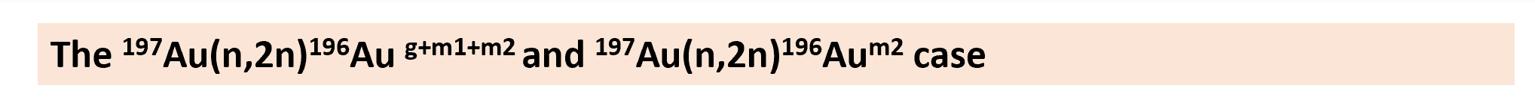
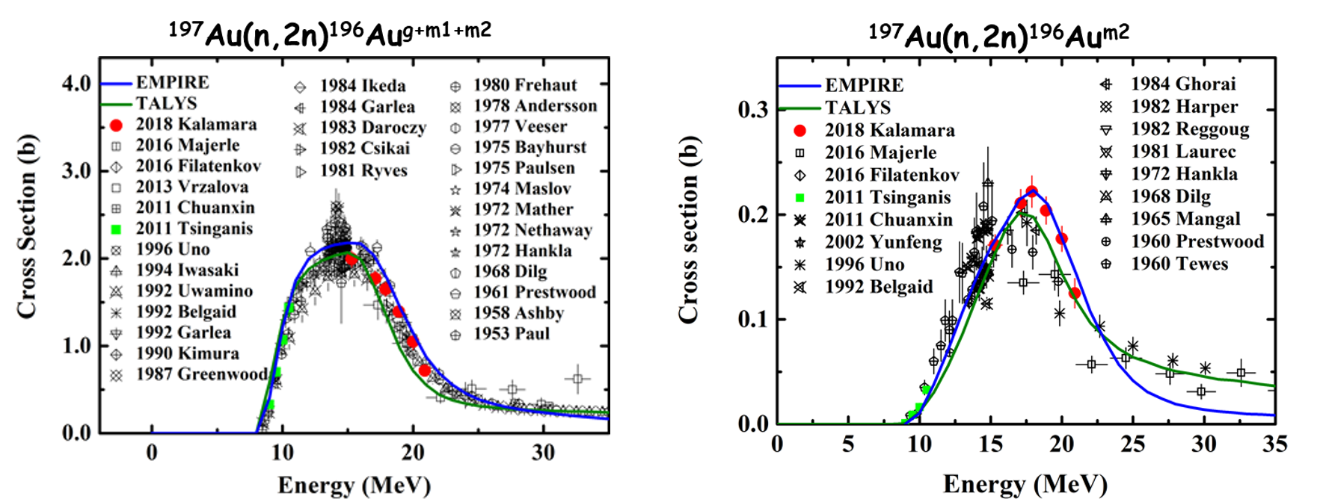
Neutron activation research activities - ¹⁹⁷Au, ^{191,193}Ir and ²⁰³Tl isotopes
Neutron induced reactions on Ir, Au and Tl : Important as reference reactions - high energy neutron dosimetry - medical and industrial applications. Important reactions for the investigation of model parameters in the frame of statistical model calculations - population of both ground and metastable states - sensitivity to spin distribution of level densities
The simultaneous reproduction of the isomeric cross section along with other channels sets a significant constraint, rendering theoretical calculations quite sensitive to the choice of specific nuclear model parameters.
Theoretical calculations using EMPIRE 3.2.2 and TALYS 1.8 codes revealed that same sets of parameters were able to reproduce very well all measured cross sections as well as all other reactions available in literature
A.Tsinganis et al., Phys.Rev.C83 (2010)024609, R.Vlastou et al., Phys. Procedia 66(2015)425
A.Kalamara et al., EPJ Web of Conf. 146(2017)11013, A.Kalamara et al., Phys.Rev.C97(2018)034615
Rosa Vlastou - WONDER 2026 – June 29 - July 3, 2026 - Aix-en-Provence, France 17/22

Slide 19
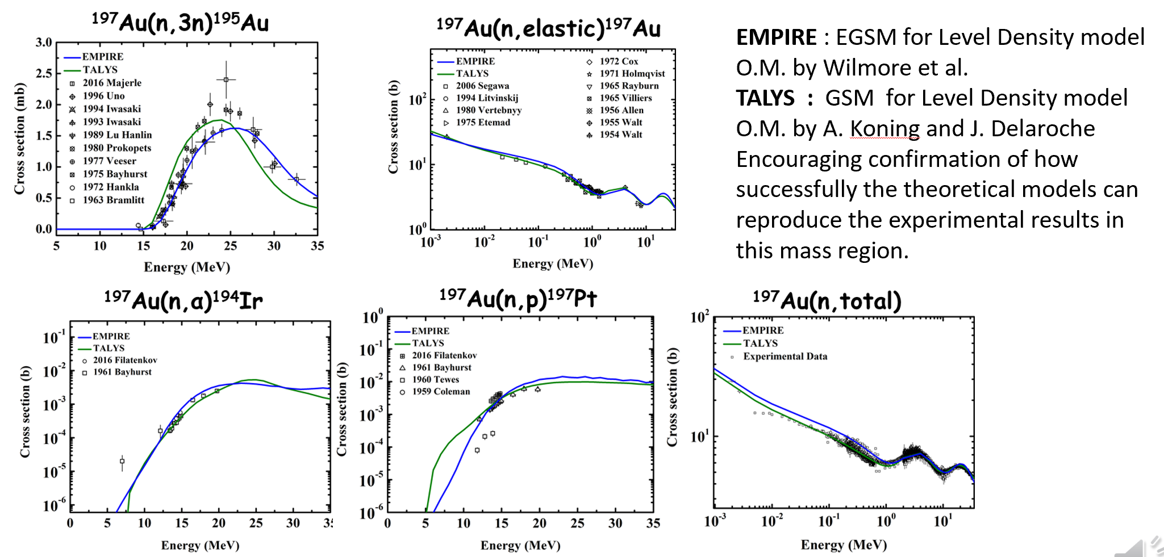
Neutron activation research activities
Other reactions on ¹⁹⁷Au with data from literature
Rosa Vlastou - WONDER 2026 – June 29 - July 3, 2026 - Aix-en-Provence, France 18/22

Slide 20
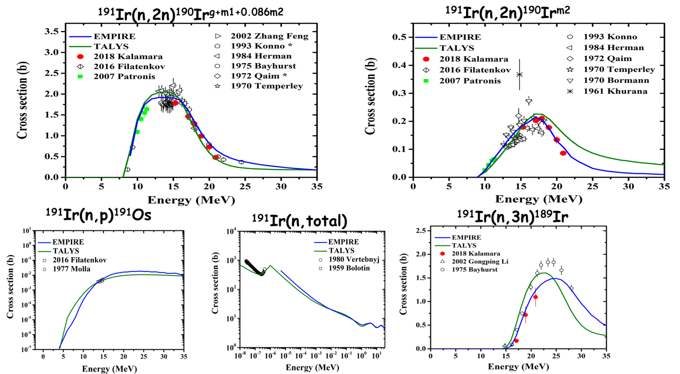
Neutron activation research activities
The ¹⁹¹Ir(n,2n)¹⁹⁰Ir ^{g+m1}, ¹⁹⁰Ir^{m2} , ¹⁹¹Ir(n,3n)¹⁸⁹Ir case and other data from literature
N. Patronis et al., Phys. Rev. C75 (2007), 034607
R. Vlastou et al., EPJ Web of Conf. 146(2017)11013
A. Kalamara et al., Phys. Rev. C 98, 034607 (2018)
A. Kalamara et al., Eur. Phys. J. A, 55: 187 (2019)
Rosa Vlastou - WONDER 2026 – June 29 - July 3, 2026 - Aix-en-Provence, France 19/22

Slide 21
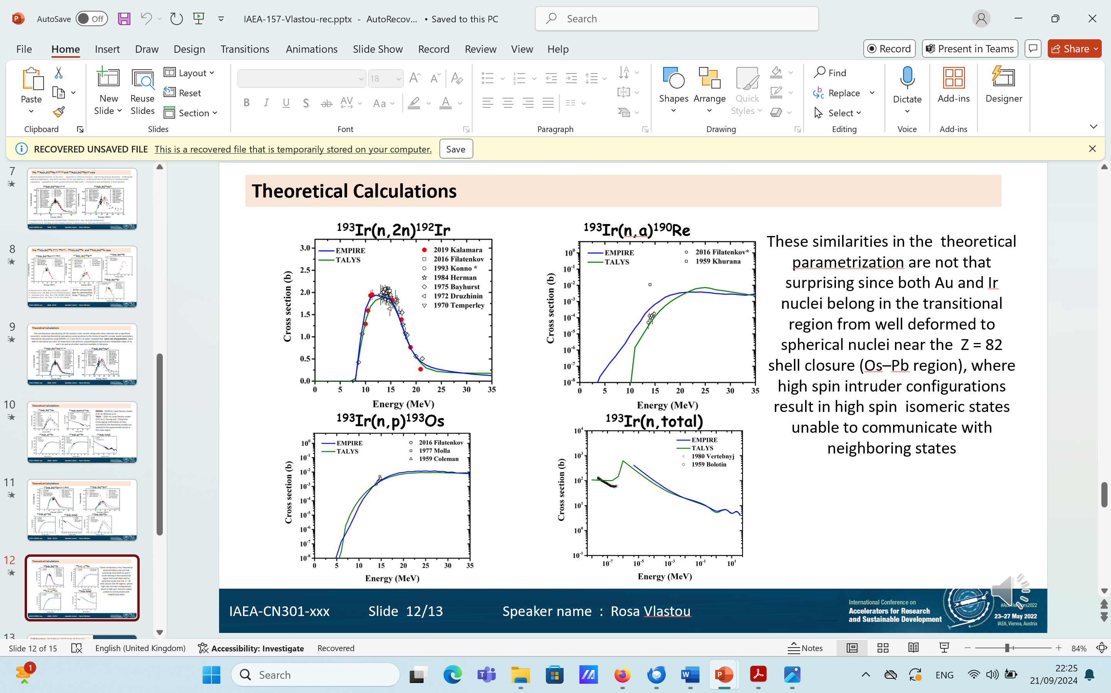
Neutron activation research activities
The ¹⁹³Ir(n,2n)¹⁹²Ir case and other data from literature
Rosa Vlastou - WONDER 2026 – June 29 - July 3, 2026 - Aix-en-Provence, France 20/22

Slide 22
Neutron activation research activities - ²⁰³Tl
The ²⁰³Tl(n,2n)²⁰²Tl , ²⁰³Tl(n,3n)²⁰¹Tl case and data for other reactions from literature
Same parameters were selected for the EMPIRE & TALYS calculations as in the case of Ir and Au.
The satisfactory theoretical calculations for Ir, Au and Tl – for many reactions and isomeric states - with the same set of parameters is an encouraging confirmation of how successfully the theoretical models can reproduce the experimental data in this mass region.
Rosa Vlastou - WONDER 2026 – June 29 - July 3, 2026 - Aix-en-Provence, France 21/22

Slide 23
Acknowledgements
Collaborators : M.Kokkoris, M.Diakaki, N.Patronis, A.Tsinganis, S.Harissopulos, M.Axiotis, A.Lagoyannis, M.Serris
PhD Students : V.Michalopoulou, A.Kalamara, A.Stamatopoulos, S.Chasapoglou, Z.Eleme, E.Georgali, K.Kaperoni, N.Kyritsis, Z.Bari, S.Kopanos, N.Giannakou, L.Amanatidis
Many MSc and Diploma Students
Thank you for your attention
Rosa Vlastou - WONDER 2026 – June 29 - July 3, 2026 - Aix-en-Provence, France 22/22

Slide 24
Back-up slides

Slide 25
¹⁹⁷Au(n,2n)¹⁹⁶Au ¹⁹¹Ir(n,2n)¹⁹⁰Ir

Slide 26
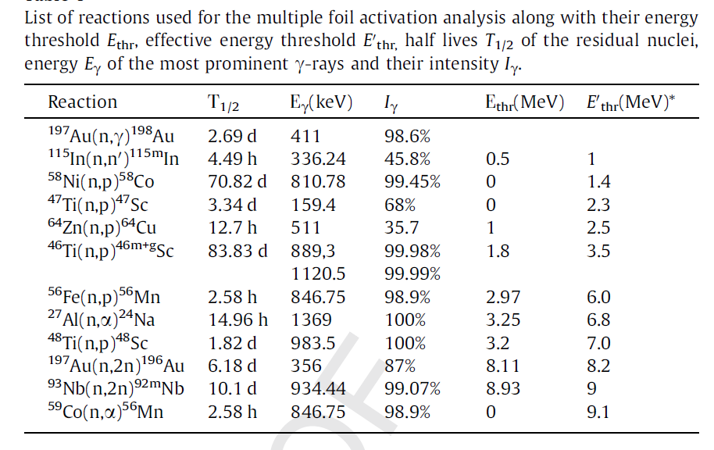
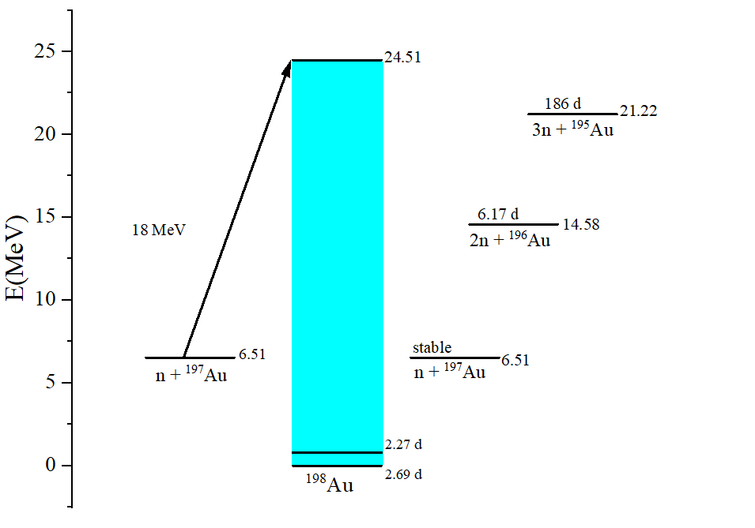

Slide 27

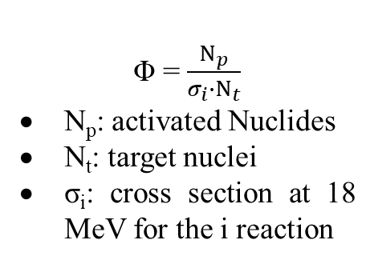
Φ = $\frac{Ν_{p}}{σ_{i}{∙Ν}_{t}}$
N_{p}: activated Nuclides
N_{t}: target nuclei
σ_{i}: cross section at 18 MeV for the i reaction
$${SA}_{i}=\frac{N_{γi}}{Ι_{γ}∙ε∙{D∙f}_{c}∙t_{irr}∙f_{s}∙F}$$
N_{γi} : yield obtained from the two HPGe detectors for the i reaction
I_{γ} : intensity of the gamma ray
ε : photopeak efficiency of the HPGe detector
D : analytic calculated destimulations after the irradiation
t_{irr}: irradiation time
f_{c} : analytic calculated destimulations during the irradiation
fs : solid angle correction, calculated via Monte Carlo code, MCNP5
F : internal absorption of gamma ray, calculated via Monte Carlo code MCNP5
The SAND II (Spectrum Analysis by Neutron Detectors II) unfolding code has been developed to determine spectra by a fully automated iterative method when a multiple foil activation technique has been implemented. The code uses as input the experimentally derived neutron induced activities, an initial differential neutron flux (‘guess’ spectrum) and the grouped cross sections from the IRDFF library. The SAND II algorithm subsequently adjusts iteratively the neutron flux spectrum to obtain an appropriate fit between the theoretically calculated and the experimentally determined reaction rates, within the energy range of 0-18 MeV divided into 620 intervals.

Slide 28
Recoil energy spectra in the BC501A liquid scintillator, using the neutron beam from the ⁷Li(p,n) reaction at 2.3 and 2.7 MeV
The DIFBAS code was used to unfold the pulse height spectra measured by the BC501A scintillator into neutron spectra. The algorithm is based on the Bayesian conditional probability assuming normal distributions of the pulse height spectra. The input files are the pulse height spectrum, and an a priori neutron energy spectrum, while the covariance matrix and the neutron response matrix are incorporated in the program for the BC501A detector under study.

