Slide 1
Further improvements to the nuclear data processing code GALILÉE-1
Mireille Coste-Delclaux - Cédric Jouanne - Claude Mounier
Wonder 2026, Aix-en-Provence

Slide 2
Outline
1 – Nuclear data Processing & Simulation
2 – TSL processing
3 – Probability Table processing
4 – Conclusion
M. Coste-Delclaux, et al. (2024). « Recent developments in the GALILÉE-1 processing code ».
EPJ Web of Conferences (Vol. 294, p. 06003). EDP Sciences. (2024)

Slide 3
Nuclear data processing for Monte Carlo codes
Evaluation
NJOY
(LANL)
Cross sections Reconstruction
Linearization
Doppler Broadening
Thermal data processing
PENDF File
NJOY
(LANL)
Kinematics of outgoing
particles
ACE File
TRIPOLI-4®
(CEA Saclay)
Available @NEA
MCNP (LANL)
TRIPOLI-5®
(CEA Saclay)
Under dev.
OpenMC
(MIT)

Slide 4
Nuclear data processing for Monte Carlo codes
Evaluation
NJOY
(LANL)
Cross sections Reconstruction
Linearization
Doppler Broadening
Thermal data processing
GALILÉE-1
(CEA Saclay)
Since 2025
PENDF File
NJOY
Kinematics of outgoing
particles
GALILÉE-1
Under dev.
ACE File
TRIPOLI-4®
(CEA Saclay)
Available @NEA
MCNP (LANL)
TRIPOLI-5®
(CEA Saclay)
Under dev.
OpenMC
(MIT)
Cross checking on nuclear data processing
Cross checking on Monte Carlo calculations

Slide 5
Current state of GALILÉE-1 regarding the GNDS format
  GALILÉE-1 is able to process TRIPOLI-4® libraries with evaluations in GNDS format:
    Cross-sections reconstruction in RRR, URR & Continuum
    Probability Tables
    Based on the new specifications, we plan to cross-check the ENDF/BVIII.1 TRIPOLI-4® library (ENDF-6 format against the GNDS.2.2.rc1 format)
  The reaction products are currently being read

Slide 6
GNDS vs ENDF-6
Big Ten (ieu-met-fast-007_2Z)
Two-zone homogenized model:
an inner cylindrical core enriched to 10%
in U235, surrounded by
a natural-uranium outer cylinder
Experimental value: 0.99480 (100)
 | k_{eff} | Δk_{eff}
NJOY (PENDF) without PT | 0.99219 (3) | -3
GALILÉE-1 from ENDF-6 without PT | 0.99222 (3) | -
GALILÉE-1 from GNDS without PT | 0.99215 (3) | -7
NJOY (PENDF) with PT | 0.99511(3) | -3
GALILÉE-1 from ENDF-6 with PT | 0.99514 (3) | -
GALILÉE-1 from GNDS with PT | 0.99514 (3) | 0

Slide 7
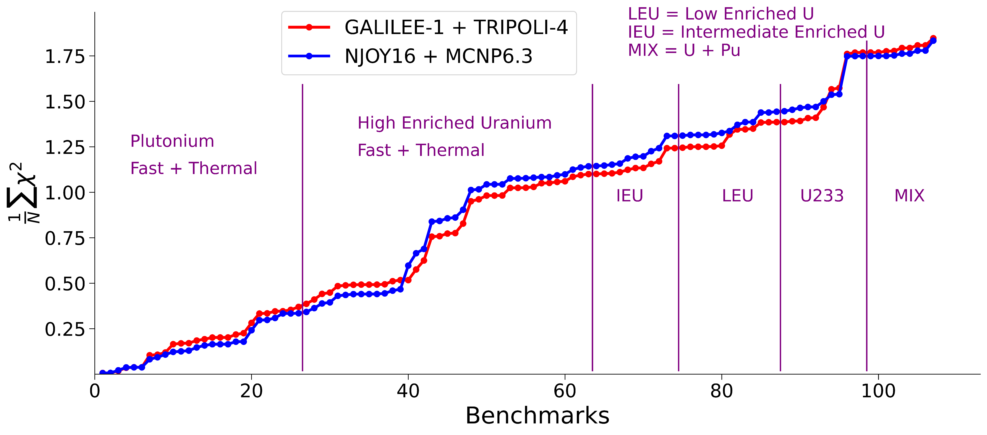
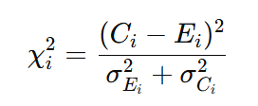
GALILÉE-1 + TRIPOLI-4® or NJOY16 + MCNP
Very good agreement between NJOY + MCNP and GALILÉE-1 + TRIPOLI-4® calculations
→ very high level of confidence in the use of the library
Example : ICSBEP criticality benchmarks using JEFF-4 Library
Courtesy of Steven
Van der Marck (MCNP results)
The differences are mainly due to the definitions of the geometry.
Thanks to Oscar for sharing the MCNP files.

Slide 8
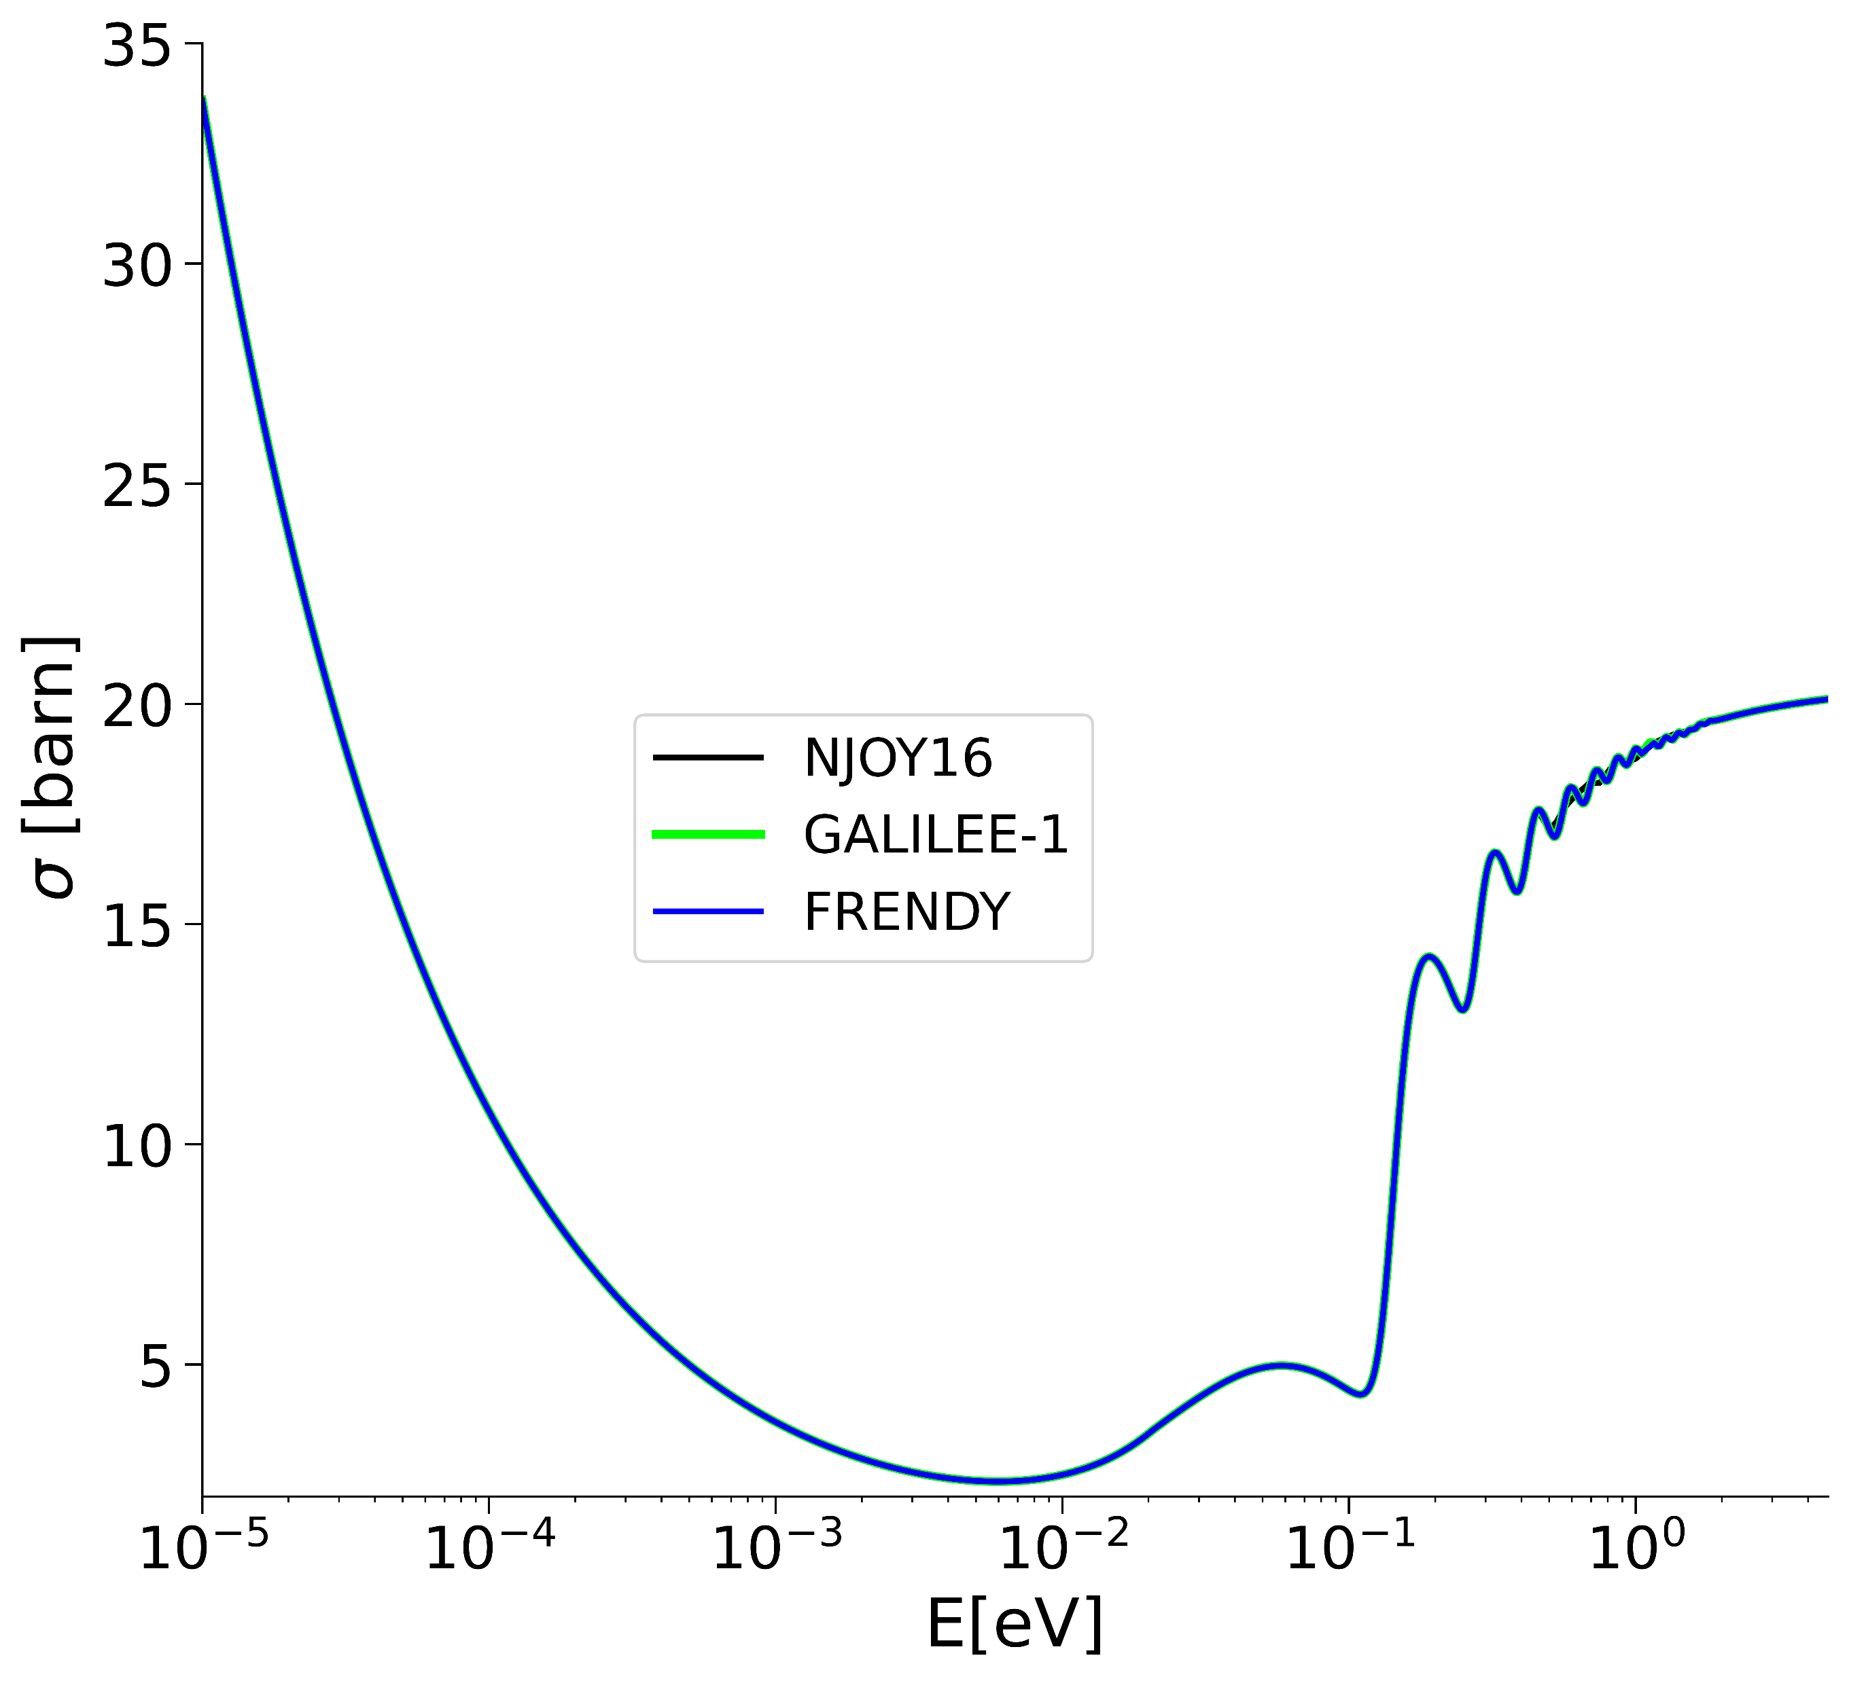
TSL processing
GALILÉE-1 now supports the treatment
of double elastic scattering, including
both coherent and incoherent components
Inelastic cross section
JEFF-3.3 : H1 in ZrH @294K

Slide 9
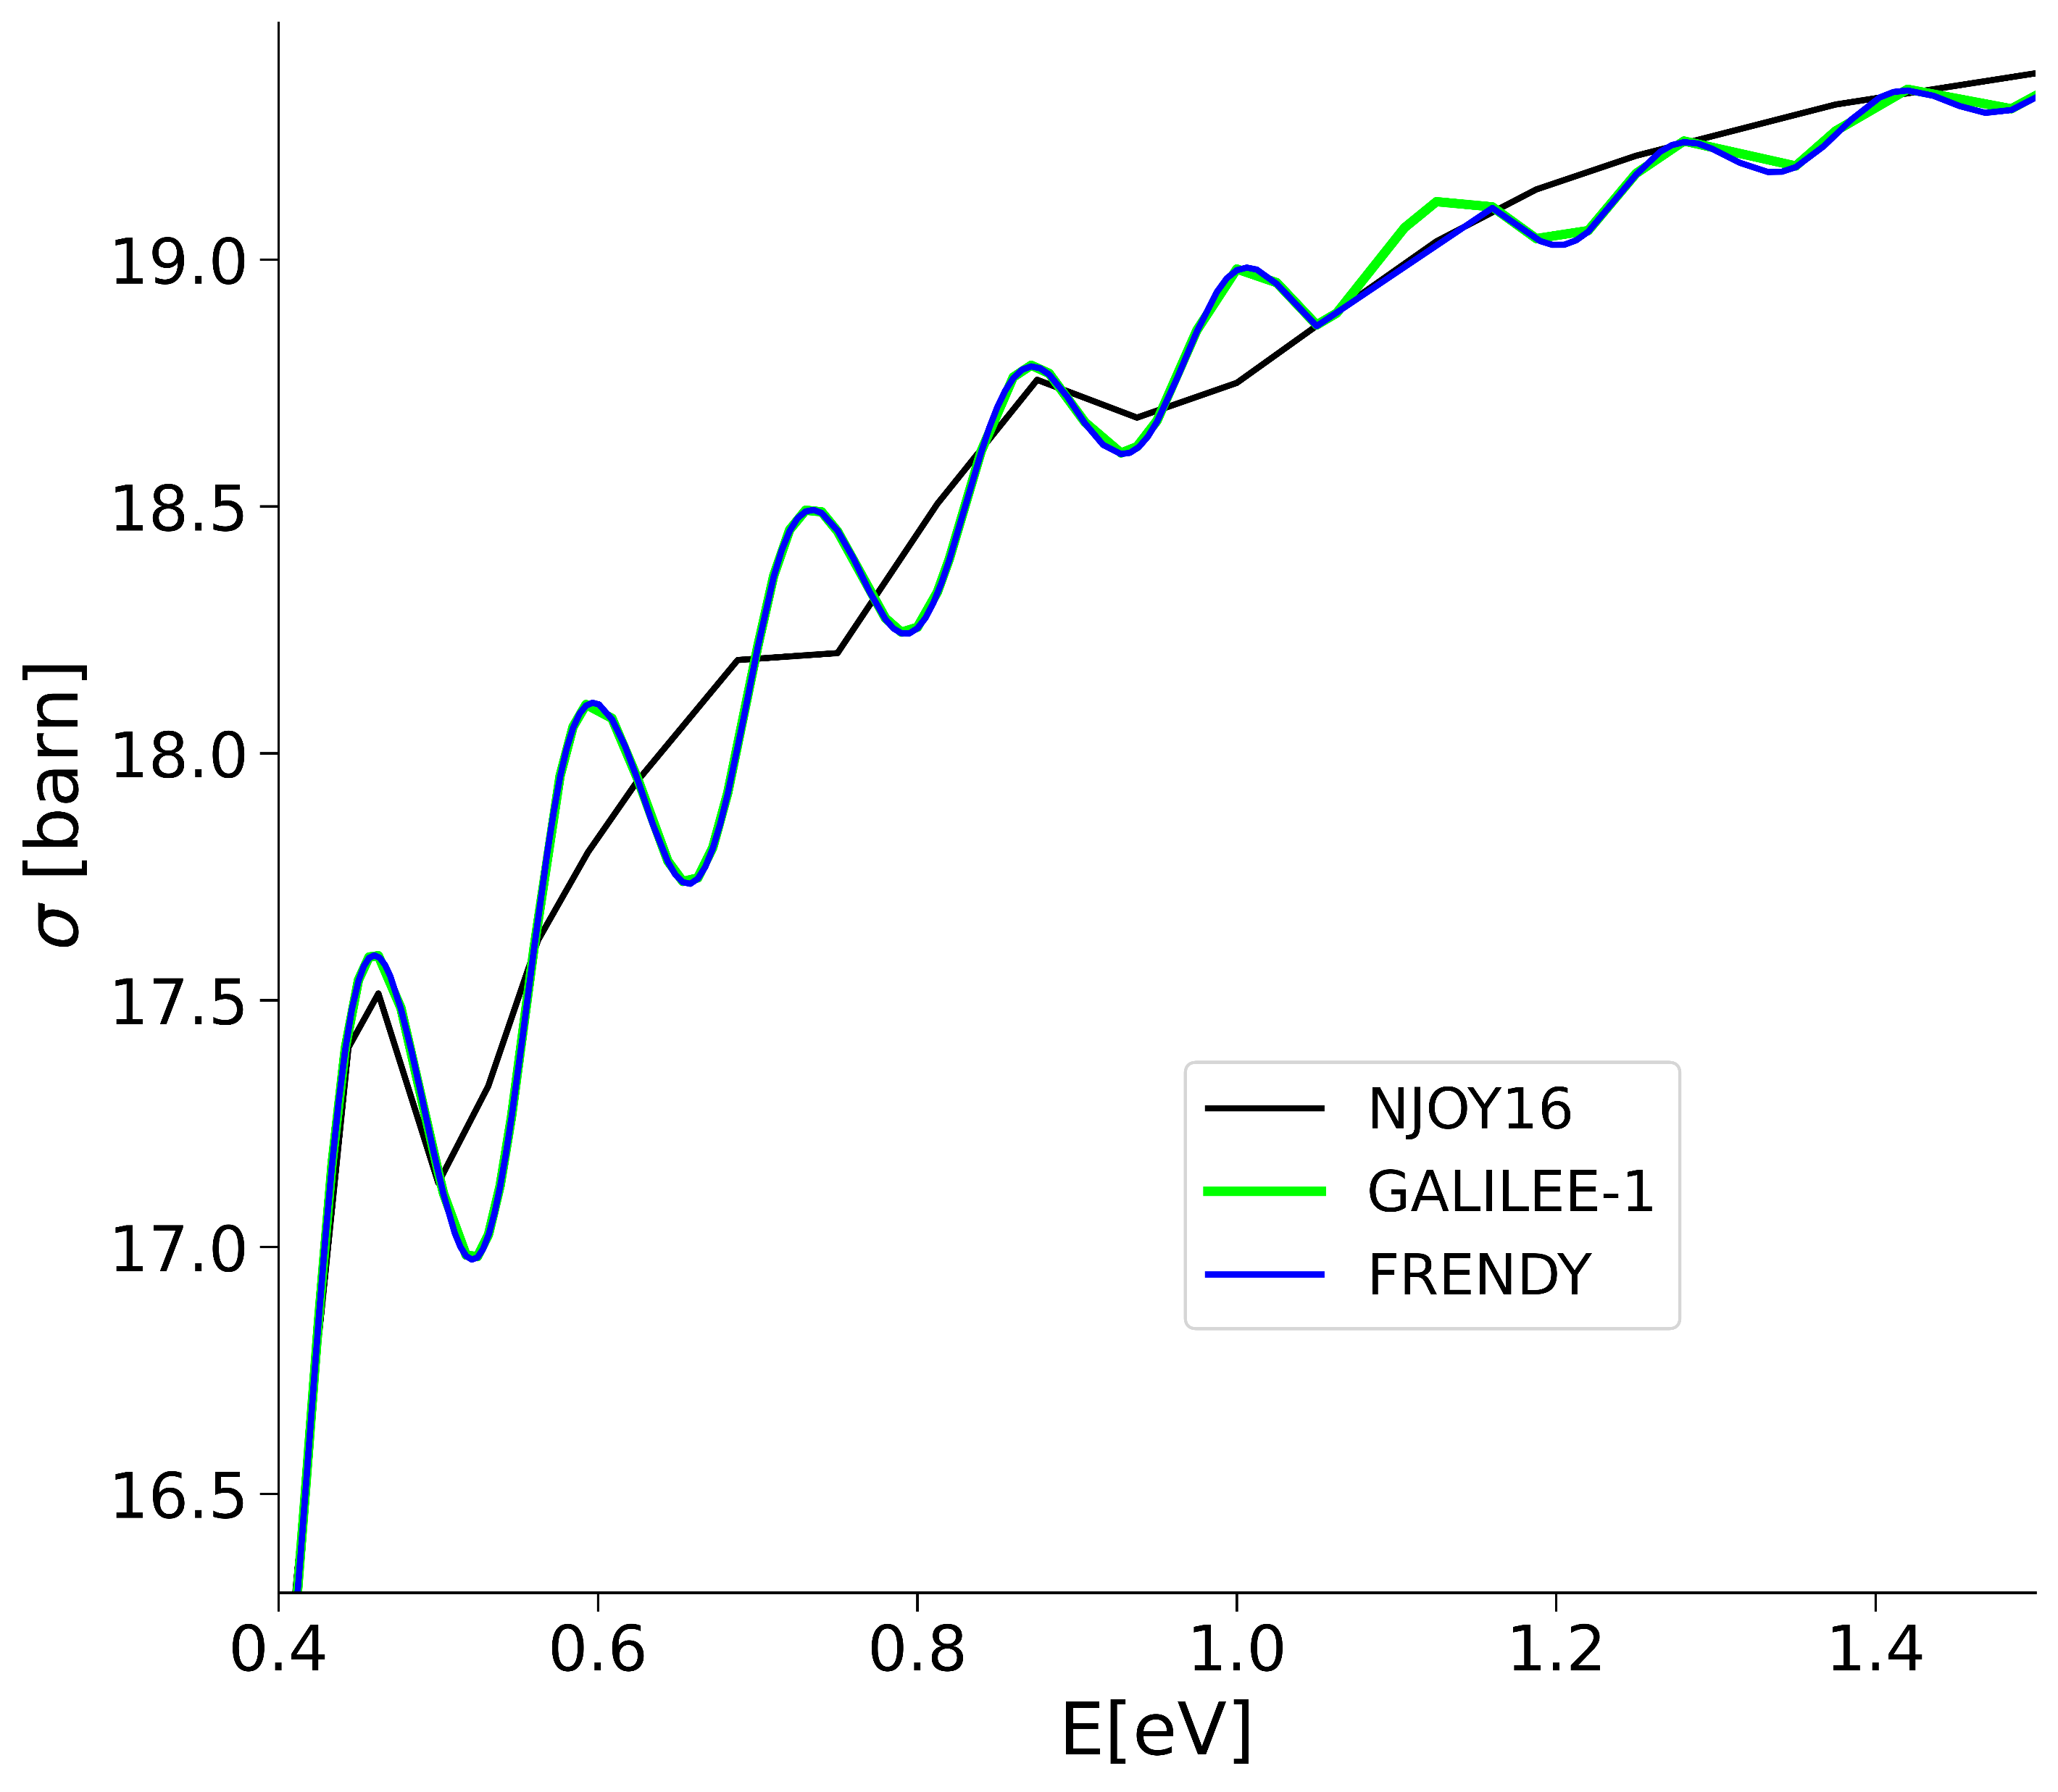
TSL processing
Inelastic cross section
JEFF-3.3 : H1 in ZrH @294K

Slide 10
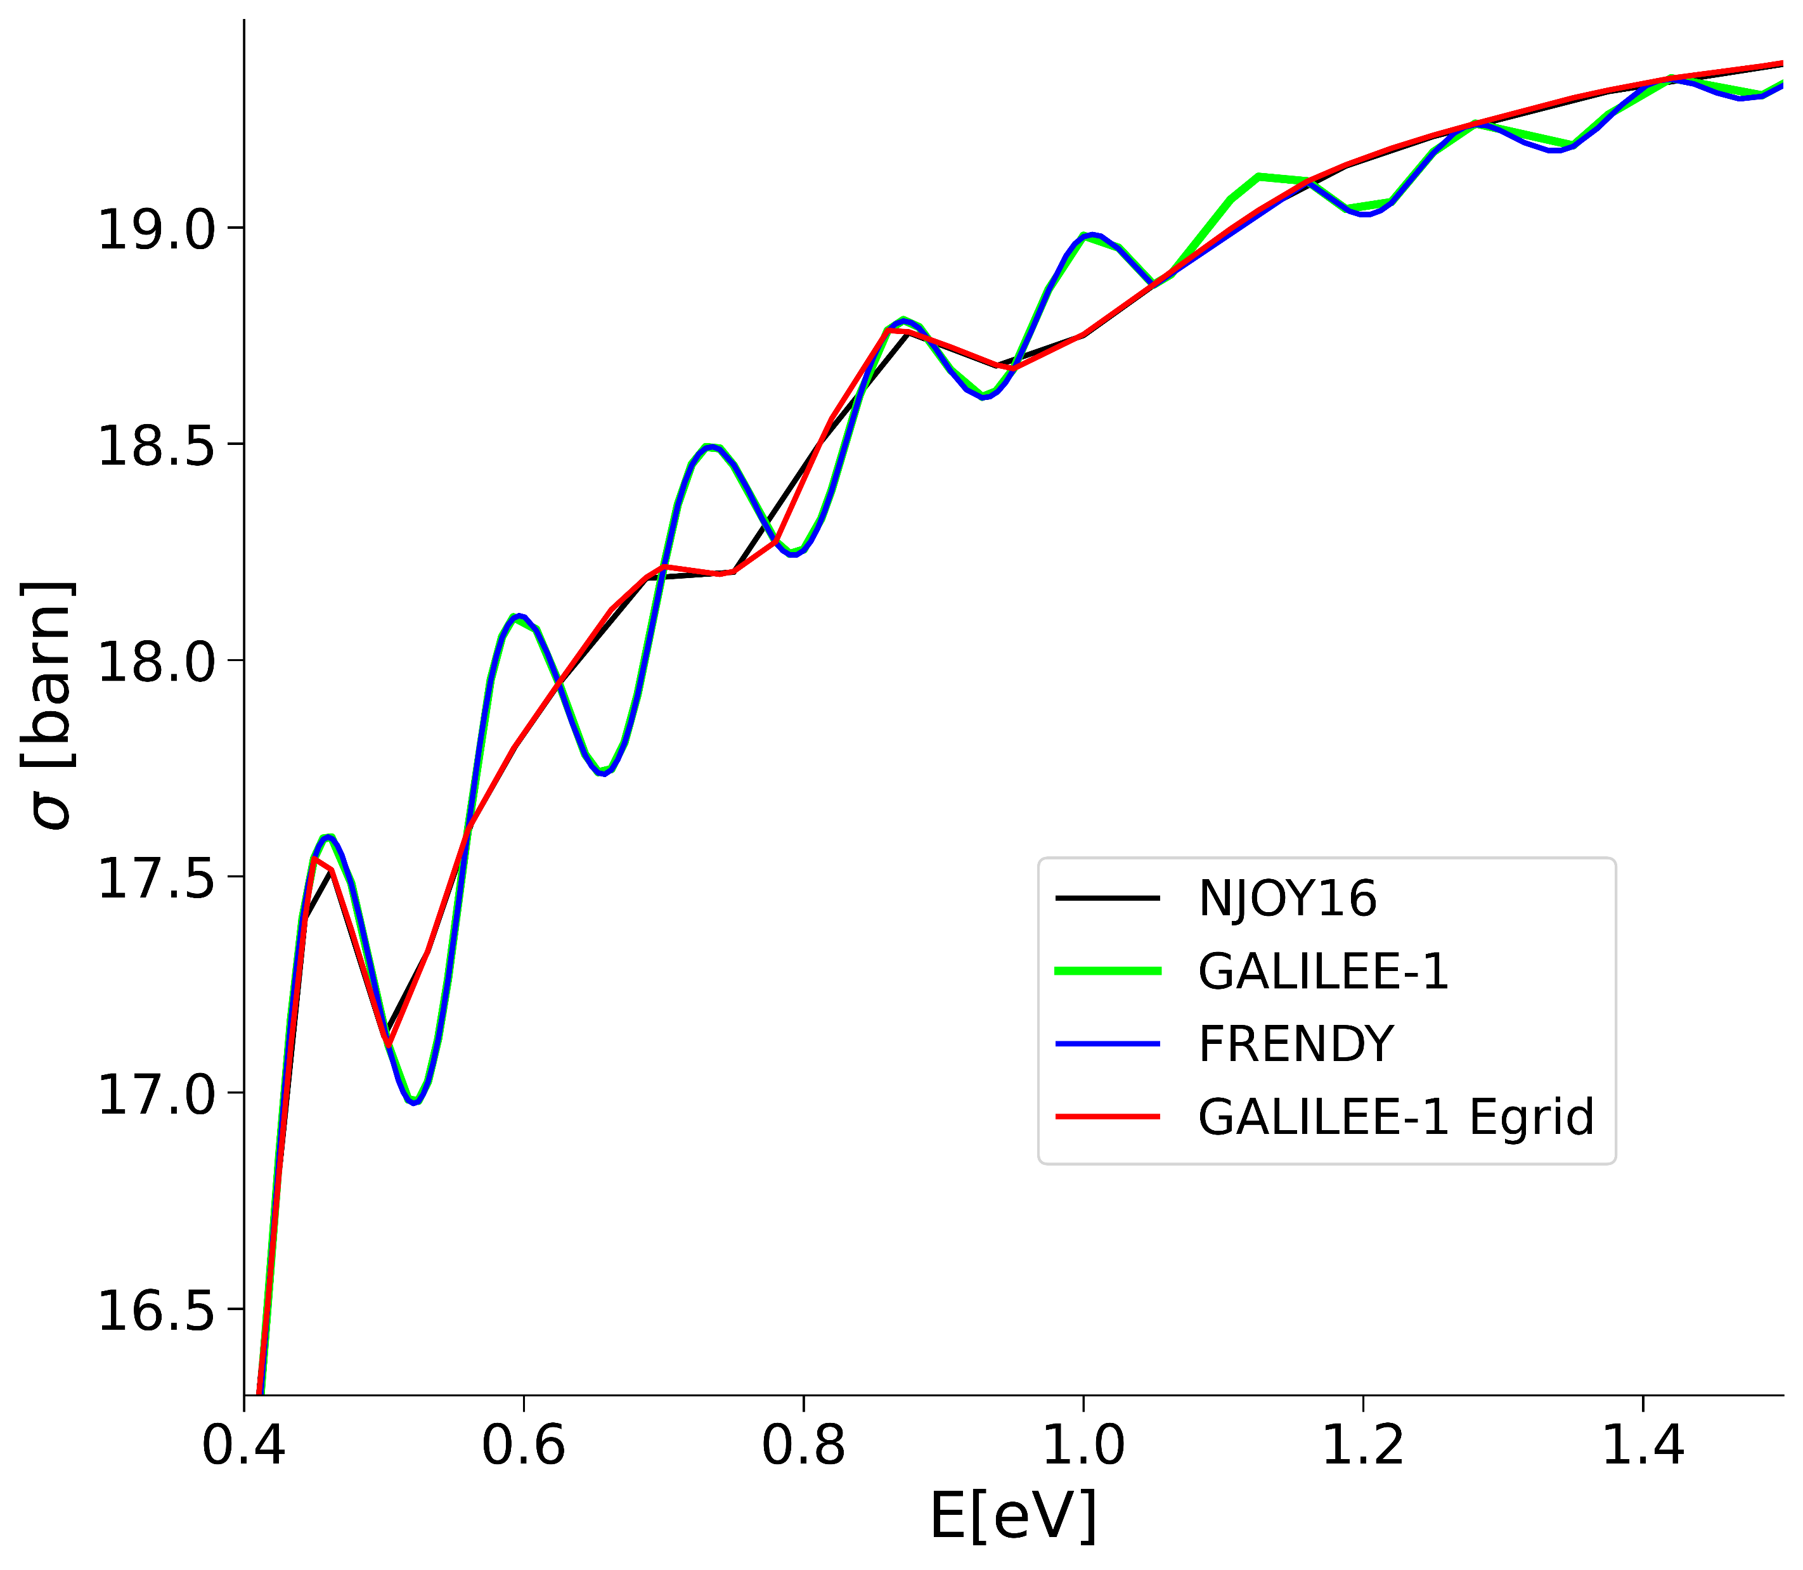
TSL processing
Inelastic cross section
JEFF-3.3 : H1 in ZrH @294K
Vibration-induced oscillations
→ Impact of Energy grid (NJOY)

Slide 11
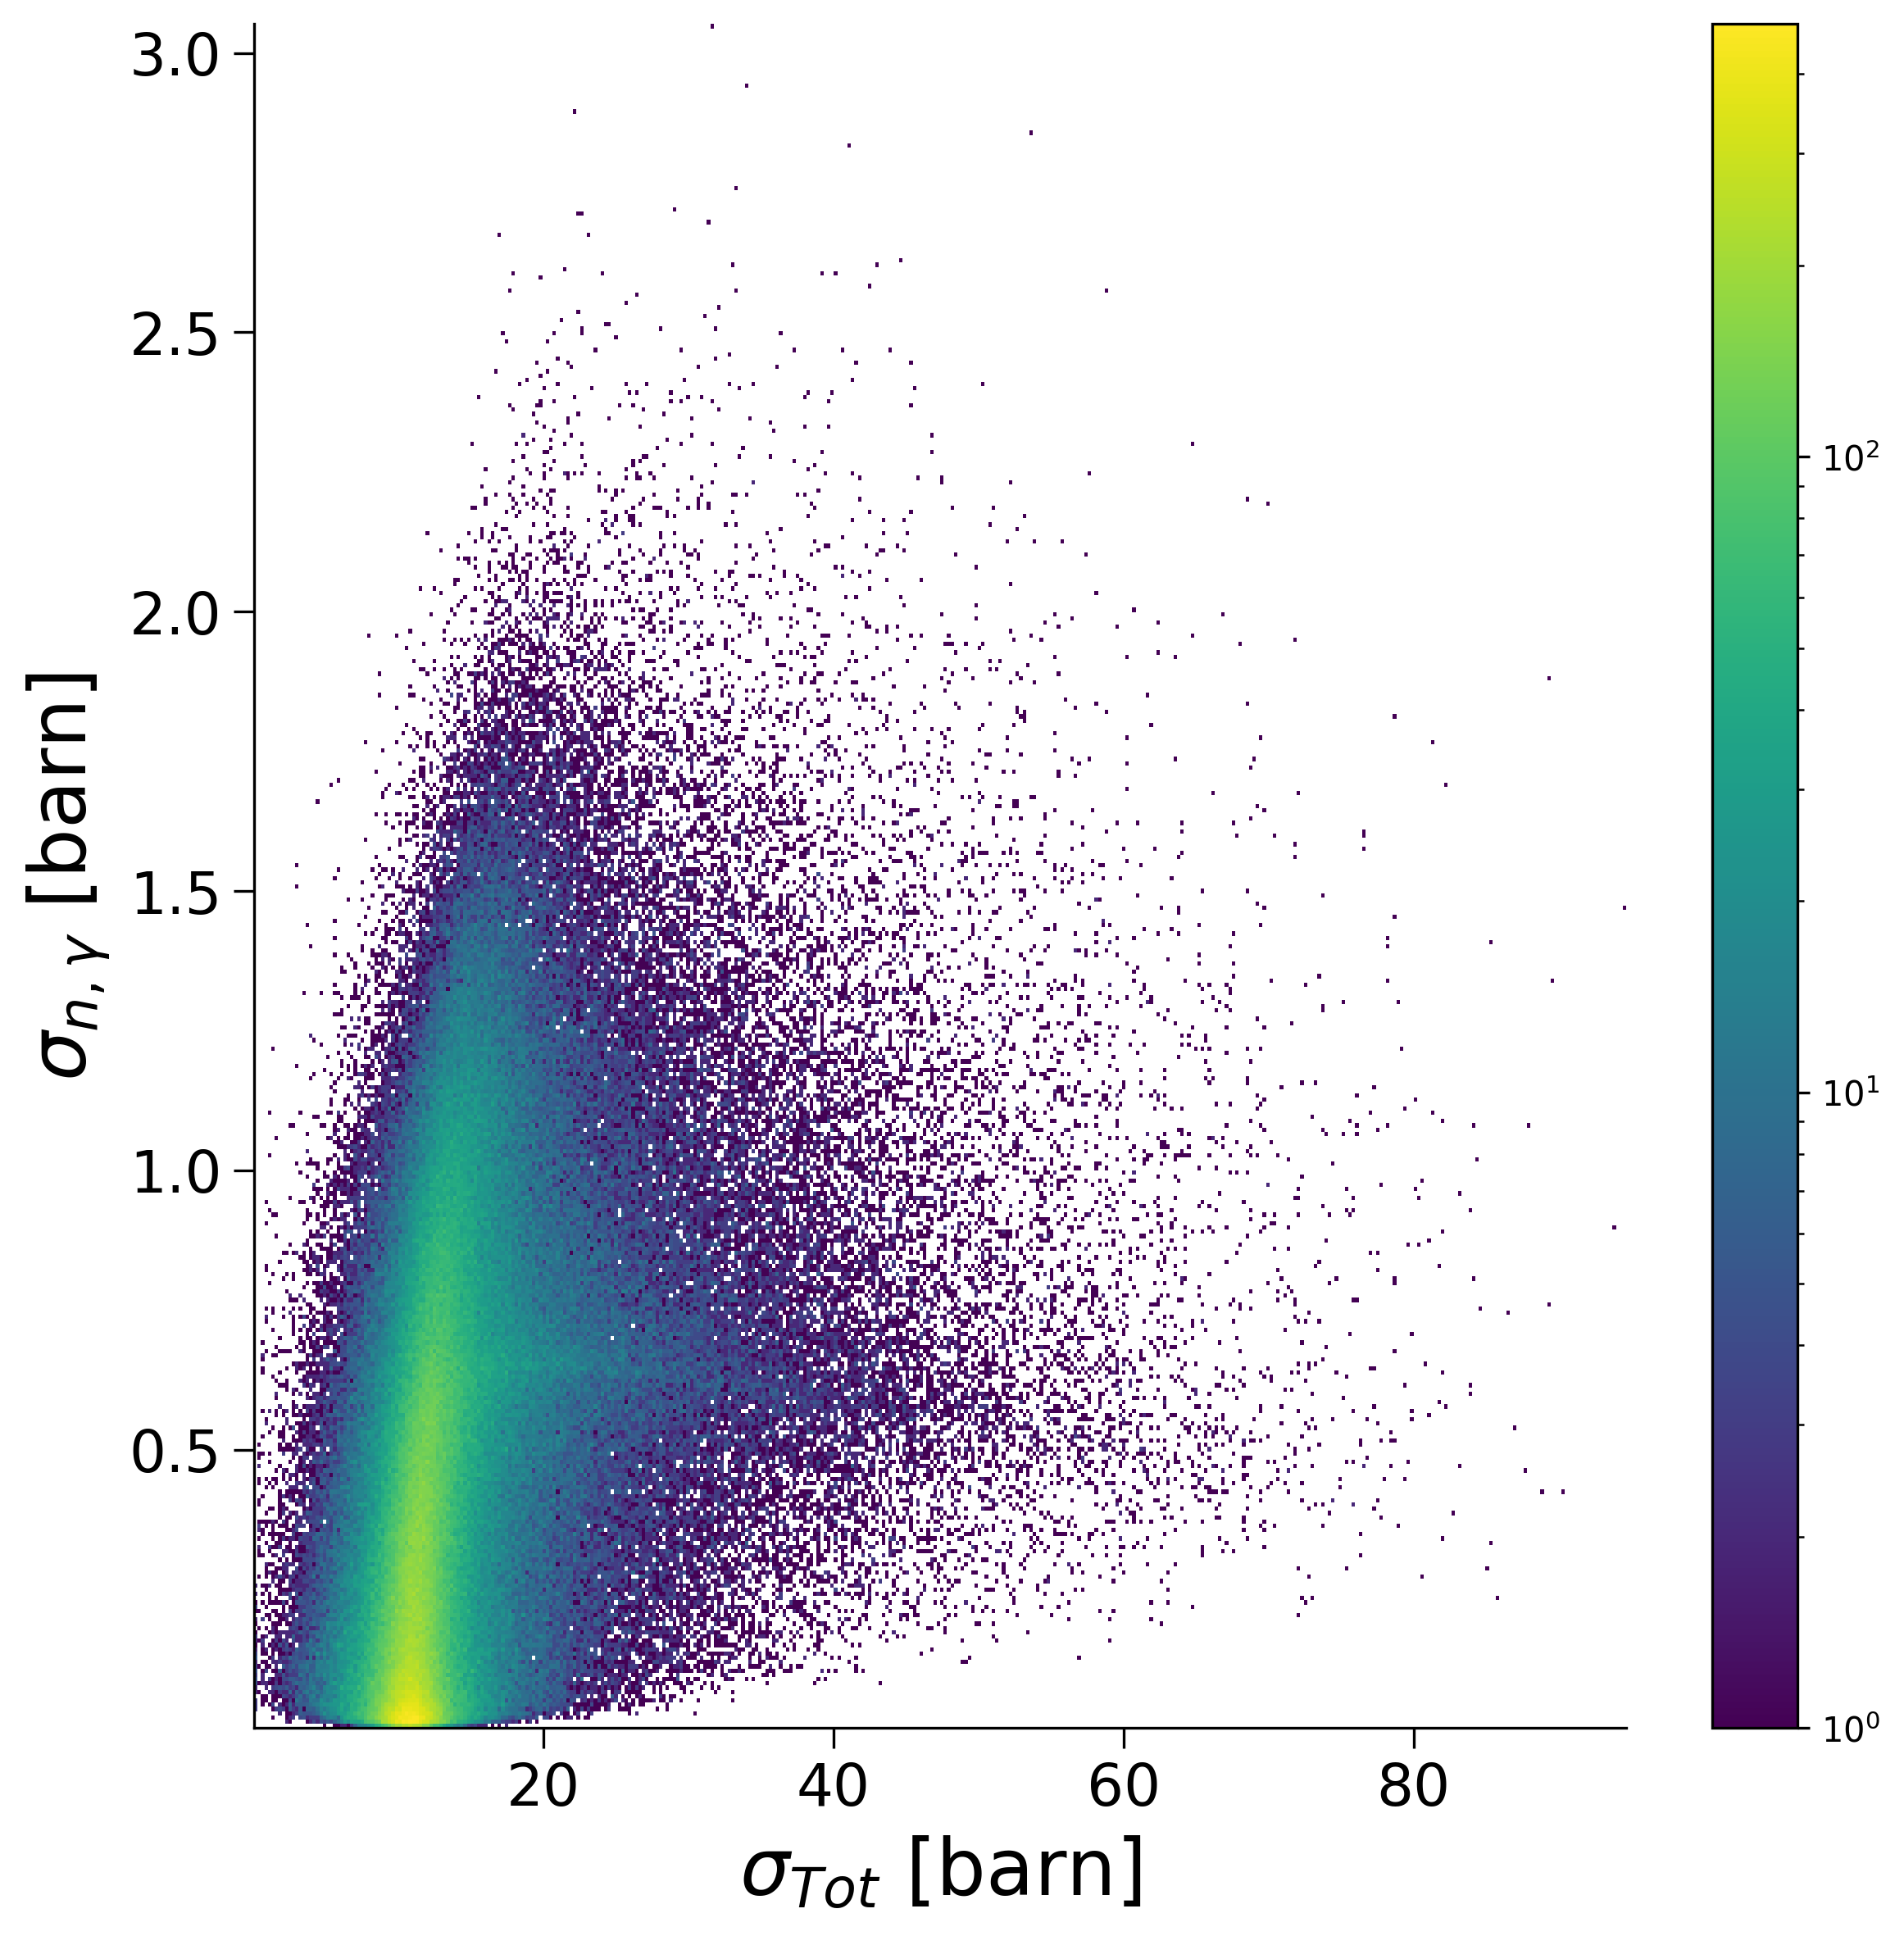
Probability Table processing
JENDL-5 Library : U238 @ 23 keV (294 K)
GALILÉE-1 :
Two ways for generating probability tables (PTs):
1/ Random PENDF in URR + Cross sections Moments
2/ Random cross sections values at one energy + Tally
Probability tables are calculated using total cross sections
→ Representation of small partial cross sections ?

Slide 12
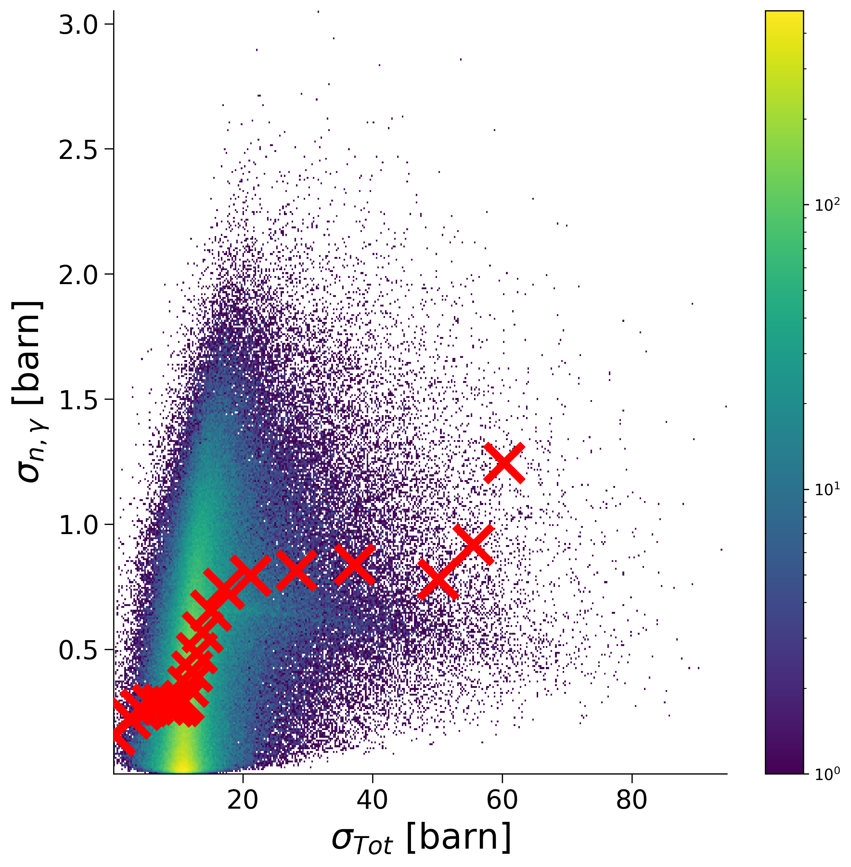
Probability Table processing
JENDL-5 Library : U238 @ 23 keV (294 K)
GALILÉE-1 :
Two ways for generating probability tables (PTs):
1/ Random PENDF in URR + Cross sections Moments
2/ Random cross sections values at one energy + Tally
Probability tables are calculated using total cross sections
→ Representation of small partial cross sections ?

Slide 13
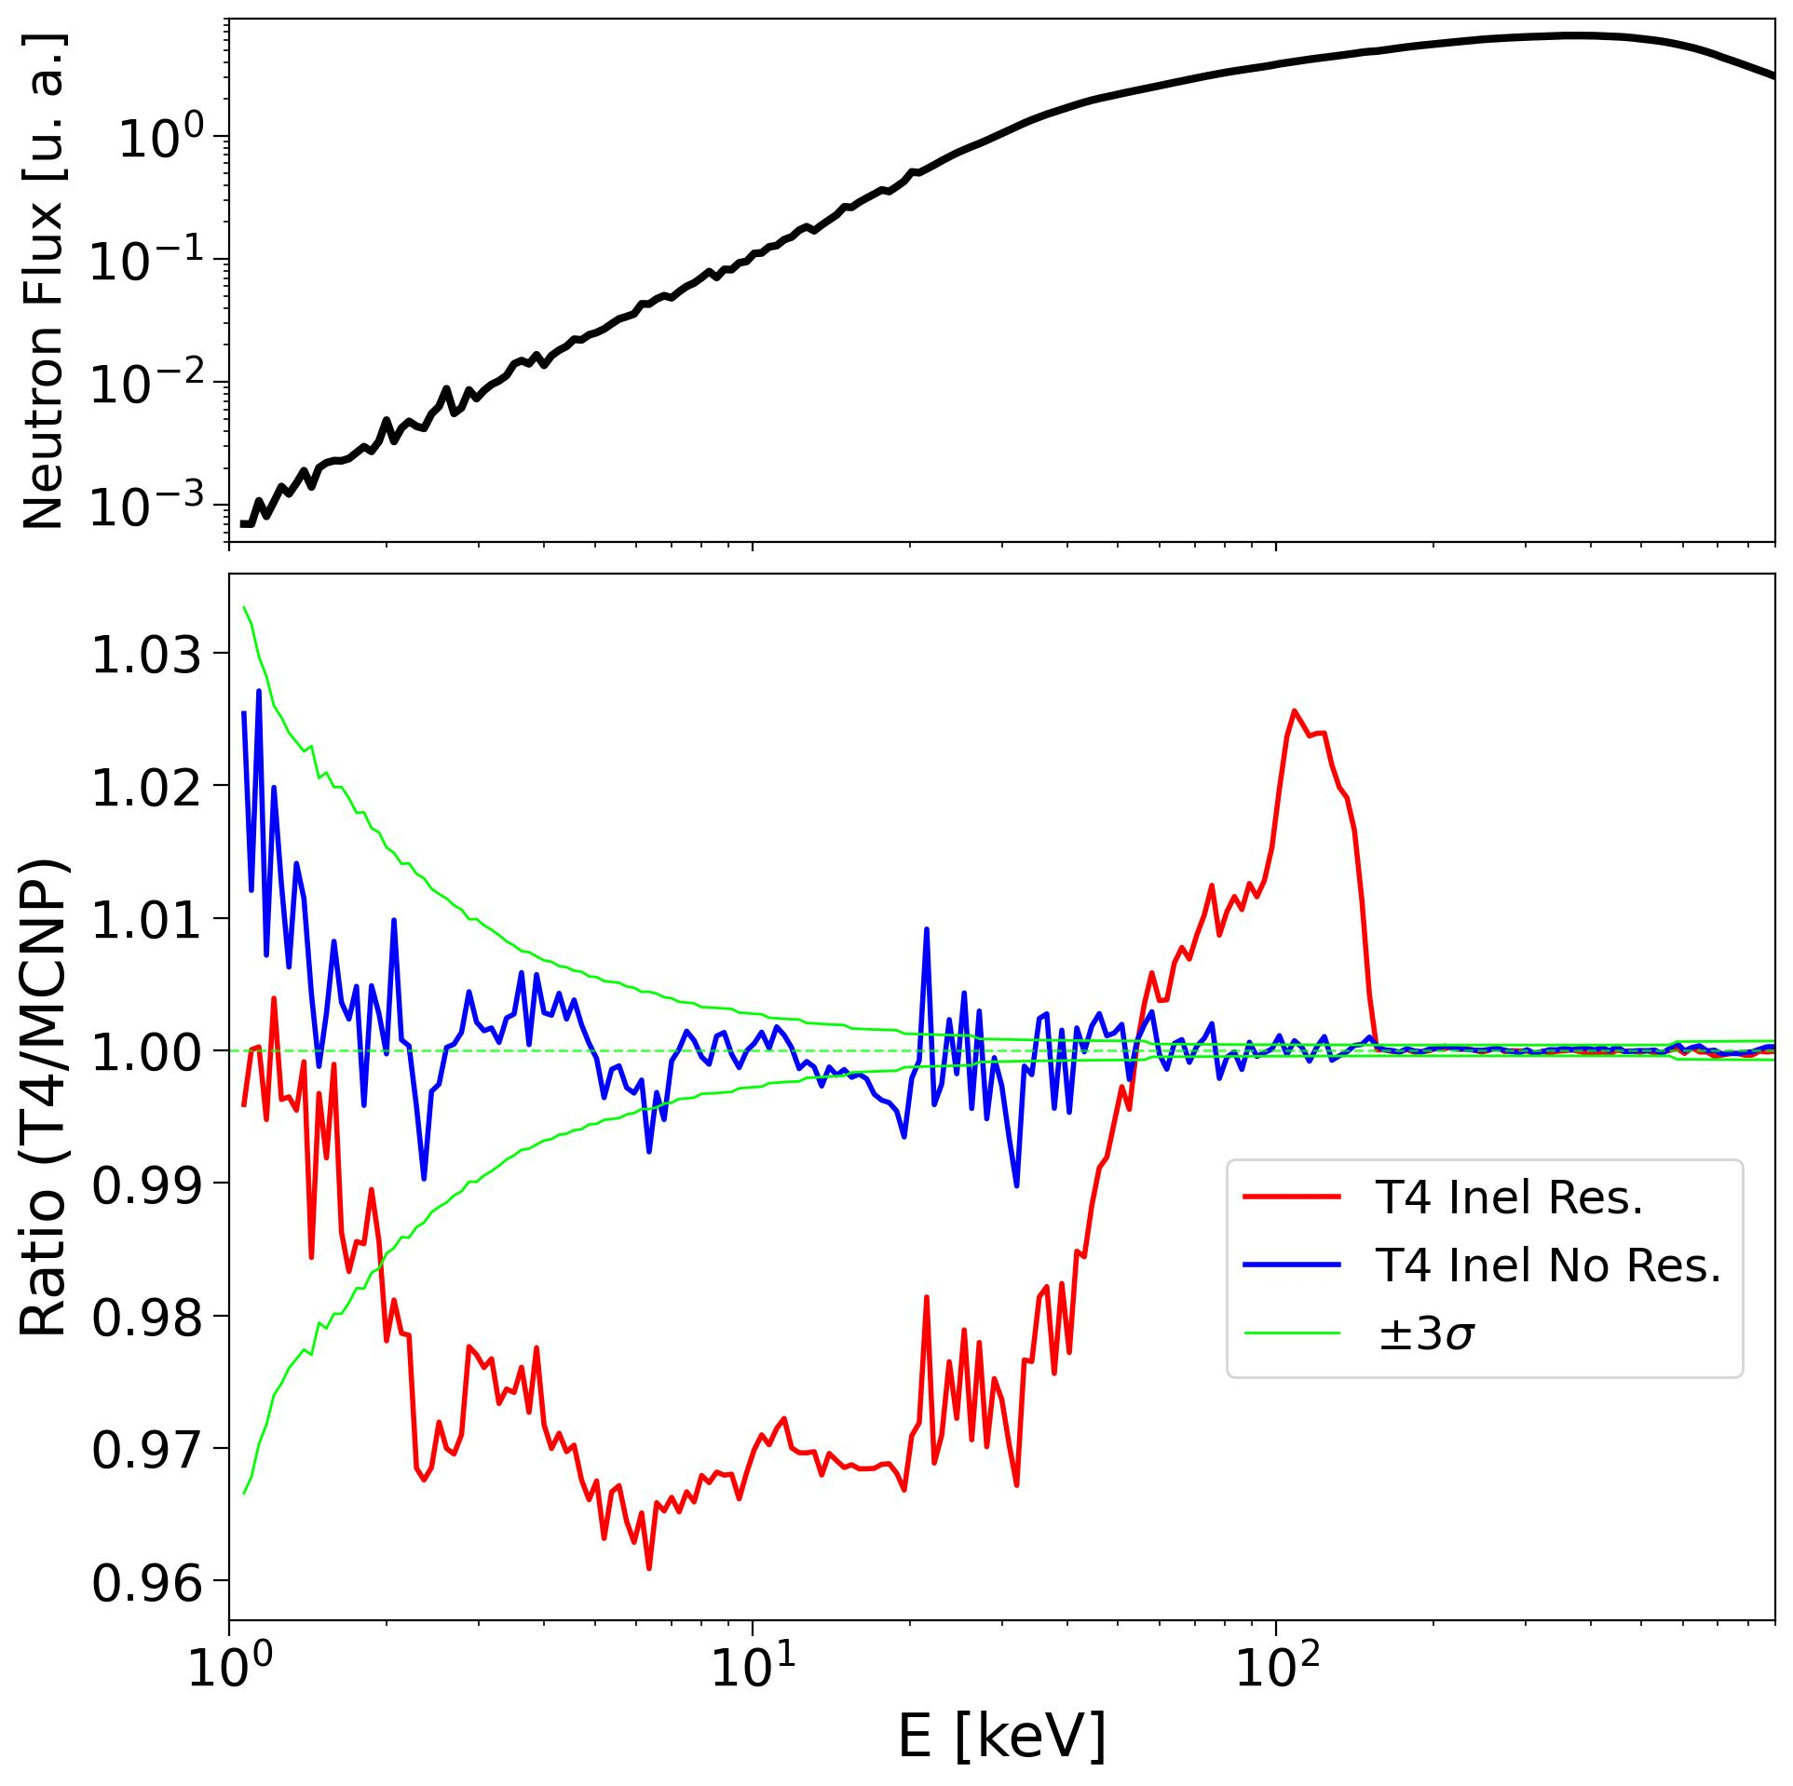
Probability Table processing
Big Ten (ieu-met-fast-007_2Z)
Calculation Mode | K_{eff} | ΔK_{eff}
MCNP without PTs | 0.99151 (3) | -1
TRIPOLI-4 without PTs | 0.99152 (2) | -
MCNP using PTs | 0.99458 (2) | +2
TRIPOLI-4 using PTs Non resonant inelastic (URR) | 0.99456 (2) | -
TRIPOLI-4 using PTs Resonant inelastic (URR) | 0.99513 (2) | +57

Slide 14
Conclusion
GALILÉE-1 is now fully operational for generating nuclear data libraries for TRIPOLI-4®.
Further developments are needed to produce accurate and reliable probability tables.
Next milestone (2027): Generation of ACE libraries for TRIPOLI-5®, MCNP,
and other Monte Carlo codes.
Long-term objective: Generation of multigroup nuclear data libraries (APOLLO libraries).

Slide 15
Thank You !
Cédric Jouanne
CEA Saclay
cedric.jouanne@cea.fr

