Slide 1







⁵⁰Cr and ⁵³Cr (n,γ) cross section measurements at n_TOF and HiSPANoS
P. Pérez-Maroto, C. Guerrero, a. casanovas,
B. Fernández & the n_TOF Collaboration.
Wonder 2026, aix-en-provence. 30/06/2026

Slide 2
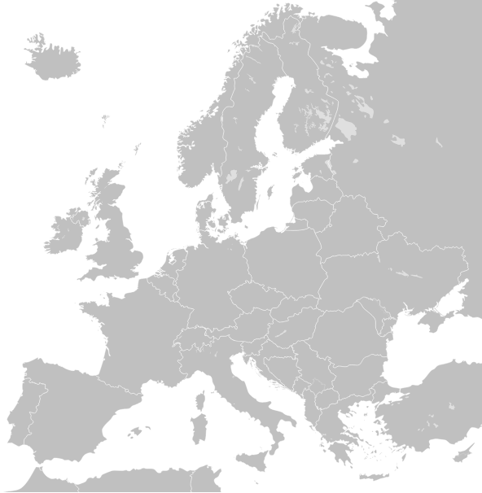

Index
I. Introduction
II. ⁵⁰Cr activation measurement at HiSPANoS
III. ^{50,53}Cr time-of-flight measurement at EAR1-n_TOF
IV. Summary & Conclusions
Geneva
Seville
P. Pérez-Maroto PhD: “Measurement of ⁵⁰Cr and ⁵³Cr neutron capture
cross sections for nuclear technology at CERN n_TOF and HiSPANoS”
Pablo Pérez Maroto || WONDER 2026 || 30/06/2026

Slide 3
I. Introduction
Pablo Pérez Maroto || WONDER 2026 || 30/06/2026

Slide 4
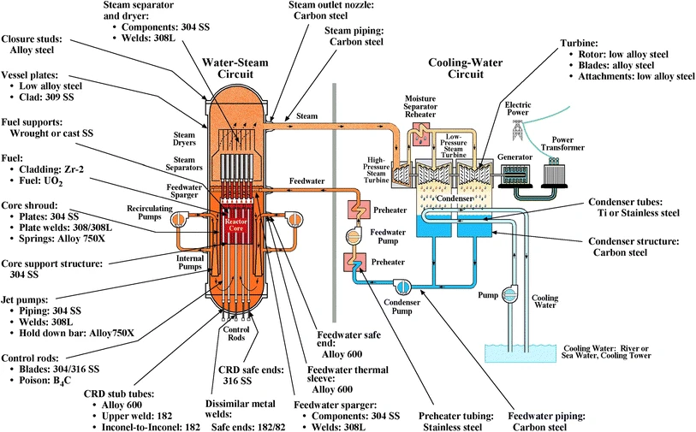
Why ^{50,53}Cr neutron capture?
Stainless Steel → structural material in nuclear reactors.
Contains 11-26% of chromium.
Criticality benchmarks sensitive to chromium → dominated by
^{50,53}Cr (n,γ)
~30% discrepancies in ⁵⁰Cr and ⁵³Cr cross sections → 1% change in k_{eff} †.
†A. Trkov, “On the Benchmarking of New Evaluated Nuclear Data Libraries”, INDC (NDS)-0751 (2018)
Pablo Pérez Maroto || WONDER 2026 || 30/06/2026

Slide 5
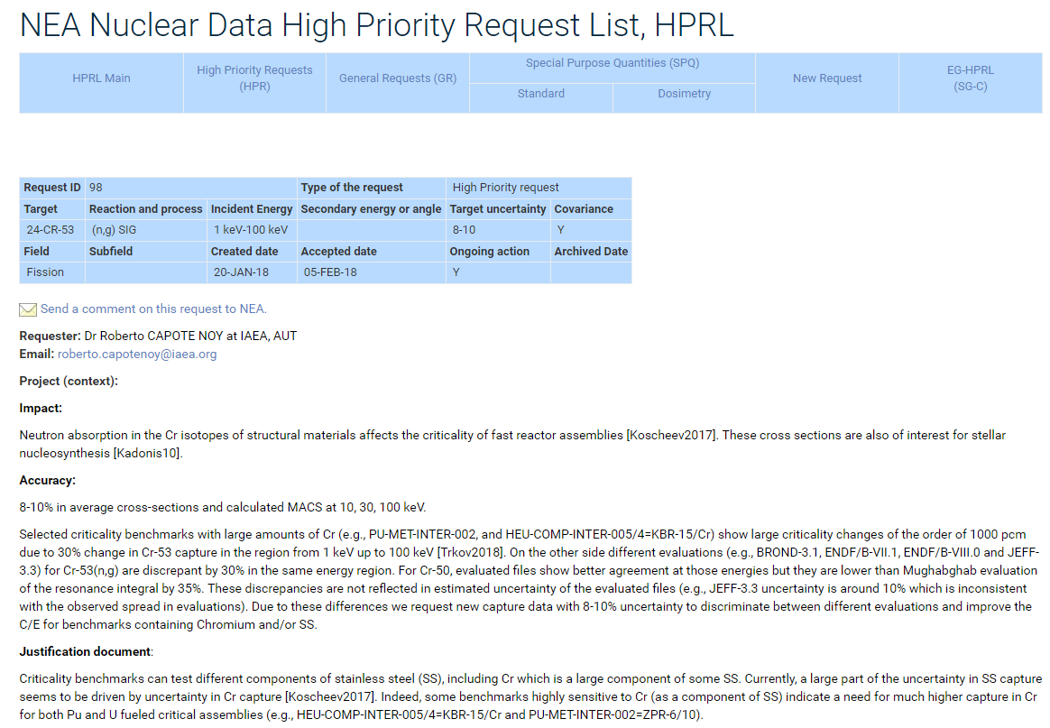
Why ^{50,53}Cr neutron capture?
Stainless Steel → structural material in nuclear reactors.
Contains 11-26% of chromium.
Criticality benchmarks sensitive to chromium → dominated by
^{50,53}Cr (n,γ)
~30% discrepancies in ⁵⁰Cr and ⁵³Cr cross sections → 1% change in k_{eff} †.
↓
NEA High Priority Request List (HPRL):
^{50,53}Cr σ(n,γ) within 8-10% from 1 to 100 keV
†A. Trkov, “On the Benchmarking of New Evaluated Nuclear Data Libraries”, INDC (NDS)-0751 (2018)
Pablo Pérez Maroto || WONDER 2026 || 30/06/2026

Slide 6
Previous measurements and evaluations
Several measurements have been performed during the 70s and 80s, and a more recent one in ORELA by Guber et al. (2011) †.
Experiment | Stieglitz (1971) | Beer (1975) | Kenny (1977) | Brusegan (1986) | Guber (2011)
Facility | RPI | FZK | ORELA | GELINA | ORELA
Detector | Scin.tank | Scin.tank | C₆F₆ | C₆D₆ | C₆D₆
Thickness ⁵⁰Cr (10⁻³ at/barns) | 8 | 18 | 5/8 | 7 | -
Thickness ⁵³Cr (10⁻³ at/barns) | 14 | 14 | 8/12 | 12/60 | 14
Goal: as many resonances as possible, even at high energies.
Very thick samples were used → large neutron multiple-scattering effects.
Guber improves the neutron sensitivity → Issues with sample characterization.
†K. H. Guber et al., “Neutron cross-section measurements on structural materials at ORELA”, J. Korean Phys. 59, nº 2(3) (2011)
Pablo Pérez Maroto || WONDER 2026 || 30/06/2026
Notes:
Very thin -> 1-15 keV. The first resonance affects the most to the criticality safety calculations
Thin -> 15-100 keV. Thanks to the very intense neutron flux at n_TOF
natCr -> (50,52,53,54) = (4.3, 83.8, 9.5, 2.4)% (50Cr half-life = 2E17 years = 0.2 trillones de años)

Slide 7
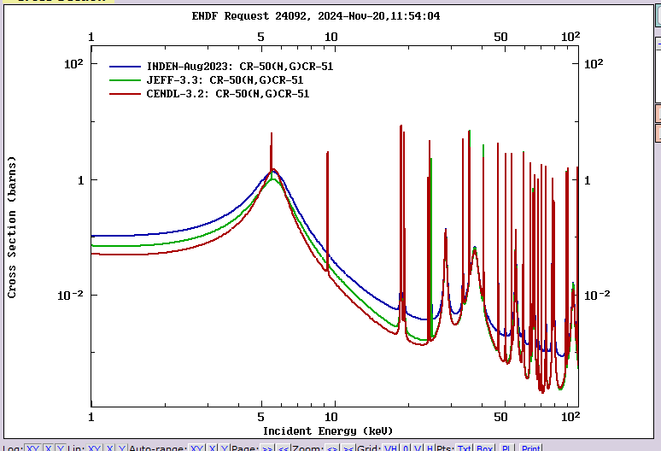
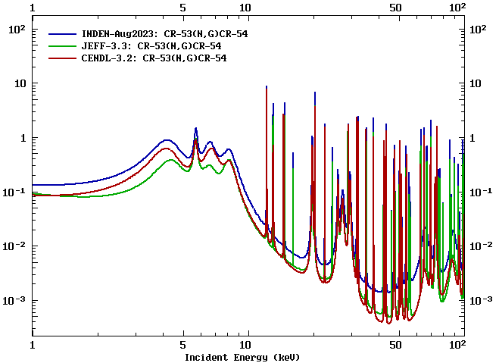
Previous measurements and evaluations
Evaluated data
JEFF-3.3, ENDF/B-VIII.0 & JENDL-5 → Same XS, mainly based on Guber et al (2011).
CENDL-3.2 → Uses data from the 70’s and 80’s.
INDEN → Careful re-evaluation of multiple-scattering effects at Guber et al. data.
ENDF/B-VIII.1, JEFF-4.0 → Has adopted INDEN.
⁵⁰Cr
⁵³Cr
40%
100%
Pablo Pérez Maroto || WONDER 2026 || 30/06/2026
Notes:
Very thin -> 1-15 keV. The first resonance affects the most to the criticality safety calculations
Thin -> 15-100 keV. Thanks to the very intense neutron flux at n_TOF
natCr -> (50,52,53,54) = (4.3, 83.8, 9.5, 2.4)% (50Cr half-life = 2E17 years = 0.2 trillones de años)

Slide 8
II. ⁵⁰Cr activation measurement
at HiSPANoS@CNA
Pablo Pérez Maroto || WONDER 2026 || 30/06/2026

Slide 9

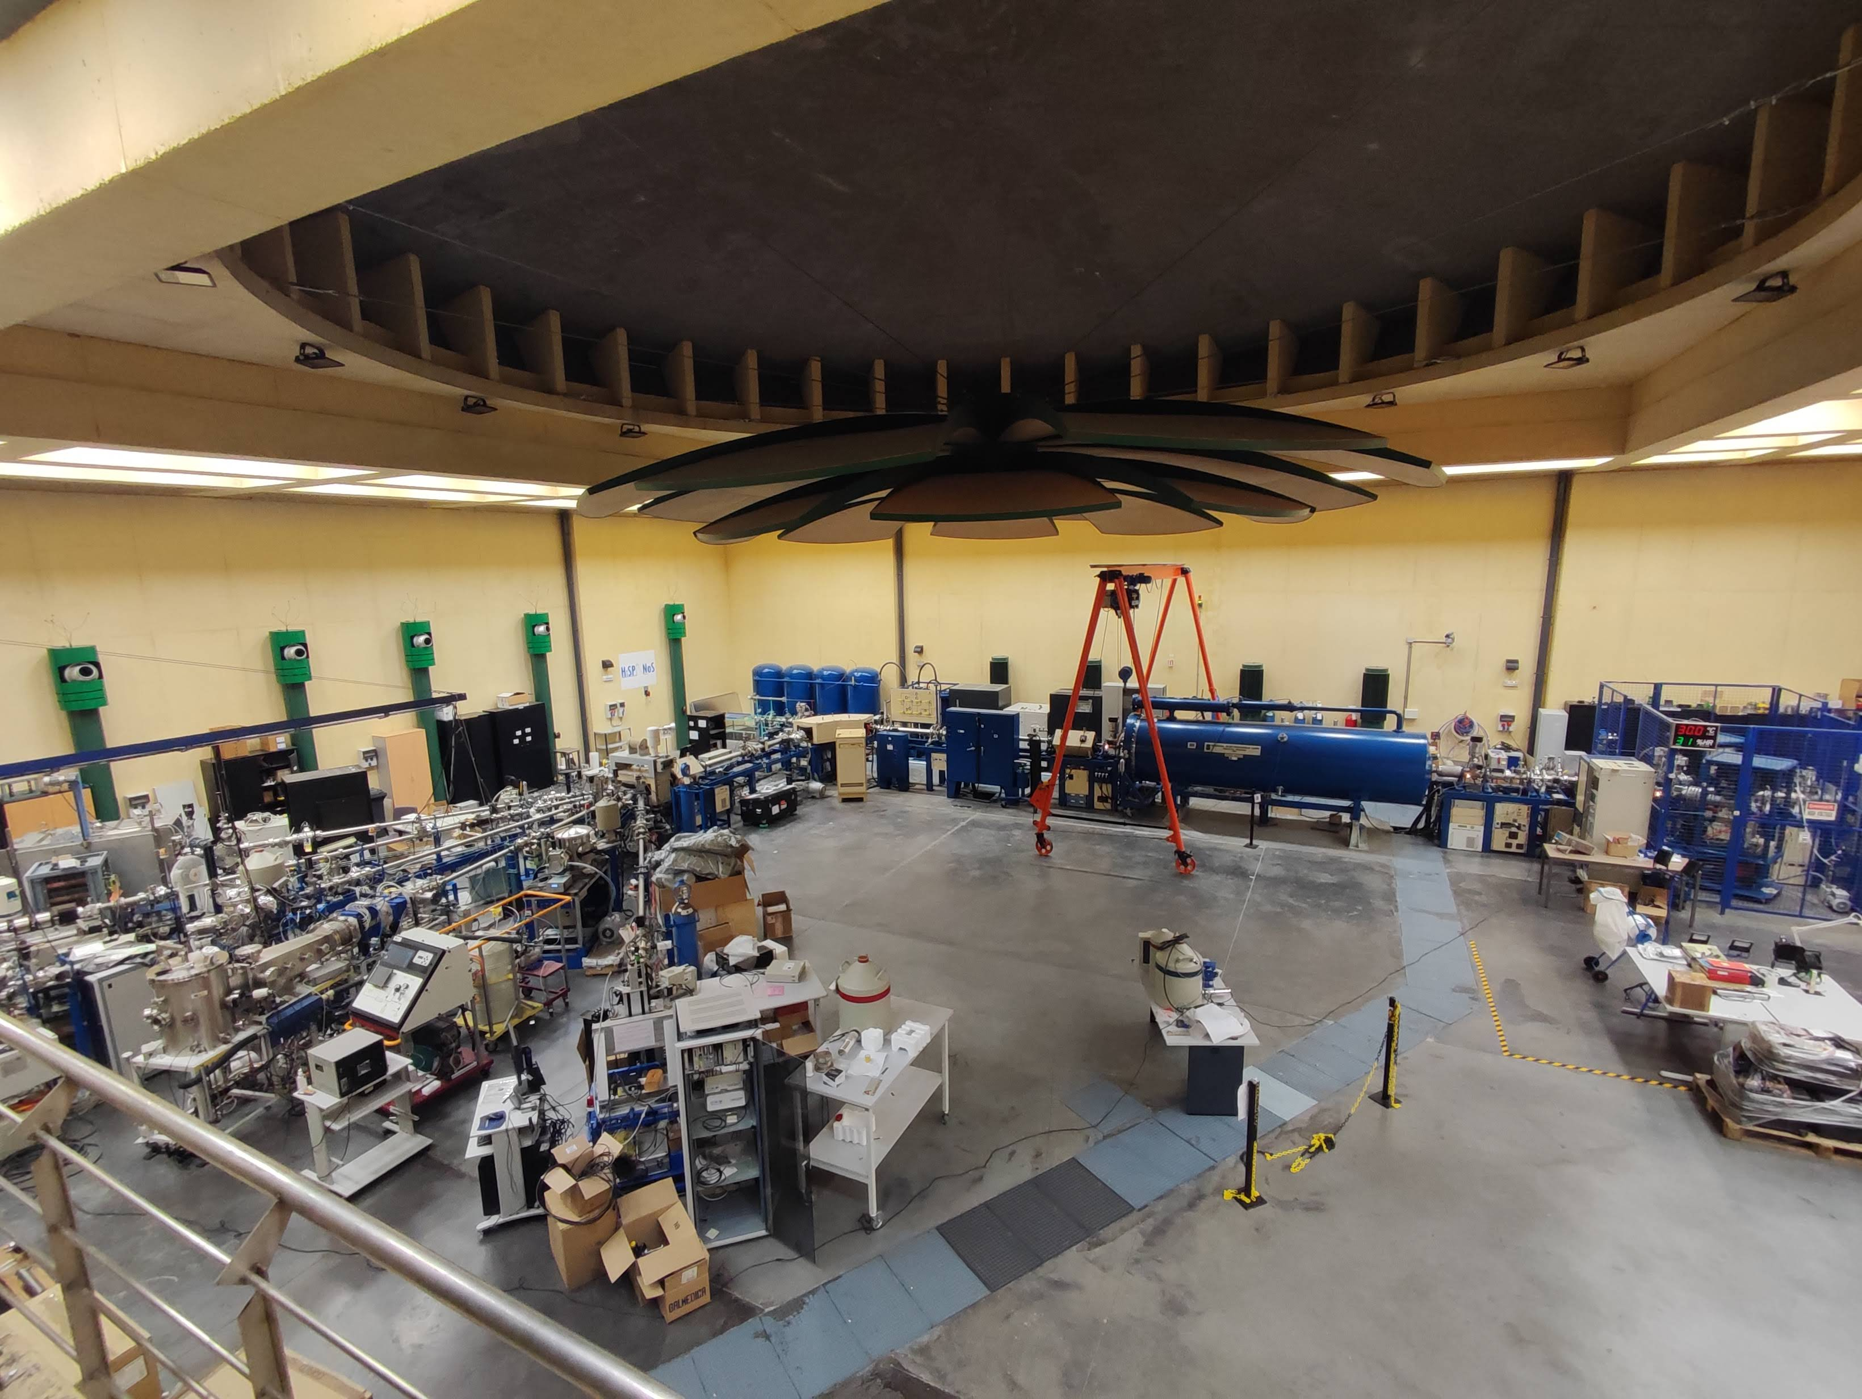
The HiSPANoS facility at CNA
HiSPANoS is the neutron facility of CNA †‡.
Thermal (eV) → moderation
Epithermal (keV) → Li(p,n)
Fast (MeV) → ²H(d,n) and Be/Li(p/d,n)
  Continuous: activations/irradiations
  Pulsed: ToF measurements
†M. Macías et al., “The first neutron time-of-flight line in Spain: …”, Rad. Phys. and Chem. 168 (2020)
‡M. A. Millán-Callado et al., “Continuous and pulsed fast neutron beams at the CNA HiSPANoS facility”, Rad. Phys. and Chem. 217 (2024)
Pablo Pérez Maroto || WONDER 2026 || 30/06/2026

Slide 10
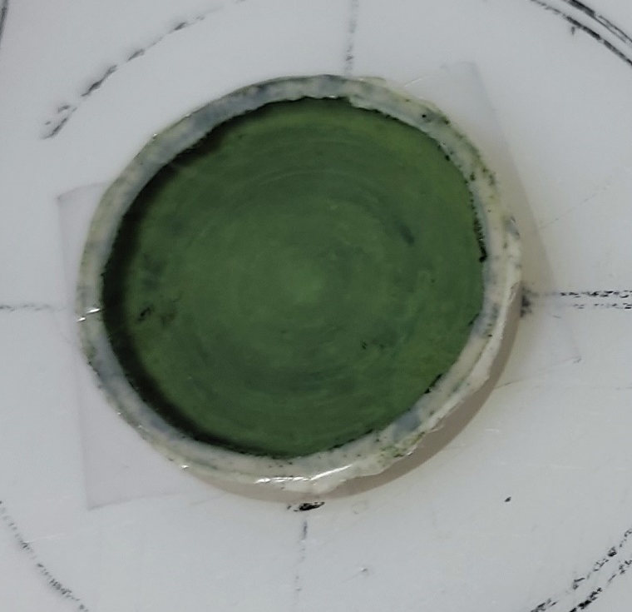
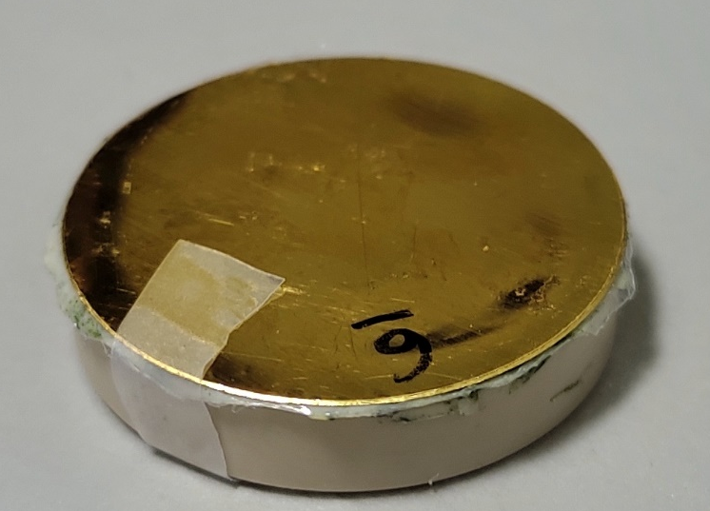
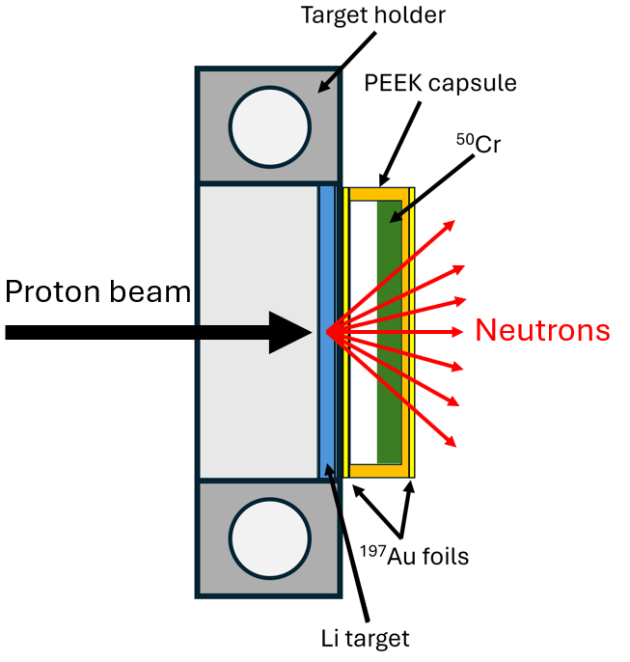
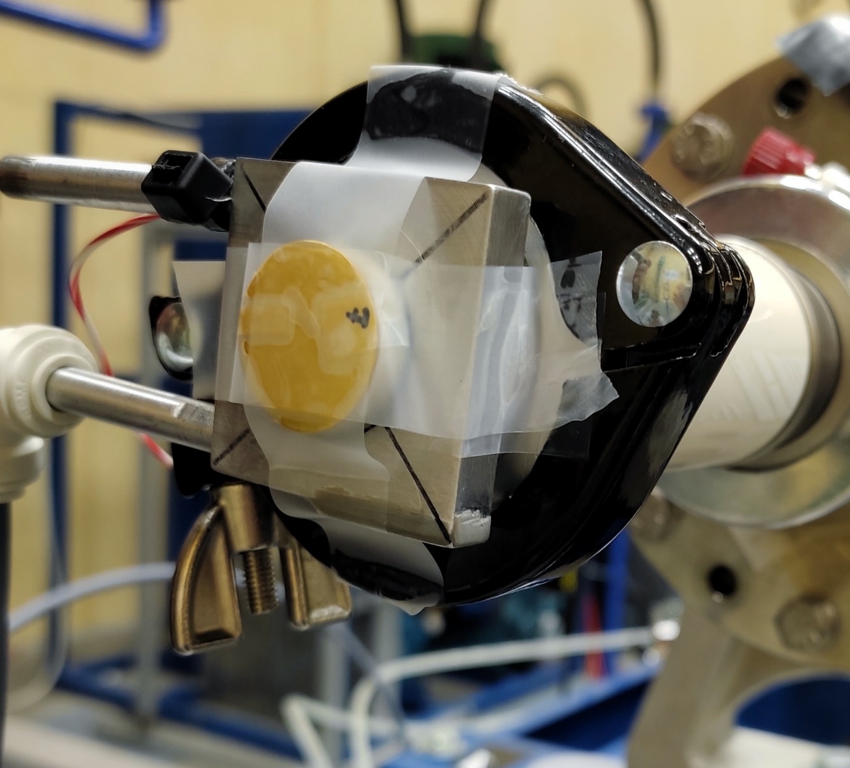
Experimental set-up. Activation sample
¹⁹⁷Au
⁵⁰Cr
94.6(4)% enriched ⁵⁰Cr₂O₃
723(3) mg of material
Inside a PEEK capsule
Measured relative to two ¹⁹⁷Au foils (standard cross section)
20 mm
12 mm collimator
~23 mm Li target
Pablo Pérez Maroto || WONDER 2026 || 30/06/2026

Slide 11
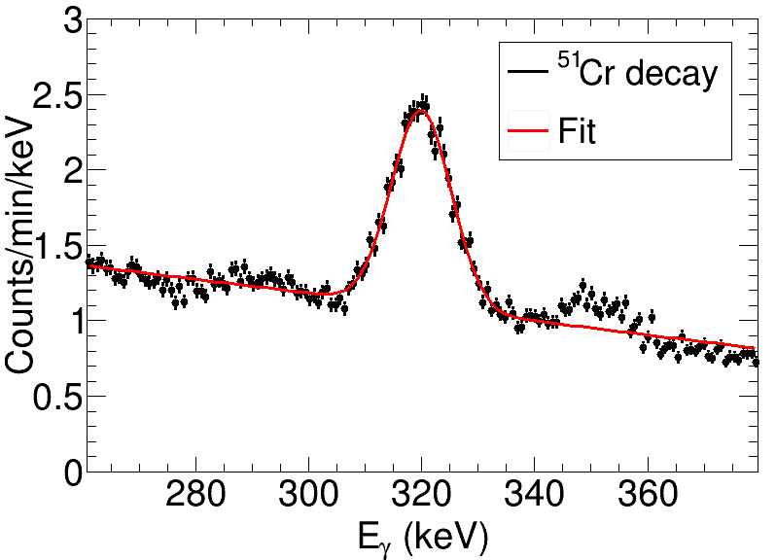
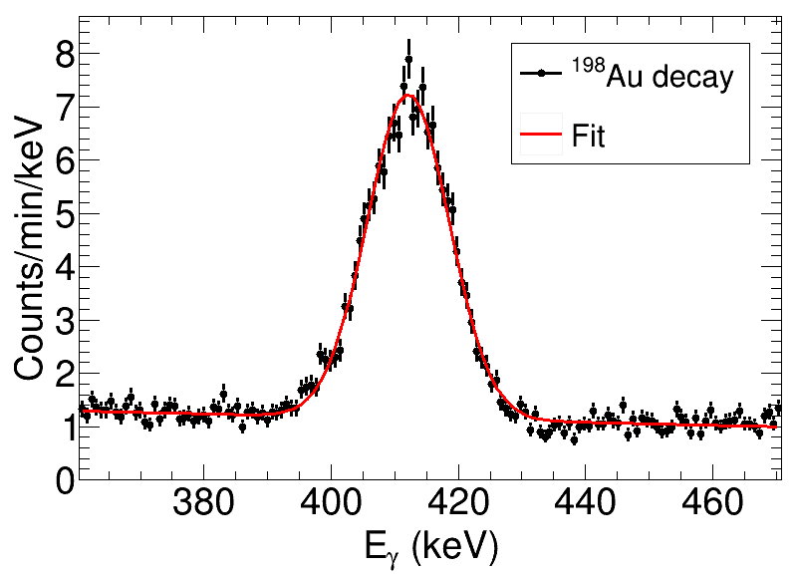
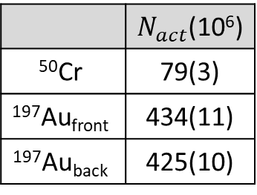
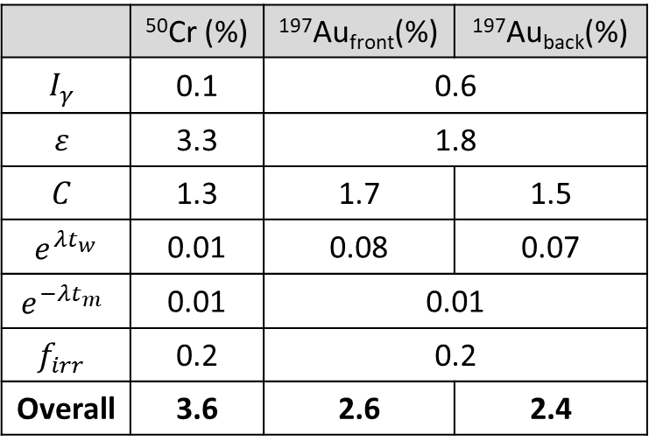
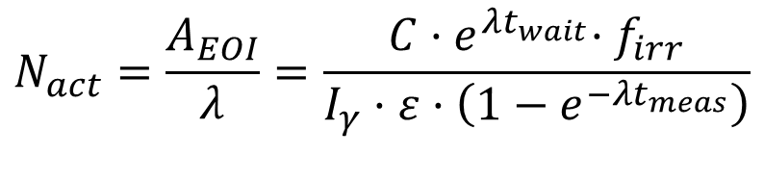
Neutron activation analysis
$$N_{act}=\frac{A_{EOI}}{λ}=\frac{C{·e}^{λt_{wait}}{·f}_{irr}}{I_{γ}·ε·\left(1−e^{−λt_{meas}}\right)}$$
 | $N_{act}$(10⁶)
$$\text{50}\text{Cr}$$ | 79(3)
$$\text{197}\text{Au}\text{front}$$ | 434(11)
$$\text{197}\text{Au}\text{back}$$ | 425(10)
 | ⁵⁰Cr (%) | ¹⁹⁷Au_{front}(%) | ¹⁹⁷Au_{back}(%)
$$I_{γ}$$ | 0.1 | 0.6
$$ε$$ | 3.3 | 1.8
$$C$$ | 1.3 | 1.7 | 1.5
$e^{λt_{w}}$ | 0.01 | 0.08 | 0.07
$$e^{−λt_{m}}$$ | 0.01 | 0.01
$$f_{irr}$$ | 0.2 | 0.2
Overall | 3.6 | 2.6 | 2.4
Efficiency is the main source of uncertainty
Pablo Pérez Maroto || WONDER 2026 || 30/06/2026

Slide 12
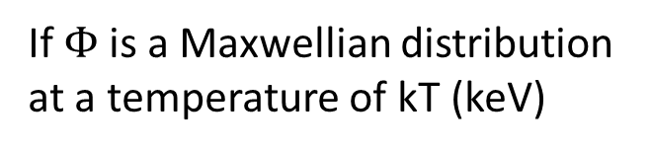
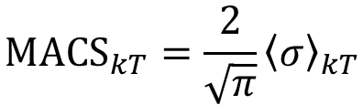
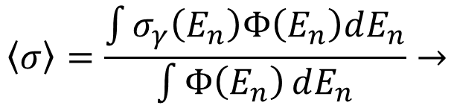
MACS₃₀(⁵⁰Cr) determination
$$\left\langle σ\right\rangle =\frac{\int{σ_{γ}\left(E_{n}\right)Φ\left(E_{n}\right)dE_{n}}}{\int{Φ\left(E_{n}\right)}dE_{n}}→$$
If $Φ$ is a Maxwellian distribution at a temperature of kT (keV)
$$MACS_{kT}=\frac{2}{\sqrt{π}}{\left\langle σ\right\rangle }_{kT}$$
Pablo Pérez Maroto || WONDER 2026 || 30/06/2026

Slide 13
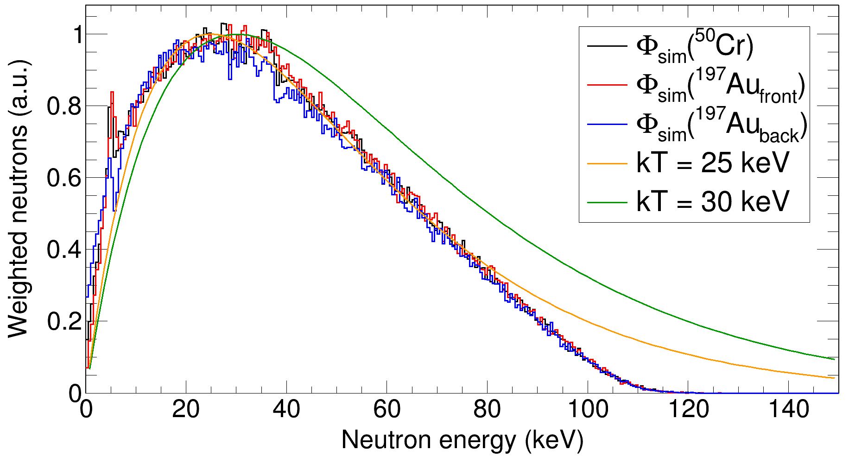

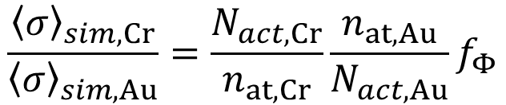
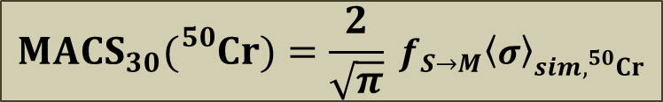
MACS₃₀(⁵⁰Cr) determination
$$\left\langle σ\right\rangle =\frac{\int{σ_{γ}\left(E_{n}\right)Φ\left(E_{n}\right)dE_{n}}}{\int{Φ\left(E_{n}\right)}dE_{n}}→$$
If $Φ$ is a Maxwellian distribution at a temperature of kT (keV)
$$MACS_{kT}=\frac{2}{\sqrt{π}}{\left\langle σ\right\rangle }_{kT}$$
MACS₃₀(⁵⁰Cr) relative to MACS₃₀(¹⁹⁷Au):
$$\frac{{\left\langle σ\right\rangle }_{sim,Cr}}{{\left\langle σ\right\rangle }_{sim,Au}}=\frac{N_{act,Cr}}{n_{at,Cr}}\frac{n_{at,Au}}{N_{act,Au}}f_{Φ}$$
↓
SimLiT + GEANT4
$$MACS_{30}({}_{}^{50}{Cr})=\frac{2}{\sqrt{π}} {f_{S→M}\left\langle σ\right\rangle }_{sim,^{50}Cr}$$
Pablo Pérez Maroto || WONDER 2026 || 30/06/2026

Slide 14
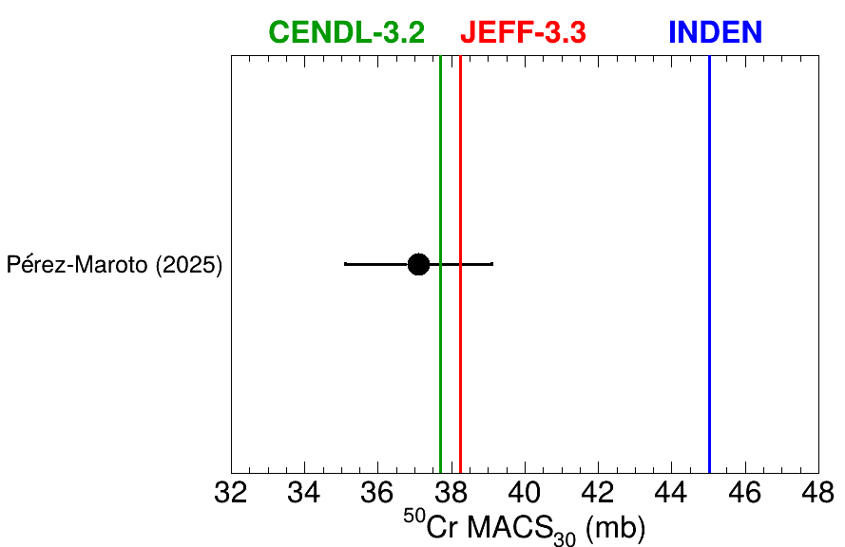
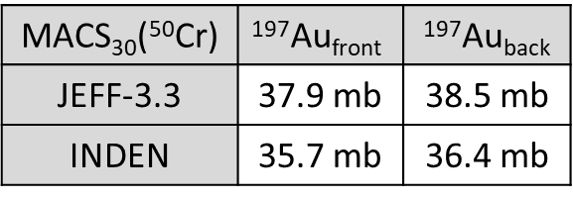
MACS₃₀(⁵⁰Cr). Comparison with previous data
First ⁵⁰Cr neutron activation measurement.
Agreement with CENDL-3.2 and JEFF-3.3 (and therefore, ENDF/B-VIII.0 and JENDL-5).
20% lower than INDEN.
MACS₃₀(⁵⁰Cr) | $$\text{197}\text{Au}\text{front}$$ | ¹⁹⁷Au_{back}
JEFF-3.3 | 37.9 mb | 38.5 mb
INDEN | 35.7 mb | 36.4 mb
MACS₃₀ (⁵⁰Cr) = 37.1(20) mb
→ <6% unc.
P. Pérez-Maroto et al., “Neutron activation as benchmark for cross section evaluations: Demonstration through the MACS of ⁵⁰Cr for nuclear technology applications”, Physics Letters B, 2025, vol. 862, p. 139360
Pablo Pérez Maroto || WONDER 2026 || 30/06/2026

Slide 15
III. ^{50,53}Cr time-of-flight measurement at EAR1-n_TOF@CERN
Pablo Pérez Maroto || WONDER 2026 || 30/06/2026

Slide 16
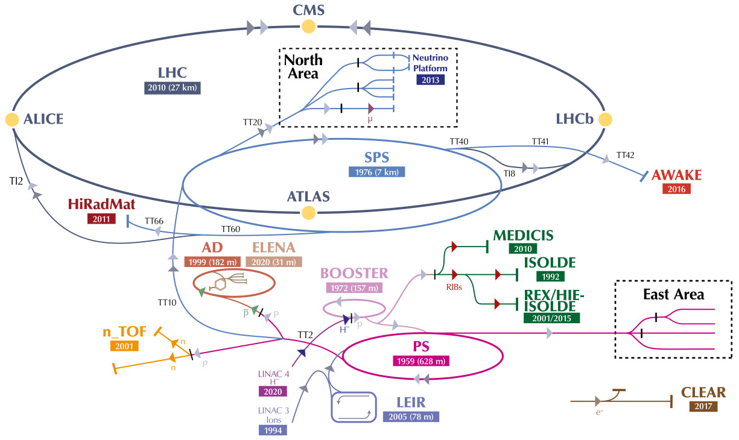
The neutron Time-Of-Flight facility at CERN
n_TOF@CERN
In operation since 2001
2026: ~150 researchers from 42 institutes
Pablo Pérez Maroto || WONDER 2026 || 30/06/2026

Slide 17
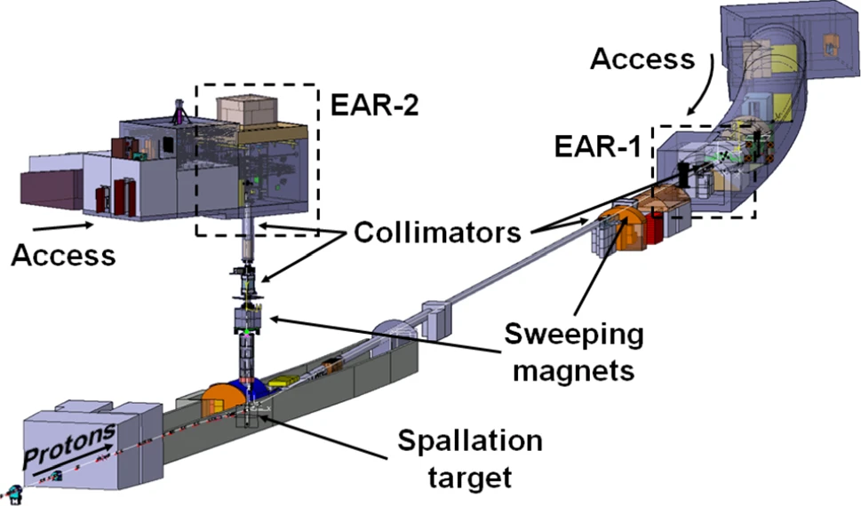
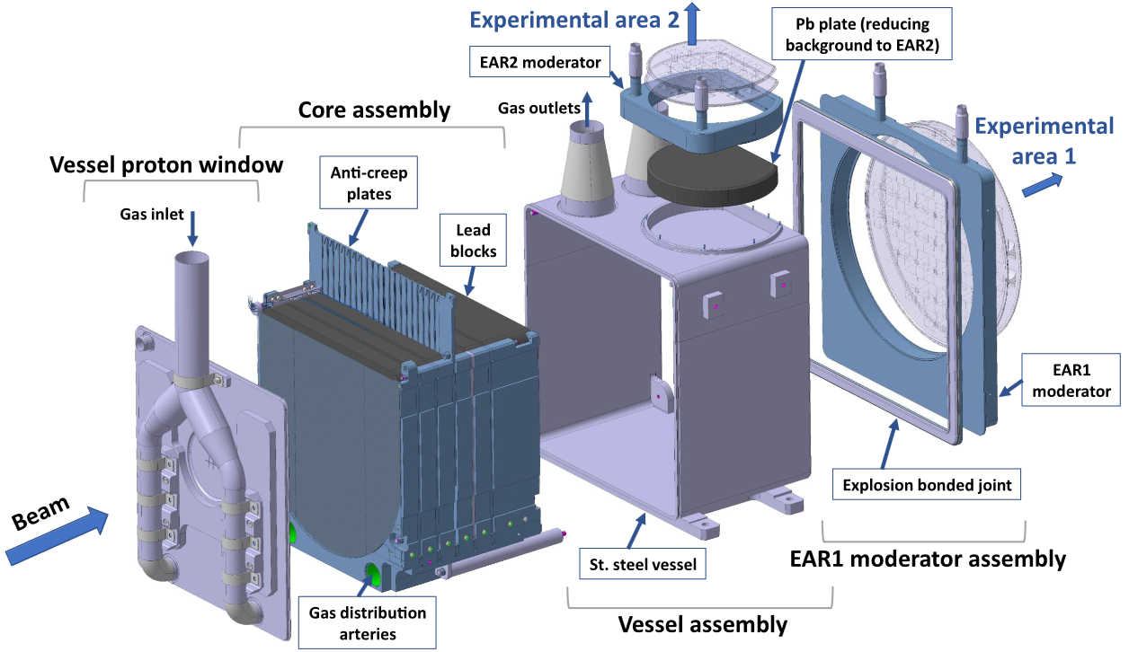
The neutron Time-Of-Flight facility at CERN
↑ Flux
↓E_{n} resolution
19 m
185 m
↓Flux
↑E_{n} resolution
NEAR
By N. Colonna
3 m
https://ntof-exp.web.cern.ch
Pablo Pérez Maroto || WONDER 2026 || 30/06/2026

Slide 18
The neutron Time-Of-Flight facility at CERN
↑ Flux
↓E_{n} resolution
19 m
185 m
↓Flux
↑E_{n} resolution
NEAR
By N. Colonna
3 m
https://ntof-exp.web.cern.ch
Pablo Pérez Maroto || WONDER 2026 || 30/06/2026

Slide 19
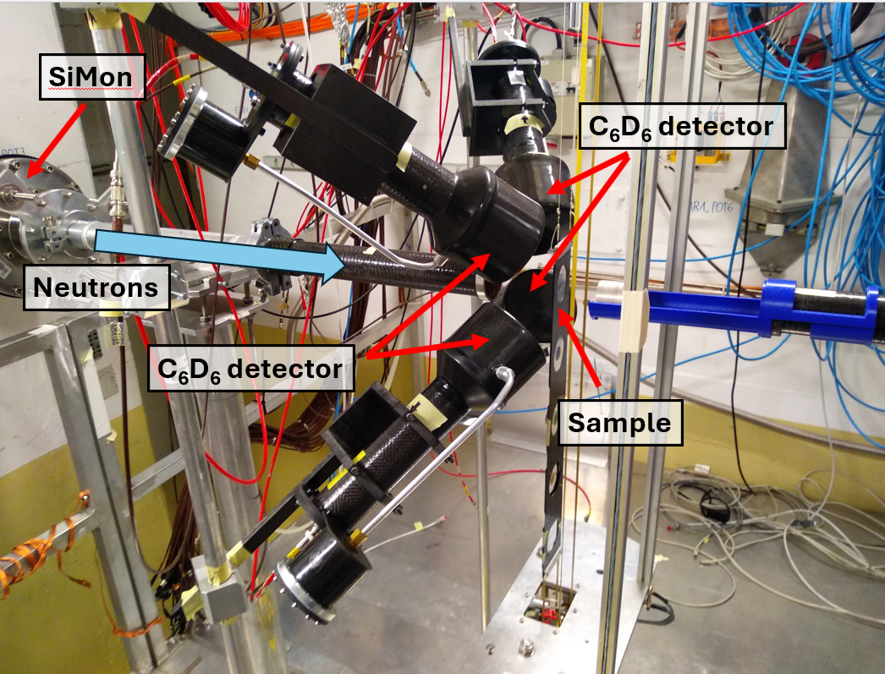
Experimental set-up. C6D6 TED detectors
4 C₆D₆ TED detectors† at 8 cm and 125° from the sample.
Developed specifically for n_TOF.
Made of carbon fiber.
Main advantages:
  Very low neutron sensitivity
  Very fast response and time resolution
TED → Pulse Height Weighting Technique.
†R. Plag et al.,“An optimized C₆D₆ detector for studies of resonance-dominated (n,γ) cross-sections”, Nucl. Inst. & Meth. in Phys. Res. A 496 (2003)
Pablo Pérez Maroto || WONDER 2026 || 30/06/2026

Slide 20
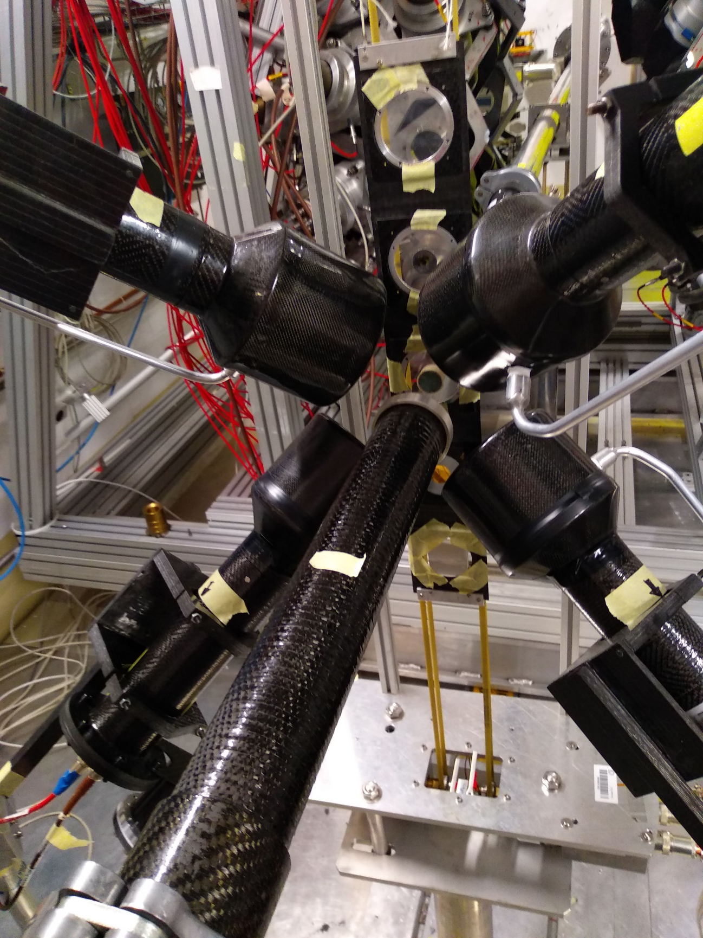
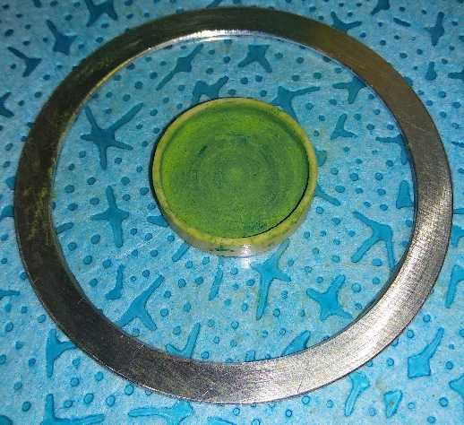
Experimental set-up. Samples
The strategy is to use two samples for each isotope.
94.6(4)% of ⁵⁰Cr and 97.7(2)% of ⁵³Cr.
C6D6
Experiment | Stieglitz (1971) | Beer (1975) | Kenny (1977) | Brusegan (1986) | Guber (2011) | This work (2024)
Thickness ⁵⁰Cr (10⁻³ at/barns) | 8 | 18 | 5/8 | 7 | - | 0.6/1.9
Thickness ⁵³Cr (10⁻³ at/barns) | 14 | 14 | 8/12 | 12/60 | 14 | 1.2/5.9
C6D6
x0.1
sample
x0.1
C6D6
neutrons
Thin samples (1-10 keV) → MS effects under control
Thick samples (10-100 keV) → Better statistics
C6D6
Thinnest samples ever measured
42 days long campaign
750·10³ protons pulses
Plus ancillary samples…
Pablo Pérez Maroto || WONDER 2026 || 30/06/2026

Slide 21
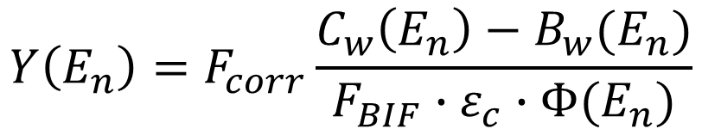
Capture yield determination
$$Y\left(E_{n}\right)=F_{corr}\frac{C_{w}\left(E_{n}\right)−B_{w}(E_{n})}{F_{BIF}∙ε_{c}∙Φ(E_{n})}$$
Pablo Pérez Maroto || WONDER 2026 || 30/06/2026

Slide 22
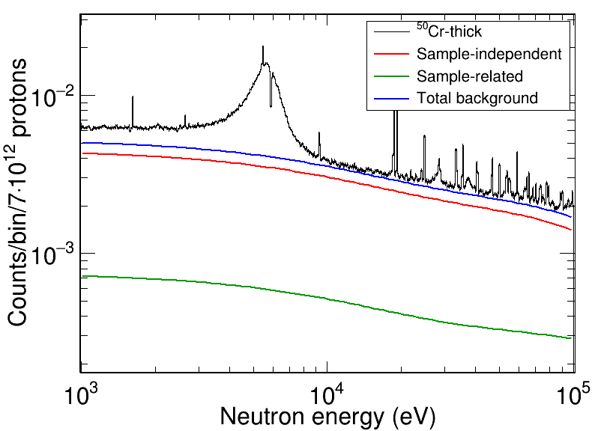
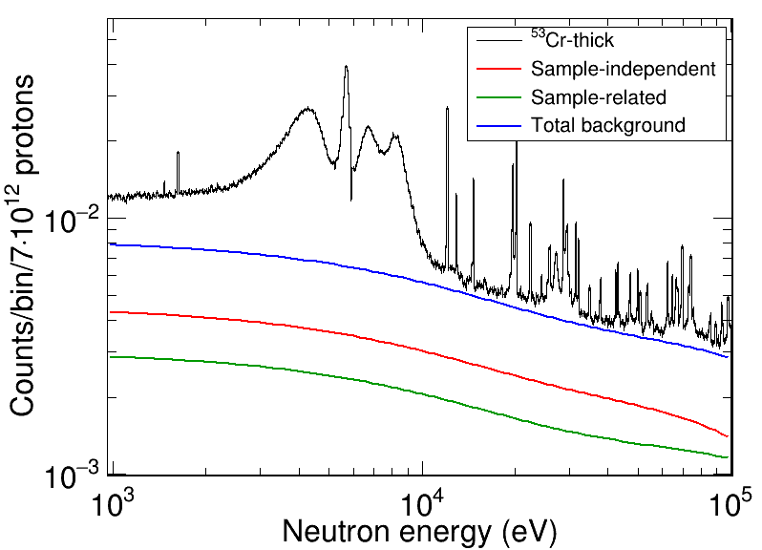
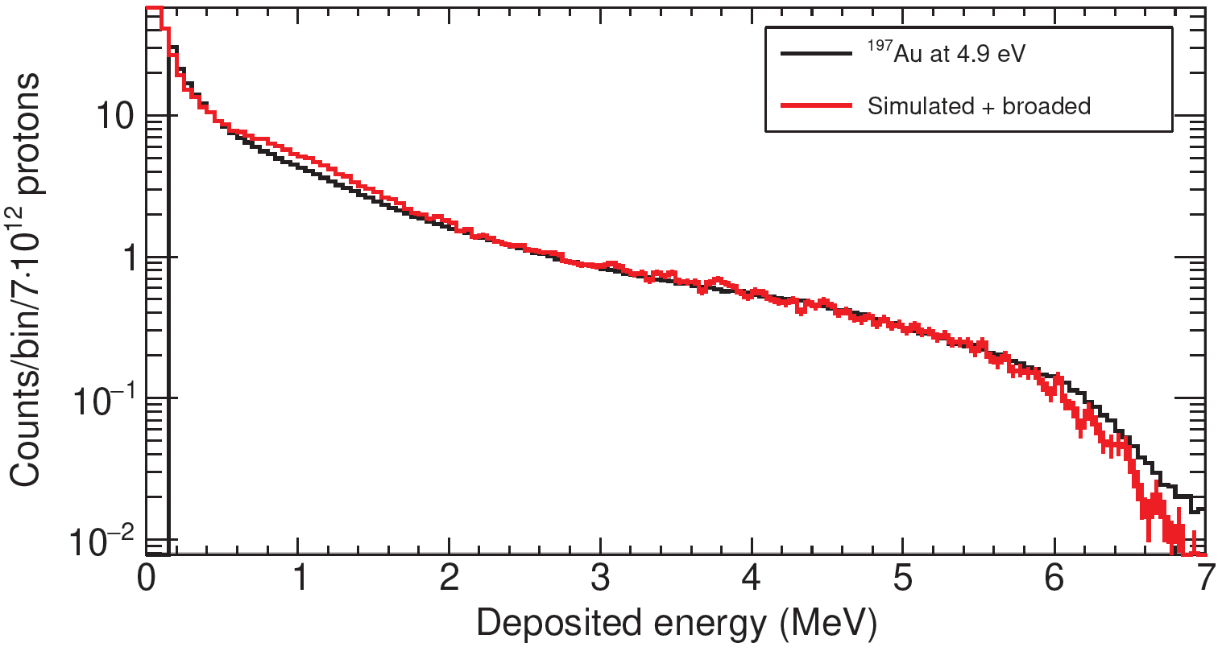
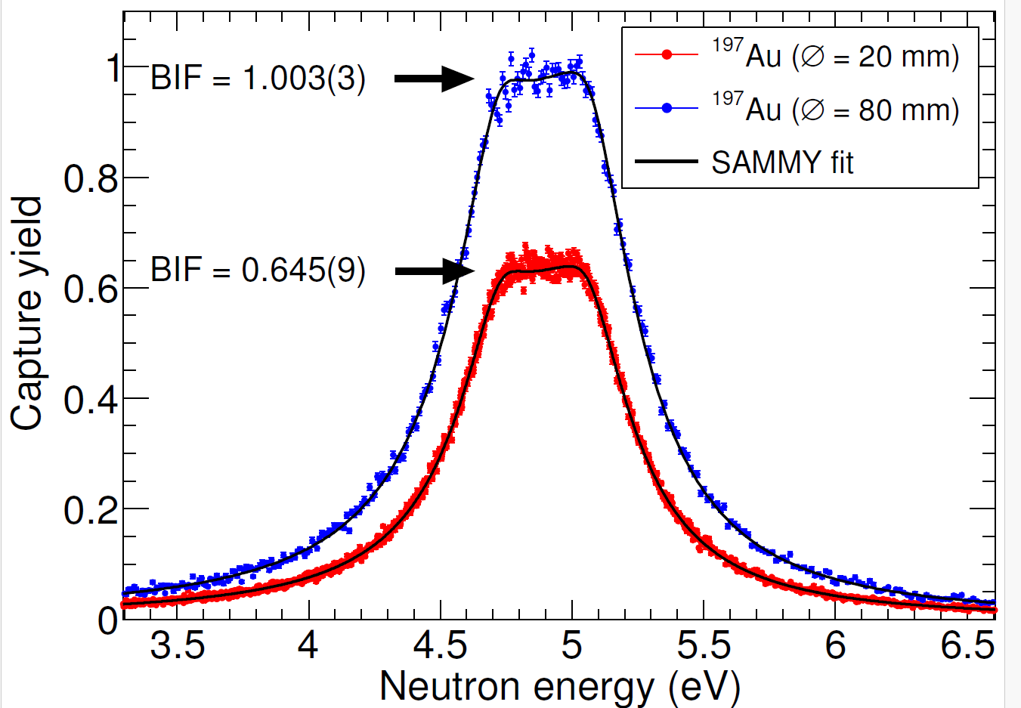
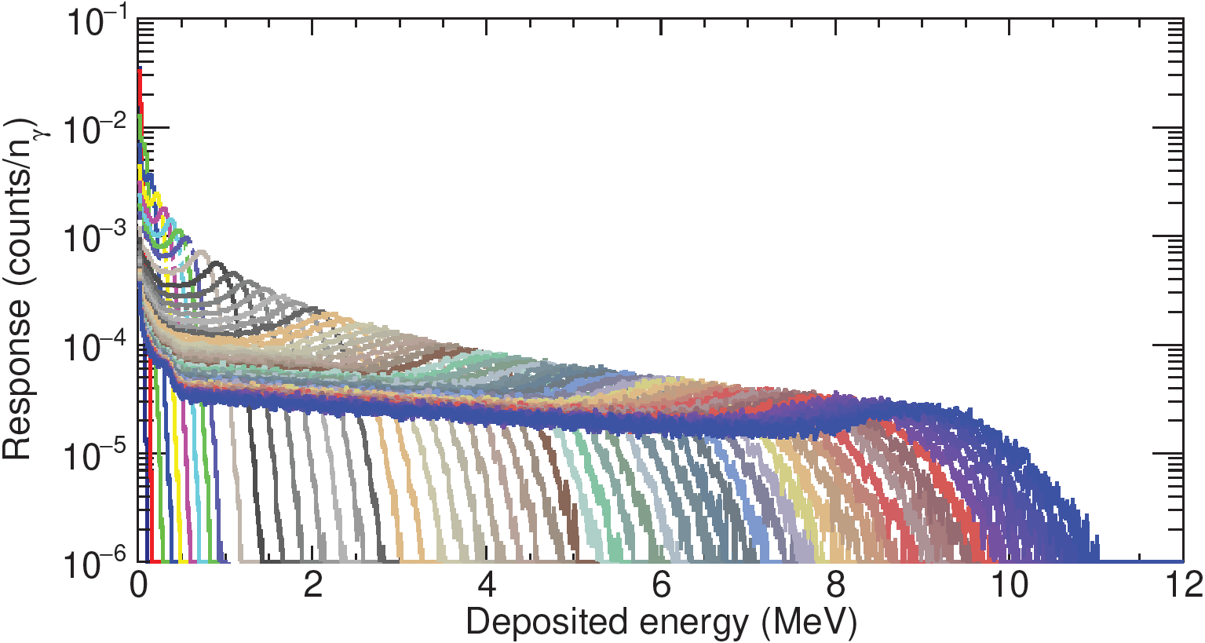
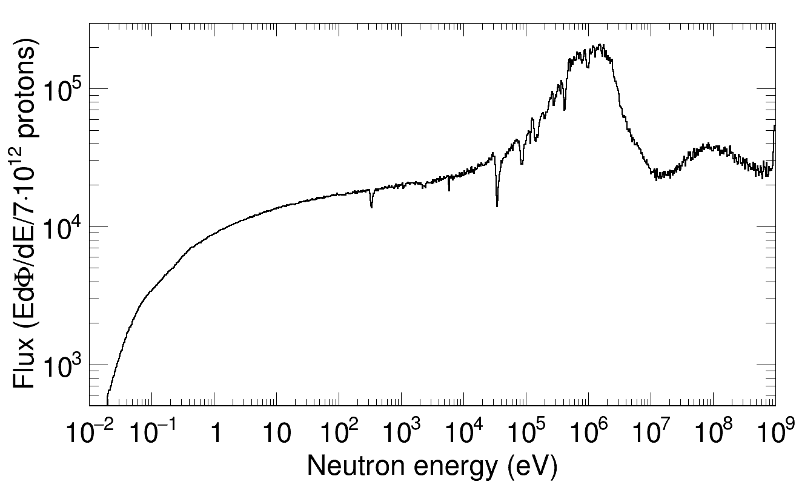
Capture yield determination
Total
weighted counts
Threshold correction factor
$$Y\left(E_{n}\right)=F_{corr}\frac{C_{w}\left(E_{n}\right)−B_{w}(E_{n})}{F_{BIF}∙ε_{c}∙Φ(E_{n})}$$
E_{thr} = 150 keV
Background weighted counts
Beam Interception Factor (SRM)
Evaluated neutron flux
Efficiency (PHWT)
Pablo Pérez Maroto || WONDER 2026 || 30/06/2026

Slide 23
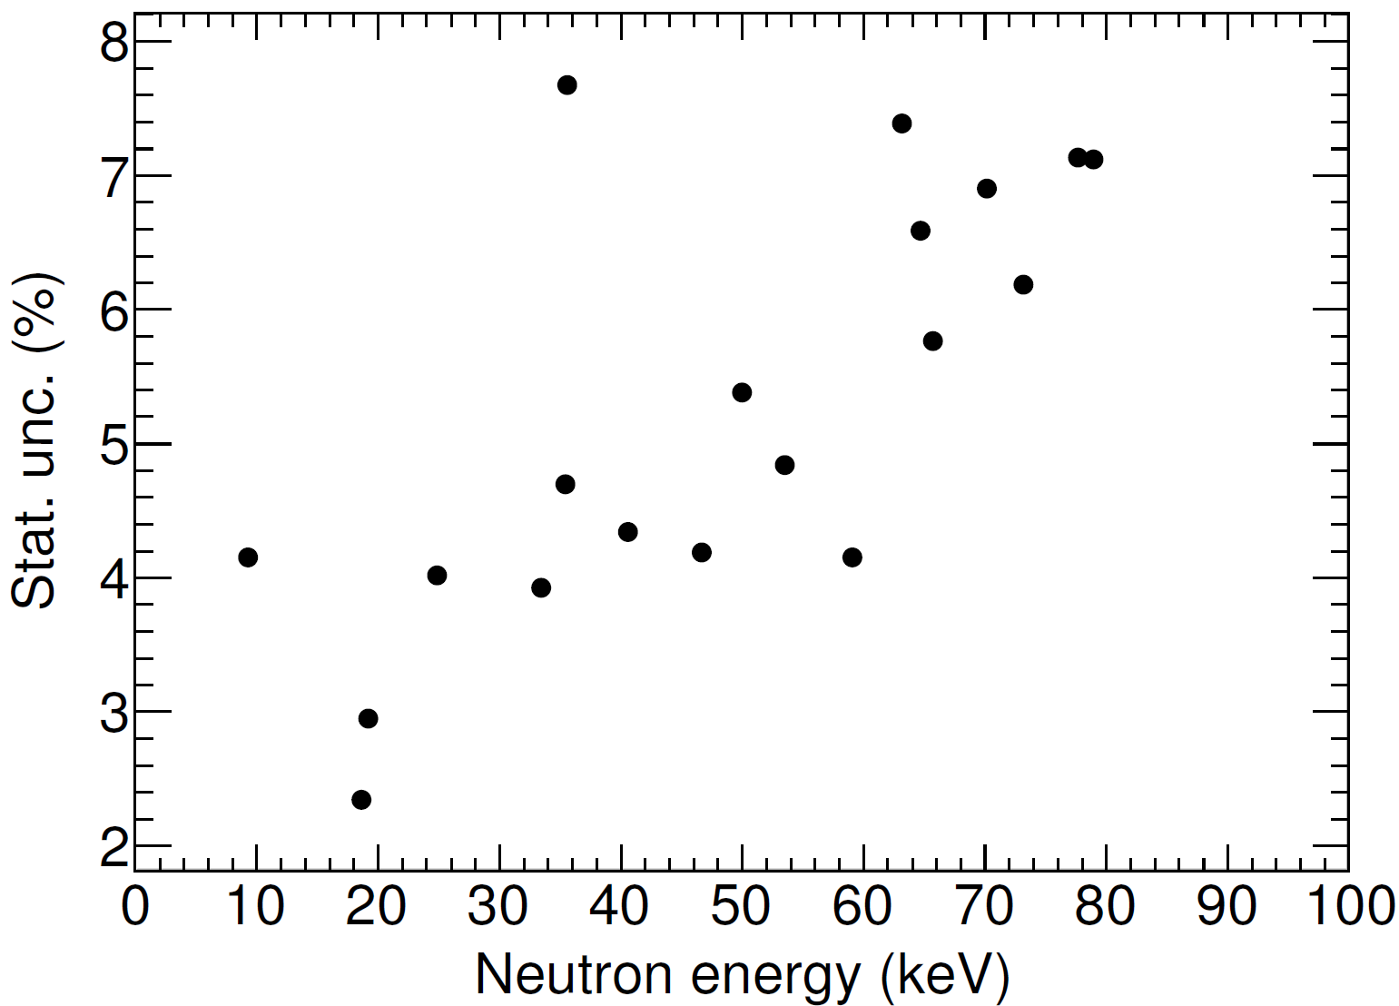
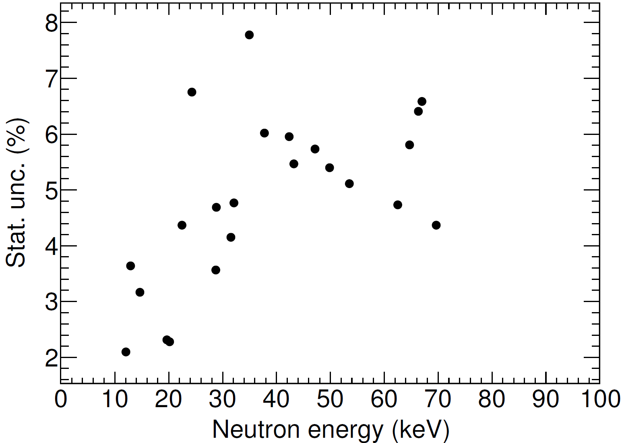
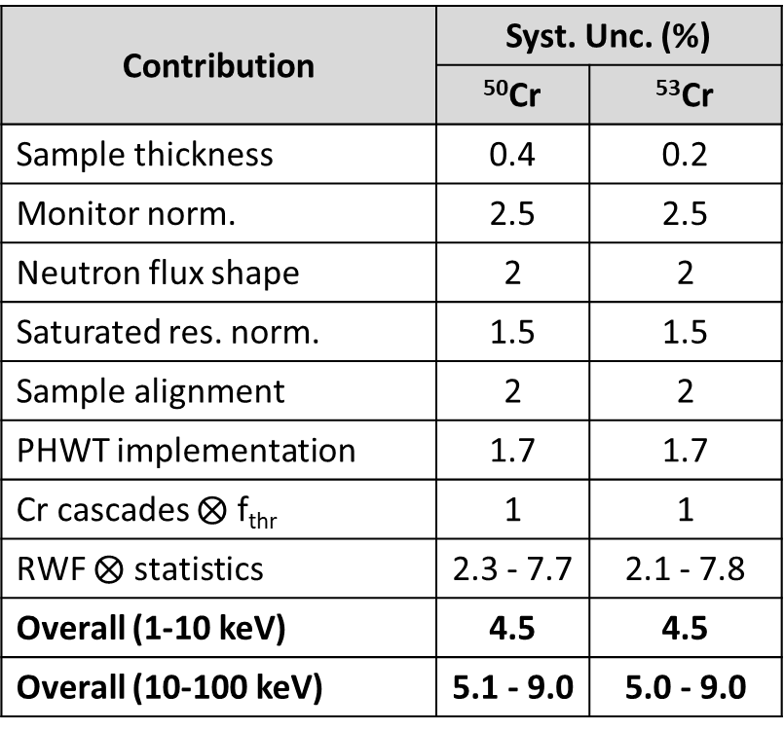
Capture yield systematic uncertainties
⁵⁰Cr
⁵³Cr
Contribution | Syst. Unc. (%)
 | ⁵⁰Cr | ⁵³Cr
Sample thickness | 0.4 | 0.2
Monitor norm. | 2.5 | 2.5
Neutron flux shape | 2 | 2
Saturated res. norm. | 1.5 | 1.5
Sample alignment | 2 | 2
PHWT implementation | 1.7 | 1.7
Cr cascades $⨂$ f_{thr} | 1 | 1
RWF $⨂$ statistics | 2.3 - 7.7 | 2.1 - 7.8
Overall (1-10 keV) | 4.5 | 4.5
Overall (10-100 keV) | 5.1 - 9.0 | 5.0 - 9.0
A new methodology to apply the PHWT was implemented, which adds a source of uncertainty associated to the resonance total counts.
In overall, the uncertainty remains below 9%, thus fulfilling the NEA requirements.
Pablo Pérez Maroto || WONDER 2026 || 30/06/2026

Slide 24
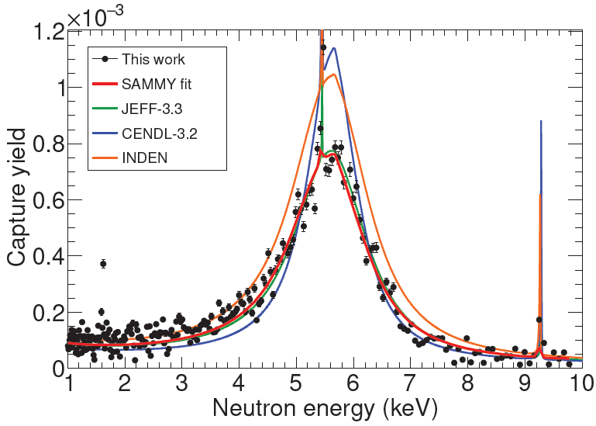
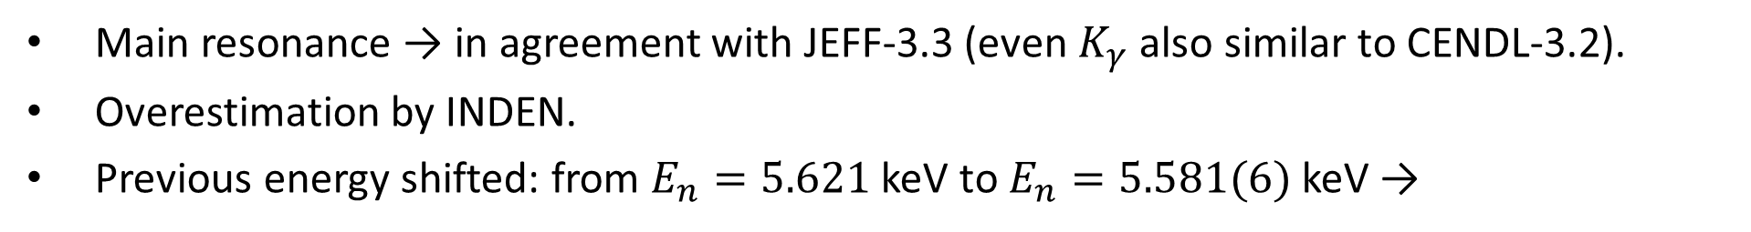
Resonance analysis with SAMMY (⁵⁰Cr)
Main resonance → in agreement with JEFF-3.3 (even $K_{γ}$ also similar to CENDL-3.2).
Overestimation by INDEN.
Previous energy shifted: from $E_{n}=5.621$ keV to $E_{n}=5.581(6)$ keV →
Multiple-scattering effects
⁵⁰Cr-thin
⁵²Cr
Pablo Pérez Maroto || WONDER 2026 || 30/06/2026

Slide 25
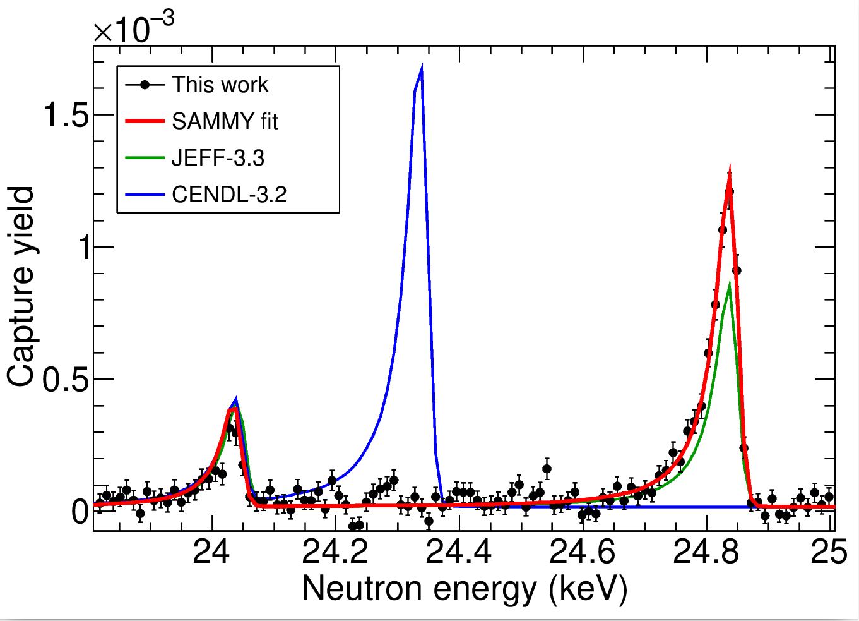
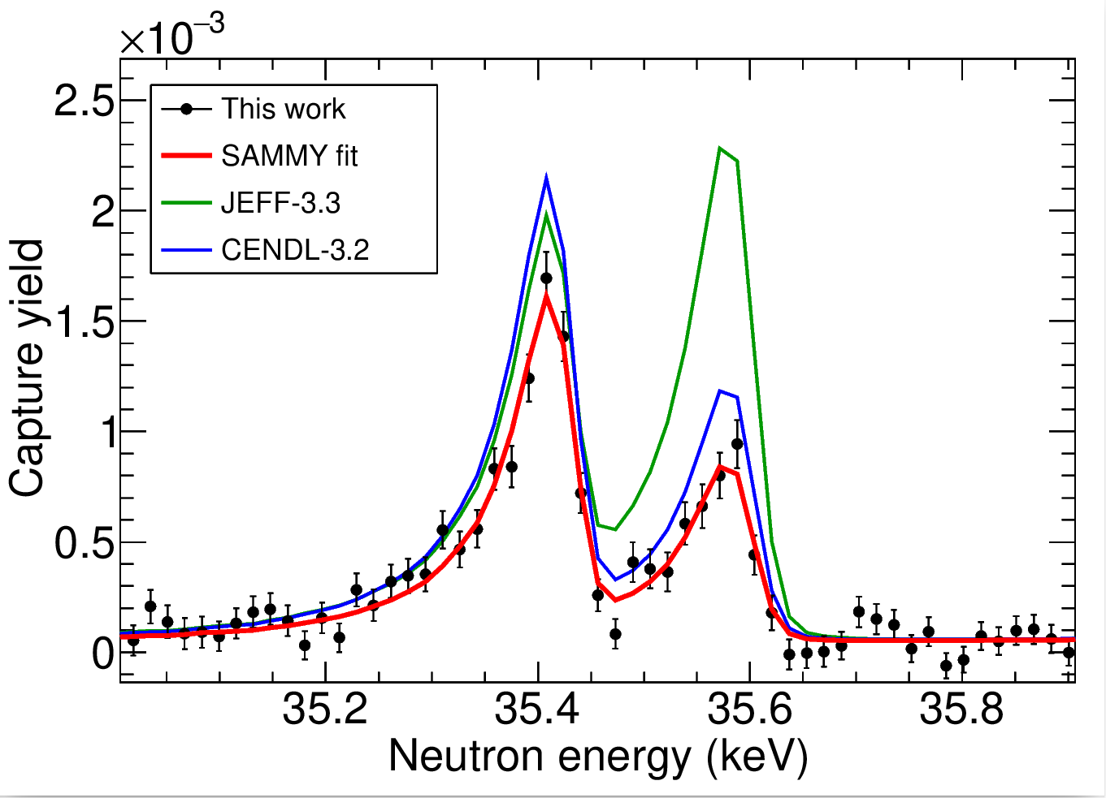
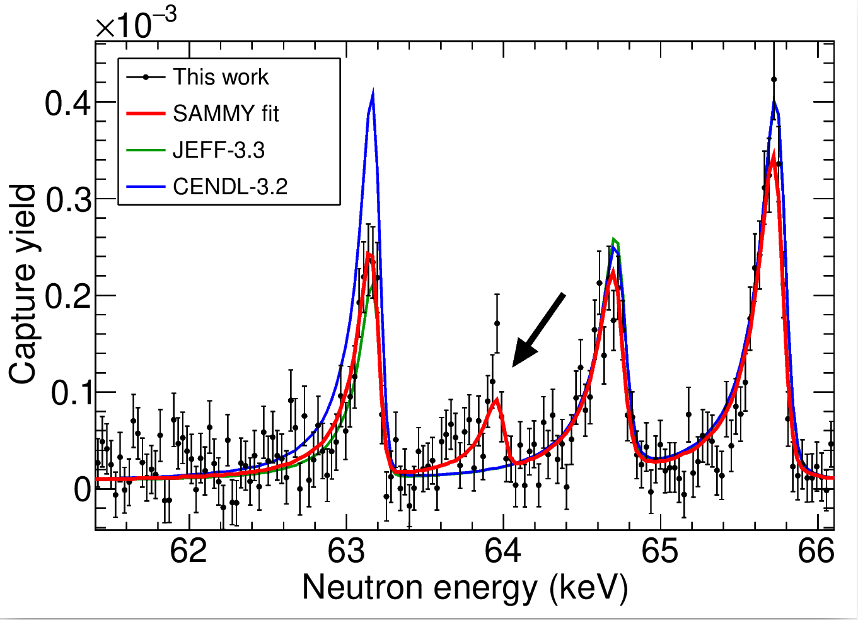
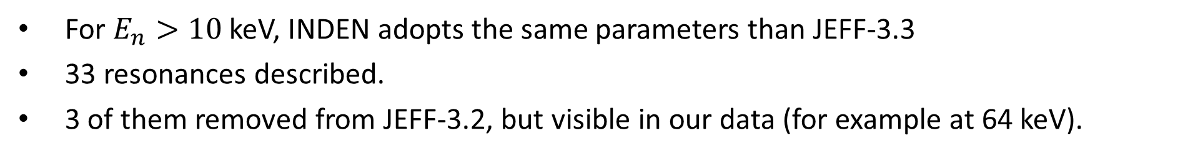
Resonance analysis with SAMMY (⁵⁰Cr)
For $E_{n}>10$keV, INDEN adopts the same parameters than JEFF-3.3
33 resonances described.
3 of them removed from JEFF-3.2, but visible in our data (for example at 64 keV).
Pablo Pérez Maroto || WONDER 2026 || 30/06/2026

Slide 26
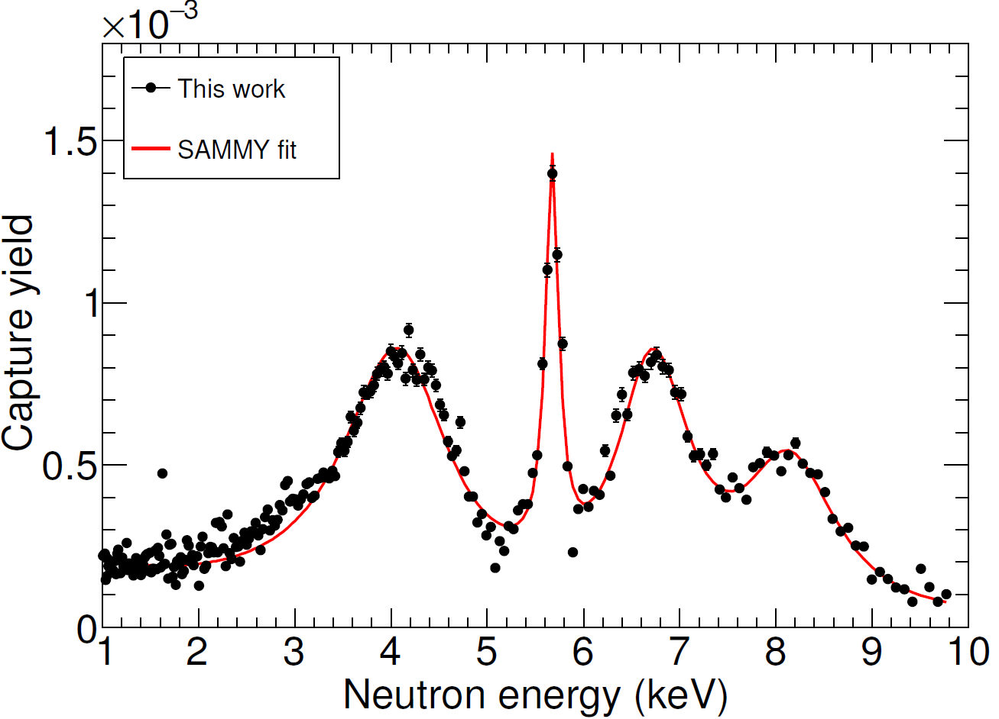
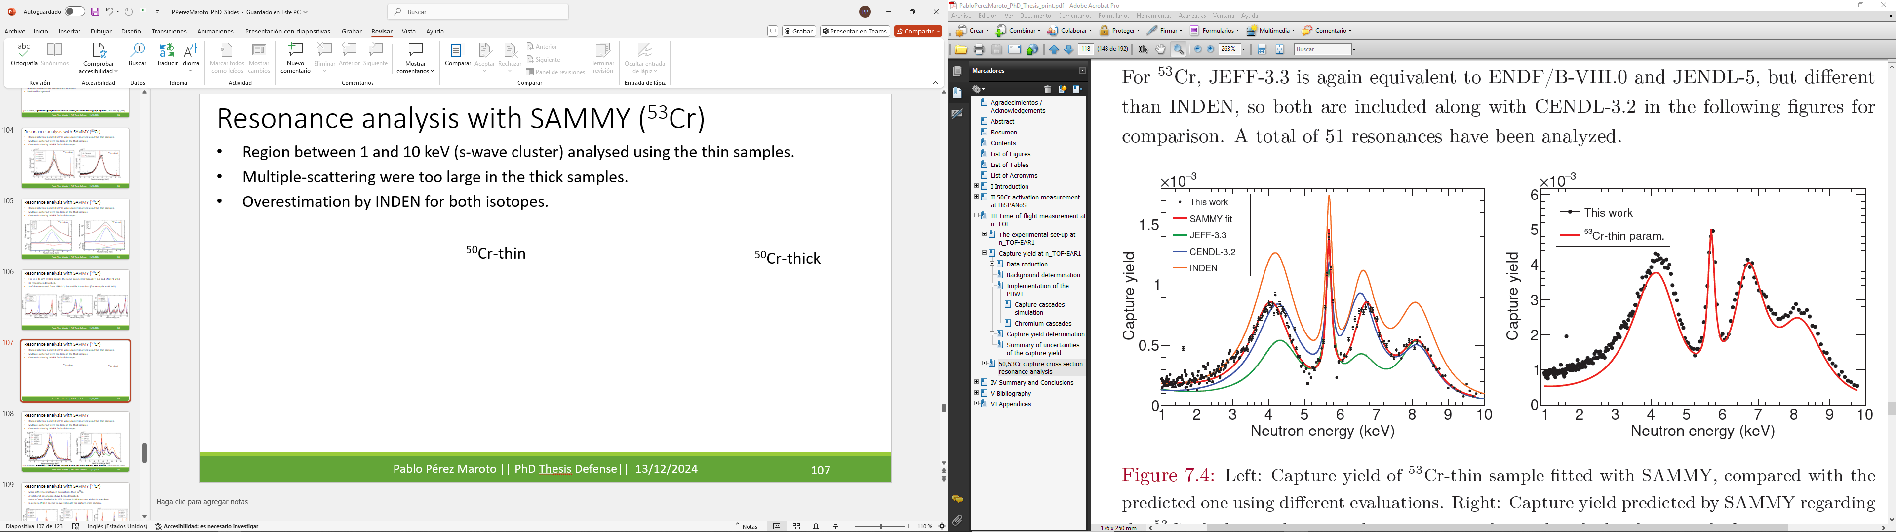
Resonance analysis with SAMMY (⁵³Cr)
The MS effects are very large → ~7mm thickness.
SAMMY fails to accurate evaluate the very strong MS effects.
⁵³Cr-thin
⁵³Cr-thick
Pablo Pérez Maroto || WONDER 2026 || 30/06/2026

Slide 27
Resonance analysis with SAMMY (⁵³Cr)
The MS effects are very large → ~7mm thickness.
SAMMY fails to accurate evaluate the very strong MS effects.
Our data is much closer to CENDL-3.2 (still with differences).
Pablo Pérez Maroto || WONDER 2026 || 30/06/2026

Slide 28
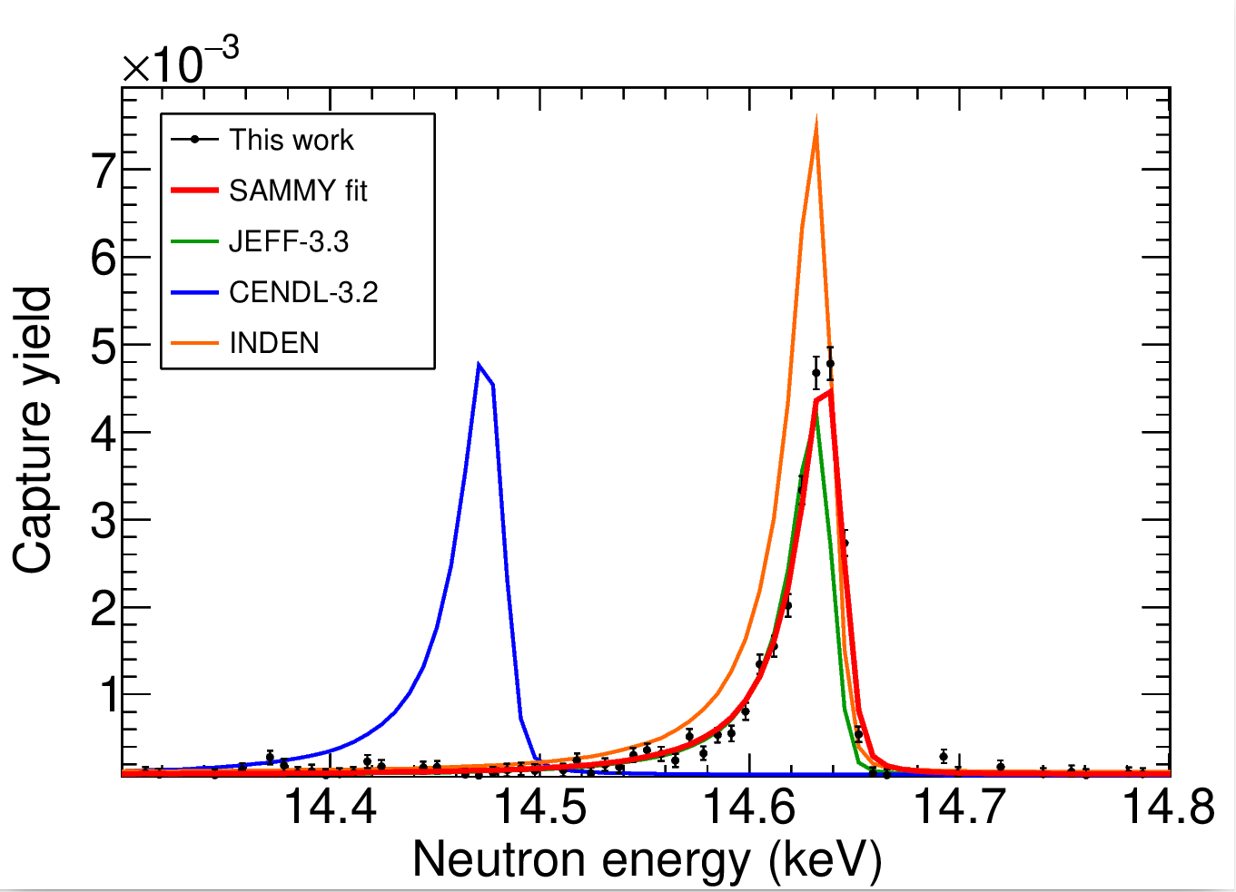
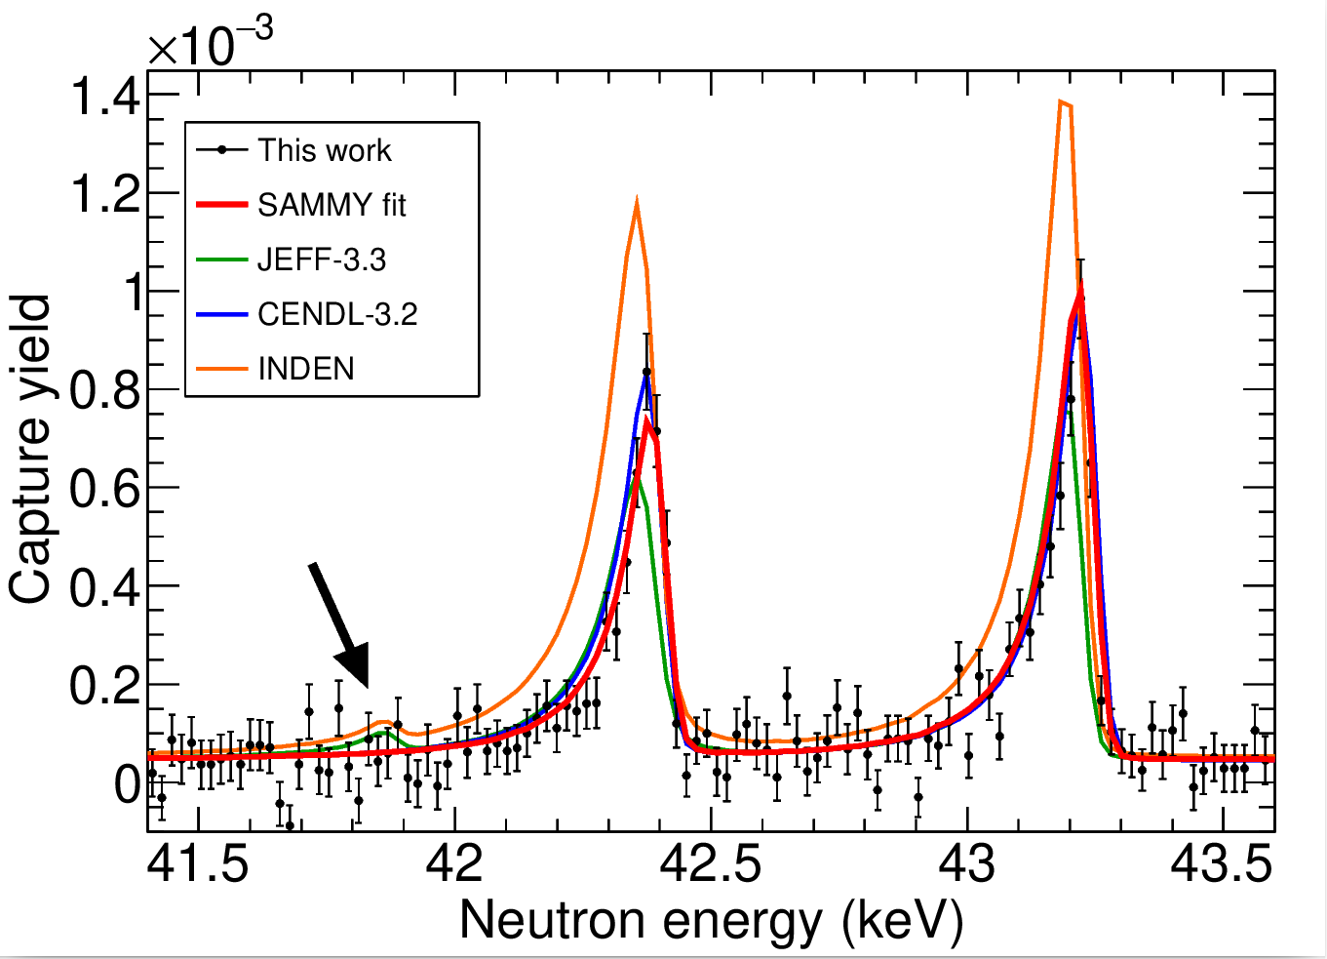
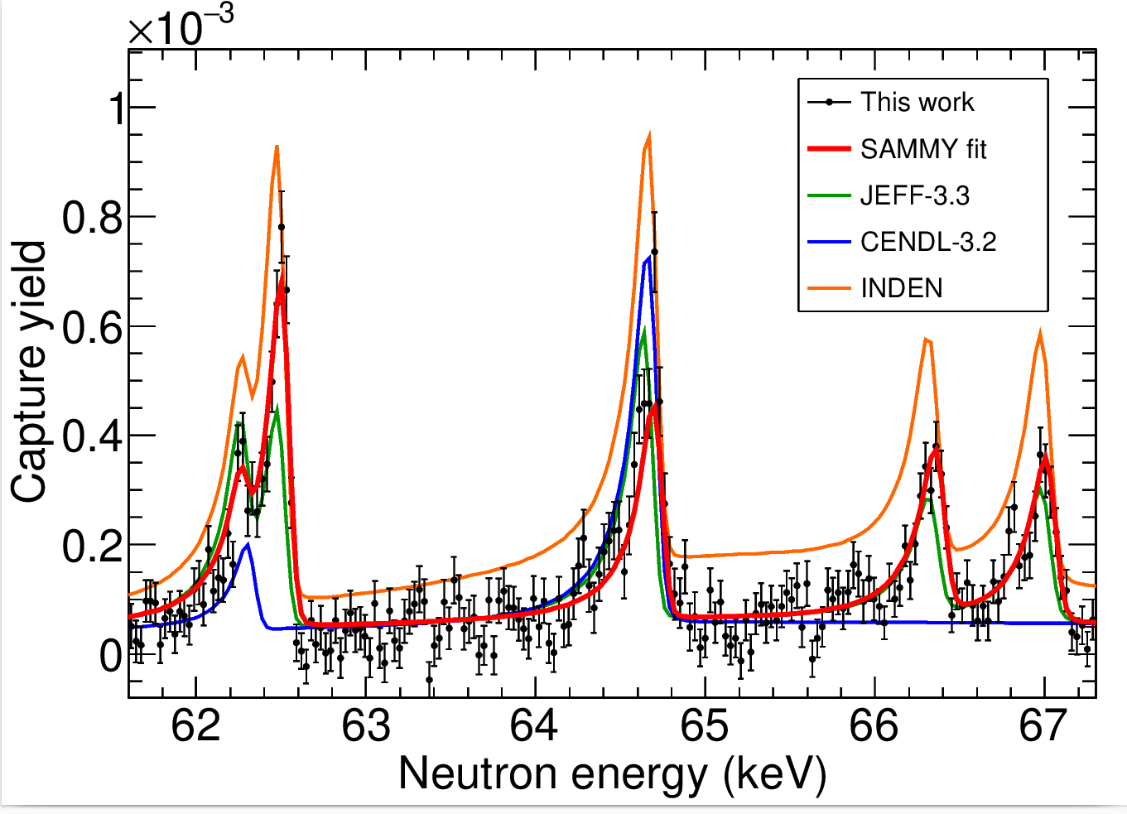
Resonance analysis with SAMMY (⁵³Cr)
More differences between evaluations than in ⁵⁰Cr.
A total of 51 resonances have been described.
Some of them (included in JEFF-3.3 and INDEN) are not visible in our data.
In general, INDEN seems to overestimate the capture cross section.
Pablo Pérez Maroto || WONDER 2026 || 30/06/2026

Slide 29


^{50,53}Cr(n,γ) at EAR1 results
MACS₃₀ extracted from n_TOF (E_{n}<100 keV) + evaluations above 100 keV.
This work (n_TOF)
This work (n_TOF)
This work (HiSPANoS)
Results for ⁵⁰Cr and ⁵³Cr are 20% and 70% lower than INDEN, respectively.
⁵⁰Cr → MACS₃₀ from HiSPANoS and n_TOF are compatible within uncertainty.
P. Pérez-Maroto et al., “New measurement ⁵⁰Cr and ⁵³Cr (n,γ) cross sections at n_TOF: a call for chromium nuclear data revision ”, The European Physical Journal A, 2026, vol. 62(1), p. 5
Pablo Pérez Maroto || WONDER 2026 || 30/06/2026

Slide 30
IV. Summary & Conclusions
Pablo Pérez Maroto || WONDER 2026 || 30/06/2026

Slide 31
Summary & Conclusions
A clear goal: improving the ^{50,53}Cr(n,γ) cross section to 8-10% accuracy at 1-100 keV.
Two experiments:
  ⁵⁰Cr activation at HiSPANoS@CNA.
  ^{50,53}Cr ToF at n_TOF@CERN.
Uncertainties within the objective.
Both cross sections clearly lower than INDEN.
Both experiments are compatible.
This work (n_TOF)
This work (n_TOF)
This work (HiSPANoS)
Pablo Pérez Maroto || WONDER 2026 || 30/06/2026

Slide 32


Thank you for your attention
Pablo Pérez Maroto - pperezma@cern.ch
Acknowledgements: Euroatom research and training programme 2014-2018 under grant agreement No 847594 (ARIEL). Spanish national projects RTI2018-098117-B-C21, PID2019-104714GB-C22, PID2021-123879OB-C21 and PID2022-138297NB-C22 funded by MCIN/AEI/10.13039/501100011033 and by "ERDF A way
of making Europe". FPI national Grant No PRE2019-089678. Recovery & Resilience Facility (Spain). The European Union – NextGenerationEU.
Pablo Pérez Maroto || WONDER 2026 || 30/06/2026

Slide 33



Backup. Why the discrepancies?
The main problem for measuring Cr(n,γ) is the large neutron multiple-scattering effects
In the previous measurements thick samples were used, aiming for good statistics in a very wide energy range
x100
Y₀
(n,γ)
Y₁
$$Y_{0}=\left(1−e^{nσ_{t}}\right)\frac{σ_{γ}}{σ_{t}}$$
(n,el)
(n,γ)
Y₄
(n,el)
(n,el)
(n,el)
Capture yield
(captures/neutron)
$$→Y=Y_{0}+Y_{1}+Y_{2}+Y_{3}…$$
(n,el)
(n,γ)
Analytical
(accurate)
Numerical
(aproximate)
Pablo Pérez Maroto || WONDER 2026 || 30/06/2026
Notes:
After scattering the neutron get captured at the same time, but with a different energy, therefore affecting the yield -> cross section
Multiple scattering increases with thickness and XS_t/XS_g ratio

Slide 34


Backup. MB spectrum: ToF characterization
A 30 keV quasi-Maxwellian spectrum can be produced by ⁷Li(p,n) with E_{p}=1912 keV†.
Li-glass detectors → based on the ⁶Li(n,α)³H reaction
Neutrons (1-120 keV)
⁶Li-glass
γ-flash
Protons
(1912 keV)
neutrons
Li target
505 mm
†W. Ratynski & F. Käppeler, “Neutron capture cross section of ¹⁹⁷Au: A standard for stellar nucleosynthesis”, Physical Review C 37(2) (1988)
Pablo Pérez Maroto || WONDER 2026 || 30/06/2026
Notes:
After scattering the neutron get captured at the same time, but with a different energy, therefore affecting the yield -> cross section
Multiple scattering increases with thickness and XS_t/XS_g ratio

Slide 35


Backup. MB spectrum: ToF characterization
The neutron field was characterized by time-of-flight + simulations.
Li-glass detectors → based on the ⁶Li(n,α)³H reaction
γ-flash
$$E_{n}=\frac{K^{2}L^{2}}{t^{2}}$$
neutrons
E_{p} = 1912 keV
σ = 3.5 keV
SimLiT → Neutron production
GEANT4 → Neutron transport
The neutron field was characterized by time-of-flight + simulations.
Pablo Pérez Maroto || WONDER 2026 || 30/06/2026
Notes:
After scattering the neutron get captured at the same time, but with a different energy, therefore affecting the yield -> cross section
Multiple scattering increases with thickness and XS_t/XS_g ratio

Slide 36




Backup. Neutron activation analysis
Counts → Gaussian + linear fit
4.7 h
Decay during irradiation → current measurement
$$N_{act}=\frac{A_{EOI}}{λ}=\frac{C{·e}^{λt_{wait}}{·f}_{irr}}{I_{γ}·ε·\left(1−e^{−λt_{meas}}\right)}$$
Decay during transport and measurement
Efficiency
270 min/
20min
24min/
300min
4.7 h
Pablo Pérez Maroto || WONDER 2026 || 30/06/2026
Notes:
After scattering the neutron get captured at the same time, but with a different energy, therefore affecting the yield -> cross section
Multiple scattering increases with thickness and XS_t/XS_g ratio

Slide 37



Backup. Ancillary samples
Some ancillary measurements were performed during the experimental campaign
Dummy (empty PEEK capsule)
Empty (empty aluminum ring)
1 mm ^{nat}C (neutron-scattering)
100 μm ¹⁹⁷Au (two diameters)
→ Background
→ Normalization
Sample | $$\text{Diameter}\text{ (}\text{mm}\text{)}$$ | n_{at} (10⁻³at/b)
Dummy (2) | 22 | -
¹⁹⁷Au | 20 | 0.583
¹⁹⁷Au | 80 | 0.644
^{nat}C | 20 | 8.702
Pablo Pérez Maroto || WONDER 2026 || 30/06/2026
Notes:
After scattering the neutron get captured at the same time, but with a different energy, therefore affecting the yield -> cross section
Multiple scattering increases with thickness and XS_t/XS_g ratio

Slide 38





Backup. Background determination
The background affecting the measurement can be divided in:
Sample independent
Sample related
→ Neutron-scattering and capture outside the sample: Dummy & Empty
→ Neutron-scattering inside the sample: ^{nat}C
$$F_{n}=\left\langle \frac{σ_{el,Cr}}{σ_{el,C}}\right\rangle \frac{n_{at,Cr}}{n_{at,C}}$$
⁵⁰Cr
Sample | $$F_{n}$$
⁵⁰Cr-thin | 0.25
⁵⁰Cr-thick | 0.72
⁵³Cr-thin | 0.59
⁵³Cr-thick | 2.91
$$B\left(E_{n}\right)=a_{0}+\sum_{i=1}^{k}{b_{i}\left(1−e^{−c_{i}E_{n}}\right)e^{−d_{i}E_{n}}}$$
Pablo Pérez Maroto || WONDER 2026 || 30/06/2026
Notes:
After scattering the neutron get captured at the same time, but with a different energy, therefore affecting the yield -> cross section
Multiple scattering increases with thickness and XS_t/XS_g ratio

Slide 39

Backup. Background determination
⁵⁰Cr-thin
⁵⁰Cr-thick
Some background is still visible below the main resonance in the thick samples → Region not used.
The residual background is included in the yield analysis.
⁵³Cr-thin
⁵³Cr-thick
Pablo Pérez Maroto || WONDER 2026 || 30/06/2026
Notes:
After scattering the neutron get captured at the same time, but with a different energy, therefore affecting the yield -> cross section
Multiple scattering increases with thickness and XS_t/XS_g ratio

Slide 40






Backup. Capture yield normalization: SRM
The final step to obtain the capture yield is the normalization factor F_{BIF} → ¹⁹⁷Au sample
$$Y\left(E_{n}\right)=\left(1−e^{−nσ_{t}}\right)\frac{σ_{γ}}{σ_{t}}$$
$$n_{at}σ_{t}≫1$$
$$→Y\left(E_{n}\right)≅1$$
Saturated Resonance Method (SRM) †
$$σ_{t}≈σ_{γ}$$
20 mm
F_{BIF} = 1.003(3)
80 mm
F_{BIF} = 0.645(9)
100 μm thick ¹⁹⁷Au sample → the 4.9 eV resonance saturates.
80 mm sample to validate the analysis methodology.
†R. L. Macklin, “Absolute neutron capture yield normalization”, Nuclear Instruments and Methods 164(1) (1979)
Pablo Pérez Maroto || WONDER 2026 || 30/06/2026
Notes:
After scattering the neutron get captured at the same time, but with a different energy, therefore affecting the yield -> cross section
Multiple scattering increases with thickness and XS_t/XS_g ratio

Slide 41


Backup. Capture yield analysis
The WF enhance the natural statistical fluctuations → Limited statistics bin-by-bin.
~15 counts
~ 16 counts
~ 18 counts
Pablo Pérez Maroto || WONDER 2026 || 30/06/2026
Notes:
After scattering the neutron get captured at the same time, but with a different energy, therefore affecting the yield -> cross section
Multiple scattering increases with thickness and XS_t/XS_g ratio

Slide 42

Backup. Capture yield analysis
The WF enhance the natural statistical fluctuations → Limited statistics bin-by-bin.
Solution: Average Weighting Factor (AWF).
Used at n_TOF to extend the energy range.
  J = 0⁺
  Heavy nuclei
Same de-excitation pattern for every resonance
~261 counts
~ 197 counts
~ 197 counts
$$WF_{res}=\frac{A_{r}^{weighted}}{A_{r}^{unweighted}}→\left\langle WF_{res}\right\rangle$$
Pablo Pérez Maroto || WONDER 2026 || 30/06/2026
Notes:
After scattering the neutron get captured at the same time, but with a different energy, therefore affecting the yield -> cross section
Multiple scattering increases with thickness and XS_t/XS_g ratio

Slide 43
Backup. Capture yield analysis
The WF enhance the natural statistical fluctuations → Limited statistics bin-by-bin.
Solution: Average Weighting Factor (AWF).
Used at n_TOF to extend the energy range.
  J = 0⁺
  Heavy nuclei
New technique proposed:
Same de-excitation pattern for every resonance
Resonance Weighting Factor (RWF)
~261 counts
~ 197 counts
~ 197 counts
$$WF_{res}=\frac{A_{r}^{weighted}}{A_{r}^{unweighted}}→\left\langle WF_{res}\right\rangle$$
Pablo Pérez Maroto || WONDER 2026 || 30/06/2026
Notes:
After scattering the neutron get captured at the same time, but with a different energy, therefore affecting the yield -> cross section
Multiple scattering increases with thickness and XS_t/XS_g ratio

Slide 44
Backup. Capture yield analysis
The WF enhance the natural statistical fluctuations → Limited statistics bin-by-bin.
Solution: Average Weighting Factor (AWF).
Used at n_TOF to extend the energy range.
  J = 0⁺
  Heavy nuclei
New technique proposed:
Same de-excitation pattern for every resonance
Resonance Weighting Factor (RWF)
Analysis strategy
Very good statistics (6) → PHWT
Good statistics (42) → RWF
Bad statistics (24) → AWF
Thin samples (1-10 keV)
Thick samples (10-100 keV)
Thick samples (10-100 keV)
Pablo Pérez Maroto || WONDER 2026 || 30/06/2026
Notes:
After scattering the neutron get captured at the same time, but with a different energy, therefore affecting the yield -> cross section
Multiple scattering increases with thickness and XS_t/XS_g ratio

Slide 45



Backup. Resonance analysis with SAMMY (⁵⁰Cr)
Main resonance → in agreement with JEFF-3.3 (even $K_{γ}$ also similar to CENDL-3.2).
Overestimation by INDEN.
Previous energy shifted: from $E_{n}=5.621$ keV to $E_{n}=5.581(6)$ keV.
Resonance deformed in the thick sample.
Multiple-scattering effects
⁵⁰Cr-thin
⁵⁰Cr-thick
Pablo Pérez Maroto || WONDER 2026 || 30/06/2026
Notes:
After scattering the neutron get captured at the same time, but with a different energy, therefore affecting the yield -> cross section
Multiple scattering increases with thickness and XS_t/XS_g ratio

Slide 46


Backup. Resonance analysis with SAMMY (⁵³Cr)
The MS effects are very large → ~7mm thickness.
SAMMY fails to accurate evaluate the MS effects.
⁵³Cr-thin
⁵³Cr-thick
Pablo Pérez Maroto || WONDER 2026 || 30/06/2026
Notes:
After scattering the neutron get captured at the same time, but with a different energy, therefore affecting the yield -> cross section
Multiple scattering increases with thickness and XS_t/XS_g ratio

Slide 47



Backup.^{50,53}Cr(n,γ) at EAR1 results
$$K_{γ}=g_{J}\frac{Γ_{γ}Γ_{n}}{Γ_{γ}+Γ_{n}}$$
The radiative kernel K_{γ} gives information resonance by resonance.
⁵⁰Cr → 7% lower than JEFF-3.3 and CENDL-3.2, 40% lower than INDEN.
⁵³Cr → 35% higher than JEFF-3.3, 10% and 60% lower than CENDL-3.2 and INDEN, respectively.
⁵⁰Cr
⁵³Cr
Pablo Pérez Maroto || WONDER 2026 || 30/06/2026

Slide 48
Backup. ^{50,53}Cr (n,γ) at EAR1 results
This work (n_TOF)
 | ⁵⁰Cr MACS (mb) | ⁵³Cr MACS (mb)
JEFF-3.3 (2017) | 38.2 | 25.9
CENDL-3,2 (2020) | 37.7 | 31.5
INDEN (2023) | 45.0 | 51.7
HiSPANoS(2025) | 37.1(20) | -
n_TOF (2025) | 35.0(24) | 30.9(22)
This work (HiSPANoS)
This work (n_TOF)
Pablo Pérez Maroto || WONDER 2026 || 30/06/2026
Notes:
After scattering the neutron get captured at the same time, but with a different energy, therefore affecting the yield -> cross section
Multiple scattering increases with thickness and XS_t/XS_g ratio

