Slide 1



²⁴²Pu and ²⁴⁰Pu neutron-induced fission cross section measurement in the 1-2 MeV energy range using ¹H(n,n) standard
Salma El Hessak¹⁾, Ludovic Mathieu¹⁾, Mourad Aïche¹⁾, Paola Marini¹⁾, Olivier Bouland^{2,†)}, Carole Chatel³⁾, Serge Czajkowski¹⁾, Deby Kattikat-Melcom¹⁾, Teresa Kurtukian¹⁾, Stephan Oberstedt⁴⁾, Igor Tsekhanovich¹⁾
¹ Laboratoire de Physique des 2 infinis de Bordeaux
² CEA/IRESNE/DES Cadarache
³ Institut Pluridicsiplinaire Hubert Curien, Strasbourg
⁴ Joint Research Center Geel, Belgium
Salma EL HESSAK
WONDER 2026

Slide 2
Outline
Introduction
Experiment
Data Analysis :
-Fission rate correction
-Time-of-Flight energy calibration
Results
Conclusion
Salma EL HESSAK
WONDER 2026

Slide 3
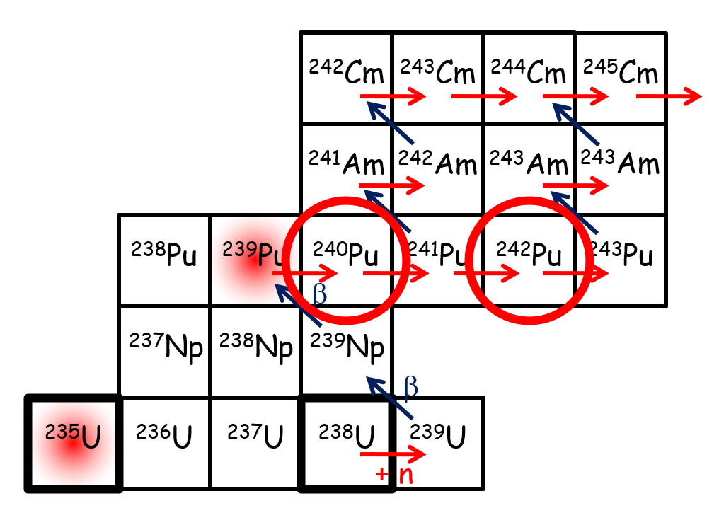
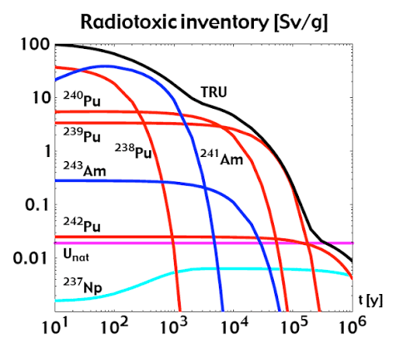
Introduction
Why to improve the Accuracy of fission cross section of ²⁴⁰Pu and ²⁴²Pu?
Long half-lives (T₁/₂): 6,560 years and 375,000 years for ²⁴⁰Pu and ²⁴²Pu, respectively
Significant contribution to the long-term radiotoxicity of nuclear waste (~10⁴–10⁵ years)
²⁴²Pu(n,f) and ²⁴⁰Pu(n,f): listed on the NEA High Priority Request List (HPRL)
Discrepancies between evaluated data and experimental measurements.
Mazgaj, P., & Darnowski, P. (2014). Transmutation: a reduction of the storage time of a spent fuel. Journal of Power Technologies, 94(4).
Salma EL HESSAK
WONDER 2026

Slide 4
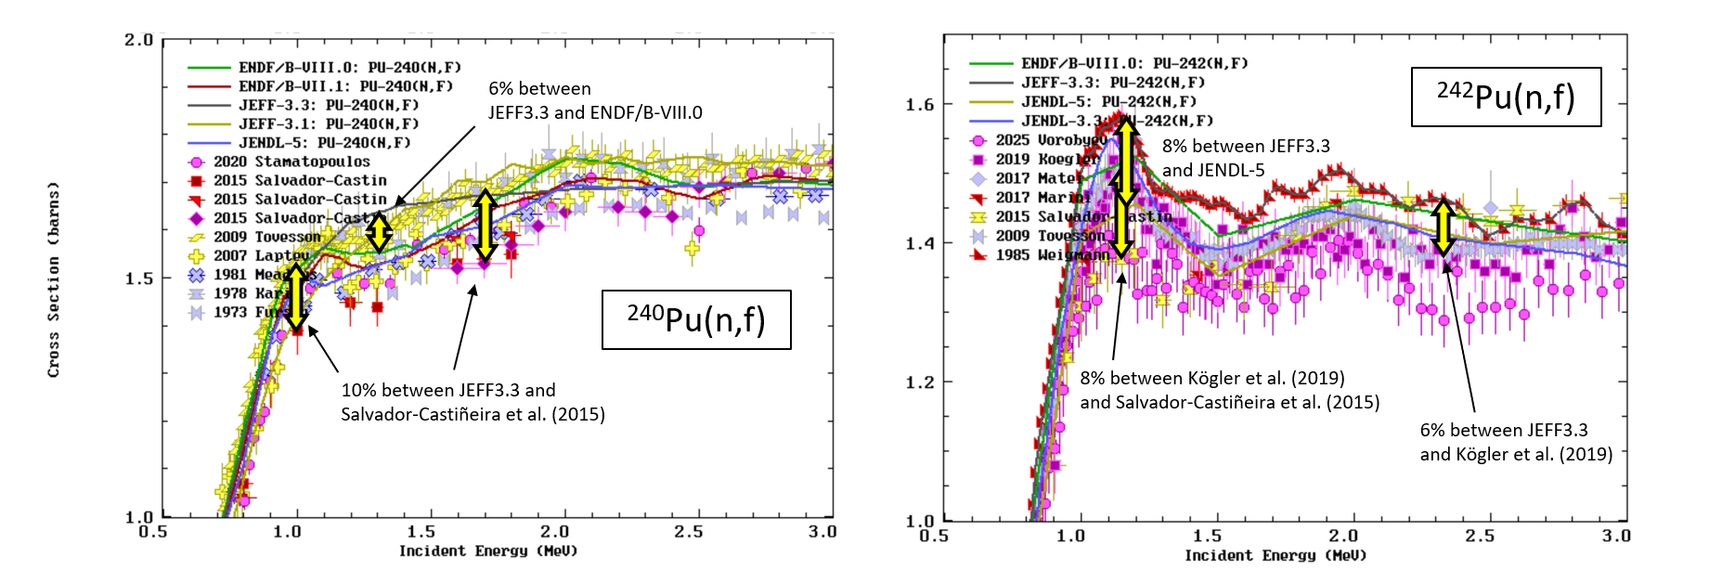
Introduction
Uncertainties requested in HPRL : 2-3 %
Uncertainties requested in HPRL : 4 %
-Discrepancies between different experimental measurements and evaluations
-Discrepancies between evaluations
-Discrepancies larger than the error bars
Main goal : improve ²⁴⁰Pu(n,f) and ²⁴²Pu(n,f) cross sections accuracy in the 1-2 MeV region
Salma EL HESSAK
WONDER 2026
4

Slide 5
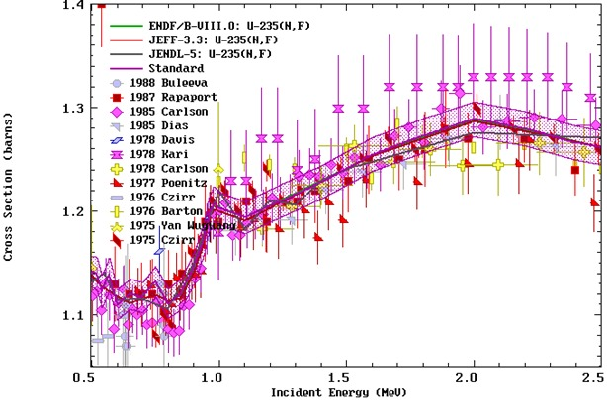
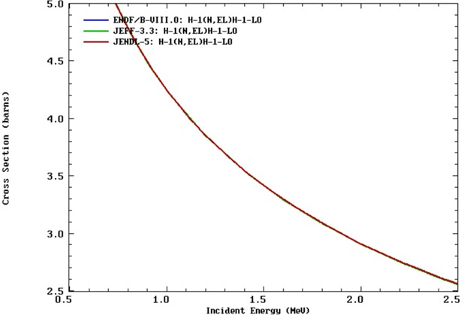
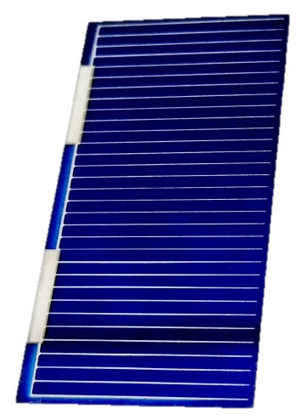
Introduction
How Can the Accuracy Be Improved?
Literature:
Measurement relative to the secondary standard ²³⁵U(n,f): 1,3% uncertainty
Measurement of both the target and the standard cross sections using the same experimental setup (fission chambers)
=> Strong correlations between the datasets.
Improve precision, or confirm the results with an independent method.
This work:
Measurement relative to the primary standard ¹H(n,n) : 0,35% uncertainty
Measurement with a different experimental setup (Photovoltaic cells)
=> Independent measurement
Salma EL HESSAK
WONDER 2026

Slide 6
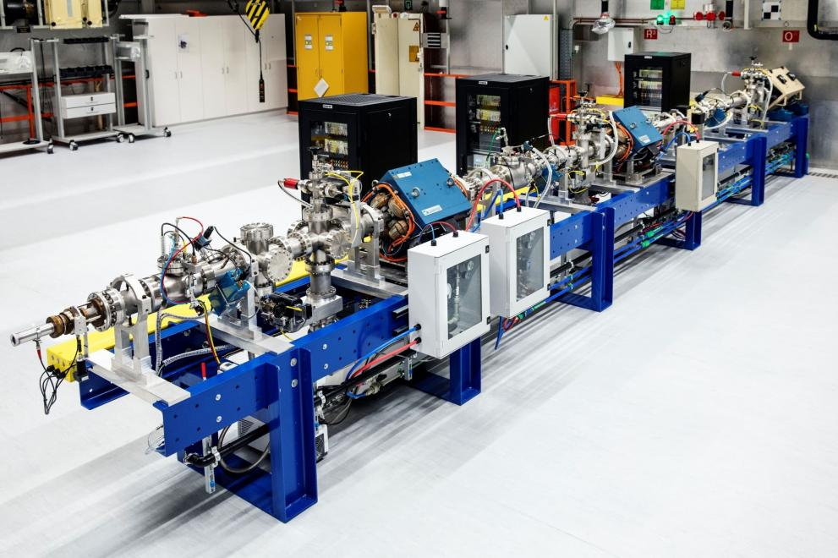
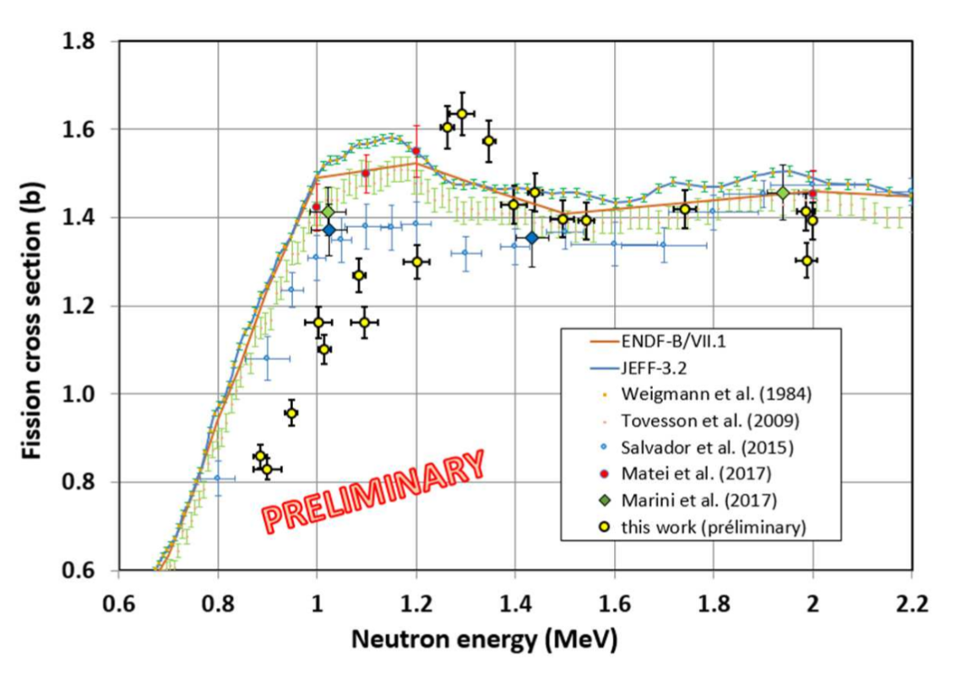
Experiment
MENPHYS 1: ²⁴²Pu(n,f) experiment performed in 2022
Preliminary results presented at WONDER 2023
Analysis resumed at the beginning of my PhD (late 2025)
Results 2023
MONNET, JRC Geel, Belgium
Possibility to use ³H beam target=> energy range of interest (0,9-3,5 MeV)
Radioactive sample Lab: availability of ²⁴²Pu and ²⁴⁰Pu targets
Expertise in reaction measurement
Mathieu, Ludovic, et al. "Measurement of 242 Pu (n, f) in the 1-2 MeV energy range." European Physical Journal Web of Conferences. Vol. 294. 2024.
MENPHYS 2: ²⁴⁰Pu(n,f) experiment in 2027 at the MONNET Facility
Salma EL HESSAK
WONDER 2026
6

Slide 7
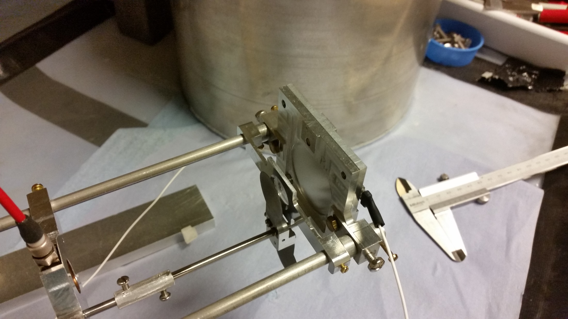
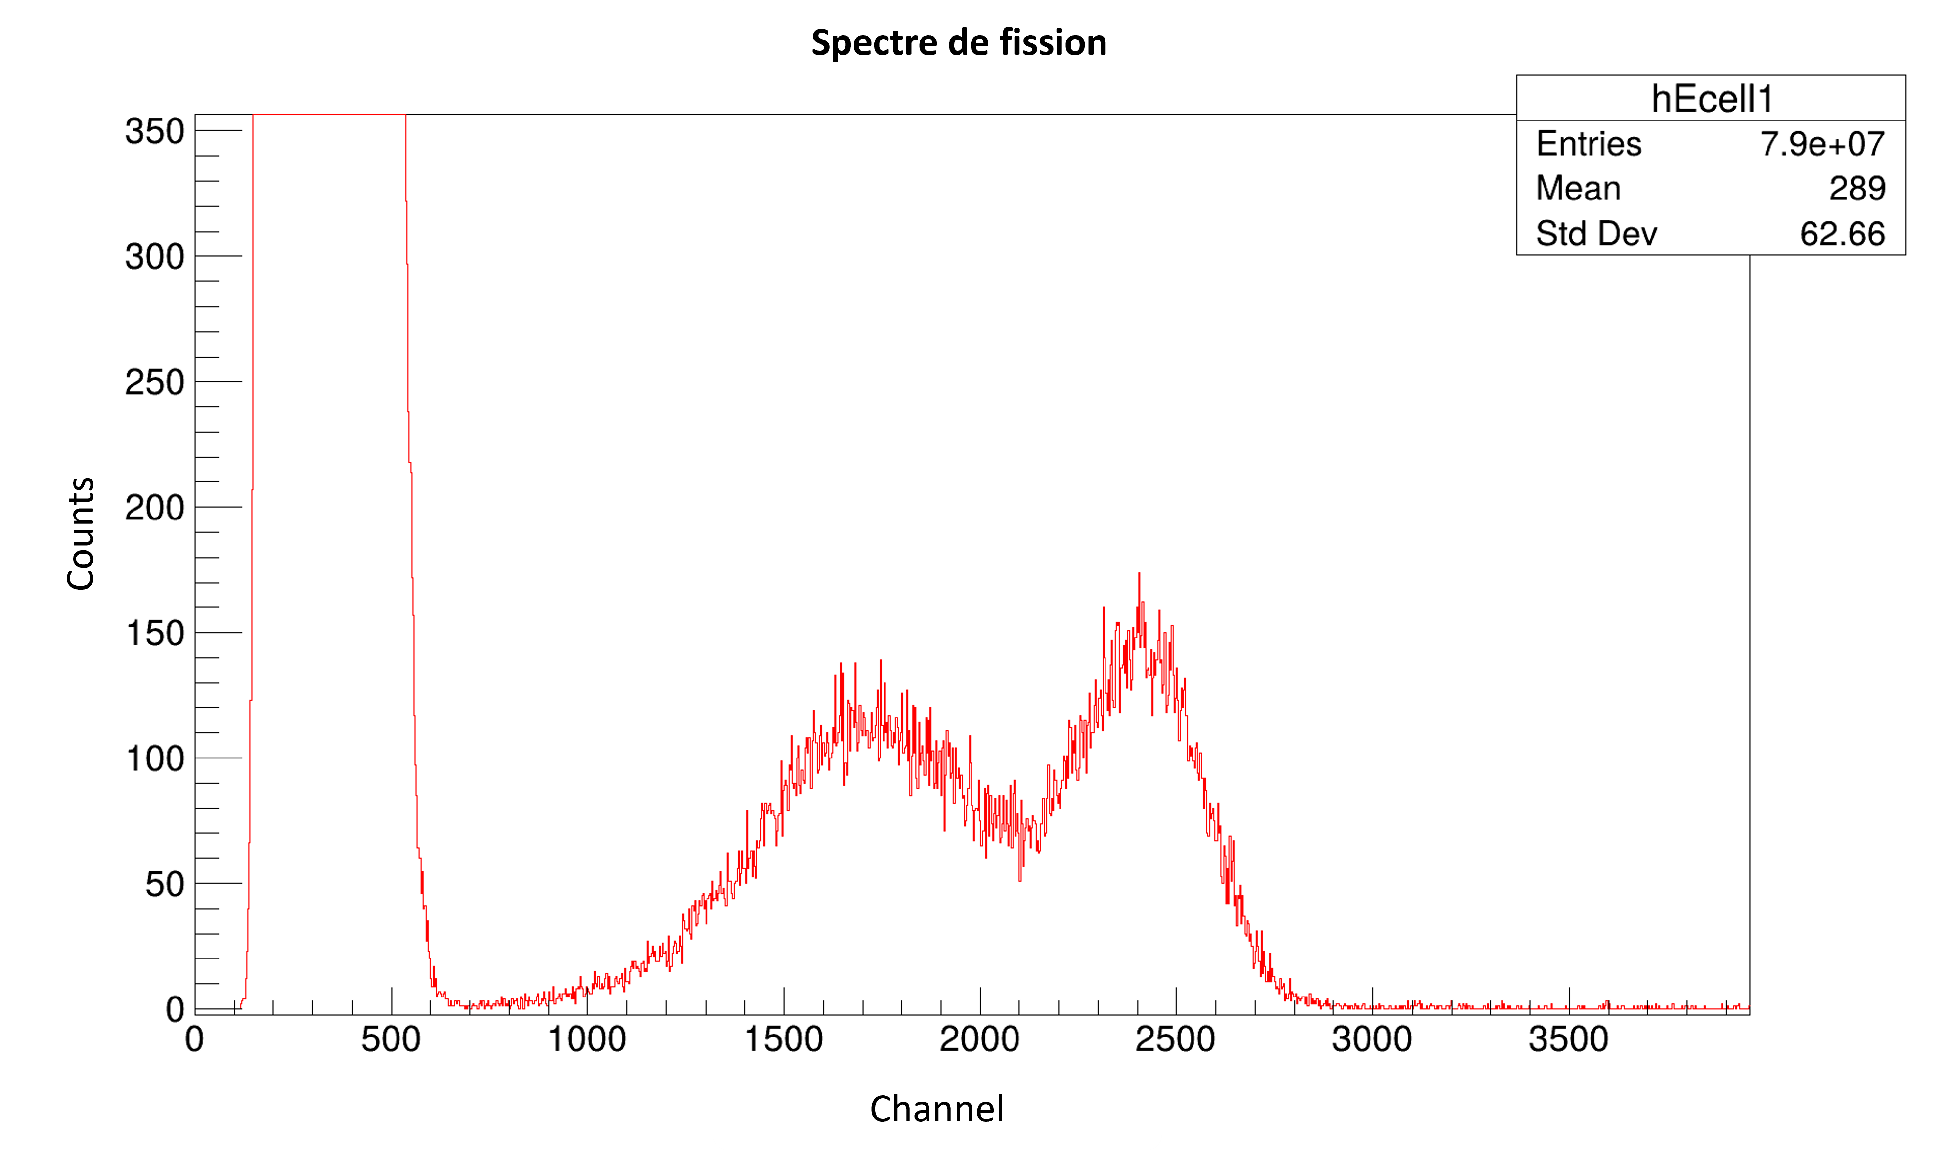
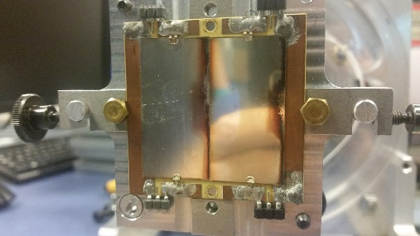
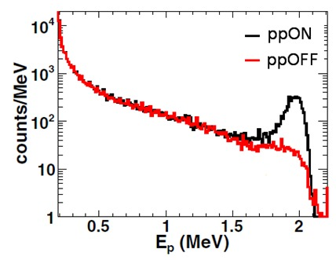
Experiment
Fission and proton recoil setup
Neutron beam
H-rich sample
(PP foil)
Very simple experimental setup
Ta sample mask
Si detector
α-FF discrimination
²⁴²Pu sample
photovoltaic cells
3 runs:
- PP ON: fission + recoil protons
- PP OFF (PP masked with Ta screen): quantify recoil proton Background.
- SF ( Beam off): fission detection efficiency + SF background
^{Fission setup}
^{Proton recoil setup}
2 Datasets (2 TiT targets):
- one data set with a 930 µg/cm² target (setup far from the source)
- one data set with a 260 µg/cm² target
Salma EL HESSAK
WONDER 2026
7

Slide 8
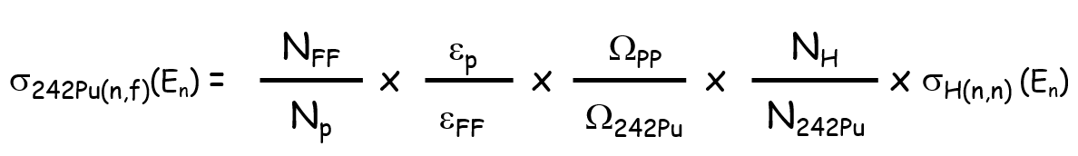
Data analysis
Cross section calculation
Each term comes with its own uncertainty
Low contribution to the total uncertainty < 0,5%
- σ_{H(n,n) :}
. Primary standard
- ε_{p} :
. Calculated by simulation with a well-defined geometry
- ε_{FF} :
. Auto-normalization on SF defection efficiency + kinematic/anisotropy effects by simulation
N_{242Pu} :
. Discarded (auto-normalization)
Salma EL HESSAK
WONDER 2026
8

Slide 9
Data analysis
Cross section calculation
Each term comes with its own uncertainty
Significant contribution to the total uncertainty
N_{FF} :
. scattered neutron contribution to fission events
N_{p} :
. background contribution
Ω_{PP} / Ω_{242Pu} :
  . Determined by simulation (require distances precision)
N_{H} :
  . determined by thickness measurement (micro-weighting)
Salma EL HESSAK
WONDER 2026
9

Slide 10
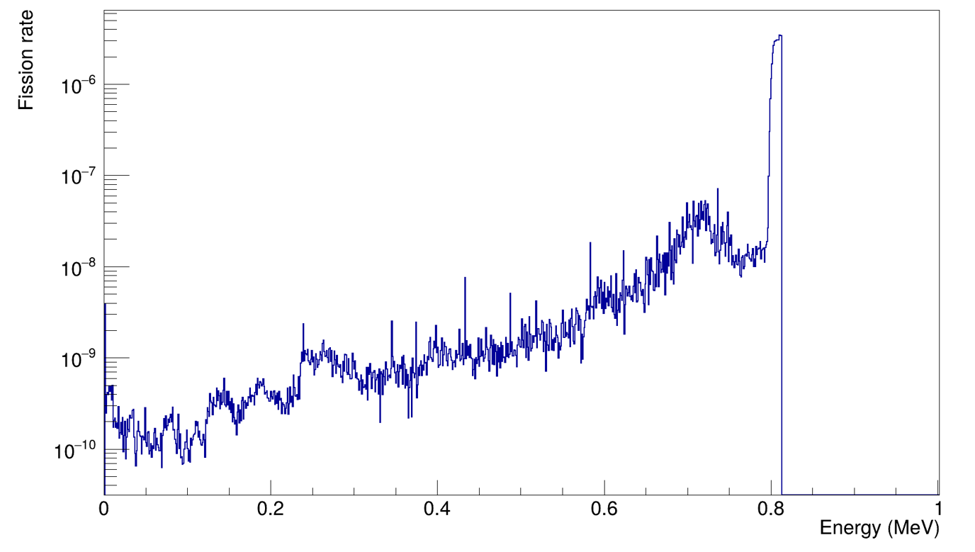
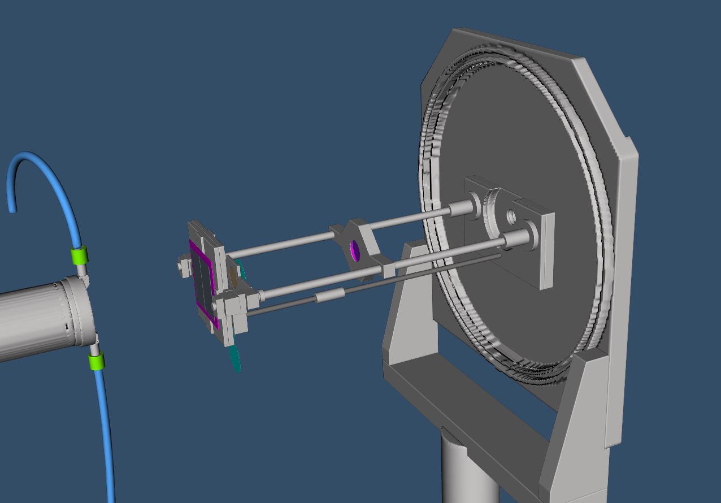
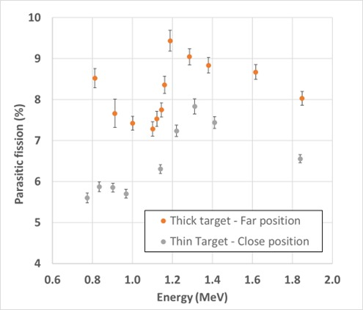
Fission rate correction
Fission rate spectra
Direct neutrons
Scattered neutrons
Neutron source
(water cooling)
Neutrons flux detection system
8,5%
Fission rate-scattered neutrons (%)
10% uncertainty on simulation
Fission detection setup
Experimental setup modeled in MCNP simulations
Salma EL HESSAK
WONDER 2026
10

Slide 11
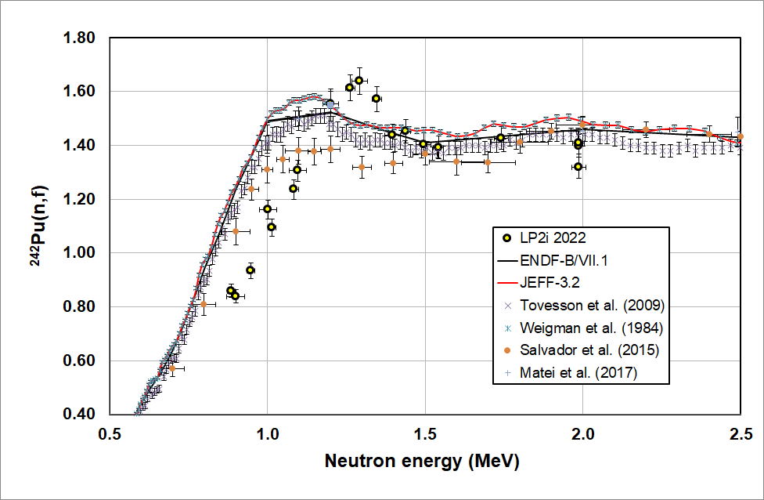
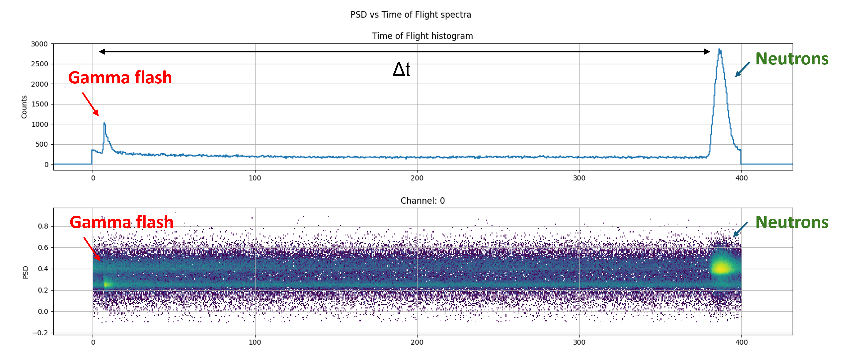
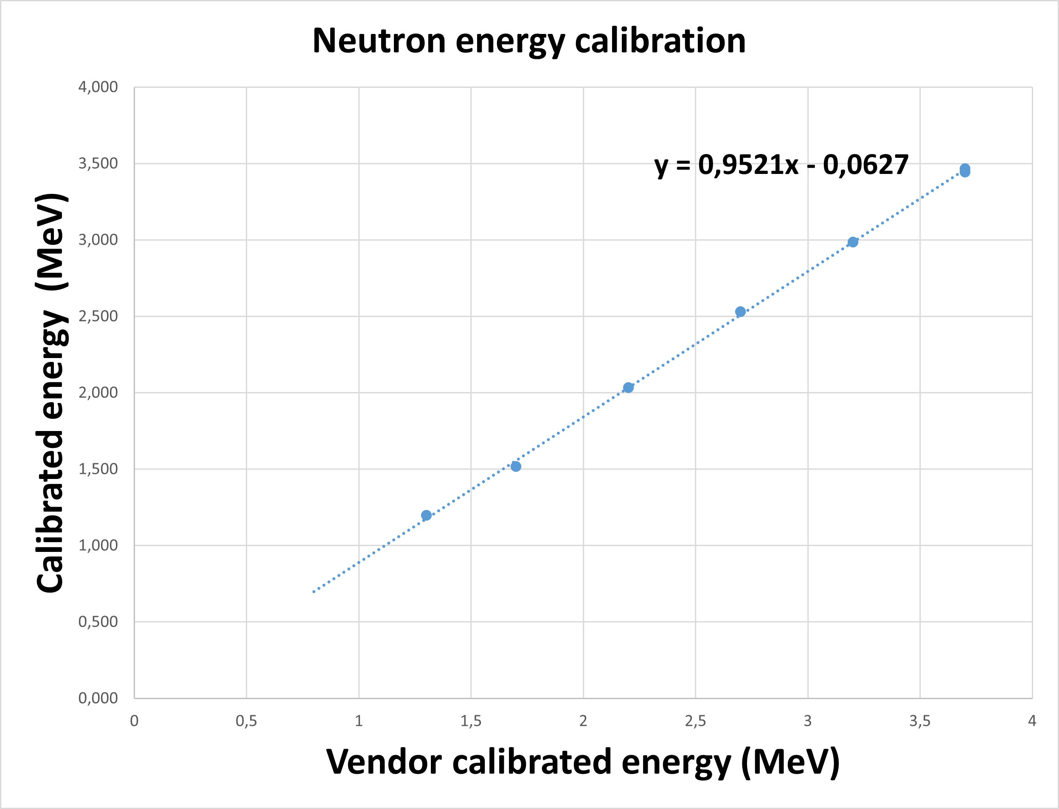
Time-of-Flight energy calibration
Problem: clear energy shift on the fission threshold.
Neutron energy calibration using Time-of-Flight (ToF) available data.
N.B: Time-of-Flight (ToF) runs acquired at the end of the experiment
Recalibration thanks to ToF runs
Salma EL HESSAK
WONDER 2026
11

Slide 12
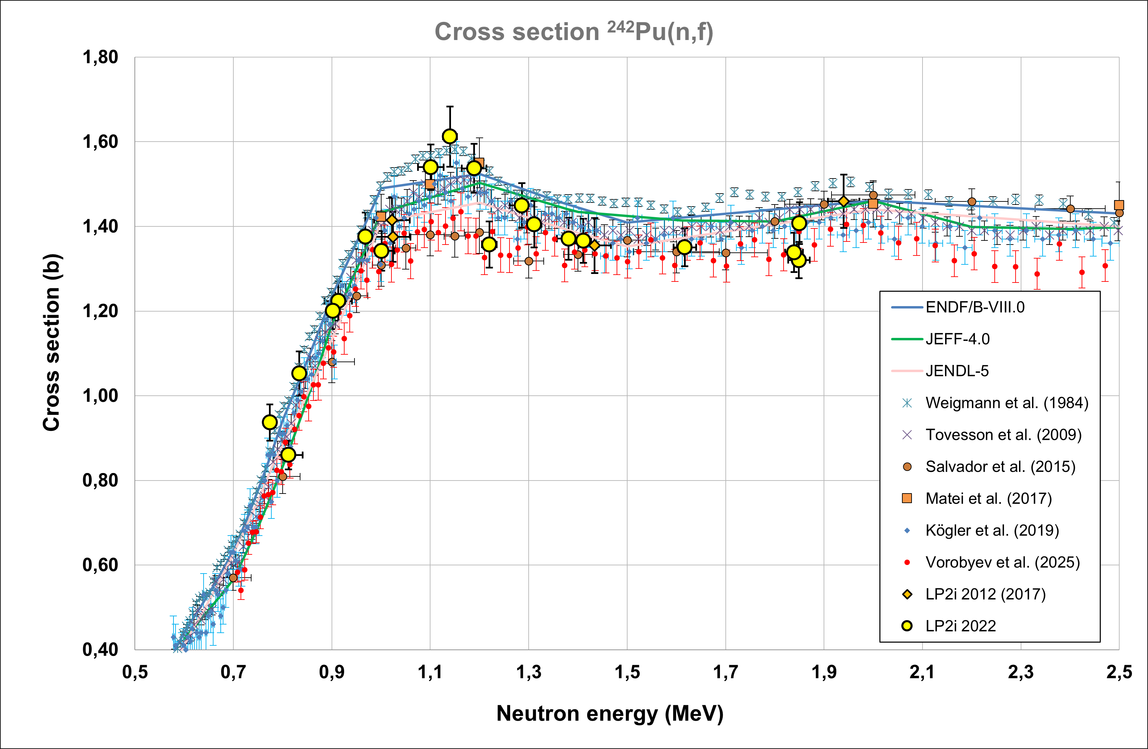
Results
Completed tasks:
-Scattered neutrons contribution to fission rate
-Neutron energy calibration
-Efficiency calculation and simulation
-Uncertainty evaluation
~15%
To do:
-More investigation on N_{p}
-PP foil characterization (N_{H})
-Uncertainty evaluation of anisotropy effects on efficiency
-Total uncertainty evaluation
PRELIMINARY
Good global shape of cross section
Structure “height” : +15% vs plateau
Salma EL HESSAK
WONDER 2026
12

Slide 13
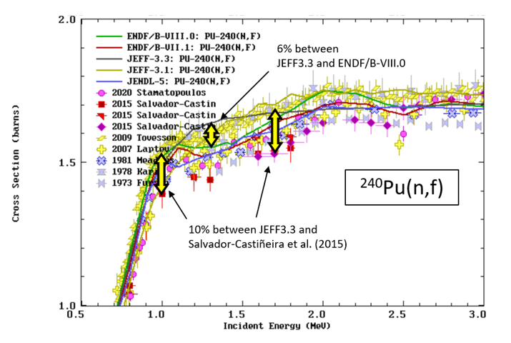
Conclusion
Measurement method:
A more complex method based on the primary standard, with an independent measurement.
For ²⁴²Pu:
Global shape of cross section.
Stress on error bars.
More investigation on N_{H} : characterization of polypropylene foils:
-Measurements using Ion Beams at AIFIRA facility at LP2iB.
-Stoichiometry Measurements.
Finalize the analysis of ²⁴²Pu(n, f) , and publish the results.
For ²⁴⁰Pu ( My main PhD subject):
Proposal accepted for the experiment (2026-1-RD-EUFRAT-MONNET)
Experiment preparation (simulation, calculation, trainings…).
Salma EL HESSAK
WONDER 2026
13

Slide 14
²⁴²Pu and ²⁴⁰Pu neutron-induced fission cross section measurement in the 1-2 MeV energy range using ¹H(n,n) standard
Salma El Hessak¹⁾, Ludovic Mathieu¹⁾, Mourad Aïche¹⁾, Paola Marini¹⁾, Olivier Bouland^{2,†)}, Carole Chatel³⁾, Serge Czajkowski¹⁾, Deby Kattikat-Melcom¹⁾, Teresa Kurtukian¹⁾, Stephan Oberstedt⁴⁾, Igor Tsekhanovich¹⁾
¹ Laboratoire de Physique des 2 infinis de Bordeaux
² CEA/IRESNE/DES Cadarache
³ Institut Pluridicsiplinaire Hubert Curien, Strasbourg
⁴ Joint Research Center Geel, Belgium
Thank you for your attention. Questions?
Contact: Salma EL HESSAK
elhessak@lp2ib.in2p3.fr
Salma EL HESSAK
WONDER 2026

