Slide 1
Impact of
Thermal Scattering Law Uncertainty on Benchmarks
Sensitive to Polyethylene
aSNR/psn-res/snc/ln
Aitor bengoechea, Vaibhav jaiswal, romain vuiart

Slide 2
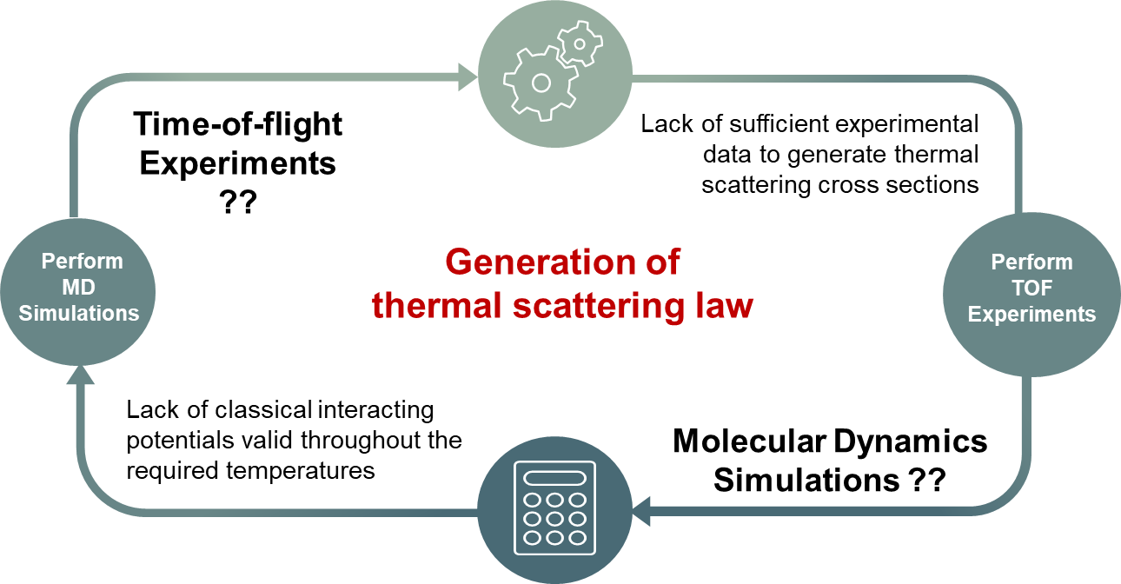
What DO we have today ?
Existing No. Of TSLs in ..
Neutron thermalization in nuclear systems depends critically on accurate thermal scattering cross sections, which are governed by the Thermal Scattering Law (TSL).
JEFF-4.0
ENDF/B-VIII.1
TSL: ~ 83
TSL: ~ 114
No available covariance matrix or uncertainty information on TSLs in any nuclear data library !
Generating TSL covariances are complex and more work is needed !
Uncertainty in TSLs impacts reactor simulations, benchmarks, safety margins !

Slide 3

Ongoing work at ASNR : Towards TSL uncertainty
TARA aims to provide the nuclear data community with a robust tool to generate random TSL files, quantify uncertainties and ultimately enable uncertainty propagation to reactor physics calculations.
TARA:
Thermal scattering law uncertainty Analysis using RAndom files
EU project:
APRENDE WP4
Task 4.2 activities - Thermal neutron scattering
My PostDoc:
Aitor FERNANDEZ BENGOECHEA
Participation:
  Gilles NOGUERE (CEA)
  Jose Ignacio MÁRQUEZ DAMIÁN (ESS)
  Mathieu HURSIN (EPFL)
The TARA project

Slide 4
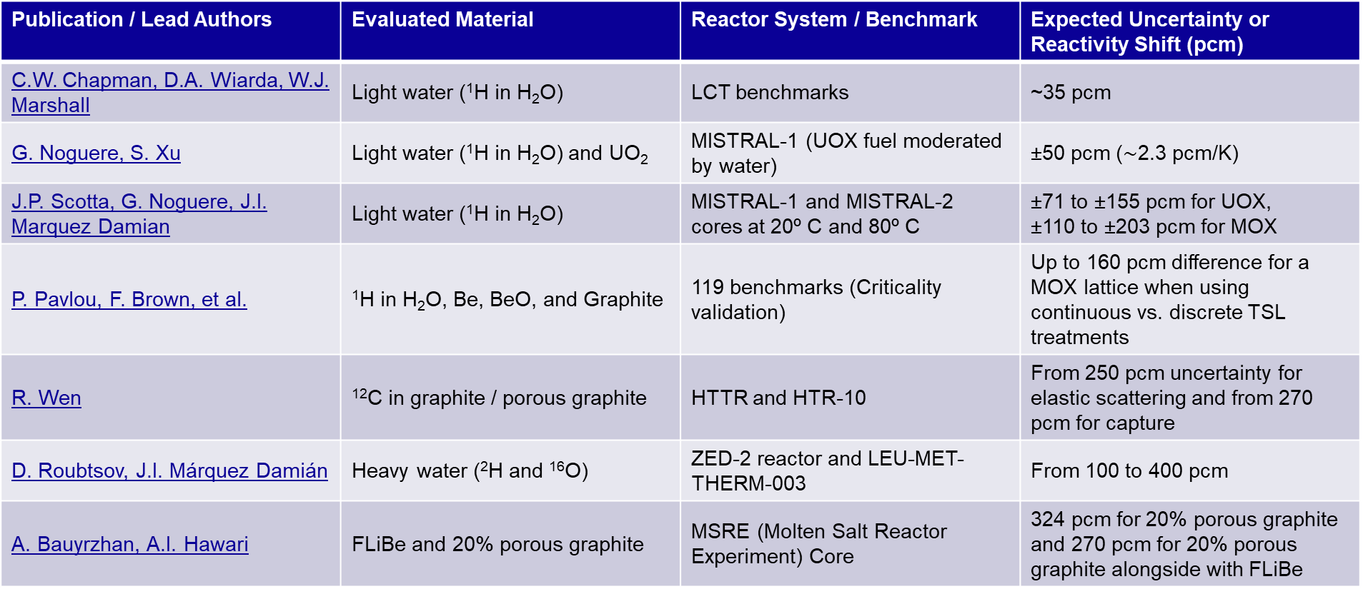
EXPECTED tsl UNCERTAINTY from bibliography
Publication / Lead Authors | Evaluated Material | Reactor System / Benchmark | Expected Uncertainty or Reactivity Shift (pcm)
C.W. Chapman, D.A. Wiarda, W.J. Marshall | Light water (¹H in H₂O) | LCT benchmarks | ~35 pcm
G. Noguere, S. Xu | Light water (¹H in H₂O) and UO₂ | MISTRAL-1 (UOX fuel moderated by water) | ±50 pcm ($\sim$2.3 pcm/K)
J.P. Scotta, G. Noguere, J.I. Marquez Damian | Light water (¹H in H₂O) | MISTRAL-1 and MISTRAL-2 cores at 20º C and 80º C | ±71 to ±155 pcm for UOX, ±110 to ±203 pcm for MOX
P. Pavlou, F. Brown, et al. | ¹H in H₂O, Be, BeO, and Graphite | 119 benchmarks (Criticality validation) | Up to 160 pcm difference for a MOX lattice when using continuous vs. discrete TSL treatments
R. Wen | ¹²C in graphite / porous graphite | HTTR and HTR-10 | From 250 pcm uncertainty for elastic scattering and from 270 pcm for capture
D. Roubtsov, J.I. Márquez Damián | Heavy water (²H and ¹⁶O) | ZED-2 reactor and LEU-MET-THERM-003 | From 100 to 400 pcm
A. Bauyrzhan, A.I. Hawari | FLiBe and 20% porous graphite | MSRE (Molten Salt Reactor Experiment) Core | 324 pcm for 20% porous graphite and 270 pcm for 20% porous graphite alongside with FLiBe

Slide 5
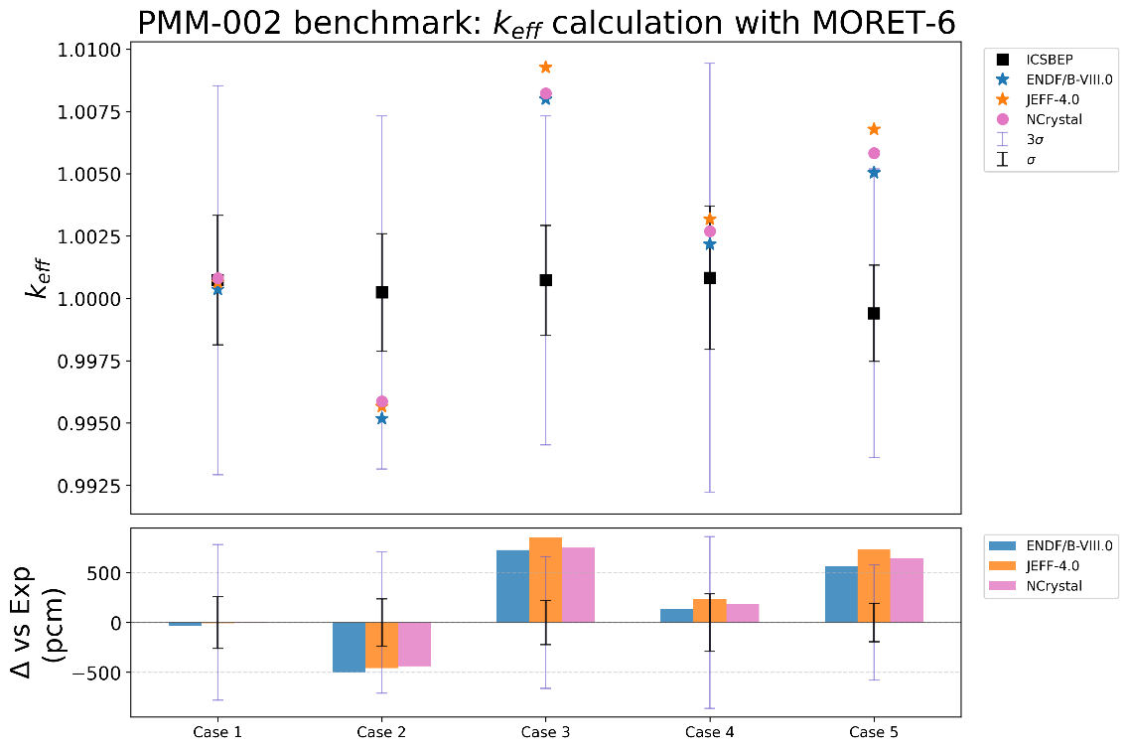
Thermal Epithermal eXperiments (TEX) Plutonium Baseline Benchmark: PMM-002
Experiment number | Thermal Fission fraction (<0.625 eV) | Intermediate Fission Fraction (0.625 eV – 100 KeV) | Fast Fission Fraction (> 100 KeV)
1 | 0.09 | 0.18 | 0.73
2 | 0.14 | 0.38 | 0.48
3 | 0.28 | 0.43 | 0.29
4 | 0.50 | 0.32 | 0.18
5 | 0.66 | 0.21 | 0.13
Five baseline Pu cases were evaluated for the International Criticality Benchmark Evaluation Project (ICSBEP) as PMM-002
The FGM cross section data library was JEFF 4.0

Slide 6
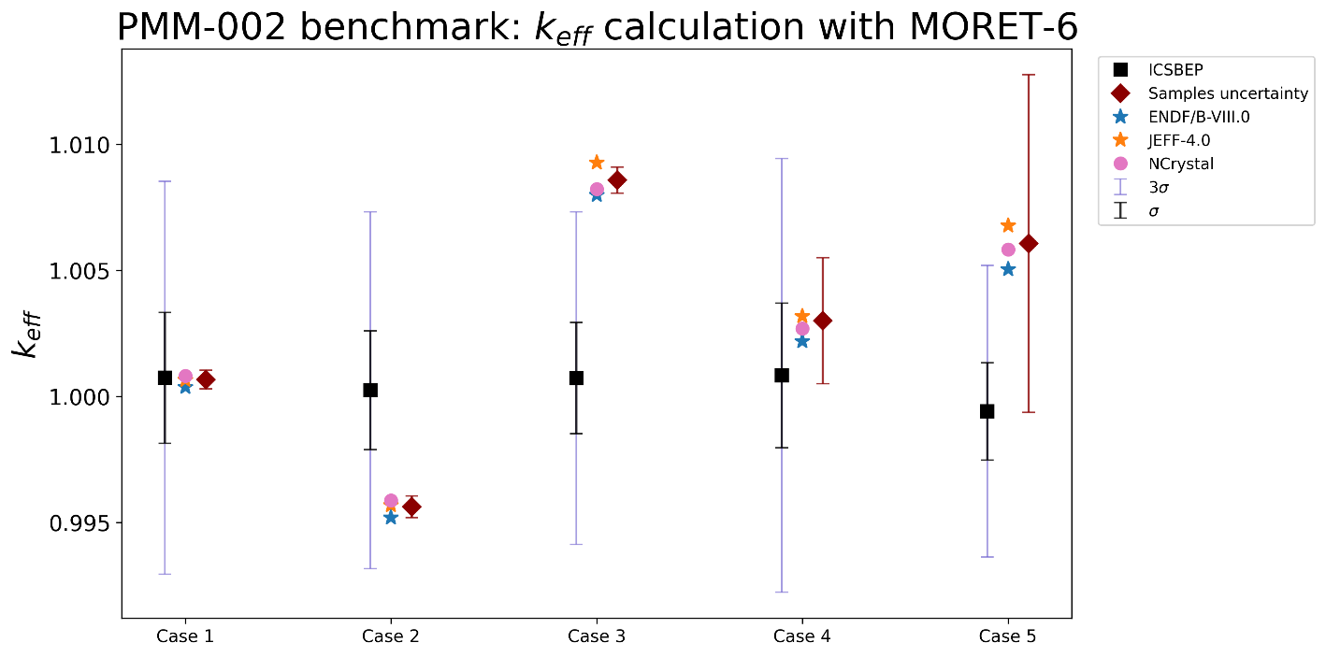
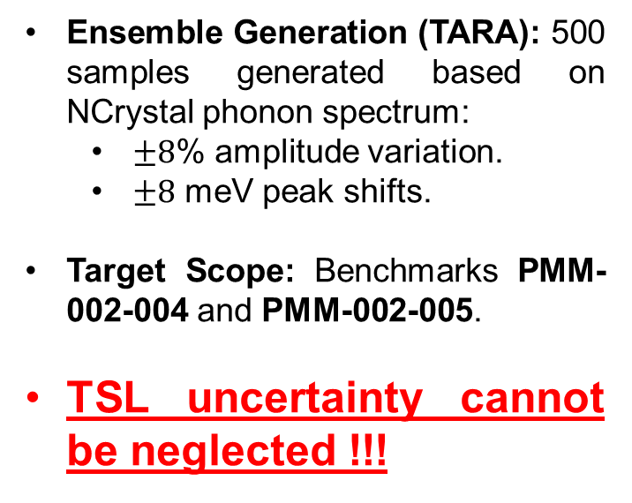
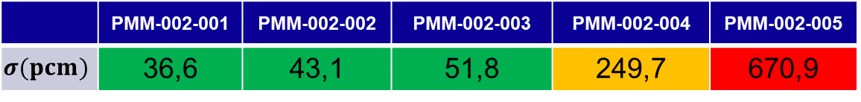
TSL UNCERTAINTY FOR PMM-002 BENCHMARK DUE TO CH2
Ensemble Generation (TARA): 500 samples generated based on NCrystal phonon spectrum:
  $±8$% amplitude variation.
  $±8$ meV peak shifts.
Target Scope: Benchmarks PMM-002-004 and PMM-002-005.
TSL uncertainty cannot be neglected !!!
 | PMM-002-001 | PMM-002-002 | PMM-002-003 | PMM-002-004 | PMM-002-005
$$σ(pcm)$$ | 36,6 | 43,1 | 51,8 | 249,7 | 670,9
The FGM cross section data library was JEFF 4.0

Slide 7
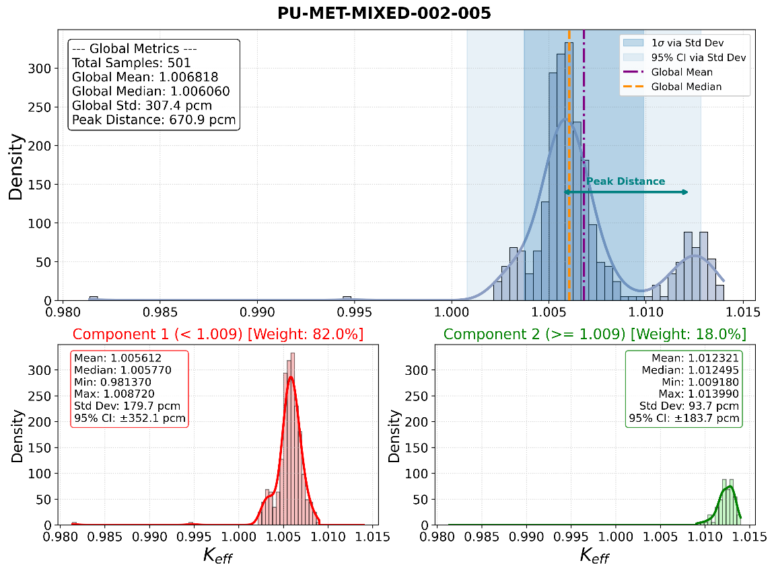
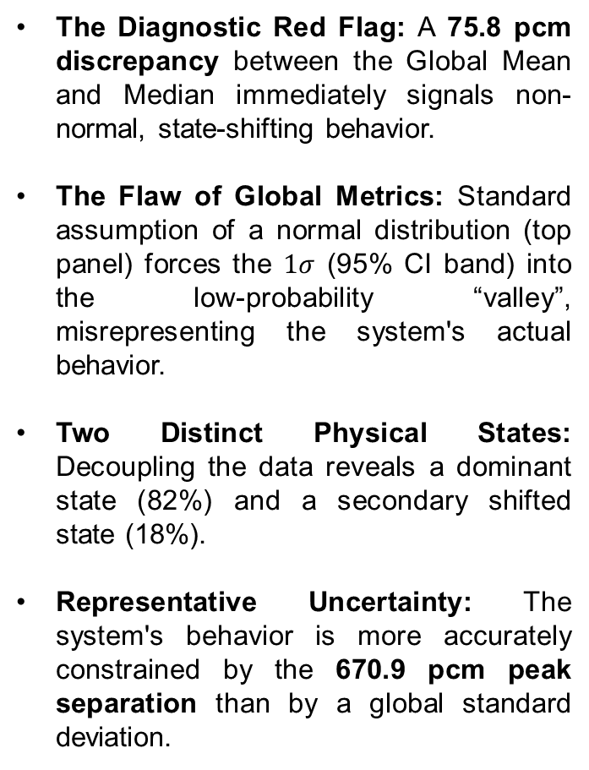
Uncertainty Metrics in Bimodal Systems (PMM-002-005)
The Diagnostic Red Flag: A 75.8 pcm discrepancy between the Global Mean and Median immediately signals non-normal, state-shifting behavior.
The Flaw of Global Metrics: Standard assumption of a normal distribution (top panel) forces the $1σ$ (95% CI band) into the low-probability “valley”, misrepresenting the system's actual behavior.
Two Distinct Physical States: Decoupling the data reveals a dominant state (82%) and a secondary shifted state (18%).
Representative Uncertainty: The system's behavior is more accurately constrained by the 670.9 pcm peak separation than by a global standard deviation.

Slide 8
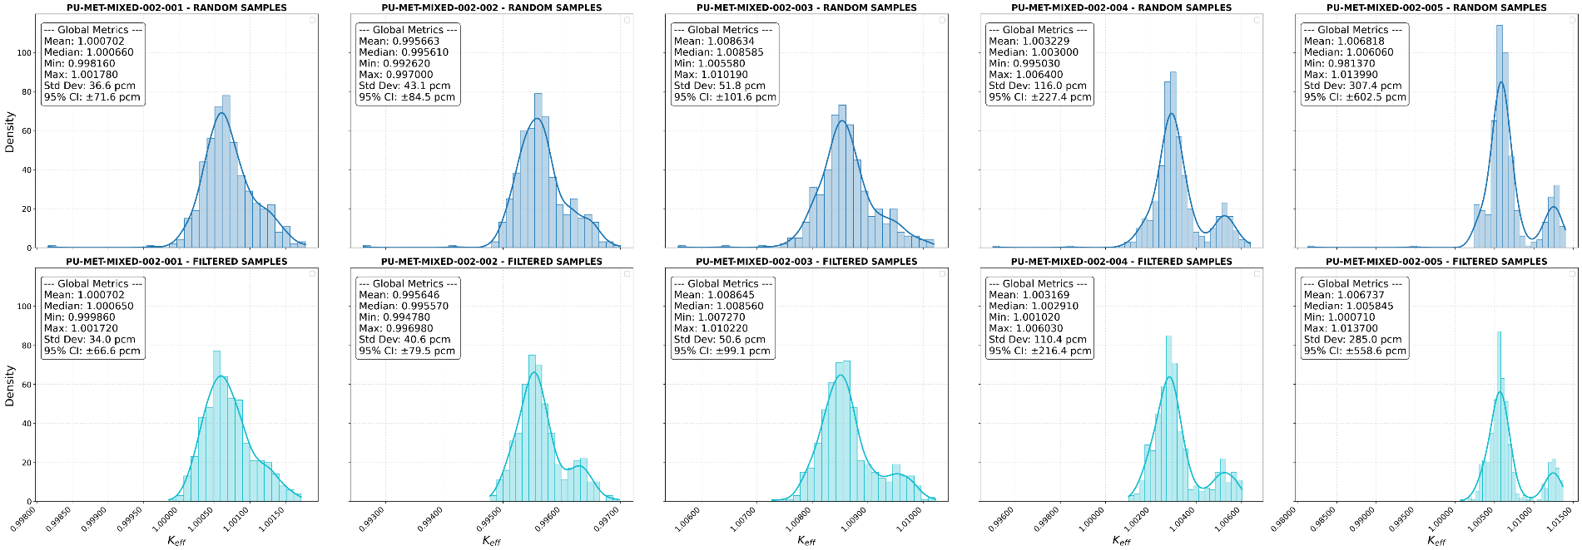
PMM-002 BENCHMARK revision: filter samples
Early State Resolution: While standard sampling (top row) indicates the emergence of a secondary state in Cases 002 & 003 with generic asymmetry, baseline filtering (bottom row) proves the bimodal divergence is an early structural feature rather than a late-stage artifact.

Slide 9
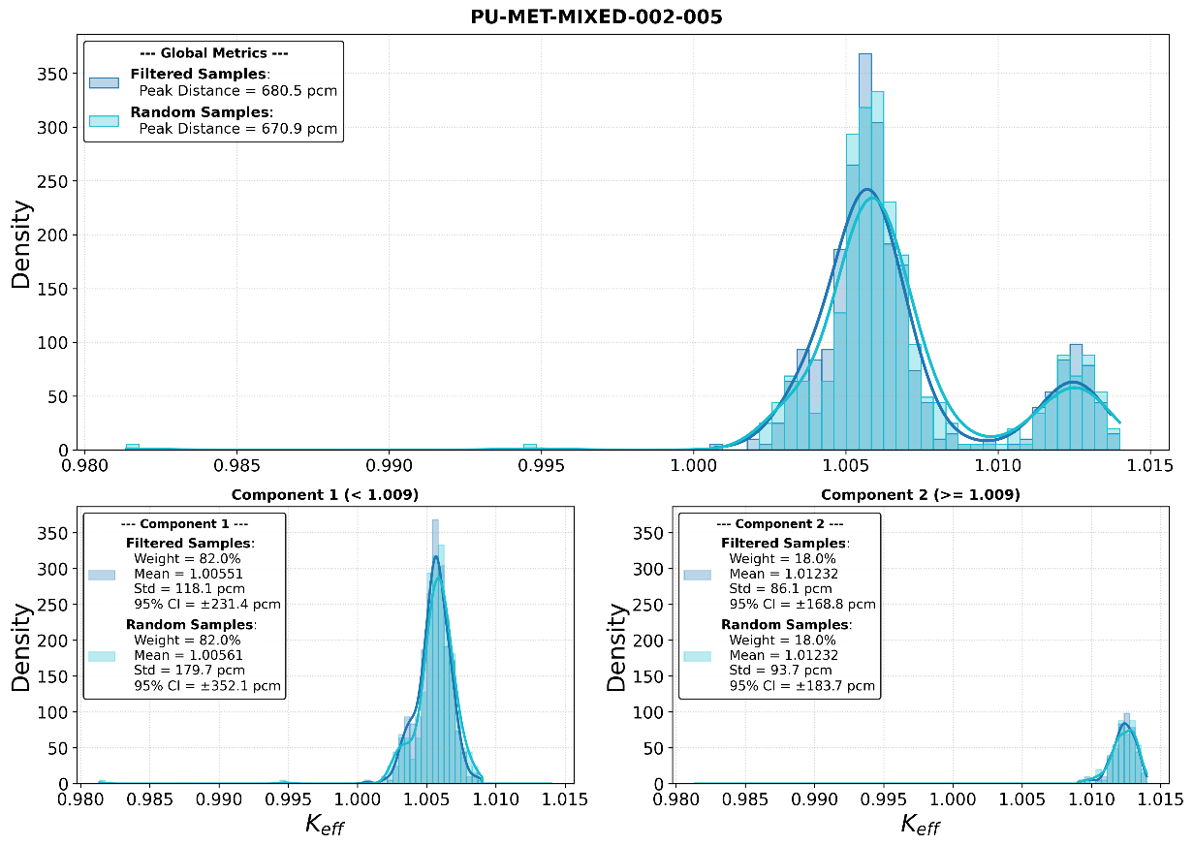
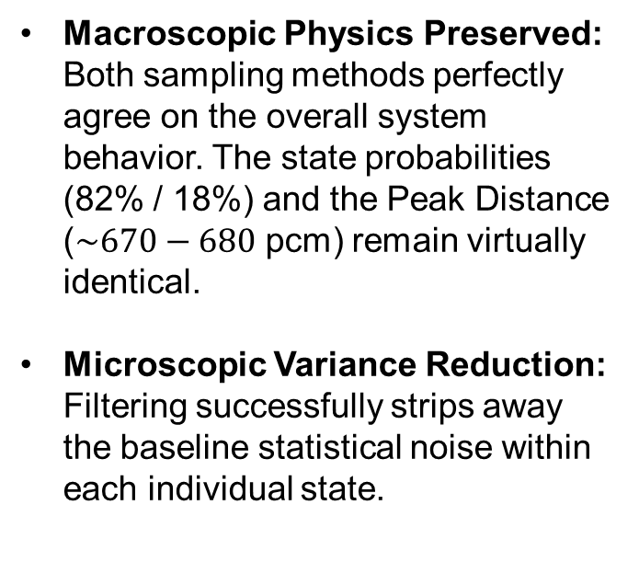
Filtering Validation: Isolating Physical States from Statistical Noise
Macroscopic Physics Preserved: Both sampling methods perfectly agree on the overall system behavior. The state probabilities (82% / 18%) and the Peak Distance ($\sim 670−680$ pcm) remain virtually identical.
Microscopic Variance Reduction: Filtering successfully strips away the baseline statistical noise within each individual state.

Slide 10

Summary: TSL UNCERTAINTY FOR PMM-002 BENCHMARK DUE TO CH2
Experiment number | Thermal Fission fraction (<0.625 eV) | Intermediate Fission Fraction (0.625 eV – 100 KeV) | Fast Fission Fraction (> 100 KeV)
1 | 0.09 | 0.18 | 0.73
2 | 0.14 | 0.38 | 0.48
3 | 0.28 | 0.43 | 0.29
4 | 0.50 | 0.32 | 0.18
5 | 0.66 | 0.21 | 0.13
 | PMM-002-001 | PMM-002-002 | PMM-002-003 | PMM-002-004 | PMM-002-005
$$σ(pcm)$$ | 36,6 | 43,1 | 51,8 | 249,7 | 680,5
The FGM cross section data library was JEFF 4.0

Slide 11
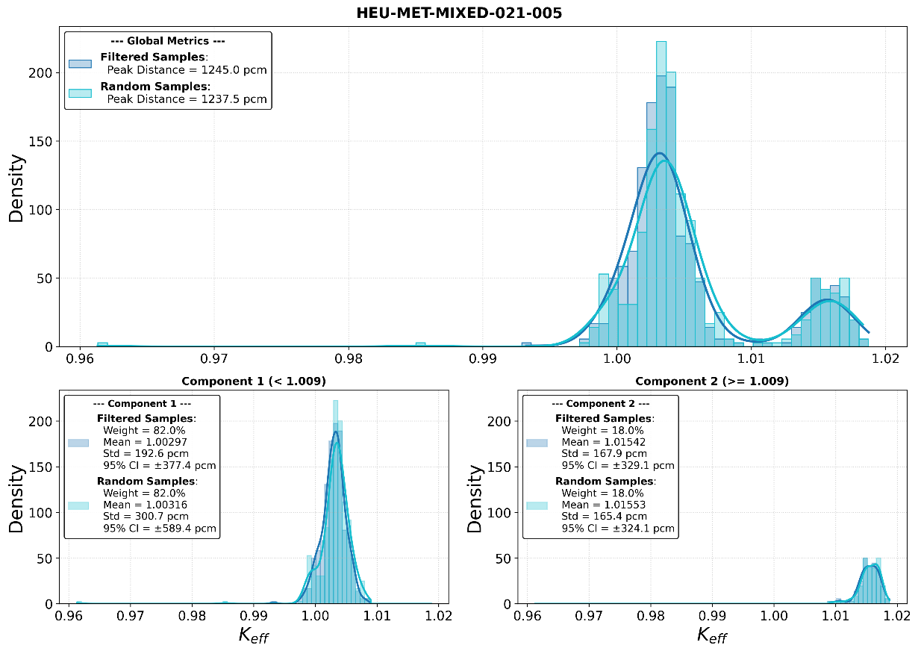
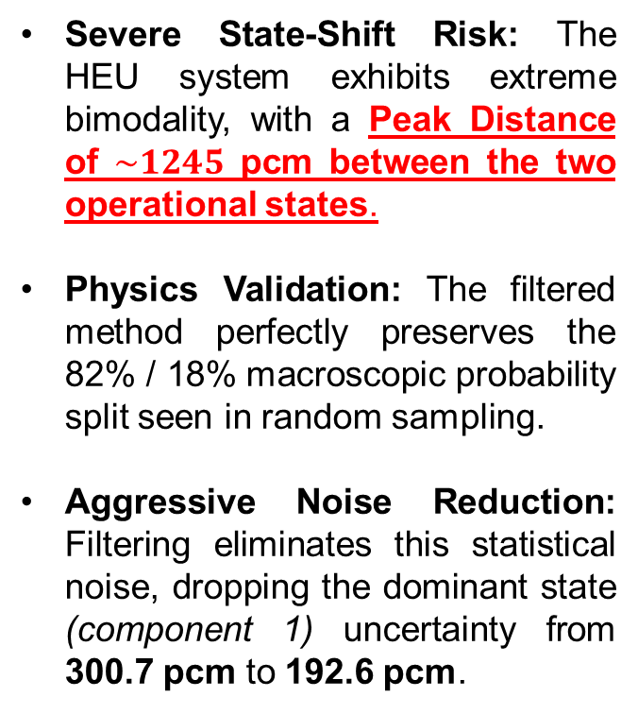
Extreme Bimodality in HEU Systems: HEU-MET-MIXED-021-005
Severe State-Shift Risk: The HEU system exhibits extreme bimodality, with a Peak Distance of $\sim 1245$ pcm between the two operational states.
Physics Validation: The filtered method perfectly preserves the 82% / 18% macroscopic probability split seen in random sampling.
Aggressive Noise Reduction: Filtering eliminates this statistical noise, dropping the dominant state (component 1) uncertainty from 300.7 pcm to 192.6 pcm.

Slide 12

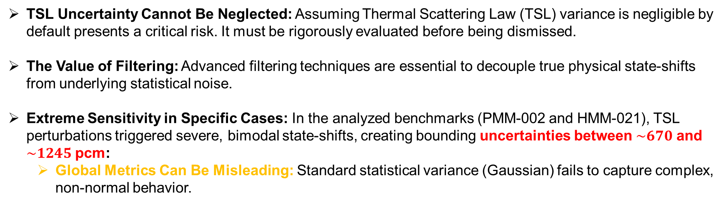
Conclusions: The Critical Impact of TSL Uncertainty
TSL Uncertainty Cannot Be Neglected: Assuming Thermal Scattering Law (TSL) variance is negligible by default presents a critical risk. It must be rigorously evaluated before being dismissed.
The Value of Filtering: Advanced filtering techniques are essential to decouple true physical state-shifts from underlying statistical noise.
Extreme Sensitivity in Specific Cases: In the analyzed benchmarks (PMM-002 and HMM-021), TSL perturbations triggered severe, bimodal state-shifts, creating bounding uncertainties between $\sim 670$ and $\sim 1245$ pcm:
  Global Metrics Can Be Misleading: Standard statistical variance (Gaussian) fails to capture complex, non-normal behavior.

