Slide 1
Past, present, future of the FRLDM model
Pastore (CEA - Cadarache)
Collaborators:
C. Azam, L. Lemay, P. Tamagno, M. Frosini,
WONDER 30/6/2026

Slide 2
Outline
Past
Present
Future

Slide 3
Past
1

Slide 4
Finite Range Liquid Drop Model
Improved LD model including:
Deformation
Shell effects
Zero point energy (collective fluctuations)
Good reproduction of masses and fission barriers

Slide 5

Finite Range Liquid Drop Model
(MeV)
Discrepancy between CONRAD and FRLDM.
Not easy to trace the origin of the differences.
Most cases the differences are ~100 keV but can go up to ~2 MeV!

Slide 6
A non-detailed procedure….
According to the choice of the pairing window we can get up to 500 keV.
How this window is adjusted?
How the window evolves with deformation?
Los Alamos groups have re-written the code and improved on some criticalities and produced eFRLDM.
No benchmark provided with the original FRLDM model.

Slide 7
Present
2

Slide 8
FRLDM @ Cadarache
What has been done:
Full rewriting of a numerical code to deal with FRLDM equations
Remove of quantal fluctuations (ill-defined method and shape-dependent) (~500 keV)
Unique pairing window to avoid arbitrary changes
Spherical Harmonic Oscillator basis to avoid arbitrary basis definition
Benchmark with CONRAD (less 1 keV discrepancy).
Implementation of a variety of shapes more suitable for fission
Out of 38 parameters only 6 are fitted on nuclear masses (~2000 nuclei AME2012)
We need a clear protocol for the other parameters but they have been kept fixed since 70s!

Slide 9
FRLDM @ Cadarache
Residuals do show still structures for low neutron number (N) around magic numbers.
Few outliers related to pairing collapse (improvable with better pairing)
The residual do contain some signal that we can capture via global regressions such as Gaussian Process
 | FRLDM (12) | FRLDM+GP
RMS | 0,57 MeV | 0,36 MeV

Slide 10
Error propagation (statistical)
From covariance matrix we calculate statistical error bars.
The typical error bars are of the order of 10s of keV much smaller that the root mean square deviation (~700 keV).
The disagreement between theory and data can not be ascribed to the fitting procedure. The systematic error is dominating!

Slide 11
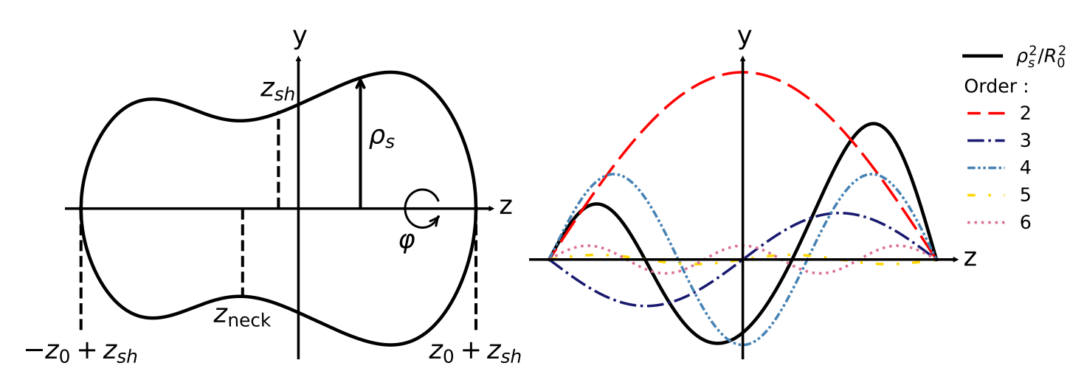
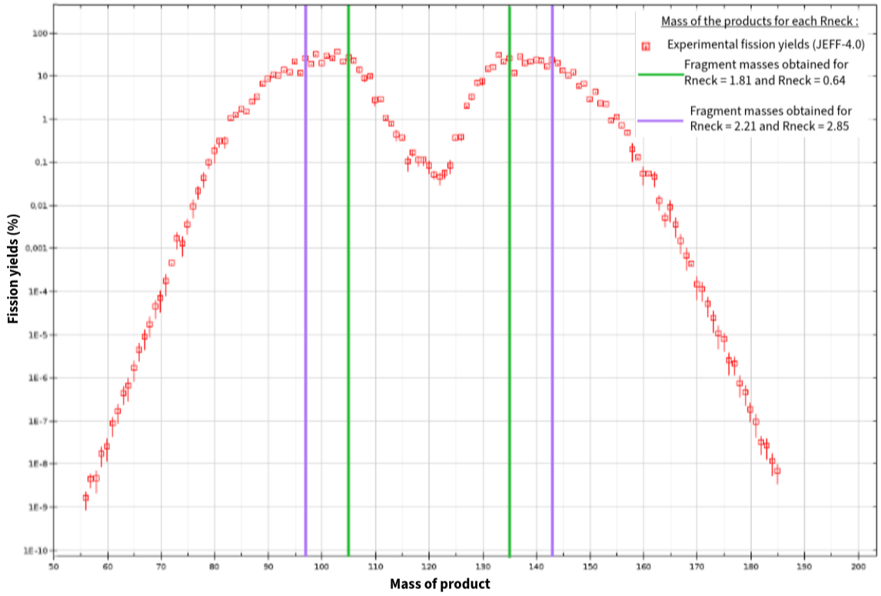
Fission ${}_{}^{240}{Pu}$
FRLDM+Fourier shape parametrization.
We get nice barriers in just 3 dimension (not 5 as in the original 3QS)

Slide 12

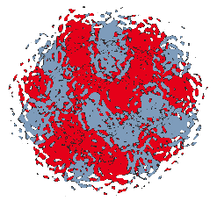
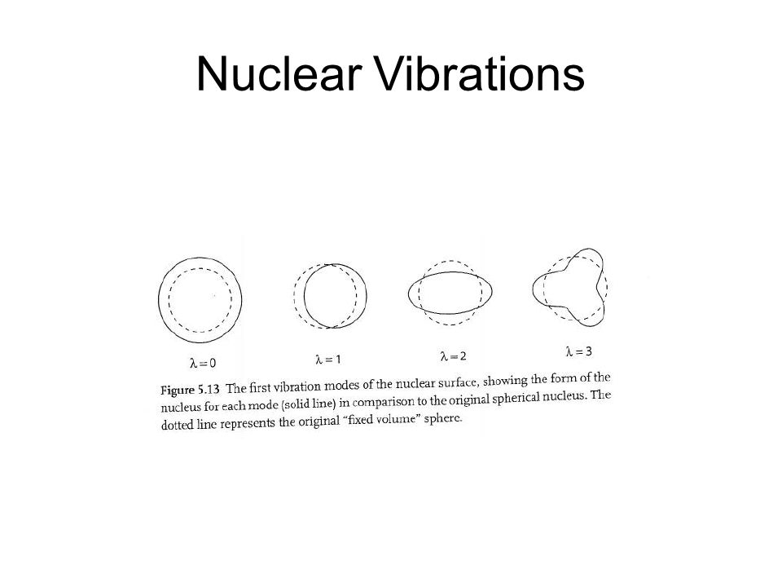
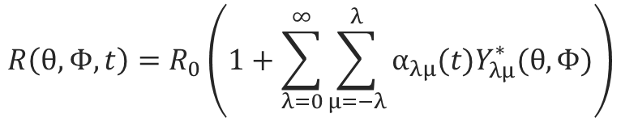
Quadrupole Bohr Hamiltonien formalism
Step 1 : Definition of collectives parameters
Aage Bohr - 1952
$$R\left(θ,Φ,t\right)=R_{0}\left(1+\sum_{λ=0}^{∞}{\sum_{μ=−λ}^{λ}{α_{λμ}(t)Y_{λμ}^{∗}(θ,Φ)}}\right)$$
A nucleons
Nuclear surface oscillations
Monopole :
Volume variations
Quadrupole :
Elongation
Dipole :
Center of mass
Octupole :
Asymmetric deformation

Slide 13
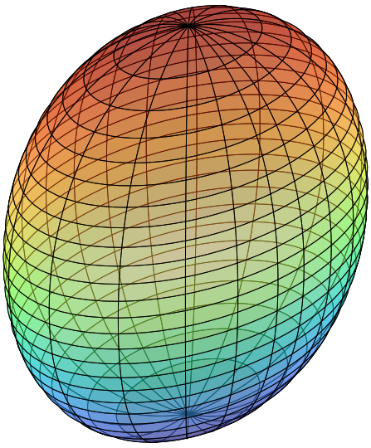
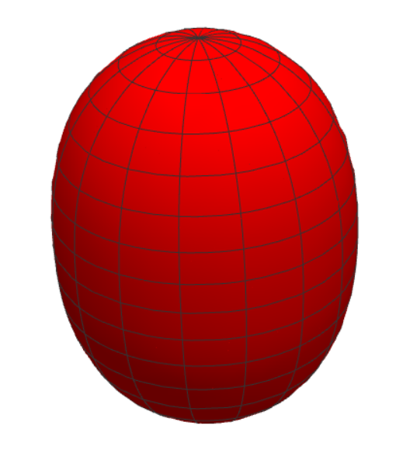
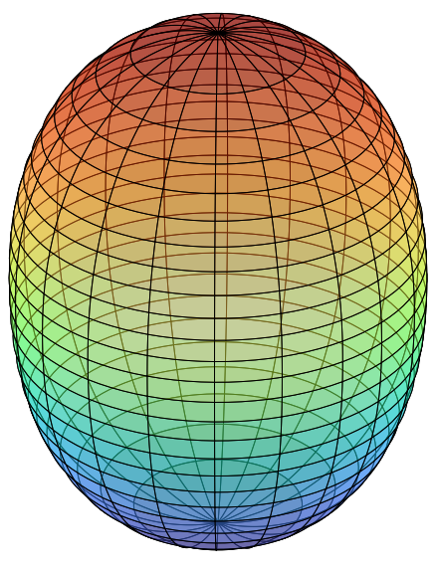
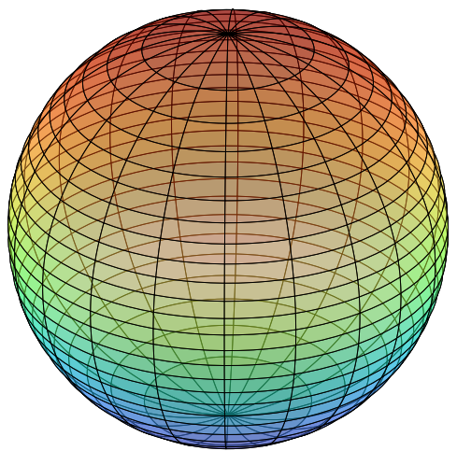
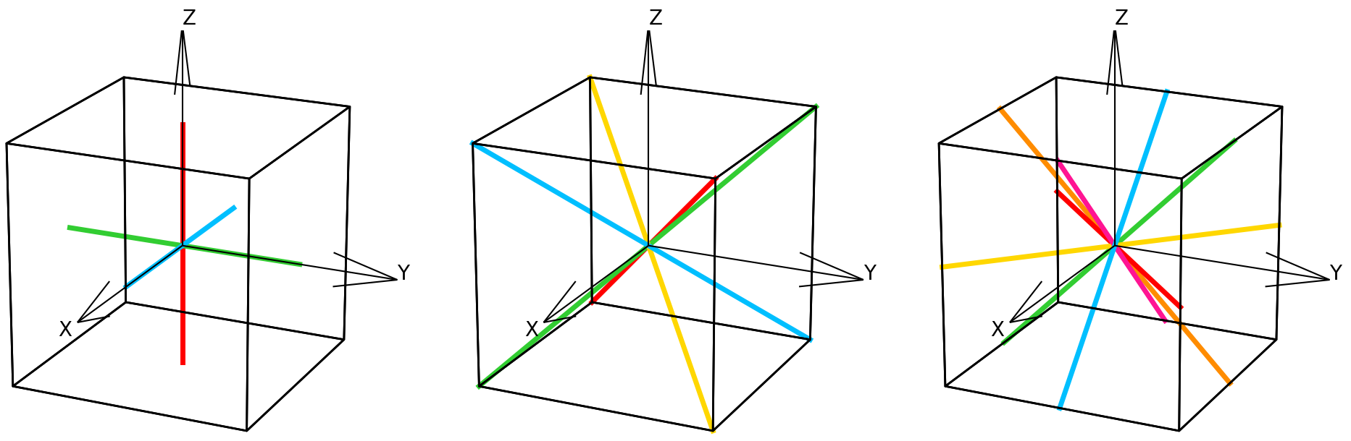
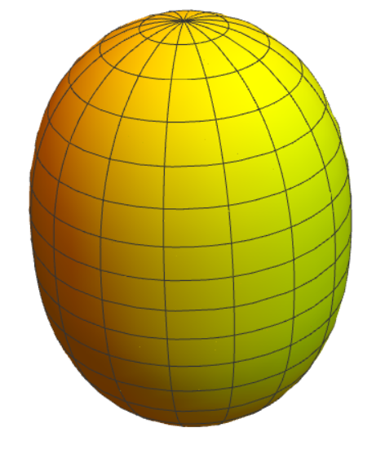
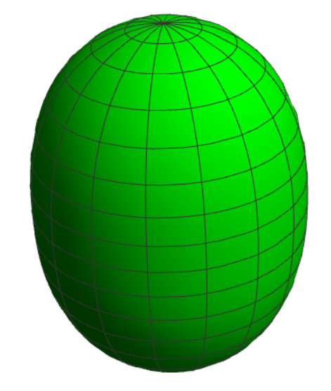
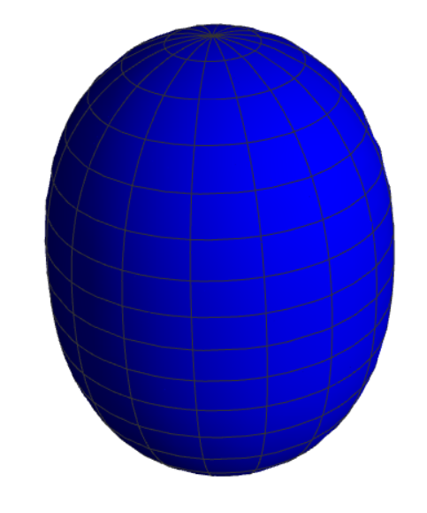





Quadrupole Bohr Hamiltonien formalism
Step 1 : Definition of collectives parameters
$$γ$$
Laboratory frame
Intrinsic frame
Rotation Euler angles
Ω=(Φ,θ,Ψ)
$$α_{2}=\left(\begin{aligned}β\sin{γ} \\ 0 \\ β\cos{γ} \\ 0 \\ β\sin{γ}\end{aligned}\right)$$
$$α_{2}=\left(\begin{aligned}α_{22} \\ α_{21} \\ α_{20} \\ α_{2−1} \\ α_{2−2}\end{aligned}\right)$$
$$α_{2}=\left(\begin{aligned}α_{22} \\ 0 \\ α_{20} \\ 0 \\ α_{22}\end{aligned}\right)$$
$$β$$
There are 48 ways to position the frame within the intrinsic axes of the nuclei.
Symmetries = Octahedral group O
. . .
The problem need to be invariant under these transformations
The γ space is reduced to [0, π/3 ]
Notes:
Trixialité : brise la symmétrie de rotation autour de l’axe principal

Slide 14
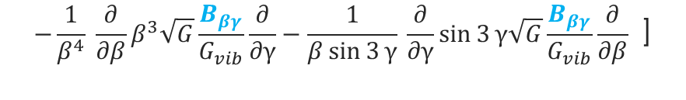
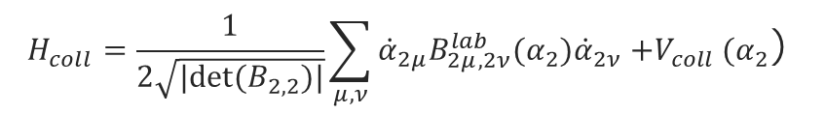




Quadrupole Bohr Hamiltonien formalism
Step 2 : Obtain collective quantum Hamiltonian
Podolsky-Pauli prescription
Classical Hamiltonian
${\hat{H}}_{coll}=\frac{1}{2\sqrt{|det⁡(B_{2,2})|}}\sum_{μ,ν}{{\hat{π}}_{2}^{μ}\sqrt{\det\left(B_{2,2}\right)}G_{2μ,2ν}\left(α_{2}\right){\hat{π}}_{2}^{ν}}−V_{coll}(α_{2}$)
$$H_{coll}=\frac{1}{2\sqrt{|det⁡(B_{2,2})|}}\sum_{μ,ν}{{\dot{α}}_{2μ}B_{2μ,2ν}^{lab}(α_{2}){\dot{α}}_{2ν}{+V}_{coll}(α_{2}\text{) }}$$
Quantum Hamiltonian
INPUT :
$${\hat{H}}_{coll}={\hat{H}}_{vib}+{\hat{H}}_{rot}+V_{coll}$$
Potential
$$= −\frac{ℏ^{2}}{2\sqrt{G}} [ \frac{1}{β^{4}} \frac{∂}{∂β}β^{4}\sqrt{G}\frac{B_{γγ}}{G_{vib}}\frac{∂}{∂β}+\frac{1}{β^{2}\sin{3}γ} \frac{∂}{∂γ}\sin{3γ}\sqrt{G}\frac{B_{ββ}}{G_{vib}}\frac{∂}{∂γ}$$
Moments of inertia
$${\hat{H}}_{vib }$$
Mass parameters
$$−\frac{1}{β^{4}} \frac{∂}{∂β}β^{3}\sqrt{G}\frac{B_{βγ}}{G_{vib}}\frac{∂}{∂γ}−\frac{1}{β\sin{3}γ} \frac{∂}{∂γ}\sin{3}γ\sqrt{G}\frac{B_{βγ}}{G_{vib}}\frac{∂}{∂β} \text{]}$$
$${\hat{H}}_{rot}= \frac{1}{2} \left[\frac{{\hat{L}}_{x}^{2}}{J_{x}}+\frac{{\hat{L}}_{y}^{2}}{J_{y}}+\frac{{\hat{L}}_{z}^{2}}{J_{z}}\right]$$
$$G=|det⁡(B)|$$
$G_{vib}$=${B_{ββ}B}_{γγ}−B_{βγ}^{2}$

Slide 15
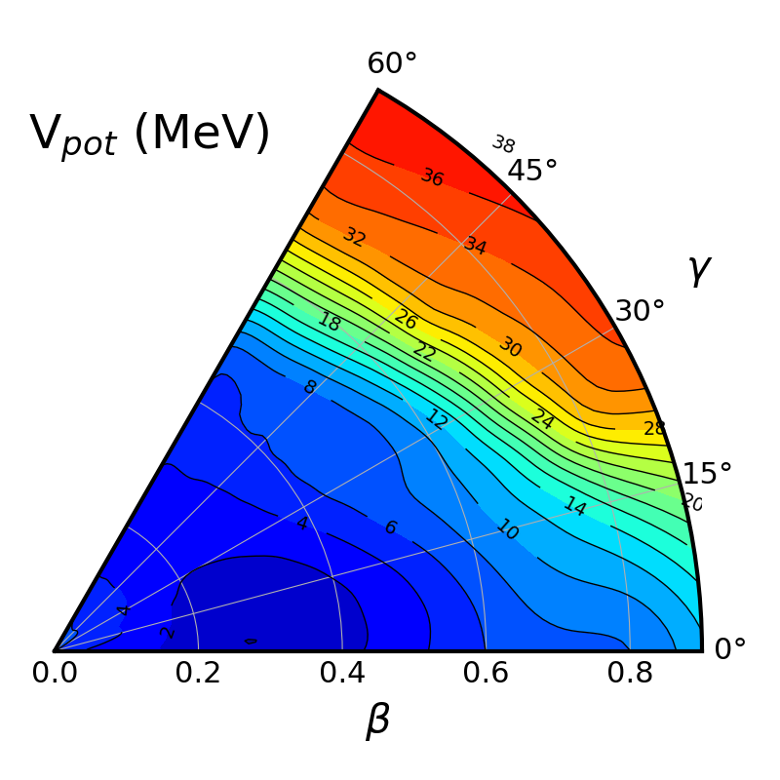
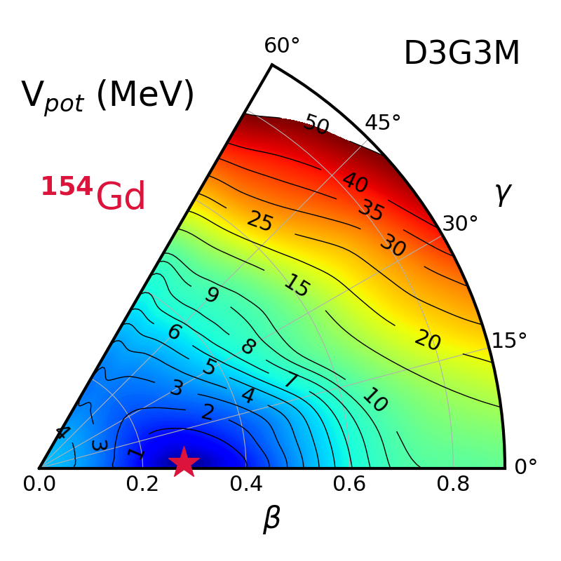
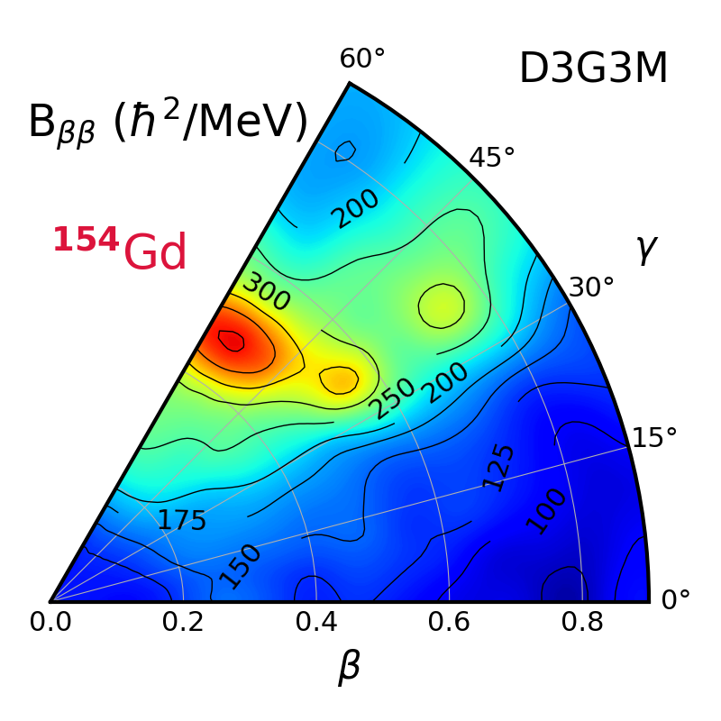
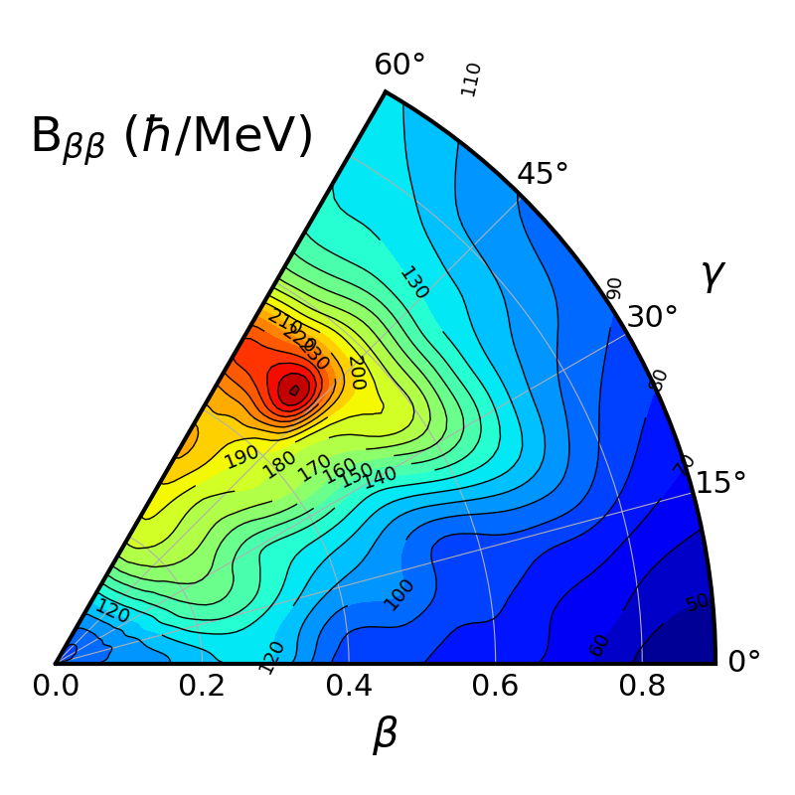
FRLDM is capable to provide a reasonably good structure of potential energy surfaces (PES) as well as collective masses (via perturbative cranking).
Limited computational cost for each point:
FRLDM: 30s
HFB: 10 min (12 shells)
FRLDM
2
FRLDM

Slide 16
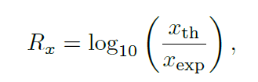
Systematic calculations of 2+ states: 10< Z< 84
Over 500 nuclei FRLDM has similar performances than Gogny D1S at a fraction of its computational cost

Slide 17
Gogny D1S has better performances on BE(2), but main issue are semi-magic nuclei where vibrational part is dominant.
FRLDM fails where Gogny fails…. Maybe issue related to the BH approximations!

Slide 18
Future
3

Slide 19
Conclusions
We have identified all issues related to the FRLDM model and confirmed the results obtained by P. Tamagno in his thesis.
We have a new FRLDM code that can be used to describe ground states or fission properties with new shape parametrisations.
We have a full covariance matrix (for the 6 parameters).
We have defined statistical error bars for the model.
We have used FRLDM to study nuclear excited states

Slide 20
What’s next?
The FRLDM has been extended to include triaxiality and a new fit of parameters is underway.
Include corrections suggested for eFRLDM (Kruppa shell correction).
Better treatment of pairing (use of a realistic interaction instead of constant pairing(?)).
Explore better methods for collective masses.

Slide 21
Merci

Slide 22
Finite Range Liquid Drop Model

