Slide 1

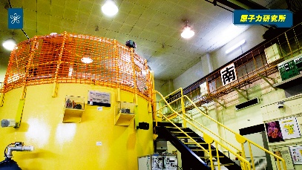
Measurements of fission cross sections of ²³⁵U at the KRUNS-LINAC
Kazushi Terada¹, Jun-ichi Hori¹, Hiroshi Yashima¹,
Yoshiyuki Takahashi¹, Tadafumi Sano²
1. Kyoto University, Osaka, Japan
2. Kindai University
This work was supported by MEXT Innovative Nuclear Research and
Development Program Grant Number JPMXD0224020564.
Notes:
Thank you for the introduction.
Good afternoon. I’m Kazushi Terada from Kyoto University.
Today, I will present our work on this topic.

Slide 2
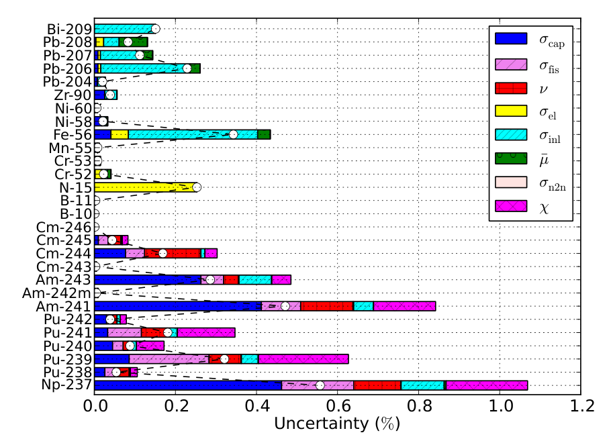
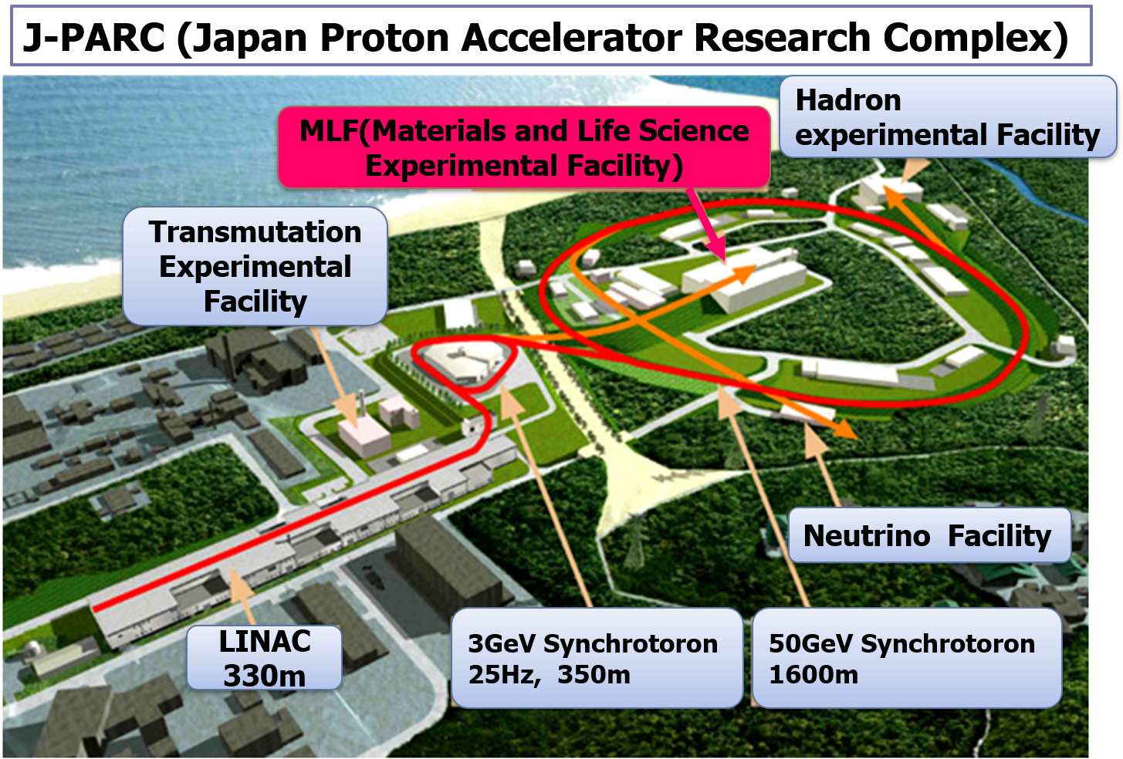
Introduction
Accurate fission and capture cross sections for minor actinides are still lacking for designing advanced reactors, including high‑burnup (100 GWd/t) PWRs and MA‑bearing systems [1,2].
The neutron capture cross sections of MAs are a major source of uncertainties.
In Japana as well, measurements at several facilities have improved their accuracy (²³⁷Np, ^{241,243}Am, etc.).
And what about σ_{f}?
Uncertainties in k_{eff} by reaction channel for the ADS [2].
G. Aliberti et al., Annals of Nuclear Energy 33 (2006) 700–733.
H. Iwamoto et al, JAEA-Research 2014-033 (2015).
Notes:
Let me briefly explain the background of this study.
For high‑burnup PWRs and advanced reactor concepts such as fast reactors and HTGRs loaded with minor‑actinide–bearing fuels, sensitivity analyses show that current nuclear‑data uncertainties do not meet the required design accuracy.
Therefore, highly accurate fission and neutron‑capture cross sections for MA nuclides are essential.
This figure summarizes the work by Iwamoto et al., who evaluated the contribution of nuclear‑data uncertainties to the keff of an ADS.
高燃焼度のPWRやMA核種を含む燃料を装荷した高速炉、高温ガス炉の感度解析では、核データの不確かさは設計の要求精度を満たしていない。
図は岩本らによるADSのkeff, ボイド反応度等の設計パラメータの核データ由来の不確かさを評価したもの。
炉定数調整法を採用し、核データを確率変数と見なしてベイズ更新を行い、不確かさを感度係数と共分散行列から計算した。
keffにはMAの不確かさの最も大きな要因であり、Pu、構造材の寄与が大きい。
MAでは捕獲断面積が主要な要因。また、MA については捕獲断面積とともに核分裂スペクトルも比較的寄与が大きい

Slide 3
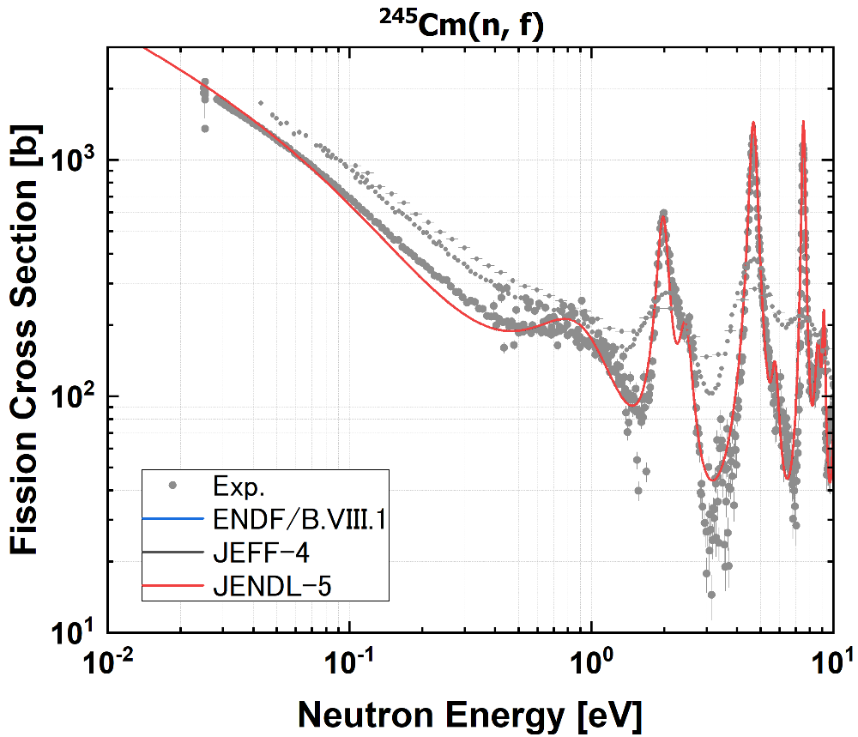
Current status and requirements
Target accuracy requirements of σ_{f [1].}
 | SFR | LFR | GFR | ADMAB
²⁴¹Am | 6% | 5% | 3% | 1%
²⁴³Am | 7% |  |  | 2%
²⁴⁴Cm | 5% | 7% | 11% | 2%
²⁴⁵Cm | 7% | 7% | 11% | 3%
For the target accuracy of MA fission cross sections, discrepancies exceeding 40% exist among measured values.
Why are there such discrepancies in the measurements?
[1] M. Salvatores, R. Jacqmin, WPEC/SG26 report:Uncertainty and Target Accuracy Assessment for Innovative Systems Using Recent Covariance Data Evaluations, OECD/NEA. No.6410(2008).
Notes:
This table summarizes the required accuracy for fission cross sections.
SFR refers to sodium‑cooled fast reactors designed for power generation and MA burning.
LFR is a lead or lead–bismuth–cooled fast reactor with a harder neutron spectrum, though material corrosion remains a challenge.
GFR is a helium‑cooled fast reactor that maintains a fast spectrum while operating at around 850 °C, enabling both MA transmutation and high‑temperature applications.
ADMAB represents ADS systems dedicated to MA transmutation using lead–bismuth coolant.
Depending on the reactor type, fission cross sections are required with an accuracy better than about 11%.
This figure shows the current status of the Cm‑245 fission cross section.
The gray points indicate past measurements, while the solid lines represent evaluated values.
The three major evaluations nearly overlap in this energy region, yet even recent measurements still differ by roughly 40%.
炉型ごとにkeffやMA燃焼率、ボイド反応度などの設計側の許容誤差を設定し、核データの不確かさが与える影響を評価。その影響を目標以内に収める条件を逆算することで核データの目標精度を出しています。
感度が大きい核データほどより厳しい精度が要求され、高速炉ではMA核分裂が重要なため1~3%の厳しい要求になっています。
感度解析は、評価済核データ（ENDF等）から共分散を取得して、adjoint法による摂動論で感度ベクトルSを評価し、出力の不確かさを計算。
中性子スペクトル × 炉型 × 核種に依存し、高速炉ではAm-241(n,f)が高感度、熱炉ではAm-241(n,γ)が高感度。
一方でMA核種の核分裂断面積データは、近年の測定を例にとってもばらつきが残っている。図はCm-245の核分裂断面積。
40％以上の差異が見られる。JENDL-5の不確かさは10.5%で過小評価している。
SFR：Na冷却の高速炉、発電＋MA燃焼が目的
LFR：鉛（鉛ビスマス）冷却高速炉、硬いスペクトル、材料腐食が欠点。
GFR：ヘリウム冷却高速炉、高速スペクトルを維持しつつ850度の高温運転、MA燃焼と高温利用
ADMAB：ADS＋MA、鉛ビスマス
図1のエネルギー領域
SFR: Am-241 <500keV, Am-243 500 keV, Cm-244 < 183 keV, Cm-245 < 9keV
LFR: Am-241 <500keV, Cm-244 < 498 keV, Cm-245 < 24.8 keV
GFR: Am-241 < 500 keV, Cm-244 < 498 keV, Cm-245 < 24.8 keV
ADMAB: Am-241 <183 keV, Am-243 <498 keV, Cm-244 < 67 keV, Cm-245 < 454 eV

Slide 4
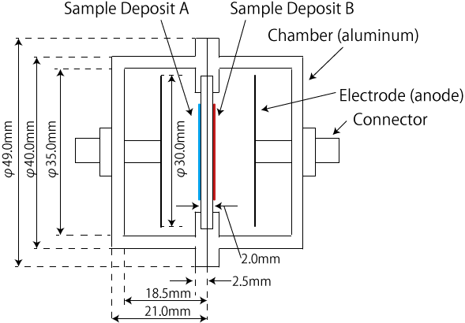
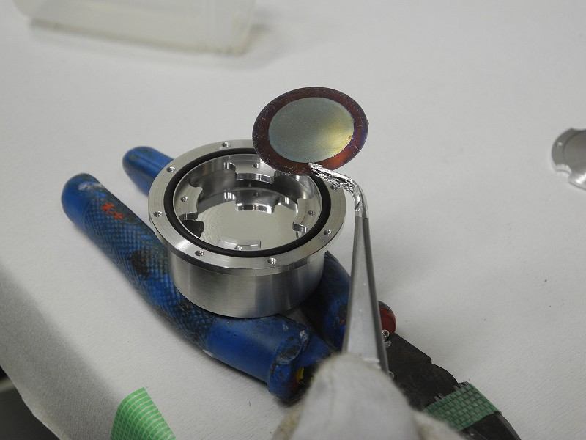
Issues in measurements
This is due to
α backgrounds from the sample.
The sample mass is severely limited (0.1 ~ 1 mg/cm²) for measurements of a fission chamber (FC).
Strict regulations on standard samples (²³⁵U, ²³⁹Pu).
Low statistics
Pu, HEU, ²³³U: Permission is required regardless of quantity (mass).
Only Kyoto University can (almost) be used in Japan (^{233,235}U) .
²⁴¹Am
²³⁵U
Back-to-Back (BTB) FC for fission rate ratio measurements.
Notes:
Fission cross sections are usually obtained by directly measuring fission events with a fission chamber.
However, strong alpha emissions from the sample often generate large background signals.
Ta target was placed inside a light‑water moderator of 170 mm diameter and 300 mm height. Moderated neutrons were guided to an experimental room at an angle of 135° relative to the electron‑beam direction.

Slide 5
Motivation
We develop a technique to precisely measure MA fission cross sections by detecting fast fission neutrons with recoil-proton neutron detectors (Eljen EJ-276D) as a collaborative study by JAEA, Science Tokyo and Kyoto University.
Purpose:
Target accuracy: ²⁴¹Am and ²⁴⁵Cm cross sections with 5 – 15% uncertainty.
Using a ²³⁵U sample at Kyoto University, We determine detector efficiency by combining an FC and the neutron detectors.
We present the preliminarily results of ²³⁵U fission cross sections to validate the developed detector system.
LINAC
1.Thick sample is available
2. Low background
3. Easy handling for U, MA
Eljen
EJ-276D
Electron
beams
²³⁵U
Fission
neutrons
neutron
FC
Collimator
Ta target +
Moderator
Experiment

Slide 6

Experimental facility
Measurements were performed at the Kyoto University, Institute for Integrated Radiation and Nuclear Science - Linear Accelerator (KURNS-LINAC)
Kansai International Airport
Kyoto University Research Reactor
Osaka
Japan
LINAC
Kyoto University Critical Assembly
Notes:
The experiment was conducted at Kyoto University.
Although the university is based in Kyoto, our research institute is located in Osaka.
This aerial photograph shows the facility.
The institute houses two research reactors: KUR and KUCA.
Having research reactors on site allows us to handle nuclear fuel materials, which is a major advantage in Japan.

Slide 7
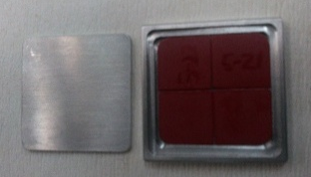
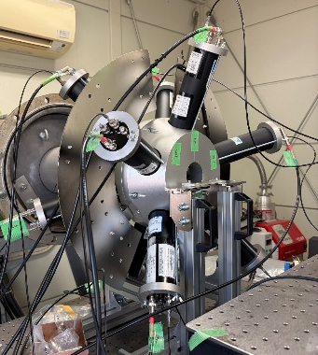
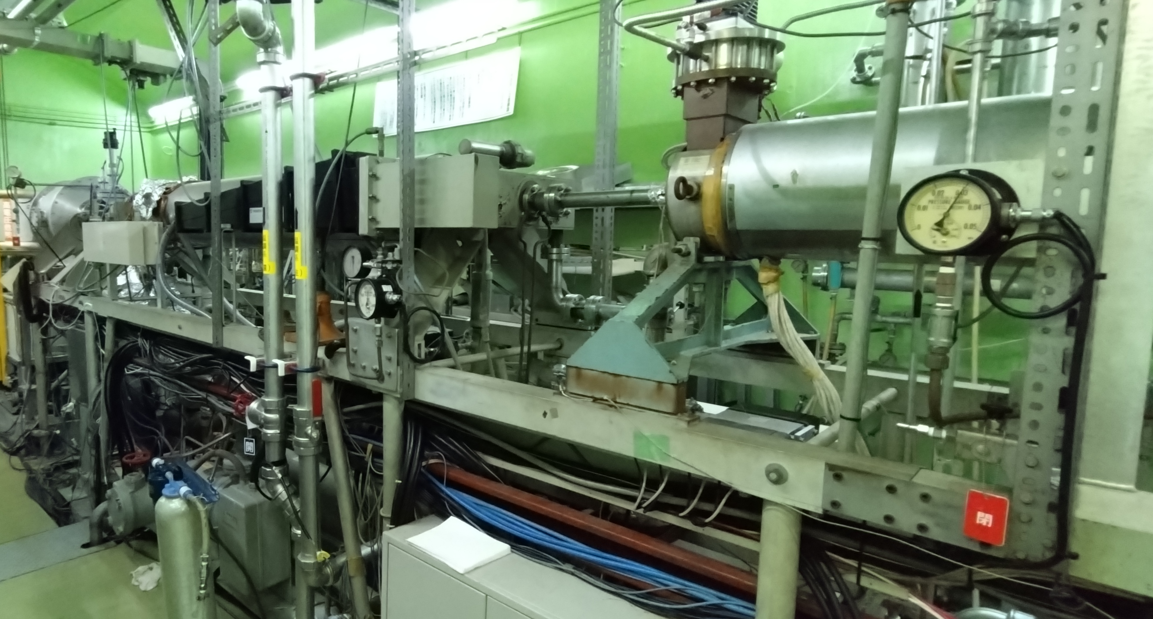
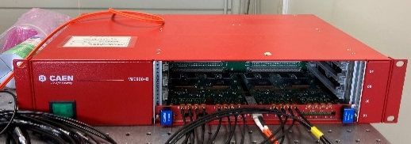
Experimental setup
97% ¹⁰B sample:
5.68x10⁻² a/b
²³⁵U sample (HU: 93%):
U₃O₈-Al alloy (½" x ½”)
Thickness：2.44x10⁻⁴ atoms/b
Dodecahedral
detector frame
LINAC
Conditions:30 MeV, 14.7 μA
Pulse width: 1 μs
Repetition: 50 Hz
EJ-276D det.
(2”x2”)
BGO det. X5 (2”x2”)
Electron Beams
Pb
Notch
Filters
Collimator
30 mmφ
γ
n
²³⁵U
γ
Ta target +
Moderator
Pb
Shadow bar
n
Borated Poly
48.5 mm
Detector signals were acquired with a CAEN
V1730S.
L = 11.25 m
Data analysis
Notes:
Pulsed electron beams were bombarded onto a water‑cooled tantalum (Ta) target.
Neutrons were produced via photonuclear reactions induced by bremsstrahlung photons.
To suppress gamma-ray backgrounds due to bremsstrahlung photons and the 2.223 MeV ¹H(n, g)²H neutron capture gamma‑rays from the moderator, a cylindrical lead shadow bar was installed. The neutron beam was collimated to a diameter of 30 mm.
Fission neutrons emitted from the sample were measured with five neutron detectors, and
Neutron capture gamma‑rays were detected using five BGO scintillation detectors. T
These detectors were mounted on a regular dodecahedral frame, providing an isotropic arrangement.
The distance from the center of the sample to the detector surface is 48.5 mm.
The U-235 sample was enriched to 93% in U-235.
Its chemical form is U[ _3 ]O[ _8 ] dispersed in metallic aluminum, with the surface coated by a radiation‑resistant resin.
The areal density of [ ^{235} ]U is [ 2.44 \times 10^{-4} ] atoms per barn.
And enriched boron -10 samples was used to determine incident neutron spectrum.

Slide 8
Data analysis
EJ-276D neutron detectors
BGO detectors
List data(TOF, PH, PSD)
List data(TOF, PH)
HU
HU+Filter
¹⁰B
Blank
Dead time correction
Dead time correction
Pulse Shape Discrimination (PSD)
Gating 478 keV gamma-rays
Background subtraction
Background subtraction
Neutron yields: Y
Neutron spectrum
Y/Φ
Normalization*
Correction
Φ
²³⁵U fission cross section
*Our final goal is to determine efficiency using a thin ²³⁵U sample with an FC, but here we used JENDL-5 for normalization.
Notes:
This slide shows the analysis procedure.
For the neutron detectors, we first apply dead‑time correction to the list‑mode data of TOF, pulse height, and PSD.
Next, gamma‑ray and neutron events are separated using PSD.
Once the neutron TOF spectrum is obtained, we subtract the background and derive the neutron yield.
For the BGO detector, the neutron‑energy distribution was determined from measurements using a boron sample.
After dead‑time correction, we gate on the 478‑keV peak to extract the TOF distribution and subtract the background.
The fission cross section is then obtained by normalizing the neutron yield with the neutron‑energy spectrum.

Slide 9
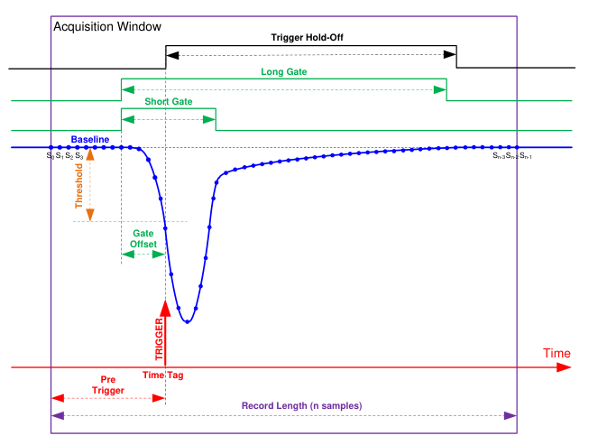
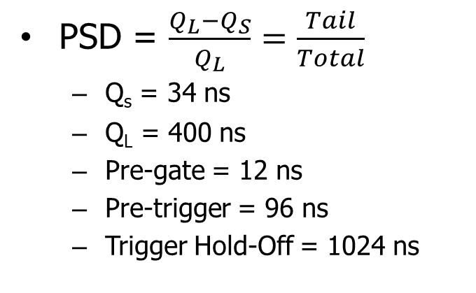
Pulse Shape Discrimination(PSD)
Neutrons: High-LET→ triplet state
Gammas: Low-LET→ singlet state
Neutron signals have longer decay times (13, 59, 460 ns) than gammas
(13, 35, 270 ns) [2].
Q_{L} and Q_{S} are obtained by long- and short-gate integration with the digitizer, and PSD is calculated as follows:
Tail
Fast
PSD = $\frac{Q_{L}−Q_{S}}{Q_{L}}=\frac{Tail}{Total}$
  Q_{s} = 34 ns
  Q_{L} = 400 ns
  Pre-gate = 12 ns
  Pre-trigger = 96 ns
  Trigger Hold-Off = 1024 ns
ｎ：PSD ～ 0.4
γ: PSD～ 0.25
：992 ns
Pulse shape and PSD parameters [1]
[1] CAEN V1730/V1730S Digitizer User Manual, Available from: https://www.caen.it/
[2] EJ-276D Pulse Shape Discrimination Plastic Scintillator,
Available from: https://eljentechnology.com/products/plastic-scintillators/ej-276
Notes:
Let me briefly explain the principle of PSD.
Neutron detection in organic scintillators is based on recoil protons.
Because protons have a high LET, they produce a larger fraction of triplet‑state excitations in the scintillator.
In contrast, gamma rays generate Compton electrons, which have a low LET and therefore create predominantly singlet‑state excitations.
As a result, neutron signals exhibit a longer decay component, whereas gamma‑ray signals decay much more quickly.

Slide 10
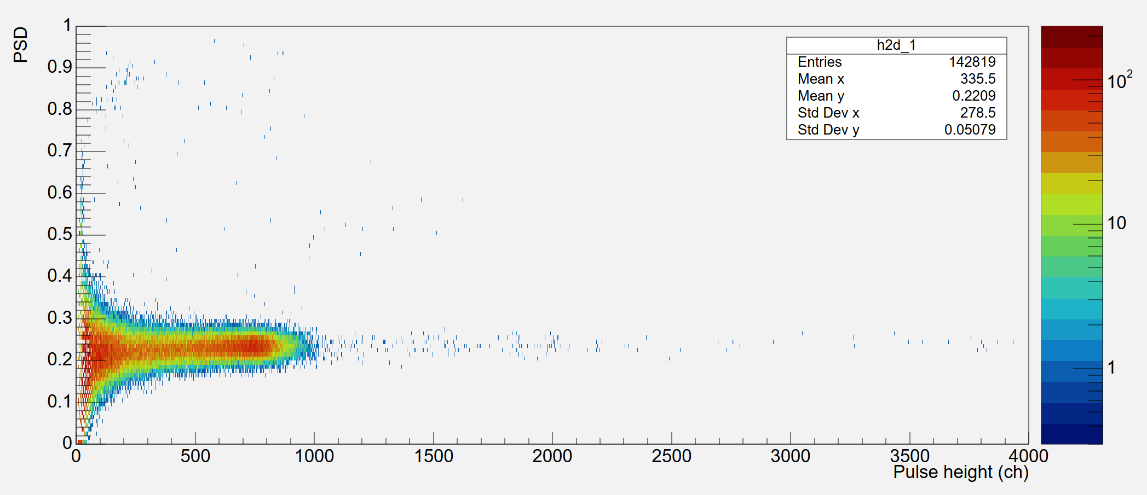
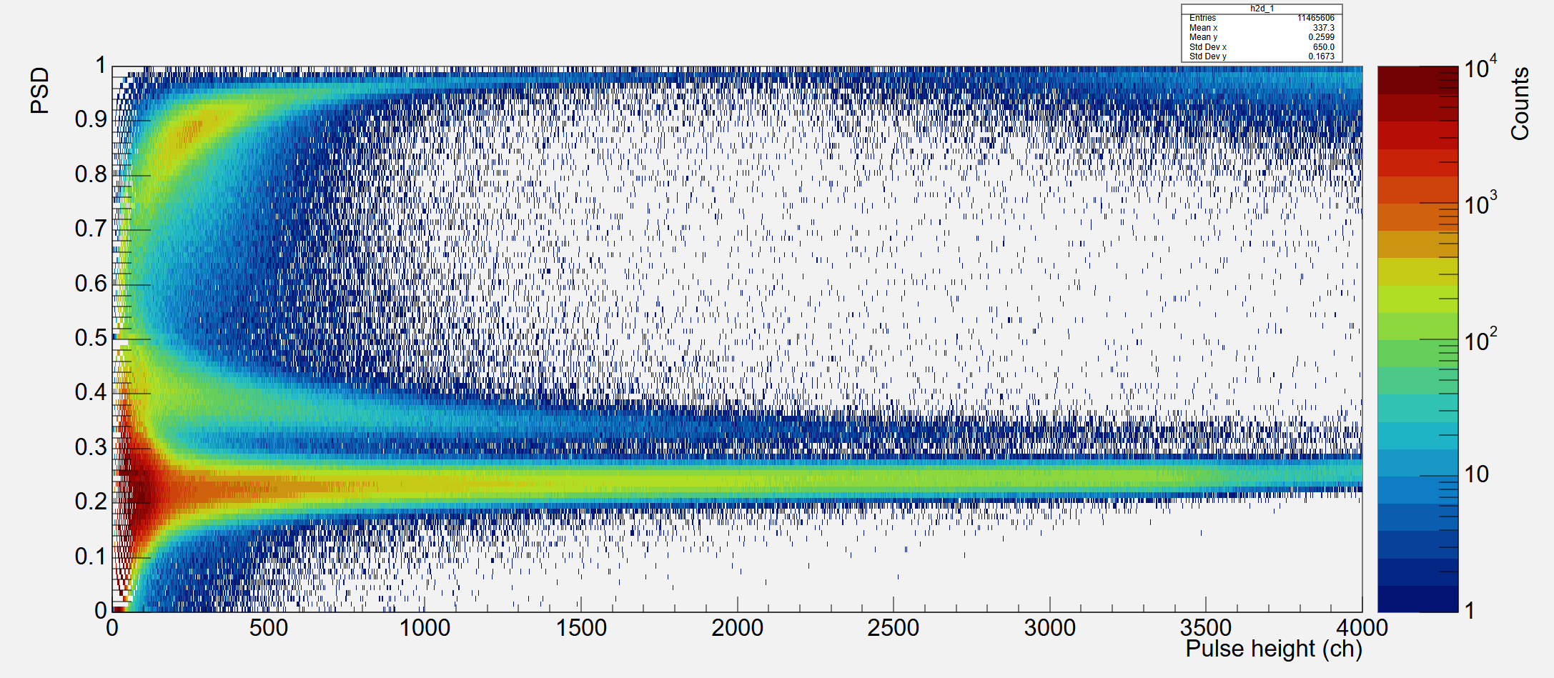
PH vs. PSD 2D distributions
¹³⁷Cs
2026年2月
¹³⁷Cs Compton edge was observed at about 850 ch.
PSD ~ 0.24.
EJ-276D light output
[MeVee]
Lp : 0.2~0.3 x E_{n}
Neutron detection threshold: ~0.5 MeV
Low sensitivity for scattered neutrons
¹³⁷Cs
478 keVee
²³⁵U
Neutron
Neutrons and gamma-rays were clearly separated
gamma-flash
Notes:
This figure shows the two‑dimensional distribution of pulse height and PSD.
It corresponds to the 662‑keV gamma rays from [ ^{137} ]Cs.
The Compton edge appears at around channel 850, and the PSD value is approximately 0.24.
This is the PH–PSD distribution for [ ^{235} ]U.
Neutron events form a clear band, and the gamma‑flash region is also visible.
The cluster in the upper‑left area corresponds to pile‑up events.
The light output of EJ‑276D follows this relationship, and the neutron threshold is about 0.5 MeV.
Therefore, the sensitivity to scattered neutrons is relatively low.

Slide 11
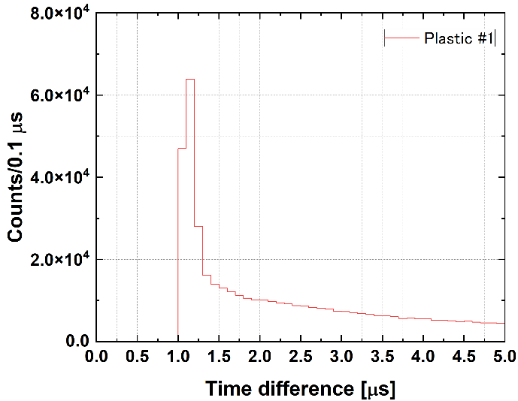
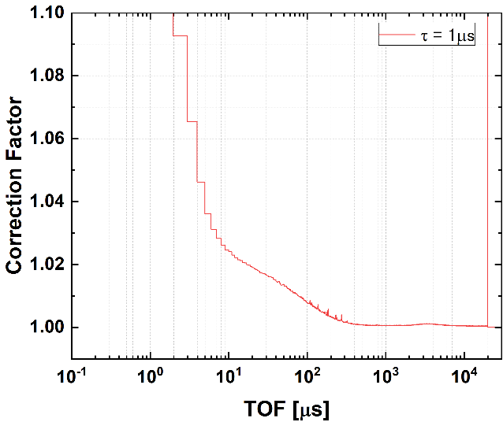

Dead time correction
Recorded
events
t
time
Time interval between each event
Dead time
⇒ 1 μs
：992 ns
Dead time correction
$$C\left(t\right)=\frac{1}{1−N\left(t−τ\right)}$$
C(𝑡)：correction factor
𝑁(𝑡)：TOF spectrum normalized by incident electron beam pulses
Notes:
Dead‑time correction was performed by analyzing the time intervals between signals.
From this distribution, the dead time for the present measurement was determined to be 1 µs, which originates from the trigger hold‑off setting.
The correction was applied assuming a non‑paralyzable model, and the overall impact of the correction was minor.

Slide 12
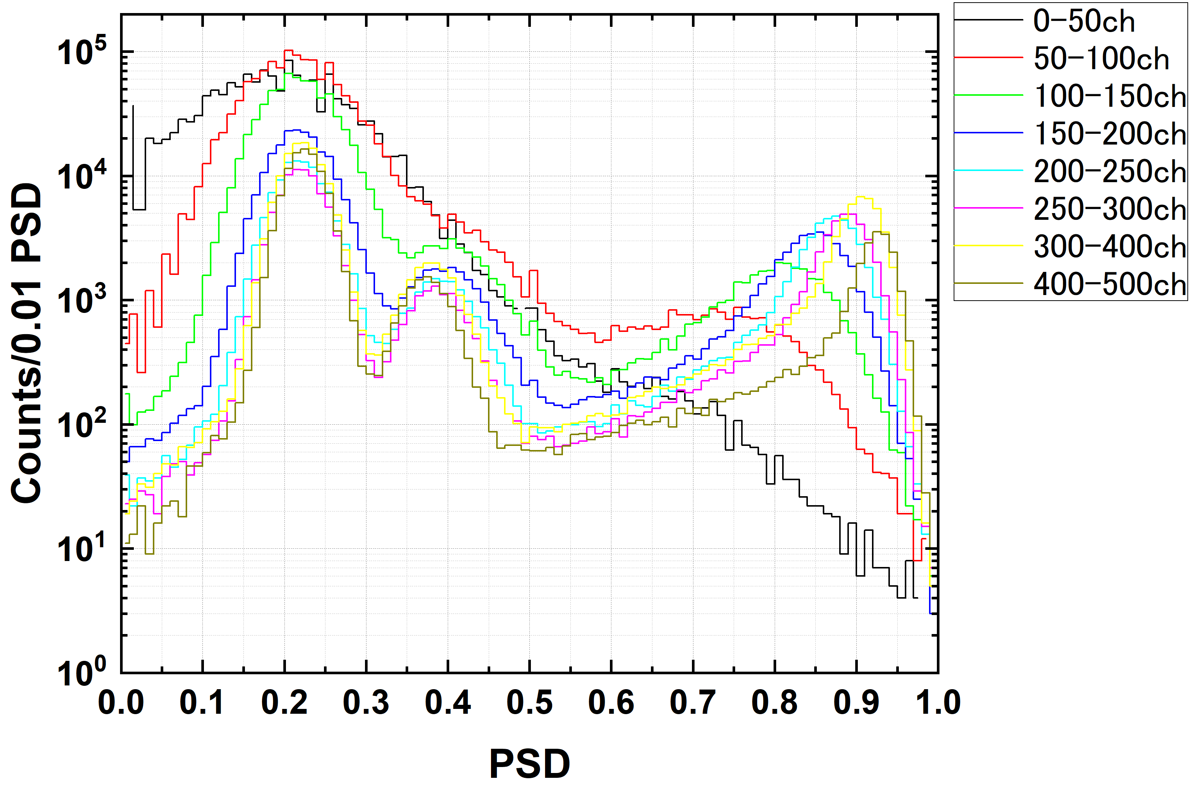
Setting the PH and PSD gate regions
By varying the LLD of the pulse height, PSD distribution was checked.
Above 200 ch. (0.11 MeVee) to separate neutron and gamma peaks.
PSD: 0.3 ~ 0.5, 200 < PH
Notes:
Next, we determined the PSD region while varying the LLD of the pulse height.
In the low‑PH region, the neutron and gamma peaks are not separated.
Above roughly 200 channels, corresponding to about 0.11 MeVee, the neutron and gamma peaks become clearly distinguishable.

Slide 13
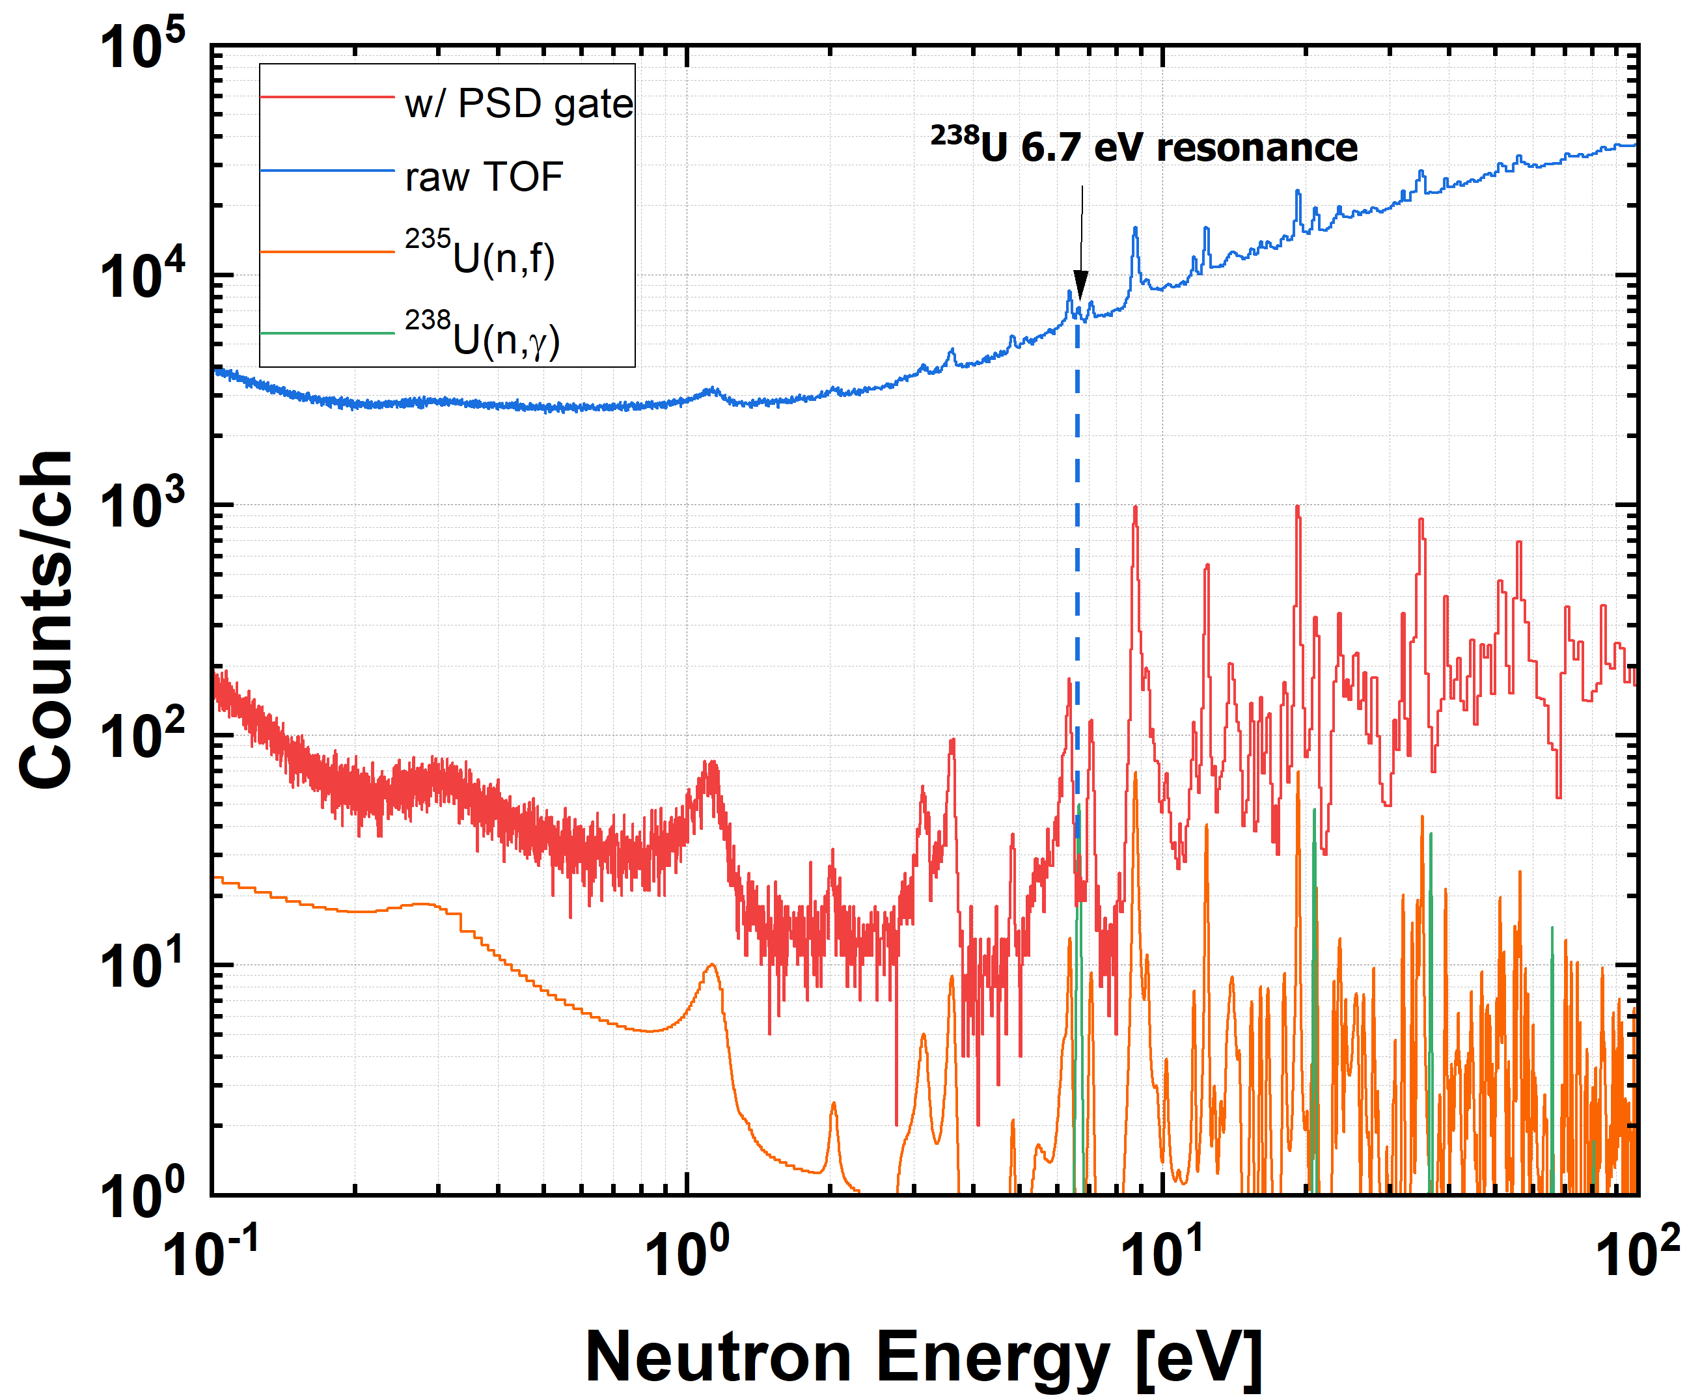
Spectra comparison before and after gating
The gamma-ray component originating from the 6.7 eV resonance of ²³⁸U has been removed.
Notes:
This slide compares the TOF spectra before and after applying the PSD gate.
The blue curve shows the raw TOF spectrum, where the signal‑to‑noise ratio is clearly poor.
After applying the PSD gate, we obtain the red spectrum.
The S/N improves dramatically, and the fission resonances become clearly visible.
The evaluated data from JENDL are also plotted.
The orange curve represents the [ ^{235} ]U fission cross section, and the green curve corresponds to the [ ^{238} ]U neutron‑capture cross section.
The 6.7‑eV resonance of [ ^{238} ]U is effectively removed by the PSD gating.

Slide 14
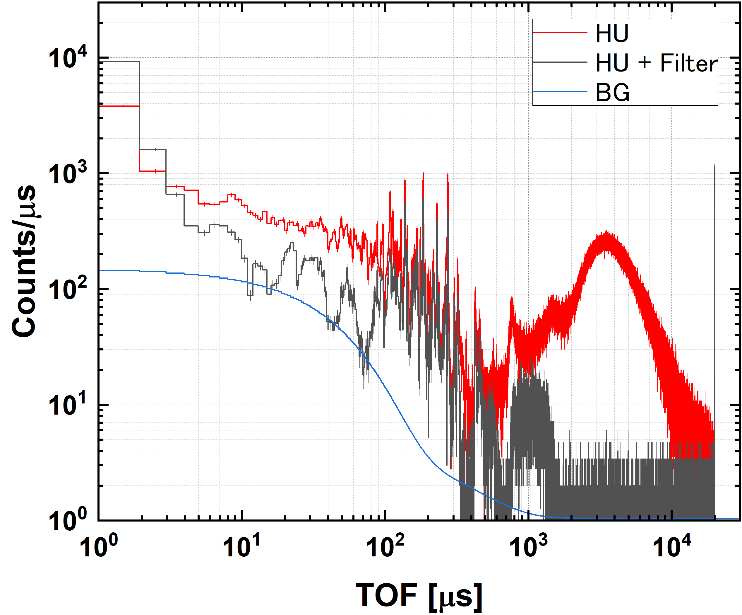
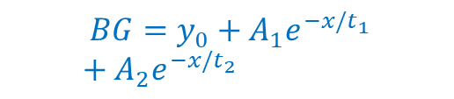
²³⁵U TOF spectra
HU: 6h
HU + Filter: 6h
Mn 341 eV
Ag 5.2 eV
Mn 2327 eV
In 1.46 eV
Co 132 eV
Spectra from four detectors were summed assuming independent events (one detector was excluded due to high noise).
Efficiency: 2~3%
Cd cut-off
$${BG=y}_{0}+A_{1}e^{−x/t_{1}}+A_{2}e^{−x/t_{2}}$$
The bottom of the resonance filter was fitted with a two-component exponential function to determine the background level.
Notes:
This is the TOF spectrum of [ ^{235} ]U
.
The HU measurement was performed for six hours, and the HU‑with‑filter measurement was also carried out for six hours.
The neutron notch‑filter measurement was used to determine the background level.
The dips caused by the resonances of Mn, In, Co, and Ag are clearly visible, and the bottoms of these dips indicate the background level.

Slide 15
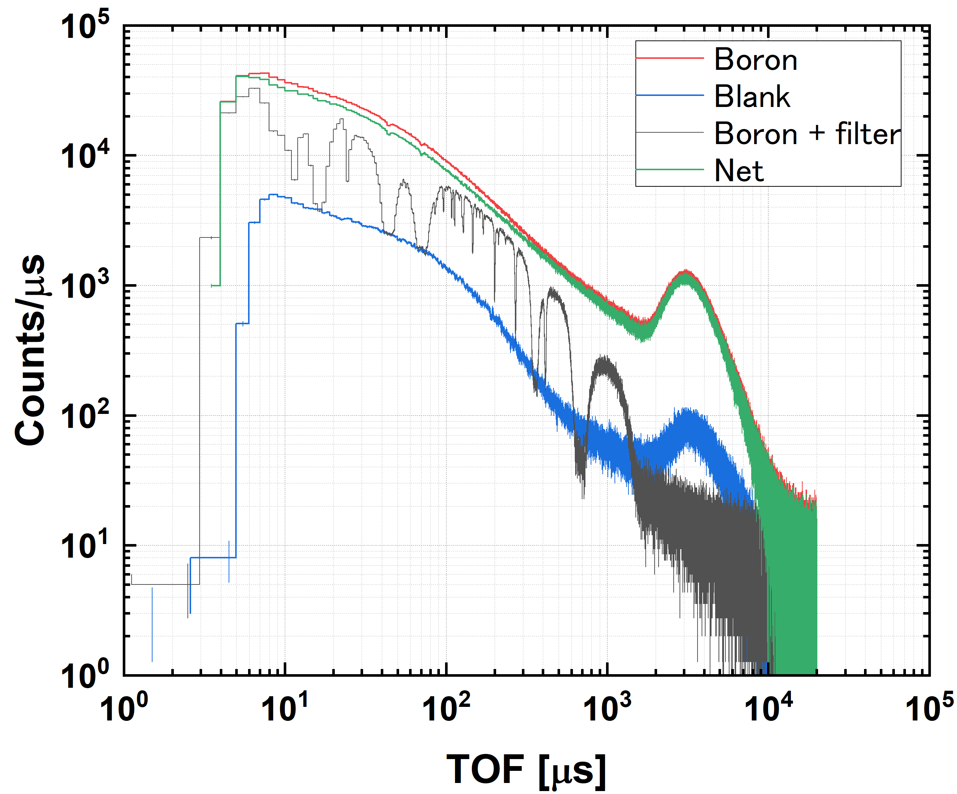
Measurements of the neutron spectrum
Incident neutron spectrum was determined by counting 478 keV gamma-rays via ¹⁰B(n,α) reactions with the BGO detectors.
The blank was subtracted as background from the 478 keV gated Boron TOF spectrum.
Cd cut-off
Mn 2327 eV
Mn 341 eV
Co 132 eV
Ag 5.2 eV
In 1.46 eV
Notes:
This figure shows the TOF spectrum obtained with the boron sample.
The red curve corresponds to the boron sample, the blue curve represents the blank measurement without the sample,
and the black curve shows the boron‑sample spectrum measured with the notch filter.
All spectra were gated on the 478‑keV peak.
The green curve is the net TOF spectrum after subtracting the background.

Slide 16
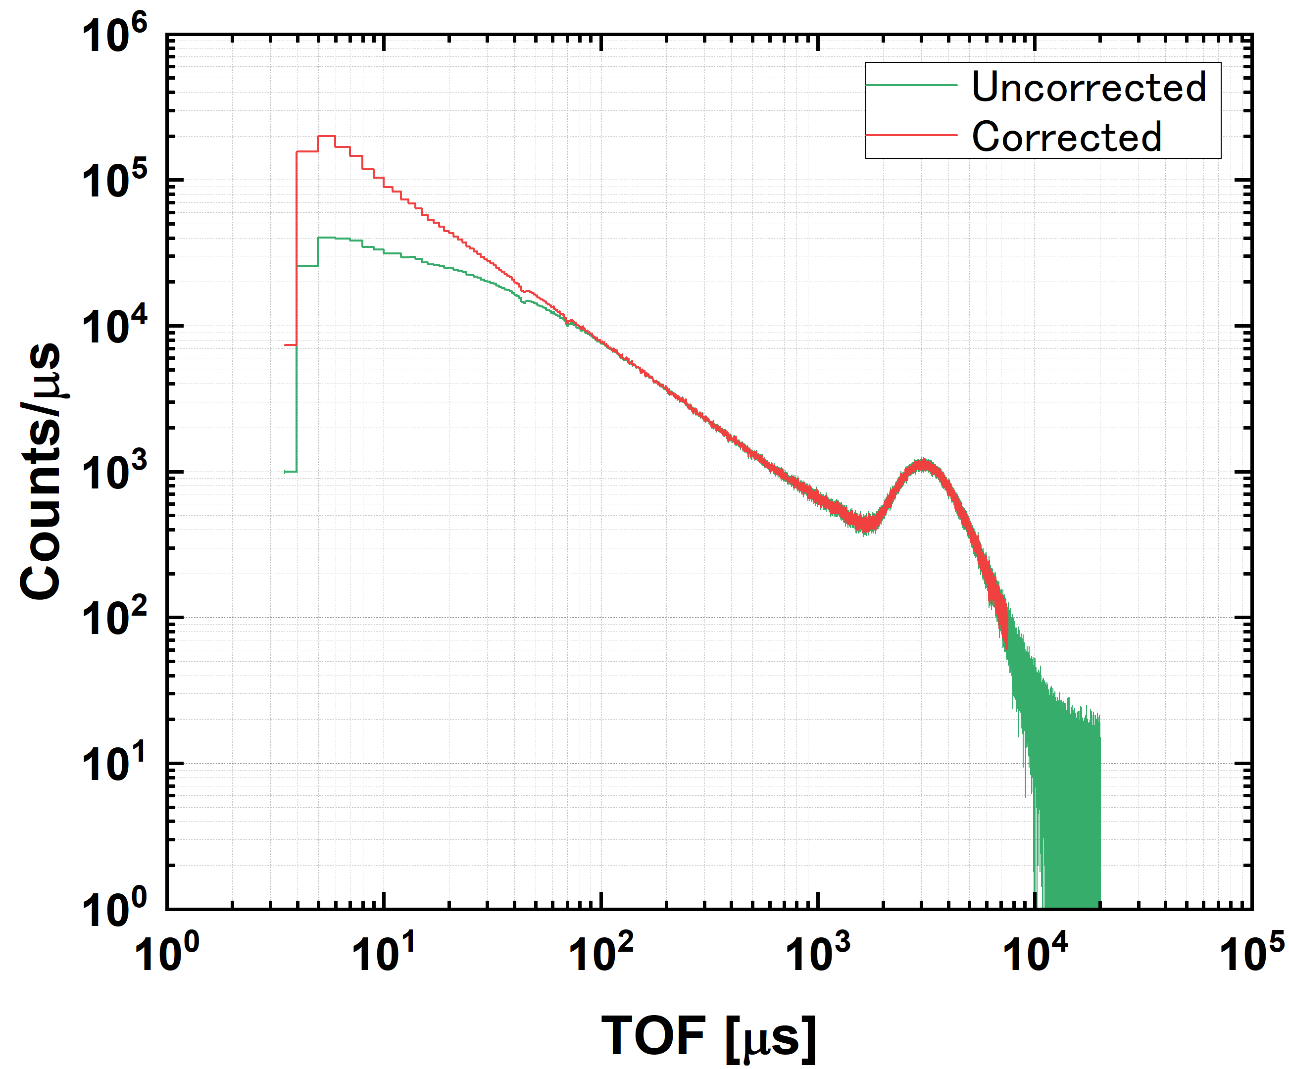


Self-absorption correction
t
$${φ_{0}}^{}$$
¹⁰B
$${φ_{0}e}^{−nσt}$$
n
fully absorbed
5.68x10⁻² atoms/b
Divided by the absorption ratio
Using a thick ¹⁰B sample, low-energy neutrons are fully absorbed, while high-energy neutrons are partially absorbed.
The absorption ratio was calculated with the PHITS code.
With the BGO efficiency, the incident neutron number is obtained.
Results
Notes:
Because a thick boron sample was used, we applied a correction for neutron absorption inside the sample.
Low‑energy neutrons are almost completely absorbed, whereas high‑energy neutrons are only partially absorbed.
The absorption fraction was determined by PHITS simulations, and the TOF spectrum was corrected by dividing by this absorption rate.

Slide 17
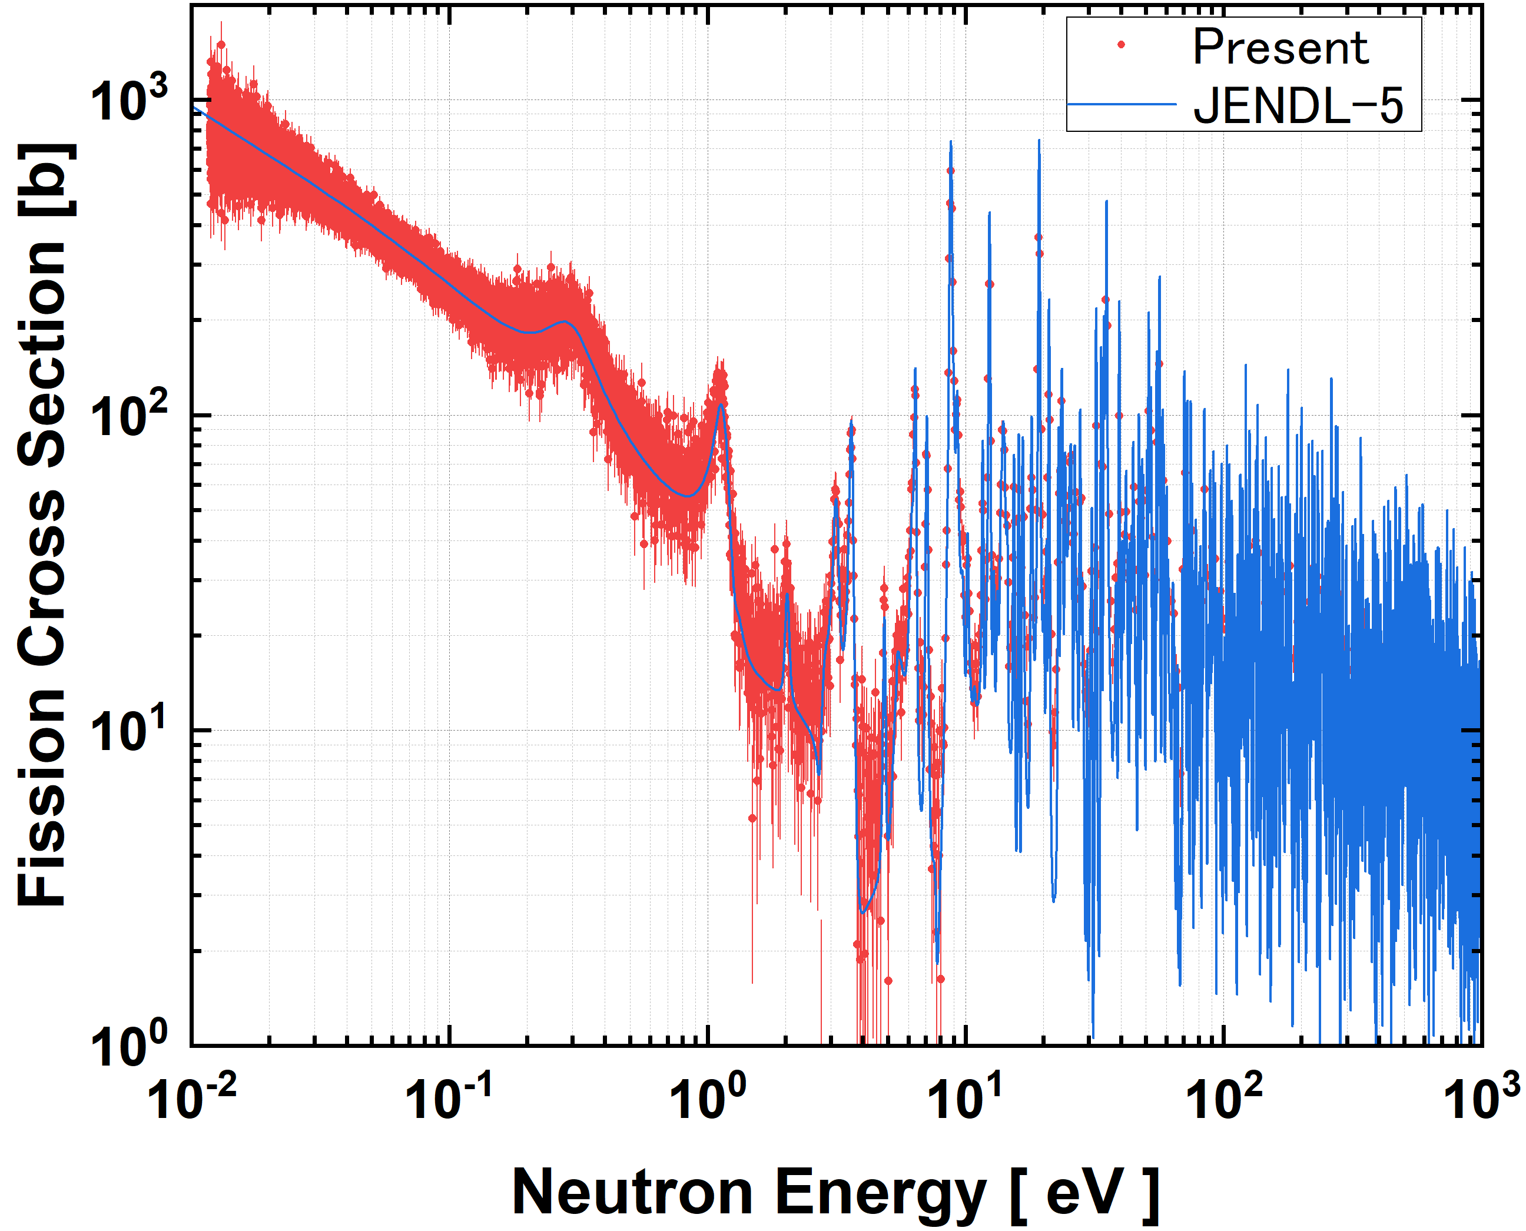
²³⁵U relative fission cross sections
²³⁵U data were normalized with JENDL-5 in the thermal region
Notes:
This is the obtained [ ^{235} ]U fission cross section.
In this analysis, the spectrum was normalized to the thermal region of JENDL‑5.
The blue curve shows the JENDL evaluated data, and the red points represent our present results.
As you can see, even the small resonances below 2 eV in [ ^{235} ]U are clearly observed.

Slide 18
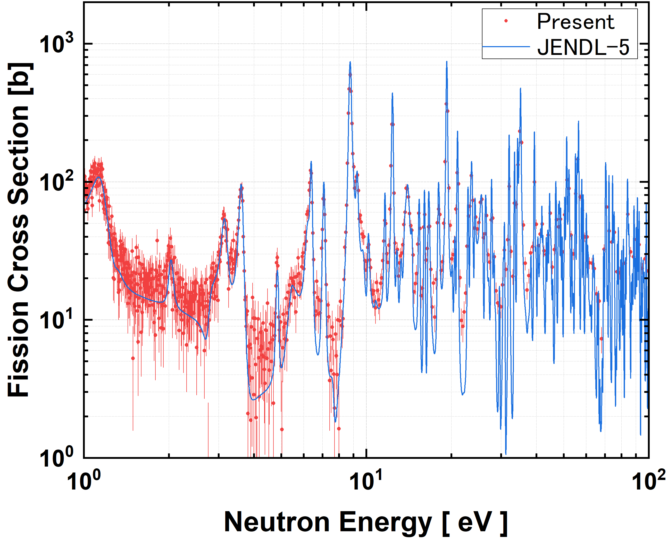
²³⁵U relative fission cross sections
Up to around 10 eV, the data drop to the bottoms of resonance dips, suggesting that PSD gate and the background subtraction is reasonable.
Gamma contamination in nγ discrimination using PSD has not yet been corrected, and some γ contamination is expected.
Gamma attenuation by the notch filters leads to a slight underestimation of the background.
Notes:
This figure shows an expanded view of the region from 1 eV to 100 eV.
Up to around 10 eV, the cross section decreases properly down to the bottoms of the resonance valleys,
Indicating that the background subtraction and the PSD settings were reasonable.
In contrast, at higher energies the valleys do not fall completely
We consider the following factors as possible reasons for this behavior.

Slide 19
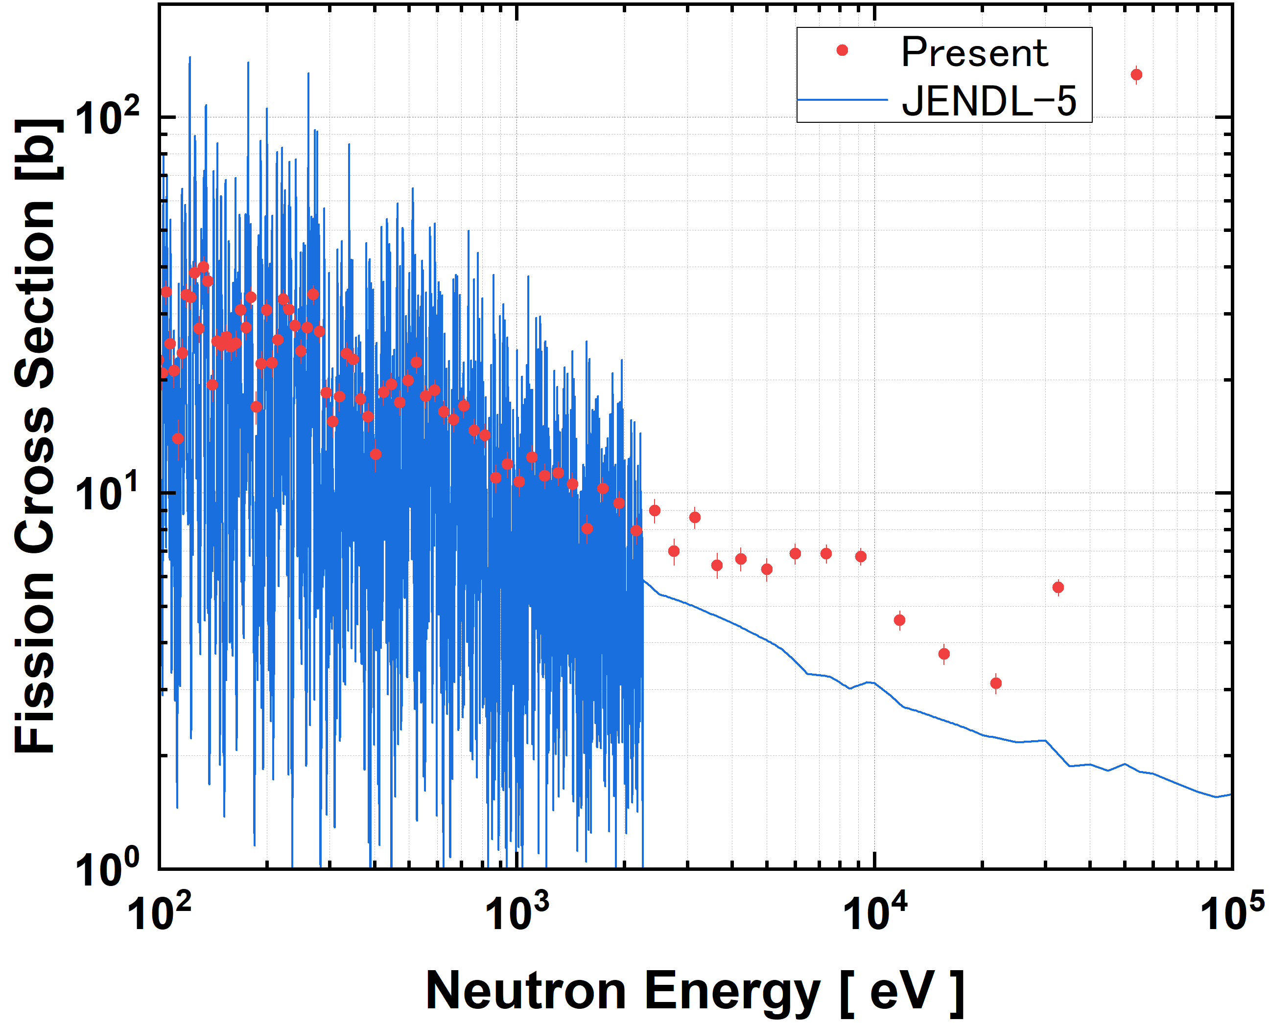
²³⁵U relative fission cross sections
Overestimate ~ 50%

Slide 20
Summary
In this study, we develop a method to precisely measure fission cross sections using recoil-proton neutron detectors, aiming to obtain ²⁴¹Am and ²⁴⁵Cm cross sections with 5 to 15% accuracy from the thermal to several hundred keV.
Measurements of fission cross sections for ²³⁵U were performed at the KURNS-LINAC to validate the developed detector system.
Neutron and gamma-ray signals were clearly separated with the PSD.
²³⁵U fission cross sections were obtained from the thermal to epithermal.
Taking advantage of the well-known ²³⁵U cross sections , we plan to determine the detection efficiency of the system by combining a FC and the neutron detectors.
We also attempt to derive the prompt neutron multiplicity and prompt neutron spectrum along with the cross sections.
Future plan:
Notes:
Finally, let me summarize this presentation.

Slide 21
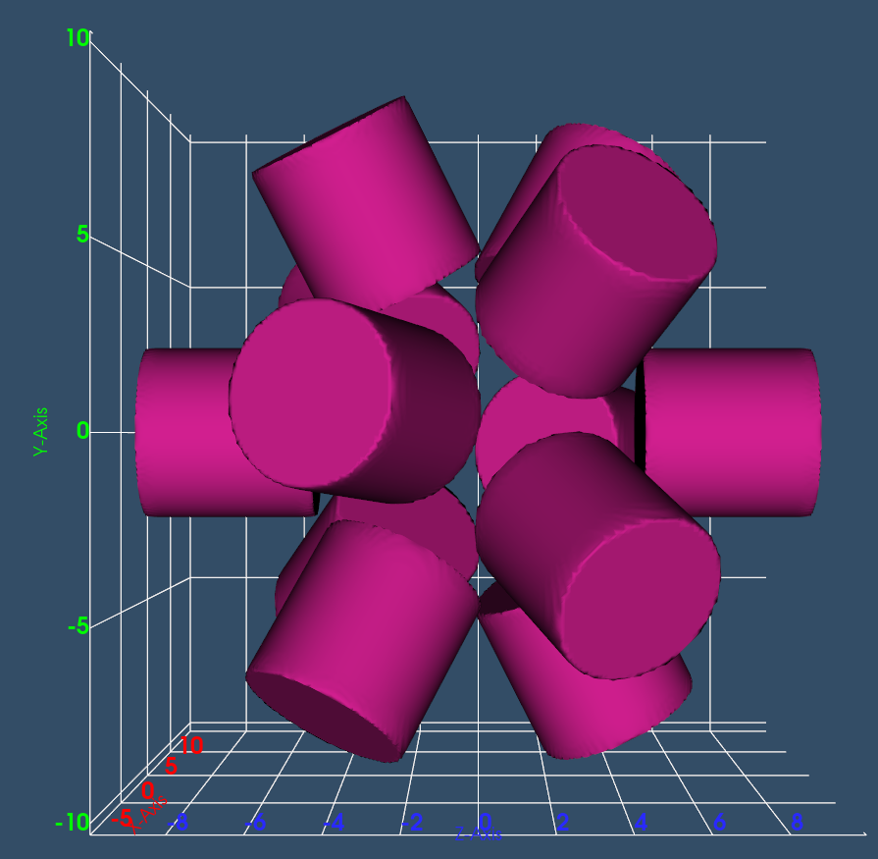
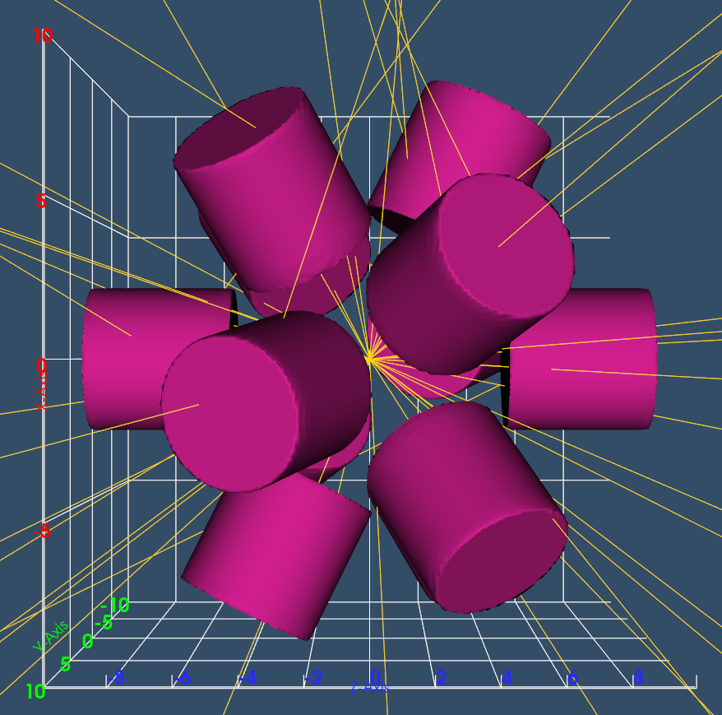
Detection efficiency
EJ-276D
Neutron tracking data
Each detector covers 5.71% of the solid angle, totaling 57% for 10 detectors.
PHITS simulation gives a detection efficiency of 1.68(2)% for 2 MeV monoenergetic neutrons.

Slide 22
