Slide 1

Uncertainty propagation of nuclear data: how and what for?
WONDER-2026 : 7th edition of the International Workshop On Nuclear Data Evaluation for Reactor Applications
June 29-July 3, 2026
Aix-en-Provence, France
Prof. Oscar Cabellos
oscar.cabellos@upm.es
Technical University of Madrid
1

Slide 2
Contents
The Speaker
Introduction and Motivation
The ND Life Cycle
The ND Covariances
Propagation of ND uncertainties
Examples of UQ-ND
Conclusion
courtesy by A.Plompen (ND2025)
2

Slide 3

1. The Speaker
I am Oscar Cabellos, full professor in nuclear engineering at the Polytechnic University of Madrid (UPM)
I am coordinator of UPM courses on “Introduction on Nuclear Technology”, “Simulation of Nuclear Power Plants” and “Design and Simulation of PWRs” which is one of the UPM coursed based on the CDIO (Conceive, Design, Implement and Operate) initiative
My background is reactor physicist, specifically in PWR (Pressure Water Reactors) simulations where I did my PhD in 1998
Since 2005 I have been involved in EU projects working on nuclear data activities: EUROTRANS (2005-2010), ANDES(2010-2013), CHANDA(2013-2018), SANDA (2019-2023), APRENDE (2024-2028)
In 2014-2017, I moved to OECD/Nuclear Energy Agency (NEA)/Data Bank as Nuclear Data Scientist working in the development of EXFOR and JEFF databases, and JANIS and NDaST web-tools
Currently, I am actively working in the JEFF (Joint Evaluation Fission and Fusion) project and WPEC (Working Party on International Nuclear Data Evaluation and Cooperation) activities of the OECD/NEA
Member of the JEFF-Coordination Group, WPEC (co-coordinator WPEC/SG46 and monitor of WPEC/SG47) , WPNCS (Working Party on Nuclear Criticality and Safety) and IAEA/INDEN Network
Member of the OECD/NEA/NSC – (Nuclear Science Committee) and OECD/NEA/MBDAV – (Management Board for the Development, Application and Validation of Nuclear Data and Codes)
Member of the IAEA - International Nuclear Data Committee (INDC)
Oscar Cabellos (UPM)
oscar.cabellos@upm.es
3

Slide 4
2. Introduction and Motivation
Motivation: The objective of this talk is not only to review methods for nuclear-data uncertainty propagation, but also to discuss why we do it, what information we need, and how the results can be used by evaluators, reactor physicists and end-users.
Focus on the role of covariance data, quality and consistency, and use in applications such as benchmark uncertainty quantification (UQ), nuclear-data adjustment (NDA) and target accuracy requirements (TAR).
Why do we propagate nuclear-data uncertainties?
  Nuclear simulations support decisions in reactor design, safety analysis and fuel-cycle applications. However, a calculated value is not enough.
  We need to know:
  How reliable is the prediction?
  Which nuclear data dominate the uncertainty?
  Are current covariances credible for the application?
  Can integral experiments reduce uncertainties consistently?
  What new measurements or evaluations are really needed?
  Uncertainty propagation connects evaluated nuclear data with application needs
Evaluated nuclear data → Covariances → Processing → Application calculation → Uncertainty / priorities
From data uncertainty to decision support
4

Slide 5
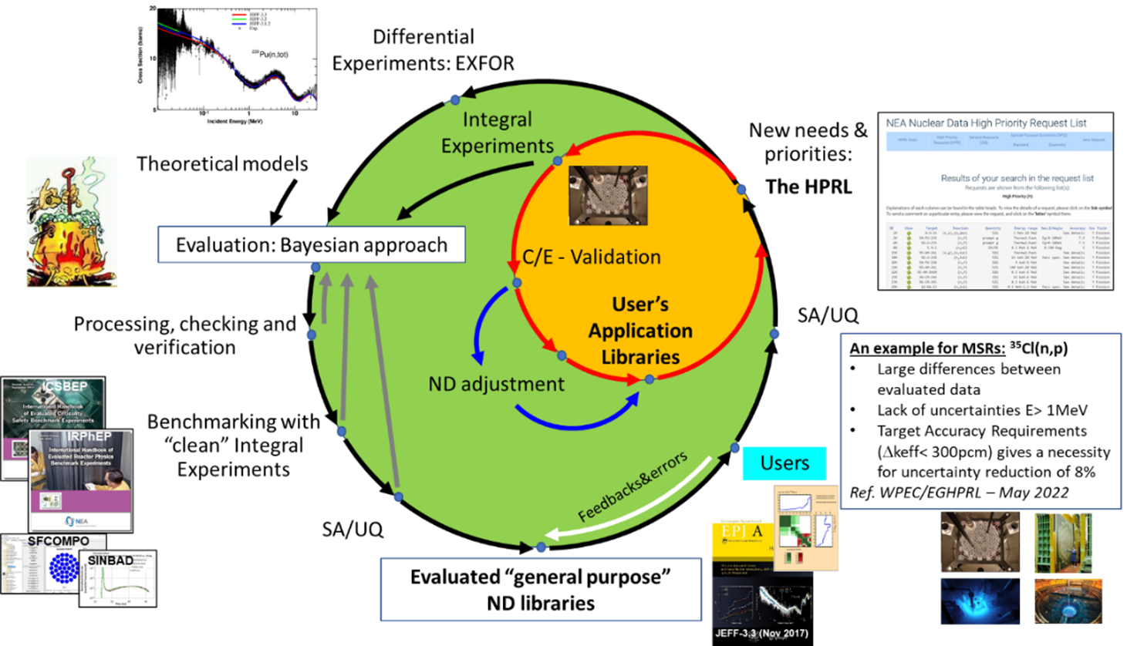
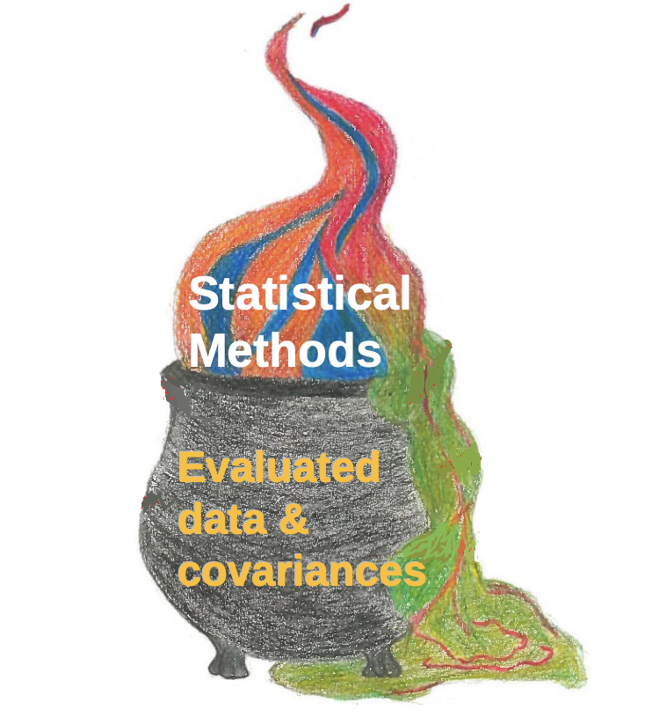
3. Nuclear Data Life Cycle
Figure 1. An example of “nuclear data life cycle”
Evaluated data & covariances
Evaluated nuclear data and covariances are not the end of the process.
They are used in:
processing and application libraries
validation against integral experiments
uncertainty propagation in user applications
nuclear data adjustment and assimilation
identification of new experimental and evaluation needs
ND-UQ is the quantitative link between evaluated data, applications and feedback
Feedbacks & nuclear data needs / HPRL
C/E validation + ND adjustment
5

Slide 6
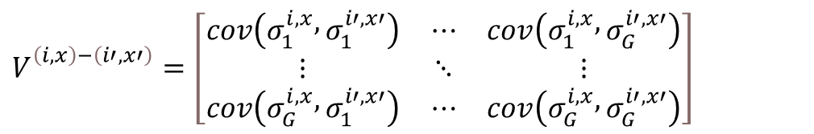
4. What is inside a covariance matrix?
A covariance matrix contains more than standard deviations. It provides variances and correlations between nuclear-data quantities across materials, reactions and energy groups.:
$$V_{}^{\left(i,x\right)−\left(i′,x′\right)}=\left[\begin{matrix}cov\left(σ_{1}^{i,x} , σ_{1}^{i′,x′}\right) & ⋯ & cov\left(σ_{1}^{i,x} , σ_{G}^{i′,x′}\right) \\ ⋮ & ⋱ & ⋮ \\ cov\left(σ_{G}^{i,x} , σ_{1}^{i′,x′}\right) & ⋯ & cov\left(σ_{G}^{i,x} , σ_{G}^{i′,x′}\right)\end{matrix}\right]$$
The covariance data included in ENDF-6 format is allocated under the following files:
MF31: covariance of average number of neutrons per fission
MF32: covariance of resonance parameters
MF33: covariance of neutron cross sections
MF34: covariance of angular distributions of secondary neutrons
MF35: covariance of energy distributions of secondary neutrons
MF40: covariance of radionuclide production
where:
i-material and i’- material
x-nuclear reaction and x’-nuclear reaction
g-energy group and g’ energy group
Thus, covariance matrices include information about:
  Energy co-variance based on physics, systematic experimental uncertainties and/or random exp. uncertainties
  Channel reaction covariance combining/subtracting two reactions to obtain other reaction
  Element/material covariance when data is measured as ratio to different materials
ENDF files provide mean values and covariance information; probability distributions are not explicitly provided
6

Slide 7
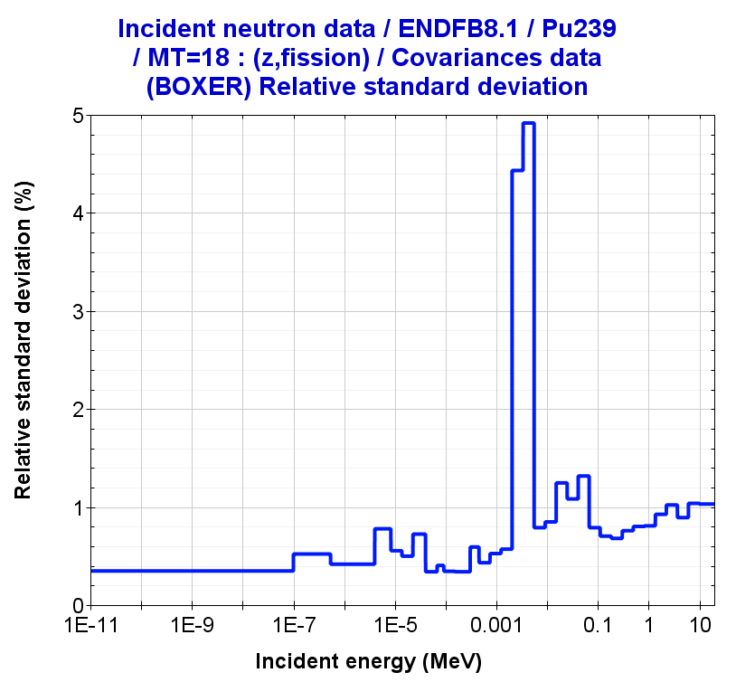
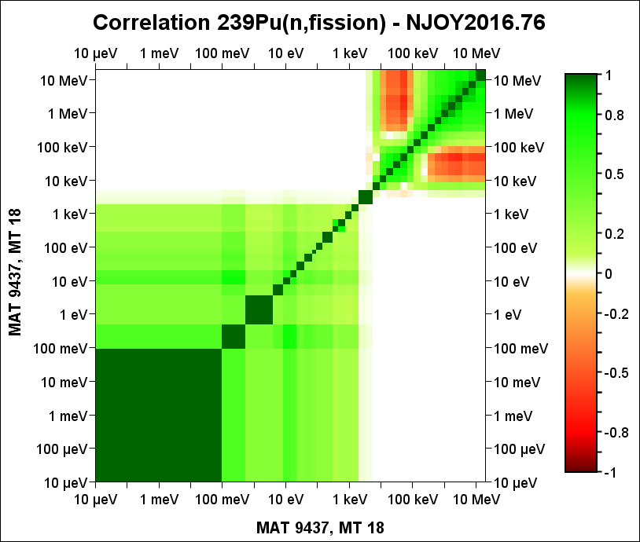
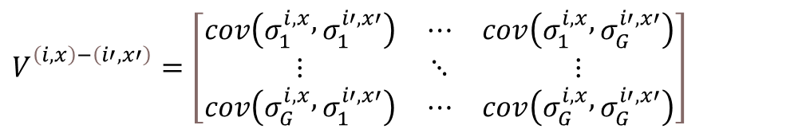
4. What is inside a covariance matrix?
Figure 2. Covariance matrix for the 239Pu(n,fission) - ENDF/B-VIII.1
Diagonal terms → individual uncertainties, e.g. standard deviations
Off-diagonal terms → correlations: how uncertainties move together
$$V_{}^{\left(i,x\right)−\left(i′,x′\right)}=\left[\begin{matrix}cov\left(σ_{1}^{i,x} , σ_{1}^{i′,x′}\right) & ⋯ & cov\left(σ_{1}^{i,x} , σ_{G}^{i′,x′}\right) \\ ⋮ & ⋱ & ⋮ \\ cov\left(σ_{G}^{i,x} , σ_{1}^{i′,x′}\right) & ⋯ & cov\left(σ_{G}^{i,x} , σ_{G}^{i′,x′}\right)\end{matrix}\right]$$
A covariance matrix is not simply a collection of error bars
  The diagonal terms quantify the uncertainty of each nuclear-data quantity, but the off-diagonal terms are equally important because they describe the relationships between data.
These relationships may come from experimental normalization, nuclear-reaction models, evaluation constraints, sum rules, conservation equations… or feedback from integral experiments
Two covariance evaluations with similar standard deviations may lead to different propagated uncertainties if their correlations are different.
“If the diagonal of a covariance matrix is a measure of our ignorance, the off-diagonal elements are a measure of our wisdom.” by M. Herman (2017)
7

Slide 8
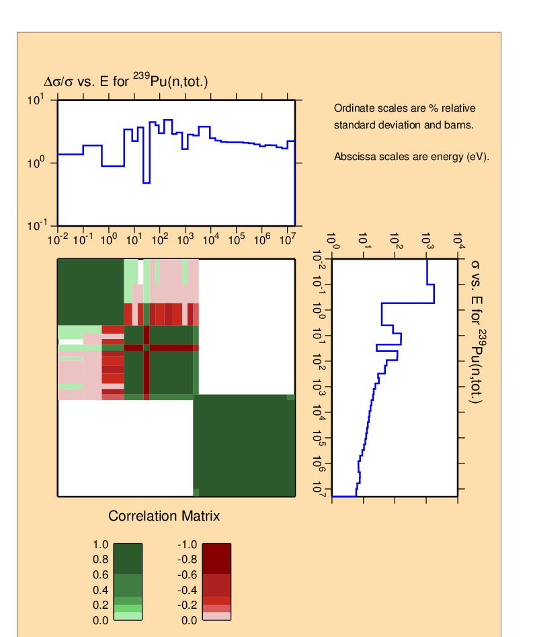
What is inside a covariance matrix?
Figure 3. Covariance matrix for the 239Pu(n,total) - ENDF/B-VIII.0 evaluation processed with NJOY2016.69 in 33 energy groups of energy.
Where do covariances come from?
experimental uncertainties and normalization factors
correlations between measured data points
nuclear-reaction model parameters
Bayesian evaluation procedures
conservation constraints and sum rules
validation feedback from integral experiments
A covariance matrix should therefore preserve the statistical and physics memory of the evaluation process.
What makes covariance data useful? For uncertainty propagation, covariance data should be:
  mathematically sound: positive definite or positive semi-definite
  complete: not only cross sections, but also nu-bar, PFNS/χ, angular distributions, fission yields, decay data and TSLs
  consistent: mean values and covariances should reflect the same evaluation information
  traceable: the origin of uncertainties and correlations should be documented
  application-aware: covariance data should be tested in representative benchmarks
8

Slide 9
4.1 Covariances beyond cross sections?
In many UQ studies, “nuclear-data covariances” are often understood as cross-section covariances. However, application responses may also depend on:
  neutron multiplicities (nu-bar) - MF31
  prompt fission neutron spectra (PFNS) – MF35
  angular distributions – MF34
  TSLs
  fission yields
  decay data
  …
A complete uncertainty propagation requires covariance data for all nuclear-data quantities to which the application is sensitive
Examples: “The relevant covariance data are application-dependent”
  Small Fast critical systems
  Angular distributions affect neutron leakage and spectrum
  LWRs
  TSLs – H in H2O
  Fission Pulse Decay Heat calculations
  Fission yields, decay data
  Fission Yield correlations can strongly reduce or reshape propagated uncertainties
9

Slide 10
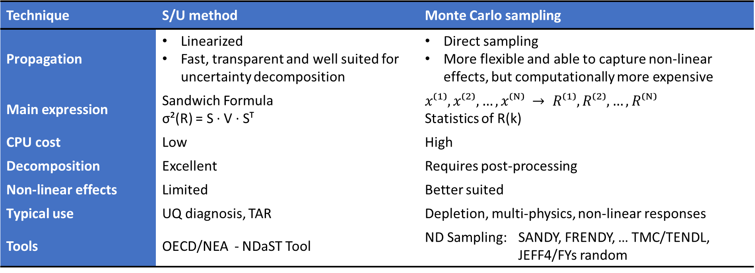
5. How do we propagate nuclear-data uncertainties?
Two complementary approaches are commonly used:
Technique | S/U method | Monte Carlo sampling
Propagation | Linearized Fast, transparent and well suited for uncertainty decomposition | Direct sampling More flexible and able to capture non-linear effects, but computationally more expensive
Main expression | Sandwich Formula σ²(R) = S · V · Sᵀ | $$x⁽¹⁾, x⁽²⁾, …, x⁽ᴺ⁾ → R⁽¹⁾, R⁽²⁾, …, R⁽ᴺ⁾$$ Statistics of R(k)
CPU cost | Low | High
Decomposition | Excellent | Requires post-processing
Non-linear effects | Limited | Better suited
Typical use | UQ diagnosis, TAR | Depletion, multi-physics, non-linear responses
Tools | OECD/NEA - NDaST Tool | ND Sampling: SANDY, FRENDY, … TMC/TENDL, JEFF4/FYs random
Both methods rely on the quality and consistency of the input covariance information
10

Slide 11
5. How do we propagate nuclear-data uncertainties?
Bias and nuclear data uncertainties in HEU-MET-FAST-001 Benchmark (Godiva)
 | JEFF-3.3 |  | ENDF/B-VIII.0
Exp. Uncertainty | ±100 |  | ±100
|C-E| | 16 |  | 6
 | NDaST | SANDY | NDaST
Nubar | 510 | 503 | 400
PFNS | 364 | 216* | 124
Fission | 648 | 643 | 788
Elastic | 109 | - | 276
Inelastic | 698 | - | 244
Capture | 375 | - | 281
Correlated Sum | 1342 | 1262 | 1036
* Differences in PFNS covariance for UQ using SANDY and NDaST
Note: (values in pcm)
NDAST – sandwich formula
Monte Carlo sampling using SANDY with 300 random samples
Both methods rely on the quality and consistency of the input covariance information
11

Slide 12
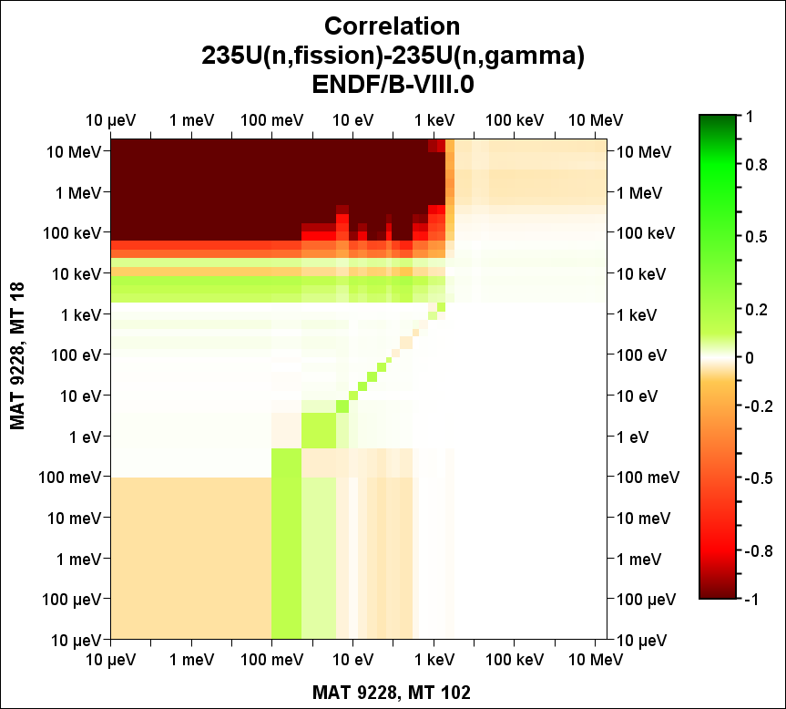
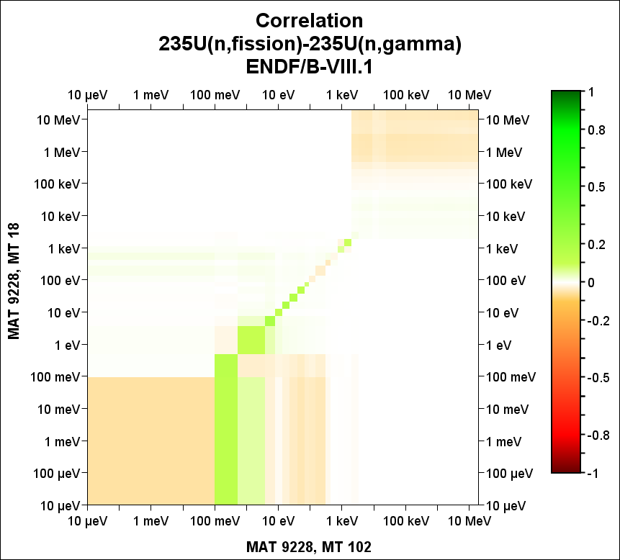
5.1 Processing and Q&A of covariances
Typical workflow:
→ covariance processing
→ multigroup representation
→ consistency checks
→ uncertainty propagation
Key Q&A checks:
covariance blocks are available and readable
missing covariance blocks or incomplete reaction-channel
energy-group collapse is consistent
correlations remain within physical limits
covariance matrices are positive semi-definite
processed data are compatible with S/U or sampling tools
uncertainty contributions are reasonable in benchmark applications
Covariance data must be usable, not only available.
Q&A is not only a numerical check: it is a physics check !
Figure 4. Processing 235U(n,f) - 235U(n,γ) ENDF/B-VIII.0 vs VIII.1
ENDF/B-VIII.0
ENDF/B-VIII.1
12

Slide 13
5.1 Processing and Q&A of covariances
Q&A checks in JEFDOC-2421, April 2025
Processing issues of 16O/ENDF/B-VIII.1 using NJOY2016
Consistency ENDF format in JEFF-4.0: MF2 vs MF32 ?
13

Slide 14
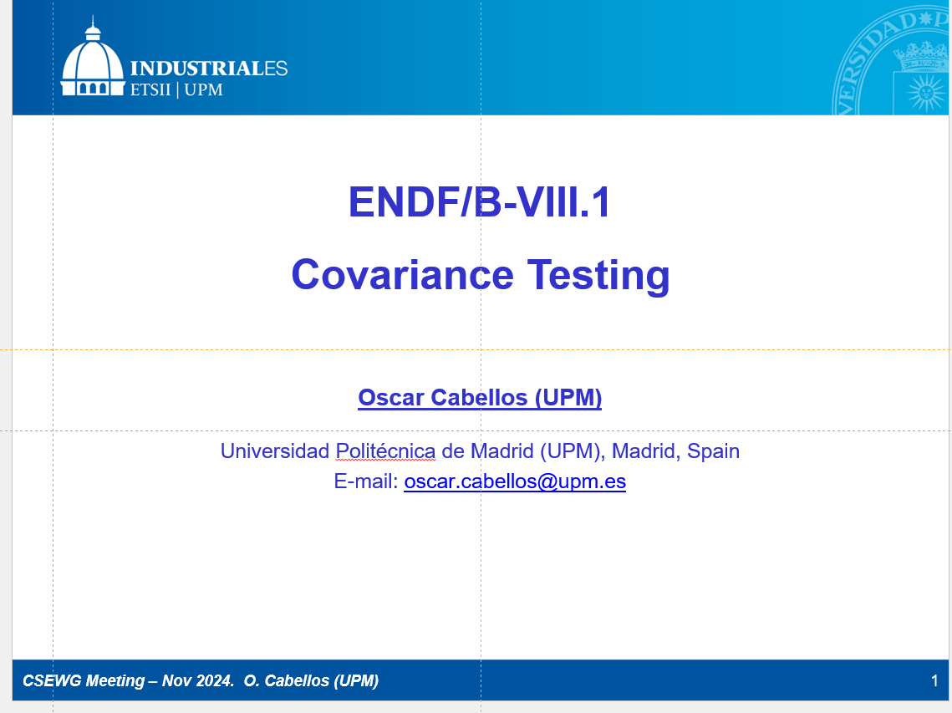
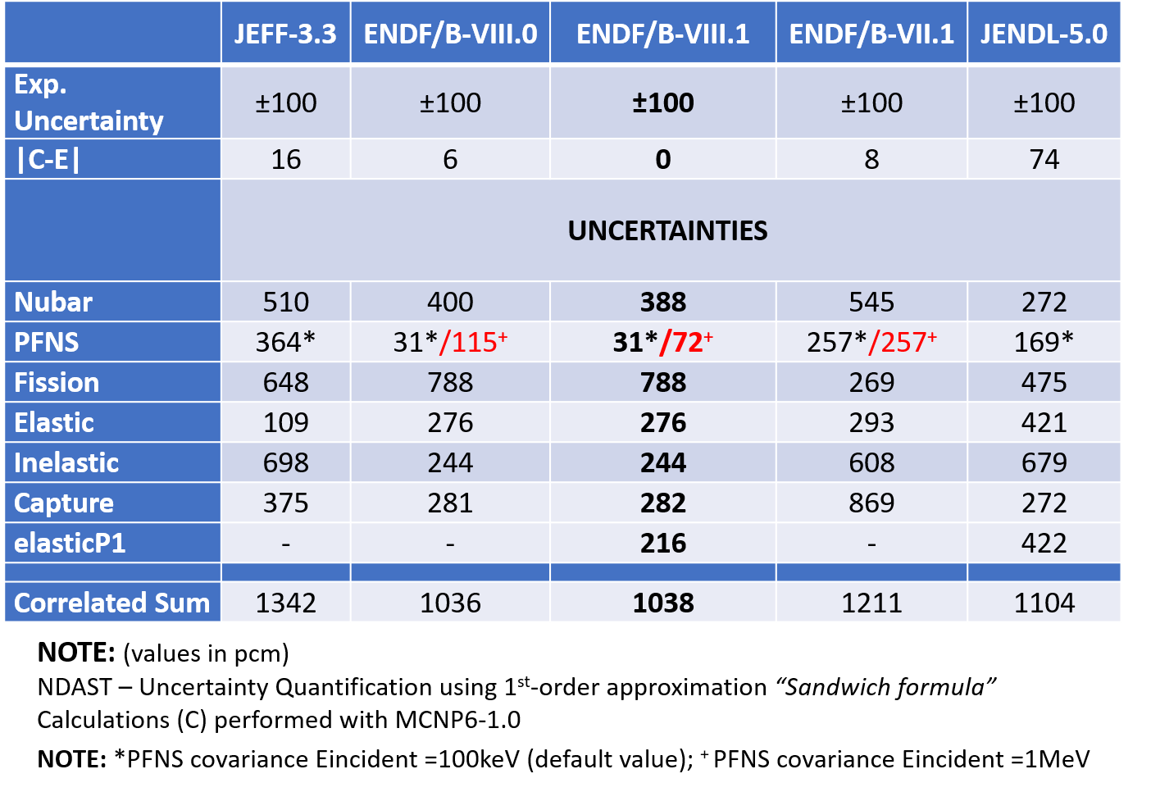
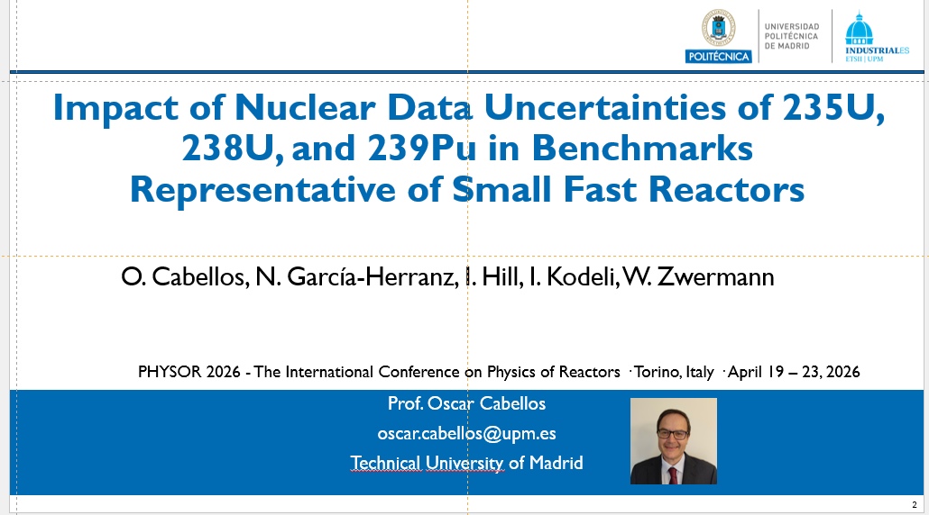
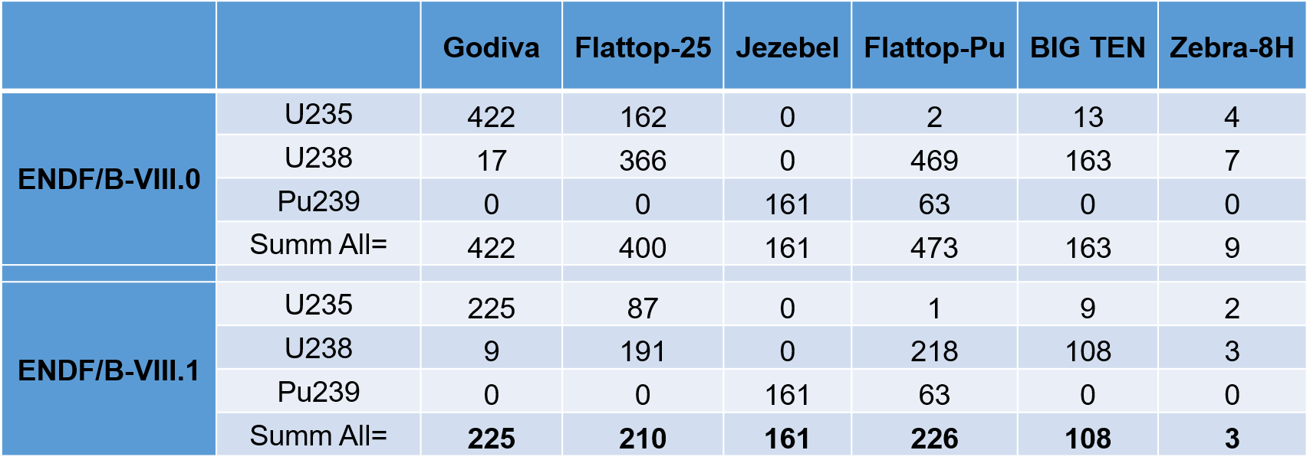
5.2 Ex: Testing covariances in Criticality
Table 1. Bias and nuclear data uncertainties in HEU-MET-FAST-001
Recent covariance testing exercises include:
processing covariance data (e.g. ENDF/B-VIII.1 )
checking covariance blocks such as MF31, MF32, MF33, MF34 and MF35
propagating uncertainties in ICSBEP-type benchmarks
decomposing contributions from cross sections, ν, PFNS and angular distributions
comparing uncertainty estimates across evaluated libraries
These tests help identify:
missing or problematic covariance files
changes between library versions
dominant uncertainty contributors
application-dependent covariance needs
Benchmark propagation is a QA tool for covariance data !
CSEWG2024
https://indico.bnl.gov/event/24320/contributions/97752/attachments/58237/100319/OCabellos_CSWEG-Nov2024-COVARIANCES-v6.pptx
Table 2. Summary of keff-uncertainties results using covariances of nuclear data in MF34
PHYSOR2026
14

Slide 15
5.3 Ex.: Individual perturbations vs UQ
Uncertainty Quantification: Main individual contributions
PHYSOR2026
Table 3. Main contributions (> 100 pcm) to the JEFF-3.3 (“J33”) vs ENDF/B-VIII.0 (“E80”) multiplication factor deviations of the set of Benchmarks in pcm, in comparison with the contributions to the uncertainties from the nuclear covariance data values in pcm).
Case | Main contributor | E80→J33* Substitution MCNP calc. | E80→J33 Perturbation S/A | JEF-3.3 =JEFF-4.0 uncertainty | ENDF/B-VIII.0 uncertainty | ENDF/B-VIII.1 uncertainty
Jezebel | Pu239(n,n’) | 742 | 773 | 131 | 679 | 578
 | Pu239(n,n) | -339 | -337 | 101 | 528 | 393
 | Pu239(n,fission) | -258 | -255 | 303 | 905 | 549
 | Pu239(n,chi) | 189 | 189 | 509 | 217 | 95
BigTen | U238(n,gamma) | -970 | -985 | 614 | 396 | 396
 | U238(n,n’) | 490 | 501 | 506 | 267 | 267
 | U235(n,gamma) | 317 | 297 | 466 | 316 | 316
 | U238(n,n) | -236 | -233 | 126 | 262 | 262
 | U238(n,fission) | 211 | 216 | 390 | 178 | 178
 | U235(n,nubar) | 151 | 150 | 410 | 311 | 248
 | U238(n,nubar) | -142 | -145 | 232 | 293 | 293
ZEBRA-8H | U238(n,gamma) | -1463 | -1456 | 860 | 583 | 582
 | U235(n,gamma) | 327 | 320 | 446 | 299 | 299
 | U238(n,fission) | 207 | 229 | 394 | 182 | 182
 | U238(n,nubar) | -159 | -146 | 249 | 315 | 293
 | U235(n,n’) | 127 | 38 | 136 | 43 | 43
 | U235(n,nubar) | 120 | 114 | 406 | 310 | 243
 | U238(n,n’) | -39 | -207 | 1326 | 786 | 786
Noticeable that in some cases, ”the individual contributions to the library deviations” are significantly higher than the respective nuclear data uncertainty contributions, see the case of:
239Pu(n,n’) in Jezebel
238U(n,gamma) in BigTen and ZEBRA-8H
15

Slide 16
5.4 Example… USER perspective
“If the diagonal of a covariance matrix is a measure of our ignorance, the off-diagonal elements are a measure of our wisdom.” by M. Herman (2017)
In practice, the diagonal terms are not only a measure of ignorance…. from the application perspective (USERS), these uncertainties may be judged too large, too conservative, or not representative of the required predictive capability.
Ref. : B. T. Rearden, W. J. Marshall, D. Wiarda, “SCALE/AMPX Sensitivity and Uncertainty Analysis Capabilities and Data”, WPEC/SG44, May 15-17, 2017
16

Slide 17
5.4 Example… USER perspective
Differences between JEFF-3.3T4 and JEFF-3.3T3
  JEFF-3.3T3: uncertainty in the fast range was based on microscopic experiment only.
  JEFF-3.3T4: reduced uncertainties to reflect adjustment (e.g. fast range to JEZEBEL).
Ref.: O. Cabellos, J.Dyrda, N. Soppera , “Checking, processing and verification of nuclear data covariances” NEA Nuclear Data Week & JEFF Meeting , 20 –24 November 2017, JEFDOC-1887
17

Slide 18
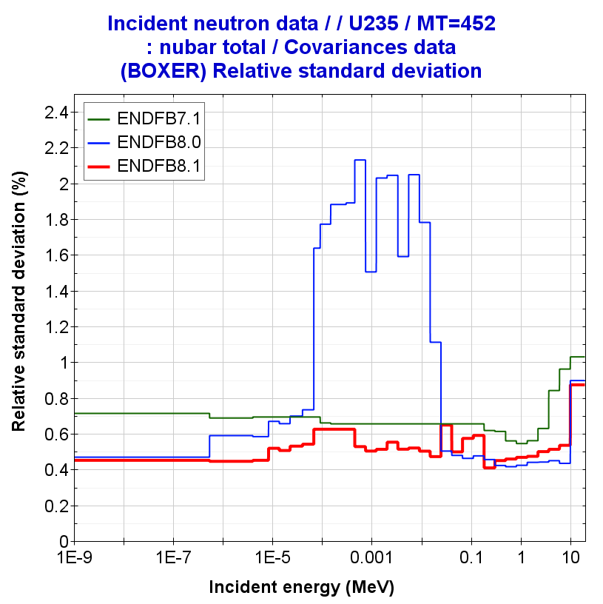
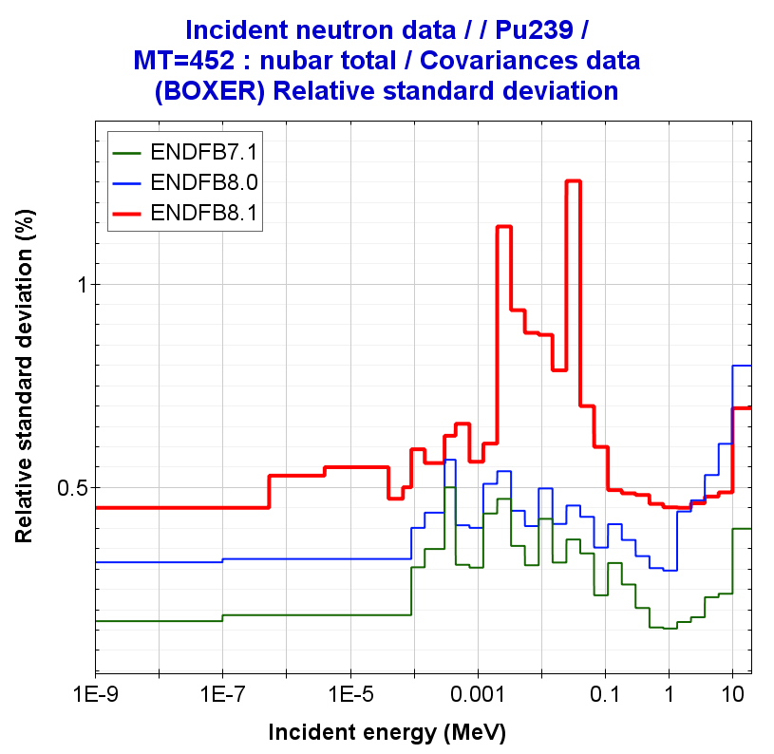
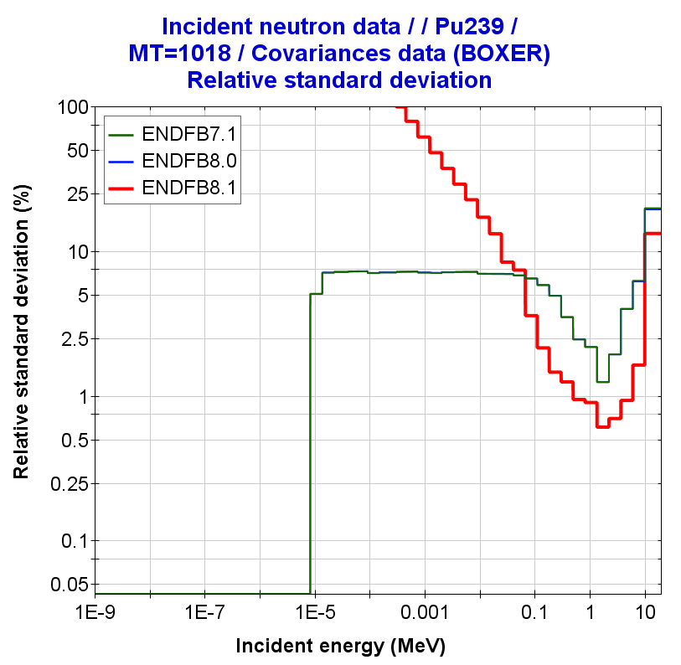
5.4 EVAL perspective in ENDF/B-VIII.1
U235(nubar)
Pu239(nubar)
Pu239(PFNS)
“Gwin nubar data were directly used from 500 eV up to 80 keV, … Uncertainties for all experimental data were reevaluated in detail using the literature of data sets as well as templates of expected ν measurement uncertainties.”
“… PFNS uncertainties for Pu assemblies dropped due to the inclusion of Chi-nu, CEA and Lestone experimental data,
while ν uncertainties increased because of considering the new standard uncertainties (252Cf(sf)) in the evaluation process.”
Ref.: G. Nobre et al, ENDF/B-VIII.1: Updated Nuclear Reaction Data Library for Science and Application, Nuclear Data Sheets 210 (2026) 1–224
18

Slide 19
6. Examples of Personal Experience dealing with Application of Covariance Data
Some examples of my experience/work…
  Activation calculations
  Depletion calculations
  Core calculations
  Fission Pulse Decay Heat
    4.1 Importance of FY correlations
  Hidden correlations / CIELO / SG44
  Uncertainty Quantification (UQ) due to Nuclear Data Uncertainties
  TAR Calculations and nuclear data needs
… especially dedicated to Olivier Serot in recognition of his outstanding contributions to FY nuclear data covariance evaluation…☺
“Wisdom comes from experience. Experience is often a result of lack of wisdom”
by Sir Terry Pratchet (1948-2015)
19

Slide 20
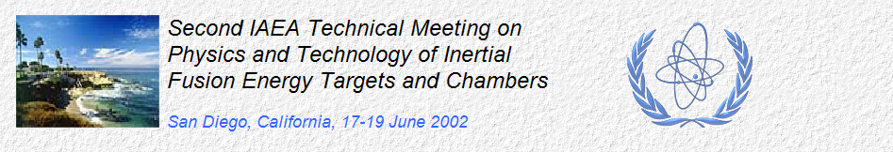
[1] Uncertainty in Activation calculations
My first publication with ND Uncertainties using Monte Carlo sampling (2002)
Experience often starts with unpublished work…
My second Monte Carlo study on ND uncertainties unpublished (2002)
“Monte Carlo Uncertainty Analyses of Pulsed Activation in the NIF Gunite Shielding”
J. Sanz, R. Falquina, A. Rodriguez, O. Cabellos, S. Reyes, J. F. Latkowski
Fusion Science and Technology | Volume 43 | Number 3 | May 2003 | Pages 473-477
doi.org/10.13182/FST03-A293
Abstract.
The need to estimate the effect of “activation cross section uncertainties” in the accuracy of isotopic inventory calculations is an issue that is drawing more and more attention. Concerning this problem, cross section uncertainty files have been made available, such as FENDL UN/A-2.0, and some calculational procedures have been proposed. We developed a method based on the first order Taylor series, which was found practical for providing the uncertainty indices associated to each of the reaction cross sections in a continuous irradiation scenario. One of the drawbacks of the method is that its application to pulsed scenarios is difficult, and the other and most important is that it is impractical to deal with the synergetic/global effect of the uncertainties of the complete set of cross sections. To overcome these limitations, we have developed a Monte Carlo procedure based on simultaneous random sampling of all the cross sections involved in a problem, and it has been implemented in the activation code ACAB. The main characteristics of the method are presented here.
“Activation Cross Sections Uncertainties Implications in the NIF Worker Doses”
TOFE2002 – 15th ANS Topical Meeting on the Technology of Fusion Energy
R. Falquina; J. Sanz; A. Rodíguez; O. Cabellos; J.F. Latkowski; S. Reyes.
No published.
… because conservative or inconsistent input uncertainties led to misleading conclusions
20

Slide 21
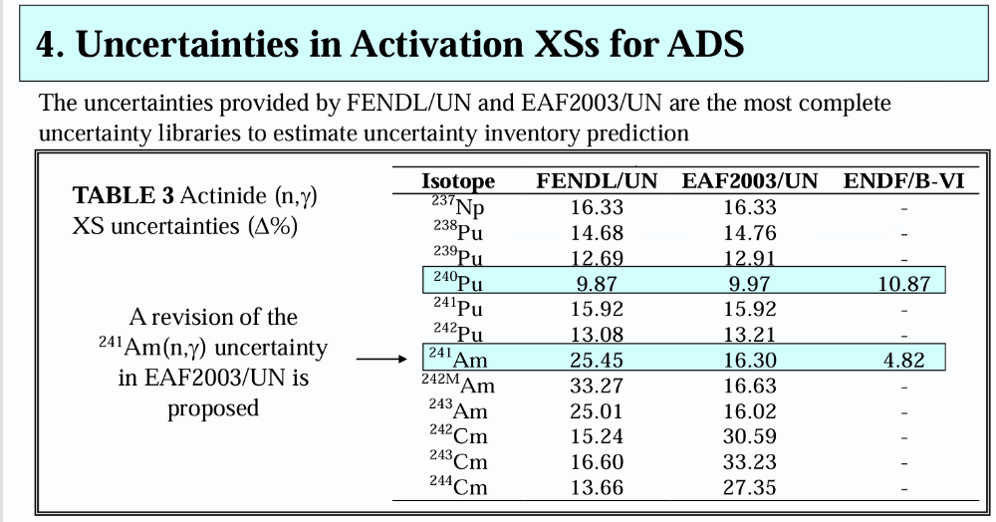
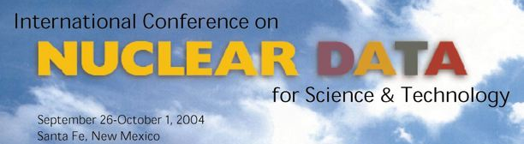
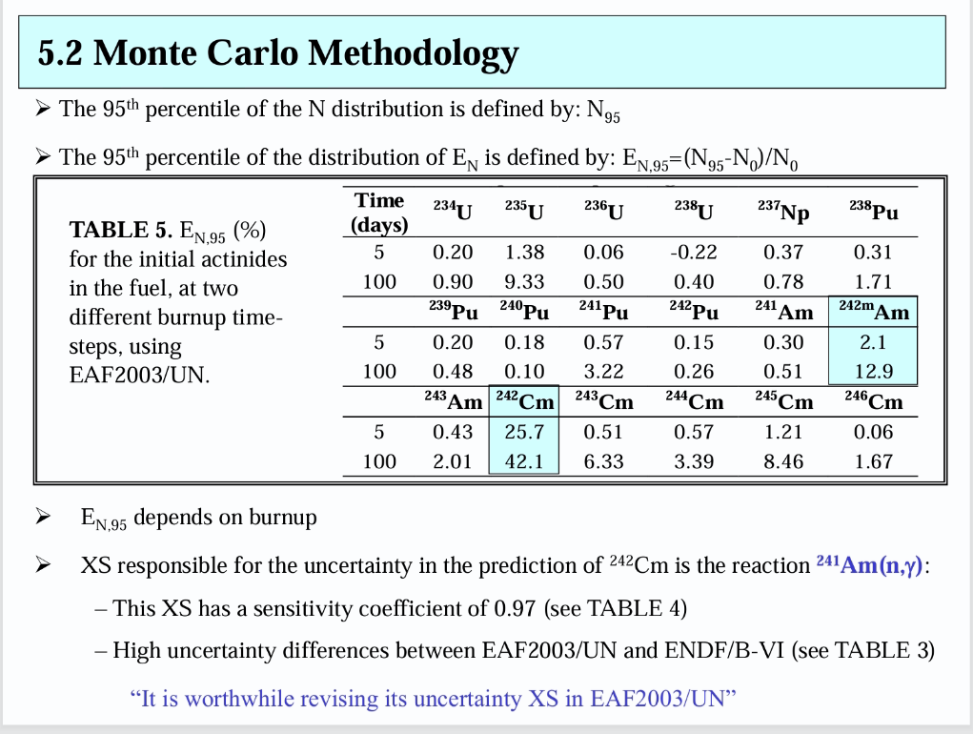
[2] Uncertainty in Depletion calculations
First publication on Transmutation UQ (2004)
  Sensitivity and Uncertainty Analysis to Burn-up Estimates on ADS Using ACAB Code
  O. Cabellos, J. Sanz et al.
  Abstract.
  Within the scope of the Accelerator Driven System (ADS) concept for nuclear waste management applications, the burnup uncertainty estimates due to uncertainty in the activation cross sections (XSs) are important regarding both the safety and the efficiency of the waste burning process. We have applied both sensitivity analysis and Monte Carlo methodology to actinides burnup calculations in a lead-bismuth cooled subcritical ADS. The sensitivity analysis is used to identify the reaction XSs and the dominant chains that contribute most significantly to the uncertainty. The Monte Carlo methodology gives the burnup uncertainty estimates due to the synergetic/global effect of the complete set of XS uncertainties. These uncertainty estimates are valuable to assess the need of any experimental or systematic re-evaluation of some uncertainty XSs for ADS.
21

Slide 22
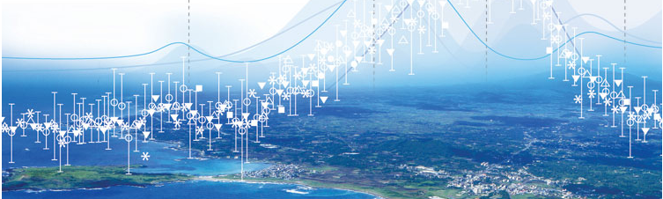
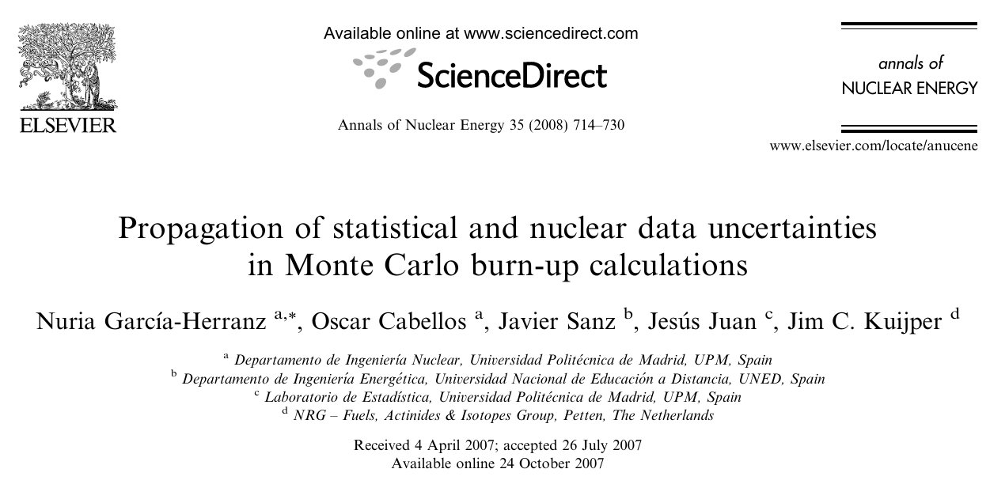
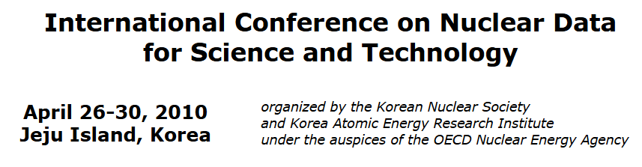
[2] Uncertainty in Depletion calculations
UQ using XSs, DD, and FYs (2010)…
Development of “Hybrid Monte Carlo method” (2008)…
  Propagation of Nuclear Data Uncertainties in Transmutation Calculations Using ACAB Code
O. Cabellos, O. Garcia-Herranz, Carlos J. Diez de la Obra, R. Alvarez-Cascos, H, Sanz, F. Ogando, P. Sauvan
J. Korean Phys. Soc. 59(2(3)), 1268 - 1271 (2011)
Abstract
The assessment of the accuracy of parameters related to the reactor core performance (e.g. keff) and fuel cycle (e.g. isotopic evolution/transmutation) due to the uncertainties in the basic nuclear data (ND) is a critical issue. Different error propagation techniques (adjoint/forward sensitivity analysis procedures and/or Monte Carlo technique) can be used to address by computational simulation the systematic propagation of uncertainties on the final parameters. To perform this uncertainty assessment, the ENDF covariance files (variance/correlation in energy and cross-reactions-isotopes correlations) are required. In this paper, we assess the impact of ND uncertainties on the isotopic prediction for a conceptual design of a modular European Facility for Industrial Transmutation (EFIT) for a discharge burnup of 150 GWd/tHM. The complete set of uncertainty data for cross sections (EAF2007/UN, SCALE6.0/COVA-44G), radioactive decay and fission yield data (JEFF-3.1.1) are processed and used in ACAB code.
22

Slide 23
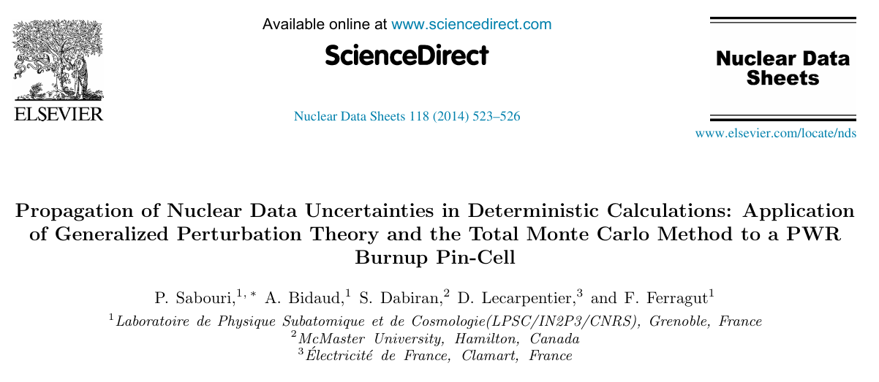
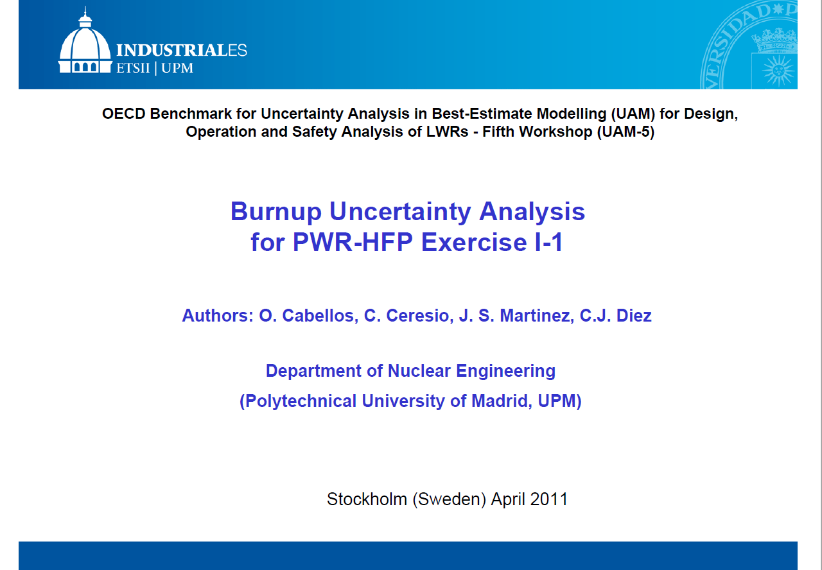
[2] Uncertainty in Depletion calculations
First UQ in Burnup calculation –
OECD/UAM (2011) …
Hybrid Monte Carlo and full Monte Carlo approaches were explored for burnup uncertainty propagation.
“Hybrid Monte Carlo” method fails in Burnup calculations… full Monte Carlo approach …
Thanks to Adrian Bidau (2014)!
23

Slide 24
[3] Uncertainty in Core Calculations
PWR core UQ using TENDL2012 random files (2013)
Figure 6. Uncertainties in the Incoherent Inelastic Scattering Cross Section Calculated from 800 Random TENDL2012 for STL-H in H2O.
Figure 5. Scheme of the PWR Core Analysis System SEANAP: WIMS-D4, COBAYA, and SIMULA
24

Slide 25
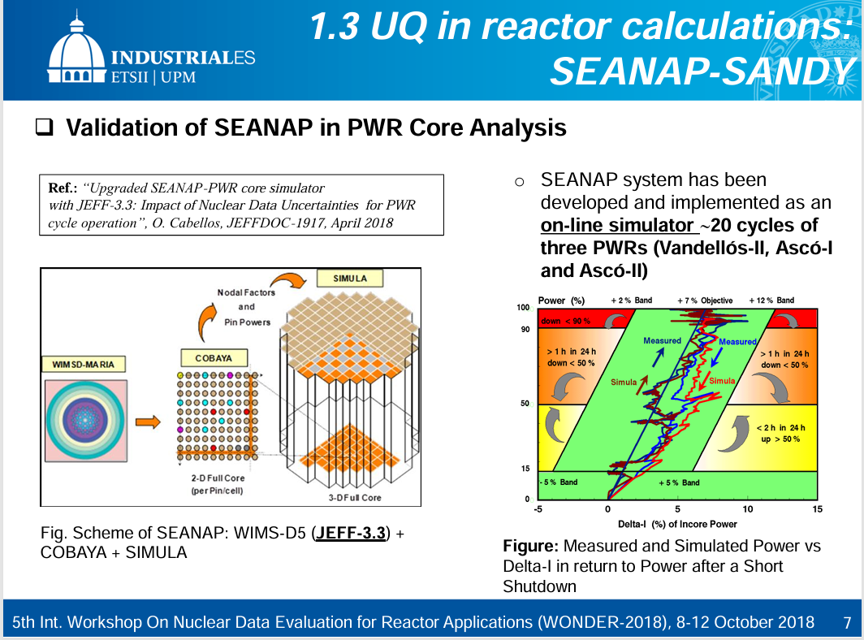
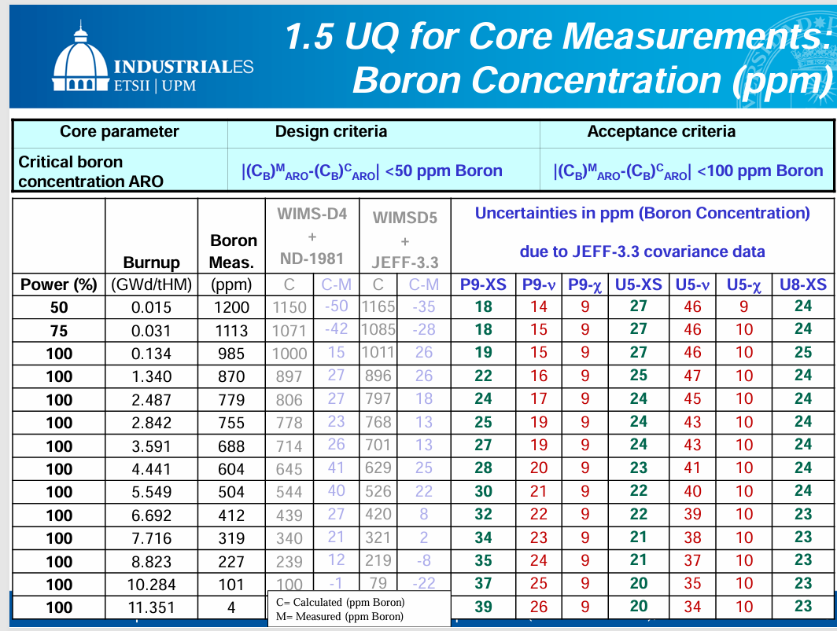
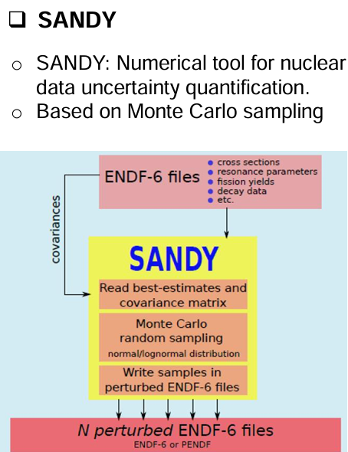
[3] Uncertainty in Core Calculations
PWR core UQ using SANDY code for ND uncertainties in JEFF-3.3 (2018)
25

Slide 26
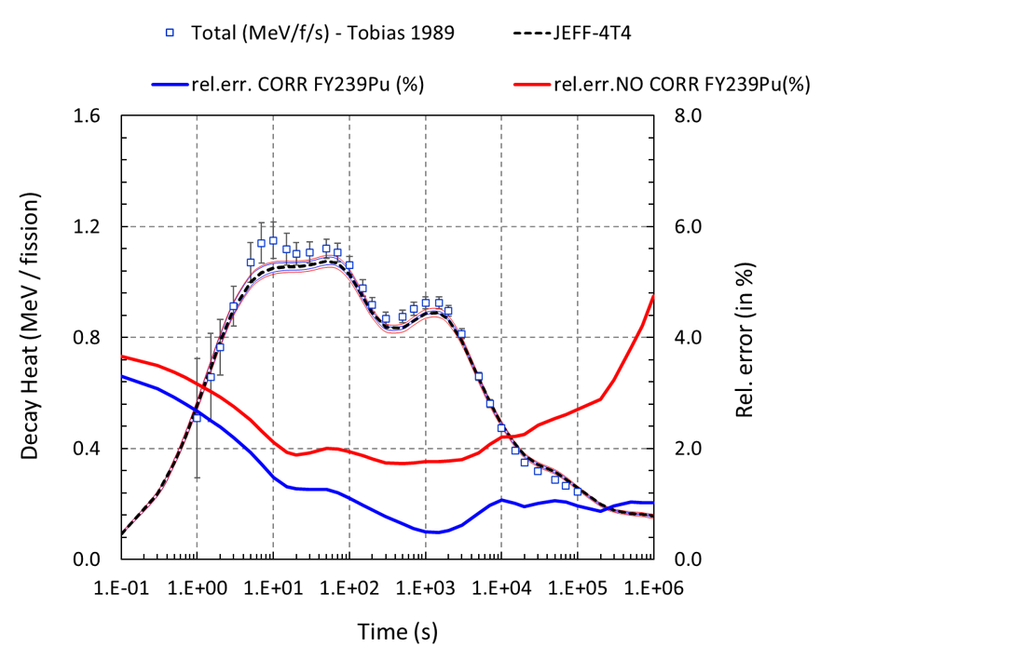
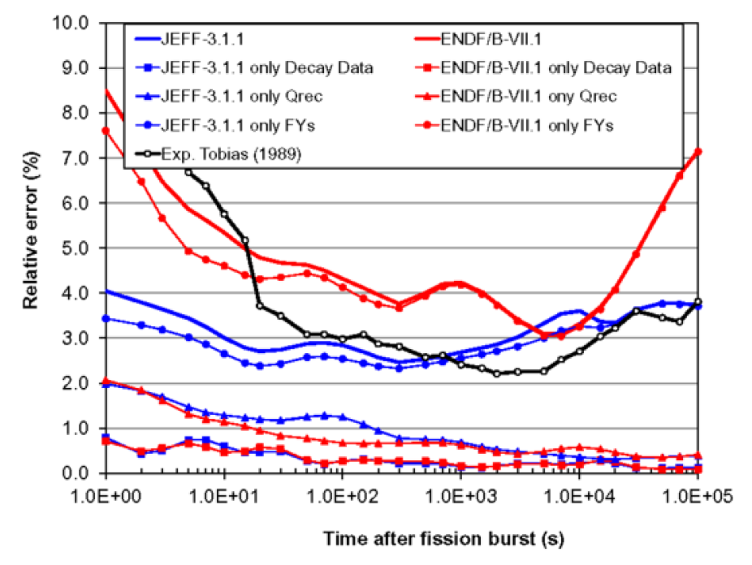
[4] Uncertainty in Fission Pulse Decay Heat
First FPDH UQ studies JEFF-3.1.1(ND 2014)
Last FPDH studies: 3rd Research Coordination Meeting on Updated FY Data for Applications … UQ using JEFF-4.0 (2024)
Figure 8. Total decay heat from thermal pulse on 239Pu.
Figure 7. Predicted relative errors (in %) due to all nuclear data uncertainties propagated together and individually, compared to experimental uncertainty of total decay heat (β+γ) for thermal neutron fission burst of 239Pu.
Strong uncertainty reduction when JEFF-4 thermal fission-yield correlations are included
26

Slide 27
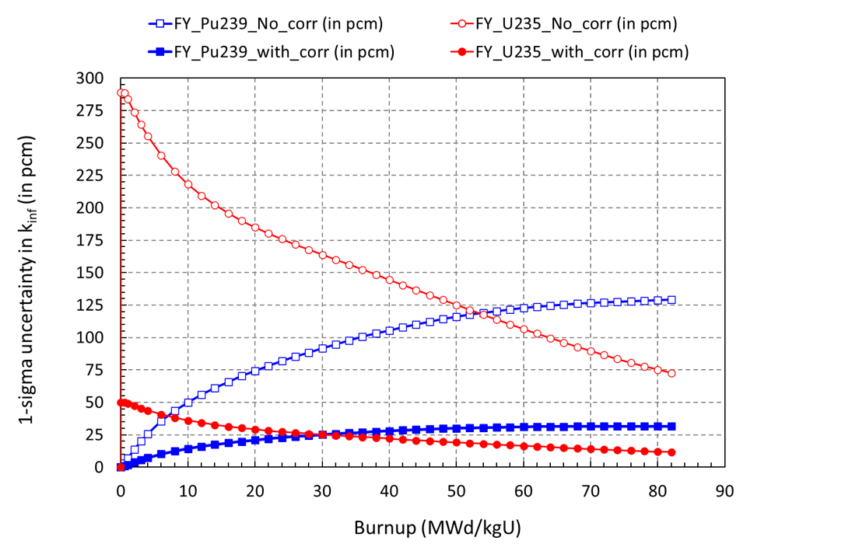
[4.1] Importance of FY correlations …
FY uncertainty in burnup calculations (UAM 2014, PHYSOR 2014) … UQ using ENDF/B-VII.1
3rd Research Coordination Meeting on Updated FY Data for Applications
… UQ using JEFF-4.0 (2024)
Assessing FY correlation matrix using Katakura/Diviliers Bayesian approach
Figure 10. Uncertainty in the kinf (in pcm) along burnup for a typical 17x17-PWR Westinghouse fuel assembly with 4.8wt%. Calculations performed with WIMSD5 code with 300 random JEFF4/FY files.
Table 5. Uncertainty in number density for some important fission products at 60 GWd/MTU. Fission Yield source of uncertainty (standard deviation) is taken from ENDF/B-VII.1
Figure 9. Relative standard deviation in keff (in %):
FY correlations strongly reduce and reshape the propagated uncertainty
27

Slide 28
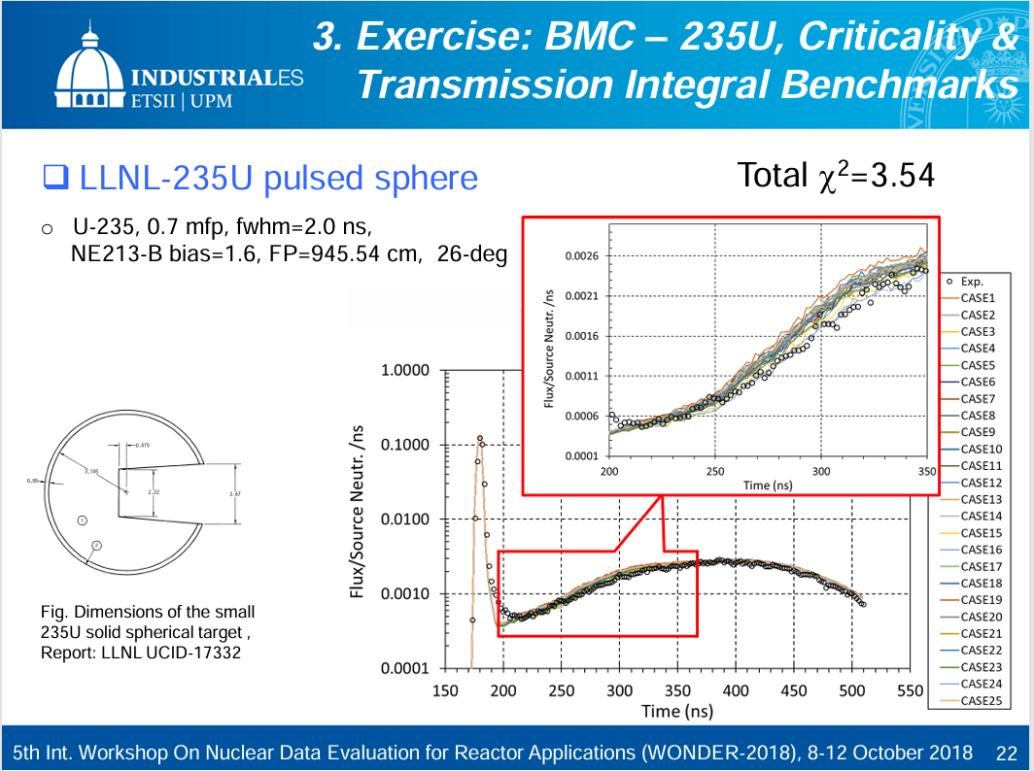
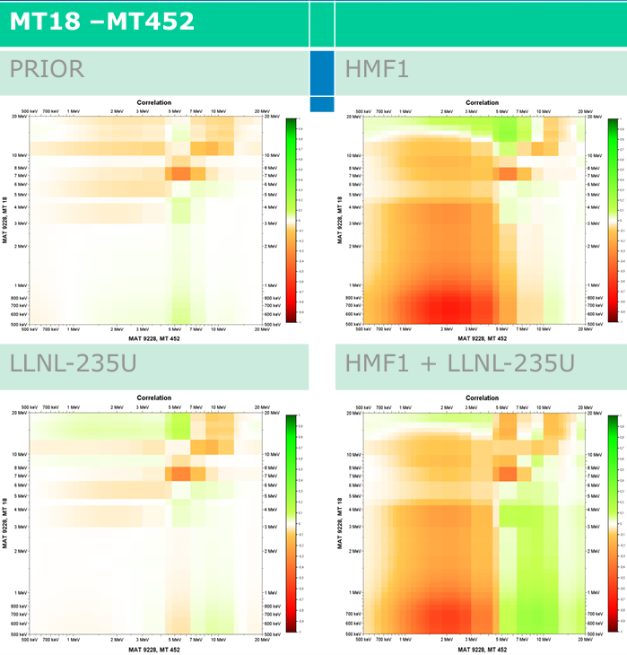
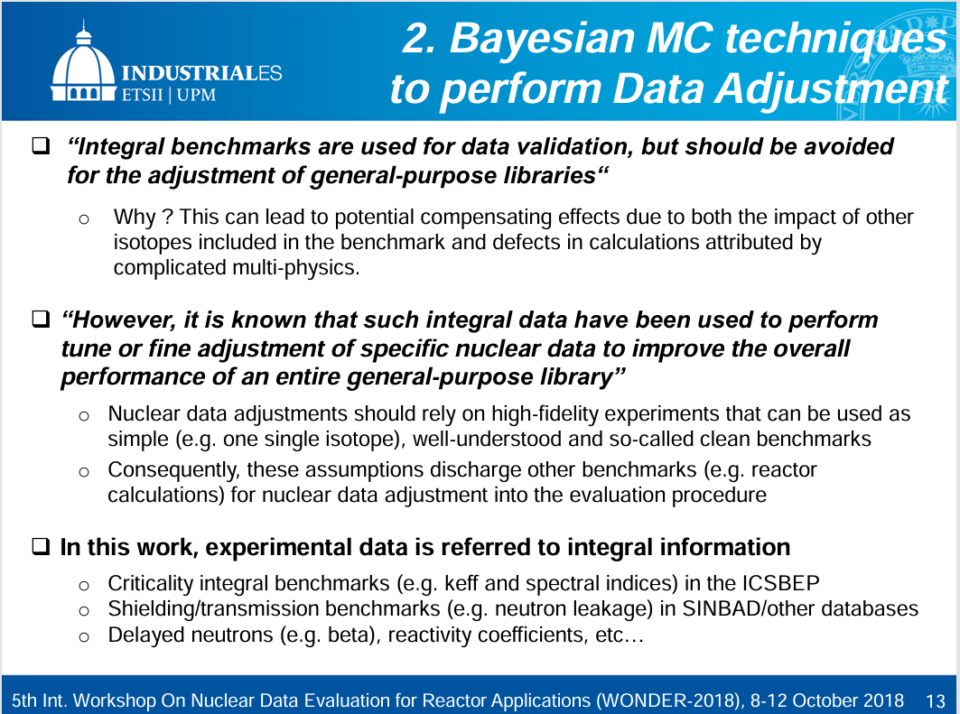
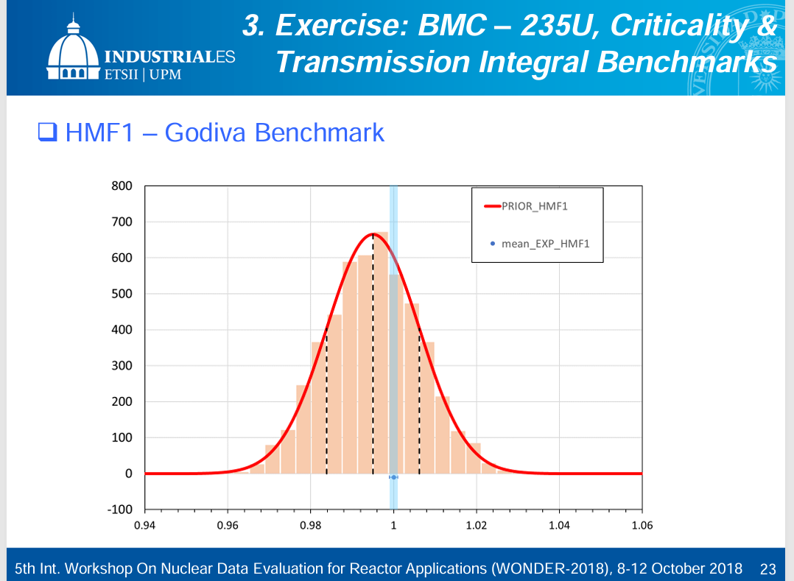
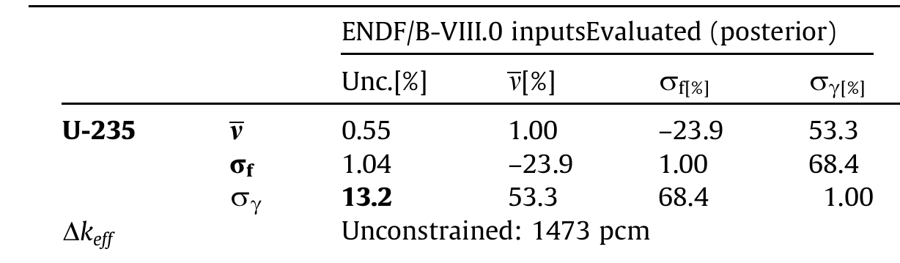
[5] Hidden correlations / CIELO / SG44
WONDER 2018…
5000 random files 235U/TENDL2014
WPEC/SG44 (2019) … 1D-1group keff
28

Slide 29
[6] Uncertainty Quantification (UQ) due to Nuclear Data Uncertainties
SG46 (2017-2023) - WONDER 2023…
Table 6. Uncertainty quantification due to nuclear data uncertainties and SG46/TAR values
System | Parameter | ENDF/B-VII.1 | ENDF/B-VIII.0 | JEFF-3.3 | JENDL-5.0 | Target
ALFRED | keff (in pcm) | 717 | 826 | 831 | 736 | 300/435 pcm
ALFRED | Coolant-density (in %) | 57.0 | 30.3 | 42.9 | 38.9 | 10%
ALFRED | Coppler (in %) | 9.0 | 4.6 | 6.5 | 5.5 | 3%
ASTRID | keff (in pcm) | 999 | 855 | 908 | 851 | 300 pcm
 | Fully voided (in %) | 20.2 | 17.2 | 16.1 | 20.2 | 10%
ESFR | keff (in pcm) | 1147 | 865 | 967 | 899 | 300 pcm
 | Fully voided (in %) | 37.1 | 31.2 | 26.7 | 33.8 | 10%
 | Doppler (in %) | 5.6 | 3.3 | 4.1 | 4.0 | 3%
 | Rod worth (in %) | 2.4 | 1.3 | 1.8 | 1.7 | 3%
JSFR-750 | keff (in pcm) | 971 | 900 | 920 | 866 | 200 / 300 pcm
 | BRS (in %) | 5.5 | 5.4 | 5.2 | 5.1 | 18% / 27%
 | CRW (in %) | 2.7 | 2.7 | 3.2 | 2.6 | 2% /-
 | DOP (in %) | 3.9 | 3.1 | 3.6 | 4.0 | 2% / 7%
 | Power distribution (in %) | 1.7 | 1.6 | 1.8 | 1.5 | 1% / 2%
 | SVR (in %) | 4.8 | 5.3 | 3.8 | 4.9 | 3% / 7%
MYRRHA | keff (in pcm) | 771 | 676 | 588 | - | 300 pcm
MACRE | keff (in pcm) | 2435 | - | - | - | 300 pcm
MOLTEX | keff (in pcm) | 584/836* | 922 | 1090 | - | 300 pcm
NUSCALE | keff (in pcm) | 748 | 522 | 669 | 397 | 300 pcm
ND uncertainty reduction is needed,
especially for keff in many advanced systems.
UQ performed with sandwich formula (S·V_{α}·S^{T}) and using the full ND covariance matrix (V_{α})
Calculations with OECD/NEA NDaST
* using covariances for ³⁵Cl above 1 MeV from TENDL2021
29

Slide 30
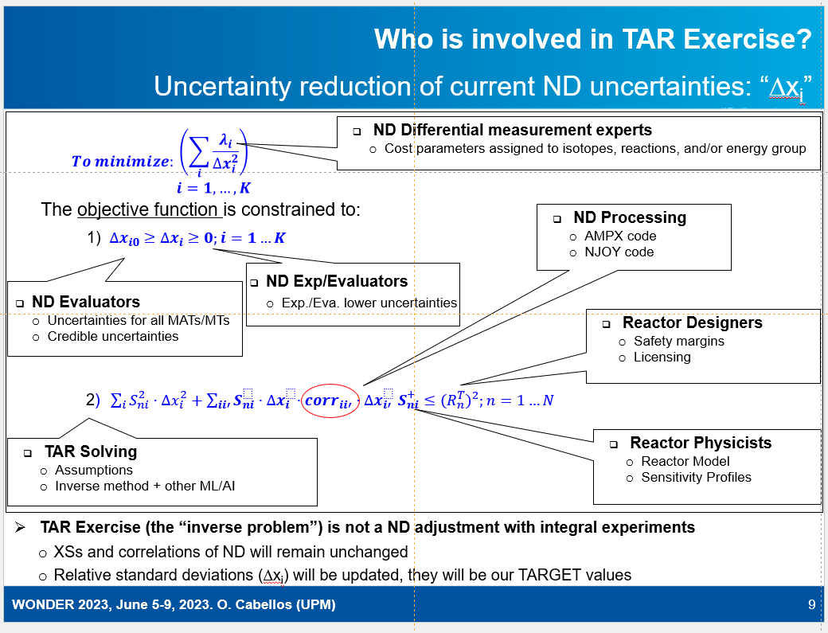
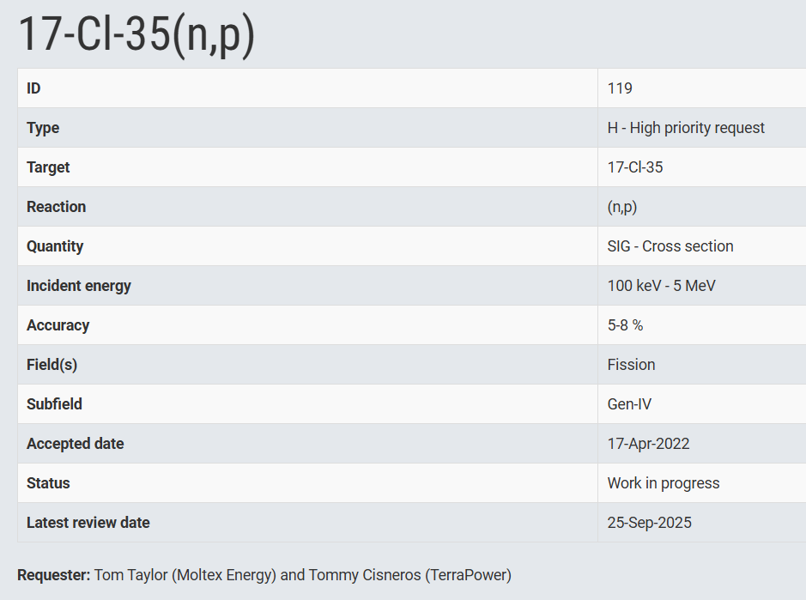
[7] TAR Calculations & nuclear data needs
Target Accuracy Requirements (TAR) Exercise within WPEC/SG46 and Feedback on Nuclear Data Needs, ND2022 and WONDER 2023
https://www.oecd-nea.org/jcms/pl_68905/17-cl-35-n-p
Correlation terms in SG46 TAR assessments can produce stringent ND uncertainty requirements.
See also: EU/SANDA Project - “Report on assessment of nuclear data needs”
http://www.sanda-nd.eu/wp-content/uploads/2024/11/SANDA-D5.5.pdf
30

Slide 31
7. Conclusion & Lessons Learned
“If the diagonal of a covariance matrix is a measure of our ignorance, the off-diagonal elements are a measure of our wisdom.” by M. Herman (2017)
Lessons learned
• ND-UQ is only as credible as the covariance data being propagated
• Covariances must preserve the statistical and physics memory of the evaluation
• Complete UQ requires more than cross sections: ν, PFNS, angular distributions, FYs, decay data and TSLs may be essential
• Benchmark propagation is a powerful QA tool for covariance data
• Integral experiments can reduce uncertainties only if the induced correlations are treated consistently
“Wisdom comes from experience. Experience is often a result of lack of wisdom”
by Sir Terry Pratchet (1948-2015)
Final messages
S/U methods are essential for diagnosis, decomposition and TAR
Monte Carlo sampling is valuable for complex, non-linear and depletion applications
Differences between evaluated libraries may reveal limitations in current covariance data
TAR translates application requirements into nuclear-data priorities
The future need is not simply more covariance data, but more complete, consistent and traceable
USERS also need clear guidance on the domain of applicability, limitations and recommended use of evaluated covariance data
31

Slide 32
Thanks for your attention !
32

Slide 33

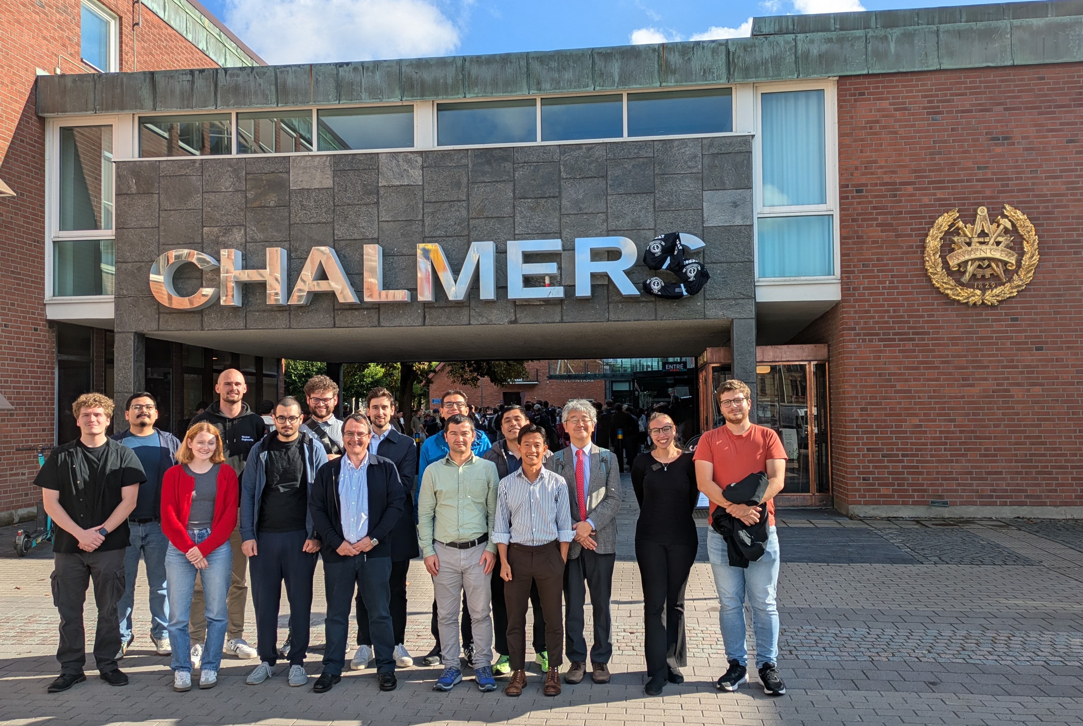



E&T in ND
Upcoming GRE@T-PIONEeR course on “Nuclear data for energy and non-energy applications” October 26-30, 2026 (https://great-pioneer.eu/)
Application period will open on August 10, 2026, and will close on August 30, 2026
E&T on nuclear data within the Great-Pioneer Project
  Experimental Data/Theory and Evaluation
  Processing/Verification
  Benchmarking/Validation
  Sensitivity Analysis and Uncertainty Quantification
  On-site participation :
  Online self-paced learning phase taking place between September 25th, 2026, and October 23rd, 2026
  Synchronous activities offered between October 26th, 2026, and October 30th, 2026 (those activities can be attended online or onsite at Chalmers University of Technology, Gothenburg, Sweden).
  To follow-up GRE@T-PIONEeR activities at:
Figure. Course on ND: Chalmers September 2025
www.great-pioneer.eu
@GREATPIONEeR_EU
@GREAT-PIONEER
33

Slide 34


Acknowledgments
This work is part of the APRENDE project (Addressing PRiorities of Evaluated Nuclear Data in Europe) that has received funding from the European Union’s HORIZON-EURATOM
under grant agreement No. 101164596
34

Slide 35
References
J. Sanz, R. Falquina, A. Rodríguez, O. Cabellos, P. Yuste, S. Reyes, J. Latkowski, “Monte Carlo Uncertainty Analyses of Pulsed Activation in the NIF Gunite Shielding”, Fusion Science and Technology, Vol. 43, pp. 473-477 (2003)
O. Cabellos, J. Sanz, A. Rodríguez, E. González, M. Embid, F. Alvarez, “Sensitivity and Uncertainty to Burn-up Estimates on ADS Using ACAB Code“, ND2004, Conference on Nuclear Data for Science and Technology, POSTER, Santa Fe (USA), September, 2004. Published in AIP Conference Proceedings, May 24, 2005, Vol 769, Issue 1, pp. 1576-1579
O. Cabellos, N. García-Herranz, J. Sanz, F. Ogando, P. Sauvan, “Propagation of Nuclear Data Uncertainties in Transmutation Calculations Using ACAB Code”, International Conference on Nuclear Data for Science and Technology (ND2010), Jeju Island, Korea, : Abril 26-30, 2010. ORAL, Published in JKNT.
D. Piedra , O.Cabellos, C.J. Diez, L. Fiorito, “Impact of the Fission Yield Covariance Data in the Pin-cell Burn-up Calculation: Exercixe I-1b”, UAM8 Workshop, 14-16, May 2014, Garching (Germany)
O. Cabellos, V. de Fusco, C.J. Diez, J.S. Martinez, E. Gonzalez, D. Cano and F. Alvarez-Velarde, “Testing JEFF-3.1.1 and ENDF/B-VII.1 Decay and Fission Yield Nuclear Data Libraries with Fission Pulse Neutron Emission and Decay Heat Experiments”, ND2014, Nuclear Data Sheets, Volume 118, April 2014, Pages 472-475
O. Cabellos, E. Castro, C. Ahnert, C. Holgado, “Propagation of Nuclear Data Uncertainties for PWR core analysis”, NET-KNS, special section on “Nuclear S/U Analysis”. http://dx.doi.org/10.5516/NET.00.2014.000, Nuclear Engineering and Technology, Vol. 46, No 3, June 2014
O. Cabellos, J.Dyrda, N. Soppera , “Checking, processing and verification of nuclear data covariances” NEA Nuclear Data Week & JEFF Meeting , 20 –24 November 2017, JEFDOC-1887
O. Cabellos, Examples of Monte Carlo Techniques Applied for Nuclear Data Uncertainty Propagation, WONDER2018 - 5th International Workshop on Nuclear Data Evaluation for Reactor Applications, October 8-12, 2018
Sobes V.; de Saint Jean C.; Rochman D.; Cabellos O.; Holcomb A.; Bauge E.; Capote R.; Trkov A.; Fleming M.. WPEC Subgroup 44 Computational Inter-comparison Exercise On Correlations in Nuclear Data Libraries. Annals of Nuclear Energy. 164 - 108605, pp. 1 – 18 (2021)
O. Cabellos, M Hursin, P Palmiotti, WPEC/SG46 Exercise on Target Accuracy Requirement, 15th International Conference on Nuclear Data for Science and Technology (ND2022),EPJ Web of Conferences 284,14012, pp-1-4, https://doi.org/10.1051/epjconf/202328414012
O. Cabellos, N. García-Herranz, Target Accuracy Requirements Exercise within WPEC/SG46 and Feedback on Nuclear Data Needs, WONDER-2023 - 6th International Workshop On Nuclear Data Evaluation for Reactor applications, EPJ Web of Conferences, Vol. 294, Art. No.05003,pp.1-10, https://doi.org/10.1051/epjconf/202429405003 (Conference Paper - Open Access 2024)
O. Cabellos, “ENDF/B-VIII.1 Covariance Testing”, CSEWG Meeting November 4-8, 2024
O. Cabellos, “Benchmarking and validation of 235U(nth,f) and 239Pu(nth,f) JEFF-4 fission yield evaluations. Uncertainty quantification using new correlation matrices”, 3rd Research Coordination Meeting on Updated FY Data for Applications – December. 2-6, 2024
O. Cabellos, “Feedbacks on Processing and Benchmarking for JEFF4-T5 (official release February 27th, 2025)”, JEF/DOC-2421, JEFF Nuclear Data Week - Evaluation Session, April 14-18, 2025
O. Cabellos, N. García-Herranz, I. Hill, I. Kodeli, W. Zwermann, “Impact of Nuclear Data Uncertainties of 235U, 238U, and 239Pu in Benchmarks Representative of Small Fast Reactors”, PHYSOR 2026 - The International Conference on Physics of Reactors · Torino, Italy · April 19 – 23, 2026
35

