Slide 1

Propagation of kinetic parameters uncertainty to reactivity measurements in VENUS-F reactor
Federico Di Croce
Federico Grimaldi
Antonin Krása
Luca Fiorito
Pierre-Etienne Labeau
Jan Wagemans
30/06/2026
Notes:
Promoter / mentor
Share the progress on the oscillation experiments program at the VENUS-F reactor.
All coauthors

Slide 2
Background

Slide 3
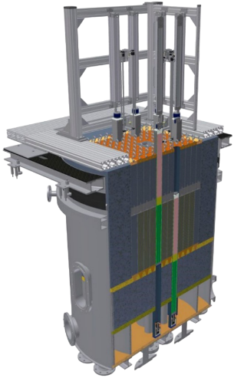
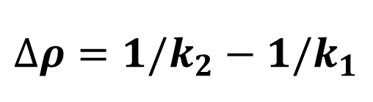
VENUS-F reactor
LFR Neutronic Mock-up
Highly enriched U fuel
Pb, Bi inserts
Fast Neutron Spectrum
Integral Experiments
Reactivity experiments
$$∆ρ={1/k}_{2}−{1/k}_{1}$$
Notes:
Remove categories of integral experiments

Slide 4
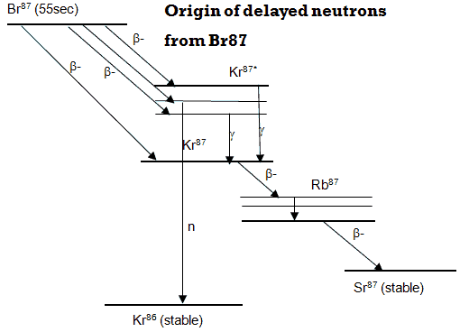
Evaluated delayed neutron (DN) data (²³⁵U and ²³⁸U)
Delayed neutrons emitted by decay of certain fission products (precursors). Grouped according to their half-lives.
JEFF (since 3.1): 8-group by Spriggs
JENDL (since 3.3): 6-group from fitting of experimental and evaluated data
ENDF/B (since VII.0): 6-group from summation calculations
DN data from different libraries produce significant discrepancies in measured reactivity effects, particularly in fast-spectrum systems.
DOI: 10.1051/epjconf/201921103004
Notes:
Simplest way to include in the reactor kinetic model is by grouping them according to their halflives.
Not unique grouping

Slide 5
Methodology

Slide 6
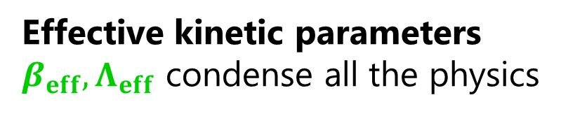


Measuring reactivity
Reactor
$$ρ(t)$$
$$N(t)$$
Effective kinetic parameters
$β_{eff},Λ_{eff}$ condense all the physics
Point Kinetic model
Negligible in our transients
Inverse Point Kinetics
$$ρ\left(t\right)=\frac{Λ_{eff}}{N\left(t\right)}\frac{dN\left(t\right)}{dt}−\frac{1}{N\left(t\right)}\sum_{i}^{G}{β_{eff,i}\left(N_{0}e^{−λ_{i}t}+λ_{i}\int_{0}^{t}{N\left(t^{′}\right)e^{λ_{i}\left(t^{′}−t\right)}dt}\right)}+β_{eff}$$
Function of reactor response + kinetic parameters
Directly measured
Evaluated
Notes:
Dynamic system, input perturbation, output reactor response (directly measured)
Condense all the physics of prompt and delayed neutrons in the system
Measurement + evaluation
Different conclusions for lambda

Slide 7
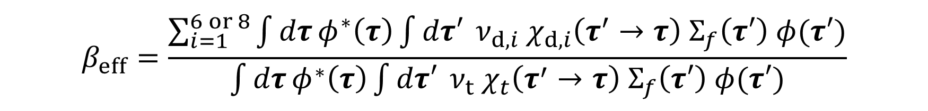
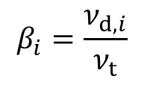

Effective kinetic parameters ($β_{eff}$)
It represents the real impact of delayed neutrons on reactor kinetics.
$$β_{i}=\frac{ν_{d,i}}{ν_{t}}$$
Emission spectrum of each precursor group
$$β_{eff}=\frac{\sum_{i=1}^{6 or 8}{\int{dτ}φ^{∗}\left(τ\right)\int{dτ′} ν_{d,i} χ_{d,i}\left(τ^{′}→τ\right) Σ_{f}\left(τ′\right) φ(τ′)}}{\int{dτ}φ^{∗}\left(τ\right)\int{dτ′} ν_{t} χ_{t}\left(τ^{′}→τ\right) Σ_{f}\left(τ′\right) φ(τ′)}$$
Numerator: importance of delayed neutrons present in the system
Denominator: importance of all (prompt+delayed) neutrons present in the system
Notes:
Adjoint weighted production of delayed neutrons / total adjoint weighted production
Prompt neutron generation time: from production by fission to absorption

Slide 8
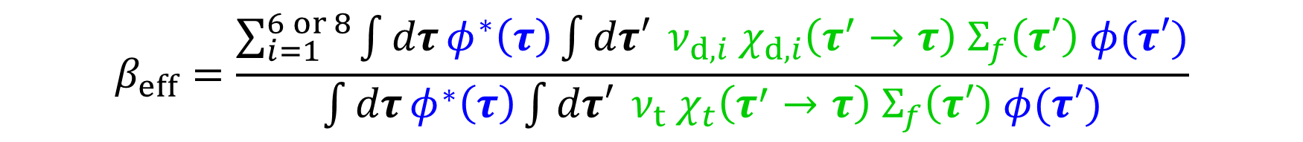
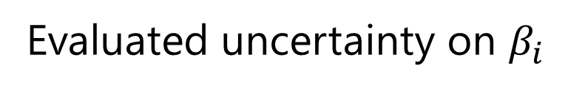
Effective kinetic parameters ($β_{eff}$)
Nuclear data
$$β_{i}=\frac{ν_{d,i}}{ν_{t}}$$
Evaluated uncertainty on $β_{i}$
$$β_{eff}=\frac{\sum_{i=1}^{6 or 8}{\int{dτ}φ^{∗}\left(τ\right)\int{dτ′} ν_{d,i} χ_{d,i}\left(τ^{′}→τ\right) Σ_{f}\left(τ′\right) φ(τ′)}}{\int{dτ}φ^{∗}\left(τ\right)\int{dτ′} ν_{t} χ_{t}\left(τ^{′}→τ\right) Σ_{f}\left(τ′\right) φ(τ′)}$$
Direct/Indirect component to the nuclear data uncertainty
Notes:
Adjoint weighted production of delayed neutrons / total adjoint weighted production
Prompt neutron generation time: from production by fission to absorption

Slide 9

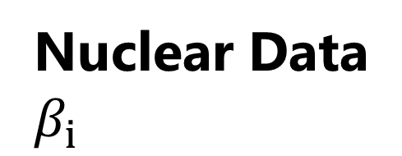

Workflow
VENUS-F model
Uncertainty
$$β_{eff}$$
$$∆ρ$$
Experiment Processing
(IPK)
Input Data
Uncertainty
Nuclear Data
$β_{i}$
Raw experimental data

Slide 10

ND impact on VENUS-F $β_{eff}$

Slide 11
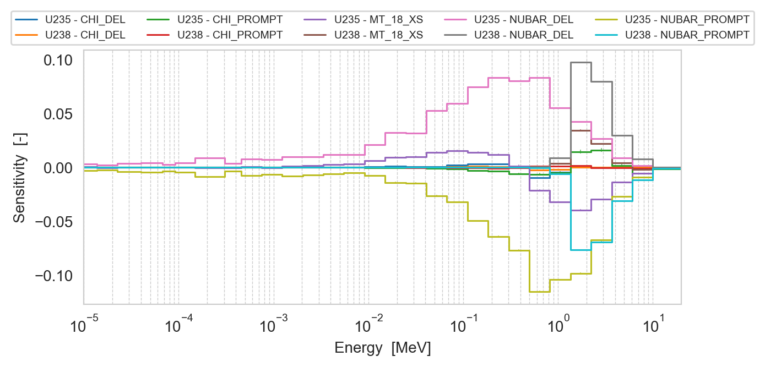
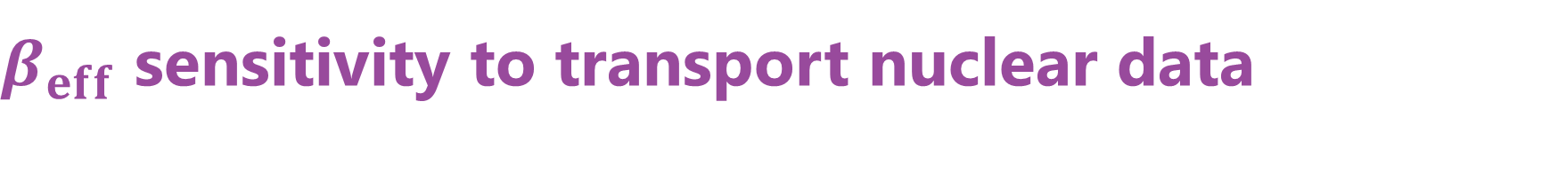
$β_{eff}$ sensitivity to transport nuclear data
1st order sensitivities from Serpent2
Direct components
Driven by fuel data
Delayed are positive
Prompt are negative
Notes:
Too dense presentation!
Details for the discussion afterward
Flow chart, clear research questions
No beta_i expression
Del + prompt nubar and sum in backup -> same 18

Slide 12
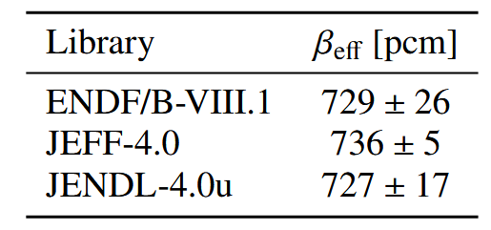
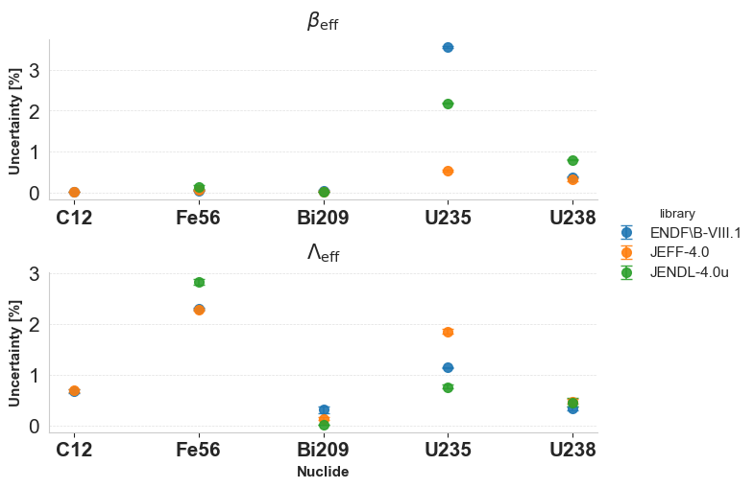
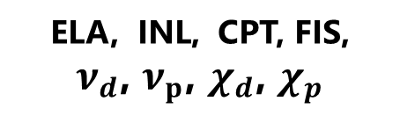
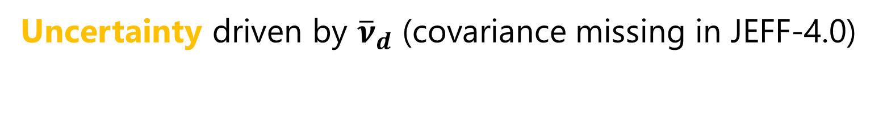
$β_{eff}$ nuclear data uncertainty across libraries
ELA, INL, CPT
ELA, INL, CPT, FIS,
$ν_{d}$, $ν_{p}$, $χ_{d}$, $χ_{p}$
Uncertainty driven by ${\overline{ν}}_{d}$ (covariance missing in JEFF-4.0)
Notes:
Reactions included

Slide 13
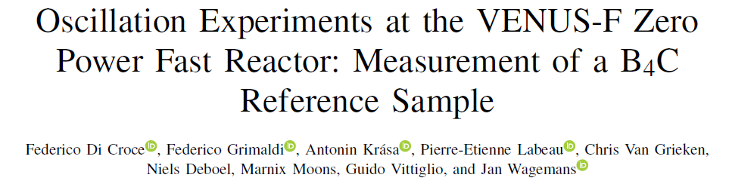
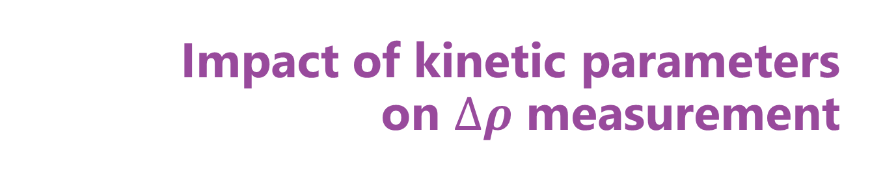
Impact of kinetic parameters on $∆ρ$ measurement
DOI: 10.1109/TNS.2026.3670518
Notes:
Remark from here on oscillation at venus

Slide 14
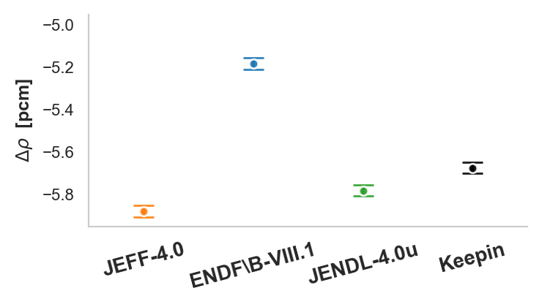
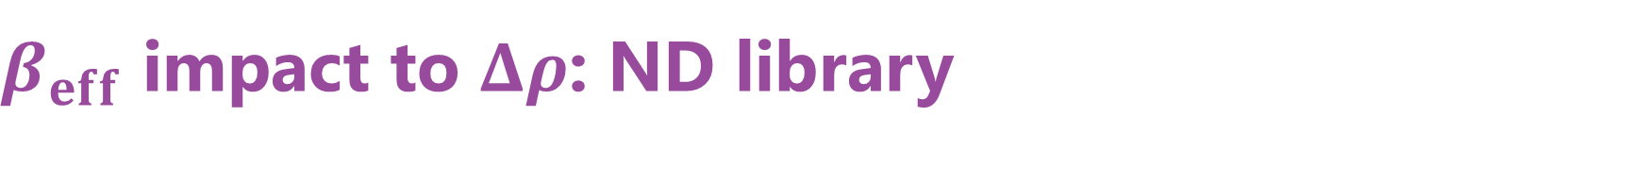
$β_{eff}$ impact to $Δρ$: ND library
Measurement uncertainty.
Only counting statistics.
Prior to ND uncertainty propagation.
12%
2%
4%
Notes:
Stress alpha_i assumption

Slide 15
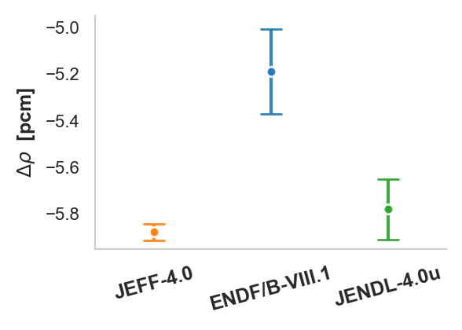
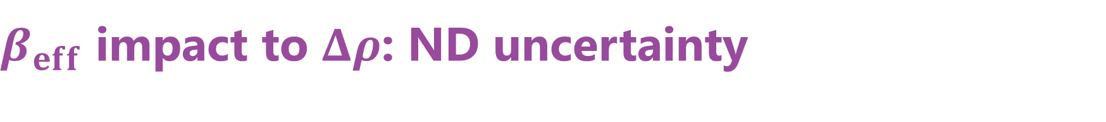
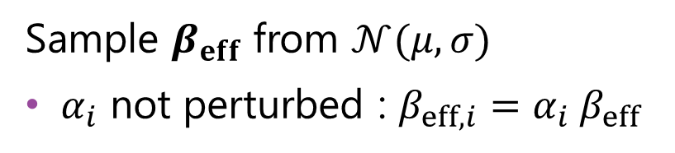

$β_{eff}$ impact to $Δρ$: ND uncertainty
Sample $β_{eff}$ from $𝒩(μ,σ)$
$α_{i}$ not perturbed : $β_{eff,i}=α_{i} β_{eff}$
ND $≫$ exp. uncertainty ($≤$ 0.04 pcm)
Persisting disagreement between libraries
Notes:
Stress alpha_i assumption

Slide 16
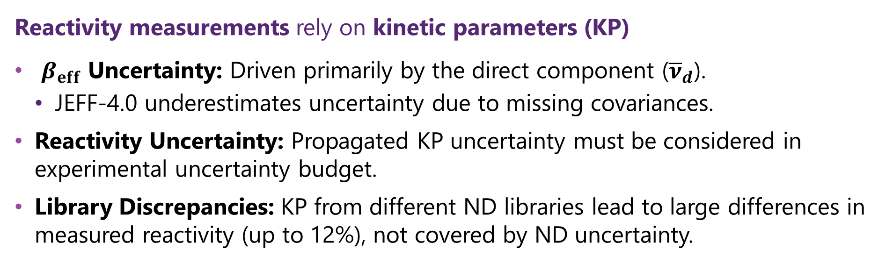
Conclusions
Reactivity measurements rely on kinetic parameters (KP)
​ $β_{eff}$ Uncertainty: Driven primarily by the direct component (${\overline{ν}}_{d}$).
  JEFF-4.0 underestimates uncertainty due to missing covariances.
Reactivity Uncertainty: Propagated KP uncertainty must be considered in experimental uncertainty budget.
Library Discrepancies: KP from different ND libraries lead to large differences in measured reactivity (up to 12%), not covered by ND uncertainty.
Notes:
Start from your research question

Slide 17
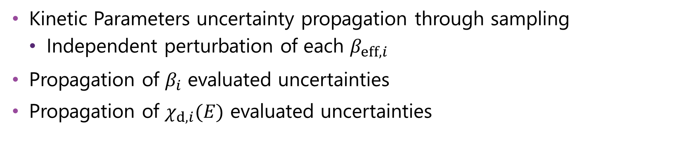
To be done
Kinetic Parameters uncertainty propagation through sampling
  Independent perturbation of each $β_{eff,i}$
Propagation of $β_{i}$ evaluated uncertainties
Propagation of $χ_{d,i}(E)$ evaluated uncertainties
Comprehensive evaluation of kinetic parameters uncertainty and their impact on reactivity measurements
Notes:
After conclusion
Call it future work, to be done

Slide 18
Back-Up

Slide 19
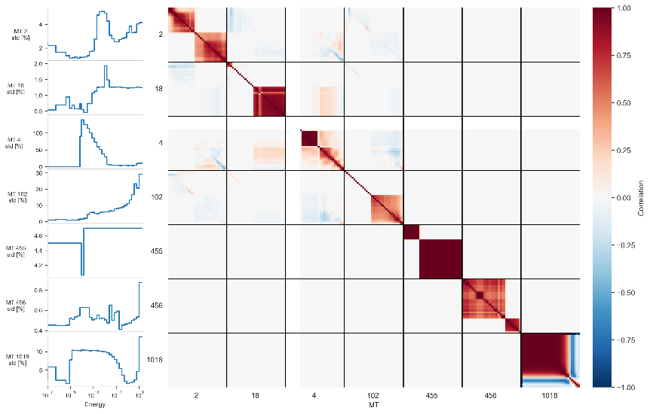
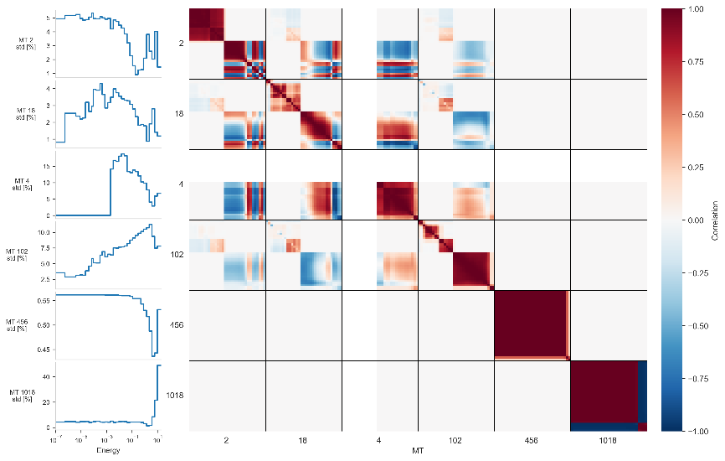
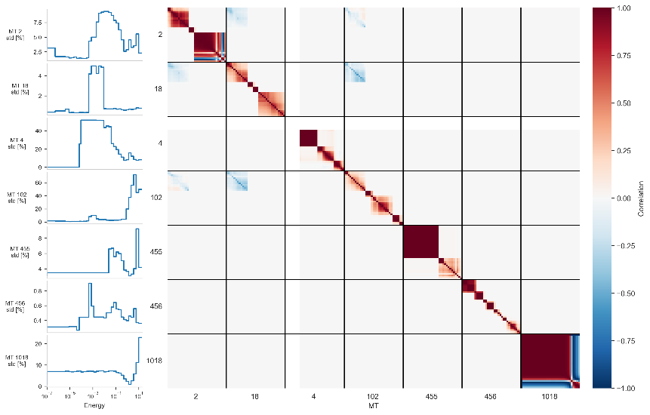
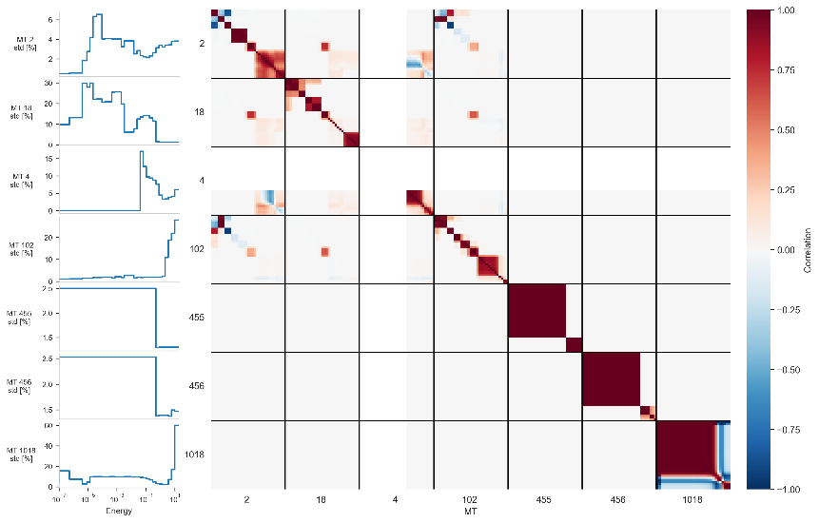
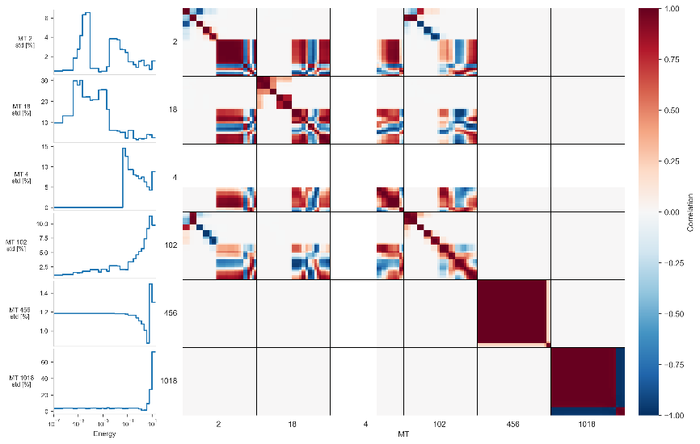
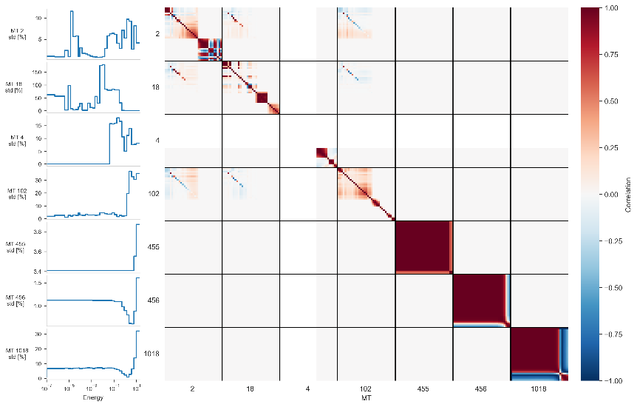
Covariance data

Slide 20
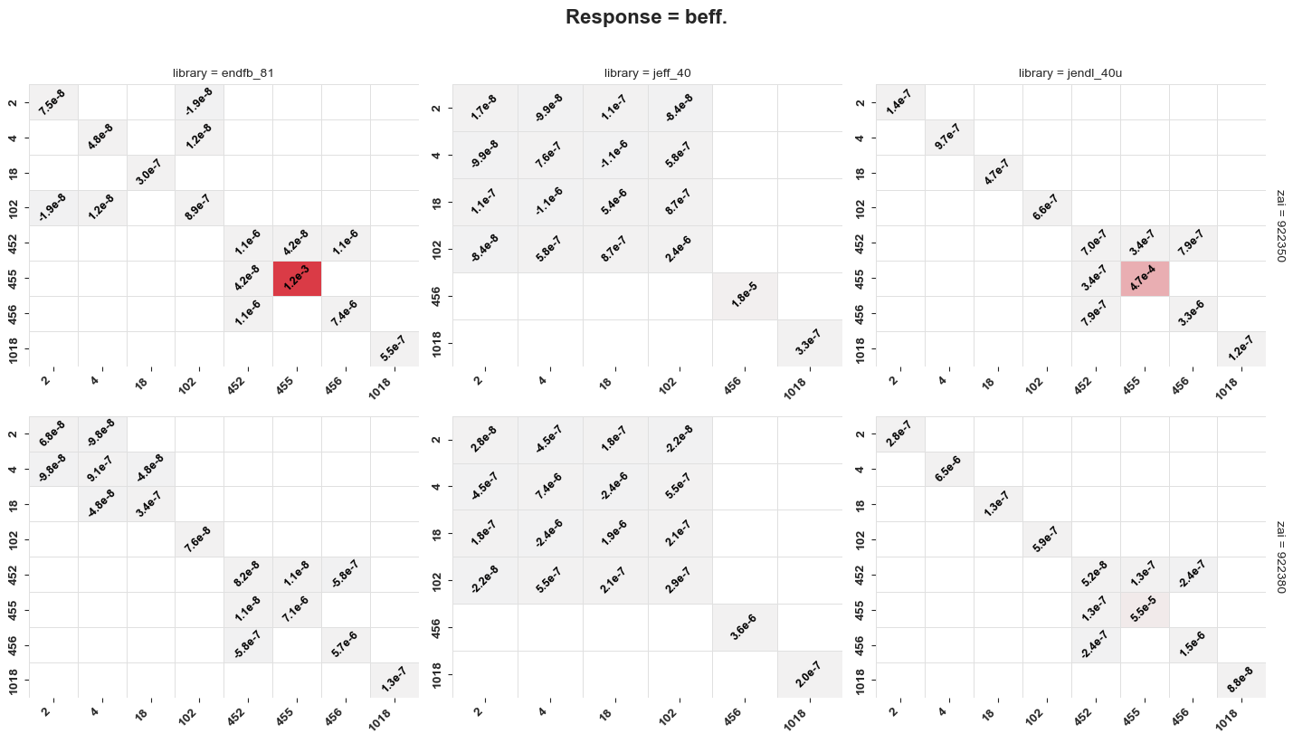
beta_eff uncertainty – Variance fraction

Slide 21
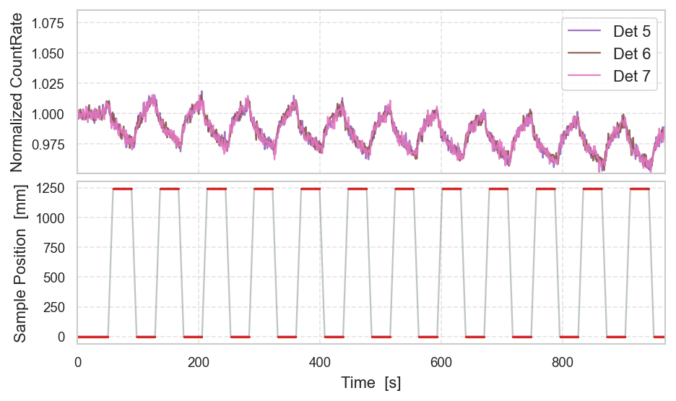

Oscillation experiments in VENUS-F
Global Effect
Detectors
$$Δρ$$
Sample

Slide 22
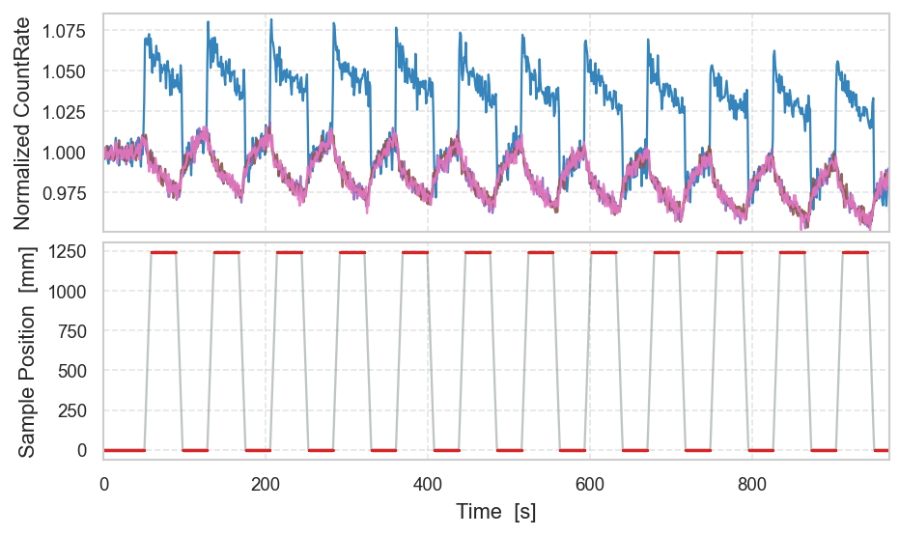
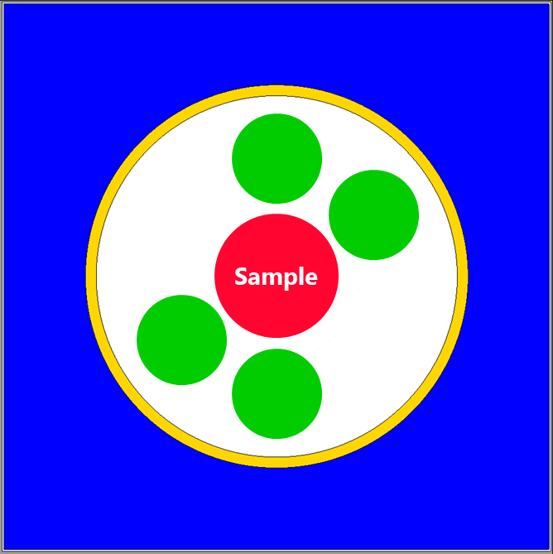
Oscillation experiments in VENUS-F
Global Detectors
Local + Global Effect
Local Detectors
Notes:
Additional piece of information for experiment analysis, interpretation
Global on top of the detector slide

Slide 23
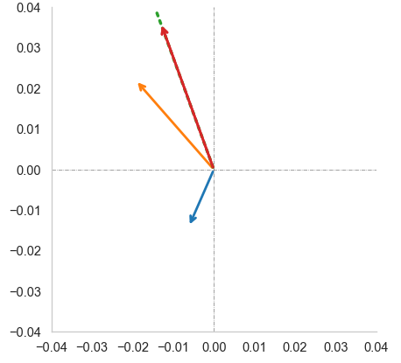
Oscillation experiments in VENUS-F
Local + Global Effect
Detectors
Local Effect
Local Detectors
Local Signal
Global
Notes:
Additional piece of information for experiment analysis, interpretation

Slide 24
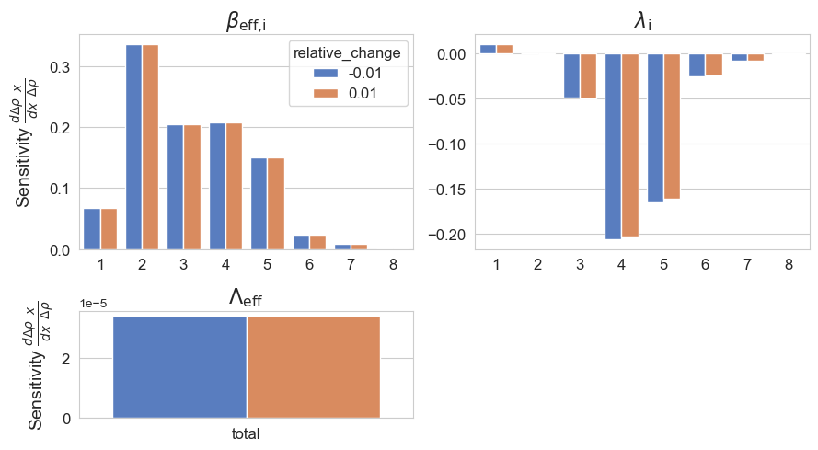
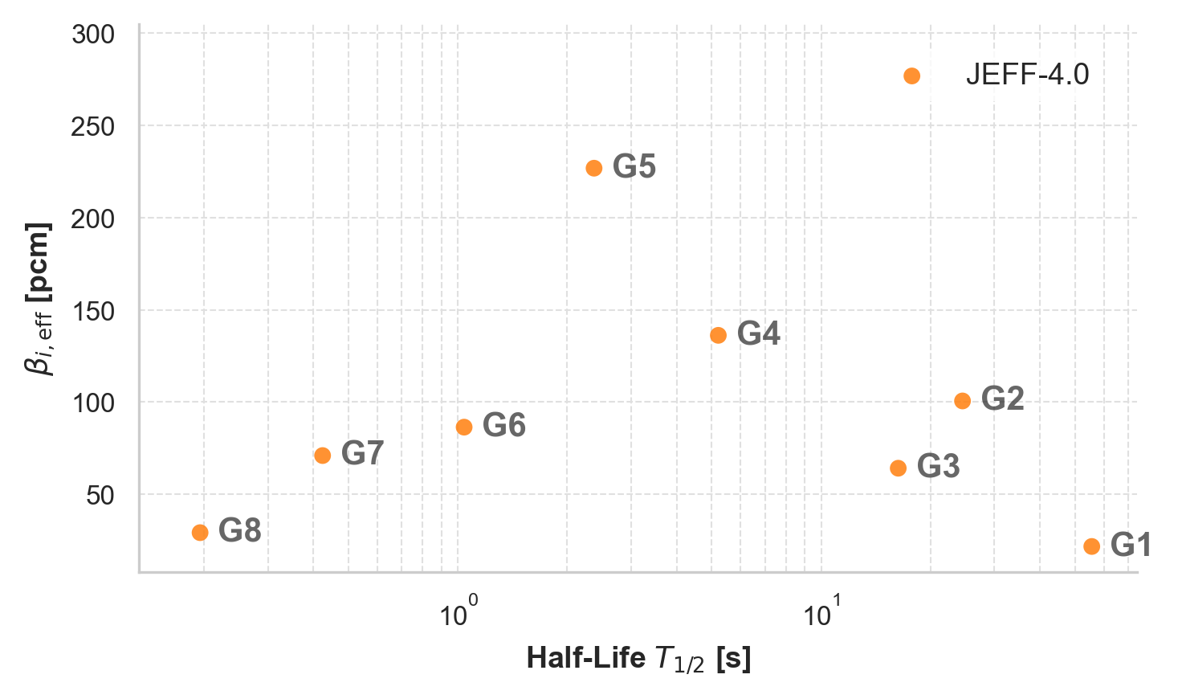
$∆ρ$ sensitivity to the kinetic parameters
Separate one-at-a-time perturbation of each parameter of 1%.

Slide 25
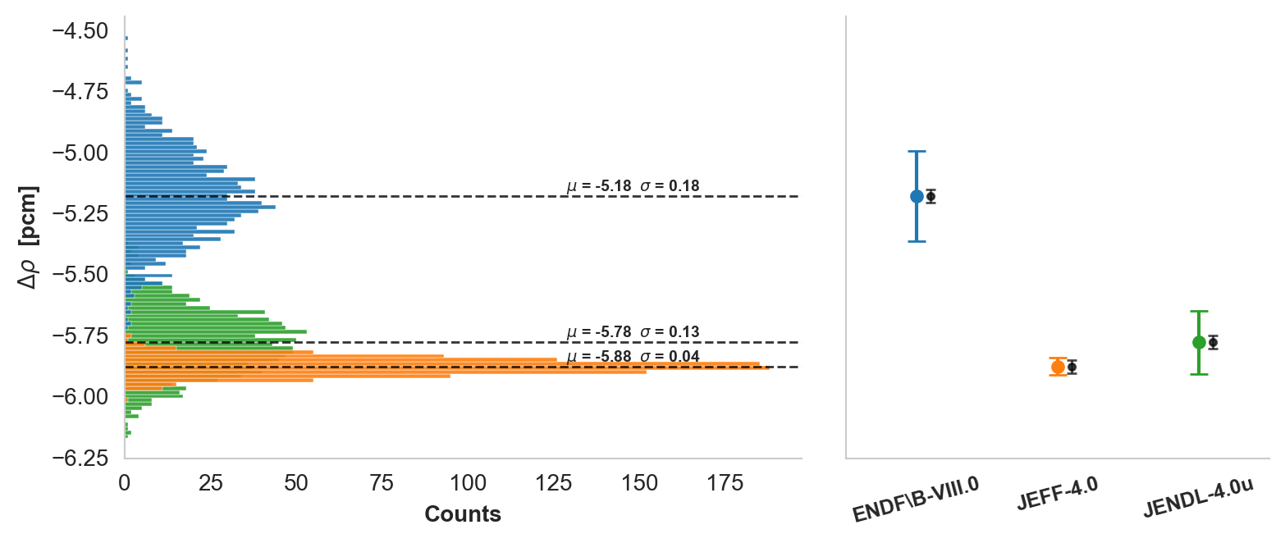

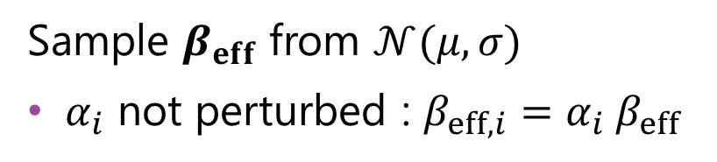
$β_{eff}$ impact to $Δρ$: ND uncertainty
Sample $β_{eff}$ from $𝒩(μ,σ)$
$α_{i}$ not perturbed : $β_{eff,i}=α_{i} β_{eff}$
ND $≫$ exp. uncertainty ($≤$ 0.04 pcm)
Persisting disagreement between libraries
Notes:
Stress alpha_i assumption

Slide 26
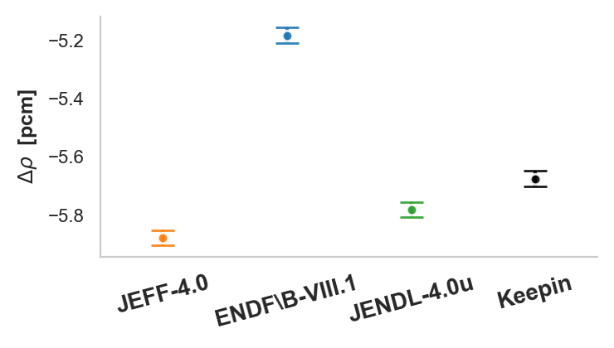
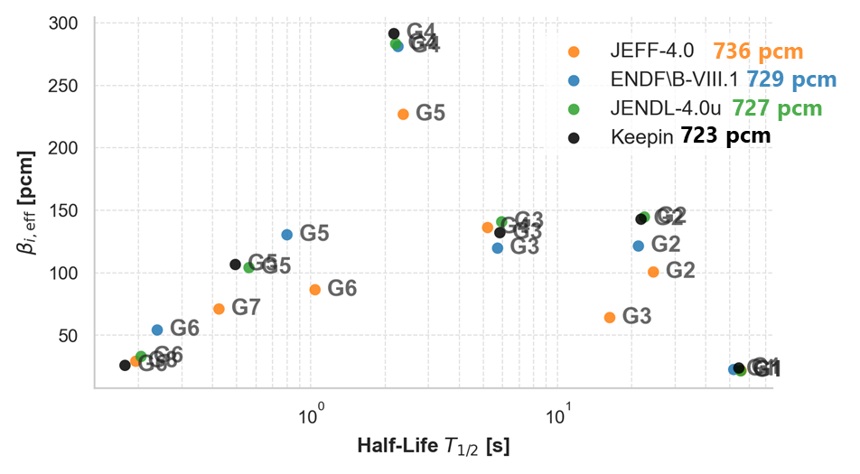
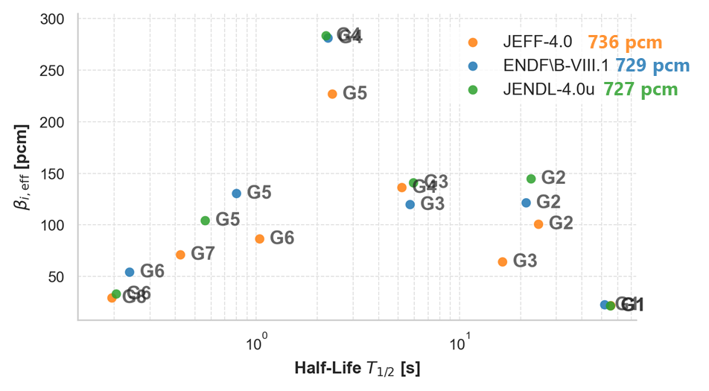
Impact of nuclear data libraries
+ Keepin data
Pure measurement uncertainty, prior to ND uncertainty propagation

Slide 27
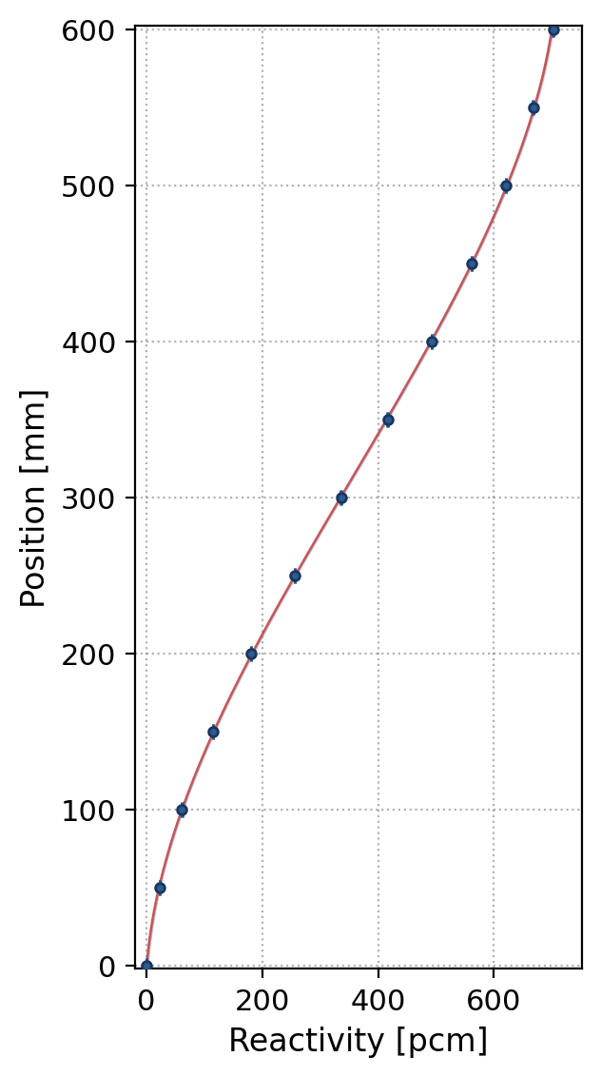
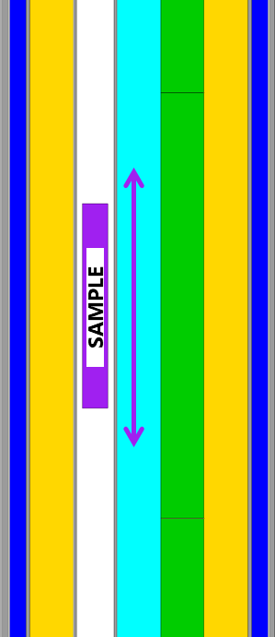
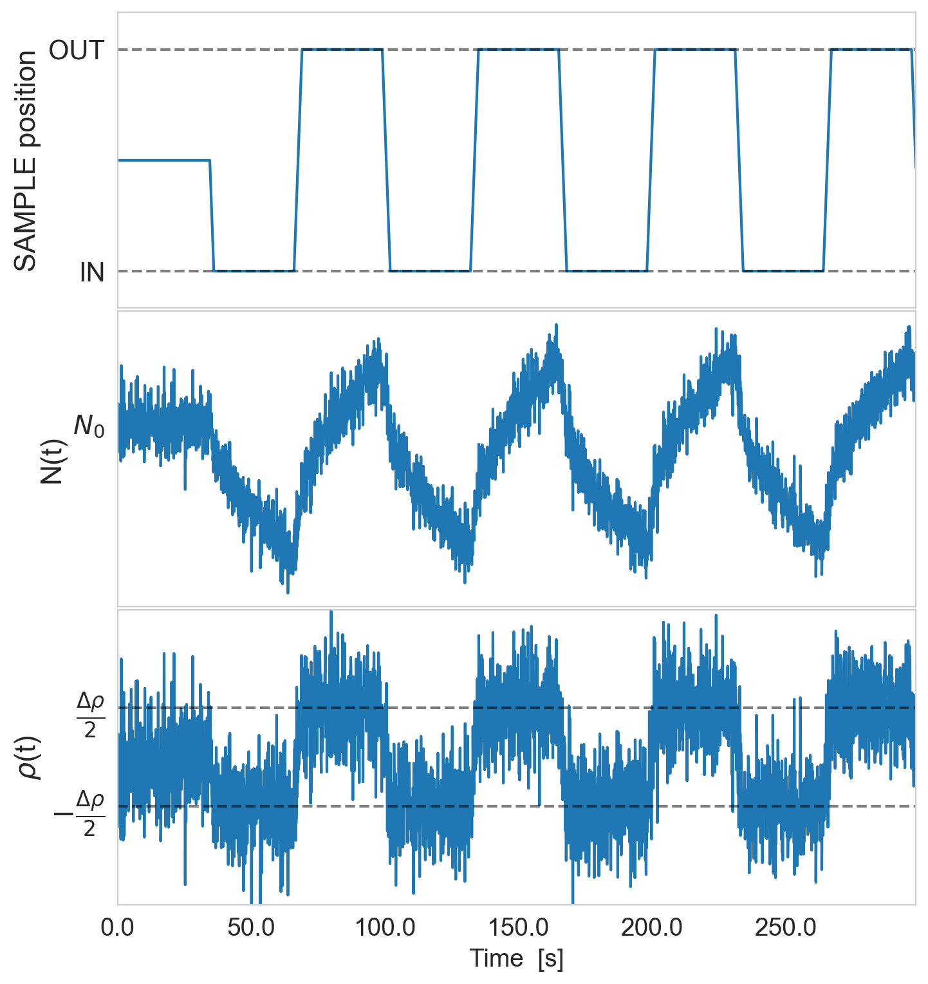
Reactivity measurements in VENUS-F
Oscillation Experiments
Control Rod Calibration
Control Rod

