Slide 1
Data-driven evaluation of Fe-56 elastic-scattering angular distributions and covariances
WONDER26 – JUNE 2026
PSN-RES/SNC/LN
Juan Antonio Monleon
(phd student)
Mariya Brovchenko (ASNR)
Dimitri Rochman (Nagra)

Slide 2
MOTIVATION AND BACKGROUND
01

Slide 3
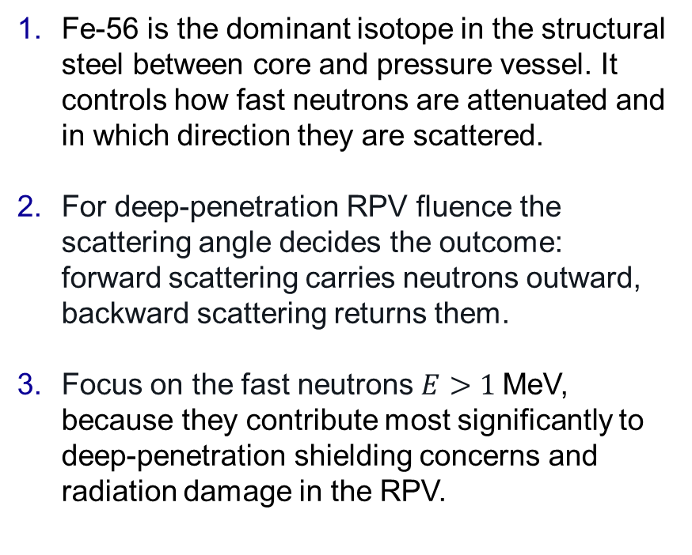
Why angular-distribution covariances for Fe-56
Fe-56 is the dominant isotope in the structural steel between core and pressure vessel. It controls how fast neutrons are attenuated and in which direction they are scattered.
For deep-penetration RPV fluence the scattering angle decides the outcome: forward scattering carries neutrons outward, backward scattering returns them.
Focus on the fast neutrons $E>1$MeV, because they contribute most significantly to deep-penetration shielding concerns and radiation damage in the RPV.
THE PREMISE
A propagated uncertainty is only as good as the covariance it rests on
For Fe-56 elastic angular distributions, those covariances are sparse and inconsistent across libraries.

Slide 4
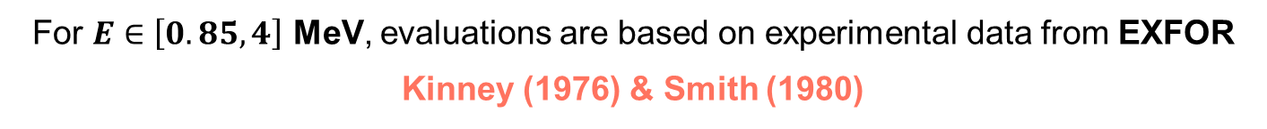
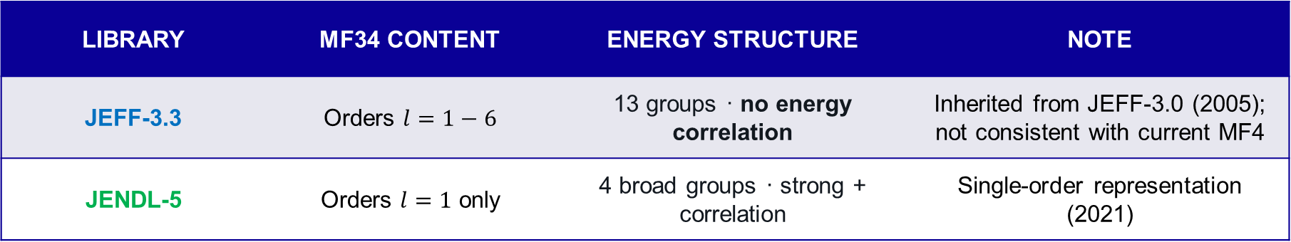
The State of MF34 in the major libraries
For $E∈\left[0.85,4\right]$ MeV, evaluations are based on experimental data from EXFOR Kinney (1976) & Smith (1980)
For this energy region:
LIBRARY | MF34 CONTENT | ENERGY STRUCTURE | NOTE
JEFF-3.3 | Orders $l=1−6$ | 13 groups · no energy correlation | Inherited from JEFF-3.0 (2005); not consistent with current MF4
JENDL-5 | Orders $l=1$ only | 4 broad groups · strong + correlation | Single-order representation (2021)
The nominal MF4 grid holds more than 1,000 pointwise energies in this window.
The covariance resolution is far coarser than the data it acts on.

Slide 5
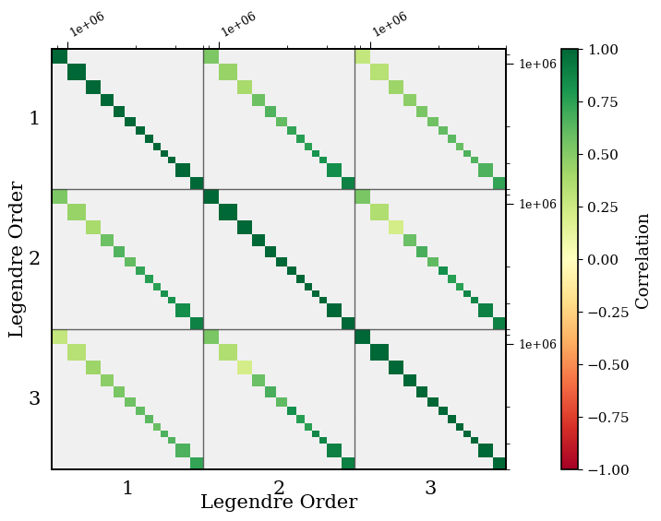
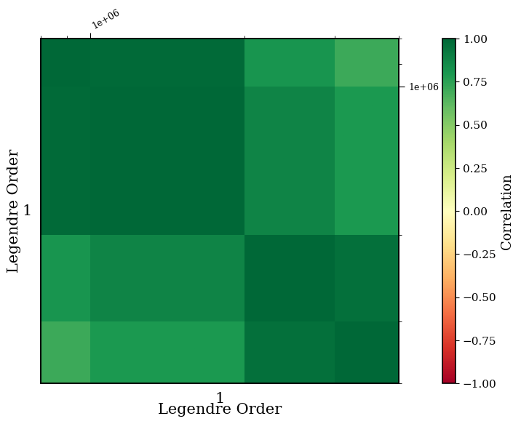
Coarse, inconsistent energy structure
JEFF-3.3 (orders 1–3) — 13 energy groups, block-diagonal: no correlation between them.
JENDL-5 (order 1) — 4 broad groups with strong positive energy correlation throughout.

Slide 6
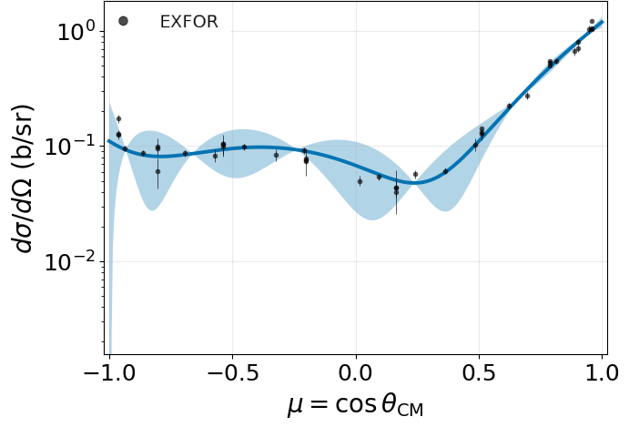
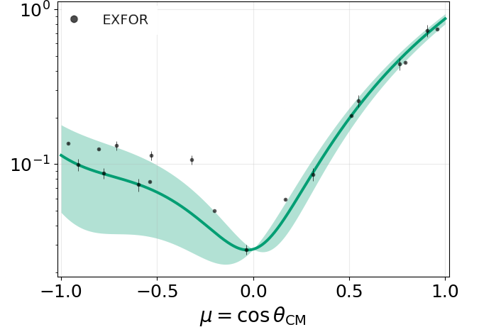
Single-order covariances drive unphysical bands
JEFF-4.0* — ℓ = 6 contribution at 2.8 MeV. Large high-order variance produces an oscillatory, lobed band
JENDL-5 — ℓ = 1 only at 1.57 MeV. The band is dipolar and collapses to zero at cos θ = 0
*covariance from JEFF-3.3

Slide 7


How well do libraries fit the data?
Both libraries sit far above unity even after their own MF34 is folded in.
≫1
Χ²/N ON THE FULL EXFOR DATABASE
Library
JEFF-4.0 | 33.3 | 20.5
JENDL-5 | 33.6 | 25.4
Their agreement is carried by the Kinney & Smith calibration anchors. Removing them degrades both by ≈ 1.4×. Campaigns are internally consistent but mutually offset by more than their declared uncertainties.
$$σ_{exp}$$
$$σ_{exp} ⨁{ σ}_{MF34}$$
67 experiments · ≈ 47,000 angular points
Motivates an independent evaluation built from the full database.

Slide 8
The evaluation pipepline
02

Slide 9
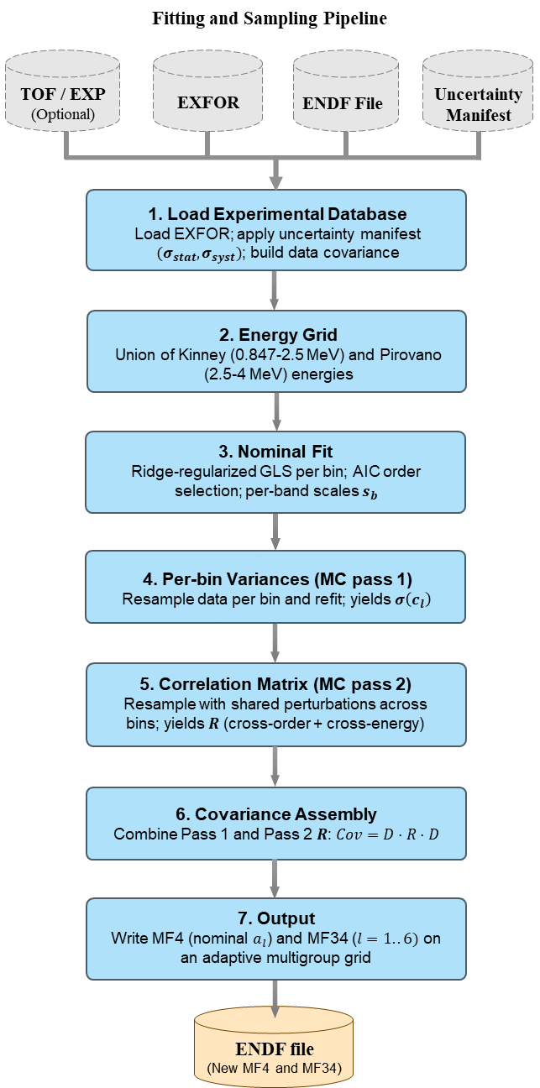
Pipeline overview
EXFOR database
Uncertainty manifest
FOUR INPUTS
Reference ENDF
TOF parameters (opt)
A nominal fit sets the central coefficients; two Monte Carlo passes supply the variances and the full correlation structure; assembly and an adaptive collapse produce the MF34.
1,738
526
energy bins
final multigroups
No prior knowledge

Slide 10
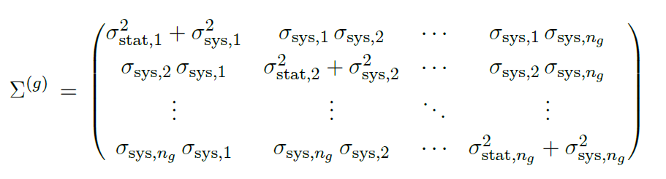
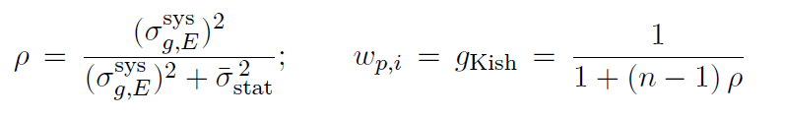


The experimental database
67
Drawn from EXFOR over 847 keV–4 MeV
From the EXFOR ERR-ANALYSIS
experiments
$$σ_{stat}$$
$$σ_{syst}$$
Kish effective sample size
Points from different experiments are taken as uncorrelated; the full data covariance is block-diagonal in experiment.

Slide 11


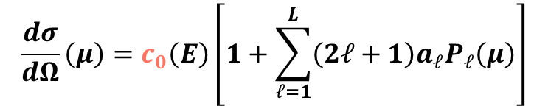
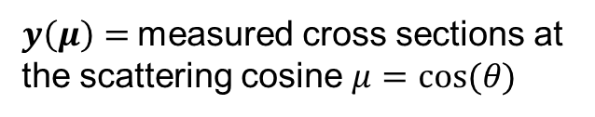
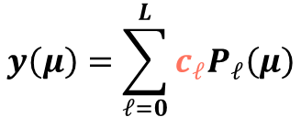


Nominal fit: ridge-GLS
ENDF-style shape normalized
$$y\left(μ\right)=\sum_{ℓ=0}^{L}{c_{ℓ}P_{ℓ}\left(μ\right)}$$
$$\frac{dσ}{dΩ}\left(μ\right)=c_{0}\left(E\right)\left[1+\sum_{ℓ=1}^{L}{\left(2ℓ+1\right)a_{ℓ}P_{ℓ}\left(μ\right)}\right]$$
$$a_{ℓ}=\frac{c_{ℓ}/c_{0}}{2ℓ+1}$$
$y\left(μ\right)=$measured cross sections at the scattering cosine $μ=cos⁡(θ)$
$P_{l}=$Legendre polynomial of order $ℓ$
$c_{l}=$The coefficient we solve for
$L=$ Highest order kept $(L=6)$
Ridge-regularized Generalized Least-Square
Points from different experiments are taken as uncorrelated; the full data covariance is block-diagonal in experiment.

Slide 12
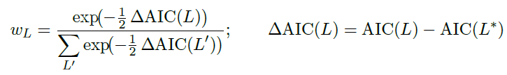

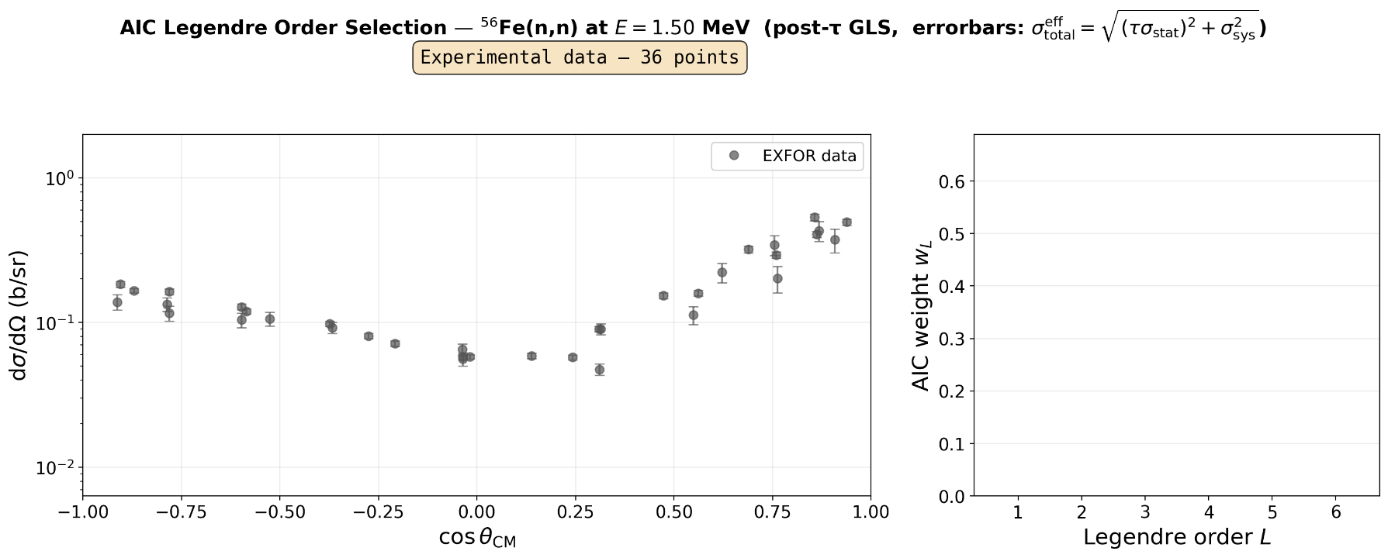
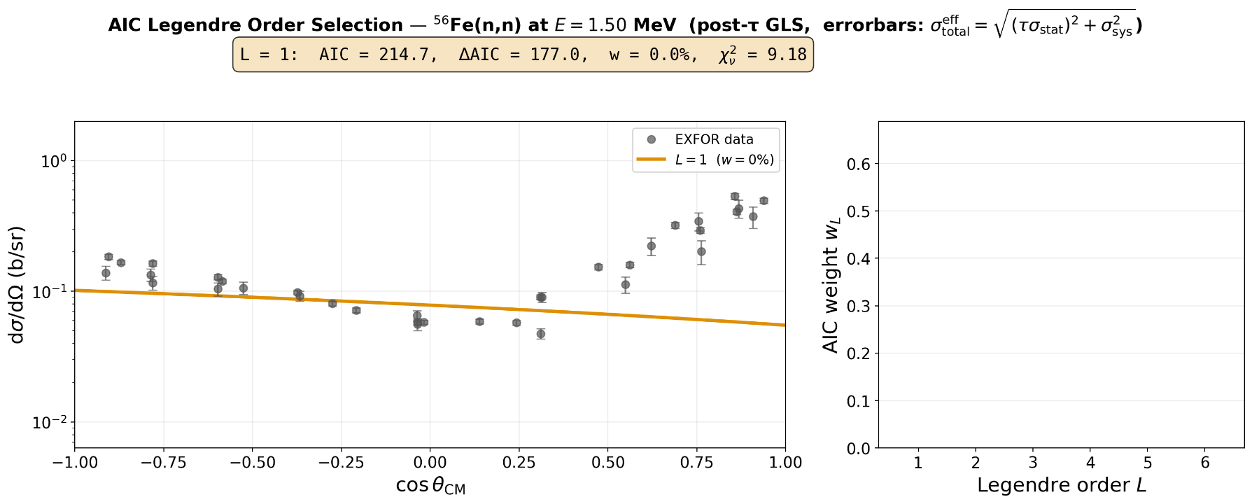
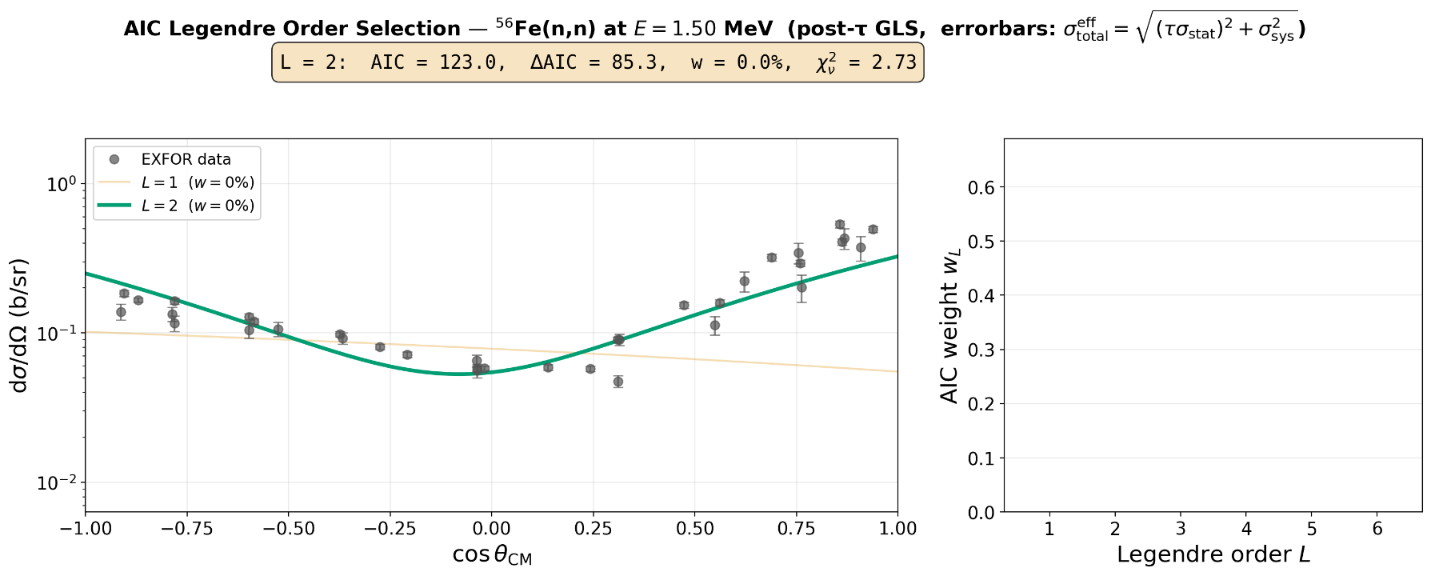
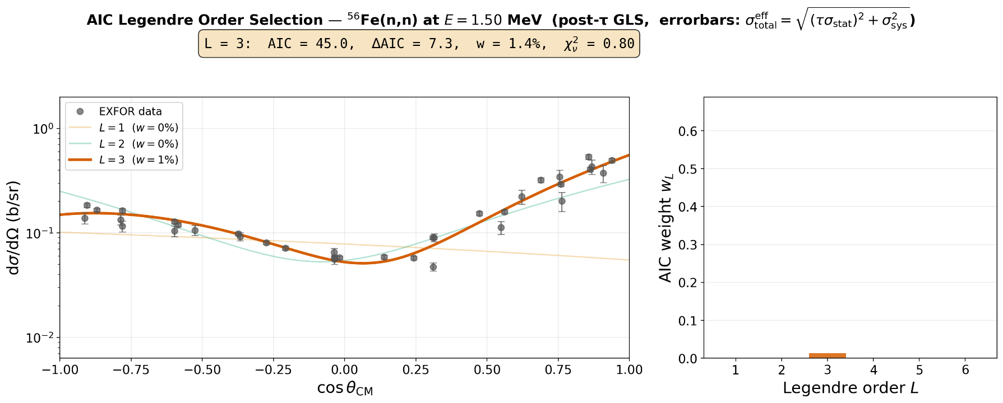
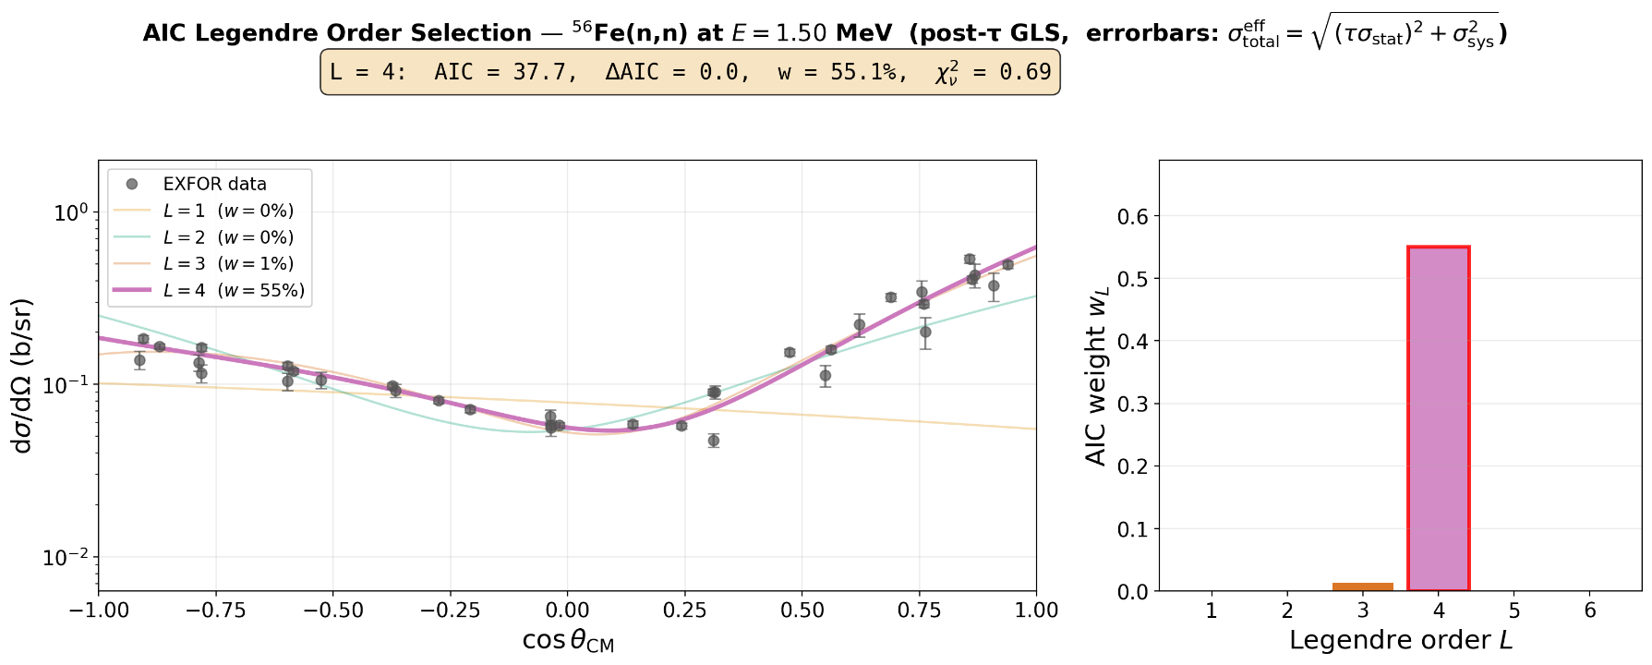
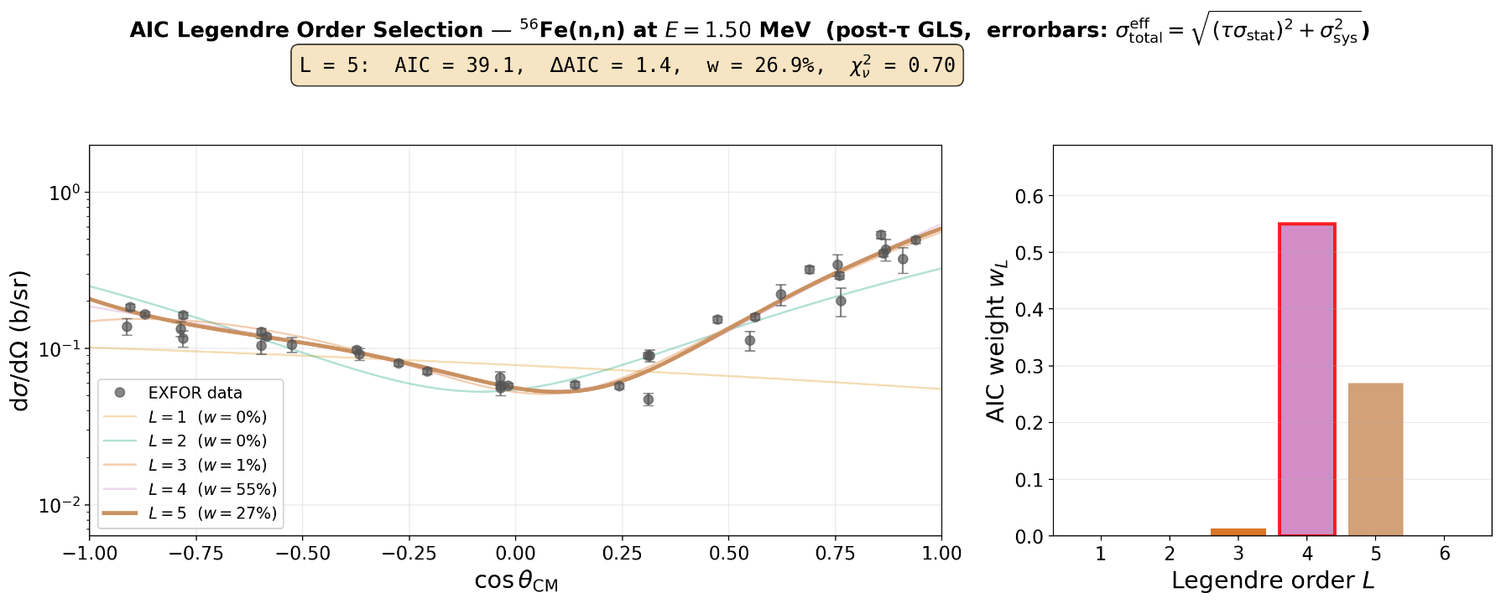
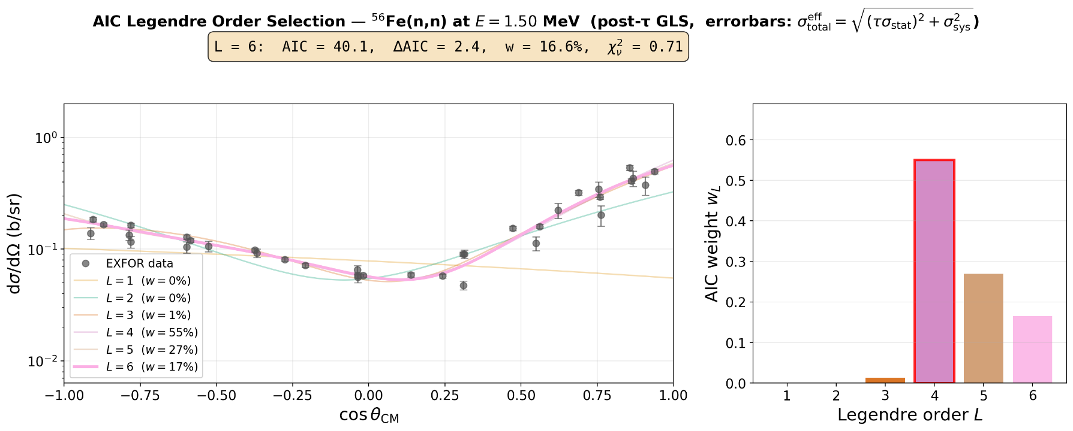
Nominal fit: order selection
Akaike weights
Points from different experiments are taken as uncorrelated; the full data covariance is block-diagonal in experiment.

Slide 13
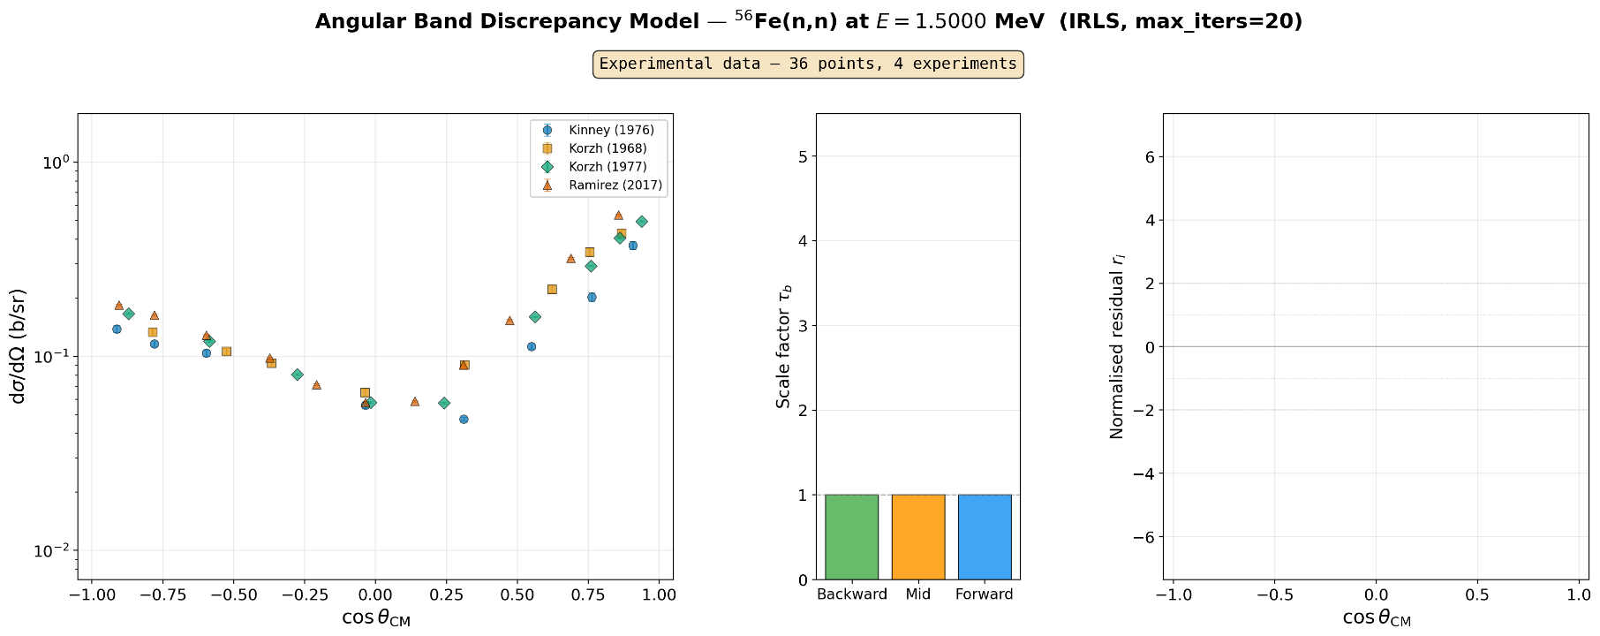
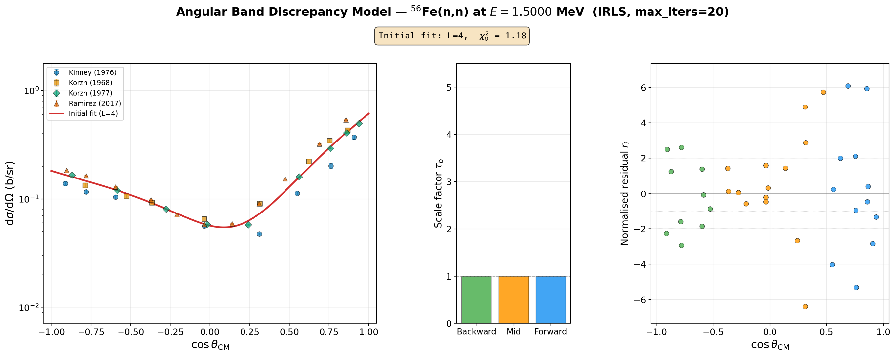
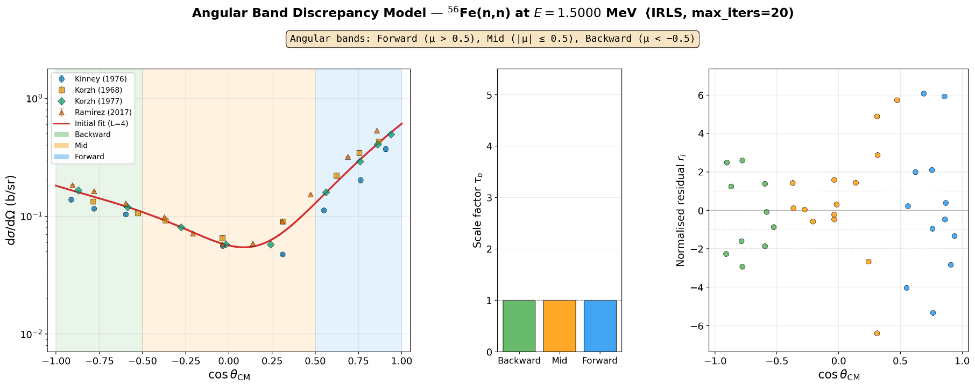
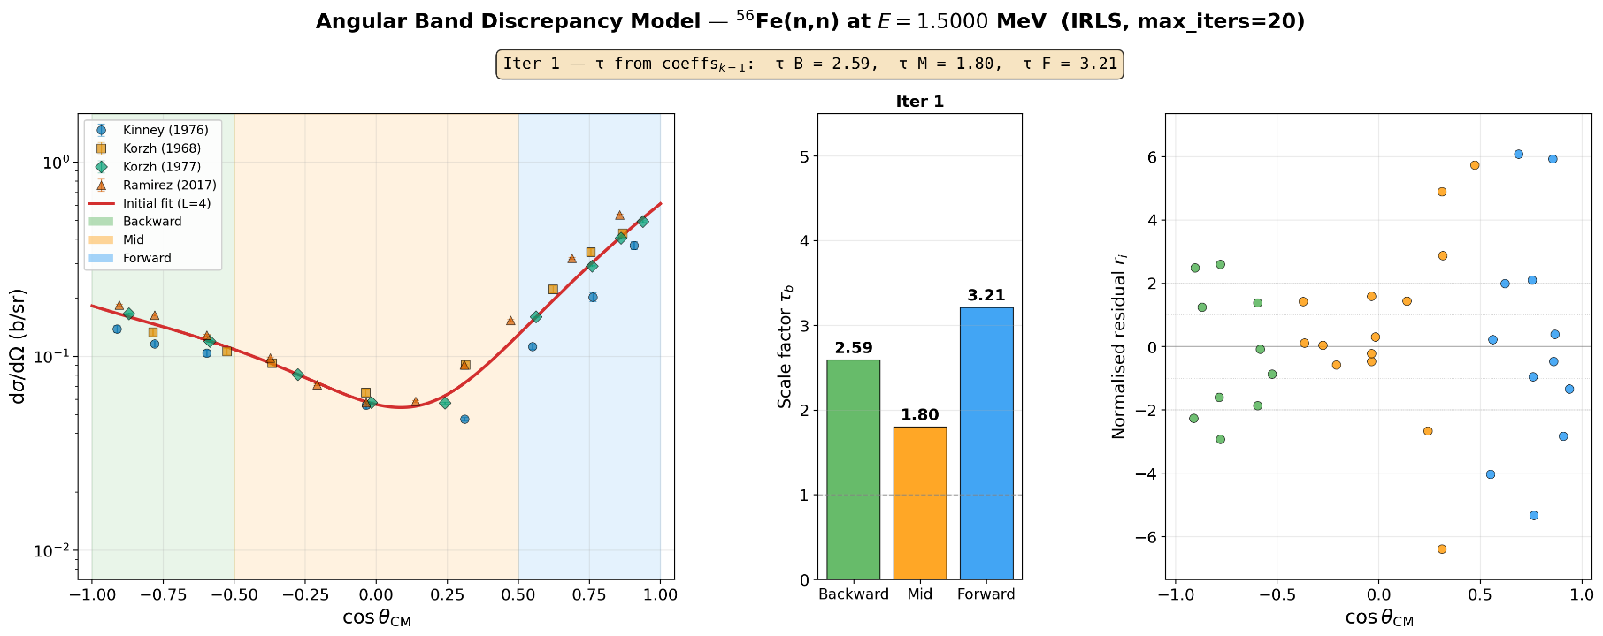
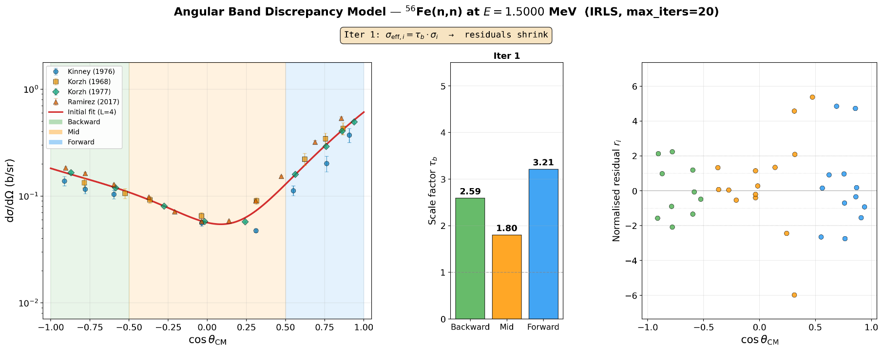
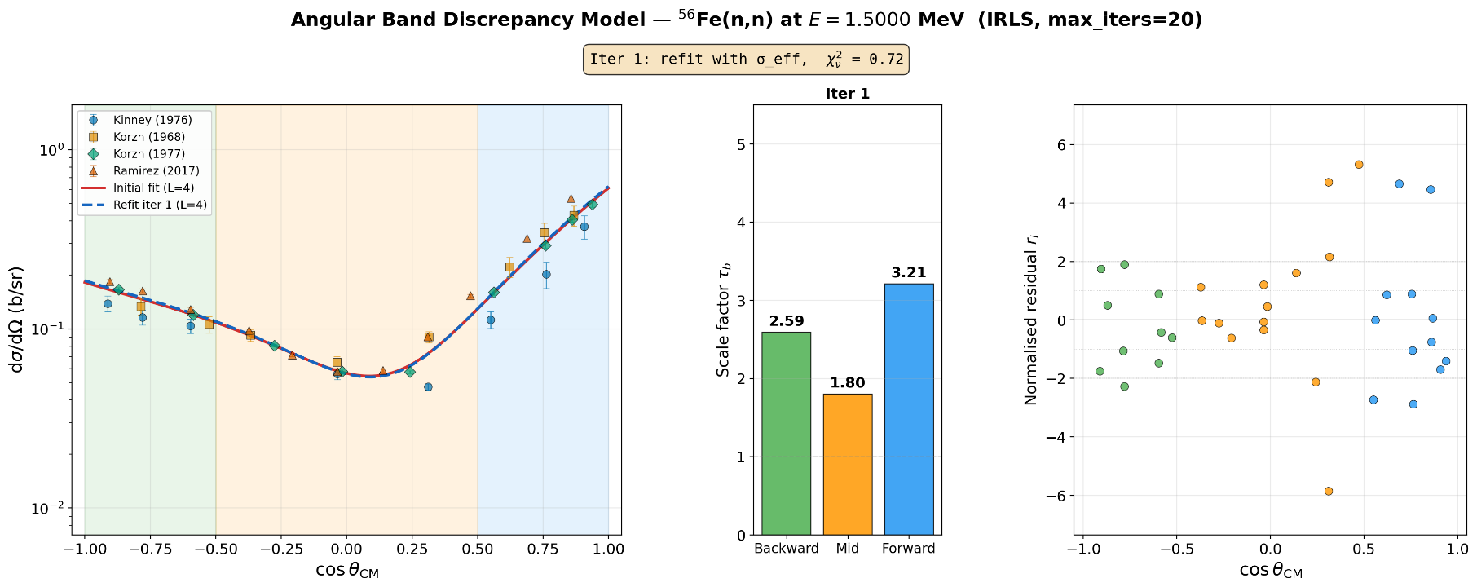
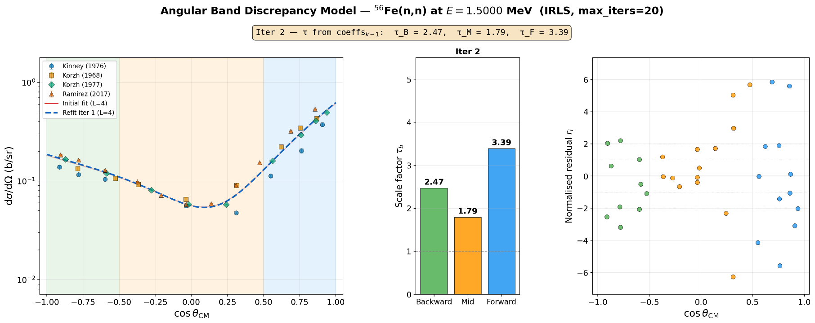
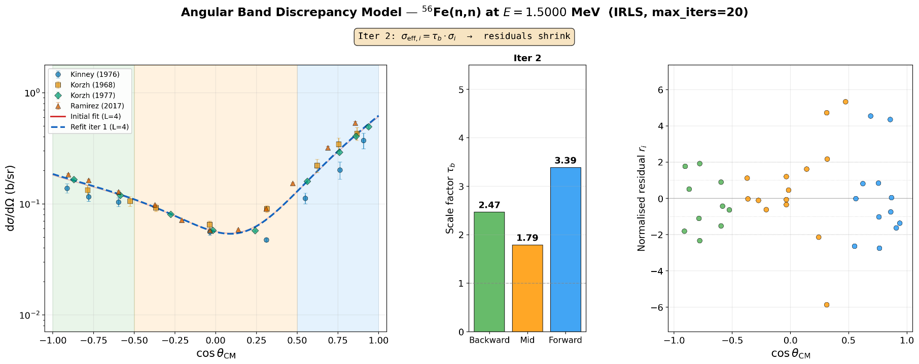
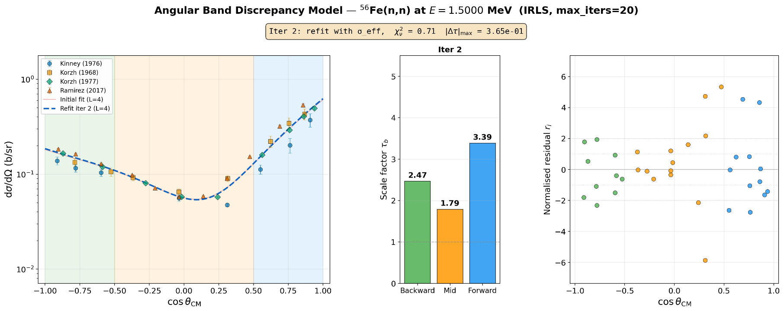

Nominal fit: tau bands
We Fix $c_{0}$ !
Points from different experiments are taken as uncorrelated; the full data covariance is block-diagonal in experiment.

Slide 14
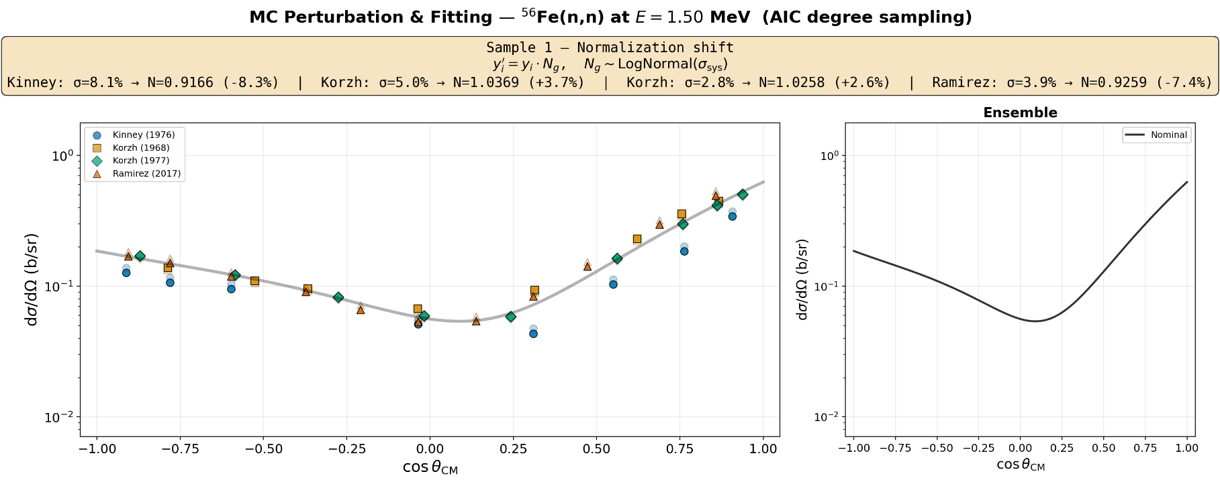
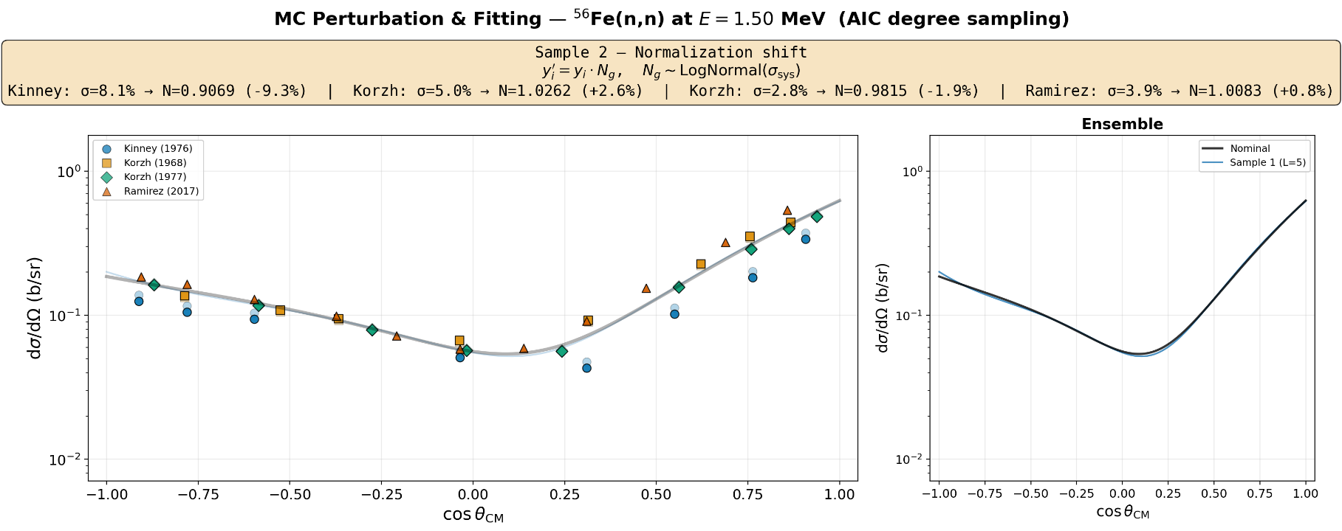
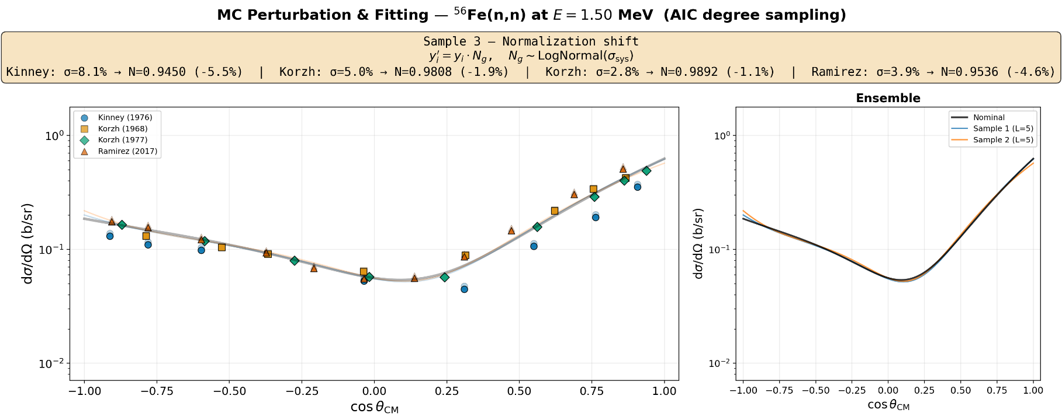
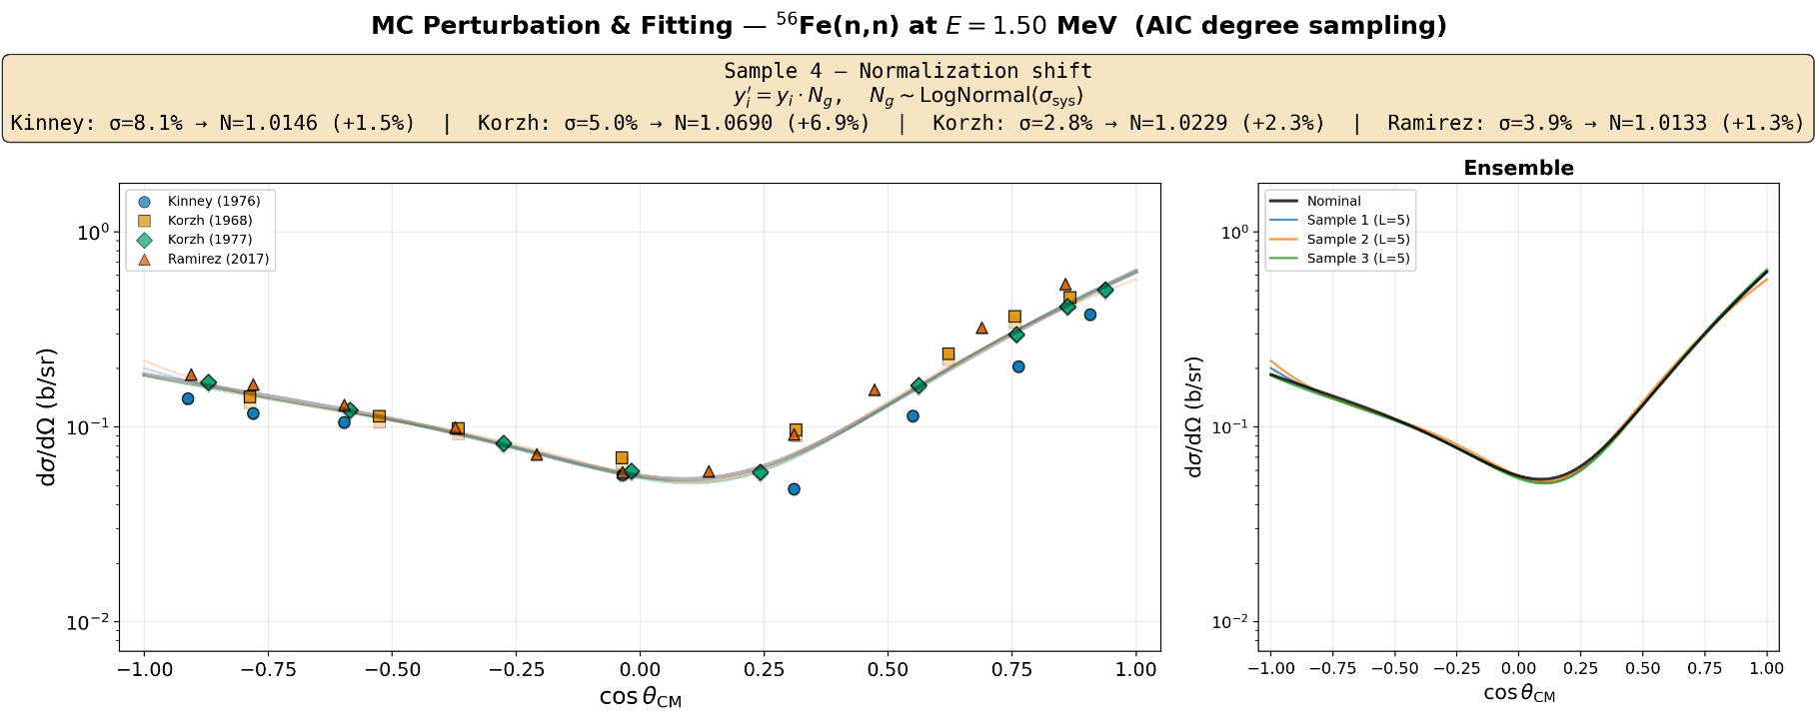
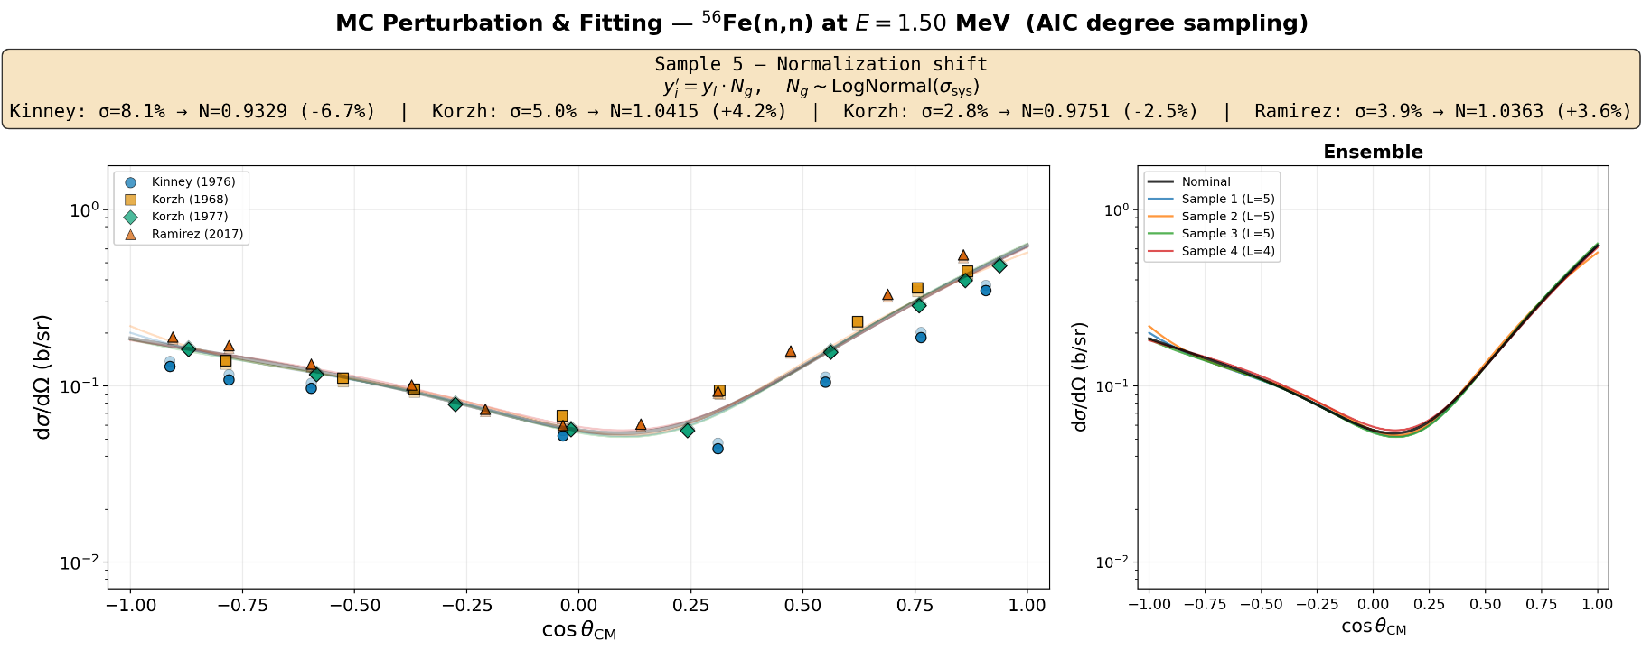
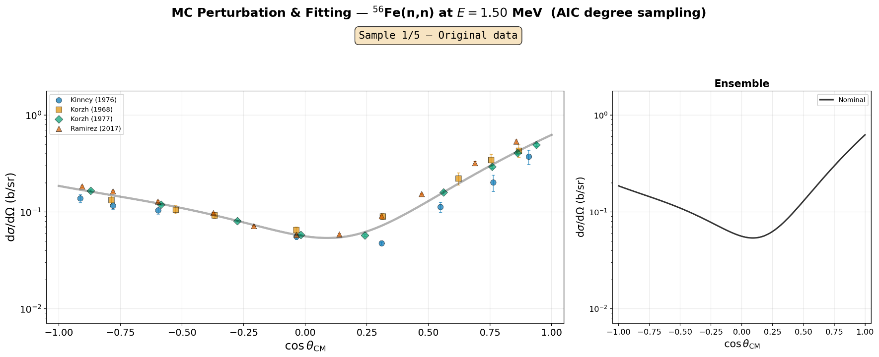
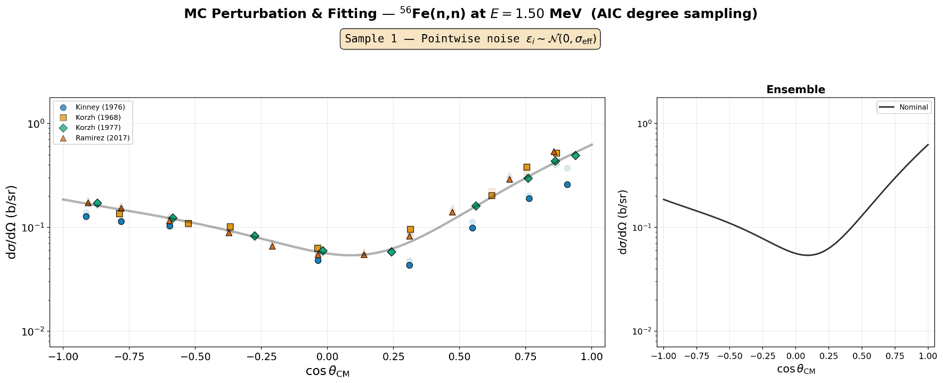
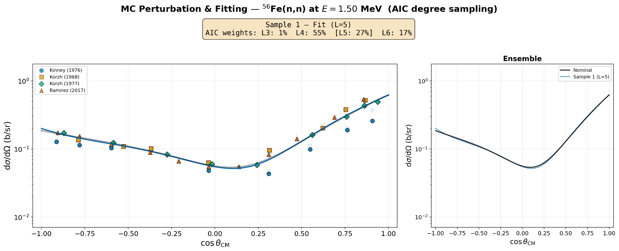
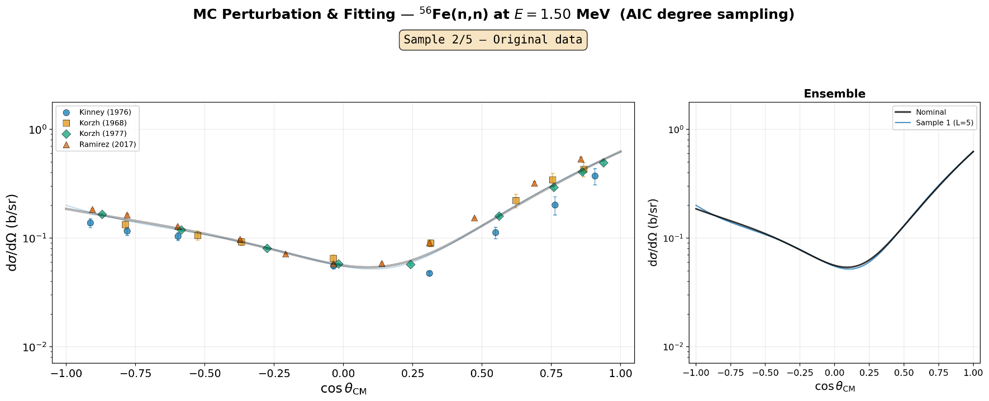
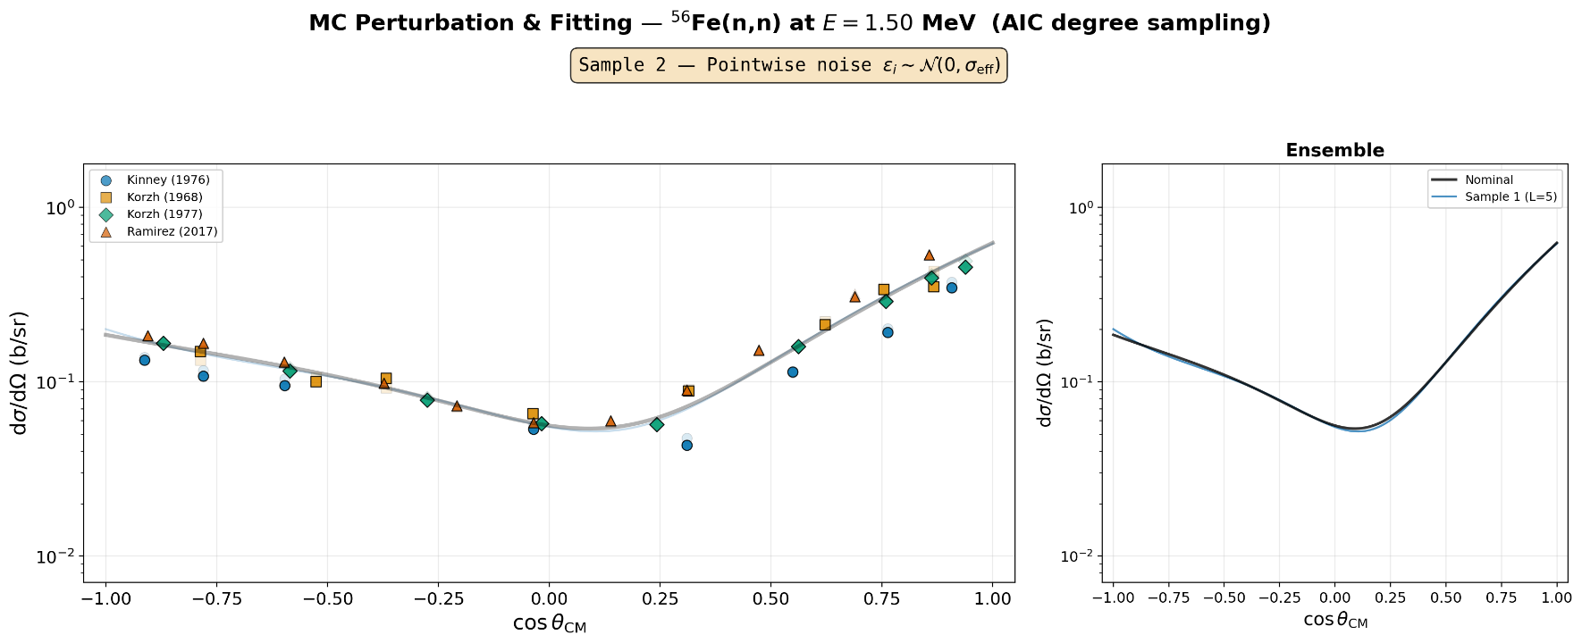
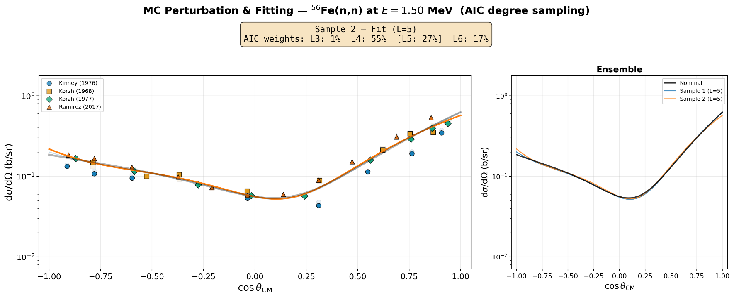
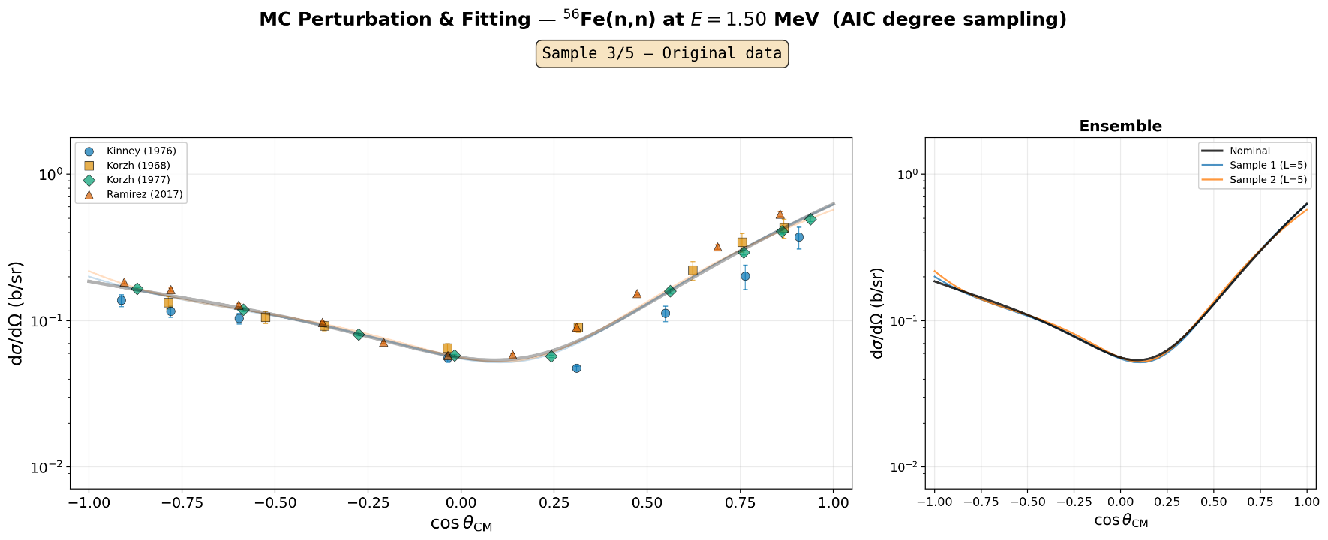
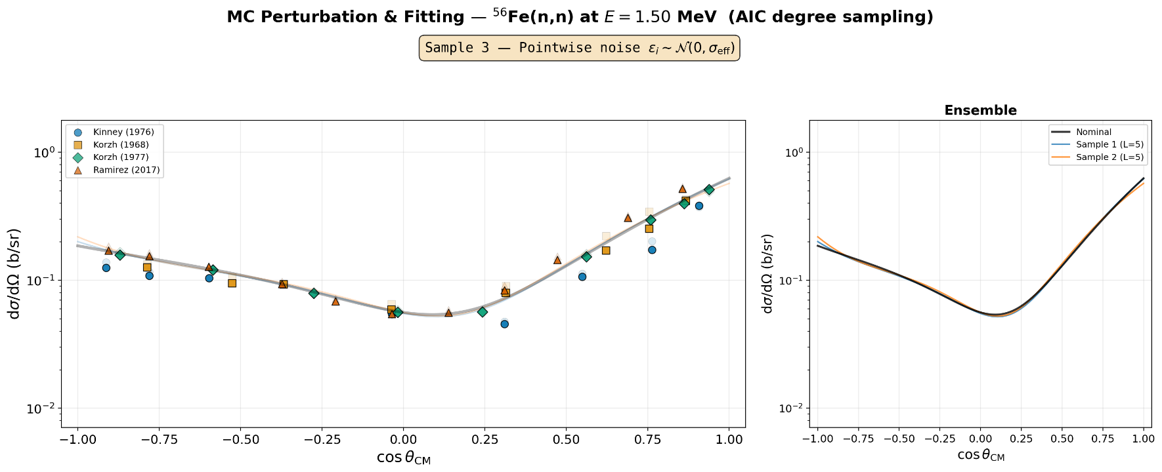
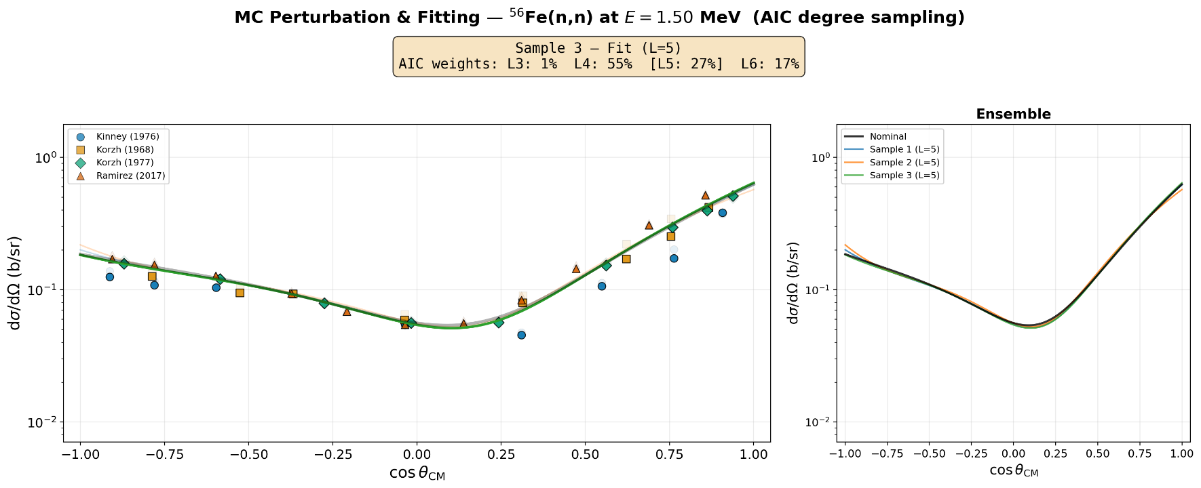
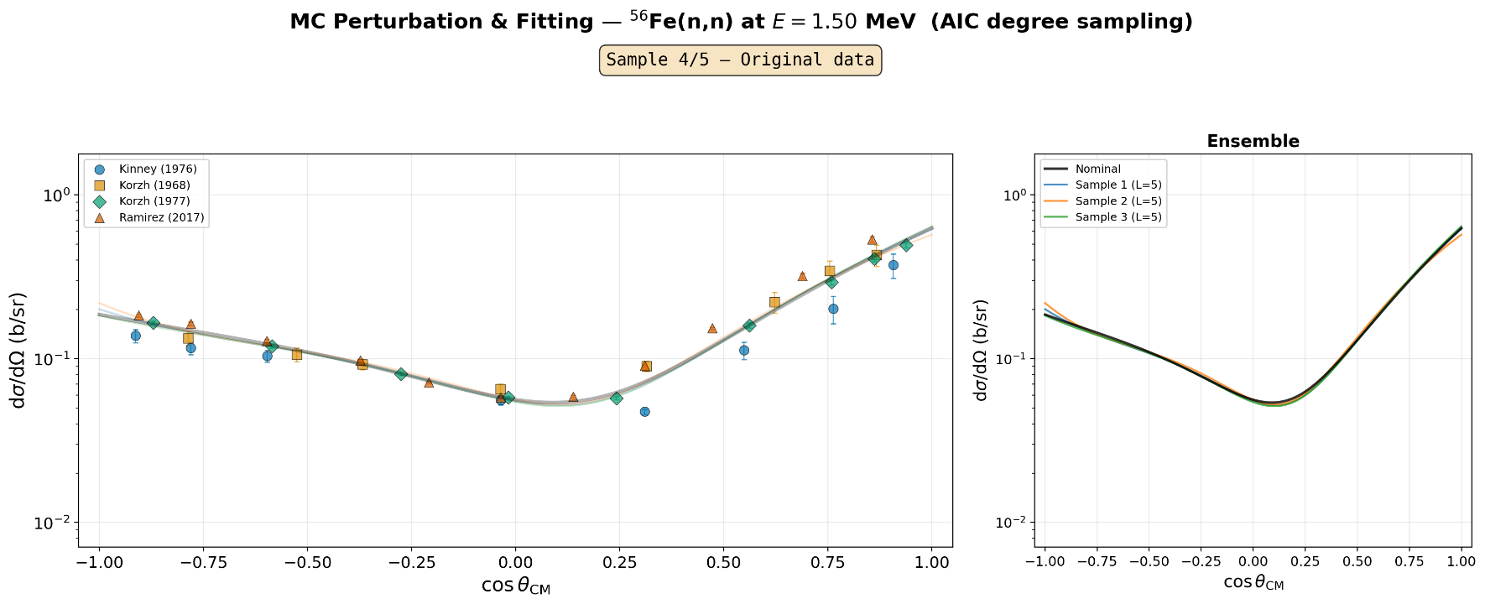
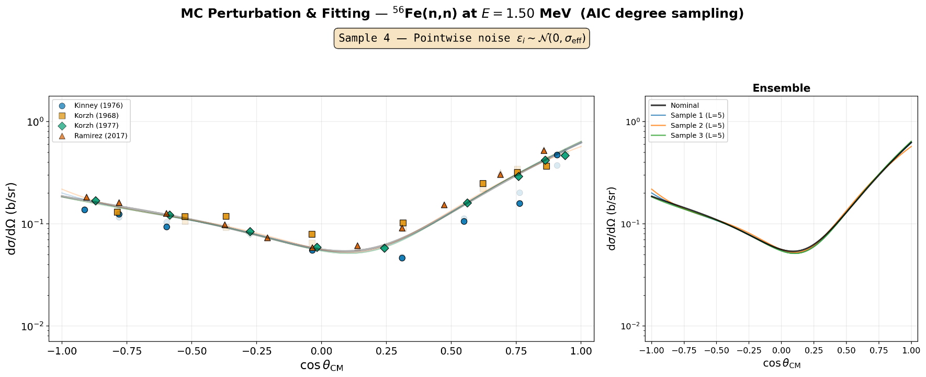
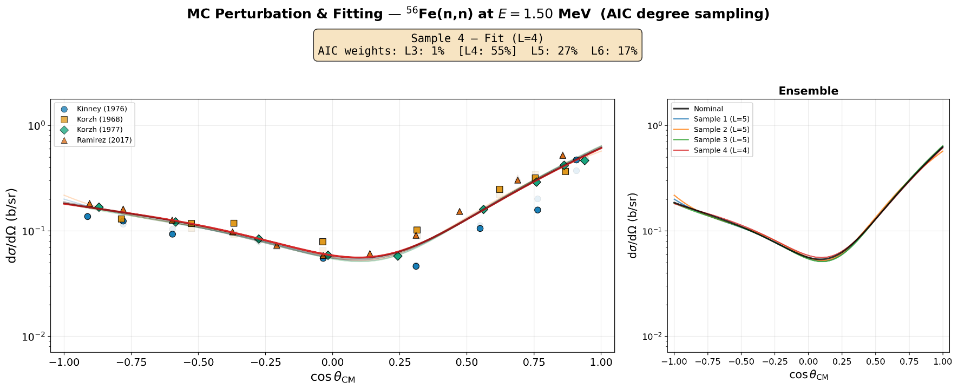
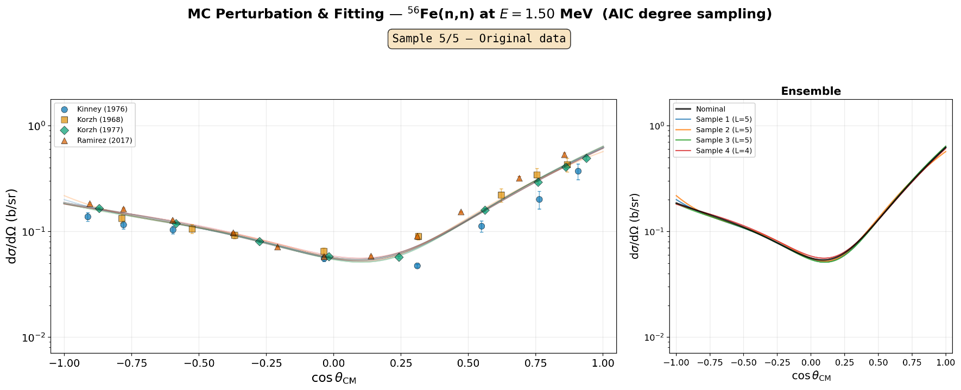
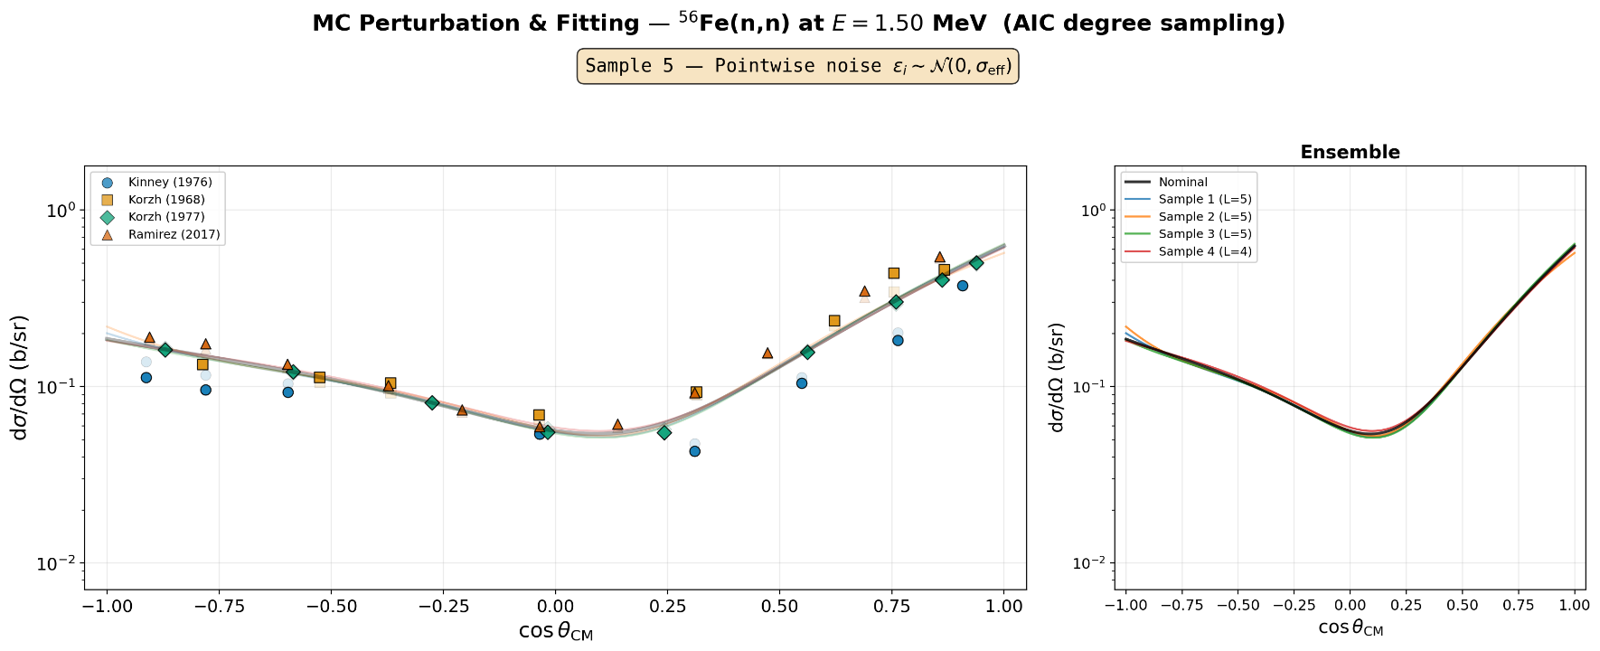
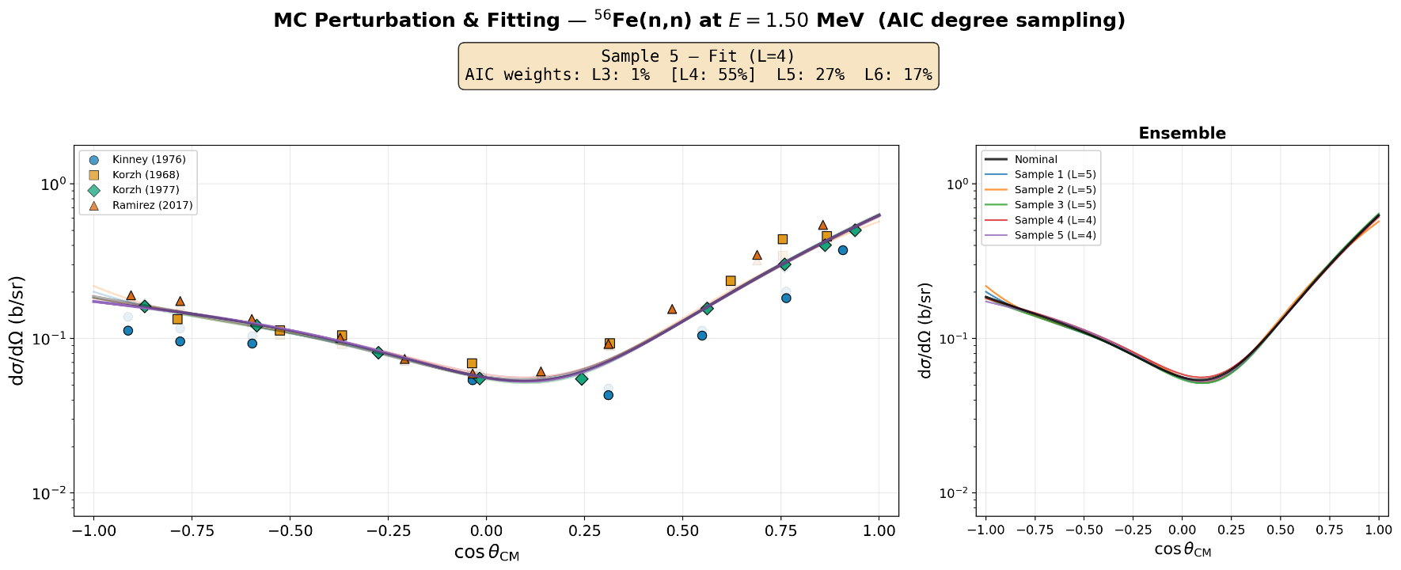


Variance calculation – mc pass 1
Fixed $c_{0}$ !
Points from different experiments are taken as uncorrelated; the full data covariance is block-diagonal in experiment.

Slide 15

correlation calculation – mc pass 2
Fixed $c_{0}$ !
Same procedure as Pass 1 but now considering points from nearby energy bins
Apply weighting factor according to their distance and the energy resolution of the experiment
Points from different experiments are taken as uncorrelated; the full data covariance is block-diagonal in experiment.

Slide 16
Covariance assembly and mf34 format
1
Per-bin variances
2
Kernel-weight correlation
→ marginal σ(a_{ℓ} ) per bin, carrying the diagonal of the covariance matrix
→ the full R: cross-order within a bin and cross-energy between bins.
ASSEMBLY
GROUP COLLAPSE
C = diag(σ) · R_{KW} · diag(σ)
Energy bins with high correlations are combined to reduce the size of the matrix
1738 → 526 groups
Points from different experiments are taken as uncorrelated; the full data covariance is block-diagonal in experiment.

Slide 17
Results and validation
03

Slide 18



Central values agree; covariance differs
Points from different experiments are taken as uncorrelated; the full data covariance is block-diagonal in experiment.

Slide 19

Example at 1.40 mev
JEFF-4.0
JENDL-5
This work
Points from different experiments are taken as uncorrelated; the full data covariance is block-diagonal in experiment.

Slide 20

Lower χ² across the database (exfor + mf34 covariance)
Full pool · χ²/N
This work
8.5
JEFF-4.0
20.5
JENDL-5
25.4
Excluding Kinney & Smith· χ²/N
This work
7.8
JEFF-4.0
27.7
JENDL-5
35.2
Points from different experiments are taken as uncorrelated; the full data covariance is block-diagonal in experiment.

Slide 21


Out-of-sample test: Gkatis 2025
Χ²/N ON G. GKATIS (2025)
Library
JEFF-4.0 | 728.9 | 591.7
JENDL-5 | 639.0 | 623.4
This work | 323.0 | 245.1
A 784-point double-differential measurement (1.01–3.93 MeV)
For this work, Gkatis is in-sample experiment
so direct comparison should be taken with caution
$$σ_{exp}$$
$$σ_{exp} ⨁{ σ}_{MF34}$$

Slide 22
conclusions
WHAT THIS WORK DELIVERS
LIMITATIONS & OUTLOOK
A reproducible, purely data-driven MF4 + MF34, between [0.85 – 4 MeV]
—
χ²/N still > 1 for all three. Uncertainties may still underestimate the spread although MF33 covariances are not considered here
✓
Uncertainty spread across orders smooth, interpretable bands.
✓
Many bins rest on only 1–2 experiments (often Kinney alone).
—
✓
Shape and magnitude decoupled
—
Check for continuity issues function of energy
Better performance on the χ²/N metrics compared to JEFF and JENDL libraries
✓

Slide 24

Lower χ² across the database (only exfor covariance)
Full pool · χ²/N
This work
16.8
JEFF-4.0
33.3
JENDL-5
33.6
Excluding Kinney & Smith· χ²/N
This work
17.0
JEFF-4.0
44.9
JENDL-5
46.7
Points from different experiments are taken as uncorrelated; the full data covariance is block-diagonal in experiment.

