Slide 1
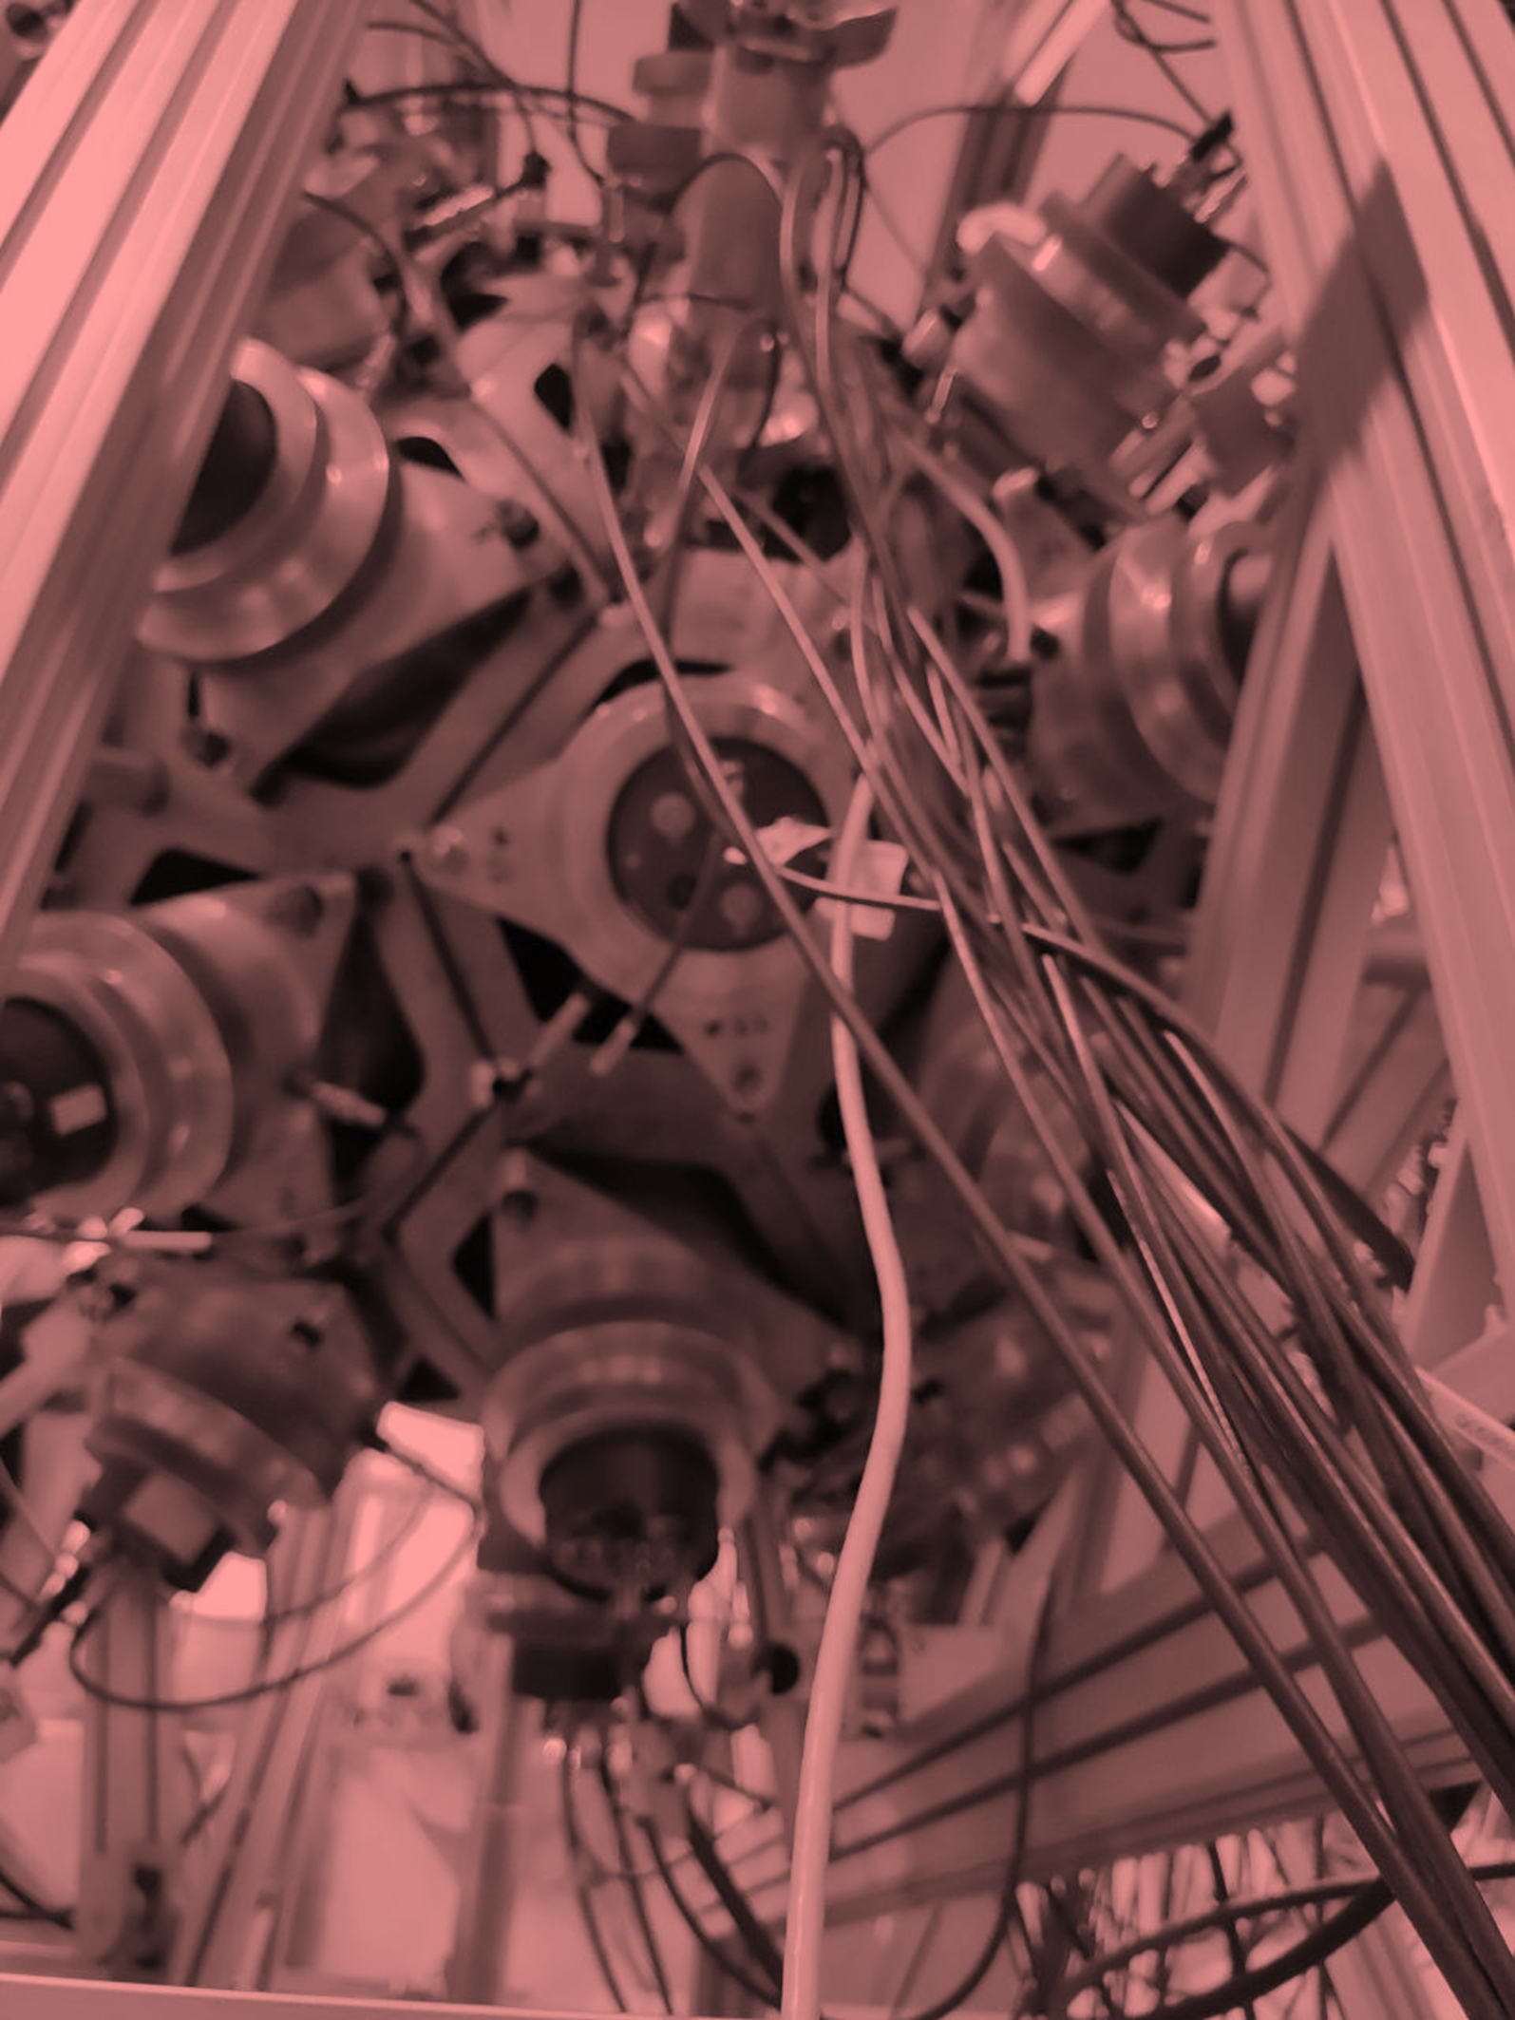



Final results of the ²³⁹Pu capture and fission cross section measurements at n_TOF (CERN)
A. Sanchez-Caballero¹, V. Alcayne¹, J. Andrzejewski², D. Cano-Ott¹, J. García-Pérez¹, E. Gónzalez-Romero¹, J. Heyse³, T. Martínez¹, E. Mendoza¹, J. Perkowski², J. Plaza del Olmo¹, A. Plompen³, P. Schillebeeckx³, G. Sibbens³, and the n_TOF collaboration.
¹CIEMAT, Spain
²University of Lodz, Poland
³JRC-Geel, Belgium

Slide 2
Contents
Overview of the ²³⁹Pu measurement at n_TOF.
Summary of the data analysis.
Fission results.
Capture results.
Conclusions.

Slide 3
1
Overview of the ²³⁹Pu measurement at n_TOF
Experimental setup

Slide 4
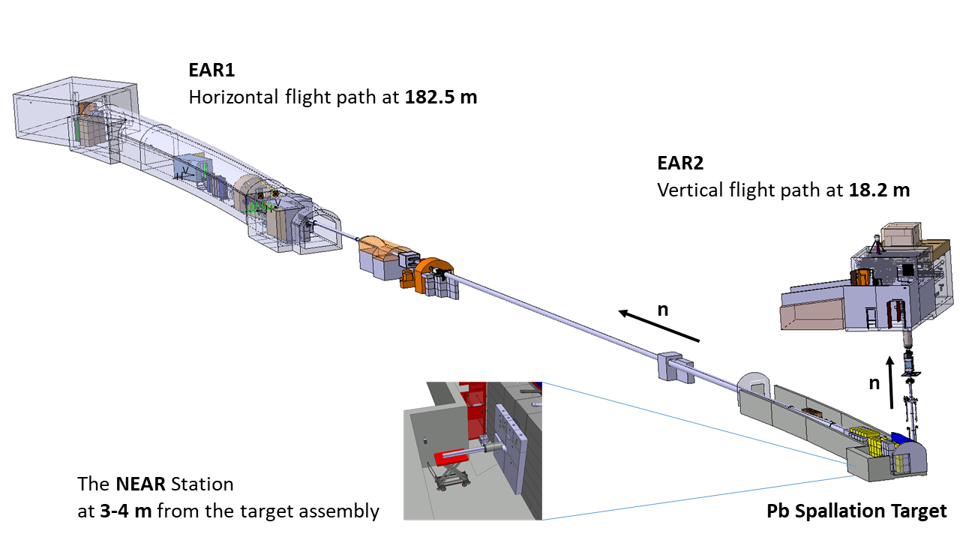
1.1 n_TOF: neutron time-of-flight at CERN
Experiment performed at n_TOF EAR1 (~185 m flight path) in Sep-Nov 2022.
Around 8 times larger flight path than in previous ²³⁹Pu measurements, which enables higher energy resolution.
n_TOF features
25 years operation, with relevant measurements for nuclear technology, nuclear astrophysics, medical science and basic research.
Neutron beam by spallation of 20 GeV protons into a lead target.
Pulses of about 1 Hz repetition rate → no overlapping pulses.
8·10¹² protons per pulse, 7 ns RMS, with option for lower intensities.
Three experimental areas for different purposes (EAR1, EAR2 and NEAR).
EAR1: moderated neutrons with a layer of borated water.

Slide 5
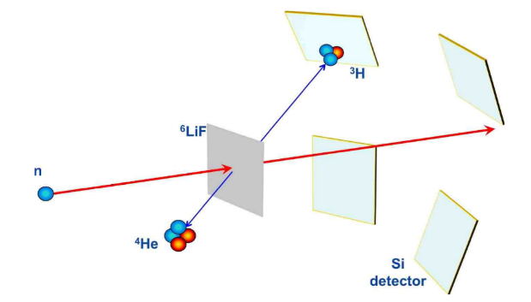
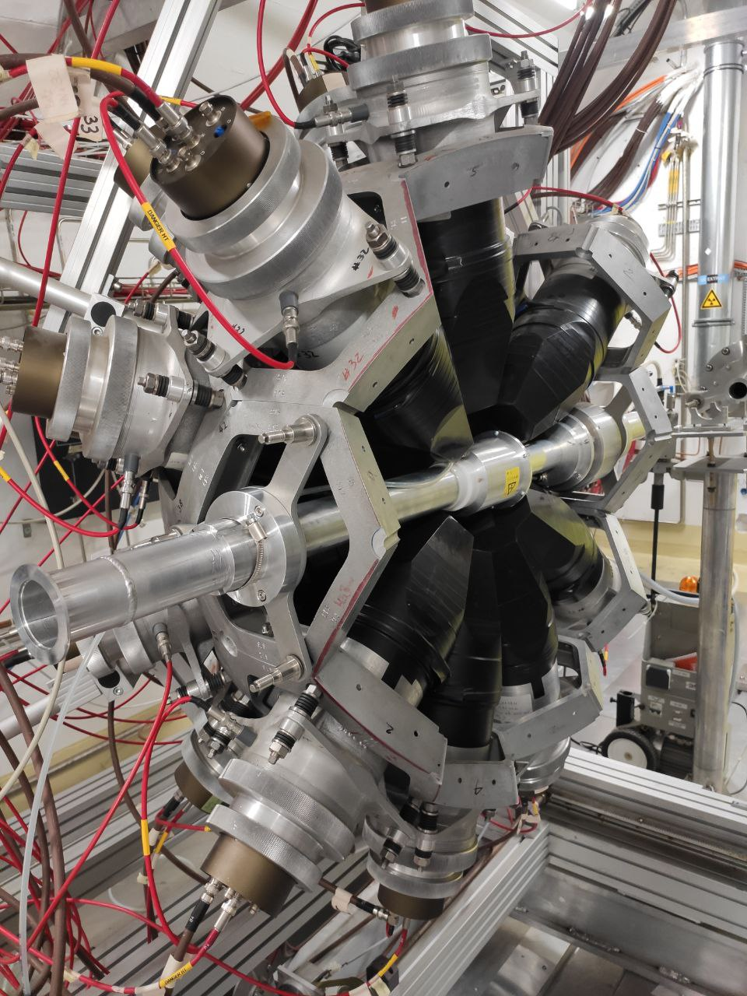
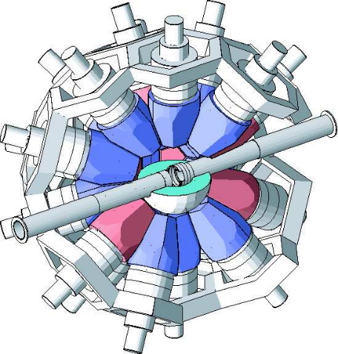
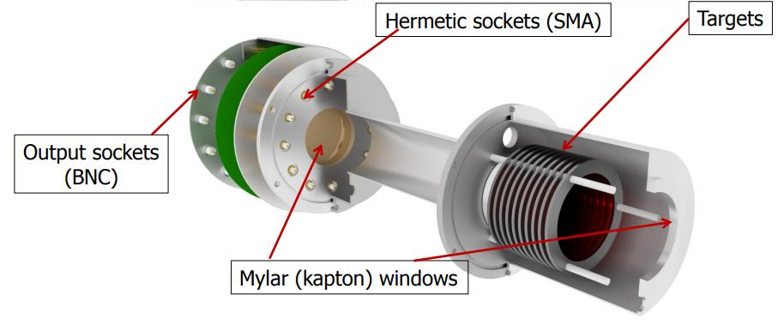
1.2 Detectors
Proton Beam Monitors
Wall Current Monitor (WCM).
Beam Current Transformer (BCT).
Neutron Beam Monitor (SiMon)
Four silicon detectors to monitor neutron beam intensity using ⁶Li(n,α)³H standard reaction.
²³⁹Pu-specific detectors at EAR1
TAC^{[2]}
Total Absorption Calorimeter
To detect capture and fission γ-rays.
Composed of 40 BaF₂ crystals operated in coincidence.
Events characterized by E_{sum} (total deposited energy from contributing crystals) and m_{cr} (crystal multiplicity).
FFD^{[1]}
Fission Fragment Detector
Detection of charged particles.
Fast pre-amplifiers.
Filled with Ar + (10%)CF₄ gas.
[1] Perkowski et al., Nucl. Instrum. Methods Phys. Res. A 1067, 169649 (2024)
[2] Guerrero et al., Nucl. Instrum. Methods Phys. Res. A 608(3), 424 (2009)

Slide 6
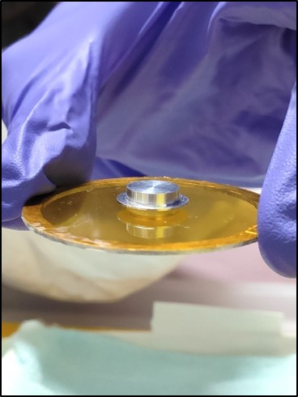
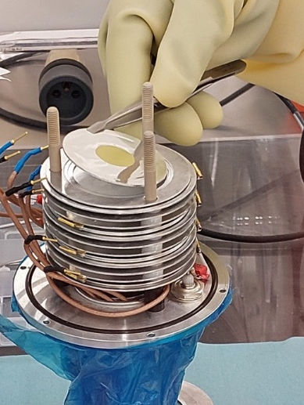
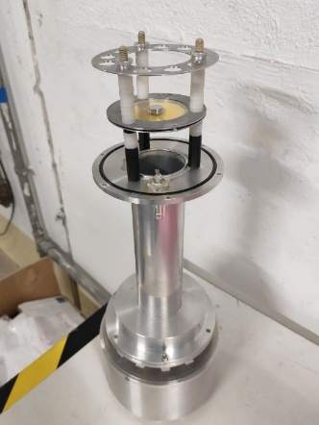
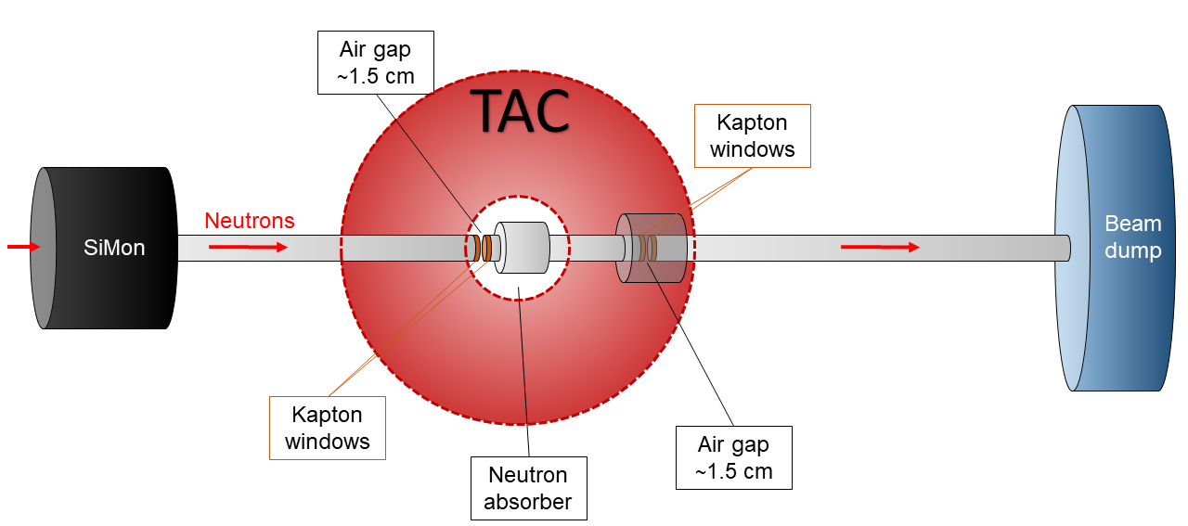
1.3 Experimental configurations and samples
Experimental campaign divided into two different configurations:
1. FC config.
- 10 thin Pu samples (<10 mg total mass) within fission chamber.
- Use FFD + TAC simultaneously.
- Measure fission and capture (up to ~1 keV), and the α-ratio.
2. TS config.
- 1 thick sample (~100 mg).
- Use only TAC.
- Measure capture above 1 keV.
- Sample inside dummy chamber to have similar bkgds.
Both setups share similar beam line configuration:
Plutonium base material
Produced by JRC-Geel and SCK CEN.
Plutonium dioxide PuO₂.
99.9% purity of ²³⁹Pu.
From the same base material, two different type of samples were prepared.
Isotopes | Abundance (%)
²³⁹Pu | 99.90
²⁴⁰Pu | 0.06
²⁴¹Pu | 0.02
²⁴²Pu | 0.01

Slide 7
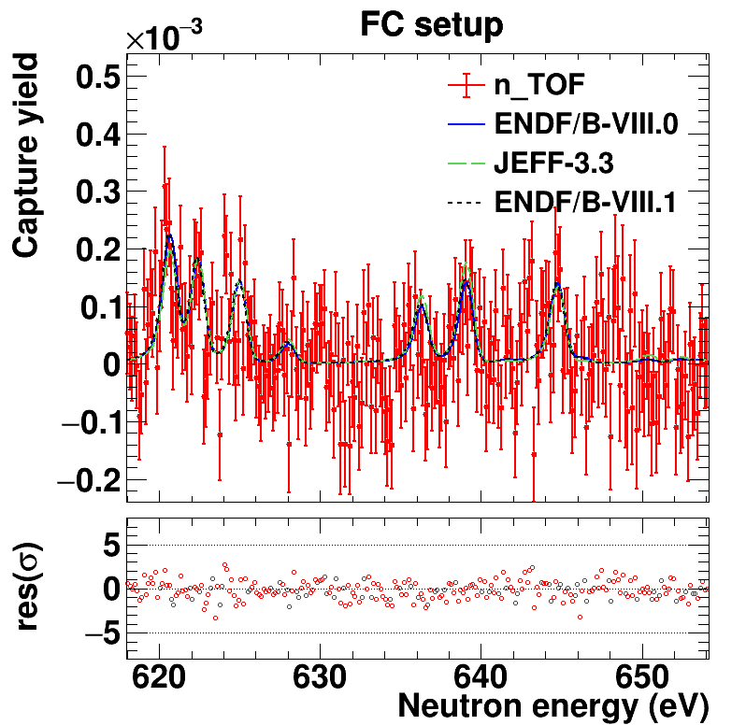
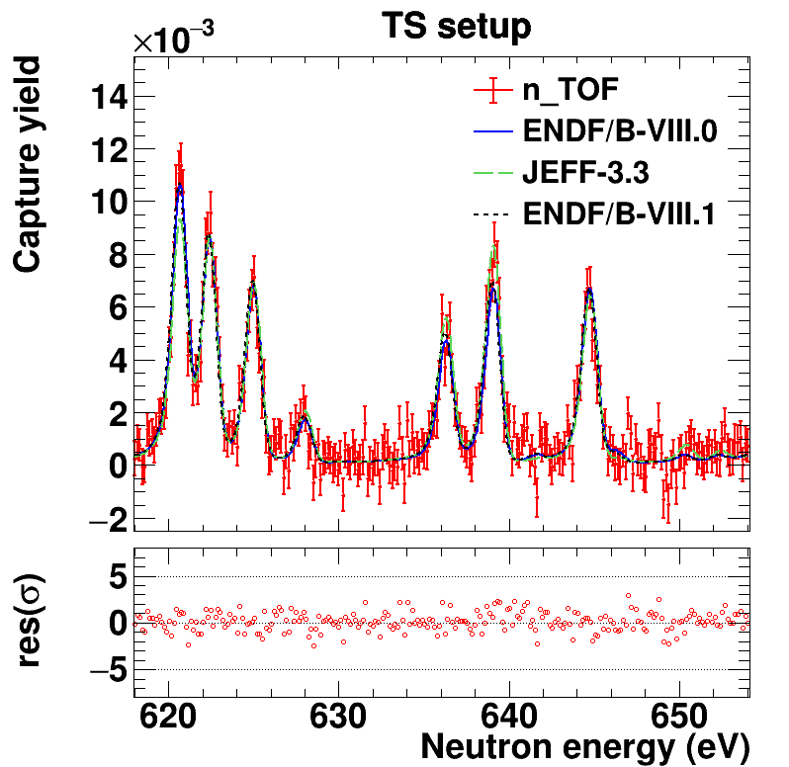
1.3 Experimental configurations and samples
Experimental campaign divided into two different configurations:
1. FC config.
- 10 thin Pu samples (<10 mg total mass) within fission chamber.
- Use FFD + TAC simultaneously.
- Measure fission and capture (up to ~1 keV), and the α-ratio.
2. TS config.
- 1 thick sample (~100 mg).
- Use only TAC.
- Measure capture above 1 keV.
- Sample inside dummy chamber to have similar bkgds.
Both setups share similar beam line configuration:
Plutonium base material
Produced by JRC-Gel and SCK CEN.
Plutonium dioxide PuO₂.
99.9% purity of ²³⁹Pu.
From the same base material, two different type of samples were prepared.
Isotopes | Abundance (%)
²³⁹Pu | 99.90
²⁴⁰Pu | 0.06
²⁴¹Pu | 0.02
²⁴²Pu | 0.01

Slide 8
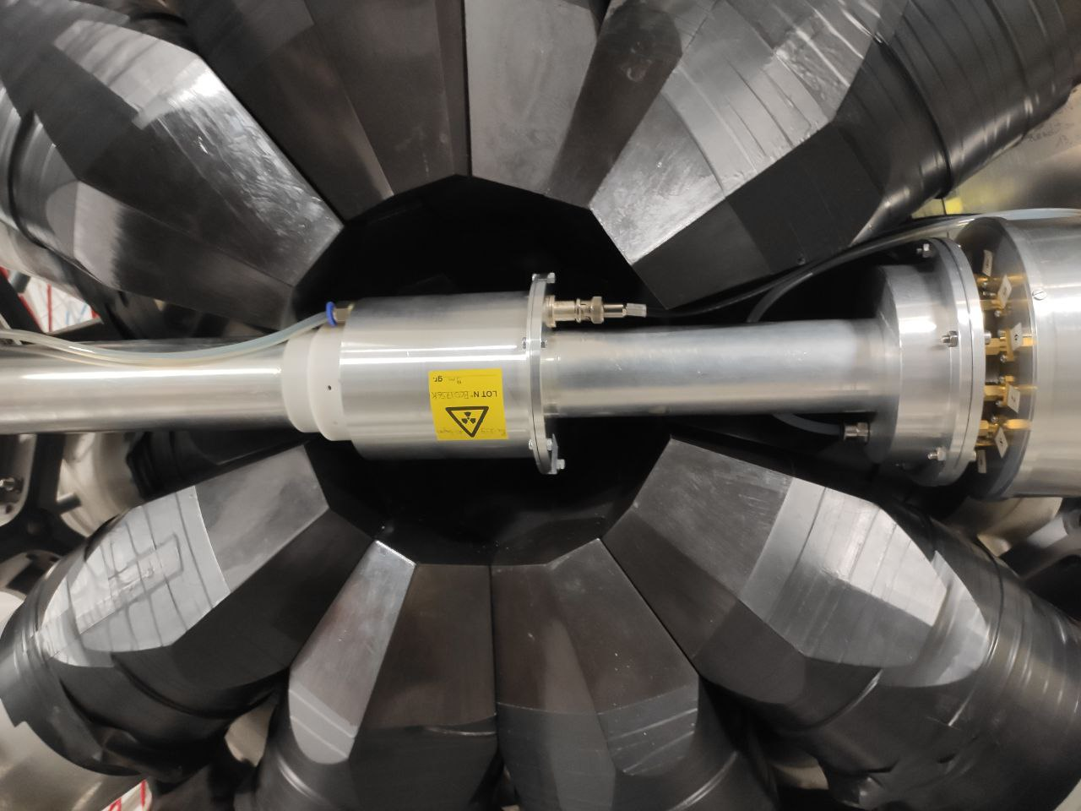
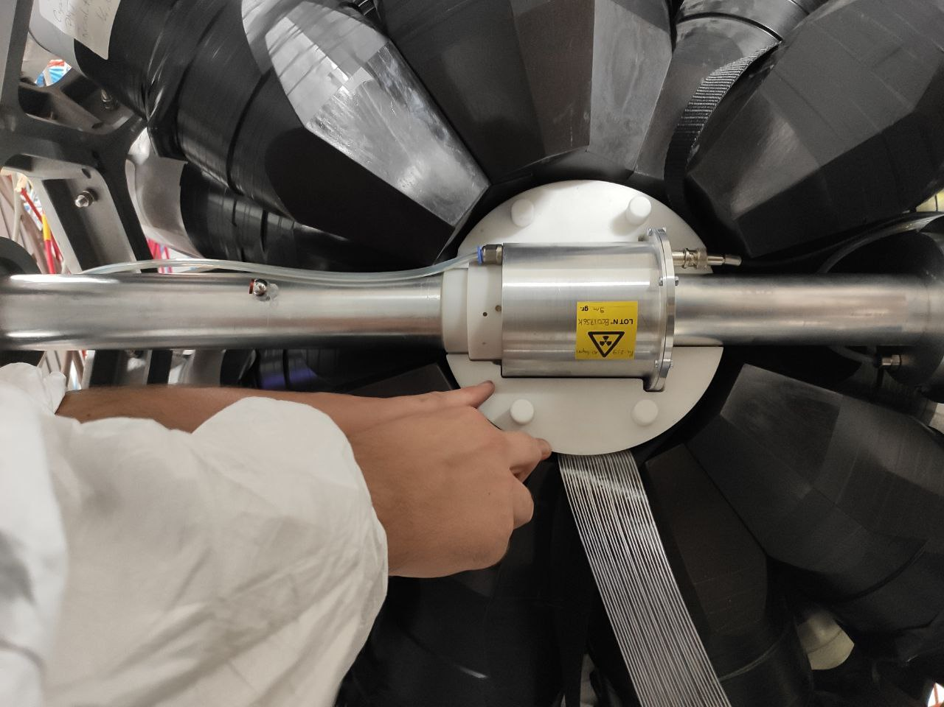
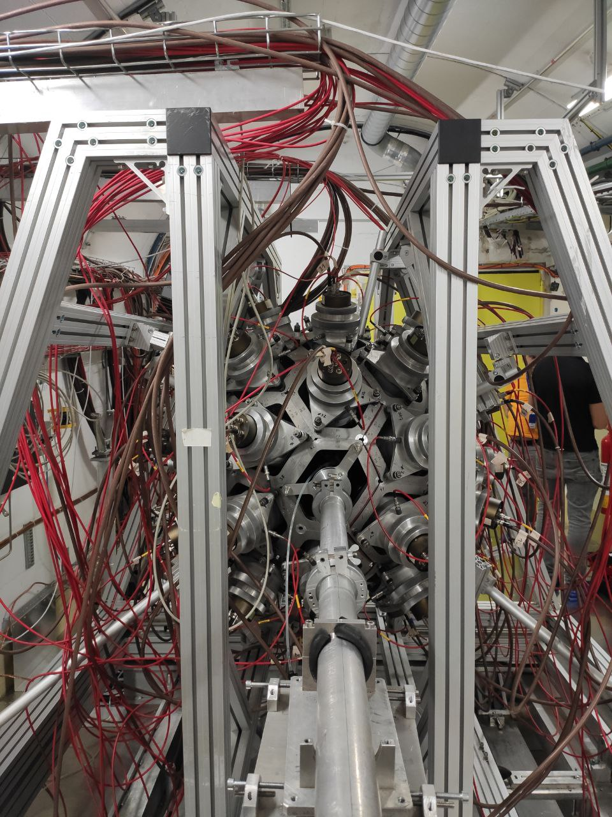
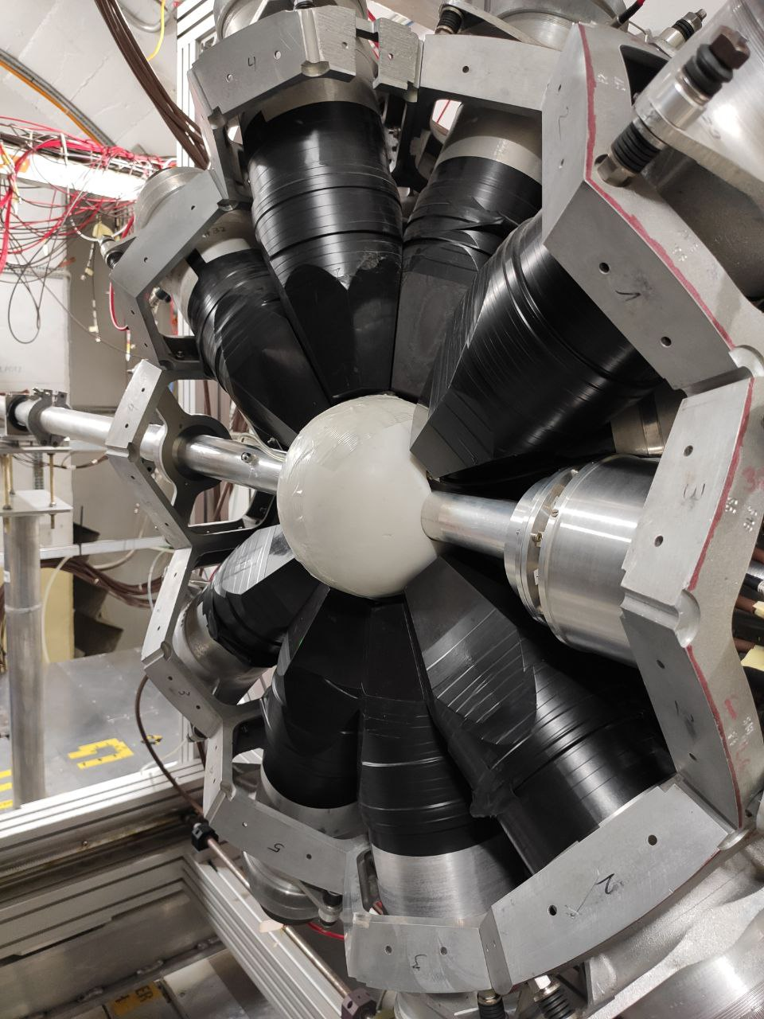
1.3 Experimental configurations (mounting)
Pictures of the mounting procedure at n_TOF EAR1 during the experimental campaign in 2022.
5. TAC closed
Li-doped polyethylene
1. The FFD is placed within the TAC
3. A neutron absorber is placed around the FFD.
2. The TAC+FFD assembly is carefully align with the neutron beam
UPSTREAM VIEW
4. Neutron absorber closed.

Slide 9
2
Summary of the Data Analysis

Slide 10
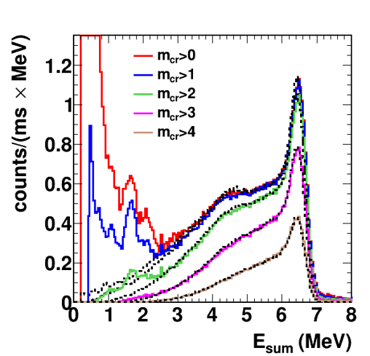
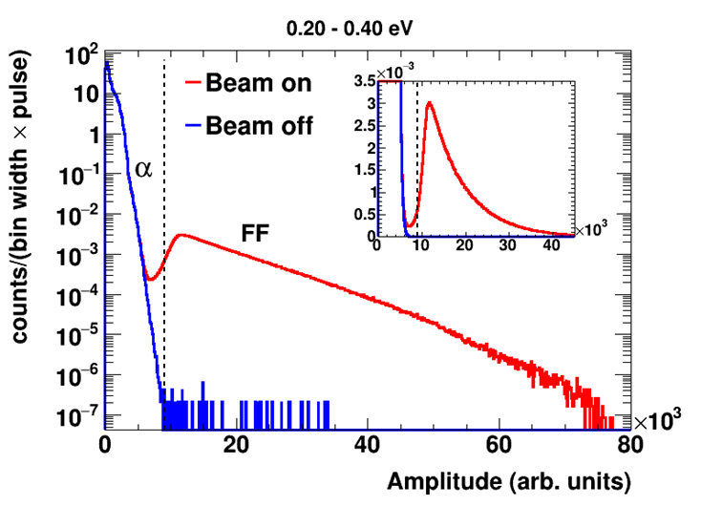
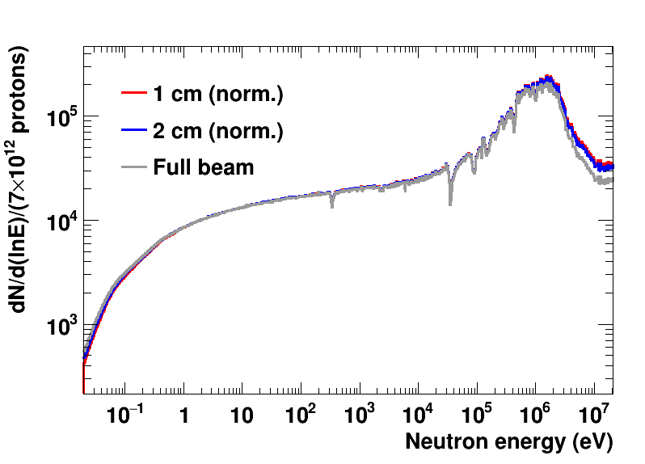
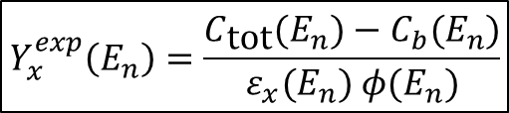
2.1 Fundamentals of the data analysis
Detection efficiency
$$Y_{x}^{exp}\left(E_{n}\right)=\frac{C_{\text{tot}}(E_{n})−C_{b}(E_{n})}{ε_{x}(E_{n}) φ(E_{n})}$$
Count rate due to background events
Can be determined experimentally or by simulations.
Only required for ²³⁹Pu(n,γ).
Measured through dedicated background measurements…
or by simulations.
Neutron fluence crossing the sample
Comparison of TAC E_{sum} spectra between experimental and MC simulations.
Data reduction (thresholds)
Depends on sample diameter.
Common for the same setup.
FFD: α-FF discrimination using amplitude threshold in the FFD signals.
MC
TAC: energy and multiplicity thresholds to improve signal-to-background ratio.

Slide 11

2.1 Fundamentals of the data analysis
Detection efficiency
$$Y_{x}^{exp}\left(E_{n}\right)=\frac{C_{\text{tot}}(E_{n})−C_{b}(E_{n})}{ε_{x}(E_{n}) φ(E_{n})}$$
Count rate due to background events
Can be determined experimentally or by simulations.
Only required for ²³⁹Pu(n,γ).
Measured through dedicated background measurements…
or by simulations.
Normalization
The fission yield was normalized to the recommended evaluated ²³⁹Pu(n,f) cross section integral (9-20 eV) by I. Durán et al. (https://doi.org/10.1016/j.nds.2024.01.004).
Absolute value of $φ\left(E_{n}\right)$, sample mass, and efficiency not needed → significantly reduce uncertainties.
Automatically determines the norma-lization for the capture yield.
Neutron fluence crossing the sample
Comparison of TAC E_{sum} spectra between experimental and MC simulations.
Data reduction (thresholds)
Depends on sample diameter.
Common for the same setup.
FFD: α-FF discrimination using amplitude threshold in the FFD signals.
MC
TAC: energy and multiplicity thresholds to improve signal-to-background ratio.

Slide 12

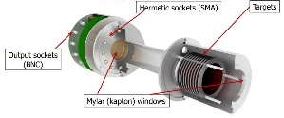
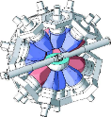

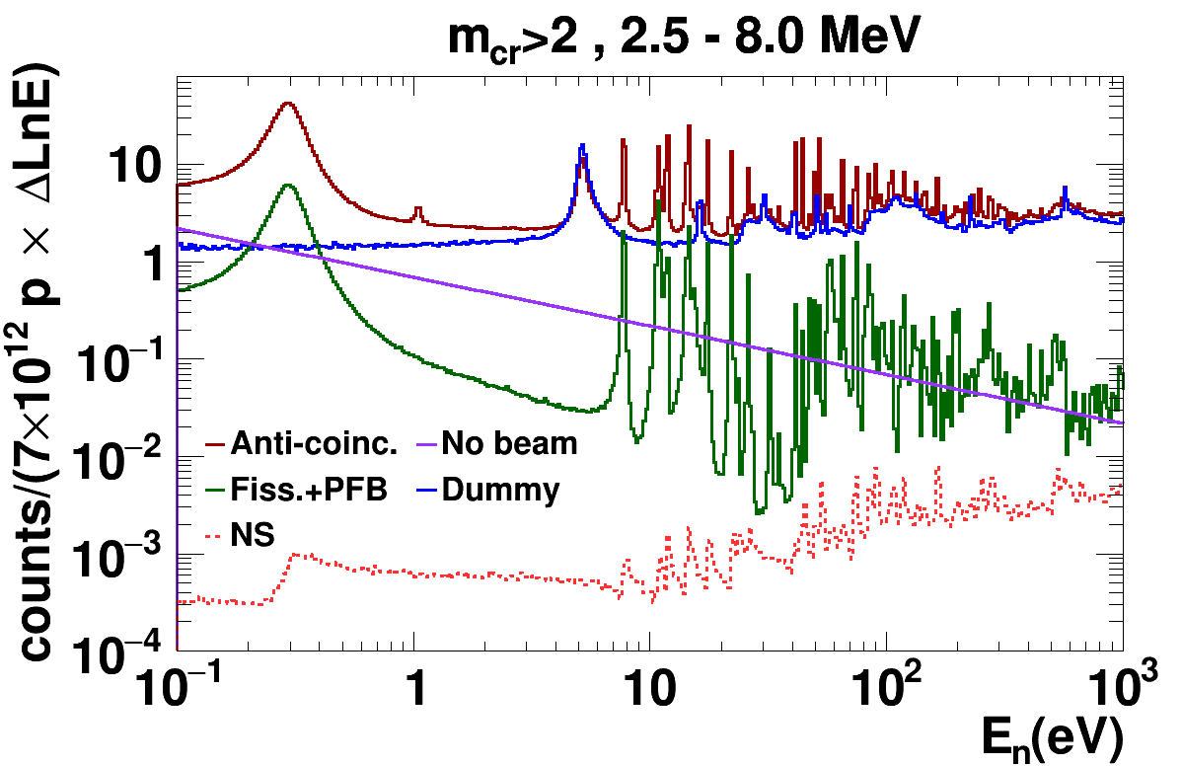
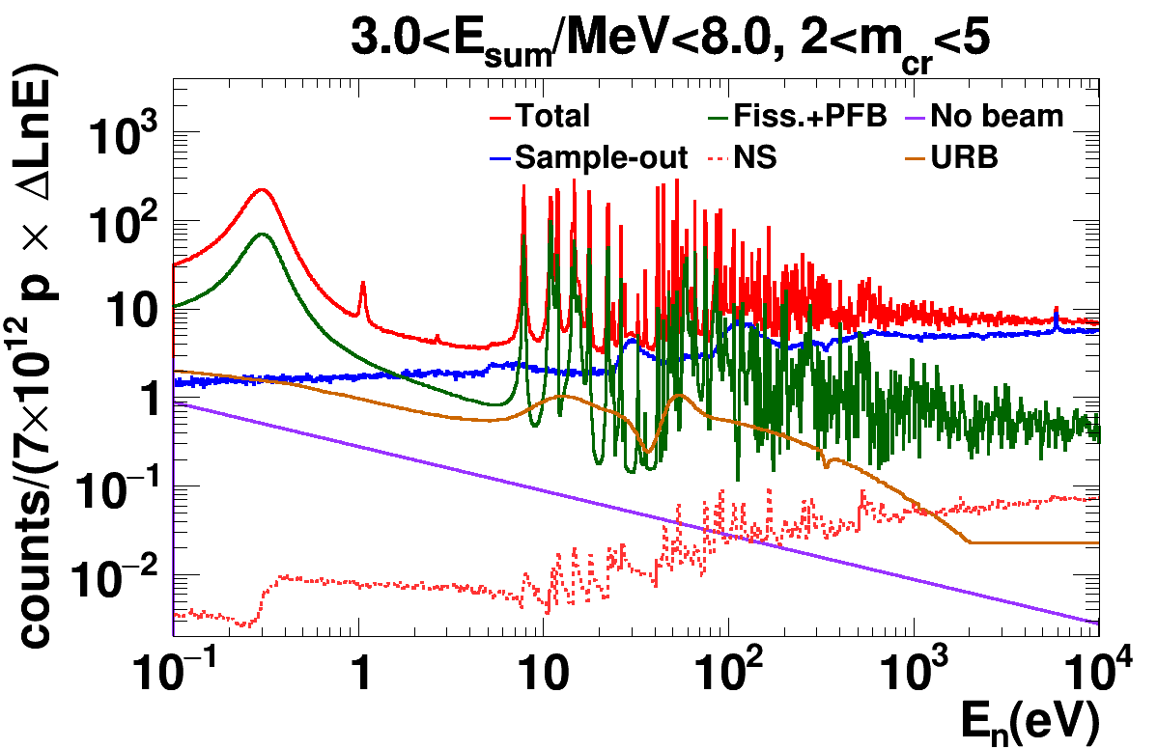
2.2 Summary of backgrounds for capture
FC setup (FFD + TAC)
TS setup (TAC)
Background contributions in both setups: some components share similar approaches but others (fission) required completely different procedures.
TAC count rates as a function of neutron energy
TAC count rates as a function of neutron energy

Slide 13
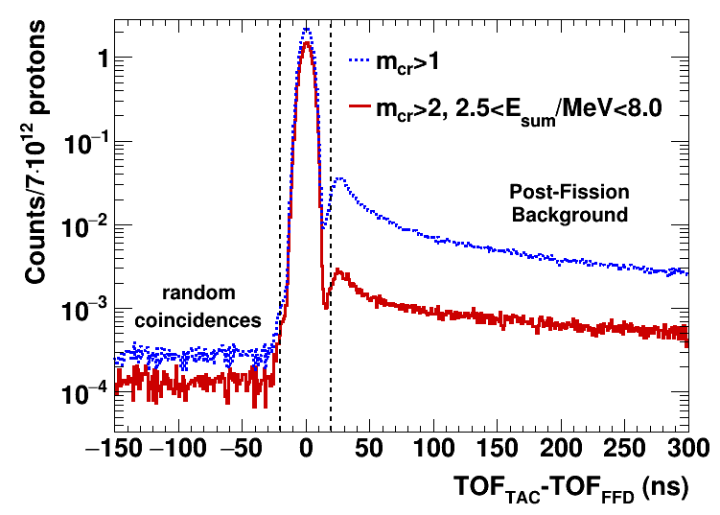
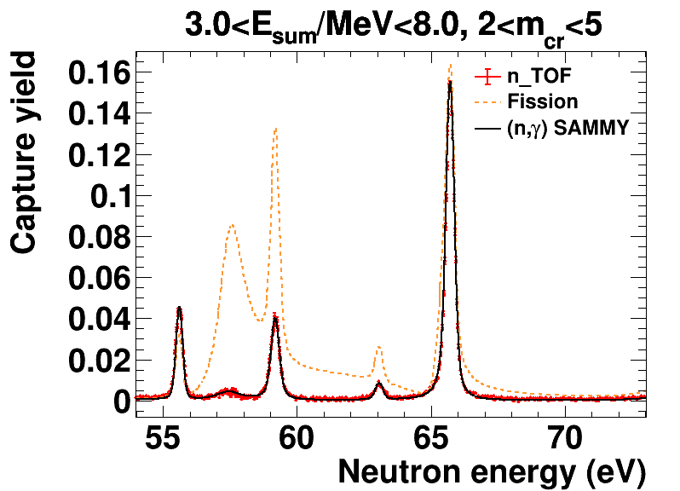
2.2 Summary of backgrounds for capture
FC setup (FFD + TAC)
TS setup (TAC)
Fission subtraction in the TS setup
Use the results from the FC setup.
FC-TS overlap region below 200 eV → fit of capture and fission yields on selected resonances (resonance parameters from SAMMY fit).
Background contributions in both setups: some components share similar approaches but others (fission) required completely different procedures.
Fission subtraction: Fission Tagging^{1,2,3}
FFD+TAC event coincidences used as veto to suppress fission background.
TAC count rates as a function of neutron energy
TAC count rates as a function of neutron energy
coincidence window
Resonances
NOT included in the fit
Resonances included in the fit
[1] C. Guerrero et al., Eur. Phys. J. A 48, 29 (2012).
[2] J. Balibrea-Correa et al., Phys. Rev. C 102, 044615 (2020).
[3] M. Bacak et al., EPJ Web of Conferences 211, 03007 (2019).

Slide 14
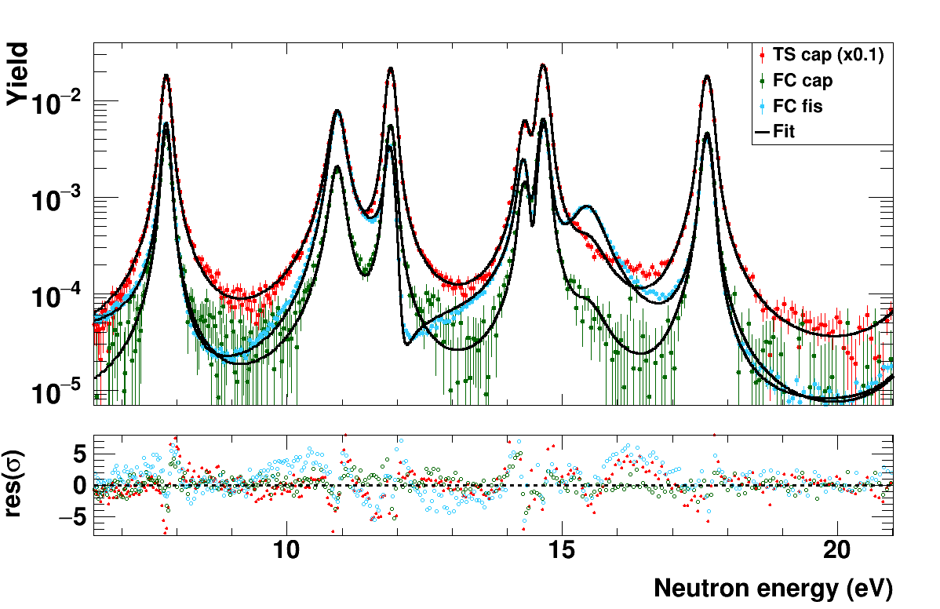
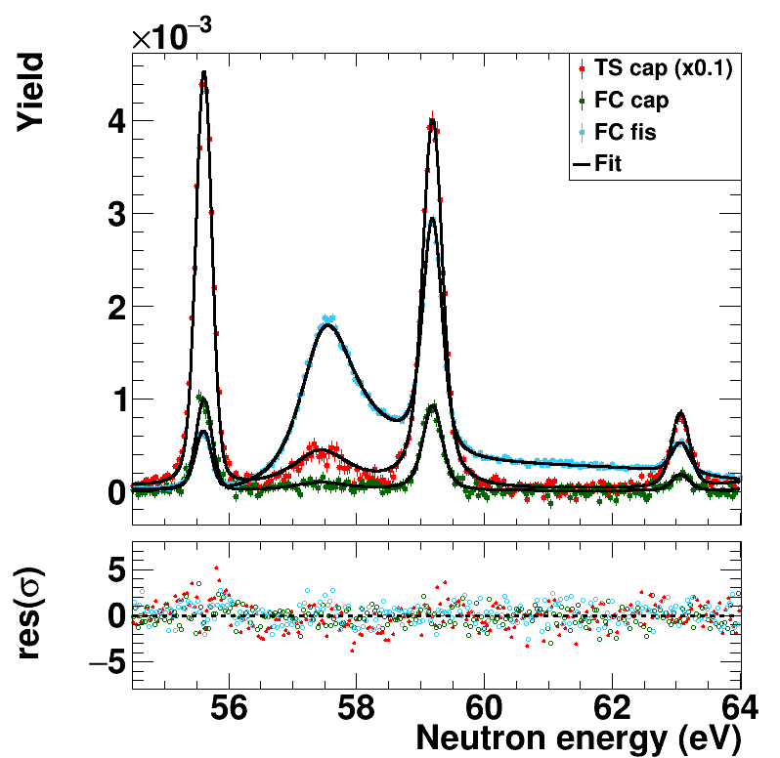
2.3 Resonance parameters: SAMMY fit
To obtain a final set of resonance parameters (RPs) combining the three measured datasets:
Fission yield (FC setup).
Capture yield (FC setup).
Capture yield (TS setup).
²³⁹Pu(n,f)
eV
0.02
10⁻¹
1
10
10²
10³
10⁴
10⁵
10⁶
10⁷
²³⁹Pu(n,γ) FC setup
(overlap region)
²³⁹Pu(n,γ) TS setup
The resonance analysis obtained the resonance parameters for 1000 resonances up to 2.5 keV:
Neutron energy E_{n}, neutron width Γ_{n}, capture width Γ_{g}, and fission width Γ_{f}.
Combine capture data from both setups:
FC data for E_{n} < 200 eV.
TS data for E_{n} > 200 eV and some low-statistics resonances below 200 eV (overlap region).

Slide 15
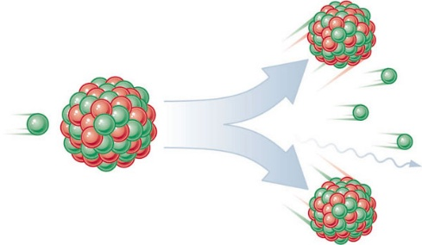
3
Fission results

Slide 16
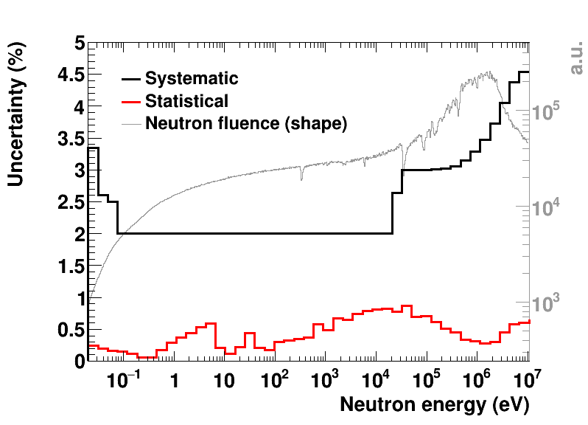
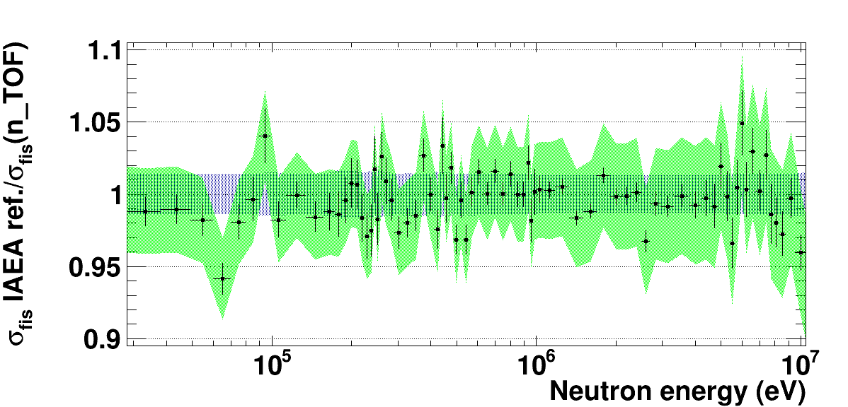
3.1 Fission results: uncertainties and integrals
Low-uncertainties were achieved due to the excellent properties of samples and fission chamber, which did not require additional corrections apart from neutron fluence shape.
1.5% unc. from eval.
Our results are compatible with the ²³⁹Pu(n,f) cross section reference (0.15-200 MeV) from the 2017 IAEA’s Neutron Data Standards (NDS).
n_TOF sys. uncertainties
Excellent compatibility with well-known ²³⁹Pu(n,f) cross section integrals, from thermal to fast energy regimes.
²³⁹Pu(n,f) spectrum-averaged cross section (SACS) in the ²⁵²Cf(sf) reference neutron field. Total SACS uncertainties are reported.
statistical
systematic
 | I₁ (0.02-0.06 eV) | I₃ (9-20 eV) | I₃/I₁ | I_{HE} (8-10 MeV)
n_TOF / I. Durán et al. | 1.011(1)(29) | 1.0 | 0.989(2)(20) | 1.014(8)(46)
n_TOF / ENDF/B-VIII.1 | 1.014(1)(29) | 1.010(1)(20) | 0.995(2)(20) | 1.007(8)(46)
n_TOF / ENDF/B-VIII.0 | 1.013(1)(29) | 1.007(1)(20) | 0.994(2)(20) | 1.016(8)(46)
n_TOF / JEFF-3.3 | 1.015(1)(29) | 1.010(1)(20) | 0.995(2)(20) | 1.011(8)(46)
Data | SACS
Derived, this work | 1802±65 (3.6%)
Derived, IAEA standard 2017¹ | 1798±23 (1.3%)
Mannhart evaluation² | 1812±25 (1.4%)
Capote et al. evaluation³ | 1826±19 (1.0%)
Excellent agreement with evaluations in the regions where the cross section is very well known → confidence in our data to improve regions where it is not so well-known.
¹Carlson et al., Nucl. Data Sheets 148, 143–188 (2018).
²Bersillon et al., IAEA TRS 452 (2006).
³Capote et al., EPJ Web Conf. 281, 00027 (2023)

Slide 17
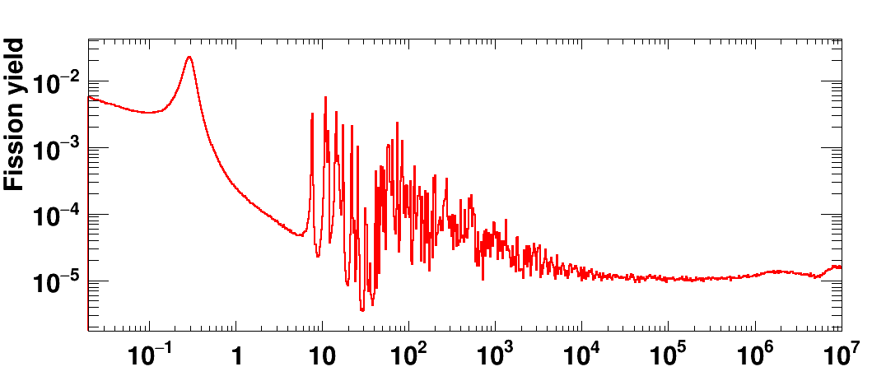
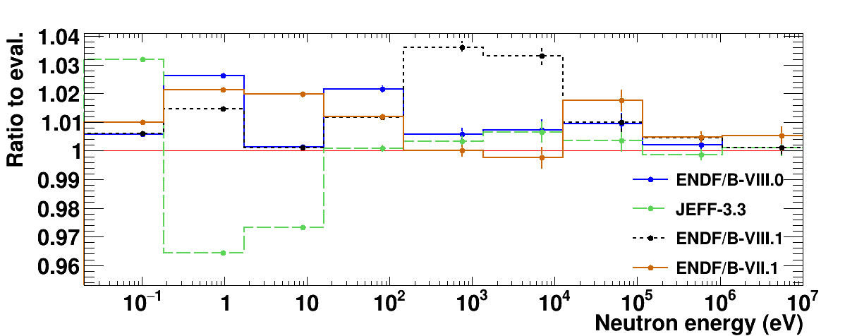
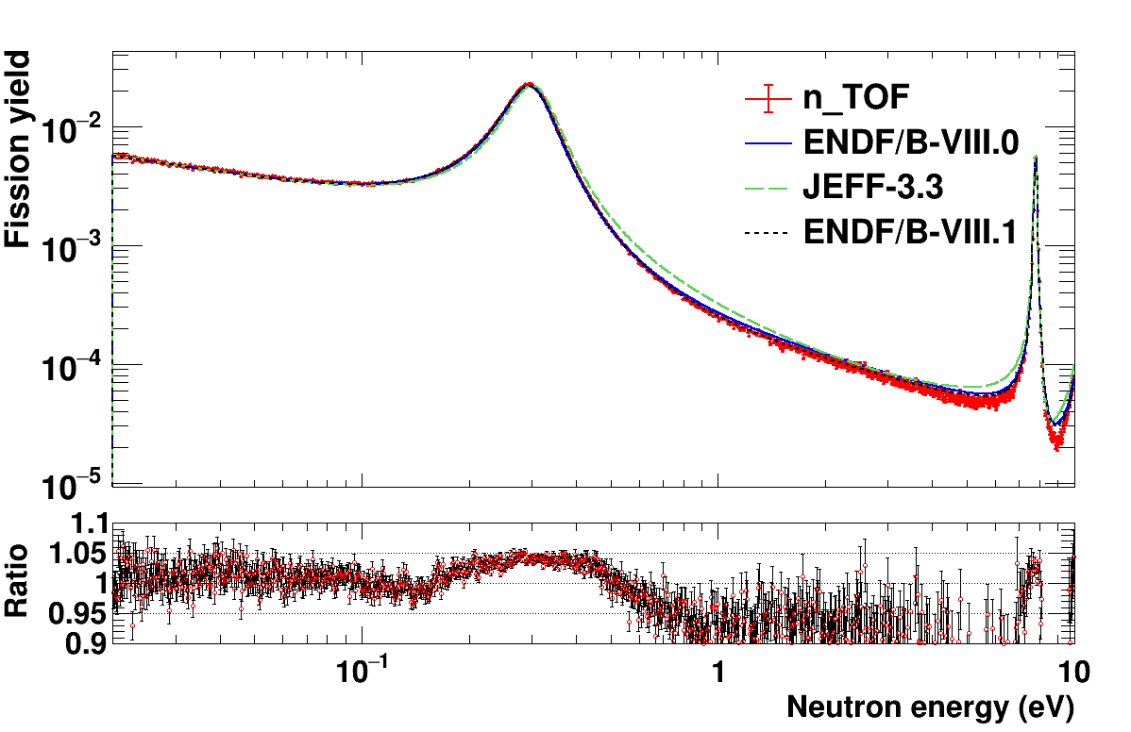
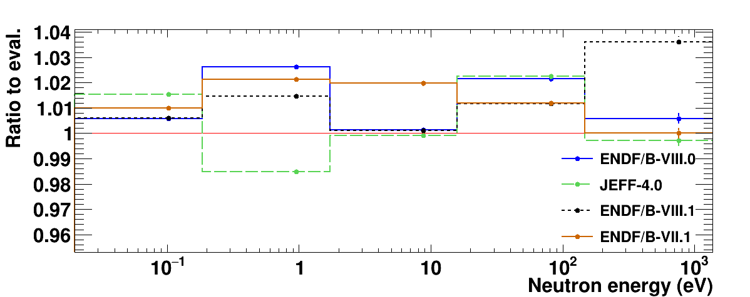
3.2 Fission results: comparison with evaluations
²³⁹Pu fission dataset with the broadest neutron energy range to date, covering almost 9 orders of magnitude, from thermal to fast region.
Ratios of our data to different ²³⁹Pu(n,f) evaluations from major libraries. With broader bins, differences are not larger than 3% (within uncertainties).
Great interest on n_TOF data shown by international evaluators (INDEN, JEFF-4.0, and IAEA’s Neutron Data Standards).
ENDF/B-VIII.1 evaluation taken from INDEN, with an increase around 1 keV not compatible with n_TOF data.
First ²³⁹Pu resonance at 0.3 eV, of relevance for nuclear reactor technology.
JEFF-3.3 ↔ JEFF-4.0
New JEFF-4.0 evaluation improves the large discrepancies observed with JEFF-3.3 in the low energy region according to n_TOF data.
n_TOF about 4% above ENDF/B-VIII.0, and closer to ENDF/B-VIII.1
Ratios calculated relative to ENDF/B-VIII.0

Slide 18
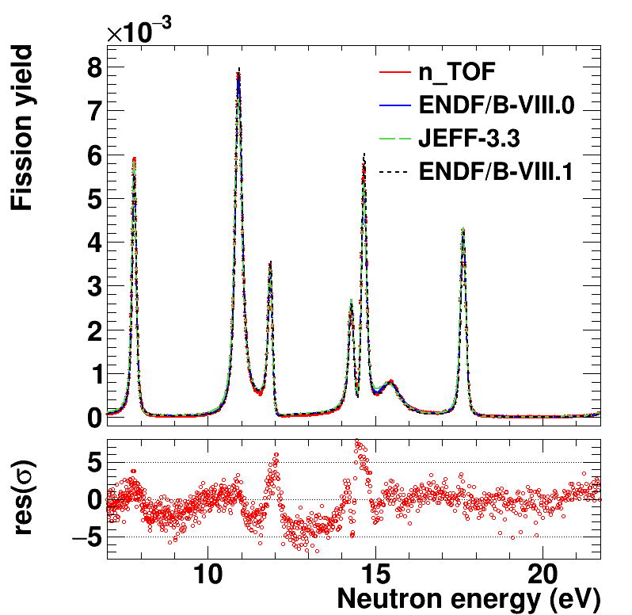
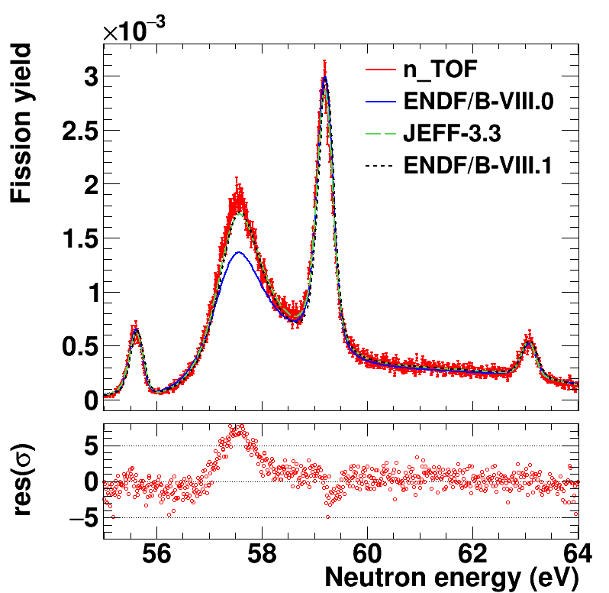
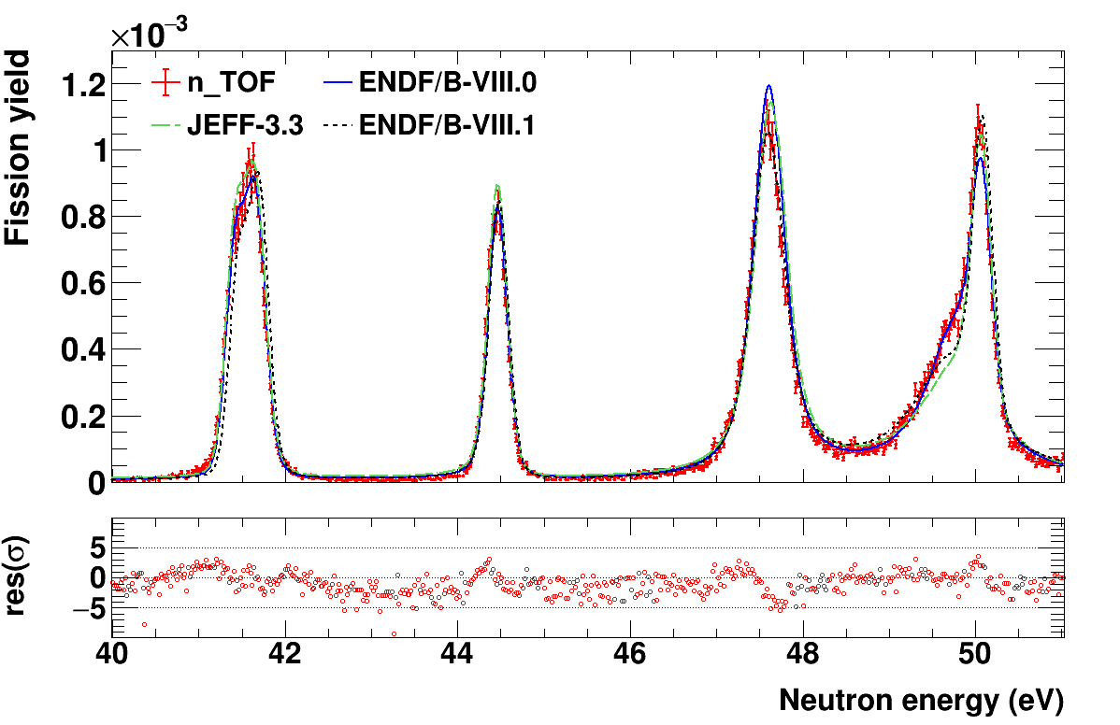
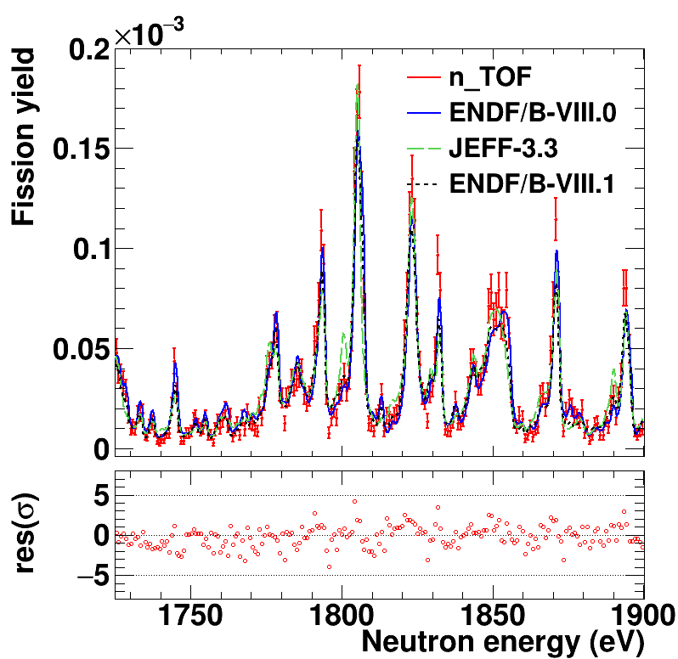
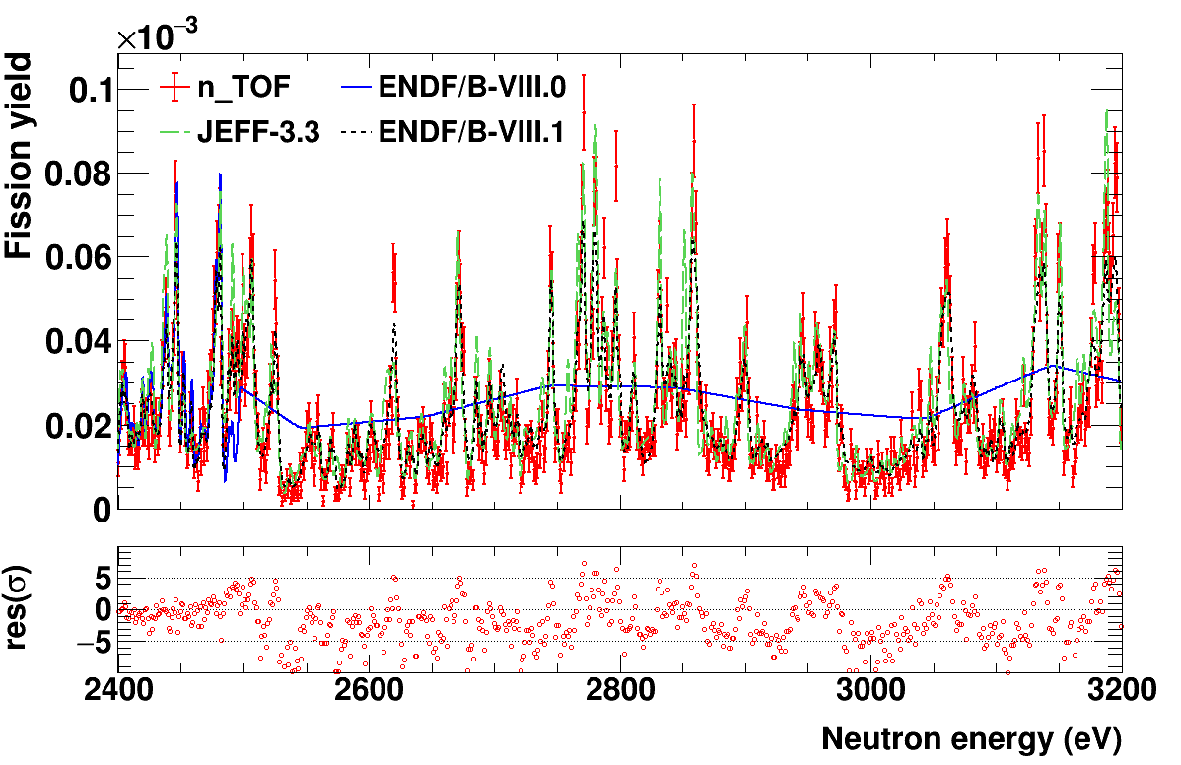
3.2 Fission results: comparison with evaluations
Some examples of fission yield resonances
Discrepancies in the shape of some resonances
Residuals calculated relative to ENDF/B-VIII.0
Resonances and structures are observed even at relatively high neutron energies, surpassing the limit of the resolved resonance region of some libraries (up to 2.5 keV).

Slide 19
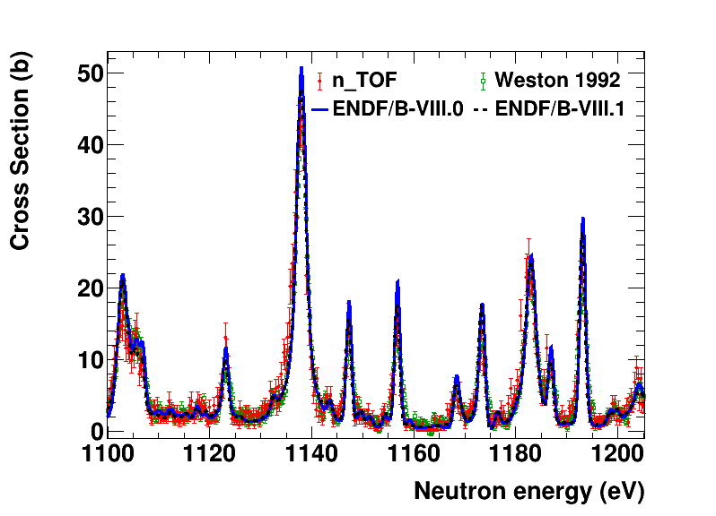
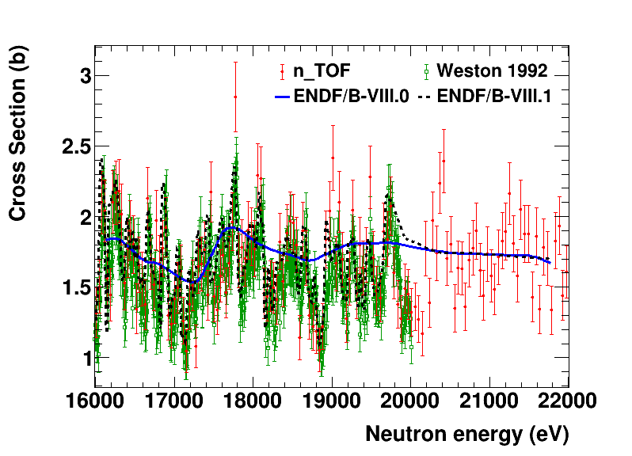
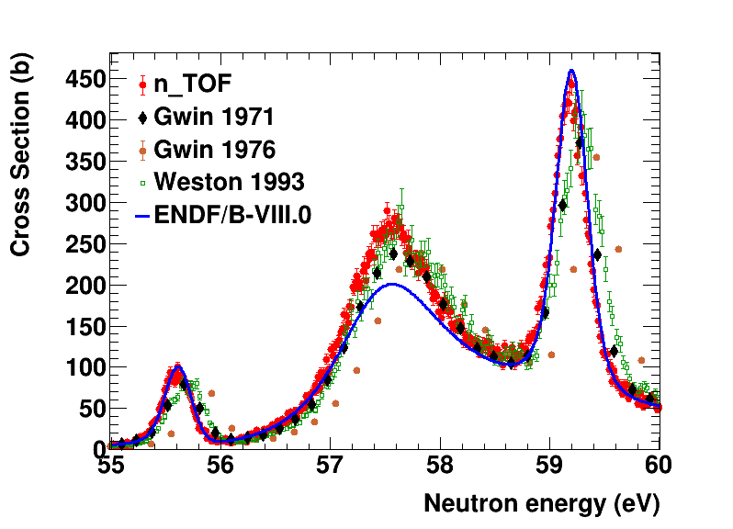
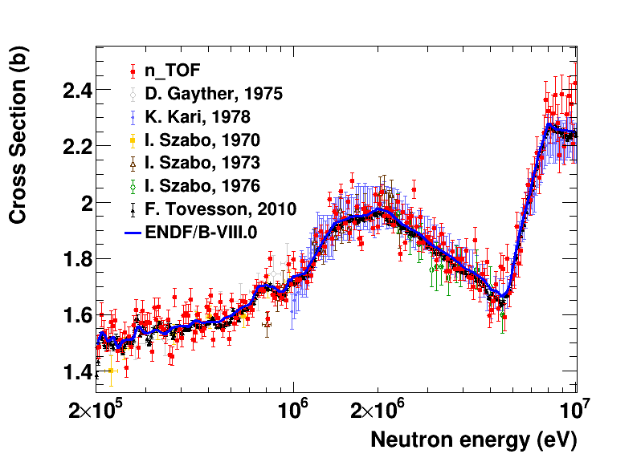
3.3 Fission results: comparison with experimental data
Energy resolution
The longer flight path of n_TOF (185.6 m) allows obtaining a higher neutron energy resolution, which is visible in the shape of some resonances.
Weston 1992 data
Good compatibility with Weston 1992 data in intermediate energy range resonances, with similar energy resolution.
High energies
Our data may help extend physical fluctuations in evaluations above 20 keV (limit of Weston 1992 data).
n_TOF data provides the broadest dataset in neutron energy with high resolution and contained uncertainties, providing valuable information in low, intermediate and high energy regions up to 10 MeV.

Slide 20
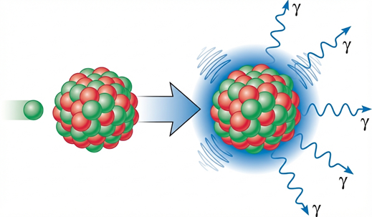
4
Capture results

Slide 21

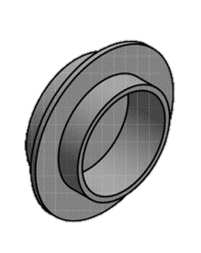
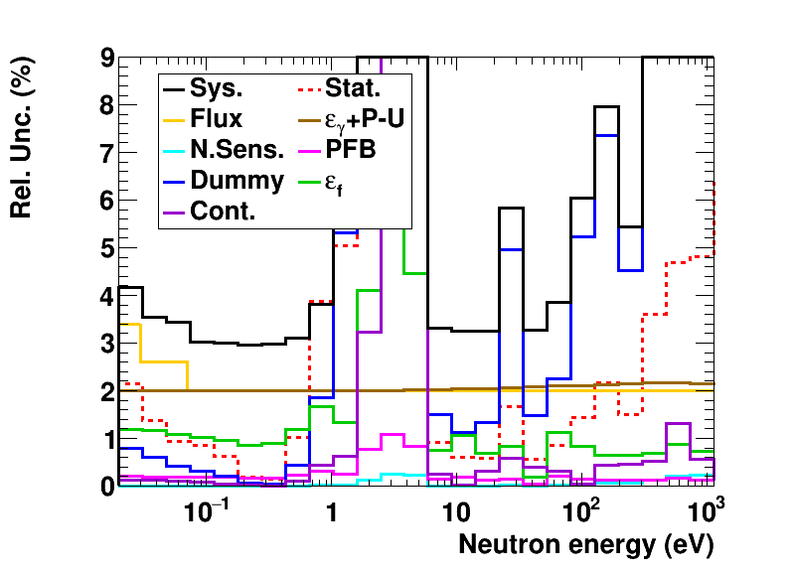
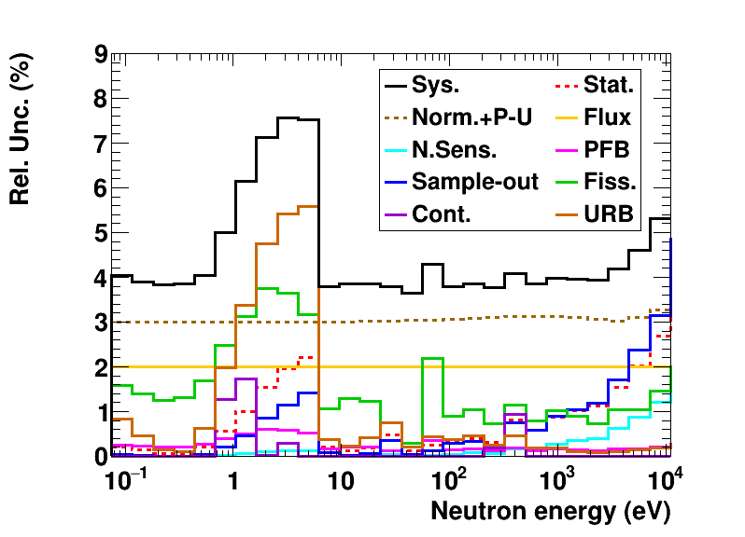
4.1 Capture results: uncertainties
FC setup
TS setup
Important:
Dummy uncertainties are overestimated in this plot, especially above 100 eV. Final values in the cross-section will be lower.
Target region of the TS setup
Valley between resonances
5 bins per decade
5 bins per decade
Overall uncertainty between 3-4%
Overall uncertainty between 4-5%

Slide 22

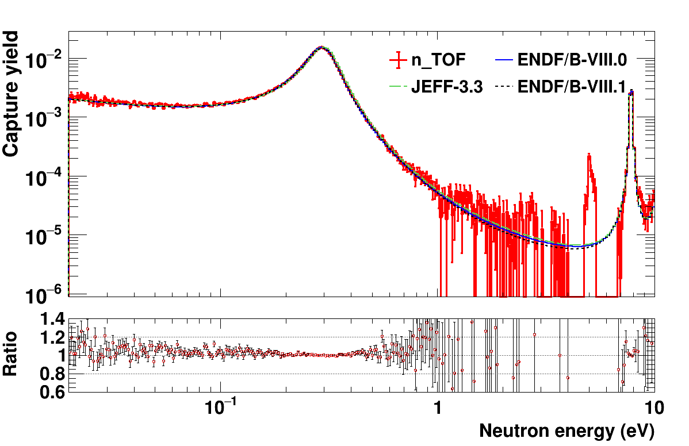




4.2 Capture results: comparison with evaluations
Some examples of capture yield resonances (FC setup)
Residuals and ratios calculated relative to ENDF/B-VIII.0
Large discrepancies with evaluations (and among themselves) in the shape of some resonances.
Great compatibility with ENDF/B-VIII.0 at the first 0.3 eV resonance.
10 bins per decade
JEFF-3.3 ↔ JEFF-4.0

Slide 23


4.2 Capture results: comparison with evaluations
TS setup data at high energies
The capture yield from the data with the larger mass sample enables preforming SAMMY analysis up to higher neutron energies with reasonable energy resolution and statistics.
Ratio of integrated yield from TS data above 1 keV: n_TOF data remains 5-10% systematically above evaluations with best agreement to the ENDF/B-VII.1 evaluation.
10 bins per decade
ENDF/B-VIII.0 and VIII.1 may be influenced by Mosby 2018 data for this region.

Slide 24



4.3 Capture results: comparison with experimental data
Scarcity of high-resolution ²³⁹Pu(n,γ) cross-section measurements. Two datasets in EXFOR (Gwin 1971, Mosby 2014/2018) mainly used for all evaluations.
High neutron energies
At higher neutron energies, from 1 keV to 10 keV (TS setup), the n_TOF cross section integrals generally stays slightly above Mosby 2018 data.
Energy resolution
First resonance @ 0.3 eV
Good compatibility within uncertainties with Gwin 1971 dataset in the shape and size of the first, large resonance at 0.3 eV. Both slightly below evaluation at peak.
Our capture data exhibit the highest neutron energy resolution among the existing experimental data.

Slide 25

5. Summary and Conclusions
Successfully accomplished the ²³⁹Pu measurement of fission and capture cross sections (and α-ratio) for the first time at n_TOF (CERN), through a collaboration between CIEMAT, JRC-Geel, SCK CEN and University of Lodz. The excellent properties of the facility, samples, and the detection systems, along with the experienced acquired through previous n_TOF fission-tagging measurements, have resulted in new high-quality experimental data for ²³⁹Pu, providing valuable input for future evaluations.
Fission
Capture
Broad energy coverage (20 meV to 10 MeV) and low-uncertainties.
Data submitted to EXFOR data bank at the end of 2025.
Publication in Physics Letters B: 10.1016/j.physletb.2025.140070
Good candidate to become a reference dataset for future evaluations.
Successful combination of thin and thick sample measurements to cover a wider energy range from 0.1 eV to 10 keV.
High-resolution dataset to contribute to the scarcity of measurements for evaluations.
Draft paper will be submitted this year.
All details in my PhD Thesis: 10.17181/179rm-jc146

Slide 26

Acknowledgments
This project has received funding from the Euratom research and training programme 2011-2018 under grant agreement No 847595 (ARIEL)
This activity is part of the scientific program approved by the European Commission H2020 Supplying Accurate Nuclear Data for energy and non-energy Applications – SANDA project (WP2, Task 2).
2021-1-RD EUFRAT-GELINA project funding for the stay at JRC-Geel.
This work was supported by the European Union NextGenerationEU/PRTR project C17.I02.P02 – SGI_GICS, subproject C17.I02.P02.S01 CIEMAT_CERN.
Spanish national projects PGC2018-096717-B-C21, PID2021-123100NB-I00 and PDC2021-120828-I00.
This work has been supported by the ENRESA-CIEMAT agreement 2023-2026 “Tecnologías Disponibles para la Transmutación de Radionucleidos de Vida Larga”.
 | EUROPEAN COMMISSION JOINT RESEARCH CENTRE Directorate G - Nuclear Safety and Security Standards for Nuclear Safety, Security and Safeguards

Slide 27
THANK YOU!

Slide 28
Backup slides

Slide 29


2.3 ²³⁹Pu samples
Samples were produced in the Target Preparation laboratory at JRC-Geel in collaboration with SCK CEN institute.
Isotopes | Abundance (%)
²³⁹Pu | 99.90
²⁴⁰Pu | 0.06
²⁴¹Pu | 0.02
²⁴²Pu | 0.01
Plutonium base material
Plutonium dioxide PuO₂.
Purified from ²⁴¹Am.
99.9% purity of ²³⁹Pu.
From the same base material, two different type of samples were prepared.
Thin samples
10 samples deposited by molecular plating on 10 µm thickness aluminum foils.
20 mm diameter.
2 MBq and 950 µg each, expect for a ~10 times thinner sample with 0.3 MBq and 120 µg.
Placed inside the FFD chamber, parallel and opposite-oriented (facing up- and down-stream).
High homogeneity.

Slide 30

3.1 Neutron fluence
The Neutron fluence (shape) for the full beam is known from the SiMon monitoring data and the n_TOF evaluated flux. However, corrections are required to take into account the smaller sizes of the samples (Beam Interception Factor, BIF).
Curves normalized at around 1 eV
EAR1 evaluated
neutron fluence
for E_{n} > 1 keV
Shape taken from the neutron beam commissioning at EAR1, using several detectors based on standard reactions:
⁶Li(n,t)⁴He
¹⁰B(n,α)⁷Li
²³⁵U(n,f)
SiMon for 0.02 eV < E_{n} < 1 keV
The transmission through different dead-materials (aluminum, mylar) and the LiF foil of SiMon was taken into account (effect of about 1%), using FLUKA simulations.
BIF correction from ¹⁹⁷Au(n,γ)
The correction for the sample diameters below 1 eV was performed using ancillary measurements with gold samples of the same diameter.
¹⁹⁷Au(n,γ) cross section is smooth and well-known in this region.
BIF from simulations
For E_{n}>1 eV, the BIF was de-termined from simulations with FLUKA.
(Normalized) Beam Interception Factor

Slide 31




3.2 Extraction of fission yield
Once the energy dependence of the neutron fluence for 2 cm samples, $φ_{\text{2}\text{cm}}$, is known, and the detectors are characterized (thresholds, calibrations…) the extraction of the fission reaction yield Y_{f}(En) is straightforward.
Fission Fragment count rate
Zero background
No background in the fission yield was observed after the α-FF separation.
$$Y_{f}\left(E_{n}\right)=\frac{C_{\text{FF}}(E_{n})−C_{b}(E_{n})}{ε_{FF}(E_{n}) φ(E_{n})}$$
0
Normalization constant N_{f}
The fission yield was normalized to the recommended evaluated ²³⁹Pu(n,f) cross section integral (9-20 eV) by I. Durán et al. (https://doi.org/10.1016/j.nds.2024.01.004).
ε_{FF} replaced by normalization factor N_{f}.
Absolute value of $φ\left(E_{n}\right)$, sample mass, and efficiency not needed → significantly reduce uncertainties.
No dependence on E_{n}.
Automatically determines the norma-lization for the capture yield.
$$φ_{\text{2}\text{cm}}(E_{n})$$
(previous slide)
N_{f}
Obtained yield compared with evaluation (ENDF/B-VIII.0)
n_TOF data below evaluations in the valleys between resonances
↓
Indication of no residual background

Slide 32



3.3 TAC background subtraction: fission (FC)
Fission subtraction in the FC setup
PFB
Post-Fission Background
Fission-related counts with ΔT>20 ns up to 3 us.
Attributed primarily to fission neutrons.
Fission tagging
Coincidences between FFD and TAC
Prompt Fission
Coincidence window:
±20 ns
It covers practically the full prompt-fission peak while minimizing the probability of tagging non-fission events (<<1%). Consistent with previous fission tagging mea-surements.

Slide 33



4.3 TAC background subtraction: fission (FC)
Fission subtraction in the FC setup
E_{sum} prompt fission spectrum under different m_{cr} cuts
Fission tagging
coincidence window
±20 ns
It covers practically the full prompt-fission peak while minimizing the probability of tagging non-fission ev-ents (<<1%). Consistent with previous fission tagging measurements.
Fission tagging
Coincidences between FFD and TAC
PFB
Post-Fission Background
Fission-related counts with ΔT>20 ns up to 3 us.
Fission tagging enables the extraction of the PFB E_{sum} and count rate distribution.
Attributed primarily to fission neutrons.

Slide 34








3.3 TAC background subtraction: fission (TS)
Fission subtraction in the TS setup
General idea: to use the results of fission and capture that were accurately measured in the FC setup below 200 eV.
Followed approach:
Subtract all known non-fission backgrounds (excluding also PFB) and divide by the neutron fluence to obtain a quasi-yield Y*.
This quasi-yield can be reasonably interpreted by a linear combination of the capture and fission yields:
We know
We want to know
Measured in the TS setup
$$Y^{∗}(E_{n})={\hat{λ}}_{γ,TS}Y_{γ,TS}(E_{n})+{\hat{λ}}_{F,TS}Y_{F,TS}(E_{n})$$
Extrapolate to the rest of neutron energies using the found ${\hat{λ}}_{γ,TS}$ and ${\hat{λ}}_{F,TS}$ (constant) values.
$Y_{F,TS}(E_{n})$ is taken from the FC setup:
Derived from the RPs for the resonance region.
Directly from the measured yield with the FFD above 2.5 keV.
Coefficients related with capture and fission detection efficiencies
Restricted below 200 eV at selected resonances
$$Y^{∗}(E_{n})={\hat{λ}}_{γ,TS}Y_{γ,TS}(E_{n})+{\hat{λ}}_{F,TS}Y_{F,TS}(E_{n})$$
${\hat{λ}}_{γ,TS}$ and ${\hat{λ}}_{F,TS}$ can be determined by matching the experimental and expected capture yields in these resonances.
Yields derived with SAMMY using RPs from the FC setup

Slide 35



3.3 TAC background subtraction: fission (TS)
Fission subtraction in the TS setup
Results for the optimal coefficients
$$λ_{γ}^{min}=1.038\left(31\right)$$
Excellent compatibility between TS and FC capture yield even in resonances not used for the optimization problem with large fission → obtained fission bkgd. for higher energies.
Resonances
NOT included in the fit
Resonances included in the fit
$$λ_{F}^{min}=1.038\left(31\right)$$
Result on the fitted yield resonances
Result on the fitted yield resonances

Slide 36






4.3 TAC background subtraction: fission (TS)
Fission subtraction in the TS setup
Obtained fitted scaling factors (change from the expected values for the efficiencies taken from simulations and FC data):
Result on the fitted yield resonances
Resonances included in the fit
Fission count rate
Obtained scaling the fission shape from FC setup (SAMMY). The PFB is then determined from the obtained prompt-fission using the FC results.
Resonances included in the fit
$$ε_{γ}=\frac{1}{λ_{γ}}{\hat{ε}}_{γ}$$
$$λ_{γ}^{min}=1.038\left(31\right)$$
$$ε_{F}=λ_{F}{\hat{ε}}_{F}$$
$$λ_{F}^{min}=1.038\left(31\right)$$
Result in E_{sum}, using shapes from FC data
Results for the X² function (to be minimized)

Slide 37


3.5 Pile-up correction
Observed pile-up effects that depend on the time-of-flight (neutron energy) within the same pulse, reproducible with artificial data buffers with sample signals. Same method as in previous measurements with the TAC^{[1]}.
Validation with experimental data
TS setup
Able to reproduce gain shifts and data losses.
Significantly larger corrections than in the FC setup, especially for E_{n}>2 keV (up to 15%).
Low intensity pulses: corrections below 2.5% up to 10 keV.
Comparison of E_{sum} prompt-fission spectra between experimental data and pile-up model at 1-3 keV.
Efficiency curves with high and low intensity pulses.
TS capture yield was measured using only low-intensity pulses to minimize pile-up corrections.
[1] E. Mendoza et al. Nucl. Instrum. Methods Phys. Res. A 768, 55 (2014).

Slide 38




4.4 α-ratio: comparison with evaluations (and exp. data)
Better agreement with ENDF/B-VIII.1 at 0.3 eV, and 3-4% below the other libraries.
This deviation is driven by the difference in the fission cross section.
Regions with large errors due to counting statistics (valleys in fission and/or capture). No valuable informa-tion there.
Residuals and ratios calculated relative to ENDF/B-VIII.0
Comparison with experimental data
Energy resolution and discrepancies
Where the comparison is possible, n_TOF data show slightly higher energy resolution than Mosby 2014 data (starting at 10 eV). There are regions with agreement but also regions with significant discrepancies be-tween both datasets.
First resonance @ 0.3 eV
New dataset for α-ratio with smaller uncertainties for the 0.3 eV resonance. Compatible with Brooks 1967 data in the tails but with more precision.

