Slide 1
ENDF/B-VIII.0 ND uncertainty propagation with CASMO-5 on SNF
02/07/2026
WONDER 2026
Raphaëlle ICHOU

Slide 2
Introduction
    Accurate estimation of SNF nuclide inventory is of great importance for safety aspects of the back-end of the nuclear fuel cycle. In this regard, it is necessary to assess the impact of nuclear data uncertainties on SNF inventories
    A PWR UO₂ post-irradiation-examination (PIE) fuel rod sample for which experimental data are available has been studied within the SG7/10/15 of WPNCS and ND uncertainty propagation was proposed for nuclides important in BUrnup Credit methodologies
    ASNR has performed CASMO-5 calculations on this sample using ENDF/B-VII.1 and ENDF/B-VIII.0 nuclear data libraries and analysed the C/E bias
    In a second step, the ND uncertainties have been propagated to the concentrations results using the random sampling method of CASMO-5 and the ENDF/B-VIII.0 nuclear data covariances and their impact on the C/E-1 bias has been studied

Slide 3
OUTLINE
01
  Case of application
    The SG7/10/15 WPNCS SG
    Benchmark model and requested results
    CASMO modelization
02
  CASMO5 C/E results
    C/E results
    ND library impact
    Comparison to MC results
03
  CASMO5 ND uncertainty propagation
    Method
    ND uncertainties
    C/E results and ND uncertainties

Slide 4
CASe of application
01

Slide 5






The SG7/10/15 WPNCS SG
Involve nuclear data sensitivity/uncertainty analysis on realistic irradiated fuel nuclide inventory where experimental (PIE) data are available (from NEA SFCOMPO database)
Analyse and assess the contribution of the nuclear data uncertainties to the total uncertainties
•Depleted
isotopic
concentration
calculations
•C/E ratios
•Analysis and
Report
•ND
uncertainties
quantification
•Comparison
of results and
methods
•Analysis and
report
Benchmark
^{SG7} Specif.
SG10
SG15
[Sept.2020-Sept. 2022] [Sept.2022-Sept. 2024] [Sept.2024-Sept. 2026]

Slide 6
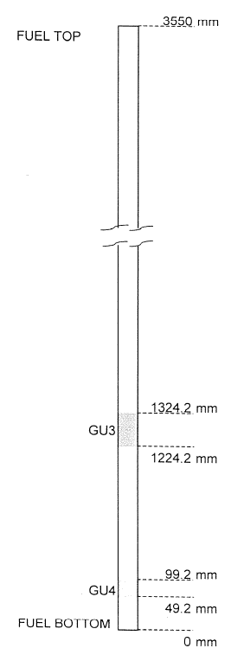
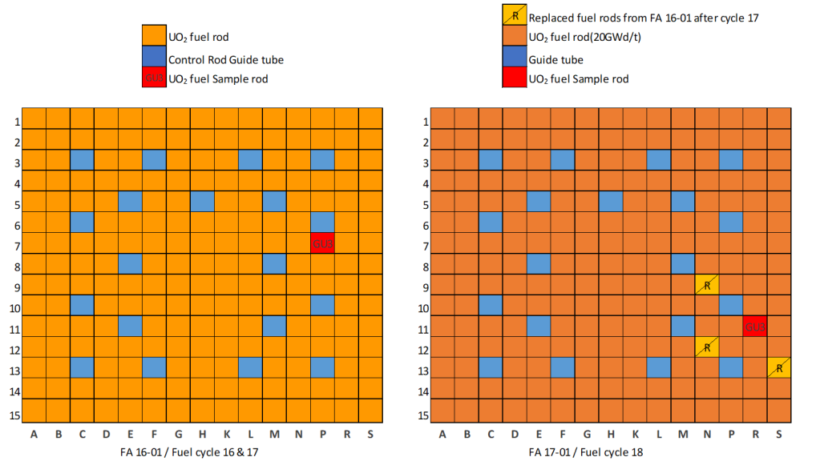

Benchmark model and requested results
General characteristics
• PWR UO2 sample, ²³⁵U initial mass enrichment of 4.1 %
• Irradiated in the Gösgen PWR (15x15) in Switzerland between 1994 and 1997 during 3 cycles
• Estimated sample burnup of 52.5 GWd/t
Radiochemical analysis
was performed by two laboratories
≈20GWd/t
SG10 Requested results
C/E values and concentrations and k_{inf} results as a function of time;
SG15 Requested results
ND uncertainty (total, xs and nubar, FY, DD)
The position of the sample fuel rod
has changed during the irradiation
Participants had the choice of the
code and ND library to be
used

Slide 7
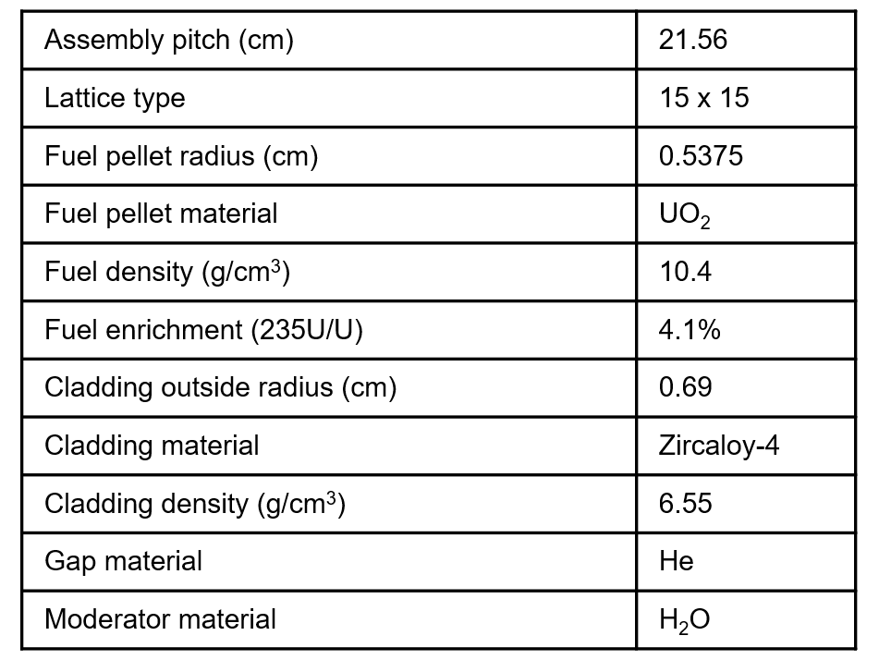
ARIANE GU3 – CASMO5 MODELling
General characteristics
  40 steps of irradiation up to 52.504 MWd/kg
  Change of assembly and position between Cycle 2 and 3
  CASMO5 version: 3.10
  ND library:
      Nominal case → ENDF/B-VII.1 (e7r1.202.586) and ENDF/B-VIII.0
      Covariance library → ENDF/B-VIII.0
  Temperatures and boron concentrations according to benchmark specifications
Modelling hypothesis
  Default options
  Gamma smearing is not considered
  No thermal expansion is simulated
  Use of the extended depletion chain (“202-300” library)
  Energy dependent branching ratio considered for Am

Slide 8
CASMO5 C/E results
02

Slide 9
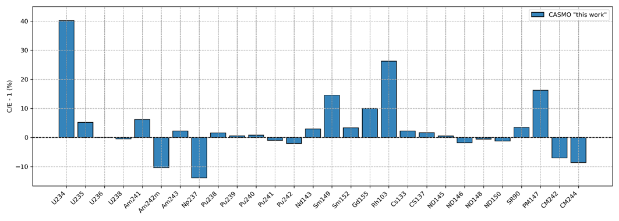
CASMO C/E results – ENDF/B-VII.1 (e7r1)
C/E usually less than 5%.
C/E larger than 10% for (U234), Am242M, Np237, Sm149, Gd155, Rh103 and Pm147M (similar list than SG10 results)

Slide 10
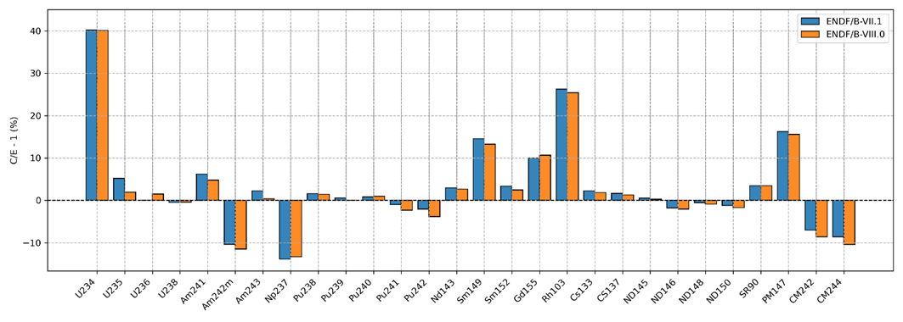
C/E results – ND library impact
ND library impact is less than 2%
Except U235 (3% discrepancy)
!
Pu239 in the CASMO ENDF/B-VII.1 library (e7r1) is taken from JENDL4 !

Slide 11
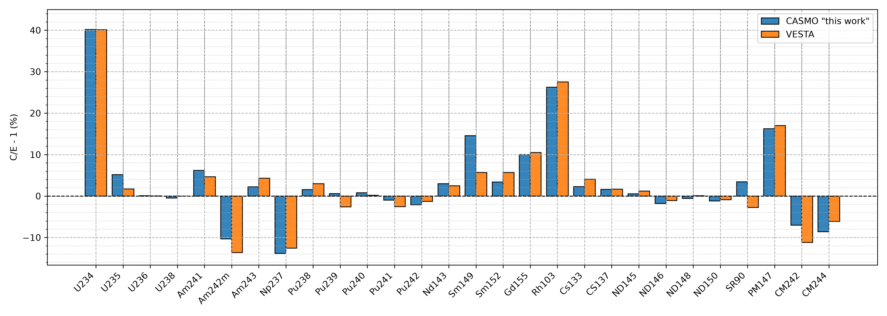
C/E results – comparison to Monte-Carlo
Reasonably good agreement (larger than 3% for U235, Am242M, Pu239, Sr90, Sm149, Cm242)
!
Pu239 in the CASMO ENDF/B-VII.1 library (e7r1) is taken from JENDL4 !

Slide 12
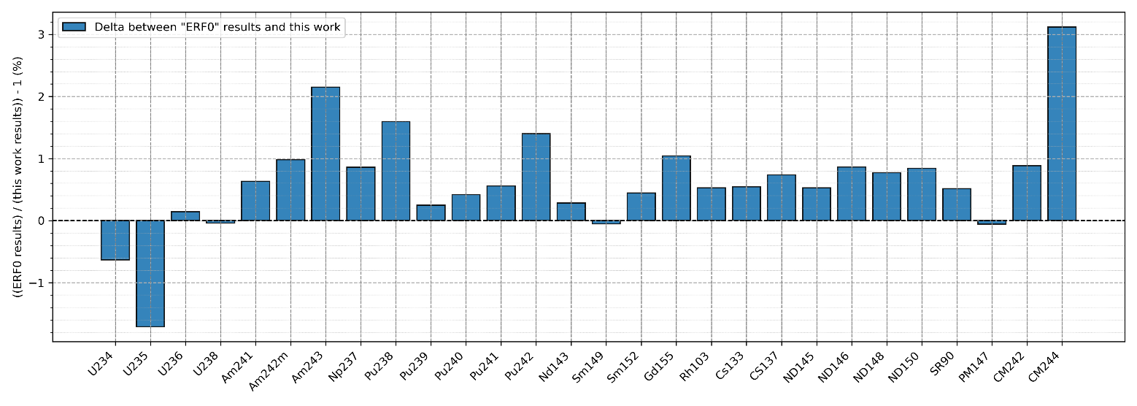
Energy deposition model impact
Impact less than 1% for most isotopes
Deviations of more than 1% for U235, Am243, Pu238, Pu242, Gd155 and Cm244

Slide 13
ND uncertainty propagation
03

Slide 14






Nuclear Data uncertainty propagation method
Sampling method using CASMO sampling tool (using ENDF/B-VIII.0 covariances):
ND (all together or one at a time)
N perturbed CASMO calculations
Get each isotope concentration result at the time of its measurement, for each calculation
Calcul, 1 ($x_{1})$
1$σ$ standard deviation from the distribution of concentration values obtained
  Cross-sections & Nubar
  Fission yields
  Decay data
Calcul, 2 ($x_{2})$
Calcul, i ($x_{i})$
$$σ=\sqrt{\frac{\sum_{i}{\left|a_{i}−\overline{a}\right|²}}{N−1}}$$
Calcul, N ($x_{N})$
N=1000-1500 samples for the individual data propagation
N=2000 samples for the simultaneous data propagation

Slide 15
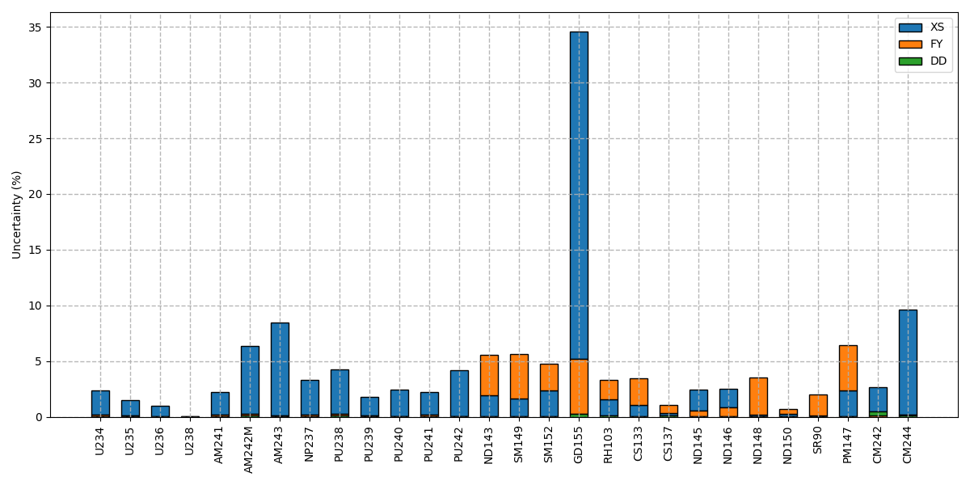
Nuclear Data uncertainty
No correlation for Fission yields in ENDF/B-VIII.0 !
Higher FY uncertainty
!
Total ND uncertainty is less than 3 % for most isotopes (using ENDF/B-VIII.0 covariances)
It is larger than 5% for Am242M, Am243, Gd155 and Cm244
  Gd155 high uncertainty is due to high uncertainty on Eu155 capture cross-section
Fission yields uncertainty is a significant part of the uncertainty on most fission products

Slide 16
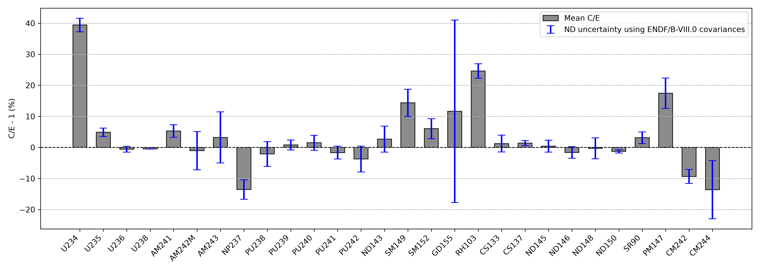
C/E and Nuclear Data uncertainty
ND uncertainty explains the C/E bias for many isotopes
But it is not the case for: (U234), U235, Am241, Np237, Sm149, Sm152, Rh103, Sr90, Pm147, Cm242

Slide 17
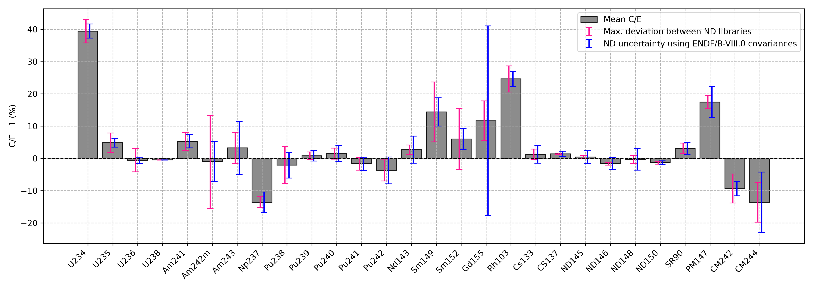
Nuclear Data uncertainty vs Library deviation
ENDF/B-VII.1, ENDF/B-VIII.0, ENDF/B-VIII.1, JEF-2.2, JEFF-3.1.1 and JEFF-3.2
Library maximal deviations are often of same order of magnitude than ENDF/B-VIII.0 ND uncertainty propagation.
Notable exceptions are:
  Am242M, Sm149, Sm152 (covariance give much lower uncertainty)
  Gd155 and Nd (covariance give much larger uncertainty)

Slide 18
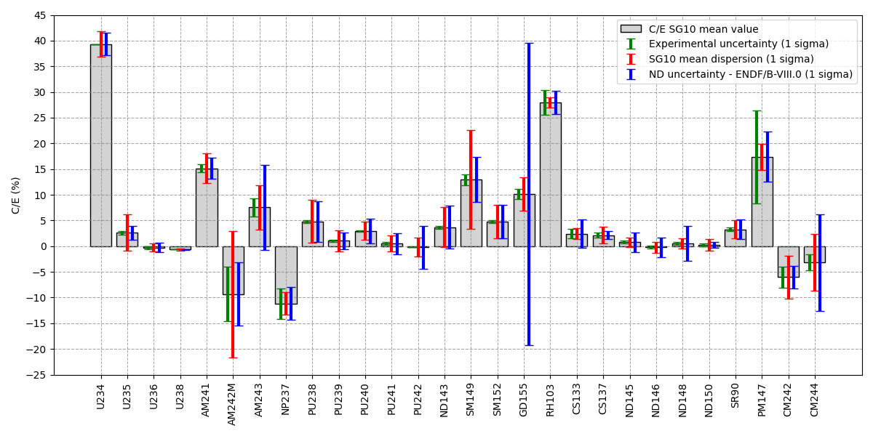
C/E and Nuclear Data uncertainty
ND uncertainty explains the C/E bias for many isotopes
But it is not the case for: U235, Am241, Am242M, Np237, Sm149, Rh103, Sr90, Pm147, Cm242
  Mean SG10 results dispersion much higher than ND uncertainty for U235, Am242M, Sm149
More investigation needed for Am241, and Rh103

Slide 19
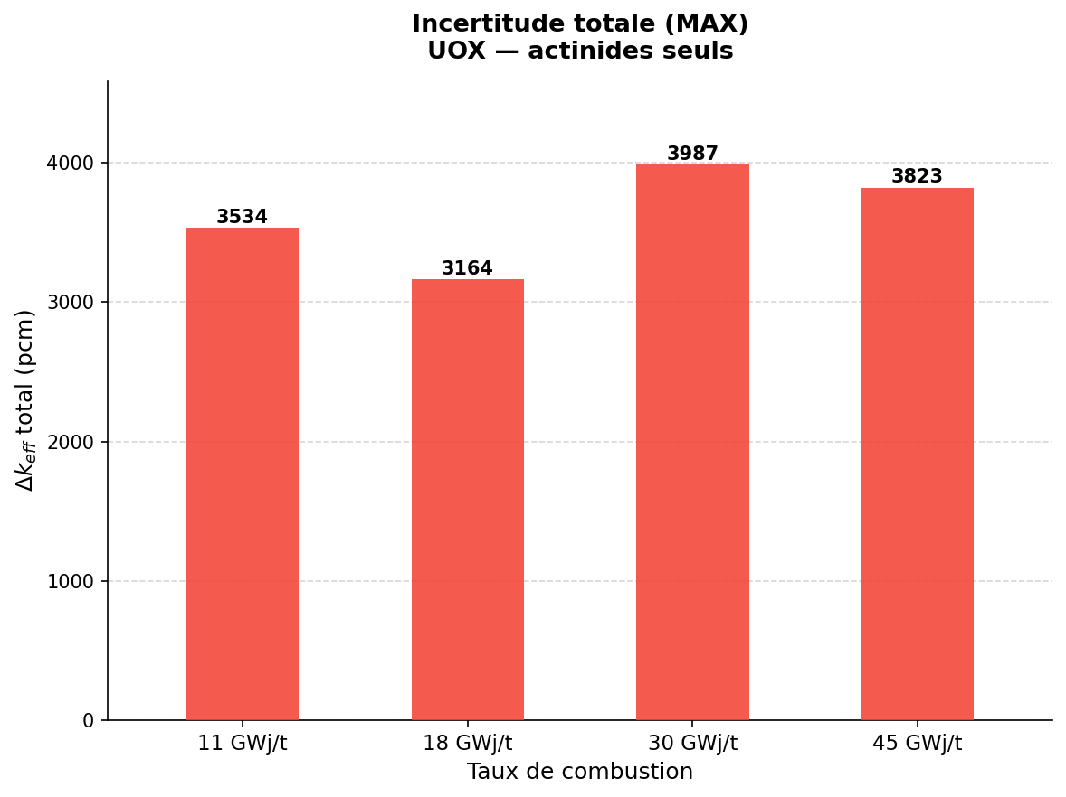
Conclusion
Different sources of uncertainty impacting SNF inventories are studied at ASNR and within WPNCS SG
      CASMO-5 calculations :
        C/E results on the ARIANE GU3 benchmark were analyzed and compared to WPNCS SG10 calculations
        Generally similar results than Monte-Carlo VESTA results and SG10 results
      ENDF/B-VIII.0 ND uncertainty propagation :
        Calculations performed with CASMO-5 sampling tool and ENDF/B-VIII.0 covariances
          ND uncertainty is less than 5%, except very few exceptions (can reach 30%)
          ND uncertainty covers the C/E bias for a fair amount of isotopes (~2/3)
          ND uncertainty usually of the same order of magnitude than library discrepancies
      Other sources of uncertainties need to be accounted:
        “Code usage” uncertainties (code options, errors..)
        Exp. Uncertainties + Model uncertainties
      Significant impact on keff uncertainty for Burnup Credit applications is expected
        Ongoing internship on the subject
        Impact up to ~4000 pcm has been estimated
Very preliminary

