Slide 1

Random-matrix approach for generating cross sections and probability table in the unresolved resonance region
K. Fujio, T. Kawano, A. E. Lovell, D. Neudecker, N. A. W. Walton
WONDER 2026
LA-UR-26-24913

Slide 2
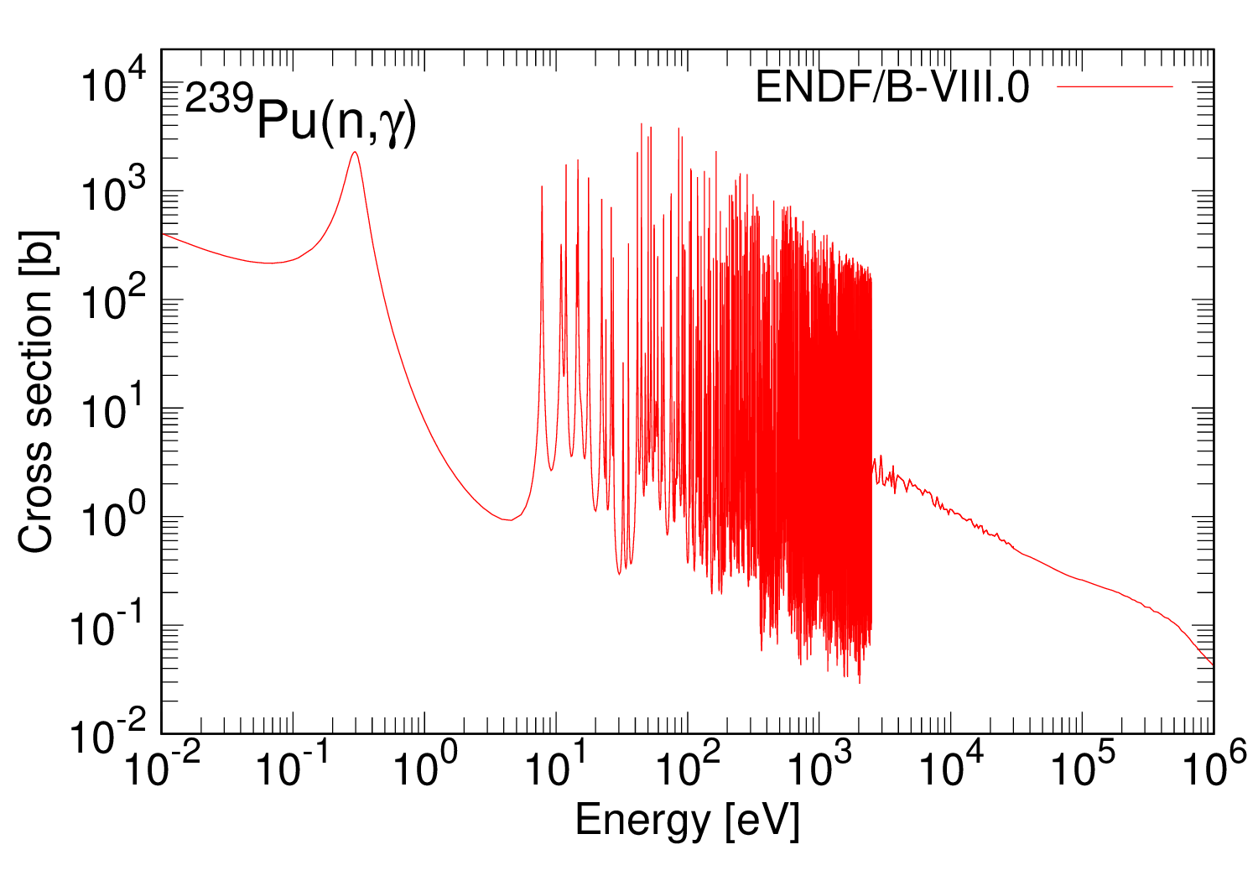
Cross section in theoretical approaches
Resolved resonance region (RRR)
・Individual resonances can be seen
・Expressed in R-matrix formalism
by using resonance parameters
Fast energy region
?
・Smooth cross section because
resonance width is bigger than the spacing
・Calculated by Hauser-Feshbach theory
RRR
URR
Fast.
Unresolved resonance region (URR)
・Resonances overlap and cannot be
separated from one another
・No commonly used theoretical model

Slide 3
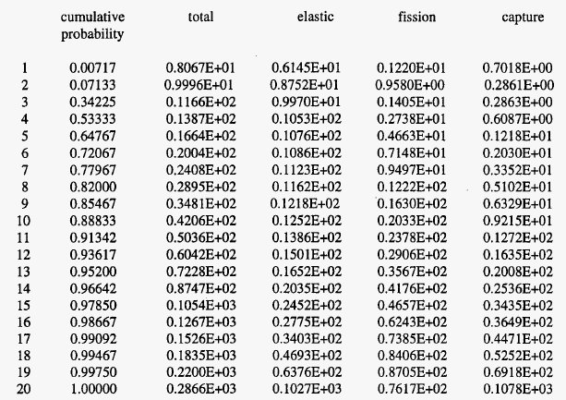
Importance of URR and probability table
Self-shielding: Neutrons are easily captured at resonance peaks, and the neutron flux
decreases at resonance energies. → Impacts on reaction rate
We need to take into account resonances in URR as well !
・A probability table which represents the
probabilistic distribution of cross sections
is employed in Monte-Carlo approaches
[b]
[b]
[b]
[b]
・Assume Wigner and chi-square distributions for
the resonance spacing and width, respectively
A theoretical approach is required to calculate the cross sections in URR without these kinds of assumptions
L. L. Carter et al., LA-UR-98-0026 (1998).

Slide 4
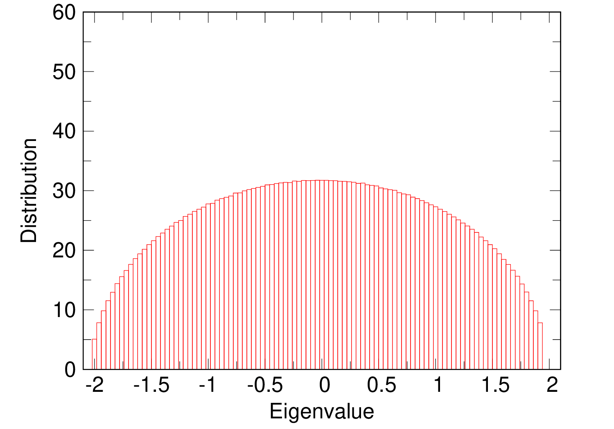
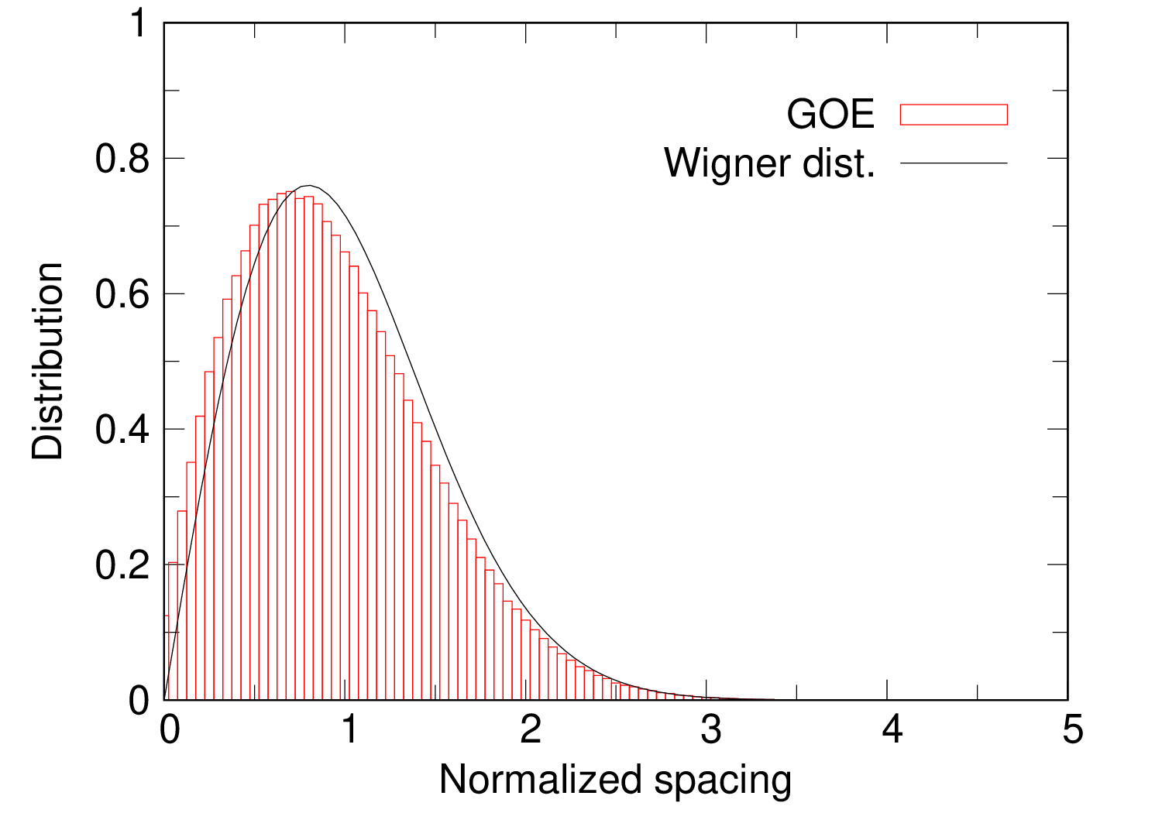
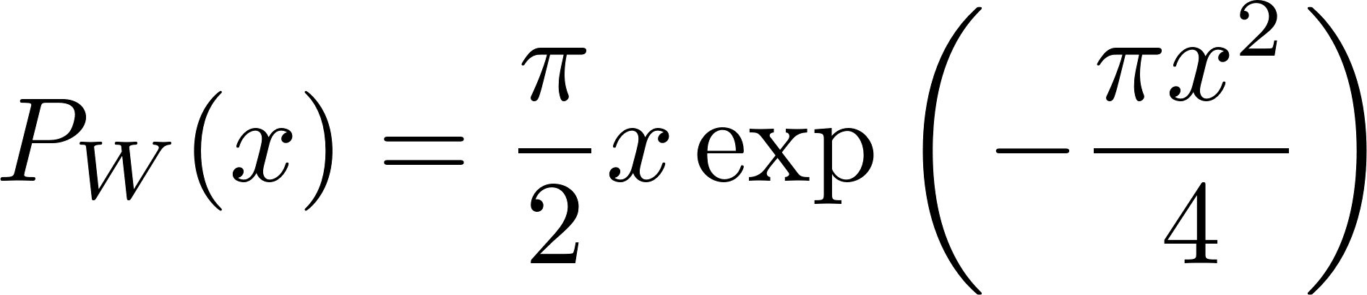
Research objective and approach
Develop a theoretical model to obtain cross sections in URR and employ them
to create the probability table
Random-matrix approach
Gaussian Orthogonal Ensemble (GOE)
・Real symmetric matrix
・Matrix elements are Gaussian distributed random numbers
Eigenvalue distribution
Distribution of spacing of each eigenvalue
The number of simulations: 0.1 M
Matrix dimensions: 100 x 100

Slide 5
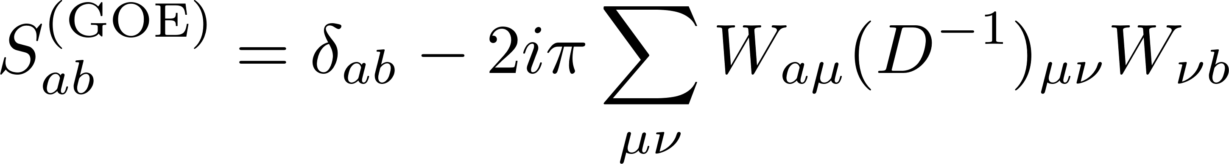
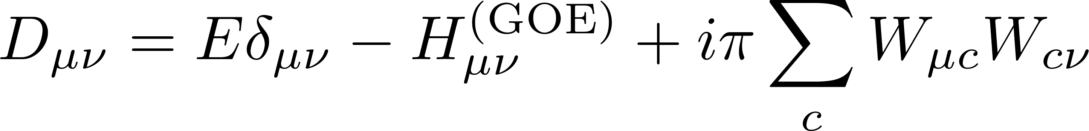
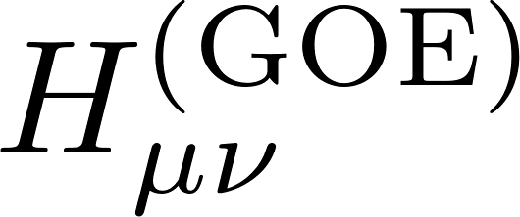
S matrix calculated using GOE
E : energy in units of λ
(Does not represent incident neutron energy!)
: Random matrix
J. J. M. Verbaarschot et al., Phys. Rep. 129, 367 (1985).
Input parameters
T. Kawano et al., Phys. Rev. C92, 044617 (2015).
・The number of levels
N
・The number of channels
Λ
- The number of inelastic scattering channels is determined by possible number of
neutron partial waves and the corresponding excited levels
・Neutron, photon, and fission transmission coefficients
T_{n}, T_{γ}, T_{f}
Notes:
To calculate cross sections, we need S matrix. The approach is established by Verbaarschot et al.

Slide 6
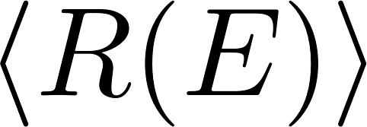
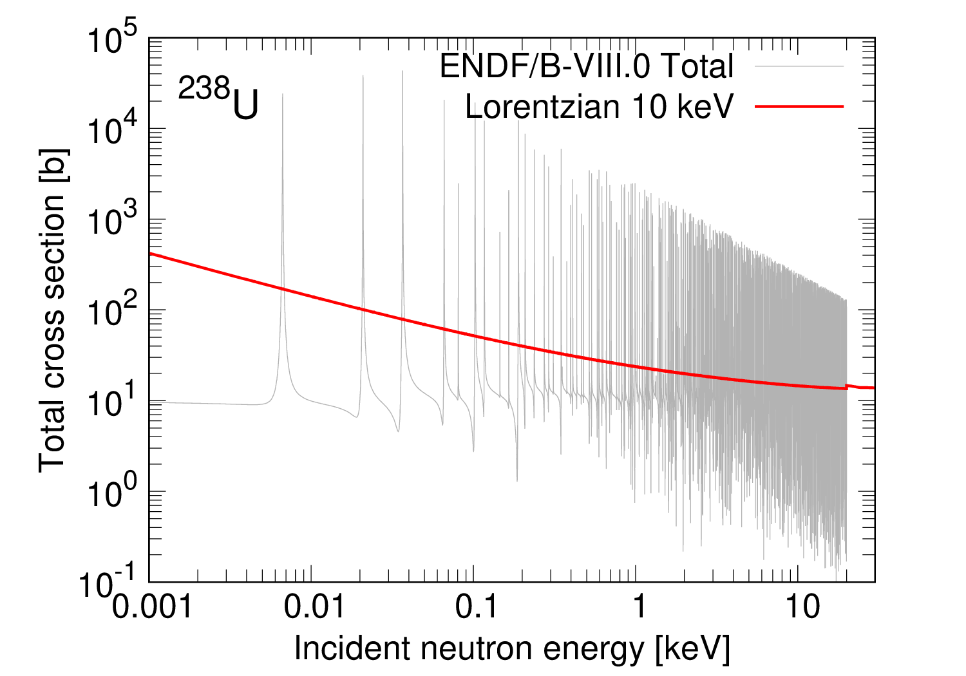
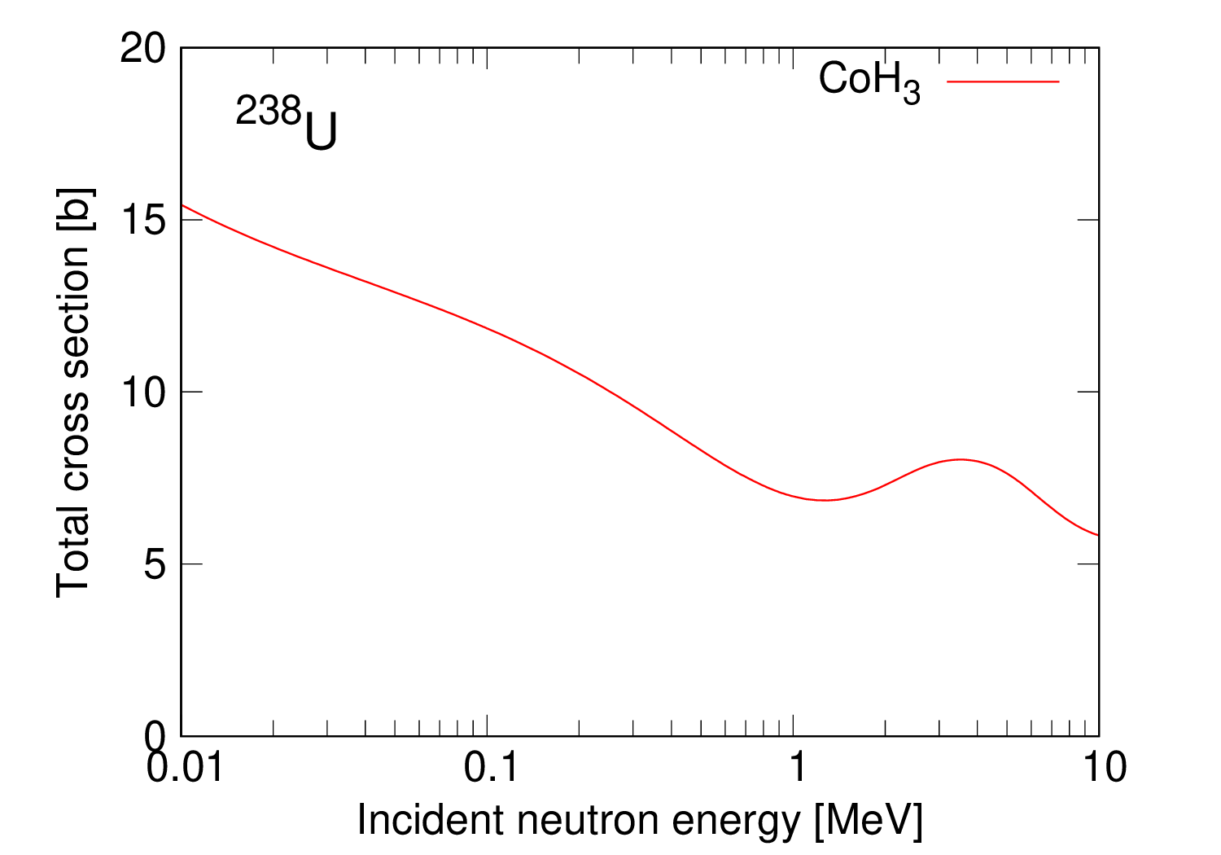
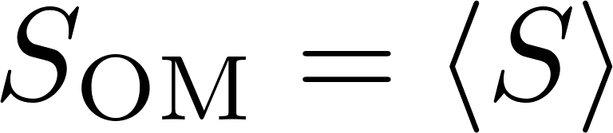
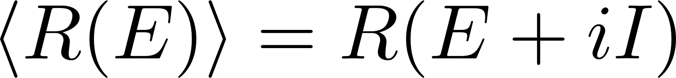
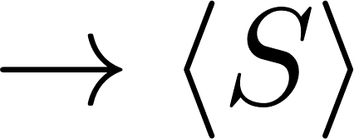
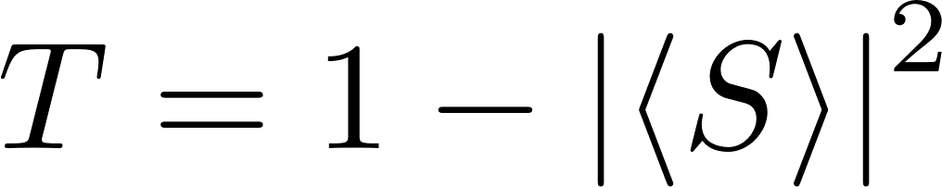
How to smoothly connect 2 regions
The S matrix smoothly connects between RRR and fast energy regions
Between RRR and URR
Between URR and fast energy regions
1. Obtain the energy-averaged R matrix in
RRR (ENDF/B-VIII.0)
✅ We can consistently use the same treatments
as those used in the Hauser-Feshbach model
and (coupled-channel) optical model in CoH₃
2. Determine the optical model parameters
to reproduce
Key input parameters:
Transmission coefficients

Slide 7
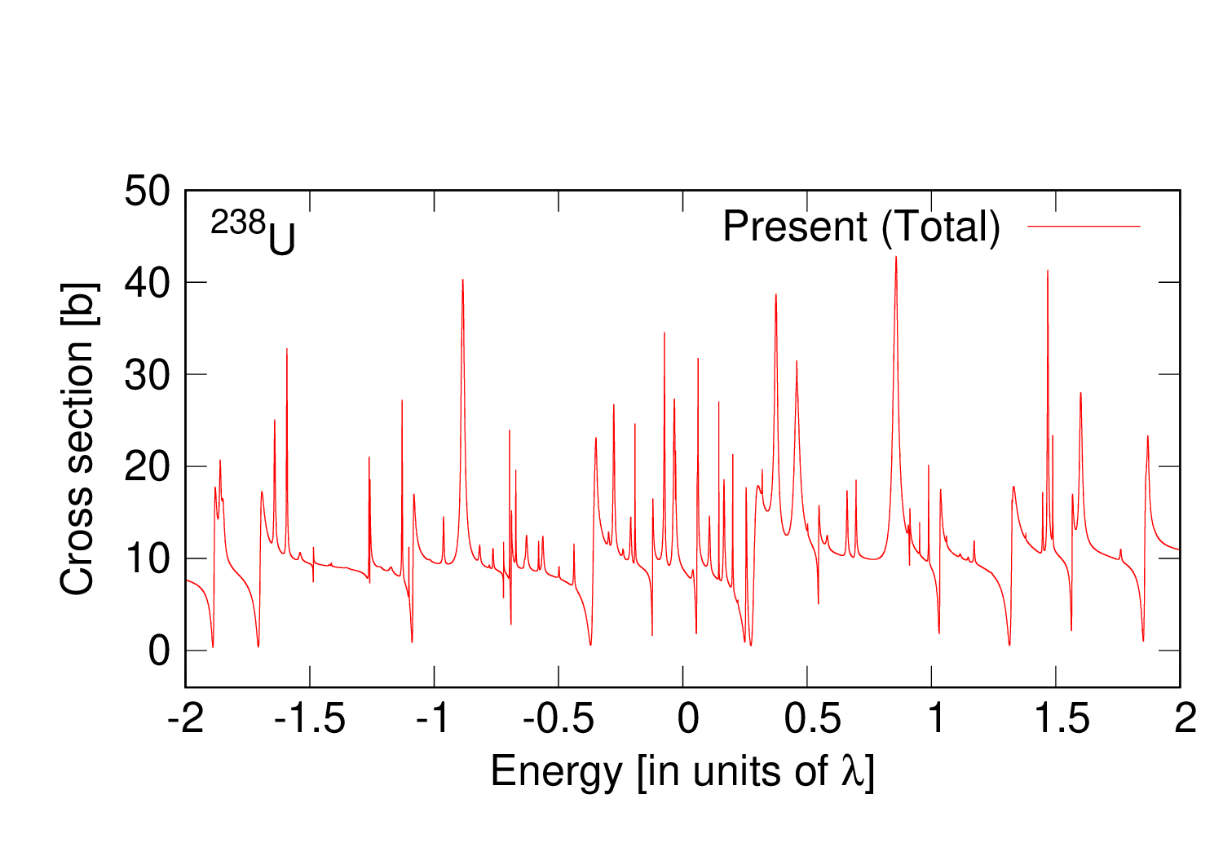
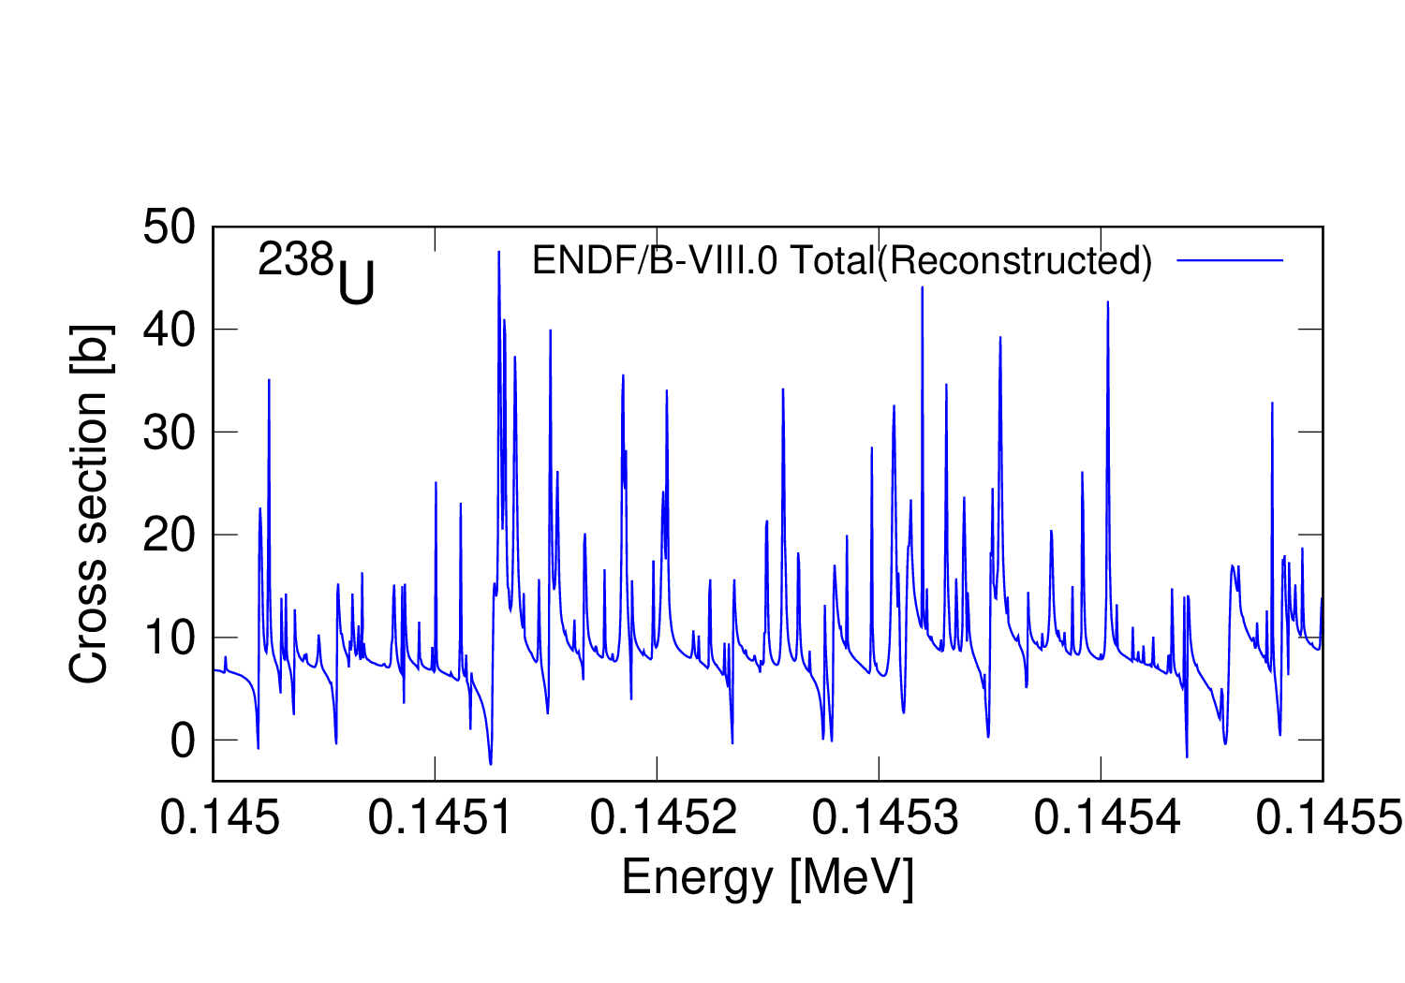
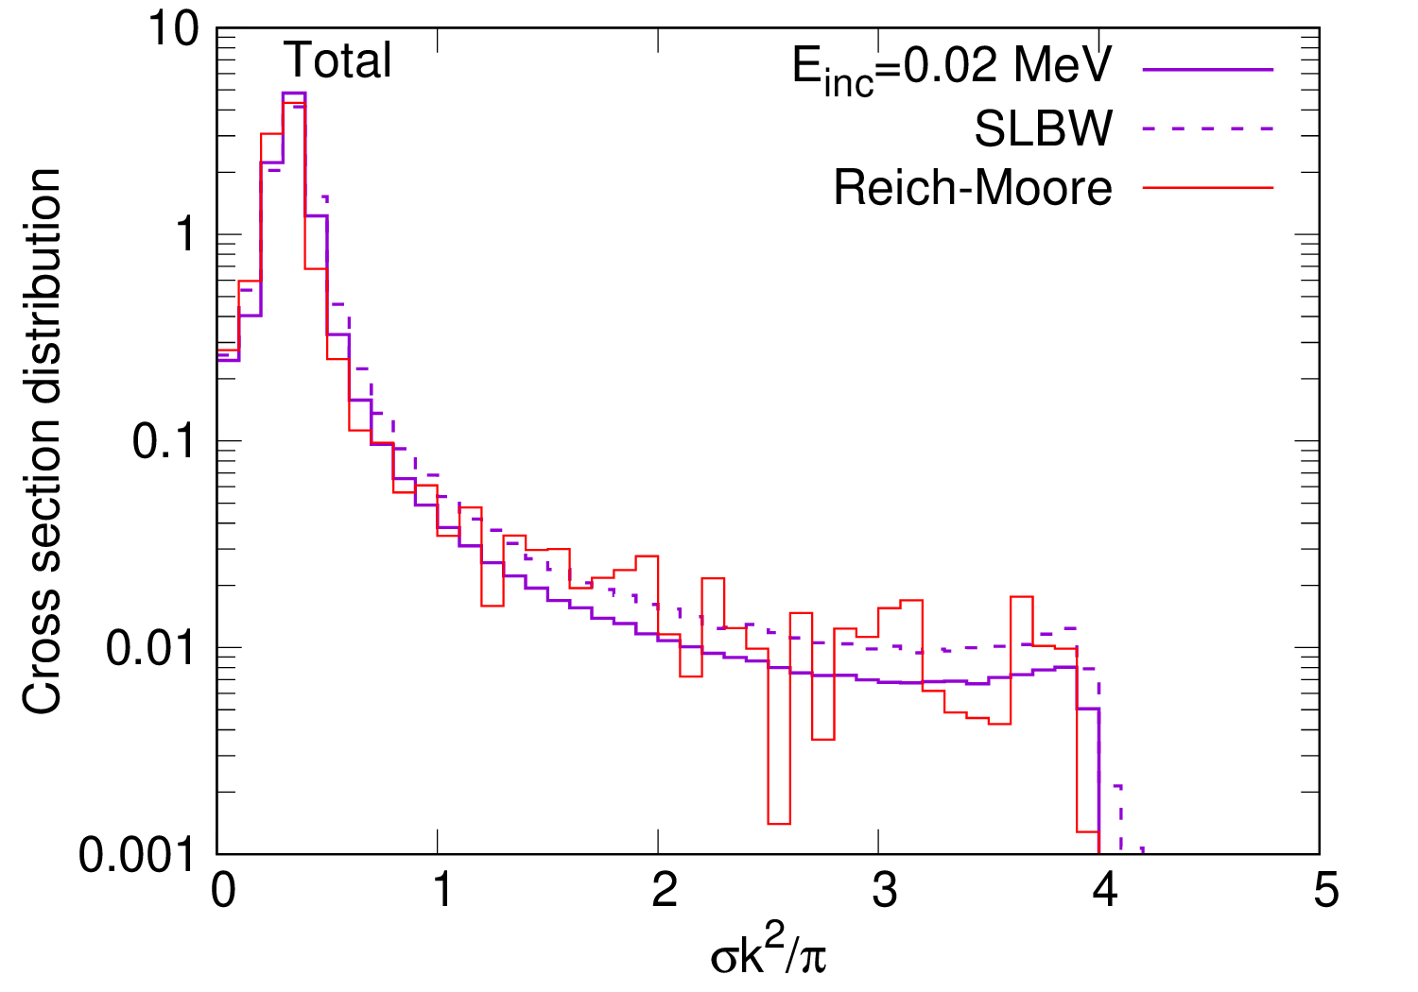
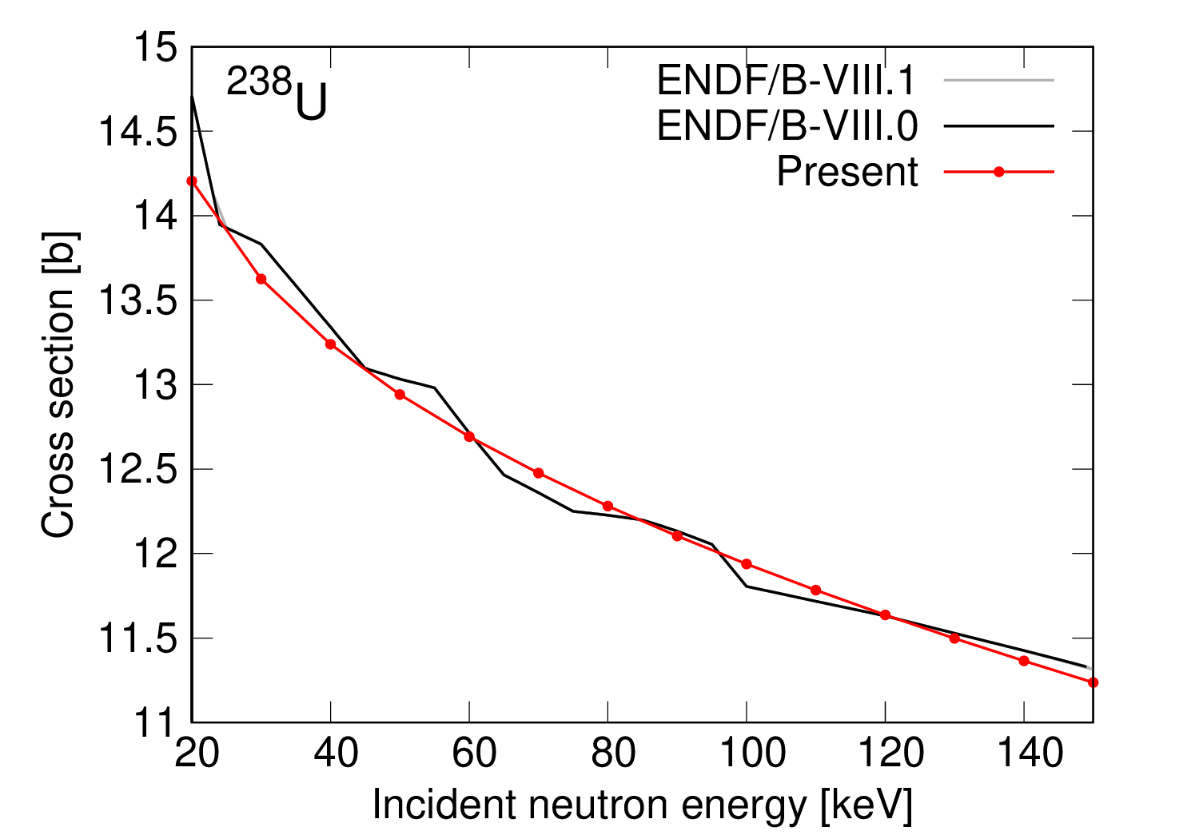
Calculated cross sections
Phys. Rev. C112, 064608 (2025).
GOE-S-matrix model (unitarity is guaranteed!)
Single-level Breit-Wigner formula (unitarity is not guaranteed)
(at 150 keV)
Smoothly connected
2 regions!
Notes:
EXPLAIN LAMBDA!

Slide 8
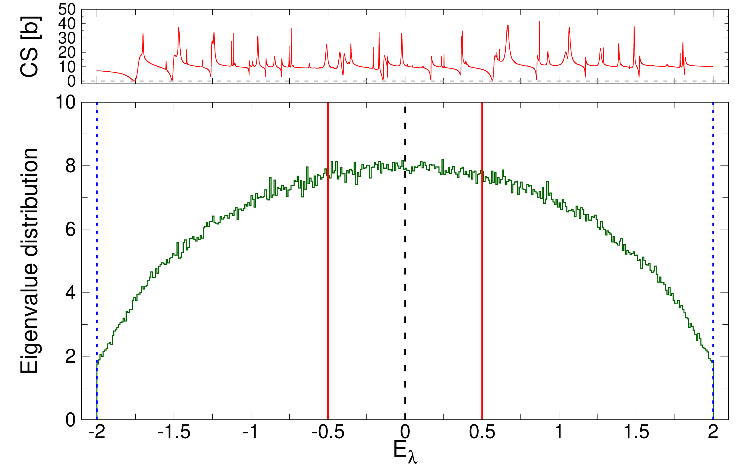
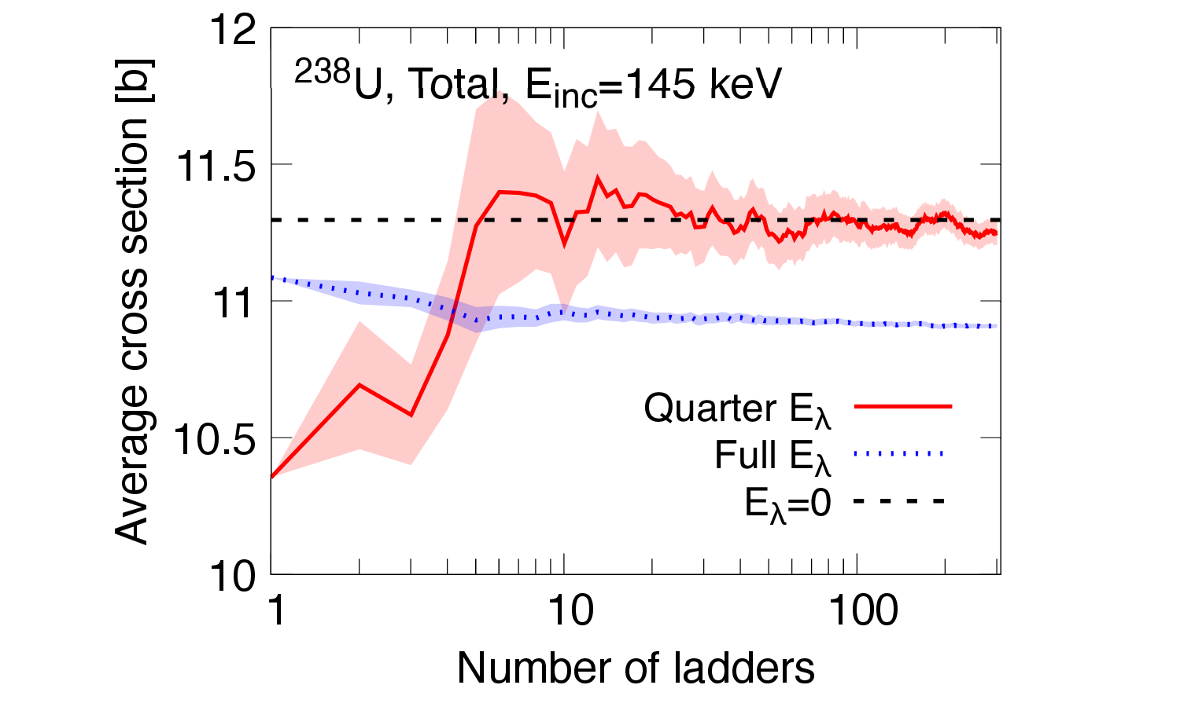
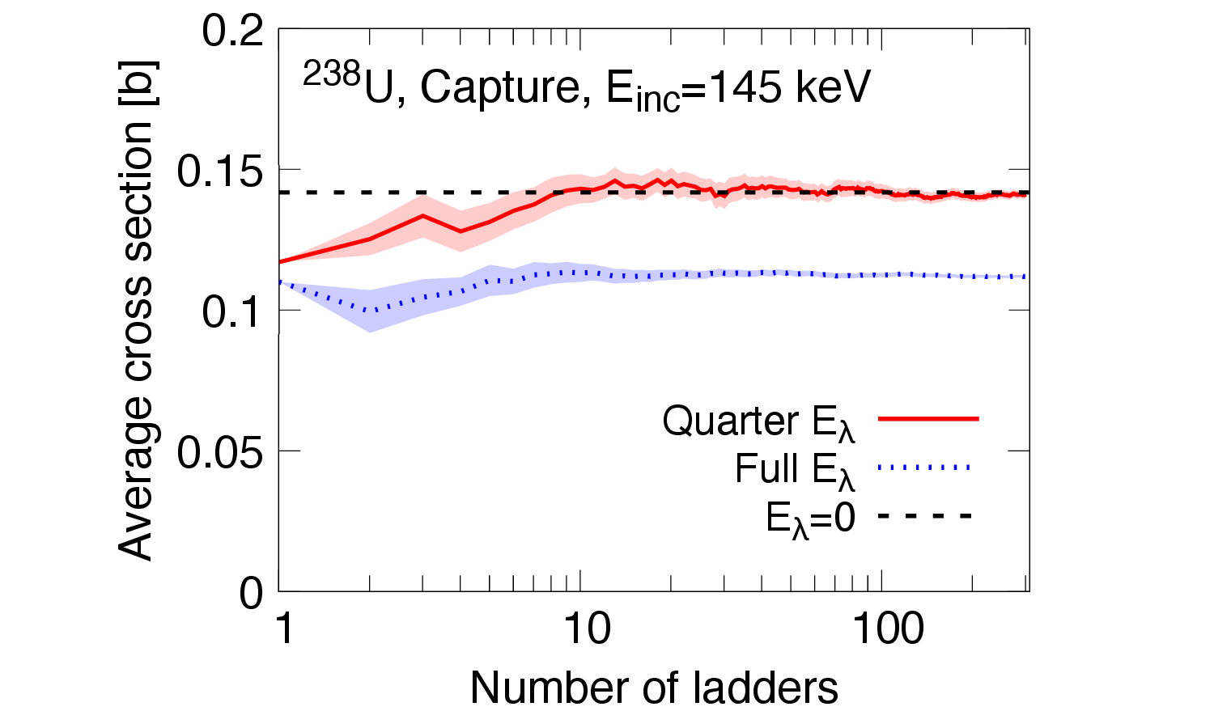
Selected energy range
・The eigenvalue distribution corresponds to the level density.
・The convergence behavior depends on the level density.
・Compared the convergence of the cross sections using
the full E_{λ} range and the quarter E_{λ} range.
We restrict the energy range to E_{λ} = ー λ/2 to λ/2.

Slide 9
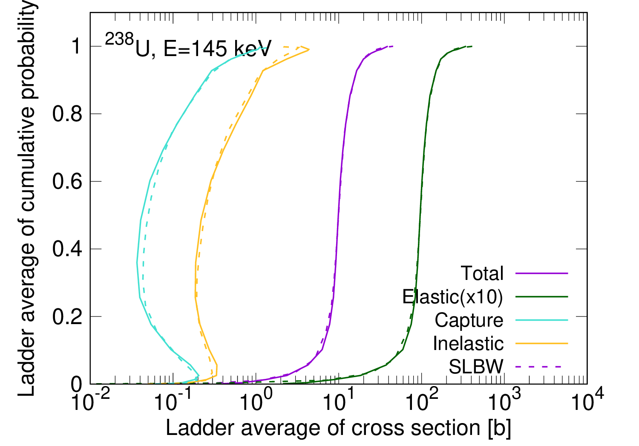
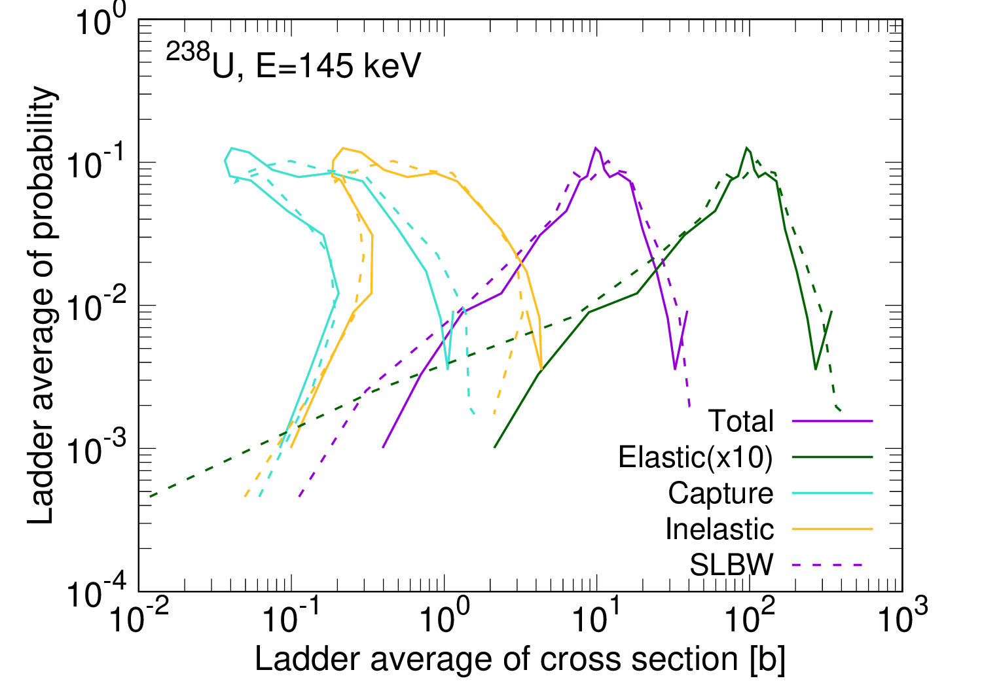
Calculated probability tables
J. Nucl. Sci. Technol. (published)
The number of ladders: 10000
・No significant differences are observed between the GOE calculation
and the single-level Breit-Wigner result.
・Small ladder average of cross sections are seen in the SLBW results
due to the negative cross sections.

Slide 10
Conclusions
・We developed a new theoretical model to obtain cross sections in URR
and employ them to create the probability table.
・The input transmission coefficients are determined that the S matrix smoothly
connects between RRR and higher energy regions.
・The average cross sections converge to evaluate data by restricting
the range to E_{λ} = ー λ/2 to λ/2.
・ The main difference in probability table between our new approach and
the SLBW comes from the unitarity condition.
Future work
・Introduce the temperature effect (Doppler broadening)

Slide 11


Acknowledgements
・Research reported in this presentation is supported by the U.S. Department of
Energy LDRD program at Los Alamos National Laboratory.
・This work was carried out under the auspices of the National Nuclear Security
Administration of the U.S. Department of Energy at Los Alamos National Laboratory
under Contract No. 89233218CNA000001.
・This work was supported by the Nuclear Criticality Safety Program, funded and
managed by the National Nuclear Security Administration for the Department of
Energy.
Notes:
This research is supported by the US department of energy LDRD program at Los Alamos National Laboratory.

Slide 13
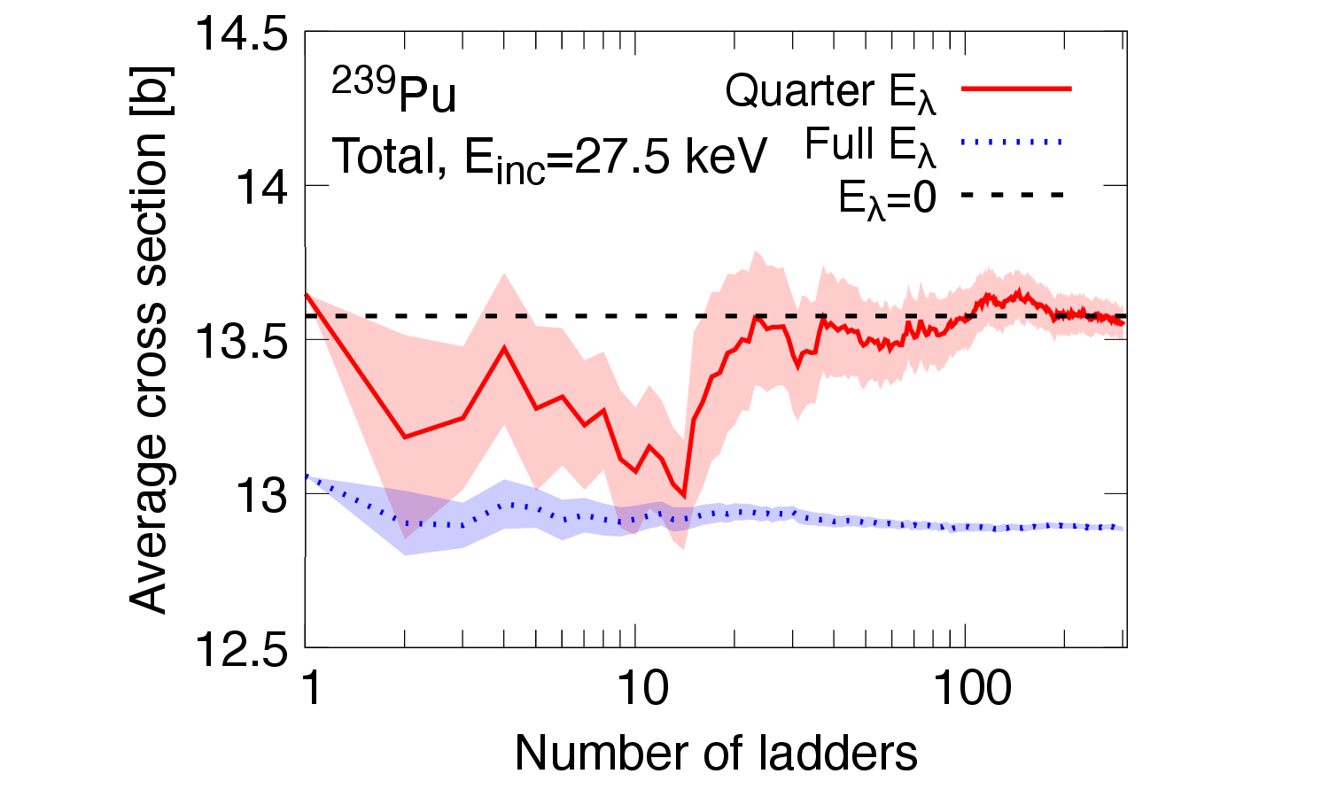
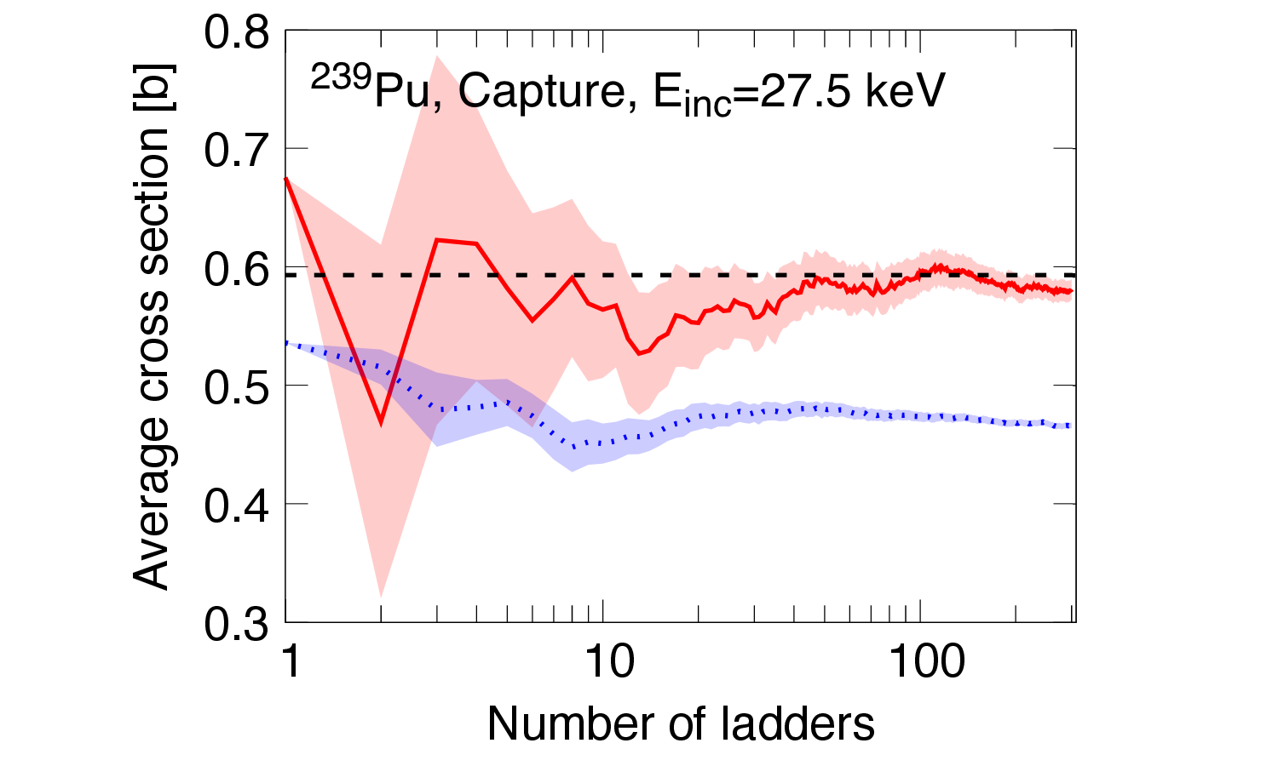
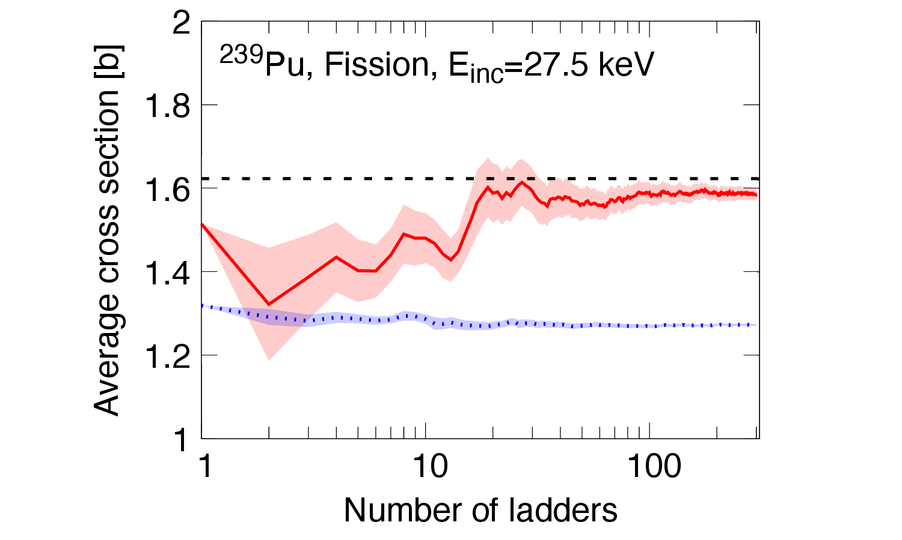

Slide 14
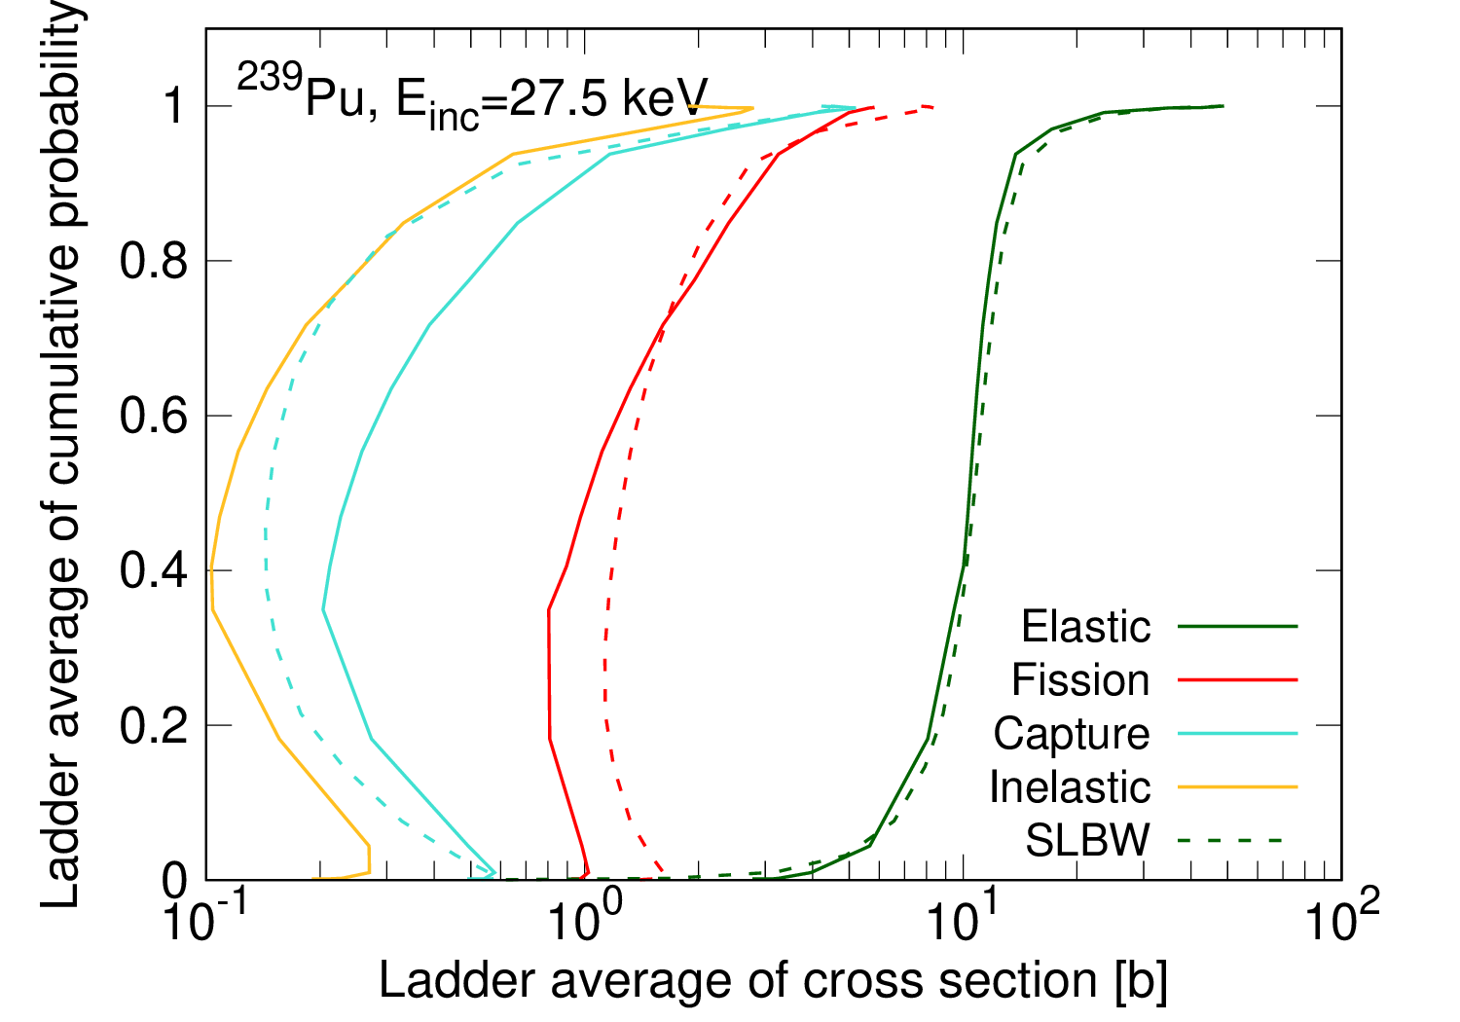
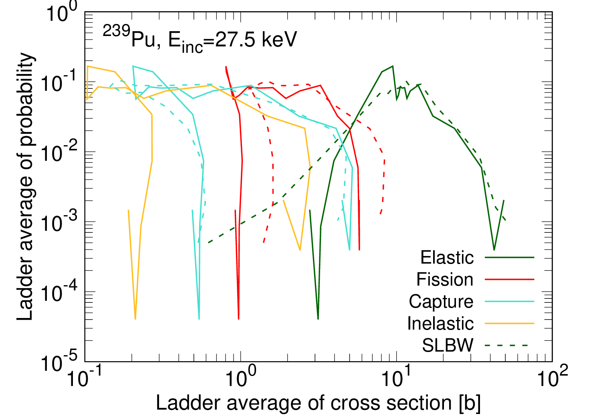

Slide 15
