Slide 1
Determination of partial prompt gamma-ray cross-sections induced by fast neutron inelastic scattering using the FaNGaS instrument
Iaroslav Meleshenkovskii, Eric Mauerhofer, Niklas Ophoven
Forschungszentrum Jülich
The 7th edition of the International Workshop On Nuclear Data Evaluation for Reactor Applications (WONDER-2026)
Aix-en-Provence, France, 2026

Slide 2
PRESENTATION OUTLINE
FaNGaS instrument
Analytical equations
Measurement campaign 2016-2020
    22 Elements study
    CaCO₃ example
Results and summary
Outlook & future research

Slide 3
Aim & Scope of FaNGaS Instrument
Chemical analysis of small to large samples using prompt gamma radiation induced by fast-neutron reactions: (n,n´γ), (n,p), (n,α), (n,2n)
Complementary method to PGNAA (cold/thermal neutrons), exceeding its limits
PGAINS method: Prompt Gamma Analysis based on Inelastic Neutron Scattering
Two major aims:
Geology & Arctic
Need of reliable nuclear data of (n,n´γ) reactions
"Demidov Atlas"^{[3-5]} (1978) must be validated!
Archaeology
Industry
Non-destructive elemental analysis for
large objects
1
^{[3]}A.M. Demidov et al., NIMA (1974)
^{[4]}A.M. Hurst et al., NIMA (2021)
^{[5]}A.M. Demidov et al., Atomizdat, Moscow (1978)
Environmental research
Fundamental
research
2
: Comprehensible (n,n´γ) data catalogue with state of the art equipment

Slide 4
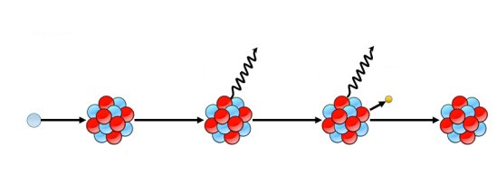
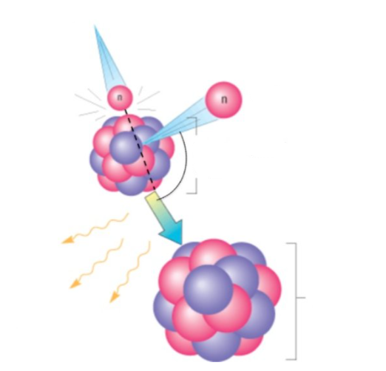







PGNAA vs PGAINS: Thermal vs Fast Neutrons
PGNAA
Prompt Gamma Neutron Activation Analysis
PGAINS
Prompt Gamma Analysis based on Inelastic Neutron Scattering
10⁻¹⁶-10⁻¹² s
10⁻⁶-10² s
Incoming neutron:
E₀
Prompt γ-ray
Delayed γ-ray
Scattered neutron: E
Target
Nucleus
Compound
Nucleus
β particle
Neutron
$$\left({}_{Z}^{A}X\right)$$
Inelastic scattering angle:
ϑ_{inelastic}
n
$\left({}_{Z}^{A}X\right)$*
(Compound Nucleus)
$$\left({}_{Z}^{A}X\right)$$
$\left({}_{Z}^{A+1}X\right)$*
$$\left({}_{Z}^{A+1}X\right)$$
$$\left({}_{Z±1}^{A+1}X\right)$$
Inelastic prompt
γ-rays
Nucleus
PGNAA
(DG)NAA
$$\left({}_{Z}^{A}X\right)$$
^{[1]}Shahabinejad et al., PROG NUCL ENERGY (2020, modified)
^{[2]}Chen, PhD thesis (2015, modified)
Radiative capture dominates at low energies, whereas inelastic scattering in the high energy region around a few MeV and is a threshold reaction!
Advantages:
Analysis of larger and denser samples
Higher sensitivity for some elements like to C, O, Ce, Pb
Less sample activation

Slide 5
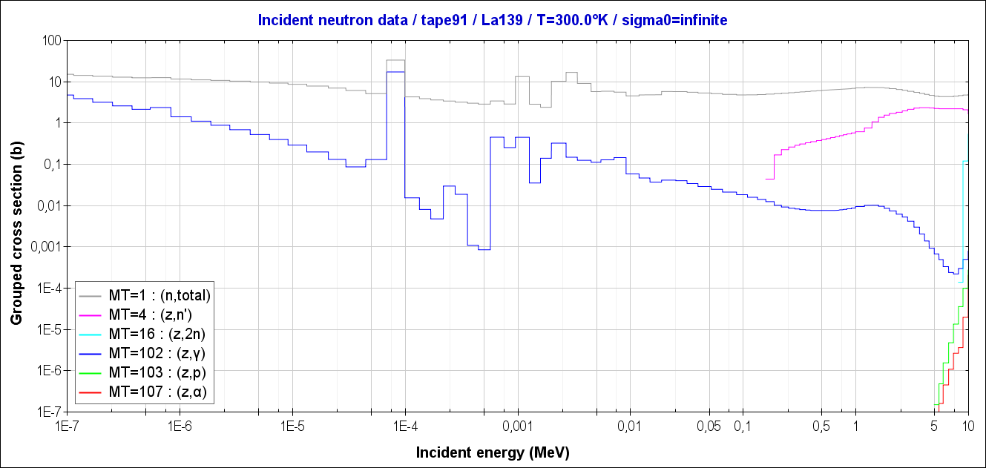
Typical Excitation Functions
ENDF/B-VIII.0 reaction data processed with NJOY for ¹³⁹La
(n,γ)
(n,n´γ)
(n,p)
(n,α)

Slide 6
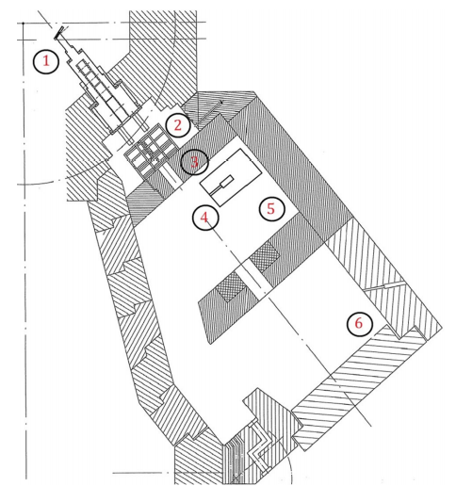
FaNGaS Instrument
FRM-II (Forschungs-Neutronenquelle Heinz-Maier-Leibnitz) reactor:
Swimming-pool type
Extraction channel: SR10 (Strahlrohr 10)
FaNGaS location
Convertor plate containing 498 g of enriched uranium (93% ²³⁵U)
Bench filters bunker (FaNGaS collimator)
Multi-leaf-collimator of MEDAPP facility
FaNGaS spectrometer (measuring position)
MEDAPP facility bunker
NECTAR facility bunker (radiography)
Neutron beam axis
Mauerhofer et al., 2021
FaNGaS supported by the German Federal Ministry of
Education and Research (BMBF) under the Project number 02S9052A

Slide 7
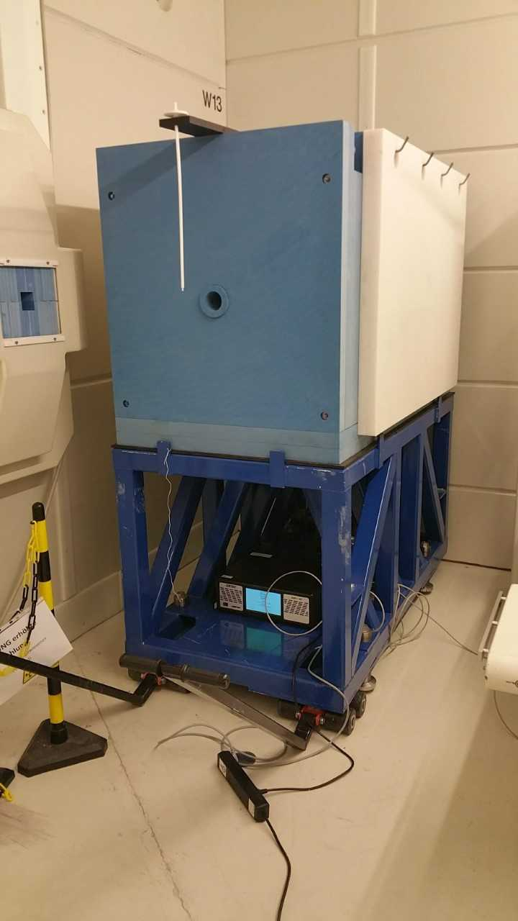
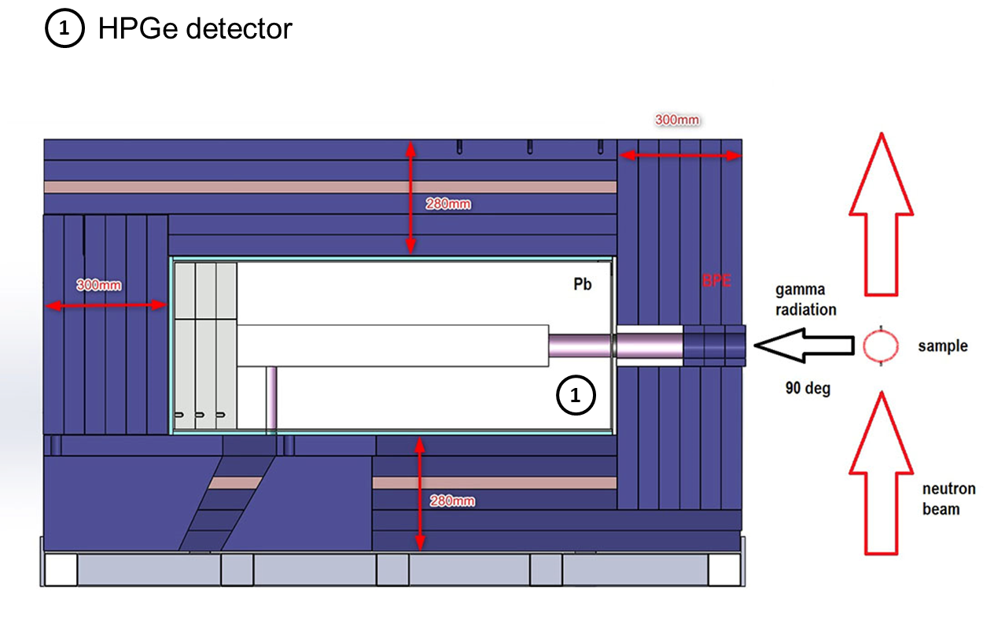
FaNGaS Instrument Specifications
Multi-leaf neutron beam collimator (beam size: 6x6 cm²)
BPE front shielding (d= 30 cm)
Detector collimator (∅= 6 cm)
Teflon (C_{n}F_{2n}) sample holder
Steel support frame
2
4
1
3
5
n-type HPGe detector
50% relative efficiency
Energy resolution: 2.1 keV @ 1.33 MeV
Sample-to-detector distance: 67 cm
Gamma/Neutron attenuator: 1 - 10 cm BPE
Source: J. Feil, MLZ
Possible to analyze samples of up to 400 cm³ volumes

Slide 8
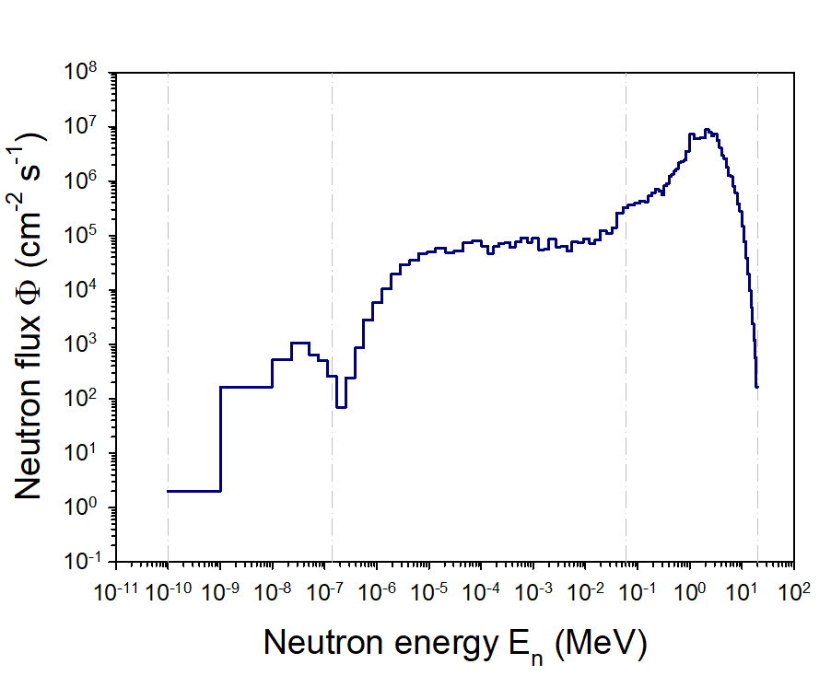
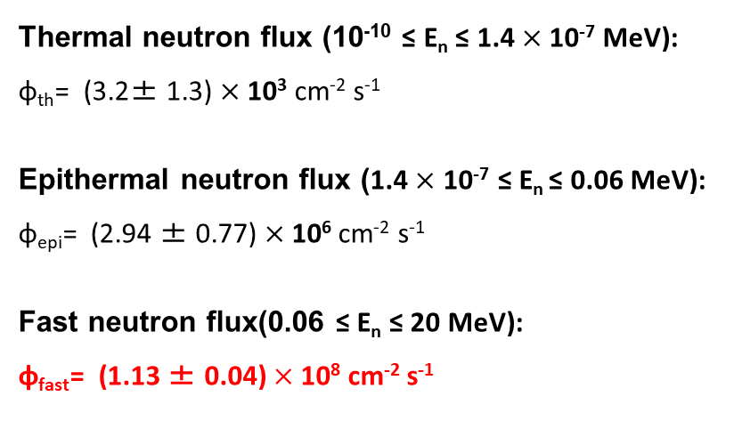
FaNGaS Instrument
Neutron spectrum @ sample position
Obtained by foil activation method and spectrum unfolding with software STASYL PNNL
Reevaluation of thermal and epithermal component due to multi-leaf-collimator of MEDAPP
Thermal neutron flux (10⁻¹⁰ ≤ E_{n} ≤ 1.4 $×$ 10⁻⁷ MeV):
φ_{th}= (3.2± 1.3) $×$ 10³ cm⁻² s⁻¹
Epithermal neutron flux (1.4 $×$ 10⁻⁷ ≤ E_{n} ≤ 0.06 MeV):
φ_{epi}= (2.94 ± 0.77) $×$10⁶ cm⁻² s⁻¹
Fast neutron flux(0.06 ≤ E_{n} ≤ 20 MeV):
φ_{fast}= (1.13 ± 0.04) $×$10⁸ cm⁻² s⁻¹
Epithermal
(~ 2.5%)
Thermal
(~ 0.003%)
Fast
(~97.5%)
Mean neutron E ~ 2.2 MeV
Z. Ilic et al., JRNC (2020)
N. Ophoven et al. JRNC (2024)

Slide 9

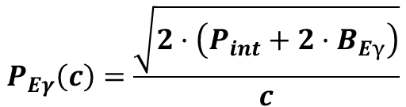


Analytical Equations
Parameters:
$\left\langle σ_{Eγ}\left(90°\right)\right\rangle$: Fast-neutron spectrum-averaged partial cross section
$P_{Eγ}$: Net count in the gamma-ray peak (HYPERMET-Pc)
$M$: Molar mass (g mol⁻¹)
$m$: Element mass (g)
$N_{A}$: Avogadro number (6.022 $×$ 10²³ mol⁻¹)
$h$: Isotopic abundance
$ε_{Eγ}$: Full-energy-peak (FEP) efficiency
$f_{Eγ}$: Gamma-ray self-absorption factor
$f_{n}$: Neutron self-shielding factor
$Φ$: Integral fast-neutron flux at sample position
$t_{c}$: Counting live time (s)
$\left\langle σ_{n,n’,γ }\right\rangle$: Integral cross section
$I_{γ}$: Absolute γ-ray intensity
$\left\langle W_{Eγ}(90°)\right\rangle$: Angular-distribution correction factor
$B_{Eγ}$: Background below gamma line (HYPERMET-Pc)
$P_{int}$: Net area of interfering peak
Quantification of partial cross-sections
$$\left\langle σ_{Eγ}\left(90°\right)\right\rangle =\frac{P_{Eγ}·M}{m·N_{A}·h·ε_{Eγ}·f_{Eγ}·f_{n}·Φ·t_{c}}$$
Anisotropic γ-ray emission:
$$\left\langle σ_{Eγ}\left(90°\right)\right\rangle =\left\langle σ_{n,n’,γ }\right\rangle ·I_{γ}·\left\langle W_{Eγ}(90°)\right\rangle$$
Detection limit (DL)
(Without interference)
(With interference)
$$P_{Eγ}\left(c\right)=\frac{\sqrt{2·B_{Eγ}}}{c}$$
$$P_{Eγ}\left(c\right)=\frac{\sqrt{2·\left({P_{int}+2·B}_{Eγ}\right)}}{c}$$
c= 0.5, i.e. 50% uncertainty using beam background spectrum

Slide 10
Measurement Campaign 2016-2020
Experimental protocol
Goal: Energies E_{g}, relative intensities I_{R} and partial cross section ⟨𝝈_𝑬𝜸 (𝟗𝟎°)⟩ of gamma lines for 23 elements: C, O, Al, Cl, Ca, Cl, Ti, Fe, Ni, Cu, Zr, In, La, Ce, Pr, Nd, Sm, Tb, Dy, Na, Si, K and S.
Element (Sample) | Form | Mass (g) | t_{i} (h) | t_{c} (h)
C (CaCO₃) | Powder | 0.288 | 8.6 | 6.5
O (CaCO₃) | Powder | 1.152 | 8.6 | 6.5
Al | Foil | 0.343 | 9.7 | 8.0
Cl (CeCl₃) | Powder | 1.146 | 3.4 | 2.7
Ca (CaCO₃) | Powder | 0.962 | 8.6 | 6.5
Ti | Foil | 0.772 | 8.2 | 6.5
Fe | Foil | 1.282 | 10.0 | 7.6
Ni | Foil | 2.809 | 10.0 | 7.0
Cu | Foil | 0.583 | 11.8 | 9.5
Na (Na₂Co₃) | Powder | 2.875 | 6.3 | 4.4
Si (SiO₂) | Powder | 1.665 | 10.1 | 8.1
Element (Sample) | Form | Mass (g) | t_{i} (h) | t_{c} (h)
Zr | Foil | 1.109 | 14.5 | 11.4
In | Foil | 1.334 | 9.9 | 7.5
La (LaCl₃·7H₂O) | Powder | 0.566 | 13.1 | 10.9
Ce (CeCl₃) | Powder | 1.509 | 3.4 | 2.7
Pr (PrCl₃·7H₂O) | Powder | 0.561 | 7.6 | 6.3
Nd (NdCl₃) | Powder | 1.074 | 3.1 | 2.5
Sm (SmCl₃·7H₂O) | Powder | 0.739 | 3.6 | 2.8
Tb (TbCl₃·6H₂O) | Powder | 0.872 | 9.7 | 7.7
Dy (DyCl₃·6H₂O) | Powder | 0.804 | 3.1 | 2.5
K (K₂Co₃) | Powder | 1.863 | 6.9 | 5.6
S | Foil | 0.317 | 12.7 | 11.2

Slide 11
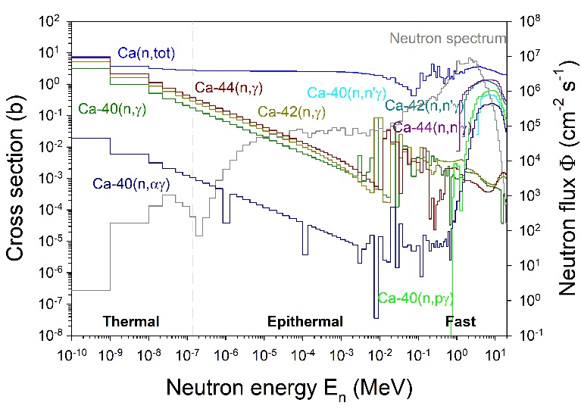
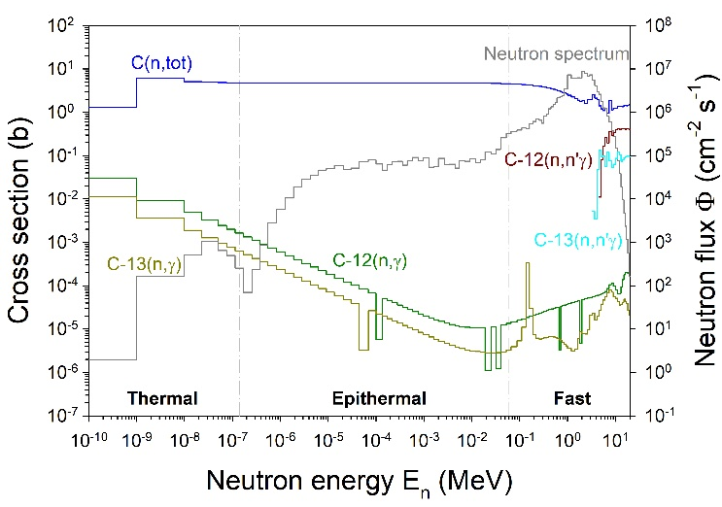
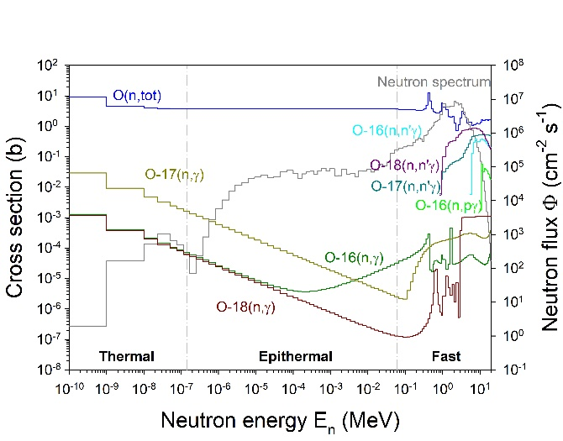
Analysis of Calcium Carbonate
Measurement configuration
Mass m: 2.40 g (Ca: 0.96 g, C: 0.29 g, O: 1.15 g)
Main isotopes: ⁴⁰Ca (96.9%), ¹²C (98.9%), ¹⁶O (99.8%)
Thickness d: powder, compressed to ~ 1 mm
Tilted by 45° relative to neutron beam
Measuring time t_{m}: 8.60 h
Counting (live) time t_{c}: 6.46 h
25% deadtime
On the right: ENDF/B-VIII.0 reaction data
processed with NJOY for all observed reactions
N. Ophoven et al., JRNC (2022)

Slide 12
Analysis of Calcium Carbonate
Measurement of active background
Acquired during 15.7 h measuring time and 14.3 h counting (live) time
Element | Source material
Hydrogen | BPE shielding
Nitrogen | Air
Iron | Iron support frame
Germanium | HPGe crystal
Indium | Detector electronics
Lead | Inner lead shielding

Slide 13
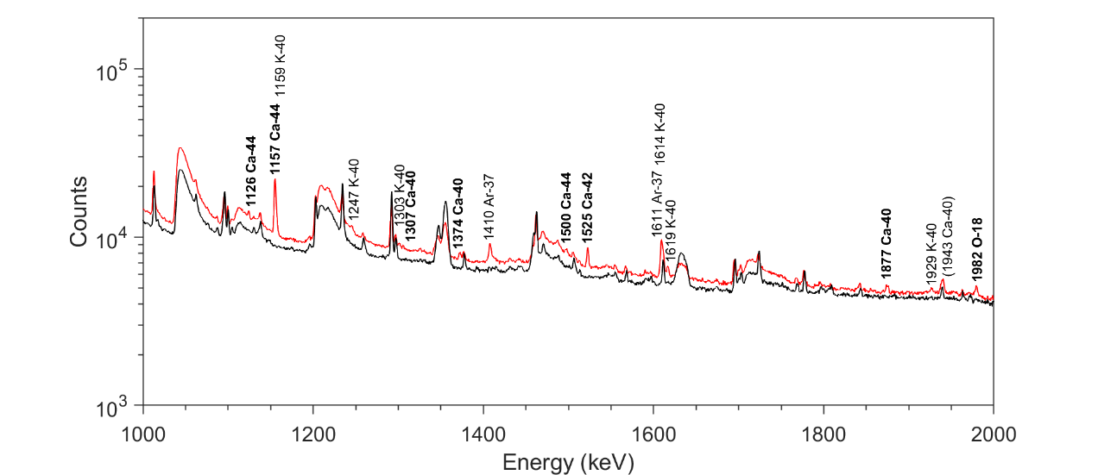
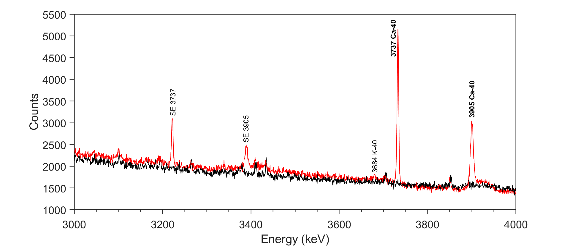
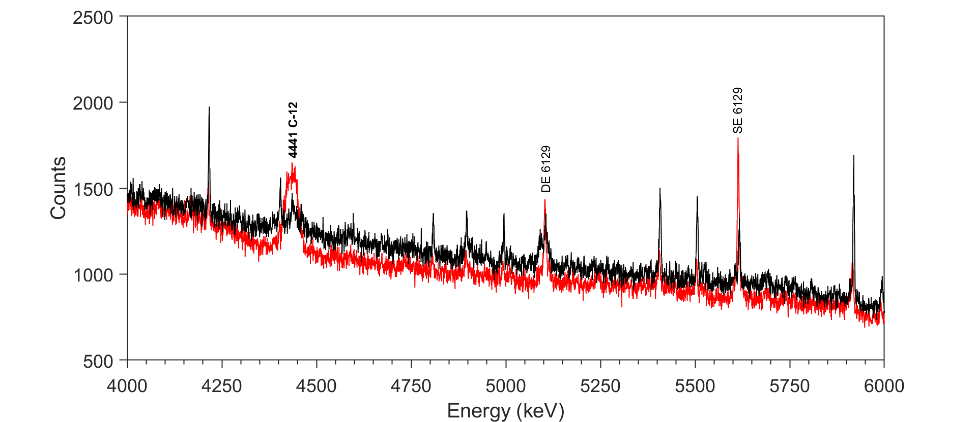
Measured Gamma-ray Spectrum
Measurement of calcium carbonate (CaCO₃)
- Background (14.3 h)
- CaCO₃ (6.5 h)
Black and bold: (n,n´γ) reactions
Black: (n,pγ) and (n,αγ) reactions on ⁴⁰Ca
4.44 MeV ¹²C Doppler-broadened
Lifetime of excited state ~ 40 fs

Slide 14
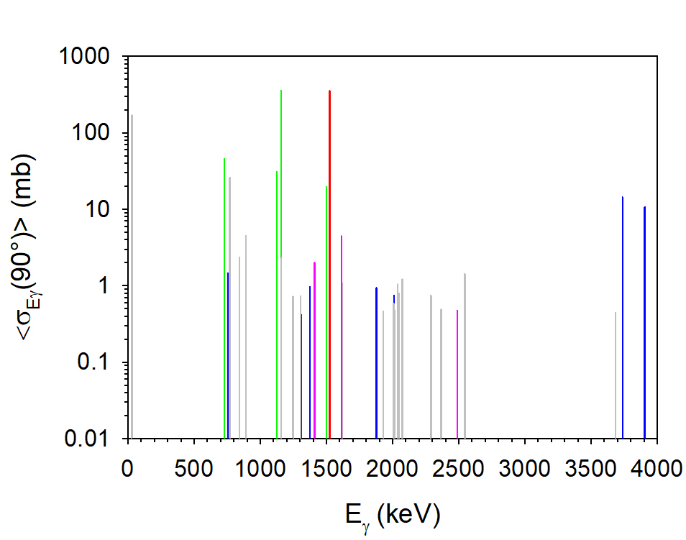
Analysis of Measured Gamma-ray Signatures
Identified gamma-lines in calcium carbonate (CaCO₃)
Element | Isotope | Reaction | n_{γ}
 |  |  | This work | Demidov Atlas | New
C | ¹²C | ¹²C(n,n´γ)¹²C | 1 | 1/1 | 0
O | ¹⁶O | ¹⁶O(n,n´γ)¹⁶O | 1 | 1/1 | 0
O | ¹⁸O | ¹⁸O(n,n´γ)¹⁸O | 1 | 1/1 | 0
Ca | ⁴⁰Ca | ⁴⁰Ca(n,n´γ)⁴⁰Ca | 7 | 5/9 | 2
Ca | ⁴⁰Ca | ⁴⁰Ca(n,p)⁴⁰K | 20 | 16/16 | 4
Ca | ⁴⁰Ca | ⁴⁰Ca(n,α)³⁷Ar | 3 | 3/3 | 0
Ca | ⁴²Ca | ⁴²Ca(n,n´γ)⁴²Ca | 1 | 1/1 | 0
Ca | ⁴⁴Ca | ⁴⁴Ca(n,n´γ)⁴⁴Ca | 4 | 4/4 | 0
Σ= |  |  | 38 | 32/36 | 6
n_{γ}: Number of gamma rays
6 new gamma-lines were observed

Slide 15
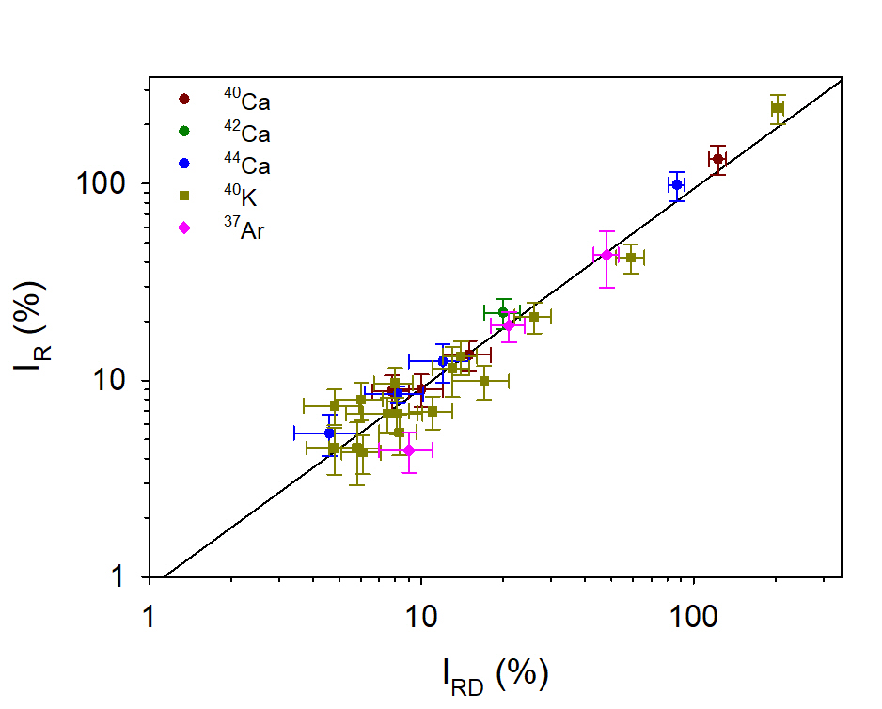
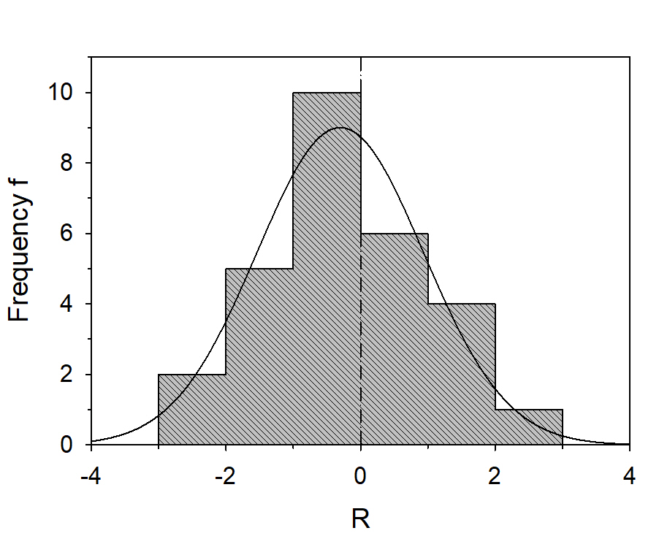


Analysis of Measured Gamma-ray Signatures
Consistency check for Identified gamma-lines in calcium carbonate (CaCO₃)
Between our data set and that of Demidov et al.:
Indices:
R: FaNGaS intensity
RD: Demidov Atlas intensity
$$R=\frac{I_{γR,1}−I_{γR,2}}{\sqrt{σ_{1}^{2}+σ_{2}^{2}}}$$
Indices:
1: FaNGaS
2: Demidov Atlas
$$I_{R}=a·{\left(I_{RD}\right)}^{b}$$
1.2σ

Slide 16
Results of Measurement Campaign 2016-2020
Identified gamma-lines, partial cross-sections and detection limits (DL)
 | Number of γ lines |  |  | Detection limits
El. | This work | Demidov Atlas | New | ^{A}Z, E_{γ} (keV) | σ_{Eγ} (mb) | DL (mg)
C | 1 | 1/1 | 0 | ¹²C, 4441.1 | 14.4 | 13
O | 2 | 2/2 | 0 | ¹⁶O, 6129.3 | 2.2 | 62
Al | 22 | 21/25 | 1 | ²⁷Al, 1013.9 | 136 | 1.0
Cl | 29 | 19/27 | 10 | ³⁵Cl, 1763.1 | 70 | 1.8
Ca | 35 | 29/35 | 6 | ⁴⁰Ca, 29.8 | 157 | 4.8
Ti | 72 | 53/63 | 19 | ⁴⁸Ti, 982.9 | 627 | 0.4
Fe | 81 | 48/69 | 33 | ⁵⁶Fe, 846.9 | 586 | 0.5
Ni | 163 | 80/85 | 83 | ⁵⁸Ni, 1453.6 | 338 | 0.7
Cu | 120 | 83/91 | 37 | ⁶³Cu, 961.5 | 410 | 0.9
Na | 19 | 19/18 | 1 | ²³Na, 439.4 | 507 | 0.1
Si | 13 | 13/12 | 1 | ²⁸Si, 1778.8 | 189 | 0.6
 | Number of γ lines |  |  | Detection limits
El. | This work | Demidov Atlas | New | ^{A}Z, E_{γ} (keV) | σ_{Eγ} (mb) | DL (mg)
Zr | 101 | 52/54 | 49 | ⁹²Zr, 933.8 | 1068 | 1.4
In | 94 | 79/92 | 15 | ¹¹⁵In, 933.1 | 222 | 1.3
La | 53 | 43/51 | 10 | ¹³⁹La, 165.7 | 574 | 0.6
Ce | 58 | 31/45 | 27 | ¹⁴⁰Ce, 1596.0 | 666 | 0.7
Pr | 69 | 56/77 | 13 | ¹⁴¹Pr, 145.3 | 889 | 0.4
Nd | 112 | 39/44 | 73 | ¹⁴⁴Nd, 696.0 | 354 | 2.1
Sm | 147 | 64/73 | 83 | ¹⁵⁰Sm, 333.4 | 967 | 0.7
Tb | 122 | 49/60 | 73 | ¹⁵⁹Tb, 57.9 | 445 | 1.2
Dy | 148 | 75/92 | 73 | ¹⁶²Dy, 184.8 | 289 | 1.6
K | 48 | 48/30 | 17 | ³⁹K, 2814.1 | 27.2 | 4
S | 20 | 20/15 | 5 | ³²S, 2230.5 | 79 | 1
DL: smallest amount of pure element detectable for a measurement time of 12 h

Slide 17
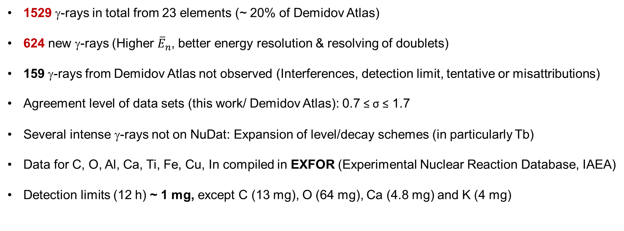
Summary Measurement Campaign 2016-2020
Energies Eγ, relative intensities I_{R} and partial cross section $\left\langle σ_{Eγ}\left(90°\right)\right\rangle$ of gamma lines for 23 elements:
C, O, Na, Al, Si, S, Cl, K, Ca, Cl, Ti, Fe, Ni, Cu, Zr, In, La, Ce, Pr, Nd, Sm, Tb, Dy, Na, K, Si and S.
1529 γ-rays in total from 23 elements (~ 20% of Demidov Atlas)
624 new γ-rays (Higher ${\overline{E}}_{n}$, better energy resolution & resolving of doublets)
159 γ-rays from Demidov Atlas not observed (Interferences, detection limit, tentative or misattributions)
Agreement level of data sets (this work/ Demidov Atlas): 0.7 ≤ σ ≤ 1.7
Several intense γ-rays not on NuDat: Expansion of level/decay schemes (in particularly Tb)
Data for C, O, Al, Ca, Ti, Fe, Cu, In compiled in EXFOR (Experimental Nuclear Reaction Database, IAEA)
Detection limits (12 h) ~ 1 mg, except C (13 mg), O (64 mg), Ca (4.8 mg) and K (4 mg)
[1] E. Mauerhofer et al., J. Radioanal. Nucl. Chem. 2020, 325.
[2] E. Mauerhofer et al., J. Radioanal. Nucl. Chem. 2022, 331.

Slide 18
Outlook & Future Research
Measurement of Sc, V, Co, Zn, Y, Eu, Gd, Ho, Er, Tm and Lu (for gamma-ray catalogue)
Determination of partial cross sections for the FaNGaS neutron spectrum from the Demidov´s data
Characterization of permanent magnets for industrial sorting/recycling using fast neutrons
Coupling of FaNGaS with Fast Neutron Imaging and Transmission techniques (ongoing R&D)
Development of advanced ML-based analysis software (in collaboration with RWTH and University d’Evri)

Slide 19
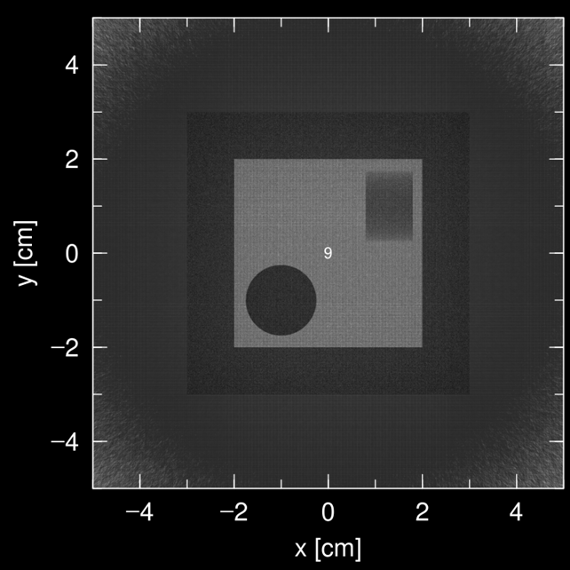
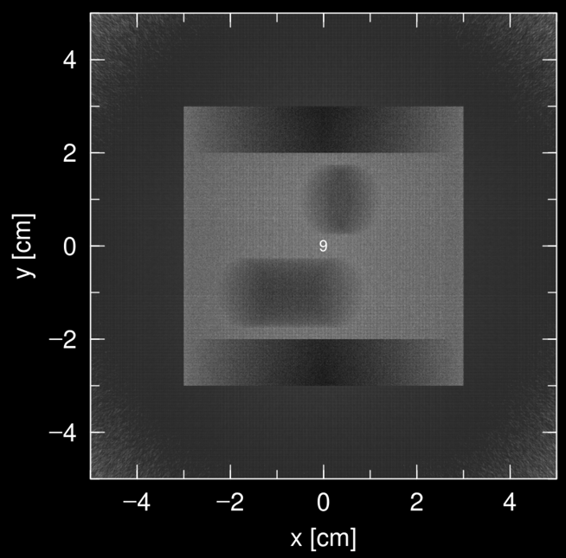
Outlook & Future Research
Measurement of Sc, V, Co, Zn, Y, Eu, Gd, Ho, Er, Tm and Lu (for gamma-ray catalogue)
Determination of partial cross sections for the FaNGaS neutron spectrum from the Demidov´s data
Characterization of permanent magnets for industrial sorting/recycling using fast neutrons
Coupling of FaNGaS with Fast Neutron Imaging and Transmission techniques (ongoing R&D)
Development of advanced ML-based analysis software (in collaboration with RWTH and University d’Evri)
Irradiation at 0º
Irradiation at 45º
MC simulations of the precise FANGAS configuration

Slide 20
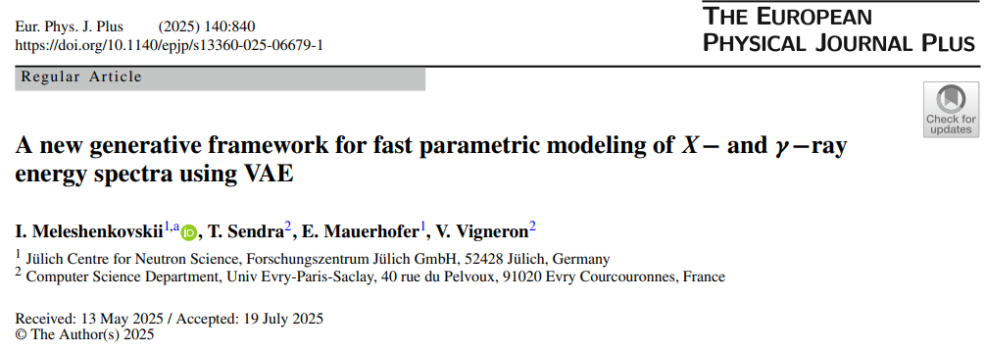
Outlook & Future Research
Measurement of Sc, V, Co, Zn, Y, Eu, Gd, Ho, Er, Tm and Lu (for gamma-ray catalogue)
Determination of partial cross sections for the FaNGaS neutron spectrum from the Demidov´s data
Characterization of permanent magnets for industrial sorting/recycling using fast neutrons
Coupling of FaNGaS with Fast Neutron Imaging and Transmission techniques (ongoing R&D)
Development of advanced ML-based analysis software (in collaboration with RWTH and University d’Evri)
FRMII reactor planned restart 2027
Open call for FaNGaS Beam Time

Slide 21
Questions?
Interested in fast neutron analytics R&D? i.meleshenkovskii@fz-juelich.de e.mauerhofer@fz-juelich.de

