Slide 1






Nuclear criticality safety relevant data with the DICER instrument at LANSCE *
Experiendo cognoscitur
Th. Stamatopoulos¹, P. Koehler¹, E. Bond², S. Chasapoglou¹, A. Couture¹, B. DiGiovine^{3,}
S. Essenmacher¹, A. Marenco⁴, G. Rusev², J. Svoboda¹
Physics Division
Chemistry Division
Weapons Engineering Verification & Validation Division
Plutonium Supply & Disposition Division
*Funded by DOE-NNSA-NCSP
7th International Workshop On Nuclear Data Evaluation for Reactor Applications (WONDER-2026)
June 29th - July 3rd 2026
LA-UR-26-25300

Slide 2
Table of Contents
Non-traditional neutron transmission measurements
Neutron transmission at LANL and DICER
A few highlights
  133Cs
  239Pu
  149Sm
  63Cu
Criticality program at LANSCE

Slide 3
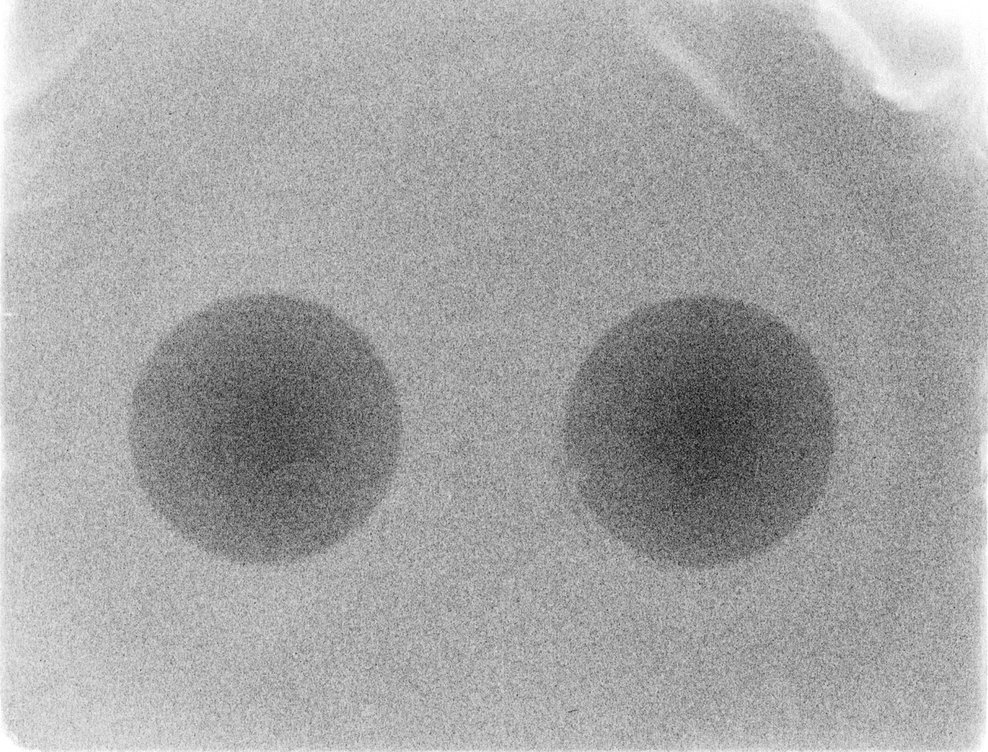
Non-traditional Neutron transmission measurements

Slide 4
Non-traditional measurements transmission: Binocular approach
DICER (Device for Indirect Capture Experiments for Radionuclides) was developed in 2022 to provide neutron capture rates for radionuclides where minuscule amounts of materials are available.
As a spin off, it provides data for criticality safety in cases where the availability of material is limited (purity, hazards, cost reduction etc)
Instead of the typical sample-in/sample-out measurements, DICER utilizes a binocular approach where both measurements, take place simultaneously.
Not to scale
Collimator
Target/moderator
Neutron
detectors
Neutron
beam
~15m
~15m

Slide 5
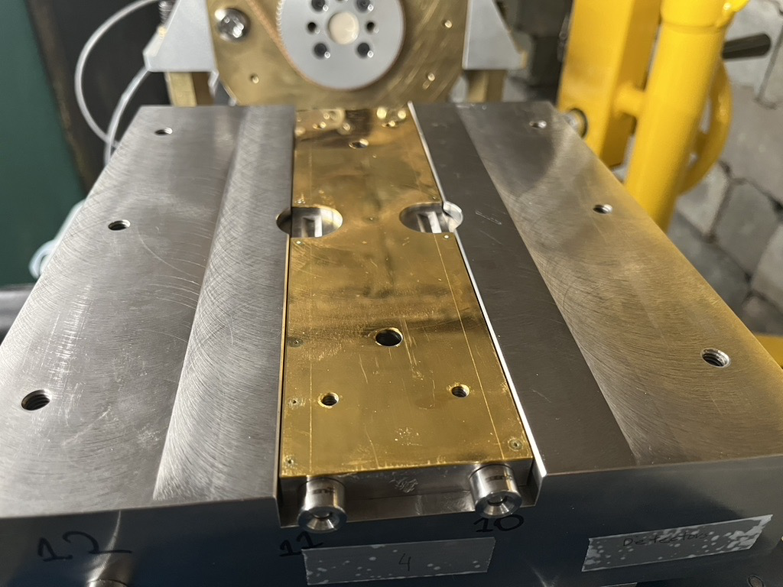
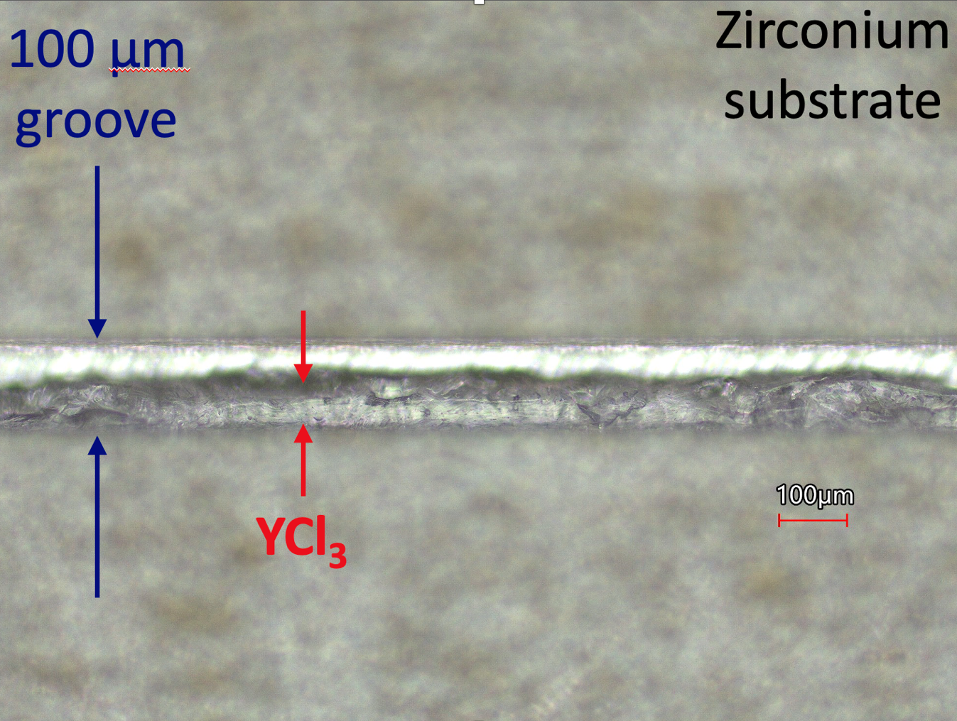
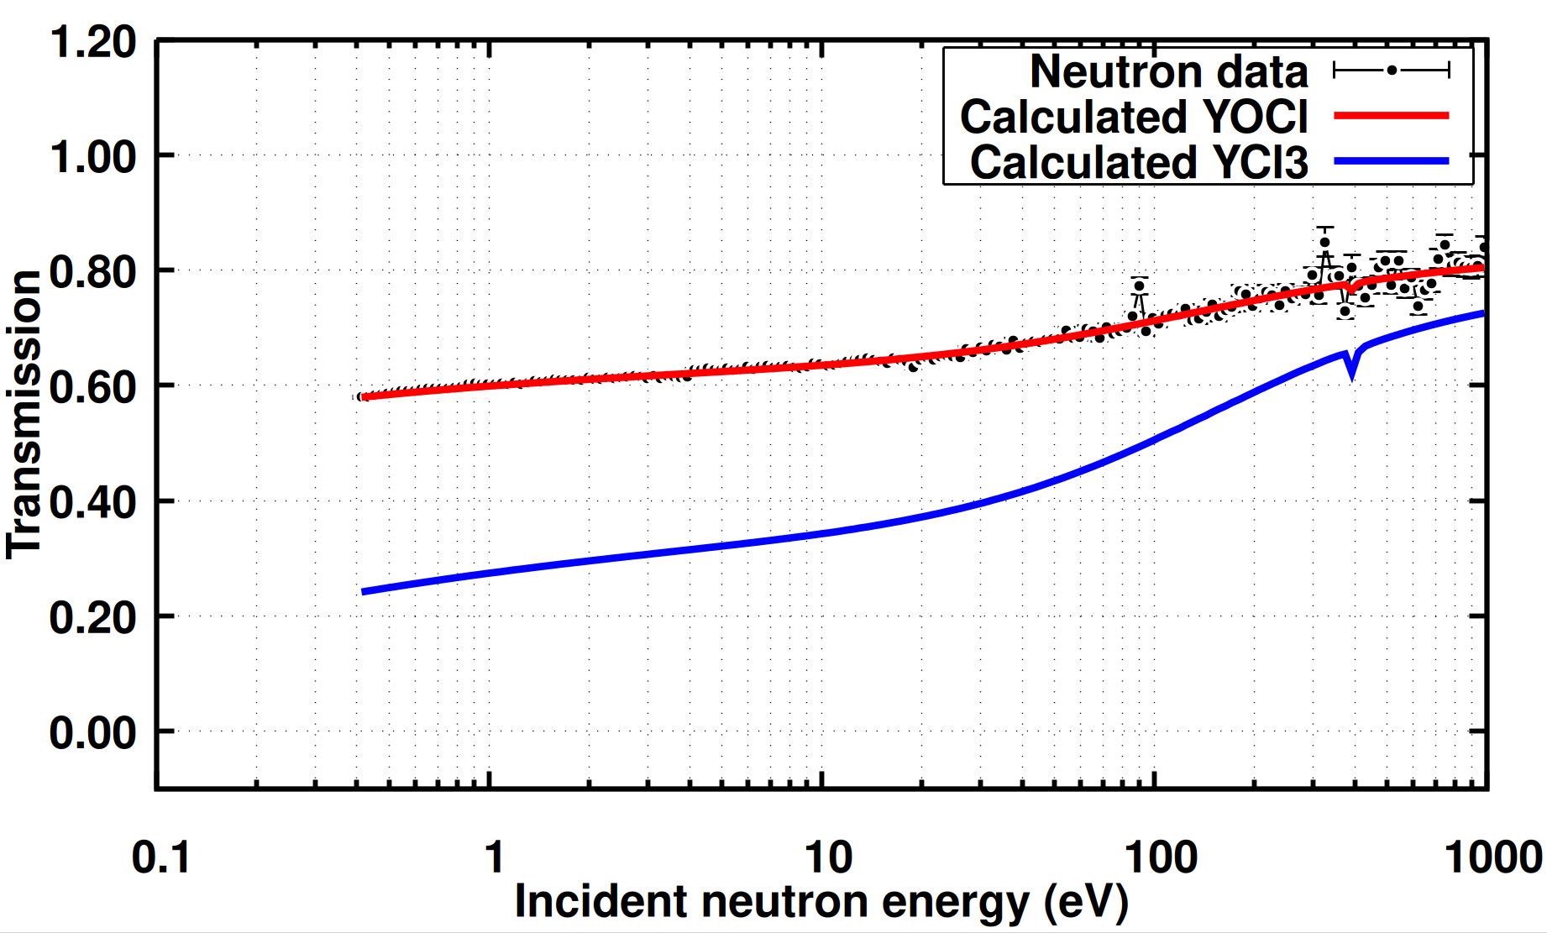
A few highlights
First ever binocular collimation system (1 mm)
  A. Stamatopoulos et al., IEEE Trans. Nucl. Science 70, (2023)
  A. Stamatopoulos et al., Nucl. Intrum. Meth. A (1025) 166166, (2022)
  A. Stamatopoulos et al., Neutron News 33, 12 – 14 (2022)
First ever tof measurement on ⁸⁸Zr
  A. Stamatopoulos et al., Phys. Rev. Lett. 134, 112702 (2025)
  A. Stamatopoulos et al. Phys. Rev. C 111, 034613 (2025)
  A. Matyskin et al, Scientific Reports 13, 1736 (2023)
  A. Stamatopoulos et al., EPJ., Conf. 260, 03006 (2022)
  A. Stamatopoulos et al., J. Rad. Nucl. Chem. 331, (2022)
Development of microjet printing for sample fabrication
Development of 0.1 mm binocular collimator
Preparing for first ever measurement on 88Y (new chemical compound, production through (p,x) on Sr etc)

Slide 6
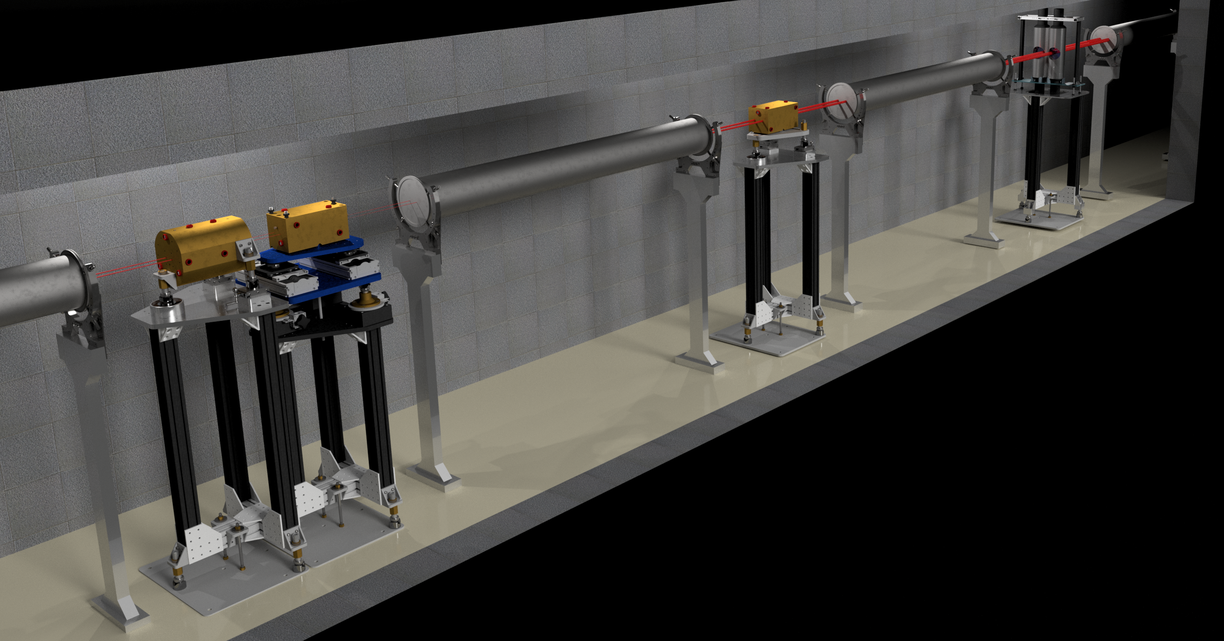
Neutron transmission at LANL

Slide 7
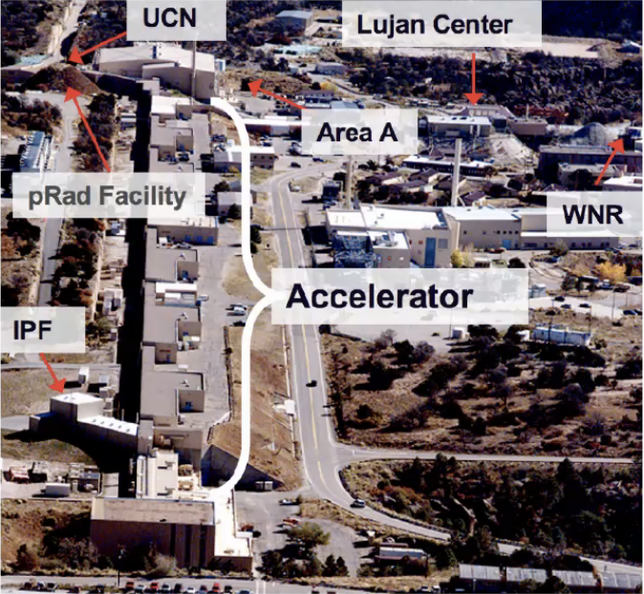
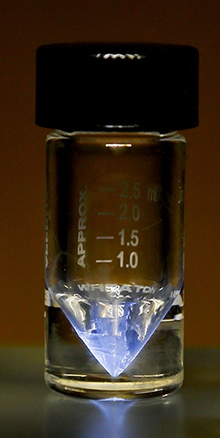
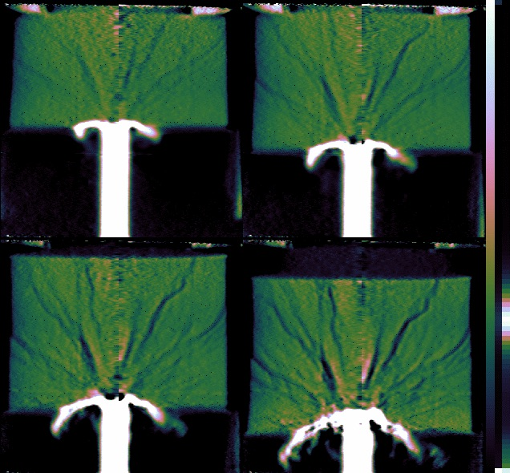
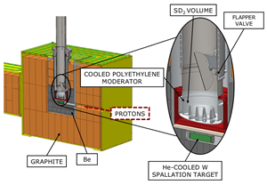
LANSCE: The Los Alamos Neutron Science Center
1 km long LINAC
Up to 800 MeV protons
Multi-user proton (p) and neutron (n) facility
  Isotope Production Facility (IPF) (100 MeV p)
  Proton irradiation (pRad) (800 MeV p)
  Ultra Cold Neutrons (UCN) (<300 neV n)
  Lujan Center (meV – keV n)
  WNR (keV – MeV n)
  Target 4 (500 - 800 MeV p)

Slide 8
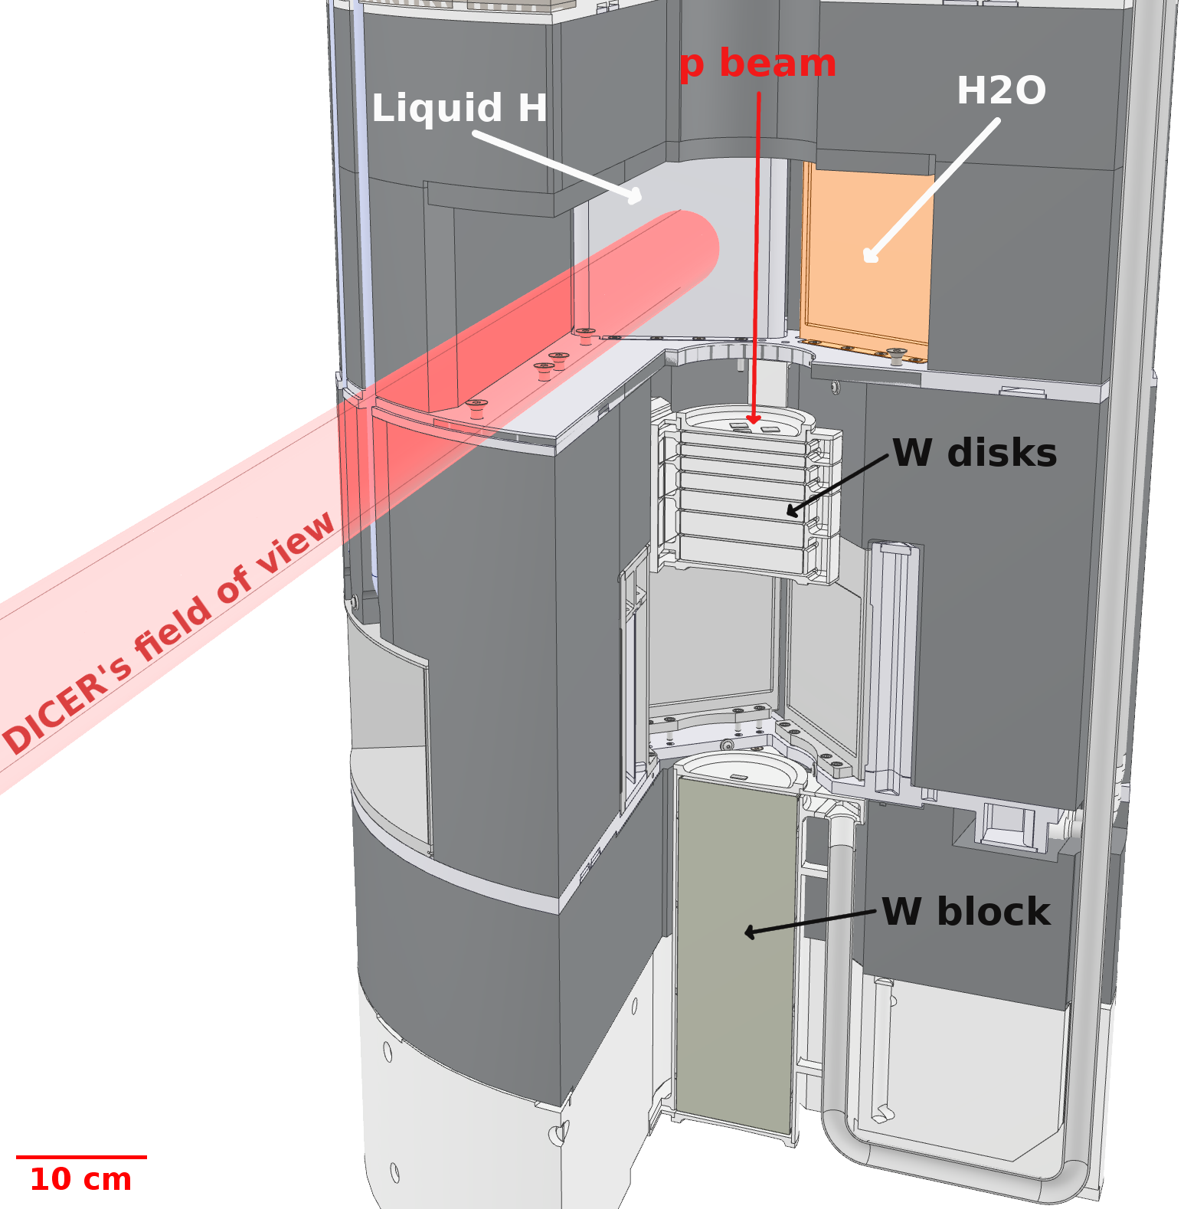
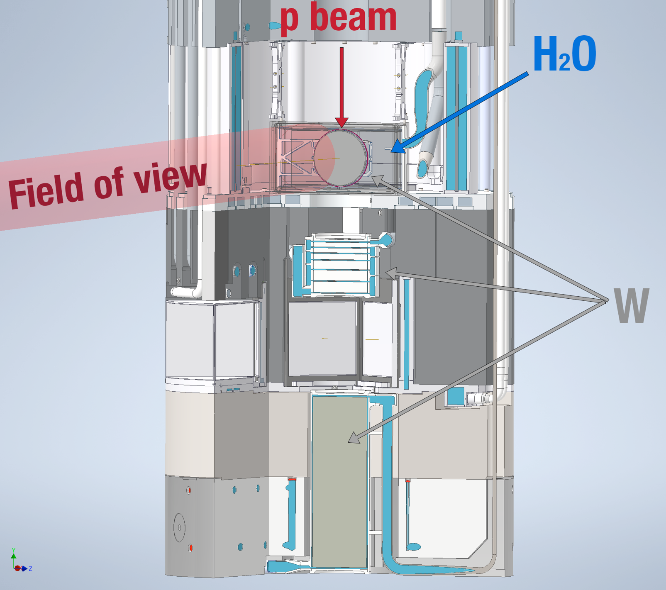
Neutron targets at Lujan
800MeV protons impinge on a W target.
Up to 20 Hz duty cycle
Proton pulse of 145 ns FWHM, tunable down to 7 ns
Old target (Mark-III) in back-scattering geometry
New target (Mark-IV) since 2022 provides more flux and better resolution
Old Mark-III
New Mark-IV

Slide 9
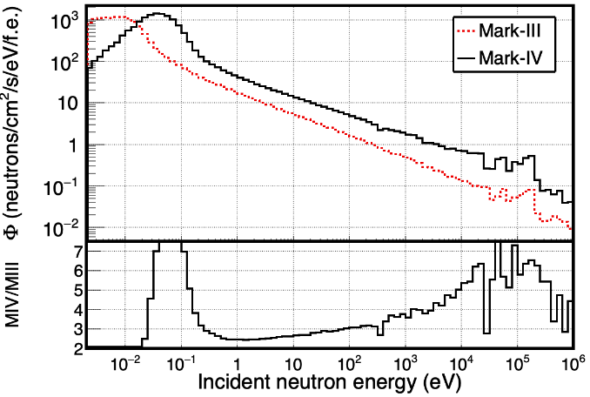
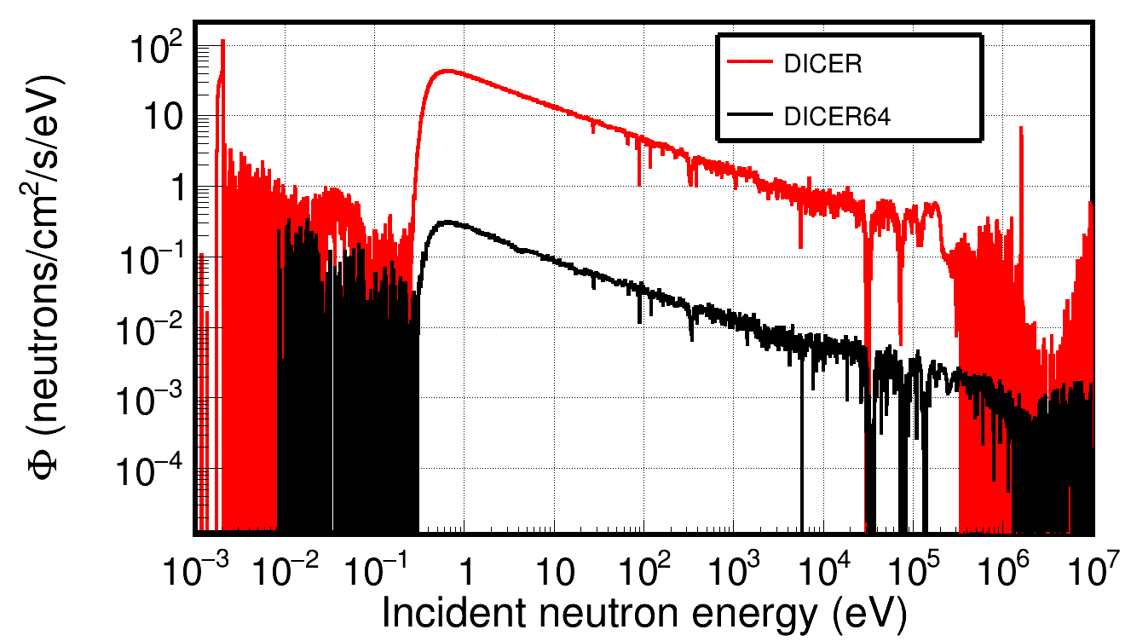
Mark-IV (M4) : New neutron target at Lujan, est. 2022
Mark-IV enhances the >keV neutron spectrum: Field-of-view on the target
Better resolution: Under-moderated target
Simulation
DICER 32 m
DICER 64 m
(development)
Ratio

Slide 10
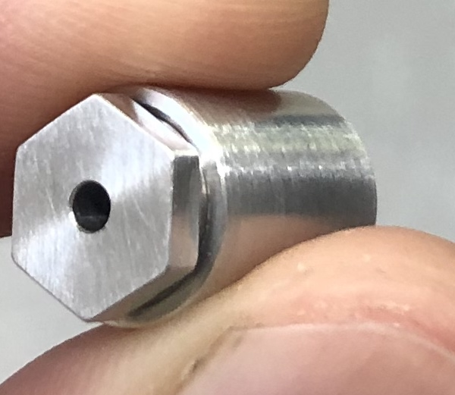
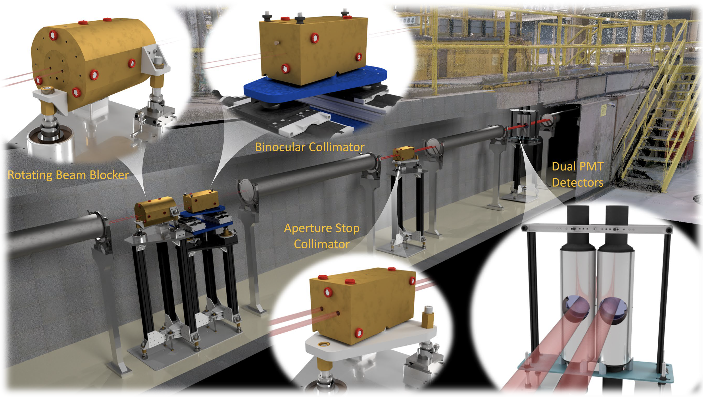
Description of the apparatus:
Device for Indirect Capture Experiments on Radionuclides (est 2022)
A. Stamatopoulos et al., NIMA (1025) 166166, 2022
A. Stamatopoulos et al., IEEE Trans. Nucl. Science 70, (2023)
A. Stamatopoulos et al., Neutron News 33, 12 – 14 (2022)

Slide 11
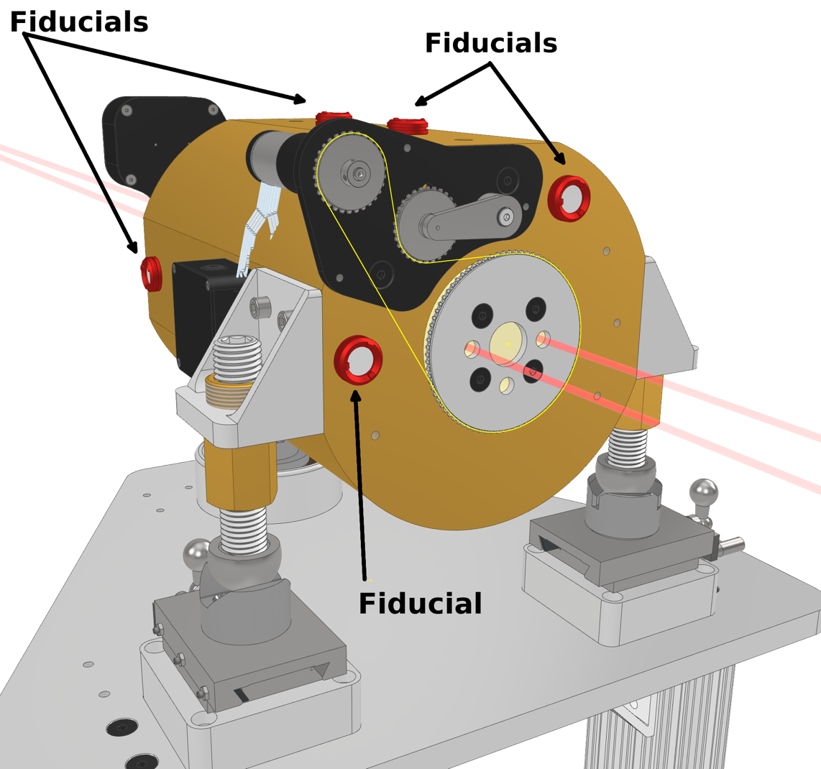
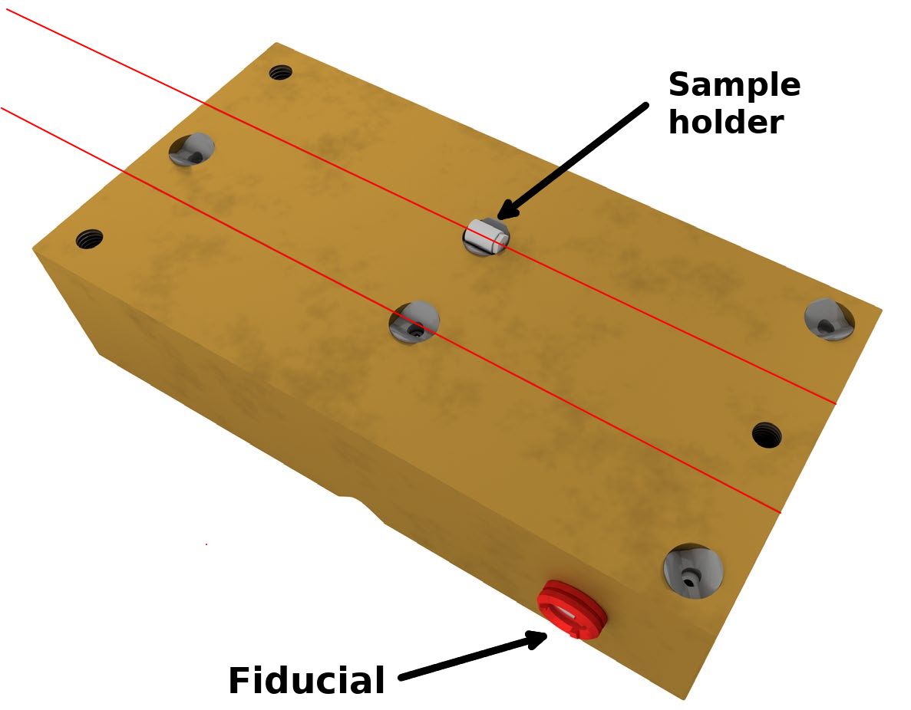
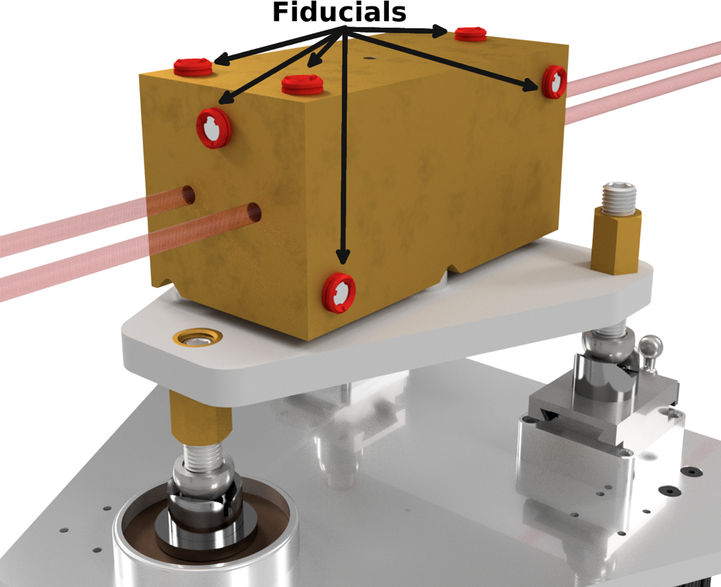
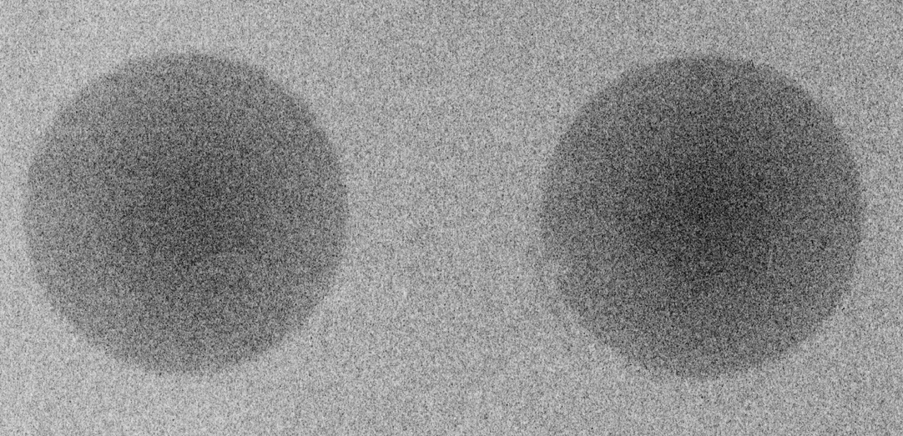
Sophisticated collimation system
Rotating beam blocker
Binocular collimator
Aperture stop
Cuts off the beam penumbra
Ensures two sharp beam spots at a 31 m, 9.5 cm in diameter
Rotating inner cylinder with 3 holes
30 cm in length
Provides 0 - 2 beams
Stepped design to avoid neutron stream paths
Remotely controlled
Divided in a top and bottom part
Sample is installed in the collimator in the Maxwell kinematic stops
1.5 cm length, 1 cm diameter sample envelope
1 mm collimation
Kinematic stops ensure repeatability when installing the top part.

Slide 12
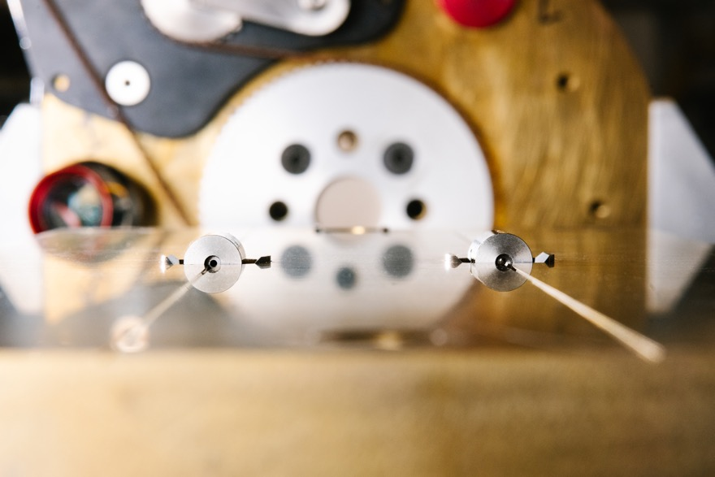
Sophisticated collimation system
Rotating beam blocker
Binocular collimator
Aperture stop

Slide 13
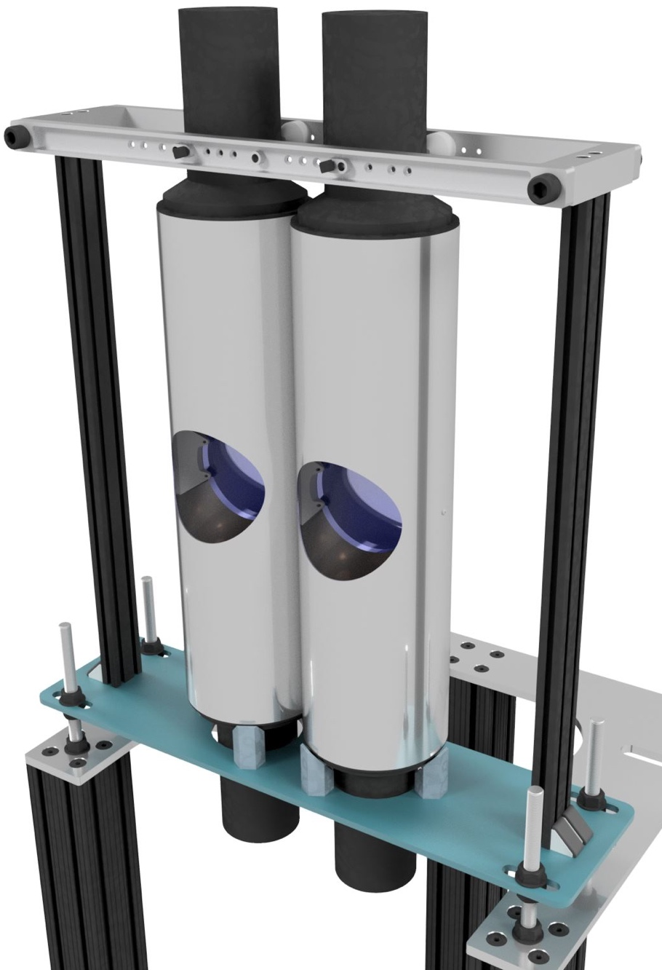
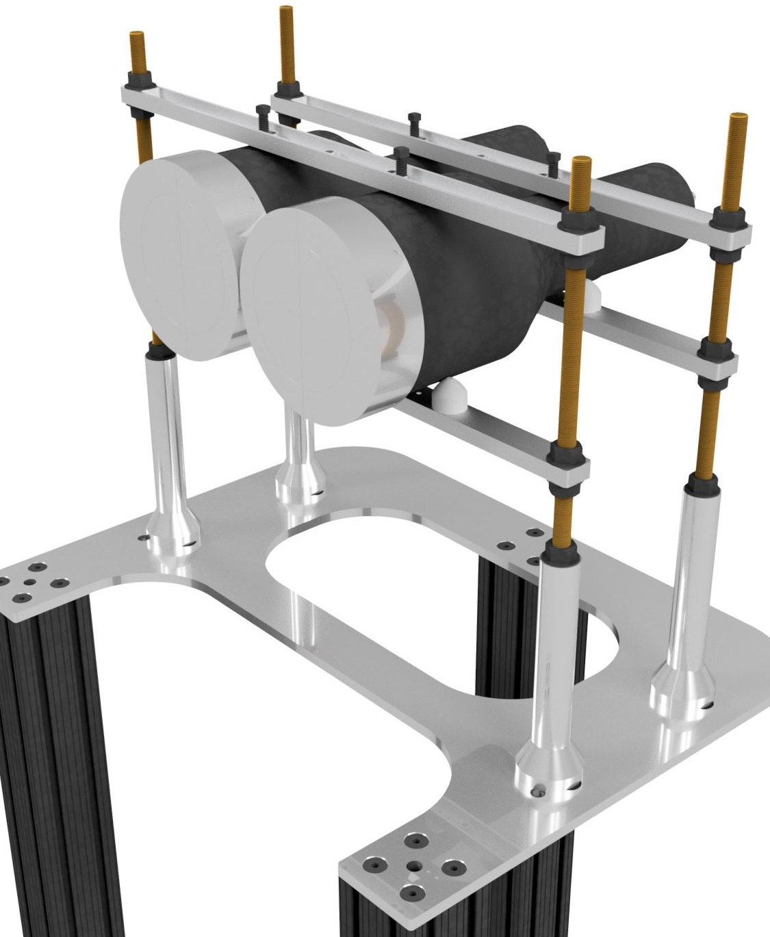
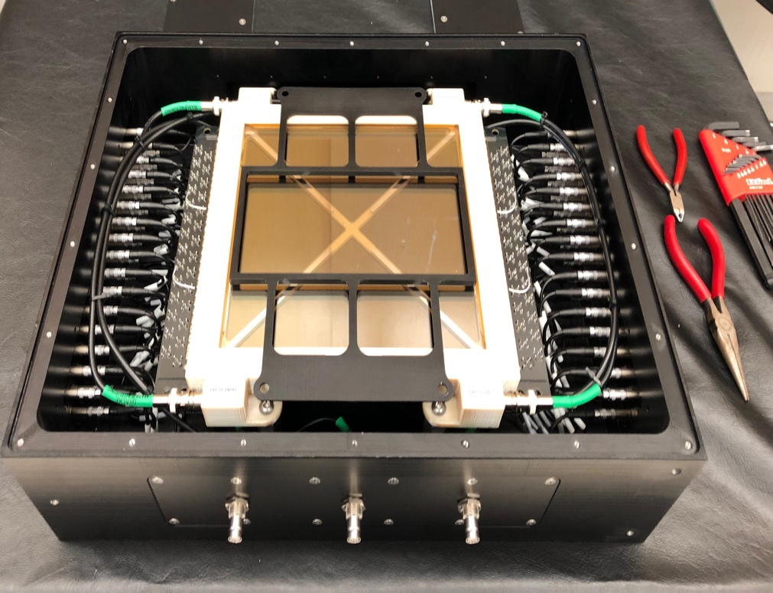
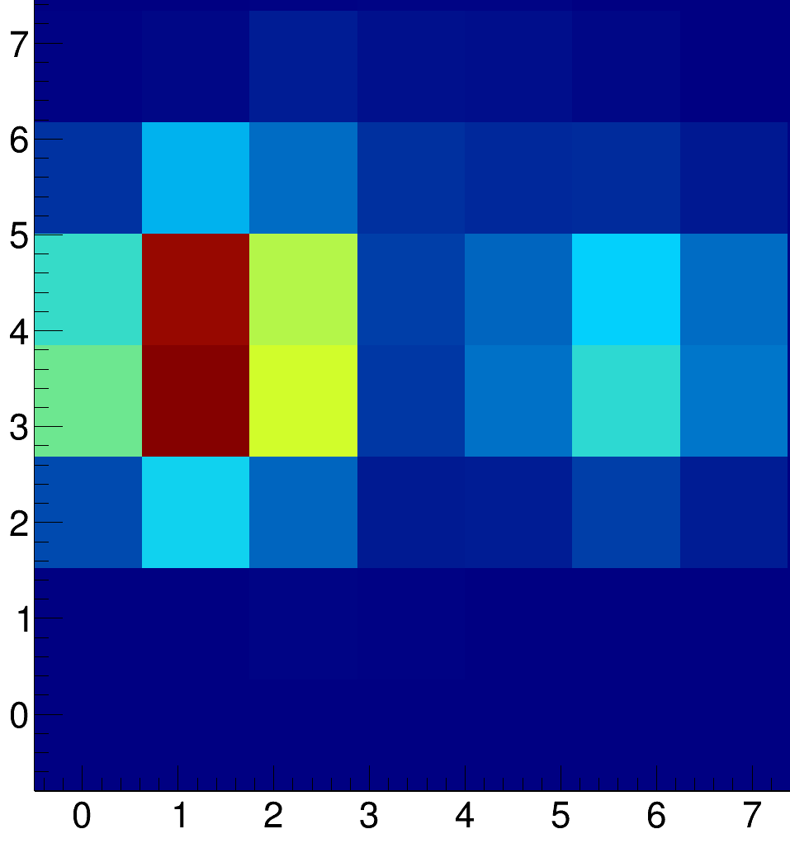
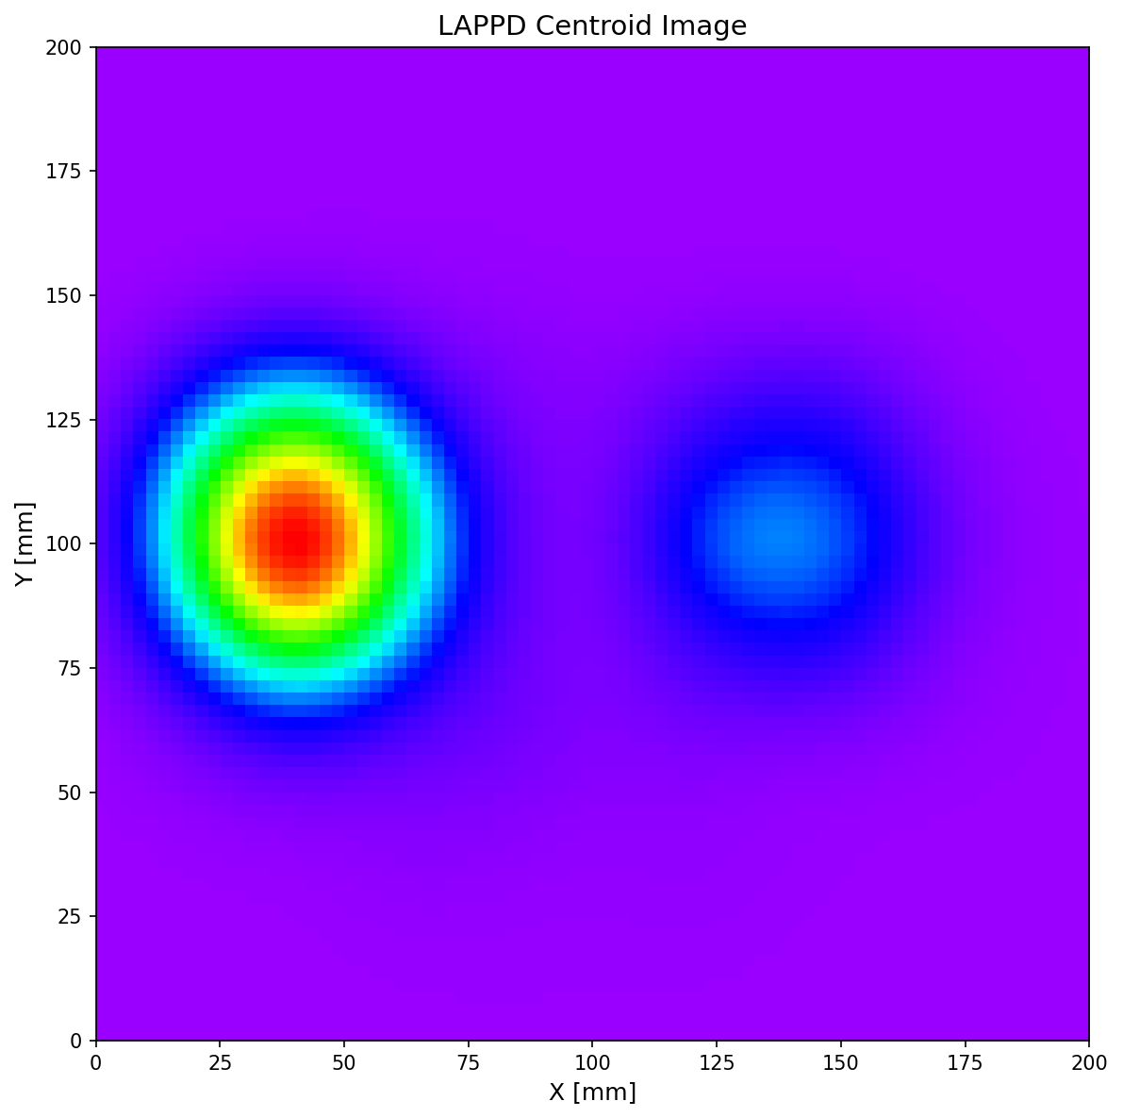
Single and multi pixel detectors
A commercial ²³⁵U loaded fission chamber is installed at ~7.8 m from the neutron source, to monitor the flux.
Two types of single pixel ⁶Li-glass neutron detectors are available
  ORELA type: Dual PMT detector. - Chi-nu type : Single PMT detector.
  Less material in beam PMT in contact with glass
  Poorer light collection More material in beam
The Large Area Picosecond Photo-detector (LAPPD) is a multi-channel plate (MCP) based detector, able to provide spatial information (nominally ~mm)
Currently exploring CLYC detectors and trying to
develop new scintillators will good efficiency from
meV - MeV

Slide 14
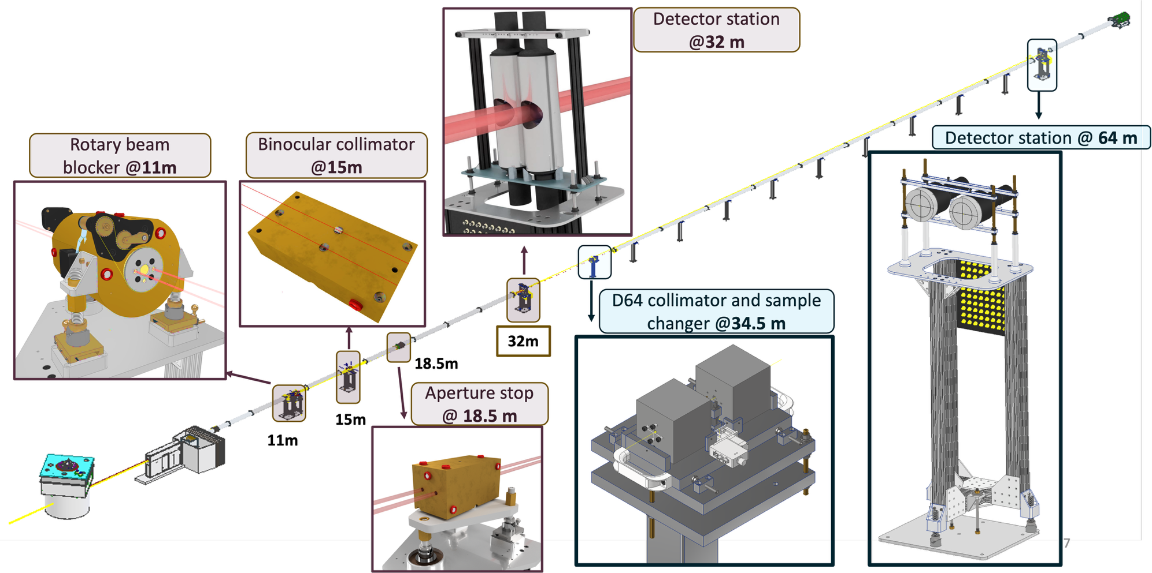
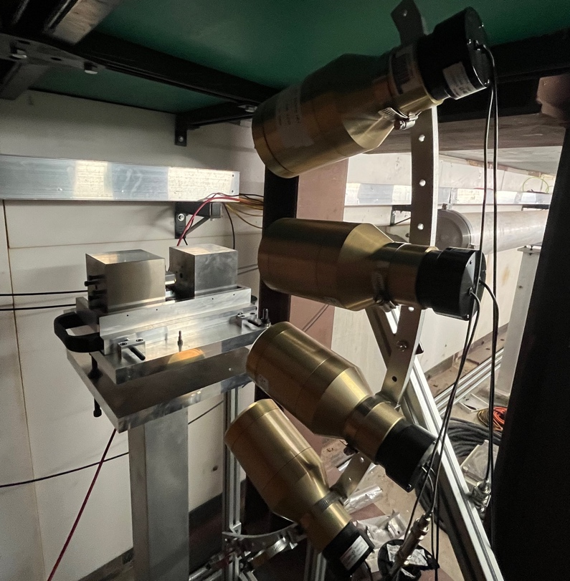
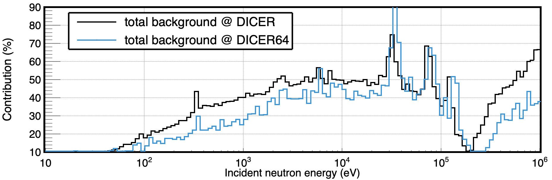
DICER64
Through an LDRD-ECR award a feasibility study of a 64 m station was carried out
Signal/Background is better at 64m
Effort to combine transmission with Prompt Gamma Activation Analysis (PGAA)

Slide 15
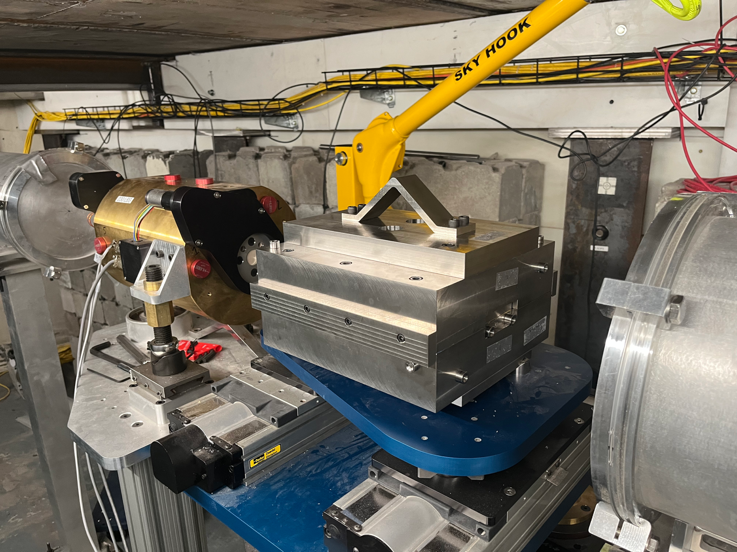
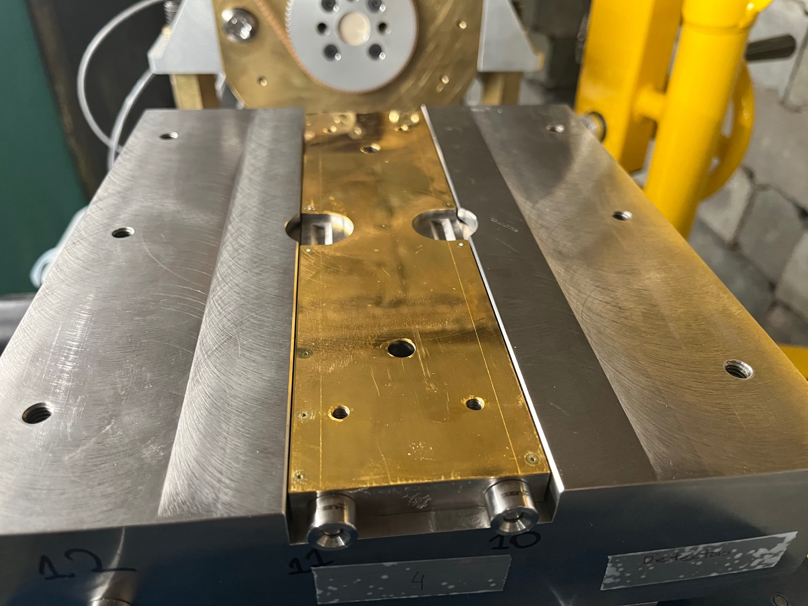
0.1 mm collimator @ DICER
Experiments on even more rare and/or radioactive nuclei: 0.1 mm collimator is driven by an upcoming measurement on 88Y (150 μg, 2 Ci/74 Gb)
Gold collimator with 500 lbs of tungsten for shielding
Robotic material handling

Slide 16
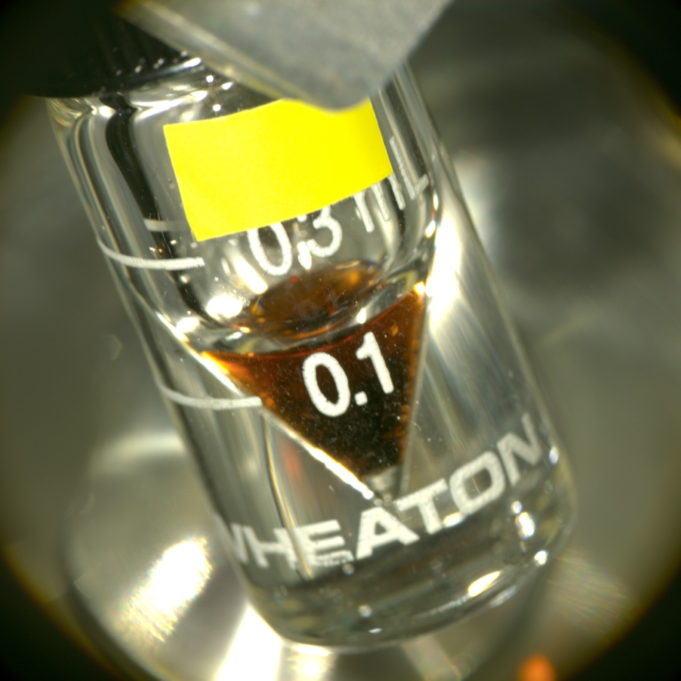
A few highlights

Slide 17
Laundry list
Measured
Will be measured in the near future
Could be measured
¹⁹¹Ir
¹⁹³Ir
^{nat}Cl
^{nat}Cd
^{nat}Gd
^{nat}Bi
¹⁹⁷Au
²³⁹Pu
⁹⁵Mo
^{nat}Cu
¹⁴⁷Sm
¹⁴⁹Sm
⁸⁸Zr
¹³³Cs
⁶³Cu
¹⁰³Rh
¹⁵¹Sm
⁸⁸Y
^{nat}Y
⁴⁰Ar
²³⁹Pu (keV–MeV)
³⁵Cl
¹⁴³Nd
²⁴⁰Pu
¹⁶⁷⁻¹⁷¹Tm
^{73,74,75}As
^{56,57,58}Co
⁸⁵Kr
³⁶Ar
⁴⁰K
⁷⁰Zn
^{72,73}Ge
^{77,82}Se
^{98,99}Ru
¹⁰⁷Pd
¹⁴⁵⁻¹⁵⁶Eu
^{153,157}Gd
^{160,161}Tb
^{163,166}Ho
¹⁶⁹Er
¹⁷⁵Yb
^{179,180m}Ta
^{173,174}Lu
¹⁸⁵W
¹⁸⁶Ru
¹⁹¹Os
^{110m}Ag
¹³⁴Cs
¹⁴⁷Nd
¹⁴⁷Pm
¹³⁵Xe
Criticality safety interest
Criticality safety interest-will be discussed

Slide 18
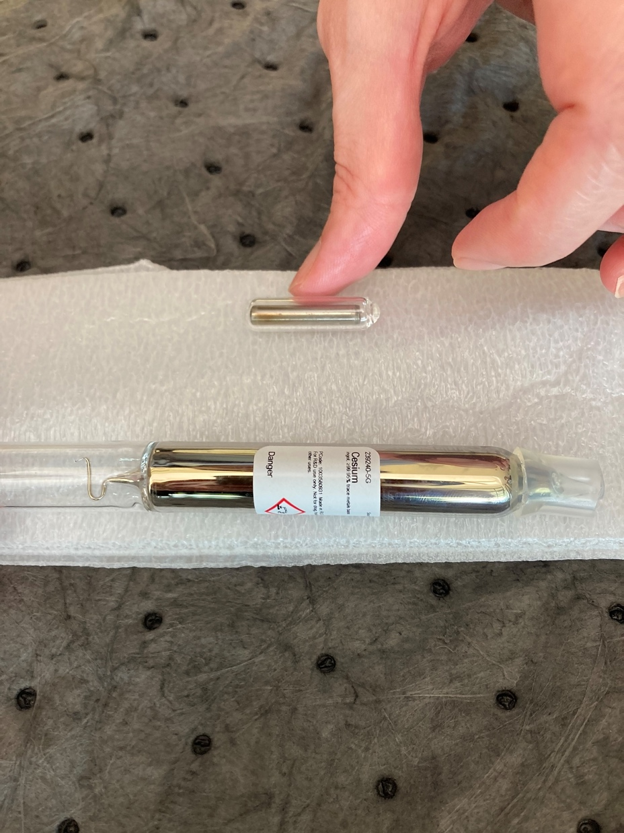
133Cs

Slide 19
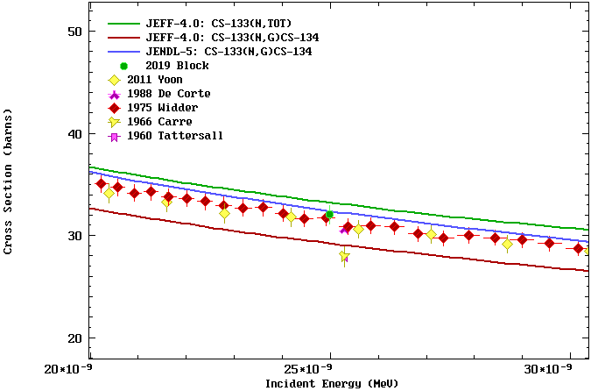
Motivation
Discrepancy between recent data (2011 Yoon, 2019 Block) and benchmarks ( CEA Cadarache, Leal ORNL/TM-2005/65 )
JEFF3 (same as JEFF4, ENDF80, ENDF81) needs to decrease
Most recent data are 3σ higher than JEFF, but agree within 1σ with each other
Most recent capture data agree within 1σ with the (n,tot) evaluations

Slide 20

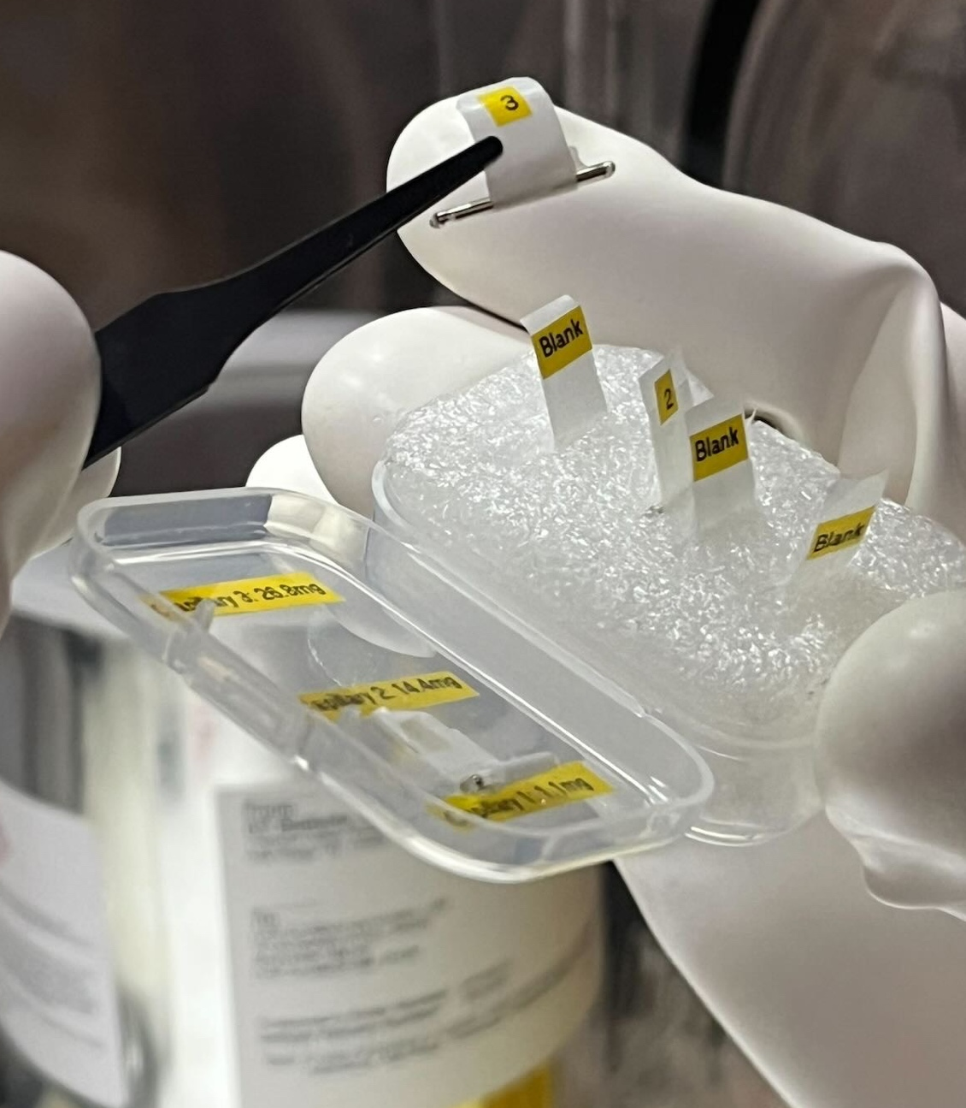
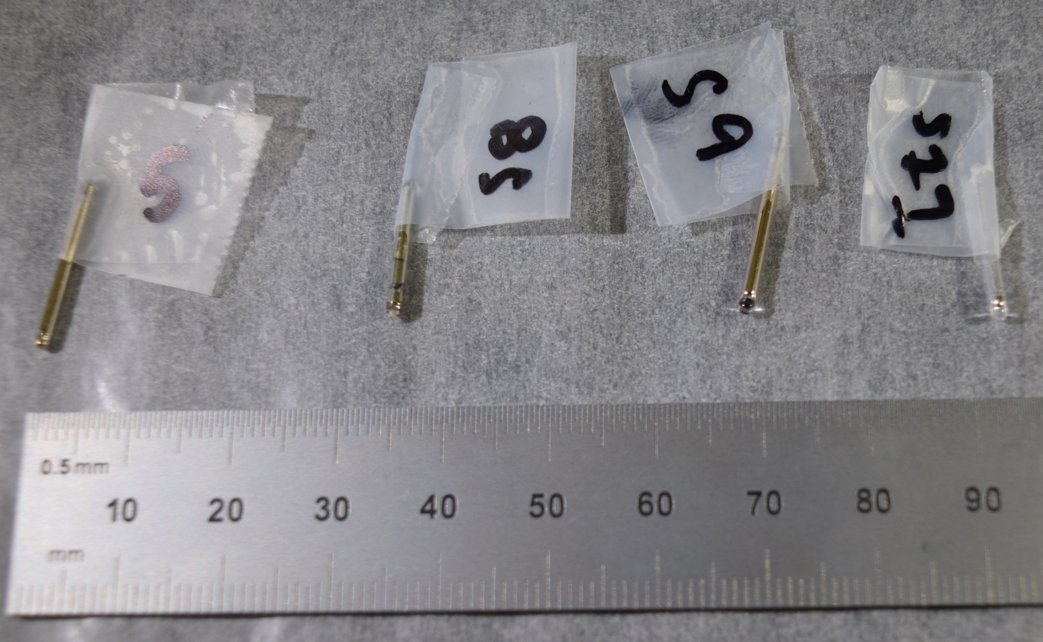
The samples
Experiments in literature used caesium compounds
Metallic caesium is pyrophoric
Small amount is crucial to operational risk mitigation
We worked with NIDC and ORNL
Huge shoutout to Jenny Conner from the Stable Isotopes group
3 samples with 3 blanks: 1.1 mg, 14.4 mg, 26.8 mg
Cs in flame sealed ampules

Slide 21
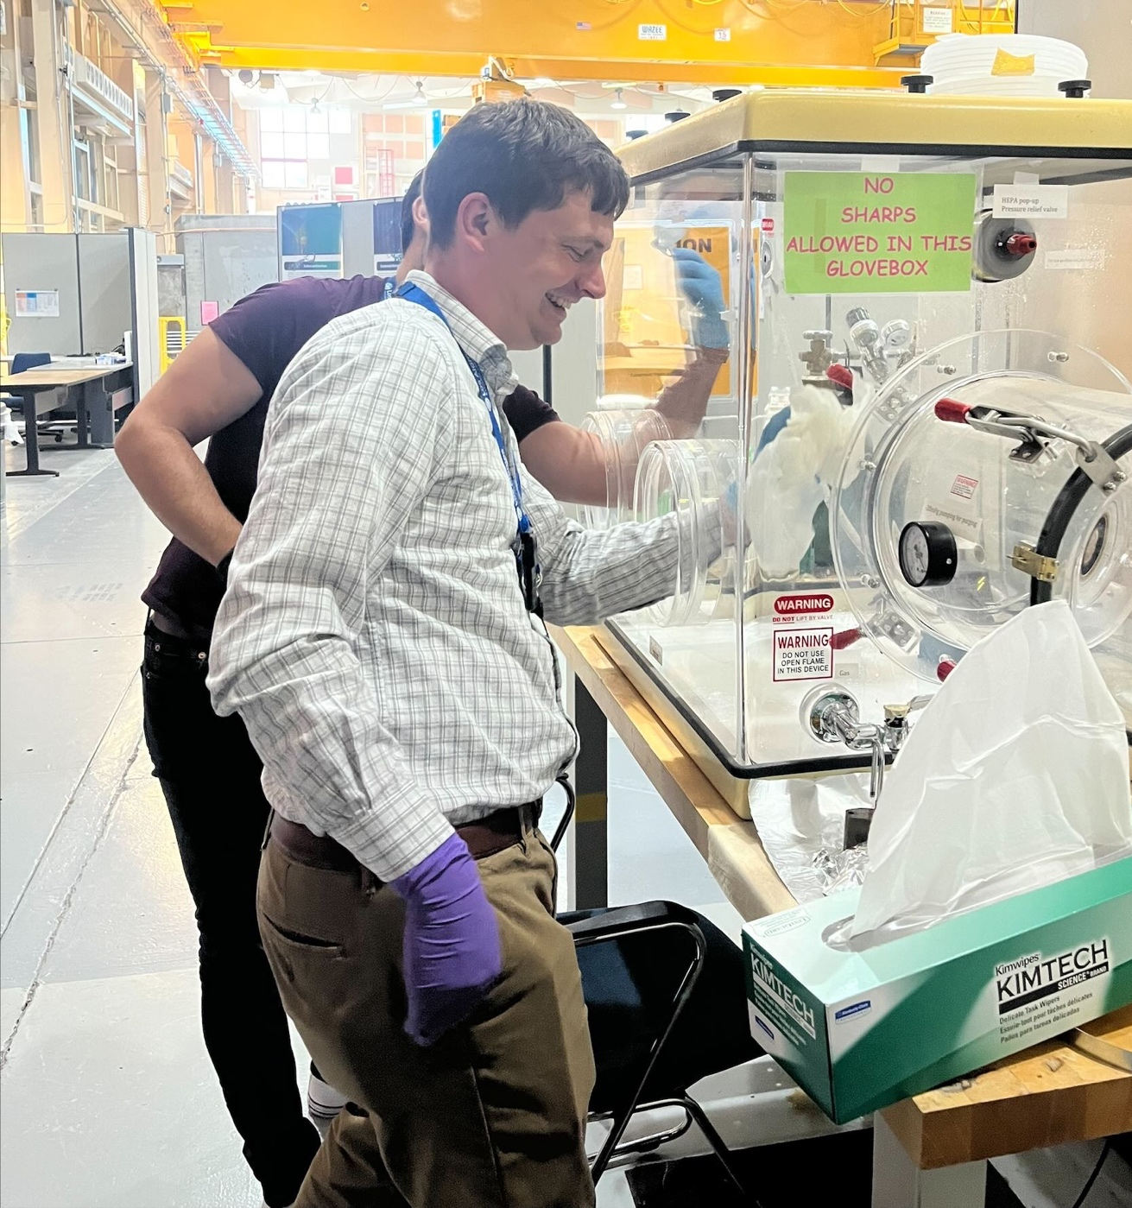
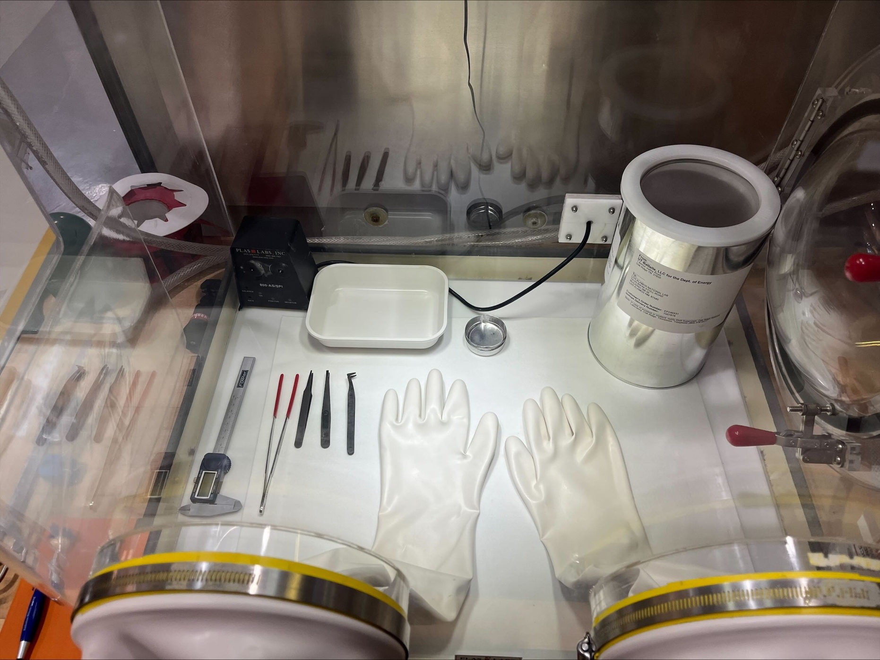
Sample handling
Despite the small amount, there is still a concern, and we have to execute the experiment within the safety basis
Sample unboxing in a resurrected glovebox
Argon atmosphere to avoid ignition in case the ampules were compromised

Slide 22
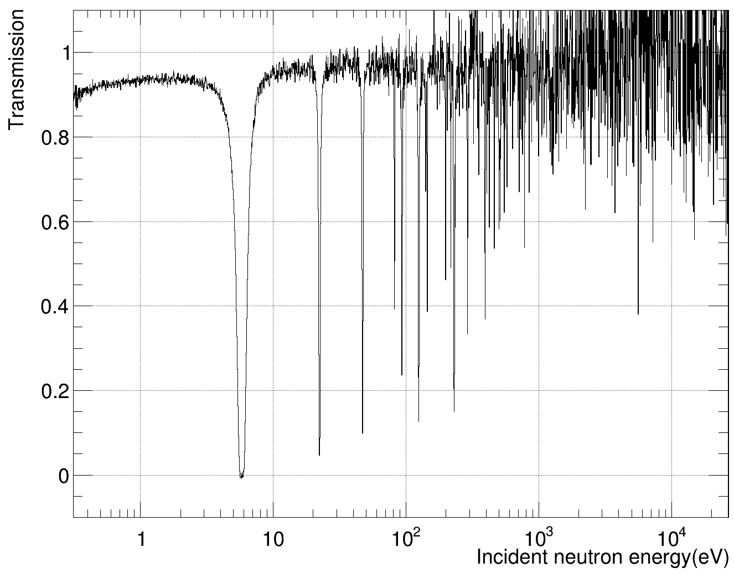

Experimental campaign and preliminary results
Data were taken with:
  2 samples : 1.1 mg (1.1 mm thick) and 14.4 mg ( 8 mm thick)
  Empty ampules
  No samples
  With and without Cd filter
Data span from 2 meV up to ~20 keV
1% difference with evaluations (within uncertainties) at thermal
Thick
Preliminary
ENDF-81
thin

Slide 23
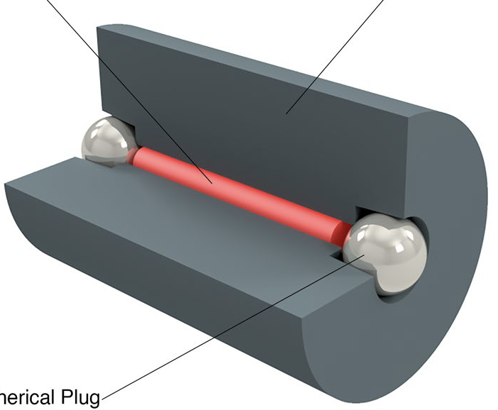
239Pu
²³⁹Pu
W canister
Pb spherical plug

Slide 24
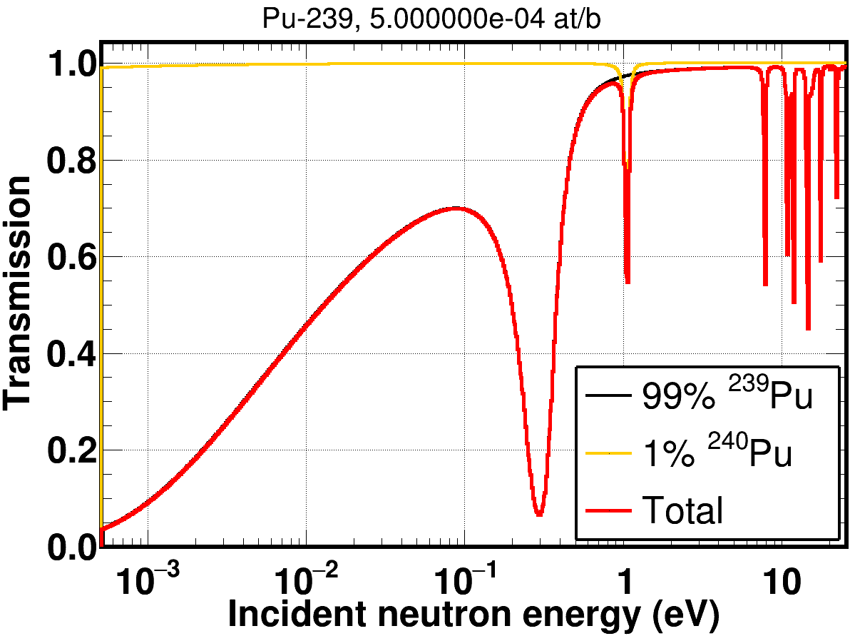
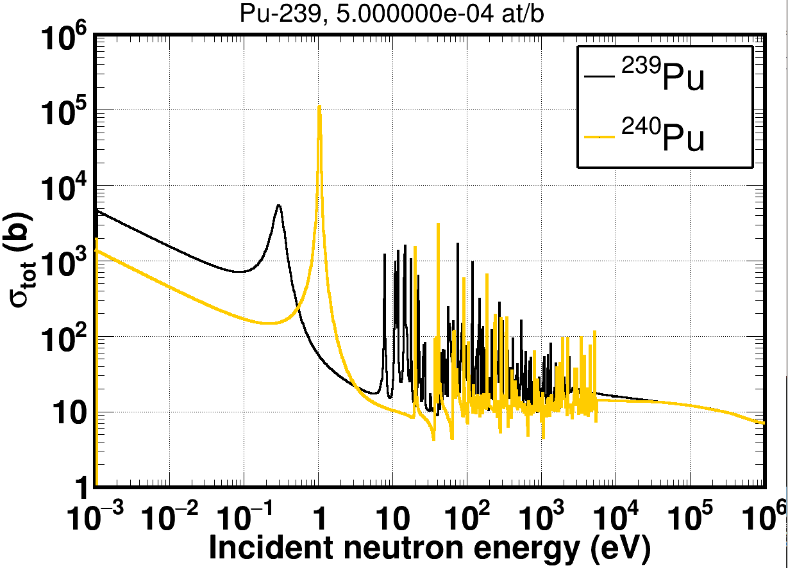
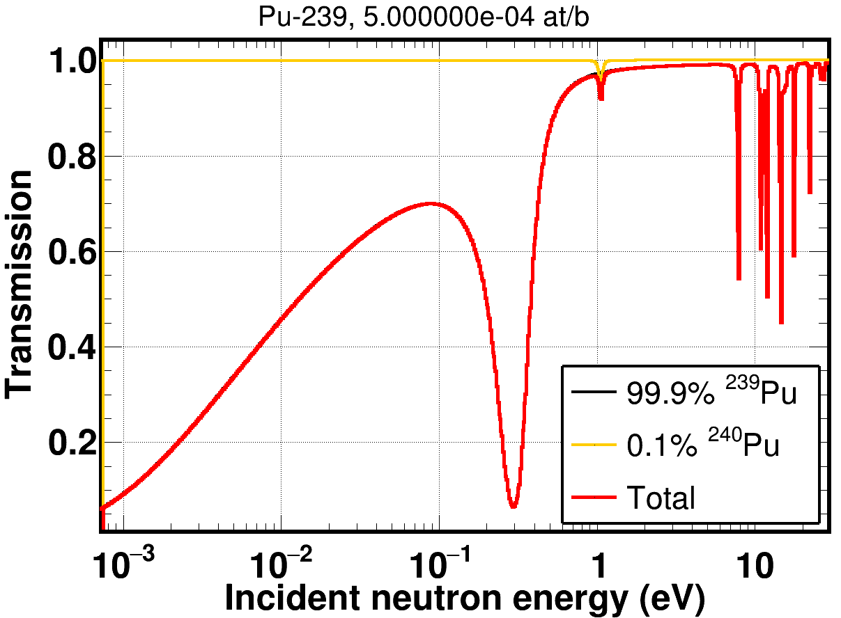
²³⁹Pu(n,tot): Why?
Data are need up to 20 eV
Usual issue is the purity of the sample:
  ²³⁹Pu comes with ²⁴⁰Pu, which has a big resonance at ~1.05 eV
  Hard to accurately characterize that resonance: a ²⁴⁰Pu experiment will utilize a sample that has some ²³⁹Pu (fissile)
Correlations in the analysis
Even small % of ²⁴⁰Pu have an effect

Slide 25
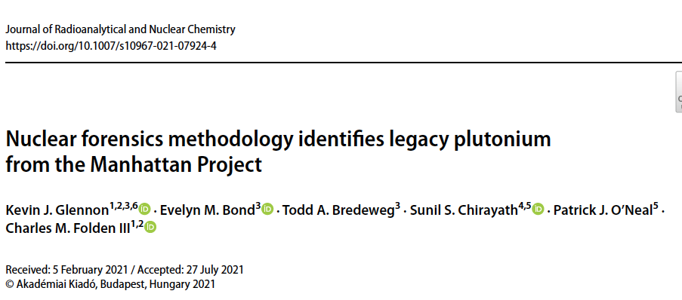
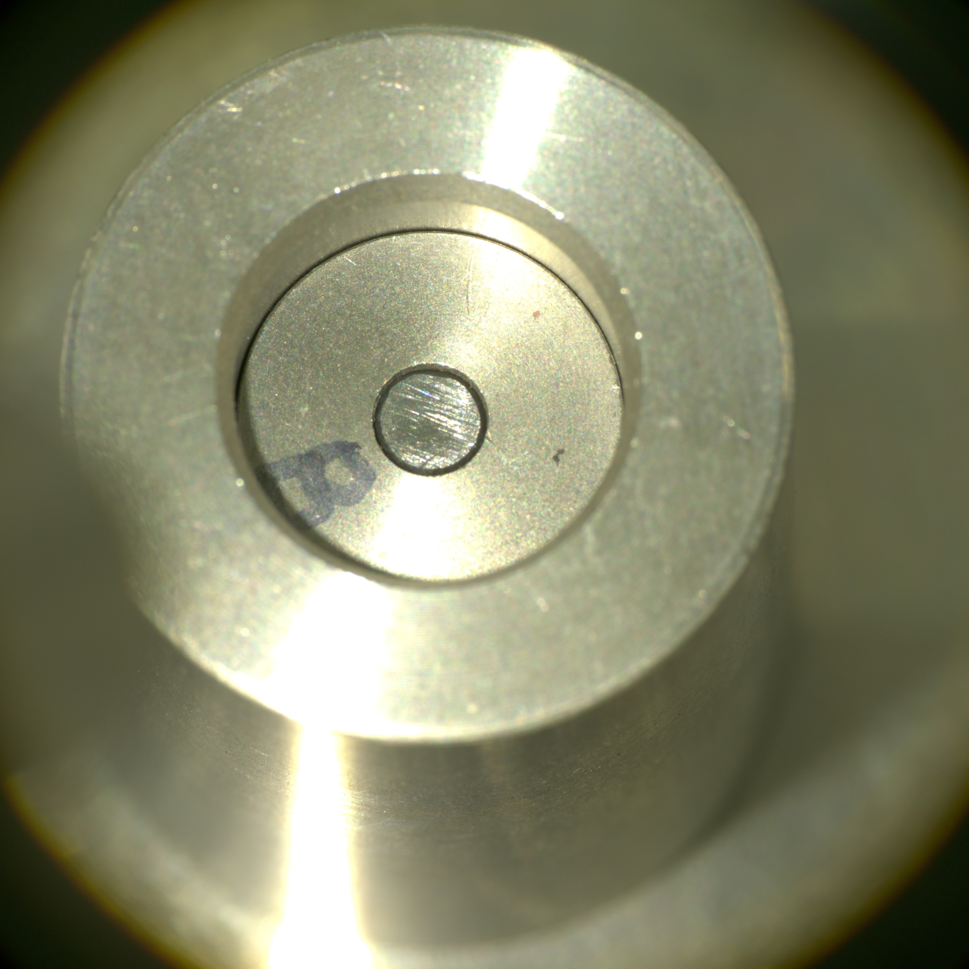
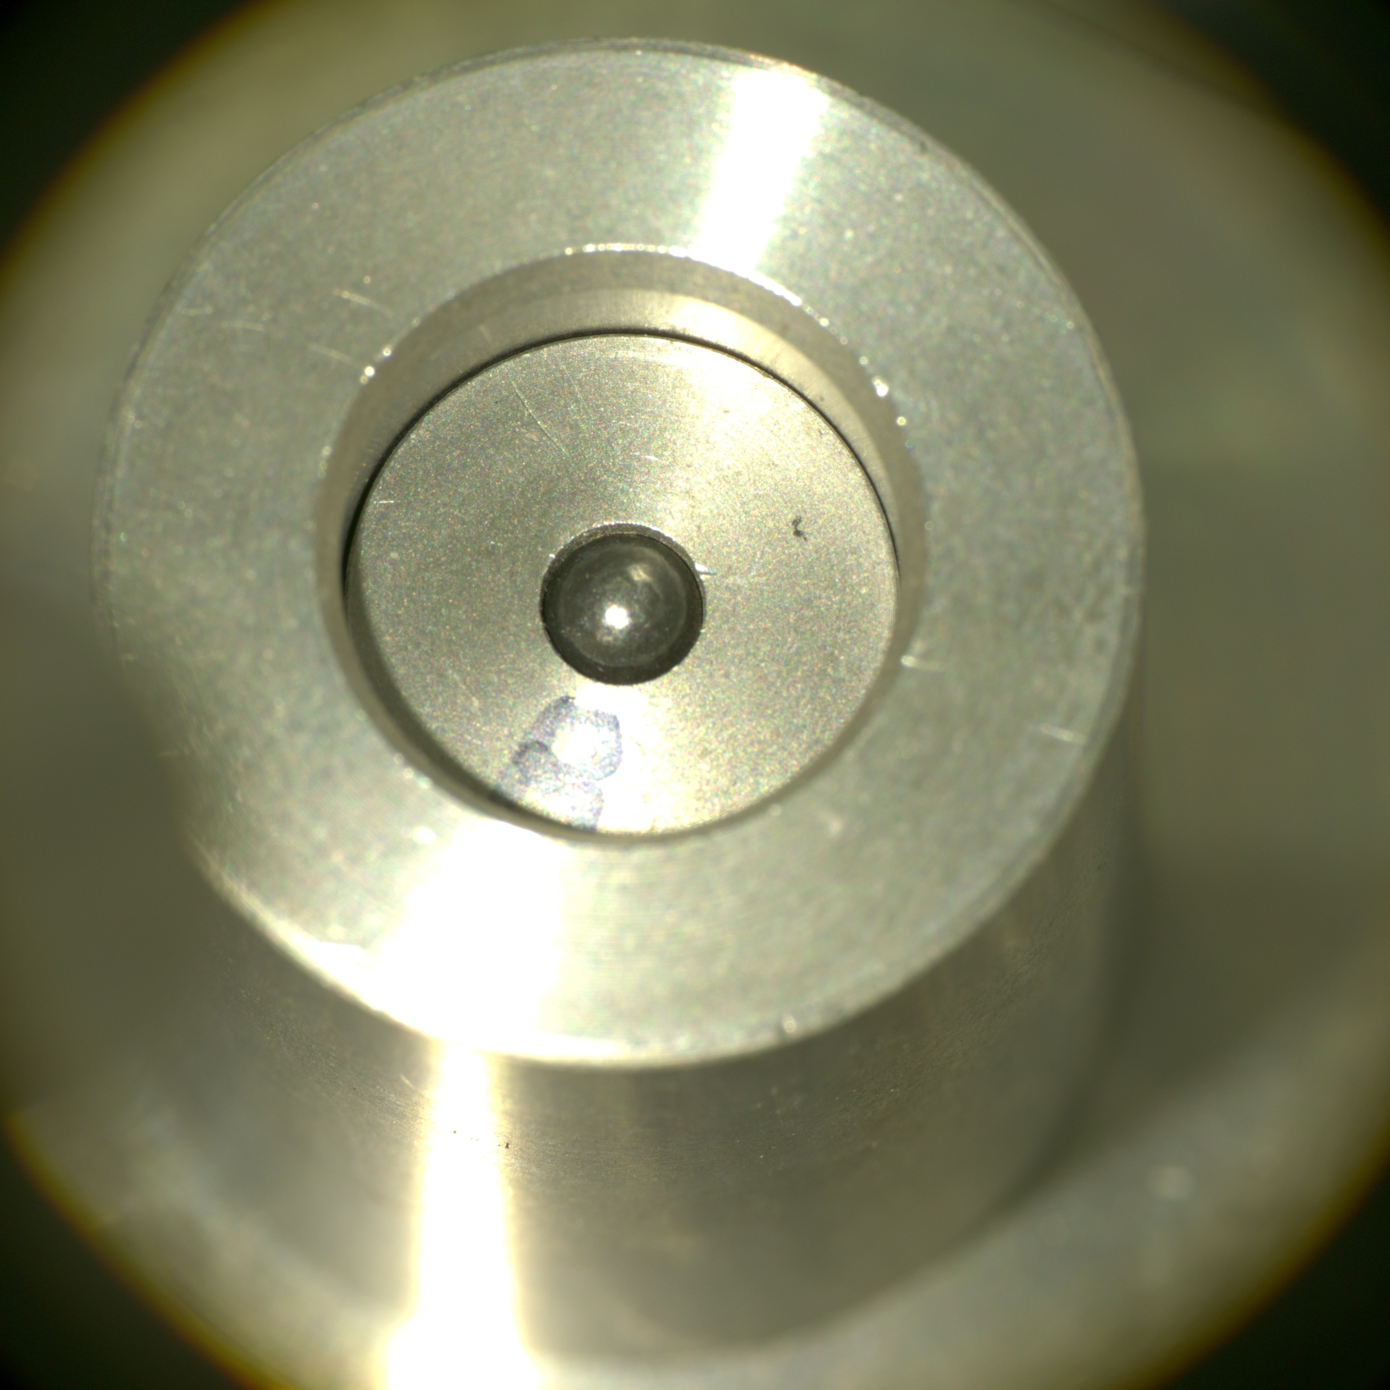
The pure sample
99.96% ²³⁹Pu, 0.04% ²⁴⁰Pu from Chemistry Division at LANL
Only ~100 mg available.
DICER only needs 1 mg
Liquid sample, enclosed in a W canister and sealed with hand-pressed Pb plugs
Liquid sample ensures uniformity: ²³⁹PuCl₄ in 6M D₂O●DCl solution

Slide 26
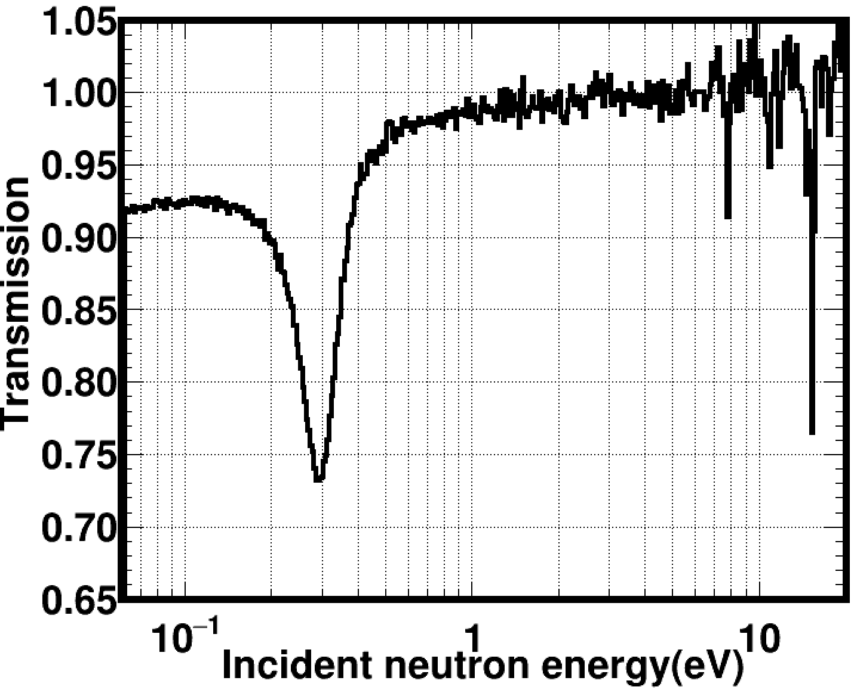
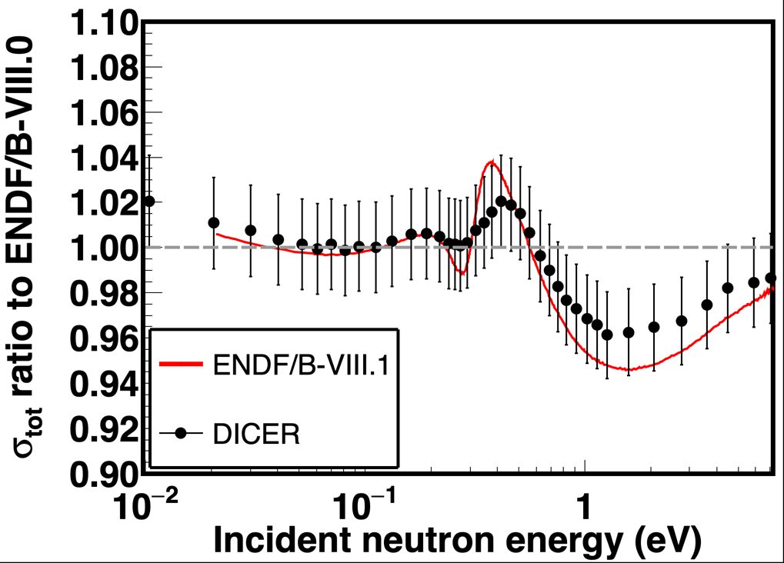
Preliminary results
Sample was free of measurable ²⁴⁰Pu
Preliminary results favor the ENDF/B-VIII.0 evaluation
Analysis is almost complete and a manuscript will be
submitted for publication to Phys. Rev. C.
Preliminary
Preliminary
²³⁹Pu
²⁴⁰Pu
²³⁹Pu

Slide 27
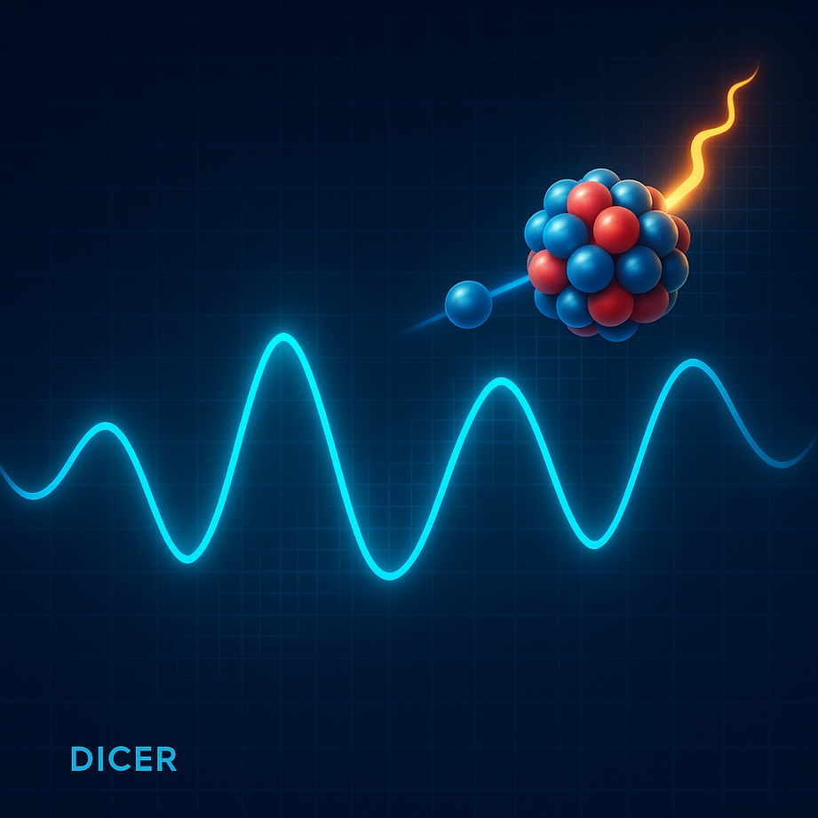
149Sm

Slide 28
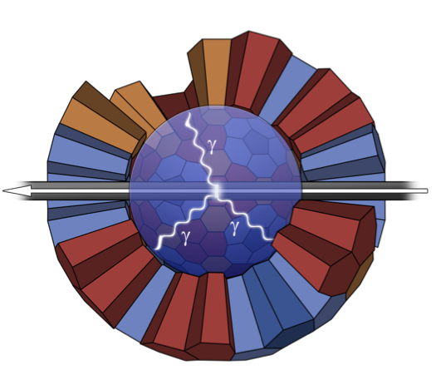
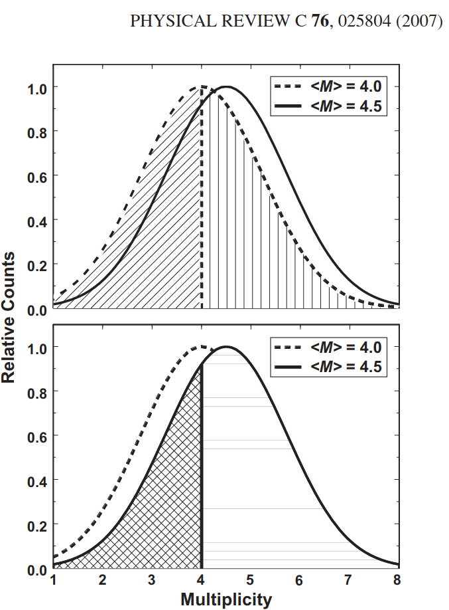

n+¹⁴⁹Sm: Capture and transmission
¹⁴⁹Sm: fission product + neutron poison
Accumulates in a reactor, like ¹³⁵Xe but it doesn’t decay away
Detector for Advanced Neutron Capture Experiments (DANCE) (See E. Leal-Cidoncha’s talk for DANCE details)
~4π calorimeter
DANCE to get the capture yields
DANCE also provides multiplicities
Different multiplicity distributions
for different spins
DANCE is used as a spinometer

Slide 29



n+¹⁴⁹Sm: R-Matrix analysis & Resonance parameters
Fits in capture and transmission data using SAMMY
About 40 spins were incorrectly assigned
Resolved 58 new resonances (215 vs 157 in evaluations)
More info on LA-UR-23-32571
Evaluated Γ_{n} is too large
Resolved doublet @ 15 eV

Slide 30



The transmission sample
Sm₂O₃ powder in capillary tubes sealed with Al plugs
Sm₂O₃ is hygroscopic
Samples were “baked” at 200 ºC under vacuum for ~3 days
Previous Sm studies: samples baked at 1000 ⁰C in atmospheric pressure for a few minutes.
There is concern if our method truly results in dry samples
We used Thermogalvanic Analysis (TGA) and studied the mass change at different temperatures
Highest mass change: 700 ⁰C (~8%)
Consistent with the mass change we observed in the transmission before and after baking the sample
ND2025 proceedings describe the study.
7.5(13)%

Slide 31




n+¹⁴⁹Sm: Non-Statistical behavior
Statistically significant change in the Γ_{γ} distributions around 200 eV was observed.
Findings will be submitted for publication to Phys. Rev. Lett. (similar findings in ¹⁴⁷Sm)
Phys. Rev. Lett.
Phys. Rev. C

Slide 32


Oscillations in cross sections
Sm work gave rise to an interesting observation
Neutron-capture cross sections are exhibiting a statistically significant oscillating behavior
Oscillations are an autocovariance. Is this autocovariance information preserved in cross-section processing for criticality applications?

Slide 33

63Cu

Slide 34


Phys. Rev. X 15, 021086
⁶³Cu, funded by LANL-LDRD
Through the PARADIGM project, we’re employing ML to identify differential and integral experiments and reduce time in nuclear data evaluations: 3 vs 25 years! (see N. Walton’s talk)
⁶³Cu(n,tot) was identified as an important experiment to showcase the new nuclear data pipeline.
Thin and thick samples were cast at ORNL
Efforts are expected to finish by the end of September
First time DICER measured above 100 keV
Preliminary

Slide 35

Criticality program at LANSCE

Slide 36
LANSCE NCSP 5-year outlook
US DOE NCSP 5-year execution plan
https://ncsp.llnl.gov/program-management/ncsp-five-year-execution-plan
LANSCE provides differential nuclear data for (n,x) reactions from meV-MeV
The following table shows NCSP funded experiments (will be) conducted at LANSCE apart from 63Cu
Reaction | Executed |  |  |  |  |  |  |  | To be executed
PFNS @ Chi-Nu (WNR) | ²⁴⁰Pu |  |  |  |  |  |  |  | ²³³U
(n,γ) @ DANCE (Lujan) | ²³³U | ¹⁴³Nd |  | ¹³³Cs |  | ⁶³Cu |  | ¹⁵¹Sm | ¹⁵¹Sm |  |  | ²⁴⁰Pu |  |  |  | ²⁴²Pu
(n,p) @LENZ (Lujan and WNR) | ³⁵Cl
(n,f)* @ SREFT (WNR) |  |  |  |  |  |  |  |  | ²³⁷Np |  |  |  | ²⁴⁰Pu
(n,n’γ)** @ CoGNAC (WNR) |  |  |  |  |  |  |  |  | ^{50, 52, 53}Cr |  | ^{58,60}Ni |  |  |  | ^{90,91,92,94,96}Zr
(n,tot)** @ DICER (Lujan) | ¹⁴⁹Sm |  | ²³⁹Pu |  | ¹³³Cs |  | ⁶³Cu |  | ³⁵Cl | ¹⁴³Nd |  | ¹⁵¹Sm |  | ²³⁶U (ORNL) |  |  | ^{240,242}Pu
* Under development
**New capabilities at LANSCE

Slide 37

Thank you for your attention!

Slide 38
⁹Back-up slides

Slide 39



The technique in a nutshell
Resonances can be used across an energy region ΔΕ to calculate the 3 ingredients needed to extract or constrain the average capture cross section
Average level spacing $D_{0}=\frac{ΔE}{N−1}$ (N: number of resonances in the ΔΕ interval).
Neutron strength function for s-waves $S_{0}=\frac{\sum{gΓ_{n}^{0}}}{ΔE}=\frac{<gΓ_{n}^{0}>}{D_{0}}$ , where
  g is the spin factor for a resonance with spin J
  Γ⁰_{n} is the reduced neutron width
Average radiation width <Γ_{γ}>
The capture cross section is related to these quantities
$$=f(\text{Γ},\text{Γ}\text{n}, D_{0})$$
k : Wave number
W : Width fluctuation factor

Slide 40

Proof of principle: in brief
Data on ¹⁵¹Sm(n,tot) from Kirouac and Einland (10.1103/PhysRevC.11.895)
Resonance data up to 300 eV (120 resonances)
Resonances were fitted with SAMMY
13 Γ_{γ} values were obtained
<Γ_{γ}> = 96.5(14) meV
Level spacing D₀ = 1.10(7) eV
Strength function 10⁴xS₀ = 3.58(59)
TALYS was adjusted to these values and compared with recent (n,γ) data
  Level density parameter α(S_{n})
  Optical model potential depth
  Optical model potential diffuseness
  Photon strength function was normalized to give the <Γ_{γ}> value
  https://nds.iaea.org/talys/tutorials/talys.pdf
Good agreement with the data in EXFOR

