Slide 1



IEEE NPSS Student Branch Chapter
Universidad Simón Bolívar
BEIS 2026
Young Professionals – Inspiring Examples
Martin Grossmann
Center for Protontherapy, Paul Scherrer Institute, Switzerland
Barranquilla, Colombia · June 2026
BEIS 2026 – Barranquilla EduCom International School
Notes:
1

Slide 2
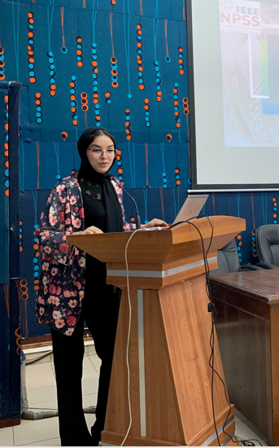
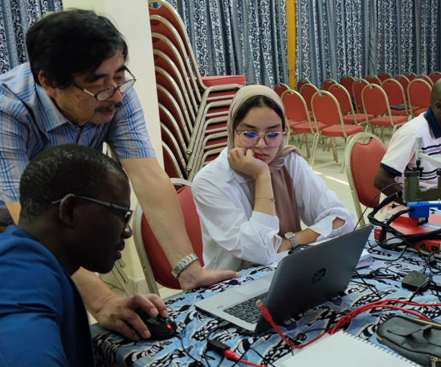
Aziza Zendour
EduCom School Dakar, Senegal – November 2022

Slide 3
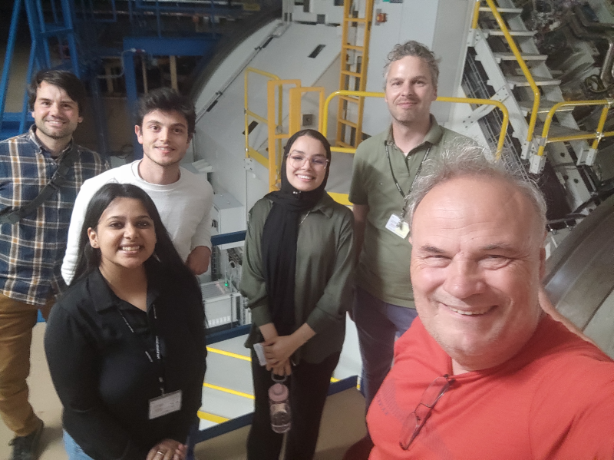
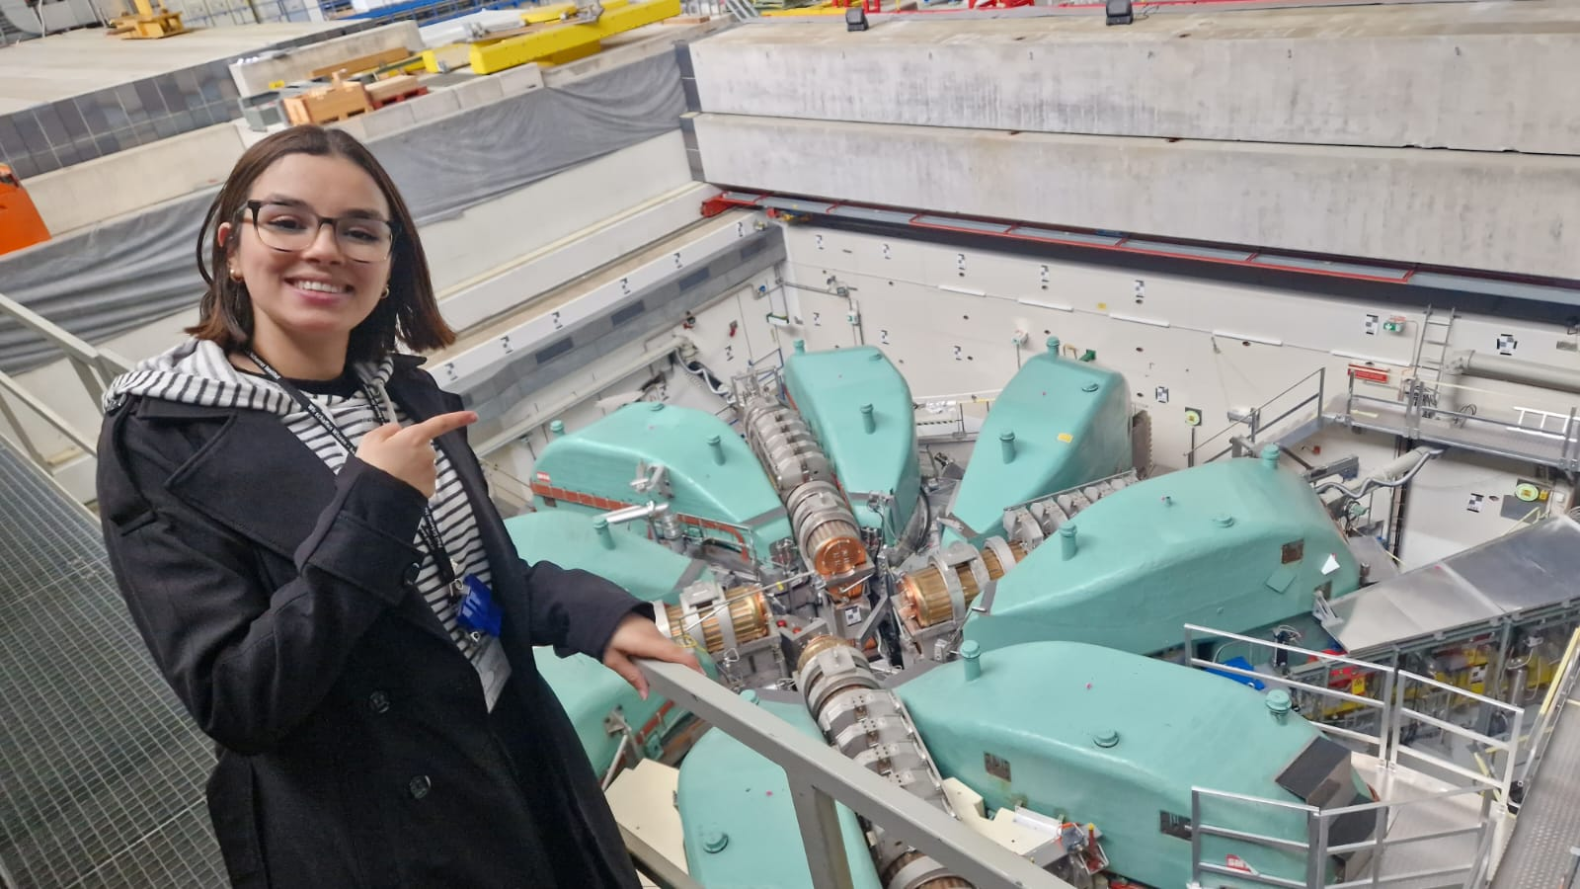
Summer Student, PSI, June 2023
PhD Student, PSI, January 2024

Slide 4
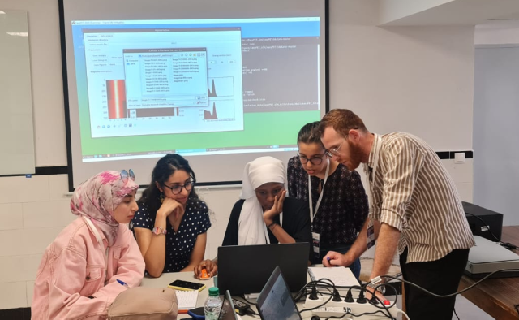
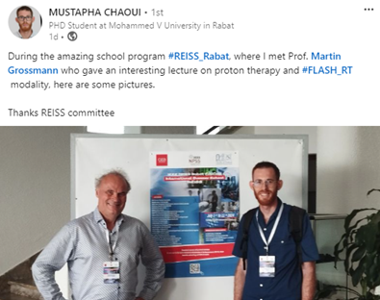
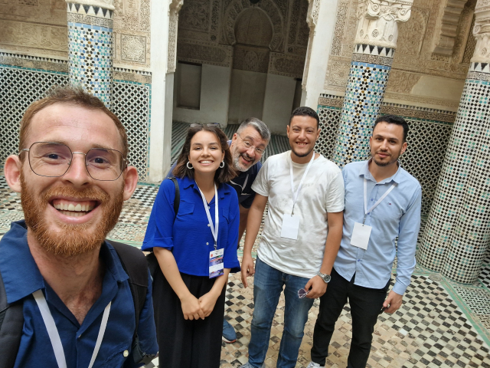
Mustapah Chaoui
EduCom School Rabat, Morocco – July 2024

Slide 5
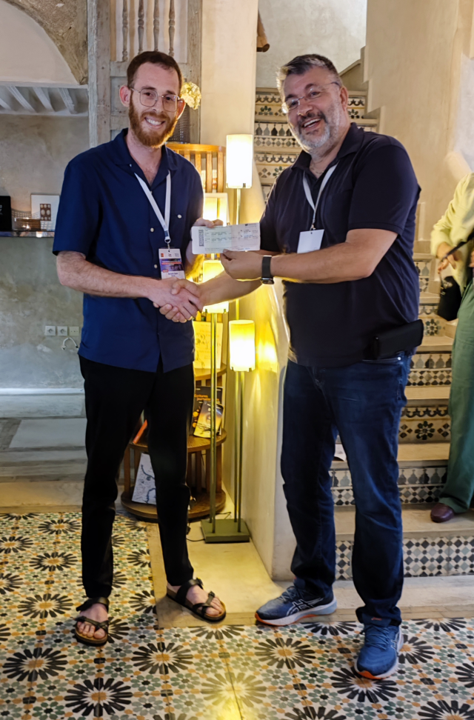
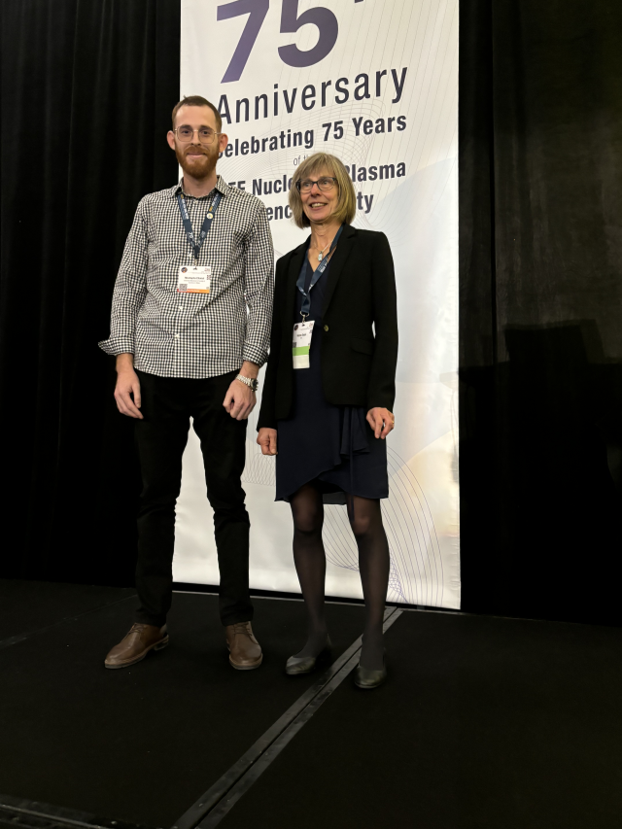
Travel Award to NSS-MIC Tampa, USA – November 2024

Slide 6
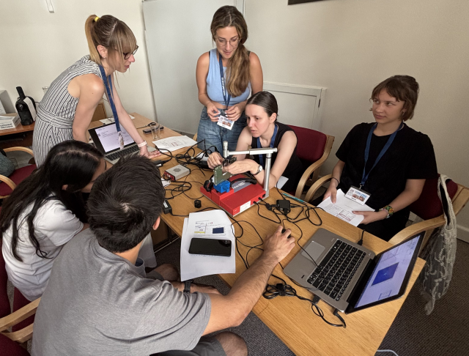
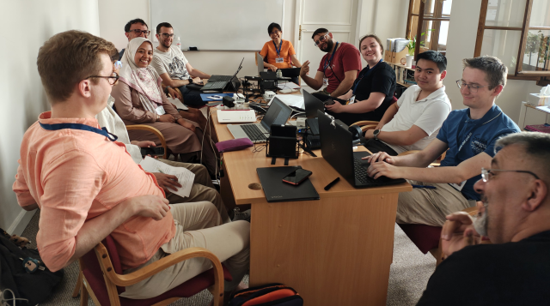
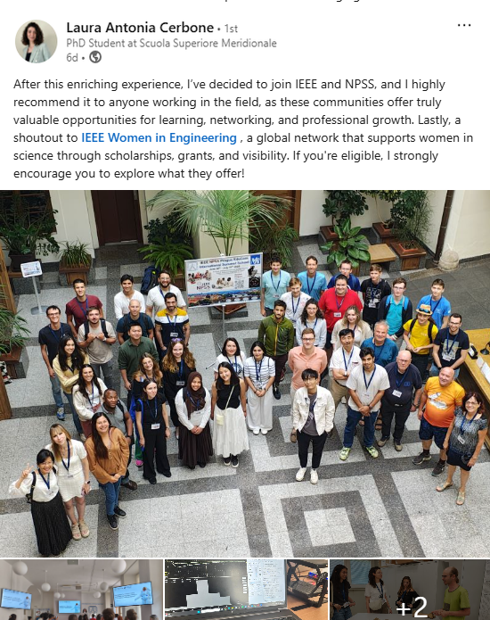
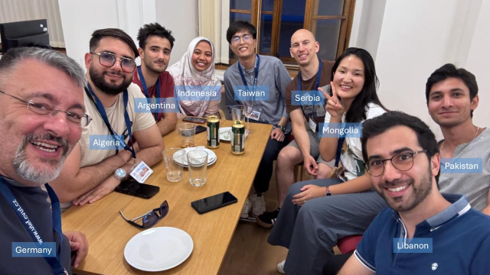
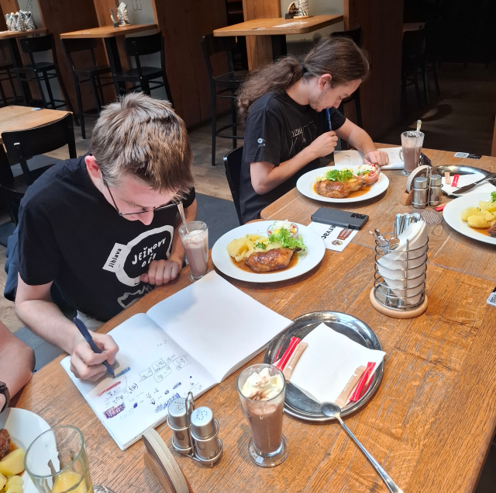
EduCom School Prague, Czechia – July 2025

Slide 7
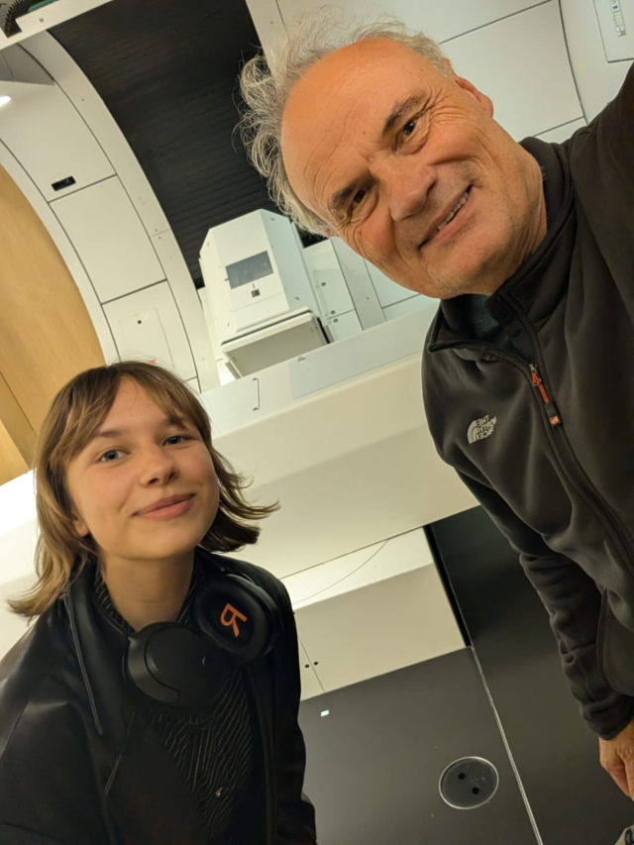
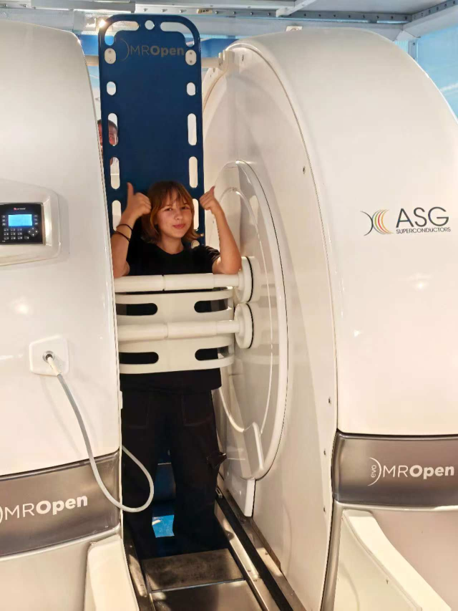
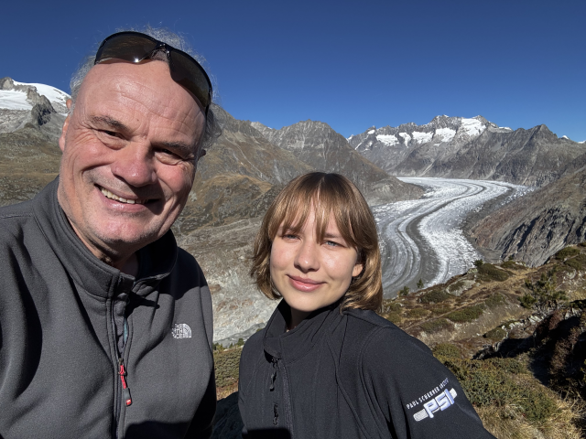

Slide 8
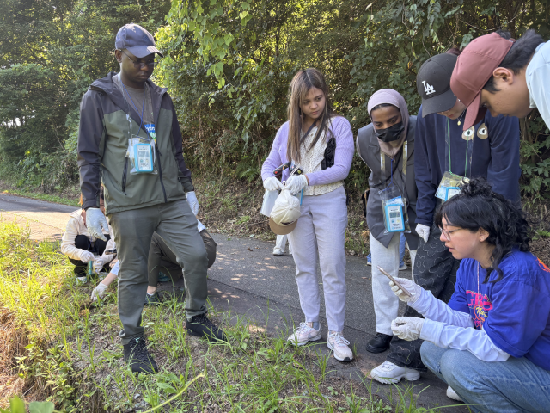
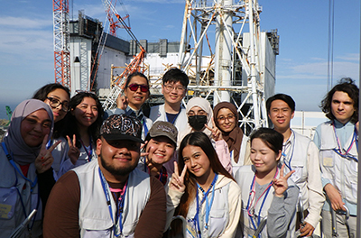
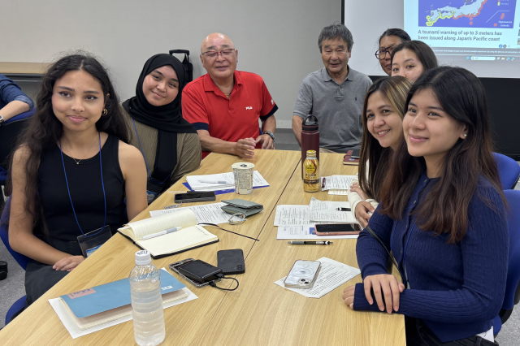
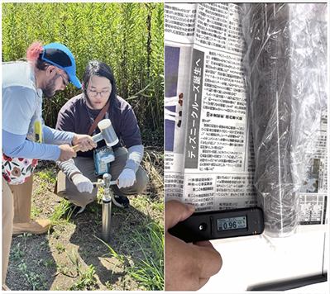
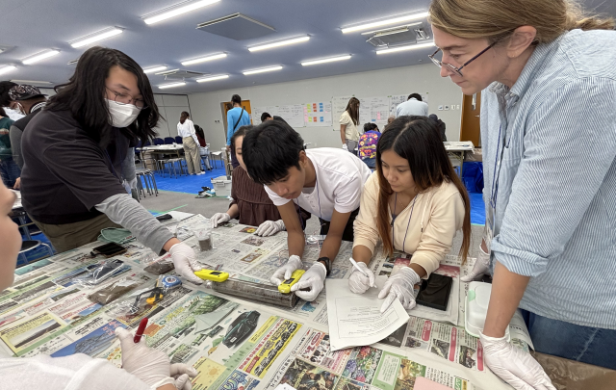
Radiation Measurements School, Fukushima Japan – July 2025

Slide 9
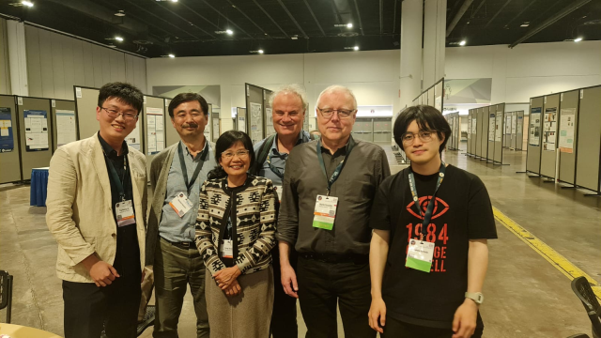
Lin Tzu-Hsiang
NSS-MIC Conference Tampa, USA – November 2024

Slide 10
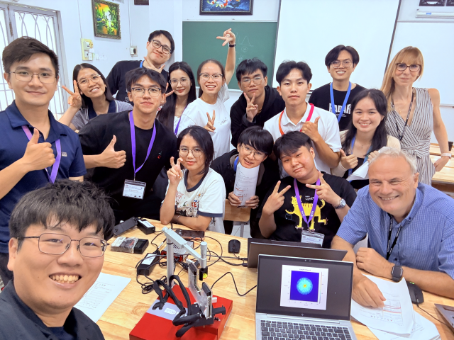

Slide 11
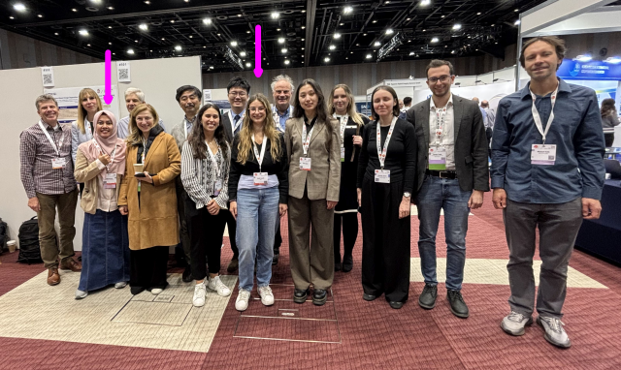
NSS-MIC Conference Yokohama, Japan – November 2025

Slide 12
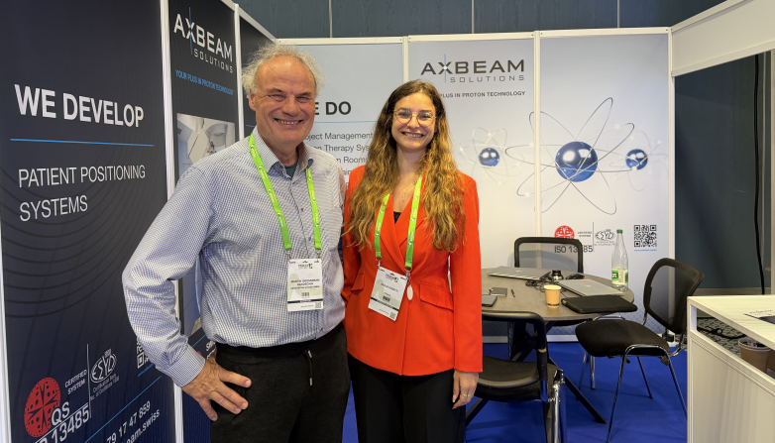
Particle Therapy Conference, Deauville France, June 2026

