Slide 1



IEEE NPSS Student Branch Chapter
Universidad Simón Bolívar
BEIS 2026
IEEE NPSS YP – Get Together Session
Andrea Gonzalez-Montoro, PhD
andrea.gm@i3m.upv.es
Instituto de Instrumentación para Imagen Molecular (i3M), CSIC-UPV, Valencia, Spain
Barranquilla, Colombia · June 2026
BEIS 2026 – Barranquilla EduCom International School
Notes:
1

Slide 2



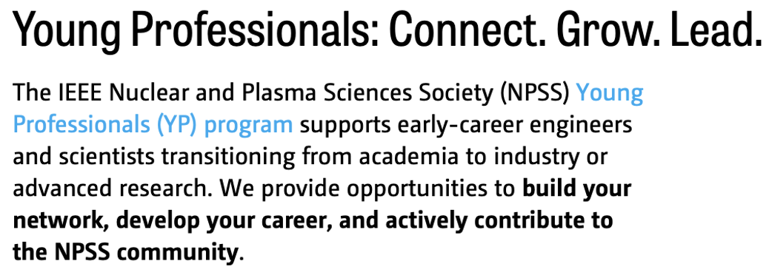
IEEE NPSS YP
Andrea Gonzalez-Montoro, phD
andrea.gm@i3m.upv.es
IEEE-NPSS YP Committee Chair

Slide 3


IEEE NPSS YP
We are a dynamic, international network of IEEE members who have graduated with their first professional degree within the last 15 years.
Whether you are navigating the final stages of your PhD or establishing yourself in industry, our program is designed to bridge the gap between your academic foundation and a professional career.
Our mission, we are dedicated to your growth and integration into the global
scientific community.
Support the transition from student to professional excellence.
Foster collaboration between academia and industry to drive innovation.
Empower young professionals within NPSS through leadership and visibility.
Build a global, inclusive, and active community of peers and experts.

Slide 4
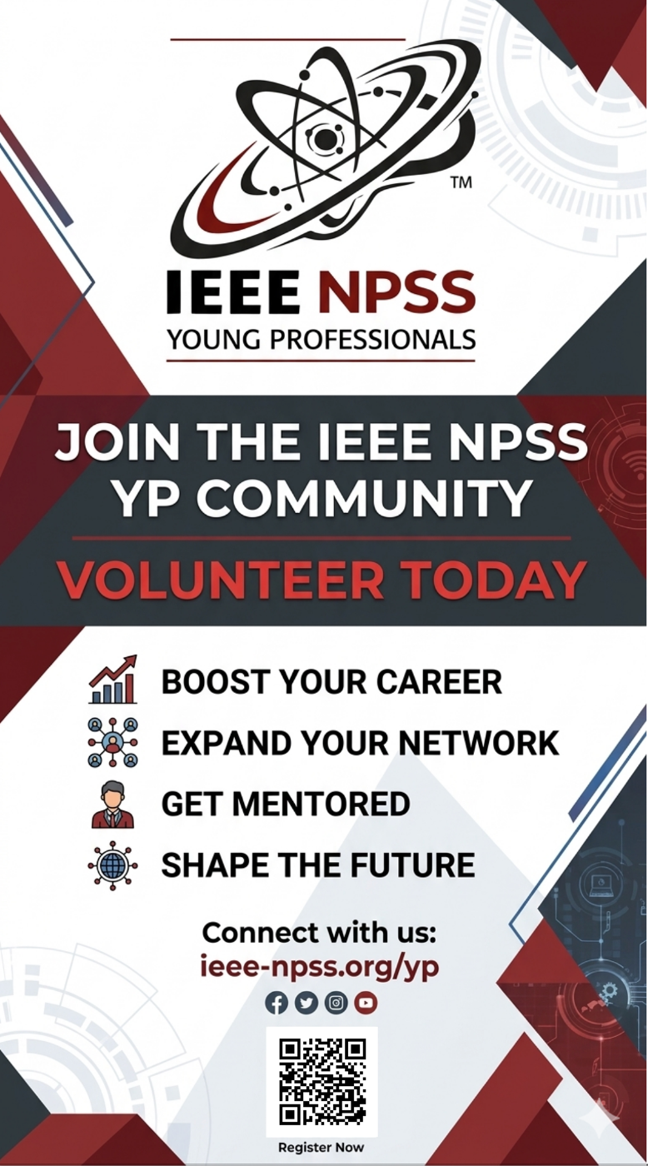

IEEE NPSS YP
Why Join the YP Community?
Being an IEEE member at the start of your scientific journey makes a tangible difference:
Expanded Networking
Exclusive Conference Events
Mentorship Opportunities
Career Insights
Do you want to know more about us?
Please, visit our webpage and explore by yourself
Notes:
Expanded Networking: Connect and engage with a global community of peers and senior leaders within and beyond your technical niche.
Exclusive Conference Events: We organize dedicated seminars, workshops, and social events at NPSS-sponsored conferences, providing a platform for direct interaction with industry giants and renowned researchers.
Mentorship Opportunities: Through our expanding mentorship activities and Young Investigators’ Workshops (YIWS), we facilitate connections that can evolve into lifelong mentor-mentee relationships with IEEE Fellows.
Career Insights: Gain “insider” knowledge on how to transition into specific roles.

Slide 5
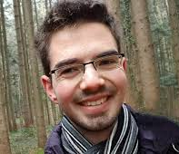
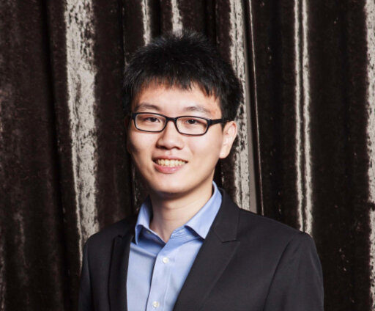
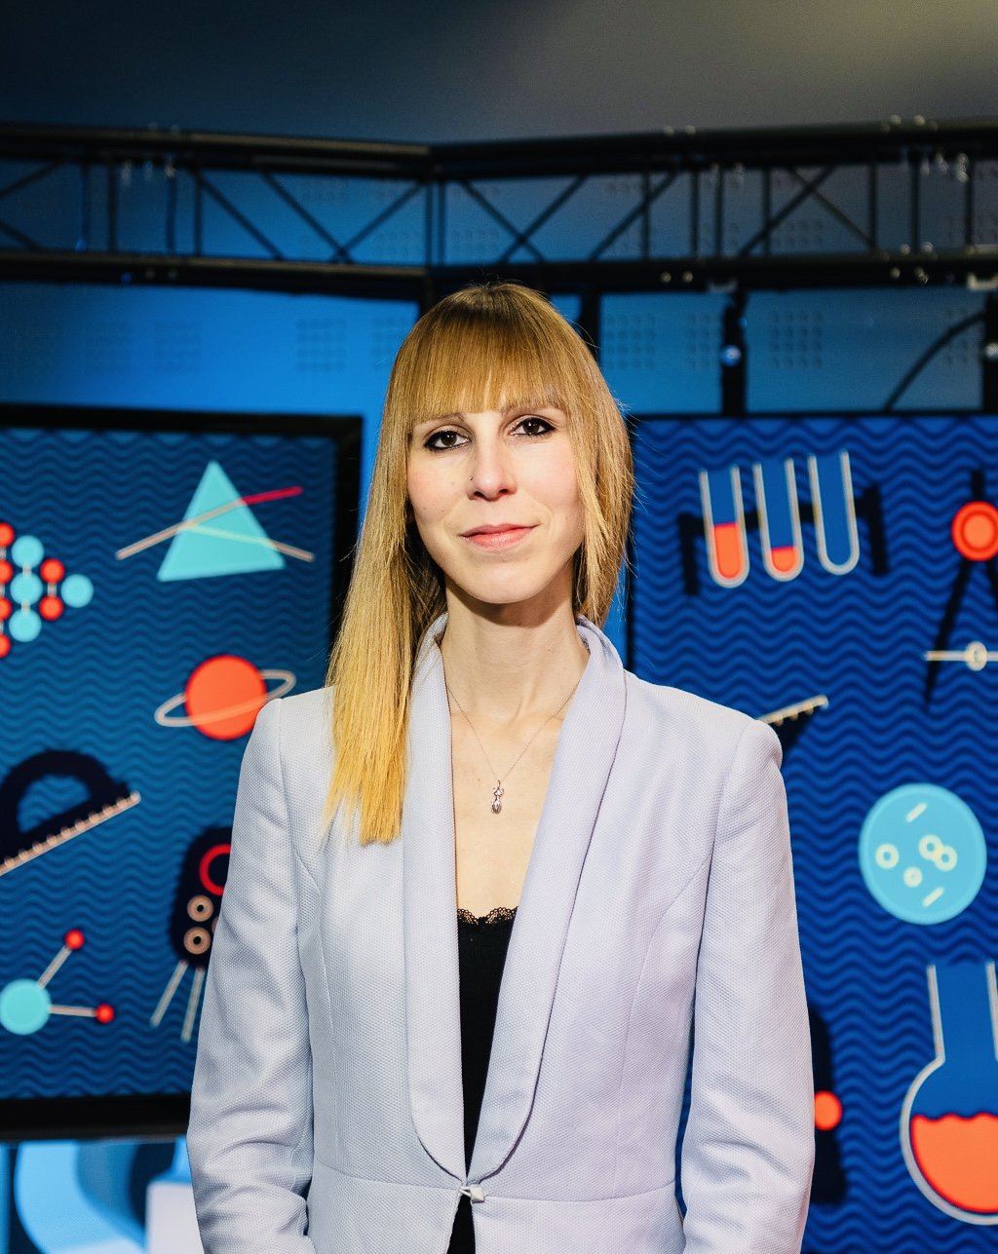
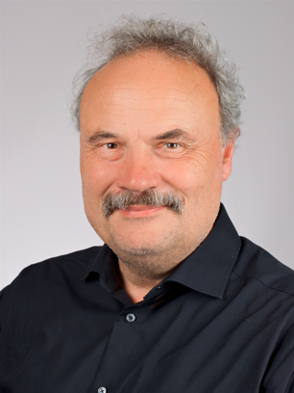
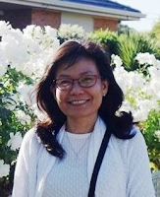
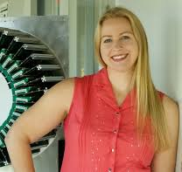
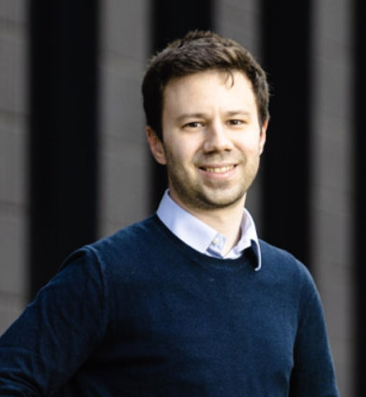
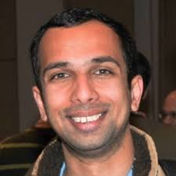
IEEE NPSS YP
New Committee – New Leadership
Chair | Andrea Gonzalez-Montoro
1️⃣ Member | Martin Grossmann
2️⃣ Member | Trang Hoang
3️⃣ Member | Audrey Corbeil
New Committee Members
Vice-Chair (do not participate in AdCom meetings)
1️⃣ David Breitenmoser - Postdoctoral Fellow
University of Michigan, USA
2️⃣ Tzu-Hsiang Lin - Postdoctoral researcher
National Tsing Hua University (NTHU), Taiwan
Incoming postdoctoral researcher at Ohio University
Functional Leads (they do not participate in AdCom meetings, only support)
1️⃣ Luca Vialetto <vialetto@ucla.edu>
Incoming Assistant Professor @ UCLA
Advisor – Previous Chair | Srilalan Krishnamoorthy (Advice)
Year 2026

Slide 6

Today´s topics
Dr. Andrea Gonzalez-Montoro
“Introduction to the IEEE NPSS YP”
“Career insights”
Dr. Martin Grossman
“Inspiring examples”
Dr. Trang Hoang
“Beyond the Chatbox”
“Mapping the AI Ecosystem for Modern Academics”

Slide 7

About me
Postdoctoral Fellow at
Stanford University 2018-2023
2023-2026
i3M-CSIC-UPV
Ramón y Cajal, Postdoc
Andrea Gonzalez-Montoro, PhD in Physics
Born in Valencia, Spain, on December 13th 1992
Degree in Physics
2010-2014
Master in Medical Physics
2014-2015
2021Young Scientific Female Talent. aRac y MasterCard España
PhD in Physics
2015-2018
ERC Stg Grant (1.5 M€)
December 2024 – 2029
PHOENIX
IEEE YP Committee Chair (NMISC)
Qualification: Cum Laude
December 2018
Darmstadt, Germany
1st international experience
Permanent position at i3M
January 2026 – On going

Slide 8
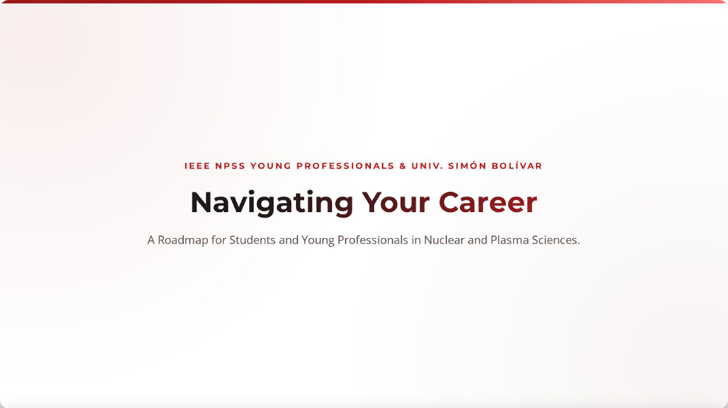
Today´s topics

Slide 9
Today´s topics
3
2
Important skills to develop
4
How to get funded positions
Academia vs. Industry
5
1
Options in Latin America (Colombia)
Career paths & how to access them

Slide 10
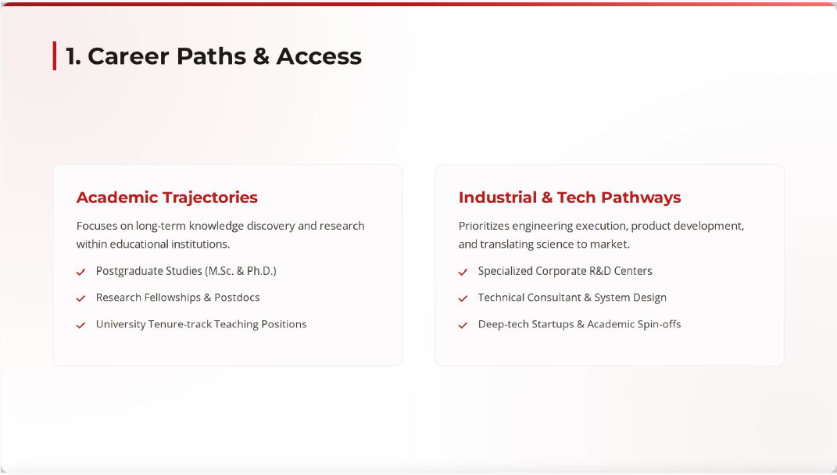
Today´s topics
1
Career paths & how to access them

Slide 11
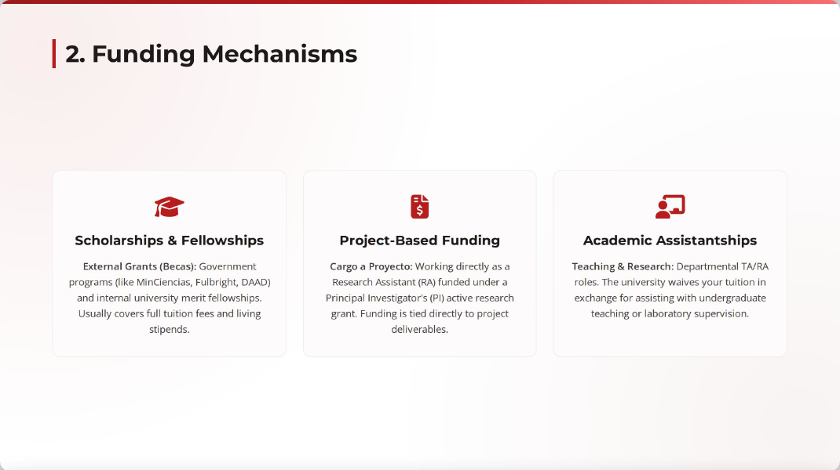
Today´s topics
2
How to get funded positions

Slide 12
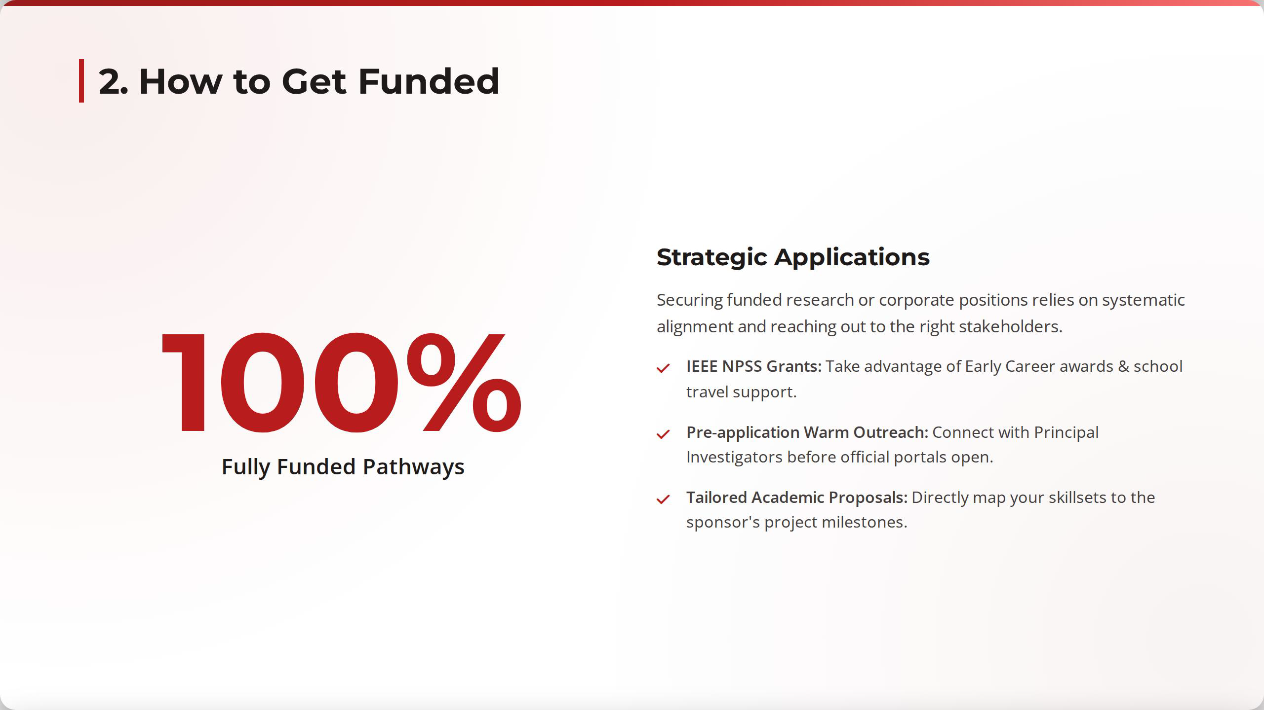
Today´s topics
2
How to get funded positions

Slide 13
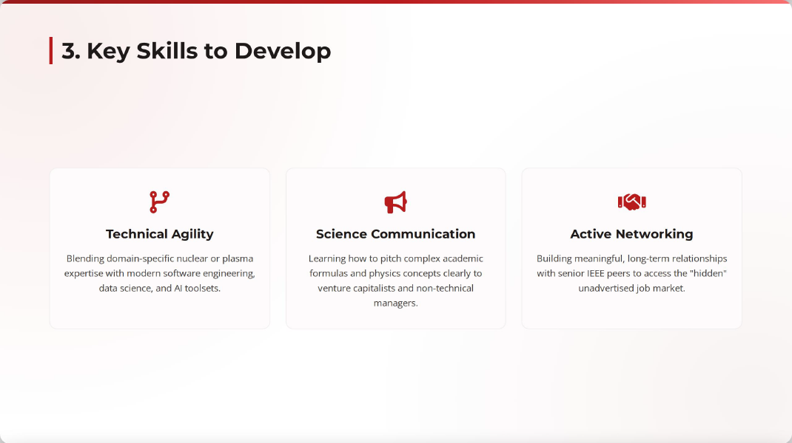
Today´s topics
3
Important skills to develop

Slide 14

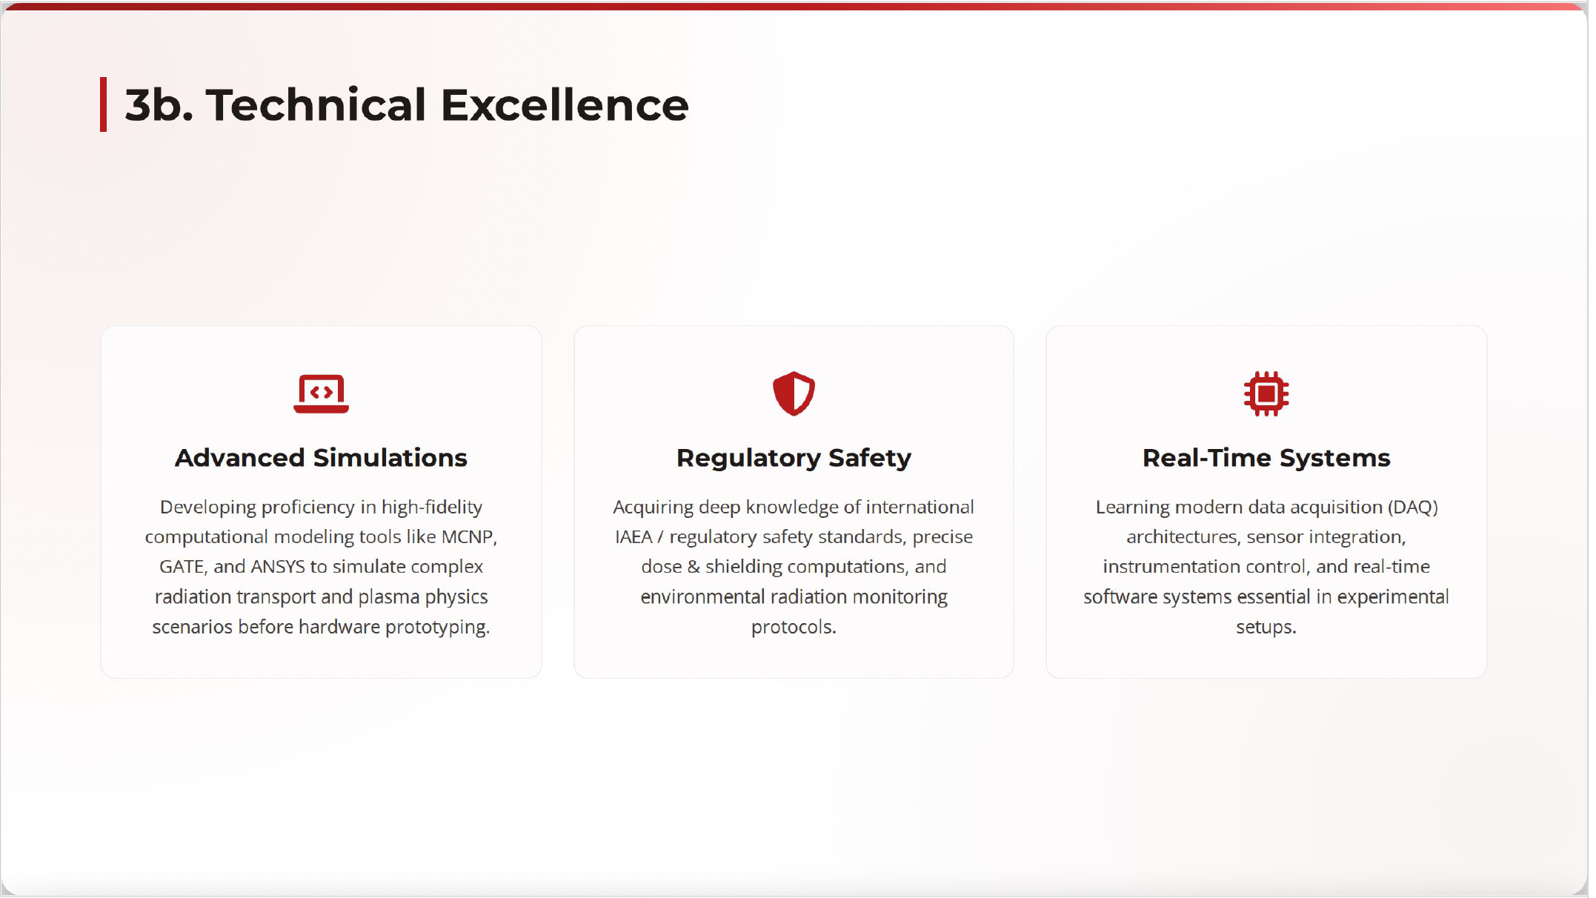
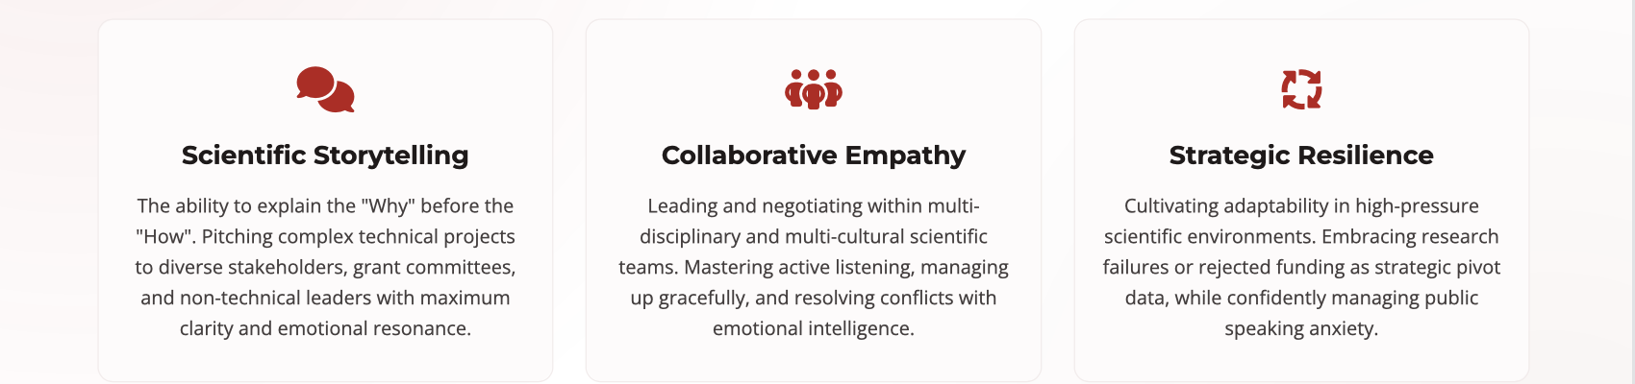
Today´s topics

Slide 15
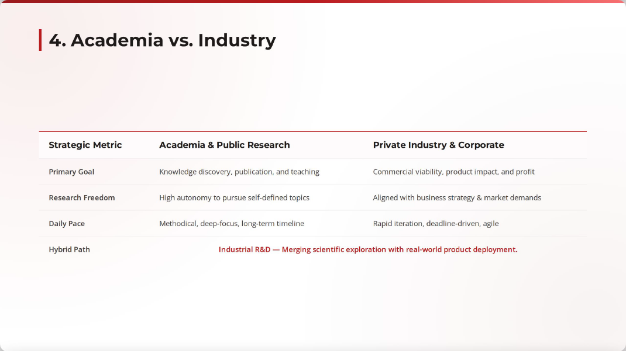

Today´s topics
4
Academia vs. Industry

Slide 16
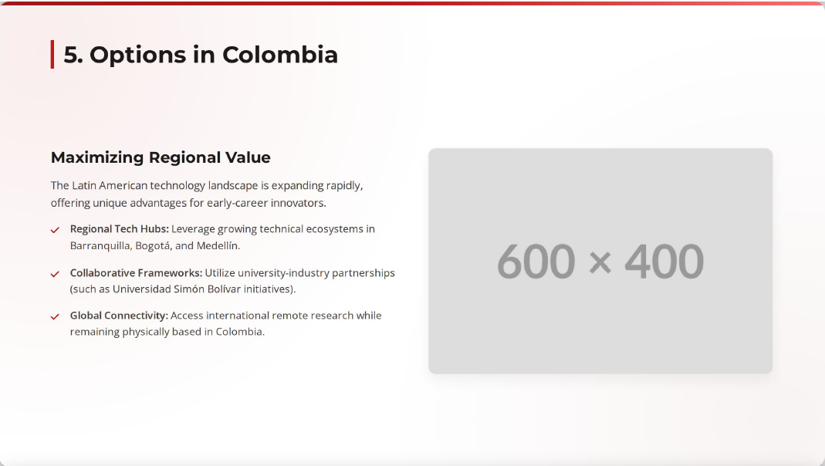


Today´s topics
5
Options in Latin America (Colombia)

Slide 17
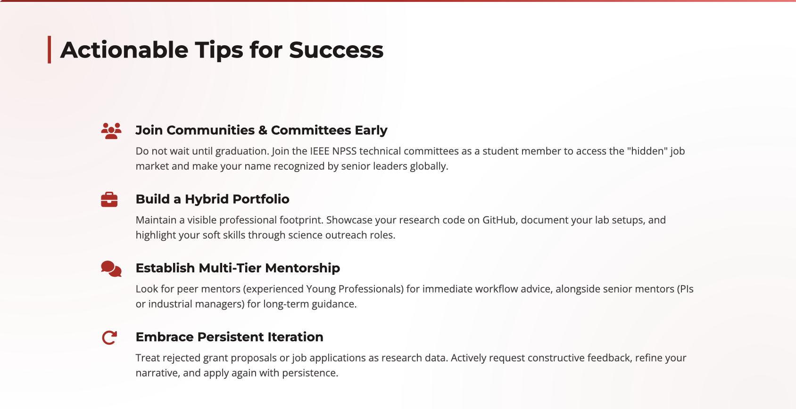
Today´s topics

Slide 18

?
Questions?
Open for Discussion
Andrea Gonzalez-Montoro, phD
andrea.gm@i3m.upv.es · Instituto de Instrumentación para Imagen Molecular (i3M), CSIC-UPV
BEIS 2026 – Barranquilla, Colombia
Notes:
10

