Slide 1



IEEE NPSS Student Branch Chapter
Universidad Simón Bolívar
BEIS 2026
Introduction to Medical Imaging
Andrea Gonzalez-Montoro, PhD
andrea.gm@i3m.upv.es
Instituto de Instrumentación para Imagen Molecular (i3M), CSIC-UPV, Valencia, Spain
Barranquilla, Colombia · June 2026
BEIS 2026 – Barranquilla EduCom International School
Notes:
1

Slide 2


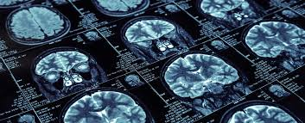
Outline
Principles of Medical Imaging
X-rays & CT
Anatomical Imaging
Molecular Imaging
Remarks
1
2
3
4
5

Slide 3

About me:
Andrea Gonzalez-Montoro, PhD in Physics
Born in Valencia, Spain, on December 13th 1992
Postdoctoral Fellow at
Stanford University 2018-2023
2023-2026
i3M-CSIC-UPV
Ramón y Cajal, Postdoc
Degree in Physics
2010-2014
Master in Medical Physics
2014-2015
2021Young Scientific Female Talent. aRac y MasterCard España
PhD in Physics
2015-2018
ERC Stg Grant (1.5 M€)
December 2024 – 2029
PHOENIX
Qualification: Cum Laude
December 2018
Darmstadt, Germany
1st international experience
IEEE YP Committee Chair (NMISC)
Permanent position at i3M
January 2026 – On going

Slide 4
Outline
Principles of Medical Imaging
X-rays & CT
Anatomical Imaging
Molecular Imaging
Remarks
1
2
3
4
5

Slide 5
Medical Imaging
Medical imaging is the technique and process of creating visual representations of the:
interior of a body for clinical analysis and medical intervention
function of some organs or tissues (physiology)
Before Medical Imaging,
studies were limited to:
external observation
studies of blood and urine
post-mortem dissection
→ Often perceived to designate the set of techniques that noninvasively produce images of the internal aspect of the body

Slide 6

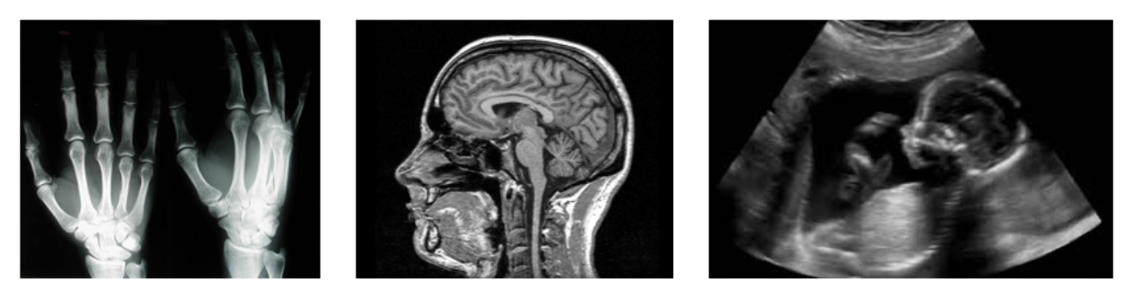
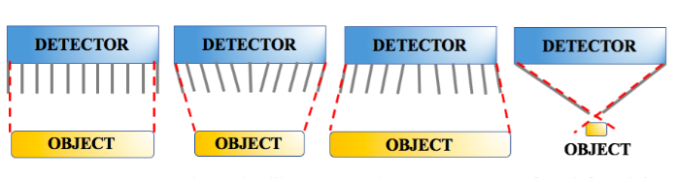
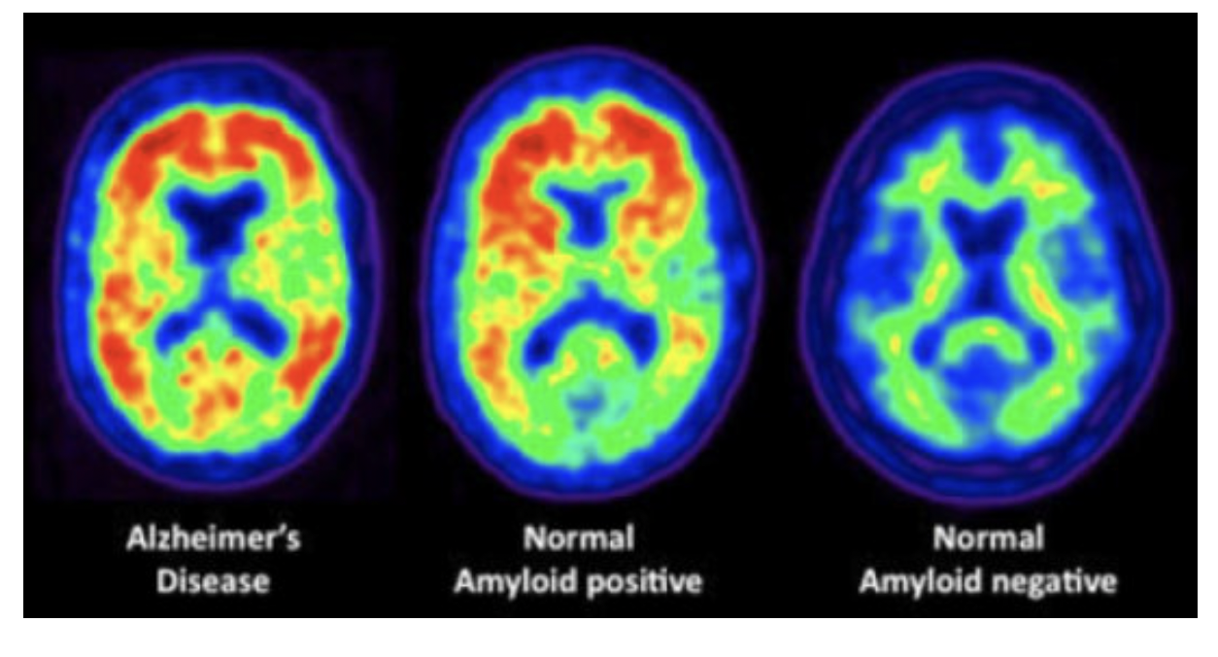
Medical Imaging
Medical Imaging
Medical Imaging
Noninvasive techniques for generating visual representations of the interior of the human (or animal) body, diagnosing, monitoring, or treating various medical conditions
x
Morphological information Anatomical. External source
Functional information.
Metabolic. Internal source
Imagen molecular
Reflexion/
Refraction
Radiotracers
Transmission
Absorption
Gamma camera
Compton camera
PET
X-rays
MRI
US
SPECT
Single photon emitters: ⁹⁹Tc
Requires collimators
Positron Emission Tomography
Don’t need collimators
Radiography
CT
Hybrid Imagen
Notes:
Di que todas son importantes (imagen funcional digo), que has trabajo sobre todo en PET, pero consideras el resto importantes y que tal vez en el futuro las toques??
Resumir bastante como introduzco el principio.
Campo de investigación: imagen molecular!!

Slide 7
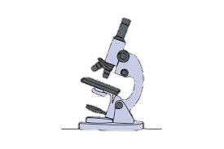
Medical Imaging
Medical Imaging
Medical imaging refers to several different technologies that are used to view the human body in order to diagnose, monitor, or treat medical conditions
Each type of technology gives different information about the area of the body being studied or treated
16th Century
Invention of the Microscope

Slide 8
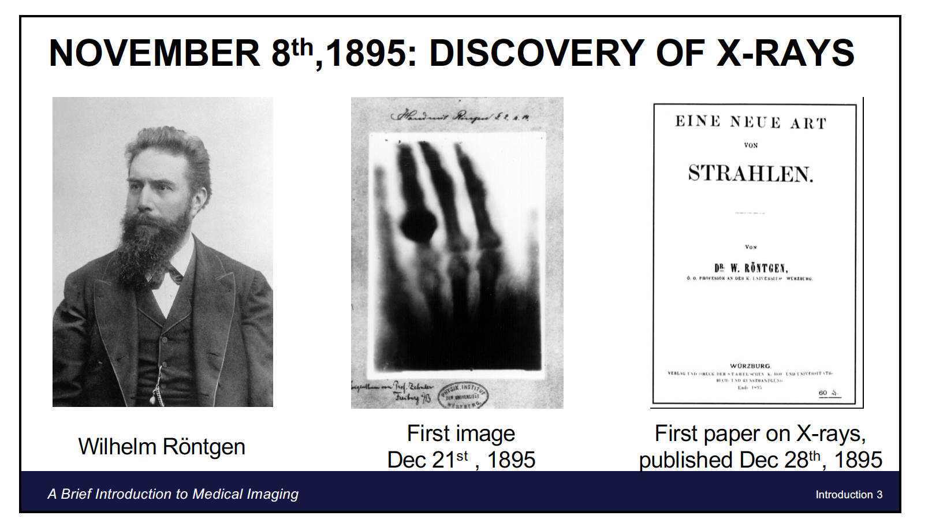
Medical Imaging
Medical Imaging
Medical imaging refers to several different technologies that are used to view the human body in order to diagnose, monitor, or treat medical conditions
Each type of technology gives different information about the area of the body being studied or treated
1895
Discovery of the X-rays
16th Century
Invention of the Microscope
1956
First Ultrasound devices

Slide 9
Medical Imaging
Medical Imaging
Medical imaging refers to several different technologies that are used to view the human body in order to diagnose, monitor, or treat medical conditions
Each type of technology gives different information about the area of the body being studied or treated
1895
Discovery of the X-rays
1961
Invention of PET scanners
16th Century
Invention of the Microscope
1956
First Ultrasound devices
1972
Invention of the CT

Slide 10
Medical Imaging
Medical Imaging
Medical imaging refers to several different technologies that are used to view the human body in order to diagnose, monitor, or treat medical conditions
Each type of technology gives different information about the area of the body being studied or treated
1895
Discovery of the X-rays
1961
Invention of PET scanners
1977
Invention of the MRI
16th Century
Invention of the Microscope
1956
First Ultrasound devices
1972
Invention of the CT

Slide 11
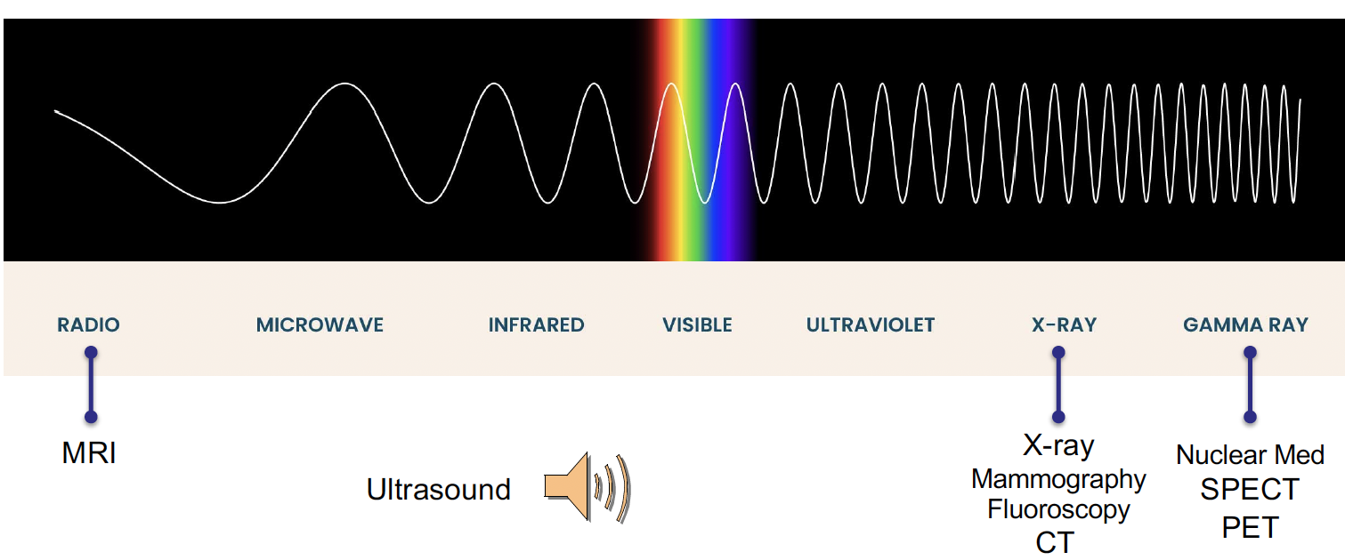
Medical Imaging
Medical Imaging
Radiation used for Medical imaging

Slide 12
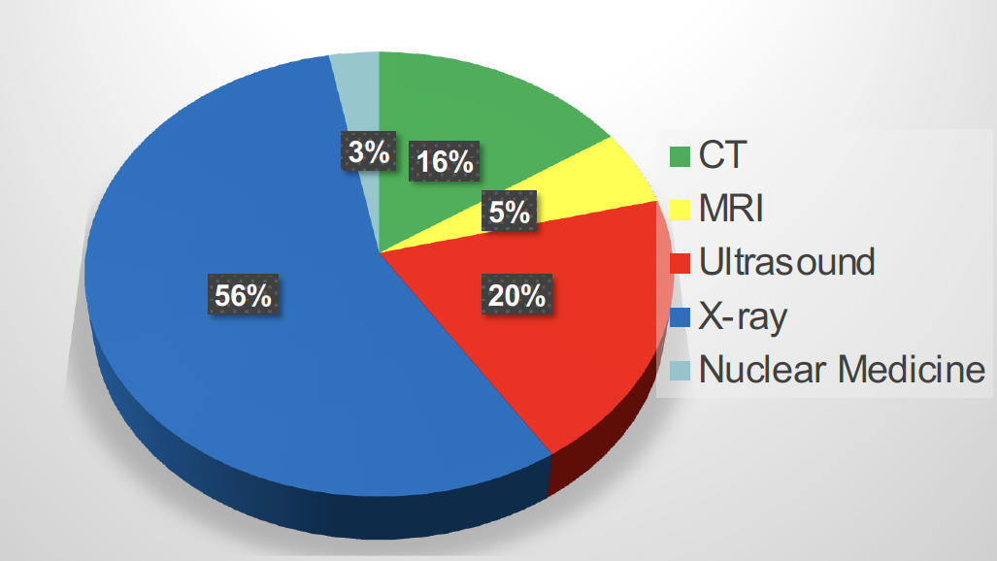
Medical Imaging
Medical Imaging
Radiation used for Medical imaging
USAGE

Slide 13
Outline
Principles of Medical Imaging
X-rays & CT
Anatomical Imaging
Molecular Imaging
Remarks
1
2
3
4
5

Slide 14
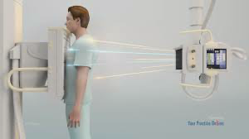

X-rays
X-rays
General Principles:
Transmission-based technique
X-rays pass through patient and detected by film or detector
Contrast arises from differential attenuation of X-rays in body
Planar radiography, image is a 2-D projection of the present tissues between x-ray source and detector

Slide 15
X-rays
X-rays
X-ray Tube:
Electrons accelerated in an electric
field (15-150 kV) and strike tungsten anode
Thermionic emission: Electrons produced by heating a filament (cathode) to ~2200°C
X-Ray Tube Current and Output
• Current: Flow of electrons between anode and cathode
• Tube current typically 50-400 mA
• Tube output (power) = tube current x applied voltage
Efficiency of X-Ray Production
Efficiency = Radiated P. / Incident P.
= 0.9 x 10⁻⁹ ZV
Only 0.01% for Tungsten
Electron interacting in tungsten
target produces x-rays, that pass
through exit window and filter

Slide 16
X-rays
X-rays
Digital Radiography Detectors:
https://www.youtube.com/watch?v=hTz_rGP4v9Y
Large-area flat-panel detectors
Amorphous silicon array layer (light detection and readout)
CsI(Tl) scintillator deposited on top (x-ray conversion)

Slide 17
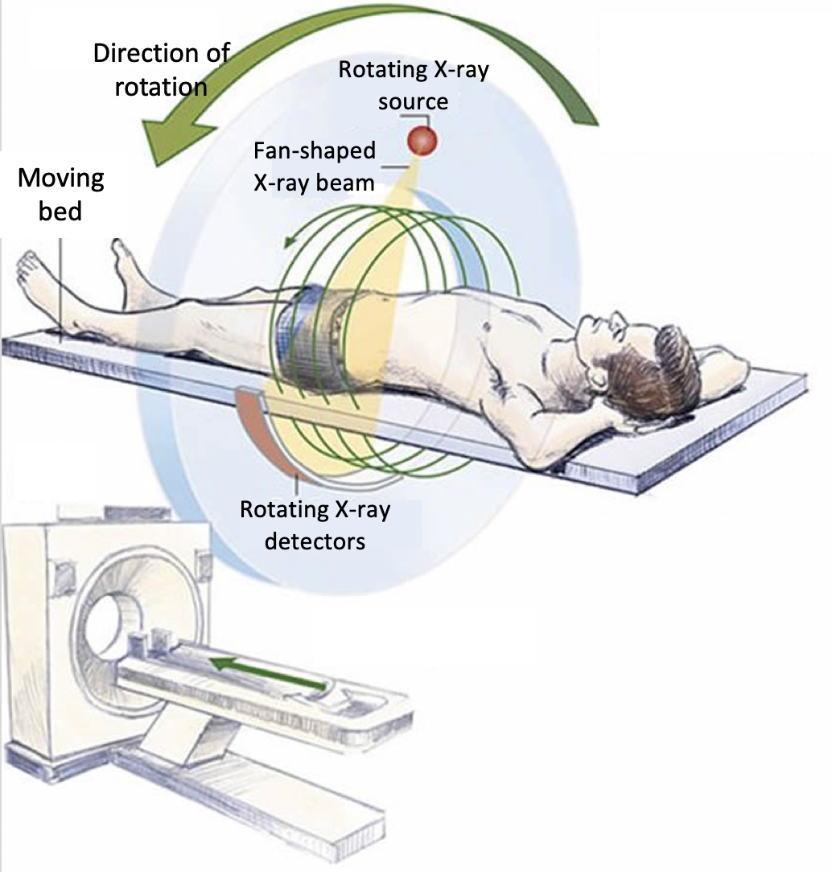
CT: Refreshment
CT
Computed Tomography (CT) is a type of medical imaging that uses X-ray techniques to create detailed images of the distribution of structures inside the body.
→ Anatomic information
Typical X-ray CT Scanner uses Multiple Detector Array
Efficient use of x-ray by acquiring multiple slices at once
https://www.youtube.com/watch?v=K4A7M1GaNGQ

Slide 18
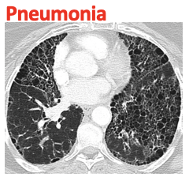
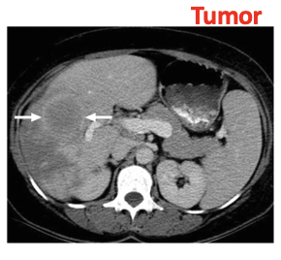
CT: Refreshment
CT
CT
Bones
Why CT is done?
Diagnose muscle and bone conditions:
  → Bone tumors and fractures
Show tumor, infection or blood clot
Guide procedures:
  → Surgery, biopsy and radiation therapy
Follow-up of diseases and conditions:
  Cancer, heart disease
  Lung nodules or liver masses
Treatment assessment
Detection of injuries and bleeding inside the body that can happen after trauma
Guiding biopsy needle
Follow-up

Slide 19
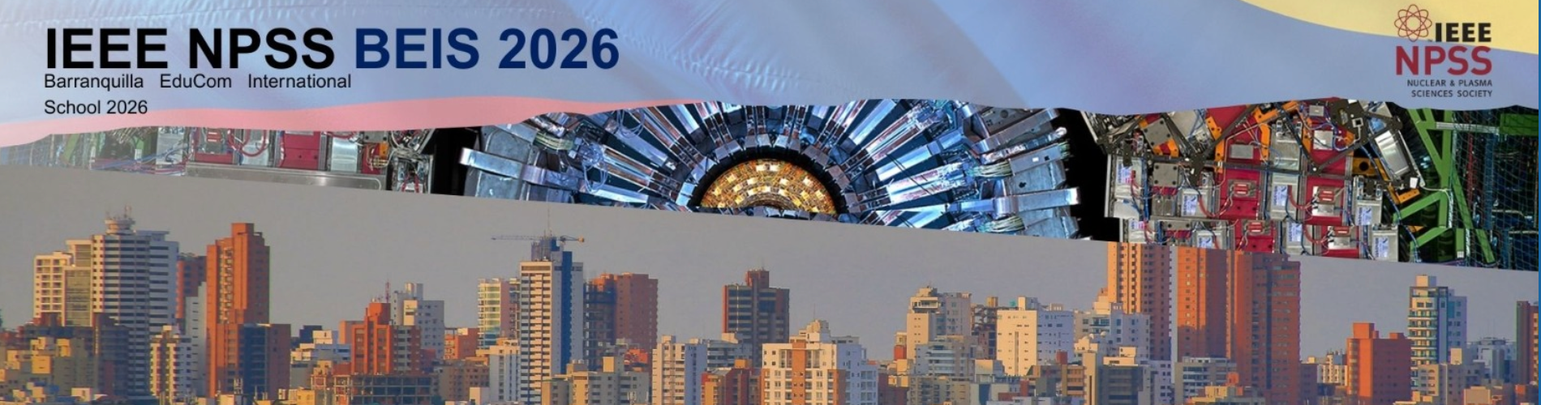
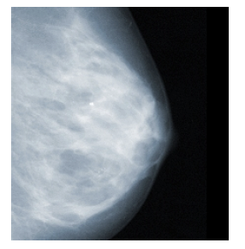
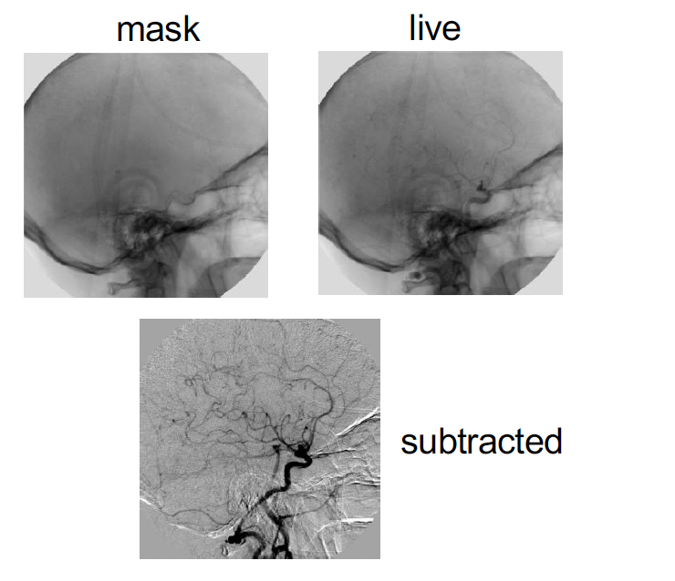
X-rays
Clinical application of X-rays
Clinical applications of X-rays:
Clinical Applications of X-rays:
Dental x-rays
Mammography
Lung disorders and diseases
Orthopedics
Sports injuries and accidents
Angiography: Vascular disease
Fluoroscopy: Image-guided interventions

Slide 20

CT: Refreshment
CT refreshment
Advantages
Disadvantages
Better detail compared with ultrasonography
Relatively quick compared with MRI
Most body systems can be scanned, eg, brain to leg.
Requires breath holding
Artefact is common - eg, metal clips.
Brain CT can be affected by bone nearby
Radiation exposure
  *Consensus: exposure in adults are small and less of a risk than withholding CT if it is required for diagnostic purposes
In children, it is preferable using modalities which don’t involve exposure to radiation

Slide 21
Outline
Principles of Medical Imaging
X-rays & CT
Anatomical Imaging
Molecular Imaging
Remarks
1
2
3
4
5

Slide 22
Magnetic Resonance
MRI
Magnetic Resonance Imaging, is a technique used to obtain images of the anatomy and in some cases of the physiological processes occurring in the body.
MRI operation principle → based on using powerful magnets to polarize and excite the Hydrogen nuclei of water molecules present in the human tissue.
MRI scanners use three magnetic fields:
Static field (B₀)
Gradient field
Radio-frequency field (B₁)
Basic Information
• 1 liter water ~ 3x10²⁶ protons
• Human body → 70% is water
• 1 Tesla = 10.000 Gauss
• MRI magnet strengths, 0.2 T up to 11 T
Earths magnetic field: 50 μT

Slide 23
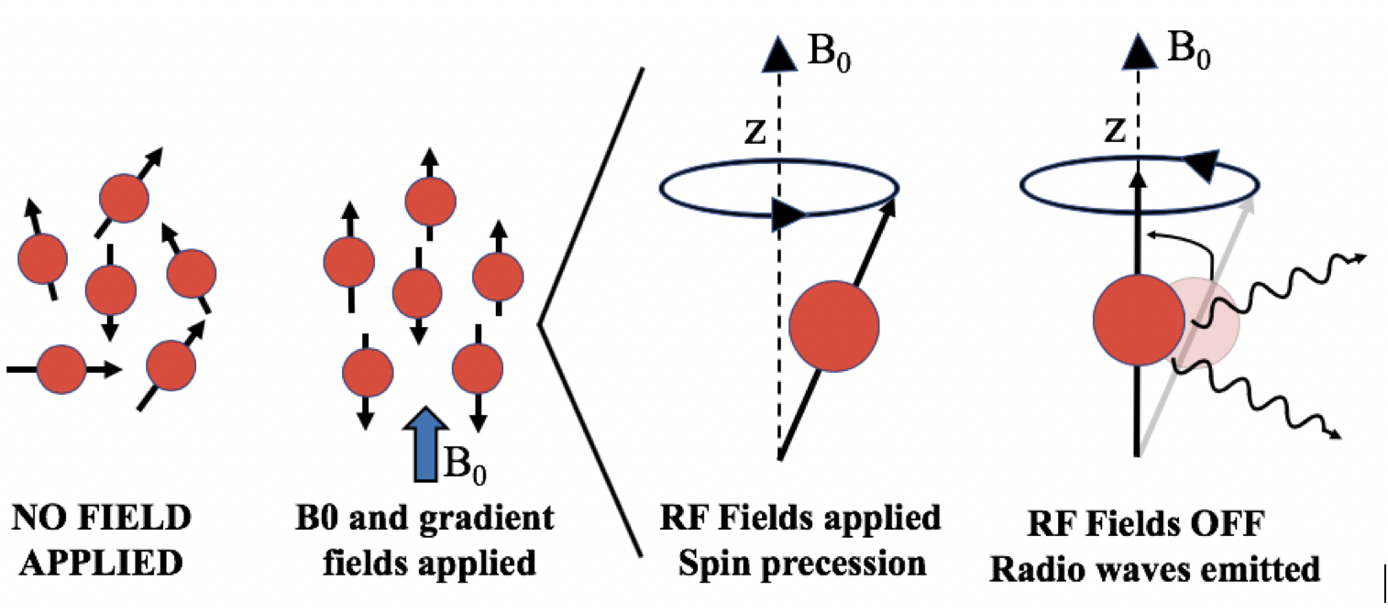
Magnetic Resonance
MRI
Anatomic Imaging: MRI
MRI operation
A strong static field (main field, B₀) polarizes the Hydrogen nuclei. B₀ is constant thus all the Hydrogen nuclei have the same resonance frequency. The emitted signals do not provide any spatial information.
For spatial information, gradient fields are applied producing different spatial encodings on the nuclear spins.
Radio frequency antennas (RF coils) emit a radio frequency pulse at the resonant frequency of the hydrogen nucleus. The RF pulse is absorbed by protons and their direction with respect to B₀ field changes. When the RF pulse is turned off, the direction of the protons comes back to its original position emitting radio-waves.
These radio-waves are detected by the receiver coil (most scanners have transmitter-receiver coils, TR coil) and are used to visualize the information into an image.

Slide 24
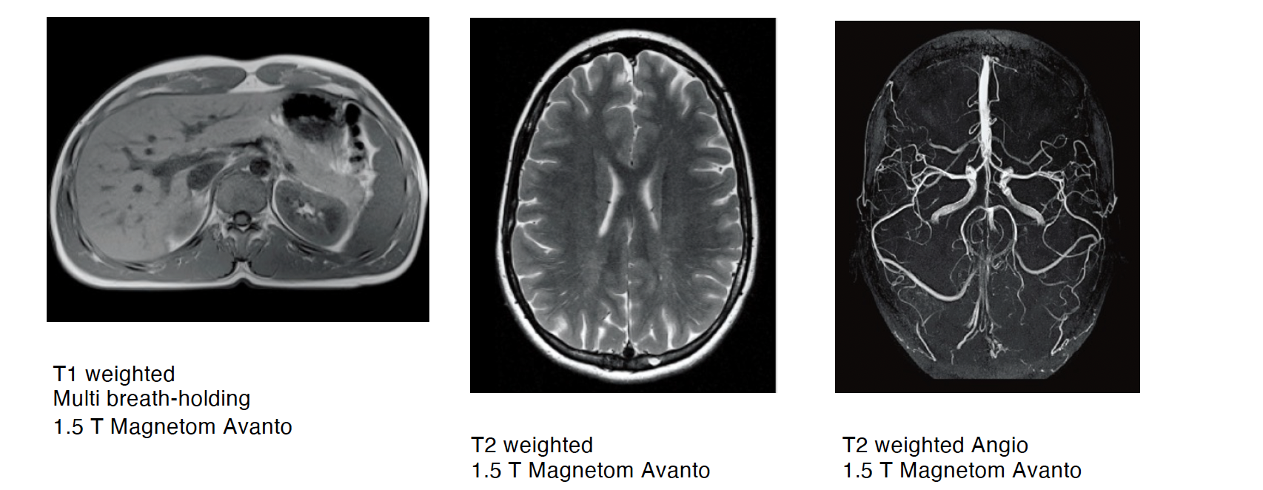
Magnetic Resonance
MRI
Anatomic Imaging: MRI
MRI applications
https://www.youtube.com/watch?v=nFkBhUYynUw
MRI creates detailed images of nearly every structure and organ inside the body. Is used for visualizing:
Anomalies of the brain and spinal cord
Tumors, cysts, and other anomalies in various parts of the body
Breast cancer screening
Study Brain disorders
Injuries or abnormalities of the joints, the back and knee
Certain types of heart problems
Diseases of the liver and other abdominal organ
Evaluation of pelvic pain in women
Suspected uterine anomalies in women

Slide 25
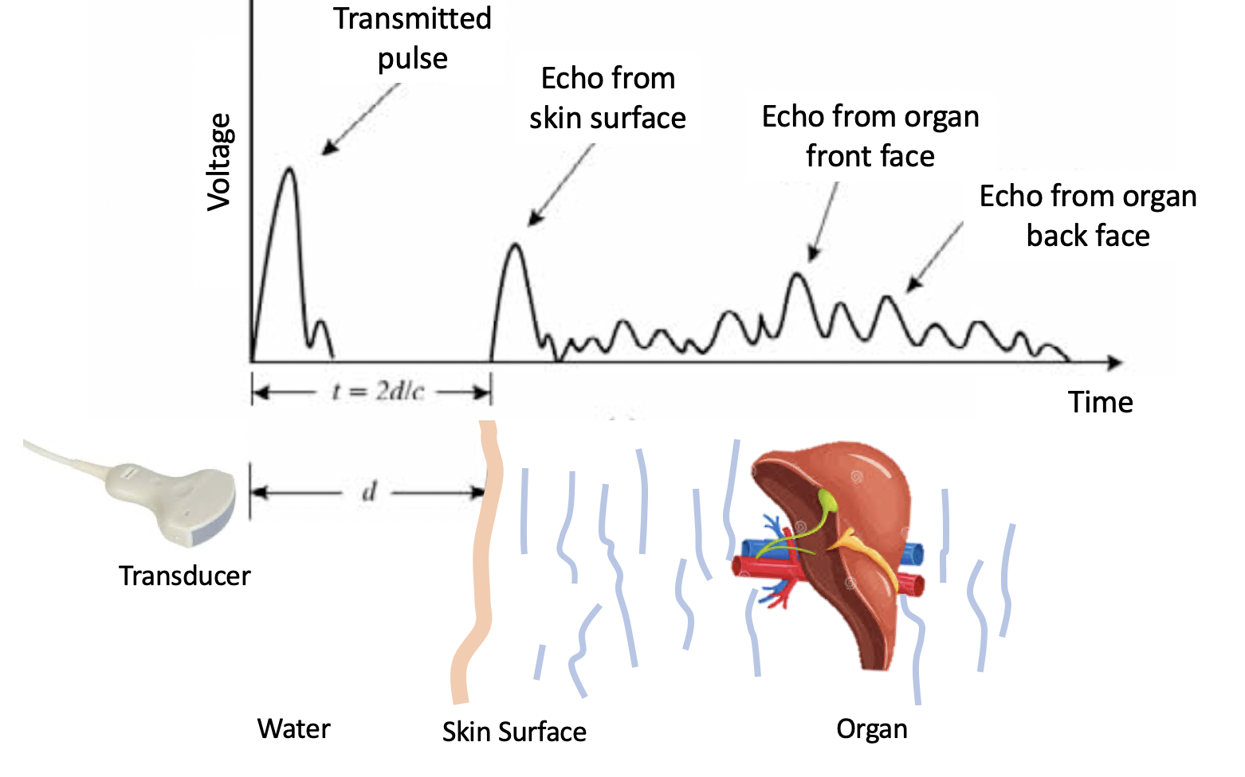
Ultrasounds
US
Anatomic Imaging: US
Ultrasound Basics
• Produces images via backscattering of mechanical energy from boundaries between tissues
→ Frequency: typically, 1 to 10 MHz
• Wavelength = 0.3 mm in water at 5 MHz
Lower frequencies for deep-lying structures
Higher frequencies for superficial structures

Slide 26
Ultrasounds
US
Anatomic Imaging: US
Ultrasound Transducer
Uses Piezoelectric Crystal → Lead Zirconate Tungstate (PZT)
• Two faces of crystal coated with a thin layer of silver as electrodes
• Usually, a disk which is flat or concave (for focused transducer)
Advantages
Portable
Real-time
No ionizing radiation
Fetal imaging
Inexpensive
https://www.youtube.com/watch?v=I1Bdp2tMFsY

Slide 27
Ultrasounds
US
Anatomic Imaging: US
Application of Ultrasounds
Obstetrics and gynecology
  Fetal health
Cardiac function
Intra-abdominal imaging
  Liver, kidneys, spleen and gallbladder
Musculoskeletal applications
Compromised flow in veins and arteries
Tracking of needle biopsies
Color Doppler Imaging

Slide 28
Outline
Principles of Medical Imaging
X-rays & CT
Anatomical Imaging
Molecular Imaging
Remarks
1
2
3
4
5

Slide 29

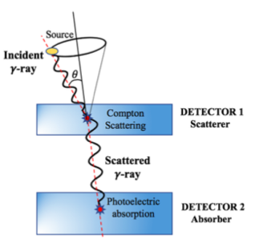
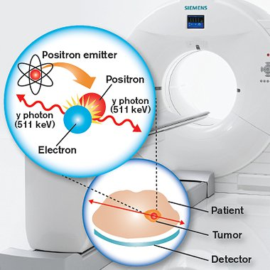
Molecular Imaging
Molecular Imaging
Nuclear Medicine
Functional Imaging using radioactive sources
PET
Positron Emission Tomography
Positron emitters: ¹⁸F, ⁶⁸G…
Does not use collimators
Gamma Camera
Compton Camera
SPECT
Single photon emitters: ⁹⁹Tc
Make use of mechanical or electronic collimators
Notes:
Nuclear Medicine: Uses radioactive substances for diagnostic and therapeutic purposes allowing to visualize physiological and biochemical processes of the human body in vivo.
Maxima cobertura angular con emisión isotrópica
COMPLEMENTARY

Slide 30
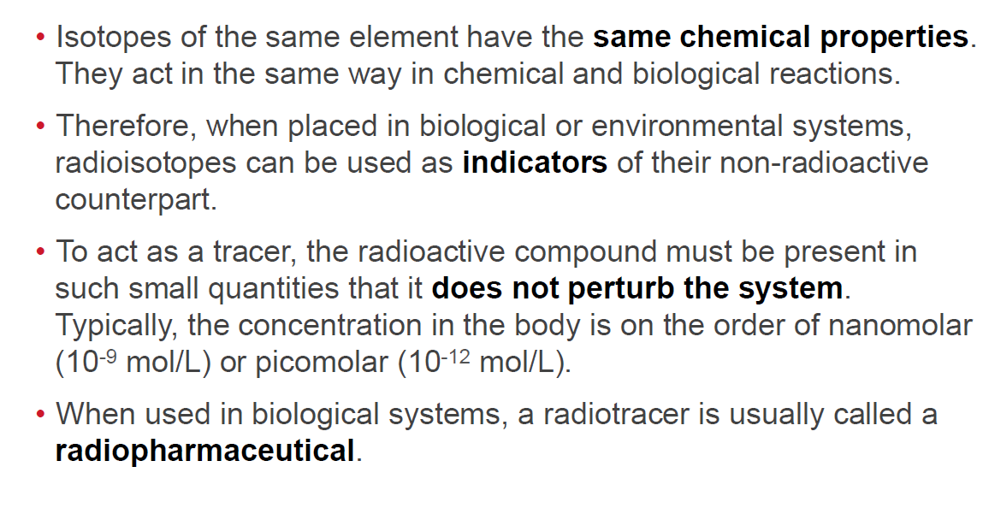
Tracer principle
Molecular Imaging
Production methods:
Nuclear Reactor
  Fission fragments
  Neutron capture
Accelerator
  Cyclotron
Generator
  Long-lived parent decaying into medically useful daughter nuclide
https://www.youtube.com/watch?v=GHLBcCv4rqk
© 2016 Bruker Corporation
26-July-16

Slide 31
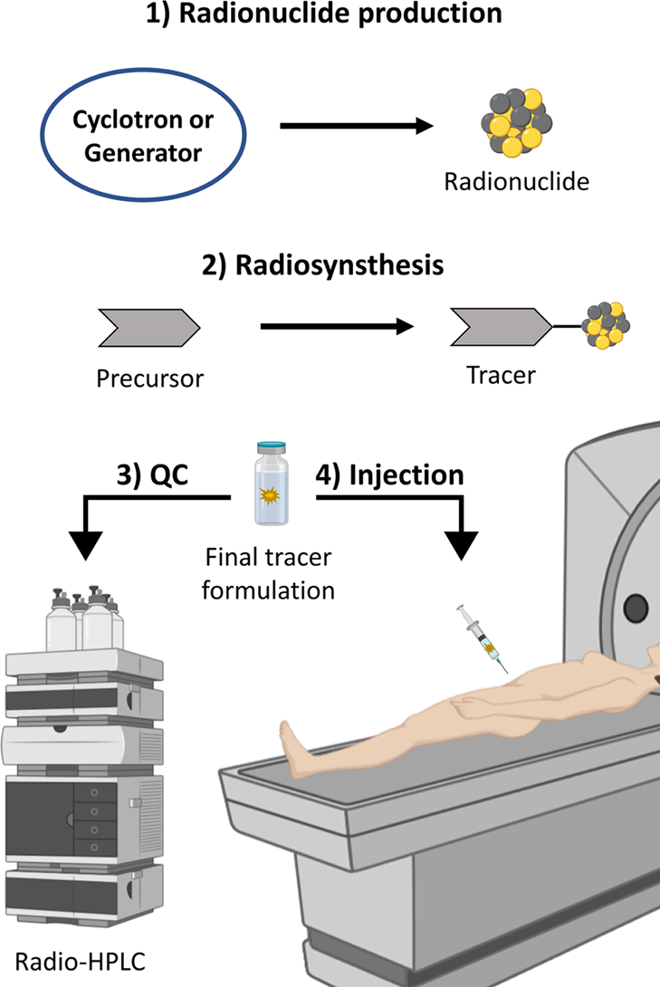
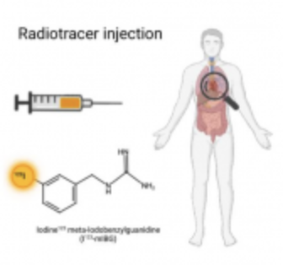
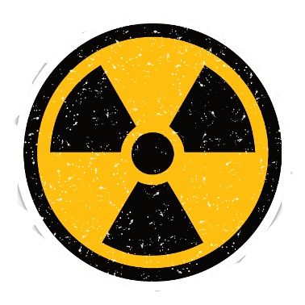
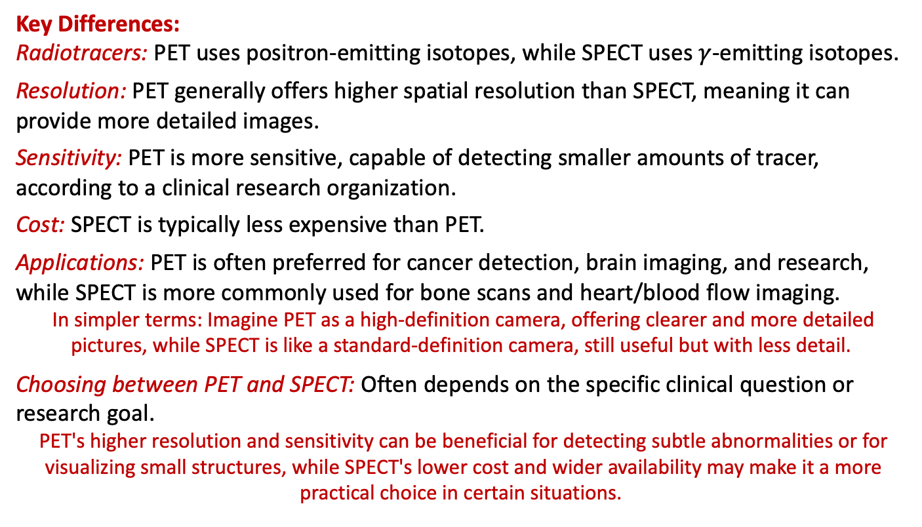
PET or SPECT
SPECT and PET are both types of nuclear medicine imaging techniques that use radioactive tracers to visualize organs and tissues.
While both are used to assess organ function and detect disease, they differ in their technical aspects, resolution, sensitivity, and cost.
Key Differences:
Radiotracers: PET uses positron-emitting isotopes, while SPECT uses $γ$-emitting isotopes.
Resolution: PET generally offers higher spatial resolution than SPECT, meaning it can provide more detailed images.
Sensitivity: PET is more sensitive, capable of detecting smaller amounts of tracer, according to a clinical research organization.
Cost: SPECT is typically less expensive than PET.
Applications: PET is often preferred for cancer detection, brain imaging, and research, while SPECT is more commonly used for bone scans and heart/blood flow imaging.
In simpler terms: Imagine PET as a high-definition camera, offering clearer and more detailed pictures, while SPECT is like a standard-definition camera, still useful but with less detail.
Choosing between PET and SPECT: Often depends on the specific clinical question or research goal.
PET's higher resolution and sensitivity can be beneficial for detecting subtle abnormalities or for visualizing small structures, while SPECT's lower cost and wider availability may make it a more practical choice in certain situations.

Slide 32
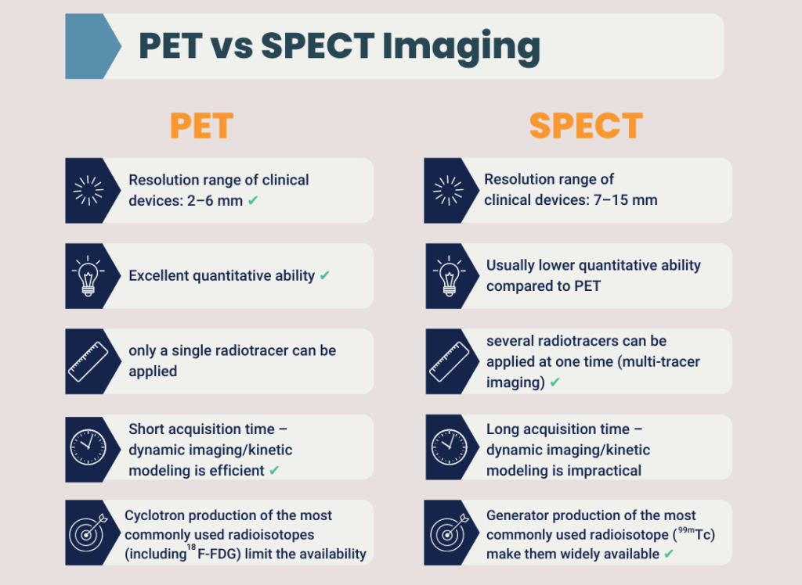

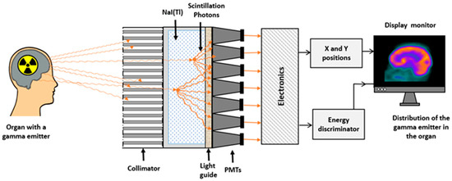
PET or SPECT?
PET or SPECT
PET or SPECT?
32

Slide 33
Remarks
PET or SPECT
Imaging Technique | Spatial Resolution | Sensitivity | Depth
PET | ≤1-2 mm | 10⁻¹¹ – 10⁻¹² mole/L | No limit, quantitative
SPECT | 0.5-2 mm | 10⁻¹⁰ – 10⁻¹¹ mole/L | No limit, semi quantitative
Optical | 1-3 mm | 10⁻⁹ – 10⁻¹² mole/L | Less 1cm luminescence Less 3cm fluorescence
MRI | 25-100 μm | 10⁻³ – 10⁻⁵ mole/L | No limit
CT | 1-200 μm | n/a | No limit measuring densities
Massoud, Genes & Development, 17:545-580, 2003.
Massoud, Genes & Development, 17:545-580, 2003.
Innovation with Integrity
21-July-16

Slide 34
SPECT basics
Single Photon Emission Tomography (SPECT) consists of the acquisition of Multiple Slices Simultaneously to generate a 3D image.
Based on multiple GCs in a rotation stage
Retrieving the tomographic 3-D information about imaging agent’s distribution
Typical angular step varies from 3º to 6º, covering all 360º
Allows for accurate functional 3-D information
Best known applications in brain imaging:
  blood perfusion to study dementia, epilepsy or traumatic brain injury (TBI)

Slide 35
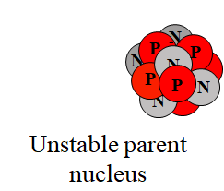

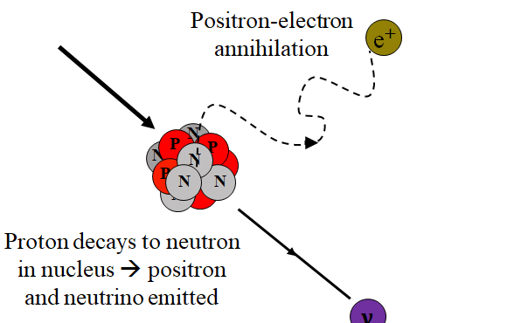
PET basics
Positron-electron annihilation
Positrons have very short lifetime, annihilate with electrons and produce two 511 keV photons that are detected.
Common isotopes for positron imaging: ¹⁸F(~H), ¹³N, ¹⁵O, ¹¹C.
𝛾
Positron-electron annihilation
Unstable parent nucleus
𝛾
Two anti-parallel 511 keV
Photons produced
Proton decays to neutron in nucleus → positron and neutrino emitted
$$ν$$
Talk: PET Detector Developments
gkjdsh

Slide 36

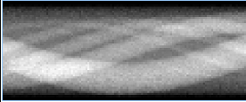
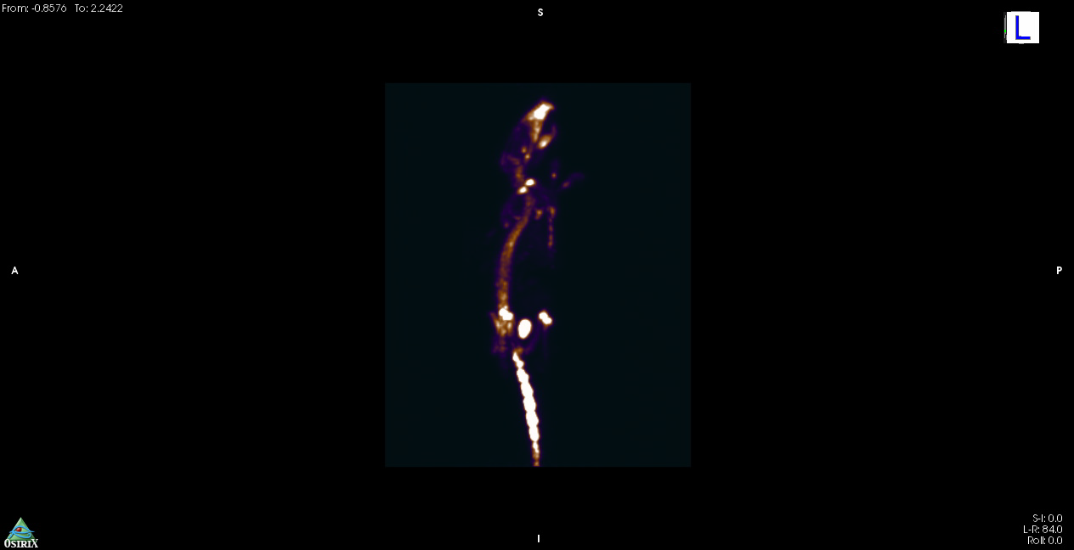
PET basics
LOR (“line of response”)
DET 1
DET 2
TC Window ~ few ns
Pulse Processing
Pulse Processing
AND
ev1
ev2
ev3
+1
t
From List-mode data or Sinograms, and “After complex software manipulation of the signal, a visual representation is reconstructed”.
Q.C. Black et al., “Radiotherapy target,” I.J. Rad. Oncol. Biol. Phys., 2004.
36
Notes:
Ventana de coincidencias < 5-10 ns
Sinograma: forma de alamcenaje más estandarizada.

Slide 37
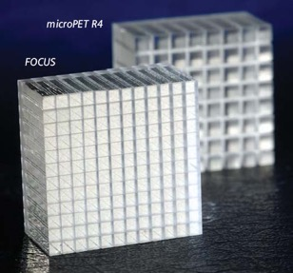
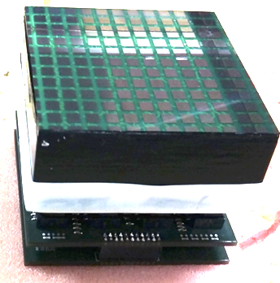
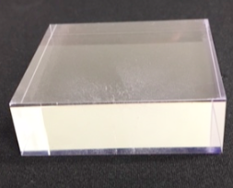
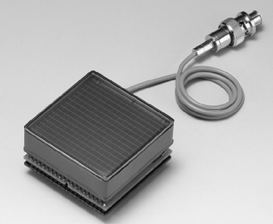
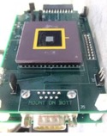
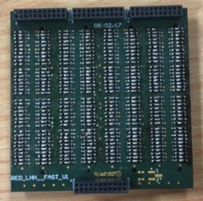
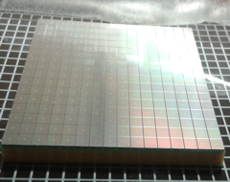
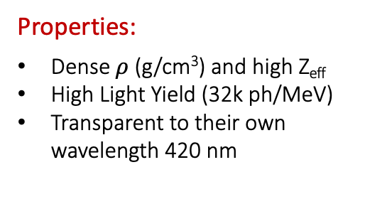
PET detector
Scintillator block
Properties:
Dense $ρ$ (g/cm³) and high Z_{eff}
High Light Yield (32k ph/MeV)
Transparent to their own wavelength 420 nm
PET detector block
Monolithic
Pixellated
Photosensor
Readout
Analog
PMTs
Solid State
SiPMs
ASIC
Notes:
Propiedades de los cristales:
-Generar muchos gammas, de menos energía
-ser transparentes a su propia longitud de onda
-high LY
Freno los gamma de 511 leV → Genero una señal medible en el fotosensor transformande la luz visible en un impulse electrico. Ganacia appr. 1000000 → acondiciono la señal (signal shaping)
PMT
GENERATING!!
MOST USED IN MEDICAL IMAGING

Slide 38
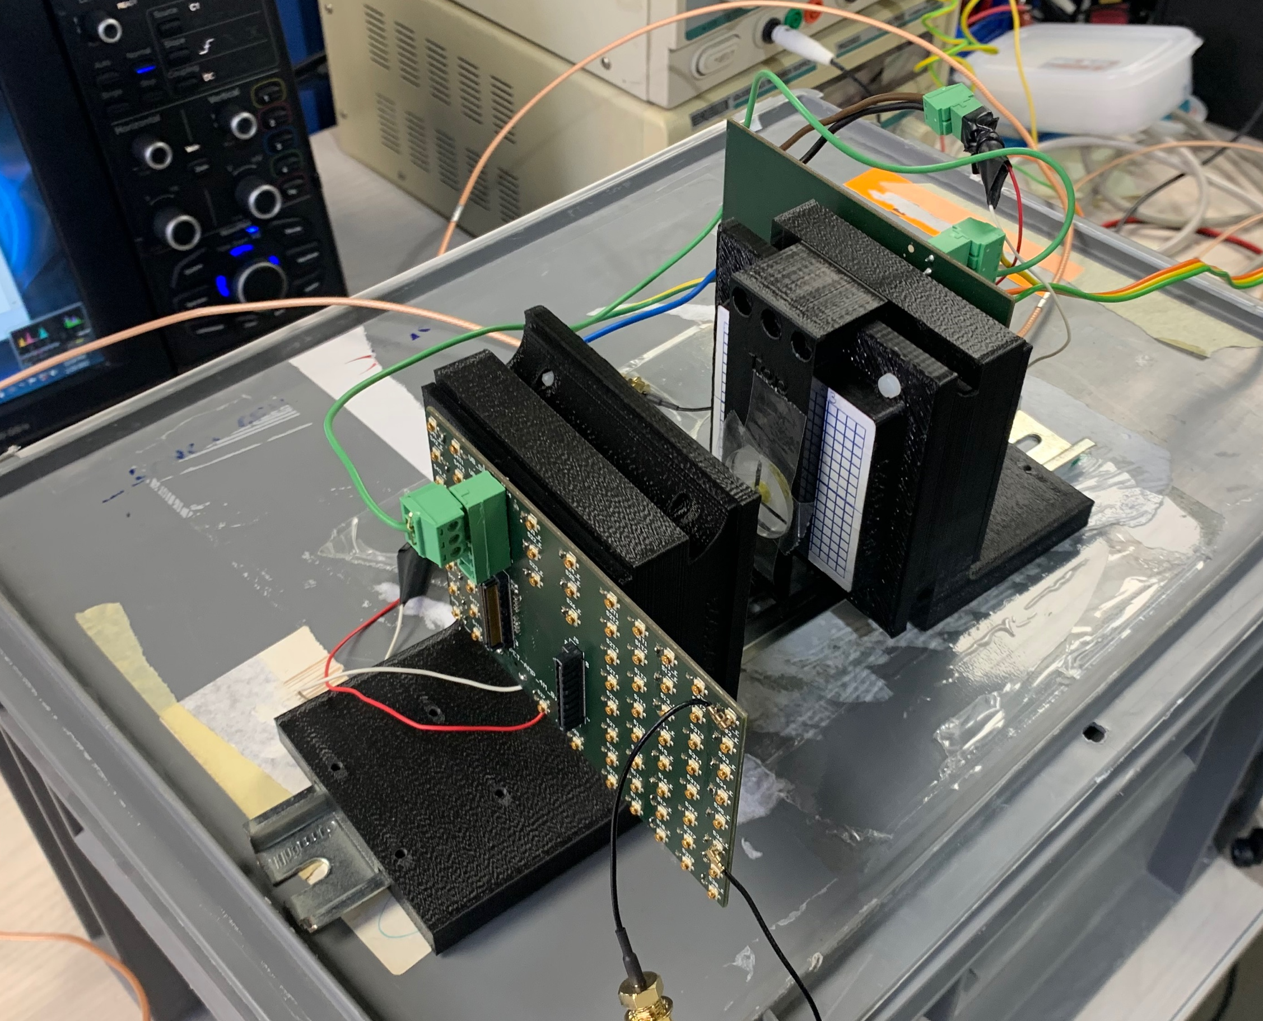
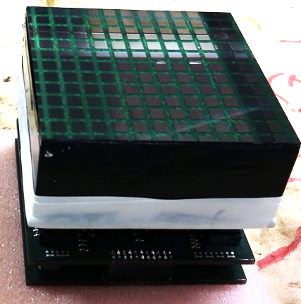
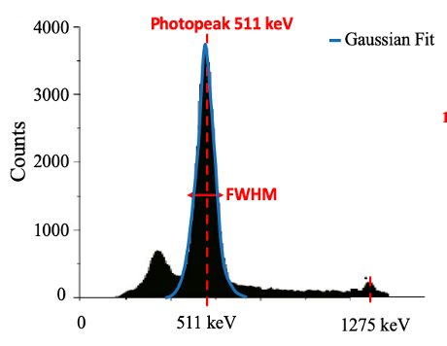
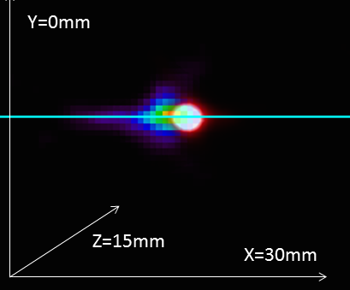
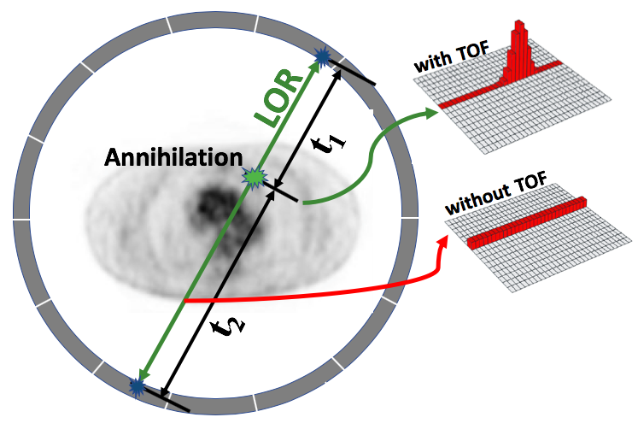
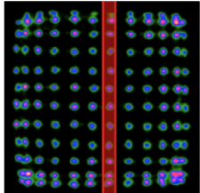
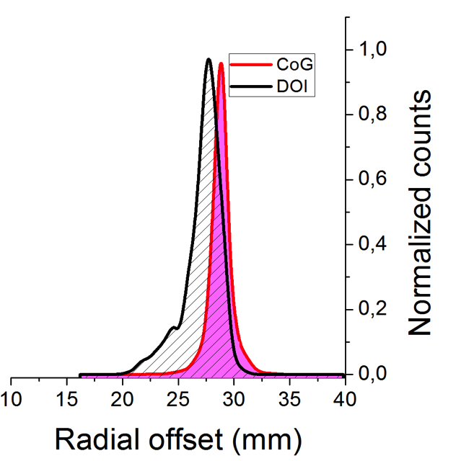
PET detector
Detector level evaluation
$γ$-ray 511 keV
²²Na source
Acquisition of coincidence data to study the Influence of bias voltages, threshold levels, temperature drifts and other factors
are also evaluated
Detectors
Energy Resolution
CTR Resolution
Spatial Resolution
DOI Resolution
∆E/E x 100% , ∆E is the FWHM and E the centroid of the 511 keV photopeak
The coincident photons arrival time to the detector is recorded and histogram.
Average FWHM and FWTM of the the light distribution profiles obtained using radioactive sources
Side irradiation experiments at known depths. Average FWHM of the profiles
Wrong LOR
Corrected LOR
38

Slide 39
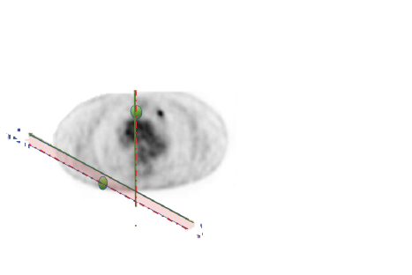
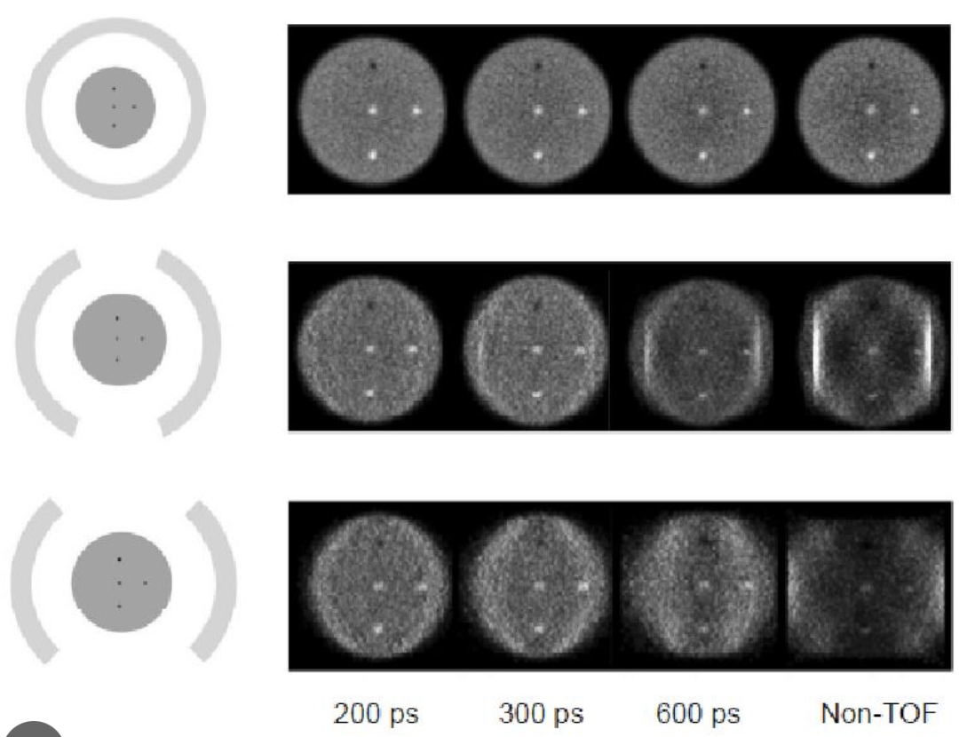
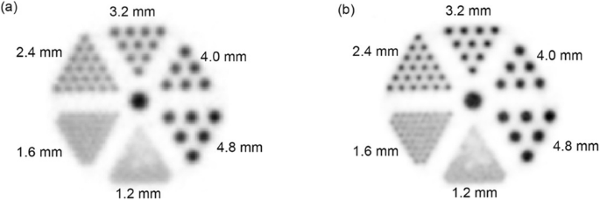
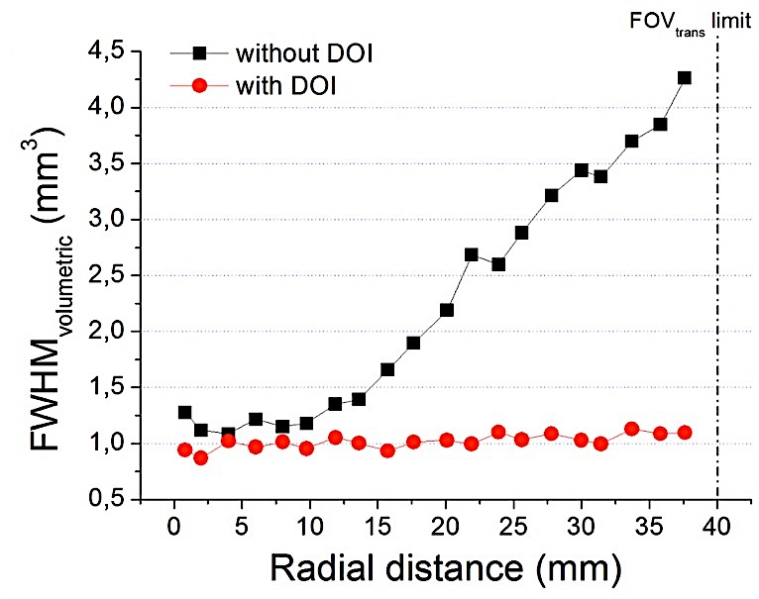

PET: DOI & TOF
PET: DOI & TOF
DOI
TOF
Wrong LOR
Corrected LOR
16
12
8
4
0
FOV Diameter
DOI
No DOI
SNR gain
!!
Non-DOI
DOI
- 100. 300 500 700
CTR (ps)
39

Slide 40

Scaling-up
PET: scaling-up
…to the system assembly
and validation
$γ$-ray 511 keV
Factors to consider for the scaling-up :
Scintillator material and surface treatment
Photodetector and arrangement
Number of elements (per module)
Number of modules
Their arrangement to minimize gaps
  High packing fraction and sensitivity
  Scintillator-photodetector coupling
Electronic readout
  Trade-off between performance,
  power consumption, and number
  of output signals
From the
detector level…

Slide 41






PET: Requirements
PET: state-of-the-art
WB-PET
TB-PET

Slide 42

PET: Axial-coverage
PET: sensitivity limitation
PET is the most sensitive (at the picomolar level) non-invasive molecular imaging system. However, PET studies are still limited by statistics (long scanning times), dose delivered to the patient (and clinicians), or both.

Slide 43

PET: State-of-the-art
PET: axial coverage
*However, its high price and the requirement for large hospital footprints is a challenge for its clinical deployment as well as research use.
SiPM
S. Vandenberghe, EJNMMI 7, 2020
Notes:
Pixelated detectors:
Coincidence data is acquired, and positioning algorithms are applied to generate 2D Flood maps.
Pixel profiles are extracted, and Gaussian fitting is applied.
Monolithic detectors:
Same procedure but, a collimator is used to generate the flood maps and extract the sources profiles.
Pixelated detectors: discrete DOI information (usually)
Monolithic detectors: continuous DOI information

Slide 44
Clinical PET/CT
Clinical PET/CT
CT → uses x-rays, and in some cases a contrast material, to produce images of the inside of the body. Provides excellent anatomic information
PET → based on the coincidence detection of annihilation photons. measures body functions, such as metabolism. Provides functional information
PET/CT → help pinpoint abnormal metabolic activity and may provide more accurate diagnoses than the two scans performed separately

Slide 45

Remarks
Clinical PET/MRI
Beyond instrumentation challenges
To further extend the clinical use of PET, it is important to consider that:
→ PET provides highly quantitative images for the study of biochemical and functional abnormalities but, the absence of background anatomical information makes it difficult to interpret the radio-tracers distribution, leading sometimes to misinterpretations of the images.
Simultaneous PET/MRI and PET/CT imaging is an
interesting line of research that helps broadening
the scope of PET imaging
Notes:
Pixelated detectors:
Coincidence data is acquired, and positioning algorithms are applied to generate 2D Flood maps.
Pixel profiles are extracted, and Gaussian fitting is applied.
Monolithic detectors:
Same procedure but, a collimator is used to generate the flood maps and extract the sources profiles.
Pixelated detectors: discrete DOI information (usually)
Monolithic detectors: continuous DOI information

Slide 46
Outline
Principles of Medical Imaging
X-rays & CT
Anatomical Imaging
Molecular Imaging
Remarks
1
2
3
4
5

Slide 47





PET: take-home message
Advancements in nuclear imaging:
High performance PET systems →
  Novel Scintillators; Enhanced Photosensors; Fast Electronics; More Efficient Algorithms (AI)
  Higher sensitivity x 2-4 → (Large coverage PET (TB) or/and TOF)
  Homogeneous spatial resolution < 2mm in the entire FOV → Accurate 3D positioning (DOI)
  Better SNR → Medical breakthroughs
Lower statistics required → Shorter scan times / Dose reduction / A combination of both
Follow-up studies and better assessment of treatments
Dynamic studies
New categories of patients (pediatric-PET)
High dynamic range
3-5 times longer acquisitions than the half-life of the isotopes
¹¹C
Screening
Low dose
WB- and TB-PET →
  Larger Axial Coverage; Simultaneous Multi-organ Studies; Intratumor Homogeneity Studies
  → Improved diagnostic quality

Slide 48
Remarks
Remarks
Imaging Technique | Spatial Resolution | Sensitivity | Depth
PET | ≤1-2 mm | 10⁻¹¹ – 10⁻¹² mole/L | No limit, quantitative
SPECT | 0.5-2 mm | 10⁻¹⁰ – 10⁻¹¹ mole/L | No limit, semi quantitative
Optical | 1-3 mm | 10⁻⁹ – 10⁻¹² mole/L | Less 1cm luminescence Less 3cm fluorescence
MRI | 25-100 μm | 10⁻³ – 10⁻⁵ mole/L | No limit
CT | 1-200 μm | n/a | No limit measuring densities
Massoud, Genes & Development, 17:545-580, 2003.
Massoud, Genes & Development, 17:545-580, 2003.
Innovation with Integrity
21-July-16

Slide 49








Remarks
Remarks
Trimodal Imaging → PET-FUS-MRI
49

Slide 50

?
Questions?
Open for Discussion
Andrea Gonzalez-Montoro, phD
andrea.gm@i3m.upv.es · Instituto de Instrumentación para Imagen Molecular (i3M), CSIC-UPV
BEIS 2026 – Barranquilla, Colombia
Notes:
10

