Slide 1

Electroweak baryon number violation in the lab?
Arttu Rajantie
Imperial College London and University of Oxford
Strong and Electroweak Matter 2026, Helsinki, Finland, 20 January 2026

Slide 2
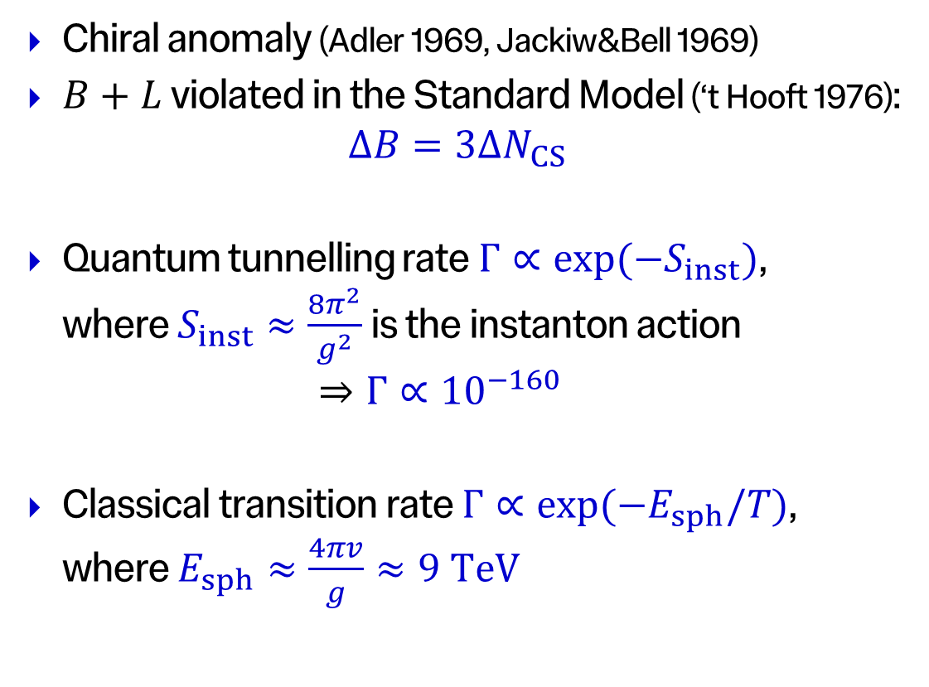
Baryon Number Violation in the Standard Model
Chiral anomaly (Adler 1969, Jackiw&Bell 1969)
$B+L$ violated in the Standard Model (‘t Hooft 1976):
$ΔB=3ΔN_{CS}$
Quantum tunnelling rate $Γ∝\exp{(−S_{inst})}$,
where $S_{inst}≈\frac{8π^{2}}{g^{2}}$is the instanton action
$⇒Γ∝{10}^{−160}$
Classical transition rate $Γ∝\exp{(−E_{sph}/T)}$,
where $E_{sph}≈\frac{4πv}{g}≈9 TeV$
energy
sphaleron
3 x proton mass
instanton
Chern-Simons number

Slide 3
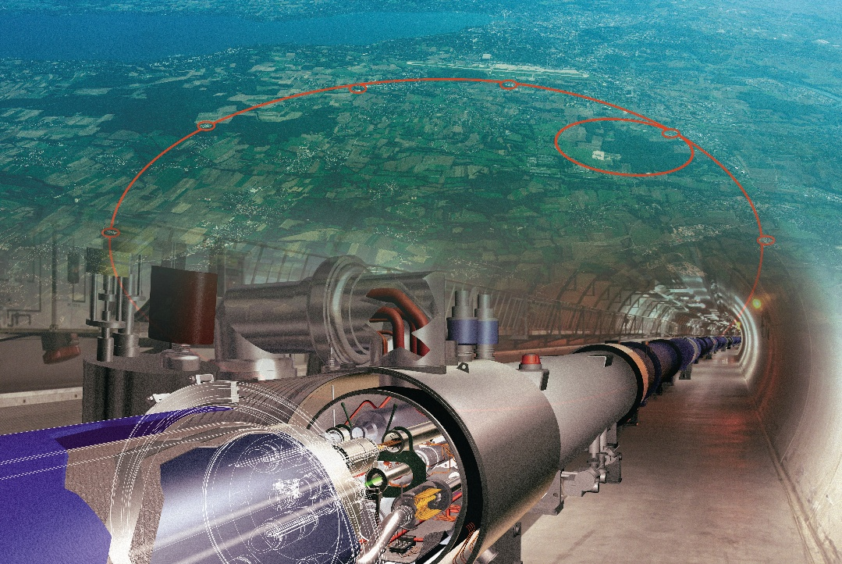
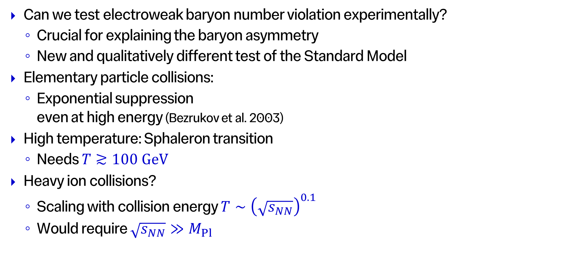
Experimental Test?
Can we test electroweak baryon number violation experimentally?
  Crucial for explaining the baryon asymmetry
  New and qualitatively different test of the Standard Model
Elementary particle collisions:
  Exponential suppression
  even at high energy (Bezrukov et al. 2003)
High temperature: Sphaleron transition
  Needs $T≳100 GeV$
Heavy ion collisions?
  Scaling with collision energy $T∼{\left(\sqrt{s_{NN}}\right)}^{0.1}$
  Would require $\sqrt{s_{NN}}≫M_{Pl}$

Slide 4
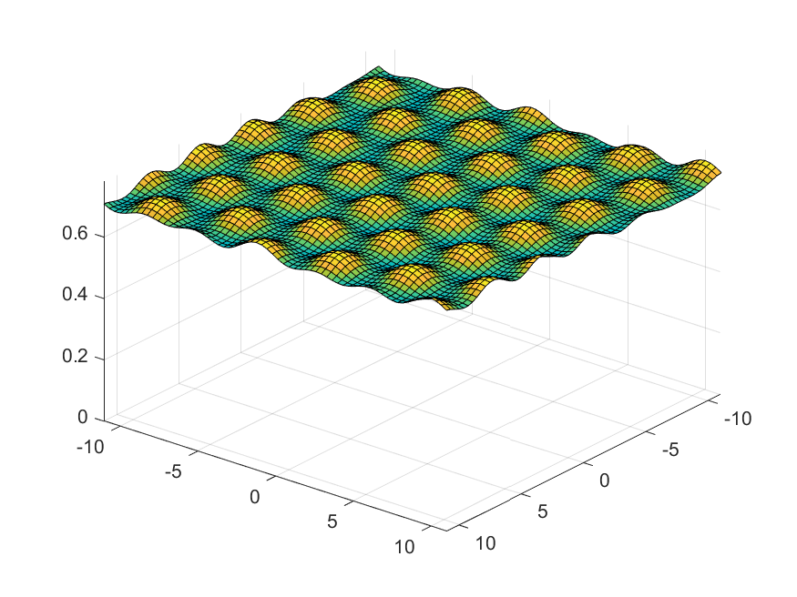


Electroweak Theory in a Magnetic Field
Sphaleron has a non-zero magnetic dipole moment (Klinkhamer 1990)
$⇒$ Magnetic field enhances the rate of baryon number violation
Electroweak vacuum changes in strong magnetic fields
(Ambjørn&Olesen 1988, 1989, 1990)
  $B>B_{crit}^{(1)}=\frac{m_{W}^{2}}{e}≈2.1×{10}^{4} GeV^{2}$:
  vortex lattice
  ${B>B}_{crit}^{(2)}=\frac{m_{H}^{2}}{e}≈5.2×{10}^{4} GeV^{2}$:
  $SU\left(2\right)×U(1)$symmetry restored
$$|φ|$$
(Ho&AR 2020)

Slide 5
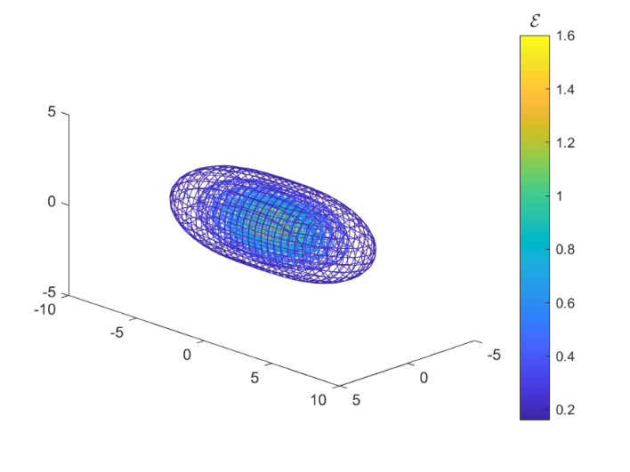
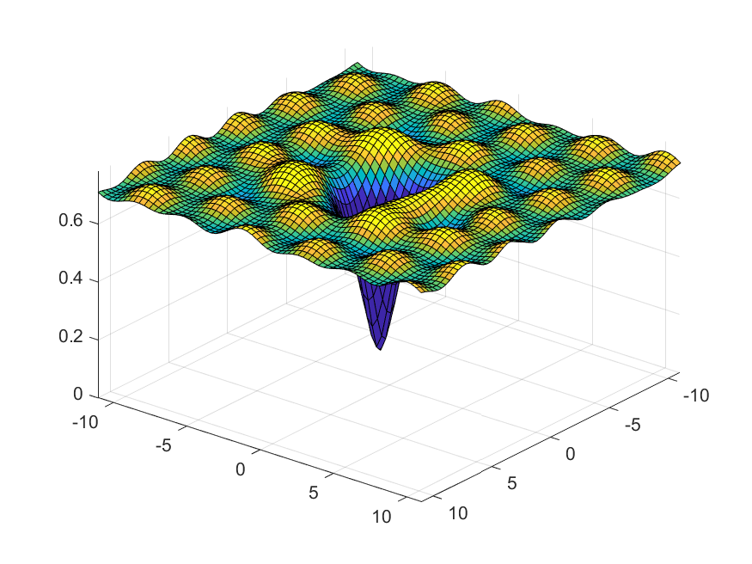
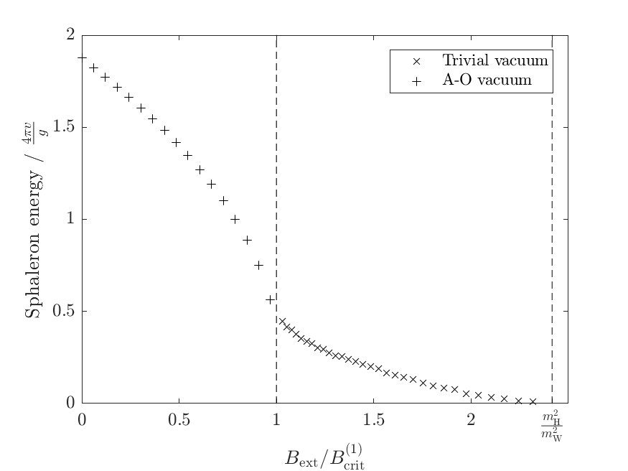
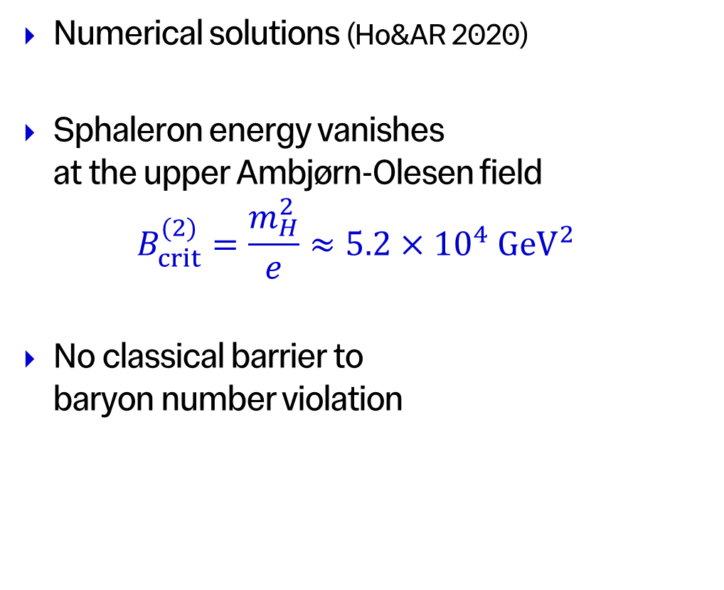
Sphaleron in a Magnetic Field
Numerical solutions (Ho&AR 2020)
Sphaleron energy vanishes
at the upper Ambjørn-Olesen field
$$B_{crit}^{(2)}=\frac{m_{H}^{2}}{e}≈5.2×{10}^{4} GeV^{2}$$
No classical barrier to
baryon number violation

Slide 6
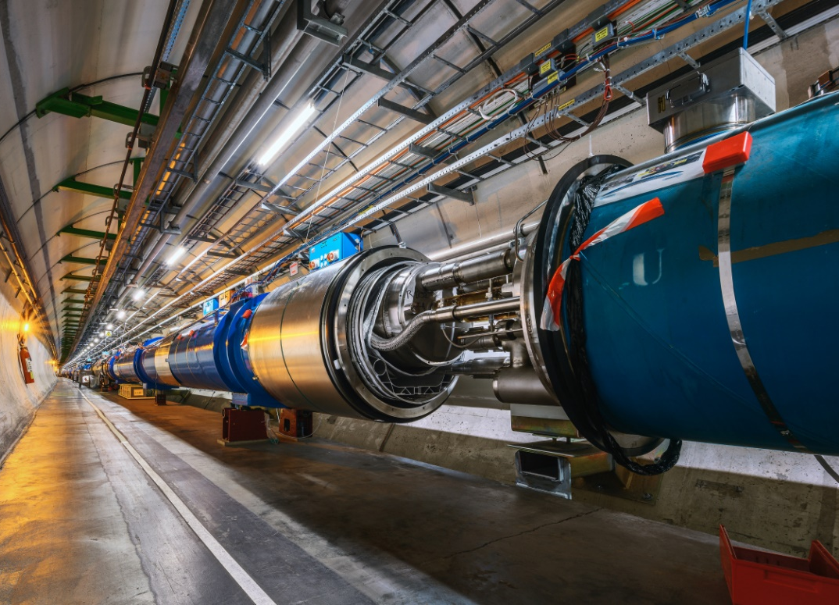

Magnetic Field Strengths
Baryon number violation needs
$$\left|\vec{B}\right|≳5.2×{10}^{4} GeV^{2}∼2.7×{10}^{20} T$$
LHC magnets $\left|\vec{B}\right| \sim 8.3 T∼1.6×{10}^{−15} GeV^{2}$

Slide 7
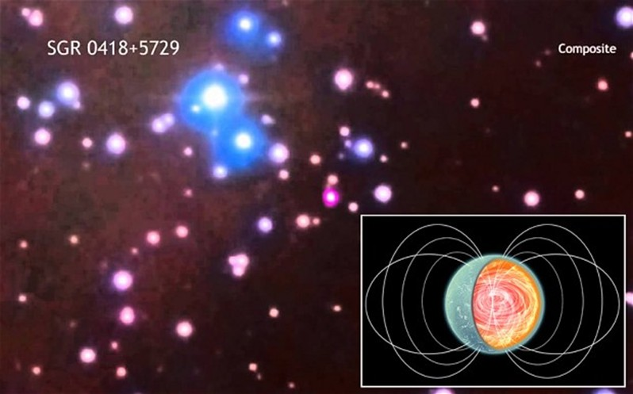
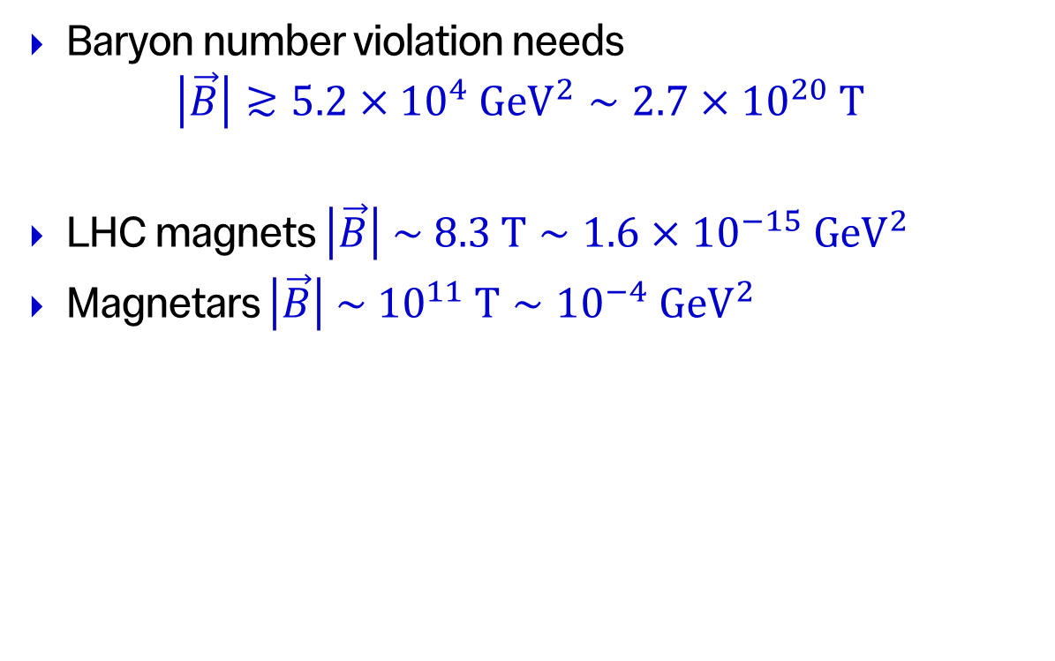
Magnetic Field Strengths
Baryon number violation needs
$$\left|\vec{B}\right|≳5.2×{10}^{4} GeV^{2}∼2.7×{10}^{20} T$$
LHC magnets $\left|\vec{B}\right| \sim 8.3 T∼1.6×{10}^{−15} GeV^{2}$
Magnetars $\left|\vec{B}\right| \sim {10}^{11} T∼{10}^{−4} GeV^{2}$

Slide 8
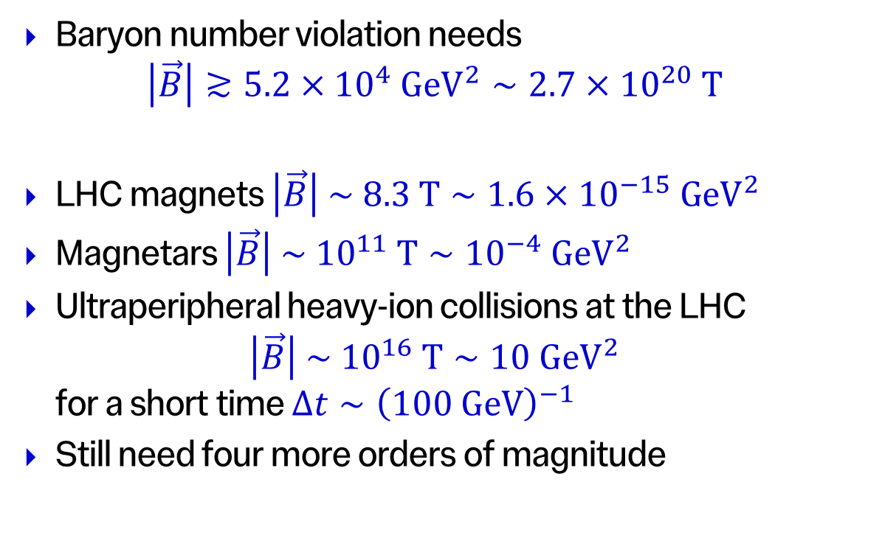
Magnetic Field Strengths
Baryon number violation needs
$$\left|\vec{B}\right|≳5.2×{10}^{4} GeV^{2}∼2.7×{10}^{20} T$$
LHC magnets $\left|\vec{B}\right| \sim 8.3 T∼1.6×{10}^{−15} GeV^{2}$
Magnetars $\left|\vec{B}\right| \sim {10}^{11} T∼{10}^{−4} GeV^{2}$
Ultraperipheral heavy-ion collisions at the LHC
$\left|\vec{B}\right| \sim {10}^{16} T∼10 GeV^{2}$
for a short time $Δt∼{\left(100 GeV\right)}^{−1}$
Still need four more orders of magnitude
(Gould,Ho&AR 2020)

Slide 9
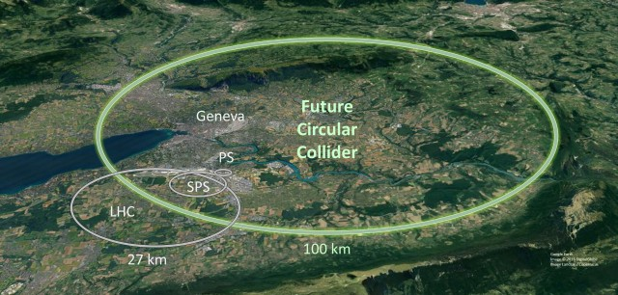

Future Prospects
Peak field strength $B≈\frac{Zeγ}{2πR^{2}}$ scales with collision energy
$B>B_{crit}^{(2)}≈5.2×{10}^{4} GeV^{2}$ needed for baryon number violation
requires $\sqrt{s_{NN}}≳35 PeV$
cf. FCC-hh : $\sqrt{s_{NN}}∼100 TeV$

Slide 10
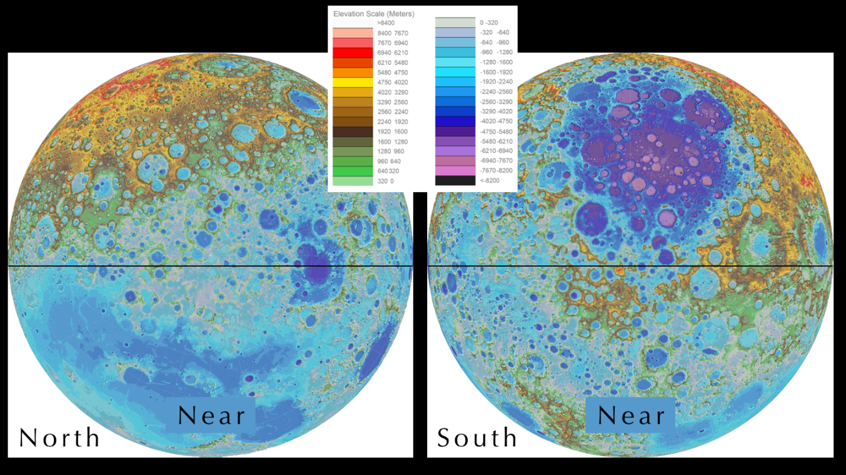
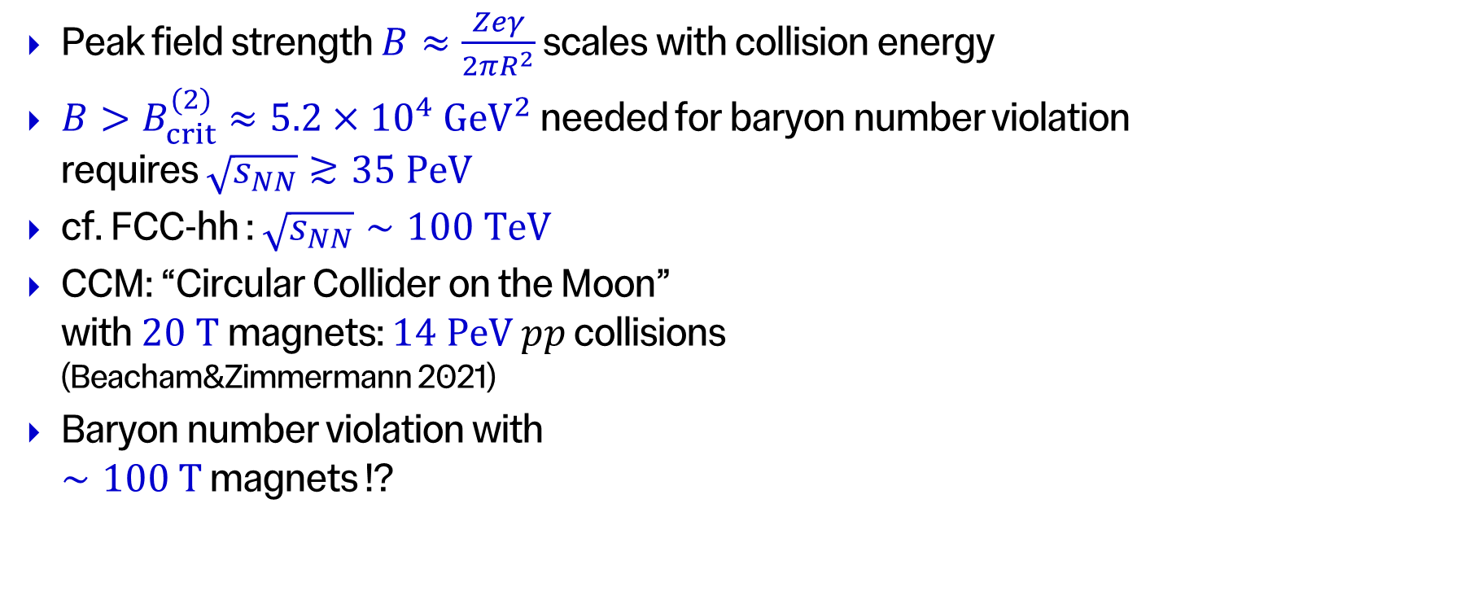
Future Prospects
Peak field strength $B≈\frac{Zeγ}{2πR^{2}}$ scales with collision energy
$B>B_{crit}^{(2)}≈5.2×{10}^{4} GeV^{2}$ needed for baryon number violation
requires $\sqrt{s_{NN}}≳35 PeV$
cf. FCC-hh : $\sqrt{s_{NN}}∼100 TeV$
CCM: “Circular Collider on the Moon”
with $20 T$magnets: $14 PeV$ $pp$ collisions
(Beacham&Zimmermann 2021)
Baryon number violation with
$∼100 T$ magnets !?

Slide 11
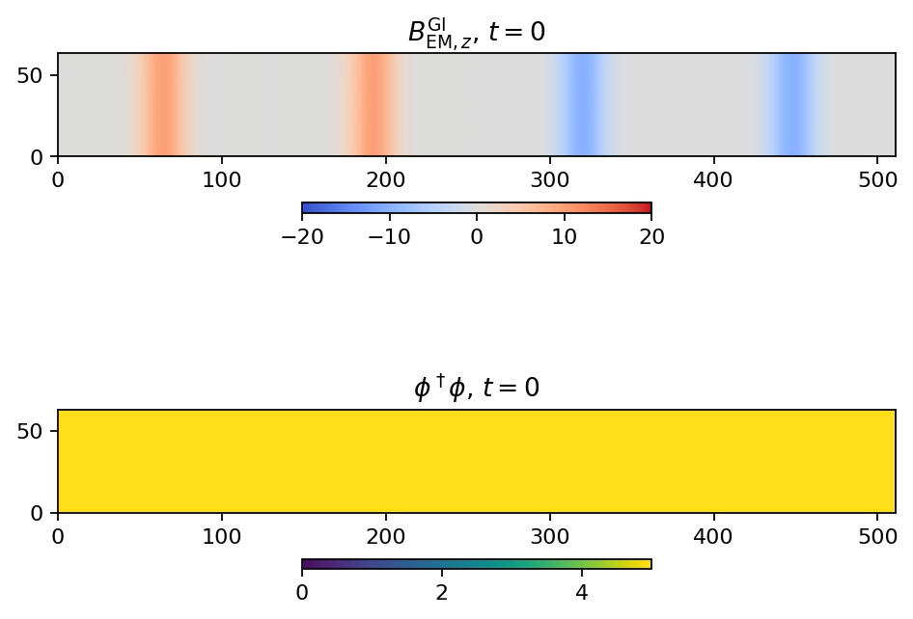
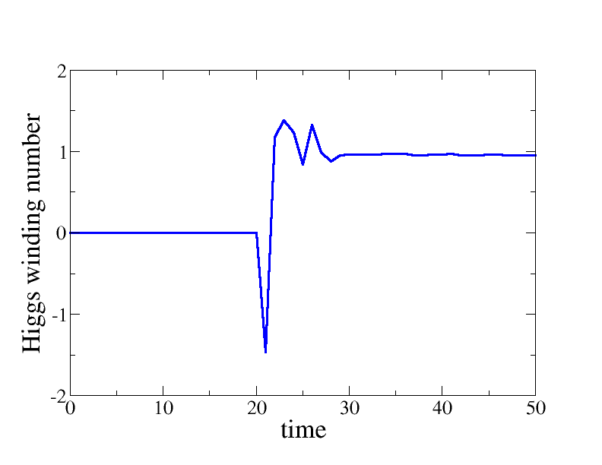

Numerical Simulation
Two Gaussian EM wave packets:
  Field $B_{0}=5m_{H}^{2}$, width $Δz=\sqrt{5}m_{H}^{−1}$
Single wave packet: ${\vec{B}}^{2}={\vec{E}}^{2}$
  No effect on vacuum
Collision: ${\vec{B}}^{2}≫{\vec{E}}^{2}⇒$Ambjørn&Olesen
  ${ΔN}_{H}≠0⇒{ΔN}_{CS}≠0⇒ΔB≠0$

Slide 12
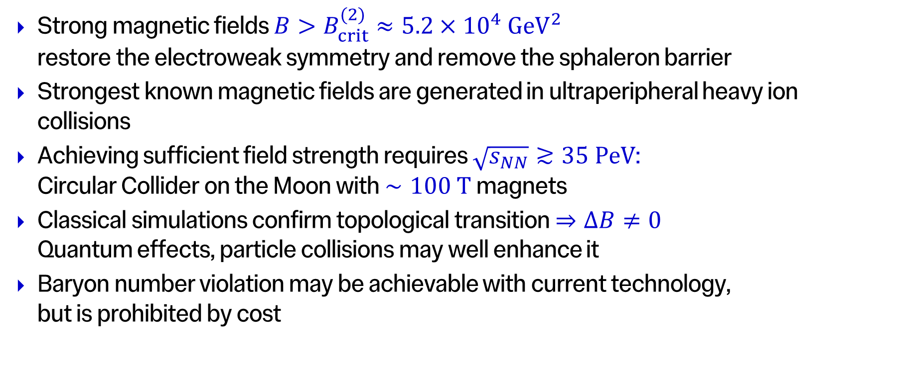
Summary
Strong magnetic fields $B>B_{crit}^{(2)}≈5.2×{10}^{4} GeV^{2}$
restore the electroweak symmetry and remove the sphaleron barrier
Strongest known magnetic fields are generated in ultraperipheral heavy ion collisions
Achieving sufficient field strength requires $\sqrt{s_{NN}}≳35 PeV$:
Circular Collider on the Moon with $∼100 T$ magnets
Classical simulations confirm topological transition $⇒ΔB≠0$
Quantum effects, particle collisions may well enhance it
Baryon number violation may be achievable with current technology,
but is prohibited by cost

