Slide 1
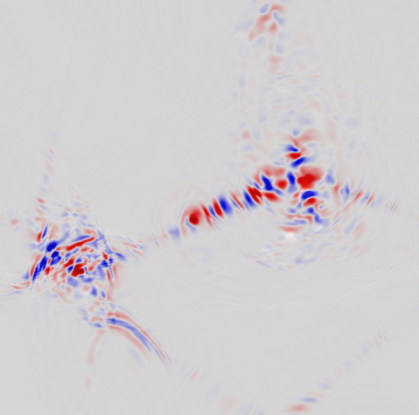


Baryon number violation
from
Standard Model Higgs bubble collisions
Nabeen Bhusal
Based on Phys.Rev.Lett. 136 (2026) 24, 241803
In collaboration with: S. Blasi, M. Cataldi, A. Chatrchyan, M. Gorghetto and G. Servant
nabeen.bhusal@desy.de

Slide 2


How does the Standard Model (SM) violate Baryon (B) Number
Motivation
The SM violates B+L, but conventional sphaleron transitions become inefficient below the electroweak scale.
Can a first-order transition generate B violation through a different mechanism?

Slide 3

How does the Standard Model (SM) violate Baryon (B) Number
The SM violates B+L, but conventional sphaleron transitions become inefficient below the electroweak scale.
Can a first-order transition generate B violation through a different mechanism?
In the SM, Baryon and Lepton number is violated by the chiral anomaly

Slide 4
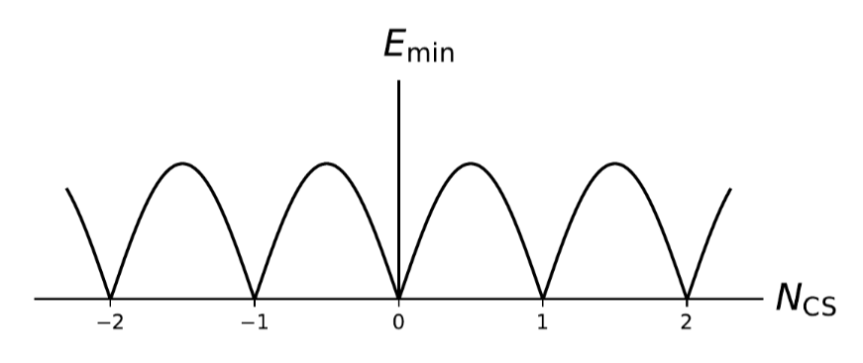

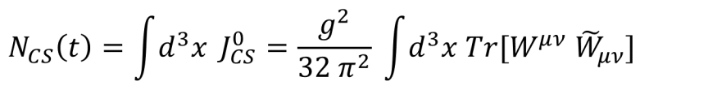
How does the Standard Model (SM) violate Baryon (B) Number
The SM violates B+L, but conventional sphaleron transitions become inefficient below the electroweak scale.
Can a first-order transition generate B violation through a different mechanism?
In the SM, Baryon and Lepton number is violated by the chiral anomaly
Sphaleron transitions

Slide 5

How does the Standard Model (SM) violate Baryon (B) Number
The SM violates B+L, but conventional sphaleron transitions become inefficient below the electroweak scale.
Can a first-order transition generate B violation through a different mechanism?
In the SM, Baryon and Lepton number is violated by the chiral anomaly
Sphaleron transitions
Changing N_{CS}​ is the key to baryon-number violation

Slide 6

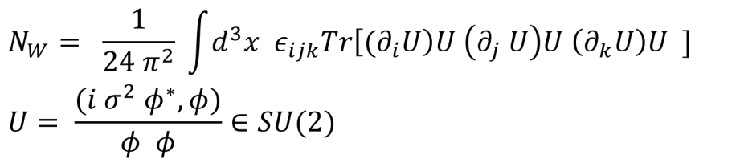
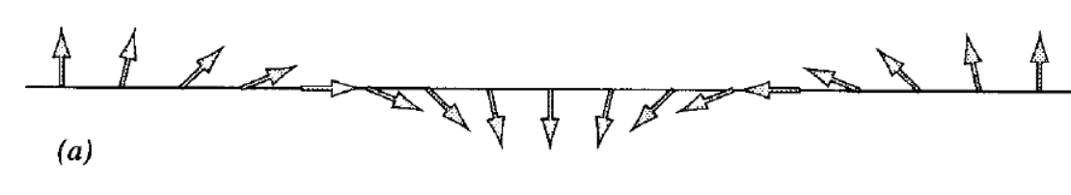
How does the Standard Model (SM) violate Baryon (B) Number
Textures: Higgs topology
Therefore,
Textures are labelled by Higgs Winding number :
In the presence of gauge fields, the gauge invariant quantity: (N_{W} - N_{CS})
Texture in 1D with N_{W}=1
Vilenkin 1994
A texture is simply a Higgs configuration with a non-trivial winding.

Slide 7

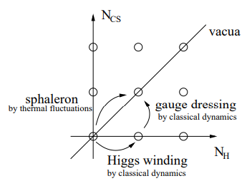
ΔB from Textures
See e.g. Turok, Zadrozny, NPB 1991
Gauge textures are unstable and collapse into the vacuum configuration
Konstandin, Servant, JCAP07(2011)024

Slide 8
ΔB from Textures
See e.g. Turok, Zadrozny, NPB 1991
Gauge textures are unstable and collapse into the vacuum configuration
→ How do textures with N_{W} − N_{CS} = 1 and gauge fields collapse to the vacuum N_{W} − N_{CS} = 0 ?
Konstandin, Servant, JCAP07(2011)024

Slide 9
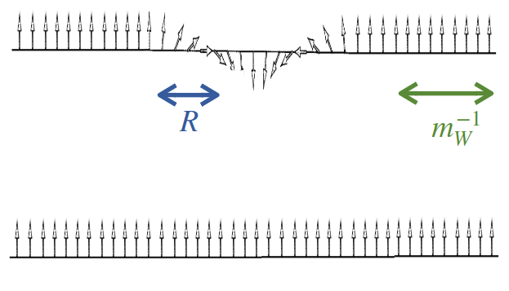
ΔB from Textures
See e.g. Turok, Zadrozny, NPB 1991
Gauge textures are unstable and collapse into the vacuum configuration
→ How do textures with N_{W} − N_{CS} = 1 and gauge fields collapse to the vacuum N_{W} − N_{CS} = 0 ?
Small texture R < M_{W}⁻¹
Unwinding
Konstandin, Servant, JCAP07(2011)024
ΔN_{W} = − 1, ΔN_{CS} = 0

Slide 10
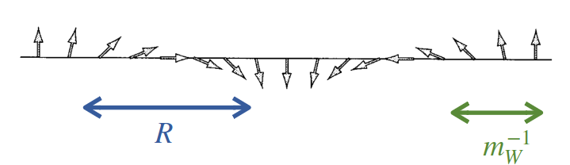

ΔB from Textures
See e.g. Turok, Zadrozny, NPB 1991
Gauge textures are unstable and collapse into the vacuum configuration
→ How do textures with N_{W} − N_{CS} = 1 and gauge fields collapse to the vacuum N_{W} − N_{CS} = 0 ?
Small texture R < M_{W}⁻¹
Large texture R > M_{W}⁻¹
Unwinding
Gauge fields turn on and cancel the gradient
Konstandin, Servant, JCAP07(2011)024
ΔN_{W} = − 1, ΔN_{CS} = 0
ΔN_{W} = 0, ΔN_{CS} = 1
Produces Baryons !

Slide 11
What dynamics can produce these textures ?

Slide 12
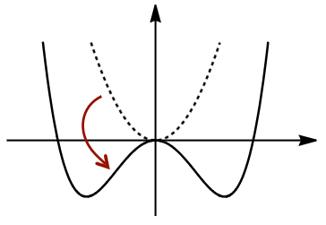
Recap: B violation from Tachyonic transition
Garcia-Bellido, Grigoriev, Kusenko,
Shaposhnikov, PRD 1990
Smit, Tranberg JHEP 2002
Higgs SU(2) symmetry broken rapidly (quenched crossover phase transition)
→ Kibble mechanism leads to formation of Textures dressed by gauge fields
→ Textures decay via changing N_{CS}
Rate of change of N_{CS} is equivalent to rate of B violation.
→ If transition is delayed : B violation at T~0 GeV [The original “Cold Baryogenesis”]

Slide 13



First-Order Phase Transition (FOPT)
Konstandin, Servant, JCAP07(2011)024
Servant, Phys. Rev. Lett. 113, 171803 (2014)
Use the same principle of Texture formation and decay but through bubble nucleation and collision
Toy Model
Geometry
3+1 D lattice
Initial Condition
N bubbles
Random SU(2) orientation
Critical bubble profile (sets limit on simulation size)
2D slice at
simulation time t=0

Slide 14

Bubble collisions create non-trivial Higgs configurations
We simulate runaway bubbles of the Electroweak phase transition
Random SU(2) configuration
Collisions
Higgs gradients → gauge-field excitation
Can bubble collisions produce gauge textures ?

Slide 15
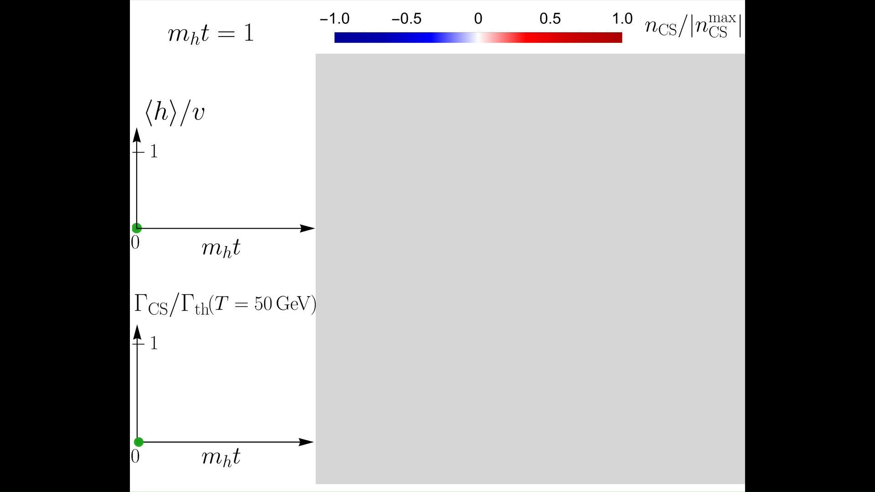

Slide 16
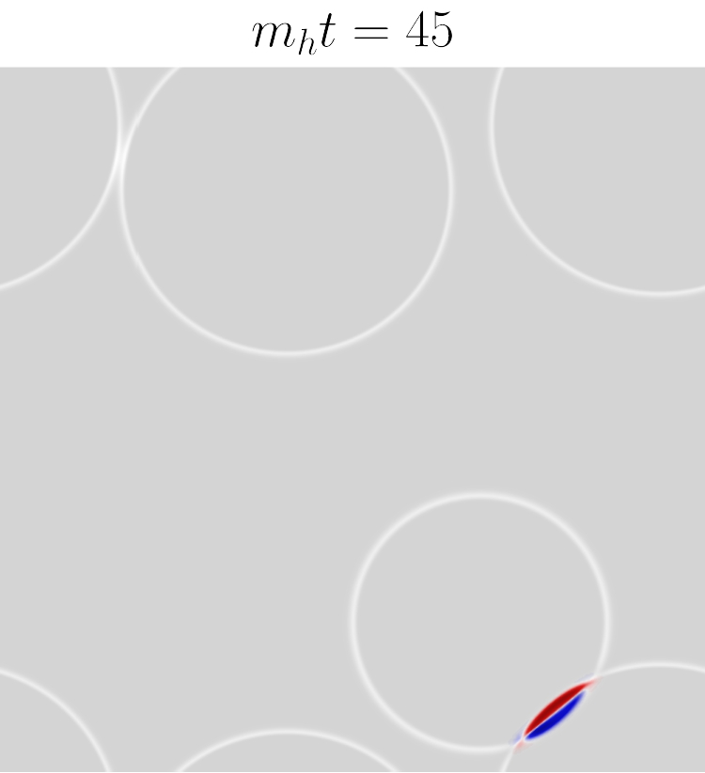
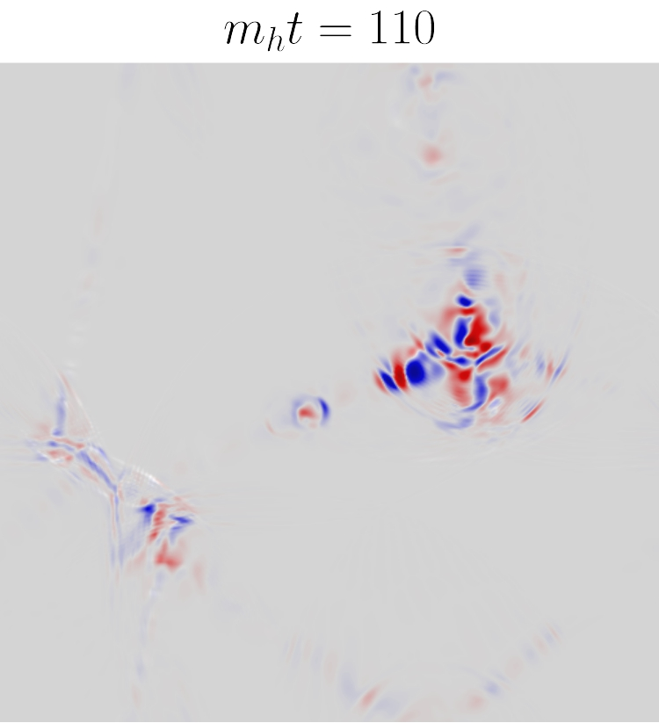
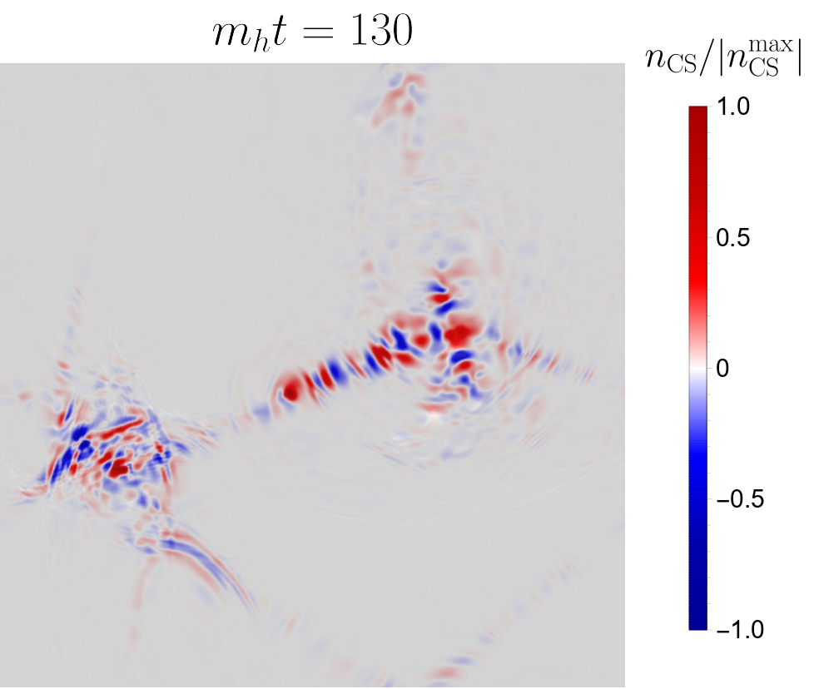
Bubble collisions to N_{CS}
Bubble collisions produce SU(2) gauge textures which then decay, leading to B violation

Slide 17
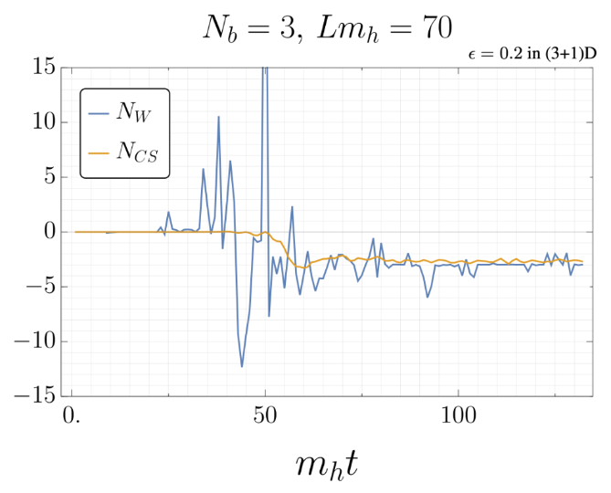
Convergence of N_{CS} and N_{W}
N_{CS} asymptotically relaxes to the produced N_{W}
(remember that in the vacuum N_{CS} = N_{W})

Slide 18
Results from the Lattice

Slide 19
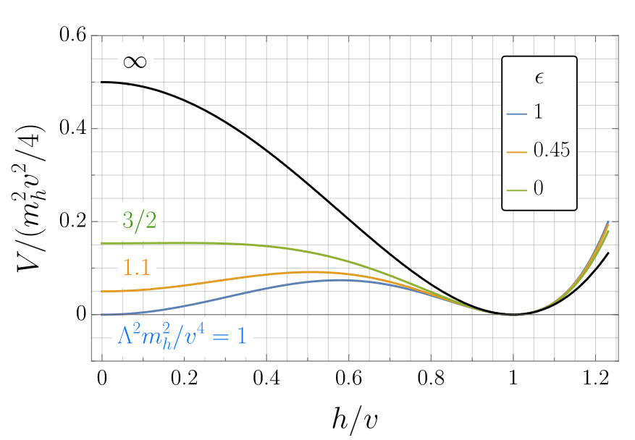

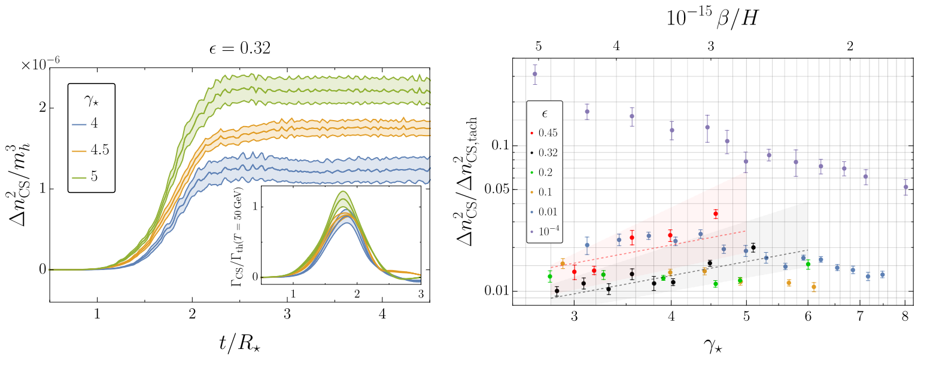
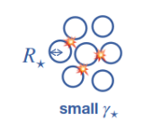
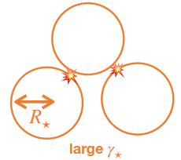
N_{CS} from Bubble Collisions
We study the dependence of the N_{CS} on:
1. Shape of the Higgs potential
ϵ → 1 : Nearly degenerate vacua → likely to restore false vacuum
ϵ → 0: Non-degenerate vacua → unlikely to restore false vacuum
*Jinno, Konstandin, Takimoto [1906.02588] JCAP
2. Lorentz-boost factor gamma of the bubble walls at collision
Since we have to extrapolate the simulation to a physical limit

Slide 20
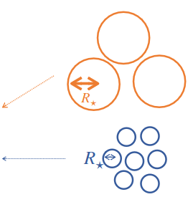
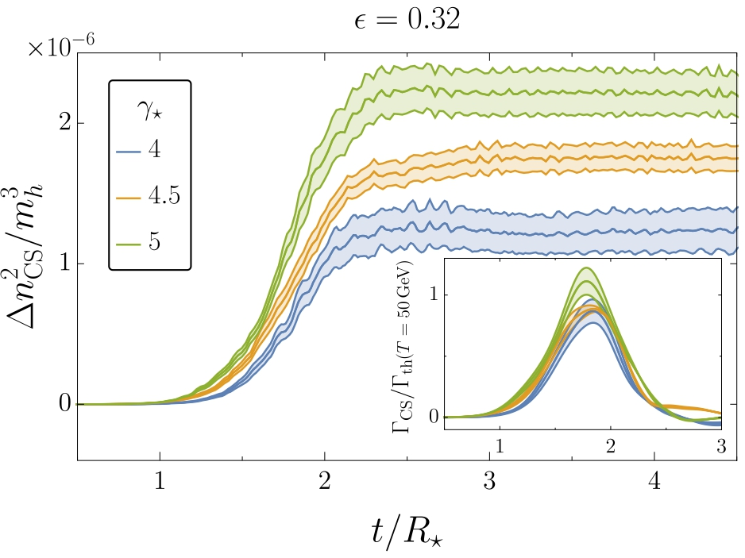
Variance and rate of N_{CS}
We measure the “amount” of N_{CS} produced through the statistical quantity “variance” averaged over ensembles

Slide 21

Variance and rate of N_{CS}
We measure the “amount” of N_{CS} produced through the statistical quantity “variance” averaged over ensembles
And the corresponding rate via
Rate is of order of "thermal" sphaleron rate !

Slide 22
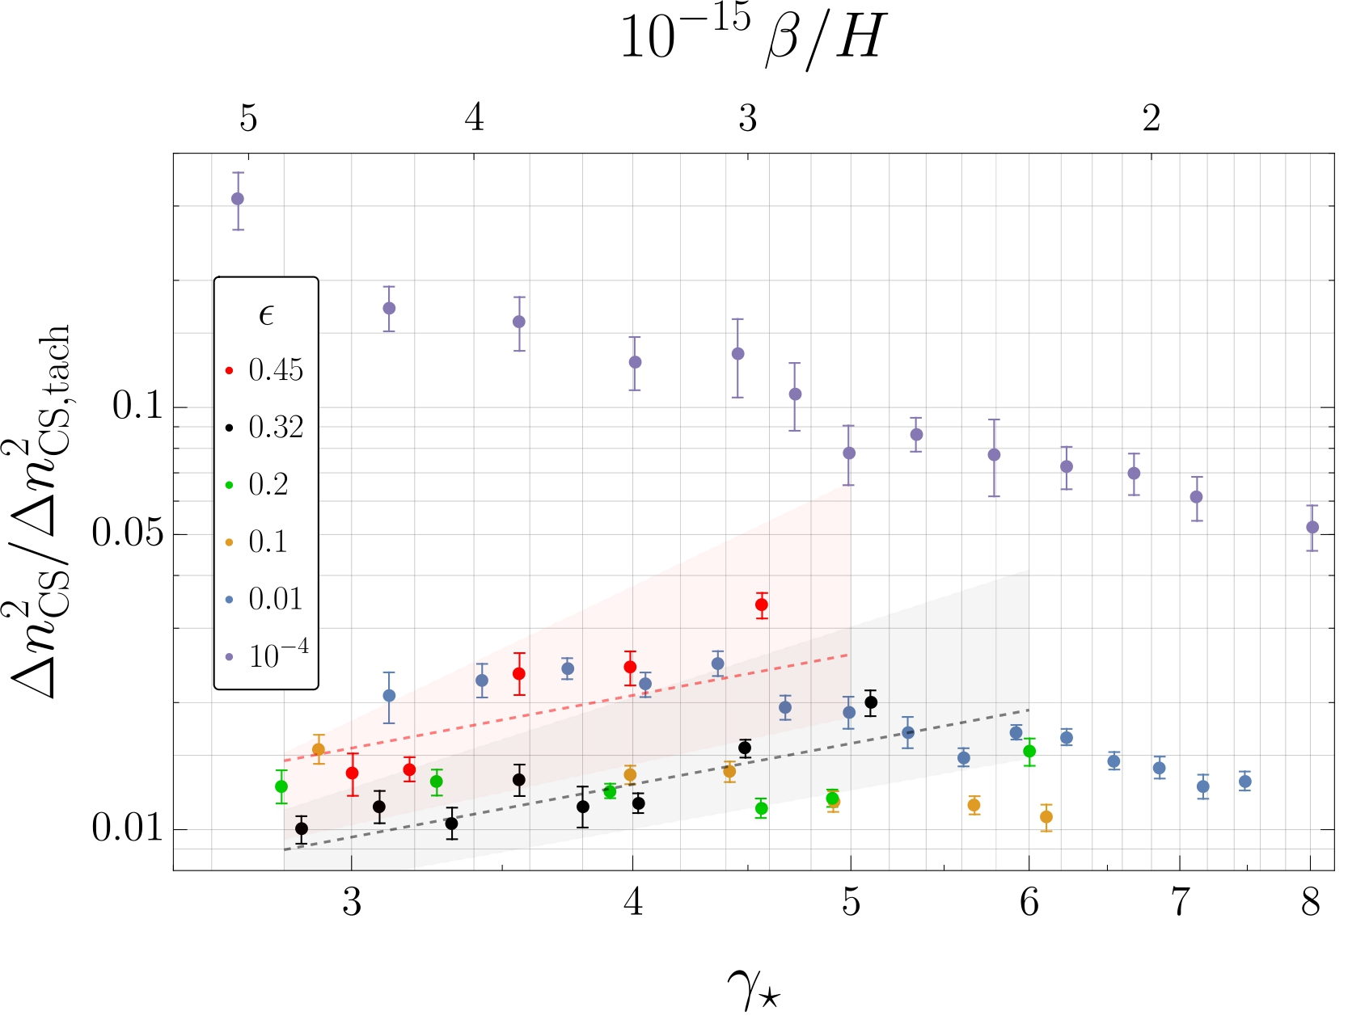

From lattice simulations to physical scales
What we simulate:
Different ϵ
Different ​ →Different bubble sizes (at collision)
→ Extrapolate to physical scale
We measure our variance in units of the variance from the tachyonic phase transition case

Slide 23

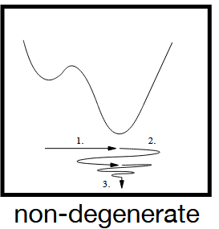
From lattice simulations to physical scales
For
Variance → 0

Slide 24

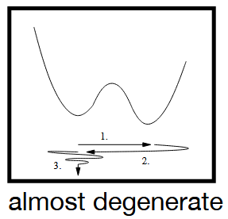
From lattice simulations to physical scales
For
Variance → 0
For
Variance → increases
Collisions with large ϵ show non decreasing N_{CS} variance
→ A sizeable B violation rate potentially to do Baryogenesis !!!

Slide 25
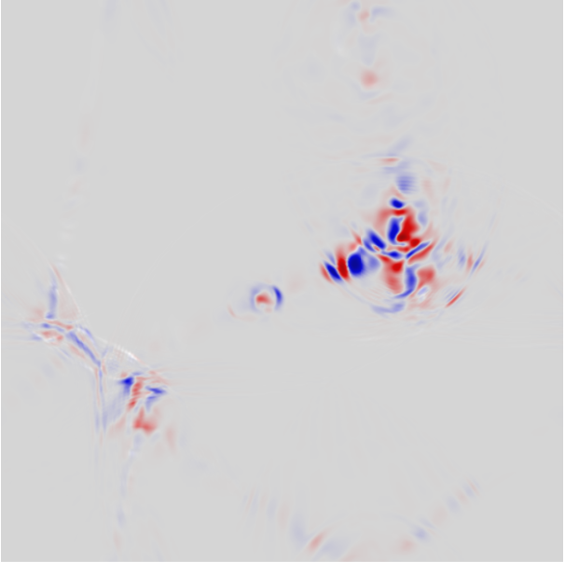
Conclusion
Bubble collisions provide a new sizeable source of Chern—Simons number
Dependence on shape of the potential and size of bubbles at collision
First-order Higgs bubble collisions provide a non-thermal source of baryon-number violation, distinct from thermal sphaleron transitions.
→ COLD BARYOGENESIS ? (Find out more on the next episode by Martina tomorrow)

Slide 26
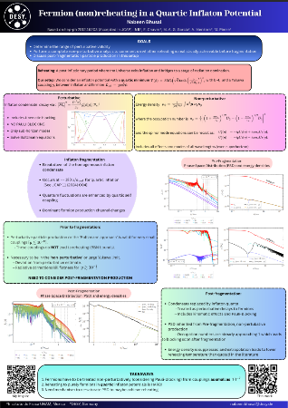
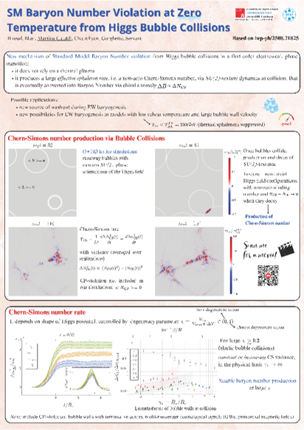
Thank you
And Martina's poster on this work !
Check out my poster on (P)reheating !

Slide 27
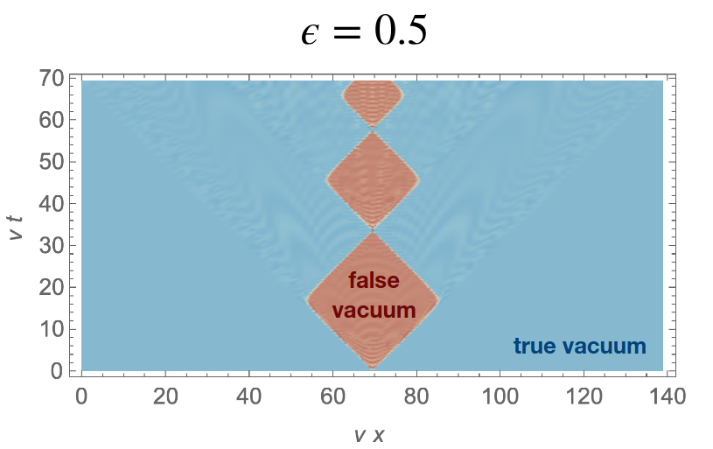
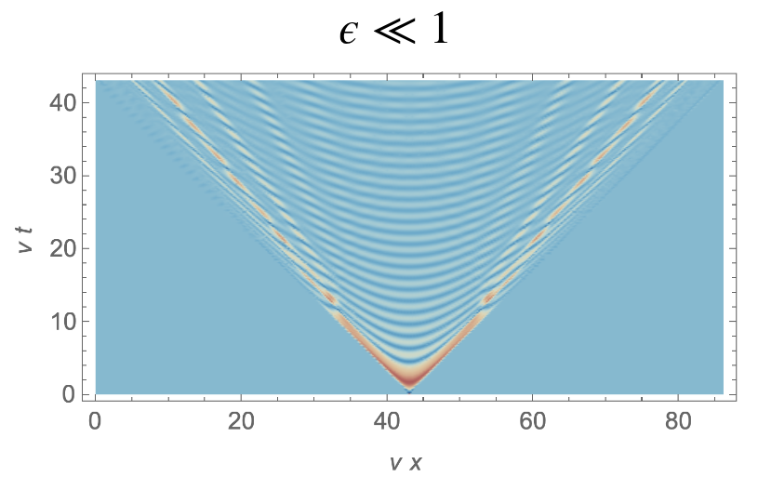
1+1D *Jinno, Konstandin, Takimoto [1906.02588] JCAP

