Slide 1
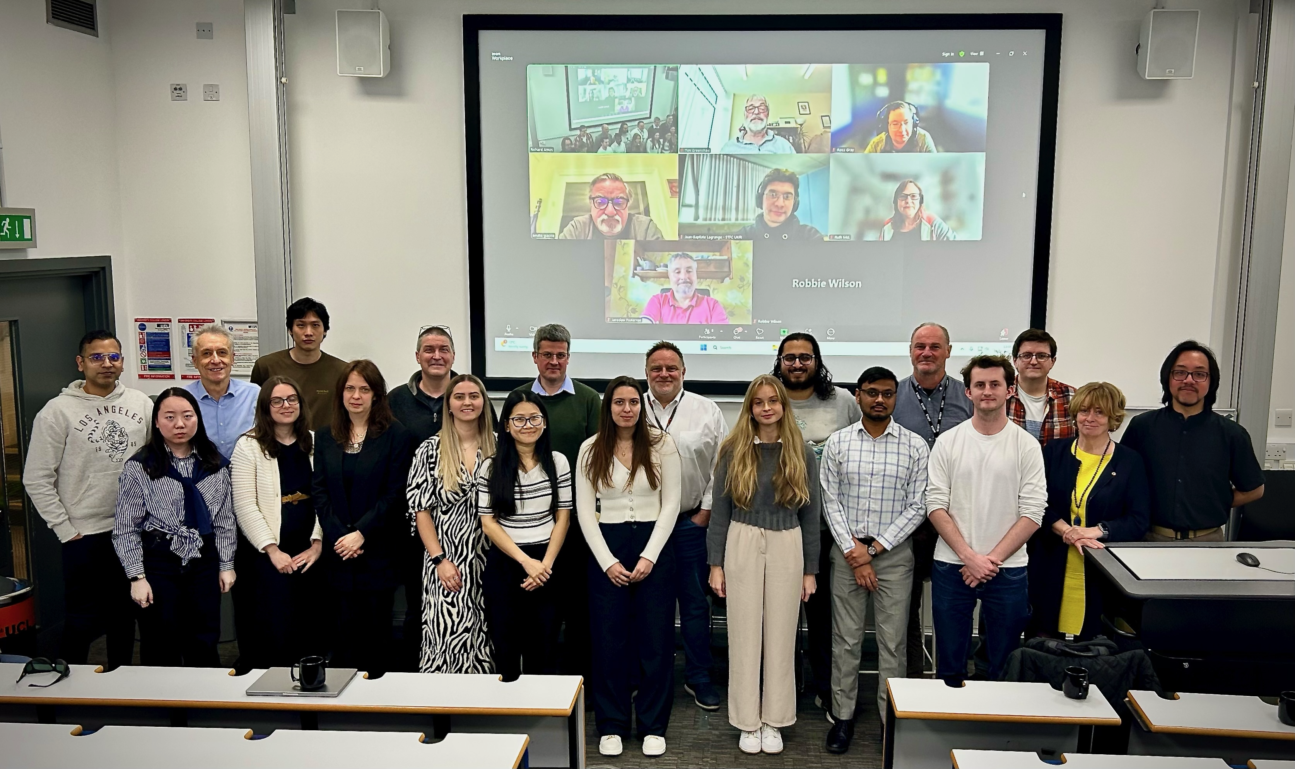
LhARA
Laser-hybrid Accelerator for Radiobiological Applications

Slide 2
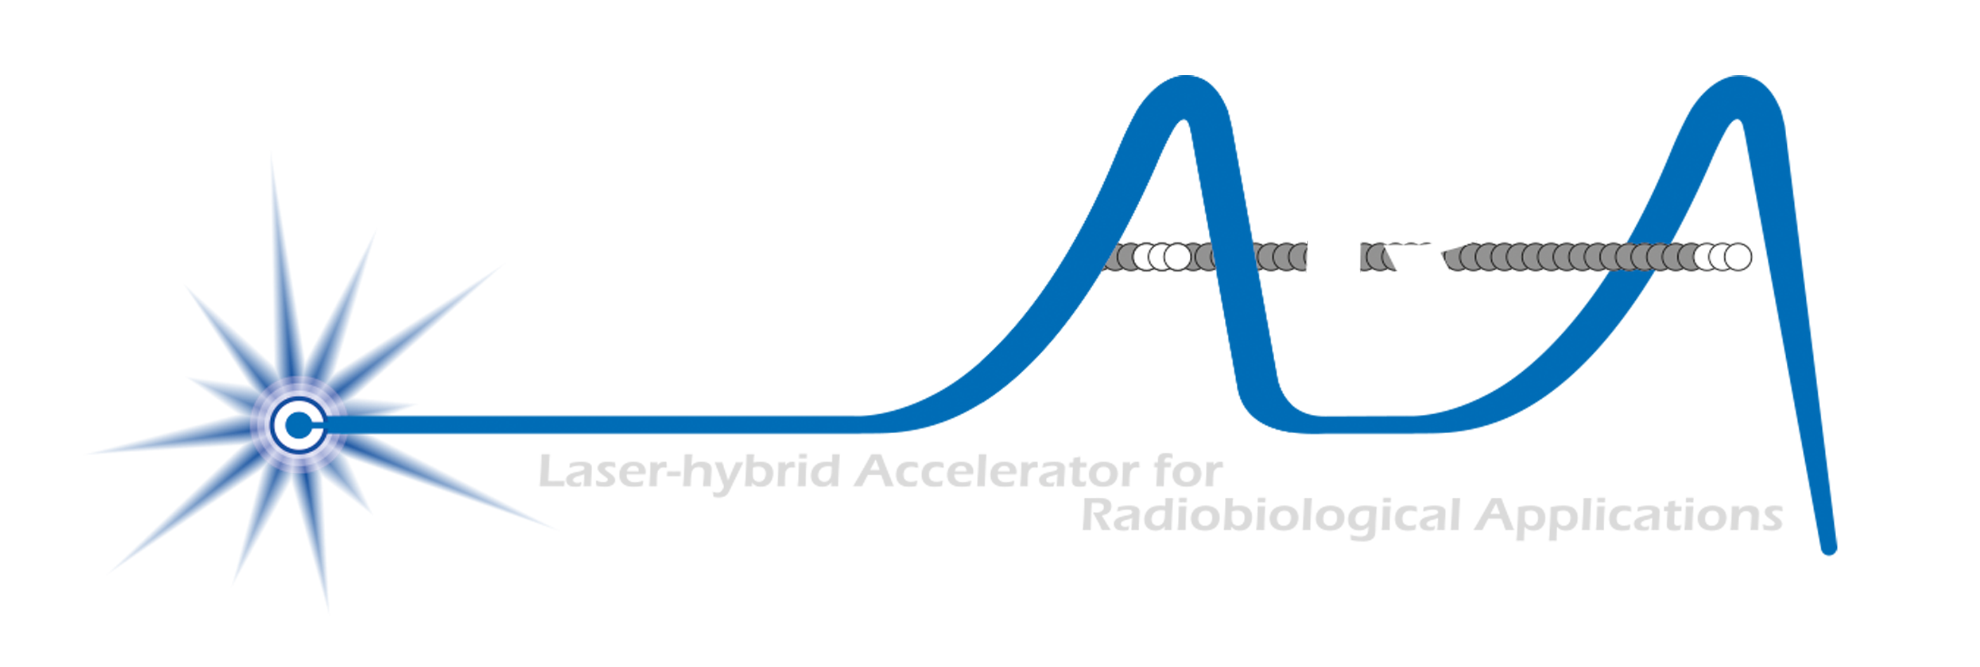
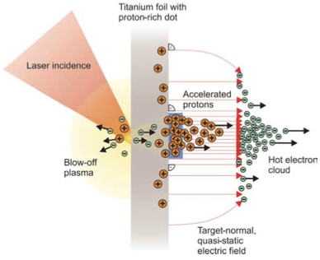
Our mission to:
Deliver a systematic and definitive radiation biology programme
Prove the feasibility of laser-driven hybrid acceleration
Lay the foundations for the transformation of PBT
  Automated, patient-specific proton and ion beam therapy
Spin back into fundamental science and innovation

Slide 3
What is LhARA?
A novel, hybrid, approach:
Laser-driven, high-flux proton/ion source
  Overcome instantaneous dose-rate limitation
    Capture at >10 MeV
  Delivers protons or ions in very short pulses
    Bunches as short as 10—40 ns
  Triggerable; arbitrary pulse structure
Novel “electron-plasma-lens” capture & focusing
  Strong focusing (short focal length) without the use of high-field solenoid
Fast, flexible, fixed-field post acceleration
  Variable energy
    Protons: 15—127 MeV
    Ions: 5—34 MeV/u
Front. Phys., 29 September 2020; DOI: 10.3389/fphy.2020.567738

Slide 4
Status; resources
At the time of the last JAI AB:
  Apr24: at month 18 of 24 month “Preliminary Activity”
Summer 2024:
  Negotiation with STFC of 2-year “flat-flat” bridging period starting 01Oct25
  In parallel:
    Guided to prepare submission to MRC to propose ITRF/LhARA be a joint MRC/STFC submission to the Infrastructure Fund …
Autumn 2024:
  MRC “Infrastructure and Capital Strategic Advisory Group” (ICSAG) review:
    “… excited by the technology and its potential …”
    But, ICSAG noted the lack of evidence of:
      The bio-science impact (i.e. preliminary data)
      An MRC “use case” or “link to patients” …
    As a result ICSAG was not able to recommend preparation of a full proposal at this time
  ICSAG also stated that it:
    “… would be prepared to look at a revised bid in later years …”
As a result; the Infrastructure Funded “clawed back” the bridging support with effect from 31May25

Slide 5
Moving forward
The collaboration remains committed! So:
Project
Structure

Slide 6
Radiobiology programme and proof-of-principle experiment
Systematic comparison:
  Radiobiology with conventional (cyclotron) and laser-driven beams
MC40 cyclotron (Brm)
Laser-driven@ SCAPA (Strathclyde)
T. Price et al
(Birmingham)
R. Gray et al (Strthclyd)

Slide 7
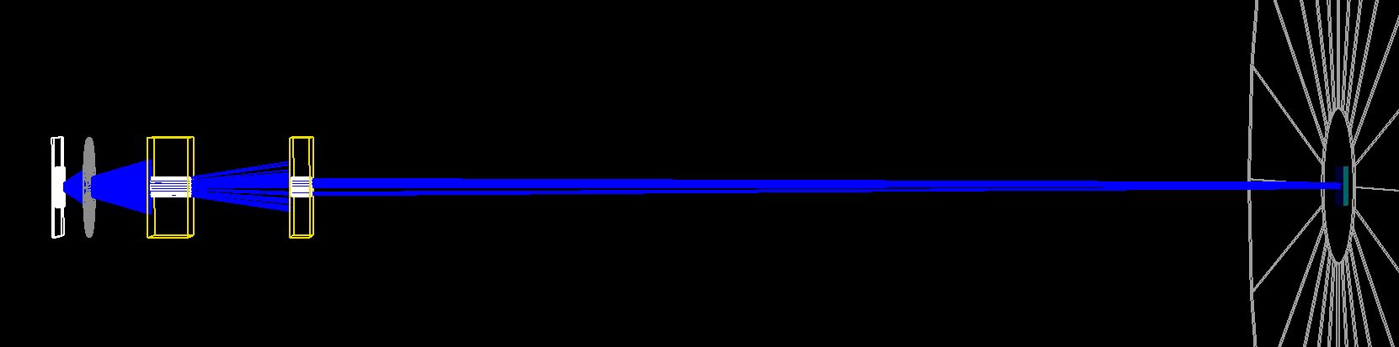
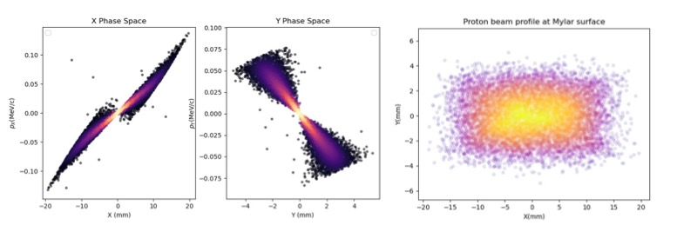
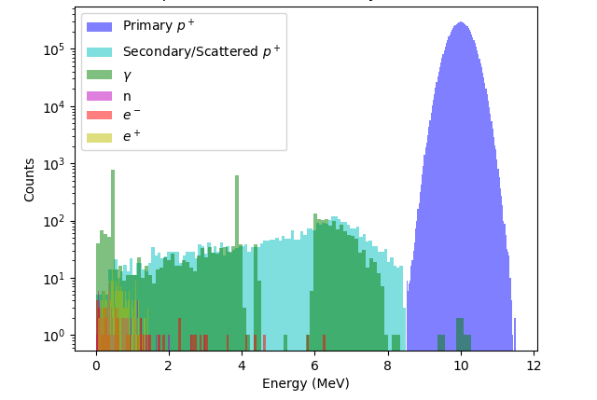
PoPLaR @ SCAPA
IC, Oxf, RHUK

Slide 8
Oxf (M. Hill)

Slide 9
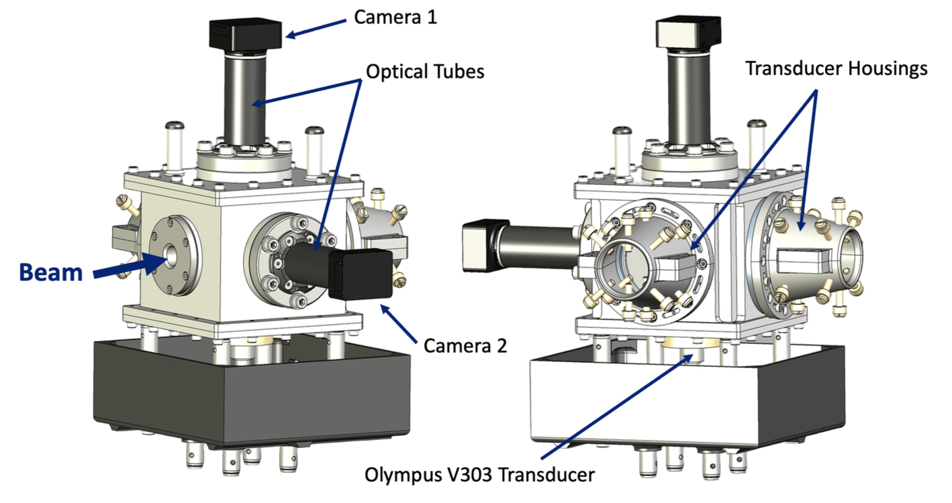
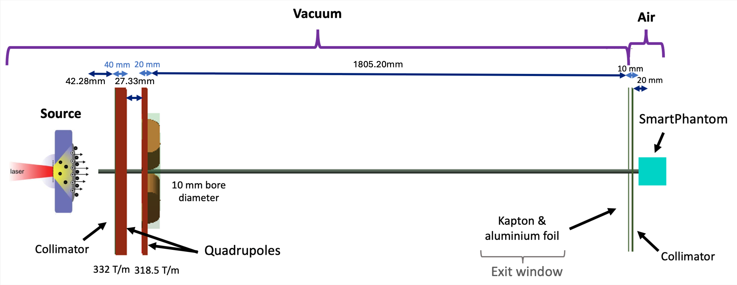
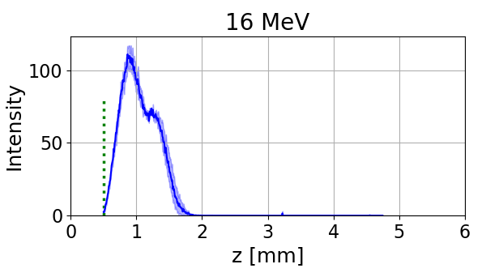
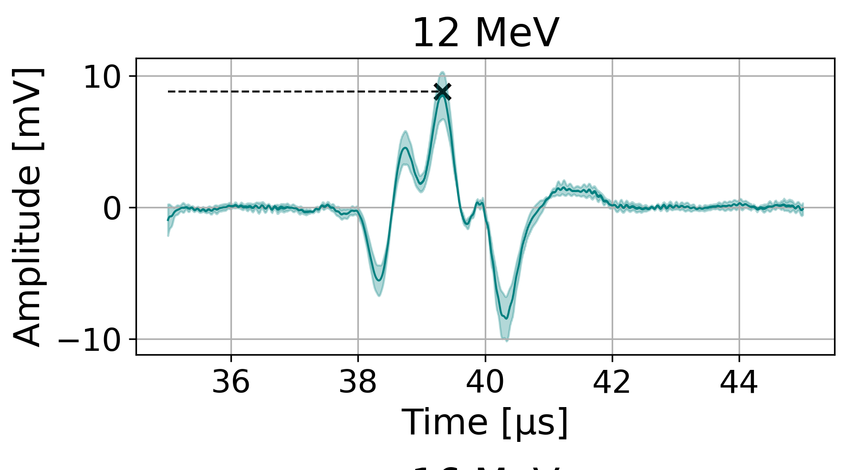
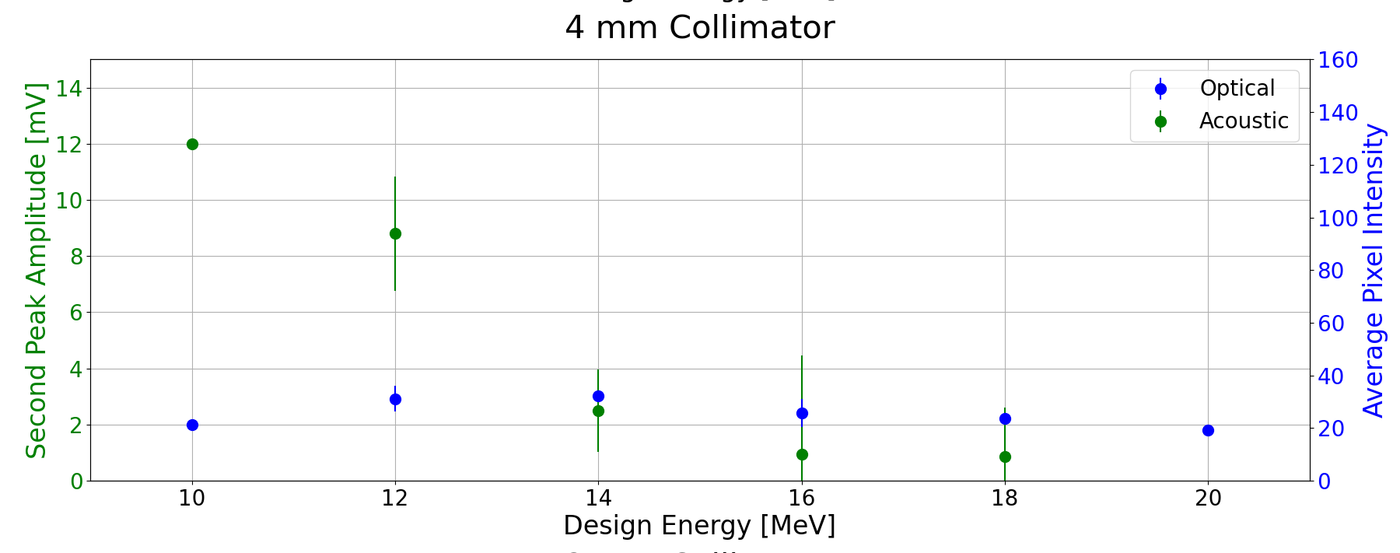
Real-time acoustic dose-profile measurement
IC (M. Maxouti)
1775.20mm
46.94mm
32.33mm
32.33mm
Test exposure on LION at LMU:
Correlation: liquid scintillator and acoustic signal

Slide 10
Detailed simulation of beamline …
Simulation required to interpret optical and acoustic measurements
IC:
M.Maxouti
C. Dyson
RHUL:
W. Shields

Slide 11
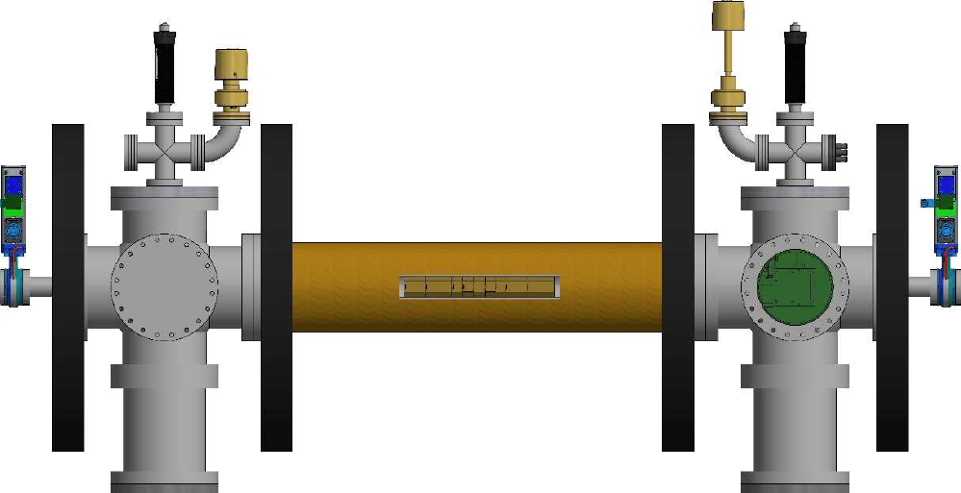
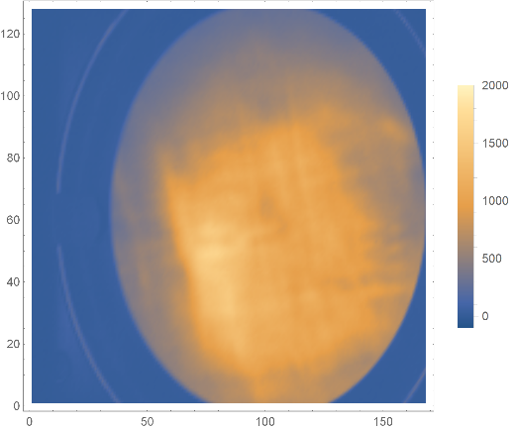
Plasma lens: progress on electron trapping
Swansea

Slide 12
Progress in design and integration
W. Shields [IC, RHUL]

Slide 13
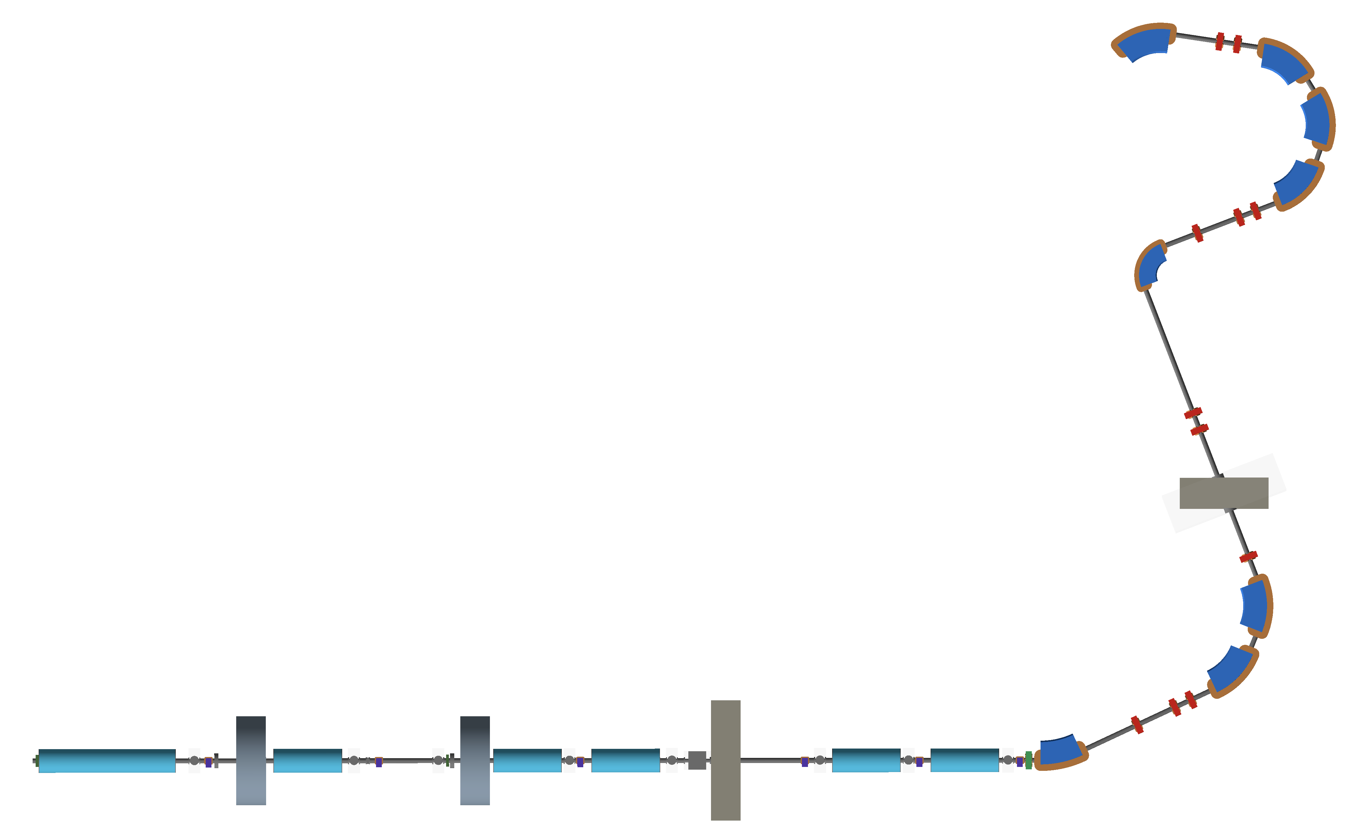
Re-optimised injection to FFA
Injection
septum
FFA
crossing
Collimation
Switching
dipole
IC: J. Pasternak
RHUL: W. Shields

Slide 14
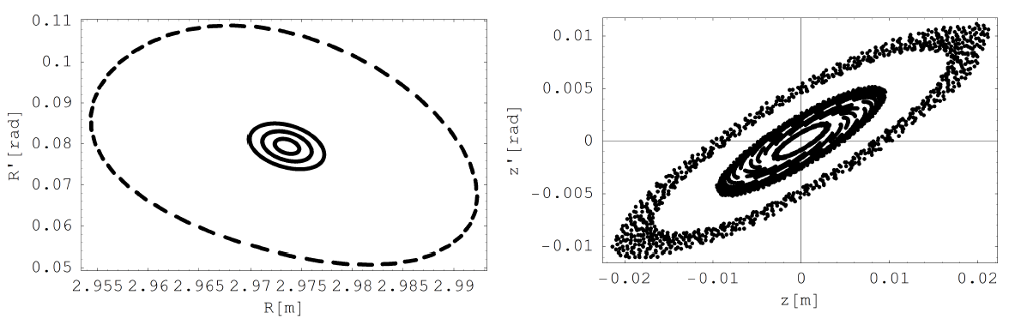
FFA reoptimised
Variable-energy FFA
Multi-ion capability
Single spiral design
Max field ~1.4 T
  Tunable
3D tracking:
  1, 2, 3 and 5σ
IC:
J. Pasternak

Slide 15
C. Hill (DL), T.J. Kuo (IC)

Slide 16
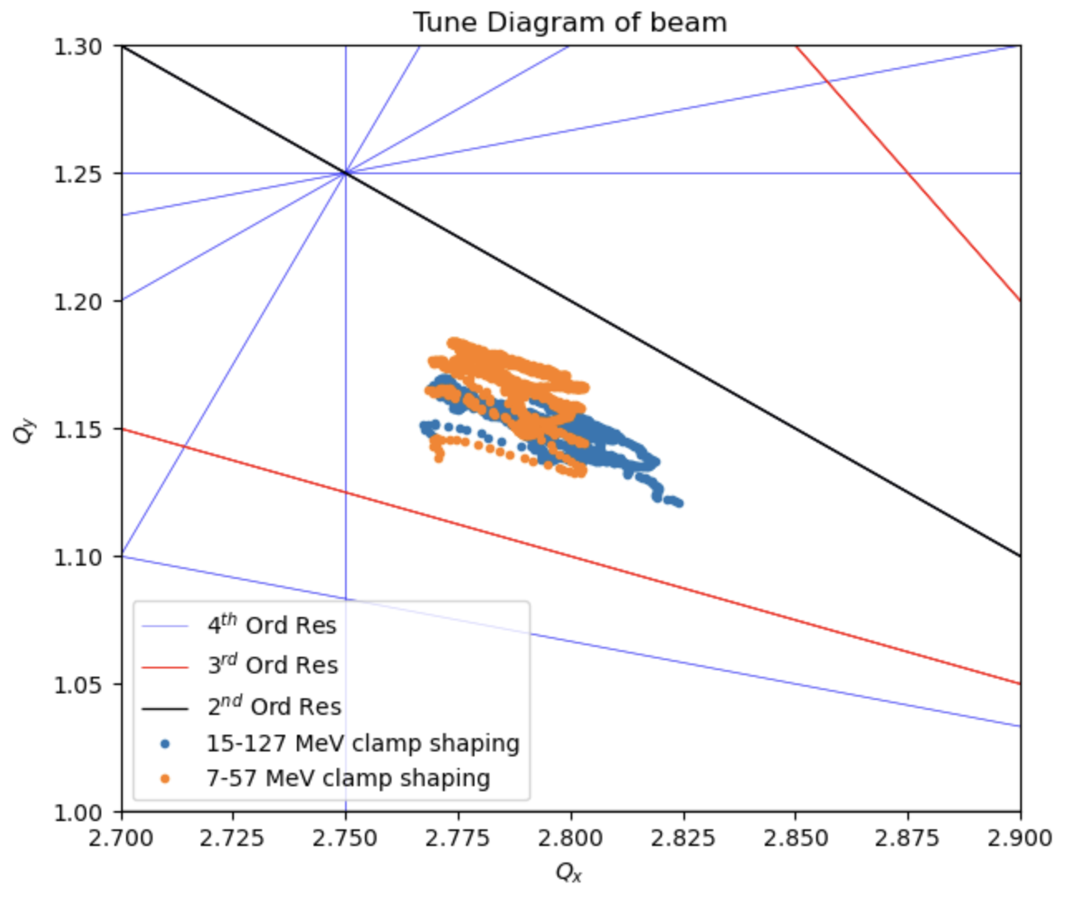
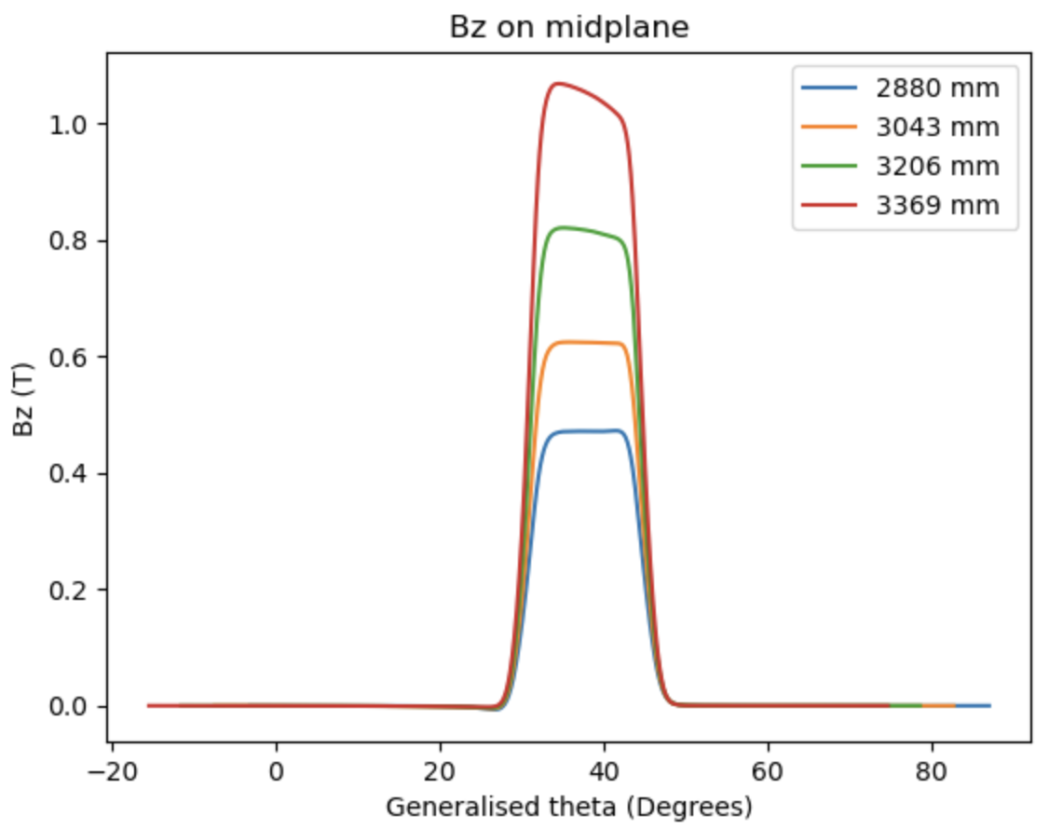
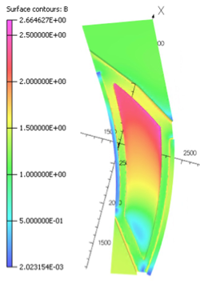
FFA magnet
IC: T.J. Kuo, J. Pasternak
in collaboration with ISIS
Magnet:
Satisfies scaling
requirement
Field in straights 60G
Tracking:
No tune crossing up to fourth order

Slide 17
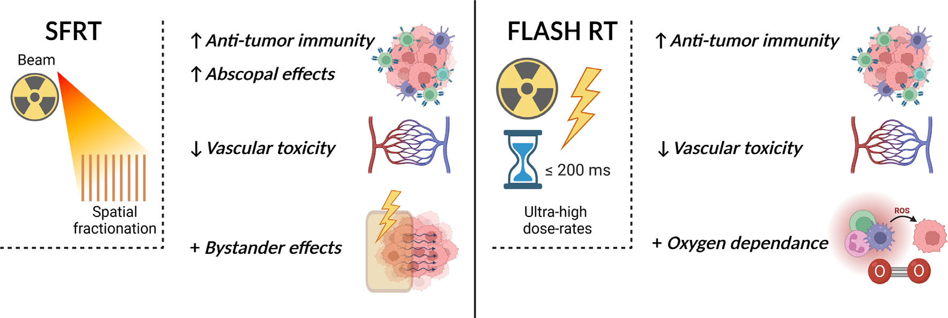
Radiobiology in new regimens
T. Schneider, C. Fernandez-Palomo, Annaïg Bertho et al.
> 40 Gy/s
Dose escalation in the tumour possible – larger tumor control prob.

Slide 18
Beam delivery to low-energy end station
Quadrupoles for minibeams:
  Doublet:
    Line focus
  Triplet:
    Spot focus
Octupole for uniformity:
IC:
R. Razak
RHUL:
M.Perriera
W. Shields

Slide 19
Multidisciplinary & multinational engagement
IC: P. Price
Multinational & Multidisciplinary
  LhARA: Particle Therapy Workshop
  Date 3rd week September 2025 IOP
  Engagement:
  International stakeholders: clinical, biological science, industry, policymakers
  Aim:
  Establishment of an International Advisory Group to guide the biology, clinical applications, and development of particle therapy.
  Outcome:
  Scientific publication and road map
  LhARA/RFI: bio/radiobiology/biotech w/s
  Planned to follow LhARA Particle Therapy Workshop in autumn/winter 2025/26

Slide 20
Conclusions
Infrastructure Fund devision a blow, but:
  Collaboration remains committed to excellent initiative
  Standard (UKRI/EU/ERC) and non-standard routes to funding being pursued
Excellent progress on:
  Radiation biology programme:
    Exploitation of MC40 cyclotron at Birmingham
    Development of PoPLaR at SCAPA
    “Breaking”: proposal to ELIMED on ELI Beam Lines (Prague)
  LhARA project:
    Source (rep rate, stability), capture (10¹⁵/m³), ion-acoustic, diagnostics (e.g. gas jet etc. (not presented), design and integration
  Engagement:
    Pre-clinical and clinical researchers, bio & bio/med tech
    Variety of more general engagement

Slide 21
Collaboration committed to realising the opportunity:
Deliver a systematic and definitive radiation biology programme
Prove the feasibility of laser-driven hybrid acceleration
Lay the foundations for the transformation of PBT
  Automated, patient-specific proton and ion beam therapy
Spin back into fundamental science and innovation

