Slide 1
Advanced Acceleration - Lasers
Zulfikar Najmudin
The John Adams Institute for Accelerator Science, Imperial College London
JAI Advisory Board, Royal Holloway College
Thursday 24 April 2025
              http://www.adams-institute.ac.uk http://www3.imperial.ac.uk/johnadamsinstitute

Slide 2
JAI effort on laser acceleration
Program | Laser Wakefield | Ion Source | Radiation | Lasers | Fundamental
 | Injection, Non-linear stages, Guided wakefields | Relativistic transparency & low density targets | Optimisation & Applications | Multiples + High rep rate sources | Compton QED, Photon-Photo Scattering
JAI staff | M. Backhouse, J. Cowley | O. Ettlinger |  | O. Ettlinger, J. Cowley
Associated | A. Hughes, M. von der Layden, R. Lahaye, L. Feder, | N. Dover, N. Xu | A. Hughes, B. Kettle | N. Xu, M. Liang, R. Lahaye | B. Kettle
Students | R. Luo, J. Hills, S. Kalos, D. McMahon, D. Chan, J. Thistlewood | G. Casati, N. Sedlackova | R. Luo, G. Christian, D. McMahon, D. Chan | S. Kalos, J. Thistlewood | M. Berboucha, L. Bradley
Faculty | R. D’Arcy, S. Hooker, S. Mangles, Z. Najmudin, P. Norreys, R. Walczak | K. Long, Z. Najmudin | S. Hooker, S. Mangles, Z. Najmudin | S. Hooker, Z. Najmudin, R. Walczak | S. Mangles, S. Rose

Slide 3
Lasers for accelerators
Pros
Very compact
Cheap (?)
Still improving
(efficiency)
Cons
repeatability
thermal issues
laser damage
difficult to control phase velocity
(efficiency)
Some key challenges:
Better beam quality (divergence, energy spread, emittance…) from laser sources
Operation at higher repetition-rate
Coupling of beams to applications and further acceleration stages
Development of better drivers

Slide 4
Laser Wakefield Acceleration

Slide 5

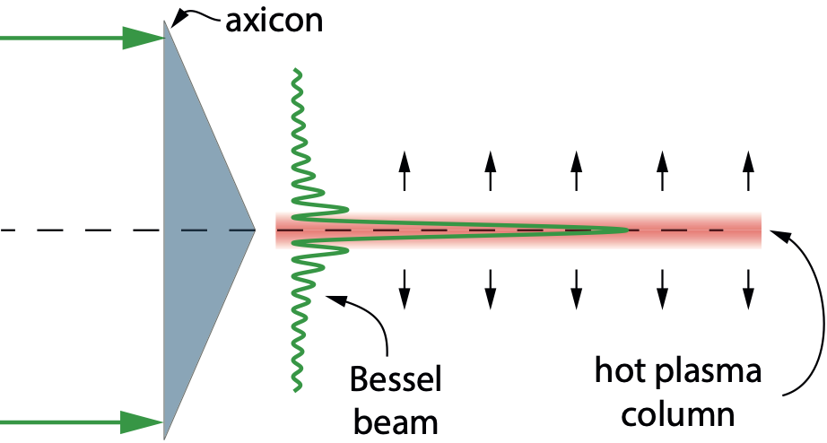
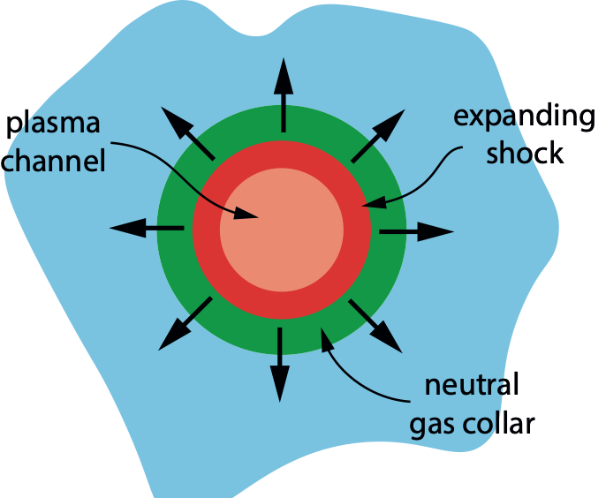

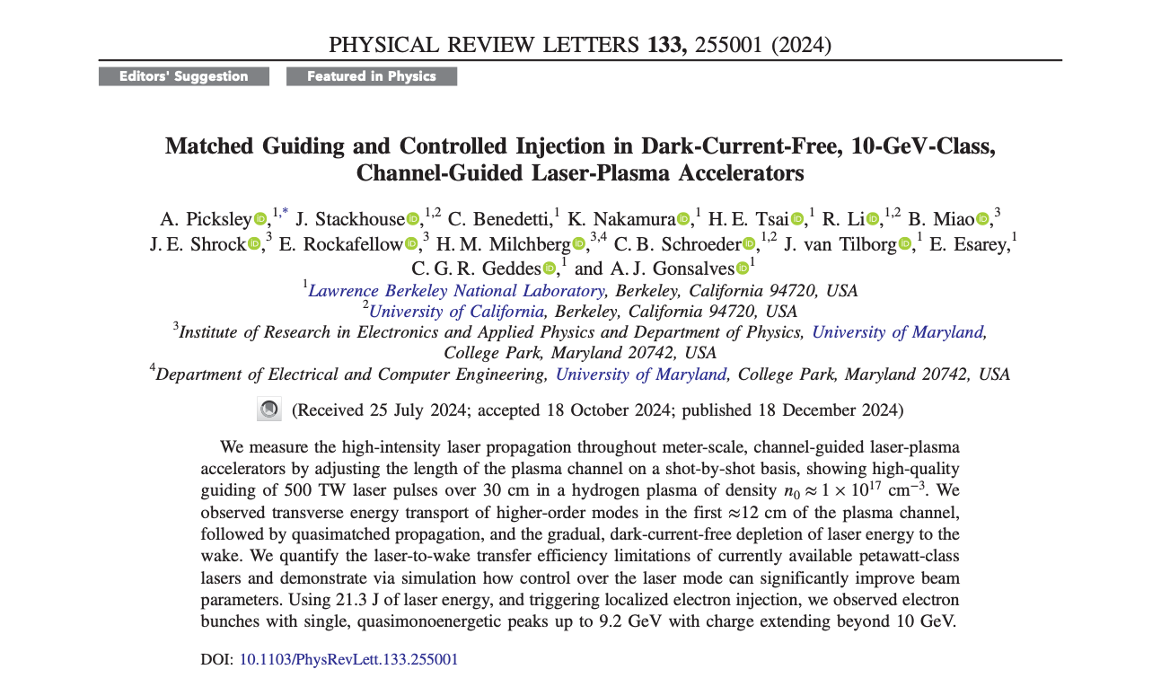

Hydrodynamic optical-field-ionized (HOFI) plasma channels
  HOFI channels developed in JAI-Oxford
    Optical field ionization generates hot plasma column that expands radially to generate a weak channel & collar of neutral
    Ionization of collar by wings of guided pulse creates v. low loss channels
  Advantages over other techniques:
    Free-standing, hence “indestructible”
    kHz operation demonstrated
    Low on-axis densities ($∼{10}^{17}{cm}^{-3}$) increases particle energy gain
  Becoming widely adopted by worldwide community
    e.g. Picksley et al., Phys. Rev. Lett. 131 245001 (2023), E = 1.2 GeV, ΔE / E = 4.5% (chosen as Editor’s Suggestion)
    30 cm long HOFI channels used by LBNL group to reach record energy of ~ 10 GeV (1st author former JAI student!)
    HOFI channels at heart of proposed plasma injector for PETRA IV upgrade
Simon Hooker, University of Oxford
JAI Advisory Board, 24th April 2025

Slide 6
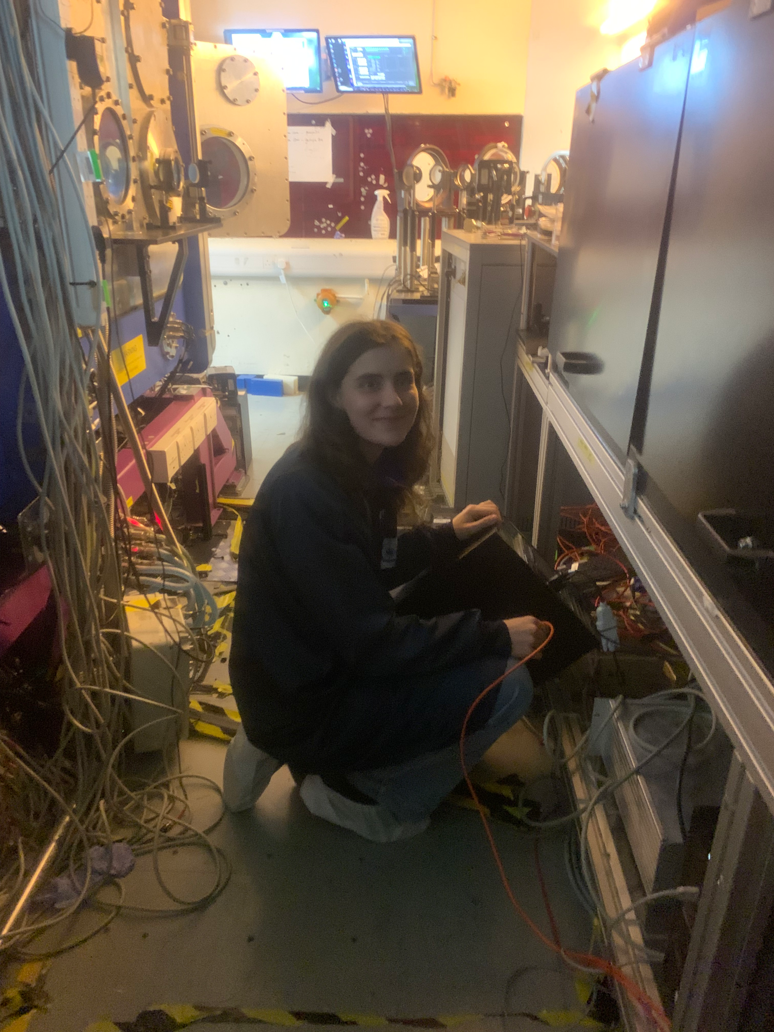
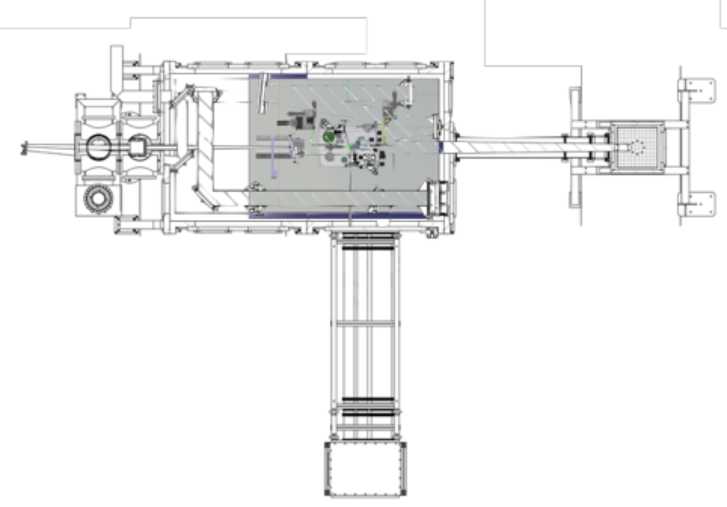
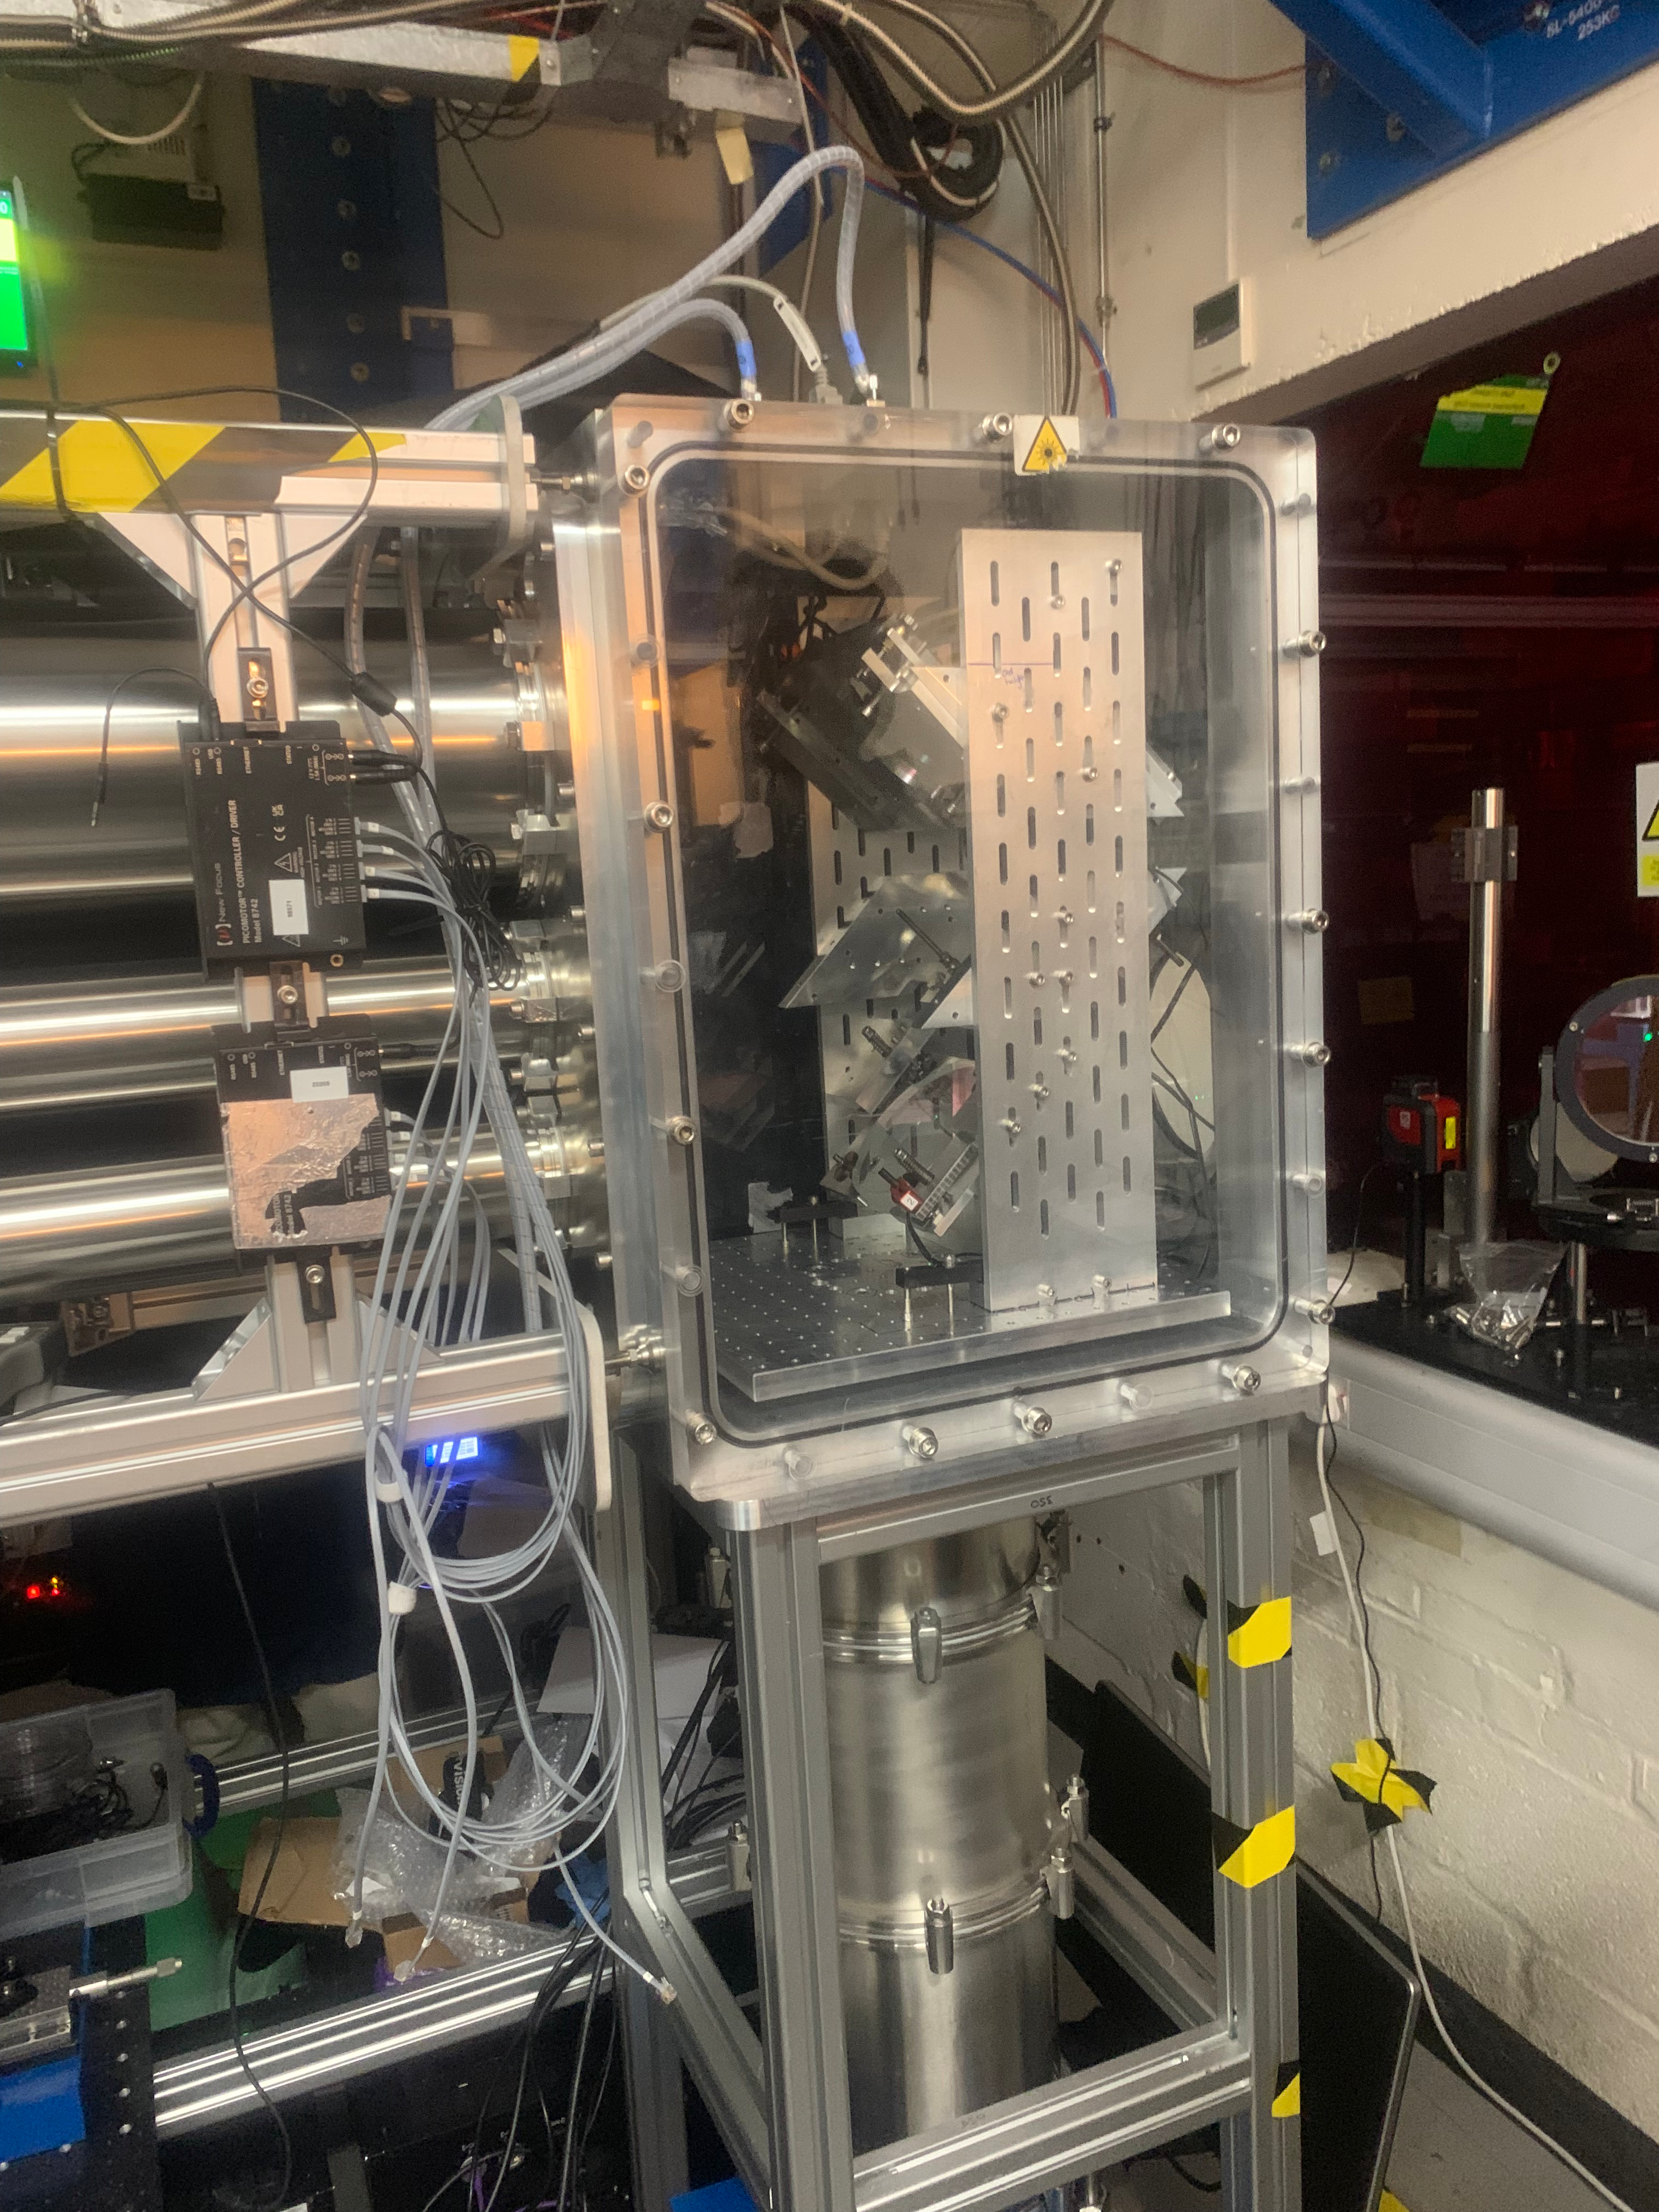
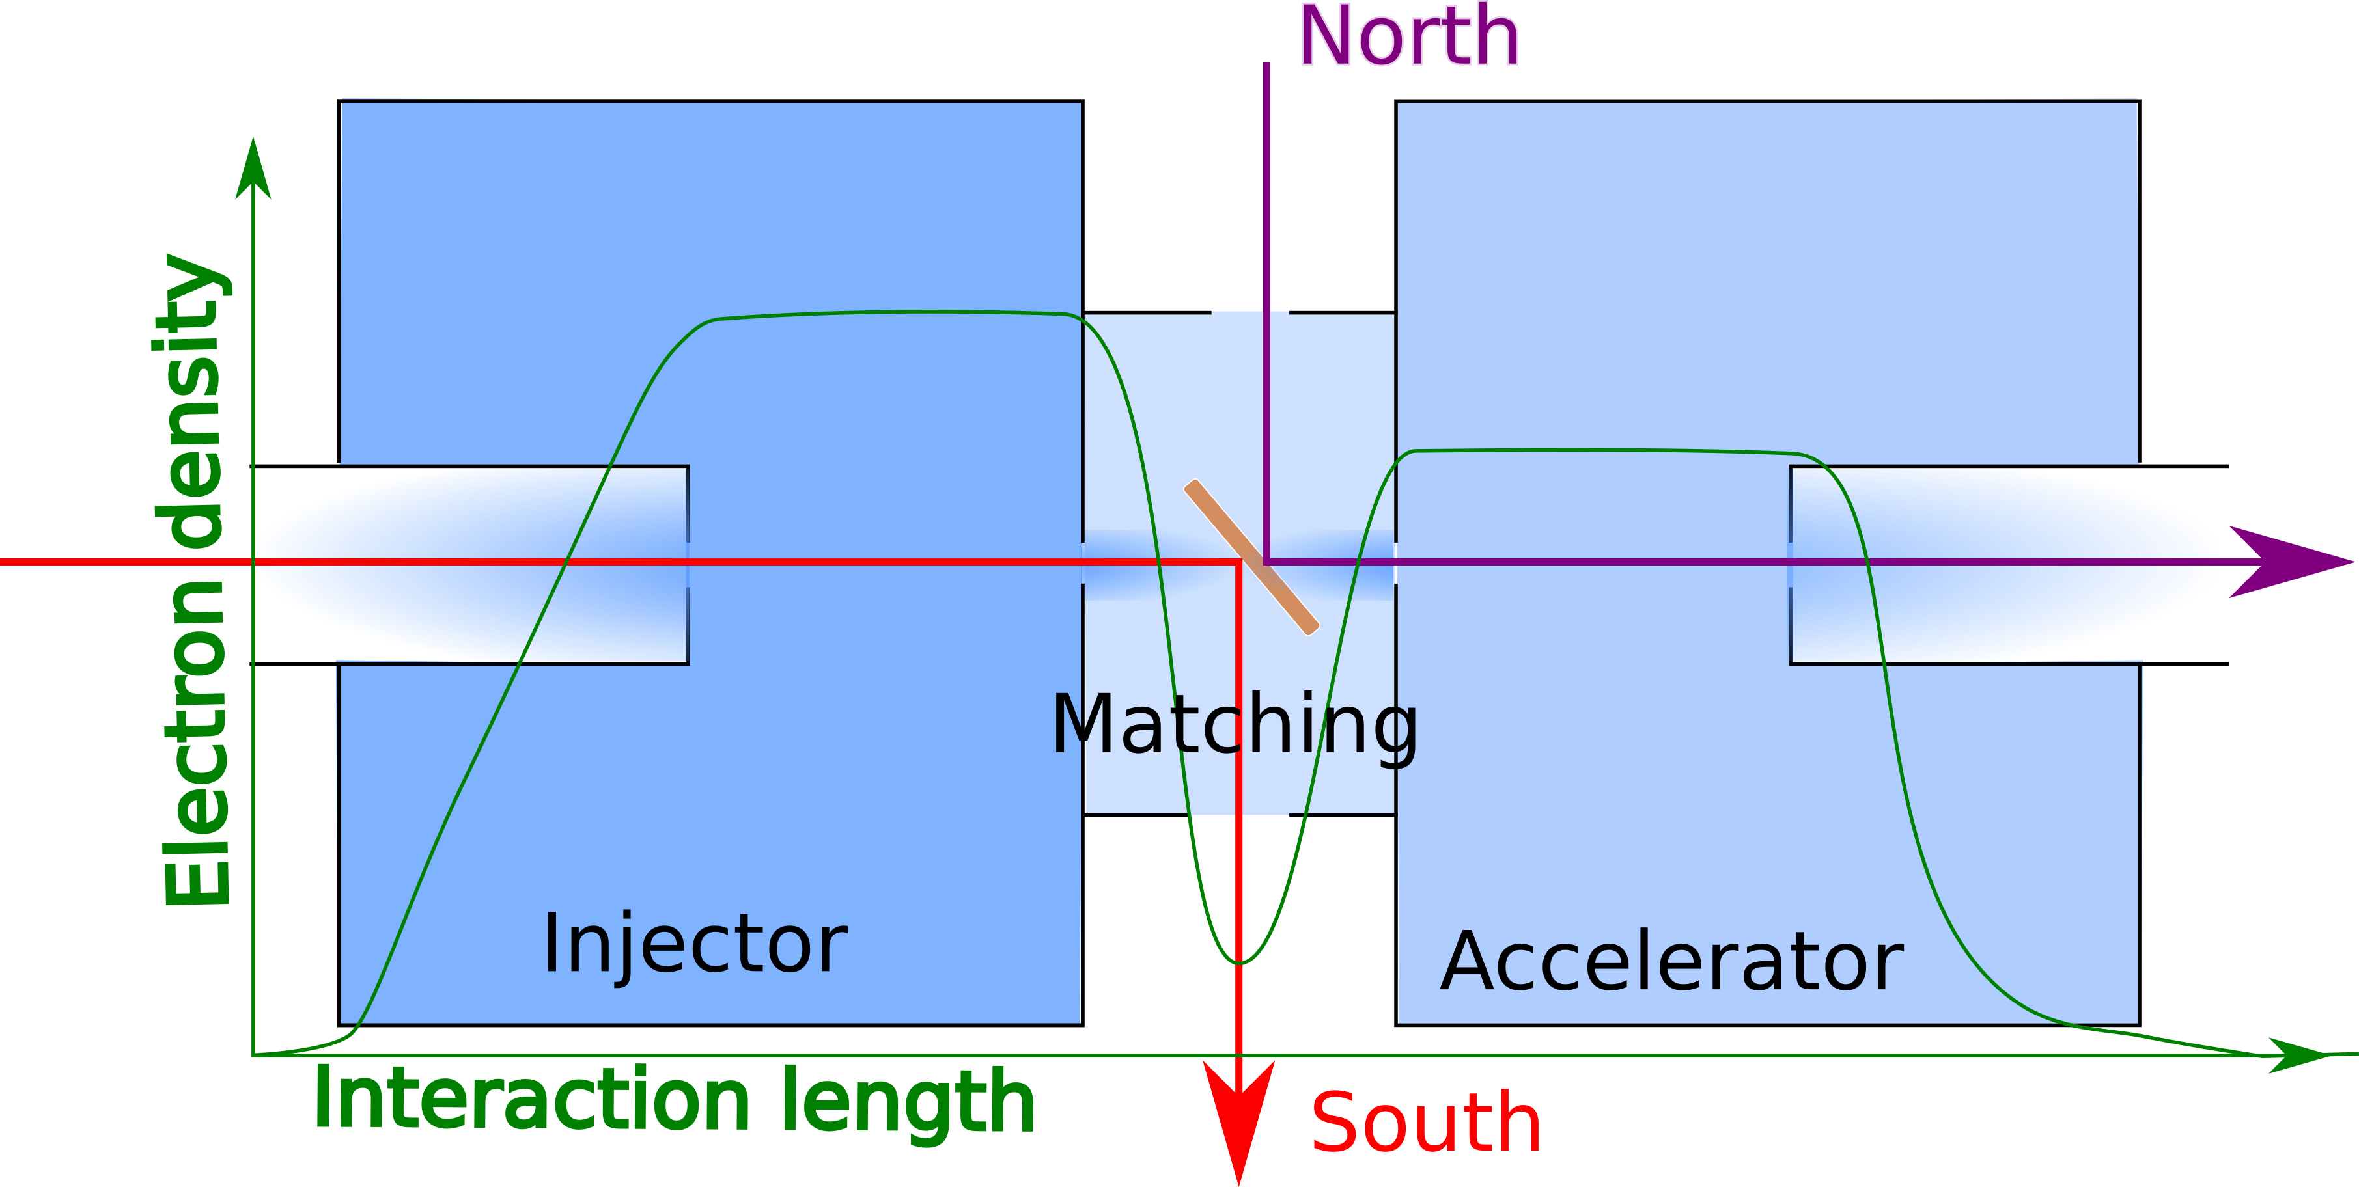
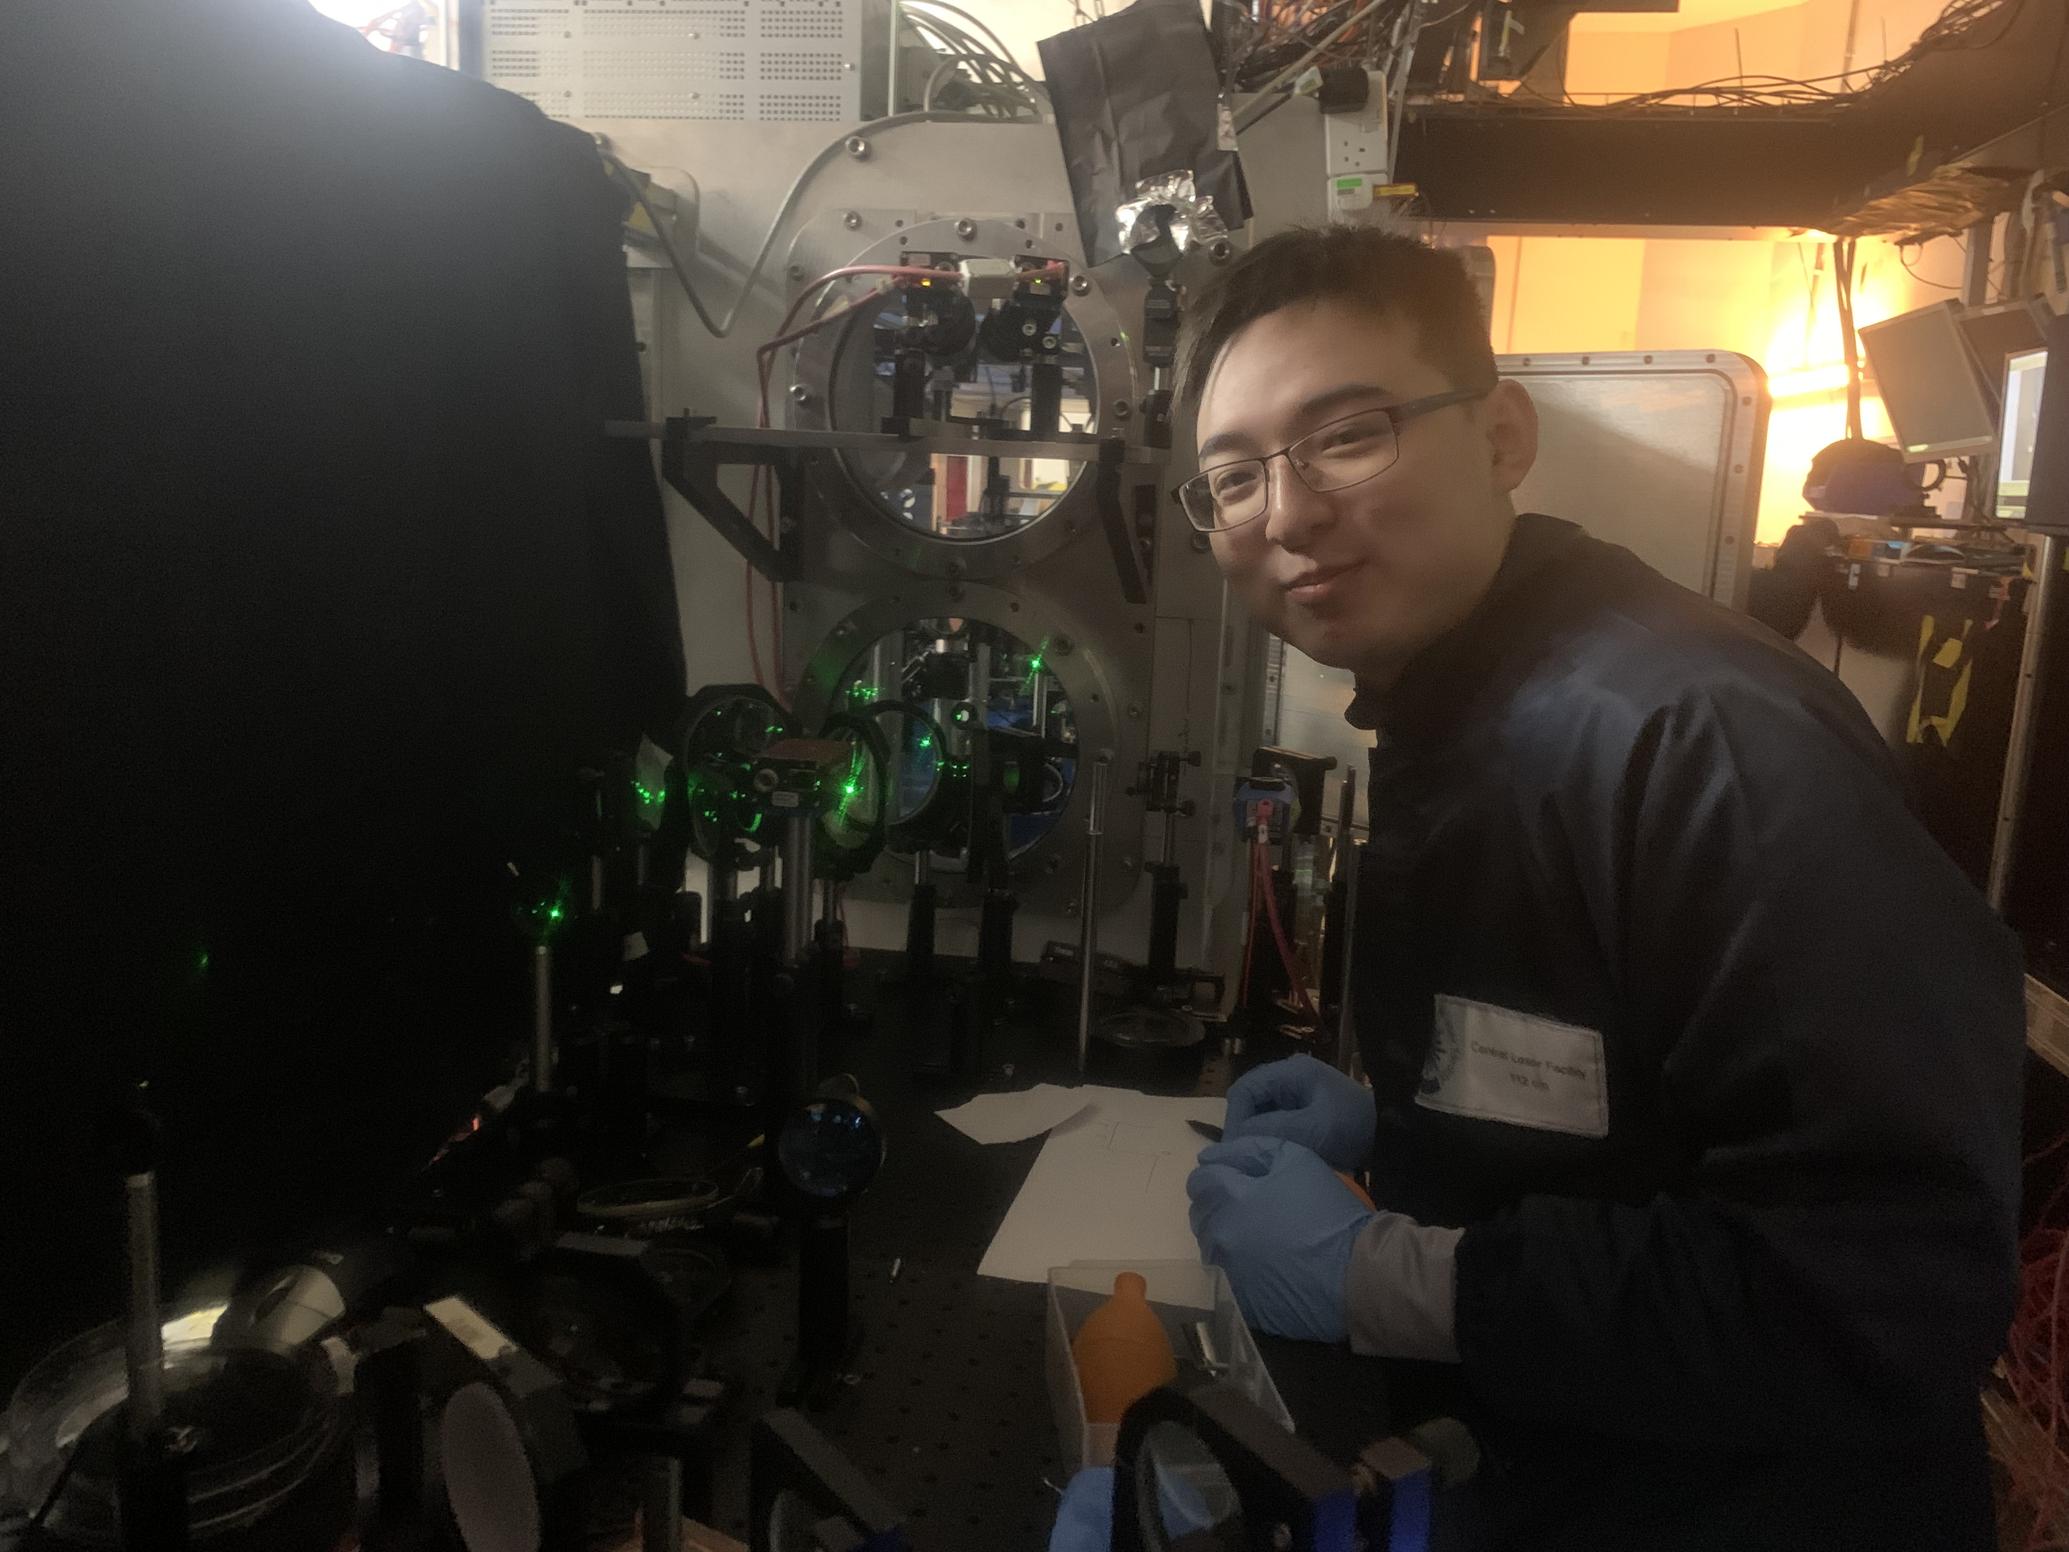
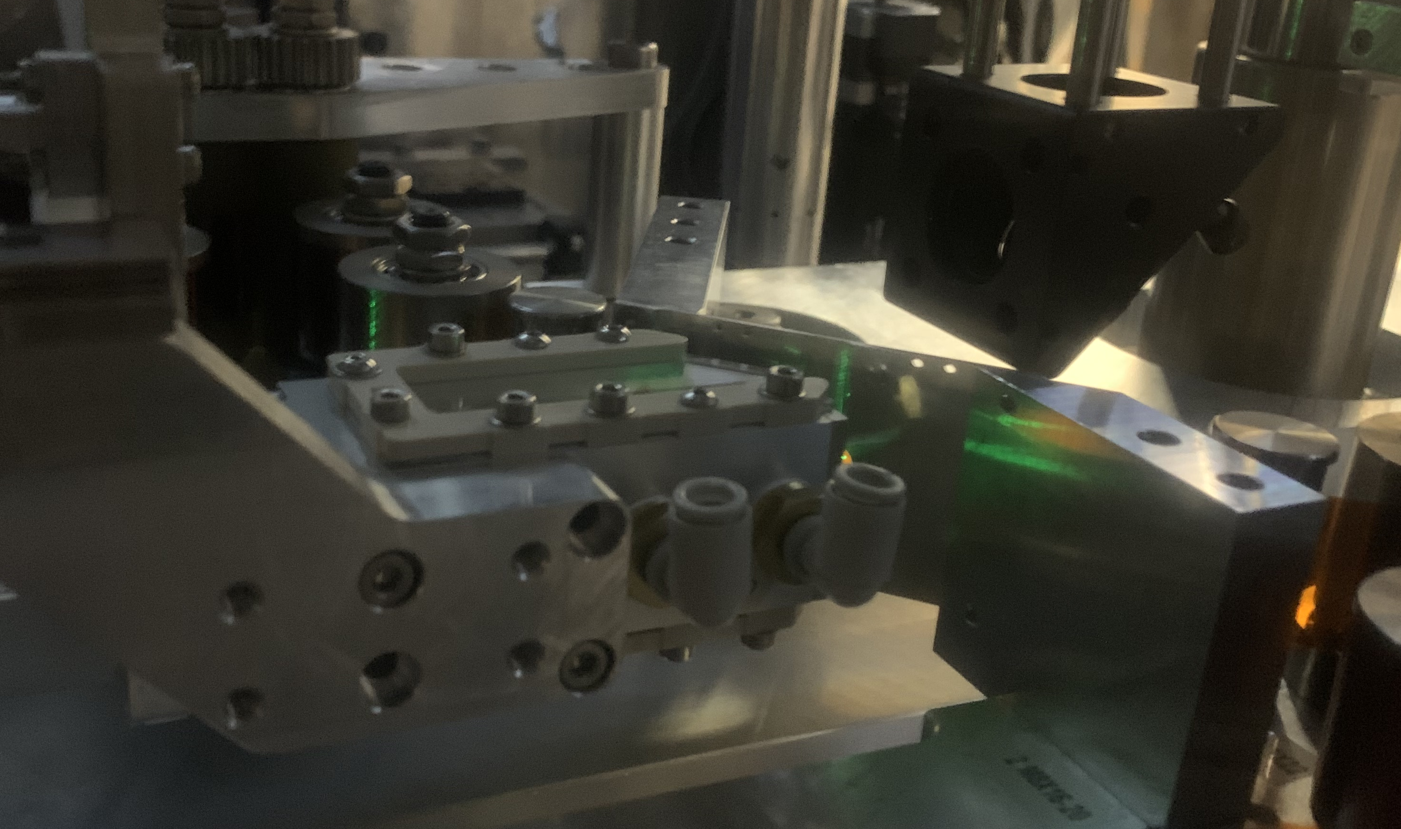
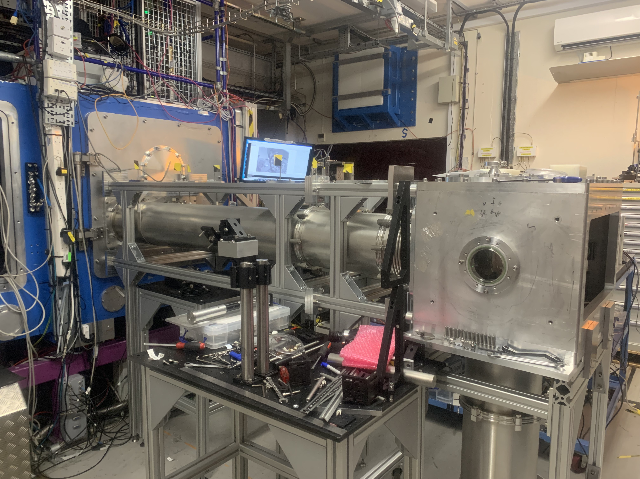
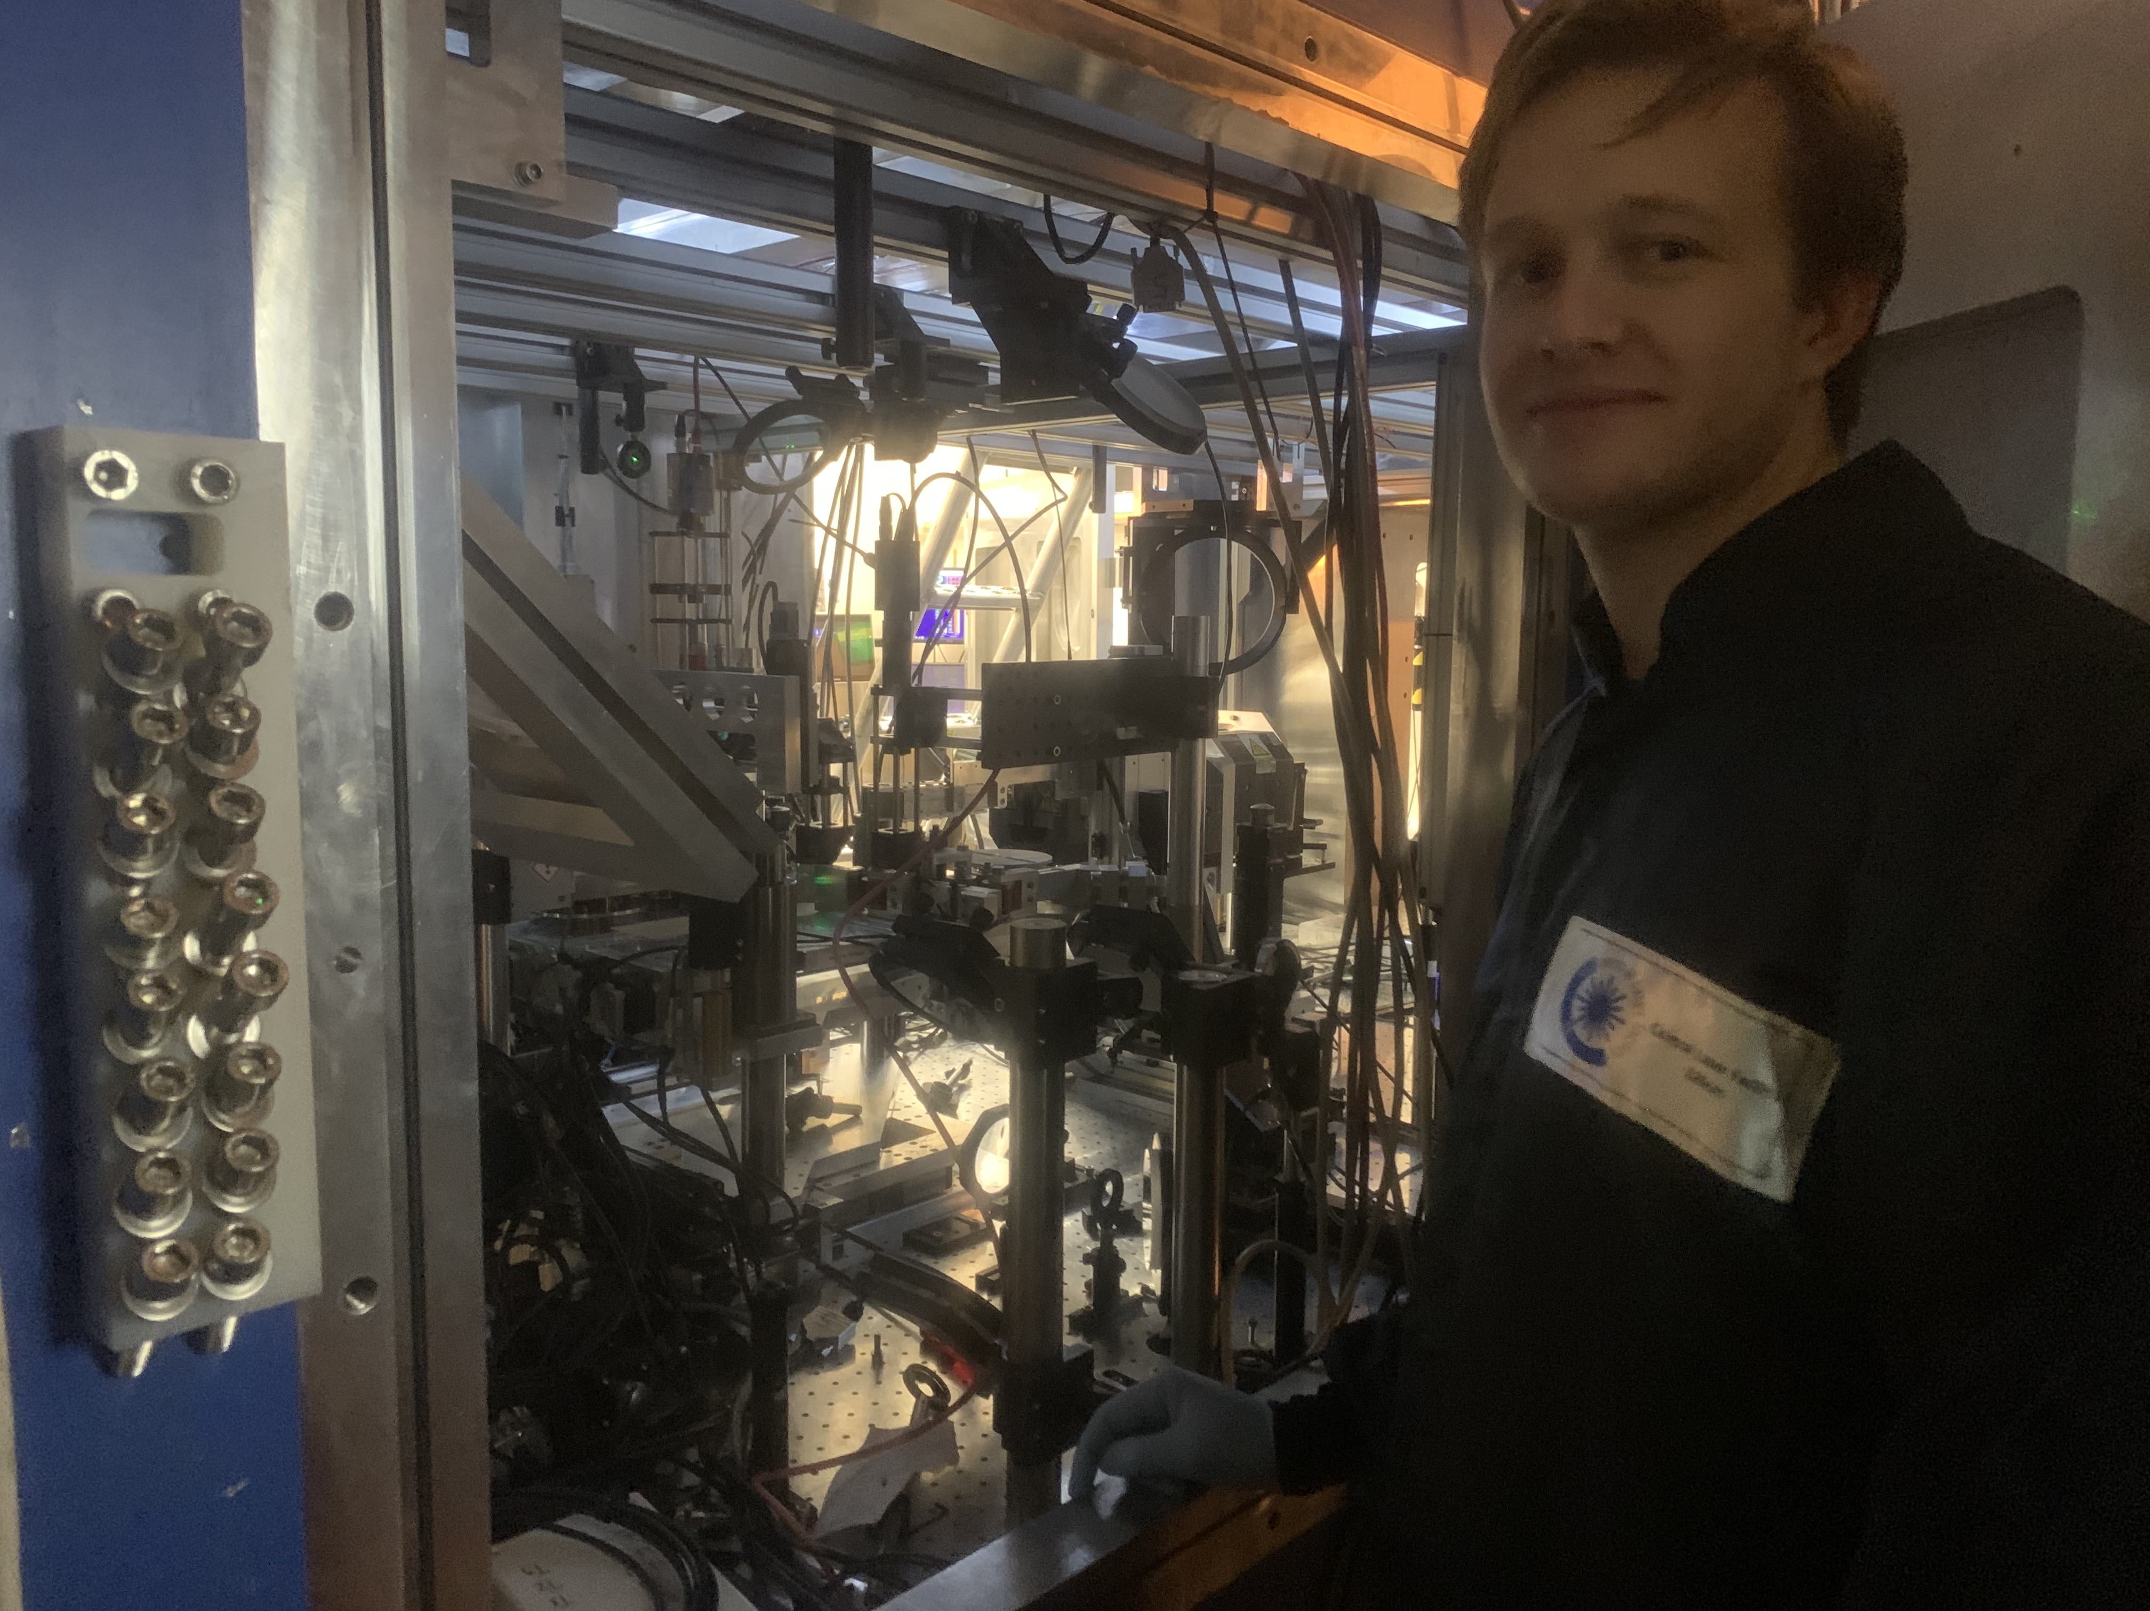
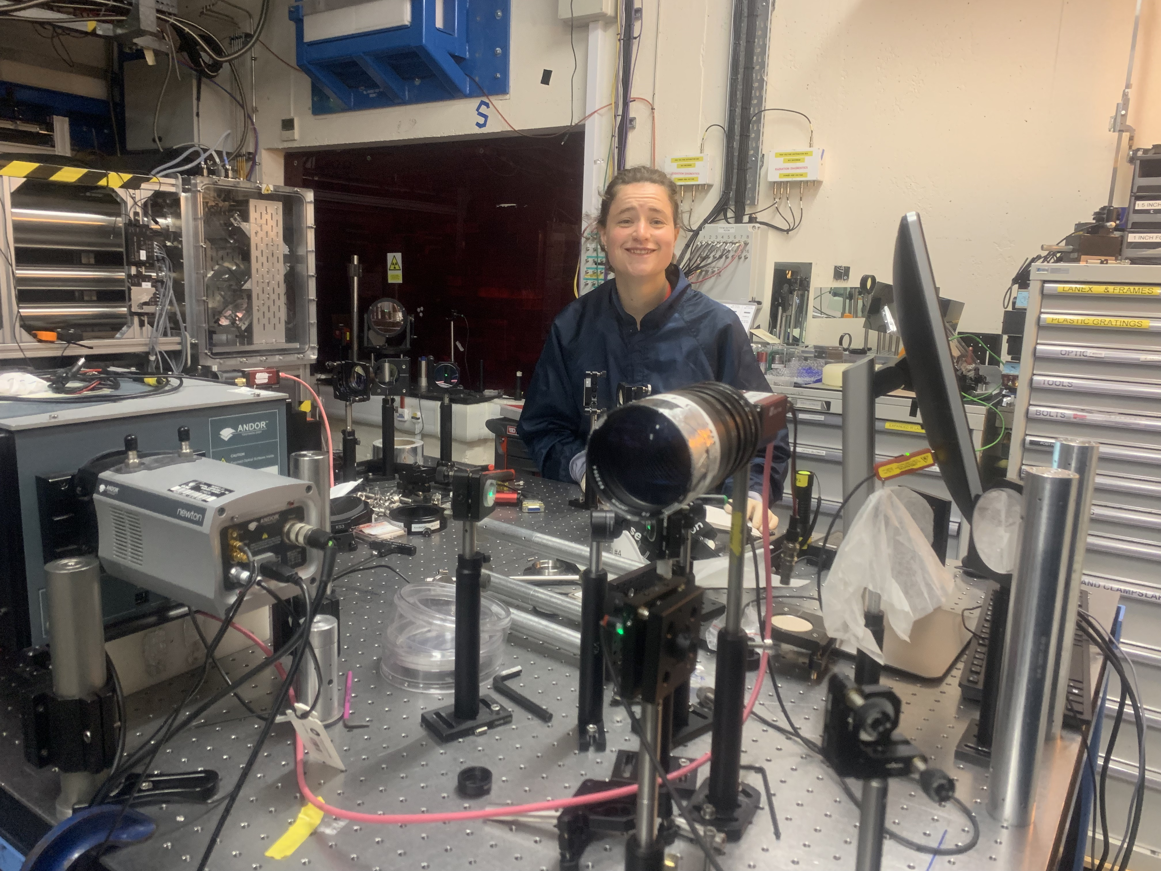
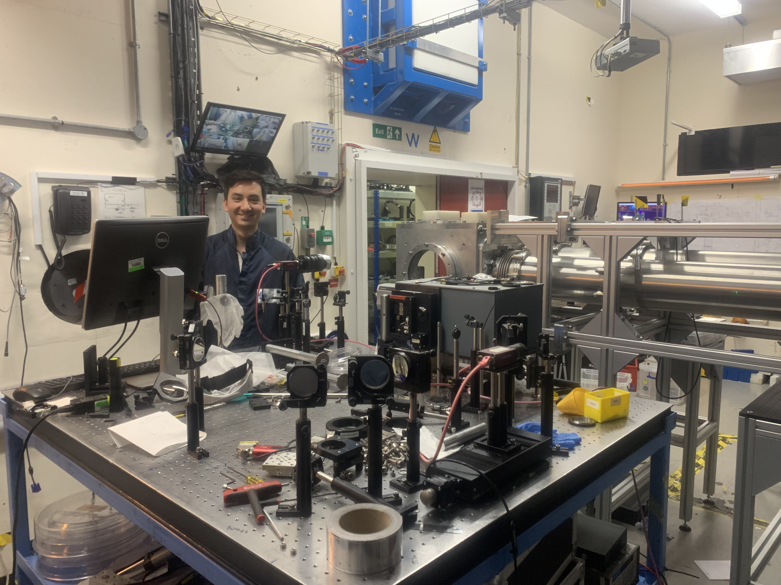
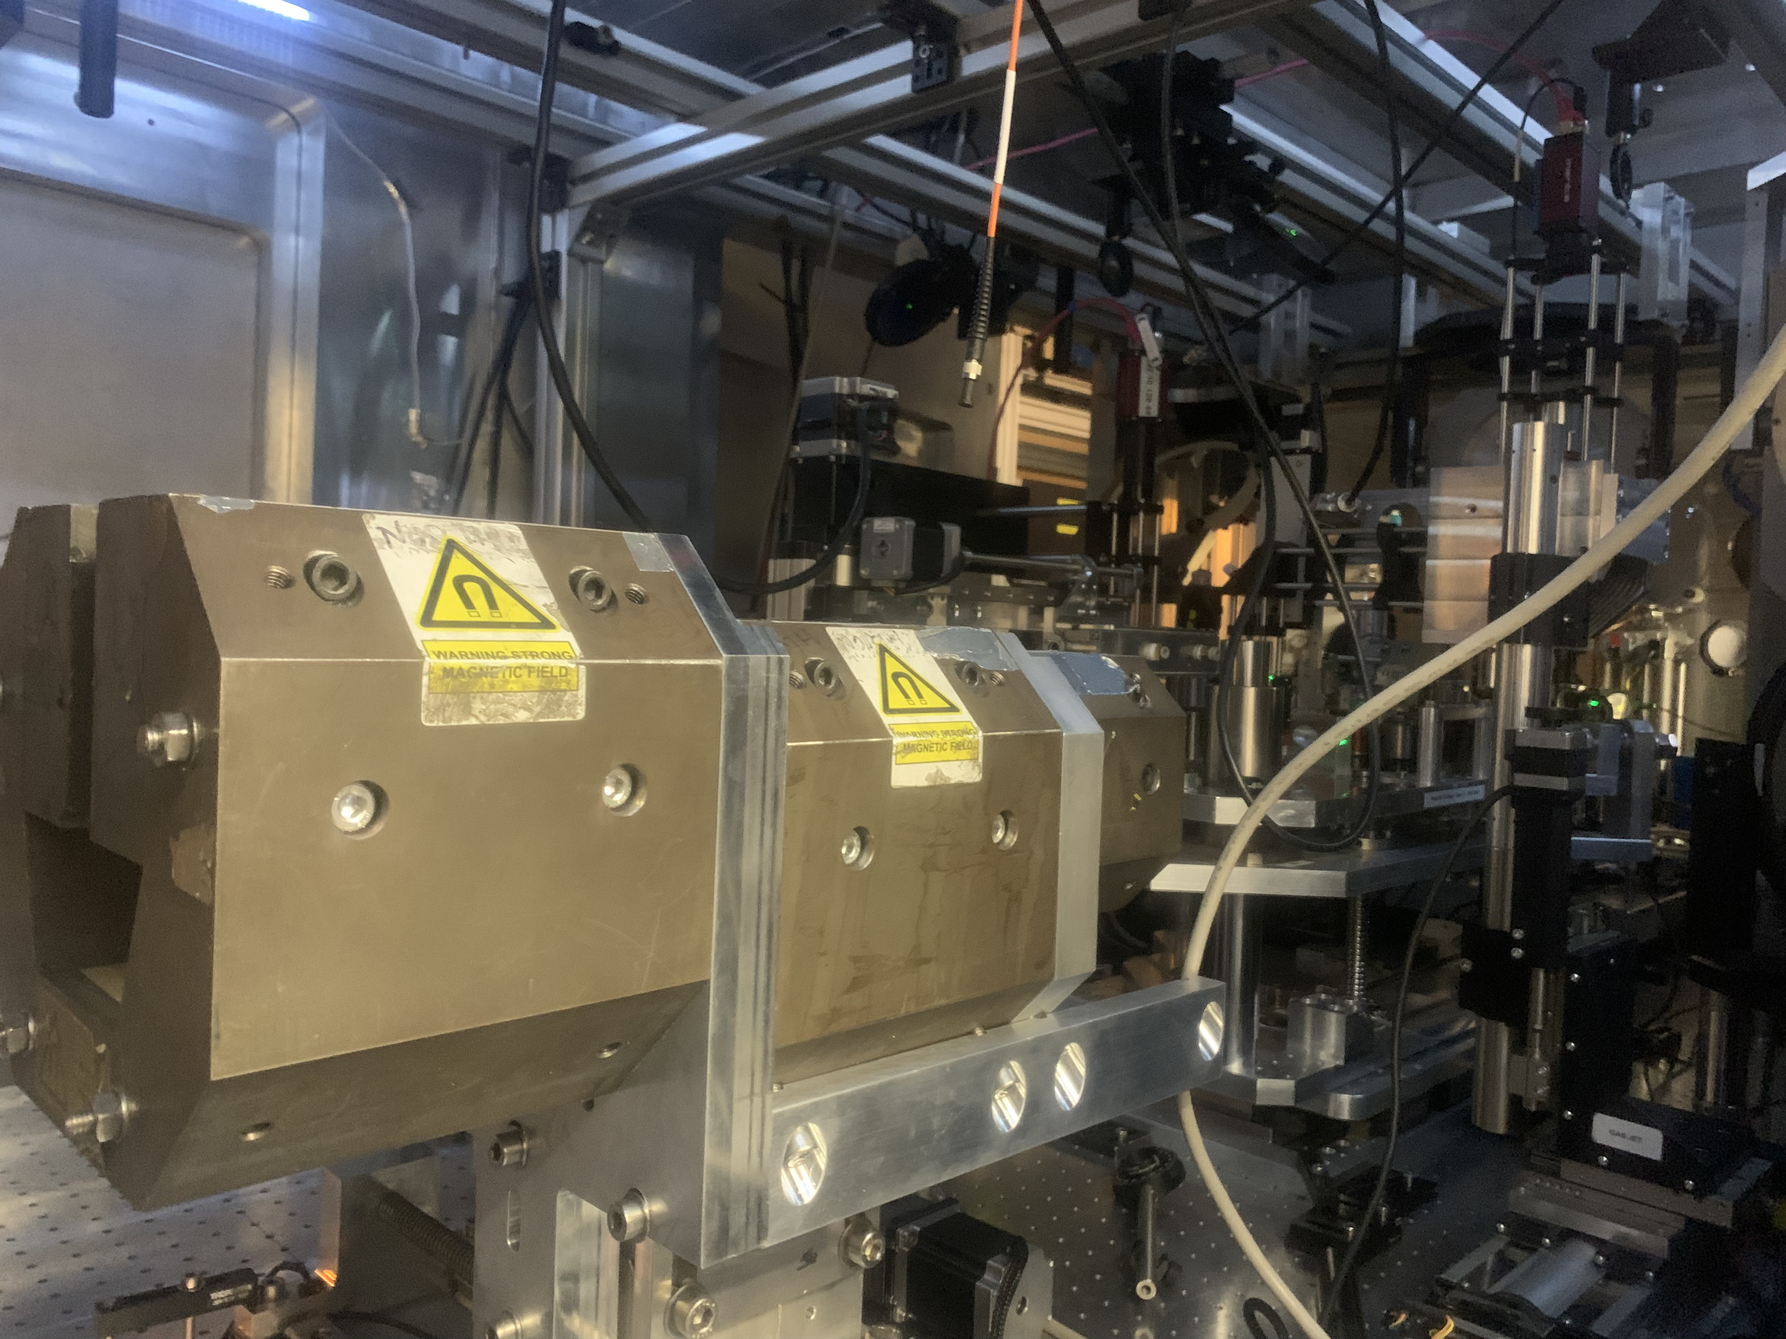
Staging run Gemini 2024
    Aims:
    1. better injector
    2. better laser coupling (plasma mirrors)
    3. better synchronisation (spatial and temporal)
Notes:
Can’t set up a permanent beam line, but studying different aspects of laser staging:
better injector
laser coupling (plasma mirrors)
synchronisation - spatial and temporal

Slide 7
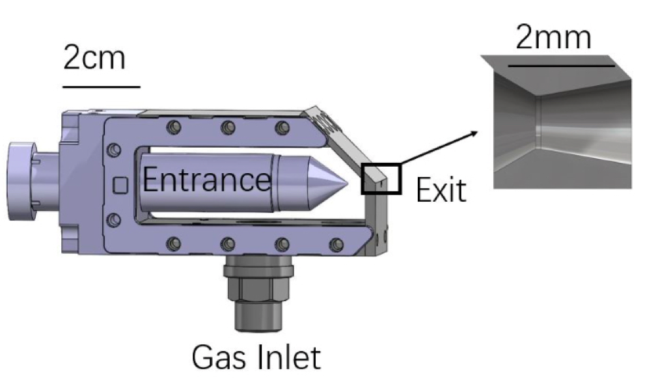
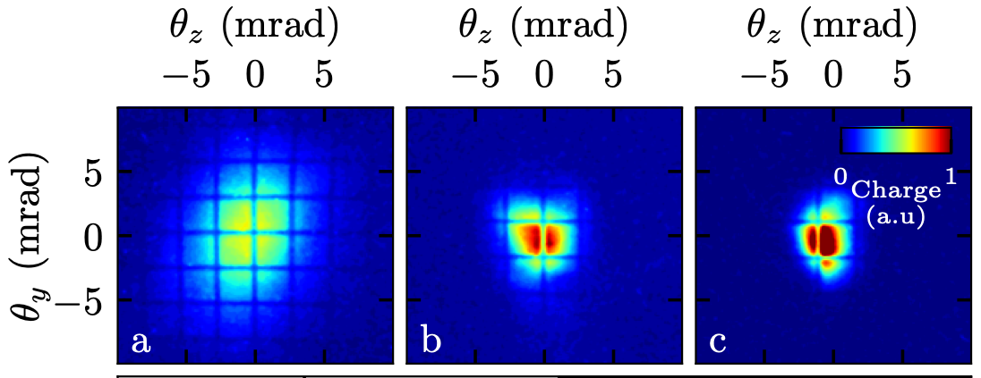
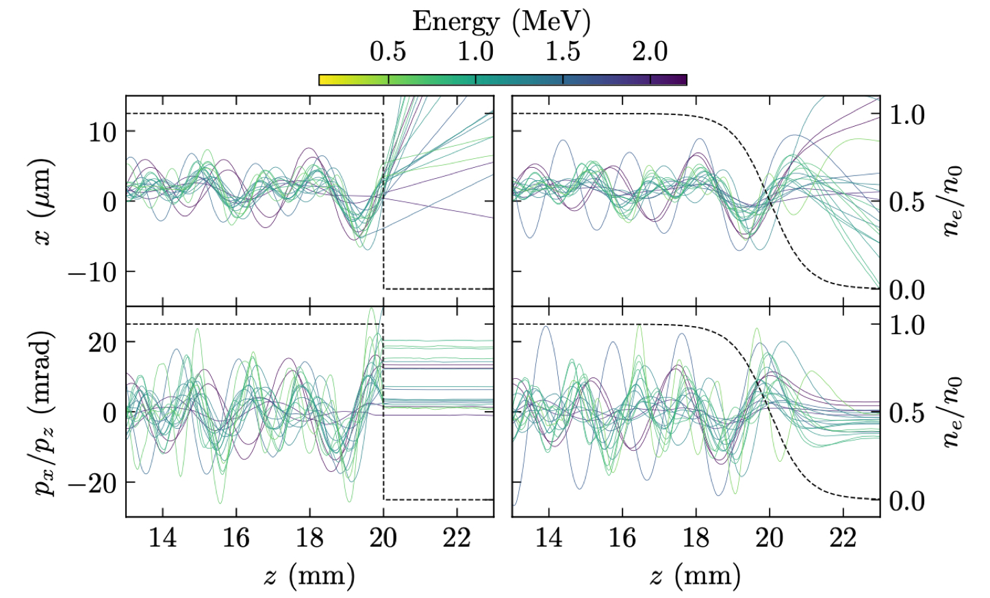
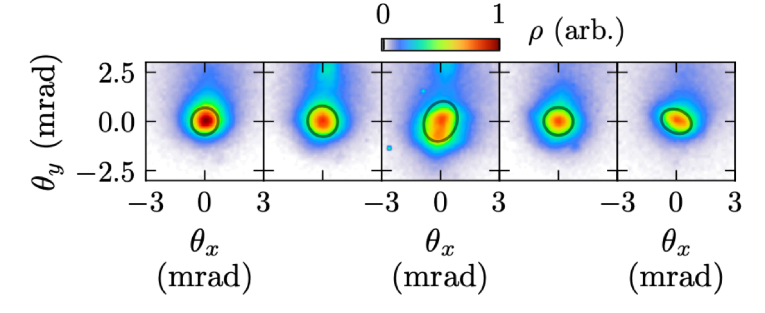
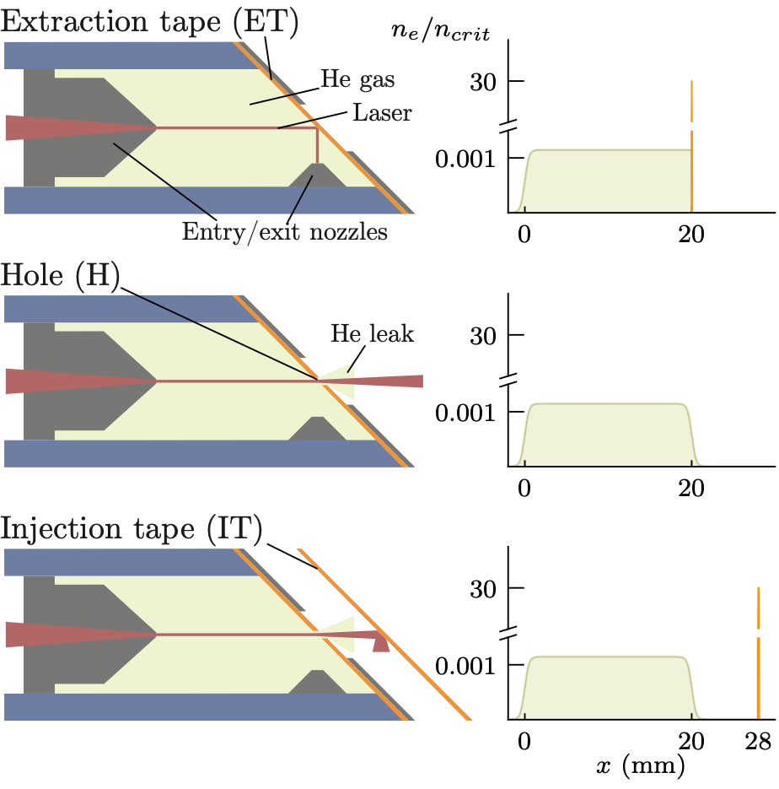

Minimising emittance growth between stages
by using a structured gas cell exit, ramp length has been increased
beams of divergence ~ 0.1 mrad now observed using ionisation injection, implying < µm emittance electron beams
M. Backhouse, R. J. Shalloo, J. C. Wood, “Measurements of the effect of density ramps on GeV laser wakefield accelerated beams: implications for staging” et al in review.
M.P.Backouse et al, Low divergence electron beams from a gas cell, RAL report 2024

Slide 8
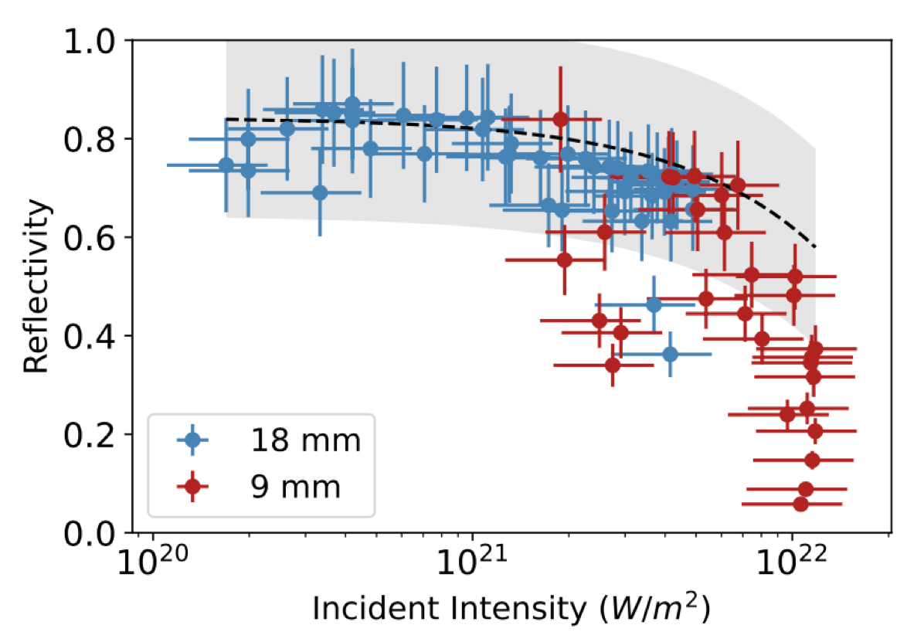
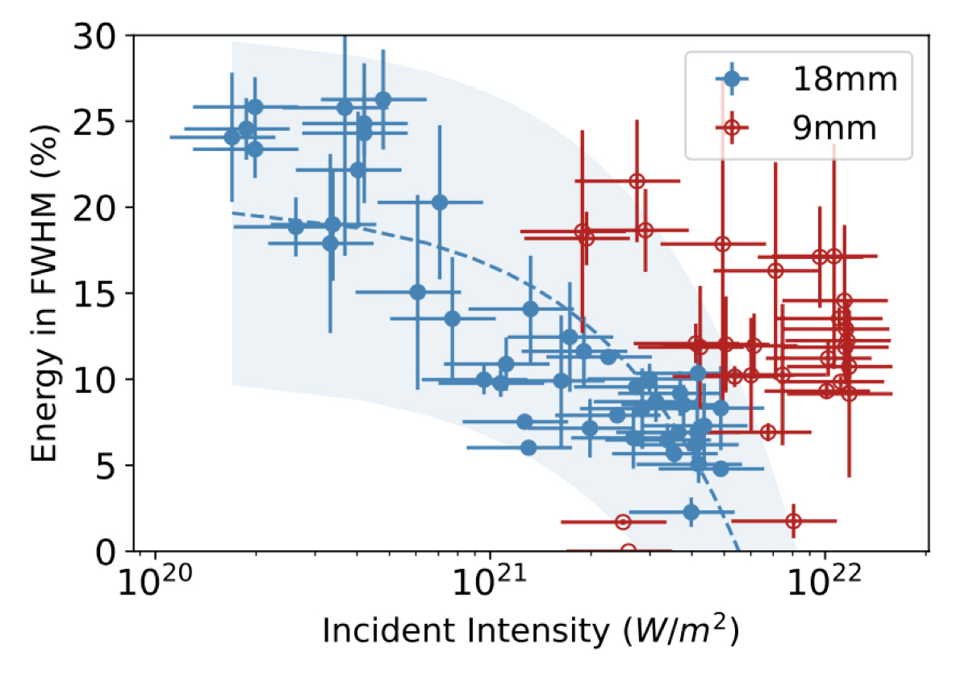
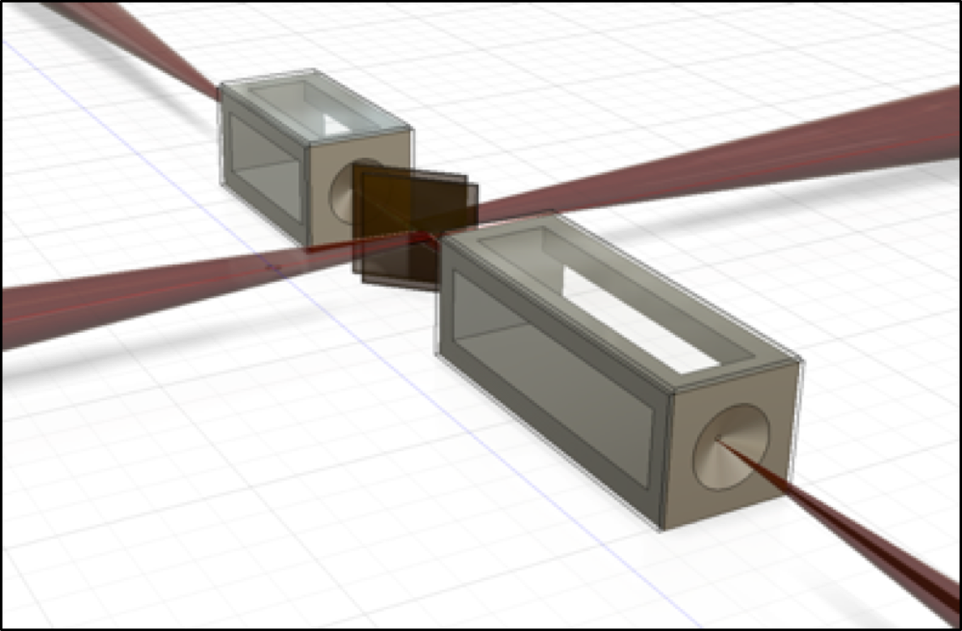
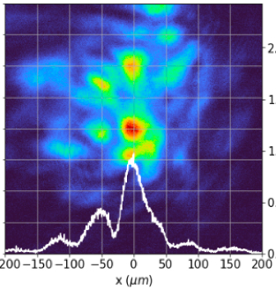
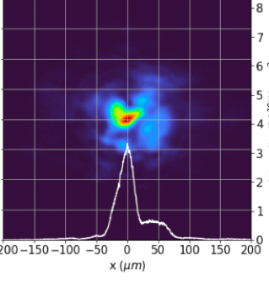
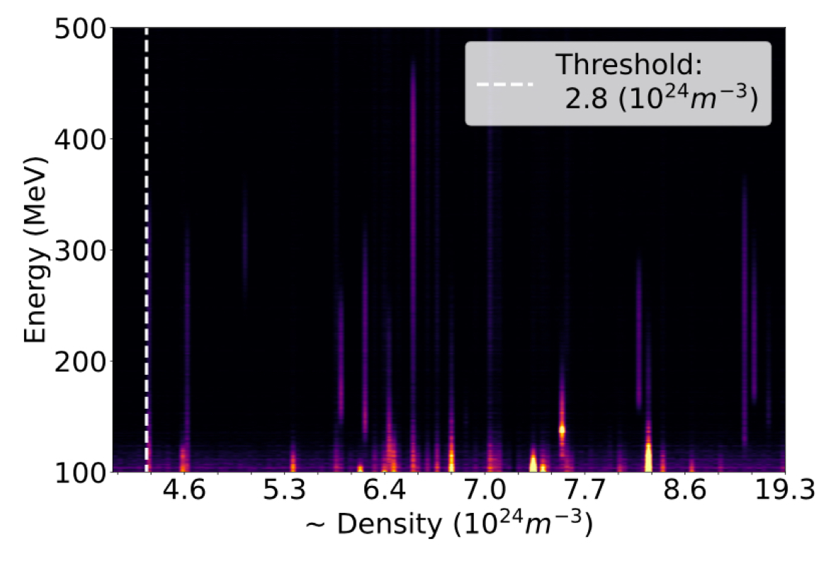
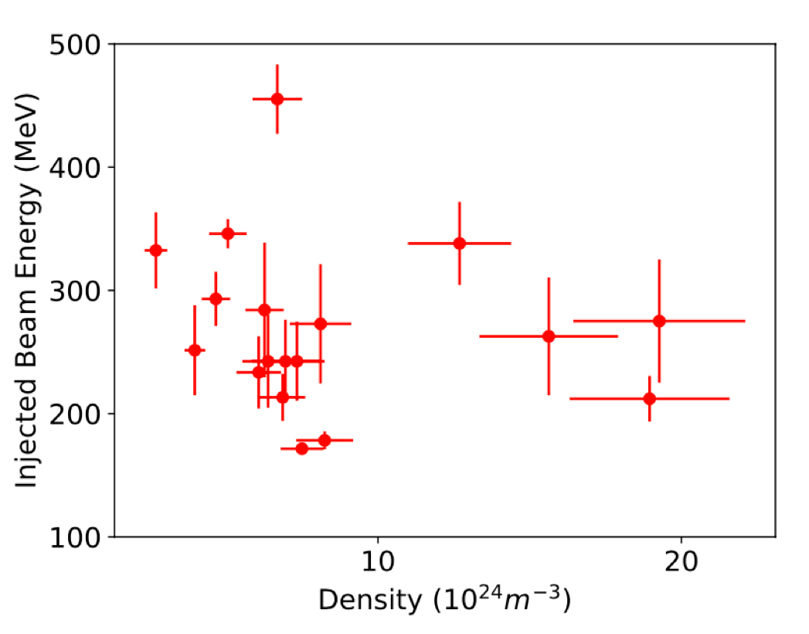
Plasma mirror studies
> 70% total reflectivity observed but energy within fwhm better when working at shorter plasma mirror working distance
better spot enabled self-injection proving generation of large amplitude wakefield
J. Hills et al, Plasma Mirror Operation at High Intensity: Reflectivity and Beam Profile, RAL report 2024
J. Hills et al, Wakefield Accelerator Driven to Ionisation Injection Using a Laser Reflected Off a Plasma Mirror at High Intensities, RAL report 2024

Slide 9
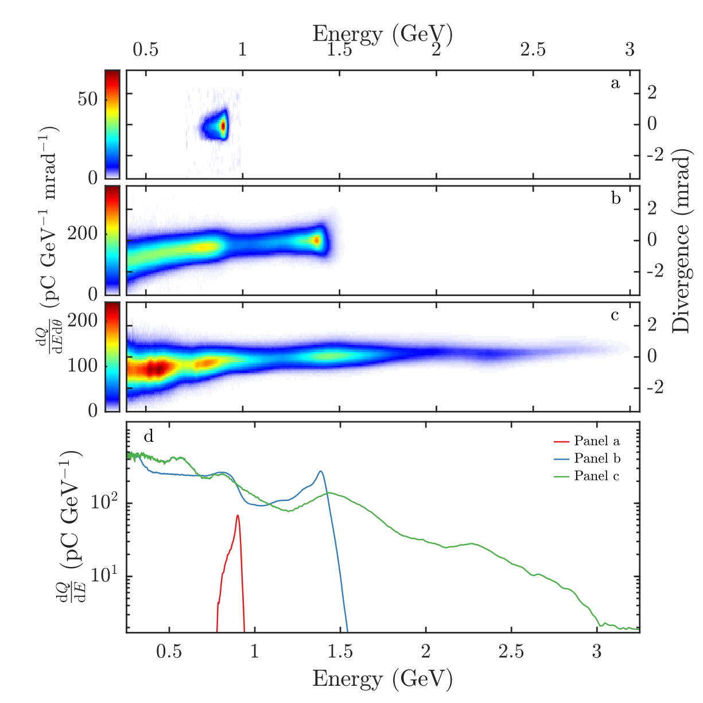
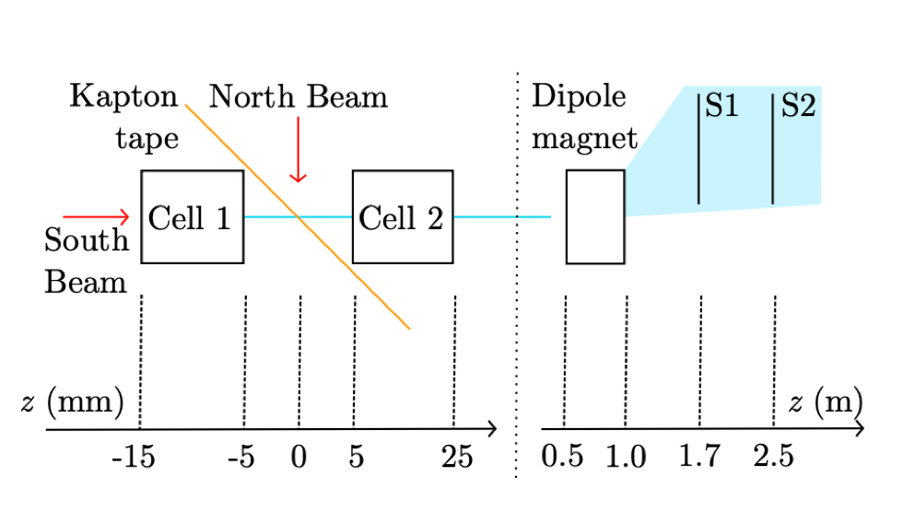
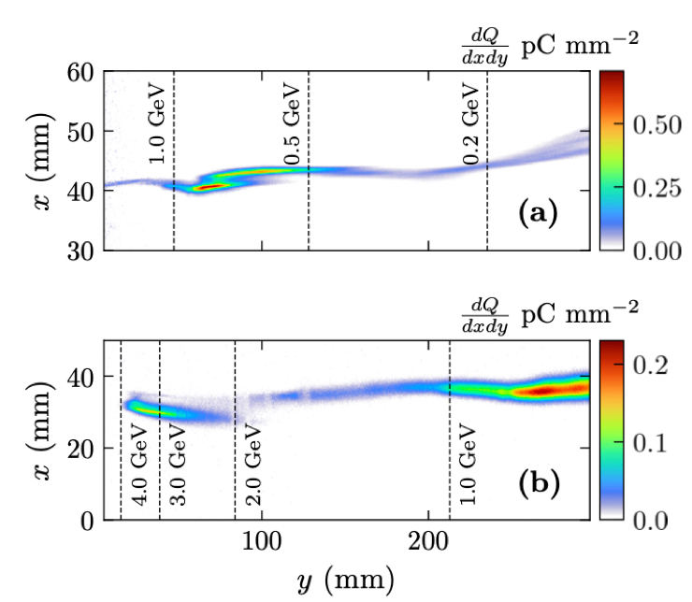
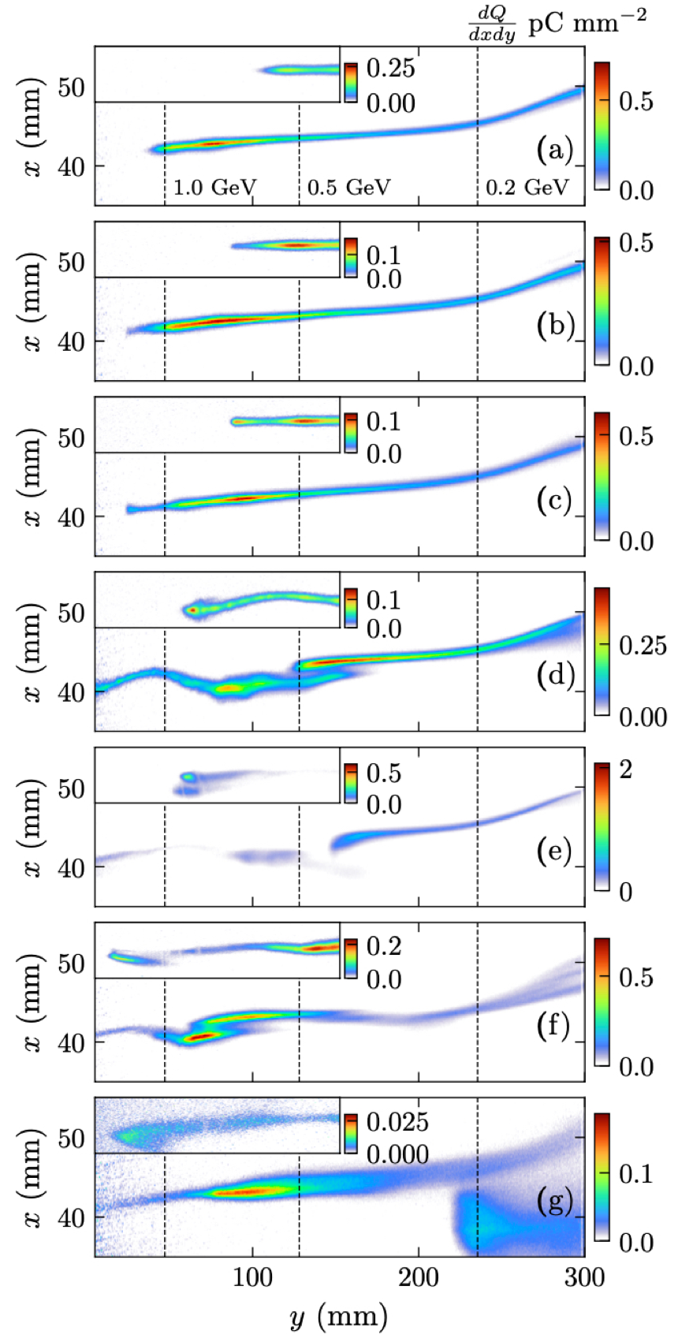
High energy beams from self-injection
no plasma
passing beam through plasma leads to large increase in maximum energy (1 GeV →> 3 GeV)
acceleration insensitive to timing suggesting self-beam driven acceleration
Põder, K. et al. Multi-GeV Electron Acceleration in Wakefields Strongly Driven by Oversized Laser Spots. Physical Review Letters 132, 195001 (2024).
M. P. Backhouse et al. Beam driven electron acceleration to 4 GeV at Gemini, RAL report 2024
plasma

Slide 10
Laser Driven Ion Sources

Slide 11
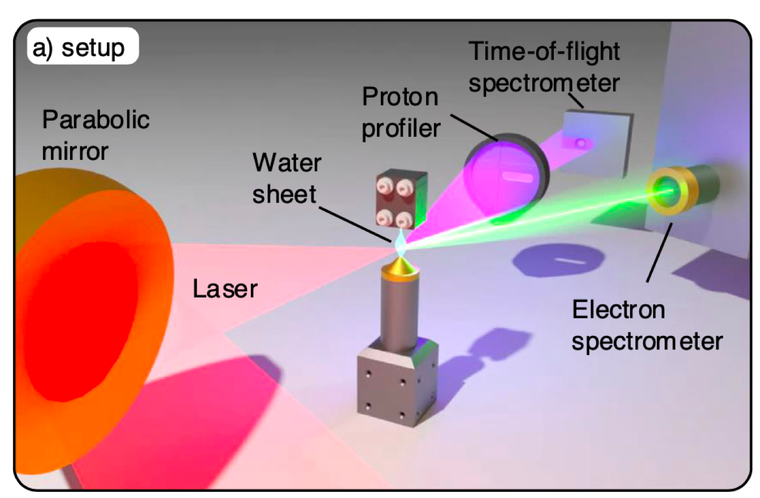
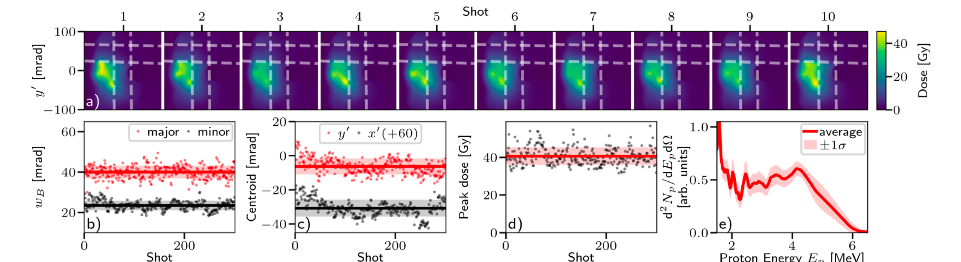
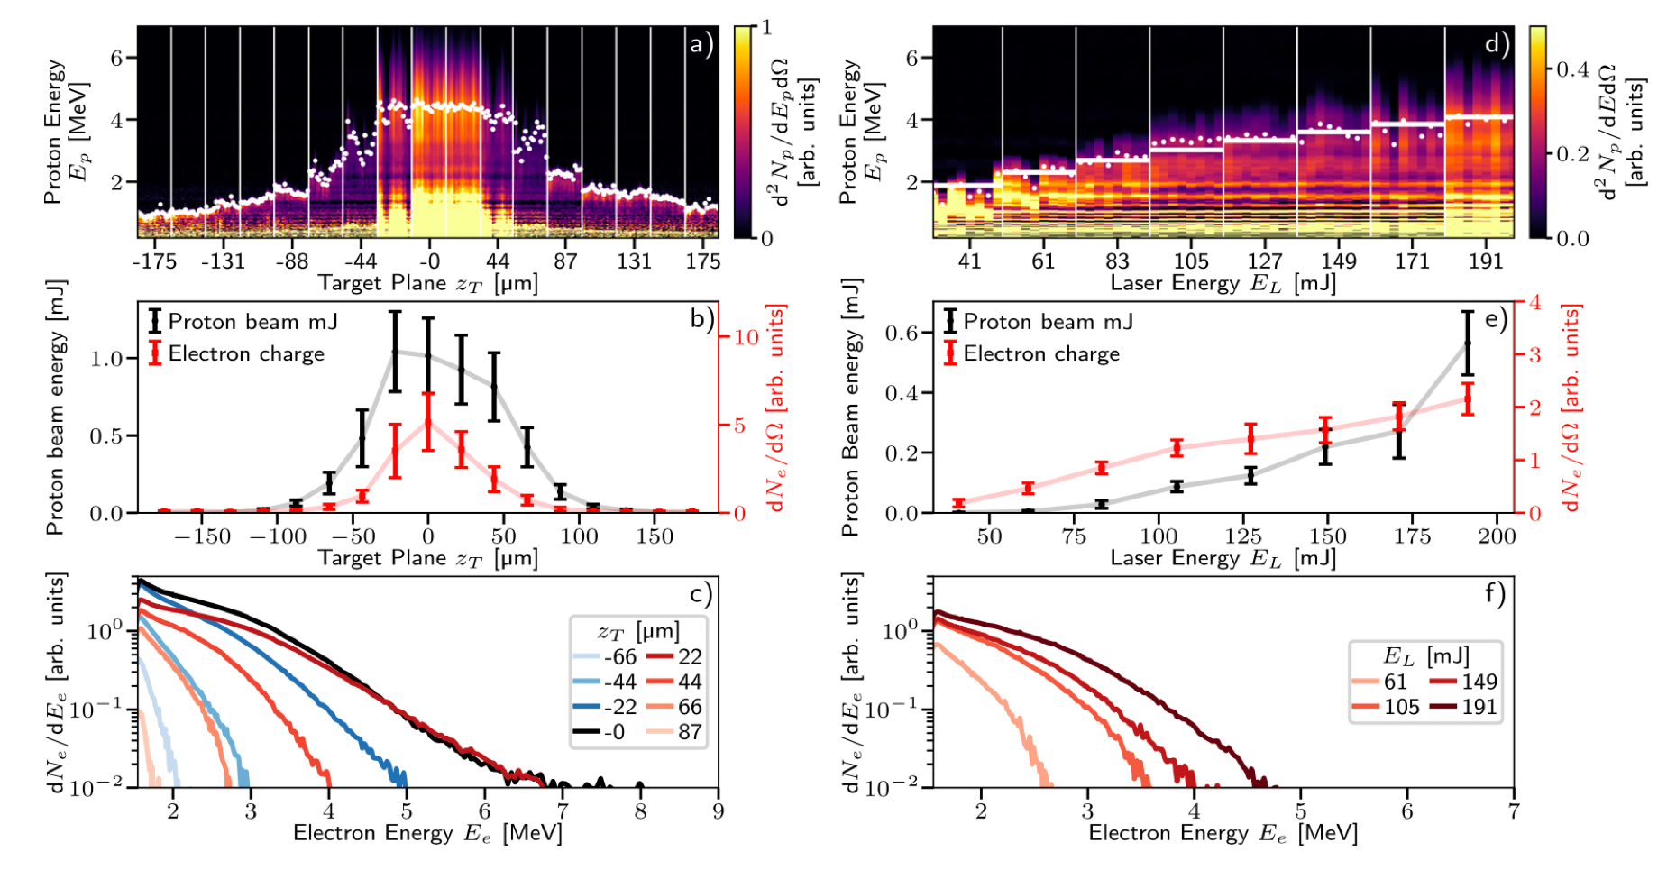
Laser driven ion beams - liquid sheet targets
Liquid sheet target run at 5 Hz repetition rate
Used water sheet target developed at SLAC
Reproducible source of ions
Enabled high rep rate operation, allowing ML optimisation of ion energies and yield
Loughran, B. et al. Automated control and optimization of laser-driven ion acceleration. High Power Laser Science and Engineering 11, e35 (2023).

Slide 12
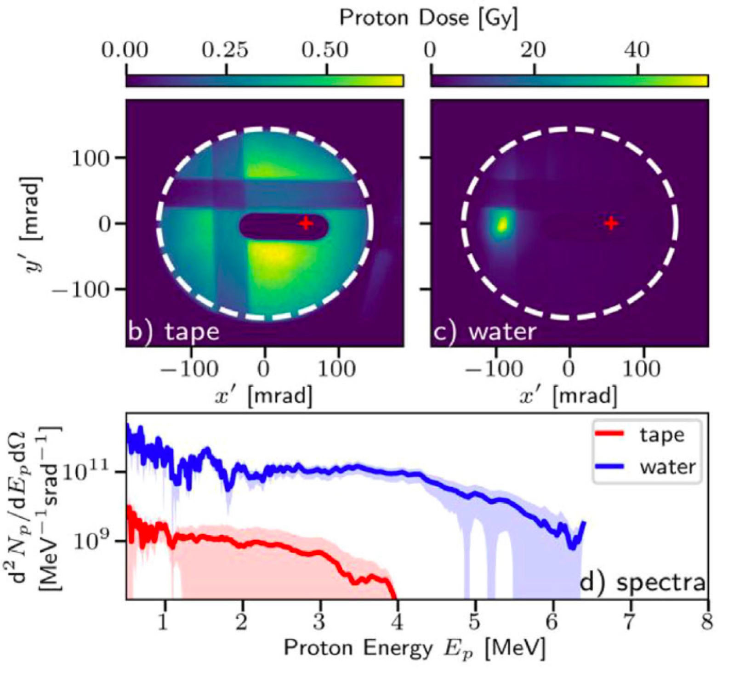
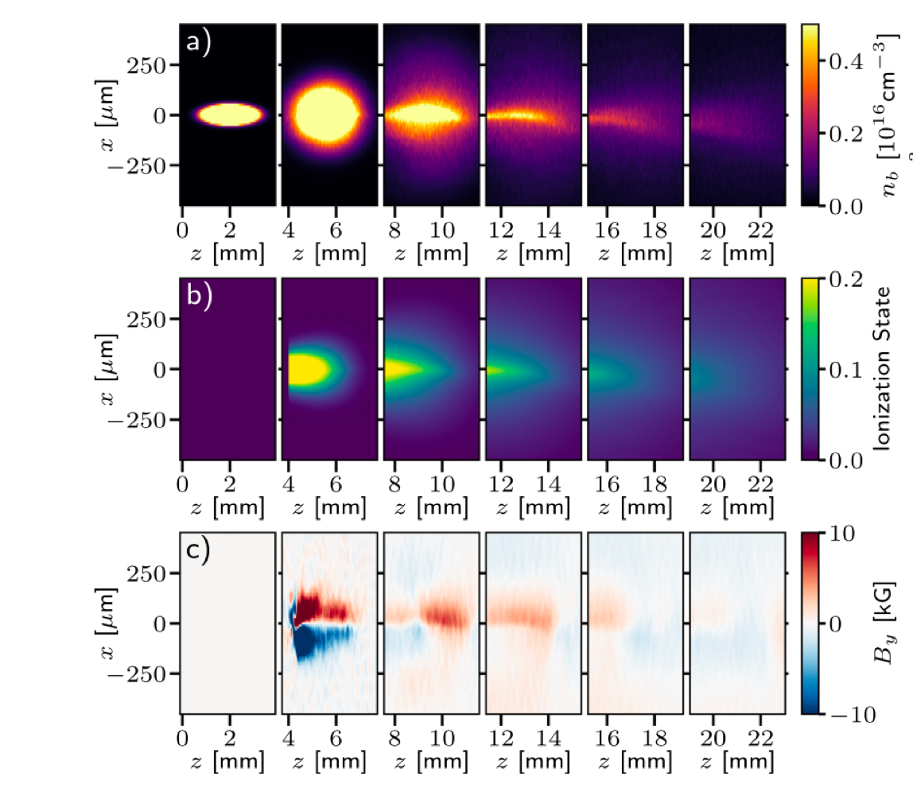
Laser driven ion beams - liquid sheet targets
Dramatic reduction in beam divergence observed relative to sheath acceleration:
Beams from water sheet targets with < 1° divergence for 100× increase in flux compared to solid targets
7 MeV protons produced with only 190 mJ of laser energy at 5 Hz
Simulations suggest magnetic fields in density ramps cause collimation of beam
nb
ne
BΘ
Streeter, M. J. v. et al. Stable laser-acceleration of high-flux proton beams with plasma collimation. Nature Communications 16, 1004 (2025).

Slide 13
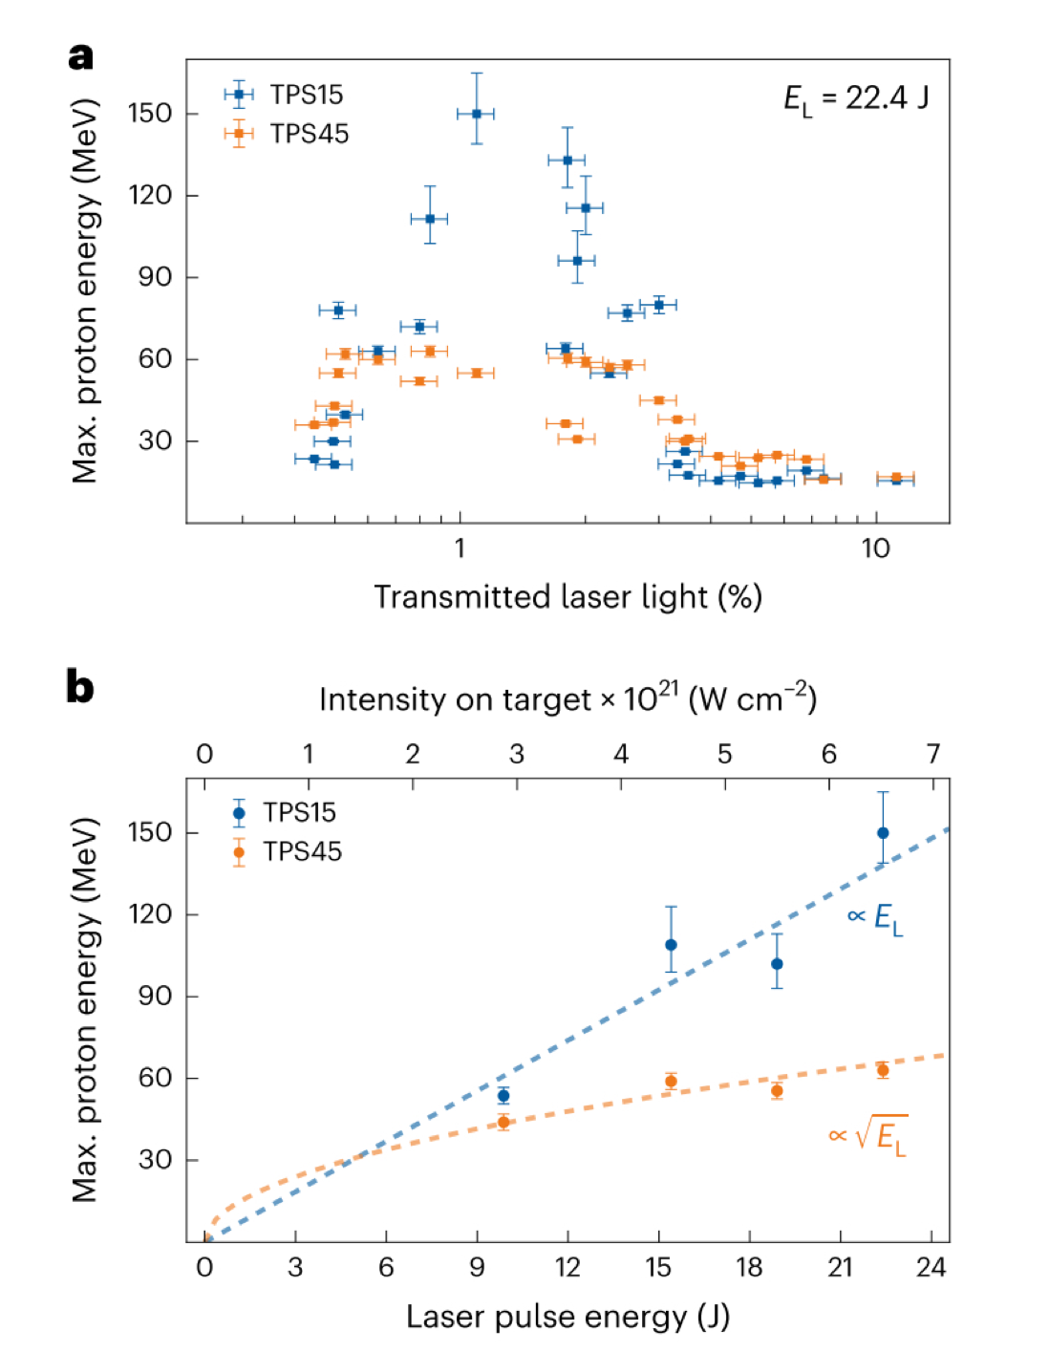
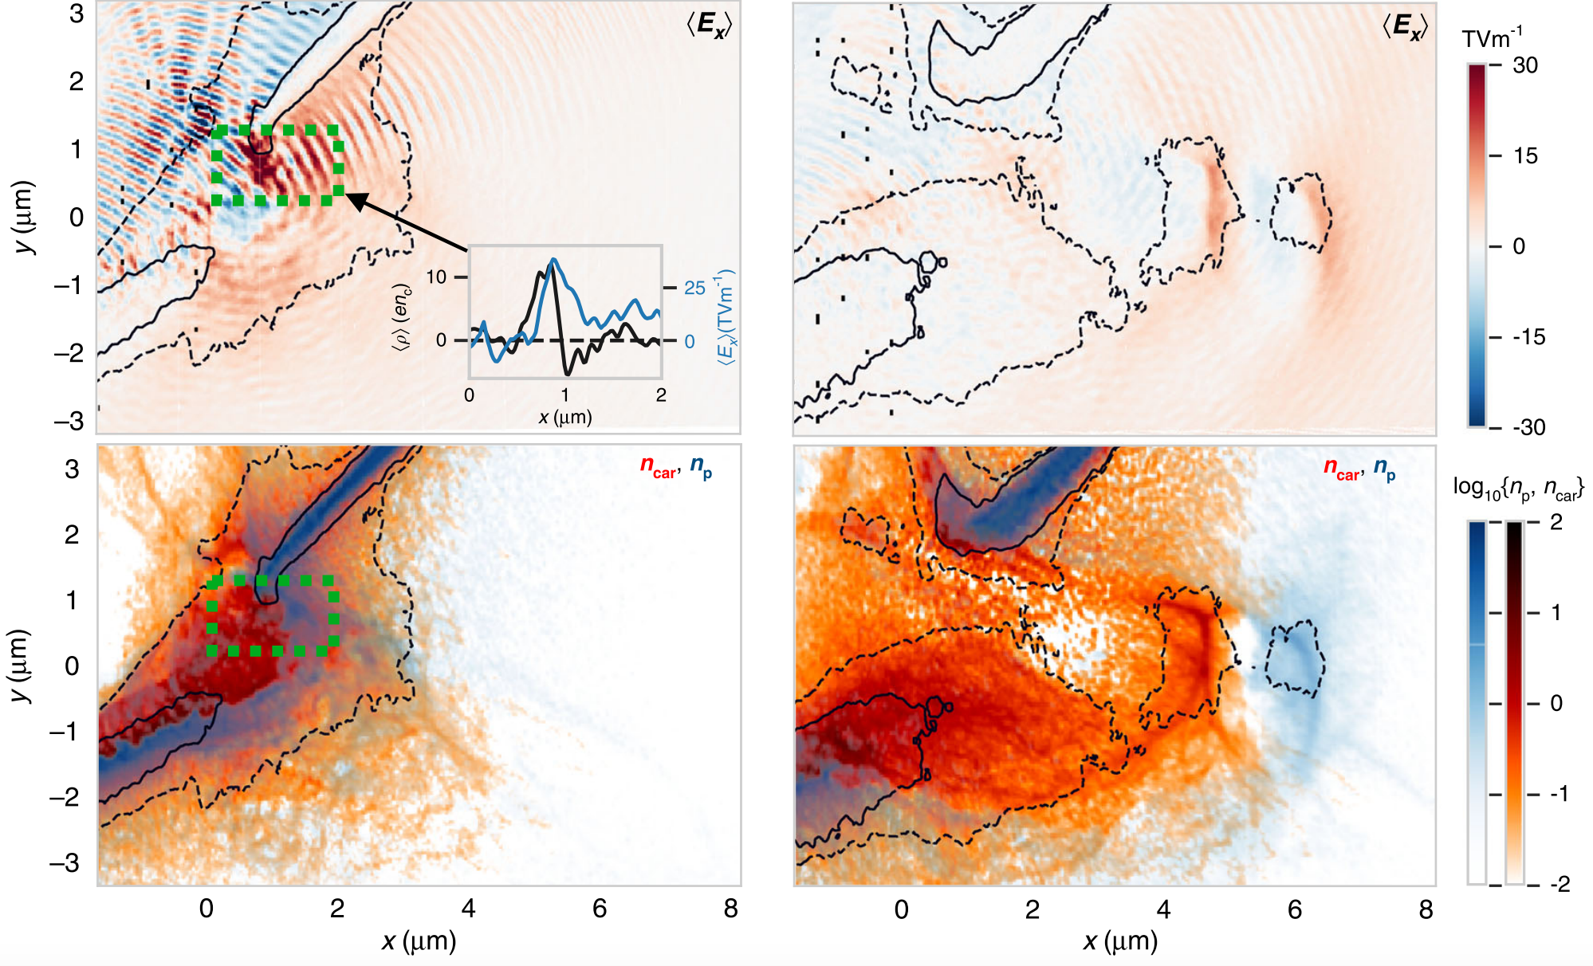
Laser driven ion beams - optimised relativistic transparency
Novel regime of ion acceleration through optimised relativistic transparency
Record ion energies from laser-matter interactions > 150 MeV at HZDR
Acceleration optimised for ~100 µm targets, when transmitted light is almost extinguished
Energy gain almost linear with laser energy
Dover, N. P., Ziegler, T., et al. Enhanced ion acceleration from transparency-driven foils demonstrated at two ultraintense laser facilities. Light: Science and Applications, 12:71 (2023)
Ziegler, T. et al. Laser-driven high-energy proton beams from cascaded acceleration regimes. Nature Physics 20:7 (2024).

Slide 14
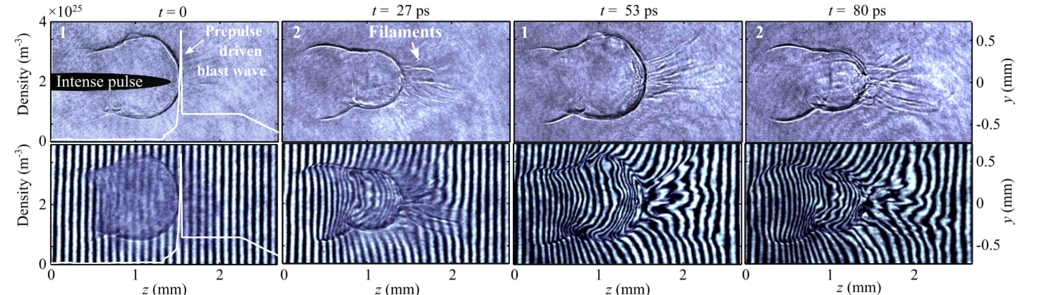
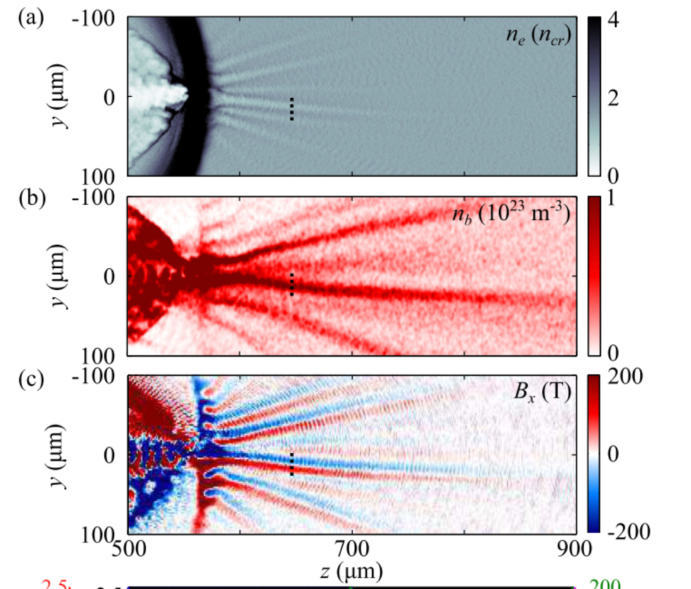
Laser driven ion beams - near critical density interactions
filamentation beyond critical surface observed due to hot electron propagation
ne
nh
BΘ
Simulations show that for nb → ne electron flow is unstable to Weibel-like current filamentation
Has important implications for heating of upstream ions in collisionless shock acceleration
Chosen as Editor’s suggestion for Physical Review Letters
Experiments restarting with CO2 laser at ATF, BNL
Dover, N. P. et al. Optical Imaging of Laser-Driven Fast Electron Weibel-like Filamentation in Overcritical Density Plasma. Physical Review Letters 134, 025102 (2025).

Slide 15
Laser Drivers

Slide 16
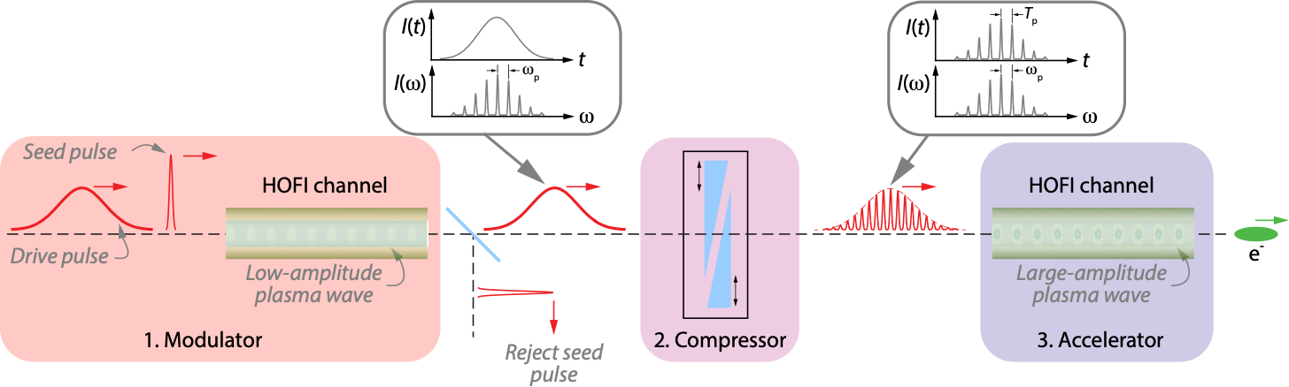
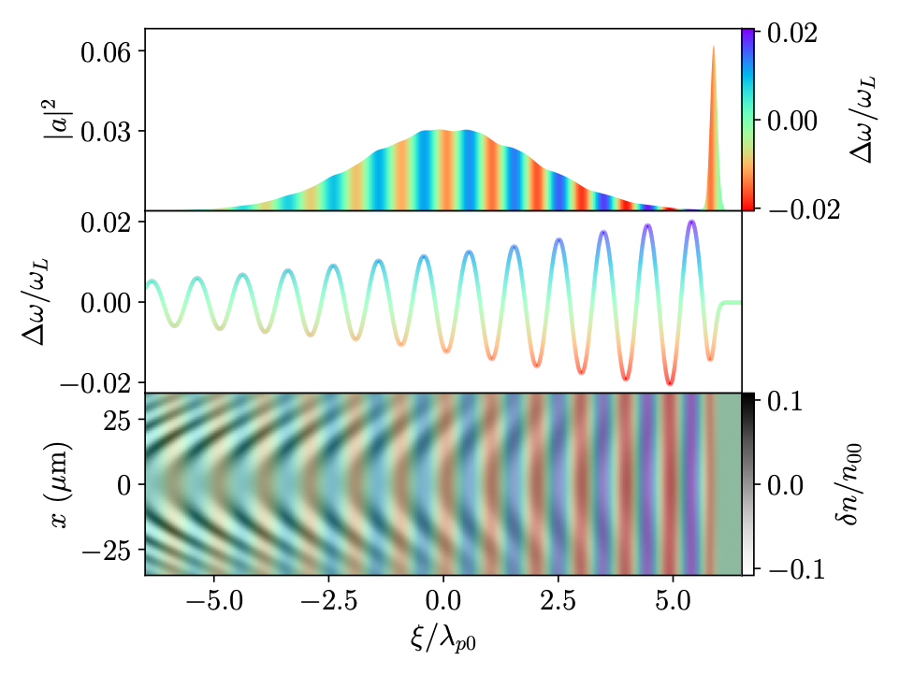
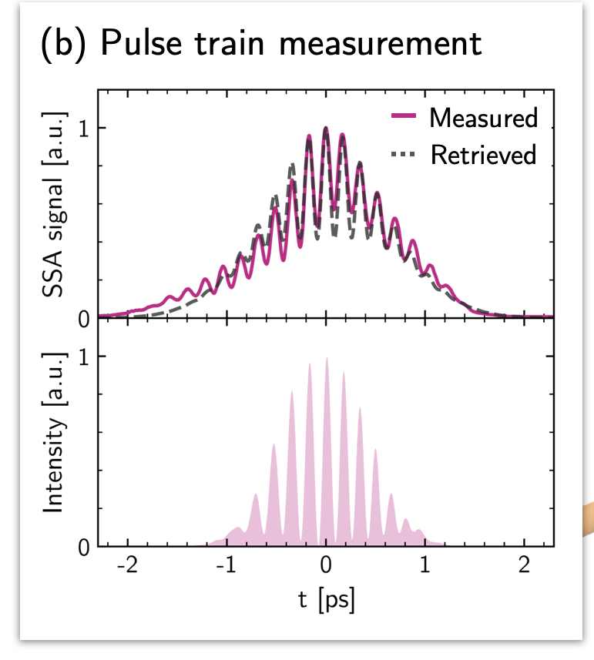
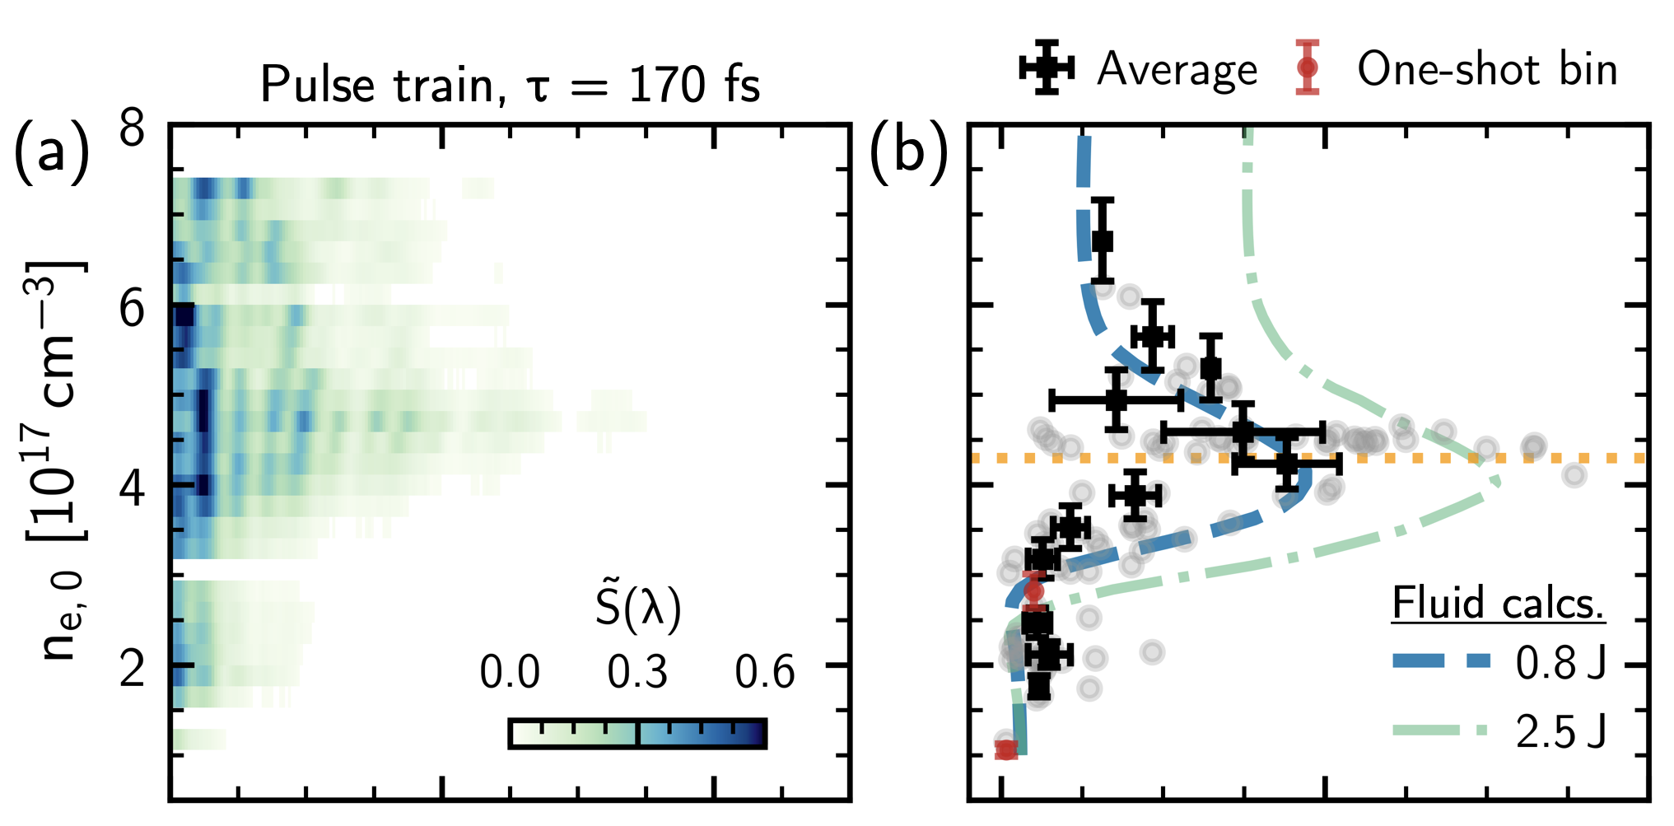
P-MoPA : Simulations show concept robust & resonant wakefield excitation demonstrated
  P-MoPA makes use of commerciall1J, kHz thin disk laser
    need to modulate using, seed wakefield disperses laser pulse which can then be modulated by removing spectral phase
  3D fluid simulations establish parameters for stable operation for Modulator stage
    Spectral modulation independent of radius making compression easier.
    Wakefield curvature reduces spectral modulation - can be controlled by channel shape
    Shape of pulses in train controlled by “strength”of spectral modulation
  PIC simulations of accelerator stage give energy gain of ~ 1.5 GeV (2.4 J drive laser)
  Demonstration of resonant wake excitation evidenced by strong red-shift of pulse train. Wake amplitude 3 - 10 GeV / m corresponding to stage energy gain of ~ 1 GeV
Simulations of modulator stage
Publications
Jakobsson et al., Phys Rev Lett 127 184801 (2021)
van de Wetering et al., Phys Rev. E 108 015204 (2023)
van de Wetering et al., Phys Rev. E 109 025206 (2024)
Ross et al., Phys Rev Res 6 L022001 (2024)
Experimental demonstration of resonant wakefield excitation using Astra-Gemini TA3 laser (CLF)
Simon Hooker, University of Oxford
JAI Advisory Board, 24th April 2025
Notes:
Long (~ 1 ps), high-energy (~1J) drive pulse spectrally-modulated by low-amplitude wake driven by short (~50 fs), low-energy (< 100 mJ) seed pulse
Dispersive system (e.g. GDD) removes spectral phase to generate train of short pulses spaced by plasma period
kPAC: kHz Plasma Accelerator Consortium
Aims to investigate & promote high-rep-rate plasma accelerators
Members: Ox, LMU, CLF & Trumpf Scientific Lasers
Seed funding of £65k from Oxford University

Slide 17
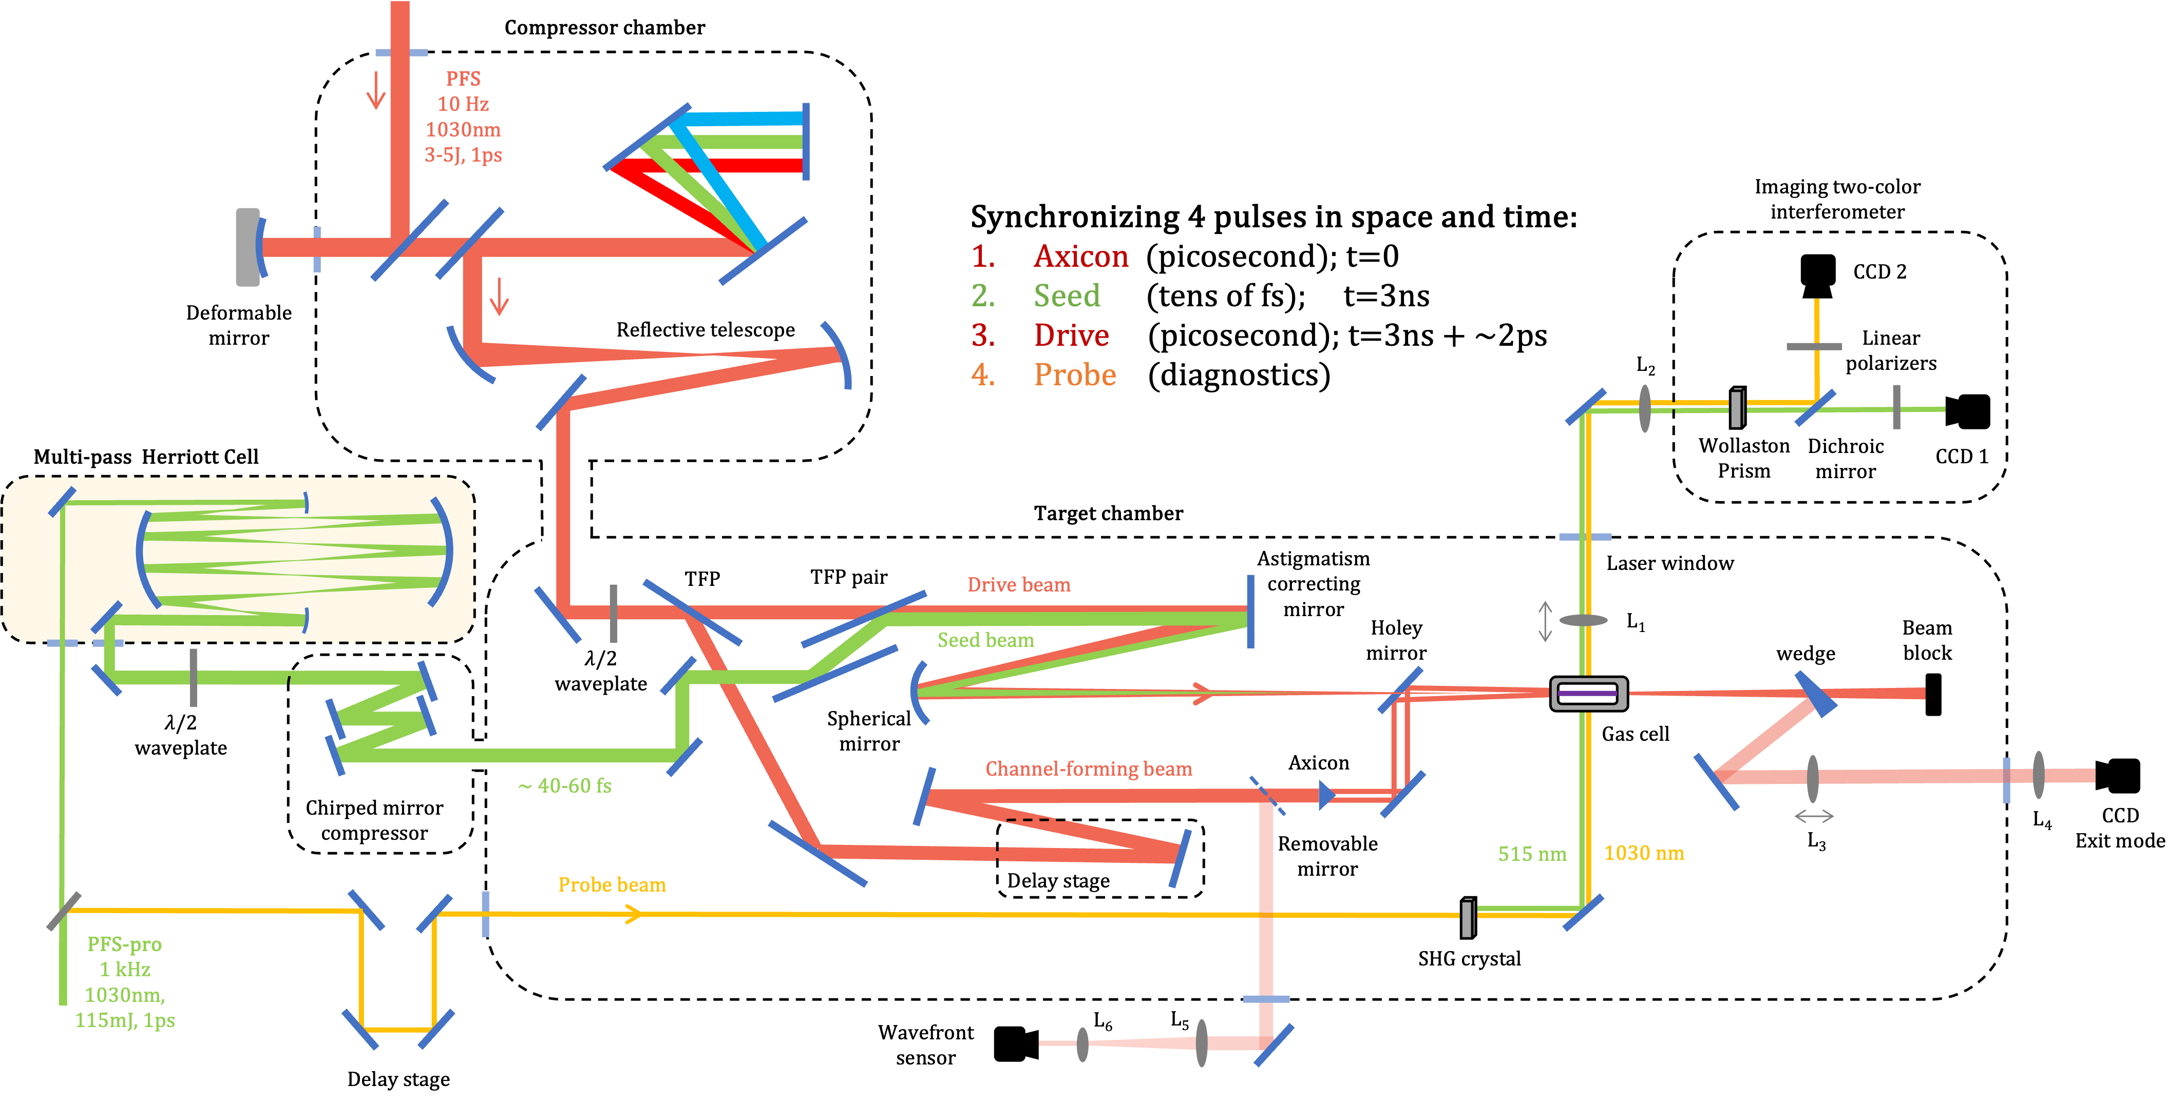
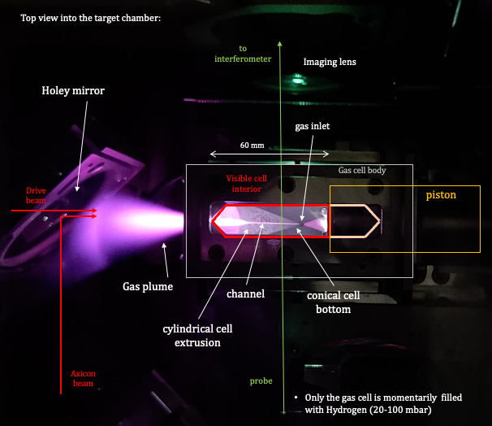
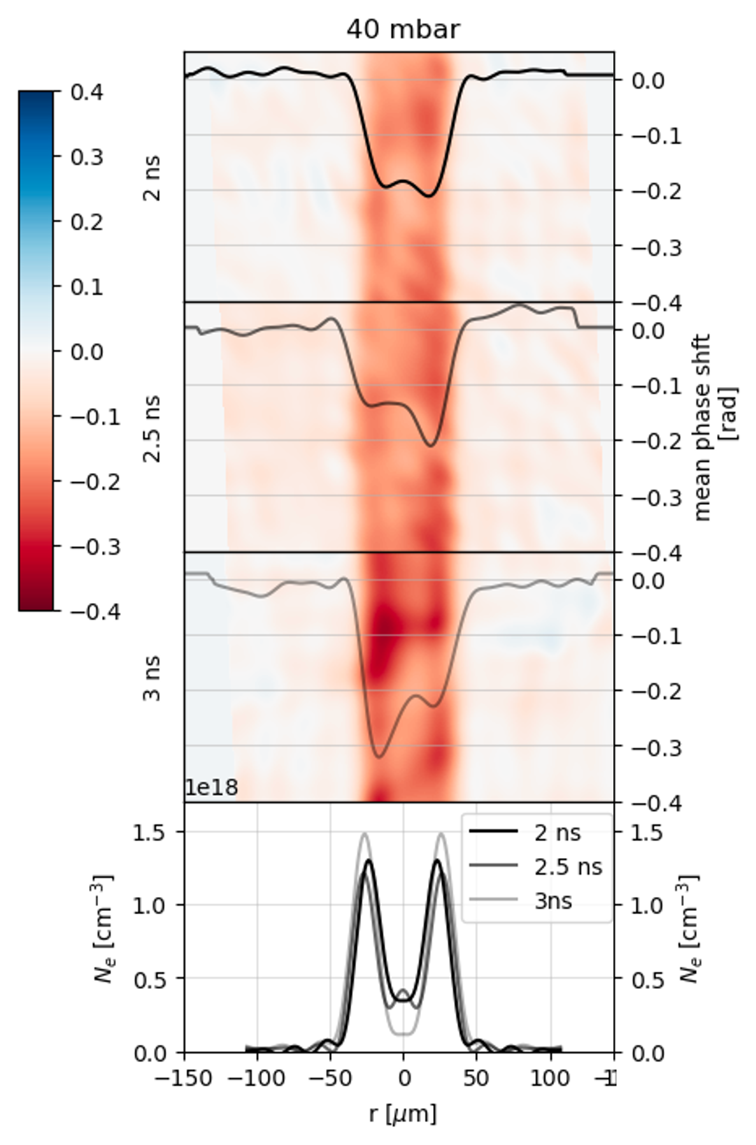
P-MoPA - Experiments underway at LMU Munich
Progress
  New beamlines built to combine pulses from 2, synchronized thin-disk lasers:
    PFS: 3 - 5 J, 1 ps, 10 Hz
    PFS-PRO: 115 mJ, 1 ps, 1 kHz
  Guiding in HOFI channels with 1 ps pulses
  Parallel set-up in Oxford at low energy (mJ)
Next steps
  Demonstrate operation of Modulator at Oxford (mJ level) and LMU (joule level)
  Design & construct Compressor
  Demonstrate pulse train generation
  Demonstrate wakefield excitation in a P-MoPA
Grants
  $670k USAF to develop optical systems
  £1.8M to demonstrate acceleration in P-MoPA
Layout of PFS & PFS-Pro beams at LMU
Prof. Stefan Karsh’s group
Interferometric measurements of HOFI channel
Photo of inside of target chamber
Simon Hooker, University of Oxford
JAI Advisory Board, 24th April 2025

Slide 18
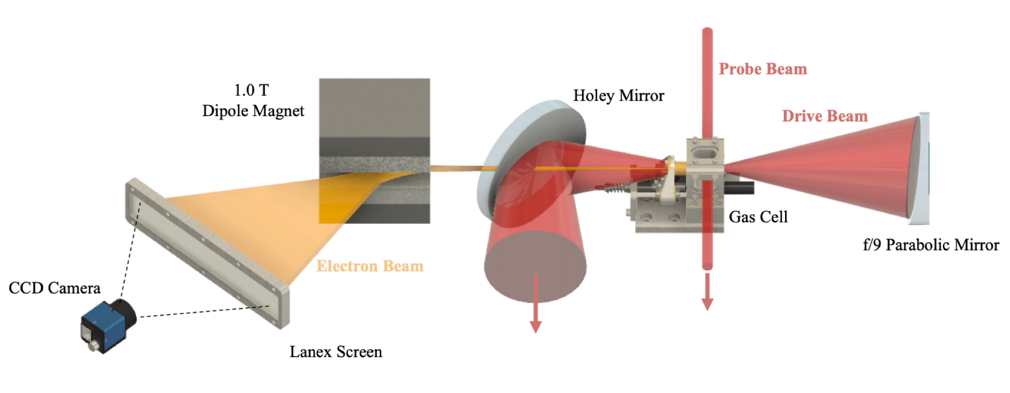
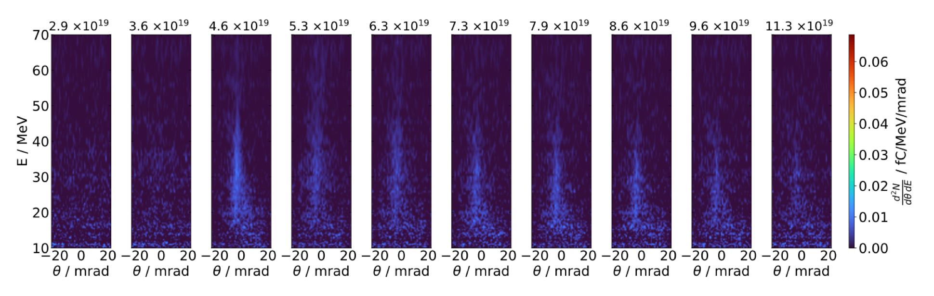
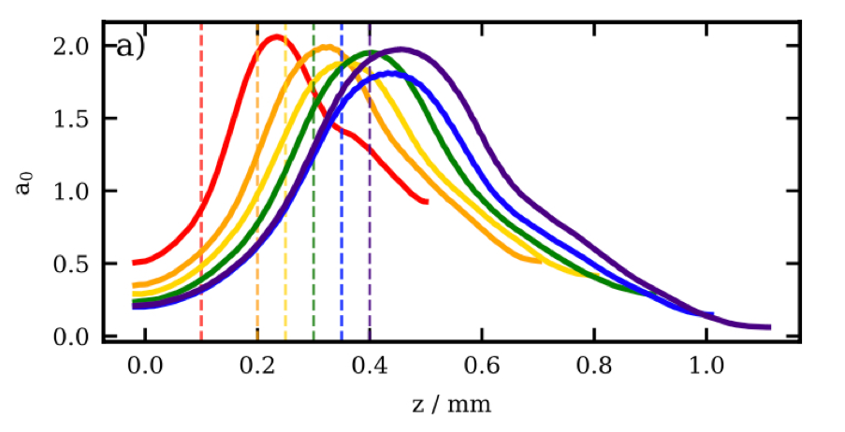
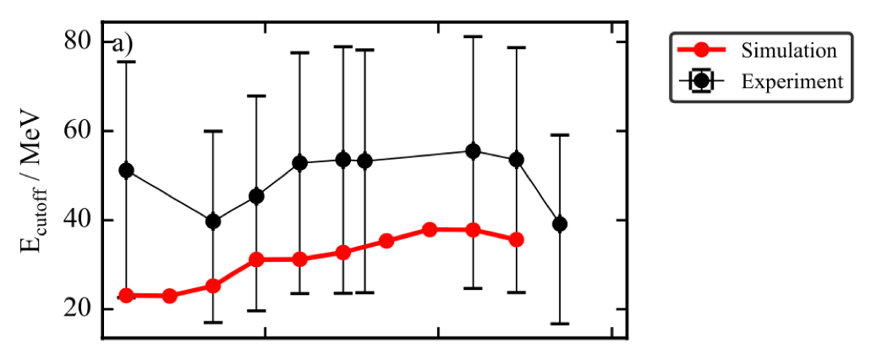
High rep-rate operations with eSYLOS at ELI-ALPS
commissioning of eSYLOS beamline produced (< pC) up to 50 MeV electrons with only 44 mJ laser energy (12 fs, 10 Hz)
Recent experiments with SYLOS laser (8 fs, 20 mJ) have now shown operation at kHz, though at lower electron energies.
shorter ramp lengths are better but can be compensated by focussing depth
A. J. Hughes et al, A 50 MeV-scale, 10 Hz Plasma Accelerator at the eSYLOS Facility, in preparation

Slide 19

EPAC
Discovery
Driving forward the scientific understanding of laser driven accelerators and sources.
Explore matter in extreme environments, usually only found off planet.
Enable experiments to simulate astrophysical events and study fundamental aspects of the universe.
Innovation
R&D for a new generation of compact, super-bright, novel accelerators.
Advanced, multi-modal, dynamic and highly penetrating imaging capabilities
New technologies for advanced sensing in defence and security
Novel radiobiology for future therapeutic modalitie
Training
High quality and broad spectrum training for engineers, apprentices, PhD and early career scientists, generating a pipeline of people with expert, high quality skills.
EPAC will deliver a state-of-the-art 10 Hz, 1 PW, laser to two independent experimental areas.
Experimental Area 1 (EA1) has a fixed configuration, delivering a long-focus laser beamline predominantly for driving a laser-wakefield accelerator. Sources derived from the accelerator will be used for experiments and industrial applications in the 20 m x 9 m applications area.
Experimental Area 2 (EA2) contains a large vacuum chamber that can be configured in a flexible way with short, medium, and long-focus beamline options. The primary application of the area will be high density laser-matter interactions for optimisation of secondary sources as well as fundamental science studies.
EPAC commissioning due to begin spring 2026
EPAC Support EPAC’s proposal to act as the EuPRAXIA Centre for R&D on a 5 GeV electron beam that is produced in a compact laser-plasma accelerator and that has sufficient beam quality for the FEL application.

Slide 20


Eupraxia experiment at LLC, Lund
Collaborative experiment (LLC, CNRS, York, Strath, ENEA, CEA) to develop a low energy spread injector for Eupraxia at LLC (0.8 J, 42 fs, 12 µm) at 100 MeV
Beams produced with ∆E/E ~ 5% and no measurable dark current
Simulations demonstrate subtle dependence on spectral phase of laser pulse
JAI has PACRI funding (as part of EUPRAXIA-PP) to develop high-rep rate driver based on P-MoPA
M. P. Backhouse et al. Spectral Phase Control for Optimized Ionization Injection in Laser WakefieldAcceleration, in preparation 2025
Notes:
Simulations including phase errors give faithful reproduction of accelerator output and determine the dependence on spectral phase on controlling injection.

Slide 21
Radiation

Slide 22






Radiation computation code
Radiation code calculates Liénard-Weichert potential on a grid then adds up contributions on a unified time grid
Doherty, A. et al. Femtosecond multimodal imaging with a laser-driven X-ray source. Communications Physics, 6:288 (2023)
Adam J. Hughes , “Modelling the Temporal and Spectral Intensity Profiles of Betatron X-rays from a Laser Wakefield Accelerator”, in preparation, 2025.
Notes:
Single shot multi-modal imaging developed with UCL (this is an image of a leaf)

Slide 23






Coherent Radiation computation code
SPARC FEL beamline
FELs provide ultrashort (femtosecond) radiation with tuneable wavelengths
Codes such as Genesis do not fully capture transverse beam dynamics
Boosted frame PIC simulations account for emittance and space charge effects
beam matching to optimise transport
Beam expansion washes out microbunching - Genesis overestimates the radiation power
Runfeng Luo “Efficient Free-Electron Laser Modelling Using a Lorentz-Boosted Coordinate System ” , LPAW conference 2025.

Slide 24
Fundamental Science

Slide 25





XANES + EXAFS using LWFA betatron radiation
Full XANES+EXAFS spectrum on single shot
Approx. Poisson limited noise, ~√N
B Kettle et al
Communications Physics, 2024
Can study:
Electron-ion equilibration in plasma
Non-thermal melting / Bond hardening / Electron-photon coupling
Insulator-metal transitions; e.g. <100 fs in VO2
Spintronics/antiferromagnets for electronics
Optical-magnetic switches; E.g. YIG:Co… Etc.
Demonstration of determination of fast electron heating in titanium.
Temporally resolved to < 100 fs
B Kettle et al
Gemini Expt, preliminary data, 2025

Slide 26



Strong Field Radiation Reaction Experiments
Intense laser collisions with GeV electron beams: accessing the Schwinger field
Statistically significant observation (>5 sigma) of radiation reaction
Substantial evidence (using Bayesian Inference framework) favouring Quantum Models of RR over classical.
Eva Los et al “Observation of quantum effects on radiationreaction in strong fields” , submitted 2025.

Slide 27
JAI effort on laser acceleration
Program | Laser Wakefield | Ion Source | Radiation | Lasers | Fundamental
 | Injection, Non-linear stages, Guided wakefields | Relativistic transparency & low density targets | Optimisation & Applications | Multiples + High rep rate sources | Compton QED, Photon-Photo Scattering
JAI staff | M. Backhouse, J. Cowley | O. Ettlinger |  | O. Ettlinger, J. Cowley
Associated | A. Hughes, M. von der Layden, L. Feder | N. Dover, N. Xu | A. Hughes, B. Kettle | N. Xu, M. Liang | B. Kettle
Students | R. Luo, J. Hills, S. Kalos, D. McMahon, D. Chan | G. Casati, N. Sedlackova | R. Luo, G. Christian, D. McMahon, D. Chan | S. Kalos | M. Berboucha, L. Bradley
Faculty | R. D’Arcy, S. Hooker, S. Mangles, Z. Najmudin, P. Norreys, R. Walczak | K. Long, Z. Najmudin | S. Hooker, S. Mangles, Z. Najmudin | S. Hooker, Z. Najmudin, R. Walczak | S. Mangles, S. Rose

