Slide 1




BDSIM Applications and Further Industry Connections
Laurie Nevay, RHUL
on behalf of the JAI
JAI Advisory Board - 7th April 2022

Slide 2
Introduction
The JAI has fundamental science at its heart, but promoting advanced accelerator applications in science and society is part of the mission
Connection with industry is a natural and valued part of its activity
An overview of other recent industry connections is presented here:
eSYLOS LWPA at ELI-ALPS
Industrialisation of BPMs for FELs
Pyroelectric accelerator facility
BDSIM applications
JAI industrial activity is supported by technology transfer experts that reside in each institution
They guide or manage aspects of IP/contracts/fundraising etc to enable the pathway to commercialisation and support JAI researchers to make strategic decisions on commercialisation of the technology

Slide 3
eSYLOS - LWFA beamline at ELI-ALPS
Z. Najmudin, G. Hicks, R. Kumar-Yembadi
JAI development of LWFA beamline at ELI-ALPS using the SYLOS laser
The Extreme Light Infrastructure project started as a bottom-up initiative by the European scientific laser community and the network of large national laser facilities, LASERLAB-EUROPE
The facilities were built in parallel in the Czech, Hungary and Romania, starting 2011 and completed in 2018 funded by European Regional Development Funds (ERDF) and contributions from the host countries totalling about 850 million euros.
The main objective of ELI Attosecond Light Pulse Source (ELI-ALPS) is the establishment of a unique attosecond facility which provides ultrashort light pulses between THz (10¹² Hz) and X-ray (10¹⁸-10¹⁹ Hz) frequency range with high repetition rate for developers and end-users.
Notes:
Emphasise: enormous increase in laser powers enabled scientists to propose new state-of-the-art laser facilities.
Funded in Eastern Europe from Regional Development funds
ELI-ALPS is in Southern Hungary and is dedicated to studying ultrashort secondary sources enabled by ultrafast (<10 fs) lasers.

Slide 4
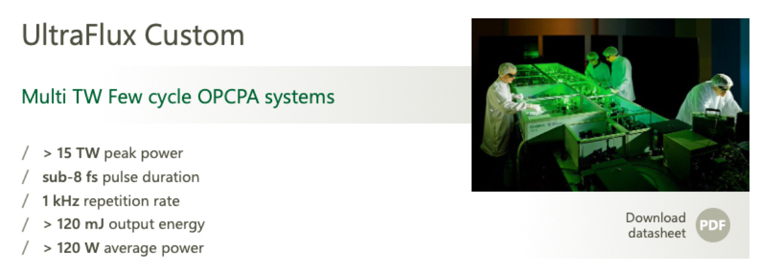

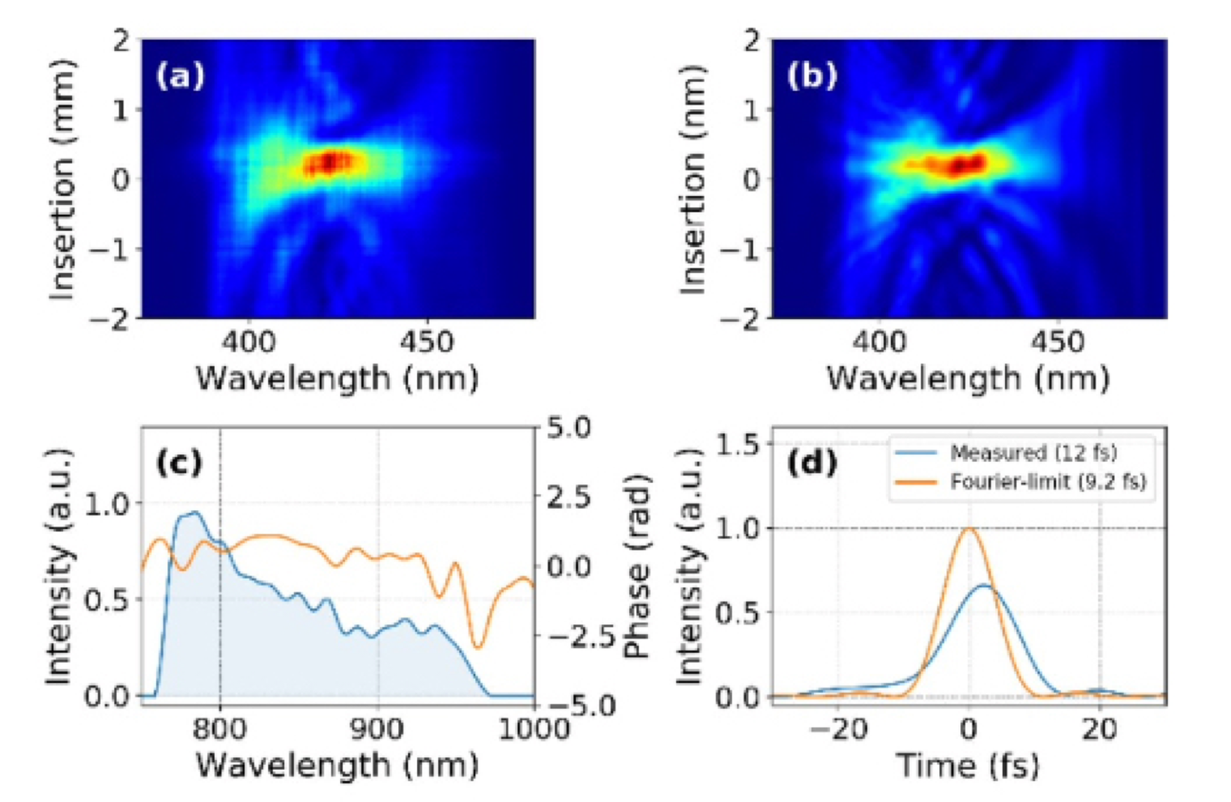
SYLOS Laser
Z. Najmudin, G. Hicks, R. Kumar-Yembadi
ELI generally built on commercially available (but cutting-edge) technology.
SYLOS laser built by EKSPLA in Lithuania will deliver > 100 mJ in < 10 fs at 1 kHz
This enables the scaling of laser wakefield accelerators to higher density
  for extremely compact high repetition rate sub-femtosecond electron beams
JAI-Imperial funded (via competitive tender) to £855k to implement ultrafast electron beamline using SYLOS laser = eSYLOS

Slide 5
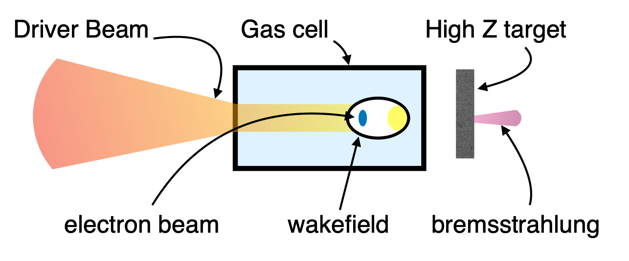
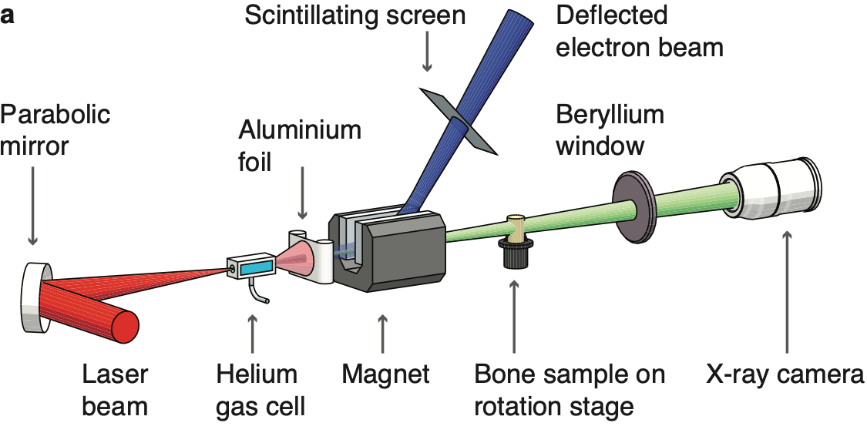
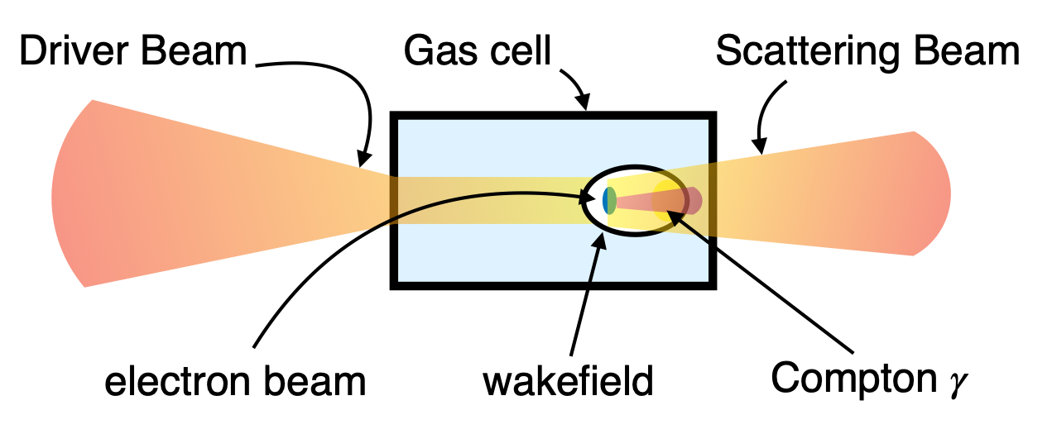
eSYLOS Radiation Techniques
Z. Najmudin, G. Hicks, R. Kumar-Yembadi
Bremsstrahlung emission from solid target ≳MeV
Betatron emission from low energy source emission ~keV
Compton Scattering from low energy probe ≳keV
Notes:
This will enable three different radiation sources to be investigated - as pictured. Using a laser source particularly enables Compton scattering with intrinsically low synchronisation jitter.

Slide 6
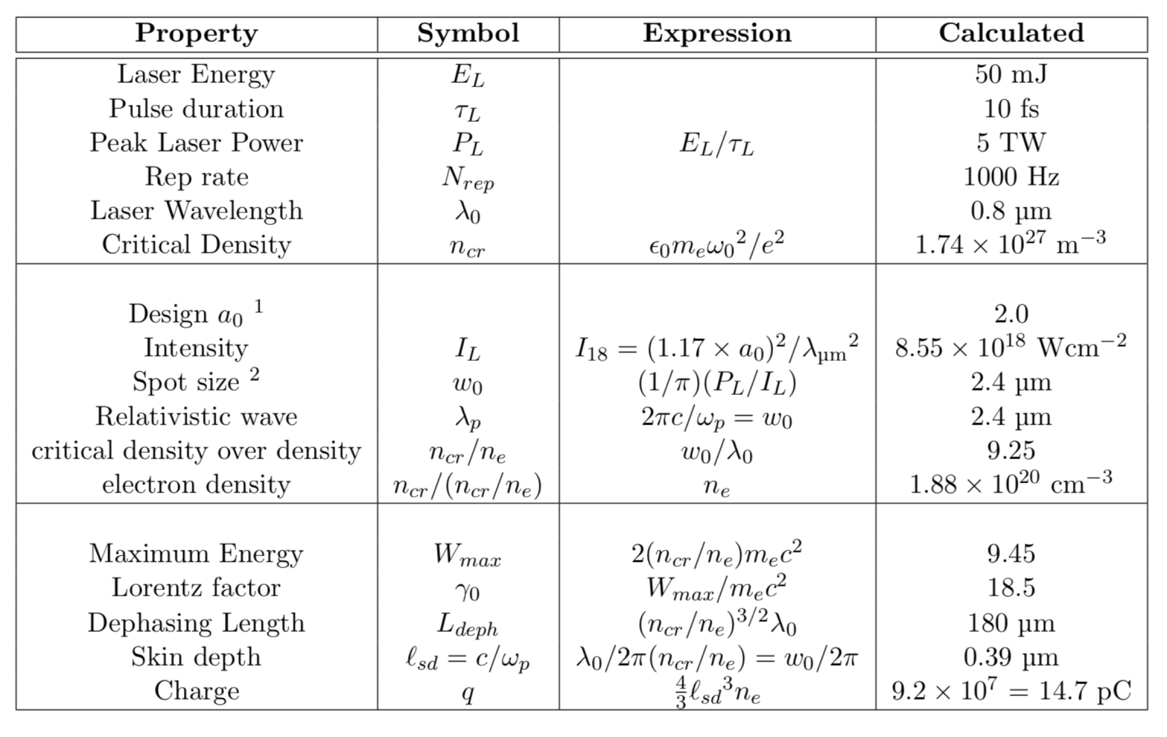
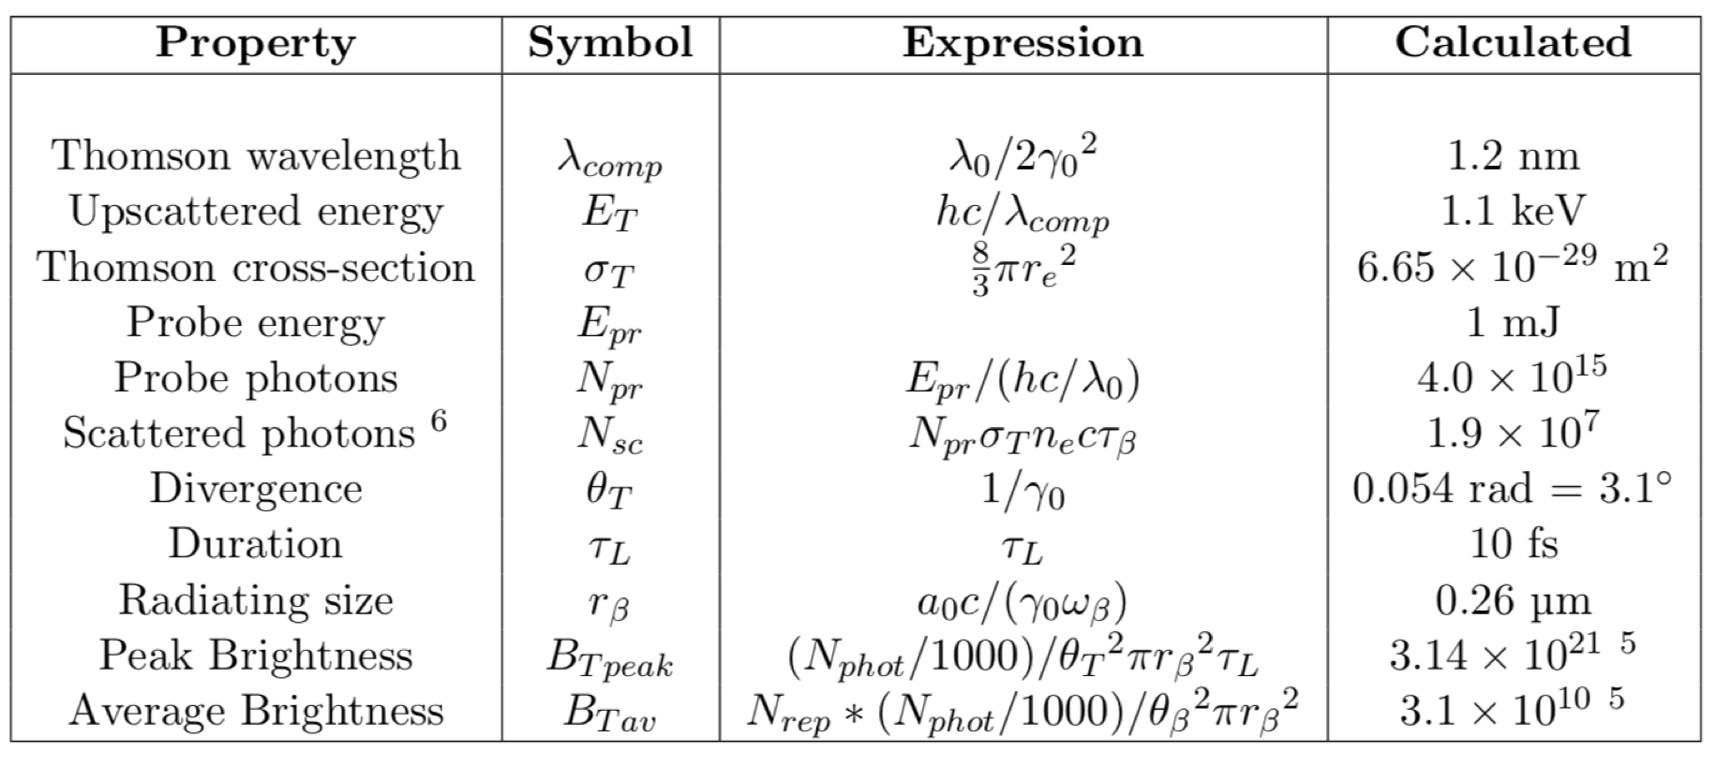
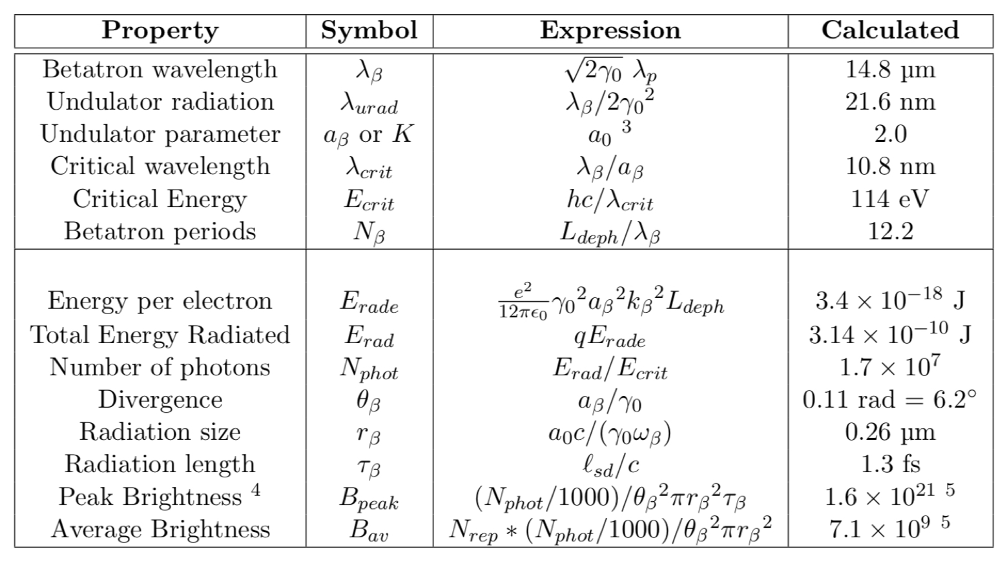
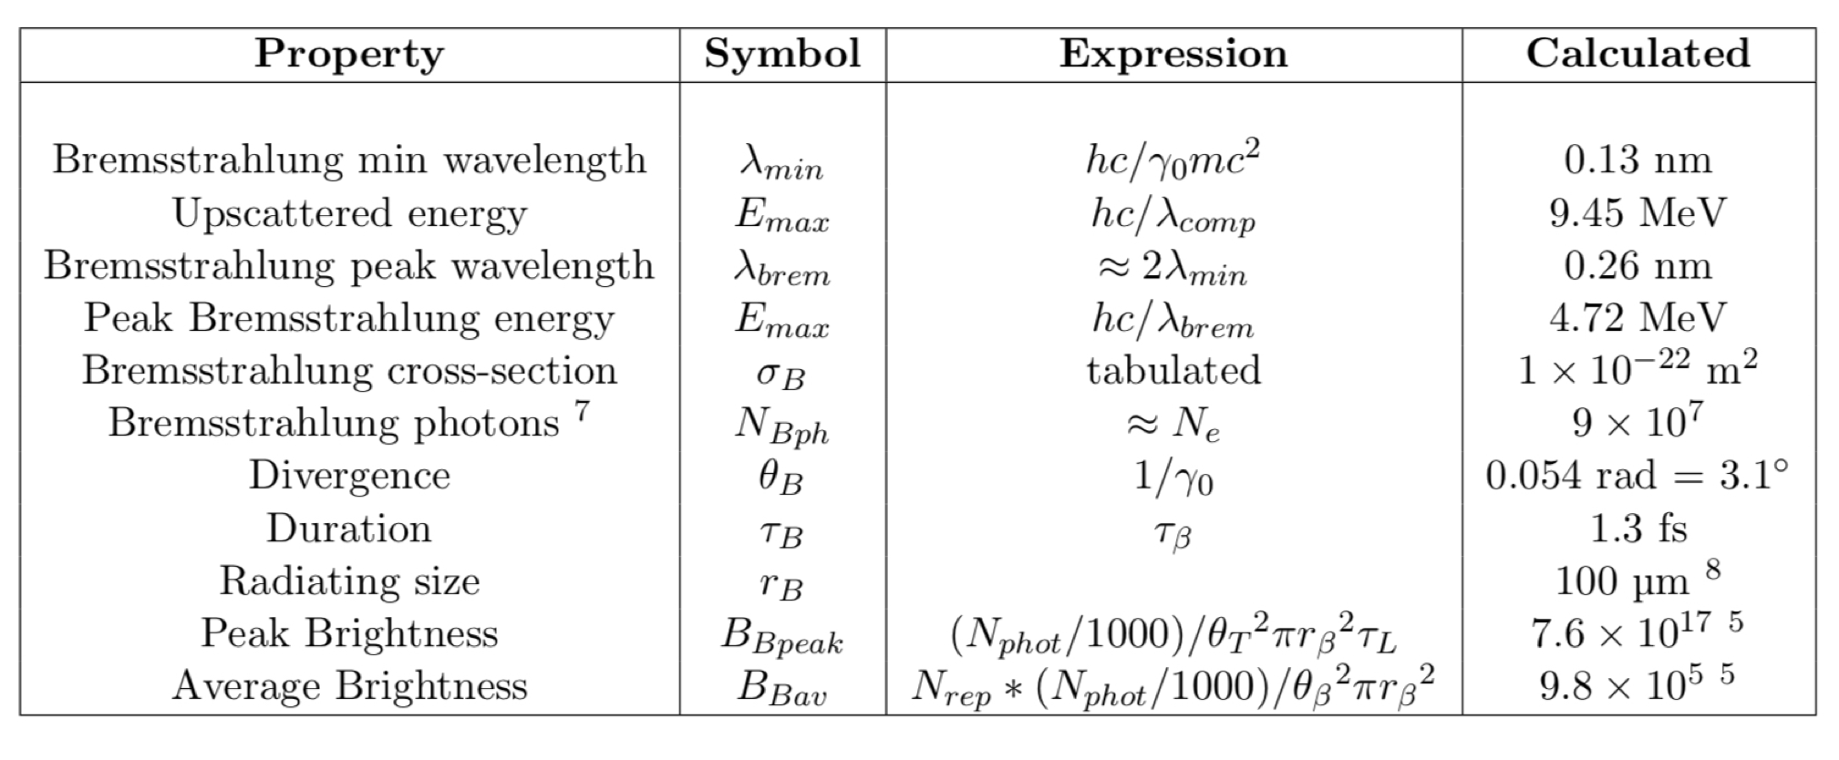
eSYLOS Parameters For Reference
eSYLOS Radiation Summary
Thomson Scattering
Betatron Radiation
Bremsstrahlung
Notes:
These are the design parameters for the lower energy (eSYLOS2) implementation again.
Simulation and scaling laws suggest high energy (> 10 MeV), few fs electron beams with few pC of charge at kHz.
All three sources can produce peak brightnesses very comparable to conventional synchrotrons (though of course over very short time duration and from very small source size).

Slide 7
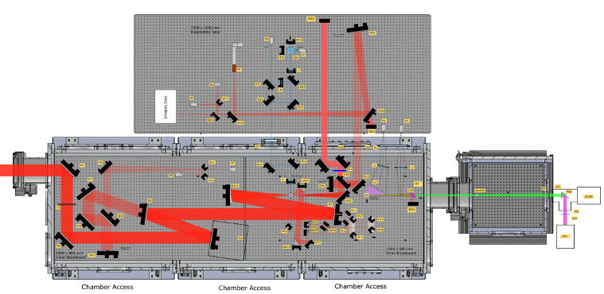
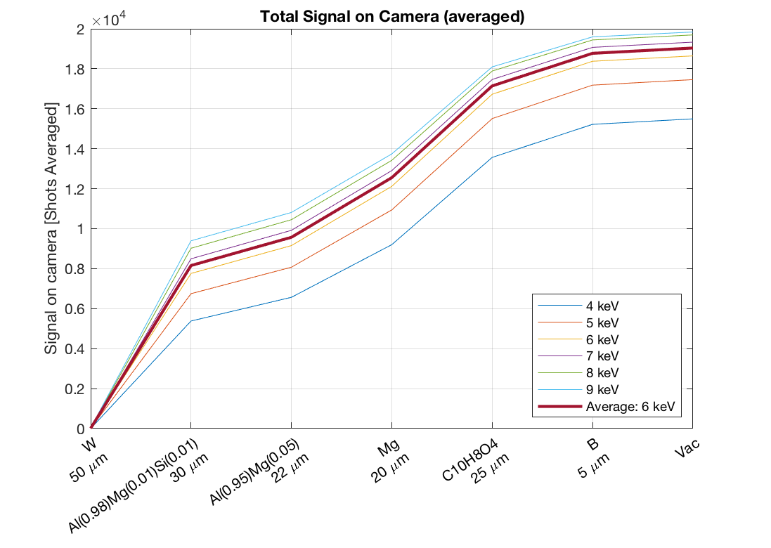
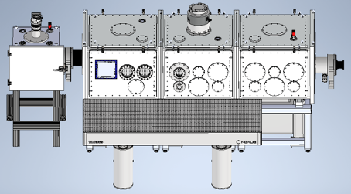
eSYLOS Status
TDR completed
Extra chamber for sample irradiation
Engineering for end of April 2022
Construction and commissioning to continue throughout 2022
Operation due early 2023
optical design
engineering design
target and filter pack simulations
Notes:
We’ve just completed TDR - above shows both engineering and optical designs (with addition of extra chamber to the right to enable a user end station for putting in samples to be irradiated).
Also shown are the targetry and filter pack simulations which we have prepared for this energy range.
Engineering to be delivered at the end of the month, and construction and commissioning to continue through-out this year. Operation due early 2023.

Slide 8
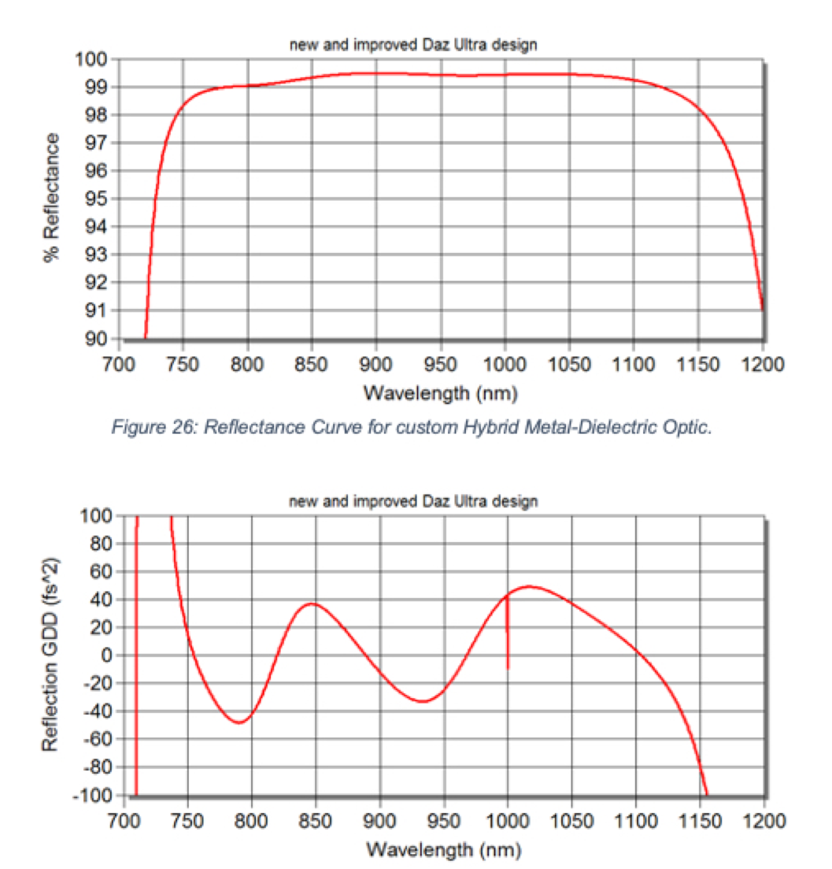
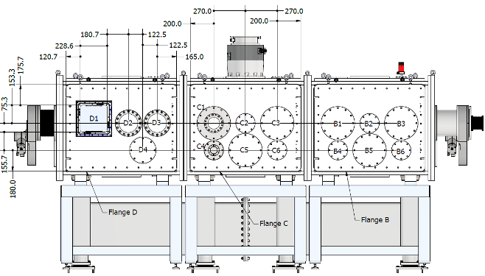
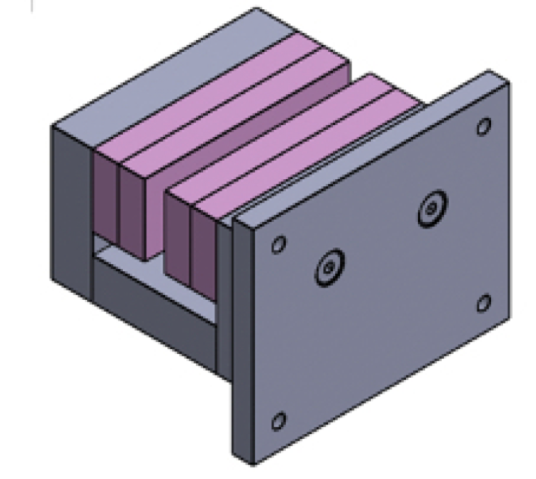
eSYLOS Industrial Connections
Unique requirements have required constant contact with suppliers
Custom vacuum design - Egken, Poland
Breadboard isolation - Quantum Optics Group, ICL
  developed by Prof. John Tisch in Q.O.G.: purchased through
  Imperial College Consultant Management (ICON)
High reflectivity and low GDD IBS mirrors - Manx Precision Optics (UK)
Compact magnet designs - Magnet Sales (UK)
Notes:
The project has required significant input from industry to help make many bespoke items, mostly obtained through competitive tender but also often requiring interaction with the suppliers for custom improvements. Examples given above.

Slide 9
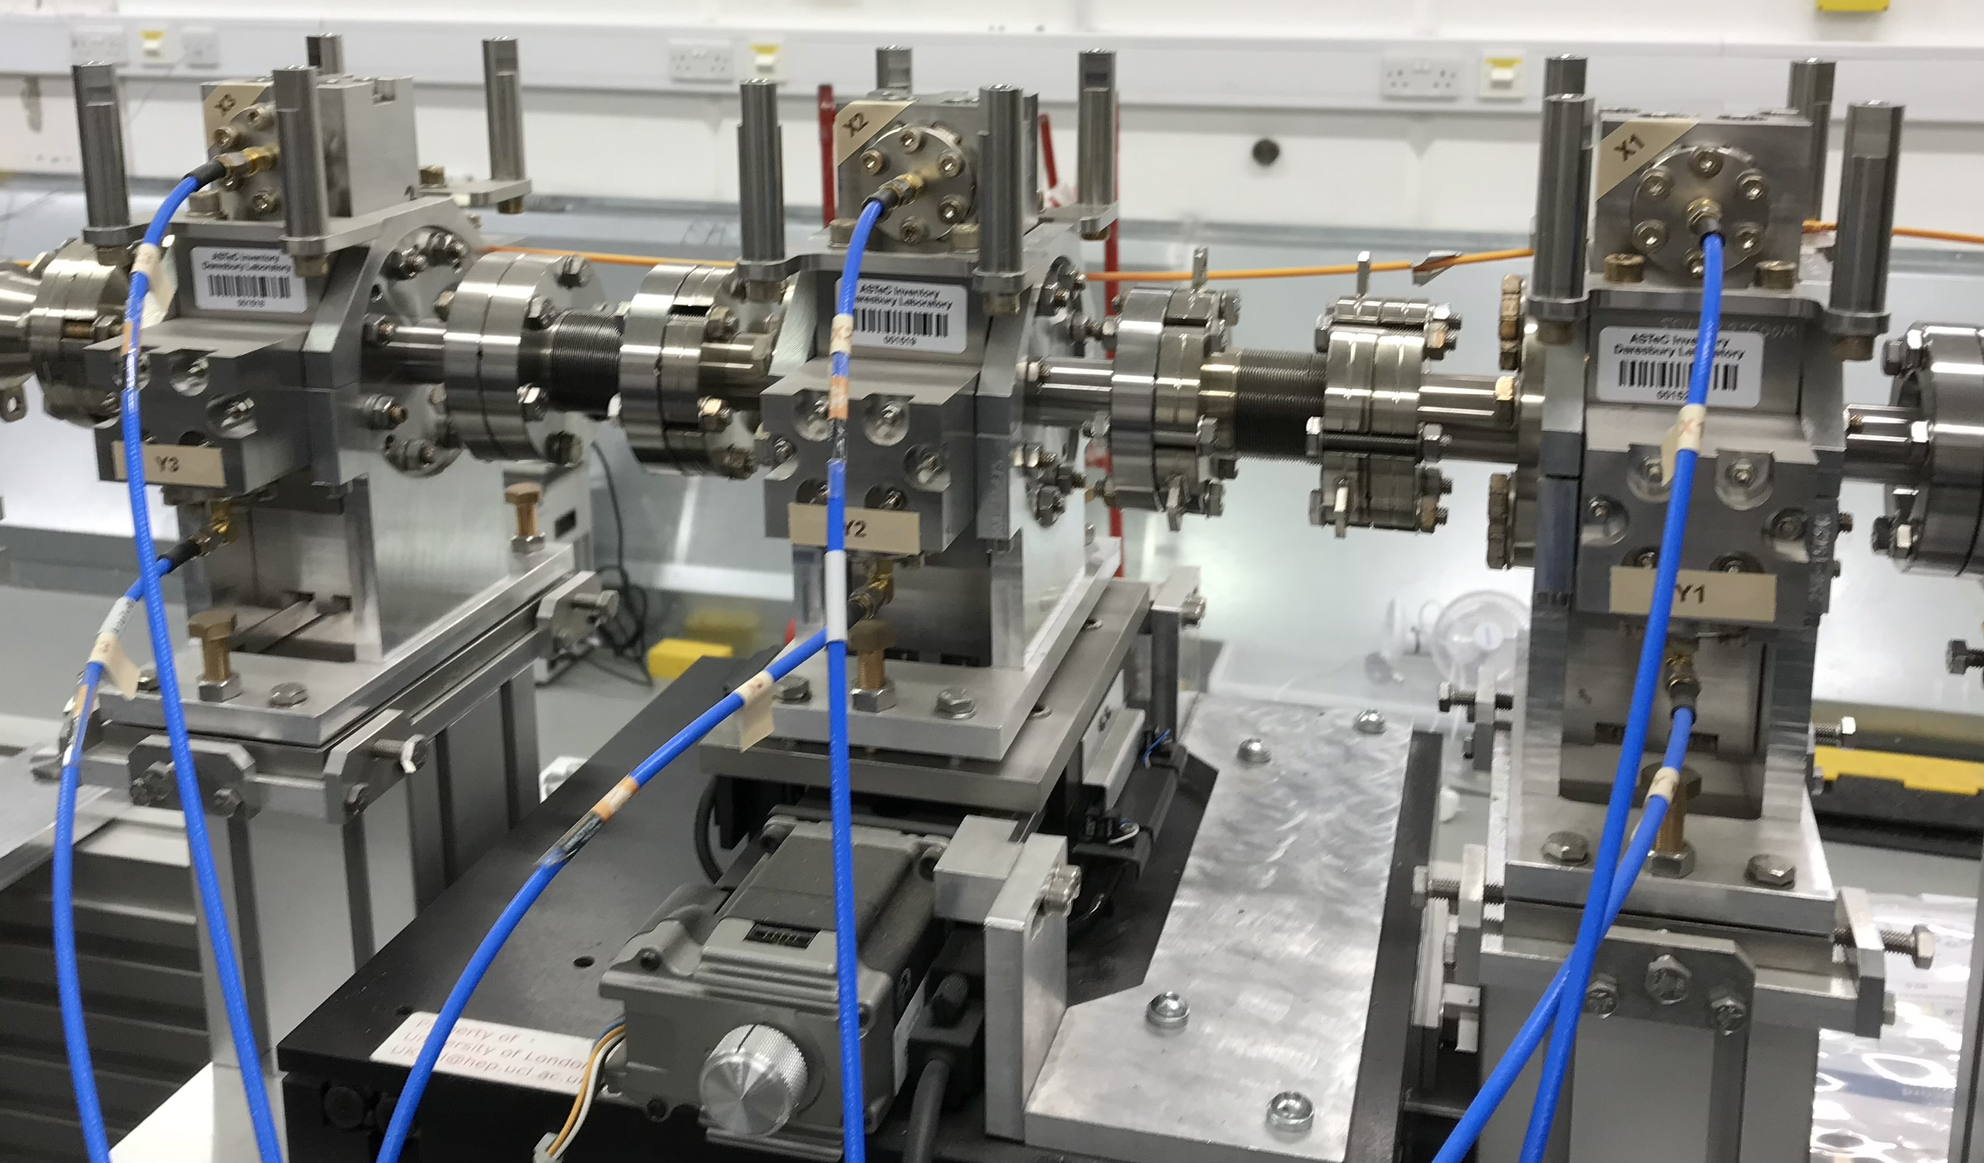
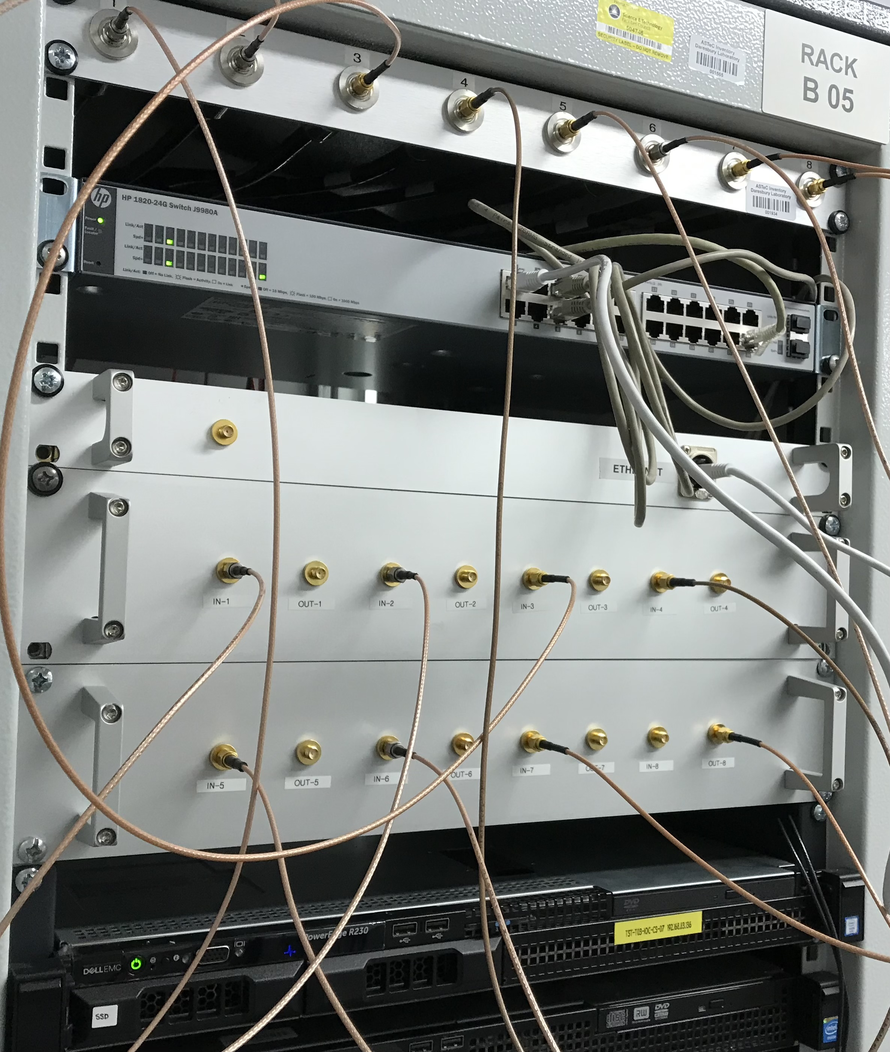
Update on Industrialisation of BPMs for FELs
A. Lyapin
Recap:
  cavity BPMs design for FELS, original developed for linear colliders
  Offer complete off-the-shelf system in partnership with FMB-Oxford and iTech
  first delivery to ELI-BL in 2021
  REF2021 case study
Current:
  recovering and upgrading the test system at Daresbury post-Covid
  install the second down-converter stage for low charge running
  sadly, no beam for resolution studies expected for 18-24 months
  but: trial of < 10pC running April 7th - 8th
Spin-off project:
  precision compact RF sources in development
  aiming to present a prototype at IBIC22
CBPM triplet at CLARA, Daresbury Laboratory
New electronics: second down-conversion stage

Slide 10
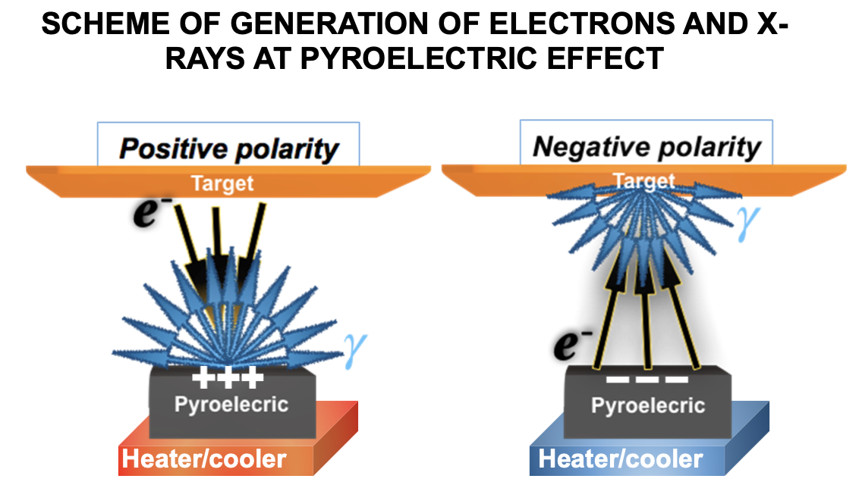
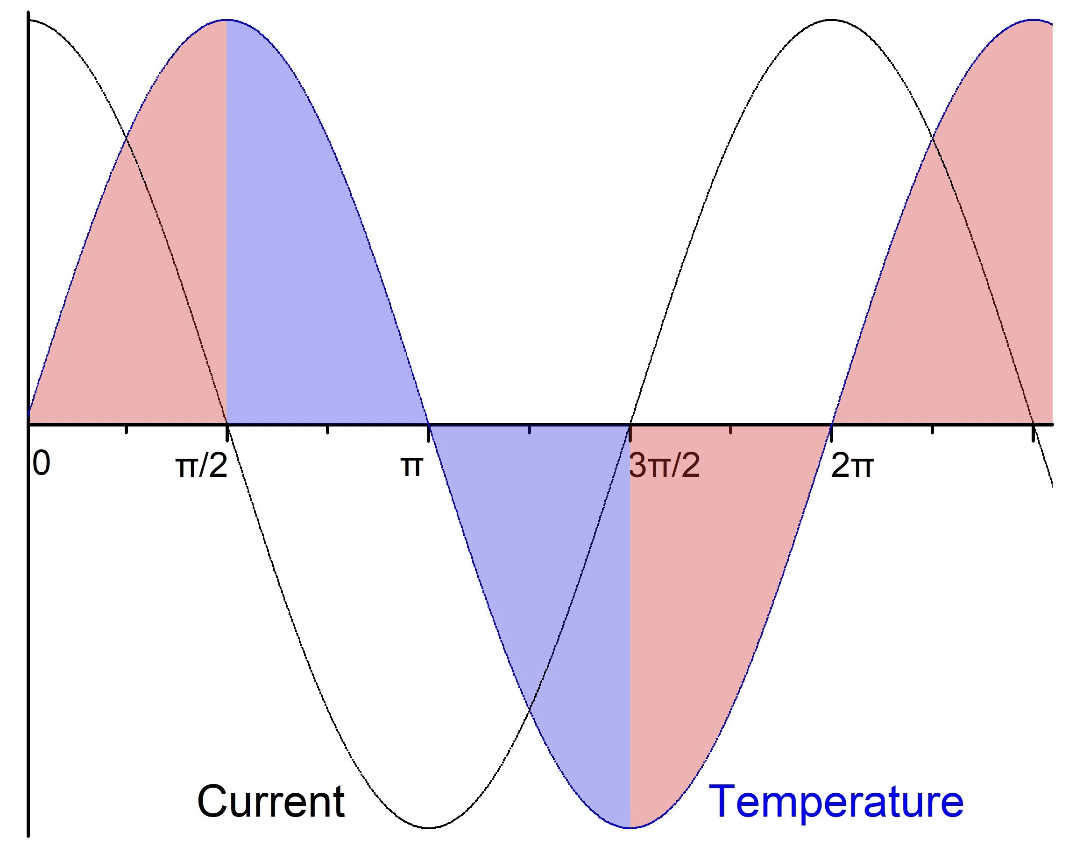
Pyroelectric Accelerator X-Ray Source
P. Karataev, A. Oleynik (Phd 2022), M. Ali (new Phd)
Goal: develop a miniature source of X-rays without the need for high power / high voltage or radioactive sources
Suitable for difficult-to-reach or clean places:
  e.g. space station, mountains, underground mines
However, instabilities within the accelerator need to be understood
  related to the temperature change regime, target and crystal configuration and purity, vacuum level and accelerator geometry
Develop a compact inexpensive particle beam facility at RHUL for educational and practical purposes
Find a way to create impact by commercialising the technology

Slide 11
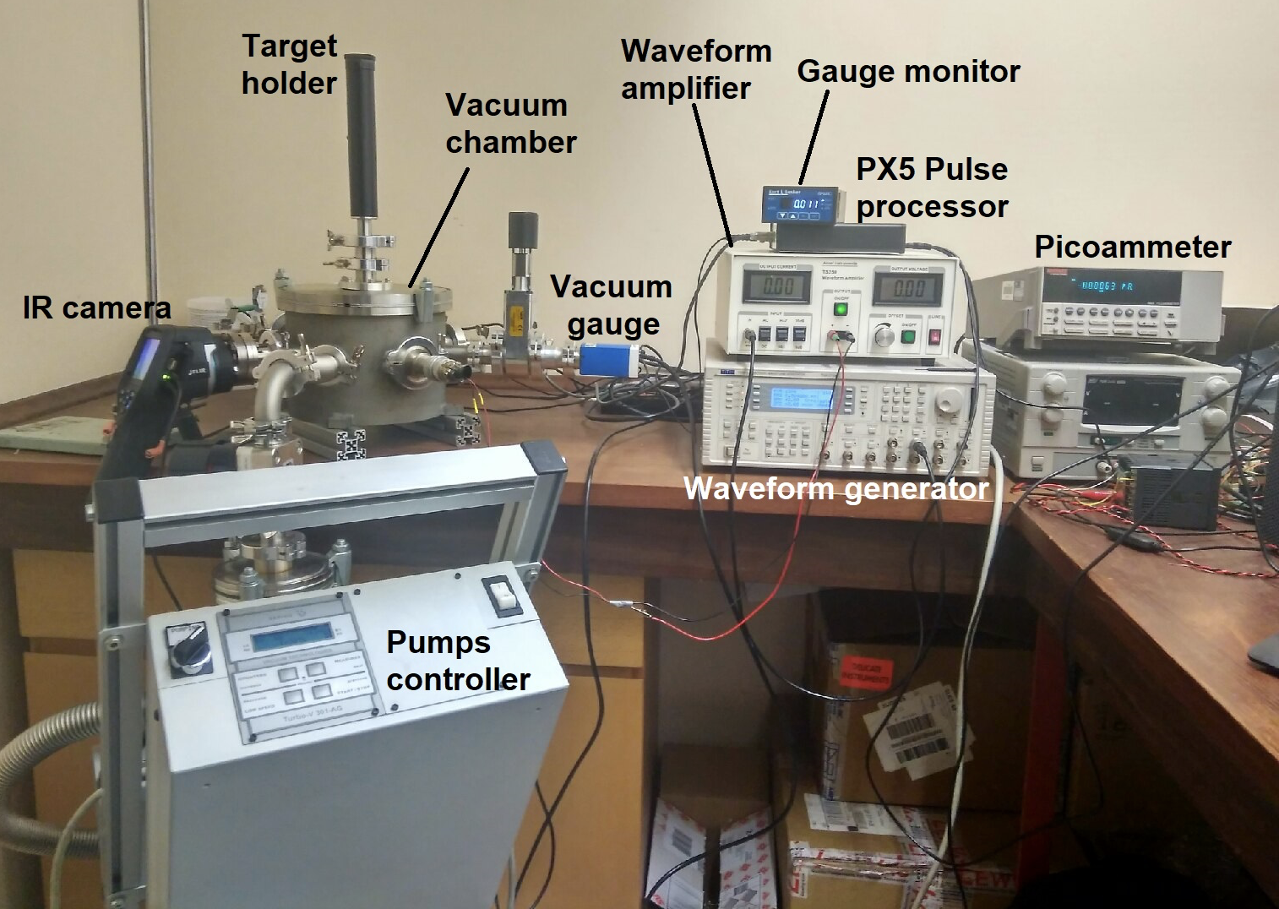
A Pyroelectric Accelerator Facility at RHUL
P. Karataev, A. Oleynik, M. Ali
  Achieved so far:
    the facility has been created
    a series of experiments on generation of electrons and X-rays have been performed
    stabilization of emission has been achieved
    Energy Dispersive Analysis of two target samples have been demonstrated
  Current Status:
    one PhD student has completed and another PhD student has taken over the research
    continue investigation of stability issues changing the accelerator conditions (vacuum, target to crystal distance, frequency and amplitude of temperature oscillations)
    novel generation schemes are being considered for higher efficiency and higher energy X-ray production

Slide 12
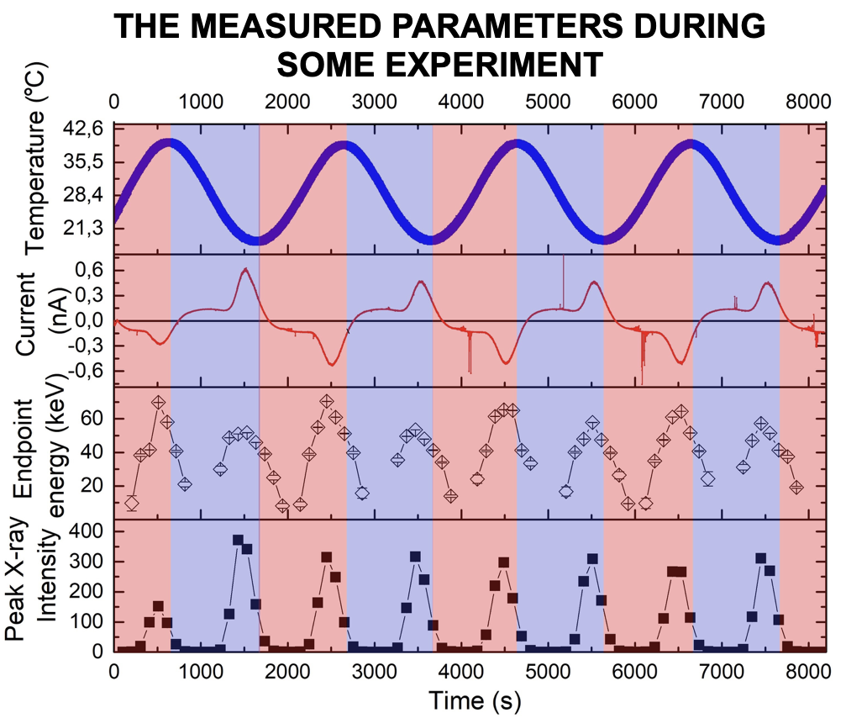
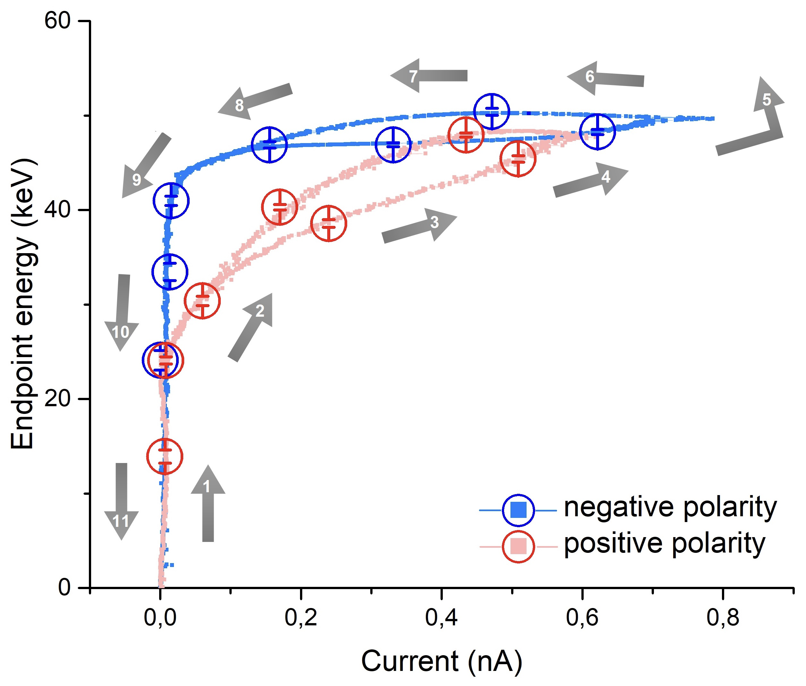
Results
P. Karataev, A. Oleynik, M. Ali
Hysteresis loop of the avalanche process
For positive and negative polarity

Slide 13
Radiation Transport Simulations
L. Nevay, S. Boogert, W. Shields, S. Alden
Specialism in simulation developed since 2004
  dedicated projects and effort since 2013
Original research was on muon backgrounds for linear colliders
  need both accelerator tracking and particle-matter interaction
Key software created:
  BDSIM program for 3D radiation transport models of accelerators
    private variant including laserwire (Compton + photo-detachment; transverse + longitudinal)
  pyg4ometry for RT geometry preparation, conversion, validation, comparison
L. Nevay and S. Boogert and now part of the Geant4 collaboration
  advanced geometry visualisation, crystal channelling physics

Slide 14

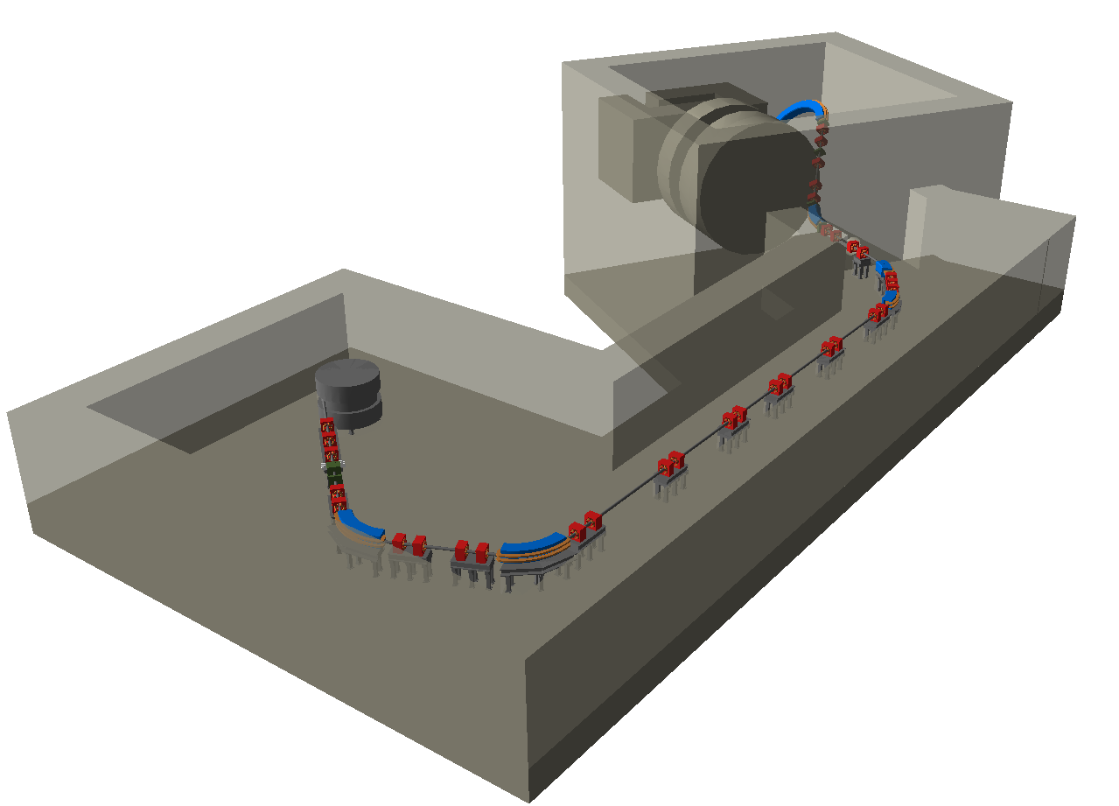

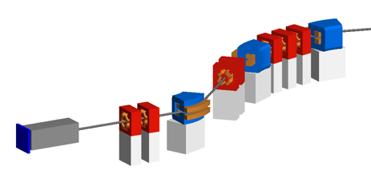
BDSIM
L. Nevay, W. Shields, S. Boogert
BDSIM re-developed since 2013
Automatic Geant4 models of accelerators
Applied to many experiments and machines
  ILC / CLIC, AWAKE, XFEL undulators, LHC collimation, Laserwires, ATLAS non-collision backgrounds, MAGIX at MESA, and recently FASER, FPF, FCC-ee, KLEVER, NA62 (PBC)
Also strong application for medical therapy systems
  including radiobiological research facilities - e.g. LhARA
Est. 50-100 users worldwide
Enables vastly reduced time to create Geant4 models of accelerators
PSI Gantry 2 model
IBA Proteus Plus beam line
Manual users 2021-2022
7-day users: 65
14-day users: 101
28-day users: 199
Computer Physics Communications (252), July 2020, 107200

Slide 15
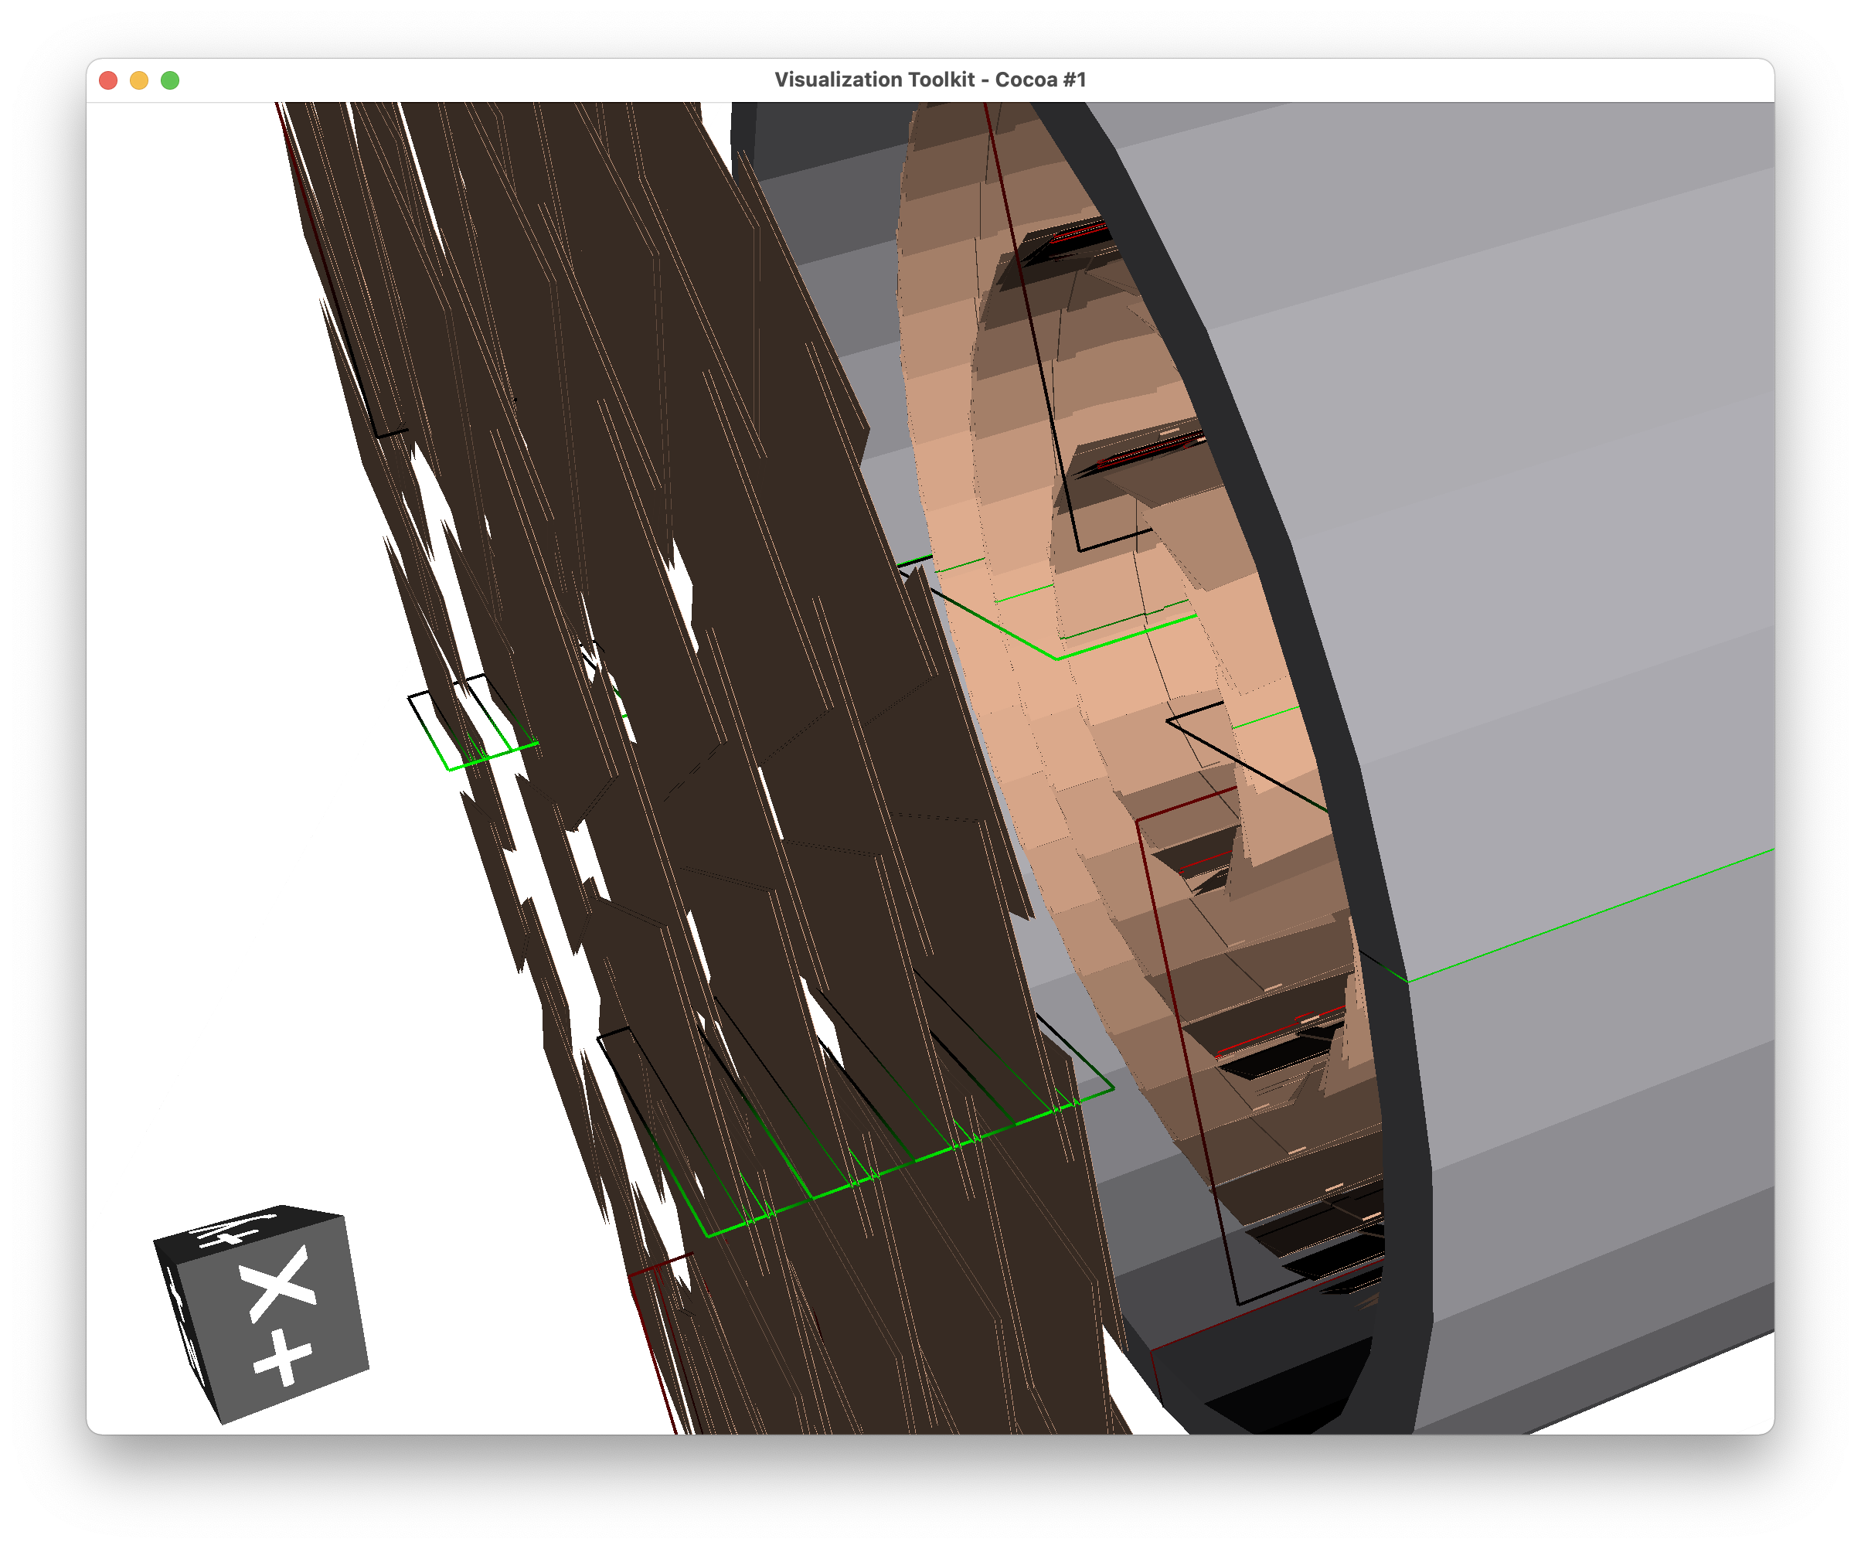
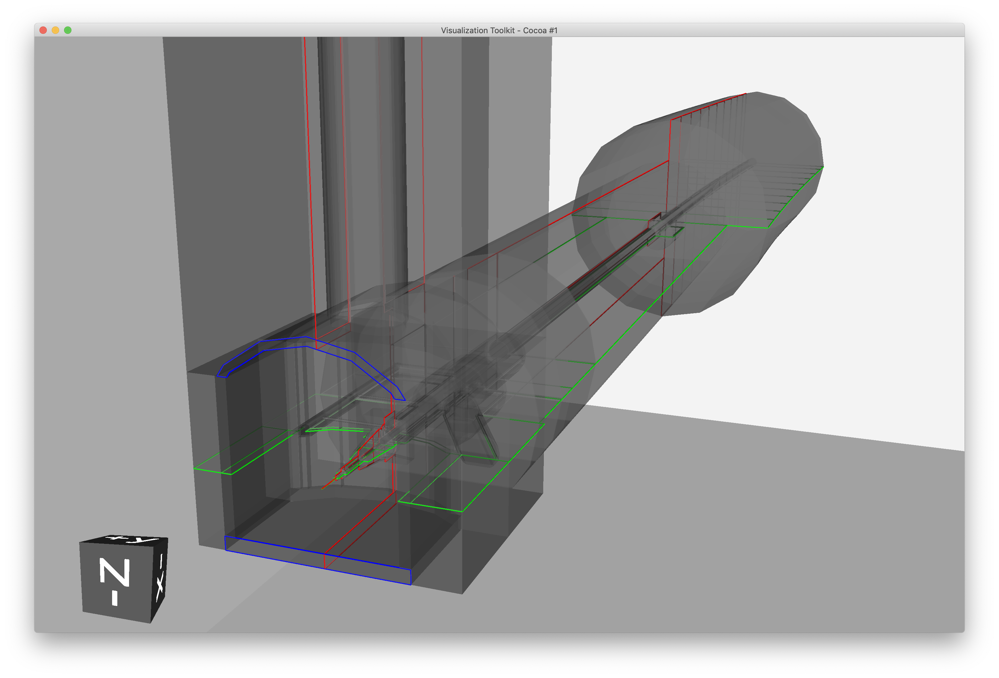
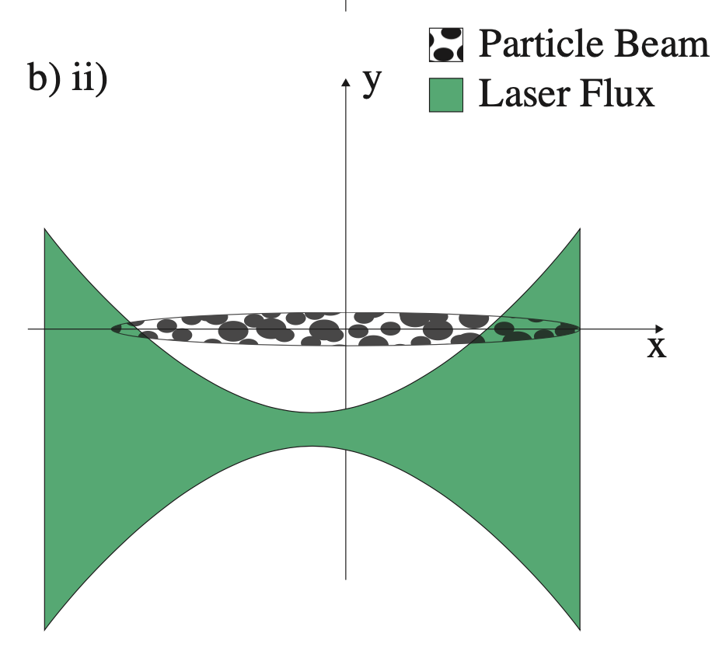
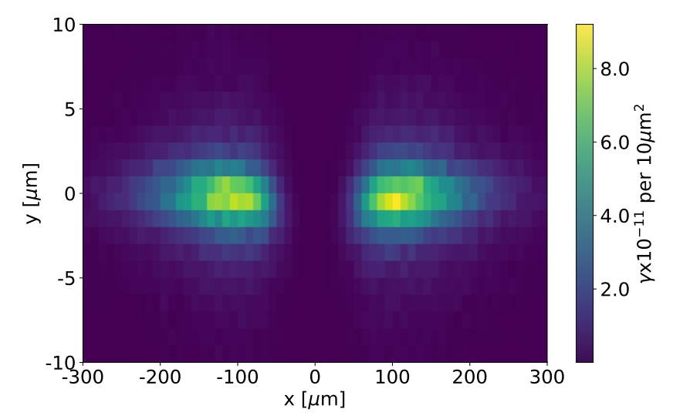
Associated Capability
pyg4ometry
create, visualise, validate, modify, convert, composite geometry
Geant4, FLUKA, ROOT, STEP
Applications as broad as Geant4 & FLUKA
Laserwire simulation in BDSIM
Introduction of laser volumes in Geant4 + new physics processes
Compton-scattering and H⁻ photo-detachment
From saturation to 'passive' LWs
Full overlap integral
Silicon detector
LHC model composition
Computer Physics Communications, 272 March 2022, 108288
reproduces non-Gaussian-like overlaps matching the ATF2 laserwire experimental data

Slide 16
Medical Facility Application of BDSIM
We have developed BDSIM for low-energy applications since 2017 and are now seeing uptake in the community for medical applications
  suited for particle-matter interactions in beam lines and that often have relatively high losses
Several groups in PSI, Hefei China using BDSIM for medical design studies
  PSI Gantry 2, SC200 proton facility
Recent publications showing excellent agreement with real facilities
  transmission / losses, beam profile
Recent PSI publication on transmission optimisation for FLASH therapy
  becoming possible to deliver field in single breath-hold
Link with IBA stable, upcoming studies on:
  repurposing high-energy facilities for eye treatment
  cross-talk between adjacent gantries for high-intensity research centres

Slide 17
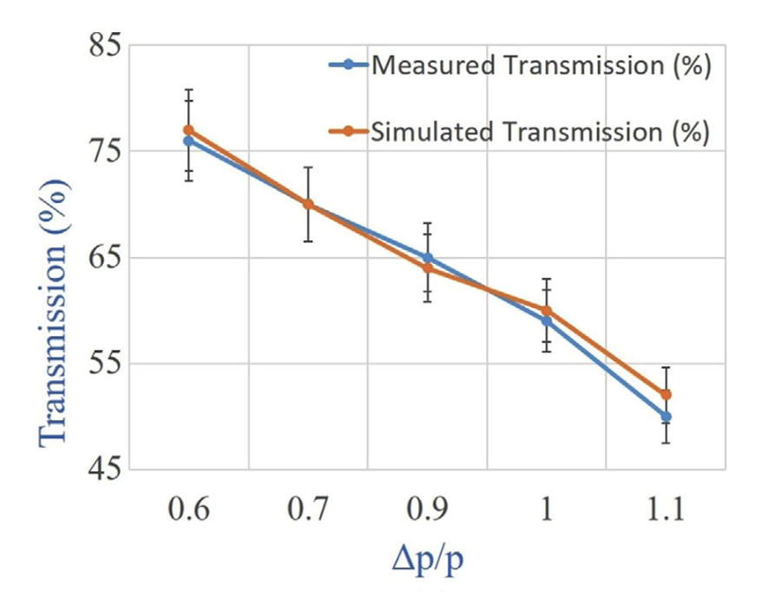
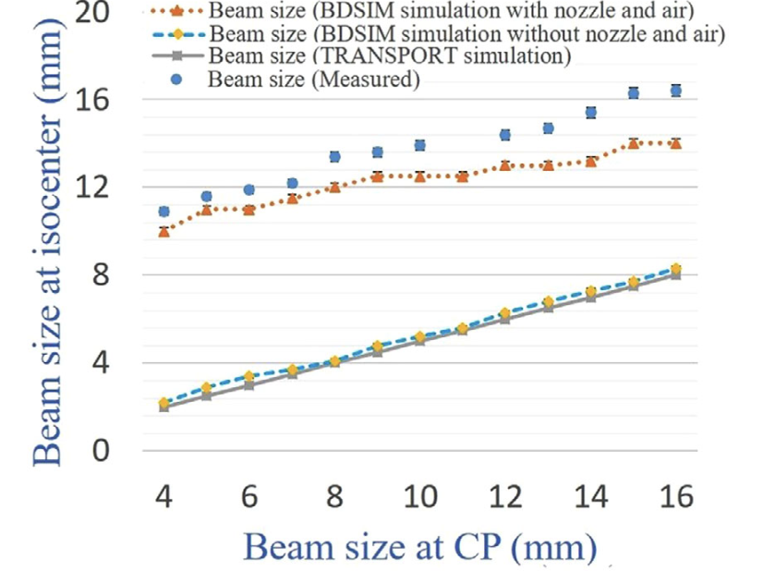
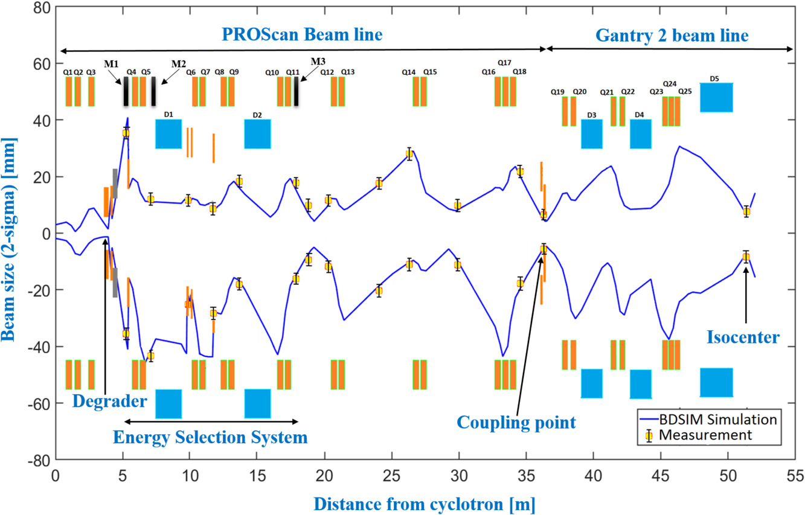
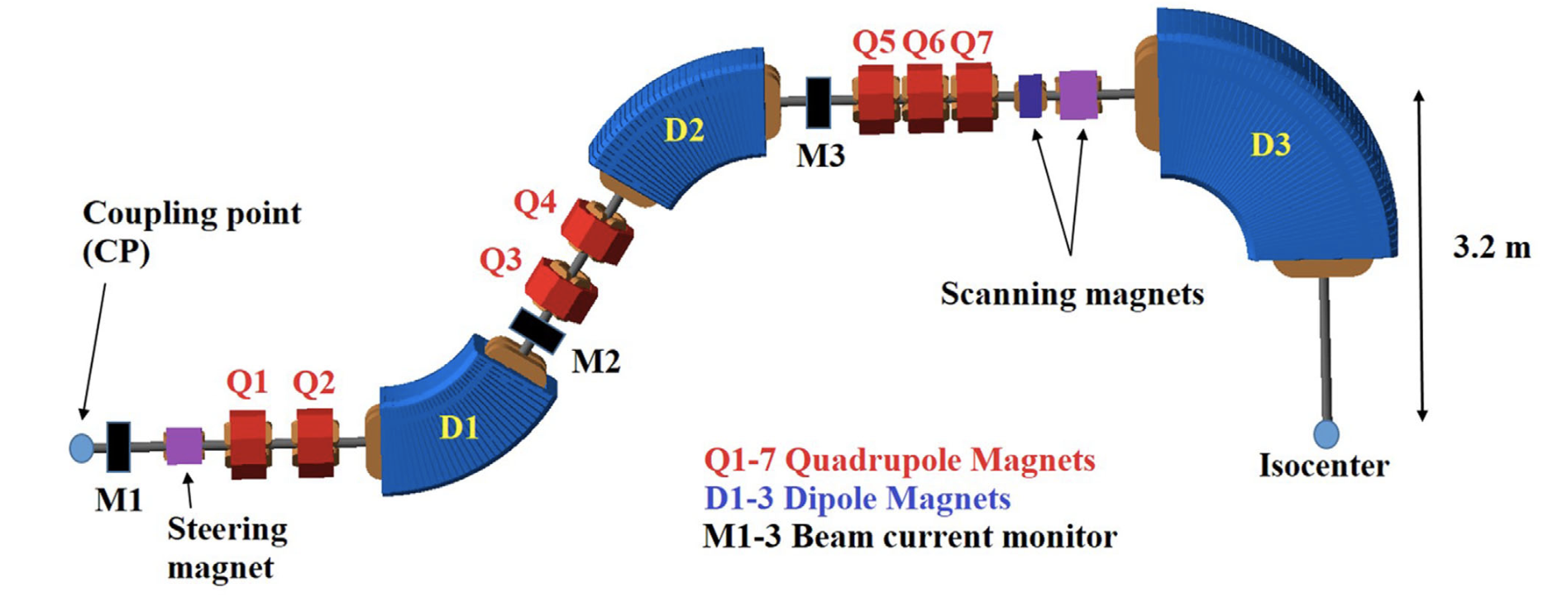
An Example of Recent Results
PSI designed new emittance selection system to increase transmission by a factor of 6 for goal of FLASH therapy
  https://doi.org/10.1002/mp.15278
Also, new optics for PSI Gantry 2 for greater acceptance
  https://doi.org/10.1002/mp.15505
Goal of higher transmission
  new optics and coupling point (CP)
Excellent agreement with experiments achieved
PSI Gantry2 Model

Slide 18


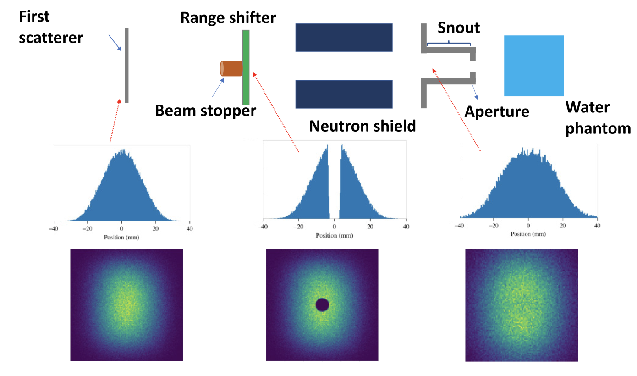
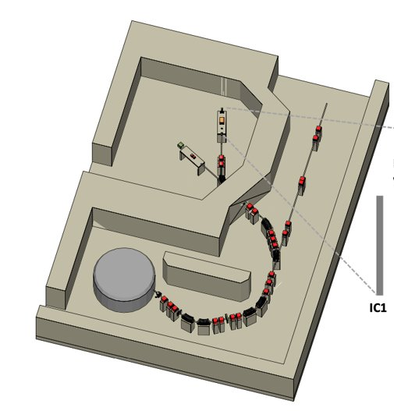
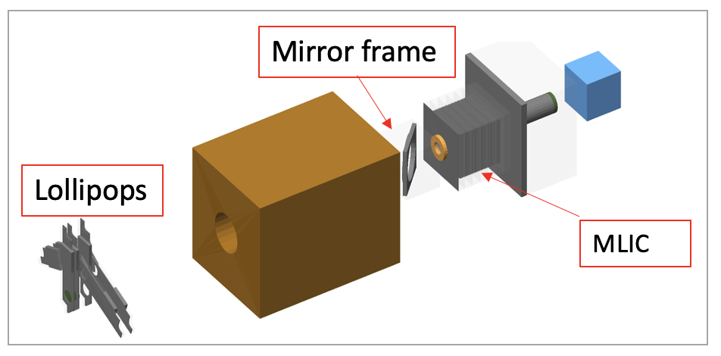
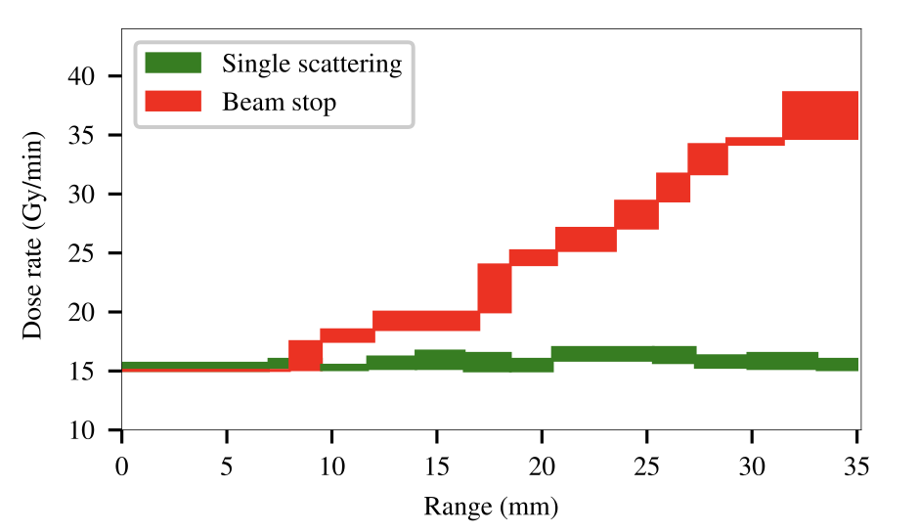
IBA Eyeline Studies
W. Shields, L. Nevay, C. Hernalsteens, ULB Group
IBA / ULB Study on increasing dose rate in eyeline
  https://doi.org/10.1103/PhysRevResearch.4.013114
Results: reduce distal fall-off and reduce treatment time by factor of 3: treatment in < 30s
  huge improvement for patient holding still
ULB contributing to new BDSIM features regularly
range of possible dose rates for chosen depth
IBA Proteus©Plus Model with eyeline

Slide 19
Prospects for Industry with RT Simulations
L. Nevay, W. Shields, S. Boogert
Many links formed in past ~ 4 years
Moving forward, the goal is to create impactful relationships
  (most) software is publicly available, but our capability exceeds this
Initial contact with Research Instruments for their project LightHouse
  will produce Mo-99 (half-life 66 hrs) source -> Te-99 (half-life 6 hrs)
  without relying on nuclear waste as a source
  discussions underway on possible joint project / studentships
Contacted by Space Talos - UK satellite shielding company
  1 week consultancy so far on Geant4 physics extension based on LHC research
  further consultancy in 2022 and also through Horizon bid (application ongoing)
  website: https://spacetalos.com
Setting up a BDSIM Collaboration managed by RHUL to permit academic contribution but a set of defined beneficiaries from any commercial activity

Slide 20
Thank you for your attention

Slide 21
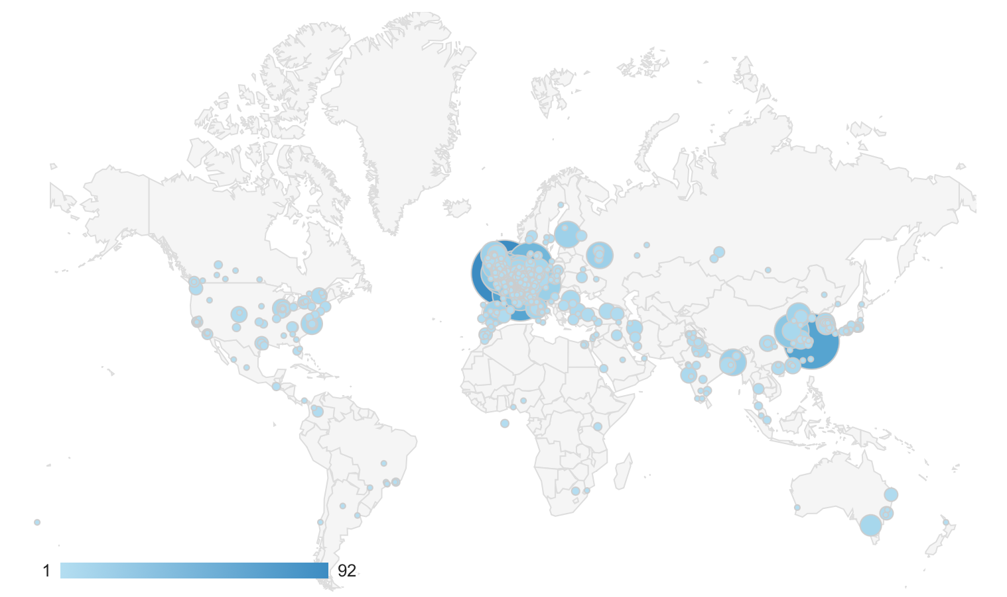
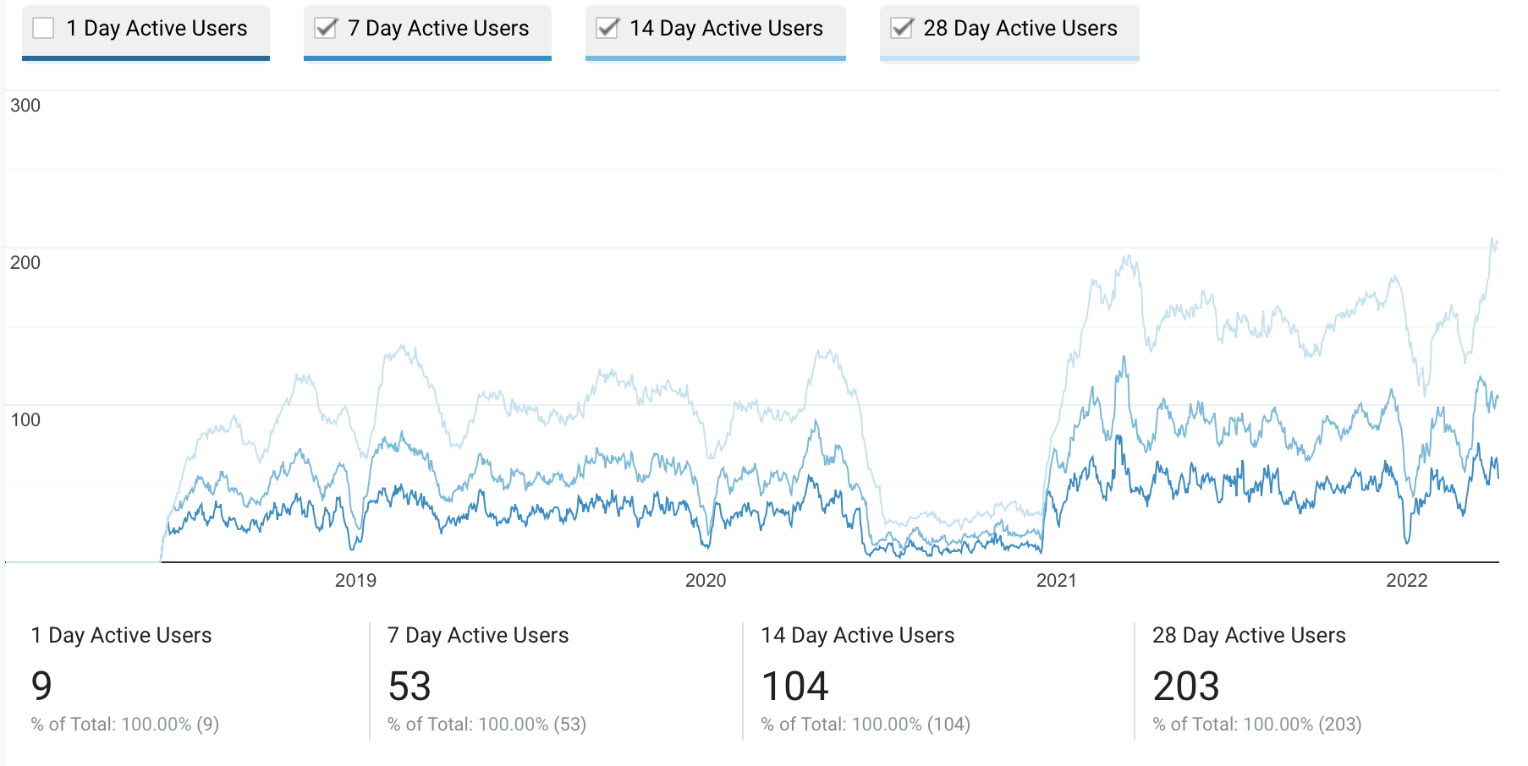
BDSIM Manual Usage
We don’t track software usage
  can't do this easily in line with academic research
  and be open-source
Google analytics for website visits
  usual publicly available information from browser
  good idea of usage in cities with facilities
Software open source but must cite paper
website hits by city in last year

