Slide 1
Intense Hadron Beams
D. W. Posthuma de Boer
Contributions from:
J. Appleby, J. Flowerdew, C. Jolly, T-J. Kuo, A. Oeftiger,
S. Preston, N. Steerenberg
JAI Advisory Board Meeting
2025-04-24

Slide 2
Contents
Intensity Limits at ISIS
  The ISIS Neutron and Muon Source
  Coherent Instabilities
  Process Optimisation
ISIS-II Development
  Sustainability – See talk by H. M. Wakeling
  Working Point
  FFA Magnet Design
  FFA Beam Stacking
IBEX Experimental Results
Conclusions

Slide 3
Intensity Limits at ISIS

Slide 4
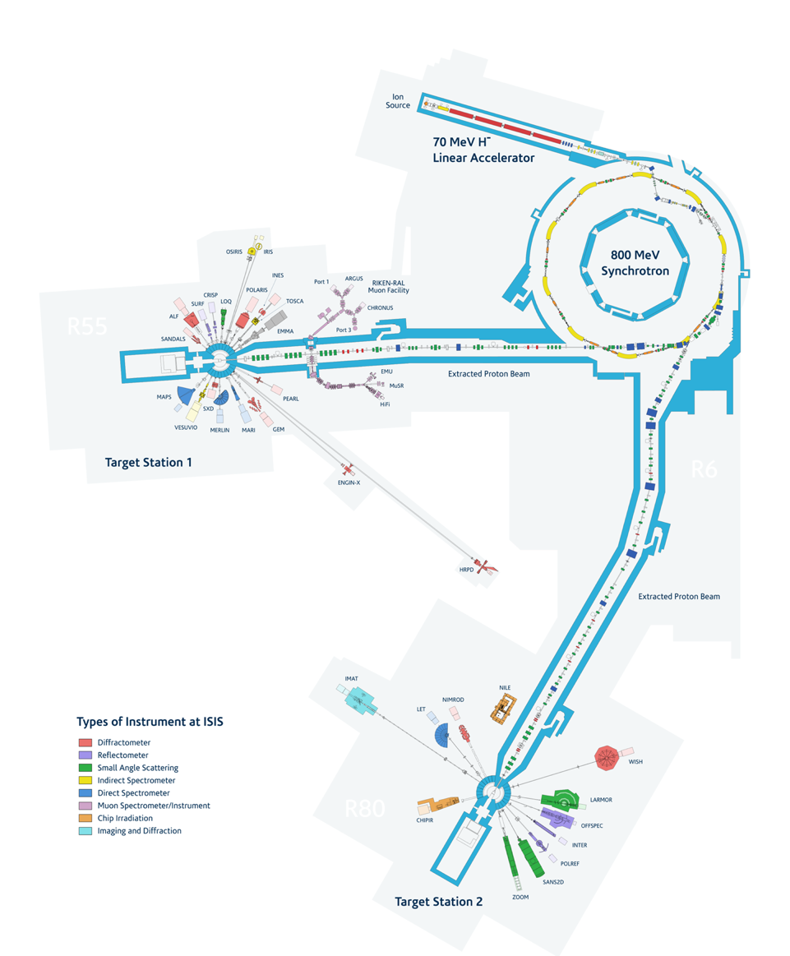
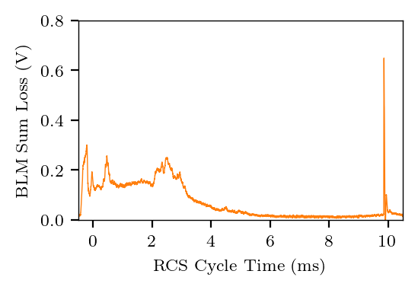
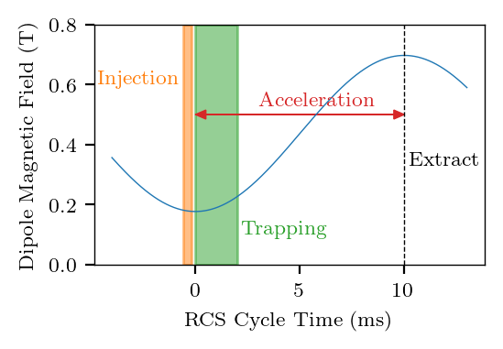
The ISIS Neutron and Muon Source
ISIS is the Neutron and Muon source at the
Rutherford Appleton Lab.
The primary constituents are:
  Penning H- ion source and RFQ
  70 MeV H- drift-tube linac
  800 MeV, 50 Hz rapid cycling proton synchrotron
  One graphite and two tungsten fixed targets + instruments
Beam loss is concentrated towards the beginning of the 10ms acceleration cycle and mainly associated with:
  Injection
  Longitudinal trapping
  Space-charge effects
  Coherent vertical instability
Intensity is beam-loss limited.
  Solutions identified on ISIS will impact future high-intensity machines.
Circumference | 163 m
Energy Range | 70 – 800 MeV
Intensity | ~ 3e13 Protons per Pulse
Repetition rate | 50 Hz
Average Power | ~ 190 kW
Injection | Multi-turn, charge-exchange
Tunes (x, y) | 4.31, 3.83 (programmable)
RF | 6 x fundamental (h=2) 4 x 2nd harmonic (h=4)

Slide 5
Coherent Instabilities

Slide 6
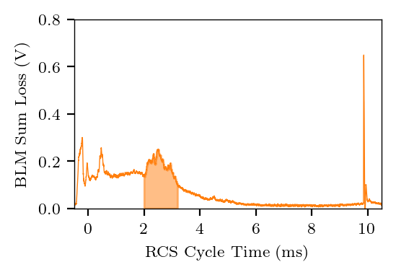
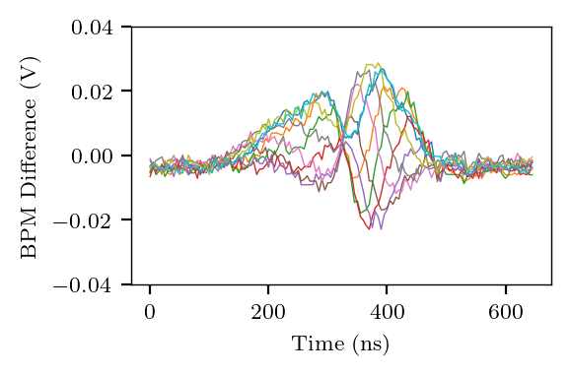
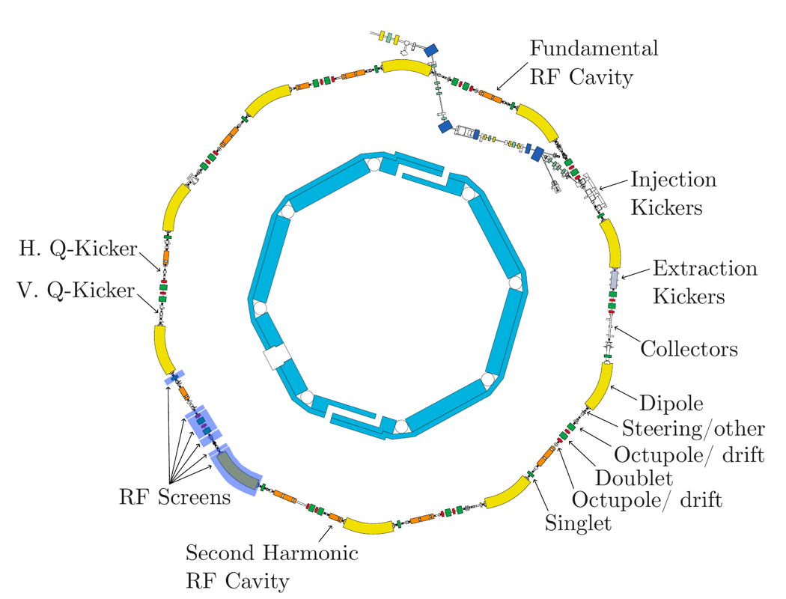
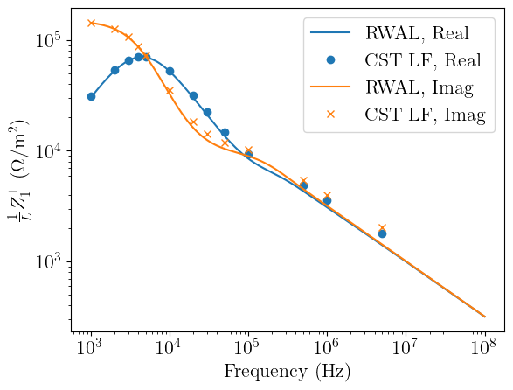
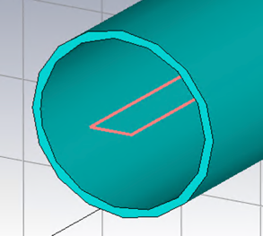
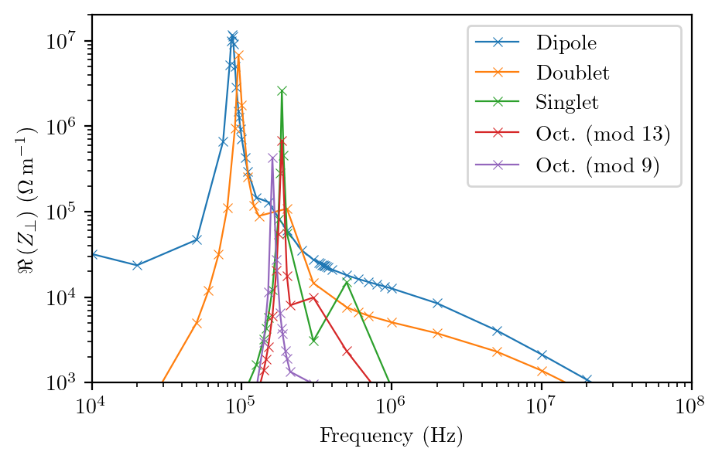

Identifying the Source of the Instability
D. W. Posthuma de Boer (JAI Student), B. Foster, C. M. Warsop, A. Oeftiger
Instability was first measured on ISIS around 1988.
  It resembled a head-tail mode-1 and has growth times on the order of 100 µs, but mode 2 or 3 was predicted with growth rates of ms.
Work by R. E. Williamson identified resonator impedance and a dependence on transverse beam size.
Primary impedance candidates identified and divided into resonator and broadband candidates.
Developed tools for studying low-frequency transverse impedances:
  RWAL (analytical resistive-wall code)
  Low-frequency finite element method
Using these tools identified the RF screens as presenting a large narrowband impedance.

Slide 7
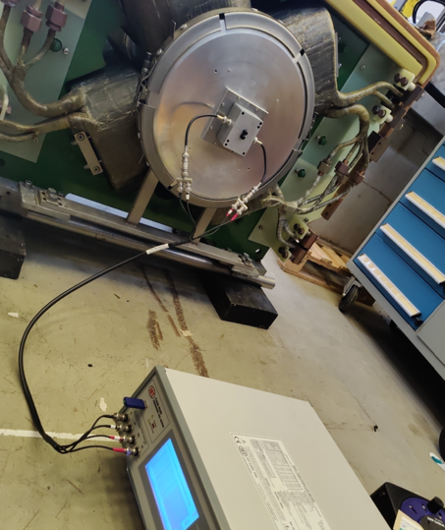
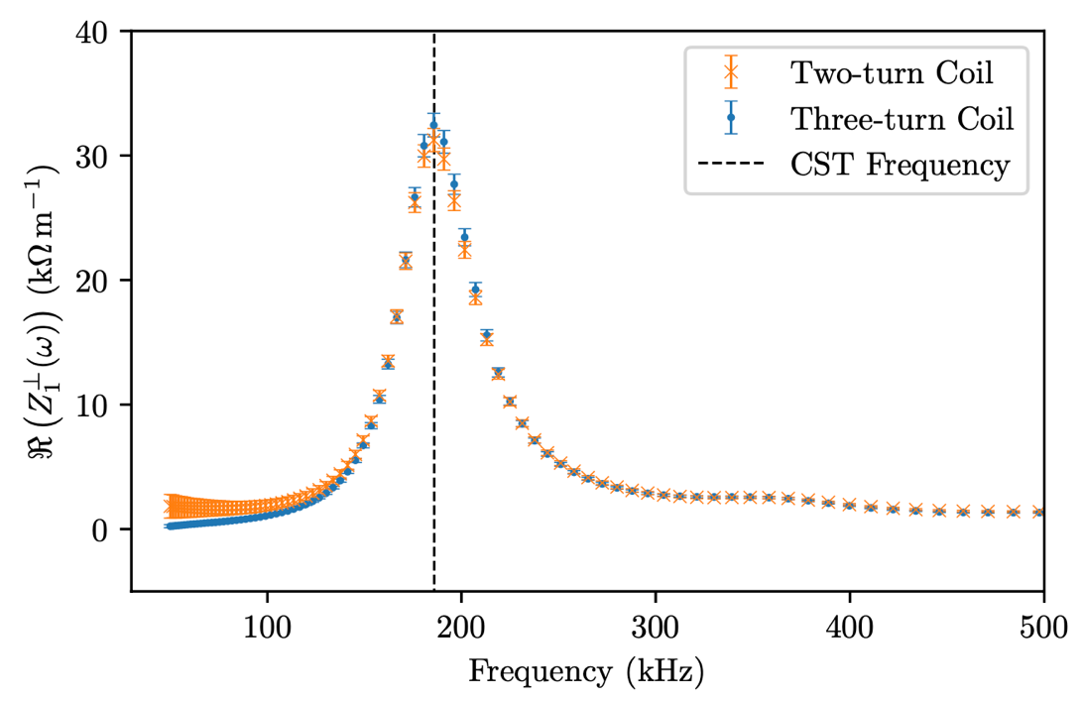
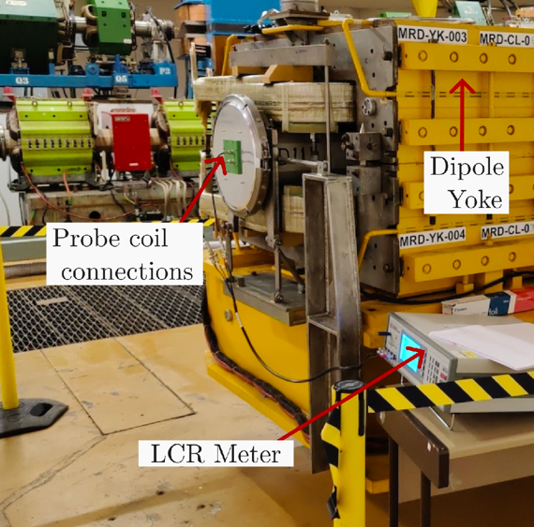
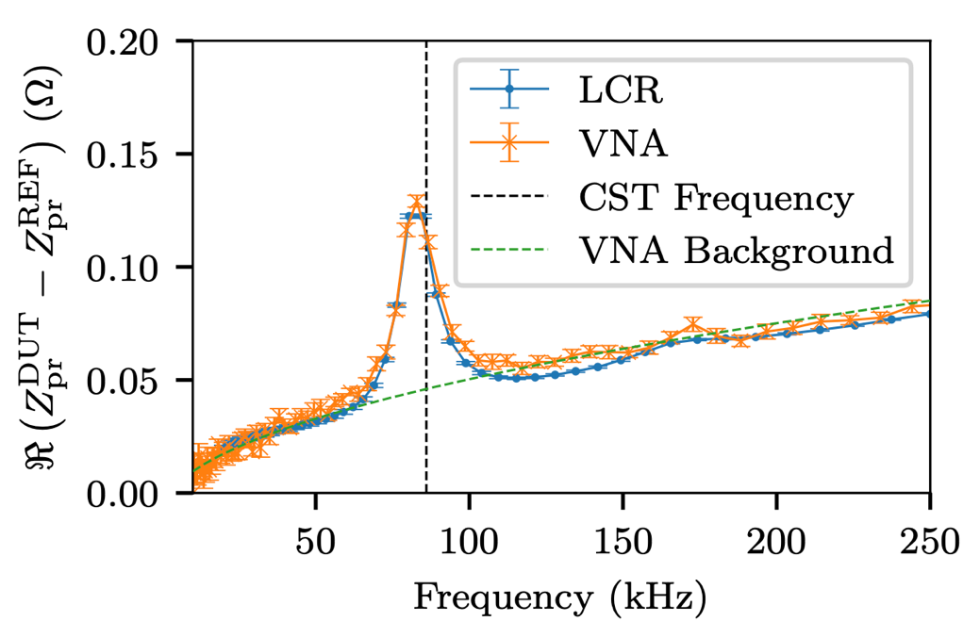
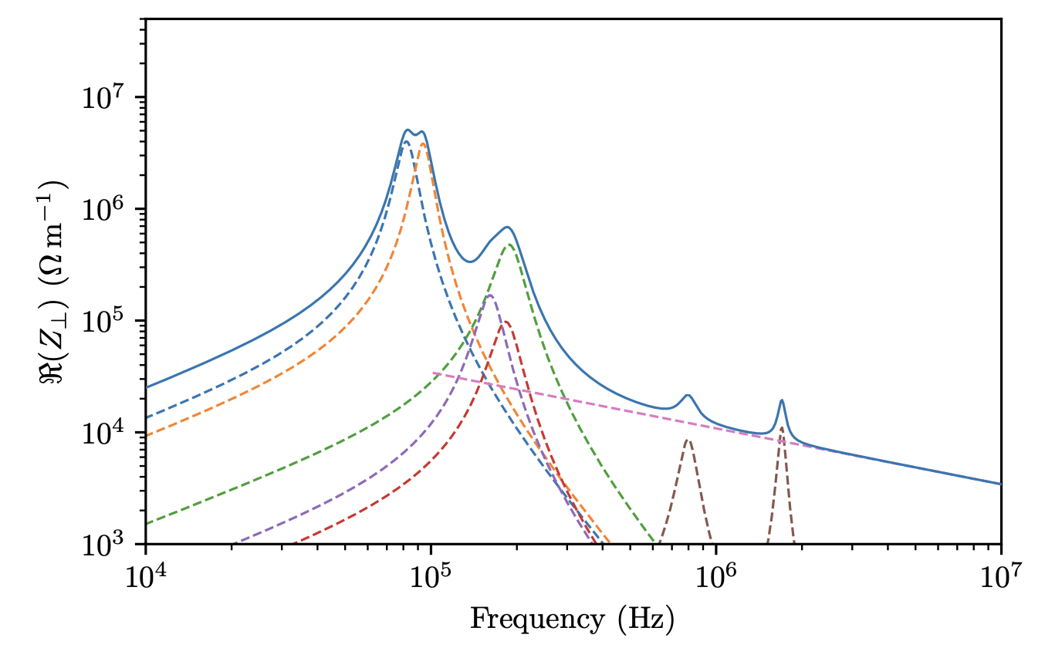
RF Screen Impedance
D. W. Posthuma de Boer (JAI Student), B. Foster, C. M. Warsop, A. Oeftiger
Probe coil measurements on a singlet magnet completed.
  Resonant frequency within 2% of prediction.
  Peak magnitude and quality factor both lower than predicted.
Probe coil measurements on a dipole also completed.
  Resonant frequency within 5% of prediction.
  Quality factor also lower than predicted.
Approximate solution developed for lower quality factors made and a new impedance model developed.
  Low frequency impedance dominated by RF screen resonator impedances.
Preliminary results presented at HB 2023.
Similar impedances now identified on RF screens at CSNS.
https://doi.org/10.18429/JACoW-HB2023-TUC4I2

Slide 8
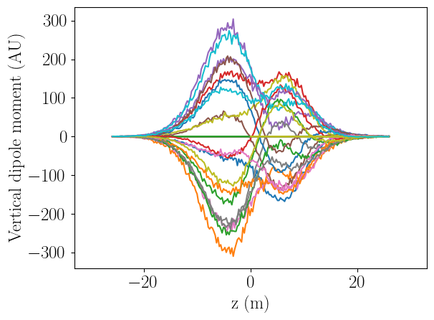
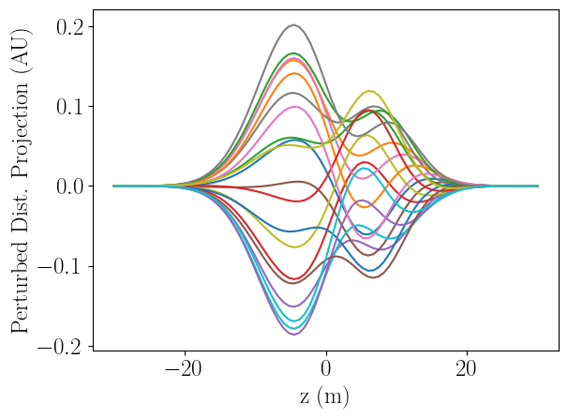
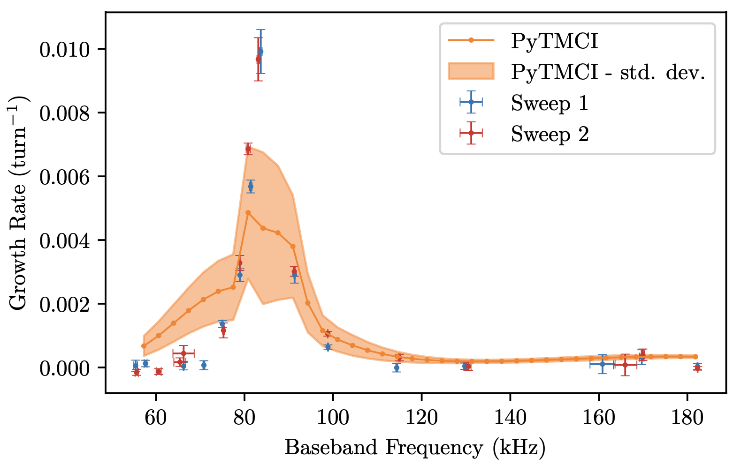
Instability Predictions
D. W. Posthuma de Boer (JAI Student), B. Foster, C. M. Warsop, A. Oeftiger
𝜏 = 72 µs
Calc. ISIS Params | Value
β | 0.45
Q_{y} | 3.83
Q_{s} | 0.015
Chromaticity | -0.5
Num Bunches | 1
Long. Model | Gaussian
σ_{z} | 6.5 m
Impedance Model | 2.4 MHz Resonator
Formulas based on simplified instability models do not provide the most accurate analytical predictions available.
Implemented new head-tail Vlasov solver, PyTMCI.
  https://github.com/stfc/PyTMCI
One benchmark is shown against PyHEADTAIL
Using the updated impedance model and a number of simplifying assumptions
  PyTMCI predicts correct order-of-magnitude growth rate in tune range observed experimentally (Sweep 1/ 2)
  PyTMCI predicts observed order-of-magnitude growth rate early into the RCS cycle.
PyHEADTAIL
𝜏 = 76 µs
PyTMCI

Slide 9
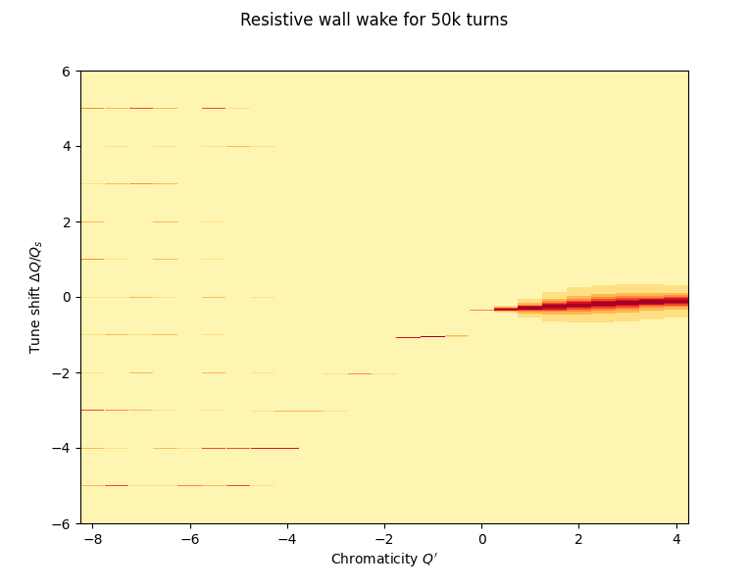
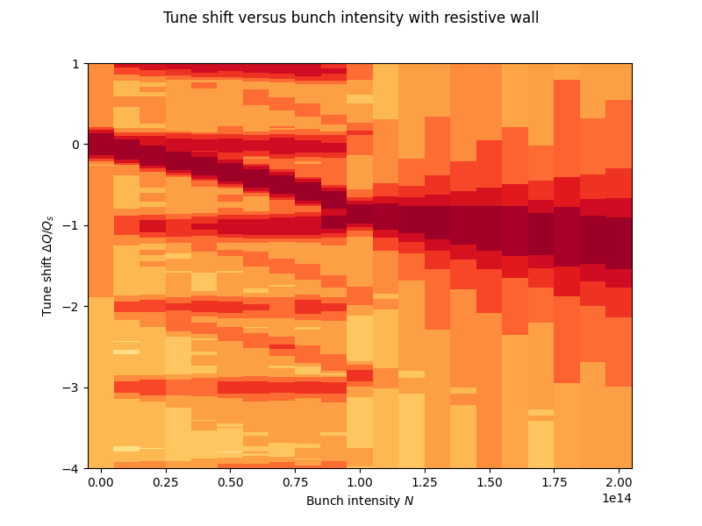
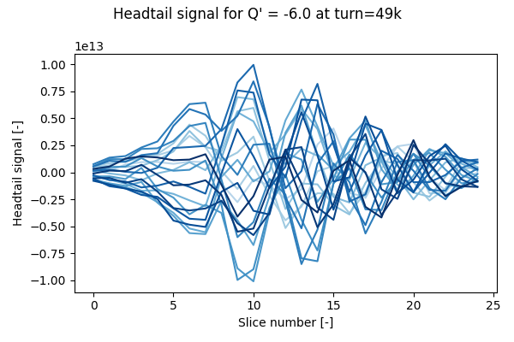
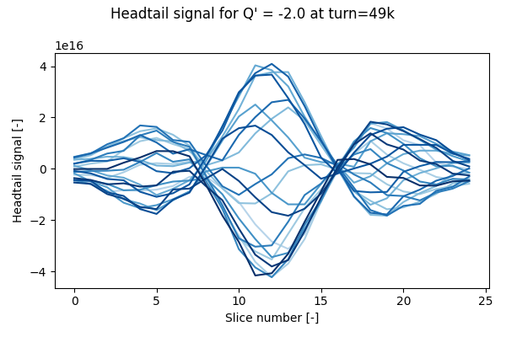
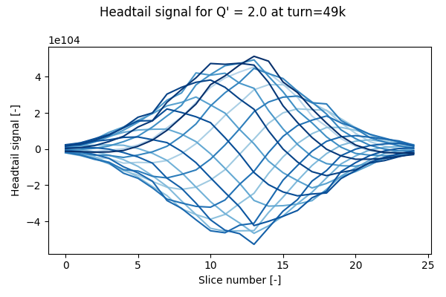
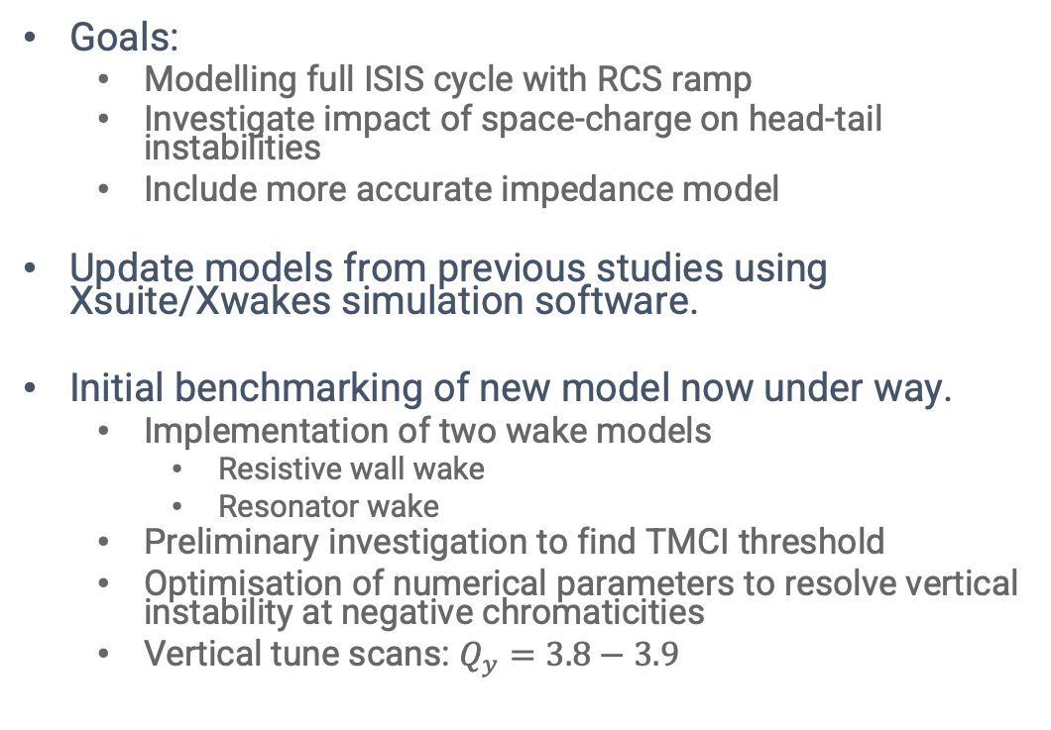
Transverse Stability at ISIS
N. Steerenberg (JAI Visiting Masters Student), A. Oeftiger
Goals:
  Modelling full ISIS cycle with RCS ramp
  Investigate impact of space-charge on head-tail instabilities
  Include more accurate impedance model
Update models from previous studies using Xsuite/Xwakes simulation software.
Initial benchmarking of new model now under way.
  Implementation of two wake models
    Resistive wall wake
    Resonator wake
  Preliminary investigation to find TMCI threshold
  Optimisation of numerical parameters to resolve vertical instability at negative chromaticities
  Vertical tune scans: $Q_{y}=3.8−3.9$
Intrabunch motion example for resistive wall wake

Slide 10
Coherent Instabilities – Future Work
Mitigation of the identified impedances has started, but more work do.
  Aiming to increase ISIS beam intensity.
Detailed study of the interaction between space-charge and the coherent instability.
  Assisted by the updated Xsuite and impedance models.
Further development of the ISIS impedance model to improve predictions.
  For example, longitudinal impedance, detuning impedance, conformal vacuum vessels etc.
Visiting masters student (N. Steerenberg) has started and new DPhil student joining in October 2025 (F. Straniero).

Slide 11
Process Optimisation

Slide 12
Process Optimisation at ISIS
S. Preston (JAI Student), P. Burrows, I. Martin
Currently optimising Linac-to-Booster injection at the Diamond Light Source using Bayesian optimisation, with the goal of automating injection over the entire complex (see I. Martin’s presentation).
Processes such as injection from the linac into the RCS, steering and focusing etc can be optimised to reduce beam losses.
  In some cases correcting of beam losses and machine set-up after a trip requires manual intervention.
Objective: Reduce downtime at ISIS by using ML to automate beam steering while minimising losses and ensuring safe operation.
The goal is to transfer the experience gained to ISIS, but with key differences:
  Must use multiple objectives (MOGP), such as maximising injection efficiency,
  while reducing halo losses within safe operating parameters.
  Investigate whether combing the optimiser being investigated at Diamond with
  deep learning methods can yield further improvements.
  Reinforcement learning is a very popular topic currently (ICFA 2025) and could help to achieve objectives.

Slide 13
Contents
Intensity Limits at ISIS
  The ISIS Neutron and Muon Source
  Coherent Instabilities
  Process Optimisation
ISIS-II Development
  Sustainability – See talk by H. M. Wakeling
  Working Point
  FFA Magnet Design
  FFA Beam Stacking
IBEX Experimental Results
Conclusions

Slide 14
ISIS-II Development

Slide 15
ISIS-II Megawatt Upgrade
ESFRI Neutron Scattering Facilities in Europe Report (2016)
“…by far the most cost effective solution would therefore be to build a MW-class short pulse facility at ISIS, reusing existing infrastructure and facilities as well as drawing upon on-site competences. The current facility could operate until the new facility is operational with its initial suite of instruments.”
Sentiment echoed in UKRI Infrastructure Opportunity Report (2023)
ISIS-II is a proposed MW-class short pulse neutron facility.
It is vital to maintain European competitiveness with Japanese (J-PARC) and American (SNS) short-pulse neutron sources
Currently investigating three accelerator drivers
  Rapid Cycling Synchrotron (RCS)
  Accumulator Ring (AR)
  Fixed-Field Alternating Gradient (FFA)
Special focus on sustainability and health of the neutron user community.
Phase 1
Phase 2
Phase 3
2019
2021
2027
2031
2040
Feasibility, design studies and R&D
Integrated facility technical design
ISIS-II construction
Phase 1.1
Physics design
Small-scale prototypes
Phase 1.2
Physics design
Large-scale prototypes

Slide 16
ISIS-II Accelerator Options
Conventional Rings
1. Lattice Design (D. J. Adams)
2. Longitudinal Dynamics (R. E. Williamson)
3. Transverse Dynamics (C. M. Warsop, et al.)
4. 3D Beam Dynamics Design (D. J. Adams, et al.)
5. Injection Straight Design and Foils (H. V. Cavanagh, B. Kyle, et al.)
6. Correction Systems (H. Rafique)
7. Collimation, Extraction (H. V. Cavanagh, H. Rafique, et al.)
8. Instabilities (R. E. Williamson, D. W. Posthuma de Boer)
Machines configurations being considered
  Rapid Cycling Synchrotron (RCS)
  Accumulator Ring (AR)
  Fixed Field Alternating Gradient Acc. (FFA)
RCS and AR facilities have demonstrated MW capability at JParc and SNS.
High-intensity FFA has not been demonstrated, so the FETS-FFA is a proposed proof-of-principle.
  Low energy but with large space-charge tune shift.
  Study injection, painting, orbit correction, resonances, stacking etc.
  CDR to be published soon.
“Conventional Rings”
FFA
1. Optics and Dynamics (S. Machida, D. Kelliher, et al.)
2. Analytical Approach (M. Topp-Mugglestone)
3. Injection & Extraction (C. Rogers, J. Pasternak)
4. Longitudinal Dynamics (D. Kelliher, C. Jolly)
5. Collective Effects (D. Kelliher)
6. Magnet Physics Design (J. B. Lagrange, T-J. Kuo)
7. Magnet Engineering (I. Rodriguez, et al.)
8. Collimation & Diagnostics (E. Yamakawa,
D. W. Posthuma de Boer, S. Sapkota)
9. RF Hardware (B. Kirk, I. S. K. Gardner)
Energy Range | 3 -12 MeV
Intensity | 3e11 ppp
Repetition Rate | 100 Hz
Mean Power (equiv.) | 60 W
Mean Orbit Radius | 3.6 – 4.2 m

Slide 17
Sustainability – See Talk by H. M. Wakeling

Slide 18
Working Point

Slide 19
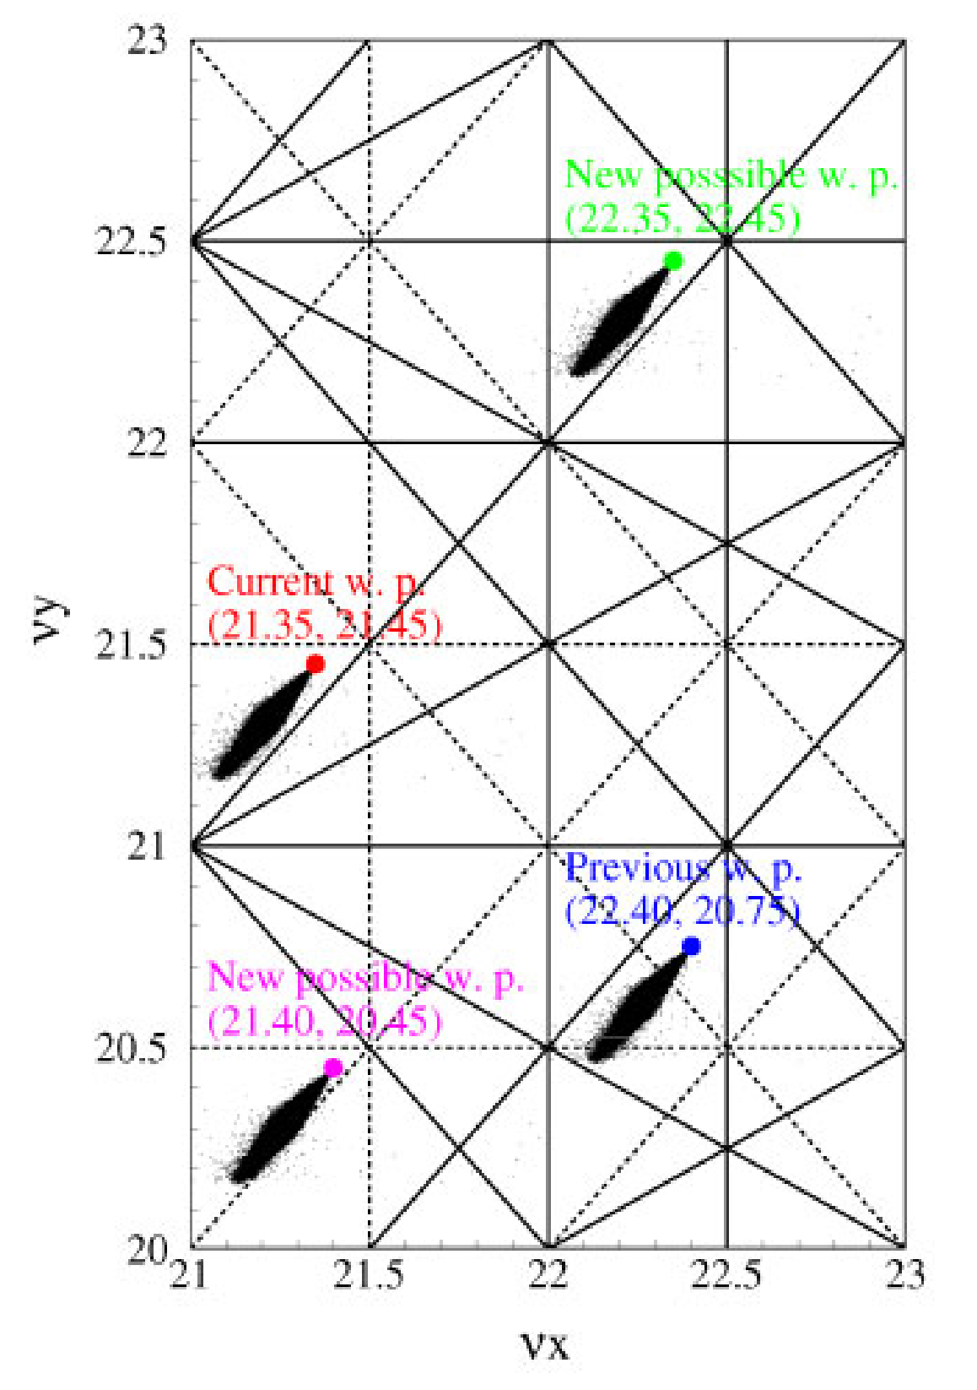
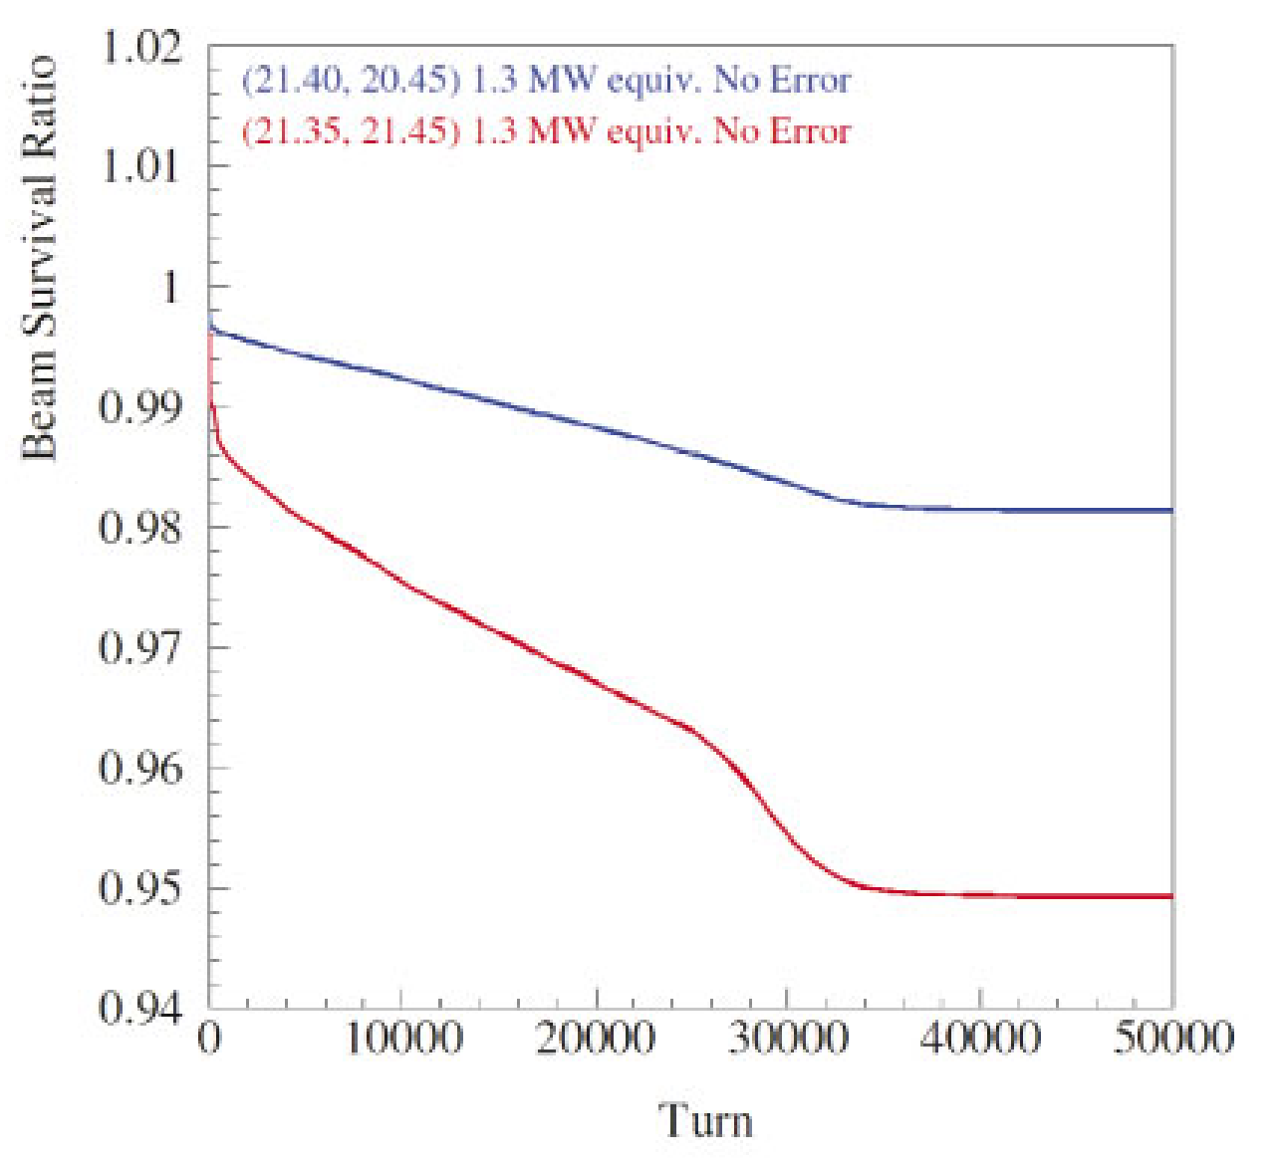
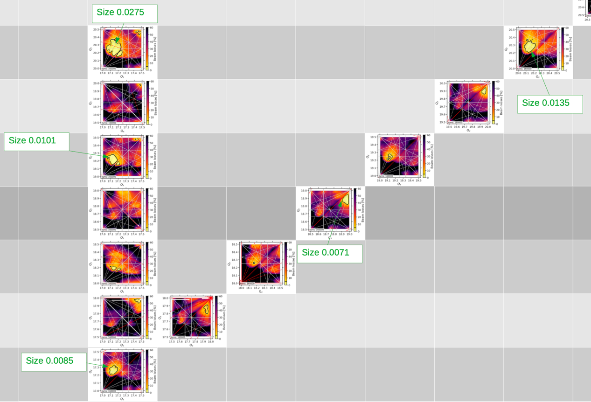
Working Points and Space Charge Limit
J. Appleby (JAI Student), A. Oeftiger
Space charge
tune footprints
in resonance
tune diagram
JPARC MR: towards 1.3MW beam power
Space charge limit =
Maximum achievable beam intensity in
space-charge-dominated accelerators
  Resonance stopbands increase with intensity
  Depends on betatron tune / working point
JPARC Main Ring and FAIR SIS100:
ongoing studies on identifying optimal working points
at space charge limit
Challenge: computationally very expensive simulations, complex beam dynamics
Can we produce higher-intensity hadron beams via split integer tunes / beam shaping? If so, why?
Collaboration project started with ISIS and JPARC to draw conclusions for ISIS-II designs
Lower beam loss at
new working point
(PIC simulations)
?
?
FAIR SIS100
?
Beam loss simulations
across tune quadrants
show better working points
than FAIR SIS100 design!
(3.5 CPU-years / quadrant)
https://doi.org/10.1103/PhysRevAccelBeams.25.054402
https://doi.org/10.1103/PhysRevLett.132.175001

Slide 20
FETS-FFA - Magnets

Slide 21
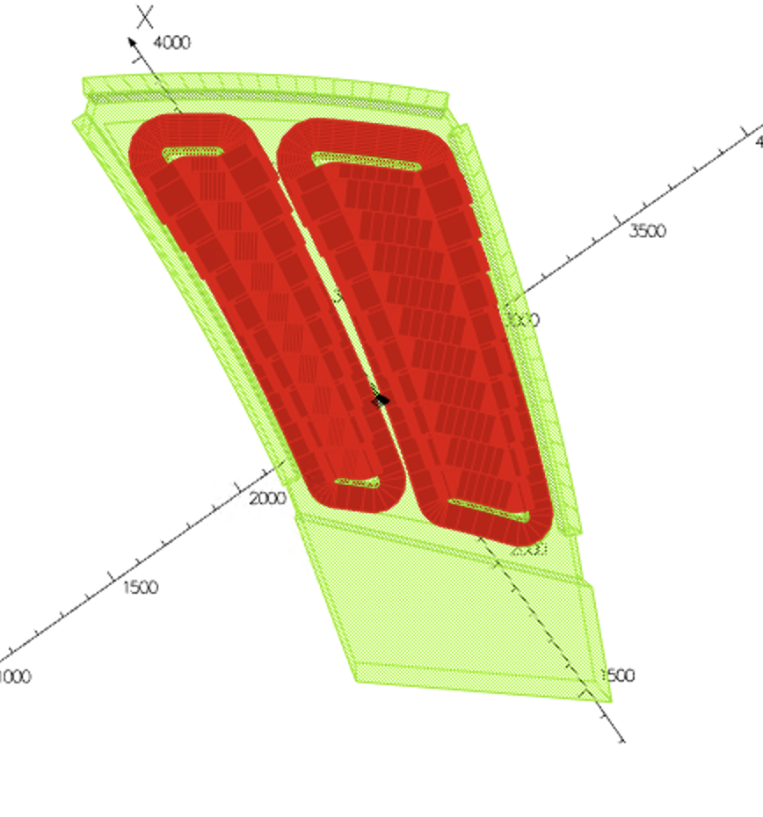
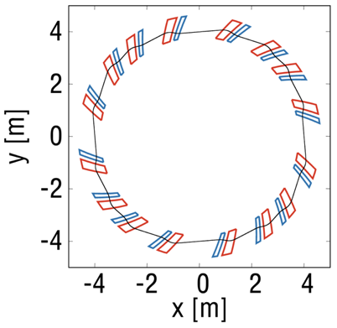
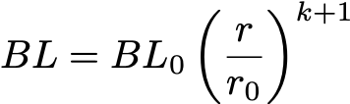

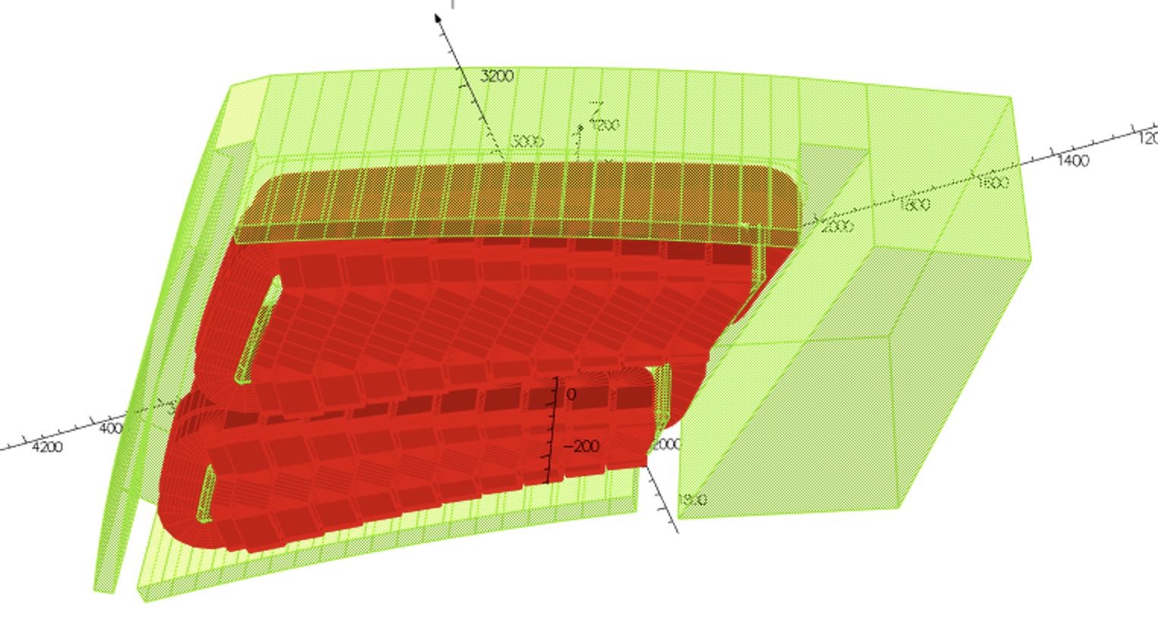

FETS-FFA Magnet Physics
T-J. Kuo (JAI Student), J. Pasternak
Demonstrator for FFA for ISIS-II
Doublet spiral design
Zero chromaticity if fields increase with radius
following scaling law:
Field index k defined by integral of field:
B field produced by distributed conductors each with a different current setting

Slide 22
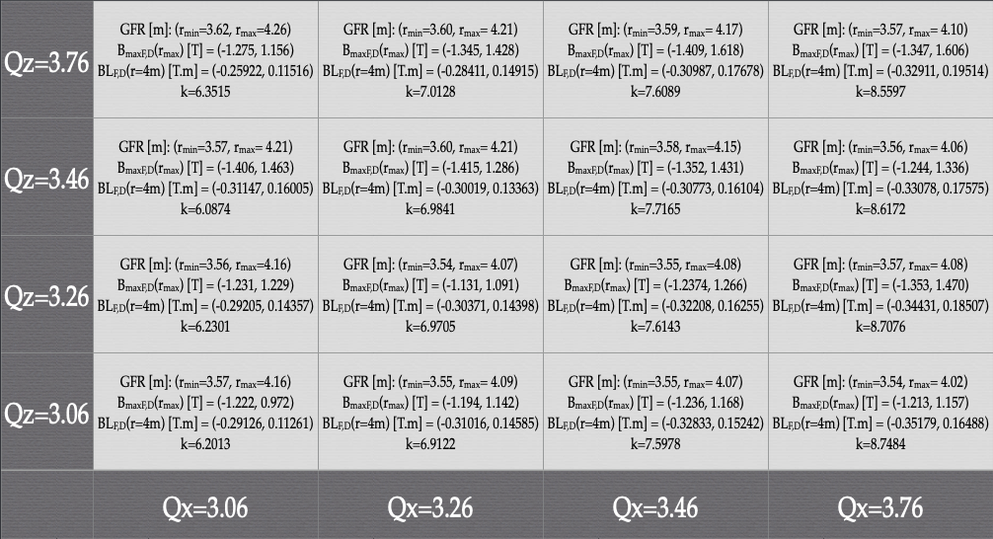
FETS-FFA Magnet Physics
T-J. Kuo (JAI Student), J. Pasternak
Flexibility in operating tune point to test dynamics for high beam intensity, target is to achieve cell tune variation: +/- 0.000625 for all the working points

Slide 23
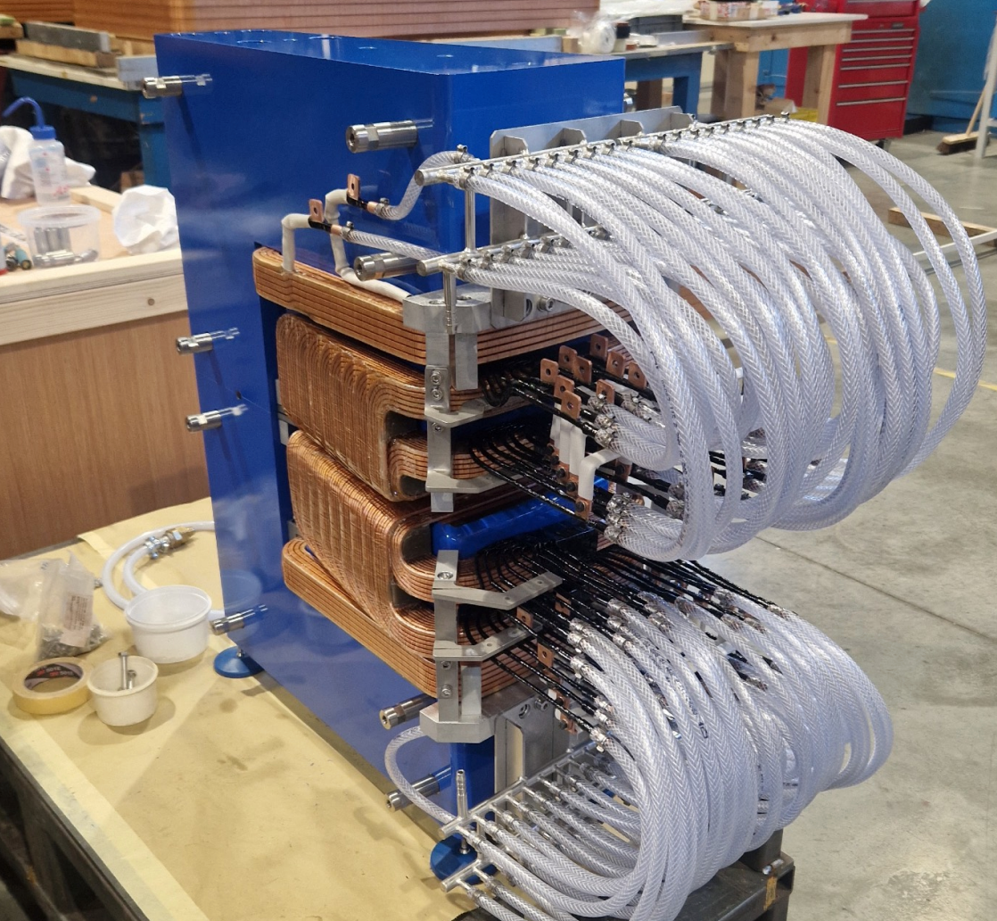
FETS-FFA Magnet Physics
T-J. Kuo (JAI Student), J. Pasternak
Smaller prototype magnet has been delivered
Measure magnet with different configurations and compare with Opera model
Create Jacobian matrix for change in field for each coil.
Investigate local correction scheme (k value and COD).

Slide 24
FFA - Dynamics (Beam Stacking)

Slide 25
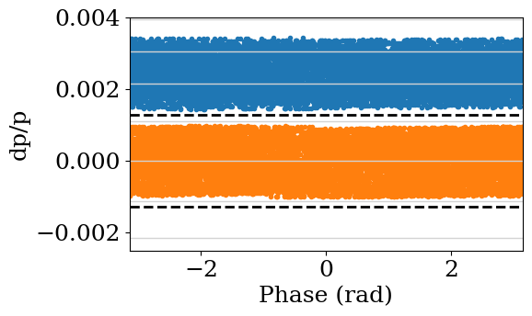
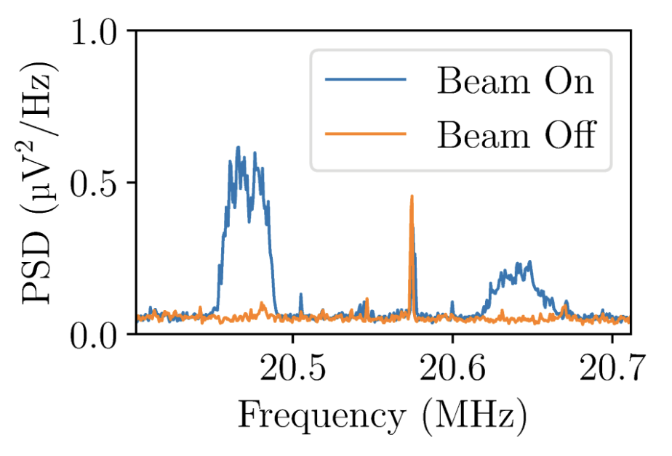
Beam stacking in FFAs
C. Jolly (JAI Student), P. Burrows, C. Rogers, A. Oeftiger
Energy
Longitudinal phase space after beam stacking
Beam stacking is one of the primary advantages of FFA for high intensity applications.
  Allows you to use the full aperture at extraction.
  Freedom with the repetition rate.
  The benefits of an Accumulator Ring without needing a full energy linac.
In 2023 we conducted an experiment to systematically study beam stacking the KURNS FFA.
Results published early 2025 and chosen as PRAB “Editors’ Suggestion”.
Time
25
https://doi.org/10.1103/PhysRevAccelBeams.28.012803

Slide 26
Beam stacking in FFAs
C. Jolly (JAI Student), P. Burrows, C. Rogers, A. Oeftiger
Energy
Longitudinal phase space after beam stacking
Beam stacking is one of the primary advantages of FFA for high intensity applications.
  Allows you to use the full aperture at extraction.
  Freedom with the repetition rate.
  The benefits of an Accumulator Ring without needing a full energy linac.
In 2023 we conducted an experiment to systematically study beam stacking the KURNS FFA.
Results published early 2025 and chosen as PRAB “Editors’ Suggestion”.
Time
In 2023 we successfully stacked two beams in the KURNS FFA
But there was significant beam loss during stacking. → loss caused by RF knockout.
26
https://doi.org/10.1103/PhysRevAccelBeams.28.012803

Slide 27

RF knockout
C. Jolly (JAI Student), P. Burrows, C. Rogers, A. Oeftiger
During beam stacking, the RF is accelerating a second beam while one beam is stored in the machine
The orbit in an FFA is dispersive.
When a particle gains energy from a cavity it moves to a new closed orbit.
→ Equivalent to a horizontal displacement at the cavity.
If the RF frequency synchronises with the horizontal tune then the displacements could build up turn-by-turn and cause beam loss.

Slide 28
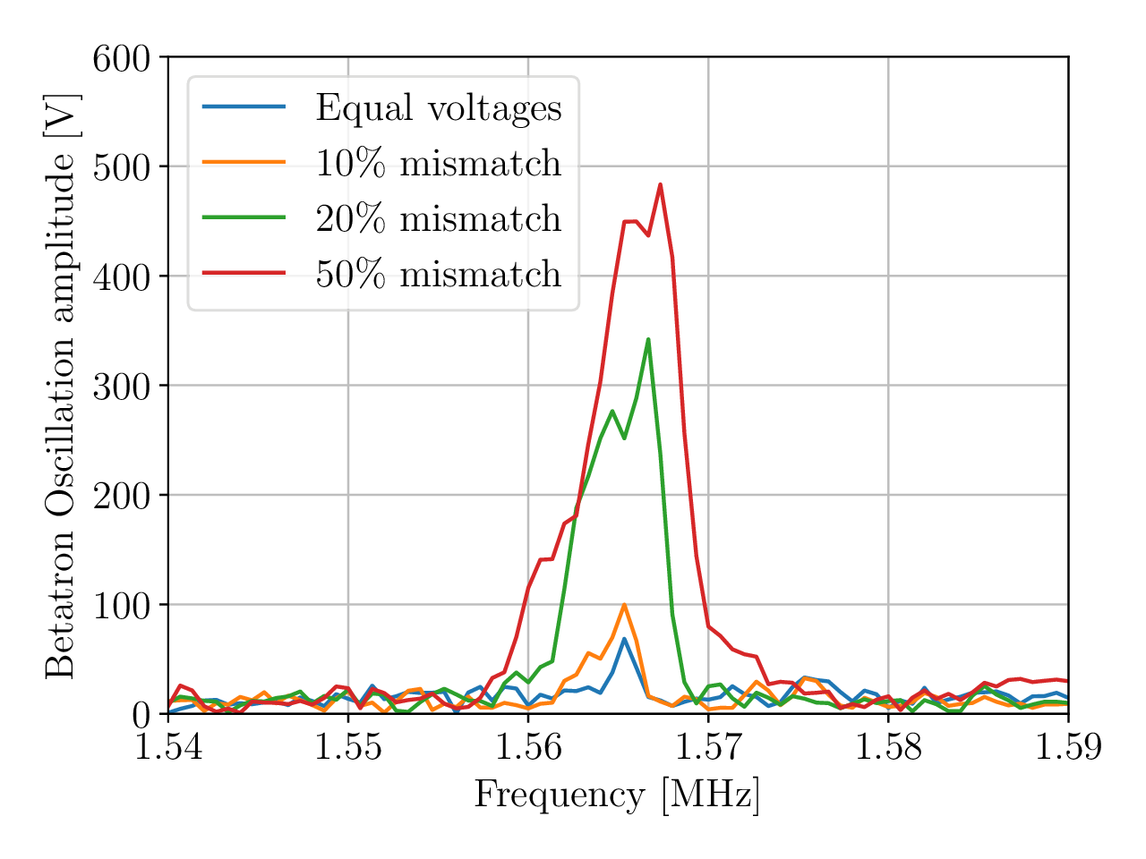
Mitigating the beam loss from RF knockout
C. Jolly (JAI Student), P. Burrows, C. Rogers, A. Oeftiger
In 2024, we used the ISIS synchrotron to characterise and test various methods for mitigating the RF knockout loss.
The experimental results below show that by using cavities placed symmetrically around the ring the RF knockout displacements can be cancelled.
RF knockout loss cancelled with equal cavity voltages.
RF knockout loss returning
With mismatched voltages.

Slide 29
Contents
Intensity Limits at ISIS
  The ISIS Neutron and Muon Source
  Coherent Instabilities
  Process Optimisation
ISIS-II Development
  Sustainability – See talk by H. M. Wakeling
  Working Point
  FFA Magnet Design
  FFA Beam Stacking
IBEX Experimental Results
Conclusions

Slide 30
IBEX Experimental Results

Slide 31
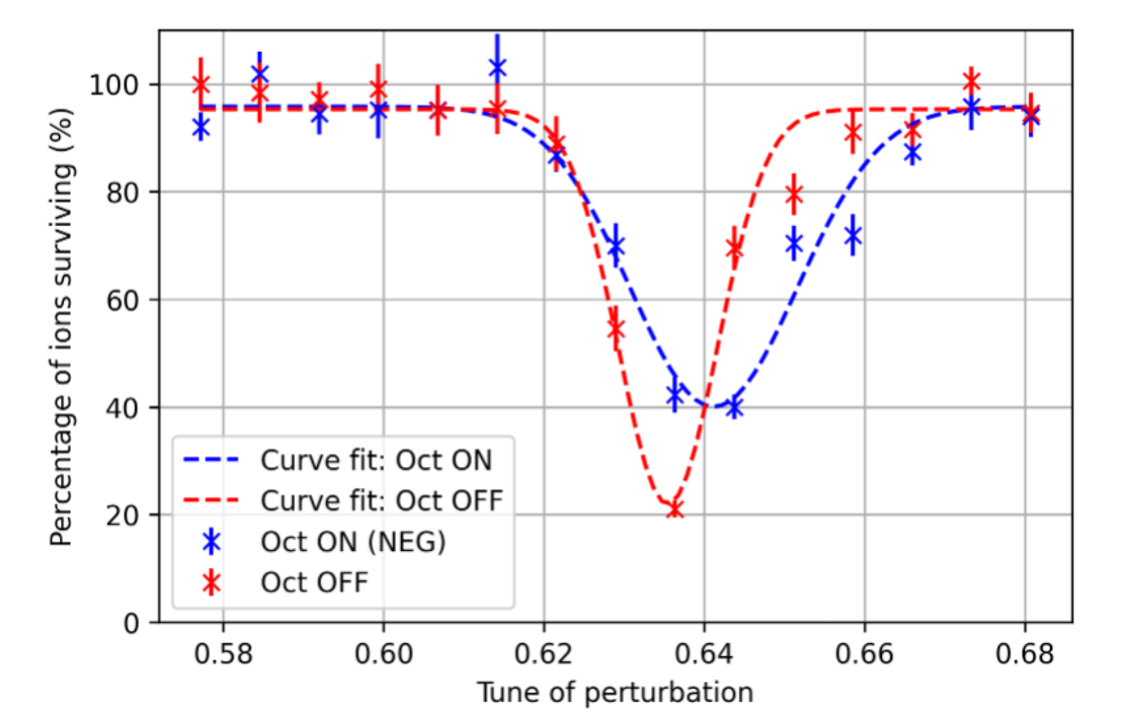
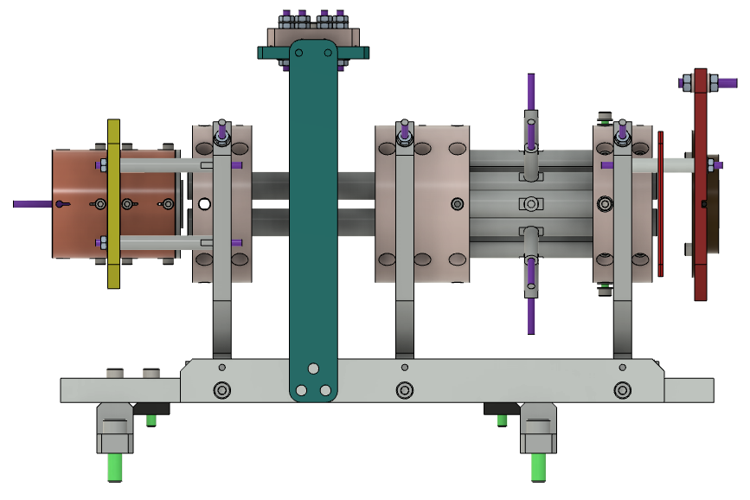
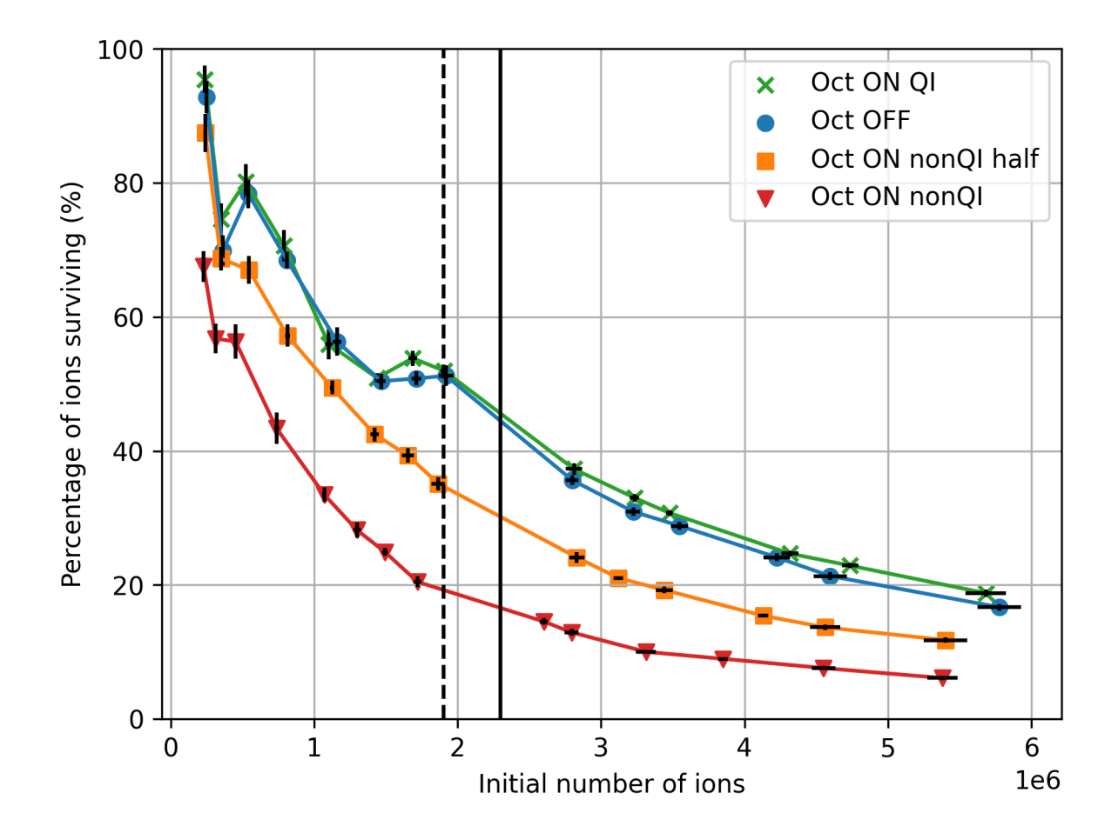
IBEX Paul Trap – Exp. Results
J. Flowerdew (Former JAI Student), A. Reichold, S. Sheehy
Nonlinear upgrade
Experimental region
MCP
FC
Reducing resonant loss with octupoles
Ionisation region
Testing Quasi-Integrable Optics
Additional electrodes for the creation of octupole fields
J. Flowerdew: Investigating Nonlinear Integrable Optics
Notes:
- IBEX Paul trap underwent an upgrade in 2022. Goal was to add additional electrodes for the creation of octupole fields (https://www.isis.stfc.ac.uk/Pages/News22_IBEX2.aspx)
Octupoles were tested by applying an external perturbation to excite a resonance (top right figure). Octupoles where shown to damp this resonance through creating a large nonlinear tune spread.
Quasi Integrable optics was also tested in the IBEX trap. A specially designed integrable lattice was created which in theory should not excite the 4th order resonance if the octupole field scales correctly with the beta function. This was shown to improve the ion survival in the lattice when compared to lattices which broke the integrability condition (nonQI).
Thesis: https://ora.ox.ac.uk/objects/uuid:edef999e-f248-49b4-80fc-da195f8c24c6
Paper: https://accelconf.web.cern.ch/hb2023/doi/JACoW-HB2023-THBP27.html

Slide 32
Summary
High intensity hadron beams are a vibrant area of research. Beams on ISIS offer unique research opportunities in the UK.
  Research into coherent instabilities has made significant progress, and is
  having an international impact. Students are joining us to continue this research.
  Progress on the impedance model can be seen as a starting point for future studies.
  New areas of research being explored, such as ML for process optimisation.
  ISIS is being used as a testbed for research into future high-intensity machines, like ISIS-II.
Significant progress in many areas of ISIS-II development.
  Working point studies have started in collaboration with international labs,
  to address a major intensity limitation in hadron machines.
  FFA studies have yielded designs for new magnets, with a prototype now delivered.
  Solutions to the RF knock-out effect have been successfully tested on ISIS.

